Slide 1

Machine Learning Hackathon CG 2022
Team Name - Machine unlearners
Team Leader Name - Rajat Bishnoi
Team Leader Email Address - bishnoirajat2@gmail.com

Slide 2
Brief description of the problem at hand:
The Problem is related to the concern of increasing phishing attacks.
We have to read the data and create a model based on the data analysis to identify if the website is legitimate or not
Dataset consists of 30 features of a phishing website with values (1-,0,1)
where, 1 represents the legitimate
0 represents suspicious
-1 represents phishing

Slide 3
Solution proposed and description:
As this is a classification problem, so we can apply any model for classification like Neural nets, SVM, KNN, Ensemble methods, etc.
We have applied Gradient Boosting Classifier on this dataset to train.
Gradient Boosting Classifier:- It is just a AdaBoosting method combined with weighted minimization, after which the classifiers and weighted inputs are recalculated. The objective of Gradient Boosting classifiers is to minimize the loss, or the difference between the actual class value of the training example and the predicted class value. It isn't required to understand the process for reducing the classifier's loss, but it operates similarly to gradient descent in a neural network.

Slide 4
Technology/Tool Stack Used:
We have used Jupyter Notebook to write and run our code
We used the following packages and libraries for the analysis:-
- Numpy
- Pandas
- Sklearn

Slide 5
Approach:
After loading the dataset, I applied Normalization on the train and test dataset.
Then, I used Cross-validation to find best parameters for the Gradient Boosting Classifier, then I trained my model on these parameters.
After this step, I just used model.predict() to make predictions on Test Data and converted the data and saved it as a csv file format specifies in the problem statement.

Slide 6
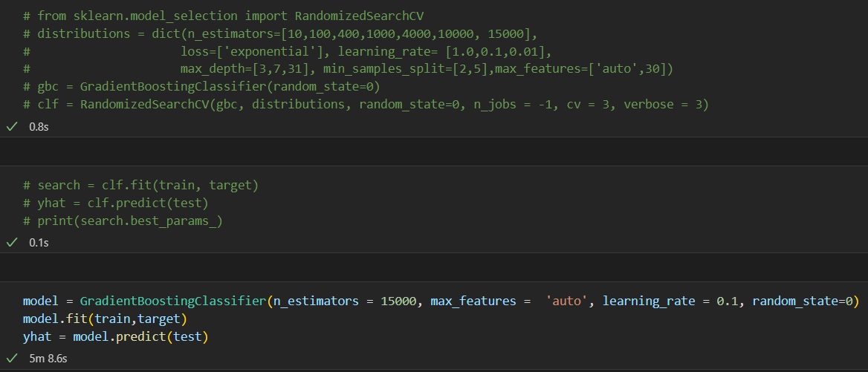
Execution Demo(Video/Screenshots) of the solution:
Cross-Validation Steps commented after running the code

Slide 7
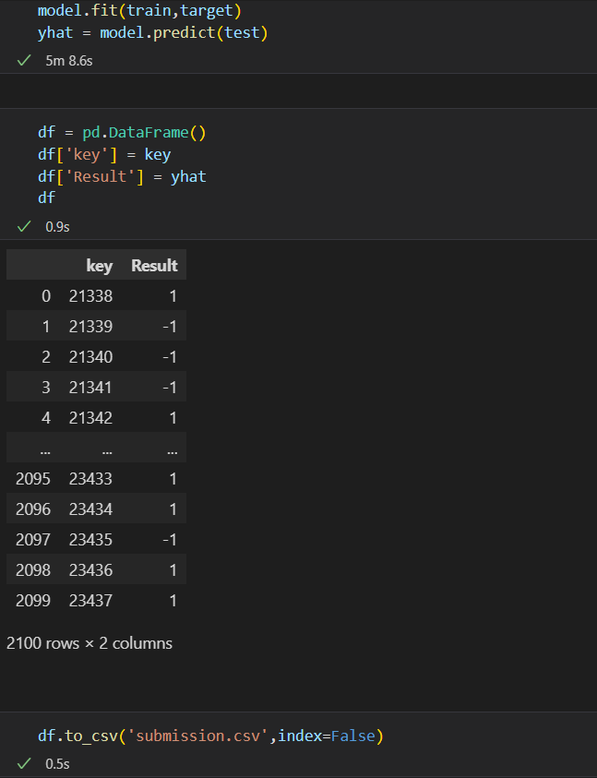
Execution Demo(Video/Screenshots) of the solution:
Prediction steps:-

Slide 8
Source code as ZIP or Github URL:
Github URL :- https://github.com/bishnoirajat2/HP_Machine_Learning_hackathon

Slide 9
THANK YOU

