Slide 1
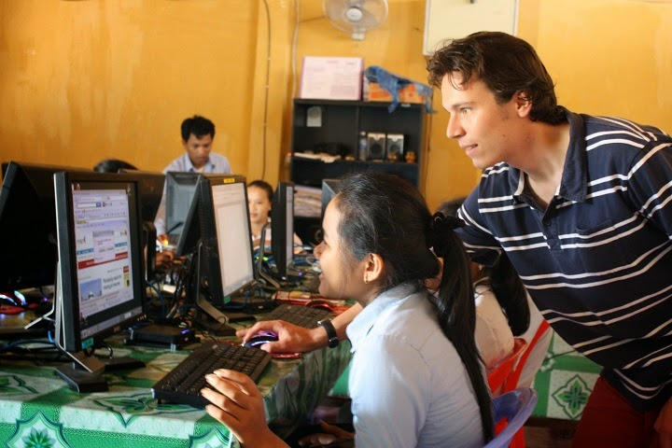
Re-create
RURAL EDUCATION
Bishnu subedi

Slide 2
INTRODUCTION
A platform independent application program with a view to help make the lives in the rural and remote communities of any part of the world easier thus helping them uplift their living standard by giving them the appropriate guidance in the right path them wish to follow .

Slide 3
Theme Support
To help guide the rural population in the right path of education.
To help them choose the right path to follow.
To help them interact with the concerned people of the respective institute or organization.
To help people make economical and worthwhile decisions in choosing the right institutions .

Slide 4
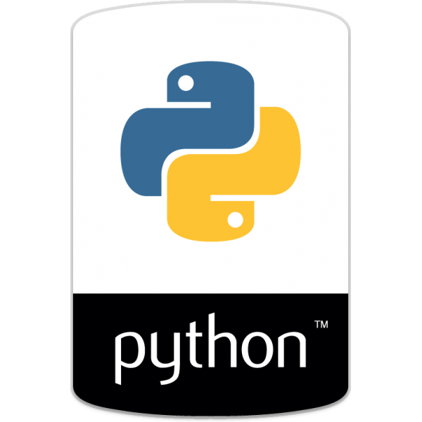
Methodology
Use of Python Programming Language.
Use of various modules within the programming language.
Use of Tkinter for adding the features of GUI .
Use of the concept of frame for switching between various parts of the program.
Use of File Handling .

Slide 5
System Overview
Python programming language being a platform independent language , this program can run in any platform . Windows-OS, Mac-0S, Linux, etc.
Requires very few system requirement as it occupies a very small space in the range of few Mega-Bytes.

Slide 6
Feasibility
Being a program developed from a platform independent programming language , this program assures to be highly portable in any platform , Windows, Mac or Linux .
On further development it can also be very easily used in any mobile devices.
The program being user centered , gives emphasis on their required results rather than the view of having any profit to any organization which makes it very suitable for rural communities.
Further development can be made by the use of native language in the user interface of the program to enrich the user experience mainly for the rural population.

Slide 7
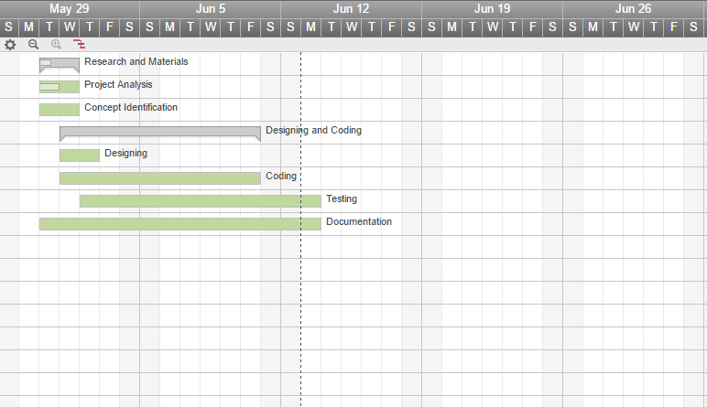
Time Schedule

Slide 8
Conclusion
So , being a platform independent program , highly portable , small in size and easily applicable and efficient in the user experience , we hope that this application provides the necessary framework for the development of rural and remote communities .

