Slide 1
MQ-135 • DHT11 • LDR MODULE — ESP8266 NODEMCU → BLYNK IOT → ML CLASSIFIERS
SMART INDOOR AIR QUALITY MONITORING
An Embedded IoT System with Machine-Learning-Based Air Quality Classification
Sensor data acquisition → Real-time dashboard → Multi-model training & evaluation of Air Quality
NAME OF INSTITUTE:
JORHAT INSTITUTE OF SCIENCE & TECHNOLOGY
PROJECT TEAM
1 Kaustabh Jyoti Nath
2 Rajnish Gogoi
3 Rishav Dutta
4 Bishnujyoti Gogoi
5 Madhurjya Mohan Nath
B.Tech — Electronics & Telecommunication Engineering

Slide 2
01 • SYSTEM OVERVIEW
From Sensors to a Trained Air-Quality Classifier
A three-stage pipeline: embedded sensing, live IoT visualization, and offline machine-learning analysis that predicts Air Quality.
01
02
03
Embedded Sensing
IoT Dashboard + Logging
Machine Learning
ESP8266 NodeMCU reads MQ-135 (gas), DHT11 (temp/humidity) and an LDR module every 10 s, then classifies Air Quality and flags gas anomalies on-device.
Readings are streamed live to Blynk for monitoring, and appended to a Google Sheet (exported as CSV) for long-term storage.
The logged CSV is loaded in Colab, cleaned & scaled, then used to train four classifiers — Logistic Regression, ANN, Random Forest, KNN — to predict Air Quality (Moderate / Poor).
Embedded Air Quality Monitoring — IoT + Machine Learning
2

Slide 3
02 • EMBEDDED IMPLEMENTATION
Sensor Hardware & On-Device Classification Logic
MQ-135 Gas Sensor
Analog — A0
Air Quality Classification Rule
Raw ADC gas concentration reading (0–1023); primary driver of Air Quality
Derived on-device from the MQ-135 raw ADC reading:
< 300
Good
DHT11 Sensor
Digital — D4
Ambient temperature (°C) and relative humidity (%)
300 – 599
Moderate
≥ 600
Poor
LDR Module
Digital — D5
Light state, used as a proxy for room occupancy
Model target used for training: the ML pipeline predicts this same 'Air quality' label from the logged sensor history.
ESP8266 NodeMCU
Wi-Fi MCU
Gas Anomaly Flag
Samples every 10 s; pushes data to Blynk + Google Sheets
MQ-135 raw value > 600 → Anomaly = 1 (secondary, on-device safety flag alongside Air Quality)
Embedded Air Quality Monitoring — IoT + Machine Learning
3

Slide 4
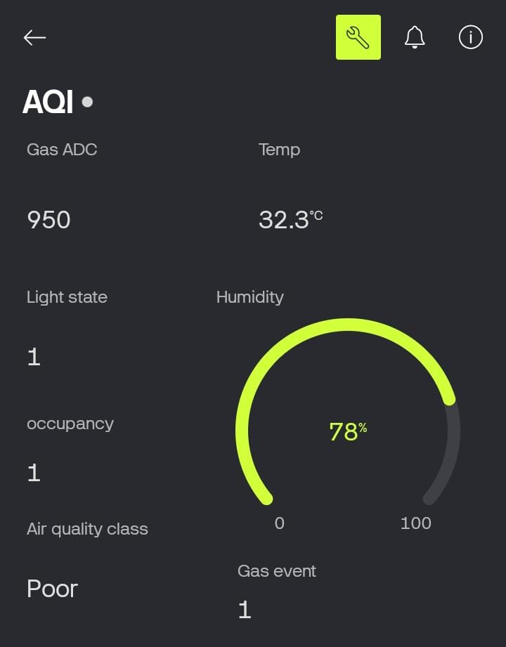
03 • LIVE DASHBOARD
Real-Time Parameters on Blynk IoT
Every 10 seconds, the NodeMCU writes seven parameters to Blynk virtual pins for live, remote monitoring.
Gas ADC (MQ-135) — Raw analog gas reading
Temperature — From DHT11, in °C
Humidity — From DHT11, shown on radial gauge
Light State — Digital LDR output (0/1)
Occupancy — Estimated from light state
Air Quality Class — Good / Moderate / Poor
Gas Event — Binary anomaly flag
Embedded Air Quality Monitoring — IoT + Deep Learning
4

Slide 5
03 • DATASET PREPARATION
From Logged Readings to an Air-Quality Training Set
1,499
6
90 / 10
Logged readings
Input features used
Poor vs. Moderate split (%)
Model Input Features
Preprocessing Pipeline
Feature | Source
Temperature (°C) | DHT11
Humidity (%) | DHT11
MQ-135 raw value | MQ-135
Light State | LDR module
Date (encoded) | Timestamp
Time (encoded) | Timestamp
1
Loaded CSV of logged sensor readings into pandas
2
Parsed Timestamp → separate Date & Time features (label-encoded)
3
Dropped non-predictive / redundant columns (e.g. Occupancy Status)
4
Label-encoded the target — Air quality (Moderate / Poor)
5
Standardized numeric features with StandardScaler
Target label — Air quality (Moderate = 0, Poor = 1 as observed in this logged set)
6
Stratified 80 / 20 train–test split for the Air quality target
Embedded Air Quality Monitoring — IoT + Machine Learning
4

Slide 6
04 • MODEL TRAINING
Four Classifiers Trained to Predict Air Quality
Every model is trained on the same 6-feature, scaled dataset and stratified 80/20 split — 1,199 training samples, 300 test samples.
Logistic Regression
Artificial Neural Network
scikit-learn LogisticRegression, max_iter = 1000. A linear baseline classifier on the scaled features.
Keras Sequential: Dense(64, ReLU) → Dense(32, ReLU) → Dense(2, Softmax). Adam optimizer, sparse categorical cross-entropy, 50 epochs, batch size 32, 10% validation split.
Random Forest
K-Nearest Neighbors
scikit-learn RandomForestClassifier with default ensemble settings — captures non-linear feature interactions.
scikit-learn KNeighborsClassifier, default k = 5 — distance-based classification on standardized features.
Embedded Air Quality Monitoring — IoT + Machine Learning
5

Slide 7
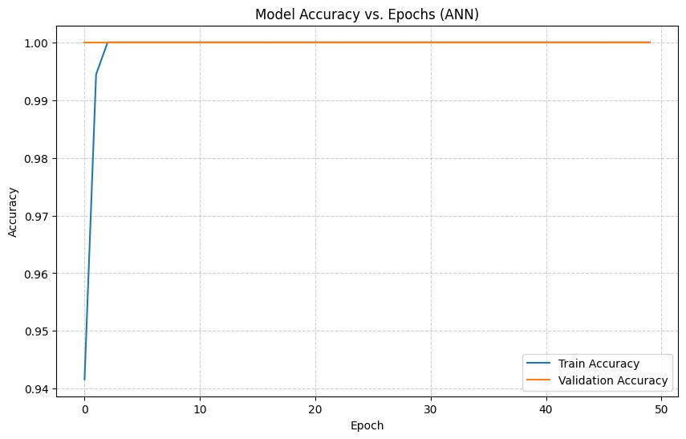
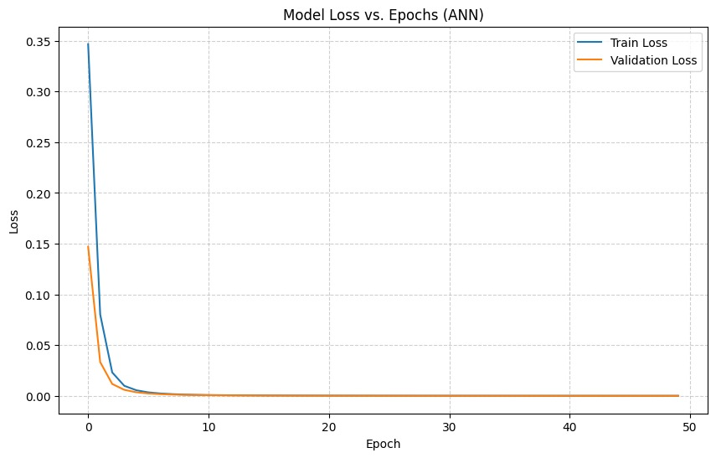
05 • ANN TRAINING BEHAVIOUR
Accuracy & Loss Across 50 Training Epochs
Both training and validation curves converge rapidly, indicating fast, stable learning on the Air Quality classification task.
Model Accuracy vs. Epochs
Model Loss vs. Epochs
Observation: training and validation accuracy both reach 1.0 within the first few epochs, and loss converges to near zero — consistent with the strong class separability seen across all four models.
Embedded Air Quality Monitoring — IoT + Machine Learning
6

Slide 8
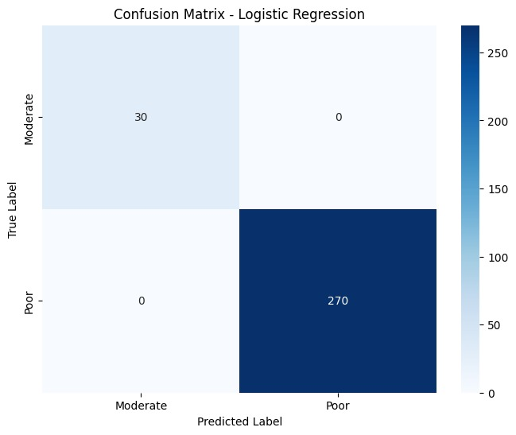
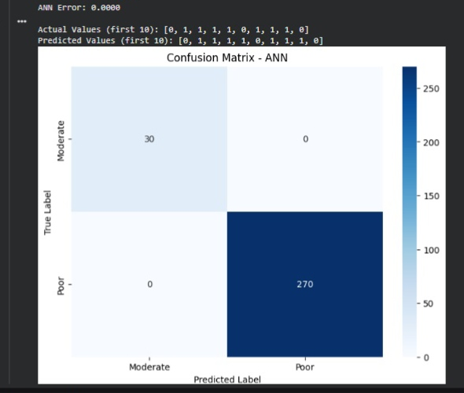
06 • EVALUATION
Confusion Matrices — Moderate vs. Poor Air Quality
Held-out 300-sample test set (30 Moderate · 270 Poor), evaluated identically across all four classifiers.
Logistic Regression
Artificial Neural Network
Embedded Air Quality Monitoring — IoT + Machine Learning
7

Slide 9

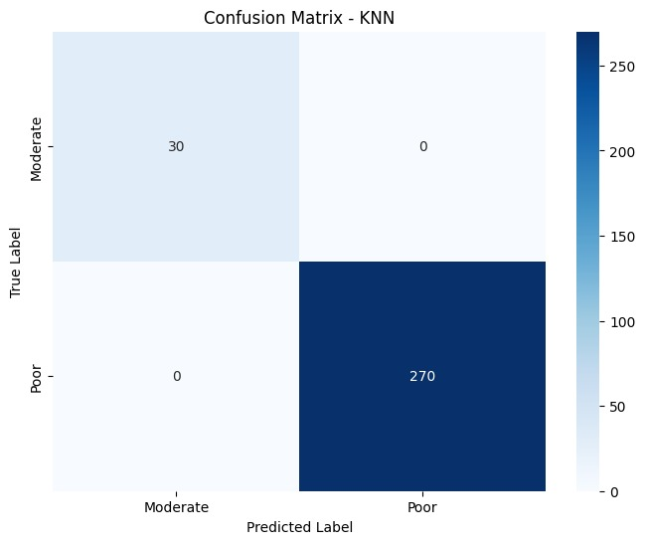
06 • EVALUATION
Confusion Matrices — Moderate vs. Poor Air Quality
Held-out 300-sample test set (30 Moderate · 270 Poor), evaluated identically across all four classifiers.
Random Forest
K-Nearest Neighbors
Embedded Air Quality Monitoring — IoT + Machine Learning
7

Slide 10
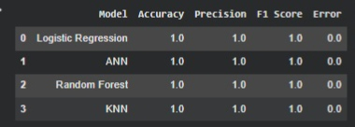
07 • MODEL COMPARISON
All Four Models Perfectly Separate Air Quality Classes
Metrics computed with scikit-learn's accuracy_score, precision_score (weighted) and f1_score (weighted) on the 300-sample test set.
Model | Accuracy | Precision | F1 Score | Error
Logistic Regression | 1.0 | 1.0 | 1.0 | 0.0
Artificial Neural Network | 1.0 | 1.0 | 1.0 | 0.0
Random Forest | 1.0 | 1.0 | 1.0 | 0.0
K-Nearest Neighbors | 1.0 | 1.0 | 1.0 | 0.0
Source Output (Colab)
Support: 30 Moderate + 270 Poor = 300 test samples
Reading the results
Perfect scores reflect a small, controlled test setup and a strongly imbalanced dataset (90% Poor readings, captured mostly in one elevated-MQ-135 environment). Results show clean class separability on this data, but broader field testing and a more balanced dataset are recommended before deployment.
Embedded Air Quality Monitoring — IoT + Machine Learning
8

Slide 11
08 • CONCLUSION
Takeaways & Next Steps
What we achieved
Where this goes next
End-to-end pipeline built: embedded sensing → live Blynk dashboard → CSV logging → multi-model training
Collect data across more environments to reduce class imbalance and add 'Good' air-quality examples
Low-cost sensor stack (MQ-135, DHT11, LDR) reliably distinguishes Good / Moderate / Poor air quality
Calibrate MQ-135 to real PPM values instead of raw ADC thresholds
Four models — Logistic Regression, ANN, Random Forest, KNN — each achieved 1.0 accuracy, precision and F1 on Air Quality classification
Cross-validate models on a larger, more balanced dataset to stress-test the perfect scores
Deploy the best-performing model on-device (TinyML) for real-time inference without the cloud round-trip
Thank You
Embedded Air Quality Monitoring — IoT + Machine Learning
9

