Slide 1


Virtual Reality (VR)
AN INTRODUCTION FOR CLASS 12 STUDENTS

Slide 2

Understanding Virtual Reality Technology
WHAT VR MEANS
VR is a technology that creates a fully immersive simulated environment, allowing users to interact with digital worlds using specialized equipment.

Slide 3
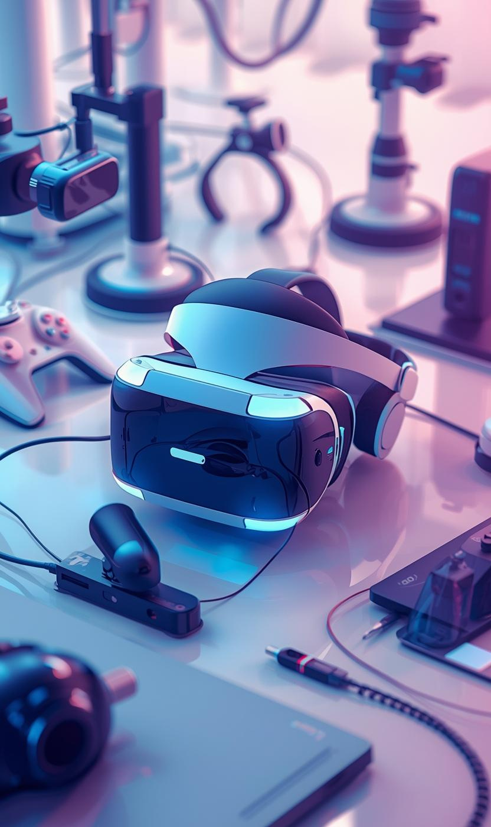

How VR Works
UNDERSTANDING THE CORE COMPONENTS OF VR
  VR headset with screens and sensors
  Motion tracking of head and hands
  Computer or console processing environment
  Optional controllers for user interaction

Slide 4
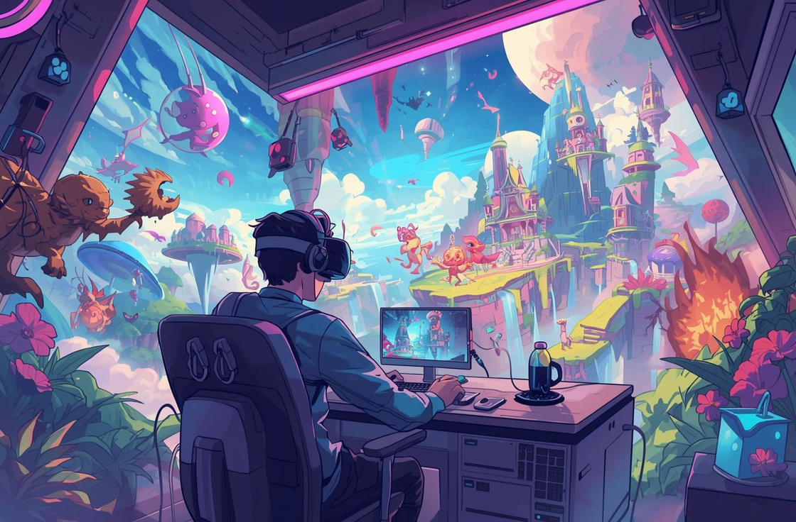
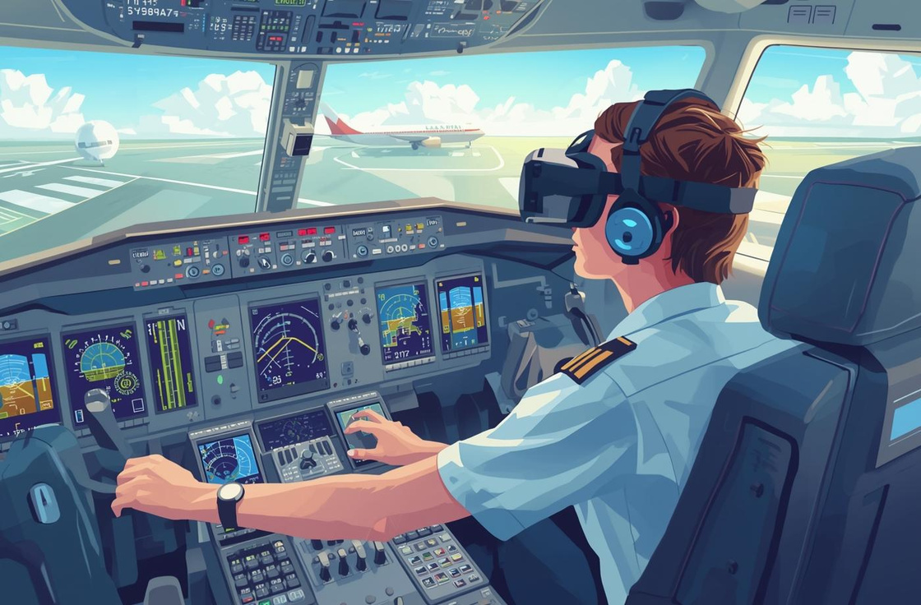
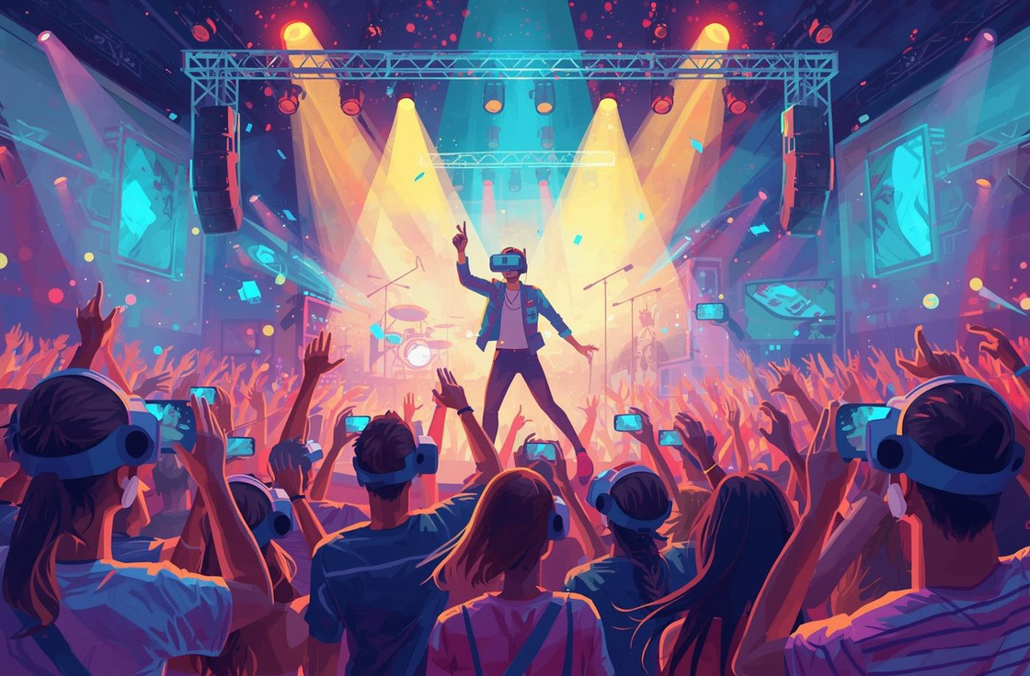
Common Applications of Virtual Reality (VR)
GAMING
TRAINING
ENTERTAINMENT
Immersive gameplay that enhances player experiences.
Essential for skill development in various fields.
Virtual concerts and movies that captivate audiences.

Slide 5
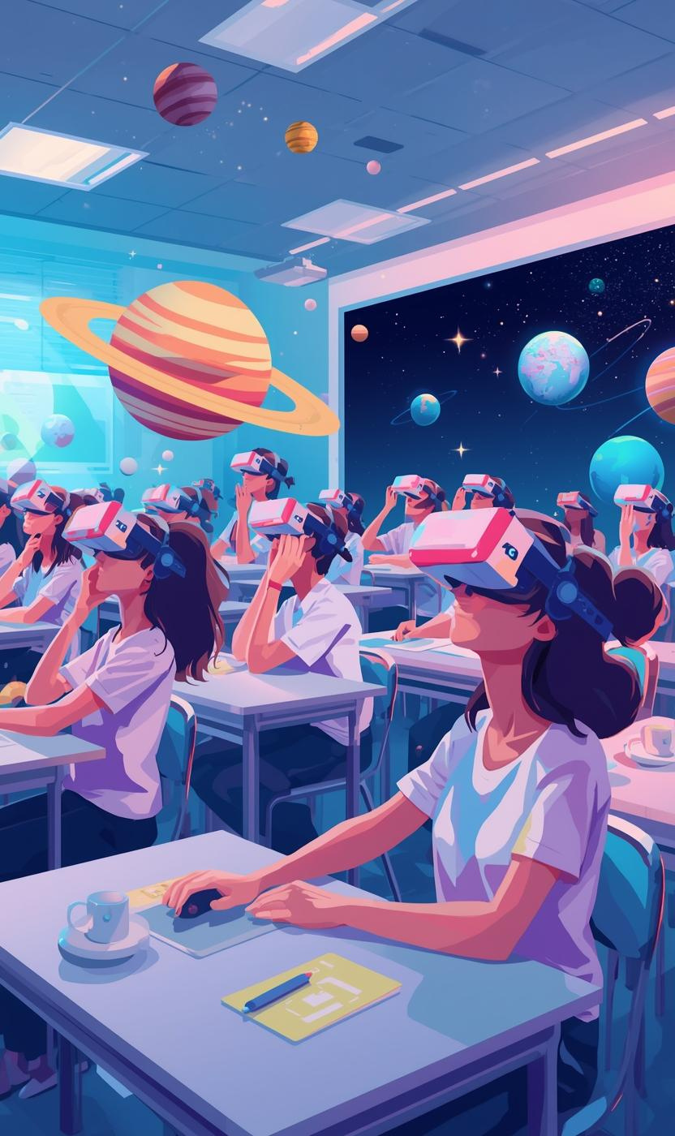
75%
EDUCATOR SUPPORT
A significant 75% of educators believe that virtual reality can enhance student engagement in the classroom. This technology allows for immersive learning experiences, enabling students to explore concepts interactively and intuitively. As VR becomes more prevalent, it has the potential to revolutionize traditional educational methods, fostering deeper understanding.

Slide 6

Benefits of VR
ENGAGEMENT
SAFE PRACTICE
EXPERIENTIAL LEARNING
VR significantly enhances student engagement by creating immersive experiences that captivate learners' attention and encourage active participation in their education.
With VR, learners can safely practice complex skills in a controlled environment, making mistakes without real-world consequences, thus building their confidence.
VR provides experiential and visual learning opportunities, allowing students to explore concepts interactively, which helps reinforce understanding and retention of information.

Slide 7
PROS OF VIRTUAL REALITY
CONS OF VIRTUAL REALITY
Virtual reality offers several significant advantages. It creates immersive experiences that capture users' attention and encourage interaction. VR's innovative technology facilitates unique learning opportunities, enabling users to explore environments that were once inaccessible. Its ability to simulate real-world scenarios enhances the educational experience, making it highly engaging and impactful.
Despite its benefits, VR also faces notable challenges. The high cost of equipment can limit access for many learners. Users may experience motion sickness during use, which can detract from the experience. Additionally, technical limitations and accessibility issues can hinder the widespread adoption of VR technologies in various settings.

Slide 8
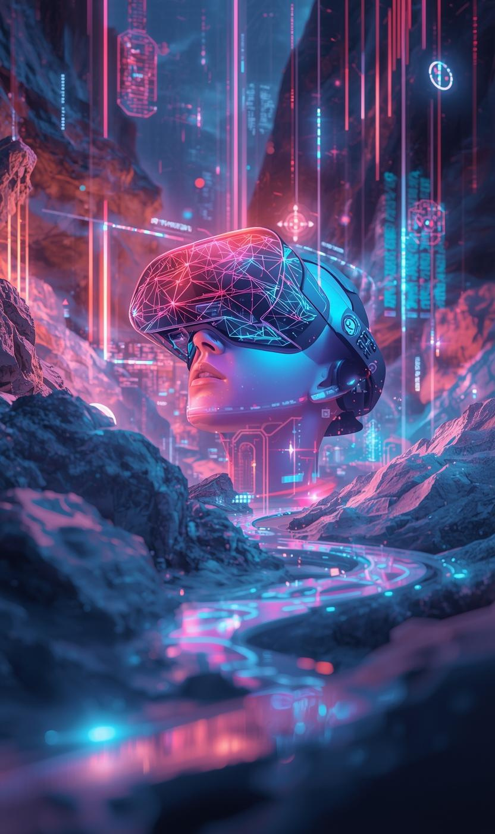
80%
ENGAGEMENT
Recent studies show that 80% of users believe virtual reality enhances their learning experience. This high level of engagement indicates that VR not only captivates attention but also improves retention and understanding of complex concepts, making it a transformative tool in both educational and professional settings.

Slide 9
Summary of Key Points
UNDERSTANDING VIRTUAL REALITY
VR creates immersive simulated environments that enhance learning experiences across various fields like gaming, training, and education, revolutionizing how we interact.
CHALLENGES AHEAD
While VR offers great benefits, it also presents challenges and limitations, including high costs and accessibility issues that need addressing for wider adoption.

Slide 10

Thank You

