Slide 1
Project 7 Health Care
Bishnu Paudel

Slide 2
Project 7: Healthcare cost analysis
Description:
Data contains hospital costs conducted by US Agency nationwide that includes inpatient samples. Specifically, the provided data has only the record for city of Wisconsin of the age group 0-17 years.
Objective: The main aim of survey was to find healthcare costs and their utilization using collected data. To achieve this, company has divided data analysis strategies into multiple sub-groups as given below:
Aim 1. To find the age category of people who frequently visit the hospital and has the maximum expenditure
Solution: Following steps were created to find the solution
First, data is loaded in R-studio
Sanity of data checked
Histogram of AGE group was created to see the frequency distribution.
It seems that infant “0” Age group visited the hospital more frequently
4. Total expenditure at hospital was summed for different age group using AGE
and TTCHG columns. It appears that “0” Age group has highest expenditure in
hospital, too. Which is 678118 for “0” Age group

Slide 3
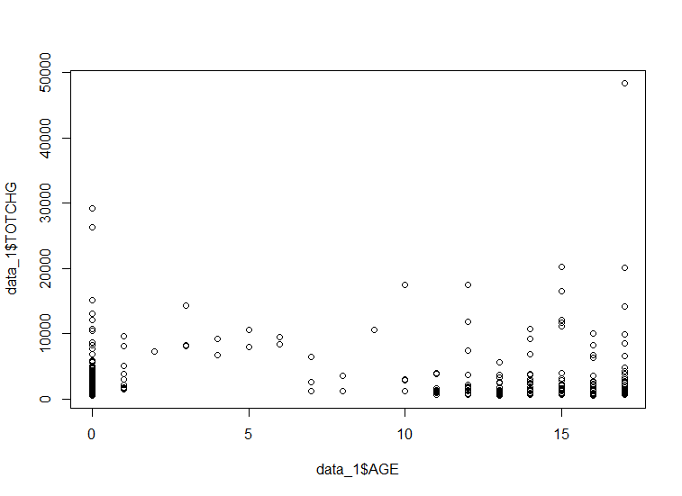
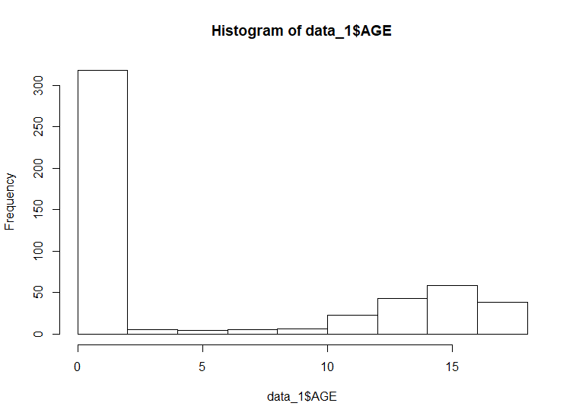
Age- 0 1 2 3 4 5 6 7 8 9 10 11 12 13 14 15 16 17
Total
Expense 678118 37744 7298 30550 15992 18507 17928 10087 4741 21147 24469 14250 54912 31135 64643 111747 69149 174777
This age group in very few occasion spends the most dollars but the frequency of occurrence is quite low and total sum of expenditure low compared to infanct age group
The scatter plot shows that age group of infant spends most $$$ in hospital and the group is frequently visits the hospital
Highest frequency age group which is infant
Infant age group spends the most dollars in total

Slide 4
Aim 2: In order of severity of the diagnosis and treatments and to find out the expensive treatments, the agency wants to find the diagnosis-related group that has maximum hospitalization and expenditure.
Solution:
To achieve this task we need to find a diagnosis-related group that stays the most in the hospital and spends the most money in total. Following strategies have been developed to achieve this task
First, determine frequency of entries by using summary function
Second, find the maximum value from step 1
Apply tapply() to determine sum of all the columns in TOTCHG, and APRDRG
Determine maximum value using max() in step 3.
From these operation 640 groups were observed to stay 44 days in hospital and had spent the most among the groups which was $437978
To add the visual affect on looking data I have plotted xy plot that provides frequency of hospital entries with corresponding hospital cost and length of stay as another parameter.

Slide 5
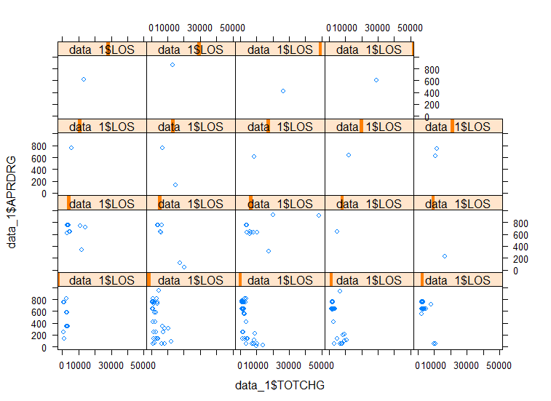
Aim 2: In order of severity of the diagnosis and treatments and to find out the expensive treatments, the agency wants to find the diagnosis-related group that has maximum hospitalization and expenditure.
The highlighted box shows maximum number of hospitalization entries, length of stay and maximum cost
xy plot shows that the shaded group represents the maximum number of hospitalization and spends the most dollars in the hospital.

Slide 6
Aim3: To make sure that there is no malpractice, the agency needs to analyze if the race of the patient is related to the hospitalization costs.
Solution: Linear regression model
Steps:
Converted the Race data into a factor as Race was originally exist as binary and hence converted to factor
Summary of the Race data was executed that shows there exist NA’s. It is necessary to remove those NA’s
NA’s were removed using na.omit() function.
A linear regression model was put forward to test the hypothesis. Null hypothesis (H₀): There is no Racism in medical practice that causes high hospital cost. Alternative hypothesis (Ha): Racism exist that causes high hospital cost
fit1 <- lm(data_1$TOTCHG~data_1$RACE) was executed
Summary(fit1) was executed that resulted following parameters
P-value observed was more than 0.05 and hence Null hypothesis cannot be rejected. Which explain that there is no racism exist during medical practice.
Multiple R-squared: 0.0003299
Adjusted R-squared: -0.001681
F-statistic: 0.164 on 1
DF: 497
p-value: 0.6856
A big change in R² value, suggesting that the proposed model of linearity is not fitting well
p > 0.05, significantly greater than 0.05, failed to reject Null hypothesis

Slide 7
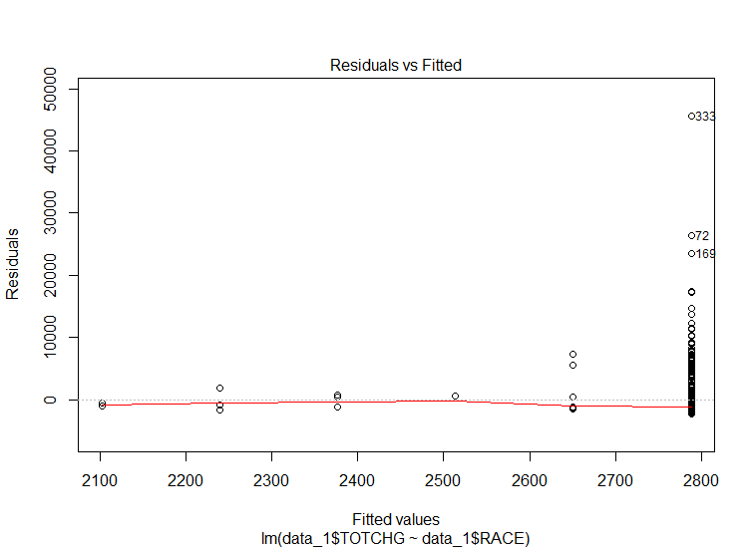
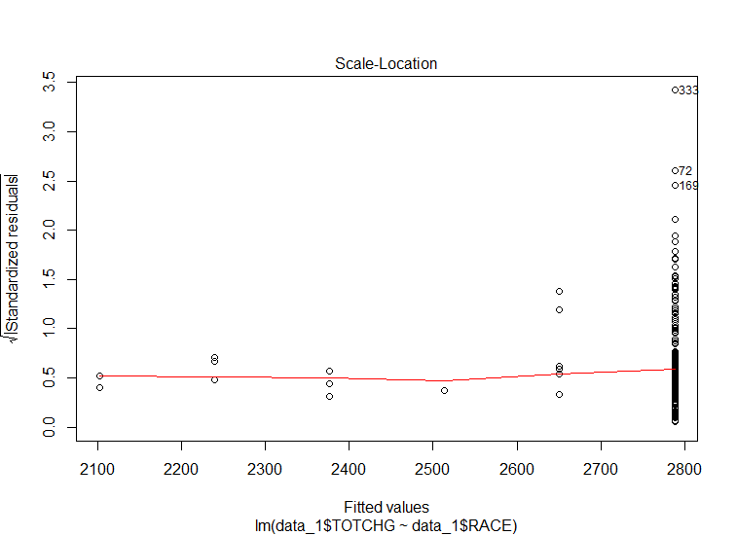
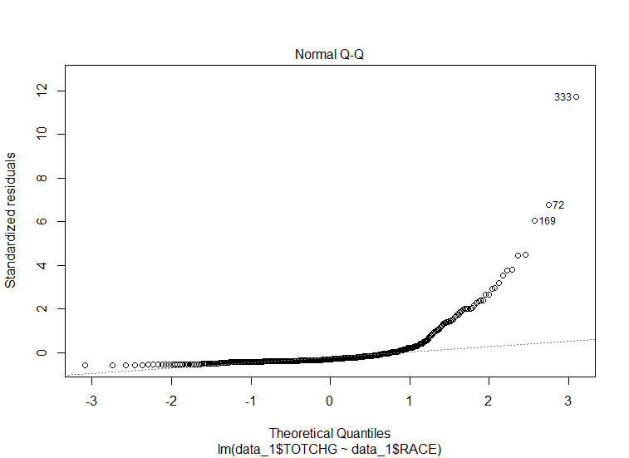
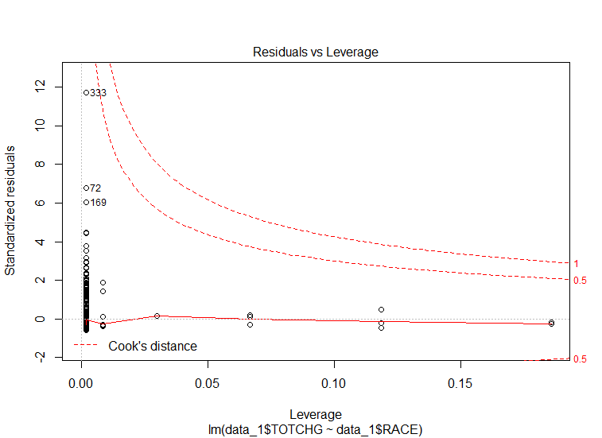
Graphs explaining Aim 3 in more details.
There is a pattern of distribution which shows heteroscedasticity or non-linearity of the data. There is large number of data points that are left over by the model fit.
Again a scale plot shows a unequal and not randomly distributed pattern which does not maintain homoscedasticity
There is a large deviation on Normal Q-Q plot where data do not follow linear dashed line but deviate largely from the linear line suggesting, deviation from normal distribution
The data lie within cook’s distance
All four plots show that points 33, 72 and 169, suggesting it is worth looking on those number for further improvement of the model

Slide 8
Aim 4: To properly utilize the costs, the agency has to analyze the severity of the hospital costs by age and gender for the proper allocation of resources.
Solution:
Following steps were performed using linear regression model
A linear regression model was proposed in which TOTCH is a depended variable and female and race are independent variables
Call: lm(formula = data_1$TOTCHG ~ data_1$AGE + data_1$FEMALE)
Residuals:
Min 1Q Median 3Q Max
–3406 -1443 -869 -152 44951
Coefficients:
Estimate Std. Error t value Pr(>|t|) (Intercept)
2718.63 261.14 10.411 < 2e-16 ***
data_1$AGE 86.28 25.48 3.387 0.000763 ***
data_1$FEMALE -748.19 353.83 -2.115 0.034967 *
As we can see here p-values are very low and significance codes shows importance of both age and female factor in determining the total charge of hospital. Rejected Null hypothesis, here. In comparison, AGE factor plays important role compared to FEMALE factor
signif. codes: 0 ‘***’ 0.001 ‘**’ 0.01 ‘*’ 0.05 ‘.’ 0.1 ‘ ’ 1

Slide 9
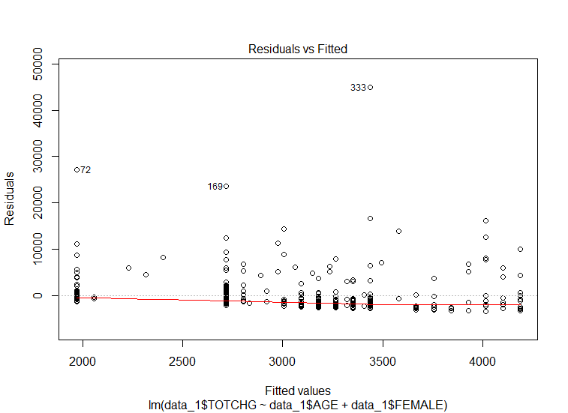
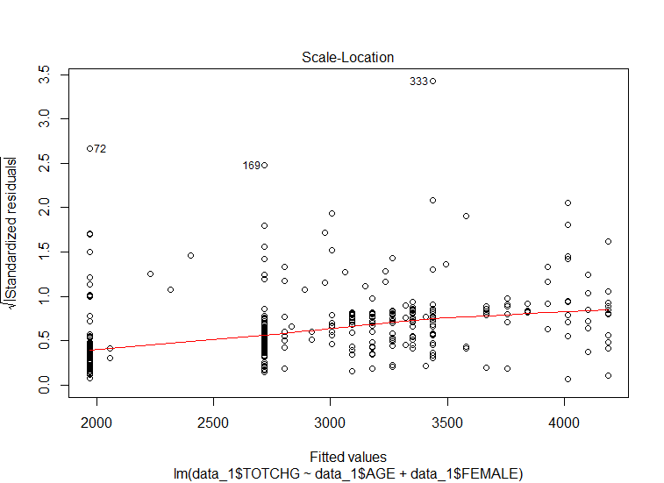
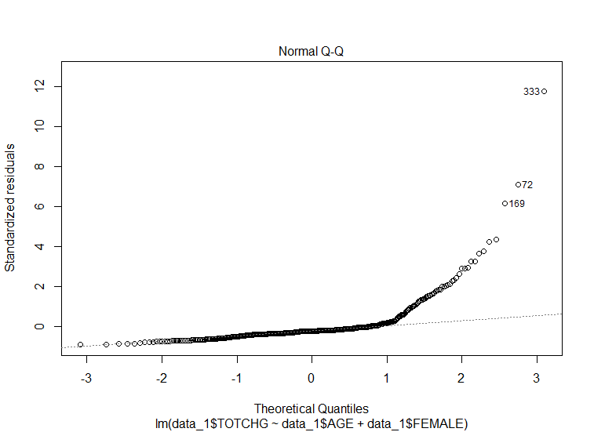
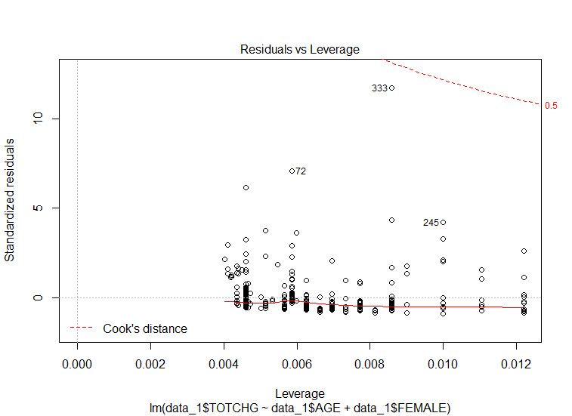
Graphs explaining Aim 4 in more details.
There is no pattern of distribution which shows homoscedasticity or linearity of the data..
Again a scale plot shows a equal and randomly distributed data pattern which maintains homoscedasticity
There is a deviation on Normal Q-Q plot where data do not follow linear dashed line but deviate largely from the linear line suggesting, deviation from normal distribution
The data lie within cook’s distance
Deviation from normal distribution

Slide 10
Aim 5: Since the length of stay is the crucial factor for inpatients, the agency wants to find if the length of stay can be predicted from age, gender, and race.
Solution:
A linear regression model is proposed to answer this. In this case, length of stay is depended variables and age, gender and race are independent variables.
Call: lm(formula = data_1$LOS ~ data_1$AGE + data_1$FEMALE + data_1$RACE, data = data_1)
Residuals:
Min 1Q Median 3Q Max
-3.22 -1.22 -0.85 0.15 37.78
Coefficients:
Estimate Std. Error t value Pr(>|t|)
(Intercept) 2.94377 0.39318 7.487 3.25e-13 ***
data_1$AGE -0.03960 0.02231 -1.775 0.0766 .
data_1$FEMALE 0.37011 0.31024 1.193 0.2334
data_1$RACE -0.09408 0.29312 -0.321 0.7484
Multiple R-squared: 0.007898, Adjusted R-squared: 0.001886
F-statistic: 1.314 on 3 and 495 DF, p-value: 0.2692
p-value is higher than 0.05 at 95% confident and hence the model is not accepted. There is good chance to improve the model by looking at alternative models. For example, in this model FEMA and RACE factor shows higher p-values, suggesting the length of stay does not depend on those factor but strongly depends on AGE factor
 | Signif. codes: 0 ‘***’ 0.001 ‘**’ 0.01 ‘*’ 0.05 ‘.’ 0.1 ,1
 | Residual standard error: 3.363 on 495 degrees of freedom
 | (1 observation deleted due to missingness)

Slide 11
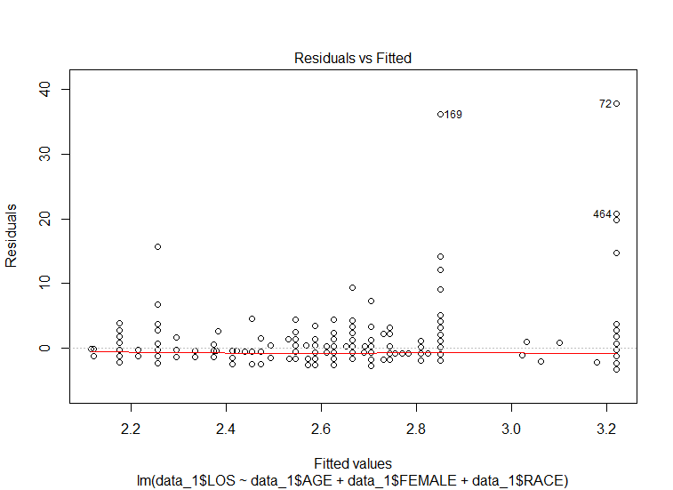
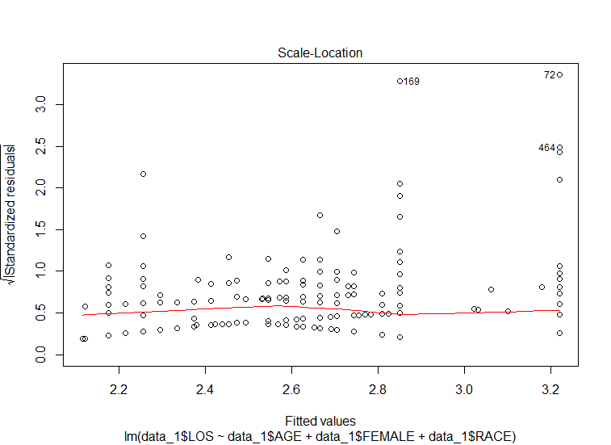
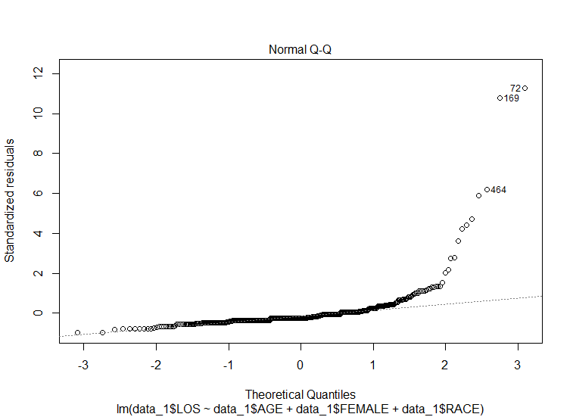
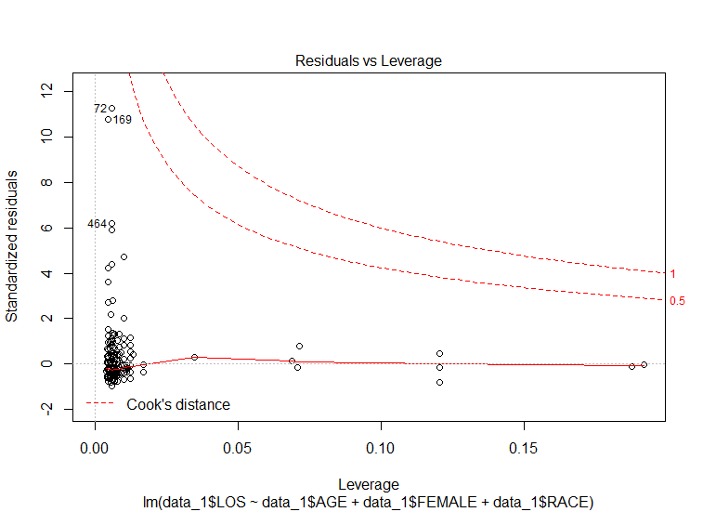
Graphs explain Aim 5 data
Maintains a homoscedastic distribution
Maintains a homoscedastic distribution
Cook’s distance shows that none of the data above 1value suggesting these data do not have significant influence on hospital total charge.
Deviation from normal distribution
Overall, these data show that length of stay cannot be predicted accurately by age, gender and race as the p-value is very high .

Slide 12
Aim 6: To perform a complete analysis, the agency wants to find the variable that mainly affects hospital costs.
Solution
Here, we have to identify which variables mostly affect the hospital costs. To address this, I am going use linear regression model using hospital cost as a depended variable and rest of the other as independent variables. Then, using summary fit function of linear regression model, I will determine which factor influence most looking at p-values. Lower the p-values more strongly influence the hospital costs and the variables the shows higher than 0.05 p-values will be considered as less influential factor under 95% confidence level.
To achieve this, following steps are performed
data_1na <- na.omit(data_1) – removes all the na values
Call regression model: fit6 <- lm(data_1na$TOTCHG~. , data=data_1na)
Summary(fit6) – results statistical summaries of all variables
fit7 <- step(fit6) – optimize model with high AIC values

Slide 13
Residuals:
Min 1Q Median 3Q Max
-6377 -700 -174 122 43378
The summary of the fit shows that LOS and APRDRG have the lowest p-values. This suggests that hospital costs strongly depends upon those factors. In contrast, FEMALE and RACE has p-values greater than 0.05, suggesting those factors influence less the cost price.
Coefficients:
Estimate Std. Error t value Pr(>|t|)
(Intercept) 5218.6769 507.6475 10.280 < 2e-16 ***
AGE 134.6949 17.4711 7.710 7.02e-14 ***
FEMALE -390.6924 247.7390 -1.577 0.115
LOS 743.1521 34.9225 21.280 < 2e-16 ***
RACE -212.4291 227.9326 -0.932 0.352
APRDRG -7.7909 0.6816 -11.430 < 2e-16 ***
Signif. codes: 0 ‘***’ 0.001 ‘**’ 0.01 ‘*’ 0.05 ‘.’ 0.1 ‘ ’ 1
Residual standard error: 2613 on 493 degrees of freedom
Multiple R-squared: 0.5536, Adjusted R-squared: 0.5491
F-statistic: 122.3 on 5 and 493 DF, p-value: < 2.2e-16

Slide 14
Library(caret)
Linear regression model is applied using caret which identifies the important independent variable that influence the dependent variables. The below result shows that “LOS” has highest number which is 21.28 suggesting this variable influence the hospital cost mostly. This confirms our earlier p-values test. The order of most influence variables in total cost price is given in order of LOS > APRDRG > AGE > FEMALE > RACE.
Overall
AGE 7.7095609
FEMALE 1.5770323
LOS 21.2800068
RACE 0.9319818
APRDRG 11.4301445

Slide 15
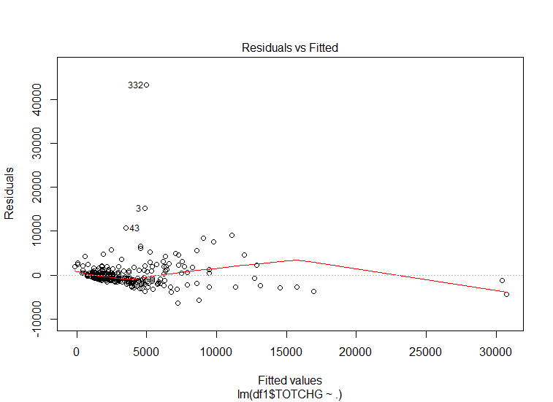
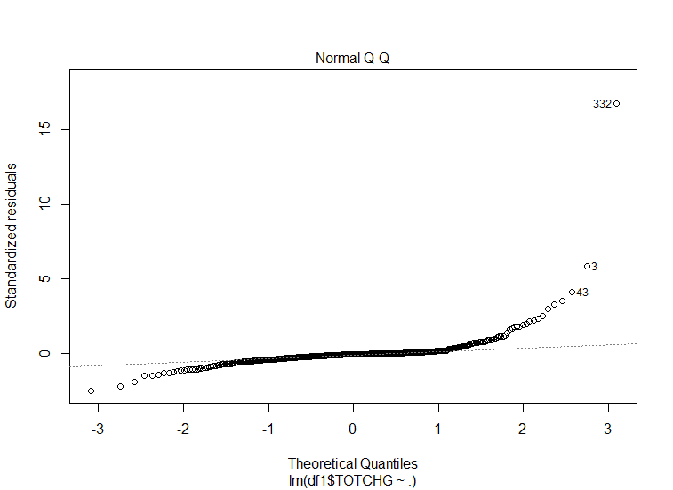
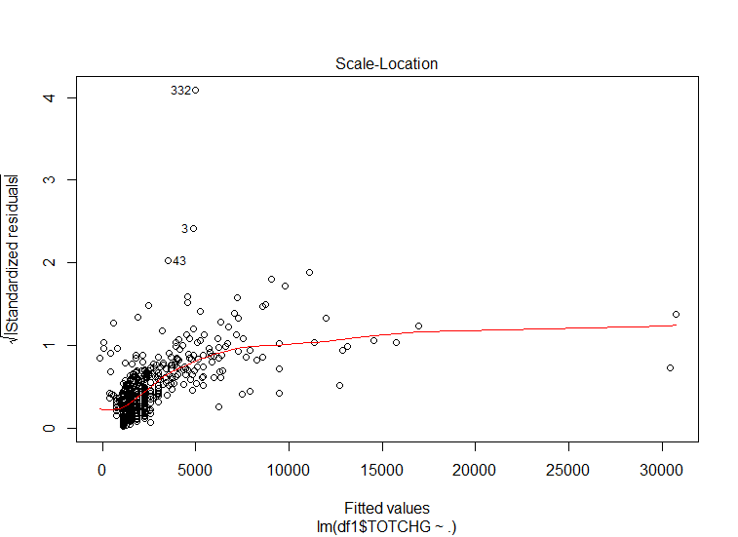
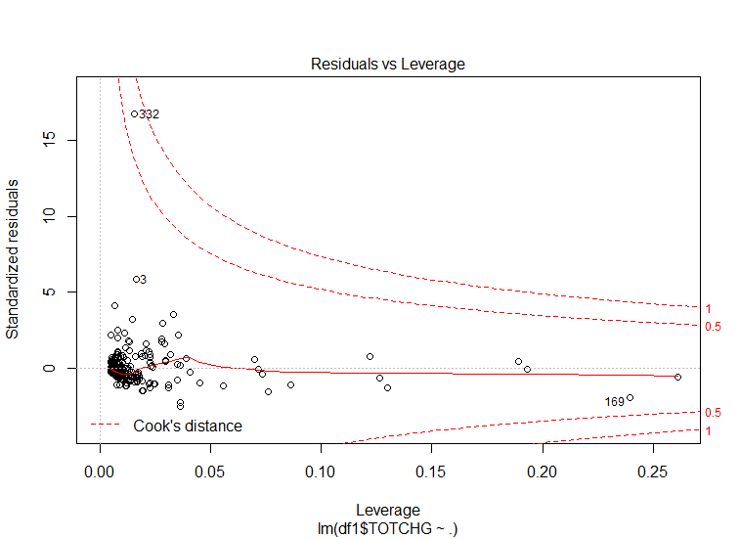
Maintains a homoscedastic distribution
Maintains a homoscedastic distribution
Cook’s distance shows that none of the data above 1value suggesting these data do not have significant influence on hospital total charge.
Not much deviation from normal distribution

Slide 16
R code
# Project 7: Hospital cost analysis
library(readxl)
library(ggplot2)
library(plotly)
# set working directory
setwd("C:/Users/ribis/Documents/Simplilearn_Data Scientist/Projects/Porject 7")
data_1 = read_xlsx("1555054100_hospitalcosts.xlsx") # read the xlsx file
View(data_1) # viewing data
summary(data_1) # summarizes each columns
names(data_1) # read name of headings

Slide 17
# AIM 1: To record the patient statistics, the agency wants to find the age category of people who frequently visit the hospital and has the maximum expenditure
is.na(data_1["AGE"]) # checking NA if exist
data_2 = na.omit(data_1["AGE"]) # not require in this case as NA not exist in AGE data
hist(data_1$AGE) # create distribtution of AGE, based on histogram infant of age group 0-1 has higest fequency of visiting hospital
plot(data_1$AGE, data_1$TOTCHG) # scatter plot showing expenditure by different age group
infant <- as.factor(data_1$AGE) # create a fator
summary(infant) # here 0 age group has maximum 307 times discharge rate meaning frequently visiting hospital
tapply(data_1$TOTCHG, data_1$AGE, sum) # finds total expenditure related to particular age group
which.max(tapply(data_1$TOTCHG,data_1$AGE,sum))

Slide 18
#AIM 2: In order of severity of the diagnosis and treatments and to find out the expensive treatments, the agency wants to find the diagnosis-related group that has maximum hospitalization and expenditure
diagnosis_expense <-as.factor(data_1$APRDRG) # converted into a factor
View(diagnosis_expense)
is.na(diagnosis_expense)
summary(diagnosis_expense) # summarize the data labelleing frequency of occurence
which.max(summary(diagnosis_expense)) # find maxium value and number of iterations. It shows 640 is the maximum value repeated for 44 times
tapply(data_1$TOTCHG, diagnosis_expense, sum) # divide the data set into groups and apply sum for the data set into each group
which.max(tapply(data_1$TOTCHG, diagnosis_expense, sum)) # provides maximum value
max(tapply(data_1$TOTCHG, diagnosis_expense, sum)) # max value of tapply function
library(plot3D)
ggplot(data=data_1, aes(x=data_1$LOS, y=data_1$APRDRG)) + geom_density2d()
xyplot(data_1$APRDRG~data_1$TOTCHG | data_1$LOS) # this plot shows that 640 entries, longest stay and maximum cost on hospitalization

Slide 19
# Aim 3: To make sure that there is no malpractice, the agency needs to analyse if the race of the patient is related to the hospitalization costs.
# Linear regression model is applicable to address this aim
malpractice <- as.factor(data_1$RACE)
View(malpractice)
summary(malpractice)
# Here NA's are present so need to remode those data
malpracticena <- na.omit(data_1$RACE)
# Now fitting to a regression model using RACE as independent variable
# Null hypothesis: Racism exist during medical practice leading high expenditure
# Alternative hypothesis (Ha): Racism does not exit during medical practice
fit1 <- lm(data_1$TOTCHG~data_1$RACE)
summary(fit1)
plot(fit1)
# Here p-value is observe 0.68 which is greater than 0.5, so fail to accept Null hypothesis, which mean there is no racism
# exist during medical treatment which lead to high hospital cost

Slide 20
#Aim 4: To properly utilize the costs, the agency has to analyze the severity of the hospital costs by age and gender for the proper allocation of resources.
fit2 <- lm(data_1$TOTCHG~data_1$AGE + data_1$FEMALE)
summary(fit2)
fit2$fitted.values
plot(fit2)
fit3 = lm(data_1$TOTCHG~ data_1$AGE, data = data_1)
fit3$fitted.values
summary(fit3)
fit4 = lm(data_1$TOTCHG~data_1$FEMALE, data=data_1)
fit4$fitted.values
summary(fit4)

Slide 21
#Aim 5: Since the length of stay is the crucial factor for inpatients, the agency wants to find if the length of stay can be predicted from age, gender, and race.
fit5 <- lm(data_1$LOS~data_1$AGE + data_1$FEMALE + data_1$RACE, data=data_1)
fit5$fitted.values
summary(fit5)
plot(fit5)

Slide 22
# Aim 6: To perform a complete analysis, the agency wants to find the variable that mainly affects hospital costs.
library(dplyr)
df1 = data.frame(data_1na)
View(df1)
names(df1)
summary(df1)
fit6 <- lm(df1$TOTCHG~. , data=data_1na)
summary(fit6)
plot(fit6)
library(caret)
fit7 <- lm(df1$TOTCHG~. , data=data_1na)
varImp(fit7, scale=FALSE)

