Slide 1
Project 7 Health Care
Bishnu Paudel

Slide 2
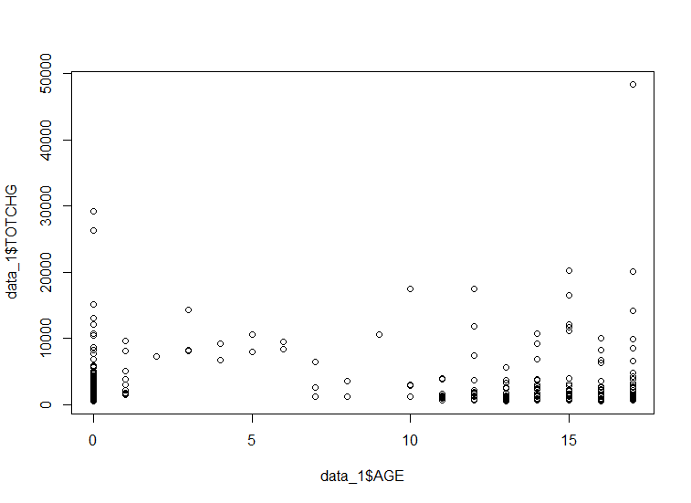
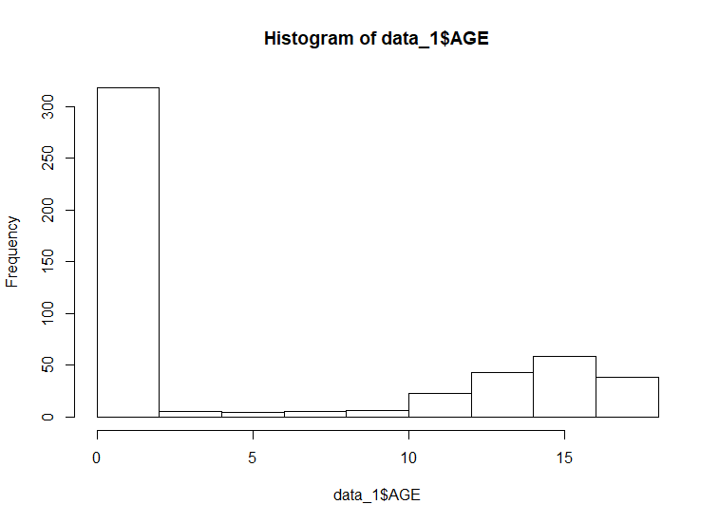
Aim 1. To find the age category of people who frequently visit the hospital and has the maximum expenditure
Age- 0 1 2 3 4 5 6 7 8 9 10 11 12 13 14 15 16 17
Total
Expense 678118 37744 7298 30550 15992 18507 17928 10087 4741 21147 24469 14250 54912 31135 64643 111747 69149 174777
This age group in very few occasion spends the most dollars but the frequency of occurrence is quite low and total sum of expenditure low compared to infanct age group
The scatter plot shows that age group of infant spends most $$$ in hospital and the group is frequently visits the hospital
Highest frequency age group which is infant
Infant age group spends the most dollars in total

Slide 3
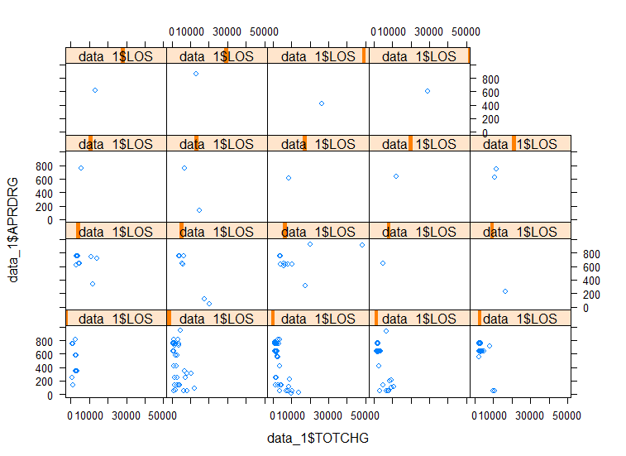
Aim 2: In order of severity of the diagnosis and treatments and to find out the expensive treatments, the agency wants to find the diagnosis-related group that has maximum hospitalization and expenditure.
The highlighted box shows maximum number of hospitalization entries, length of stay and maximum cost
xy plot shows that the shaded group represents the maximum number of hospitalization and spends the most dollars in the hospital.

Slide 4
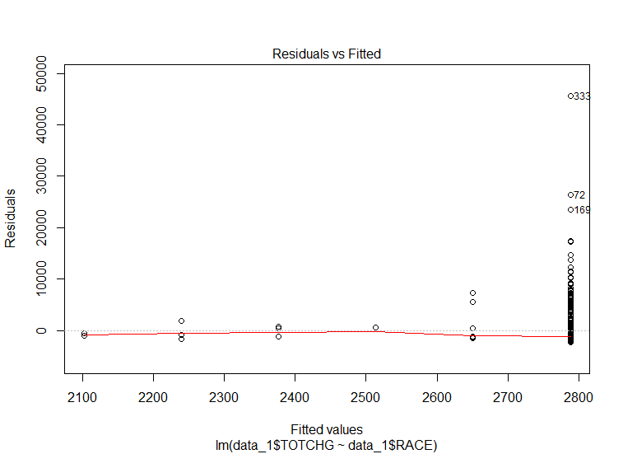
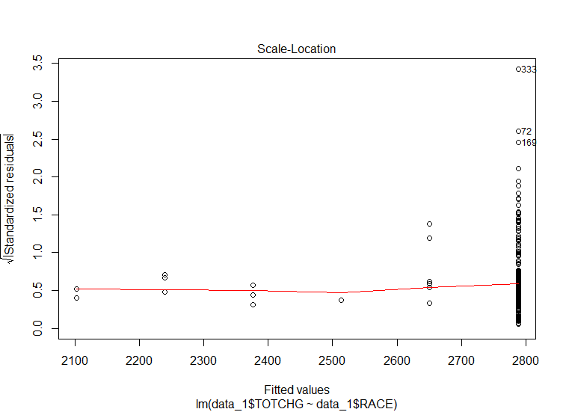
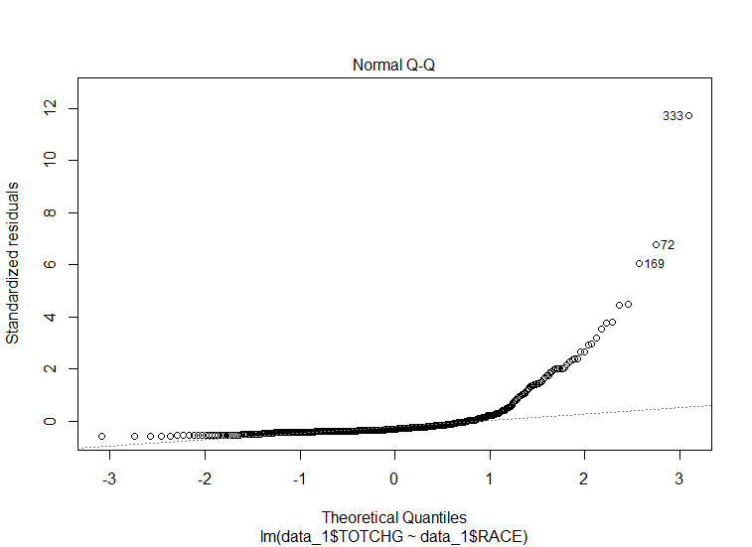
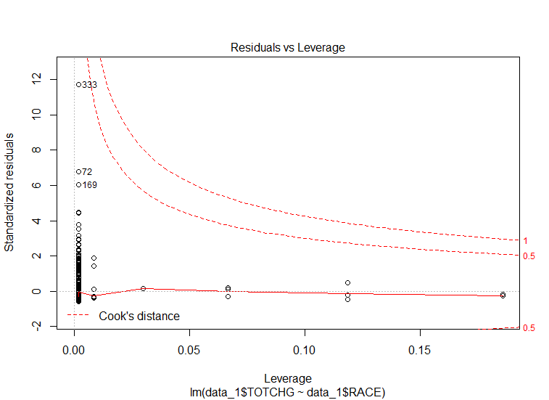
Aim3: To make sure that there is no malpractice, the agency needs to analyze if the race of the patient is related to the hospitalization costs.
There is a pattern of distribution which shows heteroscedasticity or non-linearity of the data. There is large number of data points that are left over by the model fit.
Again a scale plot shows a unequal and not randomly distributed pattern which does not maintain homoscedasticity
There is a large deviation on Normal Q-Q plot where data do not follow linear dashed line but deviate largely from the linear line suggesting, deviation from normal distribution
The data lie within cook’s distance
All four plots show that points 33, 72 and 169, suggesting it is worth looking on those number for further improvement of the model

Slide 5
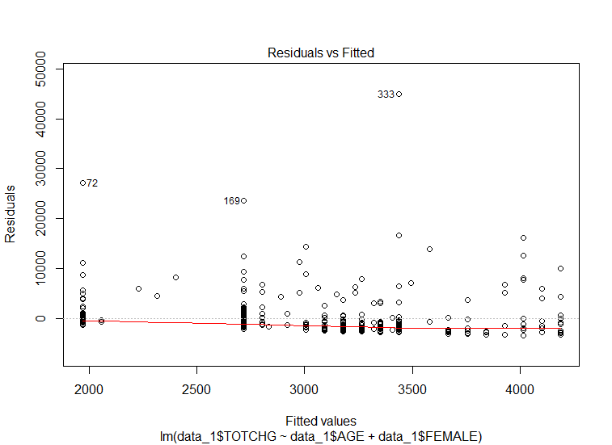
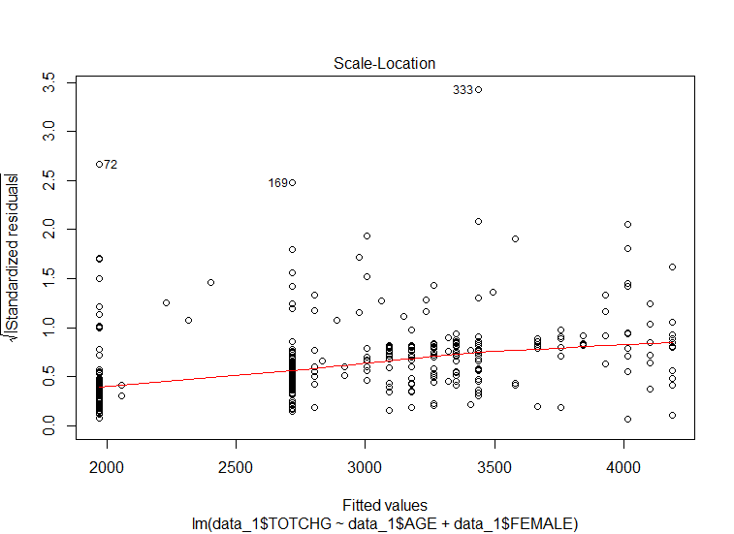
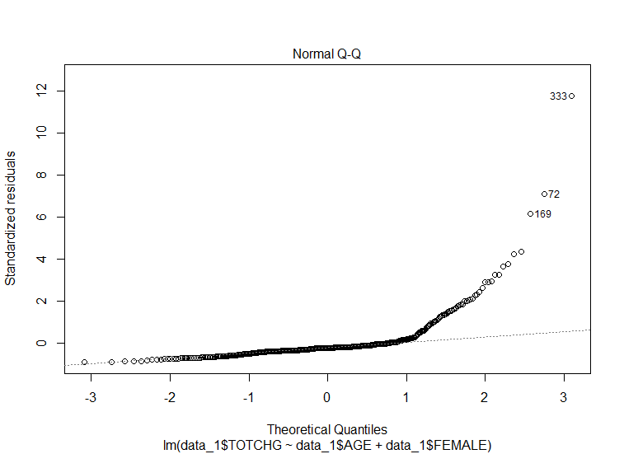
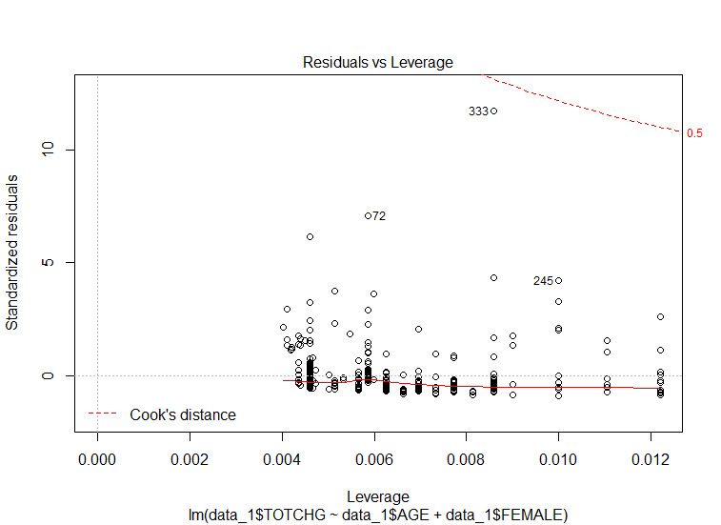
Aim 4: To properly utilize the costs, the agency has to analyze the severity of the hospital costs by age and gender for the proper allocation of resources.
There is no pattern of distribution which shows homoscedasticity or linearity of the data..
Again a scale plot shows a equal and randomly distributed data pattern which maintains homoscedasticity
There is a deviation on Normal Q-Q plot where data do not follow linear dashed line but deviate largely from the linear line suggesting, deviation from normal distribution
The data lie within cook’s distance
Deviation from normal distribution

Slide 6
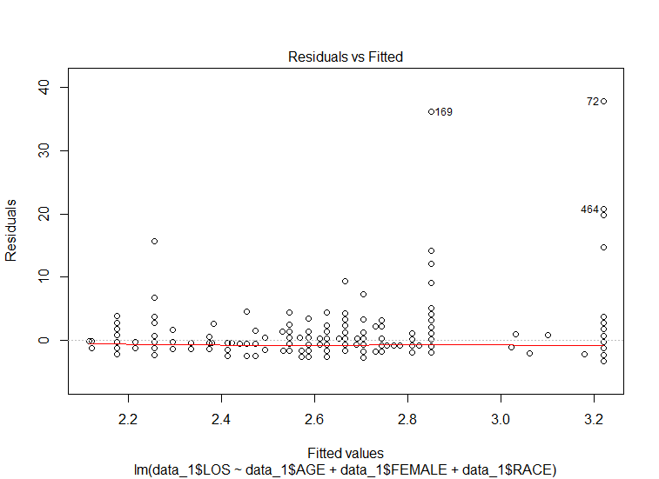
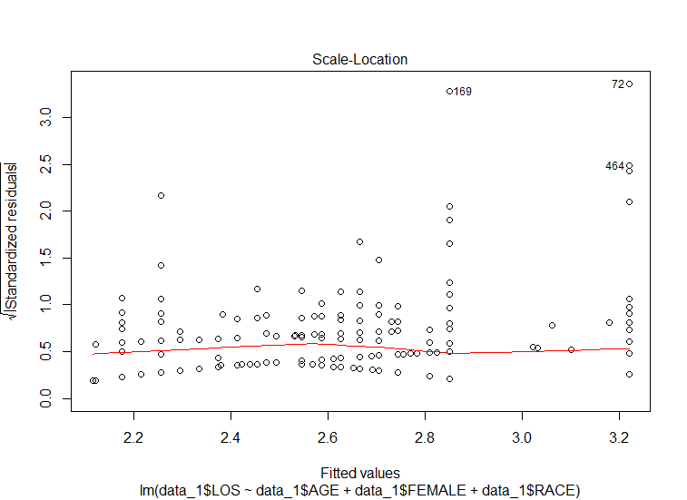
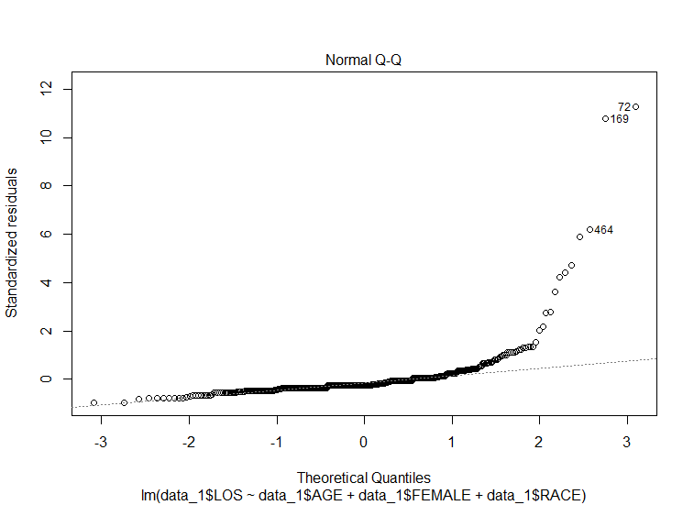
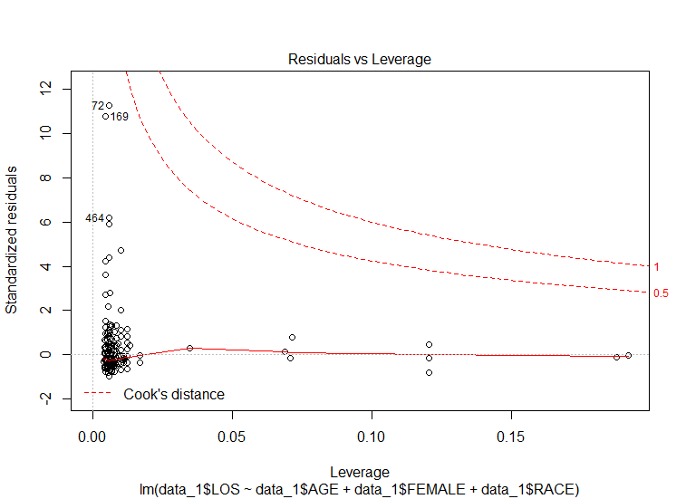
Aim 5: Since the length of stay is the crucial factor for inpatients, the agency wants to find if the length of stay can be predicted from age, gender, and race.
Maintains a homoscedastic distribution
Maintains a homoscedastic distribution
Cook’s distance shows that none of the data above 1value suggesting these data do not have significant influence on hospital total charge.
Deviation from normal distribution
Overall, these data show that length of stay cannot be predicted accurately by age, gender and race as the p-value is very high .

Slide 7
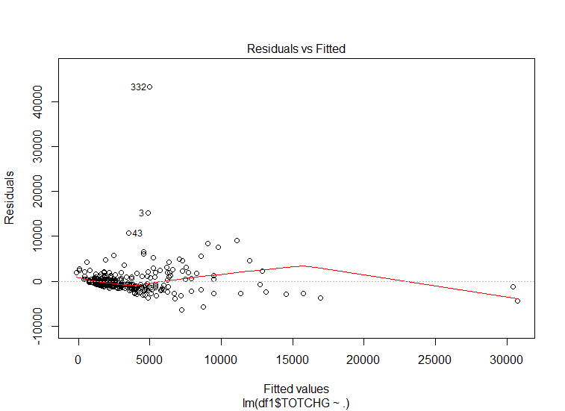
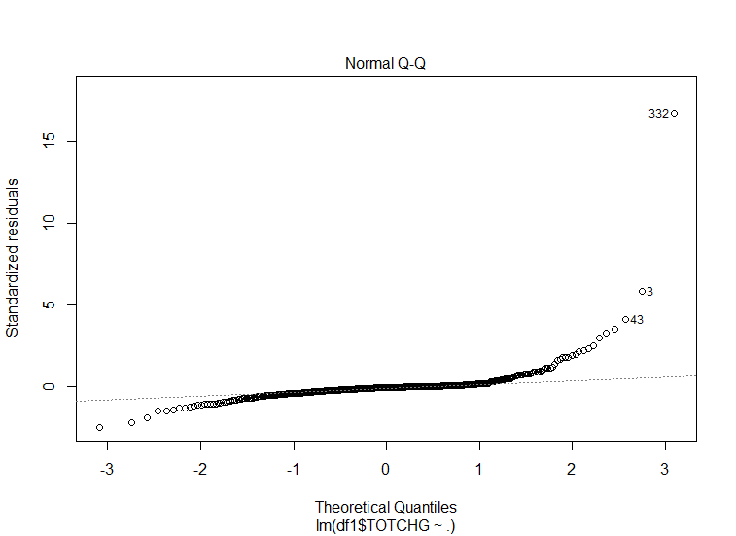
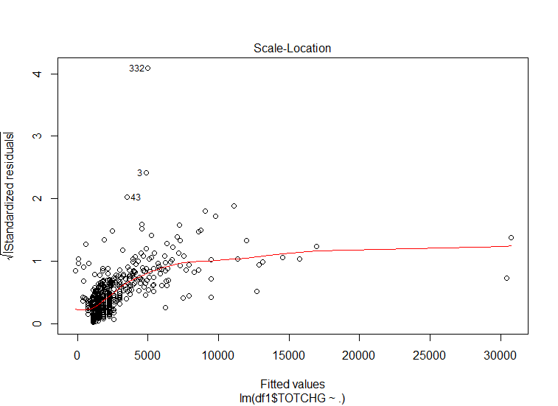
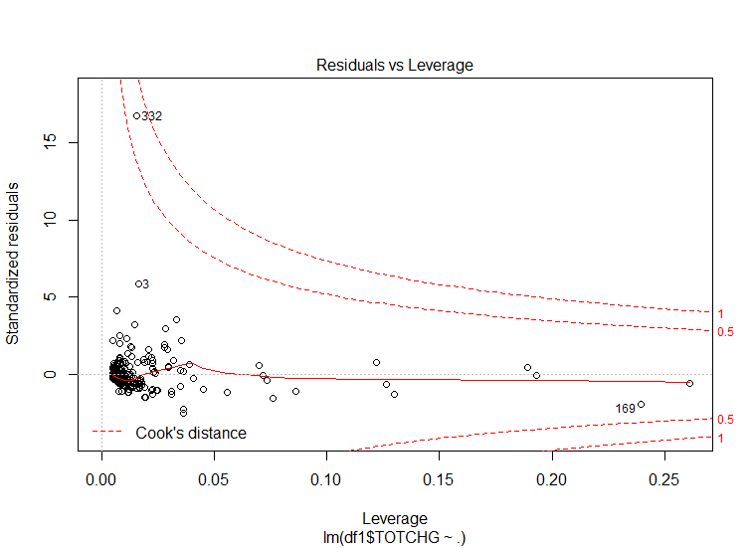
Aim 6: To perform a complete analysis, the agency wants to find the variable that mainly affects hospital costs.
Maintains a homoscedastic distribution
Maintains a homoscedastic distribution
Cook’s distance shows that none of the data above 1value suggesting these data do not have significant influence on hospital total charge.
Not much deviation from normal distribution

