Slide 1
Sadly, too often, the stigma around mental health prevents people who need help from seeking it. But that simply doesn’t make any sense. Whether an illness affects your heart, your arm or your brain, it’s still an illness, and there shouldn’t be any distinction.
Michelle Obama
(Former First Lady of USA)

Slide 2
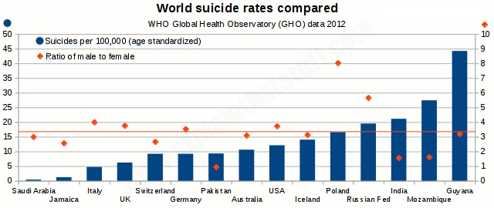

Slide 3
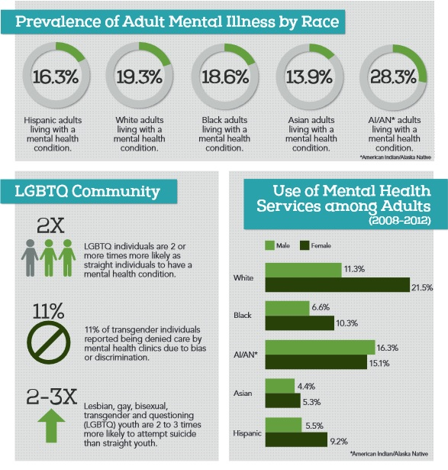

Slide 4
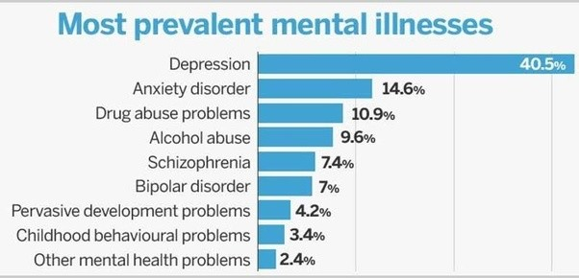

Slide 5
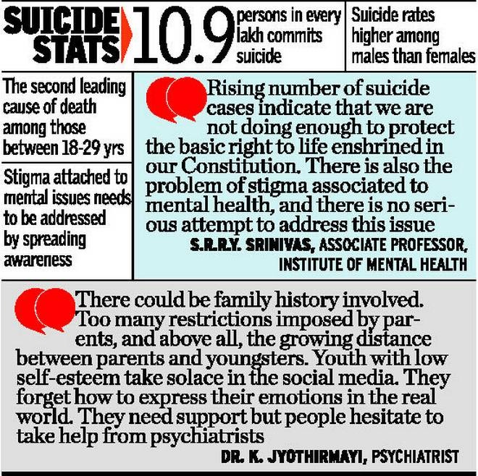

Slide 6
FREQUENT PROBLEMS FACED ON DAY TO DAY BASIS:
“As my exam is getting closer I am unable to concentrate on my studies, I am afraid I will fail the exam and will disappoint my parents.”
“I was forced to pursue engineering after my 10th but my interest lies in commerce stream. How do I speak my parents about this?”

Slide 7
“I am in a lot of debt and I don’t even have any assets left to sell and repay the loan. I am really distressed and considering suicide.”
“I feel really low, I don’t know why. I think I am going to self-harm if my feelings don’t change.”
“We have been in a relationship for over half a decade, lately I don’t feel like I can connect with him anymore.”

Slide 8
INTERVIEW WITH THERAPIST

Slide 9
INTERVIEW WITH FIRST CLIENT

Slide 10
INTERVIEW WITH SECOND CLIENT

Slide 11
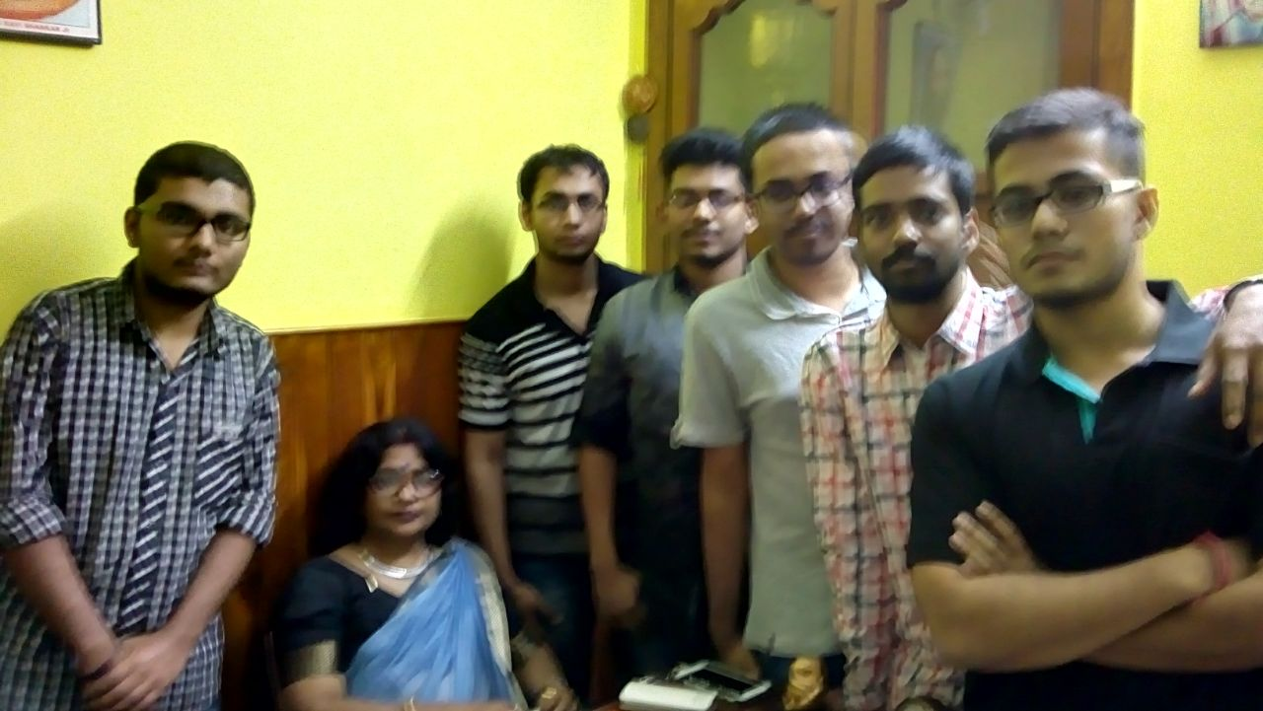
THE TEAM

