Slide 1

Problem Severity
1 in 10,000 die by suicide each year
Social taboo
Doctors are inaccessible
Doctors and social workers need to help

Slide 2

WHAT ARE WE PROPOSING
Accessible in rural areas
An integrated platform accessible to every internet user
Counsellors and social workers available

Slide 3
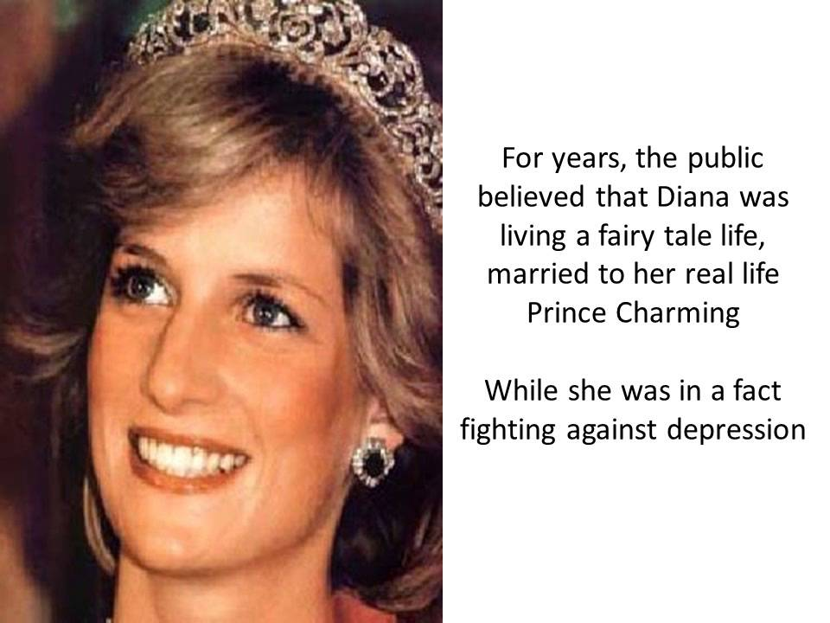
HOW IS IT UNIQUE!!
Accessible in rural areas
Locational access to counsellors
Problems to be analysed

Slide 4


OUR USERS
PEER
MOTIVATOR
CLIENT

Slide 5
Find nearby counselor
Request meeting
Attend meeting

Slide 6
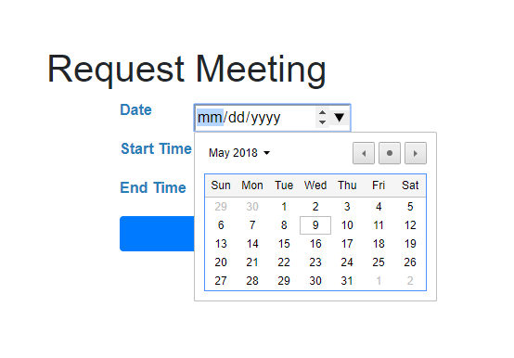
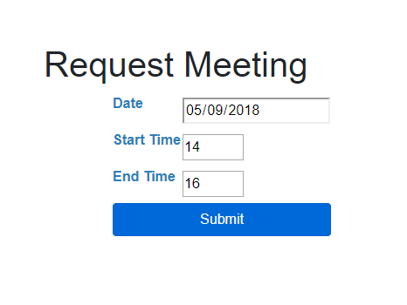
REQUEST MEETING

Slide 7


Slide 8
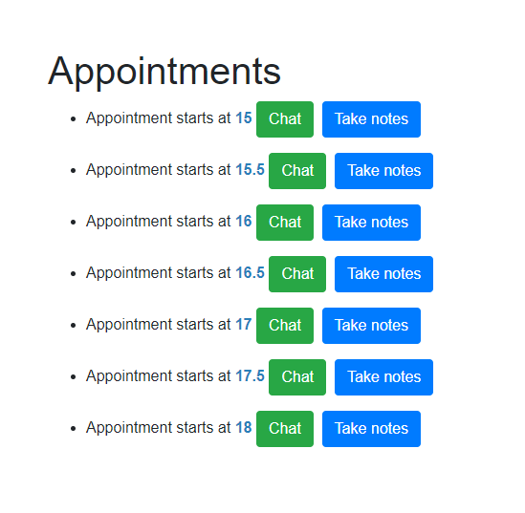
APPOINTMENTS LIST

Slide 9
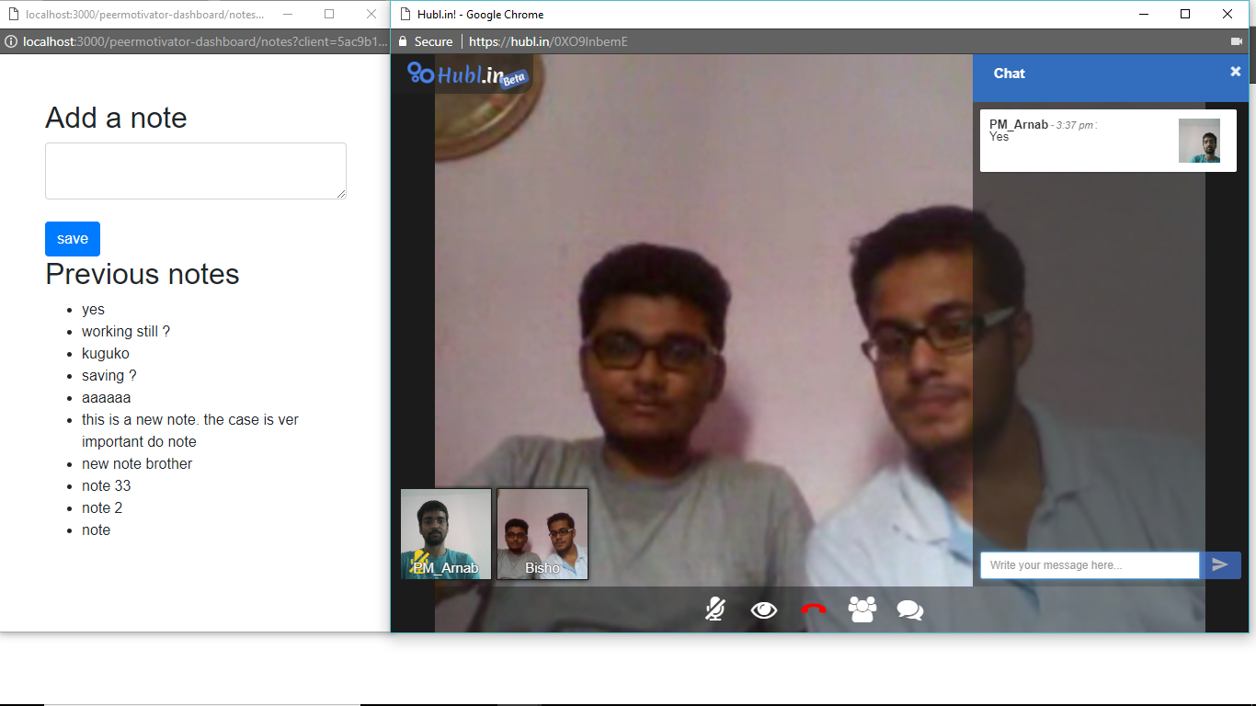

Slide 10
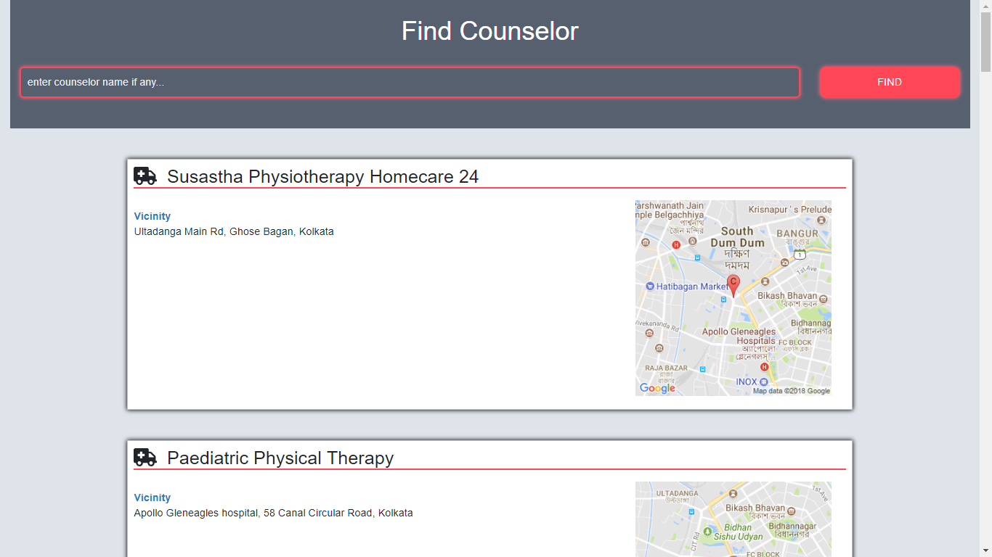
FIND COUNSELOR

