Slide 1

Tribhuvan University Institute Of Engineering Kalimati, Kathmandu
Stock Market Prediction
Presented by:
Abhishek Man Shrestha -078BCT009
Ayush Acharya -078BCT022
Bishranta Regmi -078BCT027
Dhiraj Sah -078BCT030
2081

Slide 2
SLIDE OVERVIEW
Introduction
Problem Statement
Objective
Scope and Application
Existing Systems
Solution Provided By Our System
Methodology
Block Diagram
Algorithms
Flowchart
Project Flow Overview
Use Case Diagram
Sequence Diagram
Data Flow Diagram
Tools Used
Output
Screenshots

Slide 3
1. INTRODUCTION
The stock market allows people to buy and sell shares of publicly traded companies, helping businesses raise funds for growth.
Stock prices fluctuate based on supply and demand; higher demand increases prices, while lower demand decreases them.
Investors buy shares expecting companies to grow, and if stock prices rise, they can sell at a profit.
Predicting stock prices involves statistical analysis, machine learning, and sentiment analysis to identify patterns and make informed investment decisions.

Slide 4
2. PROBLEM STATEMENTS
The stock market is vast and complicated, with significant fluctuations everyday making it challenging to future prediction.
Manual methods of predicting future market trends are tiring and often inaccurate.
Influenced by factors like politics events, economics condition, and investor psychology makes this market even more complicated.

Slide 5
3. OBJECTIVES
This project was created with the purpose to fulfill the following objectives:
To analyze trends and patterns of historical trading data of companies (date, closing price, LTP) and sentimental data (news headlines, articles, posts, etc.) to capture market trends.
To predict future price using the information from analyzed data implementing machine learning algorithms LSTM and CNN.

Slide 6
4. SCOPE AND APPLICATIONS
To bridge communication between financial investors and industries.
To assist the investors to make a sensible decision through analysis of data.
To assist people to make decision for profitable investments.

Slide 7
5. EXISTING SYSTEMS
QuantConnect - An algorithmic trading platform that allows users to create and back test trading strategies
MetaTrader5 - A popular trading platform offering tools for technical analysis and automated trading strategies that primarily focused on technical analysis
AlphaSense - An AI-powered market intelligence platform that aggregates and analyzes financial data, news, and research reports

Slide 8
5.1 LIMITATIONS OF EXISTING SYSTEMS
Many platforms require advanced programming knowledge and have steep learning curves, making them less accessible to beginner users.
Most tools focus primarily on technical analysis and do not natively support the integration of sentiment analysis from news and social media, limiting the comprehensiveness of predictions.
Advanced platforms like AlphaSense have high subscription fees, which can be prohibitive for individual investors or small teams.

Slide 9
6. SOLUTION PROVIDED BY OUR SYSTEM
This project uses the LSTM algorithm, which excels in stock price forecasting due to its ability to handle time series data and avoid short memory issues
Our system illustrates the use of sentiment analysis from news and social media and shows how it affects the trend of stock.
Using widely known programming languages, frameworks, open-source libraries and tools keeps costs low, makes the solution more accessible to broader audience, individual users and small teams.

Slide 10
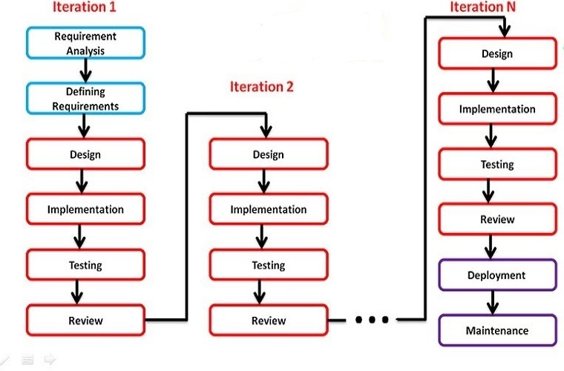
7. METHODOLOGY
Figure: Iterative Process Model

Slide 11
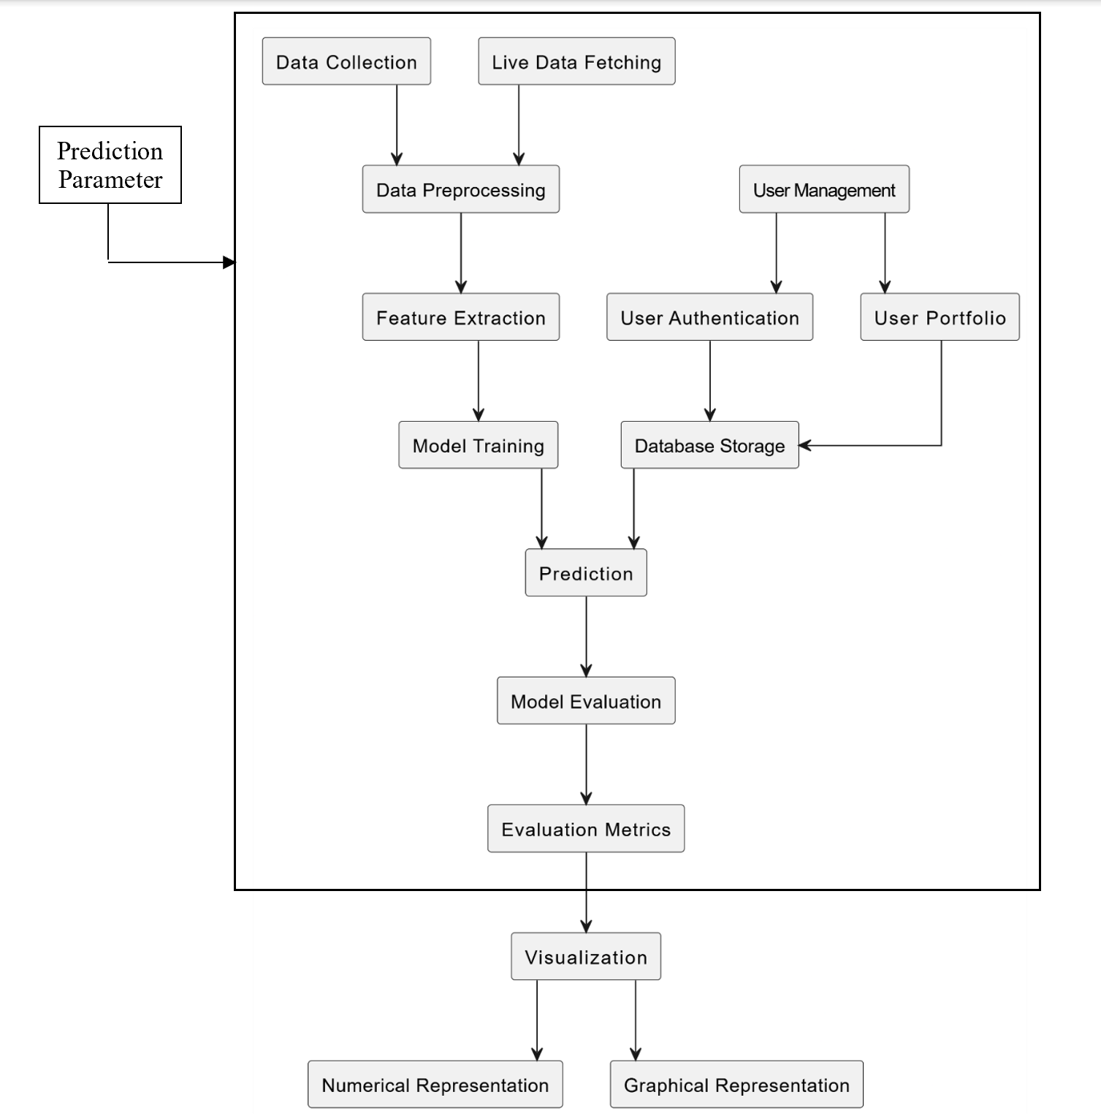
8. BLOCK DIAGRAM
Figure: System Block Diagram

Slide 12
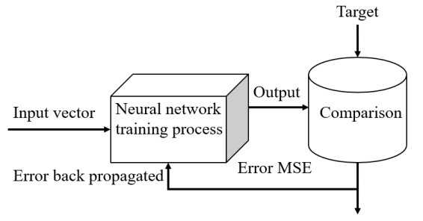
9. ALGORITHMS
Recurrent Neural Network (RNNs): Recurrent Neural Networks (RNNs) are a type of neural network that are designed to process sequential data. They can analyze data with a temporal dimension, such as time series, speech, and text. RNNs can do this by using a hidden state passed from one timestep to the next. The hidden state is updated at each timestep based on the input and the previous hidden state.
Figure: Recurrent Neural Network

Slide 13
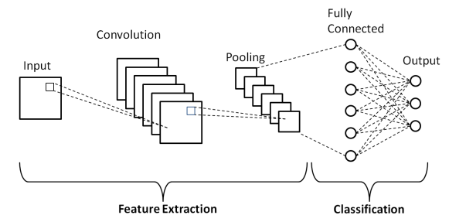
Convolution Neural Networks (CNNs): Convolutional Neural Networks (CNNs) are powerful deep learning models primarily used for image and text data analysis. In the context of stock market prediction, CNNs excel at sentiment analysis by extracting meaningful patterns from textual data such as news articles and social media posts. By identifying sentiments and trends, CNNs enhance the overall predictive accuracy when combined with time-series models like LSTM.
Figure: Convolution Neural Network

Slide 14
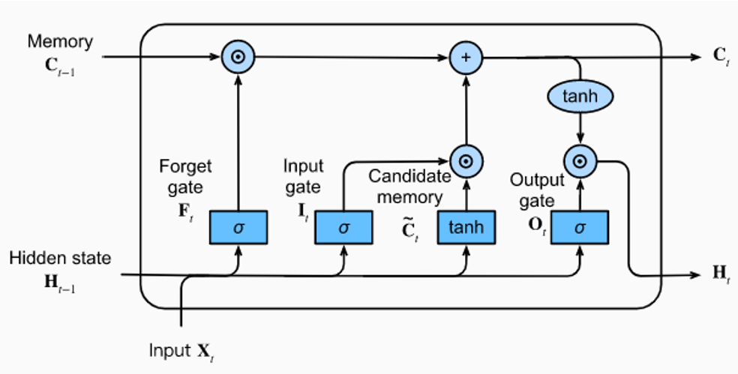
Long Short-Term Memory (LSTM): LSTMs Long Short-Term Memory is a type of RNNs that can detain long-term dependencies in sequential data. They use memory cell and gates to control the flow of information, allowing them to selectively retain or discard information as needed and thus avoid the vanishing gradient problem that plagues traditional RNNs. LSTMs are widely used in applications such as natural language processing, speech recognition, and time series forecasting.
Figure: Long Short-Term Memory

Slide 15
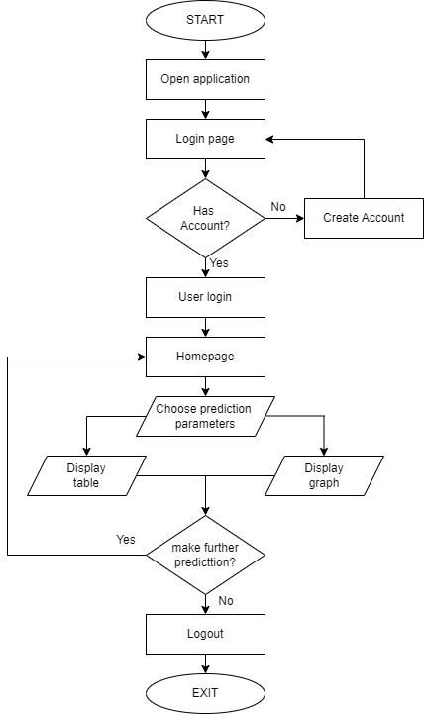
10. FLOWCHART
Figure: Flowchart

Slide 16
11.Project Flow Overview
A. Data Collection & Storage
Historical Data: Collected from NepseAlpha, stored in CSV format.
Live Data: Scraped from ShareSansar using Selenium & BeautifulSoup.
Sentiment Data: Extracted from financial news for analysis.
B. Data Preprocessing & Feature Engineering
Stock Data: Missing values handled, normalized, and converted into sequences for LSTM.
Sentiment Data: Text cleaned, tokenized, and converted into numerical form.
C. Model Training & Evaluation
LSTM for Stock Prediction: Trained on time-series data, evaluated using MAE, RMSE, MAPE.
CNN for Sentiment Analysis: Classifies news articles as positive, neutral, or negative.

Slide 17
D. Web Application Development
Backend (Flask & SQLite): Manages authentication, stock portfolio, and prediction API.
Frontend (HTML, CSS, JS, Chart.js): Displays stock trends, predictions, and sentiment scores.
User Features: Profile management, portfolio tracking, live stock updates.
E. Deployment & Scalability
Real-time Model Deployment: LSTM models loaded on-demand.
Automated Web Scraping: Updates datasets daily.

Slide 18
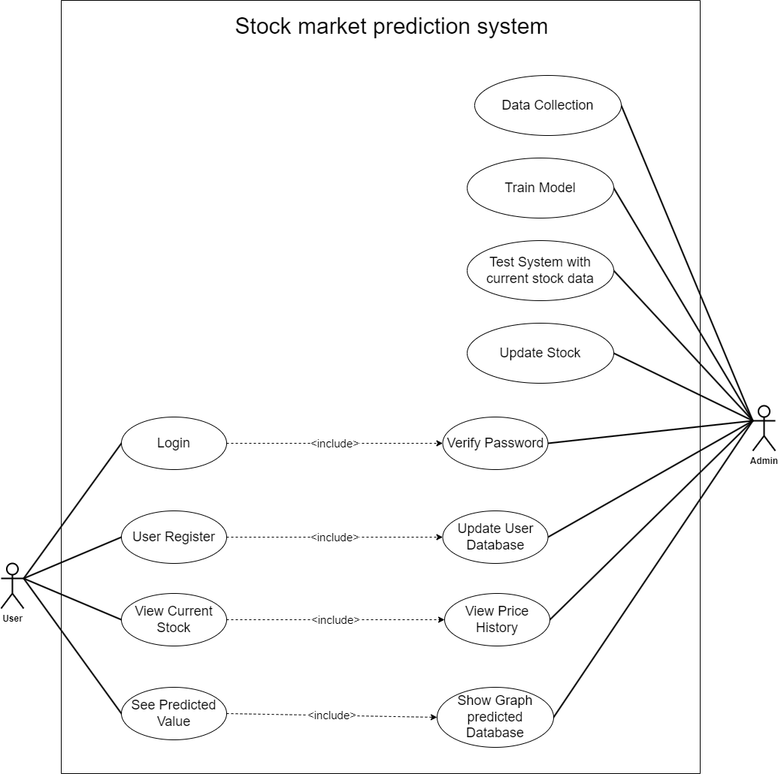
12. USE CASE DIAGRAM
Figure: Use Case Diagram

Slide 19
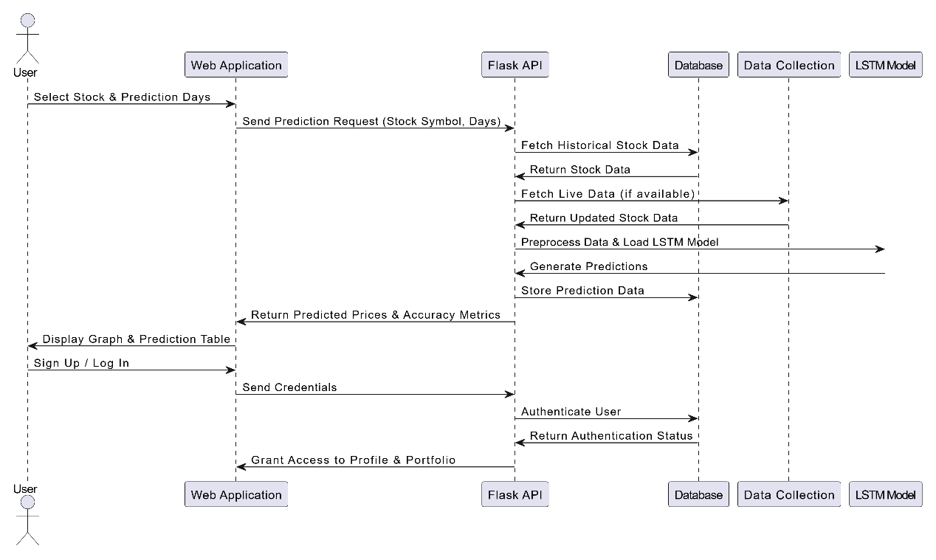
13. SEQUENCE DIAGRAM
Figure: Sequence Diagram

Slide 20
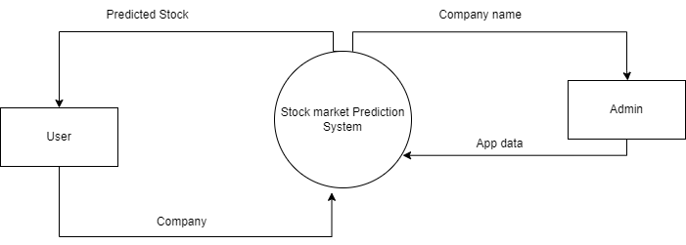
14. Data Flow Diagram
Figure: DFD Level 0

Slide 21
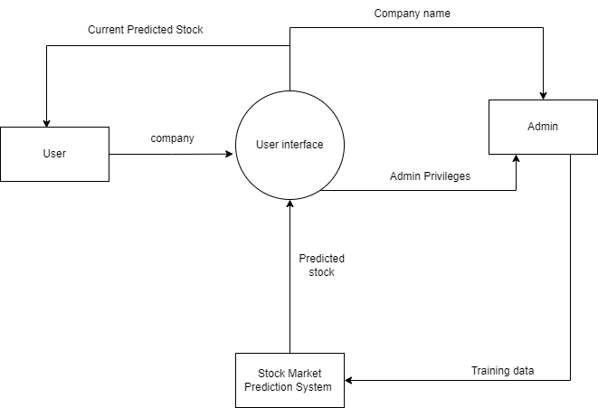
14. Data Flow Diagram
Figure: DFD Level 1

Slide 22
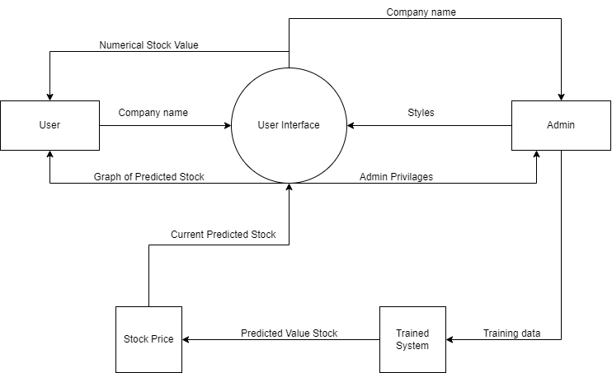
14. Data Flow Diagram
Figure: DFD Level 2

Slide 23
15. TOOLS USED
Python - Used for model building, training LSTM and CNN models, web scraping, database management, and integrating the backend with Flask.
HTML/CSS/JavaScript - Developed the frontend UI, styled webpages, and dynamically fetched and displayed stock data using Chart.js and AJAX.
Flask & Flask-Login – Managed web requests, user authentication, session handling, and database operations with Flask-SQLAlchemy.
Stack Overflow - serves as a valuable resource for troubleshooting technical issues and seeking solutions to coding challenges
GitHub - Served as a version control platform, storing datasets, managing code, and enabling team collaboration.
Selenium & BeautifulSoup – Automated data fetching from financial websites and extracted news data for sentiment analysis.
SQLite – Stored user profiles, stock portfolios, and investment records, ensuring data persistence across sessions.

Slide 24
TensorFlow & Keras – Trained LSTM models for stock prediction and CNNs for sentiment analysis, enabling real-time model deployment.
Chart.js – Visualized stock trends, historical data, and prediction results using interactive graphs on the frontend.

Slide 25
16. OUTPUT
This project shows historical data of user wanted company in graphical form.
This project is in the form of web app forecasting future stock price of a company having decent collection of historical data.

Slide 26
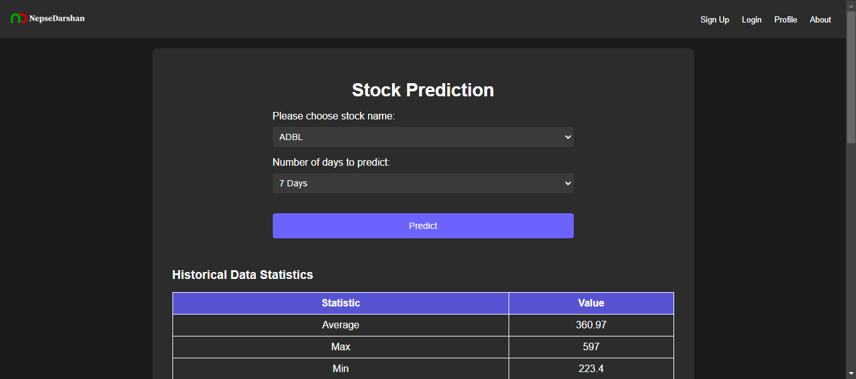
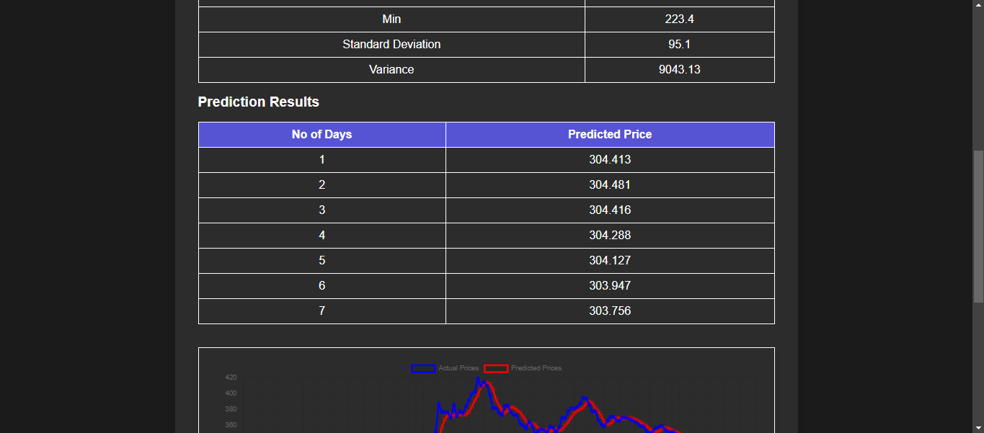
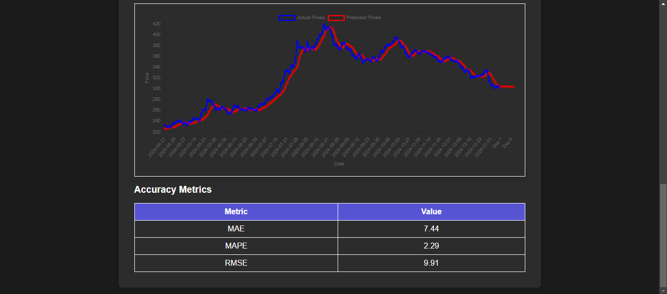
17. SCREENSHOTS

Slide 27
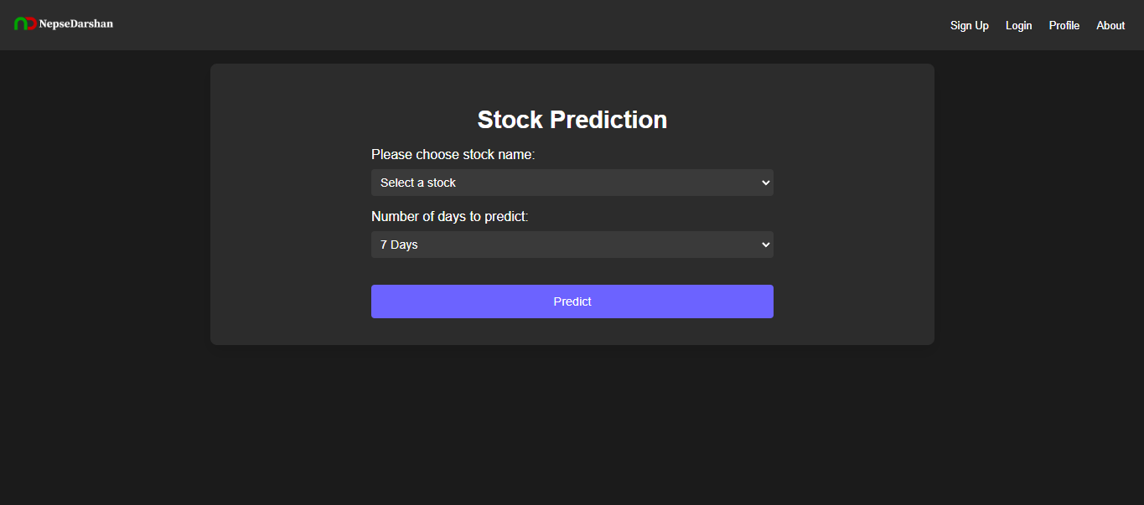
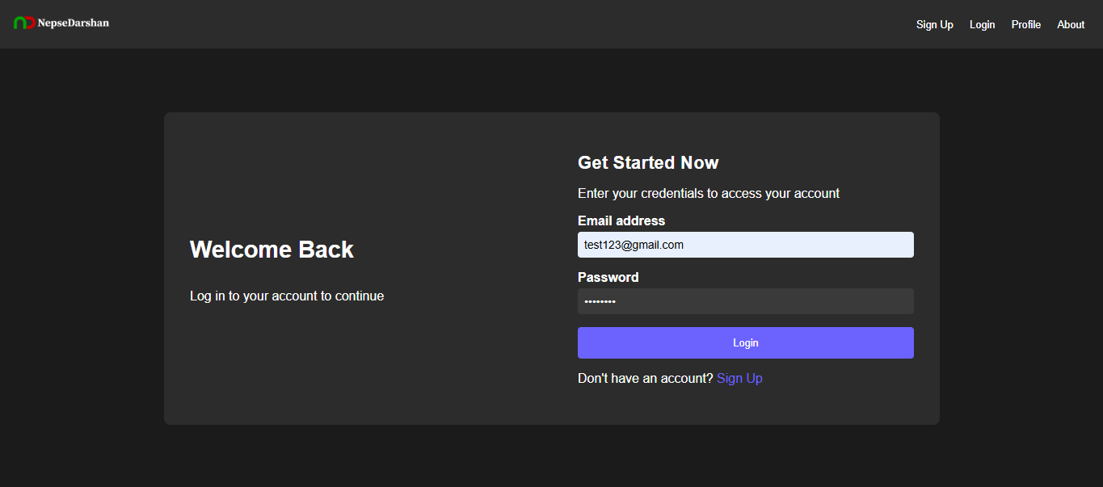
17. SCREENSHOTS

Slide 28
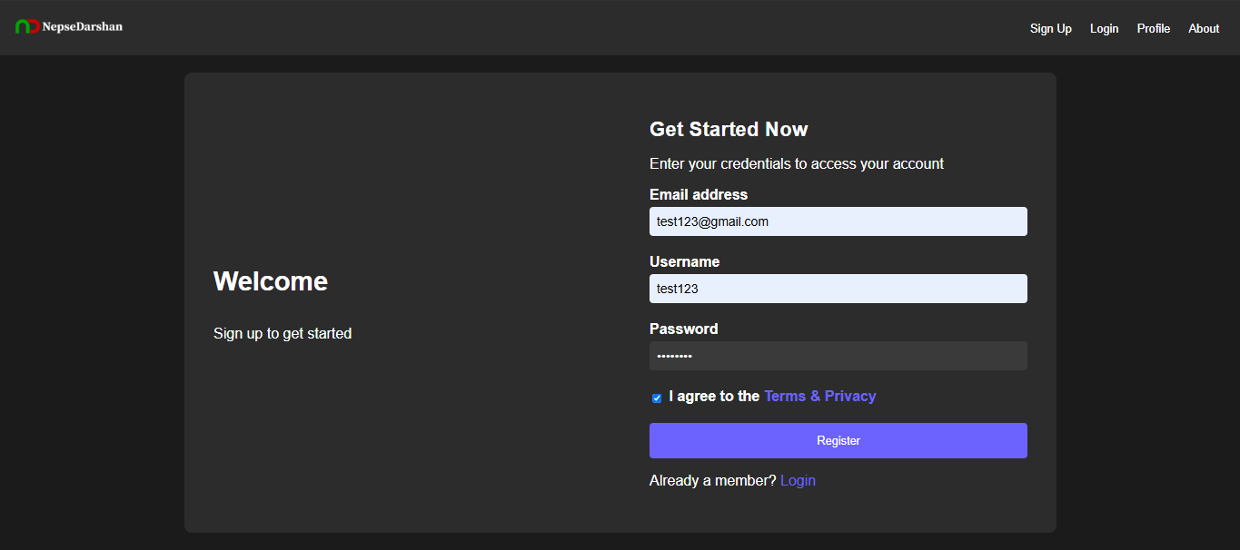
17. SCREENSHOTS

Slide 29
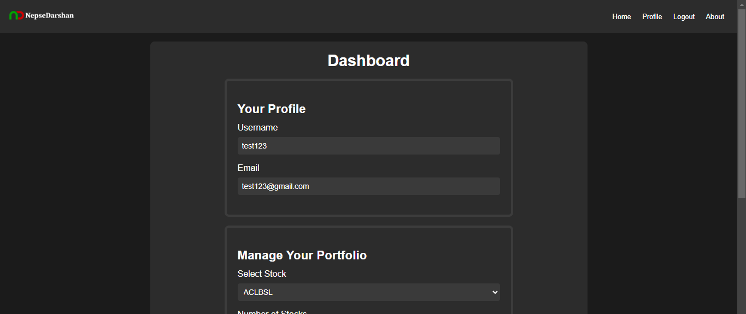
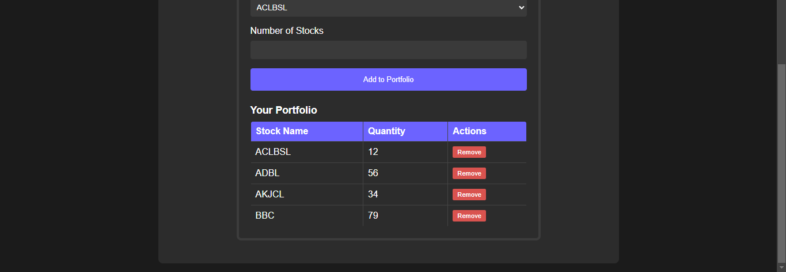
17. SCREENSHOTS

Slide 30
THANK YOU!

