Slide 1
Customer Shopping Behavior Analysis
3,900
18
Total Transactions
Dataset Columns
$59.76
3.75
Avg Purchase Amount
Avg Review Rating
A structured analysis of transactional retail data spanning customer demographics, product categories, subscription behavior, and spending patterns — powered by Python, PostgreSQL, and Power BI.

Slide 2
Project Overview
Objective
Analytical Workflow
This project analyzes customer shopping behavior using transactional data from 3,900 purchases across various product categories. The goal is to uncover insights into spending patterns, customer segments, product preferences, and subscription behavior to guide strategic business decisions.
01
Data Preparation
Python (pandas) for cleaning, imputation, and feature engineering
02
SQL Analysis
PostgreSQL for structured business queries across 10 analytical dimensions
03
Dashboard
Power BI interactive dashboard with filters and KPI visualizations
04
Recommendations
Actionable business strategies derived from data findings

Slide 3


Dataset Summary
Dataset Dimensions
Key Feature Groups
3,900 Rows
18 Columns
Customer Demographics
Total transaction records
Feature variables per record
Age, Gender, Location, Subscription Status
37 Missing
Purchase Details
Null values in Review Rating
Item Purchased, Category, Purchase Amount, Season, Size, Color
Shopping Behavior
Discount Applied, Promo Code Used, Previous Purchases, Frequency of Purchases, Review Rating, Shipping Type

Slide 4
Exploratory Data Analysis using Python
We began with data preparation and cleaning in Python:
1
Data Loading
1
Feature Engineering
Imported the dataset using pandas.
Created age_group column by binning customer ages. Created purchase_frequency_days column from purchase data.
2
Initial Exploration
2
Data Consistency Check
Used df.info() to check structure and .describe() for summary statistics.
Verified if discount_applied and promo_code_used were redundant; dropped promo_code_used.
3
Missing Data Handling
3
Database Integration
Checked for null values and imputed missing values in the Review Rating column using the median rating of each product category.
Connected Python script to PostgreSQL and loaded the cleaned DataFrame into the database for SQL analysis.
4
Column Standardization
Renamed columns to snake case for better readability and documentation.

Slide 5
Data Analysis using SQL (Business Transactions)
We performed structured analysis in PostgreSQL to answer key business questions:
Business Question | Key Finding
Revenue by Gender | Female: $75,191 | Male: $157,890
High-Spending Discount Users | 839 customers spent above avg despite using discounts
Top 5 Products by Rating | Gloves (3.86), Sandals (3.84), Boots (3.82), Hat (3.80), Skirt (3.78)
Shipping Type Comparison | Standard: $58.46 avg | Express: $60.48 avg
Subscribers vs. Non-Subscribers | Yes: 1,053 customers, $59.49 avg, $62,645 total | No: 2,847 customers, $59.87 avg, $170,436 total
Business Question | Key Finding
Discount-Dependent Products | Hat (50.00%), Sneakers (49.66%), Coat (49.07%), Sweater (48.17%), Pants (47.37%)
Customer Segmentation | Loyal: 3,116 | Returning: 701 | New: 83
Top 3 Products per Category | Accessories (Jewelry, Sunglasses, Belt), Clothing (Blouse, Pants, Shirt), Footwear (Sandals, Shoes, Sneakers), Outerwear (Jacket, Coat)
Repeat Buyers & Subscriptions | No: 2,518 | Yes: 958
Revenue by Age Group | Young Adult: $62,143 | Middle-aged: $59,197 | Adult: $55,978 | Senior: $55,763

Slide 6
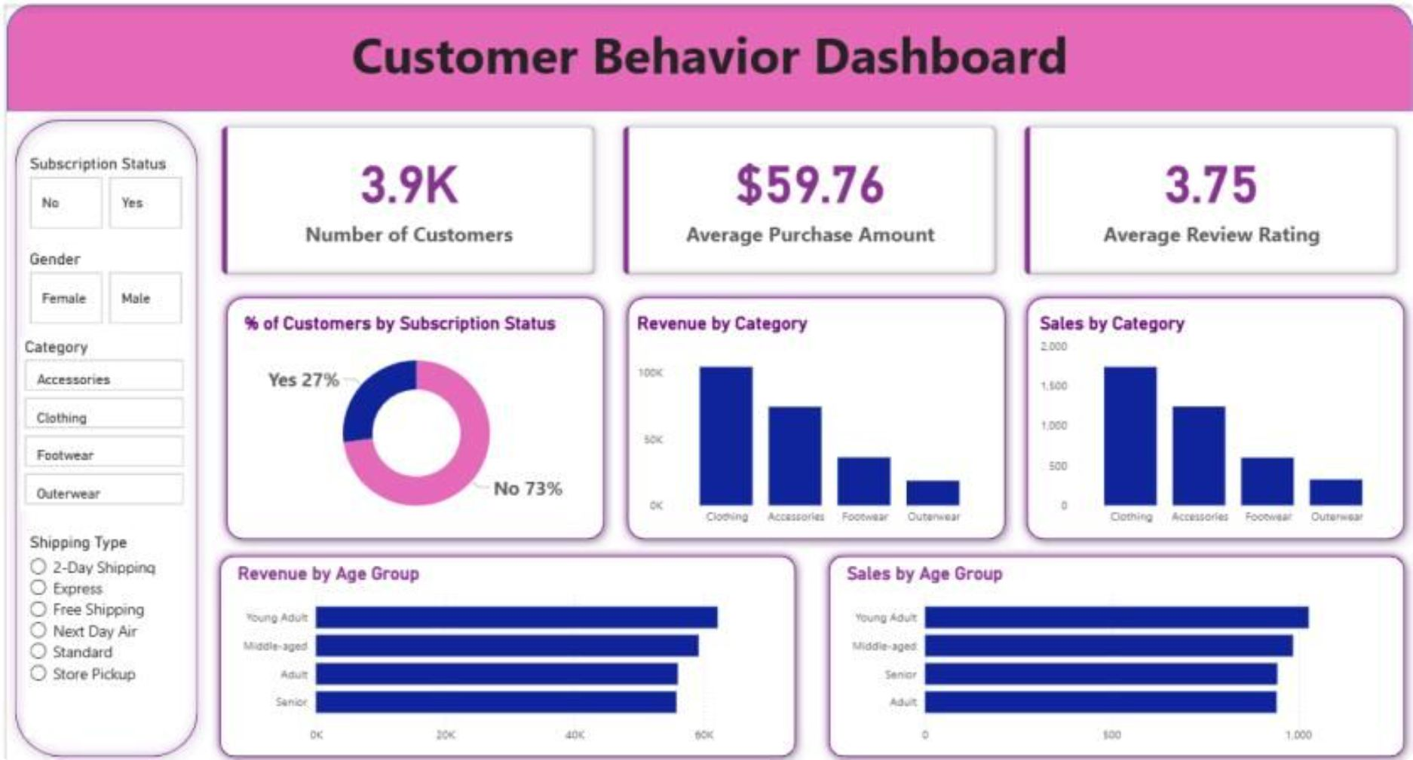
Dashboard in Power BI
Finally, we built an interactive dashboard in Power BI to present insights visually.
Key Metrics Displayed
Dashboard Features
3.9K
$59.76
Sidebar filters: Subscription Status, Gender, Category, Shipping Type
Donut chart: 27% subscribers vs. 73% non-subscribers
Bar charts: Revenue and Sales by Category (Clothing, Accessories, Footwear, Outerwear)
Horizontal bar charts: Revenue and Sales by Age Group (Young Adult, Middle-aged, Adult, Senior)
Number of Customers
Average Purchase Amount
3.75
Average Review Rating

Slide 7
Business Recommendations
1
Boost Subscriptions
Promote exclusive benefits for subscribers. With only 27% of customers subscribed, there is significant headroom to grow this high-retention segment.
2
Customer Loyalty Programs
Reward repeat buyers to move them into the "Loyal" segment. With 3,116 loyal customers already, reinforcing this behavior drives long-term revenue stability.
Review Discount Policy
3
Balance sales boosts with margin control. Products like Hat (50%) and Sneakers (49.66%) show high discount dependency — evaluate whether discounts are driving incremental revenue or eroding margin.
4
Product Positioning
Highlight top-rated and best-selling products in campaigns. Gloves, Sandals, and Boots lead on ratings — leverage these in marketing to build brand trust.
Targeted Marketing
5
Focus efforts on high-revenue age groups and express-shipping users. Young Adults generate the highest revenue ($62,143) and express-shipping customers spend more on average ($60.48 vs. $58.46).

Slide 8
Sources
Customer Shopping Behavior Analysis.pdf

