Slide 1

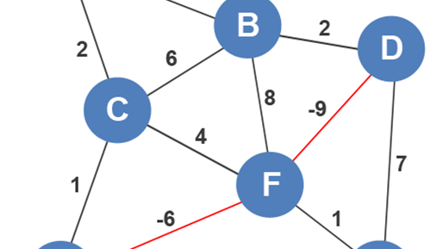
MINIMUM SPANNING TREE
DSTL PROJECT:-
ROHIT BAGHEL
SANYAM JAIN
SAHIL BISHT

Slide 2


SPANNING TREES
Given (connected) graph G(V,E),
SPANNING TREE
A minimum spanning tree (MST) is a subset of the edges of a connected, edge-weighted undirected graph that connects all the vertices together, without any cycles and with the minimum possible total edge weight

Slide 3
Minimum Spanning Trees
Edges are weighted: find minimum cost spanning tree
Applications
Find cheapest way to wire your house
Find minimum cost to send a message on the Internet

Slide 4
Kruskal’s Algorithm
Select edges in order of increasing cost
Accept an edge to expand tree or forest only if it does not cause a cycle
Implementation using adjacency list, priority queues and disjoint sets

Slide 5

Kruskal’s Algorithm
Initialize a forest of trees, each tree being a single node
Build a priority queue of edges with priority being lowest cost
Repeat until |V| -1 edges have been accepted
{
Deletemine edge from priority queue
If it forms a cycle then discard it
else accept the edge – It will join 2 existing trees yielding a larger tree and reducing the forest by one tree
}
The accepted edges form the minimum spanning tree

Slide 6
Properties of trees in K’s algorithm
Vertices in different trees are disjoint
True at initialization and Union won’t modify the fact for remaining trees
Trees form equivalent classes under the relation “is connected to”
u connected to u (reflexivity)
u connected to v implies v connected to u (symmetry)
u connected to v and v connected to w implies a path from u to w so u connected to w (transitivity)

Slide 7

Example

Slide 8
Initialization
Initially, Forest of 6 trees
F= {{1},{2},{3},{4},{5},{6}}
Edges in a heap (not shown)

Slide 9
Steps
Select edge with lowest cost (2,5)
Find(2) = 2, Find (5) = 5
Union(2,5)
F= {{1},{2,5},{3},{4},{6}}
1 edge accepted

Slide 10
Select edge with lowest cost (3,4)
Find(3) = 1, Find (4) = 4
Union(1,4)
F= {{1,3,4},{2,5,6}}
4 edges accepted

Slide 11
Result
Select edge with lowest cost (4,5)
Find(4) = 1, Find (5) = 2
Union(1,2)
F= {{1,3,4,2,5,6}}
5 edges accepted : end
Total cost = 10
Although there is a unique spanning tree in this example, this is not generally the case

Slide 12
CONCEPTS & TECHNOLOGIES USED
C++
Graph Structure

Slide 13
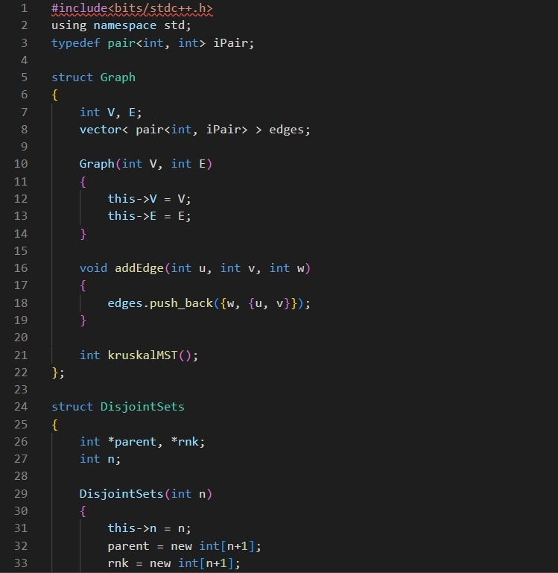
CODE SNIPPETS

Slide 14
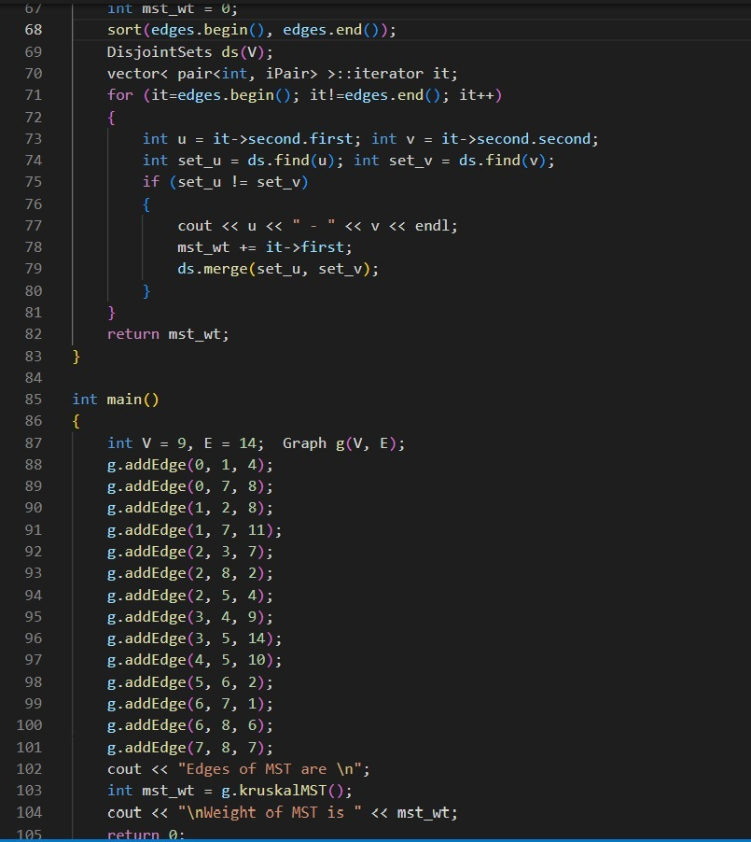
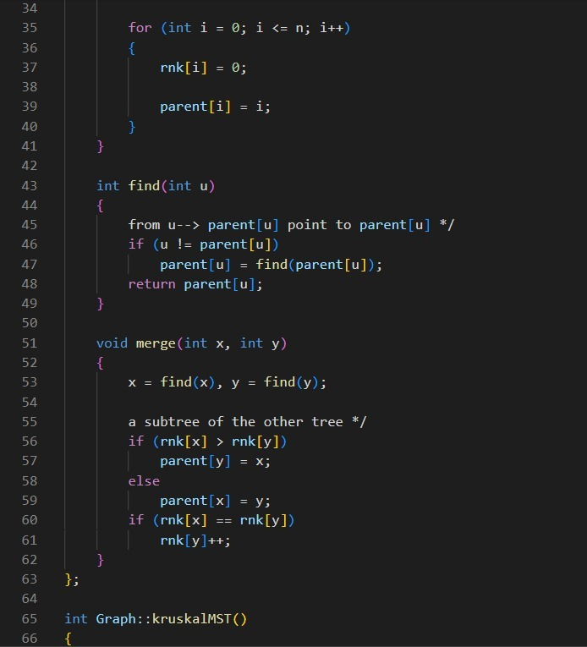

Slide 15
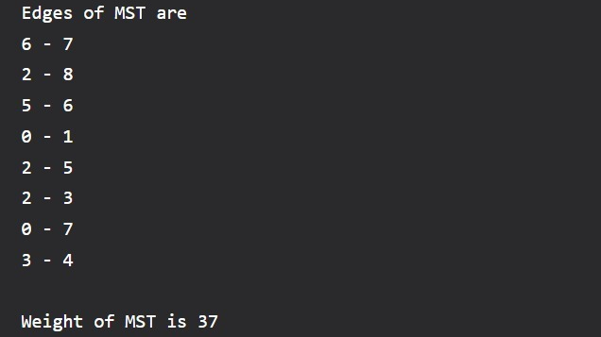
OUTPUT

Slide 16

THANKYOU

