Slide 1
Sales Analysis Dashboard
Executive Summary and Key Insights
Prepared by Kailash Bisht

Slide 2
Executive Summary
1. Total Revenue
Total sales revenue: ₹61,626.29
2. Sales Revenue by Category
Top categories:
Burger: Highest revenue
Chicken and Pasta follow behind
Lowest revenue: Wraps and Shakes

Slide 3
3. Daily Orders
Orders are fairly balanced throughout the week, with a slight peak on Sunday (20%) and Friday (20%).
4. Most Frequently Ordered Item
Side Salad is the most frequently ordered, followed closely by Big Mac and Burger.
5. Revenue Generation
Total revenue from weekdays: ₹44,577.5
Total revenue from weekends: ₹17,105.6 ➔ Weekdays contribute nearly 72% of the revenue.

Slide 4
6. Revenue by Month
March shows slightly higher sales compared to January and February, indicating a growth trend.
7. Average Number of Items per Order
Average items per order is not explicitly shown in the dashboard but can be inferred around 2-3 items based on order volumes.
8. Order Volumes by Time of Day
Afternoons have the highest order volume, followed by Evening.
Lowest sales are recorded during the Night.

Slide 5
9. Sales Trends Across Weekdays vs. Weekends
Higher sales and larger volumes are observed on weekdays compared to weekends.
10. Top 5 Menu Items Sales Comparison
Top 5 Items by revenue:
Burger
Chicken
Pasta
Sandwich
Fries
Burger sales are almost double the second item (Chicken).

Slide 6
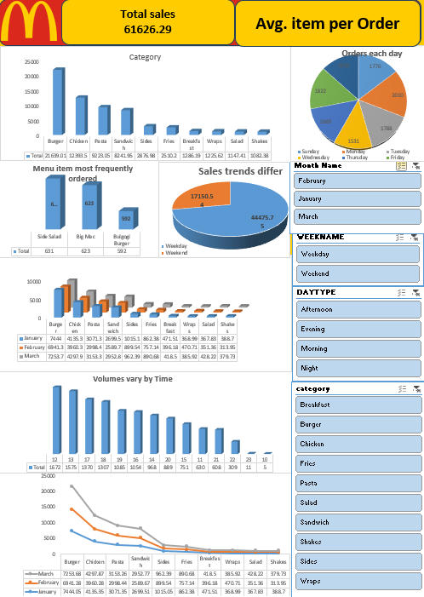
Dashboard Overview

Slide 7
THANK YOU

