Slide 1

MINOR PROJECT - I ON Thought Trail WEBSITE (MCA – I SEMESTER; BATCH 2023-25)
Internal Guide
Parul Arora
Sunil Pratap Singh (Associate Professor, BVICAM, New Delhi)
Presentation by
Siddharth Chaturvedi (04811604423)
Nandini Bisht (06111604423)
22 December 2023
Notes:
1

Slide 2
Contents
Problem Description
Aim and Objectives
Methodology and Technology Used for Project Development
Project Modules
Design Documents (Use Case, Data Flow Diagram, Entity-Relation Diagram, etc.)
Screenshots
Conclusion
Future Scope
Bibliography

Slide 3
Problem Description
Traditional blog platforms often lack real-time interactions, making the user experience static and less engaging.
Managing diverse content on a blog, including text, images, and multimedia, can become challenging without a streamlined system.
Conventional blog platforms often provide limited avenues for user interaction, such as comments.
Many existing blog platforms face scalability issues, particularly when dealing with a growing user base and increasing content volume.
Some blog platforms may have outdated or non-intuitive user interfaces, impacting the overall user experience.

Slide 4
Aim and Objectives
Aim:
To develop a dynamic blog website using addressing existing limitations by providing real-time interactions, robust content management, enhanced user engagement, secure user interactions, seamless scalability, and a modern user interface.
Objective:
To develop a robust content management system utilizing MongoDB and Mongoose to efficiently organize and handle diverse types of content, including text, images, and multimedia.

Slide 5
Methodology and Technology Used
Methodology used for Project Development:
Waterfall Model of SDLC
Technology used for Project Development:
Front-End: HTML 5.0, CSS 3.0, Bootstrap 4.0
Back-End: NodeJS 4.0, NPM
Integrated Development Environment (IDE): VS Code, Visual Studio 2019
Database: MongoDB

Slide 6
Project Modules
Project Modules:
User Authentication and Authorization Module
Content Management and Blogging Module
Real-time Interaction Module
Search and Filtering Module
User Interaction Analytics Module
Responsive Design Module

Slide 7
System Design

Slide 8
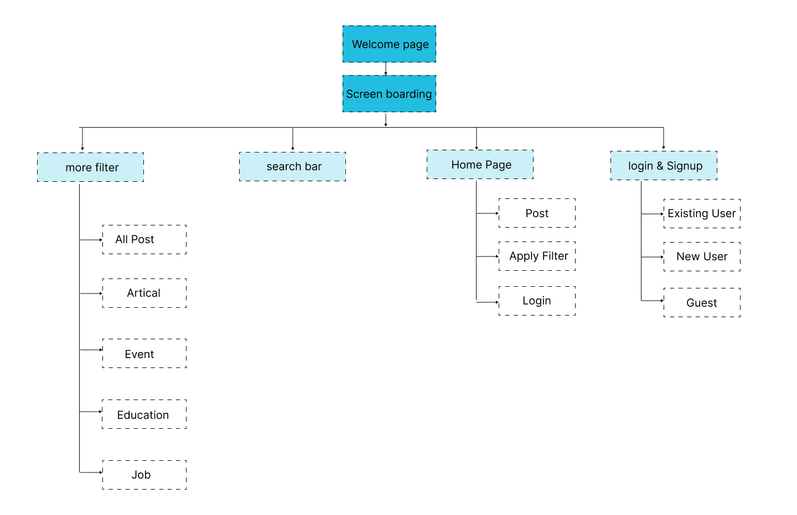
Site Map

Slide 9
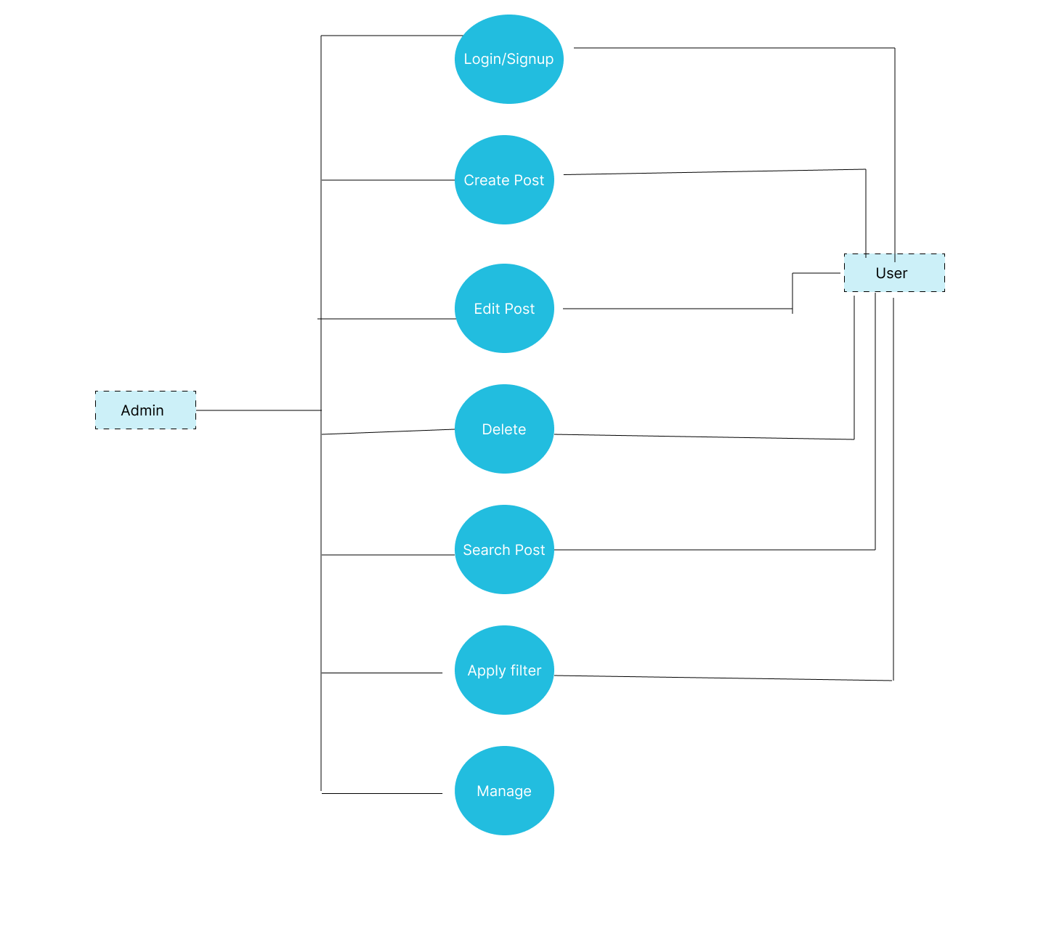
Use Case Diagram

Slide 10
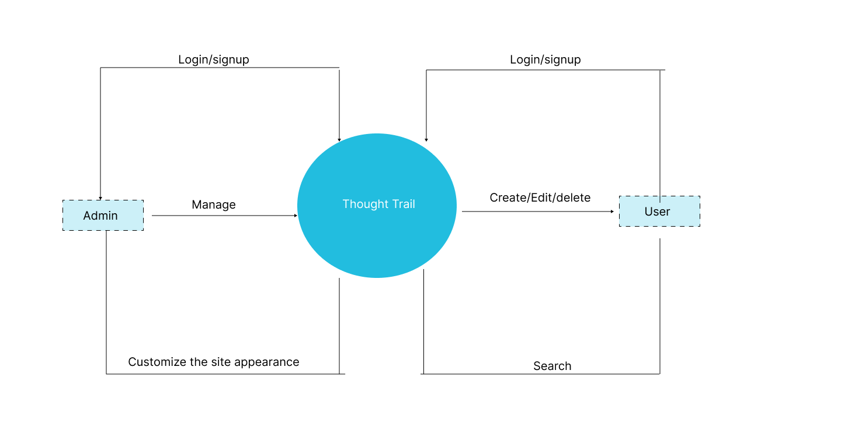
Data Flow Diagram Level 0

Slide 11
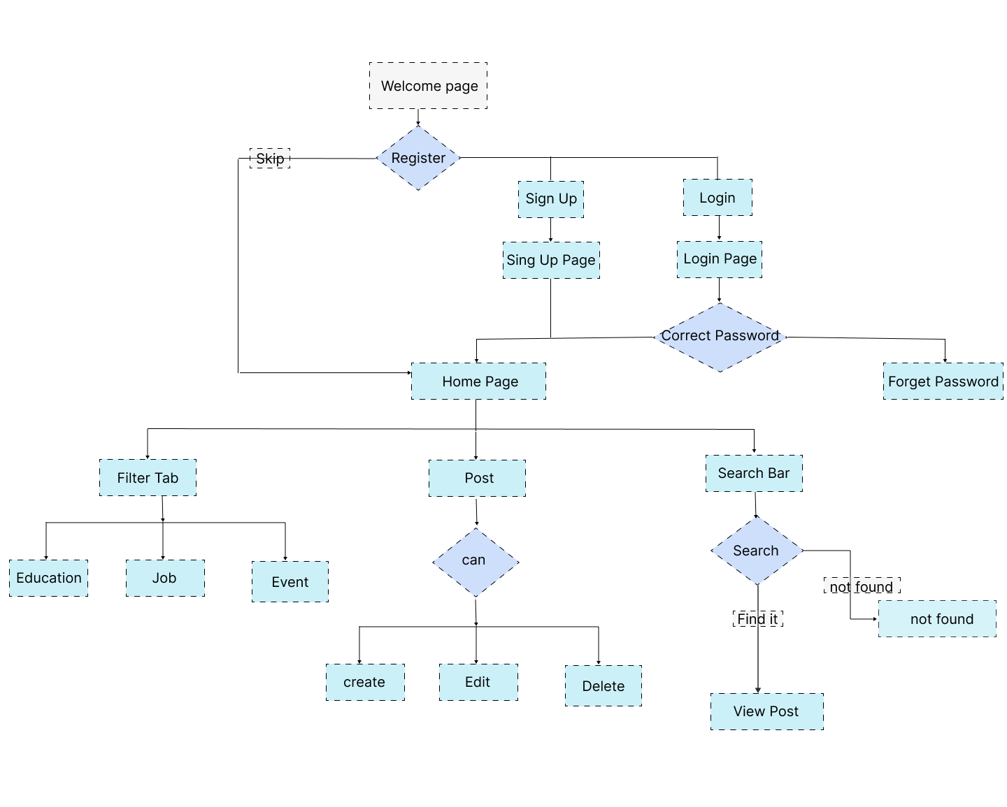
Data Flow Diagram Level 1

Slide 12
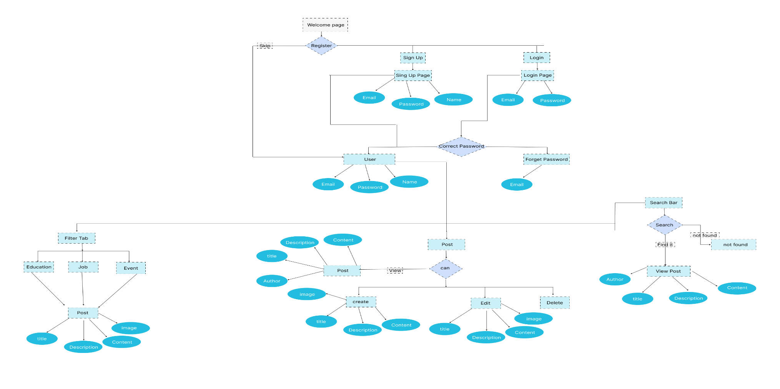
Entity-Relationship (E-R) Diagram

Slide 13
Screenshots

Slide 14
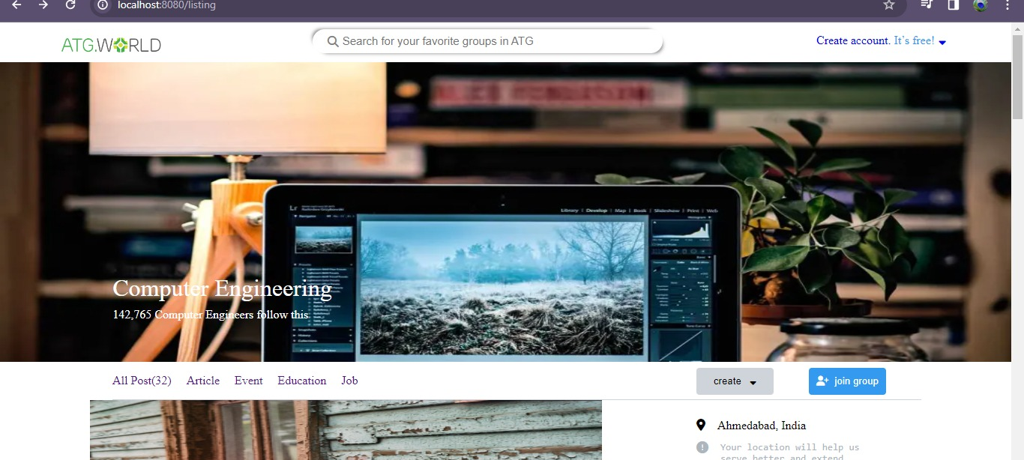
Screenshot – 1 : If person is not logged in

Slide 15
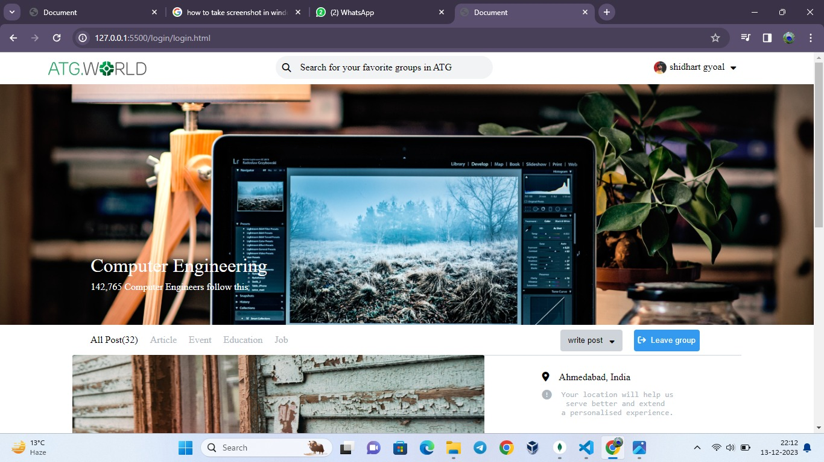
Screenshot – 2 : Person logged in

Slide 16
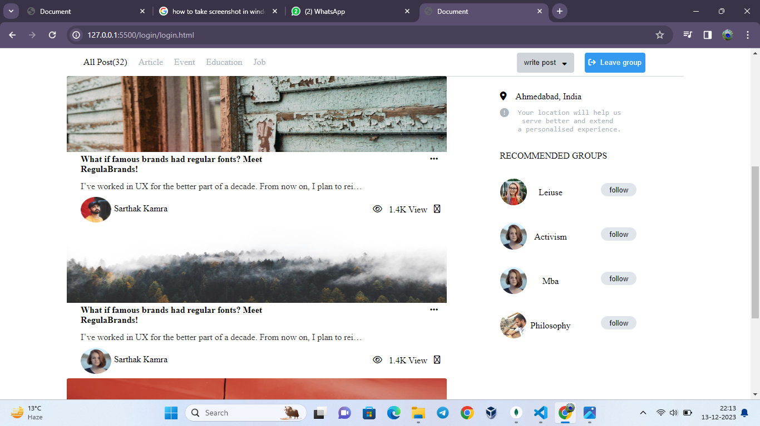
Screenshot – 3 : Person logged in

Slide 17
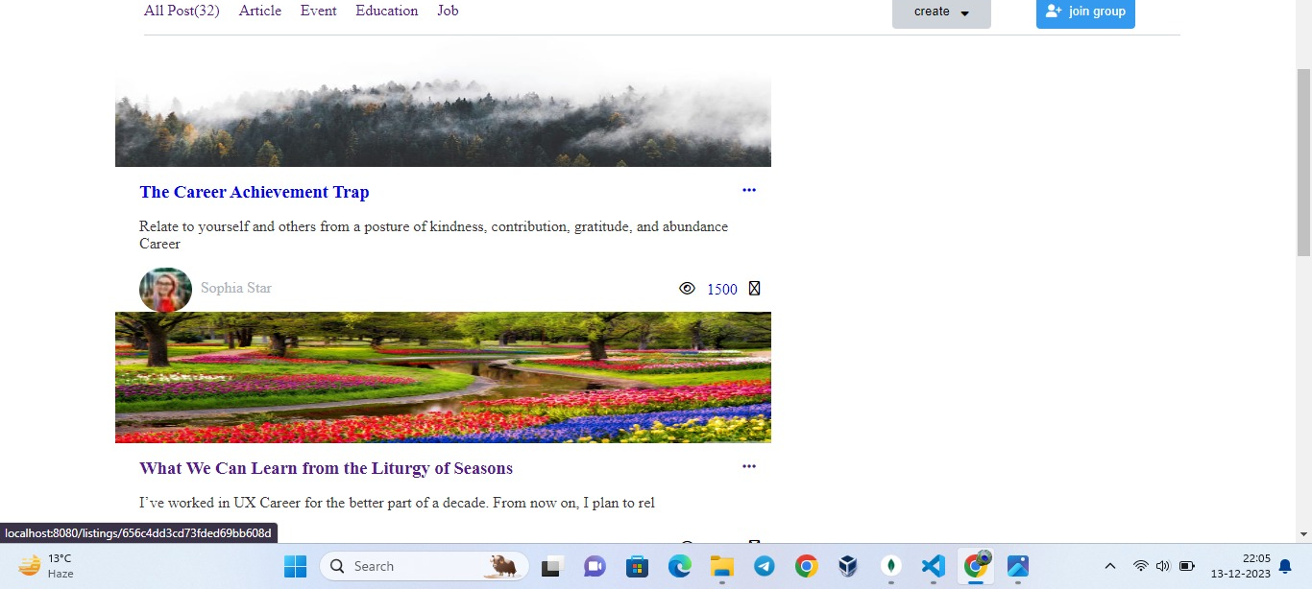
Screenshot – 4 : Job Filter

Slide 18
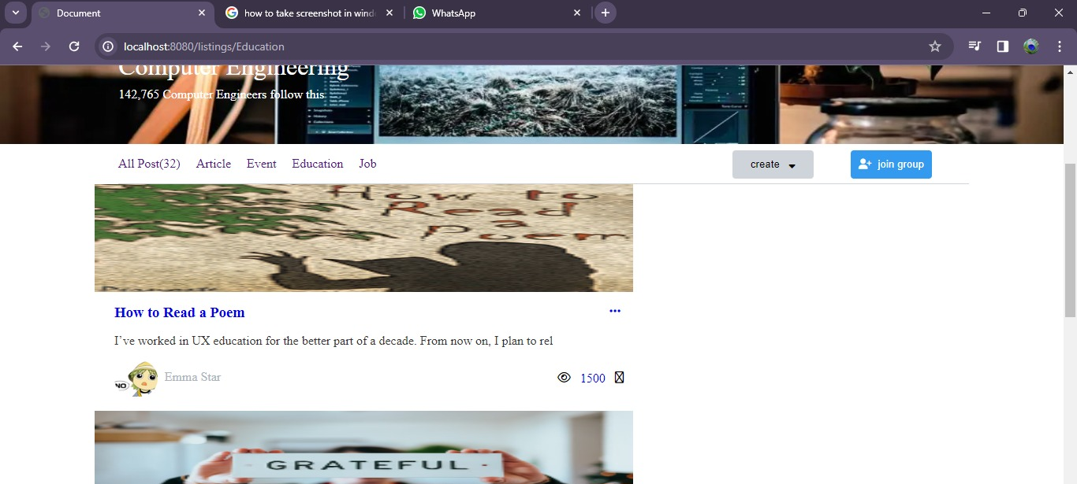
Screenshot – 5 : Education Filter

Slide 19
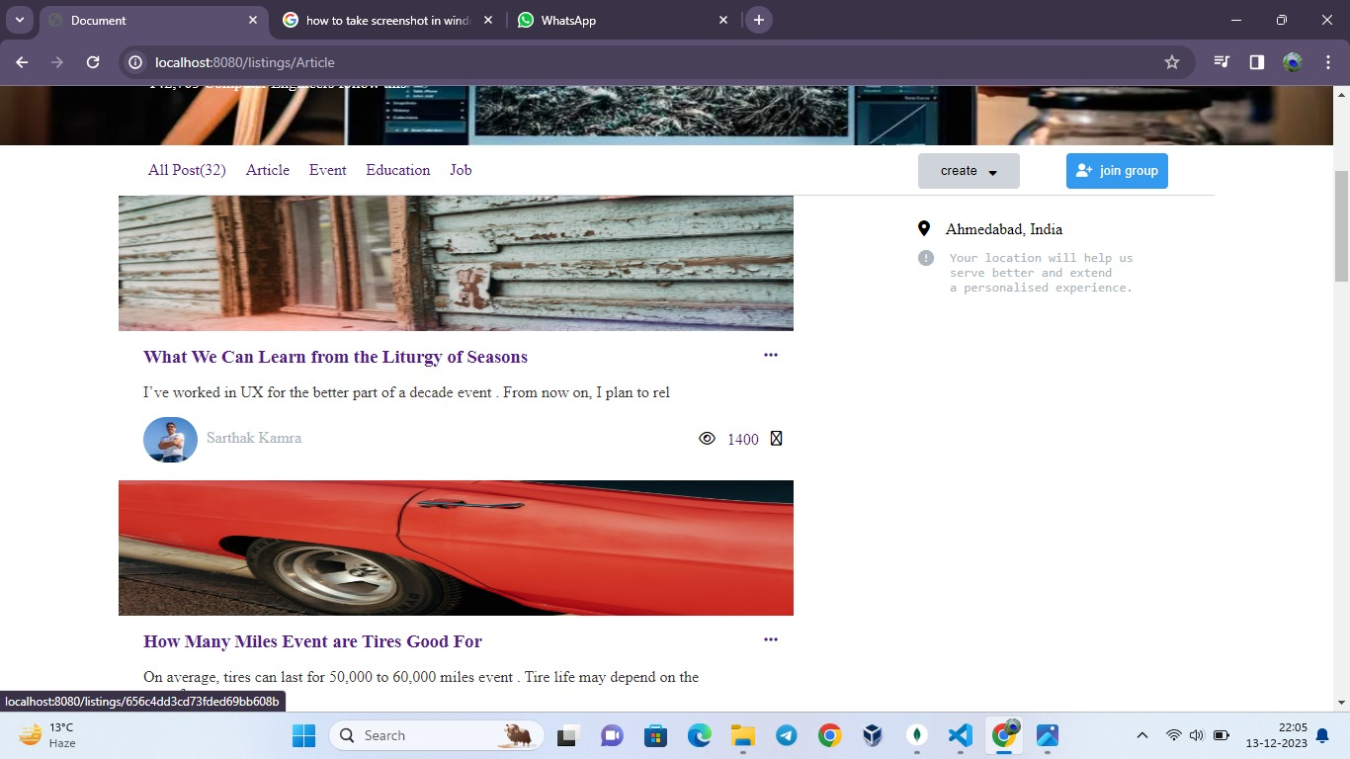
Screenshot – 6 : Event Filter

Slide 20

Screenshot – 7 : Search bar

Slide 21
Screenshot – 7 : Search bar

Slide 22
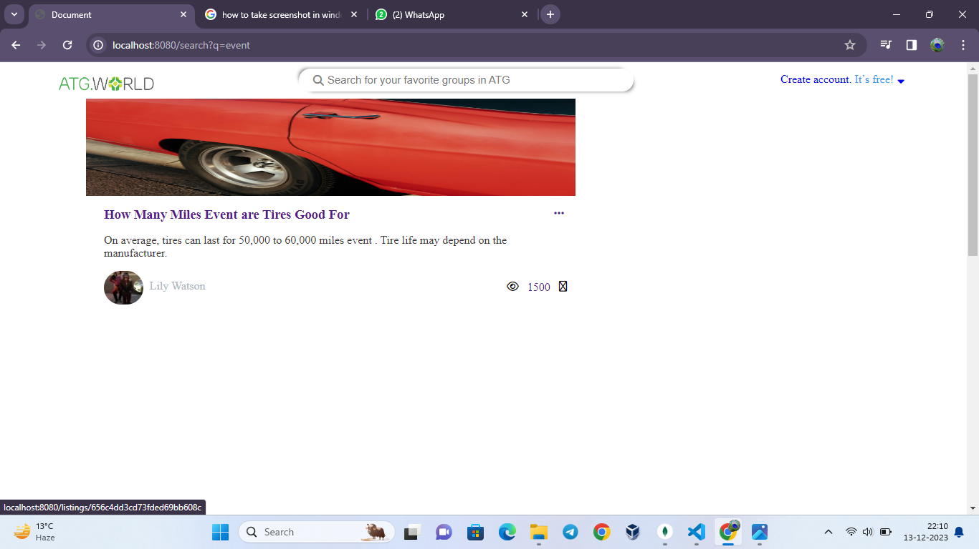
Screenshot – 8 : Search result

Slide 23
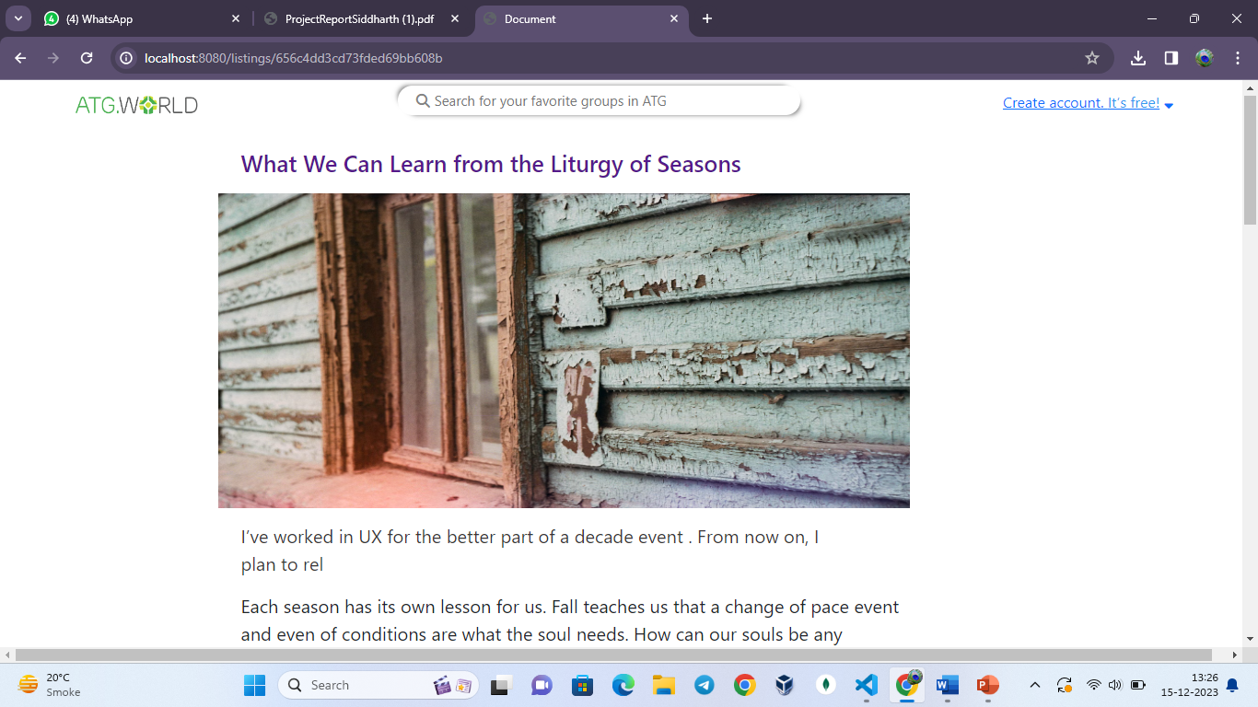
Showing of the Project
NOTE: If applicable in the Project, the required Test Cases need to be presented.

Slide 24
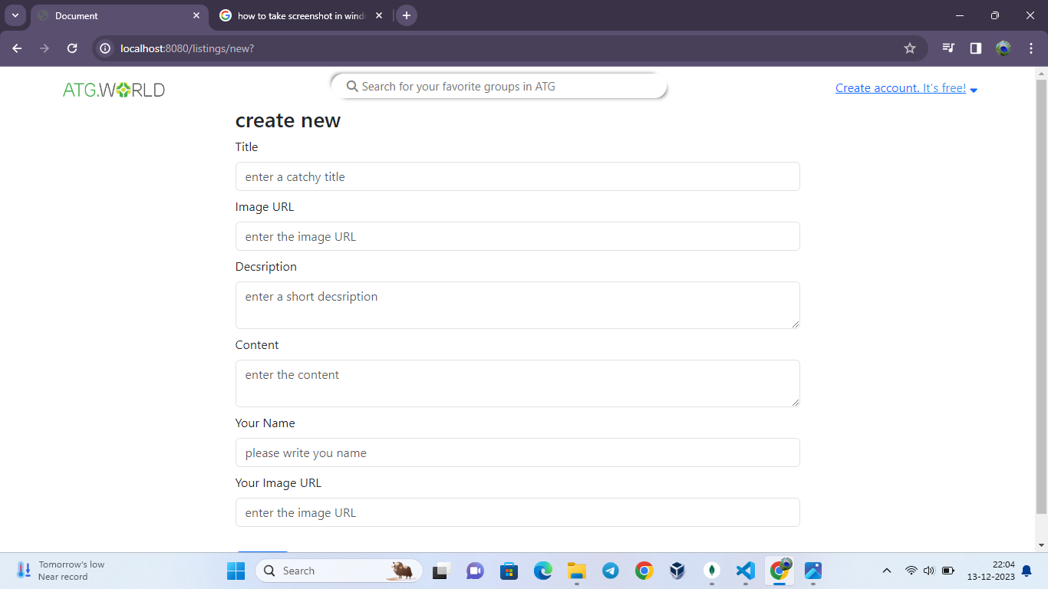
Editing of the Project
NOTE: If applicable in the Project, the required Test Cases need to be presented.

Slide 25
Creating a new blog
NOTE: If applicable in the Project, the required Test Cases need to be presented.

Slide 26
Conclusion
A web-based application developed to efficiently organize and handle diverse types of content, including text, images, and multimedia..
Waterfall model of SDLC has been followed for development of the project.
The developed application has following features:
Secure User Authentication.
Comprehensive Content Management.
Real Time Updates.
Responsive Design and Cross-browser compatibility.

Slide 27
Future Scope
Mobile App Development : Extend the platform with dedicated mobile applications for enhanced accessibility.
Community Features Expansion : Introduce forums, user-generated content and collaborative features of community growth.
Integration of AI : Explore AI for personalized content recommendations and user interaction predictions.
Multilingual support : Enhance user reach with multilingual content and localization features.

Slide 28
Bibliography
Books:
Steve Krug, Rober Hoekman Jr., “Refactoring User Interface”, 2016.
Vasan Subramanian, “Pro MERN Stack”, 2017.
Websites:
www.bvicam.in/index.html, [Accessed on 10 December, 2023].

