Slide 1
Project Designed By:
Renu Bisht
Shivanshu Johari
Shiva Pandey

Slide 2
INTRODUCTION
Welcome to Smart Project Scheduling System. It is a database software of the coaching institutes. It is accessible to three main participants of the institute, the Admin, the Academic Head and the Counsellor. The Admin handles the account of the other two participants. The Academic Head adds and updates the various courses running in the institute. Also, the Academic Head creates various categories of project and assigns project to students based on the courses they have opted for. The Counsellor adds details of the various students who are part of the institute and also updates their project status in the database of the system.

Slide 3
OBJECTIVE
Smart Project Scheduling System:
To keep a record of all the students studying the coaching institute.
To keep a record of various courses running in the institute and create various categories of projects based on the courses.
To assign various Projects to the students.
To update the project submission status of students.
To award Certificate to students who have submitted their project.
To maintain the account of various employees working in the institute.

Slide 4
Hardware And Software Requirements
Hardware Requirements:
The basic hardware required to run the project is Pentium Processor. A 2GB RAM would be sufficient for a speedy run of the application. The application requires affordable space in user’s device so memory is never going to be an issue. Besides this, as far as End Users are concerned, it is meant for all Windows Operating Systems.
Software Requirements:
If the developer’s machine has java development tool kit- jdk1.8 installed then the version of Eclipse Oxygen must be a compatible one, also the 32/64 bit OS of user’s device. Also MySQL Database is required for record maintenance.

Slide 5
Modules
Modules of Smart Project Scheduling System:
Home Frame
Sign In Frame
Feedback Frame
Admin Frame
Create account frame
Update Account frame
Delete Account frame
View report frame
Academic Head Frame
Create Course frame
Create Project Category frame
Add Project frame
Allot Project Frame
Counsellor Frame
Add Student frame
Update account frame
Delete account frame
Update Project status frame
All the Database tables linked with different frames.

Slide 6
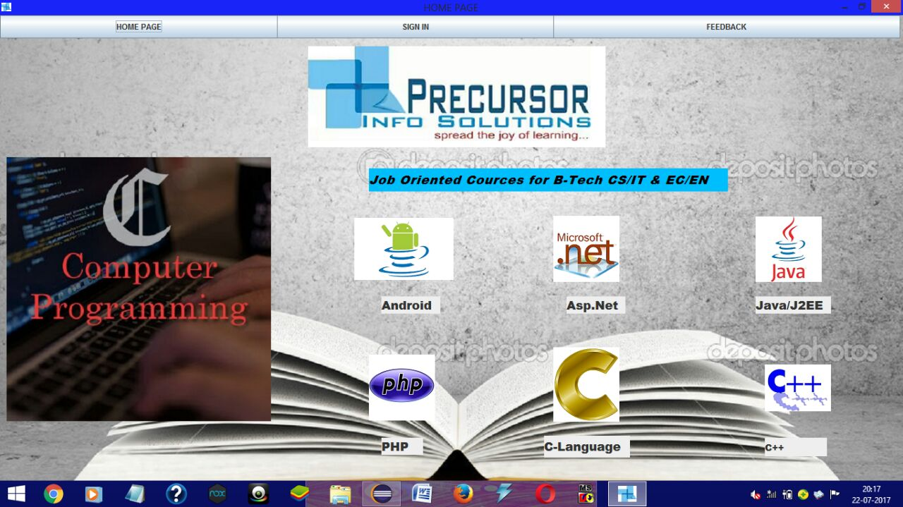
Homepage

Slide 7
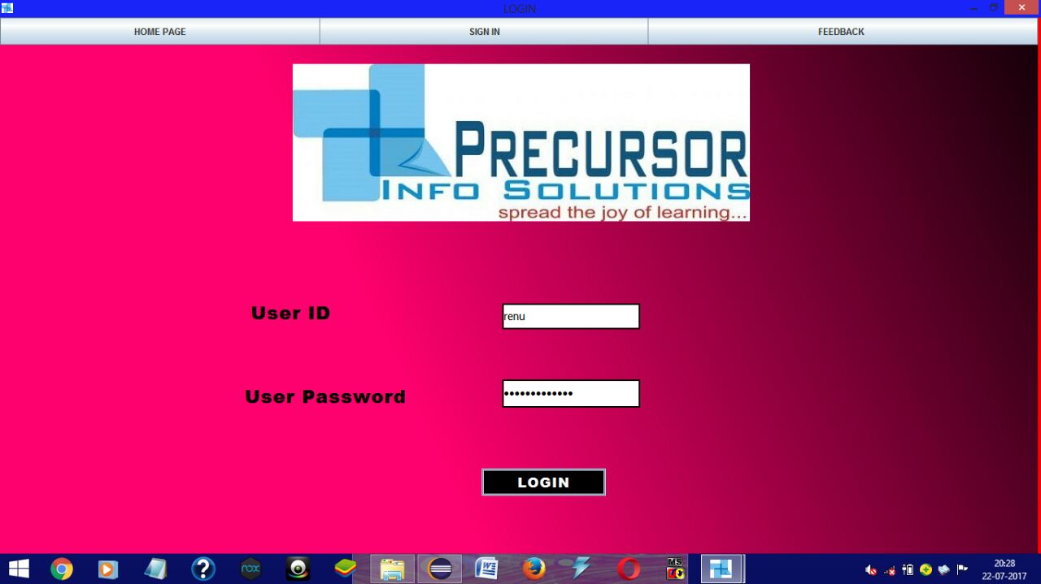
Sign In

Slide 8
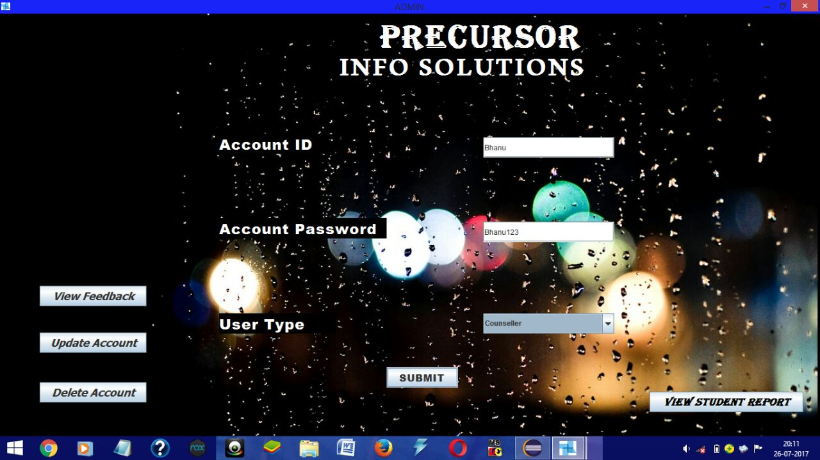
Admin Frame

Slide 9
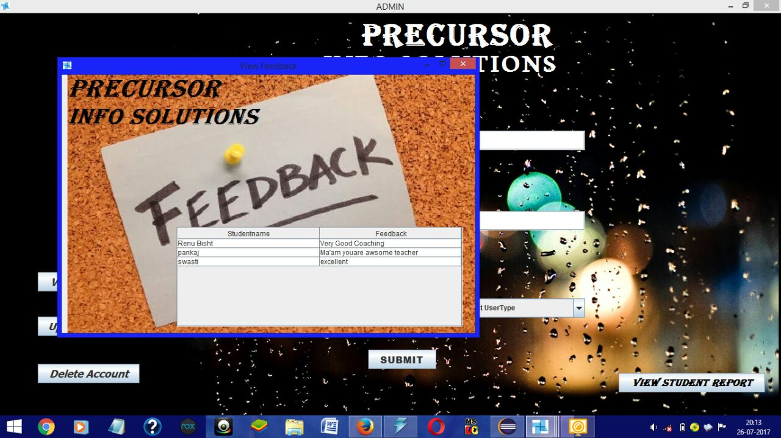
View Feedback Frame

Slide 10
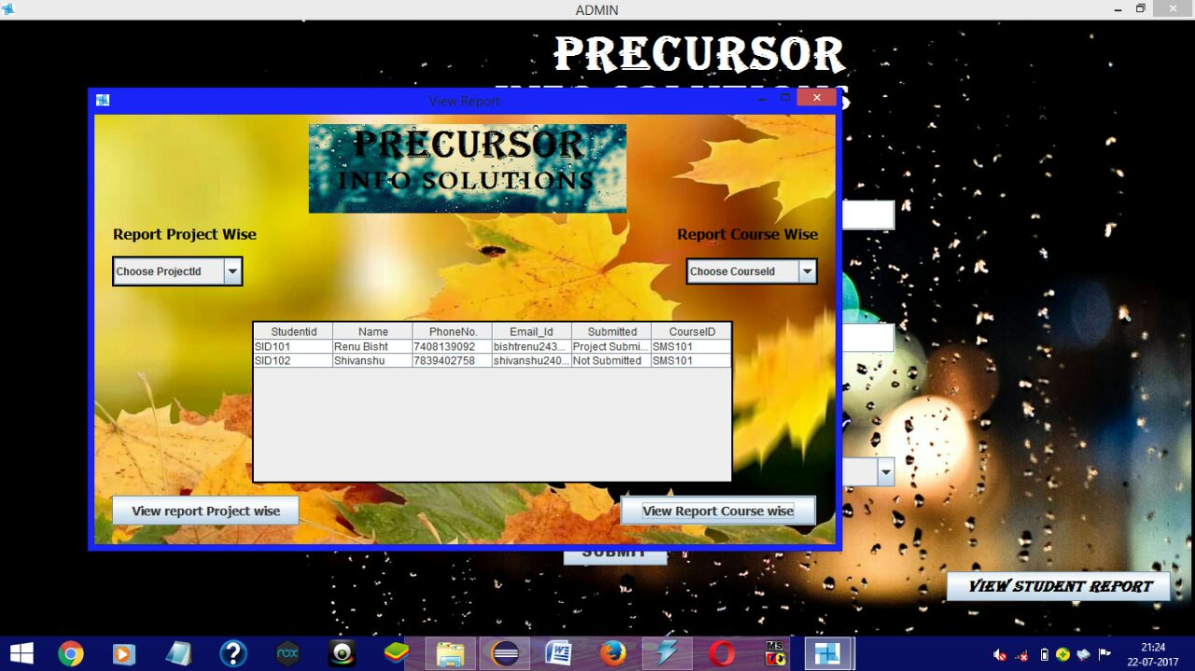
View Report Frame

Slide 11
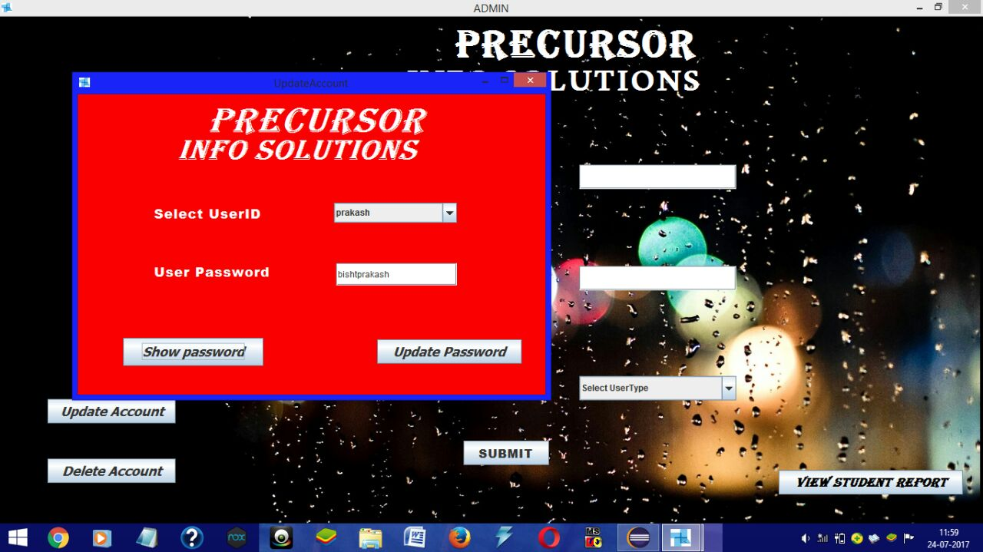
Update Account Frame

Slide 12
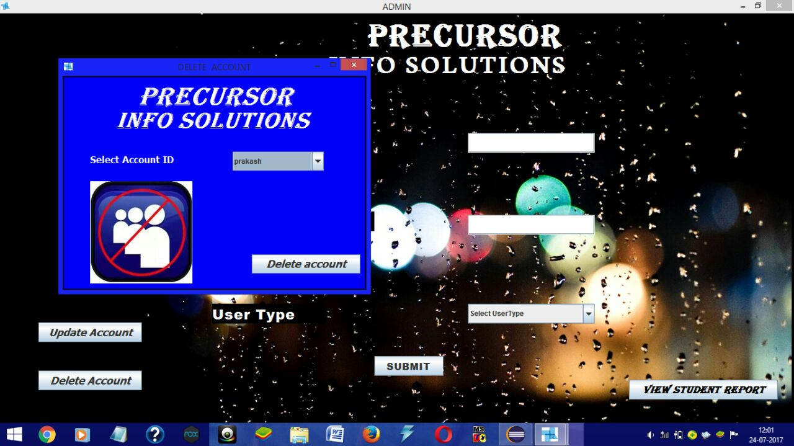
Delete Account Frame

Slide 13
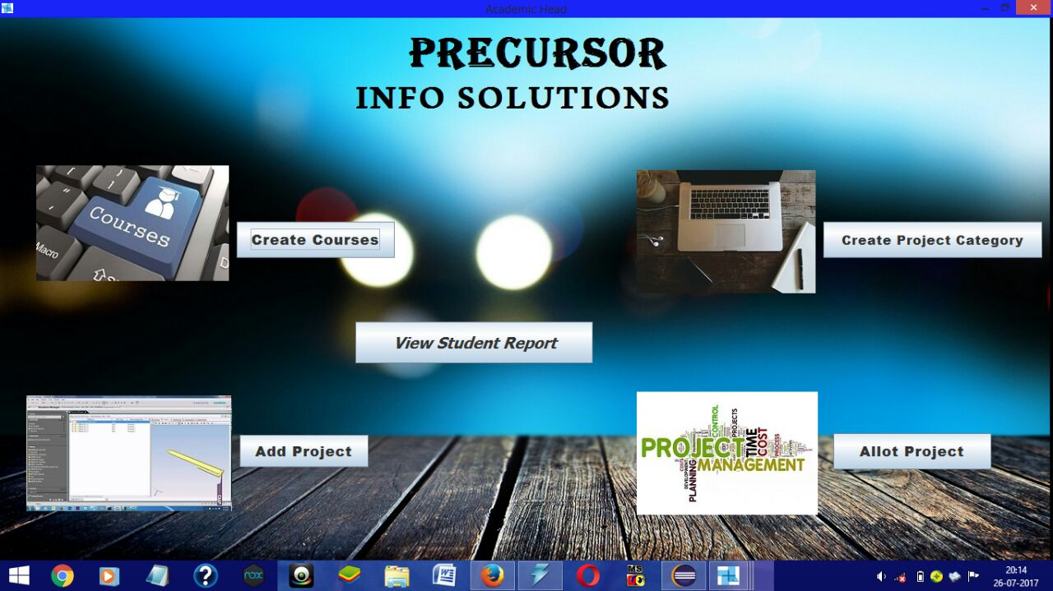
Academic Head Frame

Slide 14
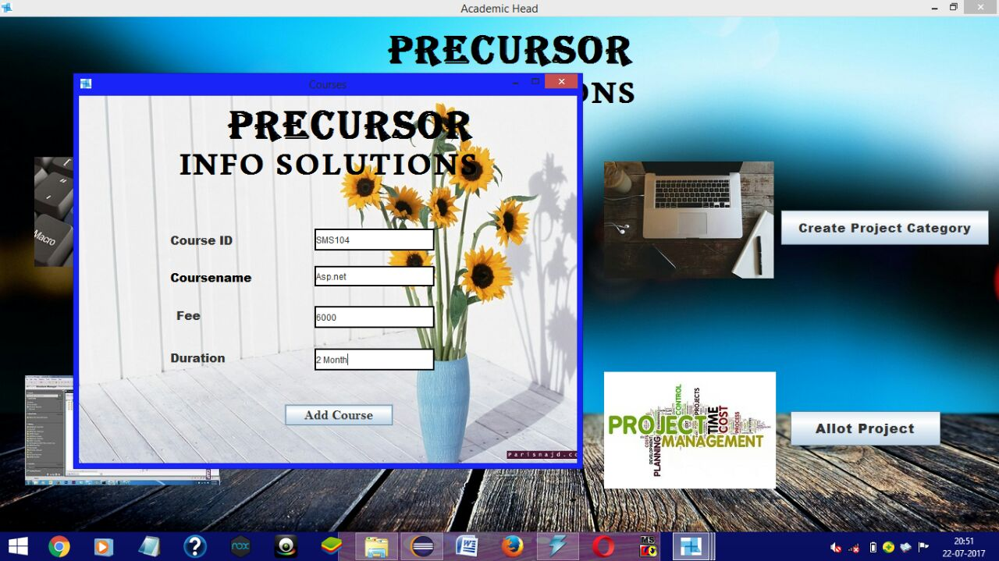
Create Course Frame

Slide 15
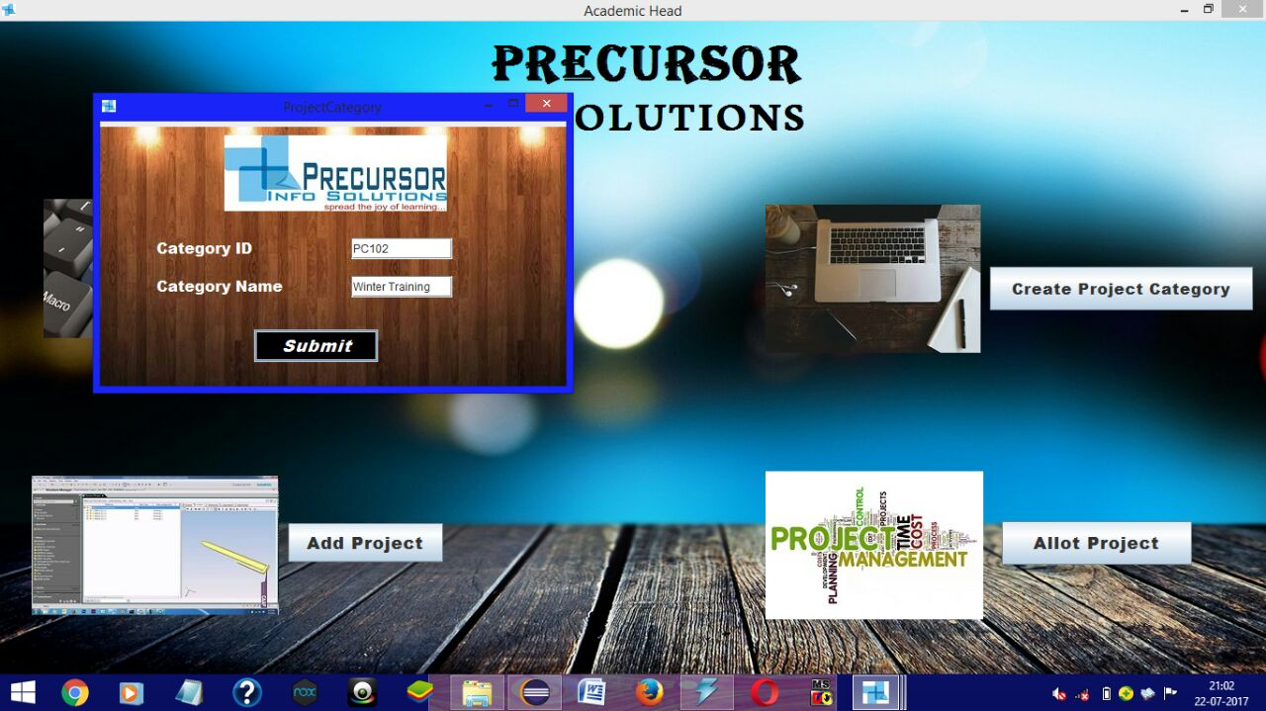
Create Project Category Frame

Slide 16
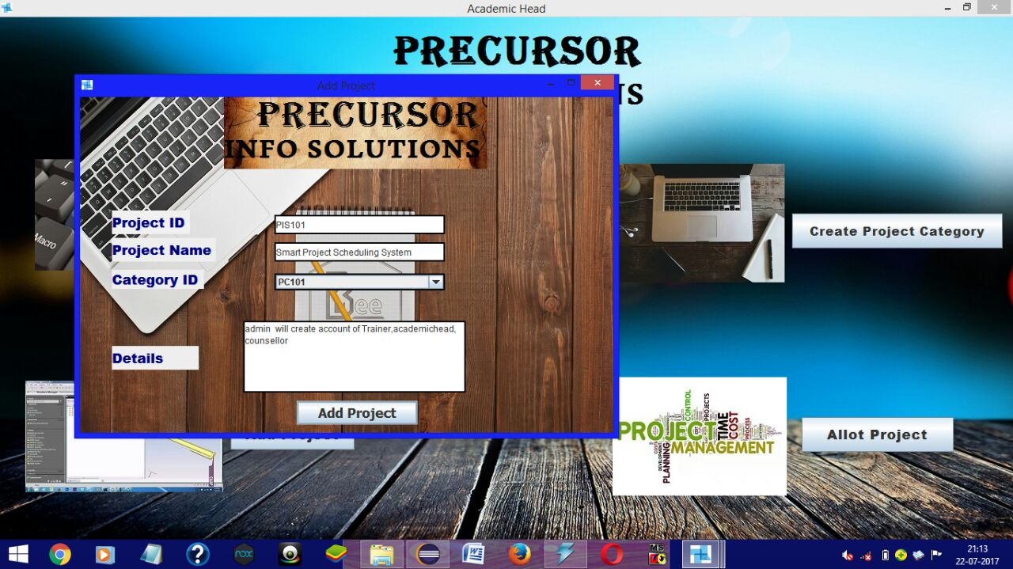
Add Project Frame

Slide 17
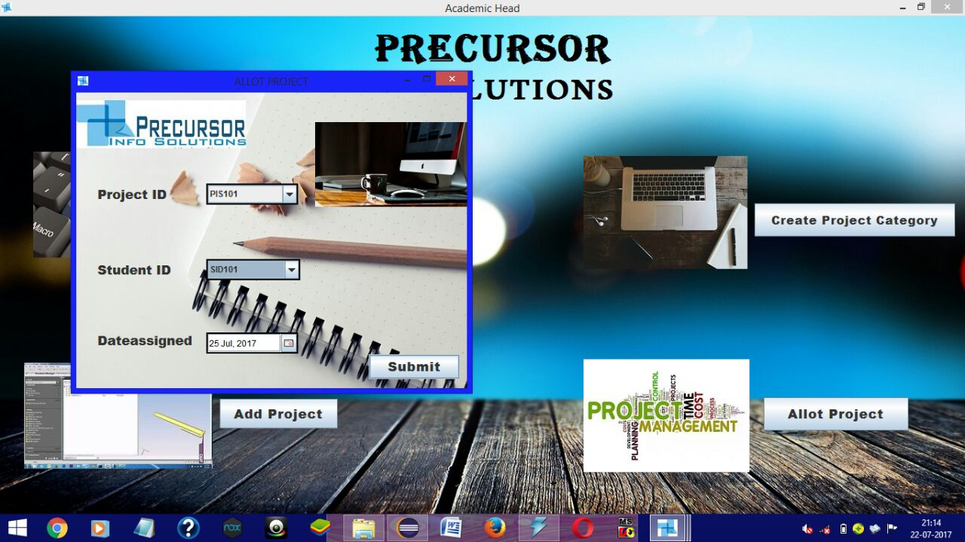
Allot Project Frame

Slide 18
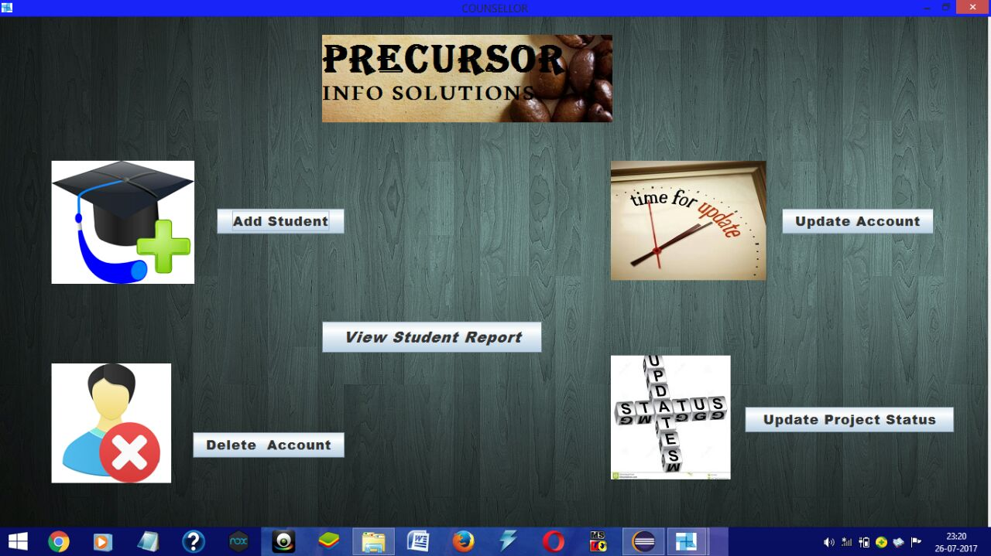
Counsellor Frame

Slide 19
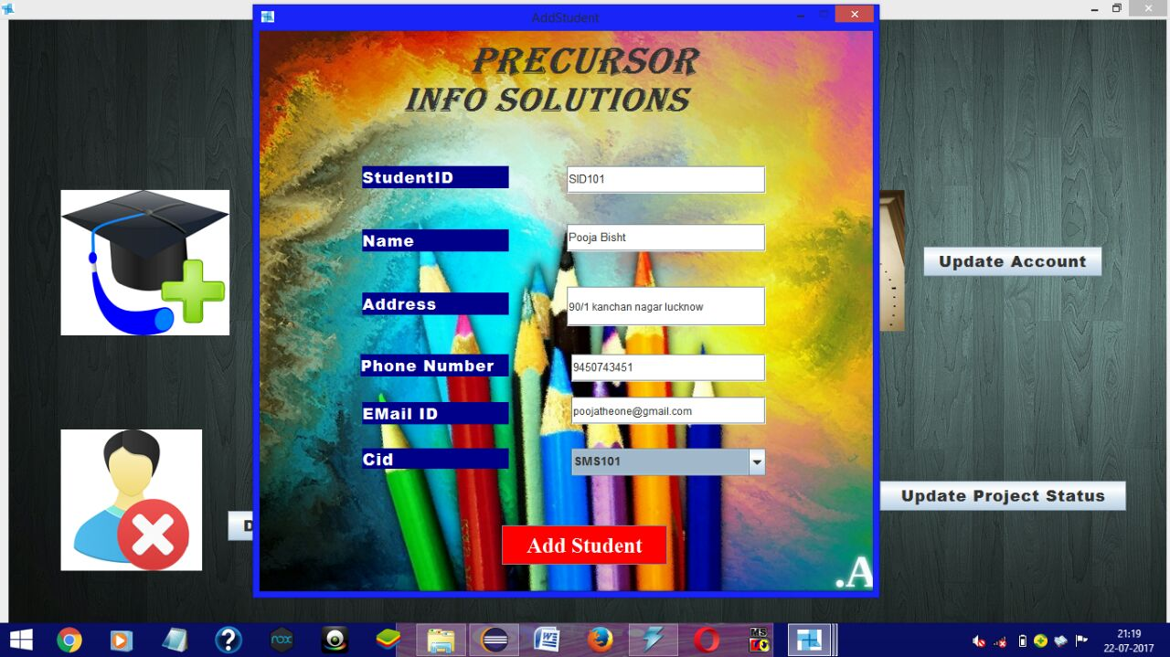
Add Student Frame

Slide 20
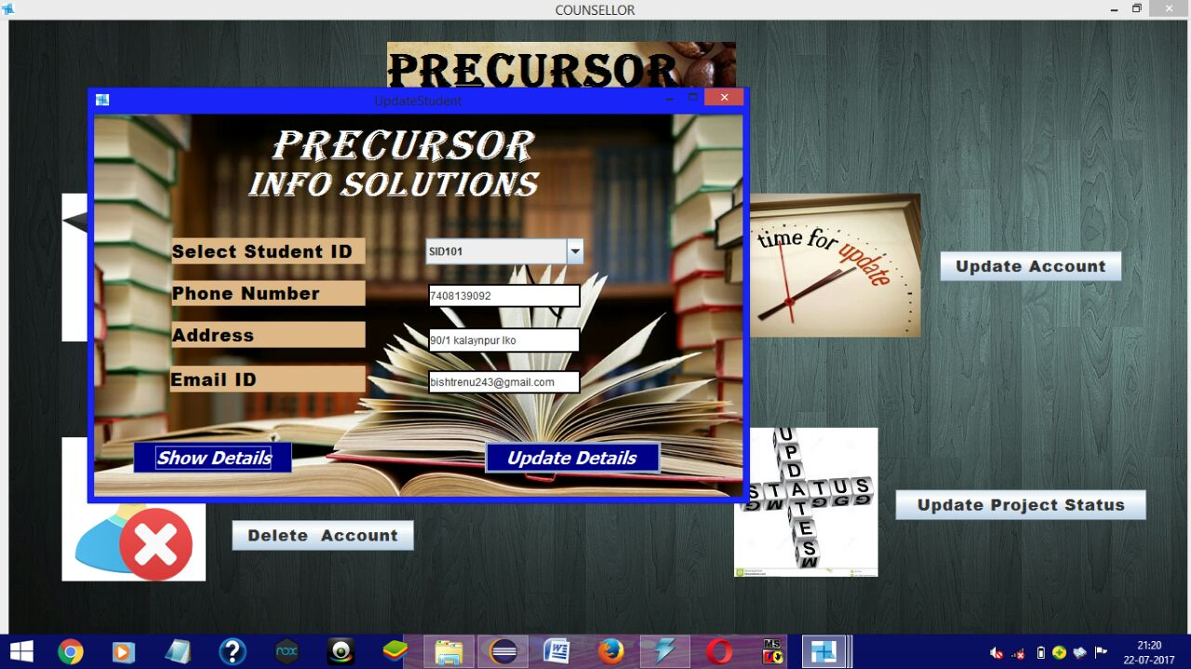
Update Student Frame

Slide 21
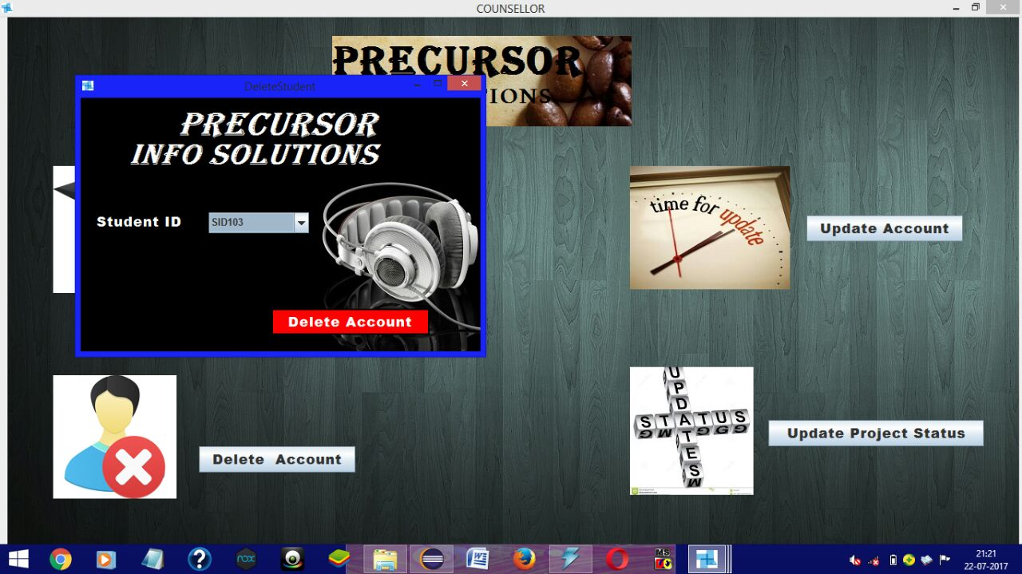
Delete Student Frame

Slide 22
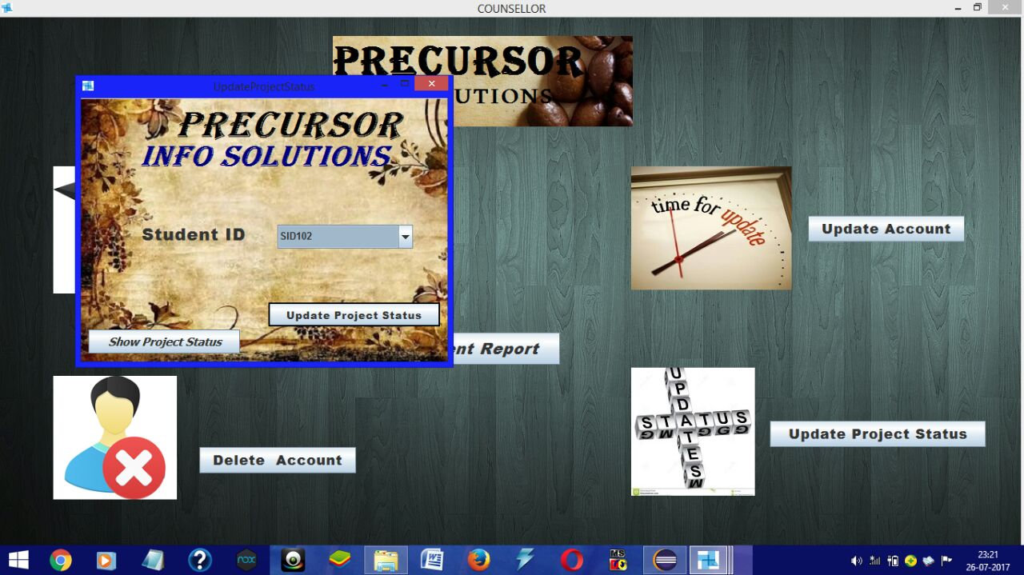
Update Project Status Frame

Slide 23
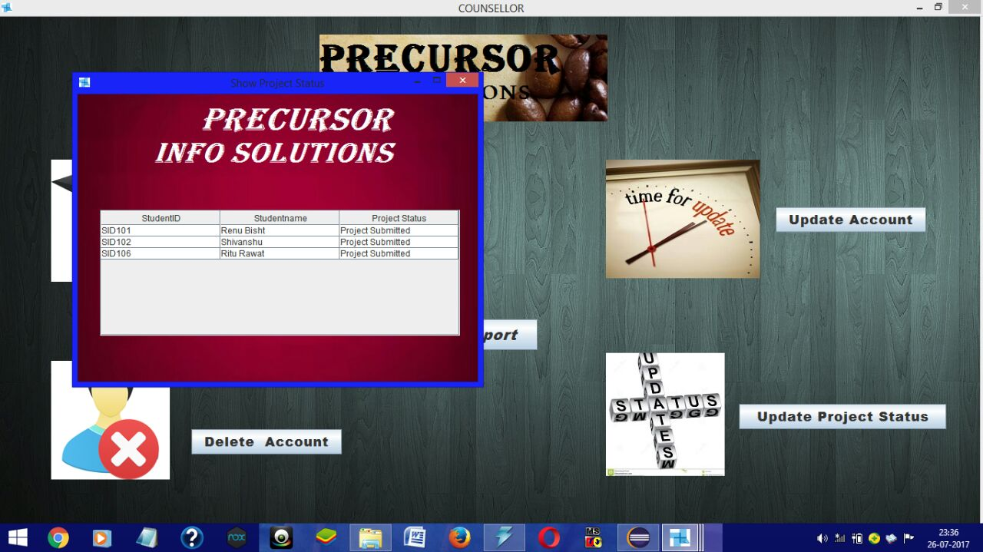
Show Project Status

Slide 24
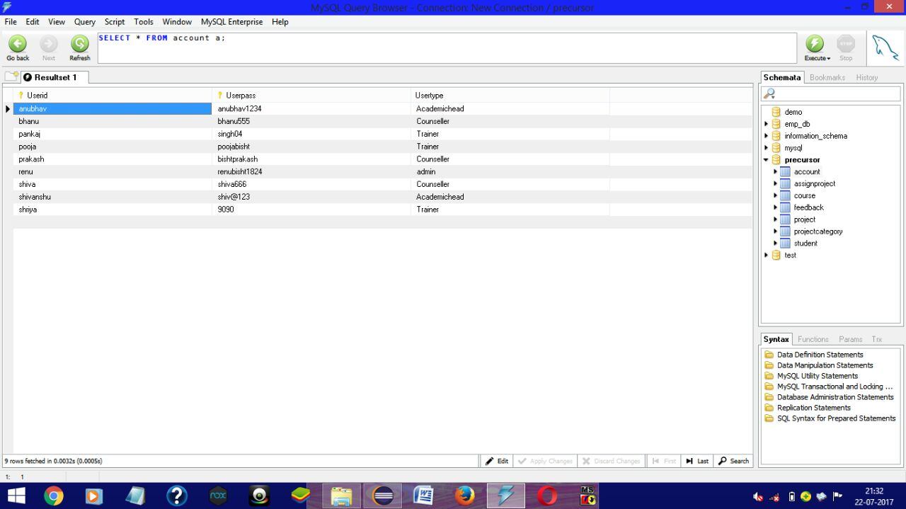
Account Table

Slide 25
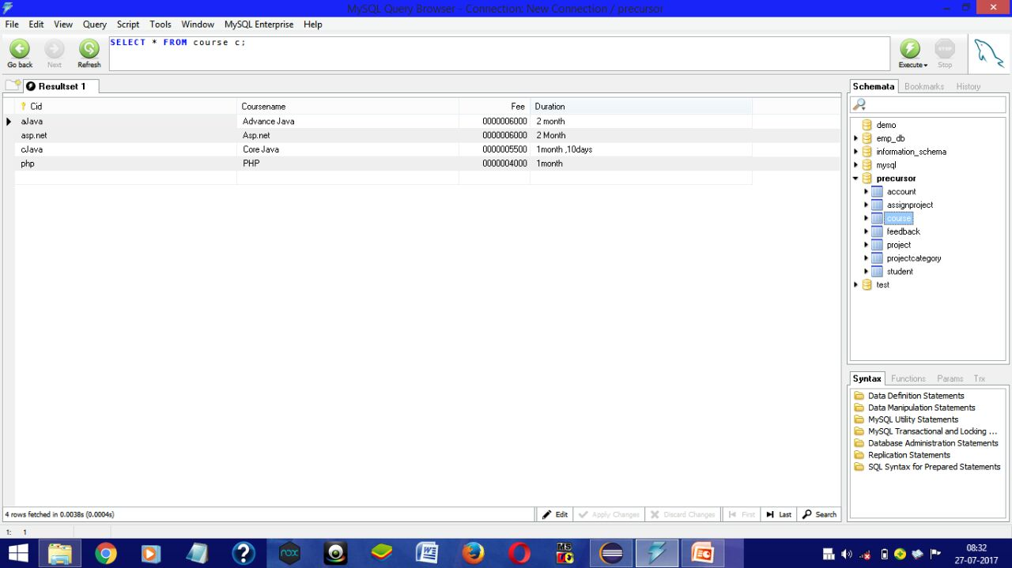
Course Table

Slide 26
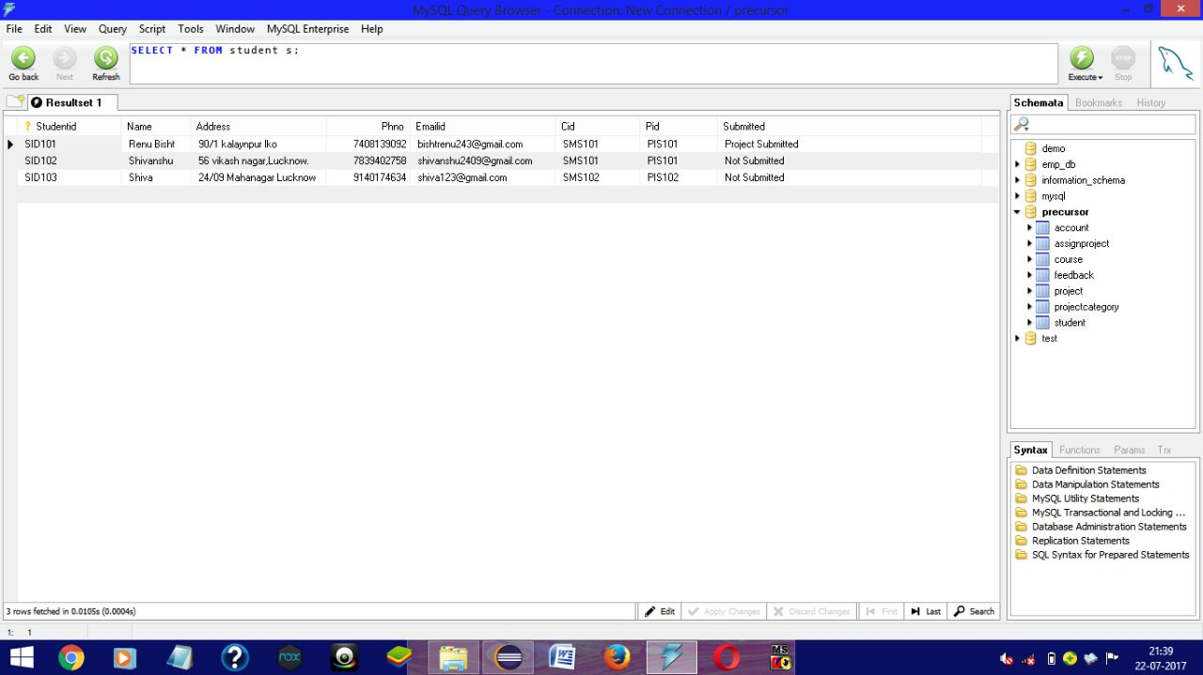
Student Table

Slide 27
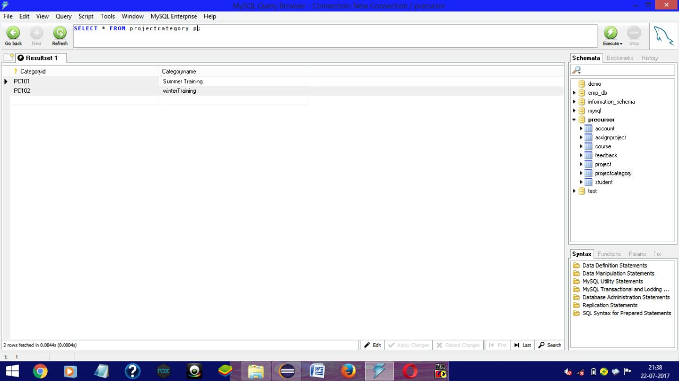
Project Category Table

Slide 28
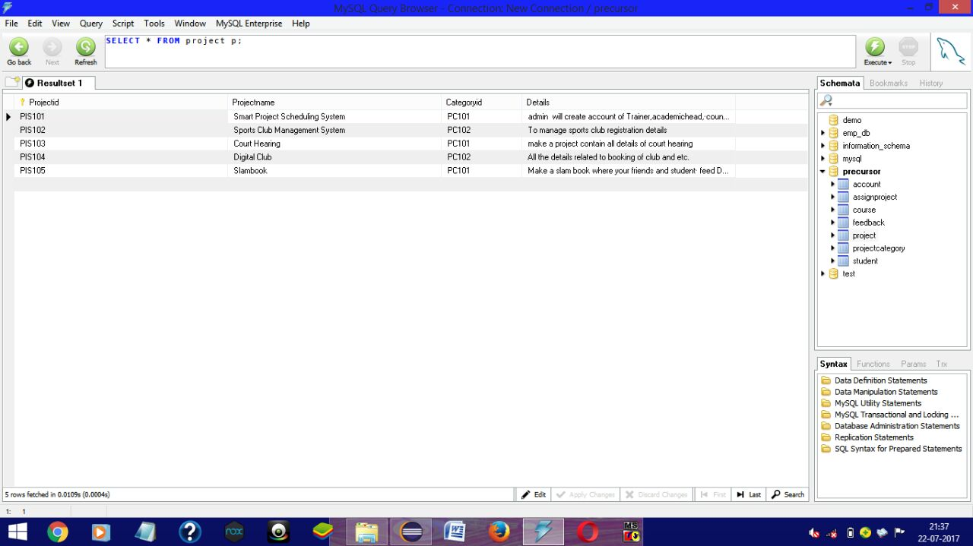
Project Table

Slide 29
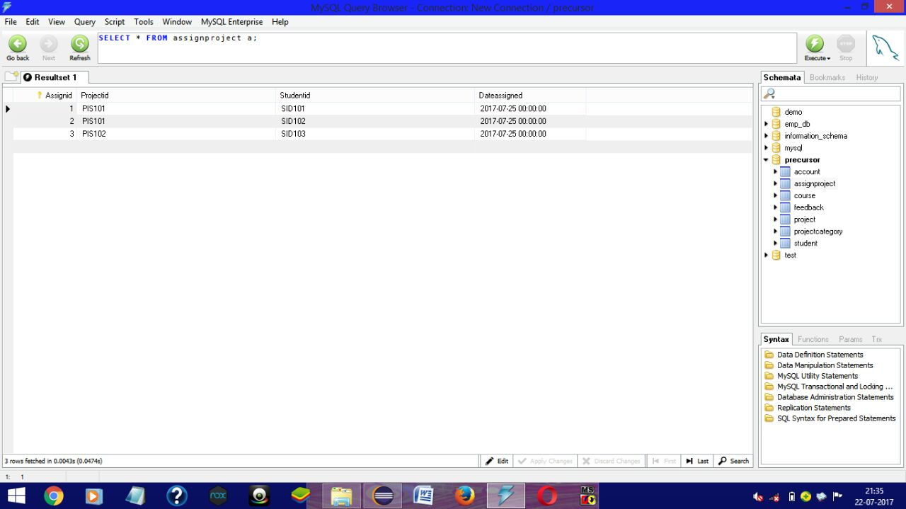
Assign Project Table

Slide 30
Bibliography and References
This Project includes the GUI and Database concepts of core JAVA.
Websites referred are:
www.Google.com
www.YouTube.com
Book Referred is:
Black book for Core JAVA.

