Slide 1
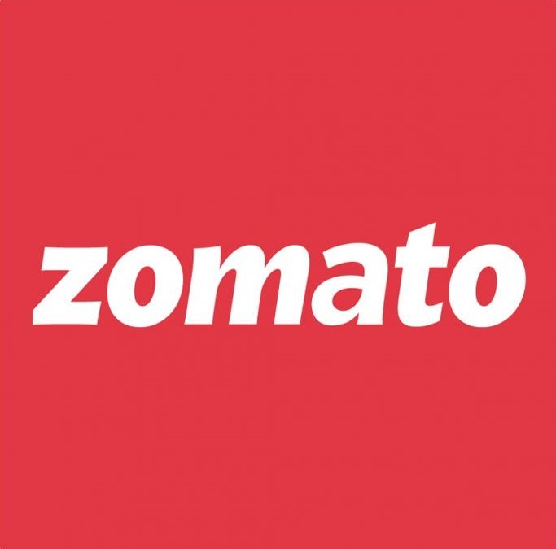
Zomato Restaurant Analysis
Presented by:
Shweta Bisht

Slide 2
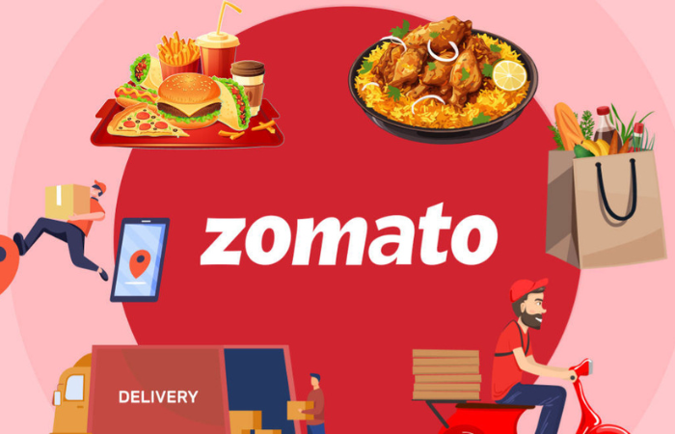
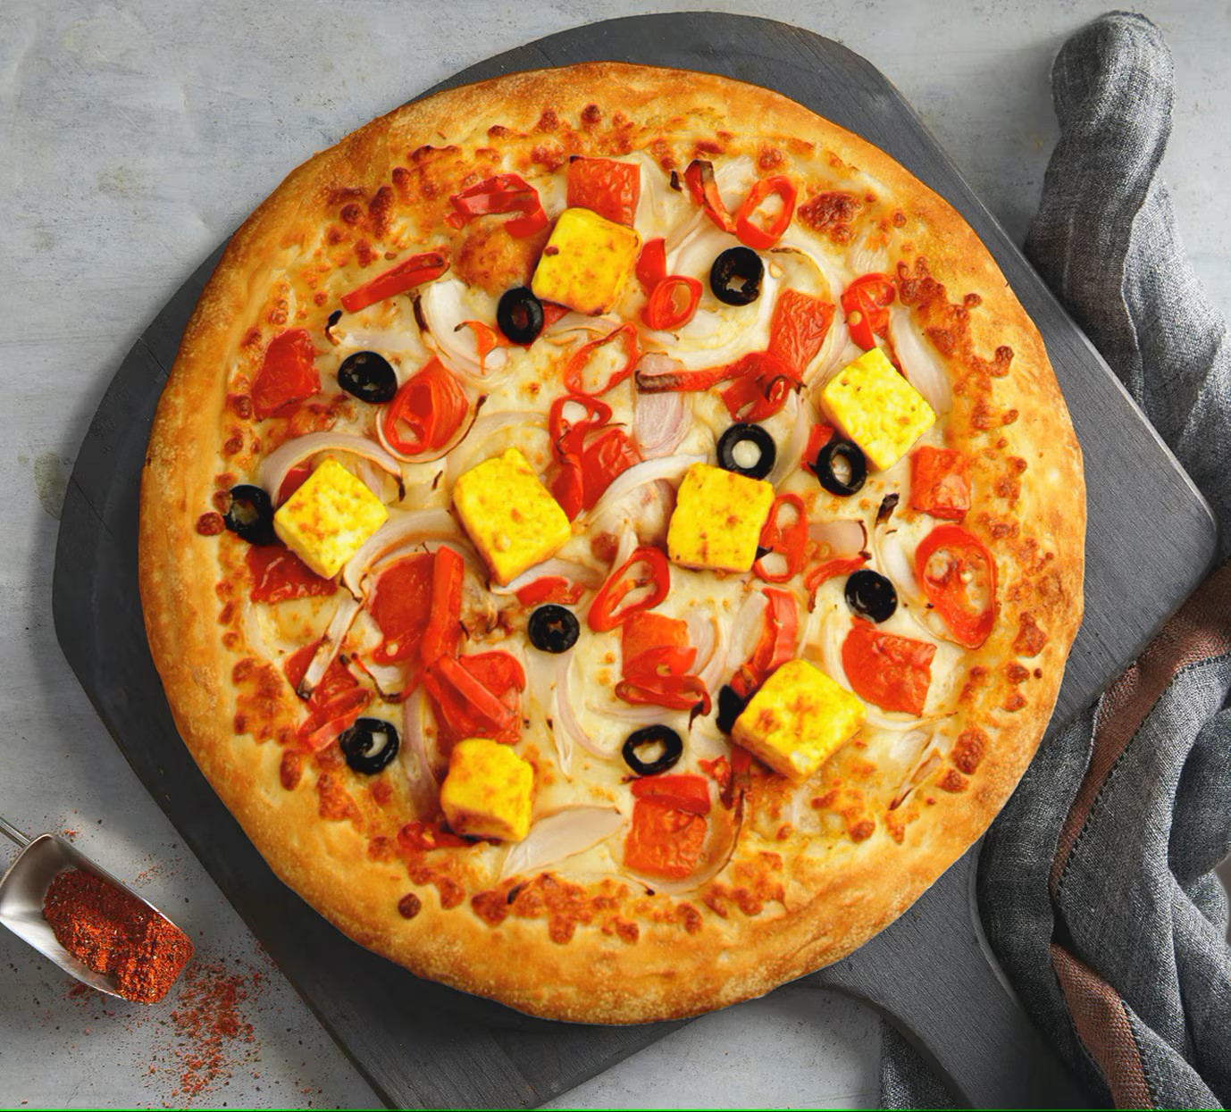
INTRODUCTION
Zomato, an Indian food delivery startup founded by Pankaj Chaddah and Deepinder Goyal, originally operated under the name "Foofiebay."
On January 18, 2010, it was rebranded as "Zomato."
Today, the app serves customers across 24 countries and 10,000 cities globally.

Slide 3
OBJECTIVE
Zomato is looking for expansion and opening new restaurants. The objective is to come up with strategies/suggestions about opening newer restaurants.

Slide 4
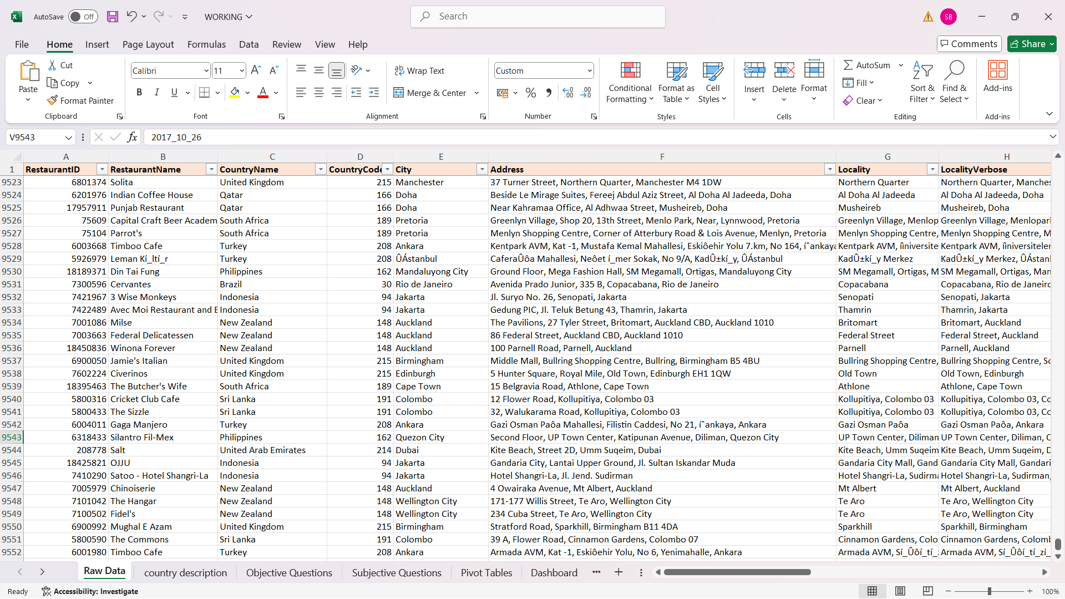
DATA OVERVIEW

Slide 5
The image above displays details about Zomato Sales Performance, including:
Restaurant ID: Unique identifier for each restaurant.
Restaurant Name: The name of the restaurant.
CountryCode: Country code of the location where the restaurant is situated.
City: The city where the restaurant is located.
Address: The specific address of the restaurant.
Locality: The locality or neighborhood where the restaurant is situated.
Locality Verbose: Detailed information about the locality.
Longitude: The geographical longitude coordinate of the restaurant.
Latitude: The geographical latitude coordinate of the restaurant.
Cuisines: The type of cuisine offered by the restaurant.
Currency: The currency used for transactions in the restaurant.
Has_Table_booking: Indicates whether the restaurant has a table booking option (Yes/No).
Has_Online_delivery: Indicates whether the restaurant offers online delivery (Yes/No).
Is_delivering_now: Indicates whether the restaurant is currently delivering (Yes/No).
Switch_to_order_menu: Indicates whether users can switch to the order menu (Yes/No).
Price_range: A numeric value indicating the price range category of the restaurant.
Votes: The number of votes or ratings/(feedback) received by the restaurant.
Average_Cost_for_two: The average cost for two people dining at the restaurant.
Rating: The overall rating of the restaurant is based on user reviews.
Datekey_opening: The date when the restaurant was opened.
Total Number of Restaurants: 9551
Number of Countries: 15
Price-range: 1 - 4
Rating: 1 - 4.9

Slide 6
METHODOLOGY
Data Cleaning
- Initial raw data was refined to ensure precise analysis and reduce errors using Excel functions like VLOOKUP, DATE, and STRING FUNCTIONS.
Data Analysis
- The refined data underwent objective and subjective analysis using various aggregation functions and logic to derive insights and suggestions based on the data.
Deriving Insights
- Insights and conclusions were drawn from the analysis for further business workup.
Further Suggestions and Operations
- Recommendations for future actions were provided for the successful establishment of the business.

Slide 7
FINDING COUNTRIES
India has the highest Count of Restaurants which is 8652.
Canada has the lowest Count of Restaurants which is 4.
So, Canada is a Country where new restaurants can be opened.
In Canada, each city has only 1 restaurant. So, all the cities are considered.

Slide 8
FINDING COUNTRIES
There are 3 Countries popping where the percent Count of Restaurants having rating <= 3. These are India, Brazil and New Zealand.
Since, India has very large number of restaurants, we’ll be taking Brazil into consideration for opening new restaurant.
At this point, we have considered Brazil twice. So, Brazil is fixed for opening new Restaurant.

Slide 9
FINDING CITIES
Sí£o Paulo has the highest Percent Count of Restaurants where Rating is <= 3.
So, Sí£o Paulo is considered for opening new restaurant.

Slide 10
VOTES
Indonesia has highest (772) Average Votes and Brazil has lowest (20) Average Votes.
From this, we can consider Brazil as one of the Counties where new Restaurant can be opened.

Slide 11
EXPENDITURE
From this chart, we can confirm that the expenditure of Canada and Brazil are approximately in the middle of the data because we want to open in a Country where people spend money on food.

Slide 12
STRATEGIC RECOMMENDATIONS:
BIGGEST COMPETITIORS
The restaurants that could be our biggest competitors
Sí£o Paulo | Chatham-Kent | Consort | Yorkton | Vineland Station
Skye - Hotel Unique | Tokyo Sushi | Consort Restaurant | Arigato Sushi | Lake House Restaurant
The above table shows the list of the restaurants that are our biggest competitors.
In Brazil - Sí£o Paulo, the biggest competitor will be Skye – Hotel Unique.
In Canda, there is 1 restaurant in each city. So, we have only 1 competitor in each city. Their names are given in the table above.

Slide 13
STRATEGIC RECOMMENDATIONS:
FAVORITE CUISINES
The highest rated restaurants have the following cusines
Sí£o Paulo | Chatham-Kent | Consort | Yorkton | Vineland Station
Brazilian | Japanese, Sushi | Chinese, Canadian | Asian | Italian, Mediterranean, Pizza
Brazilian, North Eastern
Gourmet Fast Food, Burger
French, Brazilian, Beverages
Lebanese, Arabian
Brazilian, Italian
Italian, Pizza
Steak, BBQ
Beverages, International
BBQ, Grill, Brazilian
Italian
Brazilian, Bar Food, Beverages
We see that in Brazil - Sí£o Paulo, Brazilian food is used in most of the high rated restaurants. So, we should definitely include it in the menu. Some other food items include Beverages and Italian.
In Canada, we should include all the food in the four restaurants in different cities. They are Canadian, Japanese, Sushi, Chinese, Asian, Italian, Mediterranean and Pizza.

Slide 14
STRATEGIC RECOMMENDATIONS:
PRICE - RANGE
Count of RestaurantID | Price-range
Country | 1 | 2 | 3 | 4
Australia | 4 | 14 | 5 | 1
Brazil | 2 | 7 | 16 | 35
Canada |  | 3 |  | 1
India | 4295 | 2858 | 1111 | 388
Indonesia |  | 1 | 20
New Zealand | 3 | 4 | 17 | 16
Philippines |  | 1 | 12 | 9
Qatar |  | 1 | 5 | 14
Singapore |  | 1 | 5 | 14
South Africa |  | 4 | 17 | 39
Sri Lanka |  | 6 | 11 | 3
Turkey |  | 11 | 18 | 5
United Arab Emirates |  | 9 | 29 | 22
United Kingdom | 4 | 28 | 32 | 16
United States of America | 130 | 165 | 107 | 23
In Brazil majority of the restaurants are in price-range 3 and 4. So, in beginning the price-range should be 3.
In Canada majority of the restaurant are in the price-range 2. So, in new restaurant the price-range should be 2 or 3.

Slide 15
STRATEGIC RECOMMENDATIONS:
ONLINE DELIVERY AND TABLE BOOKING
The above donut chart shows that there are 26% of restaurants having Online Delivery and only 12% have Table Booking.

Slide 16
STRATEGIC RECOMMENDATIONS:
Online and Table Booking with Average Ratings
The average rating for restaurants with Table Booking and Online Delivery is higher than those who do not have these services.
So, it can be concluded that restaurants having Online delivery and Table Booking are rated high.

Slide 17
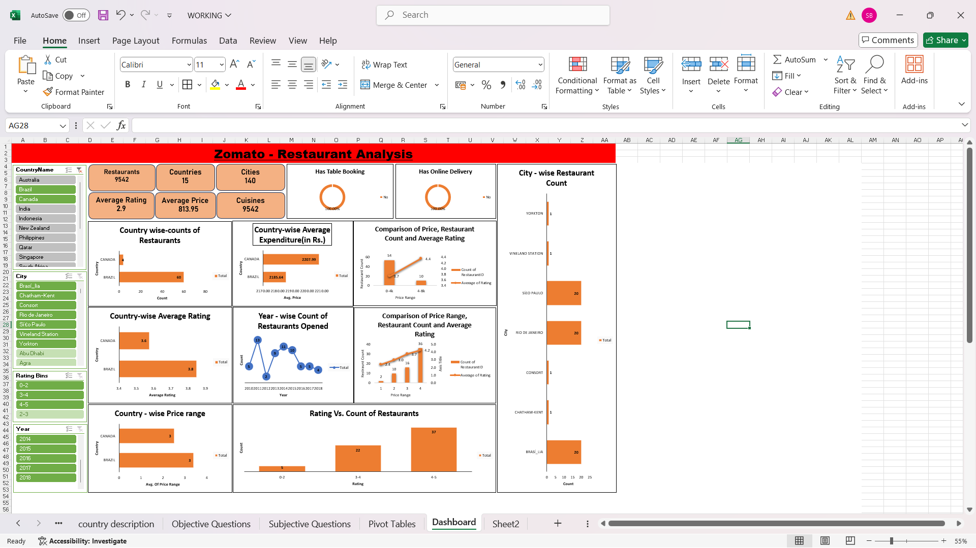
DASHBOARD

Slide 18
ABOUT DASHBOARD
The dashboard contains four slicers: Country, City, Rating, and Year, which function as filters.
By default, all slicers are in the "all selected" state, displaying the complete dataset.
Each slicer includes a button to enable the selection of multiple values.
Selecting options in the slicers updates the charts dynamically, generating results based on the chosen filters.
This interactive functionality helps interpret the dashboard effectively and extract the desired insights.

Slide 19

CONCLUSION:
Countries and Cities Suggested for New Restaurants:
Brazil: São Paulo
Canada: Chatham-Kent, Consort, Vineland Station, and Yorkton
Cuisines Suggested:
Brazil: Brazilian, Beverages, Italian
Canada: Canadian, Japanese, Sushi, Chinese, Asian, Italian, Mediterranean, and Pizza
Price Range Recommended:
Brazil: Price range 3
Canada: Price range 3 (preferred) and 2
Services to Focus On:
Online Delivery
Table Booking
These recommendations were derived from a detailed analysis of the data and are expected to lead to success in the identified regions.

Slide 20


