Slide 1
Used Car Price Prediction
Submitted by:
Bishwajit Bhattacharya

Slide 2
ACKNOWLEDGMENT
I web scrap used car data from cars24.com I took data from 25 cities.
Total in my data set has 515 used car data which has almost 215 different
Model of cars. I added emi/month also , the interest things is it is different in respect of cities.
After getting data I made this all on 1 excel .

Slide 3
INTRODUCTION
In pandemic situation all the small business field is affected even car industries.
Statistics report says car sell counts in all over the world is down , but interestingly used car business is growing. But we have to know actual used cars price if we want to grow a business , for metropolitan cities this data we can get easily but for small cities it is very tough to get.
If you saw my data I got the used cars details not only from big city like Delhi, Mumbai, Bangalore, I got the data from city like Mysore, Ghaziabad, Jaipur, Rajkot etc. Although its fact that we can not get most luxury model in this cities but it is standard and easy emi available so it can easy to process.

Slide 4
Webscraping
First stapes of getting data is to webscrap for website.
I used both selenium and beautifulsup for this project.
Selenium for first stage to get correct website,

Slide 5
After getting al the data I took all data on 1 single excel “Carprediction.xls”

Slide 6
Now the first step of data cleaning is to crate data set.
df = pd.DataFrame(pd.read_excel("Carprediction.xlsx"))
df
we have total 514 rows and 5 columns target columns is price(rs)
Then we need to check is there any null value.
df.isnull().sum()
then we need to check what is the data type
df.dtypes

Slide 7
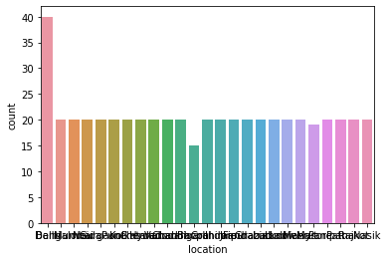
Visulization
observation is target columns price(rs) is int so we will process regression techniques but first data visualization. I plot different types of graph like count plot, catplot, regplot, scatterplot and lmpot.

Slide 8
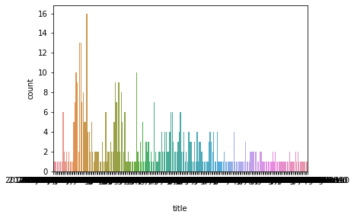

Slide 9
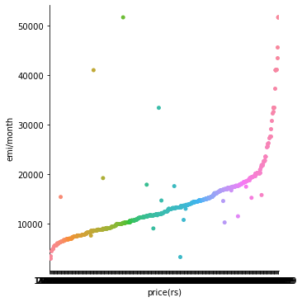

Slide 10
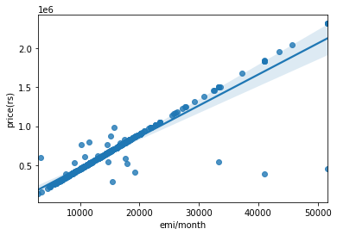

Slide 11
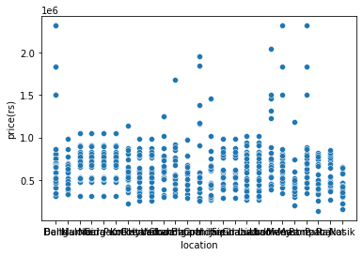

Slide 12
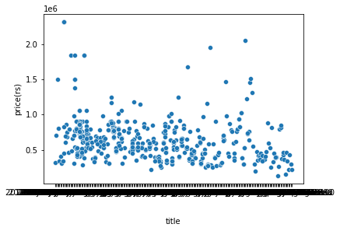

Slide 13
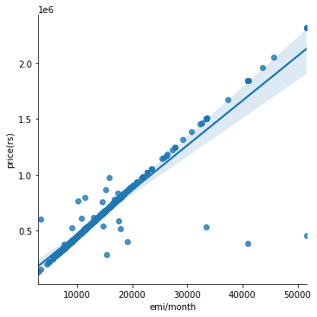

Slide 14
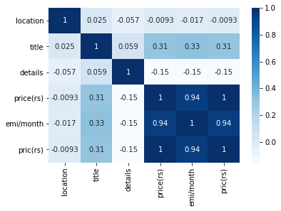
HeatMap

Slide 15
Regression
So now we will process regression Technique.
I used linear, lasso and ridge regression techniques,
Then I done the ensamble technique bye random forest techniques.
R2 score =99.9287
Cv score=98.3474

Slide 16
Conclusion
so as per observation i created a model of car prediction which can predict price of used car with r2 scor of almost 99.92% and cv score of 98.34% , i used 3 regration technique, linear , lasso and ridge. As per my observation the model very accurate and good to go.

