Slide 1
HOUSING: PRICE PREDICTION
BISHWAJIT BHATTACHARYA

Slide 2
Problem Statement:
Houses are one of the necessary needs of each and every person around the globe and therefore housing and real estate market is one of the markets which is one of the major contributors in the world’s economy. It is a very large market and there are various companies working in the domain. Data science comes as a very important tool to solve problems in the domain to help the companies increase their overall revenue, profits, improving their marketing strategies and focusing on changing trends in house sales and purchases. Predictive modelling, Market mix modelling, recommendation systems are some of the machine learning techniques used for achieving the business goals for housing companies.
I have some training data which has lots of null value. Which I taken care using SK Learn. As target value is integer, I need to process regression techniques. There is mixed of int, string and float data need to encode that also.
After all this Model will be ready.

Slide 3
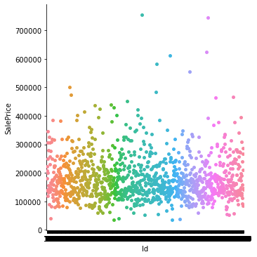
ID VS SALE PRICE

Slide 4
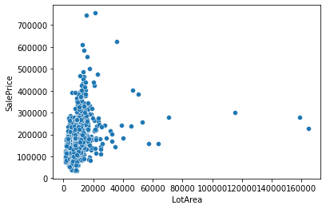
LotArea Vs SalePrice

Slide 5
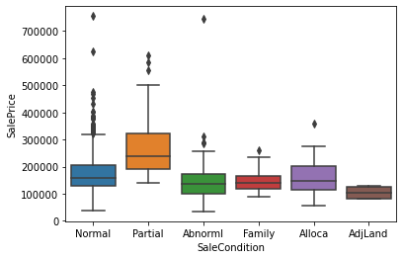
Sale Condition Vs Sale Price

Slide 6
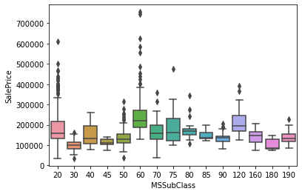
MsSubClass Vs Sale Price

Slide 7
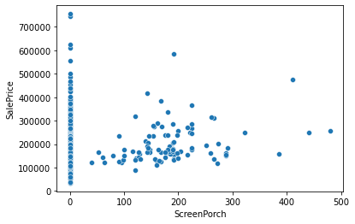
ScreenPorch Vs SalePrice

Slide 8
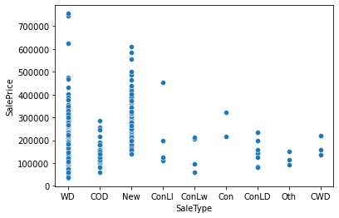
Sale Type Vs Sale Price

Slide 9
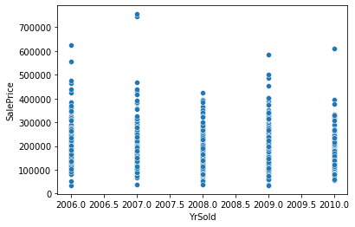
Yr Sold vs Sale Price

Slide 10
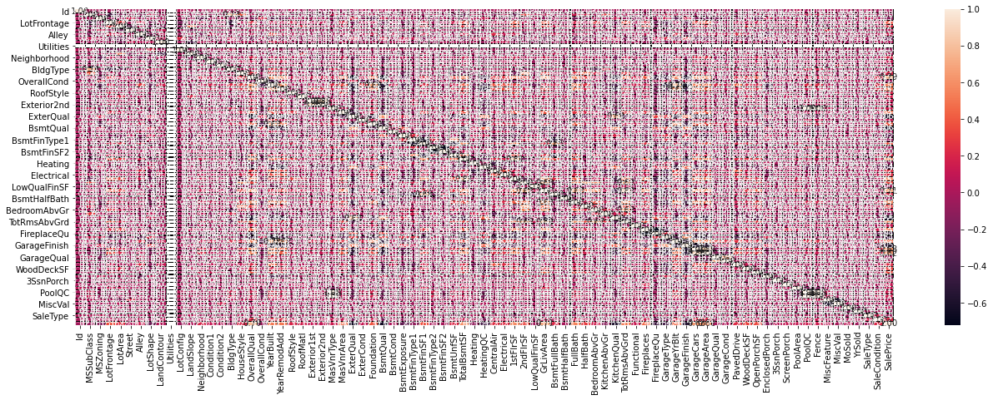
Heatmap

Slide 11
CONCLUSION
So Model is successfully created, selling price for test data can be generated by using this model.
The data set has lots of null value and also data type is different, we cannot null value if the data type is object, so first I changes the data set and then I handle the null value.
But the problem is as I put mean value instead of null, data frame gone fluctuated. Its effect my model result , although I done the overfitting bye using lasso, ridge, and also random forest grid search still my model gave 84% r2 score.
Result should be higher if data set has less null value.

Slide 12
THANK YOU
BISHWAJIT BHATTACHARYA

