Slide 1
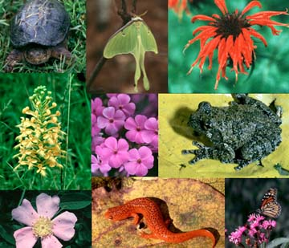
CHAPTER 4
BIODIVERSITY

Slide 2
Introduction To Biodiversity:
India a Major contributor to World’s domesticated biodiversity
We have 42 breeds of sheep,30 of cattle, 20 of goats,18 of the chicken, .50,000 varieties of rice, 1000 varieties of mangoes,500 varieties of pepper.
Green revolution, shortage of agriculture land, water and labour and an overall lack of incentives and economic gains traditional agriculture that nurtured this enormous diversity is now dying. Danger to loose genetic diversity
Example of aquarium
A large variety of plant life, ranging from grasses to huge trees, a wide variety of animals,

Slide 3
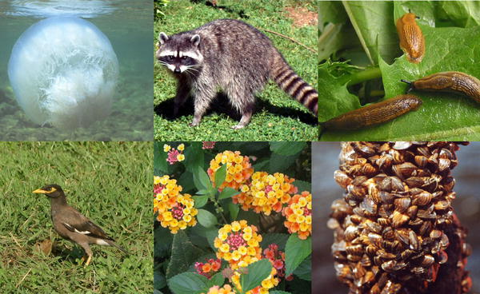
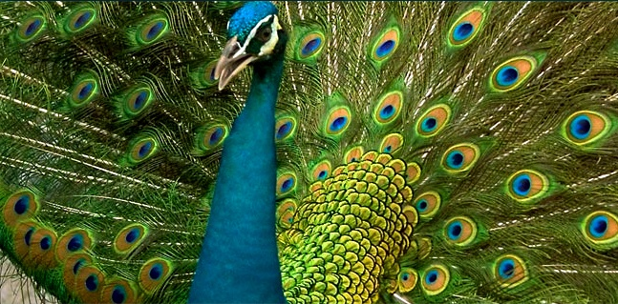
Biodiversity
The term biodiversity is made up of two words - bio and diversity. Bio means living and diversity means variety. So the variety or variability of organisms and ecosystem is referred to as biodiversity. The existence of millions of plants, animals and microorganisms, their genetic background and the complex ecosystem to which they belong show the immense biodiversity present in the biosphere.

Slide 4

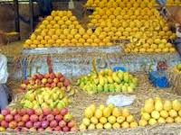
Kinds of biodiversity
Genetic Diversity
Each species from bacteria to higher plants and animals, stores an immense amount of genetic information. Variations among the genes of the same species are known as genetic diversity. It is this type of diversity that gives rise to the different varieties of rice, mangoes,etc.

Slide 5
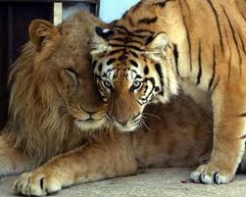
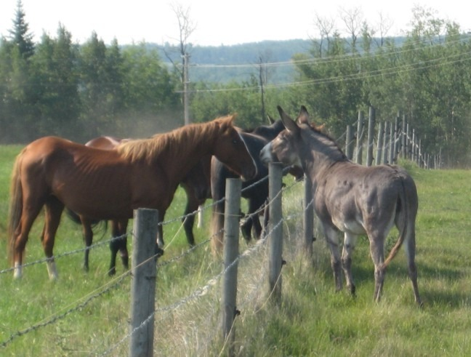
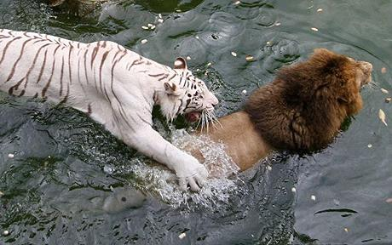
Species Diversity
Diversity which arises due to variations among species present in specific areas is called as ‘species diversity’. Horses and donkeys are distinct species, as are lions and tigers.
.

Slide 6
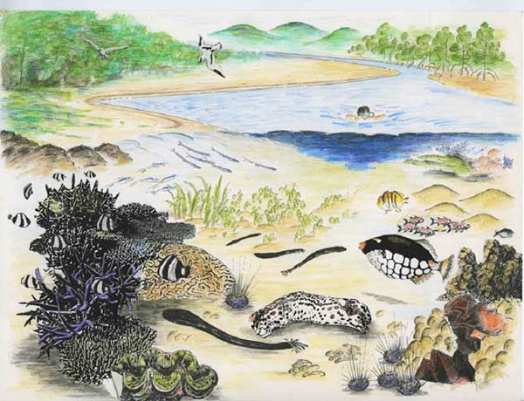
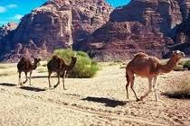
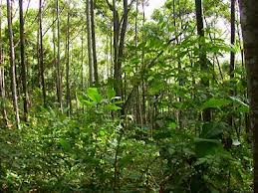
Ecosystem Diversity
Ecosystem diversity is therefore, the diversity of habitats which include the different life forms within. The term also refers to the variety of ecosystems found within a biogeographical political boundary.

Slide 7
Value of biodiversity: Earth has an enormous variety of plants and
Animals , both domesticated and wild, as also a wide array of habitats and
ecosystems. From time immemorial, humans have been dependent on plants
and animals for food, medicines,and clothing and for many other needs.
Biodiversity is imprtant to human beings for the following reasons:
Survival
Health and Healing
Ecological Services
Productive Value
Ethical and Aesthetic Value

Slide 8
Survival: Human being would perish in the absence of biological diversity. Vast no of people survives only due to biological diversity. For example in most communities in Ghana people totally depend on the biodiversity of the region for their livelihood.
Health and Healing: A large no. of communities even today depend on traditional medicines for primary health care which are derived from plants and animals. Now various Pharma co. are depending on the various natural products and medicinal plants for the prep. of various medicines.
Food Security: Biodiversity is critical. All our food requirements are met by various types of crops, vegetables ,fruits, milk ,meat, honey etc which are the outcomes of biodiversity.
Productive Value: Various products (Medicines, dyes, charcol, fuel) used by humans are made from various plants and trees

Slide 9
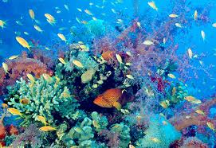
Ethical and Aesthetic Value: In order to obtain a sustainable world, it is important to develop and incorporate the concept of ethical use into our culture. The biodiversity can be retained on the earth if human put sincere efforts for the same. Biodiversity also adds the aesthetic value of the planet. Each species and ecosystem adds to the richness and beauty of life on earth. Setting of sun over an ocean, sight of leaping deer, sound of singing bird, gardening etc.

Slide 10
Ecological Services: It is impossible for a species to exist independently of others. Many species depend on each other in intricate ways for survival. Destroying one species can lead to further extinctions or changes. Specific life forms present in a particular habitat help to create conditions for other life forms to live.
For example a single tree provides not only its products, which may have economic value, but also a habitat for innumerable living things. In addition it also plays a vital role in conserving soil and water and helping to keep air clean.

Slide 11
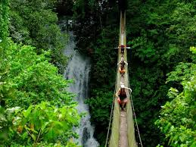
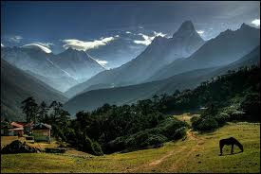
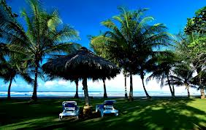
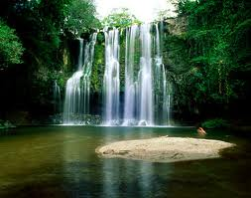
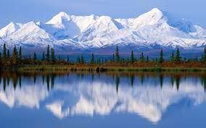
Economic Value: People who go to Costa Rica to see scarlet macaws in the wild spend huge sum of money. Millions visit the Himalyas to witness the valley of Flowers in bloom.

Slide 12
Hot spots of Biodiversity
Biodiversity is not evenly distributed on the planet. This is seen by the fact that some areas have greater concentration of living creatures than the others. Such areas which are biologically rich and hence are under a great danger of being destroyed by human intervention are known as Biodiversity Hot spots. There are some richest and most threatened reservoirs of plant and animal life on earth. They are areas of exceptionally rich concentration of species with high endemism and are extremely in danger to anthropogenic disturbances. Only 25 hotspots have been identified over the World and cover about 1.4 % of earth’s land area.
These have been identified based on three criteria:
i) The number of species present.
ii) The number of those species found exclusively in an ecosystem.
iii) The degree of threat they face.

Slide 13

Hot Spots of India
Three regions that satisfy these criteria exist in India
The Western Ghats
The Eastern Himalayas
Indo-Burma

Slide 14
Endangered species
Plant or animal species which are at the verge of their extinction are called endangered species.
Flying squirrel, Gir lion, Crocodile, Flamingo, Wild ass, etc. are some endangered animal species of India.

Slide 15
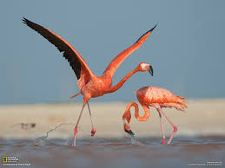
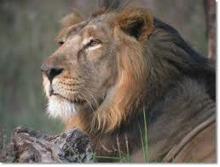
GIR LOIN
Flamingo Bird

Slide 16
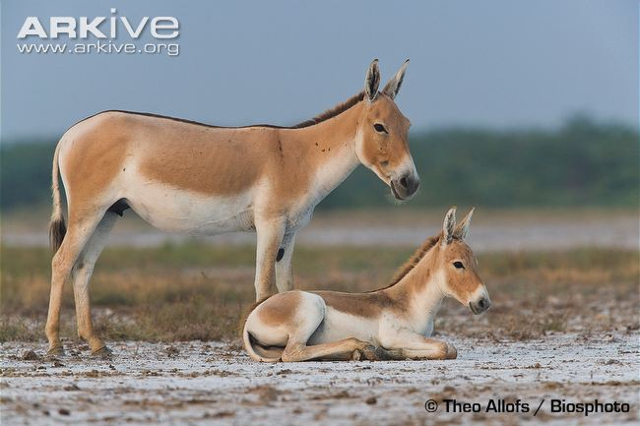
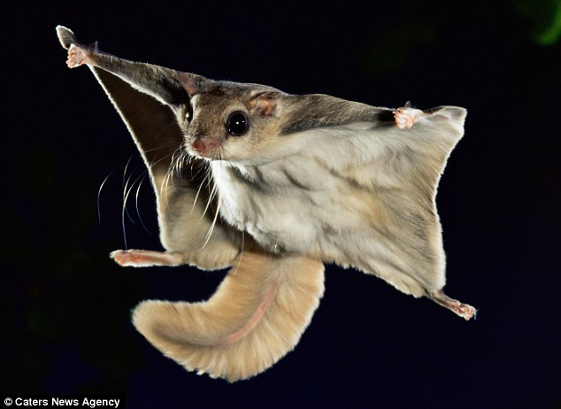
WILD ASS
Flying squirrel

Slide 17
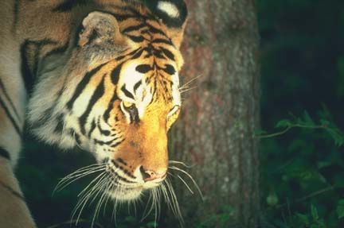
Tiger

Slide 18
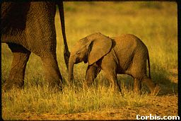
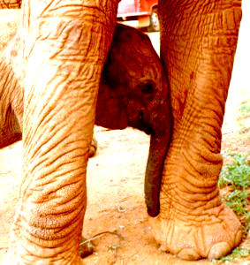
Elephant

Slide 19
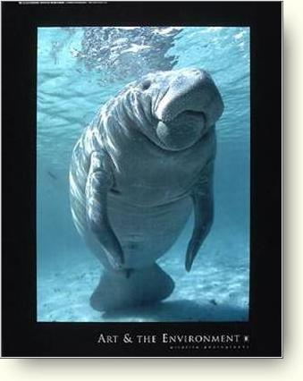
Manatee
Notes:
The large mammals spend a lot of time close to the top of the water, which brings them into contact with recreational boaters frequently.

Slide 20

Bald Eagle
Notes:
DDT was banned in the United States in 1972. Many other countries are looking to phase out the chemical.
Laws were passed to protect them from illegal hunting.
Special protected areas, called refuges were created all over the United States for eagles to live and breed.

Slide 21
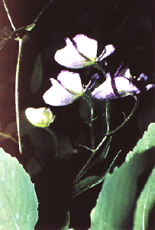
Northern Wild Monkshood

Slide 22
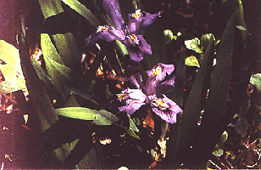
Dwarf Lake Iris

Slide 23
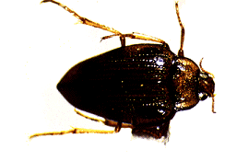
Hungerford’s Crawling Water Beetle

Slide 24
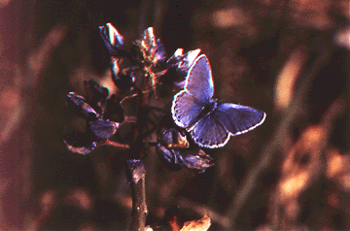
Karner Blue Butterfly

Slide 25
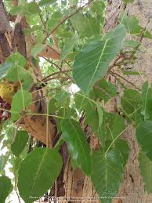
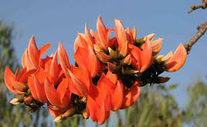
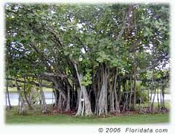
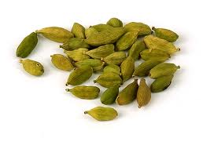
Endemic Species
The plant or animal species confined to a particular region and having originated there or a species which occur continuously in that area are known as endemic species. Restriction of species or taxa in small region is known as endemism. These species remain limited in their distribution because of certain geographical barriers such as presence of sea, valley and mountain etc. These adjust to the poorly to the envt. in wide areas and said to possess low ecological amplitude. Eletaria repens, Ficus religiosa, Butea monosperma, Ficus bengalensis, etc. are some of the endemic plants of India.

Slide 26
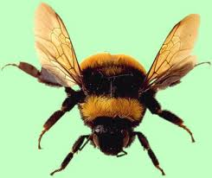
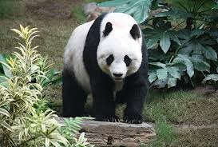
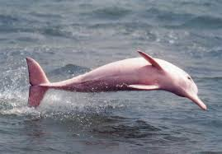
Edge Species: The term EDGE refers to species of animals that are Evolutionarily Distinct and Globally Endangered. These are considered to be one of a kind and are nearing extinction. These species are considered to be unique since they are extremely distinct in their looks, lifestyles and behavior. These species are on the verge of extinction and once extinct , there will be no species like them on the planet as they have very few relatives. Pandas, Yangtz River dolphin, bumblebee etc are some of the EDGE species.

Slide 27
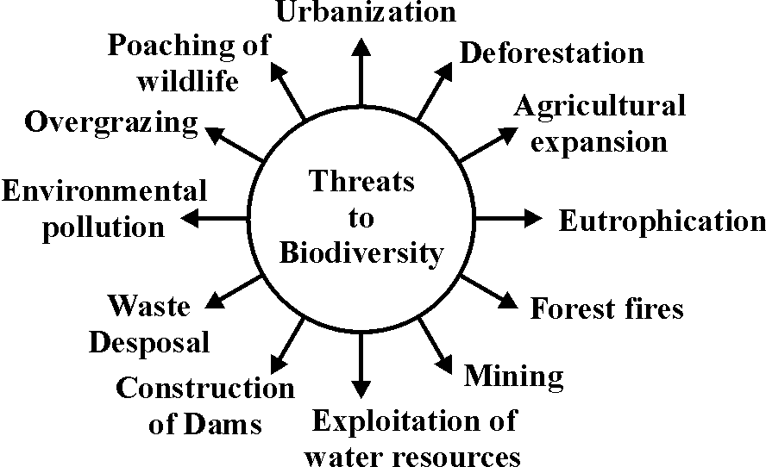
Threats to biodiversity

Slide 28
Conservation of biodiversity
Today we are losing about 1500 species every two months. It is impossible for nature to compensate for this rapid loss and therefore it becomes extremely important to conserve this threatened biodiversity.
Biodiversity conservation is the scientific management at its optimum level and derives sustainable benefit for both the present and the future. There are two major approaches for conservation of biodiversity – in situ (on site) and ex situ (off site).

Slide 29
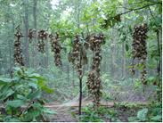
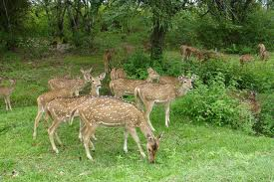
In situ conservation – In situ means the natural or the original place. In this method plants and animals are conserved in their natural habitats. In situ conservation is carried out in areas as National parks, Wildlife sanctuaries, Biosphere reserves, etc.

Slide 30
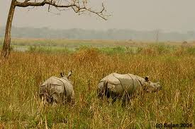
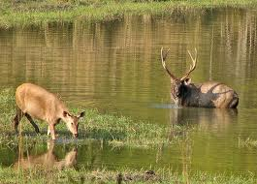
National Parks: A national park conserves the environment and natural objects and wildlife therein. National parks are areas dedicated to conserve wild animals and natural scenery of the environment. All private rights are non existent and all forestry operations and other activities such as grazing of domestic animals is prohibited. No human inhabitation is allowed in the park apart from on duty public servants and people allowed by chief wildlife warden. There are 90 parks in India. It comprises the core zone.

Slide 31
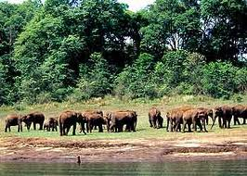
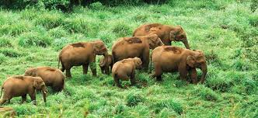
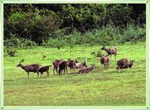
Wildlife Sanctuary: A wildlife sanctuary is an area specially designated where it is illegal to interfere in anyway with the natural life there.
Hunting, shooting and fishing would be prohibited. sanctuary is a place where killing or capturing of any animal is prohibited except under orders of the authorities concerned. they provide protection and optimum living conditions to wild animals.
A wildlife sanctuary is dedicated the wildlife but it considers the conservation of species only in addition , its boundary is not limited by state legislation. In India there are about 492 wildlife sanctuaries.

Slide 32
NATIONAL PARK VS SANCTUARY
National Park:
1. National parks are formed by Central or State Legislation.
2. Status of National Park is higher.
3. No human habitation is permitted in main area.
4. Harvesting timbers, cultivation, collection of forest products are restricted. Eg. Corbet National Park.
Sanctuary:
1. Sanctuaries are formed by the order of State or Central Government.
2. Status of sanctuary is lower.
3. Private ownership may be allowed.
4. These activities are allowed with permission. Eg. Chilika-Nalaban Sanctuary for migrating birds.

Slide 33
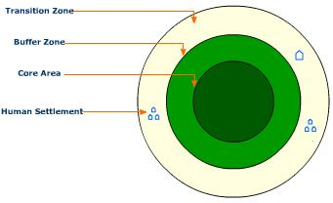
Biosphere reserve: It may be described as natural areas that are generally used for scientific study; these reserves are either left undisturbed or the conditions of disturbances are kept control. These reserves have been set up for the conservation of natural resources, ecological research and habitat preservation. 13 in no. Biosphere reserves are there in India and these consist of core, buffer, restoration and culture transition zones.
zones in biosphere reserves
Biodiversity.ppt

Slide 34

Advantages of in situ conservation:
Long term protection
Better opportunity for conservation
as well as evolution
Cheaper
Limitations of in situ conservation:
  Proper protection against environmental pollution may not be enough in natural types of ecosystems

Slide 35
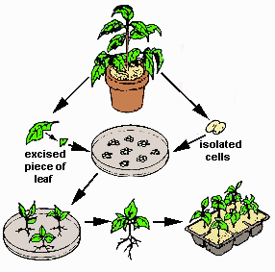
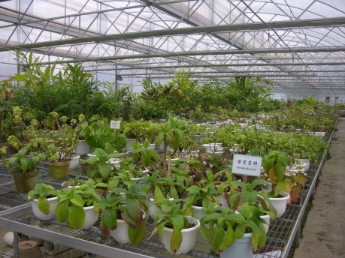
Ex situ conservation – In this technique, plant and animal species are conserved outside their natural habitats. Ex situ conservation is the chief mode of preservation of genetic resources. This can be done through establishment of gene banks, zoos, botanical gardens, culture collections, etc.

Slide 36
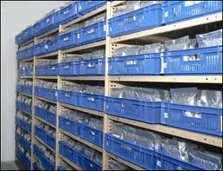
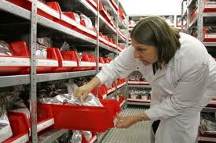
Gene Bank: Gene banks also known as germplasm banks are established for ex situ conservation. Seeds pollen grains and other vegetative propagating parts of various endangered plants can be preserved in these gene bank under viable conditions.
Biodiversity.ppt

Slide 37

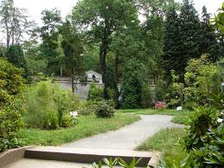
Botanical Gardens: Botanical gardens are used for the conservation of rare and endangered plant species for study and research of specific plant characters and for disseminating scientific information and experiences to promote sustainable development.
Aquaria: The aquaria are mainly used for the captive propagation of threatened of endangered fresh water species
Biodiversity.ppt

Slide 38
Tissue Culture Technique: Tissue culture refers to a special technique used for asexual propagation in plants a very small piece of shoot apex ,leaf section or even an individual cell is cut and placed in a sterile culture in a test tube, petri dish.
DNA technology: DNA of plant or animal cell or a part of it to be conserved. DNA technology can provide an innovative and effective approach for biodiversity conservation
Biodiversity.ppt

Slide 39
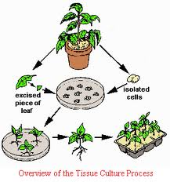
tissue culture techniques
Biodiversity.ppt

Slide 40


Advantages of ex situ conservation
Long-term conservation
The species survive longer and may breed more off spring
than usual
The quality of offspring may be improved by genetic
techniques if so required.
Breeding of hybrid species is possible.
Limitations of ex situ conservation
Not a viable option for protection of rare species due to human interference
Can be adopted for only a few kinds of species
Overprotection may result in loss of natural occurrence.

Slide 41
  Steps to Preserve Biodiversity:
  Undisturbed land should not be used for industries setup and other development activities
  Germplasm of existing species should be collected so that the threatened and endangered species may be protected against extinction.
  To meet the population needs high –yielding agricultural systems should be developed
  Measures should be taken to reduce environmental pollution.
  Effective measures for the conservation of biodiversity should be developed and strengthened in all the countries.

Slide 42

Biogeographical regions of India
The Western Himalayas
The Eastern Himalayas
Western Deserts
Gangetic Plains
Central India
Western Coast
Deccan Plateau
North-East India
Andaman and Nicobar Islands

Slide 43

The Western Himalayas: It extends from central region of Kumaon to north west region of Kashmir. This region is further classified into three regions-temperate, subtropical and alpine. The average rainfall is less and main vegetation includes fir, deodar, dhak, mango, sheesham and pine.

Slide 44

The Eastern Himalayas: It consists of regions of Sikkam and extends to the highlands of Assam. The area is warmer and receives higher rainfall in comparison to the Western Himalayas. It is also called wetland and is classified into three regions: temperate forest belt, tropical forest belt and alpine forest belt. Fir, pine , sal, deodar, oak vegetation is found

Slide 45



Western Deserts: This region covers Haryana,Punjab and some portion of Rajsthan and Gujrat.The annual rainfall is less than 70cm.Xerophytic plants are common.Main vegetation inculdes babool,kikar,amla etc.

Slide 46



Gangetic Plains: It includes the Ganga Valley and comprises of part of UP ,Bihar, Bengal. This region is highly fertile .Climatic factors such as temperature, rainfall and presence of alluvial soil provide favourable conditions for plant growth. Mango, teak, sal etc are important trees of this region.
Central India: This bio geographical region comprises of those parts of MP, Orissa and Northeren Gujarat which are situated between the plains of Ganges and southern plateau. This area recieves heavy rainfall. The dominant tree species are sal, sagwaan, mango etc.

Slide 47

Western Coast: This region is also known as the Malabar Coast. It extends southern Gujarat in north to Kanyakumari in south. Rainfall is excess and trees are thick and dense. Main vegetation includes mahogani tree, cinchona, rubber plants, coconut trees, banana trees etc.

Slide 48
Deccan Plateau: This region comprises of the entire peninsular India except Western Ghats. It includes parts of AP,TN and Karnatka. This region is dry and rocky.
North-East India: This area comprises of valleys of Brahmaputra. This region receives heaviest rainfall and dense evergreen forests are common in this area.
Andaman and Nicobar Islands: This region comprises of several and large islands near the equator. It has wide range of forests and vegetation.

Slide 49


Zoogeographical regions of India
On the type of fauna, India has been divided into following
zoogeographical regions :–
Himalayan Region
Malabar Region
Nilgiri Region
Northern Plains
Desert Lands
Deccan Plateau Region

Slide 50




Himalayan Region : Yak, gural,snow leopard
Malabar Region: Climate is moderate. Various kinds of monkeys, deer etc

Slide 51



Nilgiri Region: Richest in biodiversity, Elephants and loins are also found.
Northern Plains: Elephants, leopard ,neelgai, jakals, deer etc
Desert Lands: Deer , cheetals, sambars, neelgai, snakes
Deccan Plateau Region: Elephants, lions, tigers, monkeys, deer and
some varieties of snakes etc.

Slide 52

India – A Megadiversity nation
India is one of the four mega diversity nations of Asia
Geographical diversity
Climatic diversity
Biodiversity
Habitat diversity
Cultural diversity

Slide 53



India: A Mega diversity Nation
Mega diversity countries are a group of countries that are home to a wide variety of plants and animal species. The 17 mega diversity countries according to the world conservation Monitoring centre are Australia, Brazil, China, Colombia, Congo, Ecuador, India , Indonesia, Madagascar, Malaysia, Papua New Guinea, Philippins, South africa, United states and Venezuela.
Biodiversity.ppt

Slide 54
Geographical diversity:
India is a vast geographical region. It consists of Himalya region, Ganga plains ,Thar deserts and decan plateau.The land form includes the plains of Ganga on one side to highlands of Deccan plateau on other side. Thus India represent all kind of geographical variations found elsewhere in the world.
Climatic diversity:
Climatic condition of country range from cold temperate and frost-covered regions of Himalayan to low rain fall regions of dry tropics in the north-western part of the country.On the basis of annual rainfall, the country can be divided in 4 climatic range :WET zone (more than 200cm), Intermediate zone (100-200 cm),Dry zone (50-100 cm) , arid zone (below 50 cm).Hence India has almost all types of climatic variations

Slide 55
Biological diversity:
From biodiversity point of view ,India can be divided into nine
phyto geographical regions.
India is one of the 12 primary centre of origin of cultivated plant
and domestic animals.167 important plant species and 114 breeds
of domesticated animals are there.
Habitat Diversity:
India has high mountains range, plateau, plains, desert, etc. provide
Varity of habitats for plants and animals. Similarly a number of
fresh water and saline lakes, reservoirs, ponds, rivers and stream
Provides variety of habitats for aquatic plants and animals.

Slide 56
Cultural diversity:
Our country envisages vast cultural diversity from Jammu-Kashmir in north to Kanyakumari in south, and from west Bangal in the east to Thar desert in the West. Rajasthan and Madhya Pradesh represent an array of tribal culture.

Slide 57
LEVELS OF BIODIVERISITY
Biodiversity can be classified as
Global Level
National Level
Local Level

Slide 58
Biodiversity at global level
Biodiversity at global level is vast and widespread due to variation in
Climate
Atmosphere
Topographic factors
Edaphic factors
At global level there are about 82 million species of living organism where as
the expected total is about 50 millions species.

Slide 59
Climate zone plays an important role in delimiting the biodiversity at global level.
Classification of global biodiversity on the basis of climatic and geographical conditions.
Arctic Zone: Zone near the pole. Eg. Algea, Mosses, Lichens are chief components of vegetation and ground vegetation includes orchids, Insectivorous plants.
Northern Temperate Zone: Parts of United states of America and Canada. Forests of Gymnosperms tall tree like Oaks, Maples, Chestnuts. At high altitude trees are replaced by grassy vegetation with some herbaceous plants.

Slide 60
Southern Temperate Zone: region of southern Africa, Australia and New Zealand. In Africa vegetation is chiefly Ferns and Gymnosperms. In New Zealand Conifers along with ferns (Bryophytes). In Australi plums, nuts and varieties of acacia and casurina.
Tropical Zone: Region of trophical Africa, tropical Asia, Mexico and large areas of South America.
In mexico vegetation is xerophytes. At higher altitude trees, at mountains peaks grasses.
In Asia Orange, mango, banana etc.

Slide 61
Global Biodiversity on the basis of Fauna: 5 geographical regions
Oriental Region :Rainfall is sufficient in most parts of this region.
Tiger, neelgai, rabbit, flying, fox, gharial, peacocks
Australian Region: Deserts and dry plains
Kangaroo, Honey eaters, crowned, pigeons, owl, parrots, lizards.
Neotropical Region: Regions of South America, Central America and
some parts of Mexico, West Indies. Monkey, Dogs, Deer, Cattle,Squirrel, Electric eel, humming birds.
Nearctic Region: Green lands and North America. Flying squirrel,
vultures, kingfishers, ducks, flamingo, alligators, rattle snakes etc.
Paleartic Region: Largest geographical region include Europe,
Northen parts of Africa and Asia. 135 families of terrestrial vertebrates.

Slide 62
Biodiversity at National Level
Owing to the wide variety of physical and climatic factors, India has a rich biodiversity.
On the basis of biodiversity India has been divided into ten bio geographical regions.
Biodiversity of India is quite peculiar and highly categorized.
Most of it is localized to Western Ghats, north western Himalayas, and
Andaman and Nicobar Island.

Slide 63

Bio geographical classification of india
Biodiversity.ppt

Slide 64
Biodiversity at LOCAL Level
A variety of species found at a given place constitutes the local level biodiversity.
Local climatic conditions, geomorphic and ecological factors are responsible for
local biodiversity.
Biodiversity in Rajasthan
Desert soil - The soils of the Arid Zone are generally sandy to sandy-loam in texture.
The desert of Rajasthan is the abode of 25 species of serpents are 23 specis of lizards.
The endangered Great Indian Bustard (Ardeotis nigriceps), the Blackbuck (Antilope cervicapra),
Indian Wild Ass (Equus hemionus khur) and the Indian Gazelle (Gazella bennettii) are found here.
In fact the Keoladeo Ghana National Park also known as the Desert National Park in Jaisalmer
is the repository of striking biodiversity and wildlife and houses the Bengal fox, chinkara, desert fox,
wolf, desert cat, the black buck and a plethora of migratory birds.
The place also stores the seashells and the gigantic fossilized tree trunks that bear witness to the presence
of water and vegetation in the past.

Slide 65






Chinkara or Indian Gazelle is
found across Thar Desert
Peacock on Khejri tree
Prosopis cineraria or Khejri
highways in the Thar desert.
Camel ride in the Thar desert
near Jaisalmer, India.
Bajra kharif crop in Thar

Slide 66
Biodiversity: Importance and Threats
http://www.youtube.com/watch?v=iThpkXWVeqE

