Slide 1
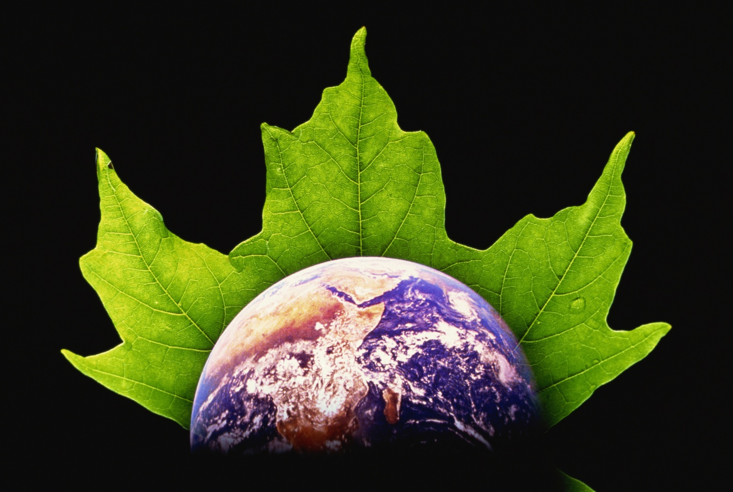
Chapter - 1
INTRODUCTION TO ENVIRONMENTAL STUDIES
Notes:
© 2009 Jupiterimages Corporation

Slide 2
Definitions
The term environment is derived from a French word environner which means ‘surrounding’. It refers to an aggregate of all conditions that affect the existence, growth, and welfare of an organism or a group of organisms. The term may be defined in a number of ways:
Environment
Environment is sum of all social, economical, biological, physical, or chemical factors which constitute the surrounding of men/living organism.

Slide 3
Types of Environment
Natural Environment
It includes components such as air, water, soil, land, forest, wildlife, flora, fauna, etc.
The natural environment on Earth is divided into the following four realms:
Lithosphere
Hydrosphere
Atmosphere
Biosphere
Anthropogenic Environment
It includes components that have been introduced by human beings depending on their needs and requirements.

Slide 4
Components of Environment
Abiotic components
Non living components of an ecosystem include all the physical and chemical factors that influence living organism Examples are air, water, soil, rocks, etc.
Biotic components
Living component of environment such as microbes, plants, animals and human beings.

Slide 5
Biotic component
Auto tropes or producers
Includes green plants and algae which manufacture their own food
chemo auto tropes chemosynthesis
photo auto tropes photosynthesis
Hetero tropes or consumers
The organism of this group are not capable of manufacturing food and depends on auto tropes to meet their food requirement.

Slide 6
Physical environment
Includes light, temperature humidity, rain, soil etc.
Chemical environment
Includes gases acids, water, inorganic elements and organic substances etc.
Biological environment
Includes all life on earth (can be bacteria, viruses, microbes, algae, herbs, shrubs, mammals etc.)

Slide 7
Segments of Environment
Lithosphere
Hydrosphere
Atmosphere
Biosphere

Slide 8
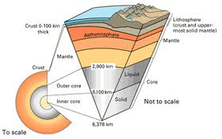
Lithosphere

Slide 9
Lithosphere
The earth’s crust consisting of the soil and rocks is the lithosphere. The soil is made up of inorganic and organic matter and water.
The main mineral constituents are compounds or mixtures derived from the elements of Si, Ca, K, Al, Fe, Mn, Ti, O etc. (Oxides, Silicates, and Carbonates).
The organic constituents are mainly polysaccharides, organic compounds of N, P and S. The organic constituents even though form only around 4% – 6% of the lithosphere, they are responsible for the fertility of the soil and hence its productivity.

Slide 10
Earth’s Crust
Igneous Rock (granite, diorite etc.)
Sedimentary Rock (lime stone, sand stone etc.)
Metamorphic Rock (marble, slate etc.)
Soil

Slide 11
Hydrosphere
Water on the earth in all forms: solid (ice), liquid (water) and gas (water vapour)
The presence of water on the earth gives it name ‘blue planet’.

Slide 12
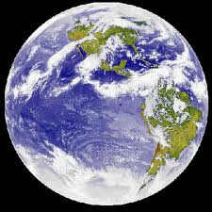
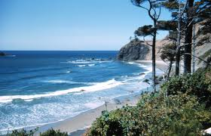
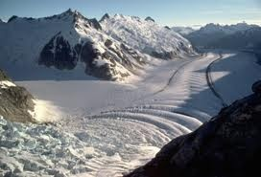
Hydrosphere

Slide 13
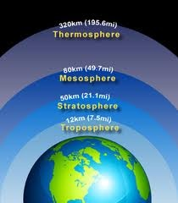
Atmosphere

Slide 14



Biosphere

Slide 15
Environmental Studies
Environmental Studies refers to the study of the environment.
It is not restricted to the point of view of one particular discipline but involves all disciplines that may affect the environment in any possible way.
It involves the study and understanding of the fact that even a single phenomenon can affect the environment in a variety of ways with varying degrees of complexity, and each of these effects can be understood from different perspectives rooted in different disciplines.

Slide 16
Programs Under Environment Studies
Environmental studies
Systematically studies the interaction of human beings with the environment. It includes natural environment, built environment, and sets of relationship between them.
Environmental sciences
Integrates physical and biological sciences (including physics, chemistry, biology soil sciences, geology, and geography)
Environmental engineering
Application of science and engineering principle to improve the quality of environment.

Slide 17
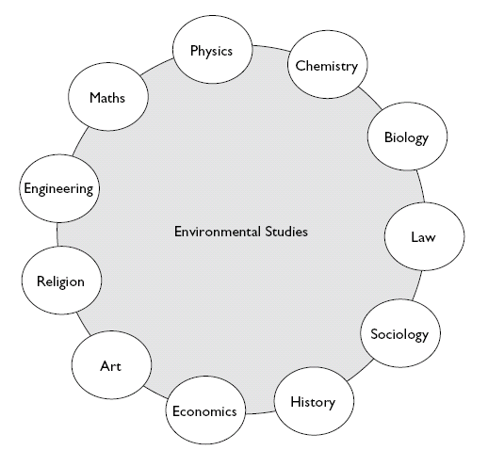
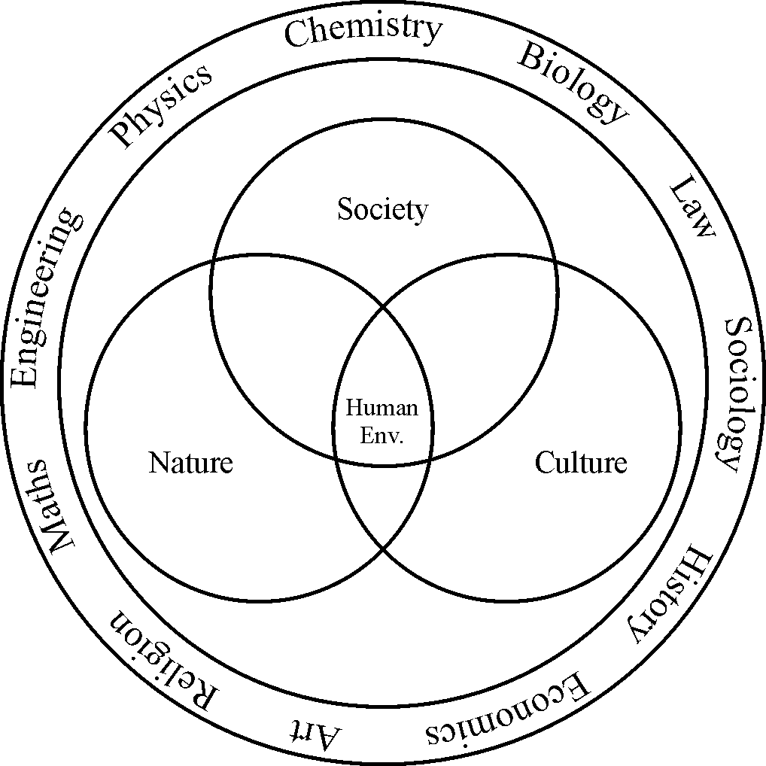
Multidisciplinary Nature of Environmental Studies
Environmental Studies requires skills that encompass a range of disciplines including chemistry, biology, earth sciences, atmospheric science, statistics, mathematics, and geography.

Slide 18
Scope of Environmental Studies
Due to its complex and multi- disciplinary nature environmental studies as a subject has a wide scope-
Natural Resources- their conservation and management
Ecology and biodiversity
Ecosystem structure and function
Environmental pollution and control
Social Issues in relation to development and environment
Human population and environment
Environment management

Slide 19
Scope of in Environmental Studies (Career Option )
Research and development (R & D)
Green advocacy
Green marketing
Green media
Environment consultancy
Forest management
Environmental journalism
Environmentalists

Slide 20
Importance of Environmental Studies
Environmental Studies is useful in checking environmental pollution.
It helps in maintaining ecological balance.
It helps to gain skills to assess the environmental impact of human activities.
It gives us basic knowledge of environment and associated problems.
It helps to achieve sustainable development.
It helps to educate people regarding their duties towards the protection of environment.

Slide 21
Objectives
The following are the main objectives of creating environmental public awareness:
To identify various plants, animals, and other living and non-living components of the environment that are endangered by human activities.
To take appropriate decisions regarding use of natural resources.
To conserve nature and natural resources for the betterment of the society from the point of view of social, cultural, and economic development.
To adopt appropriate measures for solving existing environmental issues.

Slide 22
Need for Public Awareness
Rapidly changing technology lead to abandoned waste.
Our fast and energy demanding life style pollutes the environment.
Crazy consumers leads to environmental degradation.
The earth has a definite capacity to tolerate pollutants and sustain population.

Slide 23
Environmental Degradation
Rapid Population Increase
Unsustainable Resource Use
Poverty
Market Prices of Goods
Environmental Management with Inadequate Knowledge

Slide 24
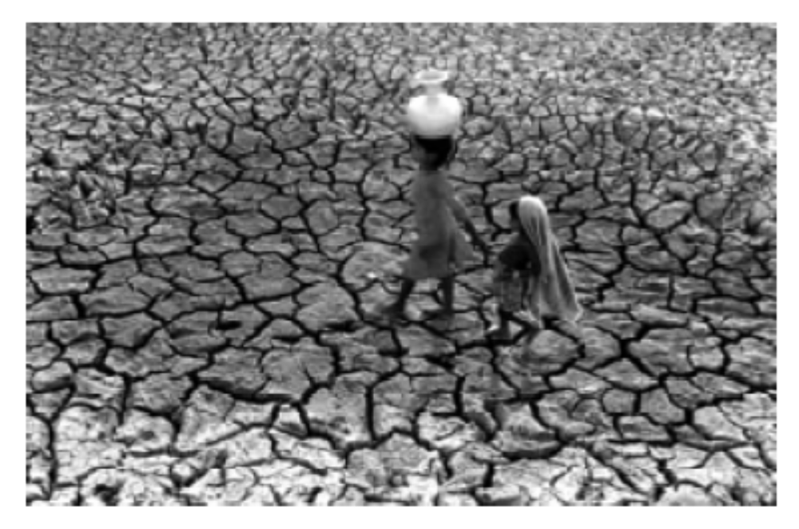
The story of Kalahandi: From forests to famine

Slide 25
The Story of Kalahandi
Kalahandi District in Orissa some decades ago:
  Full of forests
  1000s of water sources controlled by community
  Abundant diversity of crops
Kalahandi today:
  Extreme poverty and deprivation
  Often drought and famine
Reasons for decline:
  Forests cut down: erosion of soil
  Water sources taken over by govt., but not maintained
  Focus on large irrigation projects

Slide 26
Global Environmental Crisis
Population
Water and sanitation
Biodiversity
Forests
Land
Pollution
Coastal zone and the ocean
Natural disasters
Energy, global warming, climate change
Urbanization

Slide 27
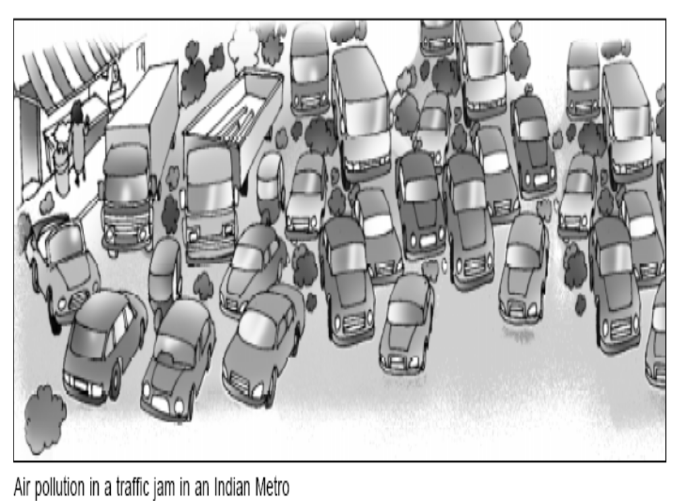
Pollution

Slide 28
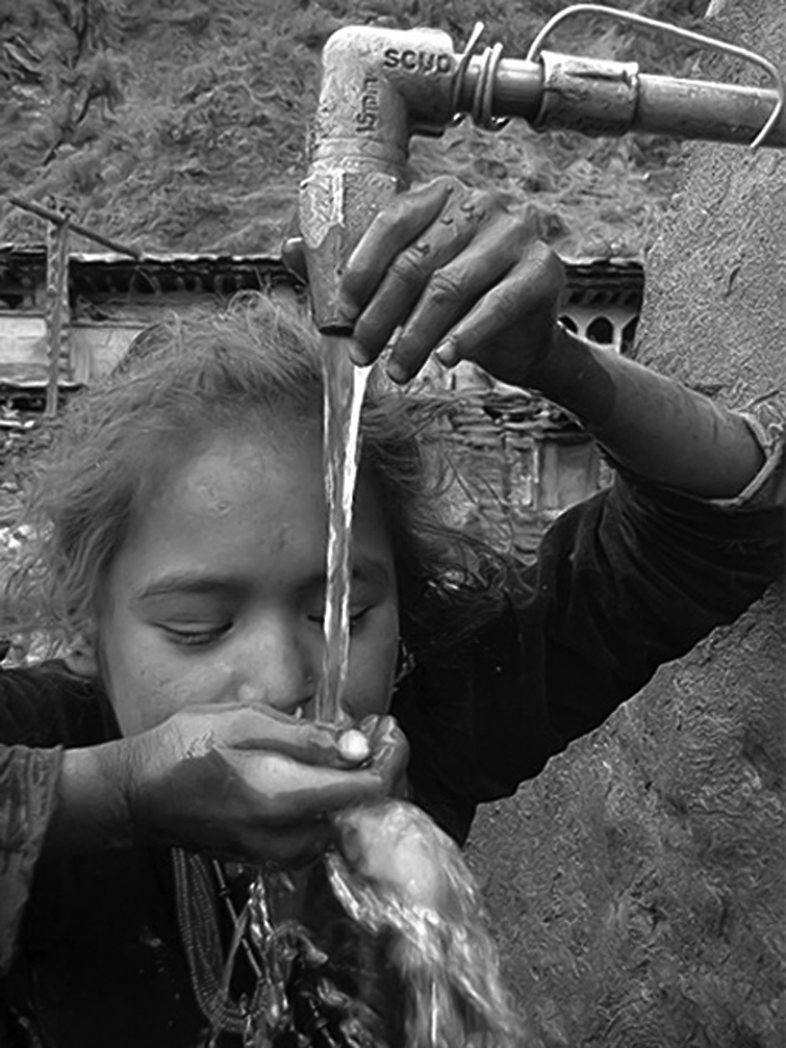
More than 60,000 Indian villages lack sources of drinking water

Slide 29
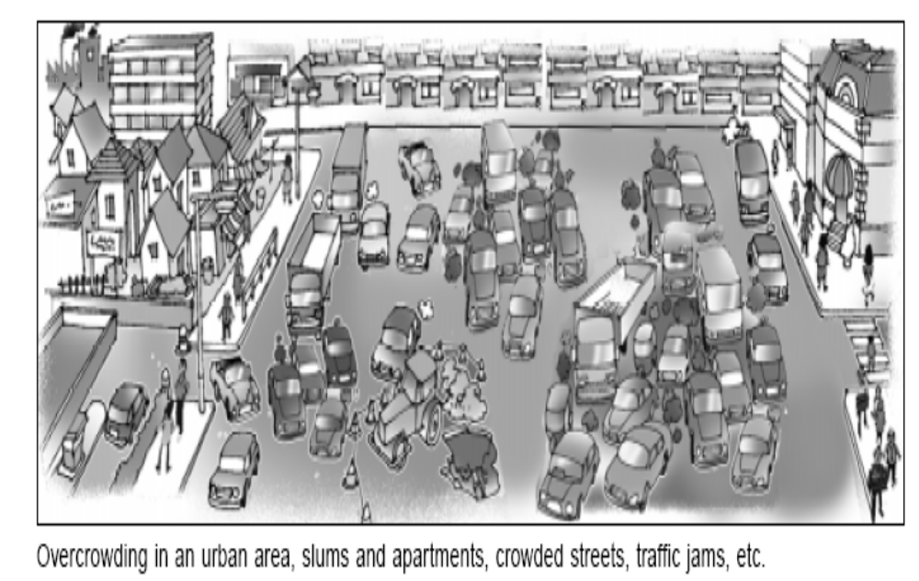
Urbanisation

Slide 30



Methods of Public Awareness
The following methods may be used for propagating public awareness regarding the environment:
Formal Method
Introducing Environmental Education in Schools and colleges
Informal Method
Mass Media (newspapers, magazines, radio, TV, etc.)
Seminars and conferences
Competitions
Entertainment (folk songs, street plays, etc.)
Science centres
International co-operation

Slide 31
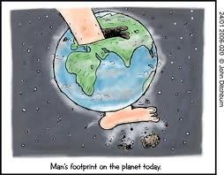
Ecological Footprint
Area required to sustain indefinitely a person, a city, a country, etc.
Accounts for the energy, food, water, and materials that are consumed and the wastes created.
Humanity’s Footprint is now more than 1.4. That is, we require 40% more than the earth’s area to sustain our consumption!
This Footprint is also increasing steadily.

