Slide 1
Hotel Smart Reservation System
PROJECT IDEA PRESENTATION
By:
Bishwas Niraula
&
Prakash Koju

Slide 2

Hotel Solution
Automatic ??
Complete ??
Specific ??

Slide 3
Hotel Smart Reservation
(a Complete Hotel Solution)
Easy reservation process
Efficient Room management
Multi-Booking system for separate Date
Easy Search Option

Slide 4
Problem Statement
Manual/ Paper work to do hotel reservation system
Although there are some available system, they have Cranky and Outdated User Interface
Unable address user requirements
Ad-hoc approach and no resiliency

Slide 5
Hotel Smart Reservation - SOLUTION
Systematic Hotel Data Management
Ease of Access
Good User Interface (UI-UX)
Iterative development approach and flexible solution to adjust with changing business scenario

Slide 6
Objective
To avoid manual and repetitive Work
Real time information presentation regarding room availability
To provide complete solution to reserve and cancel hotel room over the internet at any time
To manage customer record inside hotel

Slide 7
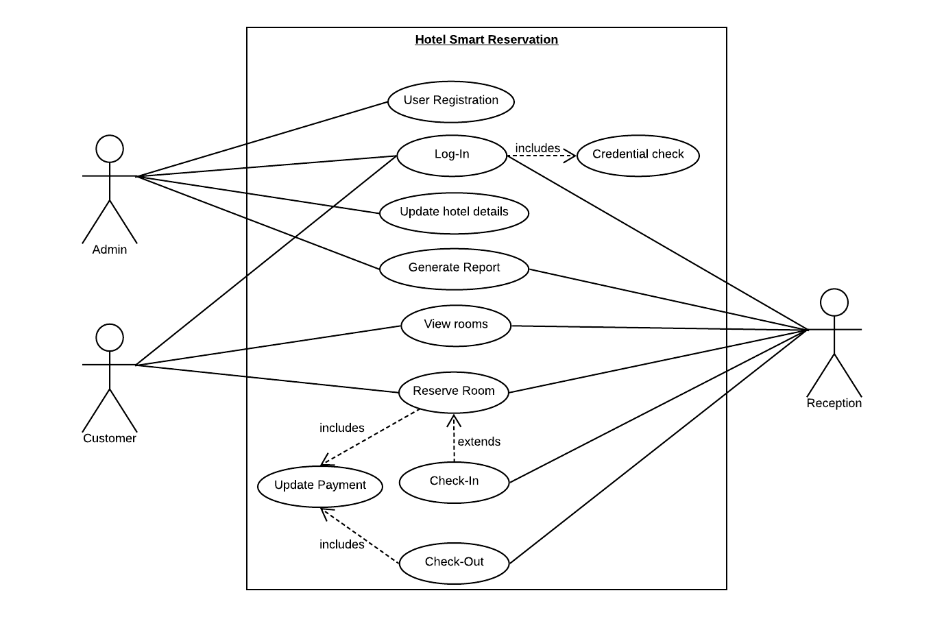
Use Case Diagram

Slide 8
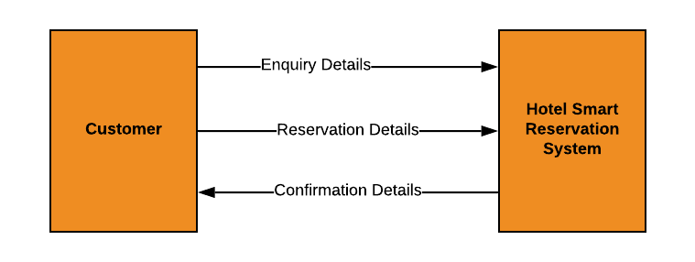
Basic System Response Architecture

Slide 9
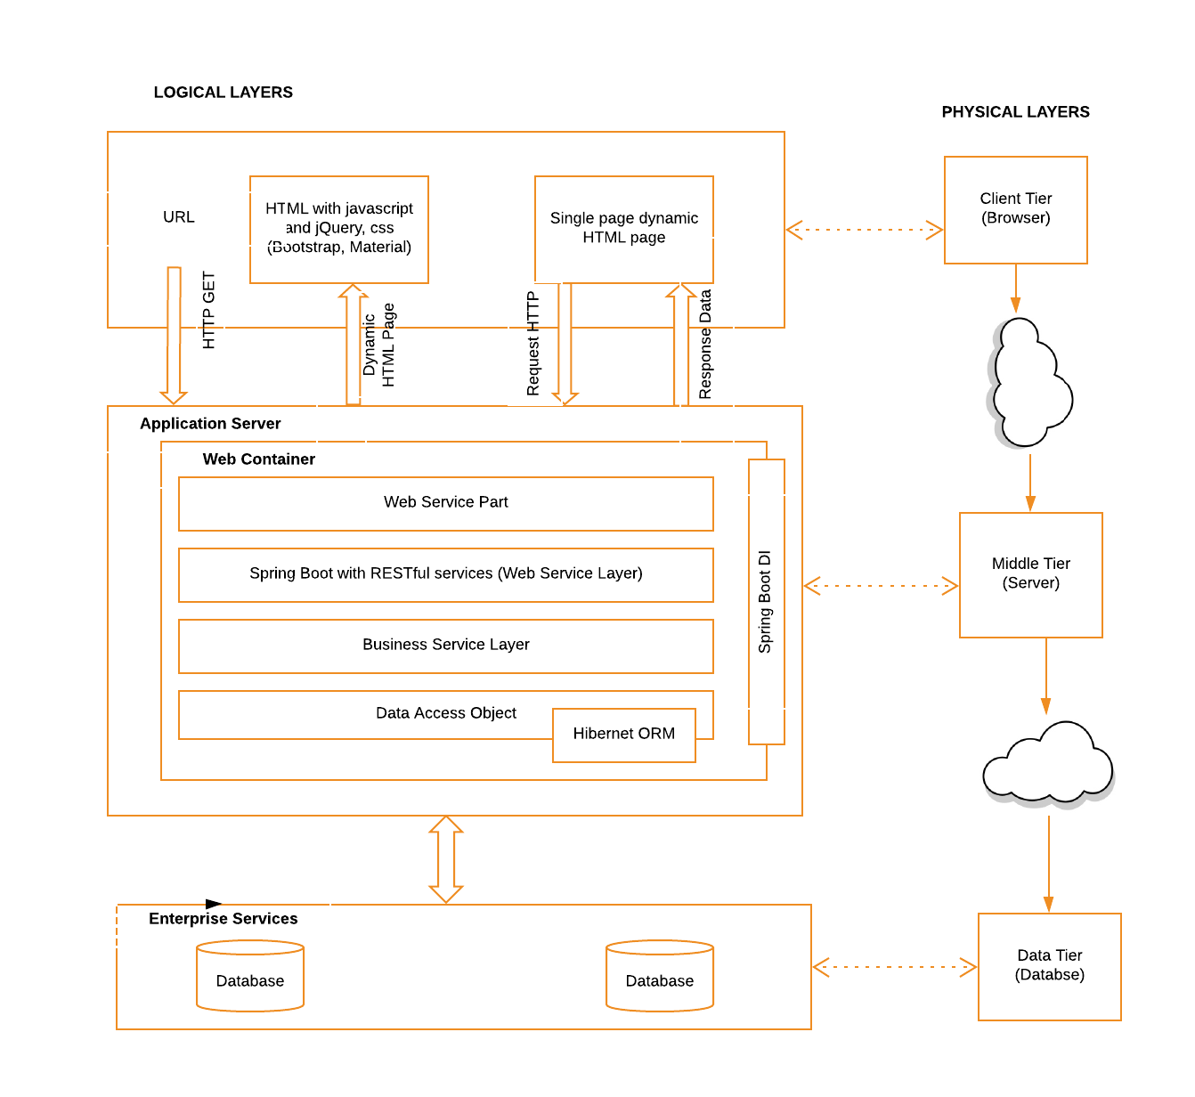
Detail System Architecture

Slide 10
Thank You!!!
Any Questions ??

