Slide 1
L08 · Thu, Nov 12, 2026
Endocrine Pharmacotherapy — Session 2
Pharmacology study deck · organized by drug class
How to read this deck
TB = textbook only (not on the lecture slides)
SG = course study guide only (not on the lecture slides)
Bold = emphasized on the lecture slides
S12 = lecture slide 12 · p. 245 = textbook page 245 · SG U1-R3 = study guide item

Slide 2
START HERE
Learning objectives
IO4.1
Identify major pharmacologic classes used in the management of endocrine conditions and describe their mechanisms of action.
Gonadal Hormones & Inhibitors, Insulin, Non-Insulin Glucose-Lowering Drugs, Parathyroid Disorders
IO4.2
Describe the indications, contraindications, adverse effects, and clinically significant interactions associated with medications used to treat endocrine conditions.
Gonadal Hormones & Inhibitors, Insulin, Non-Insulin Glucose-Lowering Drugs
IO4.3
Compare pharmacologic agents within and across therapeutic classes to distinguish clinically relevant differences in efficacy, safety, and use.
Non-Insulin Glucose-Lowering Drugs, Putting It All Together: Endocrine Toolkit
IO4.4
Select appropriate pharmacologic therapy for common endocrine conditions based on clinical presentation and patient-specific factors.
Gonadal Hormones & Inhibitors, Non-Insulin Glucose-Lowering Drugs, Parathyroid Disorders, Putting It All Together: Endocrine Toolkit
L08 · Endocrine Pharmacotherapy — Session 2
2

Slide 3
START HERE
Learning objectives (cont.)
IO4.5
Identify appropriate dosing, administration, and monitoring considerations for medications used in endocrine conditions.
Insulin, Non-Insulin Glucose-Lowering Drugs, Parathyroid Disorders
IO4.6
Explain important medication-use and safety information to patients receiving pharmacotherapy for endocrine conditions.
Gonadal Hormones & Inhibitors, Insulin, Putting It All Together: Endocrine Toolkit
SO1
Describe the mechanisms and clinical uses of gonadal hormone agents, including combined hormonal contraception, SERMs, and androgens/antiandrogens.
Gonadal Hormones & Inhibitors
SO2
Classify glucose-lowering drugs by mechanism and site of action, and compare agents on efficacy, hypoglycemia risk, and key adverse effects.
Insulin, Non-Insulin Glucose-Lowering Drugs
L08 · Endocrine Pharmacotherapy — Session 2
3

Slide 4
START HERE
Learning objectives (cont.)
SO3
Distinguish hyperparathyroidism from hypoparathyroidism and identify the drug strategy used for each.
Parathyroid Disorders
SO4
Identify key contraindications, adverse effects, and drug interactions throughout.
Gonadal Hormones & Inhibitors, Non-Insulin Glucose-Lowering Drugs
SO5
Apply the full Endocrine pharmacology toolkit to integrated clinical scenarios, and complete a cumulative recall quiz spanning both sessions.
Putting It All Together: Endocrine Toolkit
L08 · Endocrine Pharmacotherapy — Session 2
4

Slide 5

START HERE
About this lecture
Scope, readings & sources
PA PHARMACOLOGY COURSE · LECTURE 4 · SESSION 2 OF 2 — Endocrine Pharmacotherapy. Session 2: Reproductive Hormones, Diabetes, and Bone Mineral Homeostasis | Thursday, November 12 | 8:30–11:00 AM S1
Recap: Session 1 (Nov 10) covered the hypothalamic-pituitary axis, thyroid/antithyroid drugs, and adrenocorticosteroid pharmacology. Session 1 gave us the axis. S1 (notes); S2; S2 (notes)
Today the same negative-feedback logic explains contraception, then the many ways to lower glucose, finishing with the two opposite parathyroid problems — then integration and the cumulative recall quiz. S1 (notes); S2 (notes)
Today picks up with gonadal hormones (Section 4) and runs through diabetes, parathyroid disorders, integration, and the cumulative recall quiz. S2 (notes)
L08 · Endocrine Pharmacotherapy — Session 2
5

Slide 6
START HERE
About this lecture (cont.)
Scope, readings & sources
Appendix 1 abbreviation key: PO = by mouth; SC = subcutaneous; IM = intramuscular; IV = intravenous; ER / XL = extended-release; BID = twice daily; mcg = microgram; U-100 etc. = units of insulin per mL; IUD = intrauterine device. S36; S36 (notes)
DCIS = ductal carcinoma in situ; VTE / DVT / PE = venous thromboembolism / deep vein thrombosis / pulmonary embolism; MI = myocardial infarction; BPH = benign prostatic hyperplasia; PSA = prostate-specific antigen; PCOS = polycystic ovary syndrome. S36; S36 (notes)
DKA = diabetic ketoacidosis; eGFR / CrCl = estimated glomerular filtration rate / creatinine clearance; CKD = chronic kidney disease; NPH = neutral protamine Hagedorn; SGLT2 = sodium-glucose cotransporter 2; DPP-4 = dipeptidyl peptidase-4; GLP-1 = glucagon-like peptide 1. S36; S36 (notes)
MEN2 = multiple endocrine neoplasia type 2; CaSR = calcium-sensing receptor; PTH = parathyroid hormone; NYHA = New York Heart Association; CV = cardiovascular; CYP = cytochrome P450; QT = QT interval on ECG. S36; S36 (notes)
L08 · Endocrine Pharmacotherapy — Session 2
6

Slide 7
START HERE
About this lecture (cont.)
Scope, readings & sources
APPENDIX 1 gives Formulation, dose, indications, adverse effects, contraindications and toxicity — your study reference: know the dose logic, the serious adverse effects, the contraindication that changes your decision, and the toxicity you would need to recognize. S36; S36 (notes); S37-66
Appendix 2: DRUG PROFILE · SUPPORTING — supporting drugs explain interactions and rescue. Listed for context; not profiled in detail. S67; S67 (notes)
Original figures in this deck: Figures 11, 15, 19, 21 and 22 (Combined Hormonal Contraception: Suppressing the HPG Axis; Pancreatic β-Cell Insulin Secretion: Secretagogue & Incretin Targets; Glucose-Lowering Drugs by Site of Action; S68
HbA1c-Lowering Efficacy vs. Hypoglycemia Risk by Class; Parathyroid Disorders: Two Opposite Problems, Two Drug Strategies) were generated by the course director using the AI tool Claude — original diagrams, not reproduced from Katzung’s Basic and Clinical Pharmacology or any other copyrighted source. S68; S68 (notes)
L08 · Endocrine Pharmacotherapy — Session 2
7

Slide 8
START HERE
About this lecture (cont.)
Scope, readings & sources
Mechanism illustrations (AI-generated, illustrative, not reproduced from copyrighted sources; schematic and not to scale): combined pills (Figure 12, slide 6); SERMs (Figure 13, slide 8); testosterone and 5-alpha-reductase inhibitors (Figure 14, slide 9); insulin signaling (Figure 16, slide 15); S68
metformin (Figure 17, slide 17); SGLT2 inhibitors (Figure 18, slide 18); incretin drugs (Figure 20, slide 21); cinacalcet and the calcium-sensing receptor (Figure 23, slide 32). Reference: Anthropic. (2026). Claude (Sonnet 5) [Large language model]. https://claude.ai S68
L08 · Endocrine Pharmacotherapy — Session 2
8

Slide 9
ROADMAP
Drug classes in this lecture
Gonadal Hormones & Inhibitors
Objectives: SO1, SO4, IO4.1, IO4.2, IO4.4, IO4.6
Parathyroid Disorders
Objectives: SO3, IO4.1, IO4.4, IO4.5
1
4
Insulin
Objectives: SO2, IO4.1, IO4.2, IO4.5, IO4.6
Putting It All Together: Endocrine Toolkit
Objectives: SO5, IO4.3, IO4.4, IO4.6
2
5
Non-Insulin Glucose-Lowering Drugs
Objectives: SO2, SO4, IO4.1, IO4.2, IO4.3, IO4.4, IO4.5
3
L08 · Endocrine Pharmacotherapy — Session 2
9

Slide 10










Drug class 1 of 5
Gonadal Hormones & Inhibitors
Covers objectives: SO1 · SO4 · IO4.1 · IO4.2 · IO4.4 · IO4.6
Class
Prototype
Mechanism of action
Indications
Adverse effects
Contraindications
Drug interactions
Pharmacokinetics
Monitoring
Clinical pearls
10

Slide 11
GONADAL HORMONES & INHIBITORS
Objectives: SO1 · SO4 · IO4.1 · IO4.2 · IO4.4 · IO4.6
Class
Class
Suppressing, replacing, or selectively modulating the reproductive axis. Today the same negative-feedback logic explains contraception. S3; S3 (notes)
Figure 11. Original illustrative diagram (not from Katzung): exogenous estrogen and progestin suppress GnRH pulsatility and the FSH/LH surge, preventing the dominant-follicle development and LH surge required for ovulation. S4; S4 (notes)
This is the same negative-feedback template from Figure 1 (Session 1), now applied to the HPG axis. S4 (notes)
L08 · Endocrine Pharmacotherapy — Session 2
11

Slide 12
GONADAL HORMONES & INHIBITORS
Objectives: SO1 · SO4 · IO4.1 · IO4.2 · IO4.4 · IO4.6
Prototype + other drugs named
Prototype + other drugs named
Combined oral contraceptives (ethinyl estradiol plus a progestin); progestin-only: norethindrone "minipill," depot medroxyprogesterone, levonorgestrel IUD; SERMs tamoxifen, raloxifene; testosterone; finasteride; spironolactone. S5; S7
L08 · Endocrine Pharmacotherapy — Session 2
12

Slide 13
GONADAL HORMONES & INHIBITORS
Objectives: SO1 · SO4 · IO4.1 · IO4.2 · IO4.4 · IO4.6
Mechanism of action
Mechanism of action (1/2)
Mechanism: estrogen + progestin suppress GnRH/FSH/LH, preventing ovulation (Figure 11); progestin also thickens cervical mucus and thins the endometrium. S5; S6 (notes)
Chain (Figure 12): ethinyl estradiol plus progestin enter the bloodstream → hypothalamus lowers GnRH pulses; pituitary lowers FSH and LH → no follicle maturation and no LH surge, so no ovulation → result: pregnancy prevented (over 99% with perfect use). S6; S4 (notes)
SERMs: tamoxifen or raloxifene bind the estrogen receptor → the receptor shape recruits different co-factors in each tissue. S8
L08 · Endocrine Pharmacotherapy — Session 2
13

Slide 14
GONADAL HORMONES & INHIBITORS
Objectives: SO1 · SO4 · IO4.1 · IO4.2 · IO4.4 · IO4.6
Mechanism of action (cont.)
Mechanism of action (2/2)
Breast: blocked (antagonist), so cancer growth is slowed. Bone: activated (agonist), so bone density is kept. Endometrium: tamoxifen activates (cancer risk); raloxifene blocks. S8
Testes make testosterone → 5-alpha-reductase converts it to DHT in prostate and skin → DHT drives prostate growth and hair loss → finasteride blocks 5-alpha-reductase → lower DHT: smaller prostate, less hair loss. S9; S9 (notes)
L08 · Endocrine Pharmacotherapy — Session 2
14

Slide 15
GONADAL HORMONES & INHIBITORS
Objectives: SO1 · SO4 · IO4.1 · IO4.2 · IO4.4 · IO4.6
Indications
Indications
Combined contraception is available as oral pills, transdermal patch, or vaginal ring. S5
Tamoxifen — antagonist in breast tissue (breast cancer treatment/prevention), agonist in endometrium (raises endometrial cancer risk). Tissue-selective activity is the defining feature of this class. S7; S7 (notes)
Raloxifene — antagonist in breast/endometrium, agonist in bone (osteoporosis prevention) — ties back to Unit 2 bone pharmacology; prevents vertebral fracture; not used to treat breast cancer. S7; S8
Testosterone — replacement for hypogonadism; monitor hematocrit (erythrocytosis risk) and lipids. Finasteride — 5-α-reductase inhibitor; reduces conversion of testosterone to DHT (BPH, androgenetic alopecia). S7
Spironolactone — antiandrogen effect at high doses; used off-label for hirsutism/acne (same drug as the mineralocorticoid antagonist from Session 1): same molecule, different receptor, different clinical use. S7; S7 (notes); S9
L08 · Endocrine Pharmacotherapy — Session 2
15

Slide 16
GONADAL HORMONES & INHIBITORS
Objectives: SO1 · SO4 · IO4.1 · IO4.2 · IO4.4 · IO4.6
Adverse effects (boxed warnings first)
Adverse effects (boxed warnings first)
Combined pills: risks include venous thromboembolism, hypertension and stroke. Common effects: nausea, breast tenderness, breakthrough bleeding. S6
Tamoxifen raises endometrial cancer and VTE risk and causes hot flashes; patients should report vaginal bleeding. Raloxifene does not increase endometrial cancer, but raises VTE risk and hot flashes. S8; S8 (notes)
Finasteride lowers PSA by about half, so double the PSA value when screening; sexual side effects occur. S9; S9 (notes)
L08 · Endocrine Pharmacotherapy — Session 2
16

Slide 17
GONADAL HORMONES & INHIBITORS
Objectives: SO1 · SO4 · IO4.1 · IO4.2 · IO4.4 · IO4.6
Contraindications
Contraindications
Contraindications: history of VTE/stroke, estrogen-sensitive cancer, uncontrolled hypertension, migraine with aura, and smokers age 35 or older (increased thromboembolic risk). Liver disease too. S5; S5 (notes)
Smoking at age 35+ substantially raises thromboembolic/cardiovascular risk with estrogen — the basis of the contraindication. S5; SG U4-R10
"Smoker over 35" and "migraine with aura" are the classic exam triggers for choosing a progestin-only method — smokers 35 or older, migraine with aura and prior VTE rule out estrogen. S5 (notes); S6
Progestin-only options (e.g., the "minipill," depot medroxyprogesterone (bone density warning), levonorgestrel IUD) avoid estrogen-related thromboembolic risk and are preferred when estrogen is contraindicated. S5; S6; S6 (notes)
Both SERMs are contraindicated with prior VTE. Finasteride is teratogenic: pregnant women should not handle crushed or broken tablets. Testosterone: avoid in prostate cancer. S8; S9; S9 (notes)
L08 · Endocrine Pharmacotherapy — Session 2
17

Slide 18
GONADAL HORMONES & INHIBITORS
Objectives: SO1 · SO4 · IO4.1 · IO4.2 · IO4.4 · IO4.6
Drug interactions → Clinical pearls / "why" hook
Drug interactions
Pharmacokinetics
Enzyme inducers (rifampin, carbamazepine, phenytoin, St. John’s wort, some antiepileptics) lower contraceptive efficacy; use backup contraception. S5 (notes); S6; S67
CYP2D6 inhibitors (paroxetine, fluoxetine) blunt tamoxifen activation. S8 (notes); S67
Not covered in materials
Monitoring
Clinical pearls / "why" hook
Testosterone replacement: monitor hematocrit, PSA and lipids. S9; S9 (notes)
The contraindication list is the highest-yield content in contraception. S5 (notes)
L08 · Endocrine Pharmacotherapy — Session 2
18

Slide 19
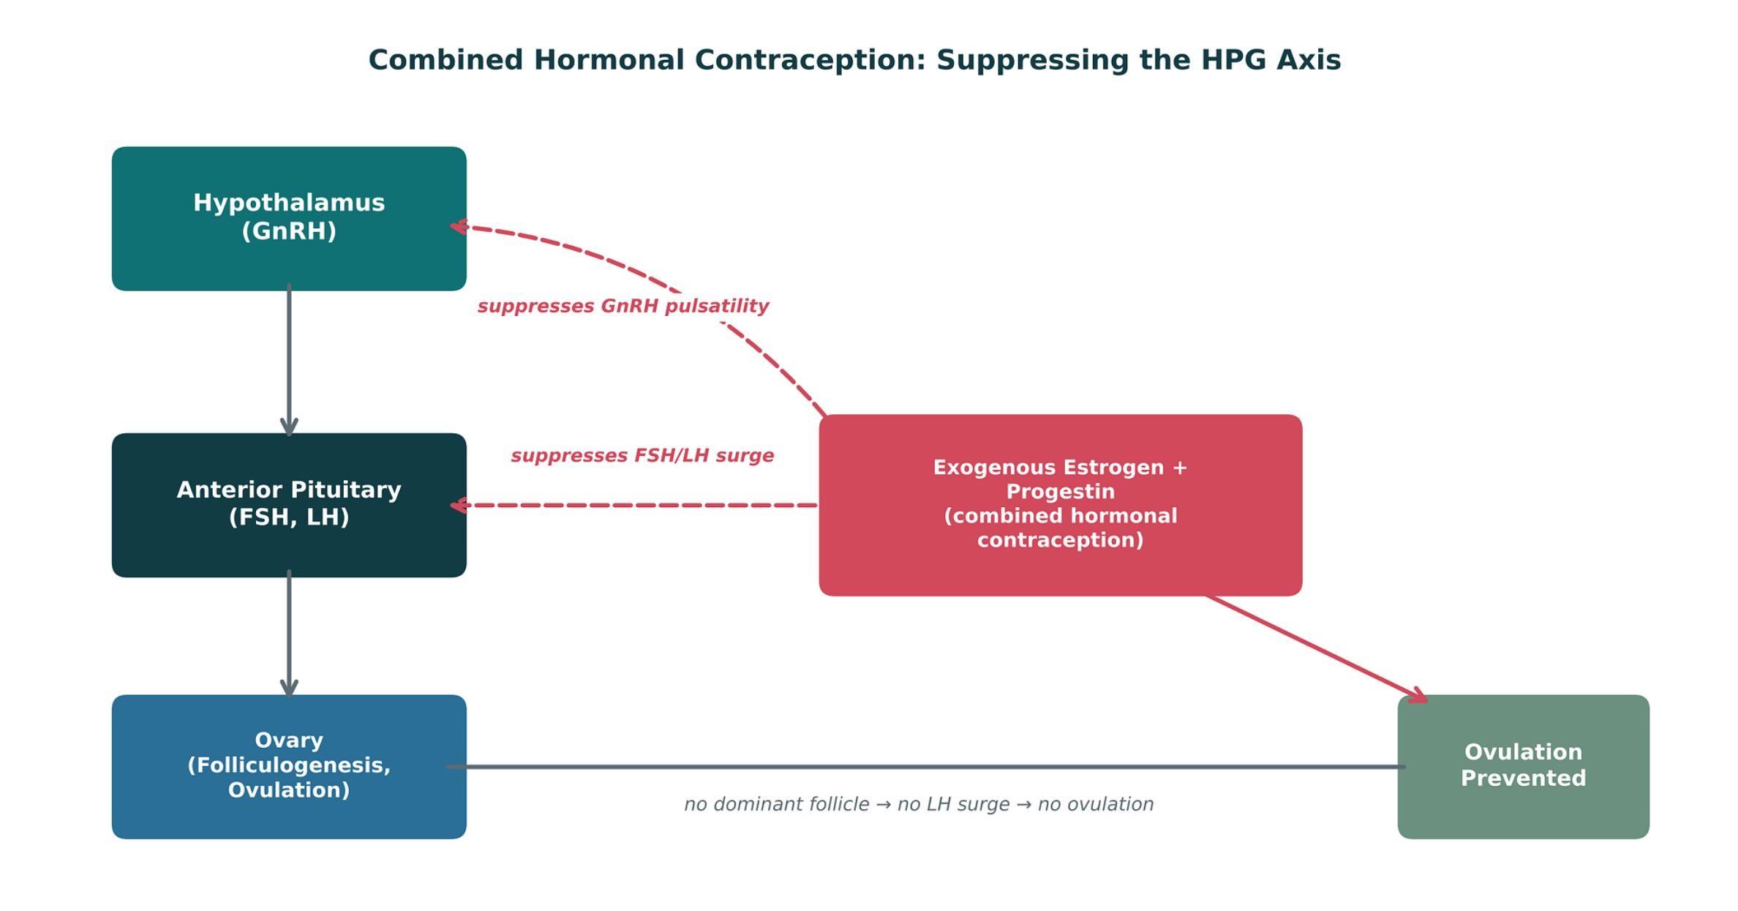
GONADAL HORMONES & INHIBITORS
Objectives: SO1 · SO4 · IO4.1 · IO4.2 · IO4.4 · IO4.6
Figure 11 · Combined hormonal contraception suppresses the HPG axis
Original illustrative diagram (not from Katzung): exogenous estrogen and progestin feed back on the hypothalamus and pituitary, suppressing GnRH pulses and the FSH/LH surge, so no dominant follicle and no ovulation. S4; S4 (notes)
L08 · Endocrine Pharmacotherapy — Session 2
19

Slide 20
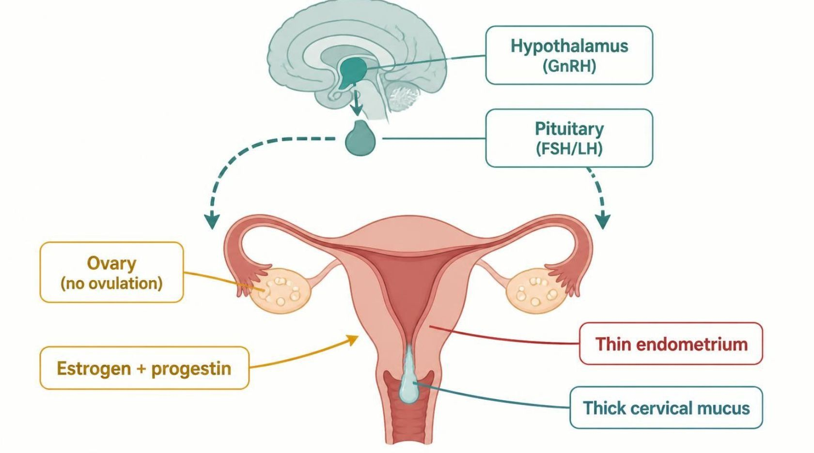
GONADAL HORMONES & INHIBITORS
Objectives: SO1 · SO4 · IO4.1 · IO4.2 · IO4.4 · IO4.6
Figure 12 · Combined pills: ovulation block and backup barriers
Schematic (illustrative) — Figure 12. Teal: hormone entry; blue: brain and ovary signaling; grey-green: local cervical and endometrial effects; red: outcome. Arrows show negative feedback: no ovulation, thick mucus, thin endometrium. S6; S6 (notes)
L08 · Endocrine Pharmacotherapy — Session 2
20

Slide 21
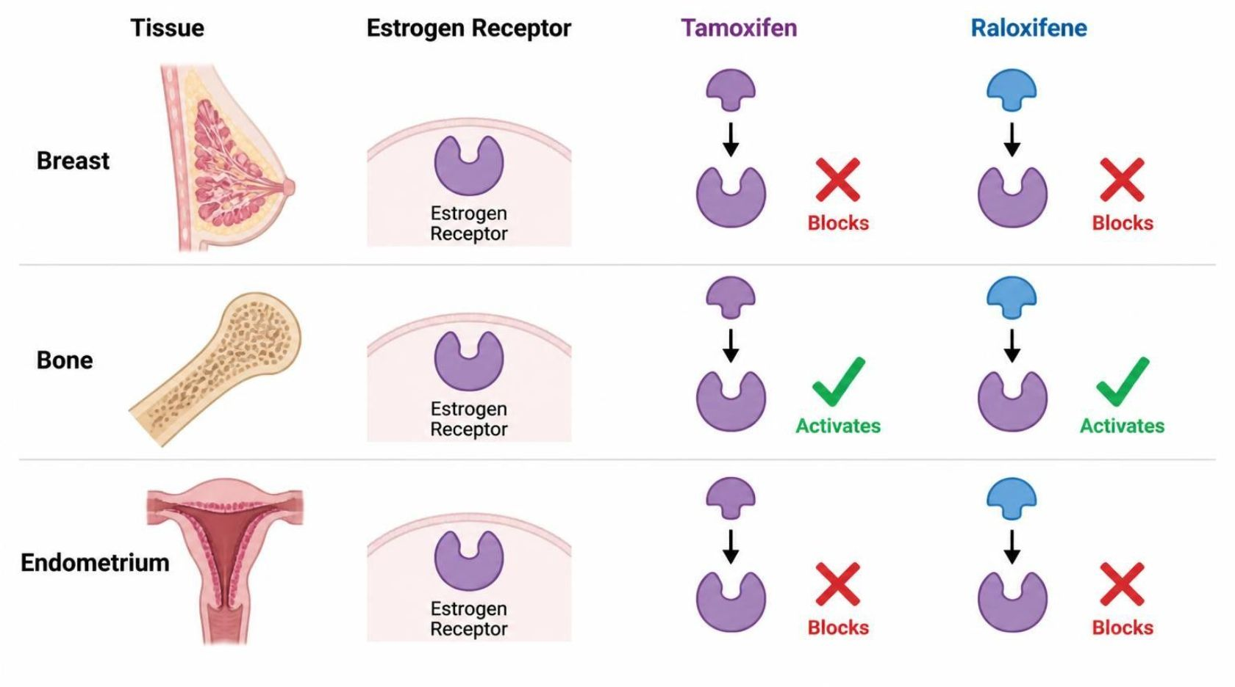
GONADAL HORMONES & INHIBITORS
Objectives: SO1 · SO4 · IO4.1 · IO4.2 · IO4.4 · IO4.6
Figure 13 · SERMs: one receptor, different tissue effects
Schematic (illustrative) — Figure 13. Teal: receptor binding; blue and grey-green: tissue responses; green check = agonist, red X = antagonist; red outcome = risk in endometrium. Tamoxifen activates the endometrium (cancer risk); raloxifene blocks it. S8; S8 (notes)
L08 · Endocrine Pharmacotherapy — Session 2
21

Slide 22
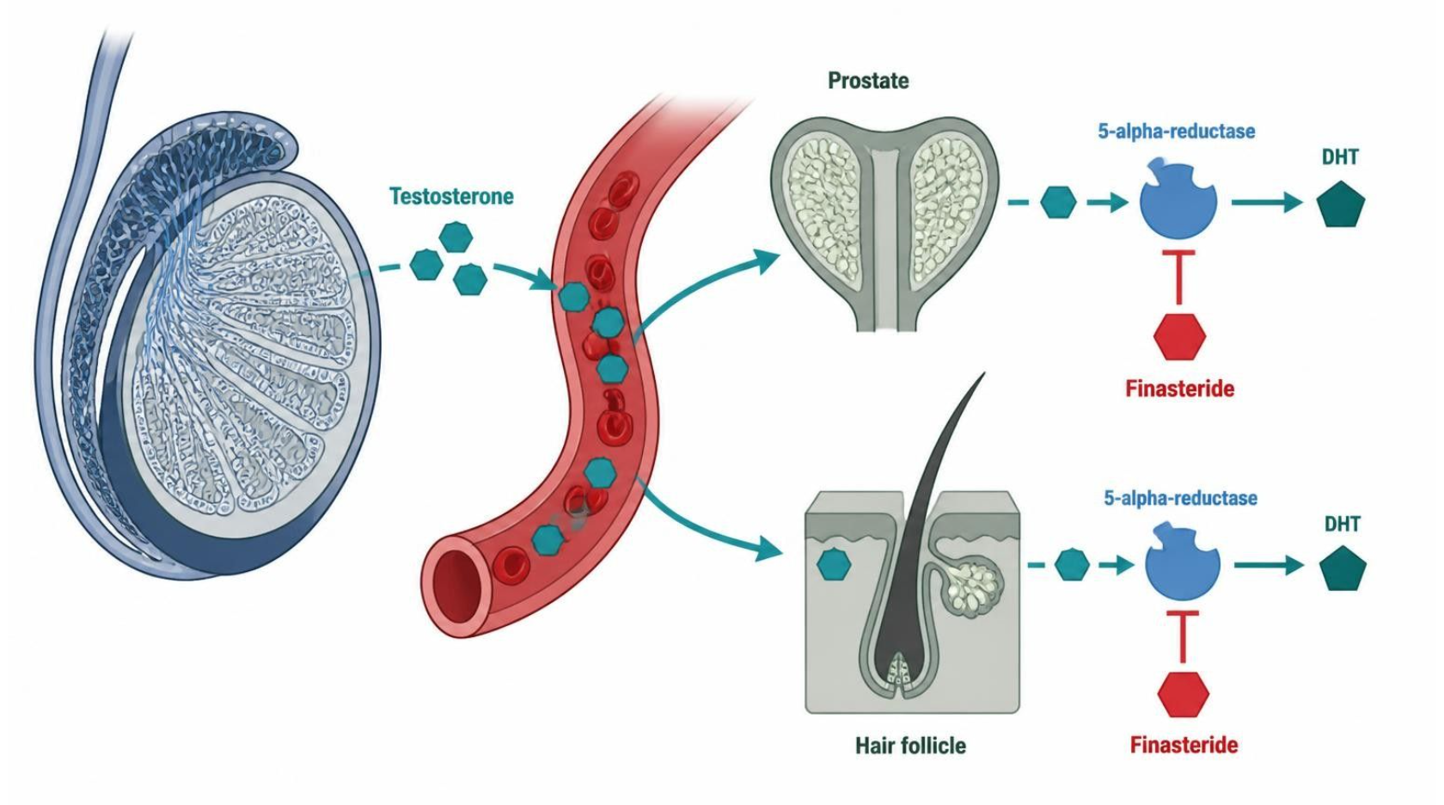
GONADAL HORMONES & INHIBITORS
Objectives: SO1 · SO4 · IO4.1 · IO4.2 · IO4.4 · IO4.6
Figure 14 · Testosterone, DHT and 5-alpha-reductase inhibitors
Schematic (illustrative) — Figure 14. Teal: start; blue: enzyme and hormone steps; green-grey: blocking drug; red: outcome, lower DHT. Finasteride blocks 5-alpha-reductase: smaller prostate, less hair loss, PSA roughly halved. S9; S9 (notes)
L08 · Endocrine Pharmacotherapy — Session 2
22

Slide 23
GONADAL HORMONES & INHIBITORS
Objectives: SO1 · SO4 · IO4.1 · IO4.2 · IO4.4 · IO4.6
Compare: Contraceptive profiles: formulation, dose, indications
Drug | Class | Formulation | Adult dose | Indications
Combined oral contraceptives (ethinyl estradiol plus a progestin) | Estrogen plus progestin | Tablets (21/28-day packs); patch; vaginal ring | Ethinyl estradiol 20-35 mcg plus a progestin PO daily; patch weekly for 3 weeks; ring 3 weeks in, 1 week out | Contraception, cycle control, dysmenorrhea, acne
Norethindrone (progestin-only pill) | Progestin | Tablet 0.35 mg | 0.35 mg PO daily at the same time, with no pill-free days | Contraception when estrogen is contraindicated, breastfeeding
Medroxyprogesterone depot (Depo-Provera) | Injectable progestin | IM 150 mg/mL; SC 104 mg/0.65 mL | 150 mg IM (or 104 mg SC) every 12-13 weeks | Contraception, endometriosis pain, endometrial protection
Levonorgestrel IUD (Mirena) | Intrauterine progestin | Intrauterine system 52 mg (about 20 mcg/day) | One system placed in the uterus; effective up to 8 years for contraception | Contraception, heavy menstrual bleeding, endometrial protection
Focus: what tells these apart. Sources: S37; S38; S39; S40
L08 · Endocrine Pharmacotherapy — Session 2
23

Slide 24
GONADAL HORMONES & INHIBITORS
Objectives: SO1 · SO4 · IO4.1 · IO4.2 · IO4.4 · IO4.6
Compare: Contraceptive profiles: adverse effects, contraindications, toxicity
Drug | Adverse effects | Contraindications | Toxicity / overdose
Combined oral contraceptives (ethinyl estradiol plus a progestin) | Nausea, breast tenderness, breakthrough bleeding, headache | VTE or stroke history, smoker 35 or older, migraine with aura, estrogen-sensitive cancer, uncontrolled hypertension, liver disease | VTE, stroke and MI risk; hyperkalemia with drospirenone; rifampin and some antiepileptics lower efficacy
Norethindrone (progestin-only pill) | Irregular bleeding, headache, acne, breast tenderness | Breast cancer, undiagnosed vaginal bleeding, liver tumor | Efficacy falls if a dose is more than 3 hours late; ectopic pregnancy risk if it fails
Medroxyprogesterone depot (Depo-Provera) | Irregular bleeding, weight gain, delayed return of fertility | Breast cancer, pregnancy, unexplained vaginal bleeding | Boxed warning: loss of bone mineral density; limit prolonged use; VTE
Levonorgestrel IUD (Mirena) | Irregular spotting, amenorrhea, ovarian cysts, pelvic pain | Pregnancy, pelvic infection, uterine anomaly, breast cancer | Uterine perforation, expulsion, infection; check strings
Focus: what tells these apart. Sources: S37; S38; S39; S40
L08 · Endocrine Pharmacotherapy — Session 2
24

Slide 25
GONADAL HORMONES & INHIBITORS
Objectives: SO1 · SO4 · IO4.1 · IO4.2 · IO4.4 · IO4.6
Compare: SERM and androgen profiles: formulation, dose, indications
Drug | Class | Formulation | Adult dose | Indications
Tamoxifen (Nolvadex) | Selective estrogen-receptor modulator | Tablet 10/20 mg | 20 mg PO daily for 5-10 years in breast cancer | Breast cancer treatment and risk reduction, DCIS
Raloxifene (Evista) | Selective estrogen-receptor modulator | Tablet 60 mg | 60 mg PO daily | Postmenopausal osteoporosis treatment and prevention, breast cancer risk reduction
Testosterone (cypionate, gel, patch) | Androgen | IM cypionate or enanthate 100-200 mg/mL; gel; patch; pellets | Cypionate 100-200 mg IM every 2 weeks (or 50-100 mg weekly); gel 50-100 mg daily | Male hypogonadism, delayed puberty
Finasteride (Proscar, Propecia) | 5-alpha-reductase inhibitor | Tablet 5 mg (BPH); 1 mg (hair loss) | 5 mg PO daily for BPH; 1 mg PO daily for male-pattern hair loss | BPH, androgenetic alopecia
Focus: what tells these apart. Sources: S41; S42; S43; S44
L08 · Endocrine Pharmacotherapy — Session 2
25

Slide 26
GONADAL HORMONES & INHIBITORS
Objectives: SO1 · SO4 · IO4.1 · IO4.2 · IO4.4 · IO4.6
Compare: SERM and androgen profiles: adverse effects, contraindications, toxicity
Drug | Adverse effects | Contraindications | Toxicity / overdose
Tamoxifen (Nolvadex) | Hot flashes, vaginal discharge, menstrual irregularity | History of DVT or PE, pregnancy, warfarin (for risk-reduction use) | Endometrial cancer, VTE, stroke, cataracts; CYP2D6 inhibitors (paroxetine, fluoxetine) reduce activation
Raloxifene (Evista) | Hot flashes, leg cramps, peripheral edema | VTE history, pregnancy | Boxed warning: VTE and fatal stroke risk; does not stimulate the endometrium
Testosterone (cypionate, gel, patch) | Acne, erythrocytosis, sleep apnea, gynecomastia, testicular atrophy | Prostate or breast cancer, polycythemia, pregnancy | Erythrocytosis, thrombosis, secondary exposure with gels; monitor hematocrit, PSA, lipids
Finasteride (Proscar, Propecia) | Decreased libido, erectile dysfunction, reduced ejaculate, gynecomastia | Pregnancy and women who may be pregnant (do not handle crushed tablets), hypersensitivity | Lowers PSA by about half; reports of depression; teratogenic to a male fetus
Focus: what tells these apart. Sources: S41; S42; S43; S44
L08 · Endocrine Pharmacotherapy — Session 2
26

Slide 27
GONADAL HORMONES & INHIBITORS
Objectives: SO1 · SO4 · IO4.1 · IO4.2 · IO4.4 · IO4.6
Memory hooks
Why it happens
Why does a smoker over 35 get a progestin-only method? Estrogen adds clotting risk on top of smoking and age — the progestin-only options carry no estrogen. S5; S6
L08 · Endocrine Pharmacotherapy — Session 2
27

Slide 28

GONADAL HORMONES & INHIBITORS
Objectives: SO1 · SO4 · IO4.1 · IO4.2 · IO4.4 · IO4.6
High-yield summary
If you remember nothing else
No estrogen with prior VTE/stroke, smoker ≥ 35, migraine with aura, estrogen-sensitive cancer, uncontrolled hypertension → progestin-only. S5; S6
Tamoxifen: endometrial agonist (report bleeding); raloxifene: bone agonist, endometrium blocked; both VTE. S7; S8
L08 · Endocrine Pharmacotherapy — Session 2
28

Slide 29
CLINICAL VIGNETTE · LECTURE QUICK CHECK S33; S35
Objectives: SO1 · SO4 · IO4.1 · IO4.2 · IO4.4 · IO4.6
Question 1
A 37-year-old who smokes a pack a day wants hormonal contraception. Which choice fits best?
A
Any combined method at low dose
B
A combined oral contraceptive pill
C
A combined vaginal ring
D
A combined transdermal patch
E
A levonorgestrel IUD (progestin-only)
L08 · Endocrine Pharmacotherapy — Session 2
29
Notes:
Answer on the next slide. Source: S5; S33; S35

Slide 30

CLINICAL VIGNETTE · ANSWER
Objectives: SO1 · SO4 · IO4.1 · IO4.2 · IO4.4 · IO4.6
Answer 1: E
E. A levonorgestrel IUD (progestin-only)
Smoking at 35 or older contraindicates estrogen; progestin-only options are preferred (S5; S35). S5; S33; S35
Why the other choices are wrong
A. Any combined method at low dose — Still estrogen (S5).
B. A combined oral contraceptive pill — Estrogen contraindicated (S5).
C. A combined vaginal ring — Contains estrogen (S5).
D. A combined transdermal patch — Contains estrogen (S5).
L08 · Endocrine Pharmacotherapy — Session 2
30

Slide 31
CLINICAL VIGNETTE
Objectives: SO1 · SO4 · IO4.1 · IO4.2 · IO4.4 · IO4.6
Question 2
A woman on a combined pill starts rifampin for latent TB. What counseling is needed?
A
Use backup contraception
B
No change; rifampin has no effect
C
Double the pill each day
D
Stop the pill during rifampin
E
Switch rifampin to St. John’s wort
L08 · Endocrine Pharmacotherapy — Session 2
31
Notes:
Answer on the next slide. Source: S6; S67

Slide 32
CLINICAL VIGNETTE · ANSWER
Objectives: SO1 · SO4 · IO4.1 · IO4.2 · IO4.4 · IO4.6
Answer 2: A
A. Use backup contraception
Enzyme inducers (rifampin, some antiepileptics, St. John’s wort) lower contraceptive efficacy (S6). S6; S67
Why the other choices are wrong
B. No change; rifampin has no effect — It lowers efficacy (S6).
C. Double the pill each day — Not the advice (S6).
D. Stop the pill during rifampin — Backup, not stopping (S6).
E. Switch rifampin to St. John’s wort — Also an inducer (S6).
L08 · Endocrine Pharmacotherapy — Session 2
32

Slide 33
Drug class 2 of 5
Insulin
Covers objectives: SO2 · IO4.1 · IO4.2 · IO4.5 · IO4.6
Class
Prototype
Mechanism of action
Indications
Adverse effects
Contraindications
Drug interactions
Pharmacokinetics
Monitoring
Clinical pearls
33

Slide 34
INSULIN
Objectives: SO2 · IO4.1 · IO4.2 · IO4.5 · IO4.6
Class
Class (1/2)
Many mechanisms, one shared goal: glycemic control without excess hypoglycemia. Today we cover the many ways to lower glucose. S10; S10 (notes)
Figure 15. Original illustrative diagram (not from Katzung): glucose entry raises ATP, closing K-ATP channels and triggering depolarization and calcium-dependent insulin release; S11; S11 (notes)
sulfonylureas/meglitinides force channel closure directly, while GLP-1 receptor agonists and DPP-4 inhibitors amplify glucose-dependent release via the incretin pathway. S11
L08 · Endocrine Pharmacotherapy — Session 2
34

Slide 35
INSULIN
Objectives: SO2 · IO4.1 · IO4.2 · IO4.5 · IO4.6
Class (cont.)
Class (2/2)
This is the mechanistic foundation for the insulin secretagogue and incretin-based drug classes that follow — the "glucose-dependent" nature of incretin-based therapy is exactly why these agents carry lower hypoglycemia risk than sulfonylureas. S11 (notes)
TB Diabetes mellitus has four categories: type 1 (beta-cell destruction, absolute insulin deficiency), type 2, other specific types, and gestational diabetes (about 7% of US pregnancies). p. 789; p. 790
TB Diagnosis: fasting plasma glucose ≥126 mg/dL or HbA1c ≥6.5%, confirmed by repeat testing. p. 790
L08 · Endocrine Pharmacotherapy — Session 2
35

Slide 36
INSULIN
Objectives: SO2 · IO4.1 · IO4.2 · IO4.5 · IO4.6
Prototype + other drugs named · Mechanism of action
Prototype + other drugs named
Mechanism of action
Insulin lispro, aspart (rapid); regular (short); NPH (intermediate); glargine, detemir, degludec (long-acting). S12
Mechanism: exogenous insulin activates the insulin receptor, promoting cellular glucose uptake and suppressing hepatic gluconeogenesis. S12
Chain (Figure 16): insulin binds the insulin receptor on muscle, fat and liver cells → receptor autophosphorylation starts the signal cascade → GLUT4 moves to the cell surface so glucose enters. S13; S13 (notes)
Then the liver stores glycogen and stops making glucose → blood glucose falls (hypoglycemia is the main risk). S13
L08 · Endocrine Pharmacotherapy — Session 2
36

Slide 37
INSULIN
Objectives: SO2 · IO4.1 · IO4.2 · IO4.5 · IO4.6
Indications
Indications
Rapid-acting (lispro, aspart) — mealtime dosing; onset ~15 minutes. Short-acting (regular) — onset ~30 minutes. S12
Intermediate-acting (NPH) — cloudy suspension; more variable absorption. Long-acting (glargine, detemir, degludec) — basal coverage; relatively peakless profile. S12
Rapid-acting is given with meals; regular 30 minutes before. NPH peaks at about 4–10 hours; glargine, detemir and degludec are basal. Only regular insulin is given IV. S12 (notes); S13
Sort any named insulin into rapid, short, intermediate or long-acting before discussing regimens — the scaffold for every insulin question. S12 (notes)
TB Glucagon (IM, SC, IV, or 3-mg nasal powder) treats severe hypoglycemia when oral glucose is impossible; place the patient on their side (vomiting). p. 789
L08 · Endocrine Pharmacotherapy — Session 2
37

Slide 38
INSULIN
Objectives: SO2 · IO4.1 · IO4.2 · IO4.5 · IO4.6
Adverse effects (boxed warnings first) · Contraindications
Adverse effects (boxed warnings first)
Contraindications
Primary adverse effect across all insulins: hypoglycemia — counsel patients on recognition and treatment (rapid-acting carbohydrate). S12
Adverse effects: hypoglycemia, weight gain, lipohypertrophy, hypokalemia. Never share pens. S13
TB Rotate injection sites to avoid lipohypertrophy; insulin allergy (IgE) is rare. p. 794; p. 795
Not covered in materials
L08 · Endocrine Pharmacotherapy — Session 2
38

Slide 39
INSULIN
Objectives: SO2 · IO4.1 · IO4.2 · IO4.5 · IO4.6
Drug interactions · Pharmacokinetics
Drug interactions
Pharmacokinetics
Beta-blockers can mask hypoglycemia warning symptoms. Glucagon and dextrose: rescue for severe hypoglycemia. S12 (notes); S13; S67
TB Insulin preparations: lispro/aspart onset 5–15 min, 3–4 h duration; regular 30–60 min, 6–8 h; NPH 2–4 h, peak 6–7 h; glargine about 24 h, peakless. p. 791; p. 793
TB Glargine is acidic (pH 4.0) — never mix it in the same syringe with other insulins. p. 793; p. 794
L08 · Endocrine Pharmacotherapy — Session 2
39

Slide 40
INSULIN
Objectives: SO2 · IO4.1 · IO4.2 · IO4.5 · IO4.6
Monitoring · Clinical pearls / "why" hook
Monitoring
Clinical pearls / "why" hook
Rule of 15 for hypoglycemia: 15 g carbohydrate, recheck in 15 minutes. S12 (notes); S13
Not covered in materials
L08 · Endocrine Pharmacotherapy — Session 2
40

Slide 41
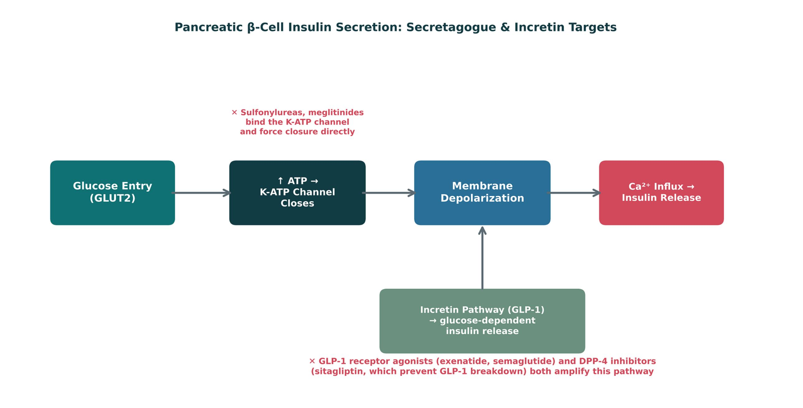
INSULIN
Objectives: SO2 · IO4.1 · IO4.2 · IO4.5 · IO4.6
Figure 15 · β-cell insulin secretion: secretagogue and incretin targets
Original illustrative diagram (not from Katzung): glucose → ATP → K-ATP channels close → depolarization → Ca²⁺ → insulin release. Sulfonylureas/meglitinides force closure directly (any glucose); GLP-1 agonists and DPP-4 inhibitors amplify release only when glucose is high. S11; S11 (notes)
L08 · Endocrine Pharmacotherapy — Session 2
41

Slide 42
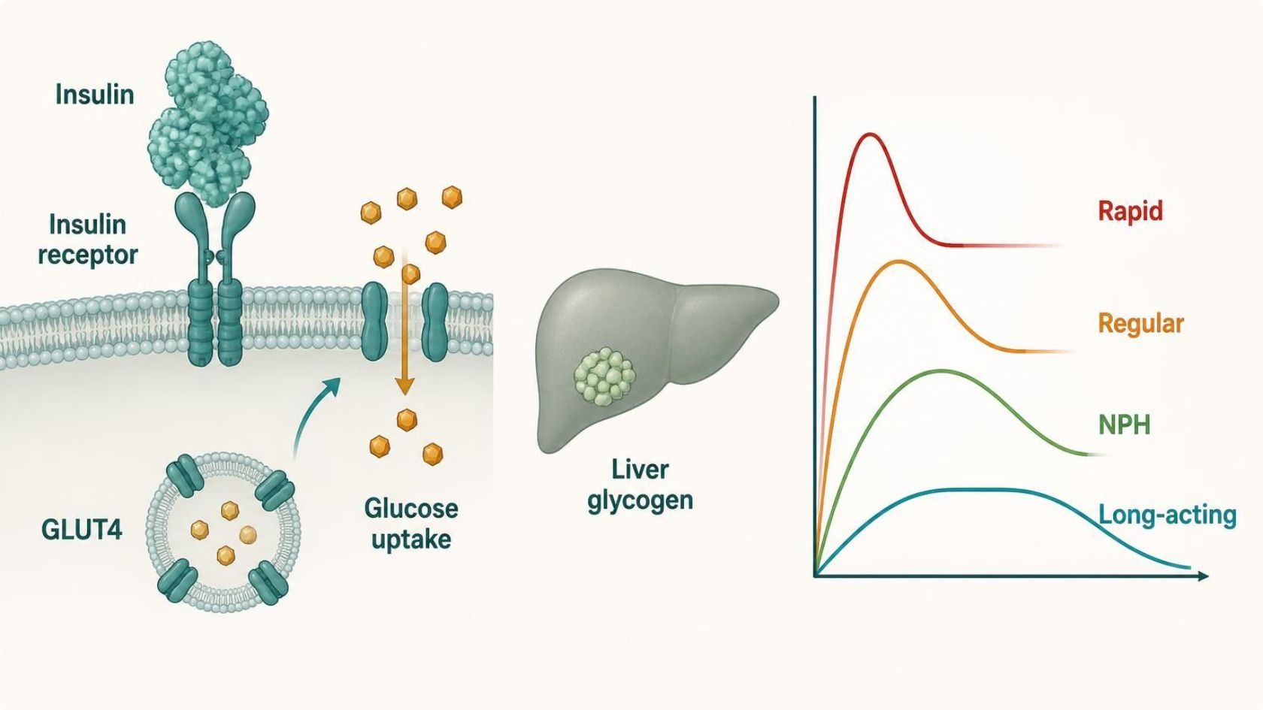
INSULIN
Objectives: SO2 · IO4.1 · IO4.2 · IO4.5 · IO4.6
Figure 16 · Insulin: receptor signaling and time-action profiles
Schematic (illustrative) — Figure 16. Teal: insulin binding; blue: intracellular signaling and glucose uptake; grey-green: liver; red: outcome. Right panel shows onset, peak and duration by insulin type: rapid (lispro, aspart), short (regular), NPH (peak ~4–10 h), basal (glargine, detemir, degludec). S13; S13 (notes)
L08 · Endocrine Pharmacotherapy — Session 2
42

Slide 43
INSULIN
Objectives: SO2 · IO4.1 · IO4.2 · IO4.5 · IO4.6
Compare: Insulin by time-action (S12)
Type | Examples | Onset / profile | Use
Rapid-acting | Lispro, aspart | ~15 min | Mealtime
Short-acting | Regular | ~30 min | 30 min before meals; only IV insulin
Intermediate | NPH | Cloudy; peak ~4–10 h; variable | Basal/peak coverage
Long-acting | Glargine, detemir, degludec | Relatively peakless | Basal coverage
Focus: what tells these apart. Sources: S12; S13
L08 · Endocrine Pharmacotherapy — Session 2
43

Slide 44
INSULIN
Objectives: SO2 · IO4.1 · IO4.2 · IO4.5 · IO4.6
Compare: Insulin profiles: formulation, dose, indications
Drug | Class | Formulation | Adult dose | Indications
Insulin lispro (Humalog) | Rapid-acting insulin analog | SC or IV vial or pen 100 or 200 units/mL | Mealtime dose 0-15 minutes before eating; total daily insulin about 0.5-1 unit/kg; onset about 15 minutes | Type 1 and type 2 diabetes
Insulin aspart (NovoLog) | Rapid-acting insulin analog | SC or IV vial and pen cartridges 100 units/mL | Mealtime dose 0-15 minutes before eating; part of total daily insulin 0.5-1 unit/kg | Type 1 and type 2 diabetes, pump therapy
Regular insulin (Humulin R, Novolin R) | Short-acting human insulin | Vial 100 units/mL; U-500 concentrate; IV | SC 30 minutes before meals; IV infusion for DKA about 0.1 units/kg/hour | Diabetes mellitus, DKA and hyperkalemia (IV)
NPH insulin (Humulin N, Novolin N) | Intermediate-acting human insulin | Vial or pen 100 units/mL (cloudy suspension) | SC once or twice daily; basal start about 0.1-0.2 units/kg; peaks at 4-10 hours | Type 1 and type 2 diabetes, steroid-induced hyperglycemia
Focus: what tells these apart. Sources: S45; S46; S47; S48; S49; S50; S51
L08 · Endocrine Pharmacotherapy — Session 2
44

Slide 45
INSULIN
Objectives: SO2 · IO4.1 · IO4.2 · IO4.5 · IO4.6
Compare: Insulin profiles: formulation, dose, indications (cont.)
Drug | Class | Formulation | Adult dose | Indications
Insulin glargine (Lantus, Basaglar, Toujeo) | Long-acting basal insulin analog | SC pen or vial 100 or 300 units/mL | Start 10 units SC daily (or 0.1-0.2 units/kg) and titrate to fasting glucose | Type 1 and type 2 diabetes (basal)
Insulin detemir (Levemir) | Long-acting basal insulin analog | SC pen or vial 100 units/mL | 10 units (or 0.1-0.2 units/kg) once or twice daily, titrated to fasting glucose | Type 1 and type 2 diabetes (basal)
Insulin degludec (Tresiba) | Ultra-long-acting basal insulin analog | SC pen 100 or 200 units/mL | 10 units (or 0.1-0.2 units/kg) once daily; dosing interval flexible if at least 8 hours apart | Type 1 and type 2 diabetes (basal)
Focus: what tells these apart. Sources: S45; S46; S47; S48; S49; S50; S51
L08 · Endocrine Pharmacotherapy — Session 2
45

Slide 46
INSULIN
Objectives: SO2 · IO4.1 · IO4.2 · IO4.5 · IO4.6
Compare: Insulin profiles: adverse effects, contraindications, toxicity
Drug | Adverse effects | Contraindications | Toxicity / overdose
Insulin lispro (Humalog) | Hypoglycemia, weight gain, lipohypertrophy, hypokalemia | Hypoglycemia, hypersensitivity | Severe hypoglycemia, hypokalemia; dose errors with concentrated pens; rotate sites
Insulin aspart (NovoLog) | Hypoglycemia, weight gain, injection-site reactions | Hypoglycemia, hypersensitivity | Severe hypoglycemia; hypokalemia; do not mix in a pump with other insulins
Regular insulin (Humulin R, Novolin R) | Hypoglycemia, weight gain, hypokalemia (IV) | Hypoglycemia | Only regular insulin may be given IV; U-500 dosing errors; monitor potassium
NPH insulin (Humulin N, Novolin N) | Hypoglycemia (nocturnal), weight gain, variable absorption | Hypoglycemia | Nocturnal hypoglycemia at the peak; mix suspension gently before use
Focus: what tells these apart. Sources: S45; S46; S47; S48; S49; S50; S51
L08 · Endocrine Pharmacotherapy — Session 2
46

Slide 47
INSULIN
Objectives: SO2 · IO4.1 · IO4.2 · IO4.5 · IO4.6
Compare: Insulin profiles: adverse effects, contraindications, toxicity (cont.)
Drug | Adverse effects | Contraindications | Toxicity / overdose
Insulin glargine (Lantus, Basaglar, Toujeo) | Hypoglycemia, weight gain, injection-site reactions | Hypoglycemia, hypersensitivity | Hypoglycemia; do not mix with other insulins; U-300 is not interchangeable unit for unit
Insulin detemir (Levemir) | Hypoglycemia, weight gain, injection-site reactions | Hypoglycemia | Hypoglycemia; duration depends on dose; availability varies, so verify
Insulin degludec (Tresiba) | Hypoglycemia, weight gain, injection-site reactions | Hypoglycemia | Lower nocturnal hypoglycemia than glargine; steady state in 3-4 days; check pen strength
Focus: what tells these apart. Sources: S45; S46; S47; S48; S49; S50; S51
L08 · Endocrine Pharmacotherapy — Session 2
47

Slide 48

INSULIN
Objectives: SO2 · IO4.1 · IO4.2 · IO4.5 · IO4.6
Memory hooks
Mnemonic (memory aid)
Rule of 15: 15 g fast carbohydrate, recheck in 15 minutes. S13
L08 · Endocrine Pharmacotherapy — Session 2
48

Slide 49
INSULIN
Objectives: SO2 · IO4.1 · IO4.2 · IO4.5 · IO4.6
High-yield summary
If you remember nothing else
Insulin’s main risk is hypoglycemia; beta-blockers mask its warning signs; only regular insulin goes IV. S12; S13
L08 · Endocrine Pharmacotherapy — Session 2
49

Slide 50
CLINICAL VIGNETTE
Objectives: SO2 · IO4.1 · IO4.2 · IO4.5 · IO4.6
Question 5
A patient on insulin and propranolol has a glucose of 45 mg/dL but no tremor or palpitations. Why?
A
The meter is reading falsely low
B
Hypoglycemia never causes tremor
C
Propranolol raises glucose
D
Insulin is no longer working
E
Beta-blockade masks warning symptoms
L08 · Endocrine Pharmacotherapy — Session 2
50
Notes:
Answer on the next slide. Source: S13; S67

Slide 51
CLINICAL VIGNETTE · ANSWER
Objectives: SO2 · IO4.1 · IO4.2 · IO4.5 · IO4.6
Answer 5: E
E. Beta-blockade masks warning symptoms
Beta-blockers can mask hypoglycemia warning symptoms (S13; S67). S13; S67
Why the other choices are wrong
A. The meter is reading falsely low — Not the taught answer (S13).
B. Hypoglycemia never causes tremor — Tremor is a warning sign masked here (S13).
C. Propranolol raises glucose — Not the reason (S13).
D. Insulin is no longer working — Glucose is low (S13).
L08 · Endocrine Pharmacotherapy — Session 2
51

Slide 52
Drug class 3 of 5
Non-Insulin Glucose-Lowering Drugs
Covers objectives: SO2 · SO4 · IO4.1 · IO4.2 · IO4.3 · IO4.4 · IO4.5
Class
Prototype
Mechanism of action
Indications
Adverse effects
Contraindications
Drug interactions
Pharmacokinetics
Monitoring
Clinical pearls
52

Slide 53
NON-INSULIN GLUCOSE-LOWERING DRUGS
Objectives: SO2 · SO4 · IO4.1 · IO4.2 · IO4.3 · IO4.4 · IO4.5
Class · Prototype + other drugs named
Class
Prototype + other drugs named
Four non-incretin oral cards: metformin, sulfonylureas/meglitinides, TZDs, SGLT2 inhibitors; then the incretin classes (GLP-1 RAs, DPP-4 inhibitors) and the site-of-action map. S14; S14 (notes)
Figure 19. Original illustrative diagram (not from Katzung): glucose-lowering drug classes act at distinct sites — pancreatic β-cell, liver, muscle/fat, kidney, gut, and the incretin axis — each converging on overall blood glucose control. S17; S17 (notes)
Metformin; glipizide, glyburide (sulfonylureas); repaglinide (meglitinide); pioglitazone (TZD); empagliflozin (SGLT2); exenatide, liraglutide, semaglutide (GLP-1 RA); sitagliptin, linagliptin (DPP-4). S14; S18
L08 · Endocrine Pharmacotherapy — Session 2
53

Slide 54
NON-INSULIN GLUCOSE-LOWERING DRUGS
Objectives: SO2 · SO4 · IO4.1 · IO4.2 · IO4.3 · IO4.4 · IO4.5
Mechanism of action
Mechanism of action (1/2)
Metformin decreases hepatic gluconeogenesis: enters hepatocytes through OCT1 → inhibits mitochondrial complex I and activates AMPK → gluconeogenesis falls → insulin sensitivity improves in muscle → fasting glucose falls without hypoglycemia. S14; S15; S15 (notes)
Sulfonylureas / meglitinides force K-ATP channel closure — insulin secretagogues (glipizide, glyburide, repaglinide). TZDs (pioglitazone) increase peripheral insulin sensitivity. S14
Match each drug class to its mechanism/site: metformin — ↓ hepatic gluconeogenesis; sulfonylureas — force K-ATP channel closure (insulin secretagogue); TZDs — ↑ peripheral insulin sensitivity; SGLT2 inhibitors — block renal glucose reabsorption. SG U4-M; SG U4-R11
GLP-1 receptor agonists — glucose-dependent insulin release, slowed gastric emptying; DPP-4 inhibitors — prevent endogenous GLP-1 breakdown (incretin pathway). Sulfonylureas carry the highest hypoglycemia risk (glucose-independent insulin release). SG U4-M; SG U4-R11
L08 · Endocrine Pharmacotherapy — Session 2
54

Slide 55
NON-INSULIN GLUCOSE-LOWERING DRUGS
Objectives: SO2 · SO4 · IO4.1 · IO4.2 · IO4.3 · IO4.4 · IO4.5
Mechanism of action (cont.)
Mechanism of action (2/2)
SGLT2 inhibitors block renal glucose reabsorption: glucose is filtered at the glomerulus → SGLT2 in the proximal tubule normally reabsorbs about 90% → empagliflozin blocks SGLT2. S14; S16
Glucose and water are lost in the urine (glucosuria) → glucose, weight and blood pressure fall; infection risk rises. S16; S16 (notes)
GLP-1 receptor agonists: glucose-dependent insulin release, slow gastric emptying, promote satiety/weight loss. DPP-4 inhibitors prevent breakdown of endogenous GLP-1, prolonging its glucose-dependent effect. S18; S18 (notes)
Incretin chain (Figure 20): food in the gut releases GLP-1 → GLP-1 acts on the beta cell: glucose-dependent insulin release, less glucagon → DPP-4 normally breaks GLP-1 down quickly. S19; S19 (notes)
Sitagliptin blocks DPP-4; semaglutide and liraglutide mimic GLP-1 → lower glucose, slower gastric emptying and less appetite. S19
L08 · Endocrine Pharmacotherapy — Session 2
55

Slide 56
NON-INSULIN GLUCOSE-LOWERING DRUGS
Objectives: SO2 · SO4 · IO4.1 · IO4.2 · IO4.3 · IO4.4 · IO4.5
Indications
Indications (1/2)
Metformin: first-line for type 2 diabetes; no weight gain and low hypoglycemia risk. S14; S15; S15 (notes)
SGLT2 inhibitors: cardiorenal benefit — benefits in heart failure and chronic kidney disease, beyond glucose lowering. S14; S16; S16 (notes)
Figure 21. Original illustrative comparison (illustrative relative values, not from Katzung): insulin and sulfonylureas show the greatest HbA1c-lowering efficacy but also carry the highest hypoglycemia risk, S20
while metformin, DPP-4 inhibitors, and SGLT2 inhibitors show a more favorable efficacy-to-hypoglycemia-risk balance. S20
L08 · Endocrine Pharmacotherapy — Session 2
56

Slide 57
NON-INSULIN GLUCOSE-LOWERING DRUGS
Objectives: SO2 · SO4 · IO4.1 · IO4.2 · IO4.3 · IO4.4 · IO4.5
Indications (cont.)
Indications (2/2)
Figure 21 is the quantified summary of the drug-class discussion — it answers "why is metformin still first-line": not because it is the most potent, but because of its favorable risk profile. S20 (notes)
TB Semaglutide lowers HbA1c 1.5–1.8%; liraglutide 3 mg and semaglutide 2.4 mg are approved for weight loss without diabetes. p. 800
TB SGLT2 inhibitors lower HbA1c 0.5–1%, cause 2–5 kg weight loss, and reduce heart-failure events (dapagliflozin hazard ratio 0.74). p. 801; p. 802
L08 · Endocrine Pharmacotherapy — Session 2
57

Slide 58
NON-INSULIN GLUCOSE-LOWERING DRUGS
Objectives: SO2 · SO4 · IO4.1 · IO4.2 · IO4.3 · IO4.4 · IO4.5
Adverse effects (boxed warnings first)
Adverse effects (boxed warnings first)
Sulfonylureas: highest hypoglycemia risk among oral agents. TZDs: fluid retention/heart failure, weight gain. S14
Metformin: GI upset is common — start low and take with food; vitamin B12 deficiency with long-term use; monitor B12 levels. S15; S15 (notes)
SGLT2 inhibitors: genital yeast (mycotic) infections, volume depletion, euglycemic DKA — hold when ill or before surgery; rare Fournier gangrene. S14; S16; S16 (notes)
GLP-1 RAs: nausea/GI upset, vomiting, pancreatitis risk and gallstones. DPP-4 inhibitors are generally weight-neutral, well tolerated, with low hypoglycemia risk. S18; S18 (notes); S19
TB Sulfonylureas: hypoglycemia and weight gain; elderly patients are at particular risk. p. 796; p. 797
TB Acarbose (an alpha-glucosidase inhibitor, a drug that affects absorption of glucose): treat hypoglycemia with glucose, not sucrose. p. 799
L08 · Endocrine Pharmacotherapy — Session 2
58

Slide 59
NON-INSULIN GLUCOSE-LOWERING DRUGS
Objectives: SO2 · SO4 · IO4.1 · IO4.2 · IO4.3 · IO4.4 · IO4.5
Contraindications
Contraindications
Metformin: avoid in significant renal impairment — lactic acidosis risk; avoid when eGFR is below 30; hold for contrast dye with reduced kidney function (iodinated contrast). S14; S15; S15 (notes); S67
GLP-1 RAs: contraindicated with personal or family history of medullary thyroid carcinoma or MEN2 (thyroid C-cell warning). S18; S18 (notes); S19
SGLT2 inhibitors: avoid for glycemic effect when eGFR is low. S16
TB Metformin: full dose at eGFR 45–60, cautious at 30–45, contraindicated below 30; avoid in decompensated liver failure; check renal function at least annually. p. 798
TB Thiazolidinediones are contraindicated in NYHA class III and IV heart failure. p. 799
L08 · Endocrine Pharmacotherapy — Session 2
59

Slide 60
NON-INSULIN GLUCOSE-LOWERING DRUGS
Objectives: SO2 · SO4 · IO4.1 · IO4.2 · IO4.3 · IO4.4 · IO4.5
Drug interactions · Pharmacokinetics
Drug interactions
Pharmacokinetics
Do not combine a GLP-1 RA with a DPP-4 inhibitor. Gemfibrozil raises repaglinide levels (CYP2C8). S19; S67
TB Sitagliptin: reduce dose in renal impairment (50 mg at eGFR 30–50, 25 mg below 30). Exenatide is not approved below eGFR 30. p. 800; p. 801
L08 · Endocrine Pharmacotherapy — Session 2
60

Slide 61
NON-INSULIN GLUCOSE-LOWERING DRUGS
Objectives: SO2 · SO4 · IO4.1 · IO4.2 · IO4.3 · IO4.4 · IO4.5
Monitoring
Monitoring
Not covered in materials
L08 · Endocrine Pharmacotherapy — Session 2
61

Slide 62
NON-INSULIN GLUCOSE-LOWERING DRUGS
Objectives: SO2 · SO4 · IO4.1 · IO4.2 · IO4.3 · IO4.4 · IO4.5
Clinical pearls / "why" hook
Clinical pearls / "why" hook (1/2)
Case: a 72-year-old with type 2 diabetes on metformin monotherapy, HbA1c above goal, lives alone, prior fall. Which class of add-on therapy best balances efficacy and safety for this patient, and why? S21; S21 (notes)
Given the fall history and the risks of hypoglycemia-induced falls, a DPP-4 inhibitor or SGLT2 inhibitor (low intrinsic hypoglycemia risk) is generally preferable to a sulfonylurea in an older adult living alone — S21
matching drug choice to patient-specific risk, not just HbA1c-lowering potency. S21
This vignette applies Figure 21 directly to a geriatric safety scenario: "most potent" and "most appropriate" are not always the same answer. S21 (notes)
Drug names reveal the class: -gliptin DPP-4 inhibitor (sitagliptin, linagliptin; low hypoglycemia risk); -glutide GLP-1 receptor agonist (liraglutide, semaglutide; weight loss, GI upset). S28; S28 (notes)
L08 · Endocrine Pharmacotherapy — Session 2
62

Slide 63
NON-INSULIN GLUCOSE-LOWERING DRUGS
Objectives: SO2 · SO4 · IO4.1 · IO4.2 · IO4.3 · IO4.4 · IO4.5
Clinical pearls / "why" hook (cont.)
Clinical pearls / "why" hook (2/2)
-gliflozin SGLT2 inhibitor (empagliflozin; genital infections, euglycemic DKA); -glitazone thiazolidinedione (pioglitazone; fluid retention, heart failure); -glinide meglitinide (repaglinide; mealtime insulin secretagogue). S28
gli- (prefix) sulfonylurea (glipizide, glyburide; K-ATP closure, hypoglycemia); -ifene SERM (tamoxifen, raloxifene; tissue-selective estrogen action); -steride 5-alpha-reductase inhibitor (finasteride; lowers DHT); -gestrel progestin (levonorgestrel). S28
-calcet calcimimetic (cinacalcet; activates the CaSR, lowers PTH). A stem is a memory aid, not a rule: where no shared stem exists, learn the class name instead. S28
TB SGLT2 inhibitors: not recommended for glycemic control below eGFR 45, contraindicated below 30 (for glucose). p. 802
L08 · Endocrine Pharmacotherapy — Session 2
63

Slide 64
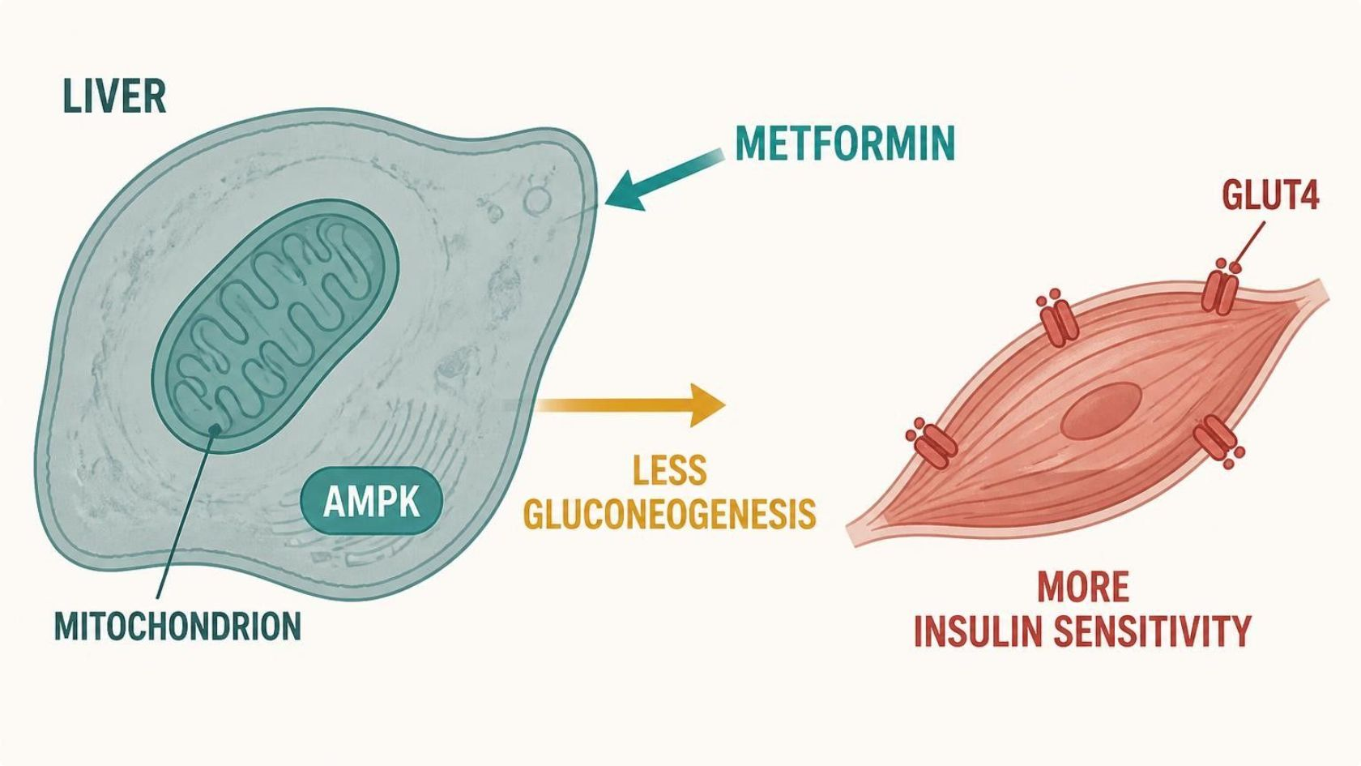
NON-INSULIN GLUCOSE-LOWERING DRUGS
Objectives: SO2 · SO4 · IO4.1 · IO4.2 · IO4.3 · IO4.4 · IO4.5
Figure 17 · Metformin: hepatic glucose output and AMPK
Schematic (illustrative) — Figure 17. Teal: drug entry; blue: AMPK signaling and glucose output; grey-green: muscle; short arrow = reduced gluconeogenesis; red: outcome — fasting glucose falls without hypoglycemia. S15; S15 (notes)
L08 · Endocrine Pharmacotherapy — Session 2
64

Slide 65
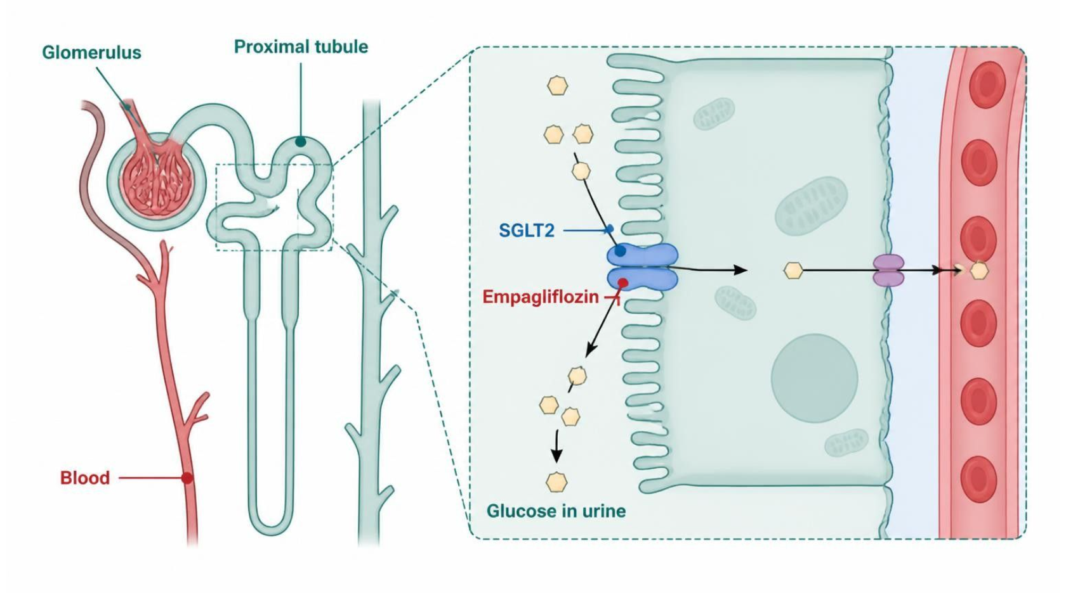
NON-INSULIN GLUCOSE-LOWERING DRUGS
Objectives: SO2 · SO4 · IO4.1 · IO4.2 · IO4.3 · IO4.4 · IO4.5
Figure 18 · SGLT2 inhibitors: glucose lost in the urine
Schematic (illustrative) — Figure 18. Teal: filtration; blue: tubule transport; green-grey: drug block; red: outcome, glucose lost in urine — lower glucose, weight and BP, with genital infection and euglycemic DKA risks. S16; S16 (notes)
L08 · Endocrine Pharmacotherapy — Session 2
65

Slide 66
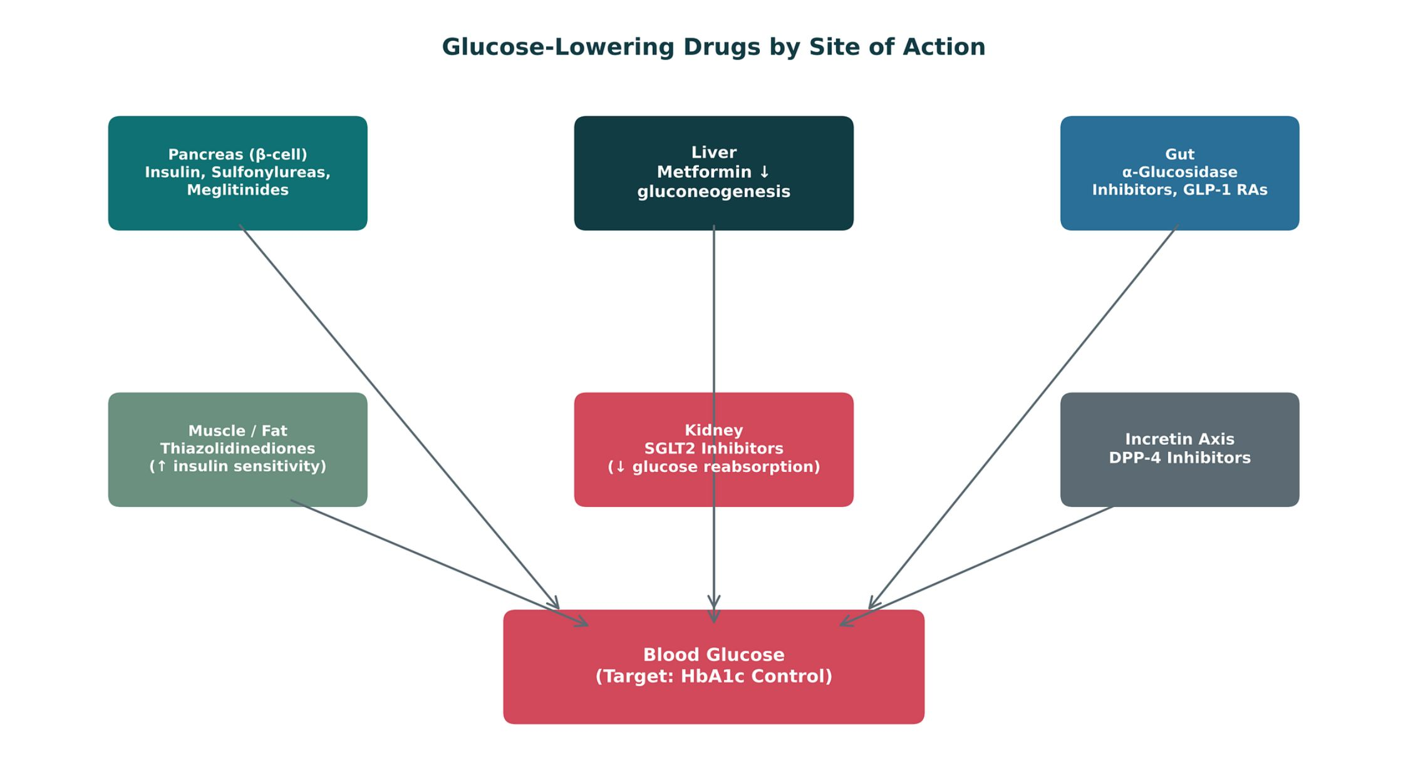
NON-INSULIN GLUCOSE-LOWERING DRUGS
Objectives: SO2 · SO4 · IO4.1 · IO4.2 · IO4.3 · IO4.4 · IO4.5
Figure 19 · Glucose-lowering drugs by site of action
Original illustrative diagram (not from Katzung): β-cell (sulfonylureas, meglitinides), liver (metformin), muscle/fat (TZDs), kidney (SGLT2 inhibitors), gut and incretin axis (GLP-1 RAs, DPP-4 inhibitors) — all converging on blood glucose. S17; S17 (notes)
L08 · Endocrine Pharmacotherapy — Session 2
66

Slide 67
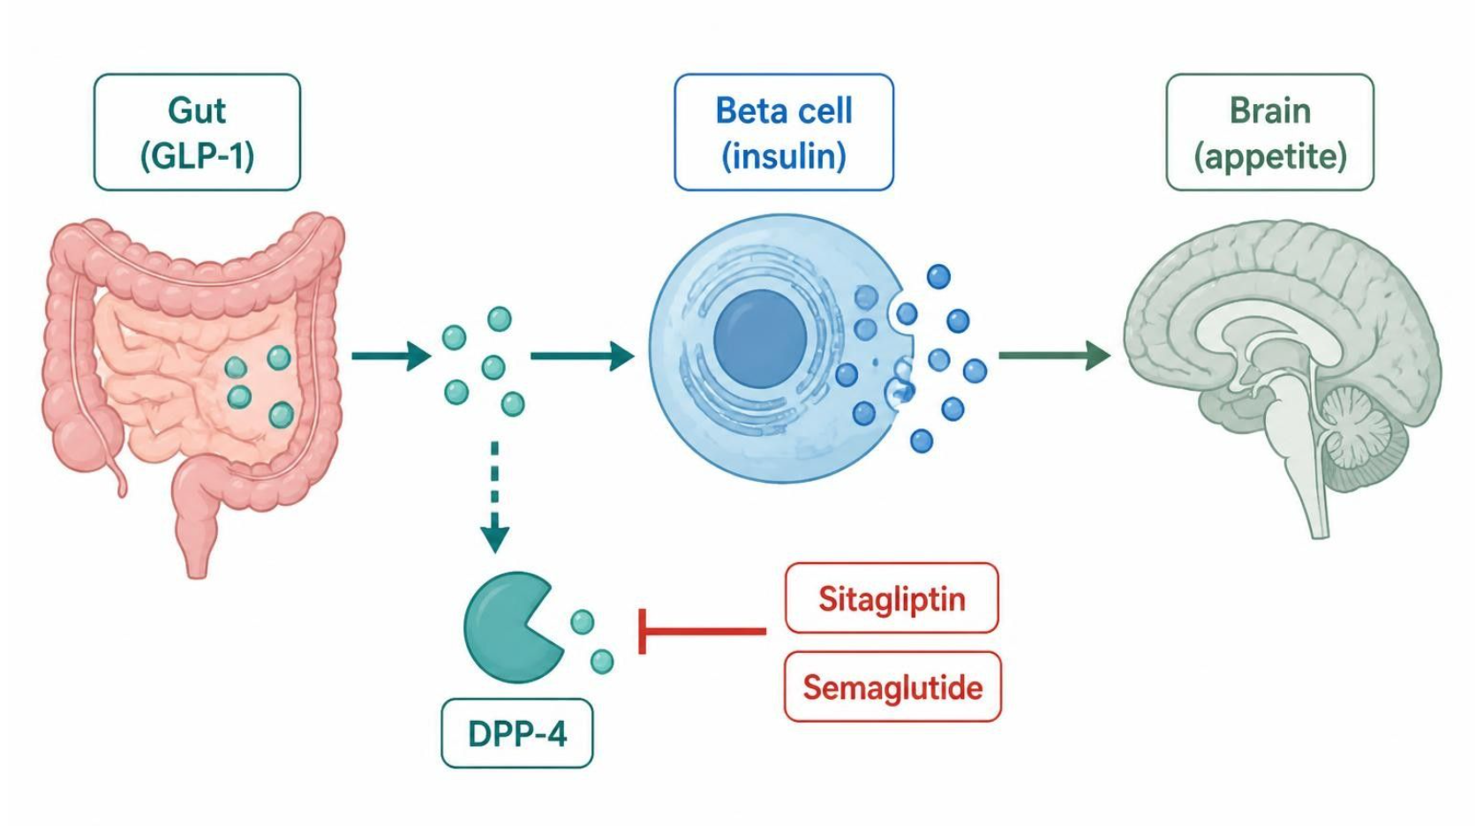
NON-INSULIN GLUCOSE-LOWERING DRUGS
Objectives: SO2 · SO4 · IO4.1 · IO4.2 · IO4.3 · IO4.4 · IO4.5
Figure 20 · Incretin drugs: gut, pancreas and brain
Schematic (illustrative) — Figure 20. Teal: gut signal; blue: beta-cell and enzyme steps; green-grey: drugs; red: clinical outcome. GLP-1 RAs mimic GLP-1; DPP-4 inhibitors protect it — lower glucose, slower gastric emptying, less appetite. S19; S19 (notes)
L08 · Endocrine Pharmacotherapy — Session 2
67

Slide 68
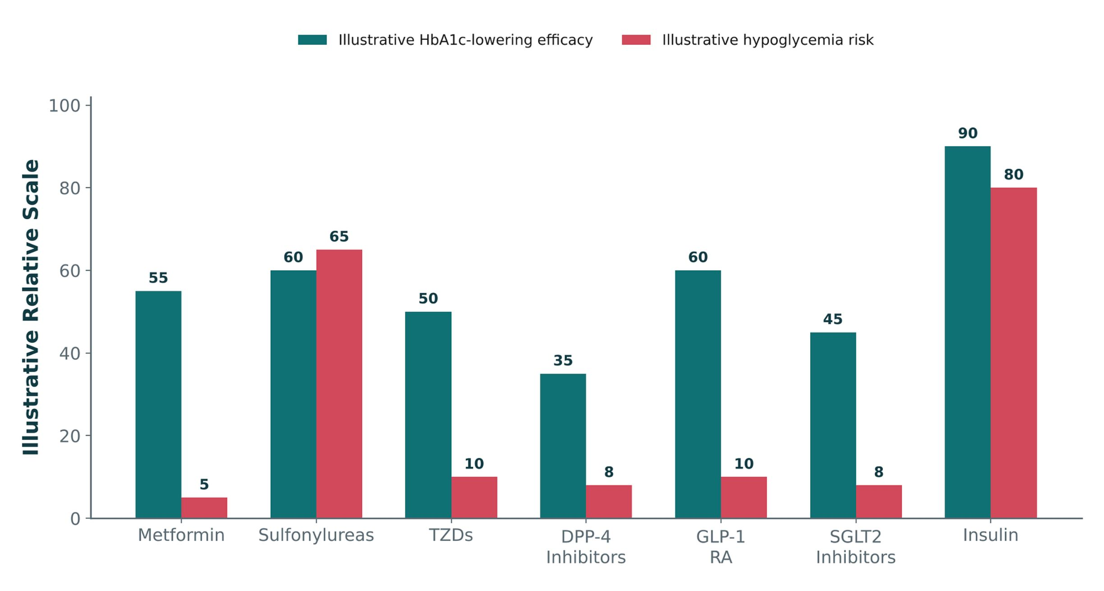
NON-INSULIN GLUCOSE-LOWERING DRUGS
Objectives: SO2 · SO4 · IO4.1 · IO4.2 · IO4.3 · IO4.4 · IO4.5
Figure 21 · HbA1c lowering vs. hypoglycemia risk
Original illustrative comparison (illustrative relative values, not from Katzung): insulin and sulfonylureas lower HbA1c most but carry the highest hypoglycemia risk; metformin, DPP-4 inhibitors and SGLT2 inhibitors balance efficacy and hypoglycemia risk more favorably. S20; S20 (notes)
L08 · Endocrine Pharmacotherapy — Session 2
68

Slide 69


NON-INSULIN GLUCOSE-LOWERING DRUGS
Objectives: SO2 · SO4 · IO4.1 · IO4.2 · IO4.3 · IO4.4 · IO4.5
⚠ Sources disagree: Metformin and eGFR
Lecture slides say
Textbook says
Avoid when eGFR is below 30. S15
TB Full use at 45–60, cautious at 30–45 (lower doses), contraindicated below 30. p. 798
L08 · Endocrine Pharmacotherapy — Session 2
69

Slide 70
NON-INSULIN GLUCOSE-LOWERING DRUGS
Objectives: SO2 · SO4 · IO4.1 · IO4.2 · IO4.3 · IO4.4 · IO4.5
Compare: Glucose-lowering classes (S14; S18)
Class | Example | Mechanism | Key risk
Metformin | Metformin | ↓ Hepatic gluconeogenesis | GI, B12; lactic acidosis — avoid eGFR < 30
Sulfonylureas / meglitinides | Glipizide, glyburide, repaglinide | Force K-ATP closure | Highest oral hypoglycemia risk
TZDs | Pioglitazone | ↑ Peripheral insulin sensitivity | Fluid retention/heart failure, weight gain
SGLT2 inhibitors | Empagliflozin | Block renal glucose reabsorption | Genital mycotic infection, euglycemic DKA
GLP-1 RAs | Exenatide, liraglutide, semaglutide | Glucose-dependent insulin; slow emptying | GI, pancreatitis; MTC/MEN2
DPP-4 inhibitors | Sitagliptin, linagliptin | Protect endogenous GLP-1 | Weight-neutral; low hypoglycemia
Focus: what tells these apart. Sources: S14; S18
L08 · Endocrine Pharmacotherapy — Session 2
70

Slide 71
NON-INSULIN GLUCOSE-LOWERING DRUGS
Objectives: SO2 · SO4 · IO4.1 · IO4.2 · IO4.3 · IO4.4 · IO4.5
Compare: Oral glucose-lowering profiles: formulation, dose, indications
Drug | Class | Formulation | Adult dose | Indications
Metformin (Glucophage) | Biguanide | Tablet 500/850/1,000 mg; ER tablet; oral solution | Start 500 mg PO daily or BID with meals, titrate to 1,000 mg BID (max 2,550 mg/day) | Type 2 diabetes, prediabetes, PCOS (off-label)
Glipizide (Glucotrol) | Sulfonylurea (second generation) | Tablet 5/10 mg; XL 2.5/5/10 mg | 5 mg PO daily 30 minutes before breakfast, titrate (max 40 mg/day; XL 20 mg) | Type 2 diabetes
Glyburide (Diabeta, Micronase) | Sulfonylurea (second generation) | Tablet 1.25/2.5/5 mg; micronized 1.5/3/6 mg | 2.5-5 mg PO daily with breakfast, titrate (max 20 mg/day) | Type 2 diabetes
Focus: what tells these apart. Sources: S52; S53; S54; S55; S56; S57
L08 · Endocrine Pharmacotherapy — Session 2
71

Slide 72
NON-INSULIN GLUCOSE-LOWERING DRUGS
Objectives: SO2 · SO4 · IO4.1 · IO4.2 · IO4.3 · IO4.4 · IO4.5
Compare: Oral glucose-lowering profiles: formulation, dose, indications (cont.)
Drug | Class | Formulation | Adult dose | Indications
Repaglinide (Prandin) | Meglitinide | Tablet 0.5/1/2 mg | 0.5-2 mg PO before each meal (skip if the meal is skipped), max 16 mg/day | Type 2 diabetes (mealtime)
Pioglitazone (Actos) | Thiazolidinedione (PPAR-gamma agonist) | Tablet 15/30/45 mg | 15-30 mg PO daily, max 45 mg | Type 2 diabetes
Empagliflozin (Jardiance) | SGLT2 inhibitor | Tablet 10/25 mg | 10 mg PO once daily in the morning, may increase to 25 mg | Type 2 diabetes with cardiorenal benefit, heart failure, CKD
Focus: what tells these apart. Sources: S52; S53; S54; S55; S56; S57
L08 · Endocrine Pharmacotherapy — Session 2
72

Slide 73
NON-INSULIN GLUCOSE-LOWERING DRUGS
Objectives: SO2 · SO4 · IO4.1 · IO4.2 · IO4.3 · IO4.4 · IO4.5
Compare: Oral glucose-lowering profiles: adverse effects, contraindications, toxicity
Drug | Adverse effects | Contraindications | Toxicity / overdose
Metformin (Glucophage) | Nausea, diarrhea, metallic taste, vitamin B12 deficiency | eGFR below 30, acute metabolic acidosis, hypersensitivity | Lactic acidosis (renal impairment, contrast, alcohol, sepsis); hold around iodinated contrast; monitor B12
Glipizide (Glucotrol) | Hypoglycemia, weight gain, nausea, rash | Type 1 diabetes, DKA, severe liver disease; caution in sulfonamide allergy | Prolonged hypoglycemia (older adults, renal impairment); alcohol and beta-blockers worsen or mask it
Glyburide (Diabeta, Micronase) | Hypoglycemia, weight gain, nausea | Type 1 diabetes, DKA, bosentan co-use | Active metabolites cause prolonged hypoglycemia; avoid in older adults and CKD
Focus: what tells these apart. Sources: S52; S53; S54; S55; S56; S57
L08 · Endocrine Pharmacotherapy — Session 2
73

Slide 74
NON-INSULIN GLUCOSE-LOWERING DRUGS
Objectives: SO2 · SO4 · IO4.1 · IO4.2 · IO4.3 · IO4.4 · IO4.5
Compare: Oral glucose-lowering profiles: adverse effects, contraindications, toxicity (cont.)
Drug | Adverse effects | Contraindications | Toxicity / overdose
Repaglinide (Prandin) | Hypoglycemia, weight gain, upper respiratory infection | Type 1 diabetes, DKA, gemfibrozil co-use | Hypoglycemia; gemfibrozil markedly raises levels (CYP2C8); CYP3A4 interactions
Pioglitazone (Actos) | Edema, weight gain, fractures, upper respiratory infection | NYHA class III-IV heart failure (boxed), active bladder cancer, liver disease | Heart failure exacerbation, fractures in women, possible bladder cancer; monitor weight and edema
Empagliflozin (Jardiance) | Genital yeast infections, UTI, volume depletion | Dialysis, hypersensitivity; not indicated in type 1 diabetes | Euglycemic DKA (hold when ill or fasting), Fournier gangrene, hypotension
Focus: what tells these apart. Sources: S52; S53; S54; S55; S56; S57
L08 · Endocrine Pharmacotherapy — Session 2
74

Slide 75
NON-INSULIN GLUCOSE-LOWERING DRUGS
Objectives: SO2 · SO4 · IO4.1 · IO4.2 · IO4.3 · IO4.4 · IO4.5
Compare: Incretin drug profiles: formulation, dose, indications
Drug | Class | Formulation | Adult dose | Indications
Exenatide (Byetta, Bydureon) | GLP-1 receptor agonist | SC pen 5/10 mcg (Byetta); 2 mg weekly (Bydureon) | Byetta 5 mcg BID within 60 minutes before meals, then 10 mcg BID; Bydureon 2 mg SC once weekly | Type 2 diabetes
Liraglutide (Victoza, Saxenda) | GLP-1 receptor agonist | SC pen 18 mg/3 mL | Victoza 0.6 mg daily for 1 week, then 1.2-1.8 mg daily; Saxenda up to 3 mg daily | Type 2 diabetes, CV risk reduction, chronic weight management (Saxenda)
Semaglutide (Ozempic, Wegovy, Rybelsus) | GLP-1 receptor agonist | SC pen weekly; oral tablet 3/7/14 mg | Ozempic 0.25 mg weekly for 4 weeks, then 0.5-2 mg weekly; Rybelsus 3 mg daily, then 7-14 mg | Type 2 diabetes, CV risk reduction, obesity (Wegovy)
Focus: what tells these apart. Sources: S58; S59; S60; S61; S62
L08 · Endocrine Pharmacotherapy — Session 2
75

Slide 76
NON-INSULIN GLUCOSE-LOWERING DRUGS
Objectives: SO2 · SO4 · IO4.1 · IO4.2 · IO4.3 · IO4.4 · IO4.5
Compare: Incretin drug profiles: formulation, dose, indications (cont.)
Drug | Class | Formulation | Adult dose | Indications
Sitagliptin (Januvia) | DPP-4 inhibitor | Tablet 25/50/100 mg | 100 mg PO daily; 50 mg if eGFR 30-45; 25 mg if below 30 | Type 2 diabetes
Linagliptin (Tradjenta) | DPP-4 inhibitor | Tablet 5 mg | 5 mg PO daily; no renal adjustment | Type 2 diabetes
Focus: what tells these apart. Sources: S58; S59; S60; S61; S62
L08 · Endocrine Pharmacotherapy — Session 2
76

Slide 77
NON-INSULIN GLUCOSE-LOWERING DRUGS
Objectives: SO2 · SO4 · IO4.1 · IO4.2 · IO4.3 · IO4.4 · IO4.5
Compare: Incretin drug profiles: adverse effects, contraindications, toxicity
Drug | Adverse effects | Contraindications | Toxicity / overdose
Exenatide (Byetta, Bydureon) | Nausea, vomiting, diarrhea, injection-site nodules | Medullary thyroid cancer or MEN2 (Bydureon), CrCl below 30, severe gastroparesis | Pancreatitis, thyroid C-cell tumor warning (Bydureon), renal injury
Liraglutide (Victoza, Saxenda) | Nausea, vomiting, diarrhea, constipation, headache | Personal or family medullary thyroid cancer, MEN2, pancreatitis history | Boxed thyroid C-cell tumors, pancreatitis, gallbladder disease, dehydration with kidney injury
Semaglutide (Ozempic, Wegovy, Rybelsus) | Nausea, vomiting, diarrhea, constipation, abdominal pain | Personal or family medullary thyroid cancer, MEN2, hypersensitivity | Boxed thyroid C-cell tumors, pancreatitis, retinopathy complications, gallbladder disease, aspiration risk with anesthesia
Sitagliptin (Januvia) | Upper respiratory infection, headache, nasopharyngitis | Hypersensitivity (anaphylaxis, angioedema) | Pancreatitis, severe joint pain; low hypoglycemia risk when used alone
Linagliptin (Tradjenta) | Nasopharyngitis, cough, diarrhea | Hypersensitivity | Pancreatitis, bullous pemphigoid, arthralgia; eliminated mainly through bile
Focus: what tells these apart. Sources: S58; S59; S60; S61; S62
L08 · Endocrine Pharmacotherapy — Session 2
77

Slide 78
NON-INSULIN GLUCOSE-LOWERING DRUGS
Objectives: SO2 · SO4 · IO4.1 · IO4.2 · IO4.3 · IO4.4 · IO4.5
Memory hooks
Why it happens
Why do DPP-4 inhibitors rarely cause hypoglycemia? The incretin effect only boosts insulin when glucose is already high; sulfonylureas push insulin out regardless. S11; S35
L08 · Endocrine Pharmacotherapy — Session 2
78

Slide 79
NON-INSULIN GLUCOSE-LOWERING DRUGS
Objectives: SO2 · SO4 · IO4.1 · IO4.2 · IO4.3 · IO4.4 · IO4.5
High-yield summary
If you remember nothing else
Metformin first-line (no weight gain, low hypoglycemia); avoid eGFR < 30; hold for contrast; B12. S14; S15
Older adult with falls → DPP-4 or SGLT2, not a sulfonylurea. S21
L08 · Endocrine Pharmacotherapy — Session 2
79

Slide 80
CLINICAL VIGNETTE · LECTURE QUICK CHECK S21
Objectives: SO2 · SO4 · IO4.1 · IO4.2 · IO4.3 · IO4.4 · IO4.5
Question 8
A 72-year-old on metformin, living alone with a prior fall, needs an add-on. Which class fits best?
A
A second sulfonylurea, glipizide
B
A sulfonylurea such as glyburide
C
Mealtime insulin lispro
D
A DPP-4 inhibitor or SGLT2 inhibitor
E
Repaglinide before each meal
L08 · Endocrine Pharmacotherapy — Session 2
80
Notes:
Answer on the next slide. Source: S21

Slide 81
CLINICAL VIGNETTE · ANSWER
Objectives: SO2 · SO4 · IO4.1 · IO4.2 · IO4.3 · IO4.4 · IO4.5
Answer 8: D
D. A DPP-4 inhibitor or SGLT2 inhibitor
Low intrinsic hypoglycemia risk; sulfonylureas risk hypoglycemia-induced falls (S21). S21
Why the other choices are wrong
A. A second sulfonylurea, glipizide — Hypoglycemia risk (S14).
B. A sulfonylurea such as glyburide — Highest oral hypoglycemia risk (S14).
C. Mealtime insulin lispro — Hypoglycemia risk (S12).
E. Repaglinide before each meal — Secretagogue, hypoglycemia (S14).
L08 · Endocrine Pharmacotherapy — Session 2
81

Slide 82
MECHANISM · LECTURE QUICK CHECK S34; S35
Objectives: SO2 · SO4 · IO4.1 · IO4.2 · IO4.3 · IO4.4 · IO4.5
Question 9
Why do sulfonylureas carry a higher hypoglycemia risk than DPP-4 inhibitors?
A
There is no difference in risk
B
They force insulin release at any glucose
C
DPP-4 inhibitors do not affect insulin
D
Sulfonylureas work only in type 1
E
DPP-4 inhibitors raise glucagon
L08 · Endocrine Pharmacotherapy — Session 2
82
Notes:
Answer on the next slide. Source: S34; S35

Slide 83
MECHANISM · ANSWER
Objectives: SO2 · SO4 · IO4.1 · IO4.2 · IO4.3 · IO4.4 · IO4.5
Answer 9: B
B. They force insulin release at any glucose
Sulfonylureas close K-ATP channels regardless of glucose; incretins act only when glucose is elevated (S35). S34; S35
Why the other choices are wrong
A. There is no difference in risk — There is (S35).
C. DPP-4 inhibitors do not affect insulin — They prolong GLP-1 (S35).
D. Sulfonylureas work only in type 1 — Type 2 agents (S35).
E. DPP-4 inhibitors raise glucagon — They lower it (S19).
L08 · Endocrine Pharmacotherapy — Session 2
83

Slide 84
MECHANISM · LECTURE QUICK CHECK S34; S35
Objectives: SO2 · SO4 · IO4.1 · IO4.2 · IO4.3 · IO4.4 · IO4.5
Question 10
A patient on an SGLT2 inhibitor develops a genital yeast infection. What is the mechanism?
A
Decreased renal blood flow
B
Systemic candidemia from the drug
C
More urinary glucose feeds fungal growth
D
Direct immunosuppression by the drug
E
Euglycemic DKA lowering immunity
L08 · Endocrine Pharmacotherapy — Session 2
84
Notes:
Answer on the next slide. Source: S34; S35

Slide 85
MECHANISM · ANSWER
Objectives: SO2 · SO4 · IO4.1 · IO4.2 · IO4.3 · IO4.4 · IO4.5
Answer 10: C
C. More urinary glucose feeds fungal growth
Blocking renal glucose reabsorption raises urinary glucose, favoring fungal overgrowth (S35). S34; S35
Why the other choices are wrong
A. Decreased renal blood flow — Not the mechanism (S35).
B. Systemic candidemia from the drug — Not the mechanism (S35).
D. Direct immunosuppression by the drug — Not the mechanism (S35).
E. Euglycemic DKA lowering immunity — Not the mechanism (S35).
L08 · Endocrine Pharmacotherapy — Session 2
85

Slide 86
CLINICAL VIGNETTE
Objectives: SO2 · SO4 · IO4.1 · IO4.2 · IO4.3 · IO4.4 · IO4.5
Question 11
A patient on metformin with eGFR 40 is scheduled for a CT with iodinated contrast. What should happen?
A
Switch to glyburide permanently
B
Add an SGLT2 inhibitor the same day
C
Continue without change
D
Hold metformin around the contrast study
E
Double metformin to cover the stress
L08 · Endocrine Pharmacotherapy — Session 2
86
Notes:
Answer on the next slide. Source: S15; S67

Slide 87
CLINICAL VIGNETTE · ANSWER
Objectives: SO2 · SO4 · IO4.1 · IO4.2 · IO4.3 · IO4.4 · IO4.5
Answer 11: D
D. Hold metformin around the contrast study
Hold for contrast dye with reduced kidney function — lactic acidosis risk (S15; S67). S15; S67
Why the other choices are wrong
A. Switch to glyburide permanently — Not the taught step (S15).
B. Add an SGLT2 inhibitor the same day — Not the answer (S16).
C. Continue without change — Hold (S15).
E. Double metformin to cover the stress — Raises risk (S15).
L08 · Endocrine Pharmacotherapy — Session 2
87

Slide 88
Drug class 4 of 5
Parathyroid Disorders
Covers objectives: SO3 · IO4.1 · IO4.4 · IO4.5
Class
Prototype
Mechanism of action
Indications
Adverse effects
Contraindications
Drug interactions
Pharmacokinetics
Monitoring
Clinical pearls
88

Slide 89
PARATHYROID DISORDERS
Objectives: SO3 · IO4.1 · IO4.4 · IO4.5
Class
Class (1/2)
A brief recap of bone pharmacology, then a new angle: PTH itself. Unit 2 covered osteoporosis drug therapy in depth: bisphosphonates, denosumab, teriparatide, and raloxifene (a SERM, also discussed again this session). S22; S23
That therapy targets bone remodeling directly, generally in patients with normal parathyroid function. This section takes a different angle: what happens — and what drugs are used — when parathyroid hormone secretion itself is the primary problem. S23; S23 (notes)
If you need a refresher on bisphosphonate dosing or denosumab safety, revisit the Unit 2, Session 2 materials — that content is not repeated here. S23
This section is intentionally NOT re-teaching osteoporosis pharmacotherapy — it is new content on parathyroid pathology, so don’t expect bisphosphonate-level detail here. S23 (notes)
L08 · Endocrine Pharmacotherapy — Session 2
89

Slide 90
PARATHYROID DISORDERS
Objectives: SO3 · IO4.1 · IO4.4 · IO4.5
Class (cont.)
Class (2/2)
Figure 22. Original illustrative diagram (not from Katzung): hyperparathyroidism (excess PTH, high calcium) is treated with cinacalcet to lower PTH, S24
while hypoparathyroidism (deficient PTH, low calcium) is treated with calcitriol and oral calcium, sometimes with recombinant PTH 1-84 in severe cases. S24
Figure 22 is the organizing concept for the section — two opposite pathologies, two opposite drug strategies, both targeting the same hormone axis. S24 (notes)
L08 · Endocrine Pharmacotherapy — Session 2
90

Slide 91
PARATHYROID DISORDERS
Objectives: SO3 · IO4.1 · IO4.4 · IO4.5
Prototype + other drugs named
Prototype + other drugs named
Cinacalcet (calcimimetic); calcitriol (active vitamin D) plus calcium; recombinant human PTH 1-84. S25
L08 · Endocrine Pharmacotherapy — Session 2
91

Slide 92
PARATHYROID DISORDERS
Objectives: SO3 · IO4.1 · IO4.4 · IO4.5
Mechanism of action
Mechanism of action
Cinacalcet — a calcimimetic; activates the calcium-sensing receptor on parathyroid cells, reducing PTH secretion. S25
Chain (Figure 23): parathyroid cells sense calcium through the CaSR → low calcium keeps PTH release high → cinacalcet makes the receptor more sensitive to calcium. S26
The cell reads calcium as high and lowers PTH → PTH and serum calcium fall. S26; S26 (notes)
Calcitriol (active vitamin D) plus oral calcium — mainstay for hypoparathyroidism, since PTH deficiency impairs vitamin D activation; calcitriol bypasses the PTH activation step. S25; S25 (notes)
L08 · Endocrine Pharmacotherapy — Session 2
92

Slide 93
PARATHYROID DISORDERS
Objectives: SO3 · IO4.1 · IO4.4 · IO4.5
Indications · Adverse effects (boxed warnings first)
Indications
Adverse effects (boxed warnings first)
Cinacalcet: used for secondary hyperparathyroidism (e.g., in chronic kidney disease on dialysis) and parathyroid carcinoma. S25; S26
Recombinant human PTH 1-84 — reserved for patients not adequately controlled on calcium/calcitriol alone. S25
Cinacalcet adverse effects: nausea, hypocalcemia and QT prolongation, so monitor calcium. S26
L08 · Endocrine Pharmacotherapy — Session 2
93

Slide 94
PARATHYROID DISORDERS
Objectives: SO3 · IO4.1 · IO4.4 · IO4.5
Contraindications · Drug interactions
Contraindications
Drug interactions
Not covered in materials
Cinacalcet is a CYP2D6 inhibitor. Thiazides raise calcium, loops lower it. Vitamin D (cholecalciferol) replaces or supports calcitriol in deficiency. S26; S67
L08 · Endocrine Pharmacotherapy — Session 2
94

Slide 95
PARATHYROID DISORDERS
Objectives: SO3 · IO4.1 · IO4.4 · IO4.5
Pharmacokinetics · Monitoring
Pharmacokinetics
Monitoring
Not covered in materials
Hyperparathyroidism — cinacalcet (lowers PTH secretion); hypoparathyroidism — calcitriol (bypasses the PTH-dependent vitamin D activation step) plus oral calcium. SG U4-R13
Opposite monitoring targets: watch for hypocalcemia with cinacalcet, hypercalcemia/hypercalciuria with calcitriol/PTH replacement — a symmetry worth drawing out. S25; S25 (notes); S26
L08 · Endocrine Pharmacotherapy — Session 2
95

Slide 96
PARATHYROID DISORDERS
Objectives: SO3 · IO4.1 · IO4.4 · IO4.5
Clinical pearls / "why" hook
Clinical pearls / "why" hook
Case: a patient with chronic kidney disease is found to have an elevated PTH level with low-normal serum calcium. A second, unrelated patient who underwent recent thyroidectomy develops perioral numbness and low serum calcium with a low PTH level. S27
How does drug therapy differ between these two patients? S27
The CKD patient has secondary hyperparathyroidism and may benefit from cinacalcet to reduce PTH secretion. S27
The post-thyroidectomy patient has surgical hypoparathyroidism (inadvertent parathyroid gland injury) and needs calcitriol plus calcium replacement — the opposite pharmacologic strategy for the opposite underlying problem. S27; S27 (notes)
Post-thyroidectomy hypoparathyroidism is a classic, testable scenario and a bridge back to thyroid surgery from Session 1 (antithyroid drugs can also precede surgical management). S27 (notes)
L08 · Endocrine Pharmacotherapy — Session 2
96

Slide 97
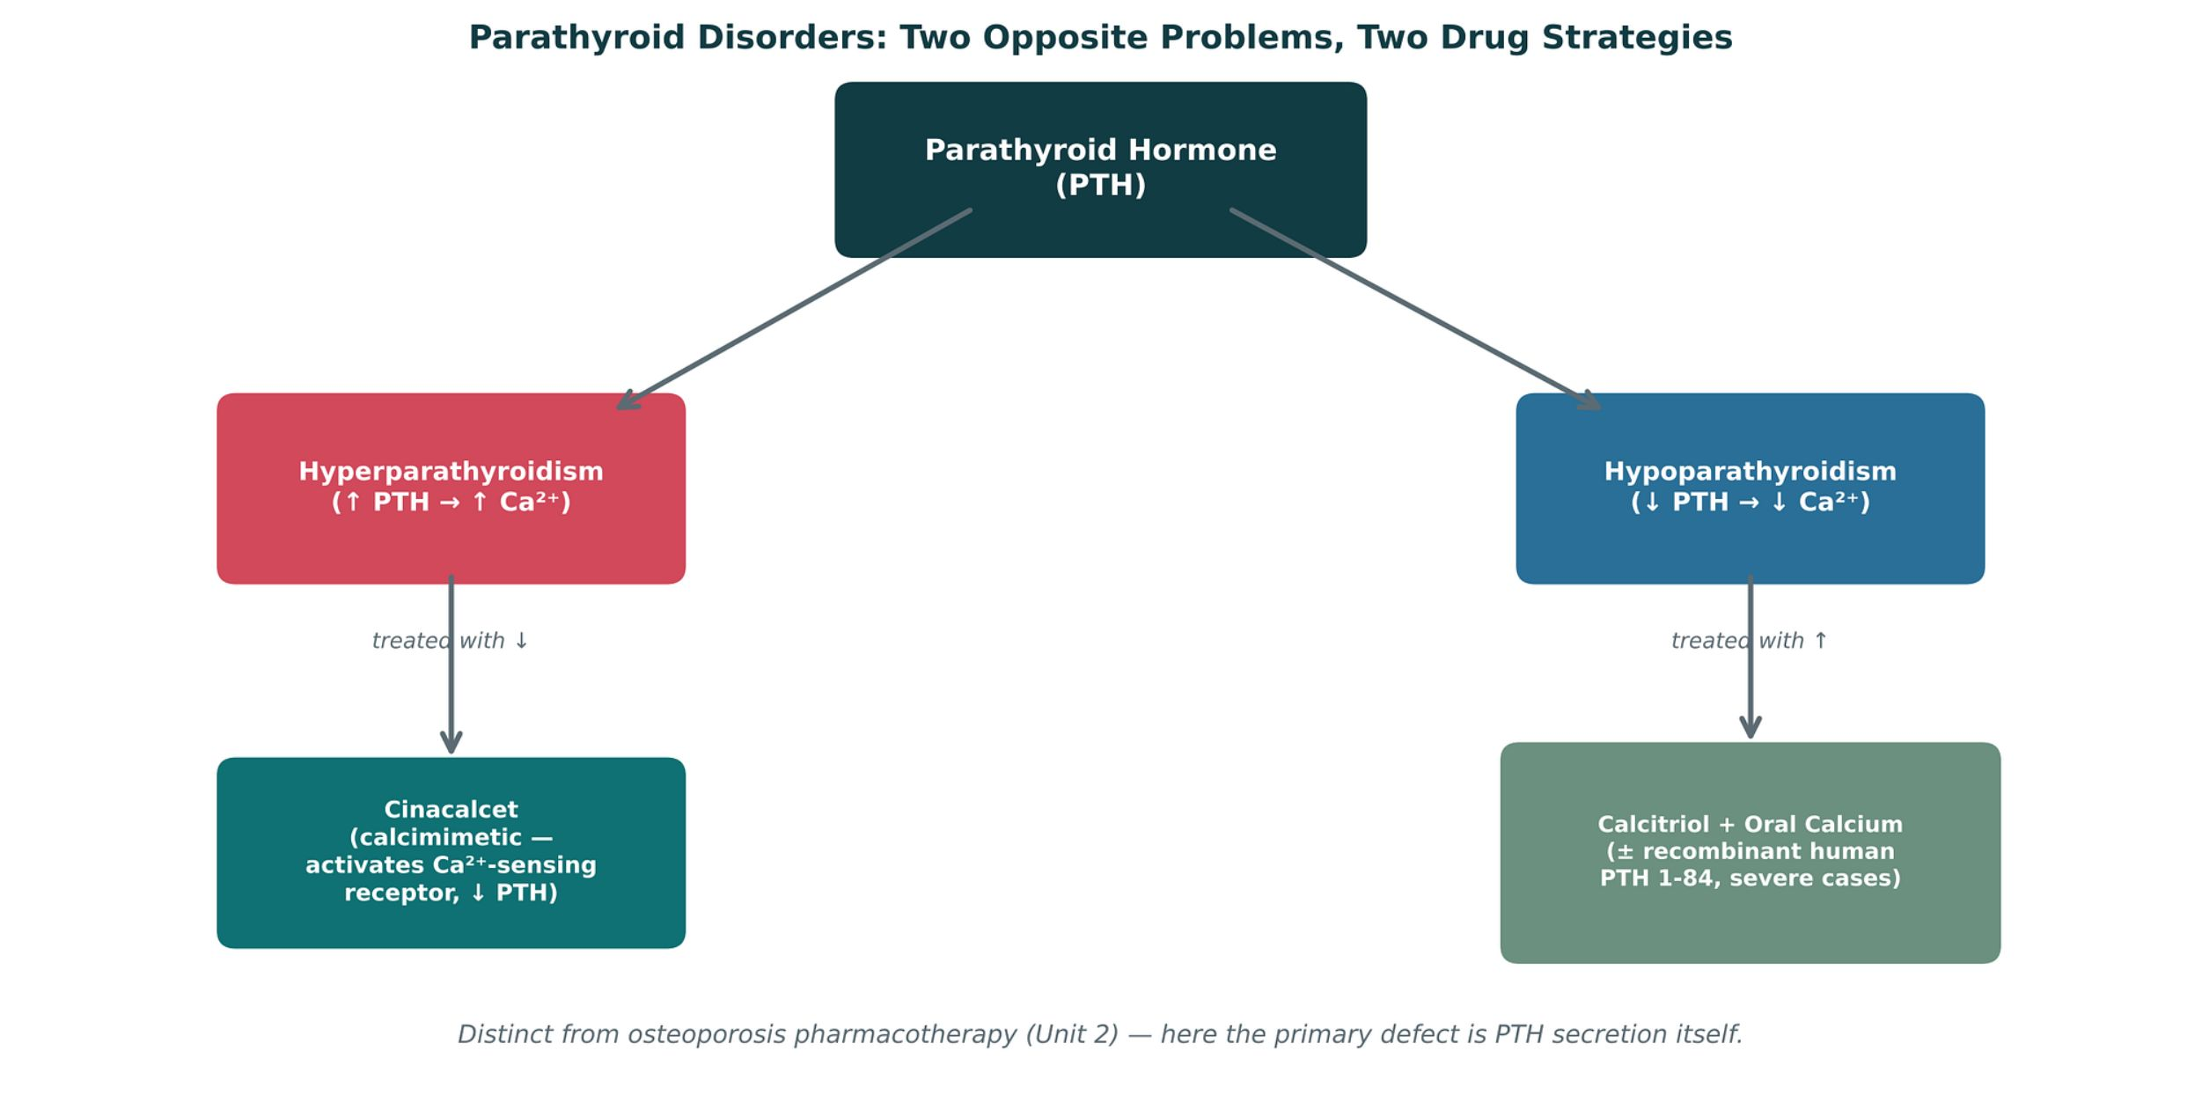
PARATHYROID DISORDERS
Objectives: SO3 · IO4.1 · IO4.4 · IO4.5
Figure 22 · Parathyroid disorders: two opposite strategies
Original illustrative diagram (not from Katzung): hyperparathyroidism (excess PTH, high calcium) → cinacalcet lowers PTH; hypoparathyroidism (deficient PTH, low calcium) → calcitriol plus oral calcium, sometimes recombinant PTH 1-84. S24; S24 (notes)
L08 · Endocrine Pharmacotherapy — Session 2
97

Slide 98
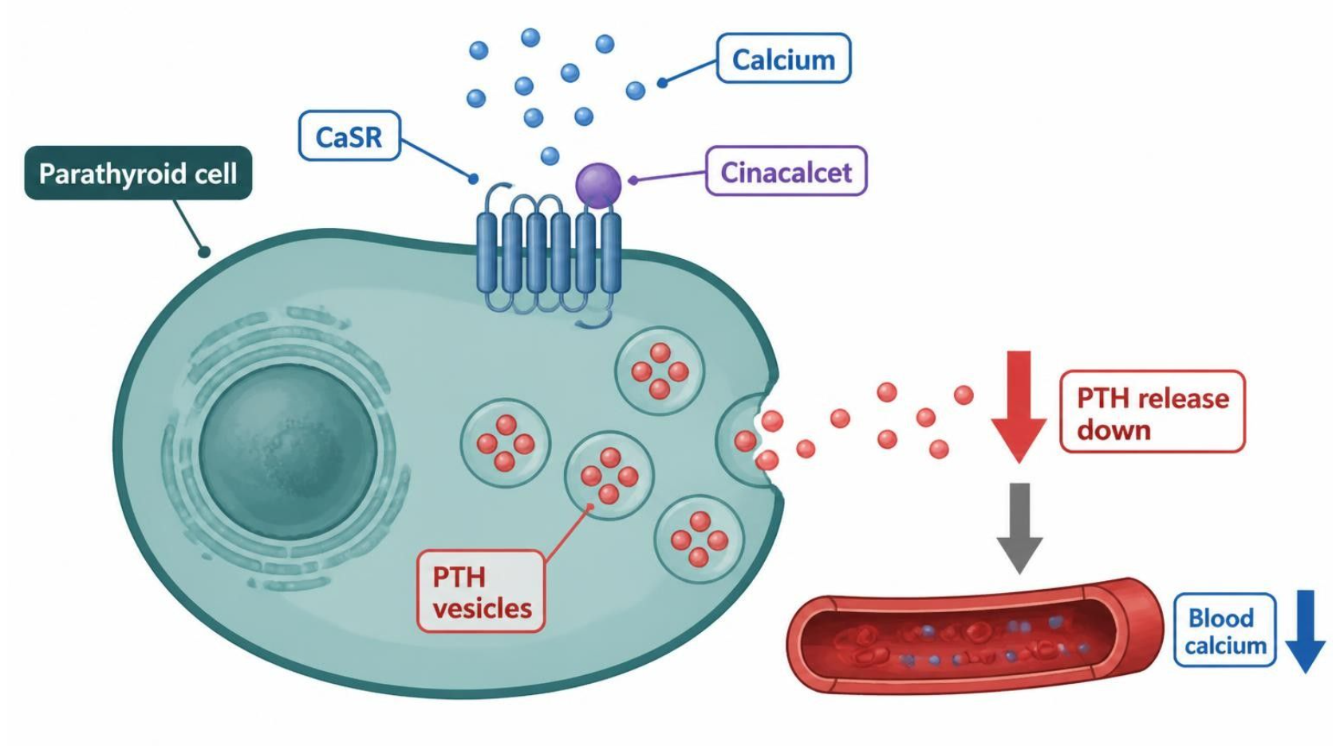
PARATHYROID DISORDERS
Objectives: SO3 · IO4.1 · IO4.4 · IO4.5
Figure 23 · Cinacalcet: tricking the calcium-sensing receptor
Schematic (illustrative) — Figure 23. Teal: sensing; blue: PTH steps; green-grey: drug; red: outcome, PTH and calcium fall. Cinacalcet sensitizes the CaSR so the cell reads calcium as high. S26; S26 (notes)
L08 · Endocrine Pharmacotherapy — Session 2
98

Slide 99
PARATHYROID DISORDERS
Objectives: SO3 · IO4.1 · IO4.4 · IO4.5
Compare: Hyperparathyroidism vs. hypoparathyroidism therapy (S25)
 | Hyperparathyroidism | Hypoparathyroidism
Drug | Cinacalcet (calcimimetic) | Calcitriol + oral calcium; PTH 1-84 if refractory
How | Activates CaSR → ↓ PTH | Bypasses the PTH-dependent vitamin D activation
Typical patient | CKD on dialysis; parathyroid carcinoma | Post-thyroidectomy
Monitor for | Hypocalcemia | Hypercalcemia / hypercalciuria
Focus: what tells these apart. Sources: S25; S26; S27
L08 · Endocrine Pharmacotherapy — Session 2
99

Slide 100
PARATHYROID DISORDERS
Objectives: SO3 · IO4.1 · IO4.4 · IO4.5
Compare: Parathyroid and calcium profiles: formulation, dose, indications
Drug | Class | Formulation | Adult dose | Indications
Cinacalcet (Sensipar) | Calcimimetic (CaSR activator) | Tablet 30/60/90 mg | 30 mg PO daily with food, titrate every 2-4 weeks (up to 180 mg/day) by PTH and calcium | Secondary hyperparathyroidism on dialysis, parathyroid carcinoma, primary hyperparathyroidism when surgery is not possible
Calcitriol (Rocaltrol) | Active vitamin D (1,25-dihydroxy) | Capsule 0.25/0.5 mcg; solution 1 mcg/mL; IV | Hypoparathyroidism: 0.25-2 mcg PO daily, titrated to calcium | Hypoparathyroidism, CKD secondary hyperparathyroidism, hypocalcemia
Focus: what tells these apart. Sources: S63; S64; S65; S66
L08 · Endocrine Pharmacotherapy — Session 2
100

Slide 101
PARATHYROID DISORDERS
Objectives: SO3 · IO4.1 · IO4.4 · IO4.5
Compare: Parathyroid and calcium profiles: formulation, dose, indications (cont.)
Drug | Class | Formulation | Adult dose | Indications
Recombinant PTH 1-84 (Natpara) | Parathyroid hormone replacement | SC pen cartridges 25/50/75/100 mcg | 50 mcg SC daily in the thigh, adjusted by 25 mcg up to 100 mcg | Hypoparathyroidism not controlled on calcium and vitamin D
Calcium carbonate or citrate | Calcium supplement | Carbonate 500-1,250 mg tablets; citrate tablets | 1,000-2,000 mg elemental calcium daily in divided doses (500-600 mg per dose) | Hypocalcemia, hypoparathyroidism, osteoporosis
Focus: what tells these apart. Sources: S63; S64; S65; S66
L08 · Endocrine Pharmacotherapy — Session 2
101

Slide 102
PARATHYROID DISORDERS
Objectives: SO3 · IO4.1 · IO4.4 · IO4.5
Compare: Parathyroid and calcium profiles: adverse effects, contraindications, toxicity
Drug | Adverse effects | Contraindications | Toxicity / overdose
Cinacalcet (Sensipar) | Nausea, vomiting, diarrhea, paresthesias, hypocalcemia | Hypocalcemia at start | Severe hypocalcemia (QT prolongation, seizures); CYP2D6 inhibitor; monitor calcium and PTH
Calcitriol (Rocaltrol) | Hypercalcemia, hypercalciuria, nausea, constipation | Hypercalcemia, vitamin D toxicity | Hypercalcemia, kidney stones, calcification; monitor calcium, phosphate, urine calcium
Recombinant PTH 1-84 (Natpara) | Hypercalcemia, hypocalcemia, paresthesias, headache | Hypersensitivity; caution with osteosarcoma risk factors | Boxed osteosarcoma warning; severe hypocalcemia if stopped abruptly; availability is restricted, so verify current status
Calcium carbonate or citrate | Constipation, bloating, hypercalcemia | Hypercalcemia, hypercalciuria, kidney stones | Hypercalcemia (especially with calcitriol); carbonate needs food and acid (citrate for PPI users); separate from levothyroxine
Focus: what tells these apart. Sources: S63; S64; S65; S66
L08 · Endocrine Pharmacotherapy — Session 2
102

Slide 103
PARATHYROID DISORDERS
Objectives: SO3 · IO4.1 · IO4.4 · IO4.5
Memory hooks
Why it happens
Why calcitriol, not plain vitamin D, after thyroidectomy? Activating vitamin D needs PTH; calcitriol is already active. S25; S35
L08 · Endocrine Pharmacotherapy — Session 2
103

Slide 104
PARATHYROID DISORDERS
Objectives: SO3 · IO4.1 · IO4.4 · IO4.5
High-yield summary
If you remember nothing else
High PTH (CKD) → cinacalcet, watch hypocalcemia; low PTH (post-thyroidectomy) → calcitriol + calcium, watch hypercalcemia. S25; S27
L08 · Endocrine Pharmacotherapy — Session 2
104

Slide 105
CLINICAL VIGNETTE · LECTURE QUICK CHECK S34; S35
Objectives: SO3 · IO4.1 · IO4.4 · IO4.5
Question 15
After thyroidectomy, a patient has perioral numbness, low calcium and low PTH. Which therapy is the mainstay?
A
Calcitriol plus oral calcium
B
Levothyroxine plus methimazole
C
Plain cholecalciferol alone
D
Bisphosphonate plus denosumab
E
Cinacalcet alone
L08 · Endocrine Pharmacotherapy — Session 2
105
Notes:
Answer on the next slide. Source: S27; S34; S35

Slide 106
CLINICAL VIGNETTE · ANSWER
Objectives: SO3 · IO4.1 · IO4.4 · IO4.5
Answer 15: A
A. Calcitriol plus oral calcium
PTH is needed to activate vitamin D; calcitriol bypasses it, with oral calcium (S35). S27; S34; S35
Why the other choices are wrong
B. Levothyroxine plus methimazole — Thyroid drugs (S35).
C. Plain cholecalciferol alone — Needs activation by PTH (S25).
D. Bisphosphonate plus denosumab — Osteoporosis drugs (S35).
E. Cinacalcet alone — Lowers PTH — wrong direction (S35).
L08 · Endocrine Pharmacotherapy — Session 2
106

Slide 107
CLINICAL VIGNETTE · LECTURE QUICK CHECK S27
Objectives: SO3 · IO4.1 · IO4.4 · IO4.5
Question 16
A dialysis patient has an elevated PTH with low-normal calcium. Which drug lowers PTH secretion?
A
Calcium carbonate
B
Cinacalcet
C
Teriparatide
D
Recombinant PTH 1-84
E
Calcitriol
L08 · Endocrine Pharmacotherapy — Session 2
107
Notes:
Answer on the next slide. Source: S25; S27

Slide 108
CLINICAL VIGNETTE · ANSWER
Objectives: SO3 · IO4.1 · IO4.4 · IO4.5
Answer 16: B
B. Cinacalcet
Calcimimetic for secondary hyperparathyroidism in CKD; monitor for hypocalcemia (S25–S27). S25; S27
Why the other choices are wrong
A. Calcium carbonate — Supplement (S66).
C. Teriparatide — Unit 2 osteoporosis (S23).
D. Recombinant PTH 1-84 — Adds PTH (S25).
E. Calcitriol — Hypoparathyroidism (S25).
L08 · Endocrine Pharmacotherapy — Session 2
108

Slide 109
MECHANISM
Objectives: SO3 · IO4.1 · IO4.4 · IO4.5
Question 17
What should be monitored after starting cinacalcet?
A
Glucose for hypoglycemia
B
Potassium for hyperkalemia
C
TSH for hypothyroidism
D
Calcium for hypercalcemia
E
Serum calcium for hypocalcemia
L08 · Endocrine Pharmacotherapy — Session 2
109
Notes:
Answer on the next slide. Source: S25; S26

Slide 110
MECHANISM · ANSWER
Objectives: SO3 · IO4.1 · IO4.4 · IO4.5
Answer 17: E
E. Serum calcium for hypocalcemia
Cinacalcet lowers PTH and calcium; monitor for hypocalcemia (and QT) (S25–S26). S25; S26
Why the other choices are wrong
A. Glucose for hypoglycemia — Not the taught target (S26).
B. Potassium for hyperkalemia — Not the taught target (S26).
C. TSH for hypothyroidism — Not the taught target (S26).
D. Calcium for hypercalcemia — That is calcitriol (S25).
L08 · Endocrine Pharmacotherapy — Session 2
110

Slide 111


Topic 5 of 5
Putting It All Together: Endocrine Toolkit
Covers objectives: SO5 · IO4.3 · IO4.4 · IO4.6
Key definitions
How it works
Clinical relevance
Drugs named as examples
Exam traps
111

Slide 112
PUTTING IT ALL TOGETHER: ENDOCRINE TOOLKIT
Objectives: SO5 · IO4.3 · IO4.4 · IO4.6
Key definitions
Key definitions
Applying the whole Endocrine pharmacology toolkit. The shared principle is negative feedback suppression by exogenous hormone. For each patient, name a first-line approach AND the single biggest safety concern. S29; S29 (notes); S30 (notes)
L08 · Endocrine Pharmacotherapy — Session 2
112

Slide 113
PUTTING IT ALL TOGETHER: ENDOCRINE TOOLKIT
Objectives: SO5 · IO4.3 · IO4.4 · IO4.6
How it works
How it works (1/2)
1. The hypothalamic-pituitary-target gland axis is a shared template across thyroid, adrenal, and gonadal pharmacology — exogenous hormone therapy suppresses the levels above it via negative feedback. S31
2. Antithyroid drug selection (methimazole vs. PTU) and glucocorticoid tapering both hinge on understanding exactly where and how each drug intervenes in its pathway. S31
3. Glucose-lowering drugs act at distinct sites (pancreas, liver, muscle/fat, kidney, gut, incretin axis) — drug selection balances efficacy against hypoglycemia and other class-specific risks. S31
L08 · Endocrine Pharmacotherapy — Session 2
113

Slide 114
PUTTING IT ALL TOGETHER: ENDOCRINE TOOLKIT
Objectives: SO5 · IO4.3 · IO4.4 · IO4.6
How it works (cont.)
How it works (2/2)
4. Hyperparathyroidism and hypoparathyroidism require opposite drug strategies (lowering vs. raising effective PTH activity) — a new angle distinct from, but related to, the osteoporosis pharmacotherapy of Unit 2. S31
5. Endocrine pharmacology is deeply interconnected — spironolactone, dopamine agonists, and SERMs each reappear across more than one organ system in this unit alone. S31
Connecting back: osteoporosis pharmacology (Unit 2) and drug-metabolism/interaction concepts (Unit 1) both reappear here — pharmacology is cumulative, not siloed by unit. S31 (notes)
L08 · Endocrine Pharmacotherapy — Session 2
114

Slide 115
PUTTING IT ALL TOGETHER: ENDOCRINE TOOLKIT
Objectives: SO5 · IO4.3 · IO4.4 · IO4.6
Clinical relevance
Clinical relevance
Patient A — Graves disease, in thyroid storm: PTU (blocks synthesis and peripheral T4-to-T3 conversion); check liver toxicity. S30; S35
Patient B — chronic prednisone user, abruptly out of refills: restart the glucocorticoid and taper; the risk is adrenal insufficiency from HPA suppression. S30; S35
Patient C — type 2 diabetes, older adult with fall history, needs add-on therapy: DPP-4 or SGLT2 inhibitor; avoid sulfonylurea hypoglycemia. S30; S21
Patient D — post-thyroidectomy, perioral numbness and low calcium: calcitriol plus calcium; monitor for hypercalcemia. S30; S27
L08 · Endocrine Pharmacotherapy — Session 2
115

Slide 116
PUTTING IT ALL TOGETHER: ENDOCRINE TOOLKIT
Objectives: SO5 · IO4.3 · IO4.4 · IO4.6
Drugs named as examples
Drugs named as examples (1/2)
A cumulative self-test spanning both sessions — use this to review before exams. The recall quiz is a standalone resource, separate from in-lecture quick checks. S32; S32 (notes); S35 (notes)
Recall Q1: PTU blocks both new thyroid hormone synthesis and peripheral T4-to-T3 conversion, giving it a faster effect on circulating active hormone than methimazole — important in thyroid storm. S33; S35
Recall Q2: a patient on chronic glucocorticoid therapy abruptly stops the medication and develops hypotension and weakness: HPA-axis suppression leaves endogenous cortisol production unable to resume quickly. S33; S35
Chronic exogenous glucocorticoid exposure suppresses CRH/ACTH via negative feedback (Figure 9), reducing the adrenal cortex’s stimulus; abrupt withdrawal does not give the axis time to recover, precipitating adrenal insufficiency. S35
L08 · Endocrine Pharmacotherapy — Session 2
116

Slide 117
PUTTING IT ALL TOGETHER: ENDOCRINE TOOLKIT
Objectives: SO5 · IO4.3 · IO4.4 · IO4.6
Drugs named as examples (cont.)
Drugs named as examples (2/2)
Recall Q3: smoking at 35 or older contraindicates estrogen-containing contraception (thromboembolic and cardiovascular risk). Q4: sulfonylureas force K-ATP closure regardless of glucose; incretins act only when glucose is high. S33; S34; S35
Recall Q4 distractor: DPP-4 inhibitors do affect insulin secretion — they prolong GLP-1’s glucose-dependent effect. S34; S35
Recall Q5: a patient with hypoparathyroidism after thyroid surgery needs treatment — the mainstay is calcitriol plus oral calcium: because PTH is required to activate vitamin D, calcitriol (already-active vitamin D) bypasses that activation step. S34; S35; SG U4-R13
Recall Q6: SGLT2 inhibitors block renal glucose reabsorption, increasing urinary glucose excretion and creating a favorable environment for genital fungal overgrowth — a mechanism-based adverse effect. S34; S35; SG U4-R12
L08 · Endocrine Pharmacotherapy — Session 2
117

Slide 118
PUTTING IT ALL TOGETHER: ENDOCRINE TOOLKIT
Objectives: SO5 · IO4.3 · IO4.4 · IO4.6
Exam traps
Exam traps
Choosing the most potent glucose-lowering drug instead of the safest for an older adult who falls. S21 (notes)
Integrated case — diabetes: a DPP-4 or SGLT2 inhibitor is preferable to a sulfonylurea given the fall history — sulfonylureas force glucose-independent insulin release, raising hypoglycemia-driven fall risk. SG U4-S
Integrated case — thyroid storm: beta-blocker + PTU first, then iodine solution only after PTU (never before — iodine first would supply substrate for new hormone synthesis before synthesis is blocked, worsening the crisis). SG U4-S
Corticosteroids also help in thyroid storm by blunting peripheral conversion and covering relative adrenal insufficiency. SG U4-S
Shared concept: effective endocrine drug selection depends on knowing exactly where in a pathway (or which receptor/site) a drug acts — that position determines both its efficacy and its specific risks. SG U4-S
L08 · Endocrine Pharmacotherapy — Session 2
118

Slide 119
PUTTING IT ALL TOGETHER: ENDOCRINE TOOLKIT
Objectives: SO5 · IO4.3 · IO4.4 · IO4.6
Compare: Which drug would you choose? (S30)
Patient | Approach | Biggest safety check
A · Graves disease, thyroid storm | PTU | Liver toxicity
B · Chronic prednisone, out of refills | Restart and taper the glucocorticoid | Adrenal insufficiency
C · Older adult with type 2 diabetes and falls | DPP-4 or SGLT2 inhibitor | Avoid sulfonylurea hypoglycemia
D · Post-thyroidectomy, low calcium | Calcitriol + calcium | Hypercalcemia
Focus: what tells these apart. Sources: S30; S35
L08 · Endocrine Pharmacotherapy — Session 2
119

Slide 120
PUTTING IT ALL TOGETHER: ENDOCRINE TOOLKIT
Objectives: SO5 · IO4.3 · IO4.4 · IO4.6
Compare: Supporting drugs at a glance (S67)
Drug(s) | Why it matters here
Rifampin, carbamazepine, phenytoin | CYP inducers that lower contraceptive efficacy
Paroxetine and fluoxetine | CYP2D6 inhibitors that blunt tamoxifen activation
Glucagon and dextrose | Rescue for severe hypoglycemia
Beta-blockers | Can mask hypoglycemia symptoms
Iodinated contrast | Hold metformin in reduced kidney function
Gemfibrozil | Raises repaglinide levels (CYP2C8)
Bisphosphonates and denosumab | Osteoporosis agents covered in Unit 2
Thiazide and loop diuretics | Thiazides raise calcium, loops lower it
Vitamin D (cholecalciferol) | Replaces or supports calcitriol in deficiency
Focus: what tells these apart. Sources: S67; S67 (notes)
L08 · Endocrine Pharmacotherapy — Session 2
120

Slide 121
PUTTING IT ALL TOGETHER: ENDOCRINE TOOLKIT
Objectives: SO5 · IO4.3 · IO4.4 · IO4.6
Memory hooks
Mnemonic (memory aid)
Every case, two answers: the approach and the one thing to check. S30 (notes)
L08 · Endocrine Pharmacotherapy — Session 2
121

Slide 122
PUTTING IT ALL TOGETHER: ENDOCRINE TOOLKIT
Objectives: SO5 · IO4.3 · IO4.4 · IO4.6
High-yield summary
If you remember nothing else
Five takeaways: shared axis template · know where each drug intervenes · glucose drugs by site · opposite parathyroid strategies · cross-system drugs. S31
L08 · Endocrine Pharmacotherapy — Session 2
122

Slide 123
MECHANISM · LECTURE QUICK CHECK S33; S35
Objectives: SO5 · IO4.3 · IO4.4 · IO4.6
Question 18
Why is PTU, rather than methimazole, preferred in thyroid storm?
A
PTU also blocks peripheral T4-to-T3 conversion
B
PTU is better absorbed orally
C
PTU has no hepatotoxicity risk
D
PTU works faster at iodide trapping
E
PTU is longer acting than methimazole
L08 · Endocrine Pharmacotherapy — Session 2
123
Notes:
Answer on the next slide. Source: S33; S35

Slide 124
MECHANISM · ANSWER
Objectives: SO5 · IO4.3 · IO4.4 · IO4.6
Answer 18: A
A. PTU also blocks peripheral T4-to-T3 conversion
PTU blocks synthesis and peripheral conversion, a faster effect on active hormone (S35). S33; S35
Why the other choices are wrong
B. PTU is better absorbed orally — Not the reason (S35).
C. PTU has no hepatotoxicity risk — Not true (S35).
D. PTU works faster at iodide trapping — Not the reason (S35).
E. PTU is longer acting than methimazole — Not the reason (S35).
L08 · Endocrine Pharmacotherapy — Session 2
124

Slide 125
MECHANISM · LECTURE QUICK CHECK S33; S35
Objectives: SO5 · IO4.3 · IO4.4 · IO4.6
Question 19
A patient on chronic prednisone stops abruptly and becomes hypotensive and weak. What is the mechanism?
A
Excess aldosterone production
B
Direct adrenal destruction by the drug
C
Suppressed HPA axis cannot restart quickly
D
An allergic reaction to prednisone
E
Prednisone-induced hypoglycemia
L08 · Endocrine Pharmacotherapy — Session 2
125
Notes:
Answer on the next slide. Source: S33; S35

Slide 126
MECHANISM · ANSWER
Objectives: SO5 · IO4.3 · IO4.4 · IO4.6
Answer 19: C
C. Suppressed HPA axis cannot restart quickly
Chronic glucocorticoids suppress CRH/ACTH; abrupt withdrawal precipitates adrenal insufficiency (S35). S33; S35
Why the other choices are wrong
A. Excess aldosterone production — Not the mechanism (S35).
B. Direct adrenal destruction by the drug — Suppression, not destruction (S35).
D. An allergic reaction to prednisone — Not the mechanism (S35).
E. Prednisone-induced hypoglycemia — Not the mechanism (S35).
L08 · Endocrine Pharmacotherapy — Session 2
126

Slide 127
CLINICAL VIGNETTE · LECTURE QUICK CHECK S33; S35
Objectives: SO5 · IO4.3 · IO4.4 · IO4.6
Question 20
Which counseling point reflects a true contraindication to estrogen-containing contraception?
A
Age under 20 at the first visit
B
Smoking at age 35 or older
C
Mild seasonal allergies each spring
D
Regular moderate exercise
E
Family history of type 2 diabetes
L08 · Endocrine Pharmacotherapy — Session 2
127
Notes:
Answer on the next slide. Source: S33; S35

Slide 128
CLINICAL VIGNETTE · ANSWER
Objectives: SO5 · IO4.3 · IO4.4 · IO4.6
Answer 20: B
B. Smoking at age 35 or older
Smoking at 35 or older raises thromboembolic and cardiovascular risk (S35). S33; S35
Why the other choices are wrong
A. Age under 20 at the first visit — Not a contraindication (S35).
C. Mild seasonal allergies each spring — Not a contraindication (S35).
D. Regular moderate exercise — Not a contraindication (S35).
E. Family history of type 2 diabetes — Not a contraindication (S35).
L08 · Endocrine Pharmacotherapy — Session 2
128

