Slide 1
L11 · Tue, Nov 24, 2026
Genitourinary & Reproductive Pharmacology — Session 1
Pharmacology study deck · organized by drug class
How to read this deck
TB = textbook only (not on the lecture slides)
SG = course study guide only (not on the lecture slides)
Bold = emphasized on the lecture slides
S12 = lecture slide 12 · p. 245 = textbook page 245 · SG U1-R3 = study guide item

Slide 2
START HERE
Learning objectives
IO6.1
Identify major pharmacologic classes used in the management of genitourinary and reproductive conditions and describe their mechanisms of action.
Estrogens, Progestins & Contraception, SERMs, Aromatase Inhibitors & Androgens, PCOS & the Reproductive-Metabolic Overlap
IO6.2
Describe the indications, contraindications, adverse effects, and clinically significant interactions associated with medications used to treat genitourinary and reproductive conditions.
Estrogens, Progestins & Contraception, SERMs, Aromatase Inhibitors & Androgens
IO6.3
Compare pharmacologic agents within and across therapeutic classes to distinguish clinically relevant differences in efficacy, safety, and use.
SERMs, Aromatase Inhibitors & Androgens, PCOS & the Reproductive-Metabolic Overlap
IO6.4
Select appropriate pharmacologic therapy for common genitourinary and reproductive conditions based on clinical presentation and patient-specific factors.
Estrogens, Progestins & Contraception, PCOS & the Reproductive-Metabolic Overlap
L11 · Genitourinary & Reproductive Pharmacology — Session 1
2

Slide 3
START HERE
Learning objectives (cont.)
IO6.5
Identify appropriate dosing, administration, and monitoring considerations for medications used in genitourinary and reproductive conditions.
SERMs, Aromatase Inhibitors & Androgens, PCOS & the Reproductive-Metabolic Overlap
IO6.6
Explain important medication-use and safety information to patients receiving genitourinary and reproductive pharmacotherapy.
Estrogens, Progestins & Contraception
SO1
Describe the physiologic roles and clinical uses of estrogens and progestins, including combined and progestin-only hormonal contraception.
Estrogens, Progestins & Contraception
SO2
Describe the mechanism, tissue-selective actions, and adverse effects of selective estrogen receptor modulators (SERMs) and aromatase inhibitors.
SERMs, Aromatase Inhibitors & Androgens
L11 · Genitourinary & Reproductive Pharmacology — Session 1
3

Slide 4
START HERE
Learning objectives (cont.)
SO3
Describe the clinical uses, adverse effects, and monitoring considerations for androgens and antiandrogens.
SERMs, Aromatase Inhibitors & Androgens
SO4
Explain the pathophysiology of polycystic ovary syndrome (PCOS) as a reproductive-metabolic overlap condition, including the central role of insulin resistance.
PCOS & the Reproductive-Metabolic Overlap
SO5
Describe the role of metformin and other antidiabetic agents in the management of PCOS and related reproductive-metabolic conditions.
PCOS & the Reproductive-Metabolic Overlap
L11 · Genitourinary & Reproductive Pharmacology — Session 1
4

Slide 5

START HERE
About this lecture
Scope, readings & sources
PA PHARMACOLOGY COURSE · LECTURE 6 · SESSION 1 OF 2 — Genitourinary & Reproductive Pharmacology. Session 1: Gonadal Hormones and the Reproductive-Metabolic Overlap | Tuesday, November 24 | 8:30–11:00 AM S1
Organizing idea: the hypothalamic-pituitary-gonadal axis. Every drug in this session replaces a sex steroid, blocks its receptor, blocks its synthesis, or reduces the metabolic driver, insulin resistance, that fuels androgen excess in PCOS. S1 (notes)
Arc: gonadal steroid pharmacology first (estrogens, progestins, SERMs, aromatase inhibitors, androgens/antiandrogens), then the reproductive-metabolic overlap through PCOS. S2 (notes)
Preview: autonomic pharmacology of the bladder and lower urinary tract continues in Session 2 (Tuesday, December 1) — mechanistically distinct, but sharing cross-system classes (alpha1 blockers, NO-cGMP signaling). S2; S2 (notes)
L11 · Genitourinary & Reproductive Pharmacology — Session 1
5

Slide 6
START HERE
About this lecture (cont.)
Scope, readings & sources
Readings: Katzung chapter 40 (The Gonadal Hormones and Inhibitors) and selected sections of chapter 41 (Pancreatic Hormones & Antidiabetic Drugs) focused on the reproductive/metabolic overlap (e.g., PCOS and insulin resistance). S3; S3 (notes)
Chapter 6 (Introduction to Autonomic Pharmacology) — the sections on Autonomic Receptors and Non-Adrenergic, Noncholinergic (NANC) Neurons — supports Session 2’s bladder and lower urinary tract content, not today. S3; S3 (notes)
Required text: Katzung’s Basic and Clinical Pharmacology, 16th Edition (Todd W. Vanderah, 2024/2025, McGraw-Hill Education; ISBN 1260463303 eBook). Pharmacotherapy Principles and Practice (Chisholm-Burns et al., 2022) remains additional support alongside all assigned chapters. S3
Appendix 1 — Drug Profiles: study reference for the drugs covered in Session 1. Know the dose logic, the serious adverse effect, the contraindication that changes decisions and the toxicity you would need to recognize. S28; S28 (notes)
L11 · Genitourinary & Reproductive Pharmacology — Session 1
6

Slide 7
START HERE
About this lecture (cont.)
Scope, readings & sources
Abbreviation key PO = by mouth IM = intramuscular IV = intravenous SC = subcutaneous BID / TID = twice / three times daily ER = extended-release IUD = intrauterine device DMPA = depot medroxyprogesterone acetate S28; S28 (notes)
GnRH = gonadotropin-releasing hormone VTE = venous thromboembolism DVT / PE = deep vein thrombosis / pulmonary embolism MI = myocardial infarction PCOS = polycystic ovary syndrome BPH = benign prostatic hyperplasia S28; S28 (notes)
PSA = prostate-specific antigen CBC = complete blood count CYP = cytochrome P450 GI = gastrointestinal DCIS = ductal carcinoma in situ eGFR / CrCl = estimated glomerular filtration rate / creatinine clearance ER-positive = estrogen receptor-positive S28; S28 (notes)
Standard adult dosing for teaching; verify against current prescribing information. S29-44
L11 · Genitourinary & Reproductive Pharmacology — Session 1
7

Slide 8
START HERE
About this lecture (cont.)
Scope, readings & sources
Appendix 2: DRUG PROFILE · SUPPORTING — supporting drugs explain interactions. Listed for context; not profiled in detail. S45; S45 (notes)
Original figures in this deck: Figures 2, 4 and 7 (The Hypothalamic-Pituitary-Gonadal (HPG) Axis: Sites of Hormonal Drug Action; Two Ways to Reduce Estrogen Signaling: SERMs vs. Aromatase Inhibitors; The PCOS–Insulin Resistance Cycle) were generated by the course director using the AI tool Claude. S46
They are original diagrams, not reproduced from Katzung’s Basic and Clinical Pharmacology or any other copyrighted source. Mechanism illustrations: Figures 1, 3, 5, 6 and 8 are illustrative AI-generated schematics. Reference: Anthropic. (2026). Claude (Sonnet 5) [Large language model]. https://claude.ai S46; S46 (notes)
L11 · Genitourinary & Reproductive Pharmacology — Session 1
8

Slide 9
ROADMAP
Drug classes in this lecture
Estrogens, Progestins & Contraception
Objectives: SO1, IO6.1, IO6.2, IO6.4, IO6.6
1
SERMs, Aromatase Inhibitors & Androgens
Objectives: SO2, SO3, IO6.1, IO6.2, IO6.3, IO6.5
2
PCOS & the Reproductive-Metabolic Overlap
Objectives: SO4, SO5, IO6.1, IO6.3, IO6.4, IO6.5
3
L11 · Genitourinary & Reproductive Pharmacology — Session 1
9

Slide 10










Drug class 1 of 3
Estrogens, Progestins & Contraception
Covers objectives: SO1 · IO6.1 · IO6.2 · IO6.4 · IO6.6
Class
Prototype
Mechanism of action
Indications
Adverse effects
Contraindications
Drug interactions
Pharmacokinetics
Monitoring
Clinical pearls
10

Slide 11
ESTROGENS, PROGESTINS & CONTRACEPTION
Objectives: SO1 · IO6.1 · IO6.2 · IO6.4 · IO6.6
Class
Class
The two core gonadal steroid classes, and how they are combined for contraception and hormone therapy. S4
Figure 2. Original illustrative diagram (not from Katzung): GnRH drives FSH/LH release, which drives gonadal sex-steroid production, which in turn negatively feeds back on the hypothalamus and pituitary — S8
with four distinct classes of drugs intervening at different points along this axis. This is the organizing map for the session: GnRH agonists/antagonists, SERMs, aromatase inhibitors and antiandrogens each anchor to a point on it. S8; S8 (notes)
L11 · Genitourinary & Reproductive Pharmacology — Session 1
11

Slide 12
ESTROGENS, PROGESTINS & CONTRACEPTION
Objectives: SO1 · IO6.1 · IO6.2 · IO6.4 · IO6.6
Prototype + other drugs named
Prototype + other drugs named
Estradiol and ethinyl estradiol (estrogens); norethindrone, medroxyprogesterone, levonorgestrel (progestins); combined oral contraceptives. S5; S6; S26
L11 · Genitourinary & Reproductive Pharmacology — Session 1
12

Slide 13
ESTROGENS, PROGESTINS & CONTRACEPTION
Objectives: SO1 · IO6.1 · IO6.2 · IO6.4 · IO6.6
Mechanism of action
Mechanism of action (1/2)
Mechanism: bind intracellular estrogen receptors (ER-alpha, ER-beta), regulating gene transcription in reproductive, bone, cardiovascular, and CNS tissue. S5; S4 (notes); SG U6-R1
Estrogen physiologic effects: endometrial proliferation, breast development, bone density maintenance, favorable lipid profile effects (↑ HDL, ↓ LDL). S5; SG U6-R1
Mechanism: bind progesterone receptors, counteracting estrogen-driven endometrial proliferation and thickening cervical mucus. S6
Unopposed estrogen chain (Figure 1): estrogen binds ER in the endometrium → proliferation and thickening of the lining → without progestin: hyperplasia and cancer risk → progestin binds PR: limits proliferation, matures the endometrium. S7; S7 (notes)
L11 · Genitourinary & Reproductive Pharmacology — Session 1
13

Slide 14
ESTROGENS, PROGESTINS & CONTRACEPTION
Objectives: SO1 · IO6.1 · IO6.2 · IO6.4 · IO6.6
Mechanism of action (cont.)
Mechanism of action (2/2)
Unopposed estrogen drives unchecked endometrial proliferation; a progestin counteracts this proliferation. SG U6-R2
Combined methods (oral pills, transdermal patch, vaginal ring) suppress ovulation via negative feedback on FSH/LH. S9
TB Estrogens raise hepatic clotting factors II, VII, IX and X and lower antithrombin III — the basis of the clotting risk; transdermal or vaginal routes avoid first-pass liver exposure. p. 761; p. 762
L11 · Genitourinary & Reproductive Pharmacology — Session 1
14

Slide 15
ESTROGENS, PROGESTINS & CONTRACEPTION
Objectives: SO1 · IO6.1 · IO6.2 · IO6.4 · IO6.6
Indications
Indications (1/2)
Estrogen clinical uses: hormonal contraception (combined with a progestin), menopausal hormone therapy for vasomotor symptoms, and hypogonadism. S5
Progestins: a required component of combined hormonal contraception (protects the endometrium from unopposed estrogen), progestin-only contraception, and management of abnormal uterine bleeding. S6
Progestin-only methods — the "mini-pill," depot medroxyprogesterone acetate (DMPA) injection, the subdermal implant, and the levonorgestrel intrauterine system — avoid estrogen-related VTE risk entirely. S6; S9; SG U6-R4
Combined methods are often chosen for added benefits: cycle regulation, acne/hirsutism improvement. S9
L11 · Genitourinary & Reproductive Pharmacology — Session 1
15

Slide 16
ESTROGENS, PROGESTINS & CONTRACEPTION
Objectives: SO1 · IO6.1 · IO6.2 · IO6.4 · IO6.6
Indications (cont.)
Indications (2/2)
When estrogen is contraindicated, a progestin-only method is not a compromise — it is often the correct first choice (safe with VTE history, migraine with aura, or smokers over 35). S9; S9 (notes)
TB Postmenopausal hormonal therapy: vasomotor symptoms, genital atrophy and bone loss; after hysterectomy estrogen alone is fine because no progestin is needed. p. 762; p. 763
TB An implantable progestin preparation (subdermal implant) provides long-acting progestin-only contraception. p. 768
TB Contraception with progestins alone suits patients with hepatic disease, hypertension, or prior thromboembolism. p. 773
L11 · Genitourinary & Reproductive Pharmacology — Session 1
16

Slide 17
ESTROGENS, PROGESTINS & CONTRACEPTION
Objectives: SO1 · IO6.1 · IO6.2 · IO6.4 · IO6.6
Adverse effects (boxed warnings first)
Adverse effects (boxed warnings first) (1/2)
Adverse effects: venous thromboembolism (VTE) risk, increased risk with smoking and age over 35, nausea, breast tenderness, and a possible increase in certain hormone-sensitive cancer risks with long-term use. S5
Estrogen’s VTE risk is the single most tested adverse effect: know the risk factors (smoking, age > 35, personal/family VTE history) that shift a patient from "candidate" to "contraindicated." S5 (notes)
Adverse effects: irregular bleeding/spotting (especially early in use), mood changes, and — with DMPA specifically — reversible bone mineral density loss with prolonged use. S6; S9; SG U6-R4
L11 · Genitourinary & Reproductive Pharmacology — Session 1
17

Slide 18
ESTROGENS, PROGESTINS & CONTRACEPTION
Objectives: SO1 · IO6.1 · IO6.2 · IO6.4 · IO6.6
Adverse effects (boxed warnings first) (cont.)
Adverse effects (boxed warnings first) (2/2)
Unopposed estrogen (estrogen without a progestin) in a patient with a uterus significantly increases endometrial cancer risk — this is why progestin-only or combined regimens, never estrogen alone, are used in patients with an intact uterus. S6; SG U6-R2
TB Oral contraceptive VTE risk tracks the estrogen, not the progestin; factor V Leiden and other inherited clotting disorders markedly raise it. p. 772
TB Estrogen therapy also increases migraine, cholestasis, gallbladder disease and hypertension; oral contraceptives raise hepatic adenoma risk. p. 764; p. 772
L11 · Genitourinary & Reproductive Pharmacology — Session 1
18

Slide 19
ESTROGENS, PROGESTINS & CONTRACEPTION
Objectives: SO1 · IO6.1 · IO6.2 · IO6.4 · IO6.6
Contraindications
Contraindications
Estrogen contraindications: history of VTE, estrogen-sensitive breast cancer, uncontrolled hypertension, and smokers over age 35 — all raise cardiovascular/thrombotic risk substantially. Smoking combined with age over 35 makes a progestin-only method (no estrogen, no added VTE risk) the appropriate choice. S5; S5 (notes); SG U6-R3
Combined methods carry estrogen-related VTE risk — require screening for contraindications. Hysterectomy patients can take estrogen alone. S7; S9
TB Contraindications & cautions: thrombophlebitis or past thromboembolism, cardiovascular or cerebrovascular disease, estrogen-dependent cancer, undiagnosed genital bleeding, liver disease. p. 764; p. 773
L11 · Genitourinary & Reproductive Pharmacology — Session 1
19

Slide 20
ESTROGENS, PROGESTINS & CONTRACEPTION
Objectives: SO1 · IO6.1 · IO6.2 · IO6.4 · IO6.6
Drug interactions · Pharmacokinetics
Drug interactions
Pharmacokinetics
Enzyme inducers (rifampin, carbamazepine, phenytoin, St. John’s wort) lower combined contraceptive efficacy. S45; S45 (notes)
TB Rifampin and phenytoin speed estrogen/progestin metabolism, and antibiotics that disturb gut flora may cut enterohepatic recycling — both can cause contraceptive failure. p. 771; p. 773
Not covered in materials
L11 · Genitourinary & Reproductive Pharmacology — Session 1
20

Slide 21
ESTROGENS, PROGESTINS & CONTRACEPTION
Objectives: SO1 · IO6.1 · IO6.2 · IO6.4 · IO6.6
Monitoring · Clinical pearls / "why" hook
Monitoring
Clinical pearls / "why" hook
Progestin-only methods have more irregular bleeding patterns, especially initially; DMPA specifically: reversible bone density loss with long-term use. S9
The "unopposed estrogen" point is a classic exam item: any patient with a uterus receiving estrogen needs a progestin too, unless she has had a hysterectomy. S6 (notes); S7 (notes)
TB Beneficial effects of oral contraceptives: lower risk of endometrial and ovarian cancer, ovarian cysts and benign breast disease; lifetime breast cancer risk unchanged. p. 773; p. 774
TB Mifepristone (RU-486) blocks progesterone and glucocorticoid receptors; 600 mg with misoprostol ends early pregnancy in over 95%. p. 775
L11 · Genitourinary & Reproductive Pharmacology — Session 1
21

Slide 22
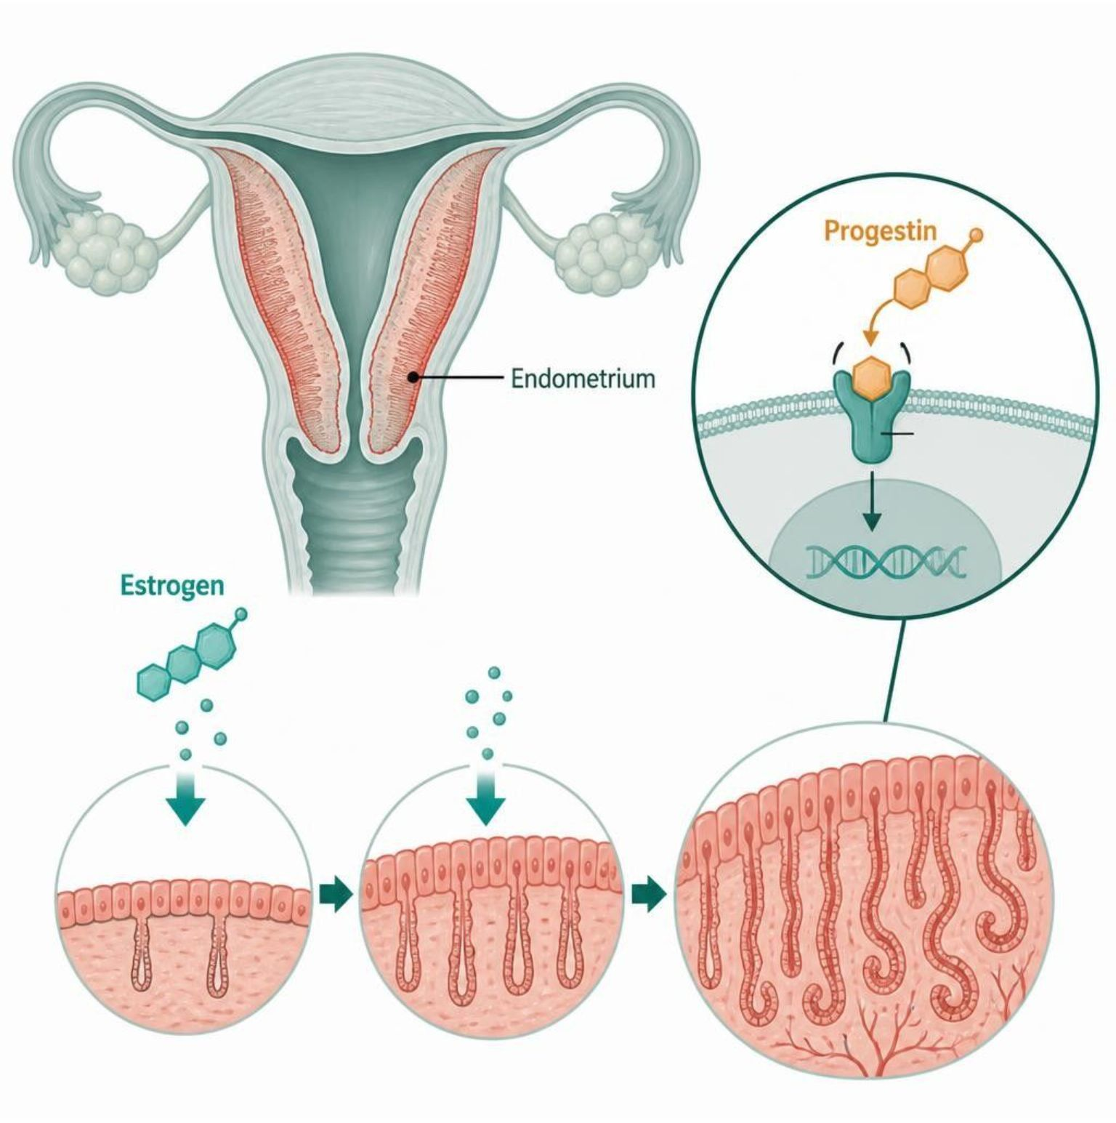
ESTROGENS, PROGESTINS & CONTRACEPTION
Objectives: SO1 · IO6.1 · IO6.2 · IO6.4 · IO6.6
Figure 1 · Unopposed estrogen: why a progestin is added
Schematic (illustrative) — Figure 1. Progestin counters estrogen’s proliferative effect on the endometrium: without it, hyperplasia and cancer risk; estrogen alone only after hysterectomy. S7; S7 (notes)
L11 · Genitourinary & Reproductive Pharmacology — Session 1
22

Slide 23
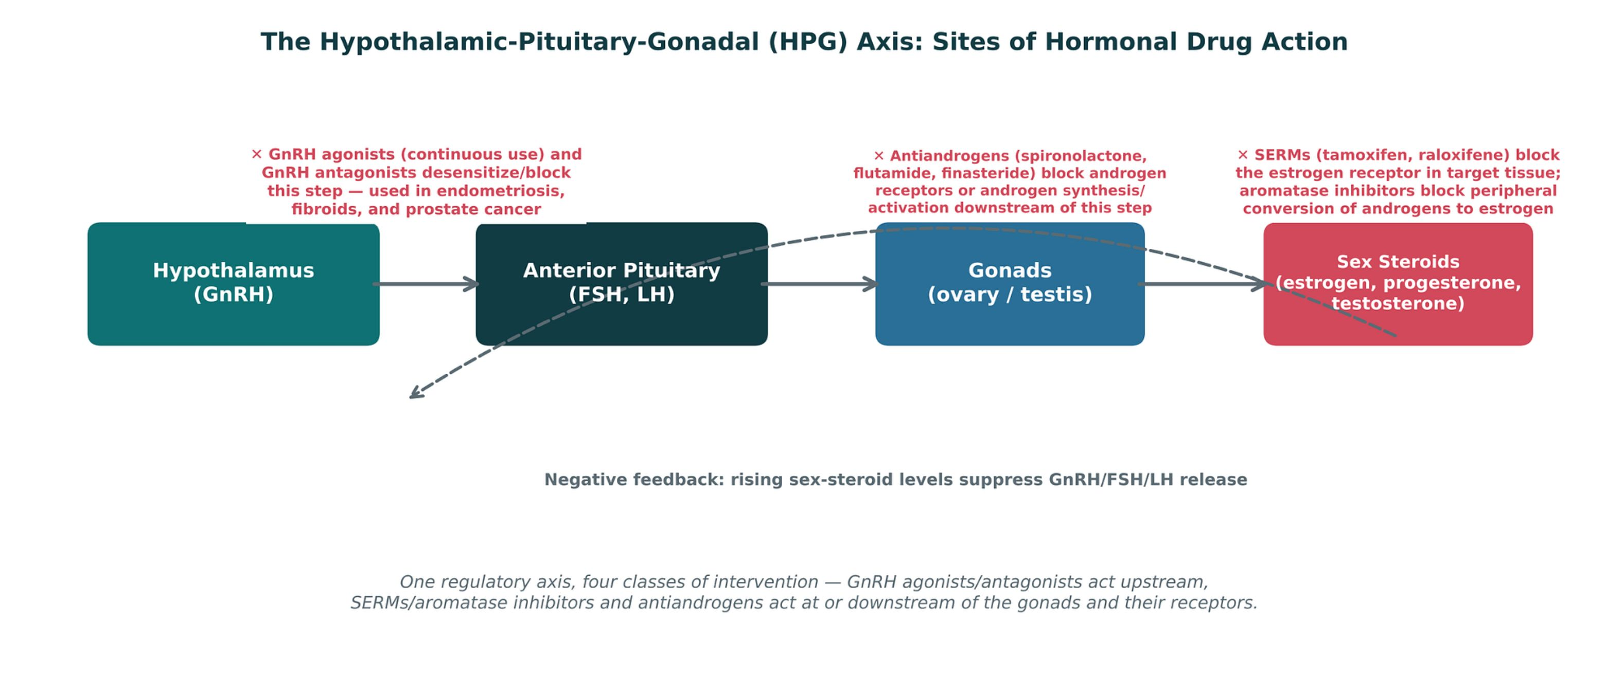
ESTROGENS, PROGESTINS & CONTRACEPTION
Objectives: SO1 · IO6.1 · IO6.2 · IO6.4 · IO6.6
Figure 2 · The HPG axis: sites of hormonal drug action
Original illustrative diagram (not from Katzung): GnRH → FSH/LH → gonadal sex steroids, which feed back negatively on the hypothalamus and pituitary; GnRH analogs, combined contraceptives, SERMs, aromatase inhibitors and antiandrogens act at different points. S8; S8 (notes)
L11 · Genitourinary & Reproductive Pharmacology — Session 1
23

Slide 24
ESTROGENS, PROGESTINS & CONTRACEPTION
Objectives: SO1 · IO6.1 · IO6.2 · IO6.4 · IO6.6
Compare: Combined vs. progestin-only contraception (S9)
 | Combined (estrogen + progestin) | Progestin-only
Forms | Oral pills, transdermal patch, vaginal ring | Mini-pill, DMPA injection, subdermal implant, levonorgestrel IUD
How | Suppresses ovulation via negative feedback on FSH/LH | Thickens cervical mucus; counters endometrial proliferation
VTE | Carries estrogen-related VTE risk — screen for contraindications | No estrogen — safe with VTE history, migraine with aura, smokers over 35
Other | Cycle regulation, acne/hirsutism improvement | Irregular bleeding early; DMPA reversible bone loss
Focus: what tells these apart. Sources: S9
L11 · Genitourinary & Reproductive Pharmacology — Session 1
24

Slide 25
ESTROGENS, PROGESTINS & CONTRACEPTION
Objectives: SO1 · IO6.1 · IO6.2 · IO6.4 · IO6.6
Compare: Estrogen, progestin and contraceptive profiles: formulation, dose, indications
Drug | Class | Formulation | Adult dose | Indications
Combined oral contraceptives (ethinyl estradiol plus a progestin) | Estrogen plus progestin | Tablets (21/28-day packs); patch; vaginal ring | Ethinyl estradiol 20-35 mcg plus a progestin PO daily; patch weekly for 3 weeks; ring 3 weeks in, 1 week out | Contraception, cycle control, dysmenorrhea, acne
Norethindrone (progestin-only pill) | Progestin | Tablet 0.35 mg | 0.35 mg PO daily at the same time, with no pill-free days | Contraception when estrogen is contraindicated, breastfeeding
Medroxyprogesterone depot (Depo-Provera) | Injectable progestin | IM 150 mg/mL; SC 104 mg/0.65 mL | 150 mg IM (or 104 mg SC) every 12-13 weeks | Contraception, endometriosis pain, endometrial protection
Focus: what tells these apart. Sources: S29; S30; S31; S32; S33
L11 · Genitourinary & Reproductive Pharmacology — Session 1
25

Slide 26
ESTROGENS, PROGESTINS & CONTRACEPTION
Objectives: SO1 · IO6.1 · IO6.2 · IO6.4 · IO6.6
Compare: Estrogen, progestin and contraceptive profiles: formulation, dose, indications (cont.)
Drug | Class | Formulation | Adult dose | Indications
Levonorgestrel IUD (Mirena) | Intrauterine progestin | Intrauterine system 52 mg (about 20 mcg/day) | One system placed in the uterus; effective up to 8 years for contraception | Contraception, heavy menstrual bleeding, endometrial protection
Estradiol (Estrace, Vivelle-Dot) | Estrogen | Oral tablets 0.5/1/2 mg; transdermal patch 0.025-0.1 mg/day; vaginal cream, tablet or ring; injectable valerate | Menopausal symptoms: 1-2 mg PO daily or patch 0.05 mg/day twice weekly, lowest effective dose; add a progestin if the uterus is intact | Menopausal vasomotor symptoms, genitourinary syndrome of menopause, hypoestrogenism, prevention of osteoporosis (when other agents unsuitable)
Focus: what tells these apart. Sources: S29; S30; S31; S32; S33
L11 · Genitourinary & Reproductive Pharmacology — Session 1
26

Slide 27
ESTROGENS, PROGESTINS & CONTRACEPTION
Objectives: SO1 · IO6.1 · IO6.2 · IO6.4 · IO6.6
Compare: Estrogen, progestin and contraceptive profiles: adverse effects, contraindications, toxicity
Drug | Adverse effects | Contraindications | Toxicity / overdose
Combined oral contraceptives (ethinyl estradiol plus a progestin) | Nausea, breast tenderness, breakthrough bleeding, headache | VTE or stroke history, smoker 35 or older, migraine with aura, estrogen-sensitive cancer, uncontrolled hypertension, liver disease | VTE, stroke and MI risk; hyperkalemia with drospirenone; rifampin and some antiepileptics lower efficacy
Norethindrone (progestin-only pill) | Irregular bleeding, headache, acne, breast tenderness | Breast cancer, undiagnosed vaginal bleeding, liver tumor | Efficacy falls if a dose is more than 3 hours late; ectopic pregnancy risk if it fails
Medroxyprogesterone depot (Depo-Provera) | Irregular bleeding, weight gain, delayed return of fertility | Breast cancer, pregnancy, unexplained vaginal bleeding | Boxed warning: loss of bone mineral density; limit prolonged use; VTE
Focus: what tells these apart. Sources: S29; S30; S31; S32; S33
L11 · Genitourinary & Reproductive Pharmacology — Session 1
27

Slide 28
ESTROGENS, PROGESTINS & CONTRACEPTION
Objectives: SO1 · IO6.1 · IO6.2 · IO6.4 · IO6.6
Compare: Estrogen, progestin and contraceptive profiles: adverse effects, contraindications, toxicity (cont.)
Drug | Adverse effects | Contraindications | Toxicity / overdose
Levonorgestrel IUD (Mirena) | Irregular spotting, amenorrhea, ovarian cysts, pelvic pain | Pregnancy, pelvic infection, uterine anomaly, breast cancer | Uterine perforation, expulsion, infection; check strings
Estradiol (Estrace, Vivelle-Dot) | Breast tenderness, nausea, headache, VTE, stroke, endometrial hyperplasia (unopposed), gallbladder disease | History of VTE or stroke, estrogen-sensitive cancer, undiagnosed vaginal bleeding, active liver disease, pregnancy | Nausea, vomiting, withdrawal bleeding; long-term risk of VTE, stroke, breast cancer; endometrial cancer if unopposed
Focus: what tells these apart. Sources: S29; S30; S31; S32; S33
L11 · Genitourinary & Reproductive Pharmacology — Session 1
28

Slide 29
ESTROGENS, PROGESTINS & CONTRACEPTION
Objectives: SO1 · IO6.1 · IO6.2 · IO6.4 · IO6.6
Memory hooks
Why it happens
Why a progestin with estrogen when the uterus is intact? Estrogen alone keeps the lining growing — hyperplasia, then cancer; the progestin matures it. S6; S7
L11 · Genitourinary & Reproductive Pharmacology — Session 1
29

Slide 30

ESTROGENS, PROGESTINS & CONTRACEPTION
Objectives: SO1 · IO6.1 · IO6.2 · IO6.4 · IO6.6
High-yield summary
If you remember nothing else
Estrogen = VTE (smoking, age > 35, VTE history); unopposed estrogen = endometrial cancer → always pair with a progestin if the uterus is intact. S5; S6
Estrogen contraindicated → progestin-only is the right first choice; DMPA = reversible bone loss. S6; S9
L11 · Genitourinary & Reproductive Pharmacology — Session 1
30

Slide 31
CLINICAL VIGNETTE
Objectives: SO1 · IO6.1 · IO6.2 · IO6.4 · IO6.6
Question 1
A 52-year-old with an intact uterus wants estradiol for hot flashes. What must be added?
A
Spironolactone for balance
B
A progestin to protect the endometrium
C
Nothing, if the dose is low
D
Tamoxifen to block the endometrium
E
An aromatase inhibitor
L11 · Genitourinary & Reproductive Pharmacology — Session 1
31
Notes:
Answer on the next slide. Source: S6; S7

Slide 32

CLINICAL VIGNETTE · ANSWER
Objectives: SO1 · IO6.1 · IO6.2 · IO6.4 · IO6.6
Answer 1: B
B. A progestin to protect the endometrium
Unopposed estrogen with a uterus raises endometrial cancer risk; add a progestin (S6–S7). S6; S7
Why the other choices are wrong
A. Spironolactone for balance — Not the answer (S15).
C. Nothing, if the dose is low — Still unopposed (S6).
D. Tamoxifen to block the endometrium — Tamoxifen stimulates it (S11).
E. An aromatase inhibitor — Not the answer (S14).
L11 · Genitourinary & Reproductive Pharmacology — Session 1
32

Slide 33
Drug class 2 of 3
SERMs, Aromatase Inhibitors & Androgens
Covers objectives: SO2 · SO3 · IO6.1 · IO6.2 · IO6.3 · IO6.5
Class
Prototype
Mechanism of action
Indications
Adverse effects
Contraindications
Drug interactions
Pharmacokinetics
Monitoring
Clinical pearls
33

Slide 34
SERMS, AROMATASE INHIBITORS & ANDROGENS
Objectives: SO2 · SO3 · IO6.1 · IO6.2 · IO6.3 · IO6.5
Class · Prototype + other drugs named
Class
Prototype + other drugs named
Tissue-selective and blocking strategies — how drugs can turn hormone signaling on in one tissue and off in another. S10
A receptor-blocking strategy and a synthesis/activation-blocking strategy exist on both the estrogen and androgen sides. S17; S17 (notes)
Tamoxifen, raloxifene (SERMs); anastrozole, letrozole (aromatase inhibitors); testosterone; spironolactone, flutamide, bicalutamide (antiandrogens); finasteride, dutasteride (5-ARIs). S11; S14; S15
L11 · Genitourinary & Reproductive Pharmacology — Session 1
34

Slide 35
SERMS, AROMATASE INHIBITORS & ANDROGENS
Objectives: SO2 · SO3 · IO6.1 · IO6.2 · IO6.3 · IO6.5
Mechanism of action
Mechanism of action (1/2)
Mechanism: bind the estrogen receptor, but act as an agonist in some tissues and an antagonist in others — the defining feature of this class. Same receptor, different conformation and co-regulators in each tissue. S11; S12 (notes); SG U6-R5
Tamoxifen: ER antagonist in breast tissue but an ER agonist in bone (preserves density) and, notably, in the endometrium. Tamoxifen antagonizes breast and agonizes bone and endometrium. S11; S12; S10 (notes)
Raloxifene: ER antagonist in breast and ER agonist in bone, but — unlike tamoxifen — essentially neutral at the endometrium; tamoxifen is an ER agonist at the endometrium (raising endometrial cancer risk), both being ER antagonists in breast. S11; S12; SG U6-R5
Aromatase chain (Figure 5): androgens (androstenedione, testosterone) → aromatase in fat tissue converts them to estrogens → estrogens drive ER-positive tumor growth → anastrozole and letrozole block aromatase. S14
L11 · Genitourinary & Reproductive Pharmacology — Session 1
35

Slide 36
SERMS, AROMATASE INHIBITORS & ANDROGENS
Objectives: SO2 · SO3 · IO6.1 · IO6.2 · IO6.3 · IO6.5
Mechanism of action (cont.)
Mechanism of action (2/2)
Figure 4. Original illustrative diagram (not from Katzung): SERMs block the estrogen receptor directly in breast tissue (while remaining agonists elsewhere), while aromatase inhibitors block the peripheral enzymatic conversion of androgens to estrogen — S13
two distinct strategies converging on the same clinical goal in hormone-sensitive breast cancer. Receptor blockade versus synthesis blockade. S13; S13 (notes)
Androgen pathway (Figure 6): testosterone (circulating androgen) → 5-alpha-reductase converts it to DHT (more potent) → binds the androgen receptor → hair follicle and prostate effects. S16; S15 (notes)
Finasteride and dutasteride block 5-alpha-reductase, lowering DHT; spironolactone, flutamide and bicalutamide block the androgen receptor. Blocking the enzyme or the receptor both reduce androgen action — different mechanisms grouped under the same broad "antiandrogen" label. S16; S16 (notes); SG U6-R8
L11 · Genitourinary & Reproductive Pharmacology — Session 1
36

Slide 37
SERMS, AROMATASE INHIBITORS & ANDROGENS
Objectives: SO2 · SO3 · IO6.1 · IO6.2 · IO6.3 · IO6.5
Indications
Indications (1/2)
Tamoxifen: ER-positive breast cancer treatment and prevention. Raloxifene: preferred option for osteoporosis prevention in postmenopausal women without a breast cancer indication. S11
Aromatase inhibitors block peripheral enzymatic conversion of androgens to estrogen rather than acting at the receptor — postmenopausal use only: before menopause the ovaries are the dominant estrogen source (often combined with ovarian suppression). S13 (notes); S14; S14 (notes); SG U6-R6
● Testosterone (androgen): used for male hypogonadism. S15
● Spironolactone (antiandrogen): blocks the androgen receptor (in addition to its aldosterone-antagonist diuretic effect from Unit 5) — used off-label for hirsutism and acne in women, especially in PCOS. S15
● Flutamide / bicalutamide (antiandrogens): pure androgen receptor blockers used primarily in prostate cancer, often combined with a GnRH agonist (leuprolide). S15; S45
L11 · Genitourinary & Reproductive Pharmacology — Session 1
37

Slide 38
SERMS, AROMATASE INHIBITORS & ANDROGENS
Objectives: SO2 · SO3 · IO6.1 · IO6.2 · IO6.3 · IO6.5
Indications (cont.)
Indications (2/2)
● Finasteride / dutasteride (5-alpha-reductase inhibitors): block conversion of testosterone to the more potent dihydrotestosterone (DHT); used for hirsutism and androgenetic alopecia here, and — in Session 2 — for benign prostatic hyperplasia (BPH). S15; S15 (notes)
Estrogen-pathway drugs are used primarily in hormone-sensitive breast cancer; androgen-pathway drugs for hirsutism, prostate cancer, alopecia, and BPH. S17
TB Tamoxifen as adjuvant therapy cuts contralateral breast cancer by 35%; benefit does not grow beyond 5 years. p. 774
TB Clomiphene, a partial estrogen agonist, blocks hypothalamic feedback to trigger ovulation (mostly in PCOS); multiple pregnancy about 10%. p. 776; p. 777
TB Other inhibitors: danazol suppresses the midcycle LH/FSH surge (endometriosis; hepatic caution); exemestane is an irreversible aromatase inhibitor. p. 775; p. 776
L11 · Genitourinary & Reproductive Pharmacology — Session 1
38

Slide 39
SERMS, AROMATASE INHIBITORS & ANDROGENS
Objectives: SO2 · SO3 · IO6.1 · IO6.2 · IO6.3 · IO6.5
Adverse effects (boxed warnings first)
Adverse effects (boxed warnings first)
Tamoxifen’s endometrial agonist activity increases the risk of endometrial hyperplasia and endometrial cancer — patients require counseling on abnormal bleeding and routine gynecologic follow-up. S11
Both SERMs carry an increased VTE risk, similar in magnitude to estrogen therapy itself. S11; S12
Aromatase inhibitor adverse effects: bone loss and joint pain. S14; S14 (notes)
Testosterone: erythrocytosis, hepatotoxicity (oral formulations), and suppression of endogenous testicular function/fertility. S15
TB Androgens & anabolic steroids: masculinization in women, polycythemia; 17-alkylated oral androgens cause cholestasis, peliosis hepatis and liver tumors. p. 779; p. 780
TB Flutamide causes gynecomastia and occasional reversible hepatotoxicity; bicalutamide is given once daily with a GnRH analog to prevent tumor flare. p. 782
L11 · Genitourinary & Reproductive Pharmacology — Session 1
39

Slide 40
SERMS, AROMATASE INHIBITORS & ANDROGENS
Objectives: SO2 · SO3 · IO6.1 · IO6.2 · IO6.3 · IO6.5
Contraindications · Drug interactions
Contraindications
Drug interactions
Spironolactone: avoid in pregnancy (teratogenic risk). S24
TB Androgens are contraindicated in pregnant women or women who may become pregnant (fetal masculinization). p. 780
CYP2D6 inhibitors (paroxetine, fluoxetine) blunt tamoxifen activation. Testosterone and tamoxifen raise INR with warfarin. S45; S45 (notes)
Bisphosphonates and calcium with vitamin D protect bone with aromatase inhibitors. ACE inhibitors, ARBs and potassium: hyperkalemia with spironolactone. S45; S45 (notes)
L11 · Genitourinary & Reproductive Pharmacology — Session 1
40

Slide 41
SERMS, AROMATASE INHIBITORS & ANDROGENS
Objectives: SO2 · SO3 · IO6.1 · IO6.2 · IO6.3 · IO6.5
Pharmacokinetics · Monitoring
Pharmacokinetics
Monitoring
TB Androgen suppression: continuous (not pulsatile) GnRH analogs such as leuprolide suppress the gonads; dutasteride has a much longer half-life than finasteride. p. 781
Testosterone therapy requires monitoring hematocrit (erythrocytosis risk) and PSA with long-term use, with additional risks of hepatotoxicity (oral formulations) and suppression of endogenous fertility. S15; SG U6-R7
L11 · Genitourinary & Reproductive Pharmacology — Session 1
41

Slide 42
SERMS, AROMATASE INHIBITORS & ANDROGENS
Objectives: SO2 · SO3 · IO6.1 · IO6.2 · IO6.3 · IO6.5
Clinical pearls / "why" hook
Clinical pearls / "why" hook
The tamoxifen-vs-raloxifene endometrial distinction is a classic high-yield comparison: tamoxifen carries the endometrial cancer risk because of tissue-selective agonism, not a class effect. S11 (notes); S12 (notes)
Finasteride/dutasteride are a direct bridge to Session 2 — the same drugs reappear for BPH (prostate growth rather than hirsutism). S15 (notes)
Case: a 52-year-old postmenopausal woman with ER-positive breast cancer starts tamoxifen; six months later, new-onset irregular vaginal bleeding. What is the most likely explanation, and what should happen next? S18
Tamoxifen acts as an estrogen receptor agonist in the endometrium even while acting as an antagonist in breast tissue — this tissue-selective agonism increases the risk of endometrial hyperplasia and endometrial cancer. S18
New abnormal bleeding on tamoxifen warrants prompt gynecologic evaluation, not reassurance. A natural contrast with raloxifene’s neutral endometrial profile. S18; S18 (notes)
L11 · Genitourinary & Reproductive Pharmacology — Session 1
42

Slide 43
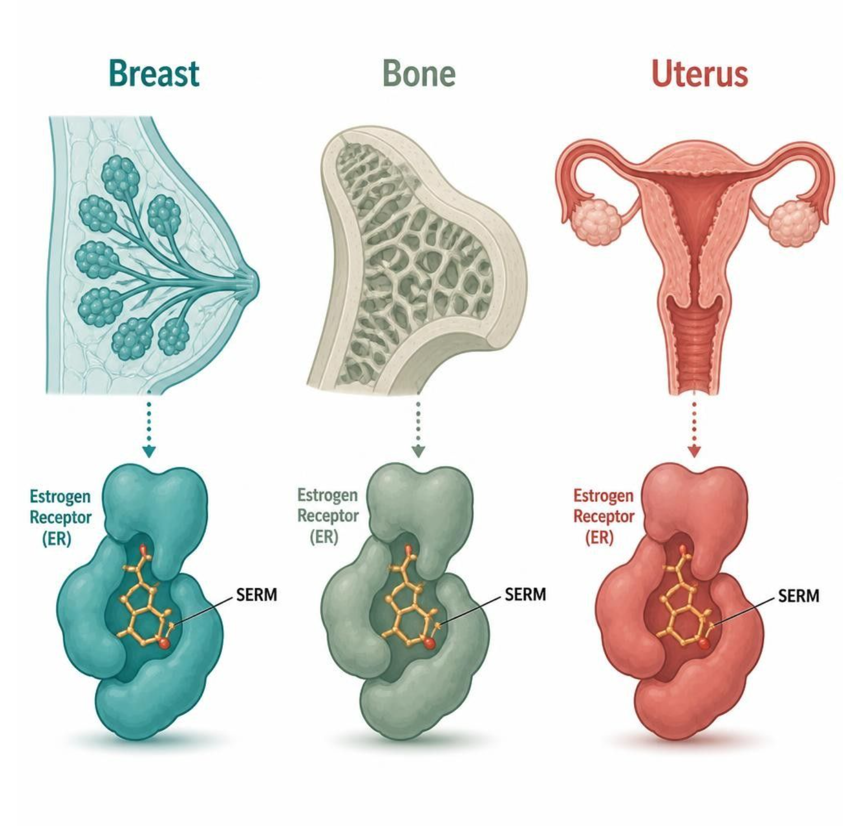
SERMS, AROMATASE INHIBITORS & ANDROGENS
Objectives: SO2 · SO3 · IO6.1 · IO6.2 · IO6.3 · IO6.5
Figure 3 · SERMs: one receptor, different tissue effects
Schematic (illustrative) — Figure 3. Tamoxifen and raloxifene act on the same receptor but differ by tissue; tamoxifen’s endometrial agonism carries cancer risk. Both raise VTE risk. S12; S12 (notes)
L11 · Genitourinary & Reproductive Pharmacology — Session 1
43

Slide 44
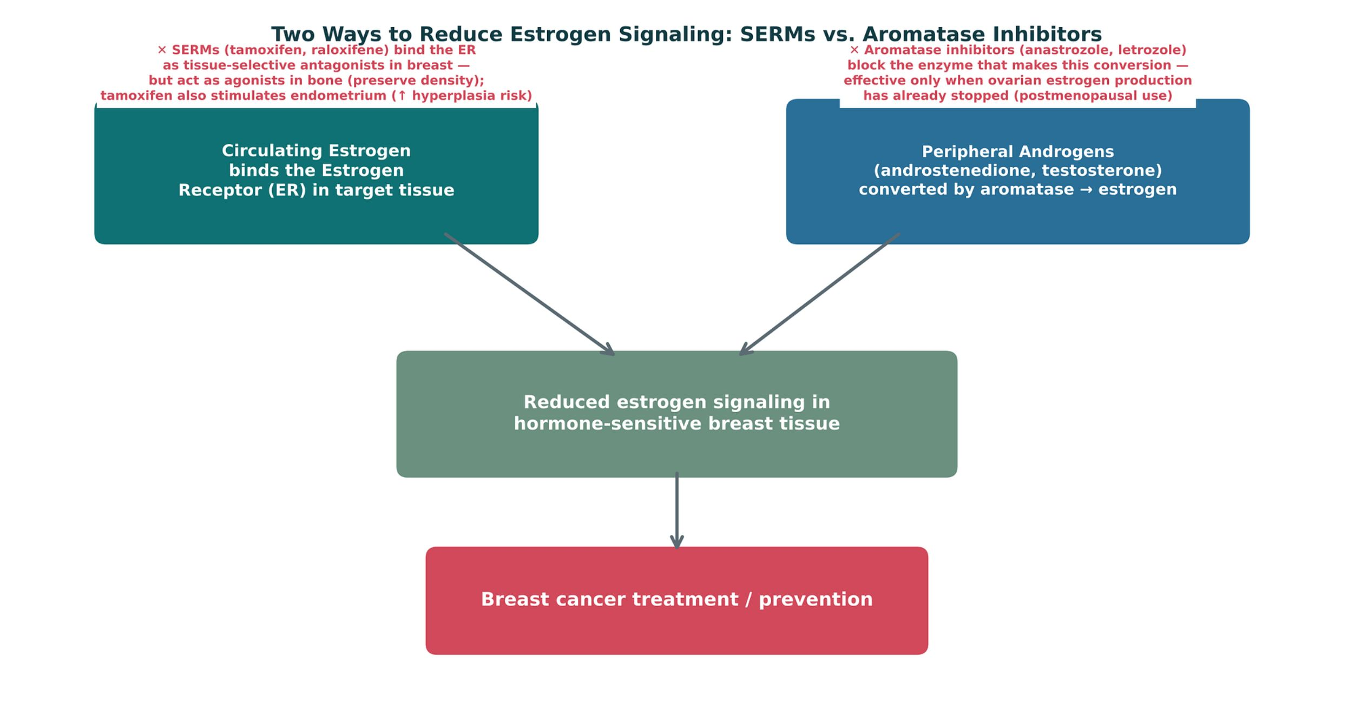
SERMS, AROMATASE INHIBITORS & ANDROGENS
Objectives: SO2 · SO3 · IO6.1 · IO6.2 · IO6.3 · IO6.5
Figure 4 · Two ways to reduce estrogen signaling
Original illustrative diagram (not from Katzung): SERMs block the receptor in breast; aromatase inhibitors block peripheral conversion of androgens to estrogen — two strategies for hormone-sensitive breast cancer. S13; S13 (notes)
L11 · Genitourinary & Reproductive Pharmacology — Session 1
44

Slide 45
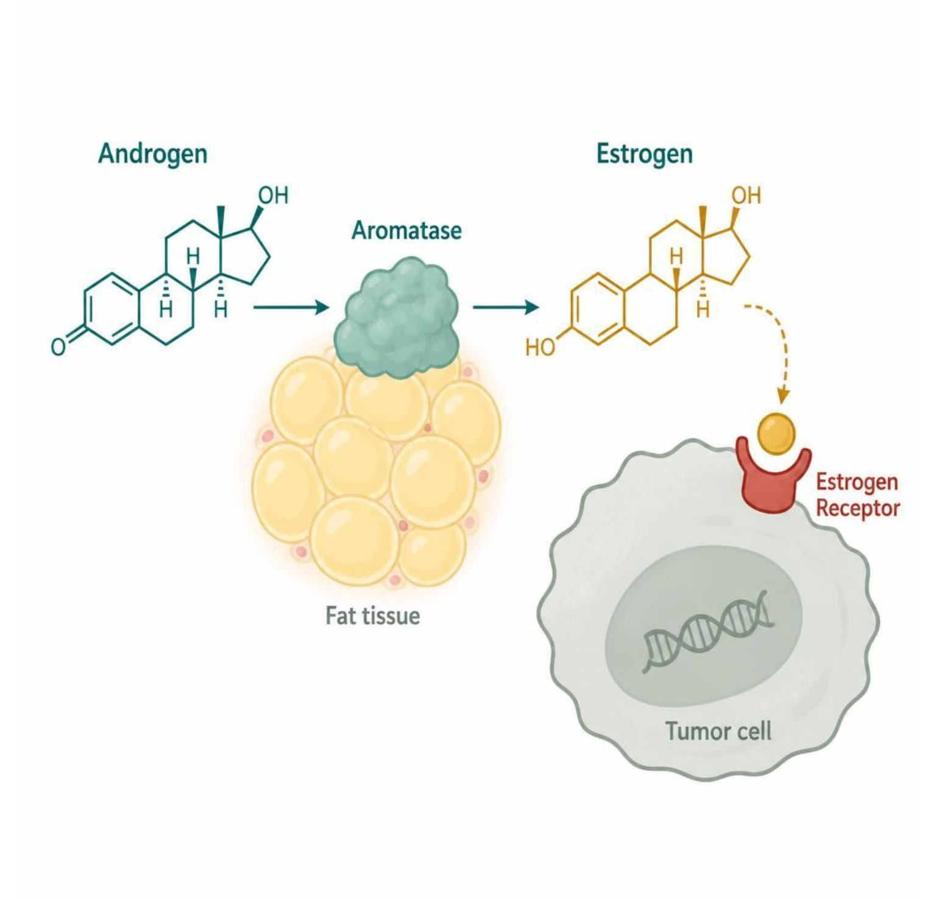
SERMS, AROMATASE INHIBITORS & ANDROGENS
Objectives: SO2 · SO3 · IO6.1 · IO6.2 · IO6.3 · IO6.5
Figure 5 · Aromatase inhibitors: blocking estrogen synthesis
Schematic (illustrative) — Figure 5. Aromatase converts androgens to estrogens in peripheral fat; aromatase inhibitors block this step. They act downstream of the ovary, so they work mainly after menopause. S14; S14 (notes)
L11 · Genitourinary & Reproductive Pharmacology — Session 1
45

Slide 46
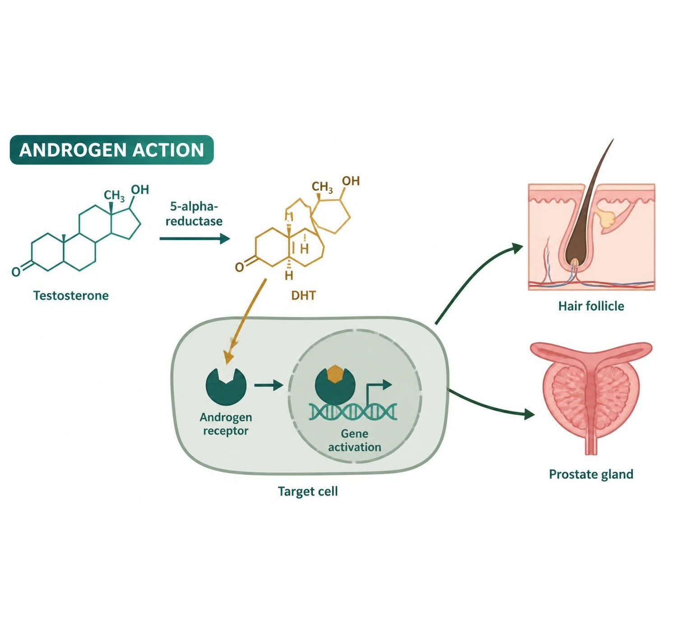
SERMS, AROMATASE INHIBITORS & ANDROGENS
Objectives: SO2 · SO3 · IO6.1 · IO6.2 · IO6.3 · IO6.5
Figure 6 · Androgen pathway: where each drug acts
Schematic (illustrative) — Figure 6. Androgen pathway from testosterone to receptor action, with the sites of finasteride, dutasteride (enzyme) and spironolactone, flutamide, bicalutamide (receptor). S16; S16 (notes)
L11 · Genitourinary & Reproductive Pharmacology — Session 1
46

Slide 47
SERMS, AROMATASE INHIBITORS & ANDROGENS
Objectives: SO2 · SO3 · IO6.1 · IO6.2 · IO6.3 · IO6.5
Compare: Estrogen-pathway vs. androgen-pathway drugs (S17)
 | Estrogen pathway | Androgen pathway
Receptor strategy | SERMs (tamoxifen, raloxifene): tissue-selective agonist/antagonist | Antiandrogens (spironolactone, flutamide): block the androgen receptor
Synthesis strategy | Aromatase inhibitors (anastrozole, letrozole): postmenopausal only | 5-alpha-reductase inhibitors (finasteride, dutasteride): block DHT formation
Main uses | Hormone-sensitive breast cancer | Hirsutism, prostate cancer, alopecia, BPH
Focus: what tells these apart. Sources: S17
L11 · Genitourinary & Reproductive Pharmacology — Session 1
47

Slide 48
SERMS, AROMATASE INHIBITORS & ANDROGENS
Objectives: SO2 · SO3 · IO6.1 · IO6.2 · IO6.3 · IO6.5
Compare: Tamoxifen vs. raloxifene (S11–S12)
Tissue | Tamoxifen | Raloxifene
Breast | Antagonist | Antagonist
Bone | Agonist | Agonist
Endometrium | Agonist — hyperplasia/cancer risk | Essentially neutral
VTE | Increased | Increased
Focus: what tells these apart. Sources: S11; S12
L11 · Genitourinary & Reproductive Pharmacology — Session 1
48

Slide 49
SERMS, AROMATASE INHIBITORS & ANDROGENS
Objectives: SO2 · SO3 · IO6.1 · IO6.2 · IO6.3 · IO6.5
Compare: SERM and aromatase inhibitor profiles: formulation, dose, indications
Drug | Class | Formulation | Adult dose | Indications
Tamoxifen (Nolvadex) | Selective estrogen-receptor modulator | Tablet 10/20 mg | 20 mg PO daily for 5-10 years in breast cancer | Breast cancer treatment and risk reduction, DCIS
Raloxifene (Evista) | Selective estrogen-receptor modulator | Tablet 60 mg | 60 mg PO daily | Postmenopausal osteoporosis treatment and prevention, breast cancer risk reduction
Focus: what tells these apart. Sources: S34; S35; S36; S37
L11 · Genitourinary & Reproductive Pharmacology — Session 1
49

Slide 50
SERMS, AROMATASE INHIBITORS & ANDROGENS
Objectives: SO2 · SO3 · IO6.1 · IO6.2 · IO6.3 · IO6.5
Compare: SERM and aromatase inhibitor profiles: formulation, dose, indications (cont.)
Drug | Class | Formulation | Adult dose | Indications
Anastrozole (Arimidex) | Aromatase inhibitor | Tablets 1 mg | 1 mg PO once daily, usually for 5 years or more | Adjuvant and metastatic hormone receptor-positive breast cancer in postmenopausal women
Letrozole (Femara) | Aromatase inhibitor | Tablets 2.5 mg | 2.5 mg PO once daily, up to 5 years or extended therapy | Hormone receptor-positive breast cancer in postmenopausal women; off-label ovulation induction
Focus: what tells these apart. Sources: S34; S35; S36; S37
L11 · Genitourinary & Reproductive Pharmacology — Session 1
50

Slide 51
SERMS, AROMATASE INHIBITORS & ANDROGENS
Objectives: SO2 · SO3 · IO6.1 · IO6.2 · IO6.3 · IO6.5
Compare: SERM and aromatase inhibitor profiles: adverse effects, contraindications, toxicity
Drug | Adverse effects | Contraindications | Toxicity / overdose
Tamoxifen (Nolvadex) | Hot flashes, vaginal discharge, menstrual irregularity | History of DVT or PE, pregnancy, warfarin (for risk-reduction use) | Endometrial cancer, VTE, stroke, cataracts; CYP2D6 inhibitors (paroxetine, fluoxetine) reduce activation
Raloxifene (Evista) | Hot flashes, leg cramps, peripheral edema | VTE history, pregnancy | Boxed warning: VTE and fatal stroke risk; does not stimulate the endometrium
Anastrozole (Arimidex) | Hot flashes, joint pain, bone loss, osteoporosis, mood changes, hypercholesterolemia | Pregnancy; ineffective in premenopausal women unless ovarian function is suppressed | Bone loss and fractures; monitor bone density and lipids; overdose causes mainly GI upset
Letrozole (Femara) | Hot flashes, arthralgia, osteoporosis, fatigue, hypercholesterolemia | Pregnancy; premenopausal status without ovarian suppression | Bone loss and fractures; monitor bone density; nonspecific toxicity in overdose
Focus: what tells these apart. Sources: S34; S35; S36; S37
L11 · Genitourinary & Reproductive Pharmacology — Session 1
51

Slide 52
SERMS, AROMATASE INHIBITORS & ANDROGENS
Objectives: SO2 · SO3 · IO6.1 · IO6.2 · IO6.3 · IO6.5
Compare: Androgen and antiandrogen profiles: formulation, dose, indications
Drug | Class | Formulation | Adult dose | Indications
Testosterone (cypionate, gel, patch) | Androgen | IM cypionate or enanthate 100-200 mg/mL; gel; patch; pellets | Cypionate 100-200 mg IM every 2 weeks (or 50-100 mg weekly); gel 50-100 mg daily | Male hypogonadism, delayed puberty
Spironolactone (Aldactone) | Aldosterone antagonist with antiandrogen activity | Tablets 25/50/100 mg | Hirsutism or acne (off-label): 50-200 mg PO daily in divided doses; hypertension and heart failure per cardiology dosing | Hirsutism and acne in PCOS (off-label), resistant hypertension, heart failure, primary hyperaldosteronism
Flutamide (Eulexin) | Nonsteroidal antiandrogen | Capsules 125 mg | 250 mg PO three times daily, given with a GnRH agonist in prostate cancer | Metastatic prostate cancer in combination with a GnRH agonist
Focus: what tells these apart. Sources: S38; S39; S40; S41; S42; S43
L11 · Genitourinary & Reproductive Pharmacology — Session 1
52

Slide 53
SERMS, AROMATASE INHIBITORS & ANDROGENS
Objectives: SO2 · SO3 · IO6.1 · IO6.2 · IO6.3 · IO6.5
Compare: Androgen and antiandrogen profiles: formulation, dose, indications (cont.)
Drug | Class | Formulation | Adult dose | Indications
Bicalutamide (Casodex) | Nonsteroidal antiandrogen | Tablets 50 mg (150 mg in some regions) | 50 mg PO once daily with a GnRH agonist in prostate cancer | Metastatic prostate cancer in combination with a GnRH agonist
Finasteride (Proscar, Propecia) | 5-alpha-reductase inhibitor | Tablet 5 mg (BPH); 1 mg (hair loss) | 5 mg PO daily for BPH; 1 mg PO daily for male-pattern hair loss | BPH, androgenetic alopecia
Dutasteride (Avodart) | 5-alpha-reductase inhibitor (types 1 and 2) | Capsules 0.5 mg; combination with tamsulosin (Jalyn) | 0.5 mg PO once daily for BPH; effects take 3-6 months; off-label for hair loss | Benign prostatic hyperplasia, off-label androgenetic alopecia and hirsutism
Focus: what tells these apart. Sources: S38; S39; S40; S41; S42; S43
L11 · Genitourinary & Reproductive Pharmacology — Session 1
53

Slide 54
SERMS, AROMATASE INHIBITORS & ANDROGENS
Objectives: SO2 · SO3 · IO6.1 · IO6.2 · IO6.3 · IO6.5
Compare: Androgen and antiandrogen profiles: adverse effects, contraindications, toxicity
Drug | Adverse effects | Contraindications | Toxicity / overdose
Testosterone (cypionate, gel, patch) | Acne, erythrocytosis, sleep apnea, gynecomastia, testicular atrophy | Prostate or breast cancer, polycythemia, pregnancy | Erythrocytosis, thrombosis, secondary exposure with gels; monitor hematocrit, PSA, lipids
Spironolactone (Aldactone) | Hyperkalemia, menstrual irregularity, breast tenderness, dizziness, gynecomastia in men | Hyperkalemia, Addison disease, anuria, pregnancy (feminization of a male fetus), concurrent potassium supplements | Life-threatening hyperkalemia, especially with CKD or ACE inhibitors or ARBs; monitor potassium; effective contraception needed
Flutamide (Eulexin) | Hot flashes, gynecomastia, diarrhea, hepatotoxicity, methemoglobinemia | Severe hepatic impairment, pregnancy | Boxed warning for severe hepatotoxicity; monitor liver tests regularly
Focus: what tells these apart. Sources: S38; S39; S40; S41; S42; S43
L11 · Genitourinary & Reproductive Pharmacology — Session 1
54

Slide 55
SERMS, AROMATASE INHIBITORS & ANDROGENS
Objectives: SO2 · SO3 · IO6.1 · IO6.2 · IO6.3 · IO6.5
Compare: Androgen and antiandrogen profiles: adverse effects, contraindications, toxicity (cont.)
Drug | Adverse effects | Contraindications | Toxicity / overdose
Bicalutamide (Casodex) | Hot flashes, gynecomastia, breast tenderness, fatigue, liver enzyme elevation | Pregnancy (not indicated in women), severe hepatic impairment | Hepatotoxicity (rare); monitor liver tests; potentiates warfarin
Finasteride (Proscar, Propecia) | Decreased libido, erectile dysfunction, reduced ejaculate, gynecomastia | Pregnancy and women who may be pregnant (do not handle crushed tablets), hypersensitivity | Lowers PSA by about half; reports of depression; teratogenic to a male fetus
Dutasteride (Avodart) | Decreased libido, erectile dysfunction, ejaculation disorders, breast tenderness, depression | Pregnancy and women of childbearing potential handling capsules, severe hepatic impairment | Lowers PSA by about half; pregnant partners must avoid handling capsules; monitor PSA and mood
Focus: what tells these apart. Sources: S38; S39; S40; S41; S42; S43
L11 · Genitourinary & Reproductive Pharmacology — Session 1
55

Slide 56
SERMS, AROMATASE INHIBITORS & ANDROGENS
Objectives: SO2 · SO3 · IO6.1 · IO6.2 · IO6.3 · IO6.5
Memory hooks
Why it happens
Why are aromatase inhibitors useless before menopause? The ovary still makes most of the estrogen; the drug only blocks the peripheral (fat) source. S13 (notes); S14
L11 · Genitourinary & Reproductive Pharmacology — Session 1
56

Slide 57
SERMS, AROMATASE INHIBITORS & ANDROGENS
Objectives: SO2 · SO3 · IO6.1 · IO6.2 · IO6.3 · IO6.5
High-yield summary
If you remember nothing else
Tamoxifen: breast antagonist, endometrial agonist → bleeding needs evaluation; raloxifene: endometrium neutral; both VTE. S11; S18
Aromatase inhibitors: postmenopausal only; bone loss and joint pain. S14
L11 · Genitourinary & Reproductive Pharmacology — Session 1
57

Slide 58
CLINICAL VIGNETTE · LECTURE QUICK CHECK S18
Objectives: SO2 · SO3 · IO6.1 · IO6.2 · IO6.3 · IO6.5
Question 6
Six months into tamoxifen for ER-positive breast cancer, a 52-year-old reports new irregular vaginal bleeding. Next step?
A
Switch to raloxifene for her cancer
B
Stop tamoxifen, no further workup
C
Reassure — expected with tamoxifen
D
Add estrogen to stabilize the lining
E
Prompt gynecologic evaluation
L11 · Genitourinary & Reproductive Pharmacology — Session 1
58
Notes:
Answer on the next slide. Source: S18

Slide 59
CLINICAL VIGNETTE · ANSWER
Objectives: SO2 · SO3 · IO6.1 · IO6.2 · IO6.3 · IO6.5
Answer 6: E
E. Prompt gynecologic evaluation
Tamoxifen is an endometrial agonist (hyperplasia/cancer risk); new bleeding needs prompt evaluation, not reassurance (S18). S18
Why the other choices are wrong
A. Switch to raloxifene for her cancer — Not a breast cancer treatment (L08 S8).
B. Stop tamoxifen, no further workup — Evaluate first (S18).
C. Reassure — expected with tamoxifen — Not reassurance (S18).
D. Add estrogen to stabilize the lining — Worsens risk (S6).
L11 · Genitourinary & Reproductive Pharmacology — Session 1
59

Slide 60
CLINICAL VIGNETTE
Objectives: SO2 · SO3 · IO6.1 · IO6.2 · IO6.3 · IO6.5
Question 8
A 45-year-old premenopausal woman with ER-positive breast cancer asks about letrozole alone. Key point?
A
It blocks the estrogen receptor
B
Its main risk is endometrial cancer
C
Ideal — works best before menopause
D
It raises estrogen to fight the tumor
E
Insufficient alone before menopause
L11 · Genitourinary & Reproductive Pharmacology — Session 1
60
Notes:
Answer on the next slide. Source: S13; S14

Slide 61
CLINICAL VIGNETTE · ANSWER
Objectives: SO2 · SO3 · IO6.1 · IO6.2 · IO6.3 · IO6.5
Answer 8: E
E. Insufficient alone before menopause
Before menopause the ovaries are the dominant estrogen source; AIs need ovarian suppression (S13–S14). S13; S14
Why the other choices are wrong
A. It blocks the estrogen receptor — It blocks synthesis (S14).
B. Its main risk is endometrial cancer — Bone loss and joint pain (S14).
C. Ideal — works best before menopause — Postmenopausal only (S14).
D. It raises estrogen to fight the tumor — Lowers it (S14).
L11 · Genitourinary & Reproductive Pharmacology — Session 1
61

Slide 62
Drug class 3 of 3
PCOS & the Reproductive-Metabolic Overlap
Covers objectives: SO4 · SO5 · IO6.1 · IO6.3 · IO6.4 · IO6.5
Class
Prototype
Mechanism of action
Indications
Adverse effects
Contraindications
Drug interactions
Pharmacokinetics
Monitoring
Clinical pearls
62

Slide 63
PCOS & THE REPRODUCTIVE-METABOLIC OVERLAP
Objectives: SO4 · SO5 · IO6.1 · IO6.3 · IO6.4 · IO6.5
Class
Class
Where Chapter 40 and Chapter 41 meet — insulin resistance as a driver of reproductive endocrine disease. S19
Polycystic ovary syndrome (PCOS) is defined by a combination of hyperandrogenism, ovulatory dysfunction, and polycystic ovarian morphology — but its pharmacologic management is fundamentally a metabolic problem as much as a reproductive one. S20
This is why PCOS management routinely pulls drugs from Chapter 41 (antidiabetic agents) as well as Chapter 40 (hormonal agents) — the two chapters converge on the same patient. PCOS pharmacology is not purely "gynecologic." S20; S20 (notes)
L11 · Genitourinary & Reproductive Pharmacology — Session 1
63

Slide 64
PCOS & THE REPRODUCTIVE-METABOLIC OVERLAP
Objectives: SO4 · SO5 · IO6.1 · IO6.3 · IO6.4 · IO6.5
Prototype + other drugs named
Prototype + other drugs named
Metformin; combined hormonal contraception; spironolactone; GLP-1 receptor agonists. S24
L11 · Genitourinary & Reproductive Pharmacology — Session 1
64

Slide 65
PCOS & THE REPRODUCTIVE-METABOLIC OVERLAP
Objectives: SO4 · SO5 · IO6.1 · IO6.3 · IO6.4 · IO6.5
Mechanism of action
Mechanism of action (1/2)
Insulin resistance and compensatory hyperinsulinemia are central to PCOS pathophysiology in most patients, independent of body weight. S20
Hyperinsulinemia stimulates ovarian theca-cell androgen production directly and lowers hepatic sex hormone-binding globulin (SHBG) production, raising free (biologically active) testosterone — the mechanistic core of PCOS. S20; S19 (notes); SG U6-R9
Figure 7. Original illustrative diagram (not from Katzung): insulin resistance and hyperandrogenism reinforce one another in a self-sustaining cycle — hyperinsulinemia raises free testosterone, and hyperandrogenism worsens insulin resistance, S21
L11 · Genitourinary & Reproductive Pharmacology — Session 1
65

Slide 66
PCOS & THE REPRODUCTIVE-METABOLIC OVERLAP
Objectives: SO4 · SO5 · IO6.1 · IO6.3 · IO6.4 · IO6.5
Mechanism of action (cont.)
Mechanism of action (2/2)
explaining why metabolic therapy improves reproductive symptoms and vice versa. Walk both arrows of the cycle. S21; S21 (notes)
Metformin is not a direct hormonal agent — it improves hyperandrogenism indirectly, by reducing hyperinsulinemia’s stimulatory effect on ovarian androgen production (Figure 7) — by improving insulin sensitivity, not by acting on any hormone receptor. S22; SG U6-R10
Chain (Figure 8): insulin resistance → high insulin → ovarian androgens up; liver SHBG down → free testosterone up → metformin lowers insulin → androgens fall; cycles and ovulation can return. S23; S23 (notes)
L11 · Genitourinary & Reproductive Pharmacology — Session 1
66

Slide 67
PCOS & THE REPRODUCTIVE-METABOLIC OVERLAP
Objectives: SO4 · SO5 · IO6.1 · IO6.3 · IO6.4 · IO6.5
Indications
Indications (1/2)
Clinical features follow the mechanism: hirsutism, acne, and anovulation/irregular cycles from hyperandrogenism; an elevated long-term risk of type 2 diabetes and metabolic syndrome from insulin resistance. S20
Metformin: first-line insulin-sensitizing agent in PCOS management; improves insulin sensitivity, can restore ovulatory cycles, and is commonly used alongside or instead of hormonal therapy depending on the patient's goals (cycle regulation vs. fertility). S22
GLP-1 receptor agonists are increasingly used off-label in PCOS patients with obesity, given their weight-loss and insulin-sensitizing effects — an emerging extension of the same principle. S22; S45
L11 · Genitourinary & Reproductive Pharmacology — Session 1
67

Slide 68
PCOS & THE REPRODUCTIVE-METABOLIC OVERLAP
Objectives: SO4 · SO5 · IO6.1 · IO6.3 · IO6.4 · IO6.5
Indications (cont.)
Indications (2/2)
Combined hormonal contraception remains first-line specifically for cycle regulation and hirsutism/acne when pregnancy is not desired — metformin and hormonal therapy are frequently used together, not as alternatives. S22; S24 (notes)
TB Polycystic ovary syndrome affects about 7% of women of reproductive age. p. 776
L11 · Genitourinary & Reproductive Pharmacology — Session 1
68

Slide 69
PCOS & THE REPRODUCTIVE-METABOLIC OVERLAP
Objectives: SO4 · SO5 · IO6.1 · IO6.3 · IO6.4 · IO6.5
Adverse effects (boxed warnings first) · Contraindications
Adverse effects (boxed warnings first)
Contraindications
Adverse effects: GI upset (common, often transient), and rare but serious lactic acidosis risk in renal impairment — recall the renal dose-adjustment principles from Unit 5. S22; S22 (notes)
Common early effect: GI upset (nausea, diarrhea); take with meals. S23
Hold metformin for an iodinated contrast study or renal impairment. S23; S23 (notes)
L11 · Genitourinary & Reproductive Pharmacology — Session 1
69

Slide 70
PCOS & THE REPRODUCTIVE-METABOLIC OVERLAP
Objectives: SO4 · SO5 · IO6.1 · IO6.3 · IO6.4 · IO6.5
Drug interactions · Pharmacokinetics
Drug interactions
Pharmacokinetics
Not covered in materials
Not covered in materials
L11 · Genitourinary & Reproductive Pharmacology — Session 1
70

Slide 71
PCOS & THE REPRODUCTIVE-METABOLIC OVERLAP
Objectives: SO4 · SO5 · IO6.1 · IO6.3 · IO6.4 · IO6.5
Monitoring
Monitoring
Not covered in materials
L11 · Genitourinary & Reproductive Pharmacology — Session 1
71

Slide 72
PCOS & THE REPRODUCTIVE-METABOLIC OVERLAP
Objectives: SO4 · SO5 · IO6.1 · IO6.3 · IO6.4 · IO6.5
Clinical pearls / "why" hook
Clinical pearls / "why" hook (1/3)
Case: a 24-year-old with PCOS — irregular cycles, hirsutism, BMI 31 — not trying to conceive, no contraindications to estrogen. What are the two major pharmacologic strategies available, and how do their goals differ? S25
Combined hormonal contraception directly regulates cycles and improves hirsutism/acne through its hormonal effects, while metformin addresses the underlying insulin resistance driving the condition metabolically. S25
The two are frequently combined rather than chosen as alternatives — contraception for immediate symptom control, metformin for the metabolic driver and long-term diabetes risk reduction. S25; S25 (notes)
Drug names reveal the class: Stem · Class · Examples · Memory aid — estr-/-estradiol estrogen (estradiol, ethinyl estradiol); -gest-/-gestrel progestin (levonorgestrel, norethindrone, medroxyprogesterone: gest- = pregnancy hormone). S26; S26 (notes)
L11 · Genitourinary & Reproductive Pharmacology — Session 1
72

Slide 73
PCOS & THE REPRODUCTIVE-METABOLIC OVERLAP
Objectives: SO4 · SO5 · IO6.1 · IO6.3 · IO6.4 · IO6.5
Clinical pearls / "why" hook (cont.)
Clinical pearls / "why" hook (2/3)
-ifene SERM (tamoxifen, raloxifene: modulates the estrogen receptor); -trozole aromatase inhibitor (anastrozole, letrozole: blocks aromatase); -steride 5-alpha-reductase inhibitor (finasteride, dutasteride: blocks steroid enzyme). S26
-lutamide antiandrogen (flutamide, bicalutamide: blocks the androgen receptor); -sterone androgen or antagonist (testosterone, spironolactone: steroid; drug sets the effect); -formin biguanide (metformin: lowers insulin). S26
Recap: 1. Estrogens and progestins are always paired in a patient with a uterus — unopposed estrogen significantly raises endometrial cancer risk (Chapter 40). S27
2. SERMs and aromatase inhibitors are two distinct strategies for reducing estrogen signaling in hormone-sensitive breast cancer — tissue-selective receptor modulation (Figure 3) vs. blocking peripheral synthesis (Figure 5), compared in Figure 4. S27
L11 · Genitourinary & Reproductive Pharmacology — Session 1
73

Slide 74
PCOS & THE REPRODUCTIVE-METABOLIC OVERLAP
Objectives: SO4 · SO5 · IO6.1 · IO6.3 · IO6.4 · IO6.5
Clinical pearls / "why" hook (cont.)
Clinical pearls / "why" hook (3/3)
3. Finasteride and dutasteride appear here for hirsutism and alopecia — the same drugs return in Session 2 for BPH. 4. PCOS: insulin resistance and hyperandrogenism reinforce one another (Figure 7), so metformin and hormonal therapy are frequently combined. S27; S27 (notes)
5. Session 2 (Tuesday, December 1) shifts to autonomic pharmacology of the bladder and lower urinary tract — mechanistically different, but sharing cross-system drug-class connections with Units 5 and 6. S27; S27 (notes)
L11 · Genitourinary & Reproductive Pharmacology — Session 1
74

Slide 75
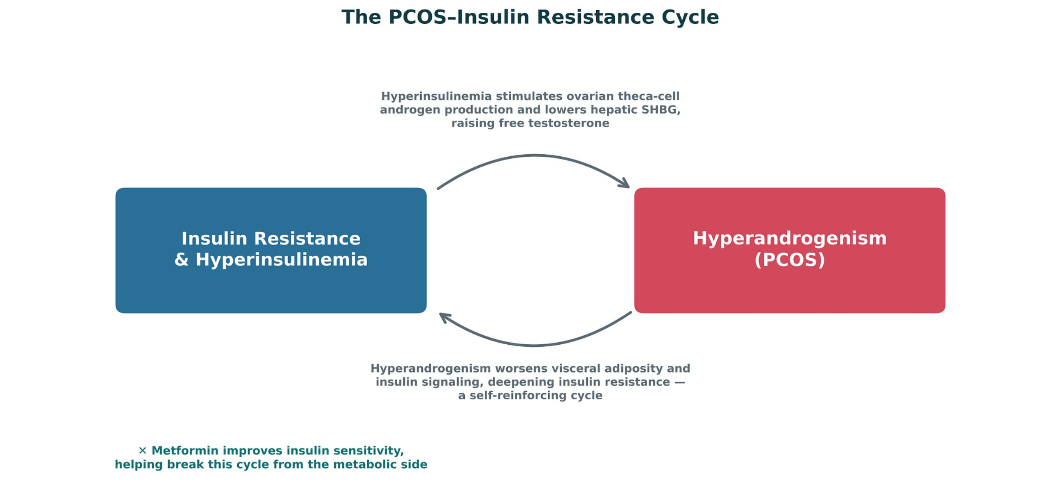
PCOS & THE REPRODUCTIVE-METABOLIC OVERLAP
Objectives: SO4 · SO5 · IO6.1 · IO6.3 · IO6.4 · IO6.5
Figure 7 · The PCOS–insulin resistance cycle
Original illustrative diagram (not from Katzung): hyperinsulinemia raises free testosterone (ovarian androgens up, SHBG down) and hyperandrogenism worsens insulin resistance — a self-sustaining cycle that metformin interrupts. S21; S21 (notes)
L11 · Genitourinary & Reproductive Pharmacology — Session 1
75

Slide 76
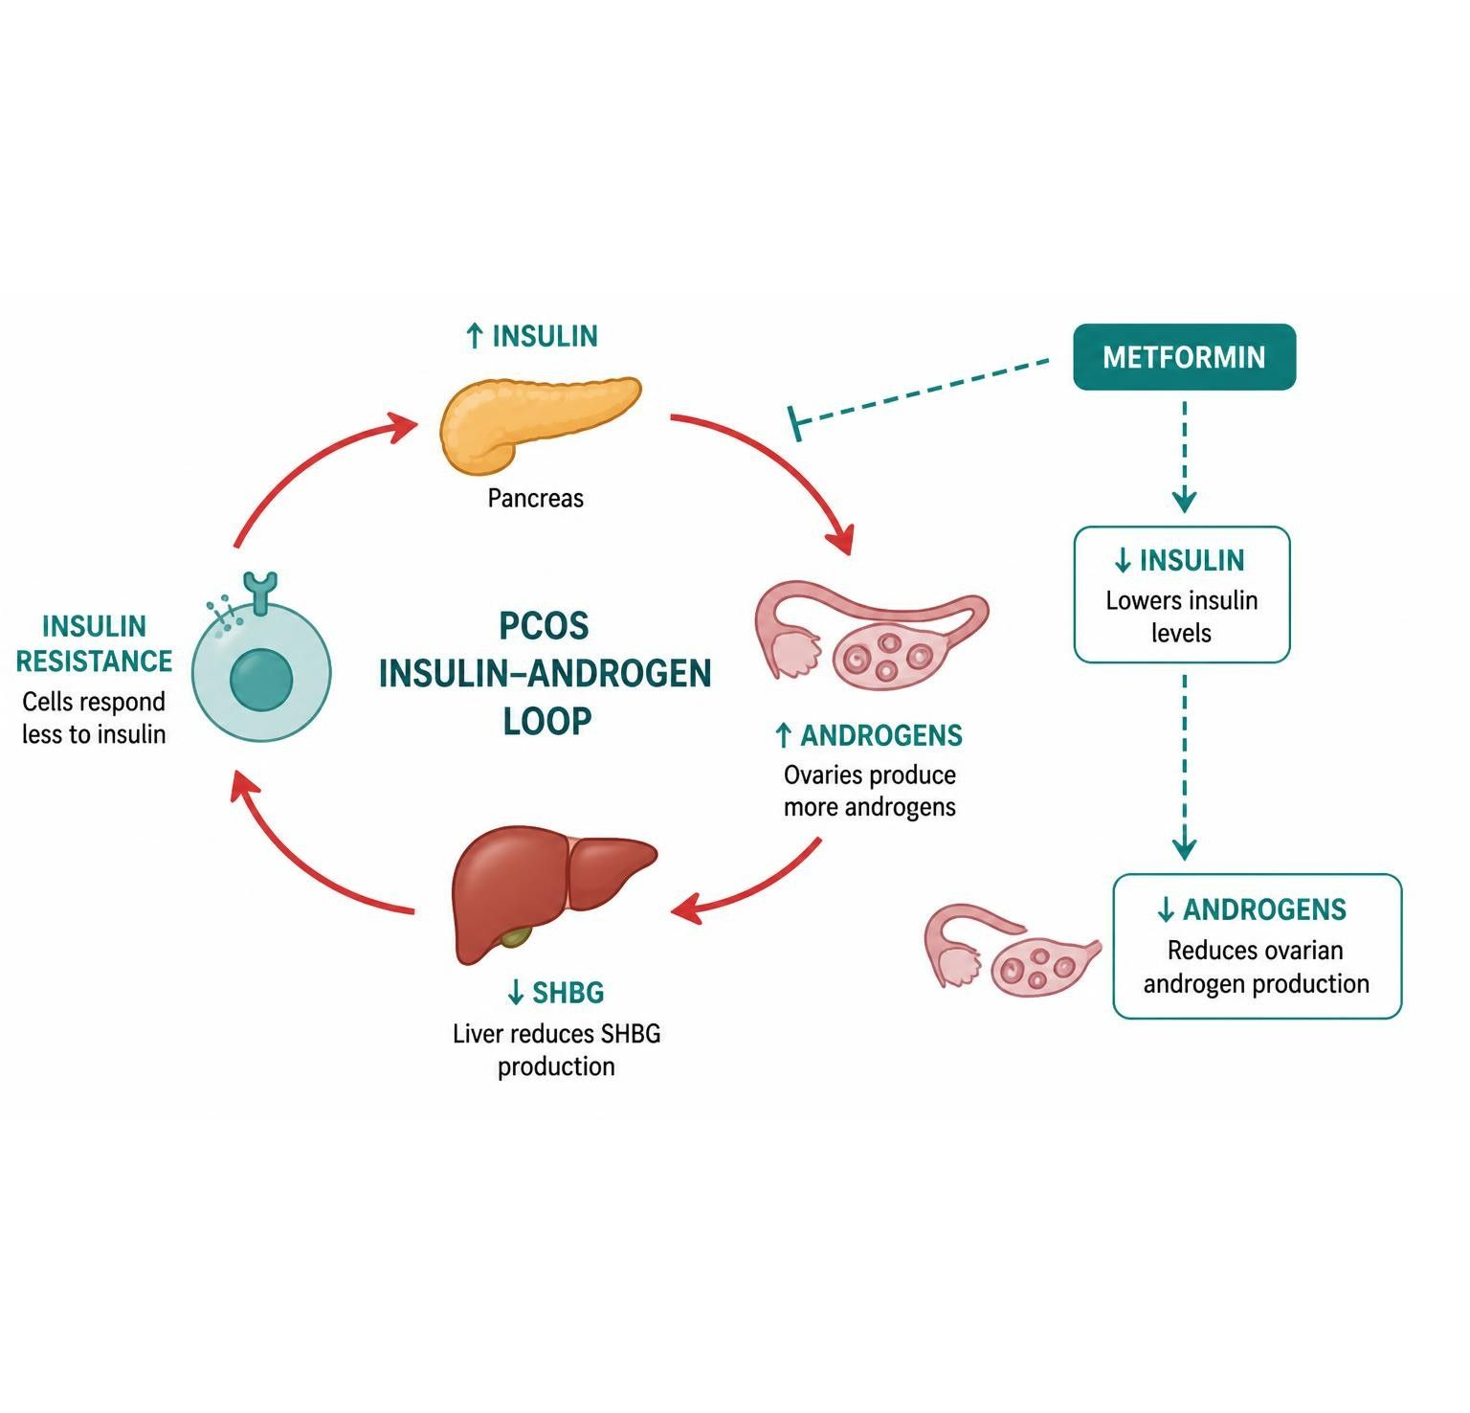
PCOS & THE REPRODUCTIVE-METABOLIC OVERLAP
Objectives: SO4 · SO5 · IO6.1 · IO6.3 · IO6.4 · IO6.5
Figure 8 · Metformin in PCOS: insulin, androgens and ovulation
Schematic (illustrative) — Figure 8. Insulin, androgens and ovulation in PCOS, and where metformin acts in the loop: lower insulin → lower androgens → cycles and ovulation can return. S23; S23 (notes)
L11 · Genitourinary & Reproductive Pharmacology — Session 1
76

Slide 77
PCOS & THE REPRODUCTIVE-METABOLIC OVERLAP
Objectives: SO4 · SO5 · IO6.1 · IO6.3 · IO6.4 · IO6.5
Compare: Table 1 · Agents used in PCOS management at a glance
Agent | Primary goal | Key teaching point
Combined hormonal contraception | Cycle regulation, hirsutism/acne | Progestin component opposes unopposed-estrogen endometrial risk
Metformin | Insulin sensitization | First-line metabolic therapy; can restore ovulation; GI upset common
Spironolactone | Antiandrogen effect on hirsutism/acne | Androgen receptor blockade; avoid in pregnancy (teratogenic risk)
GLP-1 receptor agonists | Weight loss, insulin sensitization | Emerging off-label use in PCOS with obesity
Focus: what tells these apart. Sources: S24; S24 (notes)
L11 · Genitourinary & Reproductive Pharmacology — Session 1
77

Slide 78
PCOS & THE REPRODUCTIVE-METABOLIC OVERLAP
Objectives: SO4 · SO5 · IO6.1 · IO6.3 · IO6.4 · IO6.5
Compare: Supporting drugs at a glance (S45)
Drug(s) | Why it matters here
Enzyme inducers | Rifampin, carbamazepine, phenytoin and St. John's wort lower combined contraceptive efficacy
Warfarin | Testosterone and tamoxifen raise INR
GnRH agonists | Leuprolide is used with antiandrogens in prostate cancer
GLP-1 receptor agonists | Off-label for PCOS with obesity
Clomiphene and letrozole | Ovulation induction, beyond this lecture
Bisphosphonates and calcium with vitamin D | Bone protection with aromatase inhibitors
CYP2D6 inhibitors | Paroxetine and fluoxetine blunt tamoxifen activation
ACE inhibitors, ARBs and potassium | Hyperkalemia with spironolactone
Focus: what tells these apart. Sources: S45; S45 (notes)
L11 · Genitourinary & Reproductive Pharmacology — Session 1
78

Slide 79
PCOS & THE REPRODUCTIVE-METABOLIC OVERLAP
Objectives: SO4 · SO5 · IO6.1 · IO6.3 · IO6.4 · IO6.5
Compare: Metformin profile: formulation, dose, indications
Drug | Class | Formulation | Adult dose | Indications
Metformin (Glucophage) | Biguanide | Tablet 500/850/1,000 mg; ER tablet; oral solution | Start 500 mg PO daily or BID with meals, titrate to 1,000 mg BID (max 2,550 mg/day) | Type 2 diabetes, prediabetes, PCOS (off-label)
Focus: what tells these apart. Sources: S44
L11 · Genitourinary & Reproductive Pharmacology — Session 1
79

Slide 80
PCOS & THE REPRODUCTIVE-METABOLIC OVERLAP
Objectives: SO4 · SO5 · IO6.1 · IO6.3 · IO6.4 · IO6.5
Compare: Metformin profile: adverse effects, contraindications, toxicity
Drug | Adverse effects | Contraindications | Toxicity / overdose
Metformin (Glucophage) | Nausea, diarrhea, metallic taste, vitamin B12 deficiency | eGFR below 30, acute metabolic acidosis, hypersensitivity | Lactic acidosis (renal impairment, contrast, alcohol, sepsis); hold around iodinated contrast; monitor B12
Focus: what tells these apart. Sources: S44
L11 · Genitourinary & Reproductive Pharmacology — Session 1
80

Slide 81
PCOS & THE REPRODUCTIVE-METABOLIC OVERLAP
Objectives: SO4 · SO5 · IO6.1 · IO6.3 · IO6.4 · IO6.5
Memory hooks
Why it happens
Why does a diabetes drug help hirsutism? Insulin drives the ovary to make androgens and the liver to make less SHBG; lower the insulin and free testosterone falls. S20; S23
L11 · Genitourinary & Reproductive Pharmacology — Session 1
81

Slide 82
PCOS & THE REPRODUCTIVE-METABOLIC OVERLAP
Objectives: SO4 · SO5 · IO6.1 · IO6.3 · IO6.4 · IO6.5
High-yield summary
If you remember nothing else
PCOS = insulin resistance ↔ hyperandrogenism cycle; metformin (metabolic) + combined contraception (cycles, hirsutism) are usually combined. S21; S22; S25
L11 · Genitourinary & Reproductive Pharmacology — Session 1
82

Slide 83
CLINICAL VIGNETTE · LECTURE QUICK CHECK S25
Objectives: SO4 · SO5 · IO6.1 · IO6.3 · IO6.4 · IO6.5
Question 11
A 24-year-old with PCOS (irregular cycles, hirsutism, BMI 31) does not want pregnancy and can take estrogen. Best plan?
A
Combined contraception plus metformin
B
Metformin alone, never hormones
C
Clomiphene to induce ovulation
D
Estradiol alone for cycles
E
Letrozole for hirsutism
L11 · Genitourinary & Reproductive Pharmacology — Session 1
83
Notes:
Answer on the next slide. Source: S22; S25

Slide 84
CLINICAL VIGNETTE · ANSWER
Objectives: SO4 · SO5 · IO6.1 · IO6.3 · IO6.4 · IO6.5
Answer 11: A
A. Combined contraception plus metformin
Contraception for immediate symptom control and metformin for the metabolic driver — frequently combined (S25). S22; S25
Why the other choices are wrong
B. Metformin alone, never hormones — Usually combined (S25).
C. Clomiphene to induce ovulation — She is not trying to conceive (S45).
D. Estradiol alone for cycles — Unopposed estrogen (S6).
E. Letrozole for hirsutism — Ovulation induction only (S45).
L11 · Genitourinary & Reproductive Pharmacology — Session 1
84

Slide 85
CLINICAL VIGNETTE
Objectives: SO4 · SO5 · IO6.1 · IO6.3 · IO6.4 · IO6.5
Question 14
A woman with PCOS on spironolactone for hirsutism plans pregnancy. What is the key counseling point?
A
Switch to testosterone
B
Continue; it is safe in pregnancy
C
Stop it — teratogenic in pregnancy
D
Double it to improve fertility
E
Add potassium supplements
L11 · Genitourinary & Reproductive Pharmacology — Session 1
85
Notes:
Answer on the next slide. Source: S24; S39

Slide 86
CLINICAL VIGNETTE · ANSWER
Objectives: SO4 · SO5 · IO6.1 · IO6.3 · IO6.4 · IO6.5
Answer 14: C
C. Stop it — teratogenic in pregnancy
Spironolactone: avoid in pregnancy (teratogenic risk; feminization of a male fetus) (S24; S39). S24; S39
Why the other choices are wrong
A. Switch to testosterone — Wrong direction (S15).
B. Continue; it is safe in pregnancy — Avoid (S24).
D. Double it to improve fertility — Not the advice (S24).
E. Add potassium supplements — Hyperkalemia risk (S45).
L11 · Genitourinary & Reproductive Pharmacology — Session 1
86

