Slide 1
L12 · Tue, Dec 1, 2026
Genitourinary & Reproductive Pharmacology — Session 2
Pharmacology study deck · organized by drug class
How to read this deck
TB = textbook only (not on the lecture slides)
SG = course study guide only (not on the lecture slides)
Bold = emphasized on the lecture slides
S12 = lecture slide 12 · p. 245 = textbook page 245 · SG U1-R3 = study guide item

Slide 2
START HERE
Learning objectives
IO6.1
Identify major pharmacologic classes used in the management of genitourinary and reproductive conditions and describe their mechanisms of action.
Autonomic Control of the Lower Urinary Tract, Overactive Bladder Drugs, BPH, Erectile Dysfunction & PDE5 Inhibitors
IO6.2
Describe the indications, contraindications, adverse effects, and clinically significant interactions associated with medications used to treat genitourinary and reproductive conditions.
Overactive Bladder Drugs, BPH, Erectile Dysfunction & PDE5 Inhibitors
IO6.3
Compare pharmacologic agents within and across therapeutic classes to distinguish clinically relevant differences in efficacy, safety, and use.
Overactive Bladder Drugs, BPH, Erectile Dysfunction & PDE5 Inhibitors, Putting It All Together: GU Toolkit
IO6.4
Select appropriate pharmacologic therapy for common genitourinary and reproductive conditions based on clinical presentation and patient-specific factors.
Overactive Bladder Drugs, BPH, Erectile Dysfunction & PDE5 Inhibitors, Putting It All Together: GU Toolkit
L12 · Genitourinary & Reproductive Pharmacology — Session 2
2

Slide 3
START HERE
Learning objectives (cont.)
IO6.5
Identify appropriate dosing, administration, and monitoring considerations for medications used in genitourinary and reproductive conditions.
BPH, Erectile Dysfunction & PDE5 Inhibitors
IO6.6
Explain important medication-use and safety information to patients receiving genitourinary and reproductive pharmacotherapy.
Overactive Bladder Drugs, BPH, Erectile Dysfunction & PDE5 Inhibitors, Putting It All Together: GU Toolkit
SO1
Describe the autonomic and somatic innervation of the bladder and lower urinary tract, and the receptor subtypes governing storage versus voiding.
Autonomic Control of the Lower Urinary Tract
SO2
Describe the mechanism, indications, and adverse effects of antimuscarinic agents and beta-3 agonists in overactive bladder and urinary incontinence.
Overactive Bladder Drugs
L12 · Genitourinary & Reproductive Pharmacology — Session 2
3

Slide 4
START HERE
Learning objectives (cont.)
SO3
Describe the mechanism and adverse effects of alpha1 blockers and 5-alpha-reductase inhibitors in benign prostatic hyperplasia (BPH).
BPH, Erectile Dysfunction & PDE5 Inhibitors
SO4
Describe non-adrenergic, noncholinergic (NANC) neurotransmission and the NO-cGMP pathway underlying erectile function and PDE5 inhibitor pharmacology, including the absolute nitrate contraindication.
BPH, Erectile Dysfunction & PDE5 Inhibitors
SO5
Integrate autonomic receptor pharmacology across the genitourinary and cardiovascular systems, and apply the full Unit 6 toolkit to integrated clinical scenarios with a cumulative recall quiz.
Putting It All Together: GU Toolkit
L12 · Genitourinary & Reproductive Pharmacology — Session 2
4

Slide 5

START HERE
About this lecture
Scope, readings & sources
PA PHARMACOLOGY COURSE · LECTURE 6 · SESSION 2 OF 2 — Genitourinary & Reproductive Pharmacology. Session 2: Autonomic Pharmacology of the Bladder and Lower Urinary Tract | Tuesday, December 1 | 8:30–11:00 AM S1
Recap: Session 1 covered gonadal steroid pharmacology (estrogens, progestins, SERMs, aromatase inhibitors, androgens/antiandrogens) and the PCOS reproductive-metabolic overlap. S2
Today is autonomic pharmacology — mechanistically distinct from steroid hormones; the connective tissue between sessions is mostly the finasteride/dutasteride callback and the shared organ system. Three nerve supplies, three receptor families, and every drug maps to one receptor at one location. S2 (notes)
APPENDIX 1 — Formulation, dose, indications, adverse effects, contraindications and toxicity — your study reference: know the dose logic, the serious adverse effects, the contraindication that changes decisions and the toxicity you would need to recognize. S35; S35 (notes); S36-49
L12 · Genitourinary & Reproductive Pharmacology — Session 2
5

Slide 6
START HERE
About this lecture (cont.)
Scope, readings & sources
PO = by mouth TID = three times daily IR / ER = immediate-release / extended-release BPH = benign prostatic hyperplasia PSA = prostate-specific antigen ED = erectile dysfunction PAH = pulmonary arterial hypertension OAB = overactive bladder CNS = central nervous system S35
QT = QT interval on ECG CYP = cytochrome P450 eGFR / CrCl = estimated glomerular filtration rate / creatinine clearance PDE5 = phosphodiesterase type 5 GnRH = gonadotropin-releasing hormone BP = blood pressure GI = gastrointestinal ECG = electrocardiogram NO / cGMP = nitric oxide / cyclic guanosine monophosphate S35
Standard adult dosing for teaching; verify against current prescribing information. S36-49
Appendix 2: DRUG PROFILE · SUPPORTING — supporting drugs explain interactions. Listed for context; not profiled in detail. S50; S50 (notes)
L12 · Genitourinary & Reproductive Pharmacology — Session 2
6

Slide 7
START HERE
About this lecture (cont.)
Scope, readings & sources
Original figures in this deck: Figures 9, 12, 13, 15 and 18 (Autonomic & Somatic Receptors of the Lower Urinary Tract; Antimuscarinics vs. Beta-3 Agonists: Two Mechanisms for Bladder Storage; Alpha1 Blockade at the Bladder Neck and Prostate; S51
NANC Neurotransmission and the NO-cGMP Pathway in Erectile Function; Autonomic Receptor Map Across the Genitourinary Tract) were generated by the course director using the AI tool Claude — original diagrams, not reproduced from Katzung or any other copyrighted source. S51; S51 (notes)
Mechanism illustrations: Figures 10, 11, 14, 16 and 17 are illustrative AI-generated schematics, not reproduced from copyrighted sources. Reference: Anthropic. (2026). Claude (Sonnet 5) [Large language model]. https://claude.ai S51
L12 · Genitourinary & Reproductive Pharmacology — Session 2
7

Slide 8
ROADMAP
Drug classes in this lecture
Autonomic Control of the Lower Urinary Tract
Objectives: SO1, IO6.1
1
Overactive Bladder Drugs
Objectives: SO2, IO6.1, IO6.2, IO6.3, IO6.4, IO6.6
2
BPH, Erectile Dysfunction & PDE5 Inhibitors
Objectives: SO3, SO4, IO6.1, IO6.2, IO6.3, IO6.4, IO6.5, IO6.6
3
Putting It All Together: GU Toolkit
Objectives: SO5, IO6.3, IO6.4, IO6.6
4
L12 · Genitourinary & Reproductive Pharmacology — Session 2
8

Slide 9










Drug class 1 of 4
Autonomic Control of the Lower Urinary Tract
Covers objectives: SO1 · IO6.1
Class
Prototype
Mechanism of action
Indications
Adverse effects
Contraindications
Drug interactions
Pharmacokinetics
Monitoring
Clinical pearls
9

Slide 10
AUTONOMIC CONTROL OF THE LOWER URINARY TRACT
Objectives: SO1 · IO6.1
Class
Class
Three nerve supplies, three receptor families — the physiologic foundation for every drug in this session. S3
Parasympathetic M3 contracts the detrusor, sympathetic alpha-1 closes the bladder neck and beta-3 relaxes the reservoir, and somatic nicotinic control holds the external sphincter. S3 (notes); S4 (notes)
Figure 9. Original illustrative diagram (not from Katzung): the parasympathetic, sympathetic, and somatic nervous systems each innervate a different structure of the lower urinary tract through a distinct receptor family — S4
the organizing map for every drug class covered this session. Every class is anchored back to its receptor and anatomic location; Sections 5 and 6 "zoom in" on parts of this map. S4; S4 (notes)
L12 · Genitourinary & Reproductive Pharmacology — Session 2
10

Slide 11
AUTONOMIC CONTROL OF THE LOWER URINARY TRACT
Objectives: SO1 · IO6.1
Prototype + other drugs named
Prototype + other drugs named
Oxybutynin (blocks M3 on the detrusor), tamsulosin (blocks alpha1 at the bladder neck/prostate) and mirabegron (stimulates beta3 on the detrusor body) each target one receptor of this map. S4; S5; S7
L12 · Genitourinary & Reproductive Pharmacology — Session 2
11

Slide 12
AUTONOMIC CONTROL OF THE LOWER URINARY TRACT
Objectives: SO1 · IO6.1
Mechanism of action
Mechanism of action (1/2)
The parasympathetic pelvic nerve releases acetylcholine, which acts on M3 muscarinic receptors on the detrusor muscle to produce contraction — the primary driver of bladder emptying (voiding). S5; SG U6-R11
M3 is the dominant muscarinic subtype in the bladder, though M2 receptors are also present in high density (smaller functional contribution normally, may increase in disease). S5; S5 (notes)
Chain (Figure 10): pelvic nerve releases acetylcholine → ACh binds M3 on the detrusor → Gq activates phospholipase C; calcium rises → detrusor contracts and the bladder empties. S6; S6 (notes)
M3 is the dominant bladder muscarinic subtype. M2 is more abundant but contributes less to contraction. Blocking M3 underlies antimuscarinic OAB treatment. S6
L12 · Genitourinary & Reproductive Pharmacology — Session 2
12

Slide 13
AUTONOMIC CONTROL OF THE LOWER URINARY TRACT
Objectives: SO1 · IO6.1
Mechanism of action (cont.)
Mechanism of action (2/2)
The sympathetic hypogastric nerve releases norepinephrine, which acts on two different adrenergic receptor subtypes in two different locations, producing two different (and complementary) effects. S7; S7 (notes)
Chain (Figure 11): sympathetic hypogastric nerve releases norepinephrine → alpha-1: outlet closed; beta-3: reservoir relaxed → continence maintained during storage. S8
Alpha1 receptors at the bladder neck, trigone, and proximal urethra: norepinephrine causes contraction, helping maintain continence during storage. S7; S8; SG U6-R11
Beta3 receptors on the detrusor body: norepinephrine causes relaxation, allowing the bladder to fill without a premature urge to void (low pressure). S7; S8; SG U6-R11
L12 · Genitourinary & Reproductive Pharmacology — Session 2
13

Slide 14
AUTONOMIC CONTROL OF THE LOWER URINARY TRACT
Objectives: SO1 · IO6.1
Indications · Adverse effects (boxed warnings first)
Indications
Adverse effects (boxed warnings first)
Because M3 blockade reduces detrusor contraction, antimuscarinic drugs (Section 5) are a logical treatment for conditions of bladder overactivity. S5
Both of these receptor subtypes become specific drug targets later in this session: alpha1 blockers for BPH (Section 6), and beta3 agonists for overactive bladder (Section 5). S7
Not covered in materials
L12 · Genitourinary & Reproductive Pharmacology — Session 2
14

Slide 15
AUTONOMIC CONTROL OF THE LOWER URINARY TRACT
Objectives: SO1 · IO6.1
Contraindications → Monitoring
Contraindications
Drug interactions
Not covered in materials
Not covered in materials
Pharmacokinetics
Monitoring
Not covered in materials
Not covered in materials
L12 · Genitourinary & Reproductive Pharmacology — Session 2
15

Slide 16
AUTONOMIC CONTROL OF THE LOWER URINARY TRACT
Objectives: SO1 · IO6.1
Clinical pearls / "why" hook
Clinical pearls / "why" hook
Net storage effect: sympathetic tone keeps the outlet closed (alpha1) while keeping the reservoir relaxed (beta3) — parasympathetic tone is low; both arms work together for continence. During voiding, this pattern reverses. S7; S8; S8 (notes)
This is applied Chapter 6: the same muscarinic family that governs other smooth muscle and glands throughout the body — the bladder is simply one more target organ. S5; S5 (notes)
Know which receptor does what where (alpha1 at the outlet vs. beta3 on the detrusor body) before moving on — it makes the rest of the session’s pharmacology make sense. S7 (notes)
L12 · Genitourinary & Reproductive Pharmacology — Session 2
16

Slide 17
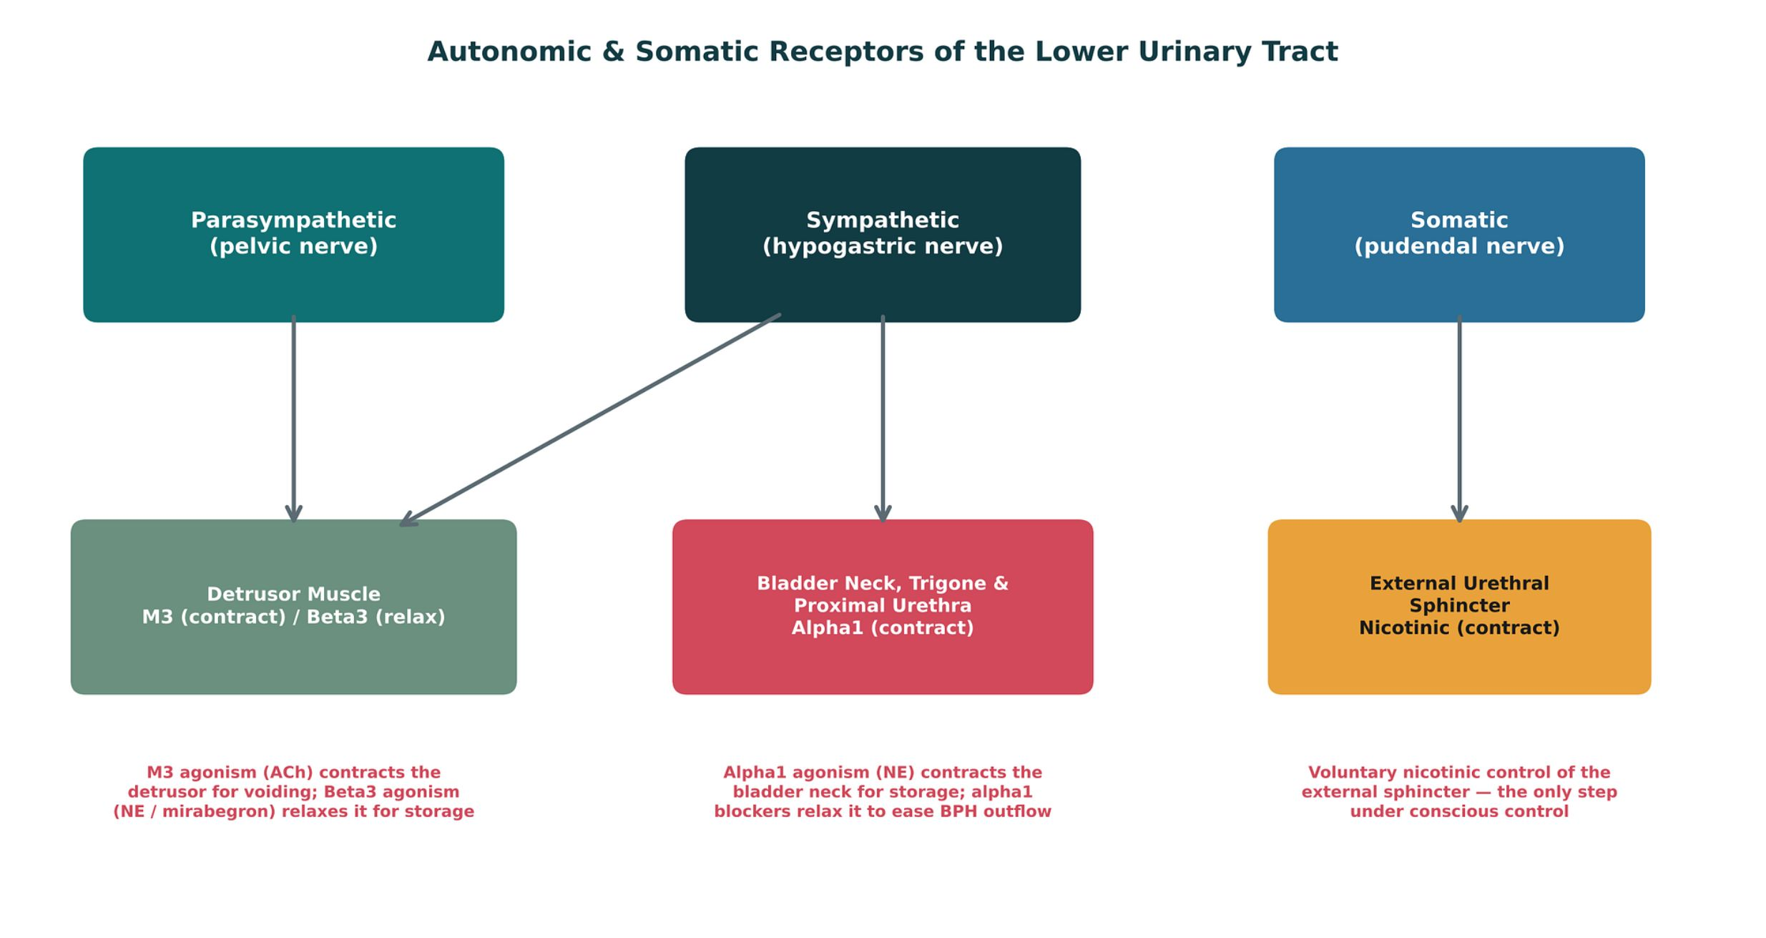
AUTONOMIC CONTROL OF THE LOWER URINARY TRACT
Objectives: SO1 · IO6.1
Figure 9 · Autonomic and somatic receptors of the lower urinary tract
Original illustrative diagram (not from Katzung): parasympathetic M3 (detrusor contraction), sympathetic alpha1 (bladder neck closure) and beta3 (detrusor relaxation), somatic nicotinic (external sphincter) — the map for every drug in the session. S4; S4 (notes)
L12 · Genitourinary & Reproductive Pharmacology — Session 2
17

Slide 18
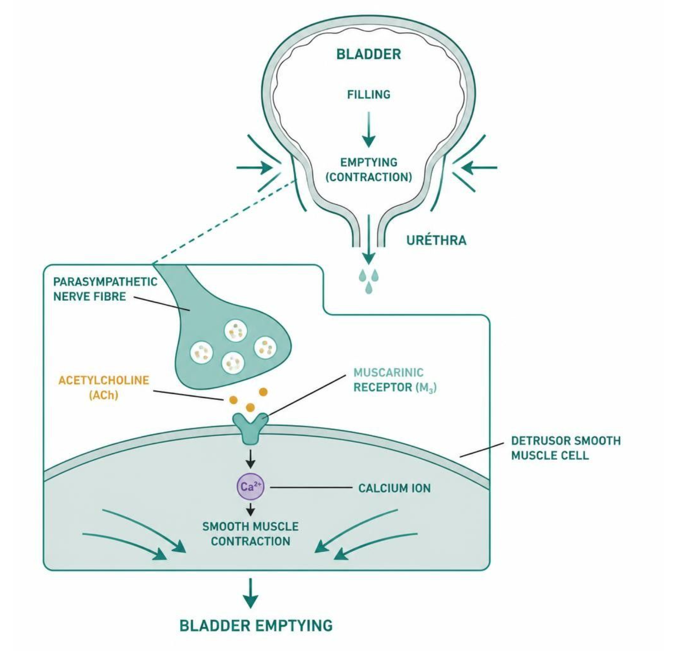
AUTONOMIC CONTROL OF THE LOWER URINARY TRACT
Objectives: SO1 · IO6.1
Figure 10 · M3 signaling and detrusor contraction
Schematic (illustrative) — Figure 10. Acetylcholine acting on M3 receptors (Gq → phospholipase C → calcium) drives detrusor contraction and bladder emptying. S6; S6 (notes)
L12 · Genitourinary & Reproductive Pharmacology — Session 2
18

Slide 19
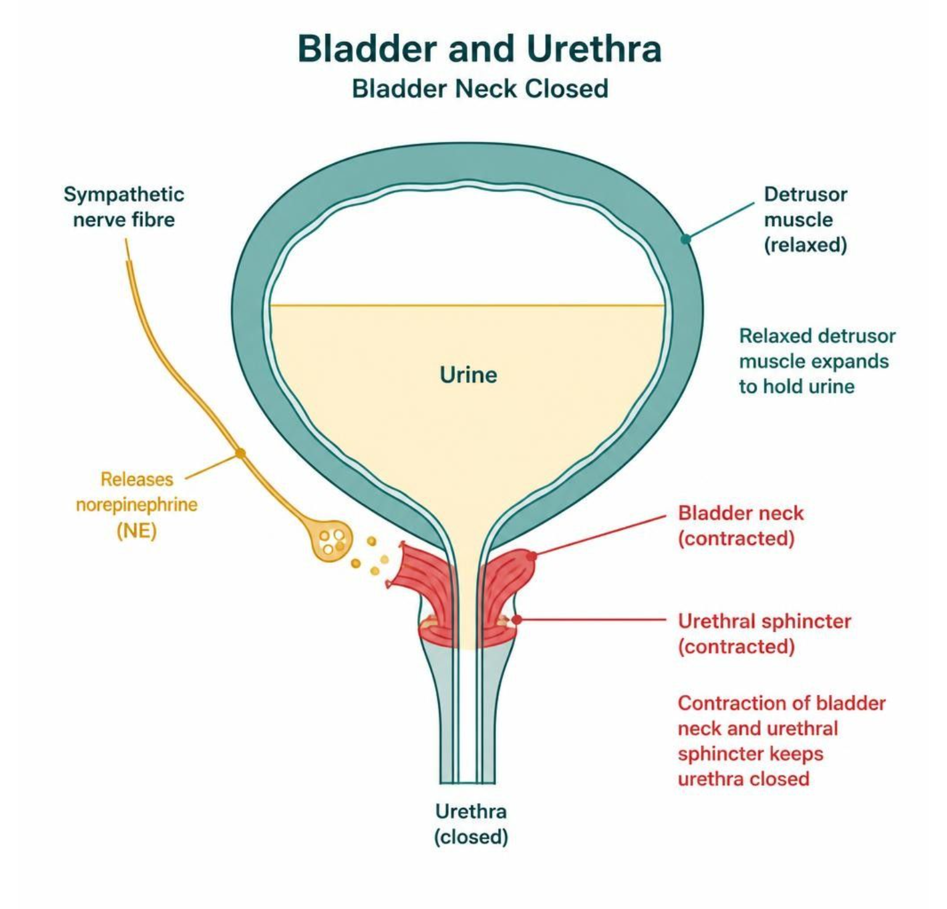
AUTONOMIC CONTROL OF THE LOWER URINARY TRACT
Objectives: SO1 · IO6.1
Figure 11 · Alpha-1 vs. beta-3: outlet closed, reservoir relaxed
Schematic (illustrative) — Figure 11. Alpha-1 contraction closes the outlet while beta-3 relaxation lets the bladder store urine — together, continence during storage. S8; S8 (notes)
L12 · Genitourinary & Reproductive Pharmacology — Session 2
19

Slide 20
AUTONOMIC CONTROL OF THE LOWER URINARY TRACT
Objectives: SO1 · IO6.1
Compare: Storage phase vs. voiding phase (S9)
 | Storage phase | Voiding phase
Dominant tone | Sympathetic | Parasympathetic
Detrusor | Beta3 agonism relaxes the detrusor body | M3 agonism contracts the detrusor body
Bladder neck | Alpha1 agonism contracts the bladder neck/urethra | Sympathetic tone withdraws, bladder neck relaxes
External sphincter | Somatic (pudendal) tone keeps it closed | Voluntary relaxation (somatic)
Focus: what tells these apart. Sources: S9; S9 (notes)
L12 · Genitourinary & Reproductive Pharmacology — Session 2
20

Slide 21

AUTONOMIC CONTROL OF THE LOWER URINARY TRACT
Objectives: SO1 · IO6.1
Memory hooks
Mnemonic (memory aid)
Store with the Sympathetic (alpha1 shuts the door, beta3 relaxes the tank); Pee with the Parasympathetic (M3 squeezes). S9
L12 · Genitourinary & Reproductive Pharmacology — Session 2
21

Slide 22

AUTONOMIC CONTROL OF THE LOWER URINARY TRACT
Objectives: SO1 · IO6.1
High-yield summary
If you remember nothing else
M3 (detrusor) contracts to void; alpha1 (neck) closes and beta3 (detrusor) relaxes to store. S5; S7; SG U6-R11
L12 · Genitourinary & Reproductive Pharmacology — Session 2
22

Slide 23
MECHANISM
Objectives: SO1 · IO6.1
Question 1
Which receptor on the detrusor body relaxes the bladder during filling?
A
M3 muscarinic receptor
B
Nicotinic receptor
C
Alpha1 adrenergic receptor
D
M2 muscarinic receptor
E
Beta3 adrenergic receptor
L12 · Genitourinary & Reproductive Pharmacology — Session 2
23
Notes:
Answer on the next slide. Source: S7; S8; SG U6-R11

Slide 24

MECHANISM · ANSWER
Objectives: SO1 · IO6.1
Answer 1: E
E. Beta3 adrenergic receptor
Norepinephrine at beta3 on the detrusor body causes relaxation during storage (S7). S7; S8; SG U6-R11
Why the other choices are wrong
A. M3 muscarinic receptor — Contracts the detrusor (S5).
B. Nicotinic receptor — External sphincter (S9).
C. Alpha1 adrenergic receptor — Contracts the bladder neck (S7).
D. M2 muscarinic receptor — Smaller contraction role (S5).
L12 · Genitourinary & Reproductive Pharmacology — Session 2
24

Slide 25
Drug class 2 of 4
Overactive Bladder Drugs
Covers objectives: SO2 · IO6.1 · IO6.2 · IO6.3 · IO6.4 · IO6.6
Class
Prototype
Mechanism of action
Indications
Adverse effects
Contraindications
Drug interactions
Pharmacokinetics
Monitoring
Clinical pearls
25

Slide 26
OVERACTIVE BLADDER DRUGS
Objectives: SO2 · IO6.1 · IO6.2 · IO6.3 · IO6.4 · IO6.6
Class
Class
Two mechanisms, one goal — calming an overactive detrusor to improve storage and reduce urgency. Antimuscarinics block the detrusor’s muscarinic signal, while beta-3 agonists relax it. S10; S10 (notes)
Figure 12. Original illustrative diagram (not from Katzung): antimuscarinics block the M3-mediated contraction signal, while beta3 agonists enhance the norepinephrine-mediated relaxation signal — S14
two distinct mechanisms converging on the same clinical goal of improved bladder storage. Complementary, not competing — the basis for combination therapy. S14; S14 (notes)
L12 · Genitourinary & Reproductive Pharmacology — Session 2
26

Slide 27
OVERACTIVE BLADDER DRUGS
Objectives: SO2 · IO6.1 · IO6.2 · IO6.3 · IO6.4 · IO6.6
Prototype + other drugs named
Prototype + other drugs named
Oxybutynin, tolterodine, solifenacin, darifenacin (antimuscarinics); mirabegron (beta3 agonist). S11; S13
L12 · Genitourinary & Reproductive Pharmacology — Session 2
27

Slide 28
OVERACTIVE BLADDER DRUGS
Objectives: SO2 · IO6.1 · IO6.2 · IO6.3 · IO6.4 · IO6.6
Mechanism of action
Mechanism of action (1/2)
Mechanism: block M3 (and, to a lesser extent, M2) muscarinic receptors on the detrusor, reducing involuntary contractions and increasing functional bladder capacity. S11; SG U6-R12
Antimuscarinic agents differ mainly in receptor selectivity and anticholinergic side-effect burden rather than core mechanism. S11
Chain (Figure 13): drug blocks M3 receptors on the detrusor → fewer involuntary contractions, larger capacity → same blockade in brain, salivary gland and bowel → bladder relaxes, but dry mouth, constipation and confusion follow. S12; S12 (notes)
L12 · Genitourinary & Reproductive Pharmacology — Session 2
28

Slide 29
OVERACTIVE BLADDER DRUGS
Objectives: SO2 · IO6.1 · IO6.2 · IO6.3 · IO6.4 · IO6.6
Mechanism of action (cont.)
Mechanism of action (2/2)
Oxybutynin has the highest CNS anticholinergic burden; mirabegron, a beta-3 agonist, avoids this anticholinergic burden. S12
Mechanism: stimulate beta3 adrenergic receptors on the detrusor, enhancing smooth muscle relaxation during the storage/filling phase. Mirabegron is the primary beta3 agonist in clinical use for overactive bladder. S13; SG U6-R13
L12 · Genitourinary & Reproductive Pharmacology — Session 2
29

Slide 30
OVERACTIVE BLADDER DRUGS
Objectives: SO2 · IO6.1 · IO6.2 · IO6.3 · IO6.4 · IO6.6
Indications
Indications
Key advantage: lacks the systemic anticholinergic burden of antimuscarinics, making it a preferred option in older adults or patients already on multiple anticholinergic medications. S13; SG U6-R13
Mirabegron can be used alone or combined with an antimuscarinic for refractory symptoms — complementary (not redundant) mechanisms. S13; S14 (notes)
L12 · Genitourinary & Reproductive Pharmacology — Session 2
30

Slide 31
OVERACTIVE BLADDER DRUGS
Objectives: SO2 · IO6.1 · IO6.2 · IO6.3 · IO6.4 · IO6.6
Adverse effects (boxed warnings first)
Adverse effects (boxed warnings first)
Adverse effects follow directly from systemic antimuscarinic blockade: dry mouth, constipation, blurred vision, and — importantly — cognitive impairment and confusion, especially in older adults. S11; S11 (notes)
Anticholinergic burden is cumulative across all of a patient’s medications — oxybutynin has the highest CNS anticholinergic burden of this class and is often avoided in older adults or those with dementia risk. S11; S12; SG U6-R12
Mirabegron: can raise blood pressure (monitor in uncontrolled hypertension); headache or nasopharyngitis; less commonly, urinary retention. S13
L12 · Genitourinary & Reproductive Pharmacology — Session 2
31

Slide 32
OVERACTIVE BLADDER DRUGS
Objectives: SO2 · IO6.1 · IO6.2 · IO6.3 · IO6.4 · IO6.6
Contraindications · Drug interactions
Contraindications
Drug interactions
Antimuscarinics: caution/contraindication in narrow-angle glaucoma and significant urinary retention. S11
Mirabegron inhibits CYP2D6. Other anticholinergics (diphenhydramine, tricyclic antidepressants) add to anticholinergic burden; cholinesterase inhibitors (donepezil) oppose antimuscarinics. S13 (notes); S50; S50 (notes)
Strong CYP3A4 inhibitors (ketoconazole, clarithromycin) raise solifenacin levels. S50; S50 (notes)
L12 · Genitourinary & Reproductive Pharmacology — Session 2
32

Slide 33
OVERACTIVE BLADDER DRUGS
Objectives: SO2 · IO6.1 · IO6.2 · IO6.3 · IO6.4 · IO6.6
Pharmacokinetics · Monitoring
Pharmacokinetics
Monitoring
Not covered in materials
Not covered in materials
L12 · Genitourinary & Reproductive Pharmacology — Session 2
33

Slide 34
OVERACTIVE BLADDER DRUGS
Objectives: SO2 · IO6.1 · IO6.2 · IO6.3 · IO6.4 · IO6.6
Clinical pearls / "why" hook
Clinical pearls / "why" hook
Case: a 78-year-old with mild cognitive impairment and urge incontinence starts oxybutynin; three weeks later, worsening confusion and new difficulty with daily tasks. What is the most likely explanation, and what change in therapy would you consider? S15
Oxybutynin carries a relatively high CNS anticholinergic burden, and in an older adult — especially one with pre-existing cognitive impairment — this can precipitate or worsen confusion. S15
Switching to a beta3 agonist (mirabegron), which lacks anticholinergic activity, treats the same overactive bladder symptoms without this risk. Review other anticholinergics too (medication reconciliation). S15; S15 (notes)
The anticholinergic-burden-in-older-adults point is the highest-yield safety point in this section; "no anticholinergic burden" is mirabegron’s single most important advantage. S11 (notes); S13 (notes)
L12 · Genitourinary & Reproductive Pharmacology — Session 2
34

Slide 35
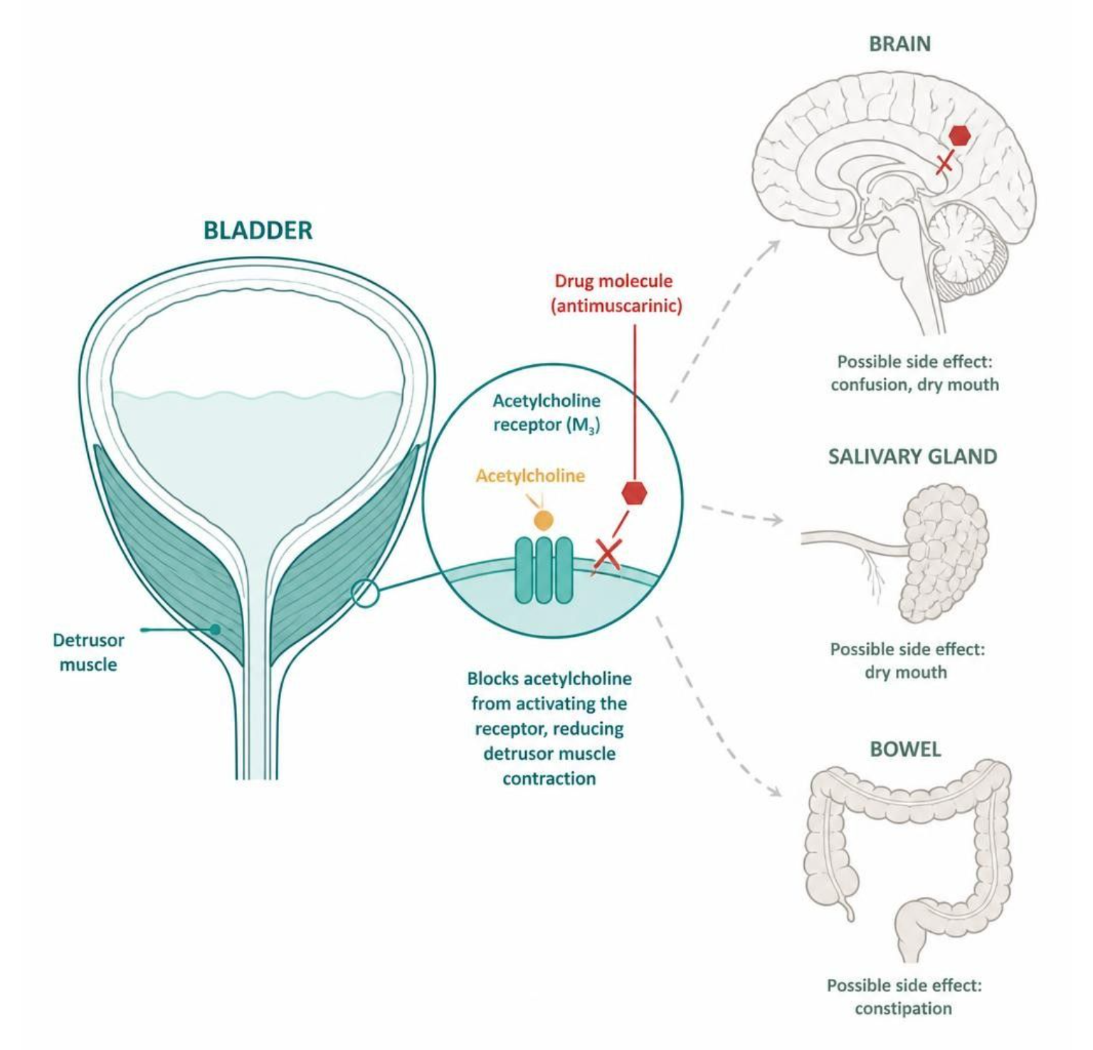
OVERACTIVE BLADDER DRUGS
Objectives: SO2 · IO6.1 · IO6.2 · IO6.3 · IO6.4 · IO6.6
Figure 13 · Antimuscarinics: bladder benefit and anticholinergic burden
Schematic (illustrative) — Antimuscarinics relax the bladder but block the same receptors throughout the body (brain, salivary glands, gut): dry mouth, constipation and confusion. (The slide labels this “Figure 93”.) S12; S12 (notes)
L12 · Genitourinary & Reproductive Pharmacology — Session 2
35

Slide 36
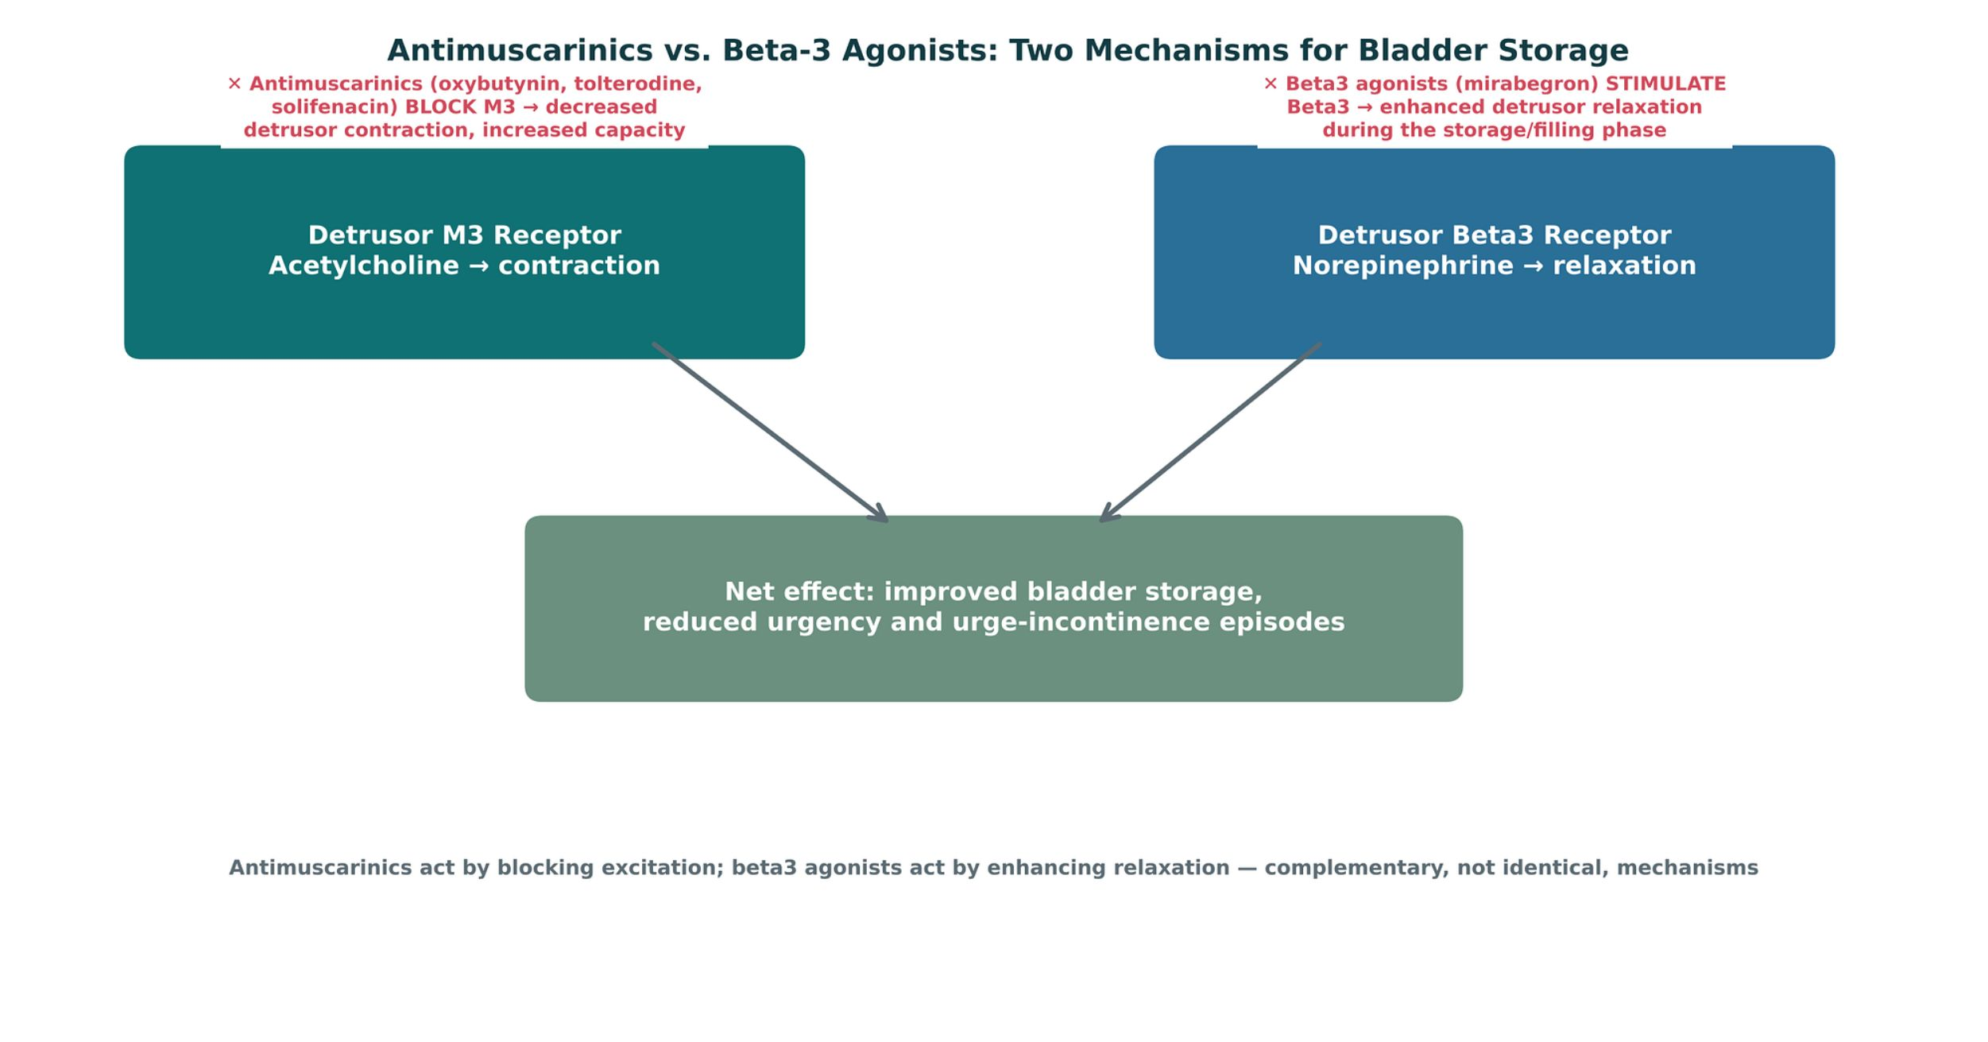
OVERACTIVE BLADDER DRUGS
Objectives: SO2 · IO6.1 · IO6.2 · IO6.3 · IO6.4 · IO6.6
Figure 12 · Antimuscarinics vs. beta-3 agonists
Original illustrative diagram (not from Katzung): antimuscarinics block the M3 contraction signal; beta3 agonists enhance the relaxation signal — complementary mechanisms for better storage. S14; S14 (notes)
L12 · Genitourinary & Reproductive Pharmacology — Session 2
36

Slide 37
OVERACTIVE BLADDER DRUGS
Objectives: SO2 · IO6.1 · IO6.2 · IO6.3 · IO6.4 · IO6.6
Compare: Antimuscarinics vs. mirabegron (S11; S13)
 | Antimuscarinics | Mirabegron (beta3 agonist)
Mechanism | Block M3 (and M2) on the detrusor | Stimulate beta3 on the detrusor
Adverse effects | Dry mouth, constipation, blurred vision, confusion | Raises BP; headache, nasopharyngitis
Older adults | Avoid oxybutynin (highest CNS burden) | Preferred — no anticholinergic burden
Cautions | Narrow-angle glaucoma, urinary retention | Uncontrolled hypertension; CYP2D6 inhibitor
Focus: what tells these apart. Sources: S11; S13
L12 · Genitourinary & Reproductive Pharmacology — Session 2
37

Slide 38
OVERACTIVE BLADDER DRUGS
Objectives: SO2 · IO6.1 · IO6.2 · IO6.3 · IO6.4 · IO6.6
Compare: Overactive bladder drug profiles: formulation, dose, indications
Drug | Class | Formulation | Adult dose | Indications
Oxybutynin (Ditropan, Oxytrol) | Antimuscarinic (overactive bladder) | IR tablets 5 mg; ER tablets 5/10/15 mg; transdermal patch 3.9 mg/day; gel | IR: 5 mg PO two to three times daily (maximum 20 mg/day); ER: 5-10 mg daily (maximum 30 mg) | Overactive bladder, urge incontinence, neurogenic bladder
Tolterodine (Detrol) | Antimuscarinic | Tablets 1/2 mg; ER capsules 2/4 mg | IR: 2 mg PO twice daily (1 mg if hepatic impairment or strong CYP3A4 inhibitors); ER: 4 mg daily | Overactive bladder with urgency, frequency, and urge incontinence
Solifenacin (Vesicare) | Antimuscarinic (M3-selective) | Tablets 5/10 mg | 5 mg PO once daily, may increase to 10 mg (maximum 5 mg with severe renal impairment or strong CYP3A4 inhibitors) | Overactive bladder
Focus: what tells these apart. Sources: S36; S37; S38; S39; S40
L12 · Genitourinary & Reproductive Pharmacology — Session 2
38

Slide 39
OVERACTIVE BLADDER DRUGS
Objectives: SO2 · IO6.1 · IO6.2 · IO6.3 · IO6.4 · IO6.6
Compare: Overactive bladder drug profiles: formulation, dose, indications (cont.)
Drug | Class | Formulation | Adult dose | Indications
Darifenacin (Enablex) | Antimuscarinic (M3-selective) | ER tablets 7.5/15 mg | 7.5 mg PO once daily, may increase to 15 mg after 2 weeks | Overactive bladder
Mirabegron (Myrbetriq) | Beta-3 adrenergic agonist | ER tablets 25/50 mg; granules for suspension | 25 mg PO once daily, may increase to 50 mg after 4-8 weeks (maximum 25 mg with eGFR 15-29) | Overactive bladder (alone or with an antimuscarinic)
Focus: what tells these apart. Sources: S36; S37; S38; S39; S40
L12 · Genitourinary & Reproductive Pharmacology — Session 2
39

Slide 40
OVERACTIVE BLADDER DRUGS
Objectives: SO2 · IO6.1 · IO6.2 · IO6.3 · IO6.4 · IO6.6
Compare: Overactive bladder drug profiles: adverse effects, contraindications, toxicity
Drug | Adverse effects | Contraindications | Toxicity / overdose
Oxybutynin (Ditropan, Oxytrol) | Dry mouth, constipation, blurred vision, drowsiness, confusion, urinary retention | Narrow-angle glaucoma, urinary retention, gastric retention, severe ulcerative colitis; avoid in older adults with dementia | Anticholinergic toxicity: confusion, hallucinations, tachycardia, hyperthermia, urinary retention; highest CNS burden in the class
Tolterodine (Detrol) | Dry mouth, constipation, headache, dizziness, dry eyes, QT prolongation (rare) | Urinary retention, gastric retention, uncontrolled narrow-angle glaucoma | Anticholinergic toxicity; reduce dose with CYP3A4 inhibitors or hepatic impairment
Solifenacin (Vesicare) | Dry mouth, constipation, blurred vision, QT prolongation, urinary retention | Urinary retention, gastric retention, uncontrolled narrow-angle glaucoma | Anticholinergic toxicity and QT prolongation in overdose; adjust dose with kidney, liver, and CYP3A4 interactions
Focus: what tells these apart. Sources: S36; S37; S38; S39; S40
L12 · Genitourinary & Reproductive Pharmacology — Session 2
40

Slide 41
OVERACTIVE BLADDER DRUGS
Objectives: SO2 · IO6.1 · IO6.2 · IO6.3 · IO6.4 · IO6.6
Compare: Overactive bladder drug profiles: adverse effects, contraindications, toxicity (cont.)
Drug | Adverse effects | Contraindications | Toxicity / overdose
Darifenacin (Enablex) | Constipation (prominent), dry mouth, dyspepsia, headache | Urinary or gastric retention, uncontrolled narrow-angle glaucoma | Anticholinergic toxicity; CYP2D6 and CYP3A4 interactions; limit dose with moderate CYP3A4 inhibitors
Mirabegron (Myrbetriq) | Hypertension, nasopharyngitis, urinary tract infection, headache, urinary retention | Severe uncontrolled hypertension, end-stage renal disease; caution with CYP2D6 substrates | Raises blood pressure; inhibits CYP2D6, increasing metoprolol and desipramine levels; no anticholinergic burden
Focus: what tells these apart. Sources: S36; S37; S38; S39; S40
L12 · Genitourinary & Reproductive Pharmacology — Session 2
41

Slide 42
OVERACTIVE BLADDER DRUGS
Objectives: SO2 · IO6.1 · IO6.2 · IO6.3 · IO6.4 · IO6.6
Memory hooks
Why it happens
Why does oxybutynin confuse an older adult? It blocks muscarinic receptors in the brain too, and anticholinergic burden adds up across every drug she takes. S11; S12; S15
L12 · Genitourinary & Reproductive Pharmacology — Session 2
42

Slide 43
OVERACTIVE BLADDER DRUGS
Objectives: SO2 · IO6.1 · IO6.2 · IO6.3 · IO6.4 · IO6.6
High-yield summary
If you remember nothing else
OAB in an older adult or anyone on other anticholinergics → mirabegron; oxybutynin has the highest CNS burden. S11; S13; S15
L12 · Genitourinary & Reproductive Pharmacology — Session 2
43

Slide 44
CLINICAL VIGNETTE · LECTURE QUICK CHECK S15; S33; S34
Objectives: SO2 · IO6.1 · IO6.2 · IO6.3 · IO6.4 · IO6.6
Question 3
A 78-year-old with mild cognitive impairment becomes more confused 3 weeks after starting oxybutynin. Best change?
A
Add a second antimuscarinic
B
Increase oxybutynin for better control
C
Switch to mirabegron (beta3 agonist)
D
Confusion is unrelated; continue
E
Add donepezil and keep oxybutynin
L12 · Genitourinary & Reproductive Pharmacology — Session 2
44
Notes:
Answer on the next slide. Source: S15; S34

Slide 45
CLINICAL VIGNETTE · ANSWER
Objectives: SO2 · IO6.1 · IO6.2 · IO6.3 · IO6.4 · IO6.6
Answer 3: C
C. Switch to mirabegron (beta3 agonist)
Oxybutynin’s CNS anticholinergic burden worsens confusion; mirabegron treats OAB without it (S15). S15; S34
Why the other choices are wrong
A. Add a second antimuscarinic — Adds burden (S33).
B. Increase oxybutynin for better control — Worsens burden (S15).
D. Confusion is unrelated; continue — It is related (S15).
E. Add donepezil and keep oxybutynin — Opposes antimuscarinics (S50).
L12 · Genitourinary & Reproductive Pharmacology — Session 2
45

Slide 46
CLINICAL VIGNETTE
Objectives: SO2 · IO6.1 · IO6.2 · IO6.3 · IO6.4 · IO6.6
Question 5
A patient with uncontrolled hypertension needs OAB therapy. What concern applies to mirabegron?
A
It can raise blood pressure
B
It causes severe confusion
C
It causes first-dose hypotension
D
It worsens narrow-angle glaucoma
E
It lowers PSA by half
L12 · Genitourinary & Reproductive Pharmacology — Session 2
46
Notes:
Answer on the next slide. Source: S13; S40

Slide 47
CLINICAL VIGNETTE · ANSWER
Objectives: SO2 · IO6.1 · IO6.2 · IO6.3 · IO6.4 · IO6.6
Answer 5: A
A. It can raise blood pressure
Mirabegron can raise blood pressure; monitor in uncontrolled hypertension (S13; S40). S13; S40
Why the other choices are wrong
B. It causes severe confusion — Antimuscarinics (S11).
C. It causes first-dose hypotension — Alpha1 blockers (S17).
D. It worsens narrow-angle glaucoma — Antimuscarinics (S11).
E. It lowers PSA by half — 5-ARIs (S19).
L12 · Genitourinary & Reproductive Pharmacology — Session 2
47

Slide 48
Drug class 3 of 4
BPH, Erectile Dysfunction & PDE5 Inhibitors
Covers objectives: SO3 · SO4 · IO6.1 · IO6.2 · IO6.3 · IO6.4 · IO6.5 · IO6.6
Class
Prototype
Mechanism of action
Indications
Adverse effects
Contraindications
Drug interactions
Pharmacokinetics
Monitoring
Clinical pearls
48

Slide 49
BPH, ERECTILE DYSFUNCTION & PDE5 INHIBITORS
Objectives: SO3 · SO4 · IO6.1 · IO6.2 · IO6.3 · IO6.4 · IO6.5 · IO6.6
Class · Prototype + other drugs named
Class
Prototype + other drugs named
Where genitourinary pharmacology meets the cardiovascular system — alpha1 blockade, nitric oxide signaling, and a life-threatening drug interaction. Alpha1 blockers relax the prostate; nitric oxide and cGMP drive erection. S16; S16 (notes)
Tamsulosin, silodosin, doxazosin, terazosin (alpha1 blockers); finasteride, dutasteride (5-ARIs); sildenafil, tadalafil, vardenafil (PDE5 inhibitors). S17; S19; S22
L12 · Genitourinary & Reproductive Pharmacology — Session 2
49

Slide 50
BPH, ERECTILE DYSFUNCTION & PDE5 INHIBITORS
Objectives: SO3 · SO4 · IO6.1 · IO6.2 · IO6.3 · IO6.4 · IO6.5 · IO6.6
Mechanism of action
Mechanism of action (1/3)
Mechanism: block alpha1 receptors at the bladder neck, prostatic smooth muscle, and proximal urethra, relaxing outflow resistance and improving urinary flow in benign prostatic hyperplasia. S17
Figure 13. Original illustrative diagram (not from Katzung): sympathetic norepinephrine normally contracts bladder neck and prostatic smooth muscle via alpha1 receptors, narrowing the outflow tract; S18
alpha1 blockers relax this same muscle to improve urinary flow — while the same receptor family elsewhere mediates vascular tone. S18; S18 (notes)
Mechanism: block 5-alpha-reductase, the enzyme that converts testosterone to the more potent dihydrotestosterone (DHT) — the same mechanism introduced in Session 1 for hirsutism and androgenetic alopecia. S19; S19 (notes)
L12 · Genitourinary & Reproductive Pharmacology — Session 2
50

Slide 51
BPH, ERECTILE DYSFUNCTION & PDE5 INHIBITORS
Objectives: SO3 · SO4 · IO6.1 · IO6.2 · IO6.3 · IO6.4 · IO6.5 · IO6.6
Mechanism of action (cont.)
Mechanism of action (2/3)
5-ARI chain (Figure 14): testosterone is converted by 5-alpha-reductase → the enzyme makes DHT → DHT drives prostate growth → enzyme blocked, DHT falls, prostate shrinks slowly. S20; S20 (notes)
Figure 15. Original illustrative diagram (not from Katzung): non-adrenergic, noncholinergic (NANC) nerves release nitric oxide, raising cGMP and relaxing corpus cavernosum smooth muscle; S21
PDE5 normally terminates this signal by breaking down cGMP, and nitrates independently raise NO/cGMP systemically — the mechanistic basis for the absolute nitrate/PDE5-inhibitor contraindication. S21
Mechanism: block phosphodiesterase type 5 (PDE5), the enzyme that normally breaks down cGMP, prolonging smooth muscle relaxation in the corpus cavernosum and sustaining erectile function (Figure 15). S22
L12 · Genitourinary & Reproductive Pharmacology — Session 2
51

Slide 52
BPH, ERECTILE DYSFUNCTION & PDE5 INHIBITORS
Objectives: SO3 · SO4 · IO6.1 · IO6.2 · IO6.3 · IO6.4 · IO6.5 · IO6.6
Mechanism of action (cont.)
Mechanism of action (3/3)
Chain (Figure 16): sexual stimulation → NANC nerves release nitric oxide → guanylate cyclase makes cGMP → cGMP relaxes corpus cavernosum smooth muscle → erection. PDE5 breaks down cGMP and ends the signal. S23
Sildenafil, tadalafil and vardenafil block PDE5 and prolong the signal; an erection still needs sexual stimulation to start the pathway. S23; S23 (notes)
L12 · Genitourinary & Reproductive Pharmacology — Session 2
52

Slide 53
BPH, ERECTILE DYSFUNCTION & PDE5 INHIBITORS
Objectives: SO3 · SO4 · IO6.1 · IO6.2 · IO6.3 · IO6.4 · IO6.5 · IO6.6
Indications
Indications
Tamsulosin, silodosin (more uroselective, less vascular effect) vs. doxazosin, terazosin (less selective, more likely to lower blood pressure systemically). S17; S17 (notes); SG U6-R14
Finasteride, dutasteride: in BPH, reducing DHT shrinks prostatic tissue over time, improving urinary symptoms. S19
Onset: 5-ARI benefit typically takes 3–6 months, unlike the rapid onset of alpha1 blockers — the classes are frequently combined (alpha1 blocker for rapid relief, 5-ARI for long-term disease modification). Alpha1 blockers act in days; 5-ARIs take months. S19; S20; SG U6-R15
PDE5 agents: sildenafil, tadalafil (longer half-life, allows more flexible dosing), vardenafil. S22
TB Finasteride is moderately effective in reducing prostate size in BPH; 1 mg/d is approved for early male pattern baldness. p. 781
L12 · Genitourinary & Reproductive Pharmacology — Session 2
53

Slide 54
BPH, ERECTILE DYSFUNCTION & PDE5 INHIBITORS
Objectives: SO3 · SO4 · IO6.1 · IO6.2 · IO6.3 · IO6.4 · IO6.5 · IO6.6
Adverse effects (boxed warnings first)
Adverse effects (boxed warnings first)
Adverse effects: orthostatic hypotension and a "first-dose effect" (pronounced hypotension with the first dose) — because alpha1 receptors also mediate vascular smooth muscle tone, not just bladder neck tone. S17; SG U6-R14
Floppy iris syndrome is a recognized intraoperative complication during cataract surgery in patients on alpha1 blockers — relevant to preoperative medication reconciliation. S17; S17 (notes)
Adverse effects: decreased libido, erectile dysfunction, and — a key counseling point — these agents lower PSA levels by roughly half, which must be accounted for when interpreting PSA values in patients on long-term therapy. S19; S20; SG U6-R15
PDE5 common adverse effects: headache, flushing, dyspepsia, and visual disturbances (blue-tinged vision, more notable with sildenafil). S22
L12 · Genitourinary & Reproductive Pharmacology — Session 2
54

Slide 55
BPH, ERECTILE DYSFUNCTION & PDE5 INHIBITORS
Objectives: SO3 · SO4 · IO6.1 · IO6.2 · IO6.3 · IO6.4 · IO6.5 · IO6.6
Contraindications
Contraindications
Absolute contraindication: concurrent use with any nitrate — both raise NO/cGMP signaling, and together they can cause profound, life-threatening hypotension. S22
Why absolute rather than relative: nitrates and PDE5 inhibitors independently raise NO/cGMP signaling, and together can produce profound, life-threatening hypotension — pharmacodynamic and severe regardless of dose. SG U6-R16
This mirrors the identical nitrate/PDE5-inhibitor warning from Unit 5's angina content, now from the opposite side of the interaction. Riociguat is also contraindicated with PDE5 inhibitors. S22; S22 (notes); S50
5-ARI pregnancy caution: finasteride/dutasteride can cause ambiguous genitalia in a male fetus; pregnant partners should avoid handling crushed or broken tablets. S19; S20
L12 · Genitourinary & Reproductive Pharmacology — Session 2
55

Slide 56
BPH, ERECTILE DYSFUNCTION & PDE5 INHIBITORS
Objectives: SO3 · SO4 · IO6.1 · IO6.2 · IO6.3 · IO6.4 · IO6.5 · IO6.6
Drug interactions
Drug interactions
Use caution with alpha1 blockers and PDE5 inhibitors together — additive hypotension, less severe than with nitrates, still warrants spacing doses or careful monitoring. S22; S25
Nitrate + PDE5 inhibitor (Figure 17): nitrate raises NO and cGMP systemically → PDE5 inhibitor stops cGMP breakdown → together, vasodilation becomes profound → severe hypotension and syncope. Never combine. S25; S25 (notes)
Antihypertensives: additive hypotension with alpha-1 blockers. Strong CYP3A4 inhibitors (ketoconazole, clarithromycin) raise PDE5 inhibitor levels. S50; S50 (notes)
L12 · Genitourinary & Reproductive Pharmacology — Session 2
56

Slide 57
BPH, ERECTILE DYSFUNCTION & PDE5 INHIBITORS
Objectives: SO3 · SO4 · IO6.1 · IO6.2 · IO6.3 · IO6.4 · IO6.5 · IO6.6
Pharmacokinetics · Monitoring
Pharmacokinetics
Monitoring
TB Finasteride lowers DHT within 8 hours, lasting about 24 hours; dutasteride has a slow onset and a much longer half-life. p. 781
PSA falls about half on long-term 5-ARI therapy; read PSA accordingly. S20
L12 · Genitourinary & Reproductive Pharmacology — Session 2
57

Slide 58
BPH, ERECTILE DYSFUNCTION & PDE5 INHIBITORS
Objectives: SO3 · SO4 · IO6.1 · IO6.2 · IO6.3 · IO6.4 · IO6.5 · IO6.6
Clinical pearls / "why" hook
Clinical pearls / "why" hook (1/3)
This is the exact same receptor family targeted by alpha1-blocking antihypertensives and central agents discussed in Unit 5 — the difference here is clinical intent (urinary flow vs. blood pressure), not a different drug class. S17; S17 (notes); S18 (notes)
Finasteride/dutasteride here are a deliberate callback to Session 1: same mechanism, same drugs, different clinical application. S19 (notes)
Figure 15 applies the Chapter 6 non-adrenergic, noncholinergic neuron reading; the nitrate warning is the highest-stakes safety point in the unit — students saw it from the nitrate side in Unit 5, today from the PDE5 side. S21 (notes); S22 (notes)
Case: a 64-year-old with stable angina on isosorbide mononitrate asks for an ED prescription — a friend takes sildenafil "with no problems." Ask yourself: What should the PA do, and why? S24
L12 · Genitourinary & Reproductive Pharmacology — Session 2
58

Slide 59
BPH, ERECTILE DYSFUNCTION & PDE5 INHIBITORS
Objectives: SO3 · SO4 · IO6.1 · IO6.2 · IO6.3 · IO6.4 · IO6.5 · IO6.6
Clinical pearls / "why" hook (cont.)
Clinical pearls / "why" hook (2/3)
PDE5 inhibitors are absolutely contraindicated with any nitrate — both raise NO/cGMP signaling, and the combination can cause severe, life-threatening hypotension. S24
This prescription should not be written while the patient remains on a nitrate; the conversation should include alternative angina management or alternative ED options that do not involve this interaction, in consultation with his cardiologist. S24; S24 (notes)
This case pulls a Unit 5 drug (isosorbide mononitrate) into a Unit 6 decision, making the shared NO-cGMP mechanism unmistakable. S24 (notes)
Drug names reveal the class: -osin alpha1 blocker (tamsulosin, doxazosin, terazosin, silodosin; opens the outlet); -terodine antimuscarinic (tolterodine, fesoterodine; dampens detrusor M3 signal); -fenacin antimuscarinic (solifenacin, darifenacin; same class, same target). S26; S26 (notes)
L12 · Genitourinary & Reproductive Pharmacology — Session 2
59

Slide 60
BPH, ERECTILE DYSFUNCTION & PDE5 INHIBITORS
Objectives: SO3 · SO4 · IO6.1 · IO6.2 · IO6.3 · IO6.4 · IO6.5 · IO6.6
Clinical pearls / "why" hook (cont.)
Clinical pearls / "why" hook (3/3)
oxybutynin / trospium antimuscarinic (older, higher CNS burden); -begron beta-3 agonist (mirabegron, vibegron; relaxes the reservoir); -afil PDE5 inhibitor (sildenafil, tadalafil, vardenafil; keeps cGMP high). S26
-steride 5-alpha-reductase inhibitor (finasteride, dutasteride; lowers DHT, shrinks prostate); -nitrate / nitro- nitrate (isosorbide, nitroglycerin; never with a PDE5 inhibitor). S26
L12 · Genitourinary & Reproductive Pharmacology — Session 2
60

Slide 61
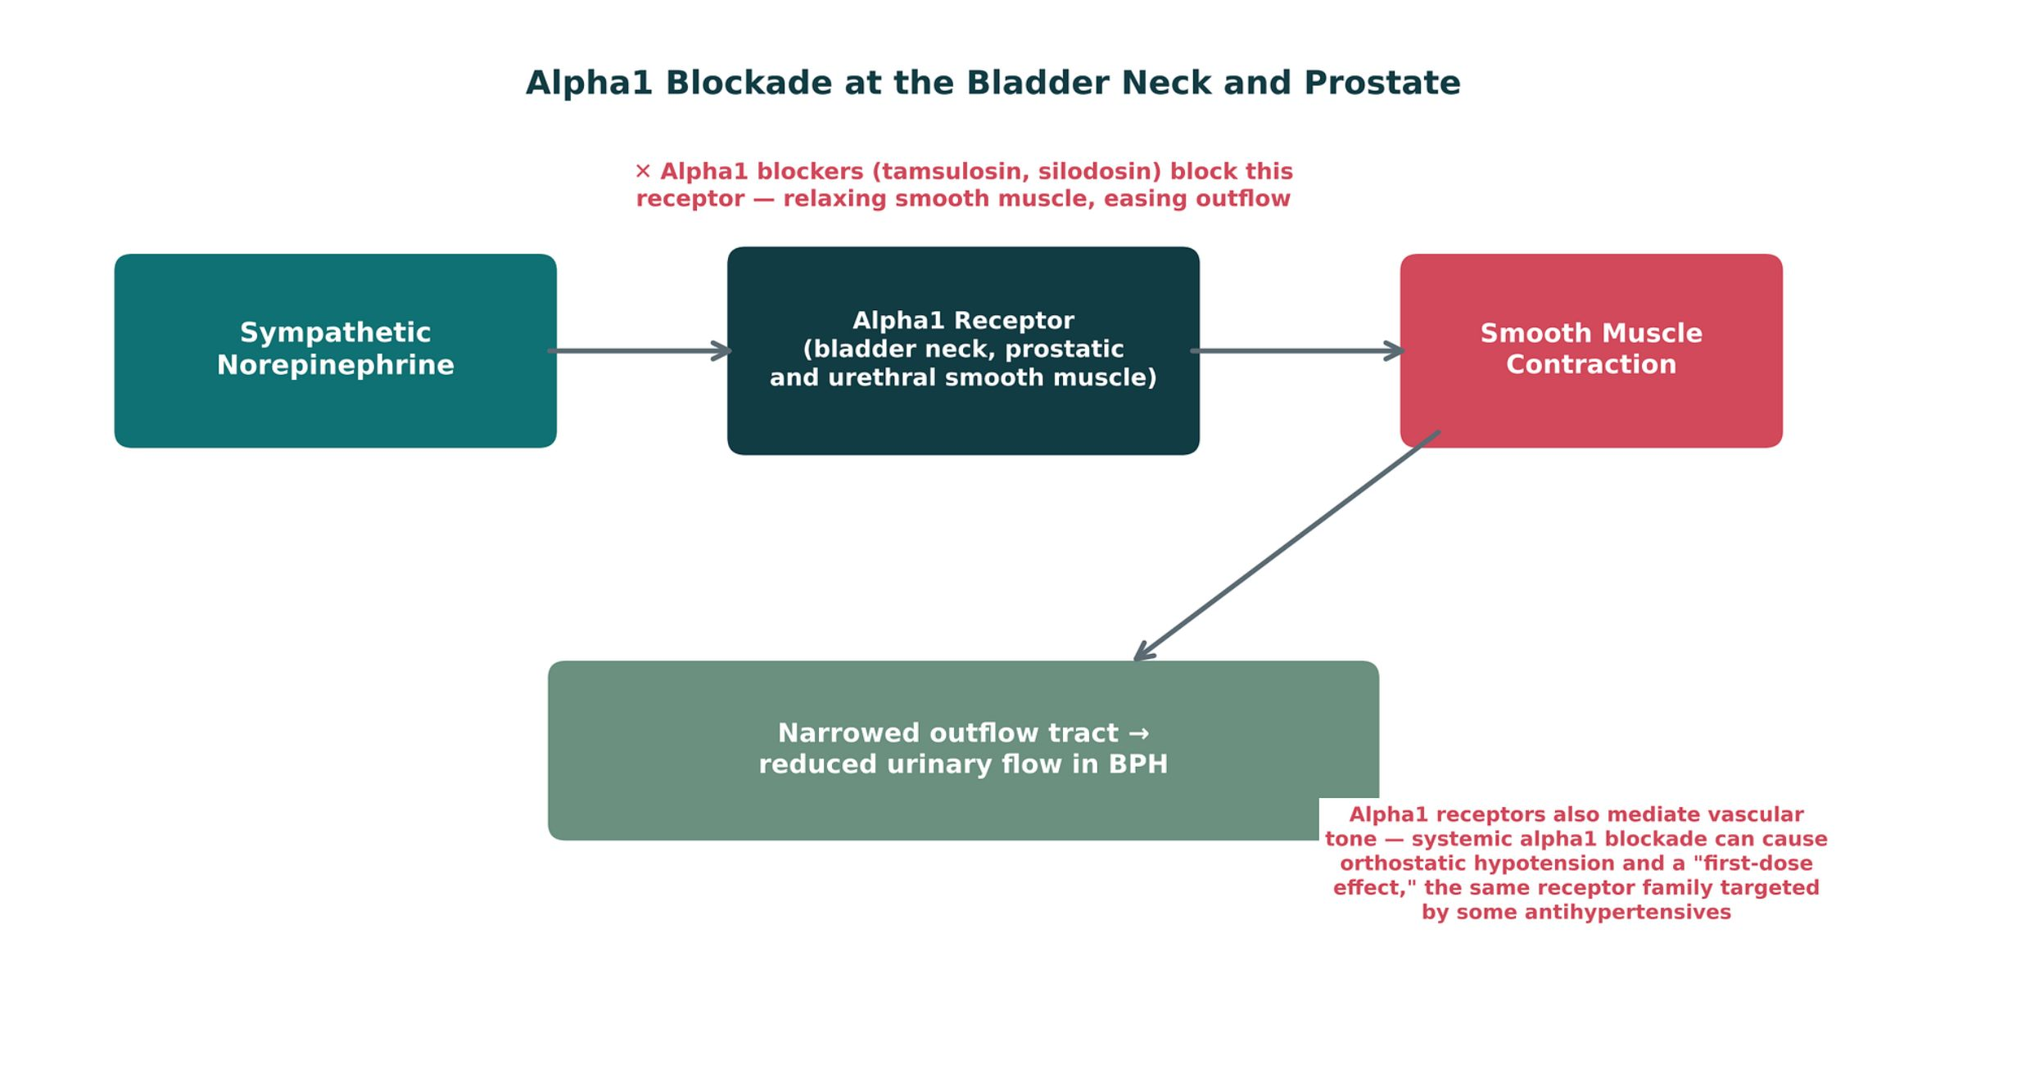
BPH, ERECTILE DYSFUNCTION & PDE5 INHIBITORS
Objectives: SO3 · SO4 · IO6.1 · IO6.2 · IO6.3 · IO6.4 · IO6.5 · IO6.6
Figure 13 · Alpha1 blockade at the bladder neck and prostate
Original illustrative diagram (not from Katzung): norepinephrine contracts bladder-neck and prostatic smooth muscle via alpha1, narrowing outflow; alpha1 blockers relax it — and the same receptors in vessels explain orthostatic hypotension. S18; S18 (notes)
L12 · Genitourinary & Reproductive Pharmacology — Session 2
61

Slide 62
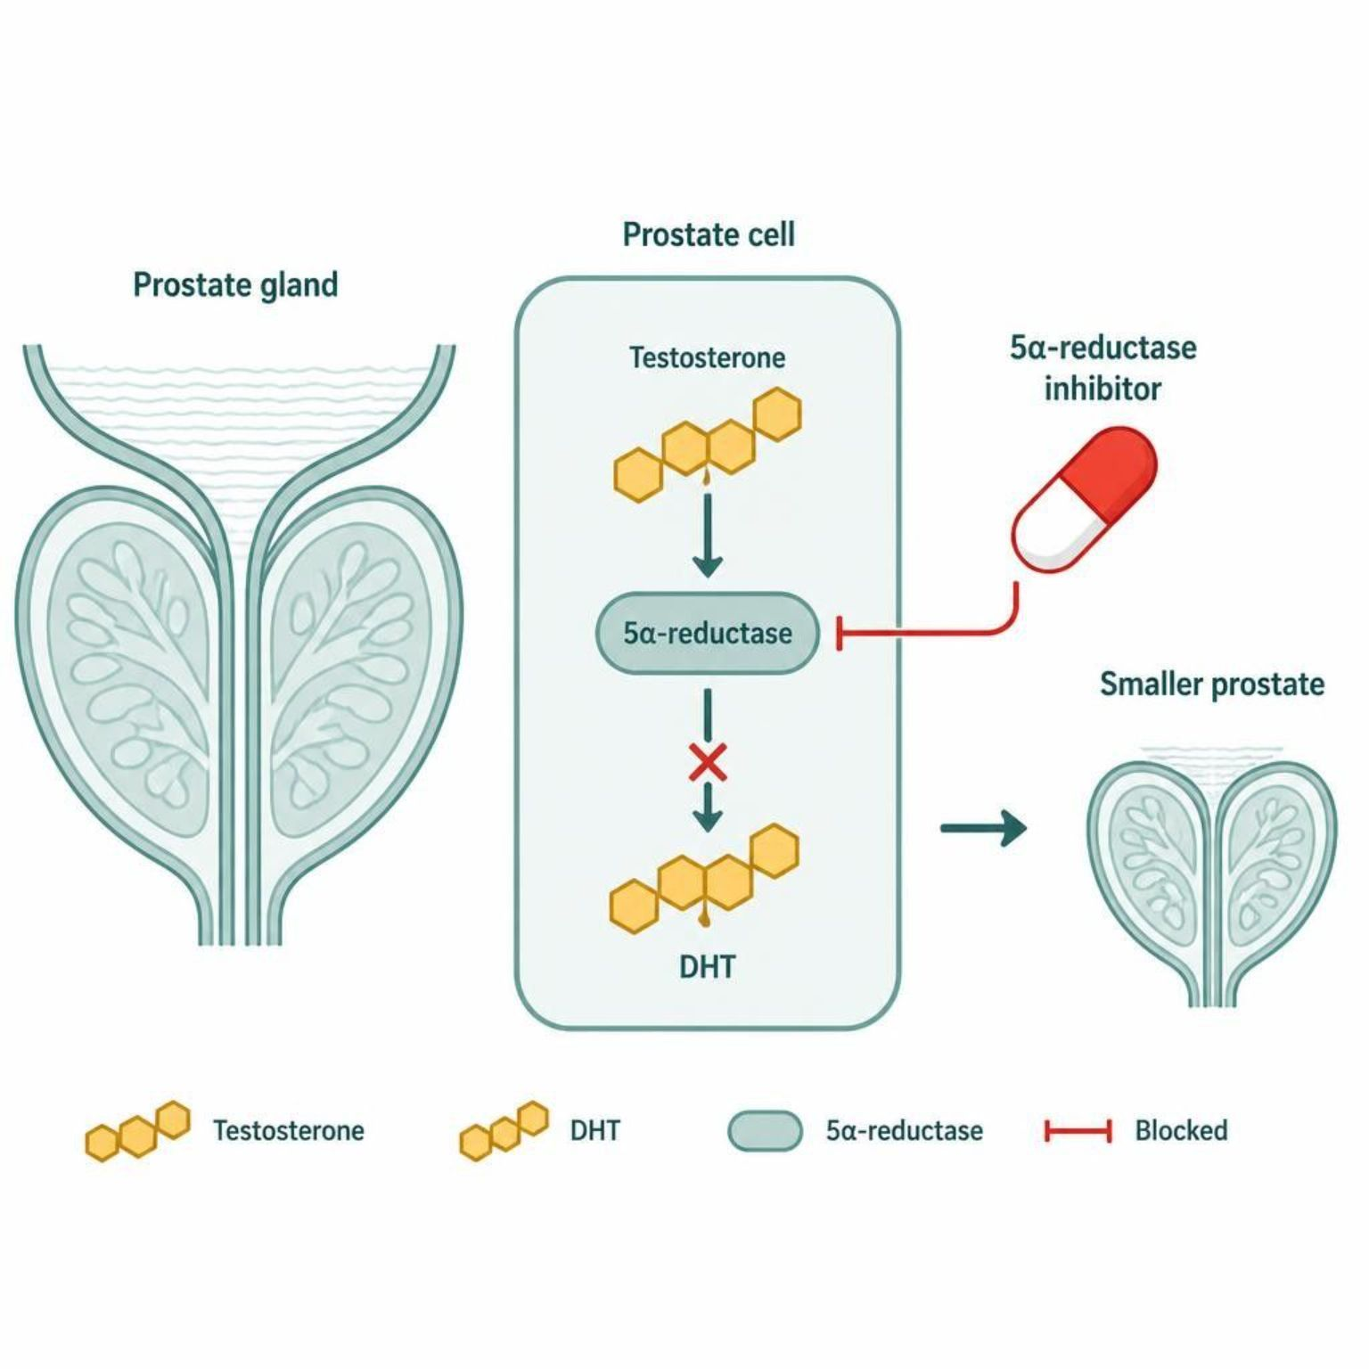
BPH, ERECTILE DYSFUNCTION & PDE5 INHIBITORS
Objectives: SO3 · SO4 · IO6.1 · IO6.2 · IO6.3 · IO6.4 · IO6.5 · IO6.6
Figure 14 · 5-ARIs: shrinking the prostate slowly
Schematic (illustrative) — Figure 14. 5-ARIs block DHT production, so the prostate shrinks slowly over months; combine with an alpha1 blocker for fast relief. S20; S20 (notes)
L12 · Genitourinary & Reproductive Pharmacology — Session 2
62

Slide 63
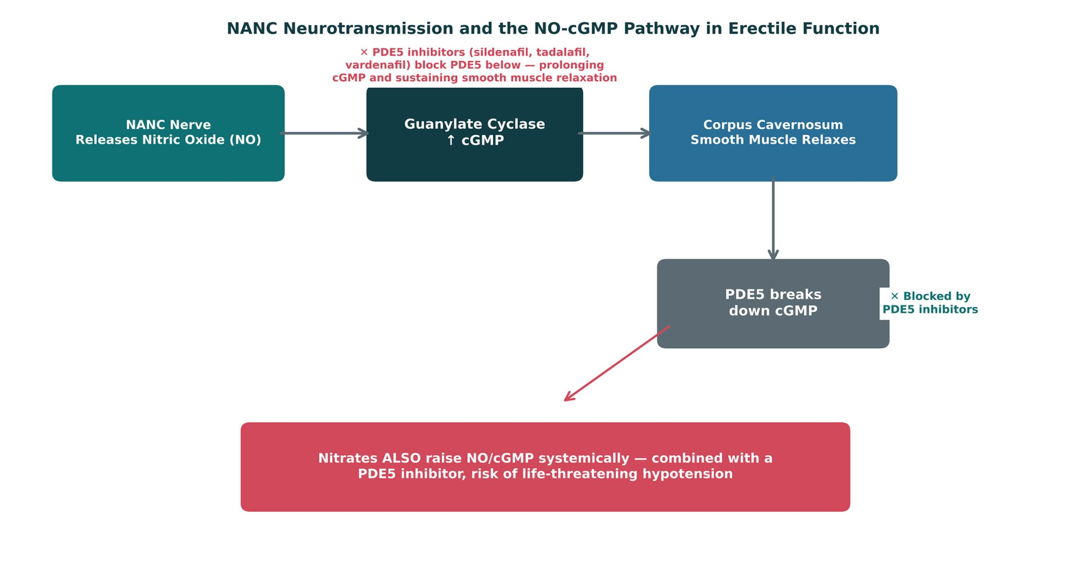
BPH, ERECTILE DYSFUNCTION & PDE5 INHIBITORS
Objectives: SO3 · SO4 · IO6.1 · IO6.2 · IO6.3 · IO6.4 · IO6.5 · IO6.6
Figure 15 · NANC neurotransmission and the NO-cGMP pathway
Original illustrative diagram (not from Katzung): NANC nerves release NO → cGMP → corpus cavernosum relaxation; PDE5 breaks cGMP down; nitrates independently raise NO/cGMP — hence the absolute contraindication. S21; S21 (notes)
L12 · Genitourinary & Reproductive Pharmacology — Session 2
63

Slide 64
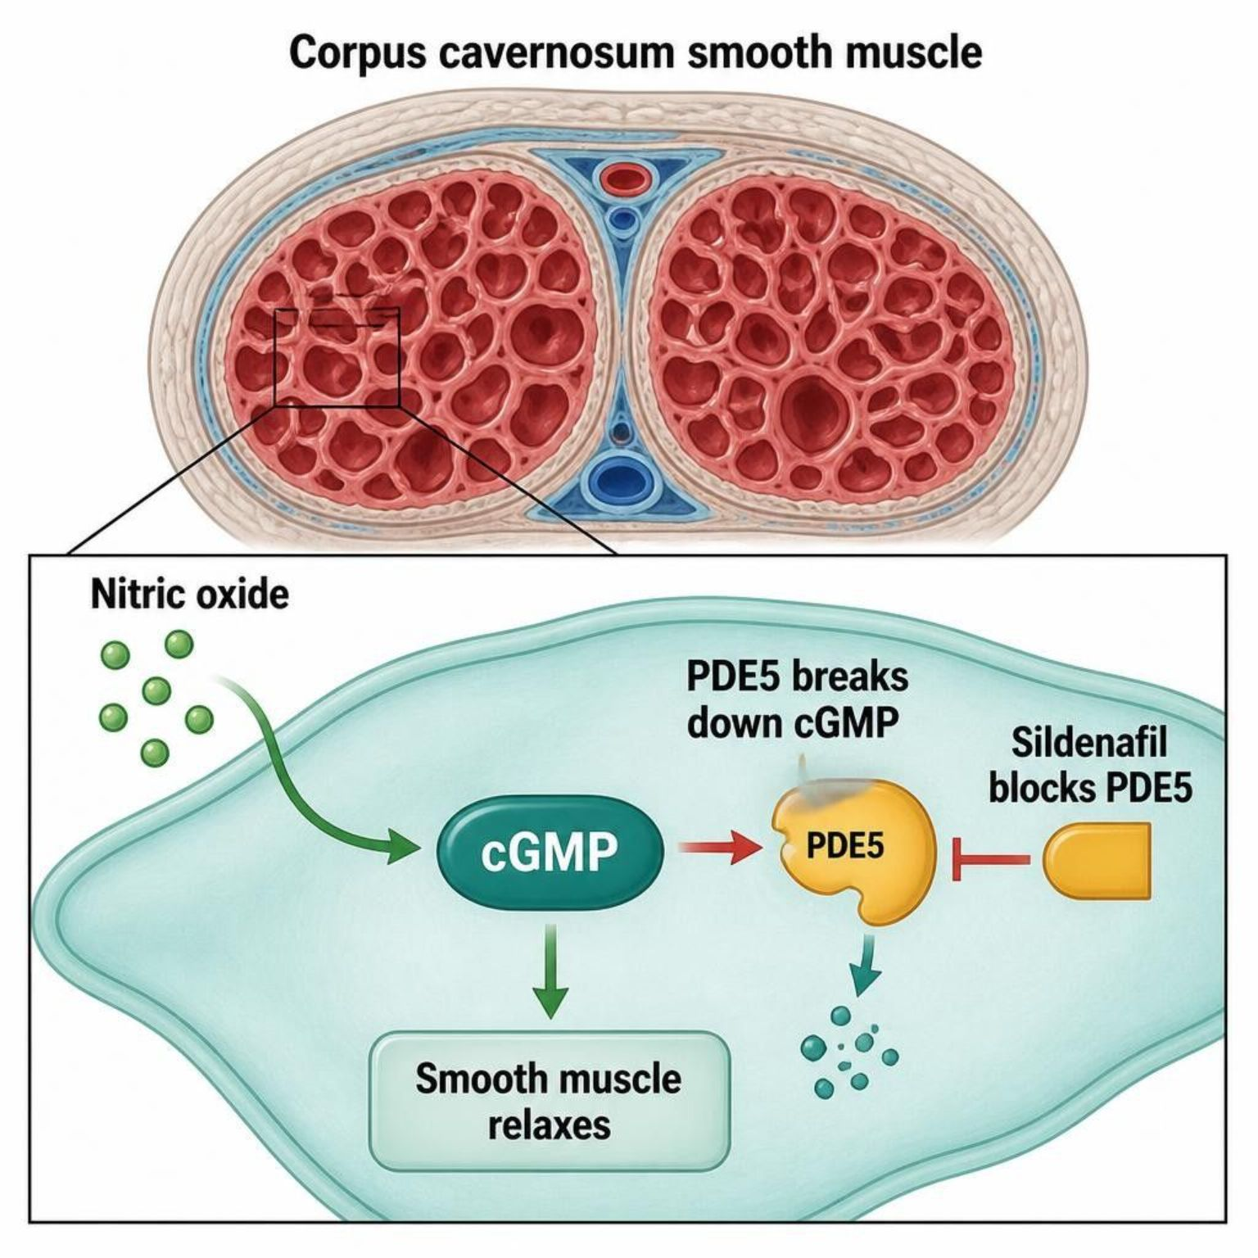
BPH, ERECTILE DYSFUNCTION & PDE5 INHIBITORS
Objectives: SO3 · SO4 · IO6.1 · IO6.2 · IO6.3 · IO6.4 · IO6.5 · IO6.6
Figure 16 · PDE5 inhibitors: NO, cGMP and erection
Schematic (illustrative) — Figure 16. PDE5 inhibitors keep cGMP high, prolonging smooth muscle relaxation; sexual stimulation is still needed to start the pathway. S23; S23 (notes)
L12 · Genitourinary & Reproductive Pharmacology — Session 2
64

Slide 65
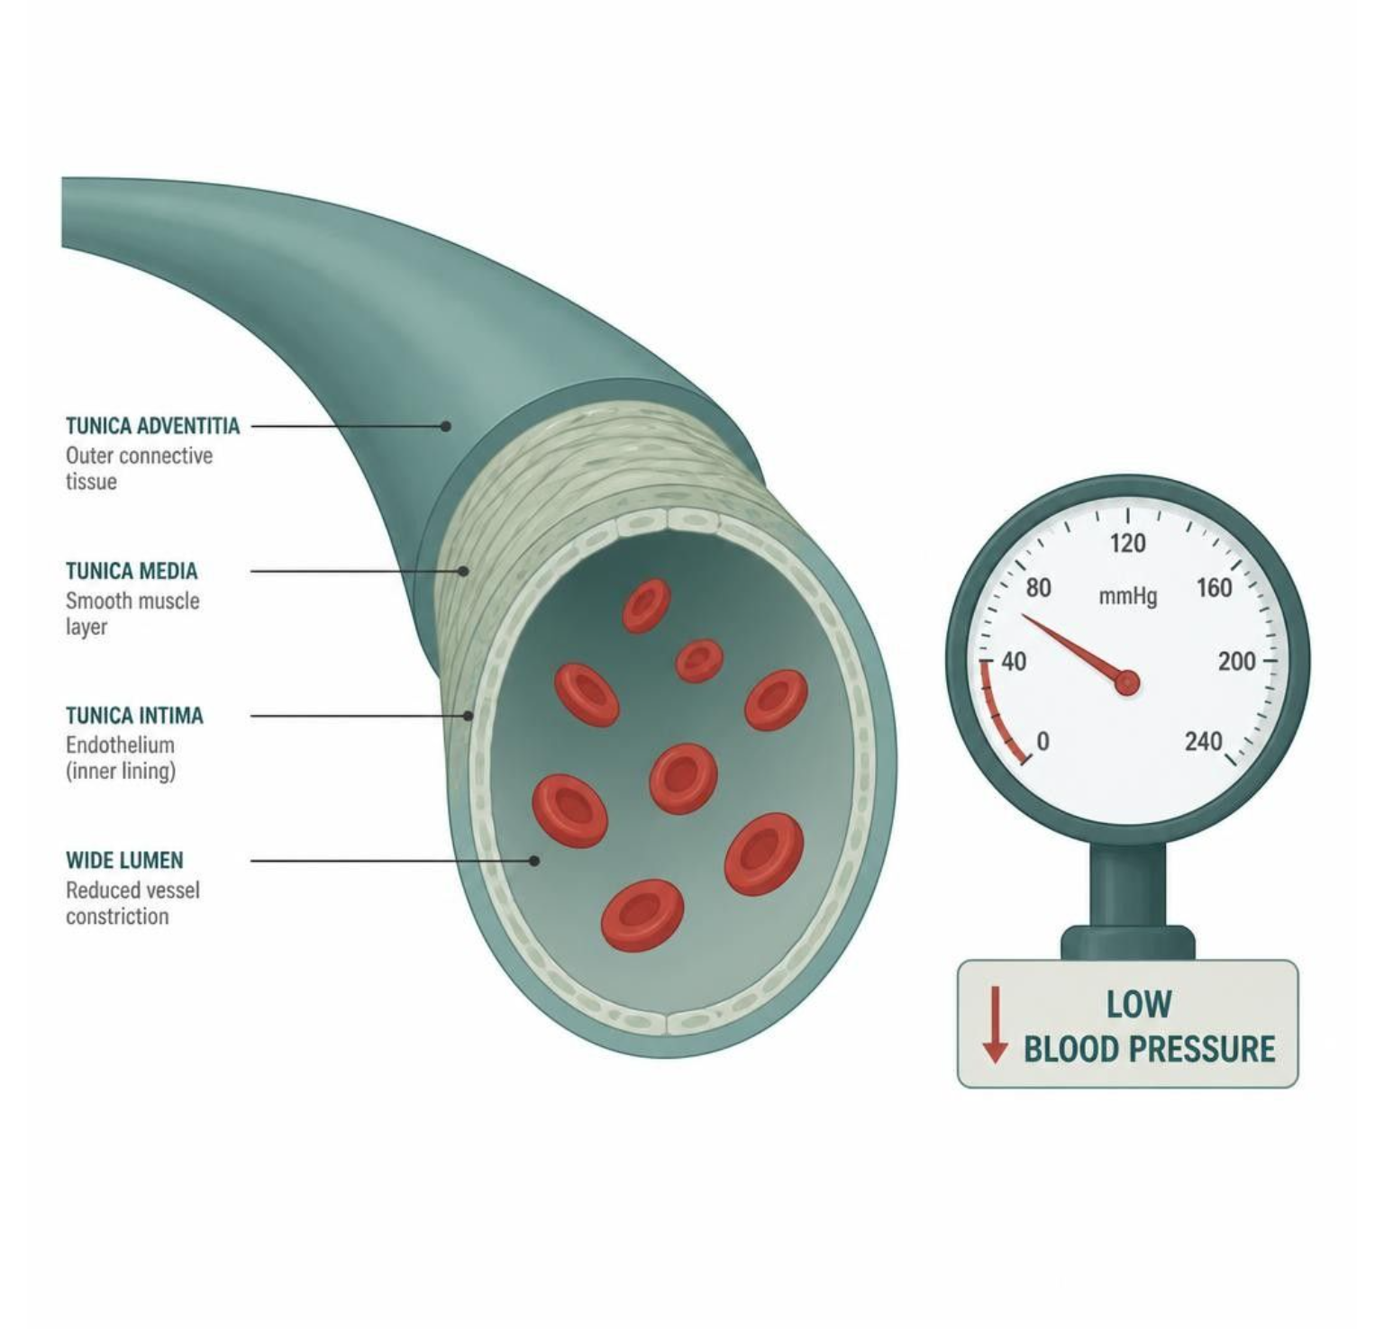
BPH, ERECTILE DYSFUNCTION & PDE5 INHIBITORS
Objectives: SO3 · SO4 · IO6.1 · IO6.2 · IO6.3 · IO6.4 · IO6.5 · IO6.6
Figure 17 · Nitrate plus PDE5 inhibitor: a double hit on cGMP
Schematic (illustrative) — Figure 17. Nitrates and PDE5 inhibitors both raise cGMP, so vasodilation and hypotension stack — severe hypotension and syncope. Never combine; caution with alpha1 blockers too. S25; S25 (notes)
L12 · Genitourinary & Reproductive Pharmacology — Session 2
65

Slide 66
BPH, ERECTILE DYSFUNCTION & PDE5 INHIBITORS
Objectives: SO3 · SO4 · IO6.1 · IO6.2 · IO6.3 · IO6.4 · IO6.5 · IO6.6
Compare: BPH drug classes (S17; S19)
 | Alpha1 blockers | 5-alpha-reductase inhibitors
Mechanism | Relax prostate/bladder-neck smooth muscle | Block testosterone → DHT; shrink the gland
Onset | Days | 3–6 months
Adverse effects | Orthostatic hypotension, first-dose effect, floppy iris | Decreased libido, ED; PSA halved
Use | Rapid symptom relief | Long-term disease modification — often combined
Focus: what tells these apart. Sources: S17; S19; S20
L12 · Genitourinary & Reproductive Pharmacology — Session 2
66

Slide 67
BPH, ERECTILE DYSFUNCTION & PDE5 INHIBITORS
Objectives: SO3 · SO4 · IO6.1 · IO6.2 · IO6.3 · IO6.4 · IO6.5 · IO6.6
Compare: Alpha1 blocker profiles: formulation, dose, indications
Drug | Class | Formulation | Adult dose | Indications
Tamsulosin (Flomax) | Alpha-1A selective blocker | Capsules 0.4 mg | 0.4 mg PO once daily 30 minutes after the same meal, may increase to 0.8 mg | Benign prostatic hyperplasia symptoms, ureteral stone passage (off-label)
Silodosin (Rapaflo) | Highly uroselective alpha-1A blocker | Capsules 4/8 mg | 8 mg PO once daily with a meal (4 mg with moderate renal impairment) | Benign prostatic hyperplasia symptoms
Doxazosin (Cardura) | Alpha-1 blocker (nonselective among alpha-1 subtypes) | Tablets 1/2/4/8 mg; ER tablets 4/8 mg | BPH: 1 mg PO daily at bedtime, titrate to 4-8 mg daily; hypertension: 1-16 mg daily | Benign prostatic hyperplasia, hypertension
Terazosin (Hytrin) | Alpha-1 blocker | Tablets 1/2/5/10 mg; capsules | BPH: 1 mg PO at bedtime, titrate to 5-10 mg daily; hypertension: 1-5 mg daily (maximum 20 mg) | Benign prostatic hyperplasia, hypertension
Focus: what tells these apart. Sources: S41; S42; S43; S44
L12 · Genitourinary & Reproductive Pharmacology — Session 2
67

Slide 68
BPH, ERECTILE DYSFUNCTION & PDE5 INHIBITORS
Objectives: SO3 · SO4 · IO6.1 · IO6.2 · IO6.3 · IO6.4 · IO6.5 · IO6.6
Compare: Alpha1 blocker profiles: adverse effects, contraindications, toxicity
Drug | Adverse effects | Contraindications | Toxicity / overdose
Tamsulosin (Flomax) | Dizziness, orthostatic hypotension, retrograde ejaculation, rhinitis, intraoperative floppy iris syndrome | Hypersensitivity (sulfonamide allergy caution); strong CYP3A4 inhibitors | Orthostatic hypotension and syncope with first dose; floppy iris syndrome in cataract surgery
Silodosin (Rapaflo) | Retrograde ejaculation (common), dizziness, orthostatic hypotension, diarrhea | Severe renal impairment (CrCl below 30 mL/min), severe hepatic impairment, strong CYP3A4 inhibitors | Orthostatic hypotension; floppy iris syndrome; contraindicated with strong CYP3A4 inhibitors
Doxazosin (Cardura) | Dizziness, orthostatic hypotension, first-dose syncope, fatigue, edema, floppy iris syndrome | Hypersensitivity to quinazolines; caution with PDE5 inhibitors | First-dose syncope and profound hypotension; restart at 1 mg after interruption of several days
Terazosin (Hytrin) | Dizziness, orthostatic hypotension, first-dose syncope, fatigue, peripheral edema, floppy iris syndrome | Hypersensitivity to quinazolines; caution with PDE5 inhibitors | First-dose hypotension and syncope; repeat titration after missed doses
Focus: what tells these apart. Sources: S41; S42; S43; S44
L12 · Genitourinary & Reproductive Pharmacology — Session 2
68

Slide 69
BPH, ERECTILE DYSFUNCTION & PDE5 INHIBITORS
Objectives: SO3 · SO4 · IO6.1 · IO6.2 · IO6.3 · IO6.4 · IO6.5 · IO6.6
Compare: 5-alpha-reductase inhibitor profiles: formulation, dose, indications
Drug | Class | Formulation | Adult dose | Indications
Finasteride (Proscar, Propecia) | 5-alpha-reductase inhibitor | Tablet 5 mg (BPH); 1 mg (hair loss) | 5 mg PO daily for BPH; 1 mg PO daily for male-pattern hair loss | BPH, androgenetic alopecia
Dutasteride (Avodart) | 5-alpha-reductase inhibitor (types 1 and 2) | Capsules 0.5 mg; combination with tamsulosin (Jalyn) | 0.5 mg PO once daily for BPH; effects take 3-6 months | Benign prostatic hyperplasia, combination therapy with an alpha-1 blocker
Focus: what tells these apart. Sources: S45; S46
L12 · Genitourinary & Reproductive Pharmacology — Session 2
69

Slide 70
BPH, ERECTILE DYSFUNCTION & PDE5 INHIBITORS
Objectives: SO3 · SO4 · IO6.1 · IO6.2 · IO6.3 · IO6.4 · IO6.5 · IO6.6
Compare: 5-alpha-reductase inhibitor profiles: adverse effects, contraindications, toxicity
Drug | Adverse effects | Contraindications | Toxicity / overdose
Finasteride (Proscar, Propecia) | Decreased libido, erectile dysfunction, reduced ejaculate, gynecomastia | Pregnancy and women who may be pregnant (do not handle crushed tablets), hypersensitivity | Lowers PSA by about half; reports of depression; teratogenic to a male fetus
Dutasteride (Avodart) | Decreased libido, erectile dysfunction, ejaculation disorders, breast tenderness, depression | Pregnancy and women of childbearing potential handling capsules, severe hepatic impairment | Lowers PSA by about half; pregnant partners must avoid handling capsules; monitor PSA
Focus: what tells these apart. Sources: S45; S46
L12 · Genitourinary & Reproductive Pharmacology — Session 2
70

Slide 71
BPH, ERECTILE DYSFUNCTION & PDE5 INHIBITORS
Objectives: SO3 · SO4 · IO6.1 · IO6.2 · IO6.3 · IO6.4 · IO6.5 · IO6.6
Compare: PDE5 inhibitor profiles: formulation, dose, indications
Drug | Class | Formulation | Adult dose | Indications
Sildenafil (Viagra, Revatio) | PDE5 inhibitor | Tablets 25/50/100 mg (Viagra); 20 mg (Revatio) | ED: 50 mg PO about 1 hour before activity (range 25-100 mg), no more than once daily; PAH: 20 mg TID | Erectile dysfunction, pulmonary arterial hypertension (Revatio)
Tadalafil (Cialis, Adcirca) | PDE5 inhibitor (long-acting) | Tablets 2.5/5/10/20 mg | ED: 10 mg PO before activity (5-20 mg), or 2.5-5 mg daily; BPH: 5 mg daily | Erectile dysfunction, BPH symptoms, pulmonary arterial hypertension (Adcirca)
Vardenafil (Levitra, Staxyn) | PDE5 inhibitor | Tablets 2.5/5/10/20 mg; orally disintegrating tablet 10 mg | 10 mg PO about 60 minutes before activity (5-20 mg), no more than once daily | Erectile dysfunction
Focus: what tells these apart. Sources: S47; S48; S49
L12 · Genitourinary & Reproductive Pharmacology — Session 2
71

Slide 72
BPH, ERECTILE DYSFUNCTION & PDE5 INHIBITORS
Objectives: SO3 · SO4 · IO6.1 · IO6.2 · IO6.3 · IO6.4 · IO6.5 · IO6.6
Compare: PDE5 inhibitor profiles: adverse effects, contraindications, toxicity
Drug | Adverse effects | Contraindications | Toxicity / overdose
Sildenafil (Viagra, Revatio) | Headache, flushing, dyspepsia, nasal congestion, visual changes (blue tint), hypotension | Concurrent nitrates or riociguat, hypersensitivity; caution with alpha-1 blockers and severe cardiovascular disease | Profound hypotension with nitrates; priapism over 4 hours is an emergency; sudden vision or hearing loss
Tadalafil (Cialis, Adcirca) | Headache, dyspepsia, back pain, myalgia, flushing, nasal congestion | Concurrent nitrates or riociguat; caution with alpha-1 blockers (except tamsulosin 0.4 mg) and strong CYP3A4 inhibitors | Profound hypotension with nitrates for at least 48 hours after the last dose; priapism
Vardenafil (Levitra, Staxyn) | Headache, flushing, rhinitis, dyspepsia, QT prolongation, visual changes | Concurrent nitrates or riociguat, congenital long QT, class IA or III antiarrhythmics | Profound hypotension with nitrates; QT prolongation; priapism
Focus: what tells these apart. Sources: S47; S48; S49
L12 · Genitourinary & Reproductive Pharmacology — Session 2
72

Slide 73
BPH, ERECTILE DYSFUNCTION & PDE5 INHIBITORS
Objectives: SO3 · SO4 · IO6.1 · IO6.2 · IO6.3 · IO6.4 · IO6.5 · IO6.6
Memory hooks
Why it happens
Why does tamsulosin cause dizziness on standing? Alpha1 receptors in blood vessels are blocked too; the uroselective drugs do it less. S17; S34
L12 · Genitourinary & Reproductive Pharmacology — Session 2
73

Slide 74
BPH, ERECTILE DYSFUNCTION & PDE5 INHIBITORS
Objectives: SO3 · SO4 · IO6.1 · IO6.2 · IO6.3 · IO6.4 · IO6.5 · IO6.6
High-yield summary
If you remember nothing else
BPH: alpha1 blocker (days; orthostasis, first dose) + 5-ARI (3–6 months; PSA halved) — often together. S17; S19
PDE5 inhibitor + any nitrate = absolute contraindication; caution with alpha1 blockers. S22; S25; SG U6-R16
L12 · Genitourinary & Reproductive Pharmacology — Session 2
74

Slide 75
CLINICAL VIGNETTE · LECTURE QUICK CHECK S24
Objectives: SO3 · SO4 · IO6.1 · IO6.2 · IO6.3 · IO6.4 · IO6.5 · IO6.6
Question 6
A 64-year-old on isosorbide mononitrate for stable angina asks for sildenafil. What should the PA do?
A
Prescribe a low dose of sildenafil
B
Do not prescribe; involve his cardiologist
C
Space the two doses by 6 hours
D
Prescribe if his BP is normal today
E
Prescribe tadalafil instead
L12 · Genitourinary & Reproductive Pharmacology — Session 2
75
Notes:
Answer on the next slide. Source: S24; SG U6-R16

Slide 76
CLINICAL VIGNETTE · ANSWER
Objectives: SO3 · SO4 · IO6.1 · IO6.2 · IO6.3 · IO6.4 · IO6.5 · IO6.6
Answer 6: B
B. Do not prescribe; involve his cardiologist
PDE5 inhibitors are absolutely contraindicated with any nitrate — life-threatening hypotension (S24). S24; SG U6-R16
Why the other choices are wrong
A. Prescribe a low dose of sildenafil — Still contraindicated (S24).
C. Space the two doses by 6 hours — Absolute contraindication (S22).
D. Prescribe if his BP is normal today — Not acceptable (S24).
E. Prescribe tadalafil instead — Same class (S22).
L12 · Genitourinary & Reproductive Pharmacology — Session 2
76

Slide 77
MECHANISM · LECTURE QUICK CHECK S33; S34
Objectives: SO3 · SO4 · IO6.1 · IO6.2 · IO6.3 · IO6.4 · IO6.5 · IO6.6
Question 7
Why are alpha1 blockers for BPH associated with orthostatic hypotension?
A
They raise cGMP like nitrates do
B
Only beta3 agonists cause it
C
Alpha1 also sets vascular smooth muscle tone
D
They block cardiac beta receptors
E
They have no effect outside the bladder
L12 · Genitourinary & Reproductive Pharmacology — Session 2
77
Notes:
Answer on the next slide. Source: S33; S34

Slide 78
MECHANISM · ANSWER
Objectives: SO3 · SO4 · IO6.1 · IO6.2 · IO6.3 · IO6.4 · IO6.5 · IO6.6
Answer 7: C
C. Alpha1 also sets vascular smooth muscle tone
Alpha1 receptors also mediate vascular tone, so blockade lowers systemic resistance (S34). S33; S34
Why the other choices are wrong
A. They raise cGMP like nitrates do — Not the mechanism (S34).
B. Only beta3 agonists cause it — Not true (S34).
D. They block cardiac beta receptors — Not the mechanism (S34).
E. They have no effect outside the bladder — They do (S34).
L12 · Genitourinary & Reproductive Pharmacology — Session 2
78

Slide 79
MECHANISM · LECTURE QUICK CHECK S33; S34
Objectives: SO3 · SO4 · IO6.1 · IO6.2 · IO6.3 · IO6.4 · IO6.5 · IO6.6
Question 8
Why is a nitrate plus a PDE5 inhibitor absolutely contraindicated?
A
Both raise heart rate dangerously
B
PDE5 inhibitors inactivate nitrates
C
The combination has no interaction
D
Nitrates block PDE5, so it is redundant
E
Both raise NO/cGMP — profound hypotension
L12 · Genitourinary & Reproductive Pharmacology — Session 2
79
Notes:
Answer on the next slide. Source: S33; S34

Slide 80
MECHANISM · ANSWER
Objectives: SO3 · SO4 · IO6.1 · IO6.2 · IO6.3 · IO6.4 · IO6.5 · IO6.6
Answer 8: E
E. Both raise NO/cGMP — profound hypotension
Both raise NO/cGMP signaling by independent mechanisms; combined, additive to synergistic hypotension (S34). S33; S34
Why the other choices are wrong
A. Both raise heart rate dangerously — Hypotension is the danger (S34).
B. PDE5 inhibitors inactivate nitrates — Not true (S34).
C. The combination has no interaction — Life-threatening (S34).
D. Nitrates block PDE5, so it is redundant — Not true (S34).
L12 · Genitourinary & Reproductive Pharmacology — Session 2
80

Slide 81
CLINICAL VIGNETTE
Objectives: SO3 · SO4 · IO6.1 · IO6.2 · IO6.3 · IO6.4 · IO6.5 · IO6.6
Question 9
A man with BPH wants fast relief and long-term shrinkage of his prostate. Best plan?
A
Alpha1 blocker plus a 5-ARI
B
Doxazosin alone for shrinkage
C
5-ARI alone for fast relief
D
Sildenafil plus a nitrate
E
Oxybutynin for outflow obstruction
L12 · Genitourinary & Reproductive Pharmacology — Session 2
81
Notes:
Answer on the next slide. Source: S19; S20; S29

Slide 82
CLINICAL VIGNETTE · ANSWER
Objectives: SO3 · SO4 · IO6.1 · IO6.2 · IO6.3 · IO6.4 · IO6.5 · IO6.6
Answer 9: A
A. Alpha1 blocker plus a 5-ARI
Alpha1 blockers act in days; 5-ARIs take 3–6 months to modify disease — combine them (S19–S20). S19; S20; S29
Why the other choices are wrong
B. Doxazosin alone for shrinkage — No shrinkage (S17).
C. 5-ARI alone for fast relief — Takes months (S19).
D. Sildenafil plus a nitrate — Contraindicated (S22).
E. Oxybutynin for outflow obstruction — Risks retention (S11).
L12 · Genitourinary & Reproductive Pharmacology — Session 2
82

Slide 83


Topic 4 of 4
Putting It All Together: GU Toolkit
Covers objectives: SO5 · IO6.3 · IO6.4 · IO6.6
Key definitions
How it works
Clinical relevance
Drugs named as examples
Exam traps
83

Slide 84
PUTTING IT ALL TOGETHER: GU TOOLKIT
Objectives: SO5 · IO6.3 · IO6.4 · IO6.6
Key definitions
Key definitions
Applying the whole genitourinary and reproductive pharmacology toolkit, across both sessions. S27
Figure 18. Original illustrative diagram (not from Katzung): the detrusor, bladder neck/prostate, and corpus cavernosum each rely on receptor families — muscarinic, adrenergic, and NO-cGMP signaling — that recur in the systemic vasculature, S28
explaining why so many genitourinary drug classes have direct cardiovascular counterparts or interactions. Receptor families are shared with the vasculature — the unifying theme of the session. S28; S28 (notes)
L12 · Genitourinary & Reproductive Pharmacology — Session 2
84

Slide 85
PUTTING IT ALL TOGETHER: GU TOOLKIT
Objectives: SO5 · IO6.3 · IO6.4 · IO6.6
How it works
How it works (1/2)
Session 1’s gonadal hormone pharmacology (Ch. 40) and PCOS (Ch. 41 overlap) and Session 2’s autonomic bladder pharmacology (Ch. 6) are distinct but connect through shared classes — 5-alpha-reductase inhibitors appear in both sessions. S30
The lower urinary tract is governed by three nerve supplies and three receptor families (Figure 9): parasympathetic/M3, sympathetic/alpha1 and beta3, and somatic/nicotinic. S30
Antimuscarinics and beta3 agonists treat overactive bladder through complementary mechanisms — blocking contraction vs. enhancing relaxation — with anticholinergic burden the key safety differentiator in older adults. S30
L12 · Genitourinary & Reproductive Pharmacology — Session 2
85

Slide 86
PUTTING IT ALL TOGETHER: GU TOOLKIT
Objectives: SO5 · IO6.3 · IO6.4 · IO6.6
How it works (cont.)
How it works (2/2)
Alpha1 blockers and 5-ARIs treat BPH through different timescales and mechanisms and are often combined; alpha1 blockade overlaps directly with Unit 5’s antihypertensive pharmacology. S30
The NO-cGMP pathway (Figure 15) underlies both erectile function and nitrate angina therapy (Unit 5) — therapeutic in one context, dangerous in combination in another: one of the highest-stakes safety points in the course. S30
Close by naming the cross-unit integration: genitourinary pharmacology shares receptor families and drug classes with cardiovascular pharmacology covered earlier in the course. S30 (notes)
L12 · Genitourinary & Reproductive Pharmacology — Session 2
86

Slide 87
PUTTING IT ALL TOGETHER: GU TOOLKIT
Objectives: SO5 · IO6.3 · IO6.4 · IO6.6
Clinical relevance
Clinical relevance
Patient A — older adult with urge incontinence and mild cognitive impairment, needs therapy that avoids anticholinergic burden: mirabegron (Section 5). S29; S29 (notes)
Patient B — man with BPH, wants both rapid symptom relief and long-term disease modification: combine an alpha1 blocker with a 5-alpha-reductase inhibitor (Section 6). S29; S29 (notes)
Patient C — woman with PCOS, irregular cycles, and hirsutism, not currently trying to conceive: combined hormonal contraception ± metformin (Session 1). S29; S29 (notes)
Patient D — man with stable angina on a long-acting nitrate, requesting treatment for erectile dysfunction: PDE5 inhibitors are contraindicated; this requires a cardiology-involved conversation about alternatives. S29; S29 (notes)
L12 · Genitourinary & Reproductive Pharmacology — Session 2
87

Slide 88
PUTTING IT ALL TOGETHER: GU TOOLKIT
Objectives: SO5 · IO6.3 · IO6.4 · IO6.6
Drugs named as examples
Drugs named as examples (1/2)
A cumulative self-test spanning both sessions — use this to review before exams. S31
Recall Q1: unopposed estrogen drives unchecked endometrial proliferation, raising hyperplasia and cancer risk with a uterus — a progestin is always paired unless she has had a hysterectomy. S32; S34
Recall Q2: tamoxifen is an endometrial agonist (cancer risk) and breast antagonist; raloxifene shares breast antagonist and bone agonist effects but is essentially neutral at the endometrium. S32; S34
Recall Q3: hyperinsulinemia stimulates ovarian theca-cell androgen production and lowers hepatic SHBG, raising free testosterone — the center of the PCOS cycle (Figure 7). S32; S34
L12 · Genitourinary & Reproductive Pharmacology — Session 2
88

Slide 89
PUTTING IT ALL TOGETHER: GU TOOLKIT
Objectives: SO5 · IO6.3 · IO6.4 · IO6.6
Drugs named as examples (cont.)
Drugs named as examples (2/2)
Recall Q4: a patient on an antimuscarinic for overactive bladder develops new confusion — switch to mirabegron, which enhances beta3-mediated detrusor relaxation without blocking muscarinic receptors. S33; S34
That avoids the cumulative anticholinergic burden that can precipitate or worsen confusion in susceptible patients, particularly older adults. S34
Recall Q5: alpha1 receptors are not bladder-specific — blockade also lowers systemic vascular resistance (orthostatic hypotension, first-dose effect). Q6: nitrates and PDE5 inhibitors both raise NO/cGMP; combined, potentially fatal hypotension. S33; S34
L12 · Genitourinary & Reproductive Pharmacology — Session 2
89

Slide 90
PUTTING IT ALL TOGETHER: GU TOOLKIT
Objectives: SO5 · IO6.3 · IO6.4 · IO6.6
Exam traps
Exam traps (1/2)
Integrated case: a PDE5 inhibitor should not be prescribed while this patient remains on isosorbide mononitrate — both drugs independently raise NO/cGMP signaling; the combination can cause profound, life-threatening hypotension. SG U6-S
This is an absolute contraindication, and any ED treatment decision must involve his cardiologist and consideration of whether his anginal nitrate therapy can be modified first. SG U6-S
Even without the nitrate, tamsulosin and a PDE5 inhibitor both lower blood pressure (alpha1 blockade and NO-cGMP potentiation) — additive orthostatic hypotension warrants spacing doses or close monitoring. SG U6-S
L12 · Genitourinary & Reproductive Pharmacology — Session 2
90

Slide 91
PUTTING IT ALL TOGETHER: GU TOOLKIT
Objectives: SO5 · IO6.3 · IO6.4 · IO6.6
Exam traps (cont.)
Exam traps (2/2)
His wife’s new vaginal bleeding on tamoxifen should not be dismissed — tamoxifen’s endometrial agonism raises hyperplasia/cancer risk; she needs prompt gynecologic evaluation. SG U6-S
Match each drug or drug class to its mechanism or site of action — tamoxifen: breast antagonist, bone/endometrium agonist; raloxifene — endometrium neutral; finasteride/dutasteride — 5-alpha-reductase inhibition; oxybutynin — M3 (and M2) antagonism on the detrusor. SG U6-M
Match: mirabegron — beta3 agonism on the detrusor; tamsulosin — uroselective alpha1 antagonism; sildenafil/tadalafil — PDE5 inhibition prolonging cGMP; metformin (PCOS) — insulin sensitization, indirectly lowering ovarian androgens. SG U6-M
L12 · Genitourinary & Reproductive Pharmacology — Session 2
91

Slide 92
PUTTING IT ALL TOGETHER: GU TOOLKIT
Objectives: SO5 · IO6.3 · IO6.4 · IO6.6
Compare: Which approach would you choose? (S29)
Patient | Approach | Biggest safety check
A · Older adult, urge incontinence, mild cognitive impairment | Mirabegron | Blood pressure; avoid anticholinergics
B · BPH, wants fast relief and disease modification | Alpha1 blocker + 5-ARI | Orthostasis, first dose; PSA halved
C · PCOS, irregular cycles, hirsutism, no pregnancy plans | Combined contraception ± metformin | Estrogen contraindications
D · Angina on a long-acting nitrate, wants ED treatment | No PDE5 inhibitor; involve cardiology | Life-threatening hypotension
Focus: what tells these apart. Sources: S29; S29 (notes)
L12 · Genitourinary & Reproductive Pharmacology — Session 2
92

Slide 93
PUTTING IT ALL TOGETHER: GU TOOLKIT
Objectives: SO5 · IO6.3 · IO6.4 · IO6.6
Compare: Supporting drugs at a glance (S50)
Drug(s) | Why it matters here
Nitrates | Isosorbide, nitroglycerin: never combine with PDE5 inhibitors
Riociguat | Contraindicated with PDE5 inhibitors
Other anticholinergics | Diphenhydramine, tricyclic antidepressants: add to anticholinergic burden
Cholinesterase inhibitors | Donepezil: oppose antimuscarinics
Antihypertensives | Additive hypotension with alpha-1 blockers
Strong CYP3A4 inhibitors | Ketoconazole, clarithromycin: raise PDE5 inhibitor and solifenacin levels
Desmopressin | Nocturia, beyond this lecture
OnabotulinumtoxinA | Refractory overactive bladder, beyond this lecture
Duloxetine | Stress incontinence, beyond this lecture
Focus: what tells these apart. Sources: S50; S50 (notes)
L12 · Genitourinary & Reproductive Pharmacology — Session 2
93

Slide 94
PUTTING IT ALL TOGETHER: GU TOOLKIT
Objectives: SO5 · IO6.3 · IO6.4 · IO6.6
Memory hooks
Mnemonic (memory aid)
Every case, two answers: the approach and the one thing to check. S29 (instructor script)
L12 · Genitourinary & Reproductive Pharmacology — Session 2
94

Slide 95
PUTTING IT ALL TOGETHER: GU TOOLKIT
Objectives: SO5 · IO6.3 · IO6.4 · IO6.6
High-yield summary
If you remember nothing else
GU receptor families recur in the vasculature: alpha1 blockers lower BP; PDE5 inhibitors and nitrates share cGMP. S28; S30
L12 · Genitourinary & Reproductive Pharmacology — Session 2
95

Slide 96
MECHANISM · LECTURE QUICK CHECK S32; S34
Objectives: SO5 · IO6.3 · IO6.4 · IO6.6
Question 12
Why is unopposed estrogen avoided in a patient with an intact uterus?
A
It raises PSA in partners
B
It has no effect on the endometrium
C
It raises endometrial hyperplasia and cancer risk
D
It matters only in postmenopausal patients
E
It always causes immediate heavy bleeding
L12 · Genitourinary & Reproductive Pharmacology — Session 2
96
Notes:
Answer on the next slide. Source: S32; S34

Slide 97
MECHANISM · ANSWER
Objectives: SO5 · IO6.3 · IO6.4 · IO6.6
Answer 12: C
C. It raises endometrial hyperplasia and cancer risk
Unopposed estrogen drives unchecked endometrial proliferation (S34). S32; S34
Why the other choices are wrong
A. It raises PSA in partners — Not related (S34).
B. It has no effect on the endometrium — It does (S34).
D. It matters only in postmenopausal patients — Any patient with a uterus (S34).
E. It always causes immediate heavy bleeding — Absolute claim (S34).
L12 · Genitourinary & Reproductive Pharmacology — Session 2
97

Slide 98
MECHANISM · LECTURE QUICK CHECK S32; S34
Objectives: SO5 · IO6.3 · IO6.4 · IO6.6
Question 13
Why does tamoxifen raise endometrial cancer risk while raloxifene largely does not?
A
Tamoxifen is an endometrial agonist
B
Tamoxifen blocks the androgen receptor
C
Raloxifene blocks aromatase
D
Both have identical endometrial effects
E
Raloxifene has no ER effects anywhere
L12 · Genitourinary & Reproductive Pharmacology — Session 2
98
Notes:
Answer on the next slide. Source: S32; S34

Slide 99
MECHANISM · ANSWER
Objectives: SO5 · IO6.3 · IO6.4 · IO6.6
Answer 13: A
A. Tamoxifen is an endometrial agonist
Tamoxifen is an ER agonist at the endometrium; raloxifene is essentially neutral there (S34). S32; S34
Why the other choices are wrong
B. Tamoxifen blocks the androgen receptor — ER, not AR (S34).
C. Raloxifene blocks aromatase — Not the mechanism (S34).
D. Both have identical endometrial effects — They differ (S34).
E. Raloxifene has no ER effects anywhere — Bone agonist (S34).
L12 · Genitourinary & Reproductive Pharmacology — Session 2
99

Slide 100
MECHANISM · LECTURE QUICK CHECK S32; S34
Objectives: SO5 · IO6.3 · IO6.4 · IO6.6
Question 14
What is the central pathophysiologic driver linking insulin resistance to hyperandrogenism in PCOS?
A
Hyperandrogenism always comes first
B
No mechanistic connection exists
C
Metformin blocks the androgen receptor
D
Hyperinsulinemia ↑ ovarian androgens, ↓ SHBG
E
Insulin raises SHBG, lowering free testosterone
L12 · Genitourinary & Reproductive Pharmacology — Session 2
100
Notes:
Answer on the next slide. Source: S32; S34

Slide 101
MECHANISM · ANSWER
Objectives: SO5 · IO6.3 · IO6.4 · IO6.6
Answer 14: D
D. Hyperinsulinemia ↑ ovarian androgens, ↓ SHBG
This raises free testosterone — the center of the PCOS cycle (S34). S32; S34
Why the other choices are wrong
A. Hyperandrogenism always comes first — Absolute claim (S34).
B. No mechanistic connection exists — There is one (S34).
C. Metformin blocks the androgen receptor — Indirect action (S34).
E. Insulin raises SHBG, lowering free testosterone — Reversed (S34).
L12 · Genitourinary & Reproductive Pharmacology — Session 2
101

