Slide 1

PA PHARMACOLOGY COURSE · LECTURE 2 · SESSION 1 OF 2
Musculoskeletal Pharmacology
Session 1: Pain, Acetaminophen, NSAIDs, and Osteoarthritis/Rheumatoid Arthritis Pharmacotherapy | Tuesday, October 27
Diane S. Allen-Gipson, Ph.D., M.S., Course Director
Notes:
Opening. Say: "Today's question is simple: how do we treat musculoskeletal pain safely? We'll follow one pathway, arachidonic acid, and see where each drug class steps in."
Instructor script:
Today's organizing idea is the pain pathway. Every drug in this session either blocks prostaglandin synthesis, modifies the immune process behind arthritis, or treats the toxicity those drugs can cause.

Slide 2

BY THE END OF THIS LECTURE
Learning Objectives — Session 1
Explain the pharmacologic basis of musculoskeletal pain and inflammation.
Compare acetaminophen and NSAIDs, including COX-1 vs. COX-2 inhibition.
Identify major NSAID adverse effects and select therapy based on patient risk factors.
Explain the mechanisms of conventional vs. biologic DMARDs, including representative generic agents in each class.
Identify key contraindications, adverse effects, and drug interactions for analgesics and DMARDs.
Preview: gout, skeletal muscle relaxants, and bone pharmacology continue in Session 2 (Thursday, October 29).
Musculoskeletal Pharmacology — Session 1 of 2 — PA Program
2
Notes:
Orient students to the arc of this session: musculoskeletal pain pathways, acetaminophen, NSAIDs, and osteoarthritis/rheumatoid arthritis pharmacotherapy including DMARDs. Tell them this is the first of two sessions on Musculoskeletal Pharmacology — Session 2 picks up with gout, skeletal muscle relaxants, and bone pharmacology on Oct 29.
Objectives. Read them aloud, then say: "By the end you should be able to choose between acetaminophen, an NSAID, and a DMARD, and defend the choice."

Slide 3

COURSE MATERIALS
Required & Recommended Readings — Unit 2
Required Text
Recommended Text (for additional support)
– Katzung's Basic and Clinical Pharmacology, 16th Edition
– Todd W. Vanderah · 2025 · McGraw-Hill Education
– ISBN 1260463303 (eBook)
– AccessMedicine: accessmedicine.mhmedical.com/book.aspx?bookid=3382
– Unit 2 — Musculoskeletal: Chapters 27, 36, and 42
– Pharmacotherapy Principles and Practice
– Chisholm-Burns, Schwinghammer, Malone, Kolesar, Lee · 2022 · McGraw-Hill Education
– Print ISBN 9781260460278 · eText ISBN 9781260460285
– Use as supplemental support alongside Katzung’s Chapters 27, 36, and 42 for Unit 2
Musculoskeletal Pharmacology — Session 1 of 2 — PA Program
3
Notes:
Point students to the required and recommended texts for Unit 2 before diving into content. Katzung’s Chapters 27, 36, and 42 are the required reading for this unit; Pharmacotherapy Principles and Practice is recommended as additional support, not a substitute.
Readings: Katzung 16th ed.; the Unit 2 chapters. One sentence only.

Slide 4

SECTION
01
Understanding Musculoskeletal Pain
Where the pain comes from shapes how we treat it.
Notes:
Section transition.
Now we move from the pathway to the pain itself.

Slide 5

CLASSIFICATION
What Causes Musculoskeletal Pain?
By Mechanism
By Time Course
– Nociceptive — direct activation of pain receptors by tissue injury
– Inflammatory — pain driven by inflammatory mediators
– Neuropathic — pain from nerve injury or dysfunction
– Acute — recent onset, often tied to identifiable injury or flare
– Chronic — persists beyond expected healing time, often > 3 months
– Treatment approach differs sharply between the two
Musculoskeletal Pharmacology — Session 1 of 2 — PA Program
5
Notes:
Most musculoskeletal pain in this lecture is a mix of nociceptive and inflammatory — pure neuropathic pain is more the territory of a separate pharmacology unit.
Say: "Pain is classified by mechanism (nociceptive, inflammatory, neuropathic) and by time (acute vs. chronic)."

Slide 6
THE CASCADE
Inflammation Drives Pain
Tissue injury → release of inflammatory mediators → sensitization of nociceptors → pain.
Key mediators include:
– Prostaglandins
– Bradykinin
– Histamine
– Cytokines (e.g., TNF-α, IL-1, IL-6)
Musculoskeletal Pharmacology — Session 1 of 2 — PA Program
6
Notes:
This mediator list is the roadmap for the whole lecture — NSAIDs target prostaglandins, biologic DMARDs target specific cytokines.
Say: "Injury releases prostaglandins, bradykinin, histamine and cytokines. These lower the nociceptor threshold, so normally harmless stimuli hurt."

Slide 7
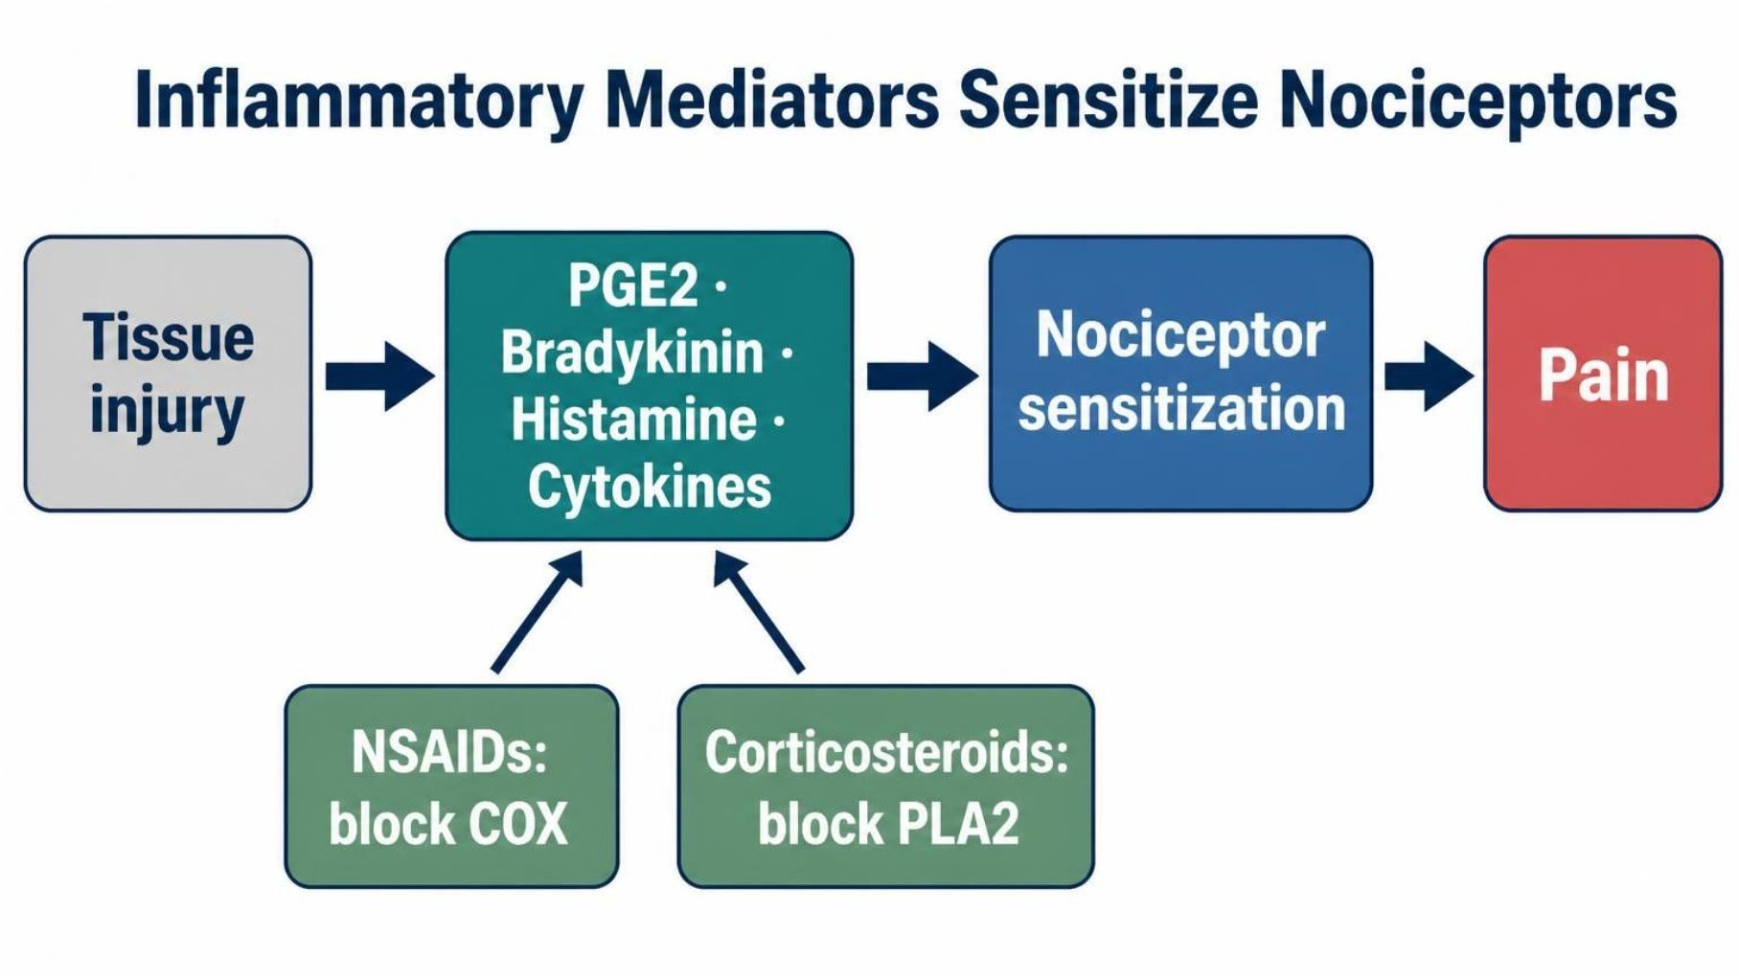
MECHANISM & DEPTH
Inflammatory Mediators Sensitize Nociceptors
Injury releases mediators: PGE2, bradykinin, histamine, and cytokines.
Nociceptor sensitization: mediators lower the pain threshold.
Where drugs act: NSAIDs block COX; corticosteroids block PLA2 upstream.
Musculoskeletal Pharmacology — Session 1 of 2 — PA Program
7
Notes:
Say: "Injury releases prostaglandins, bradykinin, histamine and cytokines. These lower the nociceptor threshold, so normally harmless stimuli hurt."
Know: Prostaglandins sensitize nociceptors, so they are the main NSAID target.
Know: Bradykinin, histamine and cytokines are not blocked by NSAIDs.
Instructor script:
Know: Inflammatory mediators sensitize nociceptors, so pain and inflammation are related but distinct.
Ask: Which mediators lower the pain threshold?

Slide 8

WHERE DRUGS INTERVENE
Therapeutic Targets in the Pain Pathway
Arachidonic
Acid
COX
Enzyme
Prostaglandins
Pain &
Inflammation
NSAIDs and COX-2 inhibitors act here; glucocorticoids act further upstream; cytokine inhibitors and analgesics act through separate, parallel pathways.
Musculoskeletal Pharmacology — Session 1 of 2 — PA Program
8
Notes:
This single arrow chain is the conceptual spine for the acetaminophen, NSAID, and corticosteroid sections that follow. The next slide builds this out further with the specific drug classes that intervene at each step.
Say: "Corticosteroids block phospholipase A2 upstream. NSAIDs block COX one step later."

Slide 9
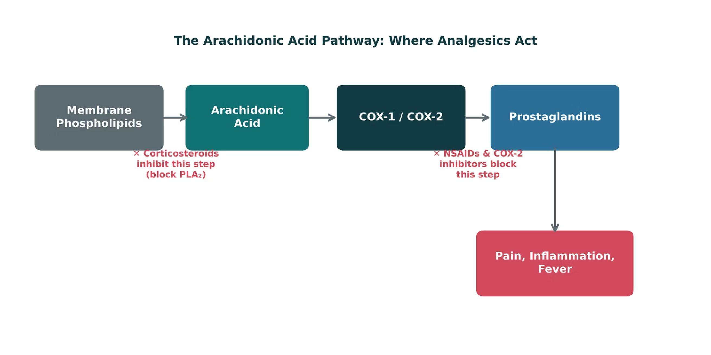
ORIGINAL ILLUSTRATION · FIGURE 1
The Arachidonic Acid Pathway: Where Analgesics Act
Figure 1. Original illustrative diagram (not from Katzung): corticosteroids block phospholipase A₂ upstream, while NSAIDs and COX-2 inhibitors block the COX step itself — two distinct points of pharmacologic intervention.
Musculoskeletal Pharmacology — Session 1 of 2 — PA Program
9
Notes:
This figure adds the drug layer on top of the previous flow slide: name the specific drug classes (corticosteroids vs. NSAIDs/COX-2 inhibitors) and exactly where each one interrupts the cascade.
Figure 1: Corticosteroids block phospholipase A2 upstream. NSAIDs block COX one step later.
Instructor script:
Walk the pathway: phospholipids to arachidonic acid, COX-1 and COX-2, prostaglandins and thromboxane. Mark where corticosteroids, NSAIDs and acetaminophen act.

Slide 10
QUICK CHECK · FIGURE 1
Quick Check
In Figure 1, corticosteroids are shown blocking the pathway at the "Membrane Phospholipids → Arachidonic Acid" step, while NSAIDs act one step later. What does this positioning explain?
Corticosteroids act upstream of NSAIDs, which is why they can suppress a broader range of inflammatory mediators, not just prostaglandins
A
B
Corticosteroids and NSAIDs block the exact same enzyme
C
NSAIDs act upstream of corticosteroids
D
Neither drug class affects the arachidonic acid pathway
Musculoskeletal Pharmacology — Session 1 of 2 — PA Program
10
Notes:
Quick check: give 30 seconds, take a show of hands, then reveal.
Instructor script:
Pause for the class to commit to an answer before you reveal it.

Slide 11
ANSWER · FIGURE 1
Answer
A
Corticosteroids act upstream of NSAIDs, broadly suppressing inflammatory mediator production.
Why: By inhibiting phospholipase A₂, corticosteroids block the release of arachidonic acid itself — upstream of COX — which is why they suppress a broader range of inflammatory mediators (not just prostaglandins) than NSAIDs, which act only at the COX step.
Musculoskeletal Pharmacology — Session 1 of 2 — PA Program
11
Notes:
Answer: corticosteroids act upstream of NSAIDs.
Instructor script:
Reveal the answer after the class has committed to one.

Slide 12
QUICK CHECK · UNDERSTANDING MUSCULOSKELETAL PAIN
Quick Check
Which mediator is the primary target of NSAID therapy within the inflammatory pain pathway?
A
Prostaglandins
B
Histamine
C
Bradykinin
D
Cytokines broadly (e.g., all of TNF-α, IL-1, IL-6)
Musculoskeletal Pharmacology — Session 1 of 2 — PA Program
12
Notes:
Quick check: give 30 seconds, take a show of hands, then reveal.
Instructor script:
Pause for the class to commit to an answer before you reveal it.

Slide 13
ANSWER · UNDERSTANDING MUSCULOSKELETAL PAIN
Answer
A
Prostaglandins.
Why: NSAIDs inhibit COX enzymes, directly reducing prostaglandin synthesis. Histamine, bradykinin, and cytokines are important inflammatory mediators too, but they are not the primary target of NSAID mechanism.
Musculoskeletal Pharmacology — Session 1 of 2 — PA Program
13
Notes:
Answer: prostaglandins are the NSAID target.
Say: "That's the pathway. Now the simplest drug on it: acetaminophen."
Instructor script:
Reveal the answer after the class has committed to one.

Slide 14

SECTION
02
Acetaminophen
Effective analgesia, with a narrow margin in overdose.
Notes:
Section transition.
Next, acetaminophen, the simplest drug on the pathway.

Slide 15

MECHANISM & EFFECTS
Acetaminophen
● Analgesic effect: relieves mild-to-moderate pain, with a central mechanism that is still incompletely understood.
● Antipyretic effect: reduces fever via central effects on the hypothalamic temperature-regulating center.
● Anti-inflammatory effect: minimal at the periphery — unlike NSAIDs, acetaminophen is not a reliable anti-inflammatory agent.
Musculoskeletal Pharmacology — Session 1 of 2 — PA Program
15
Notes:
This is the single most important distinction students need: acetaminophen treats pain and fever well, but it is not an anti-inflammatory drug the way NSAIDs are.
Say: "Acetaminophen is mainly central, with analgesic and antipyretic effects and minimal peripheral anti-inflammatory action."
Know: It is not an anti-inflammatory drug.

Slide 16
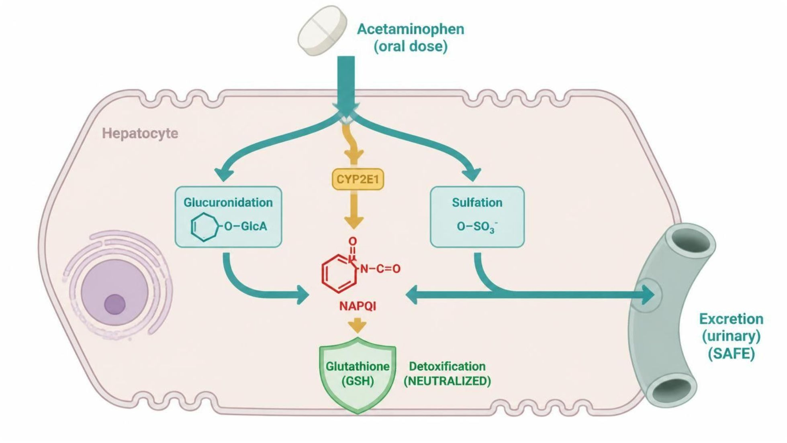
MECHANISM & DEPTH
Acetaminophen: Safe vs. Toxic Metabolism
Oral acetaminophen → Liver
Major route (~90%)
Minor route (~5–10%)
↓
↓
Glucuronidation and sulfation
CYP2E1 oxidation
↓
↓
Safe urinary excretion
NAPQI (toxic)
↓
GSH conjugation → safe excretion
Major route: glucuronidation and sulfation handle ~90% safely.
Minor route: CYP2E1 makes NAPQI, normally neutralized by glutathione.
Schematic (illustrative)
Figure 19. Acetaminophen metabolism: major glucuronidation and sulfation route versus minor CYP2E1 route to NAPQI.
Musculoskeletal Pharmacology — Session 1 of 2 — PA Program
16
Notes:
Explain the major safe route first, then the minor CYP2E1 route, where NAPQI is normally neutralized by glutathione conjugation at therapeutic doses.
Say: "About 90% goes down the safe route of glucuronidation and sulfation. A small fraction goes through CYP2E1 to NAPQI, which glutathione neutralizes at normal doses."
Instructor script:
Know: Therapeutic doses are conjugated; overdose saturates conjugation and CYP2E1 makes NAPQI.

Slide 17
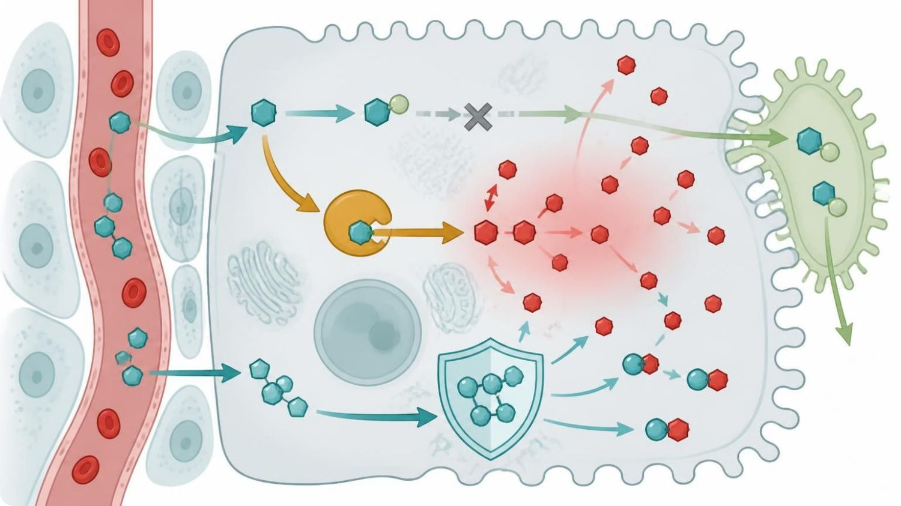
MECHANISM & DEPTH
Acetaminophen Overdose and NAC Rescue
Overdose: saturated glucuronidation/sulfation
↓
More drug shunted to CYP2E1
↓
More NAPQI; GSH depleted
←
NAC replenishes GSH
↓
NAPQI binds hepatocyte proteins
↓
Centrilobular liver necrosis
Schematic (illustrative)
Overdose: GSH exhausted; NAPQI injures hepatocytes.
Antidote: NAC replenishes GSH; give early.
Pearl: alcohol and fasting lower GSH; both induce CYP2E1.
Figure 4. Overdose saturates safe conjugation, shunting drug to CYP2E1; NAC restores glutathione.
Musculoskeletal Pharmacology — Session 1 of 2 — PA Program
17
Notes:
Overdose saturates glucuronidation and sulfation, shunting more drug to CYP2E1 and producing more NAPQI. Once glutathione is depleted, NAPQI injures hepatocytes. Give N-acetylcysteine early.
Say: "In overdose the safe route saturates, more drug goes to CYP2E1, glutathione runs out, and NAPQI injures hepatocytes."
Know: The antidote is N-acetylcysteine (NAC), given early.
Know: Chronic alcohol use and fasting raise the risk.
Know: Use the Rumack-Matthew nomogram for acute single ingestions, and check AST/ALT.
Instructor script:
Know: N-acetylcysteine replenishes glutathione.

Slide 18
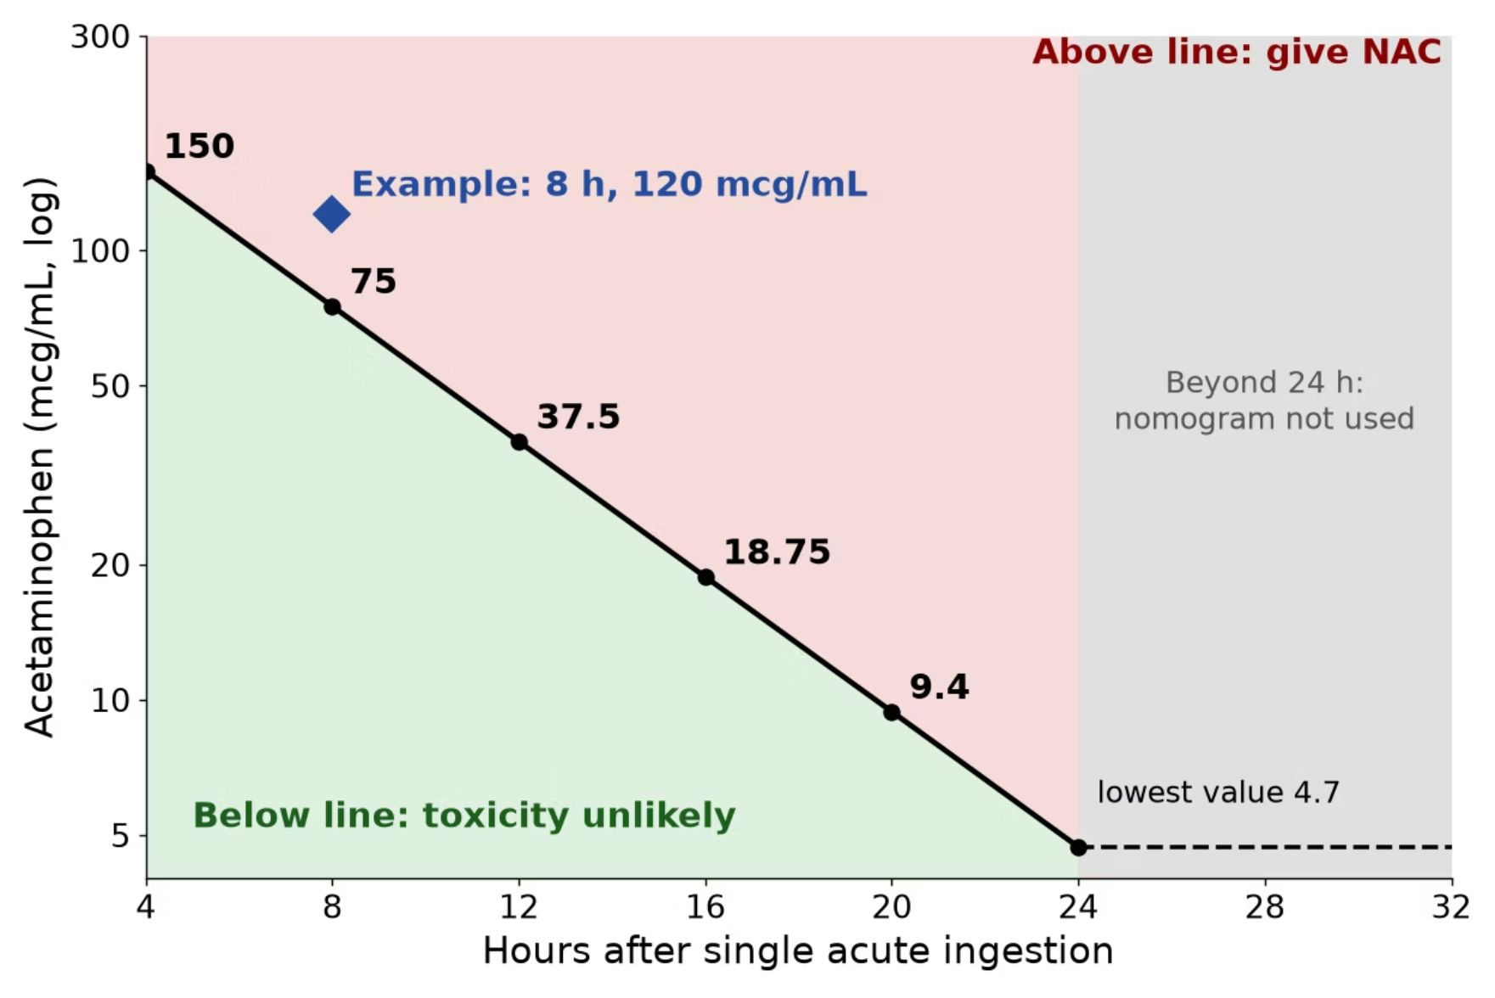
MECHANISM & DEPTH
Rumack-Matthew Nomogram: Assessing Toxicity
Illustrative schematic, single acute ingestion.
How to use: draw a level at 4 hours or later after a single acute ingestion and plot it against time since ingestion.
Above the treatment line: give NAC.
Below the line: toxicity unlikely.
Limits: not valid before 4 hours, for unknown ingestion time, staggered or repeated supratherapeutic ingestion, or chronic use; treat these using clinical judgment, AST/ALT and poison control.
Example: 8 h, 120 mcg/mL is above the line, so start NAC.
Musculoskeletal Pharmacology — Session 1 of 2 — PA Program
18
Notes:
The nomogram predicts hepatotoxicity risk after a single acute ingestion; if time of ingestion is unknown or ingestion is chronic, do not rely on it. Start NAC without waiting if presentation is late or the level is unavailable and ingestion is significant.
After 24 hours the nomogram is not used: 4.7 mcg/mL is only where the treatment line ends, not a safe cutoff. Get AST/ALT; a detectable level or elevated AST/ALT guides NAC, per protocol or poison control.
Instructor script:
Know: Use the Rumack-Matthew nomogram.

Slide 19

OVERDOSE MECHANISM
Acetaminophen Toxicity
Acetaminophen
NAPQI
(toxic metabolite)
Glutathione
Conjugation
Safe
Excretion
In overdose, glutathione stores are depleted, NAPQI accumulates, and hepatocyte injury follows — this is why N-acetylcysteine (a glutathione precursor) is the antidote.
Musculoskeletal Pharmacology — Session 1 of 2 — PA Program
19
Notes:
NAPQI = N-acetyl-p-benzoquinone imine. Tie this directly back to the "toxic metabolite" bullet from Lecture 1’s drug metabolism section.
Ask: "What is the danger of a cold-and-flu product on top of regular acetaminophen?" Look for: unintentional double dosing from combination products.

Slide 20

CLINICAL CASE
The Hidden Acetaminophen Overdose
A patient takes acetaminophen regularly for chronic back pain. For a cold, they also start an over-the-counter combination cold-and-flu medication.
Ask yourself: What is the hidden danger in this combination?
Clinical pearl: Many combination cold, flu, and sleep products also contain acetaminophen — unintentional double-dosing is a leading cause of acetaminophen-related liver injury. Always ask about ALL sources of acetaminophen.
Musculoskeletal Pharmacology — Session 1 of 2 — PA Program
20
Notes:
Good moment to reinforce generic-name awareness from Lecture 1 — patients often do not realize a product contains acetaminophen unless they check the label.
Hidden overdose case (slides 18-19): see the Ask on the previous slide.
Instructor script:
Ask: What changes the risk in a chronic drinker?

Slide 21
QUICK CHECK · ACETAMINOPHEN
Quick Check
In acetaminophen overdose, hepatotoxicity results primarily from which mechanism?
A
Direct COX inhibition in the liver
B
Excess Phase II glucuronidation
C
Accumulation of NAPQI after glutathione stores are depleted
D
Renal crystal formation
Musculoskeletal Pharmacology — Session 1 of 2 — PA Program
21
Notes:
Quick check: give 30 seconds, take a show of hands, then reveal.
Instructor script:
Pause for the class to commit to an answer before you reveal it.

Slide 22
ANSWER · ACETAMINOPHEN
Answer
C
Accumulation of NAPQI after glutathione stores are depleted.
Why: NAPQI, normally detoxified by conjugation with glutathione, accumulates once glutathione stores are exhausted in overdose, causing hepatocyte injury — which is why N-acetylcysteine (a glutathione precursor) is the antidote.
Musculoskeletal Pharmacology — Session 1 of 2 — PA Program
22
Notes:
Answer: NAPQI accumulation after glutathione depletion.
Say: "Acetaminophen leaves inflammation alone. NSAIDs go after it directly."
Instructor script:
Reveal the answer after the class has committed to one.

Slide 23

SECTION
03
NSAIDs
Powerful anti-inflammatory effect, with real systemic risk.
Notes:
Section transition.
Now we turn to the NSAIDs, which act on the same pathway.

Slide 24

MECHANISM
How NSAIDs Work
NSAID
COX
Inhibition
↓ Prostaglandins
↓ Pain, Inflammation,
Fever
Musculoskeletal Pharmacology — Session 1 of 2 — PA Program
24
Notes:
Say: "NSAIDs inhibit COX, so less arachidonic acid becomes prostaglandins and thromboxane. That gives less pain, inflammation and fever."

Slide 25
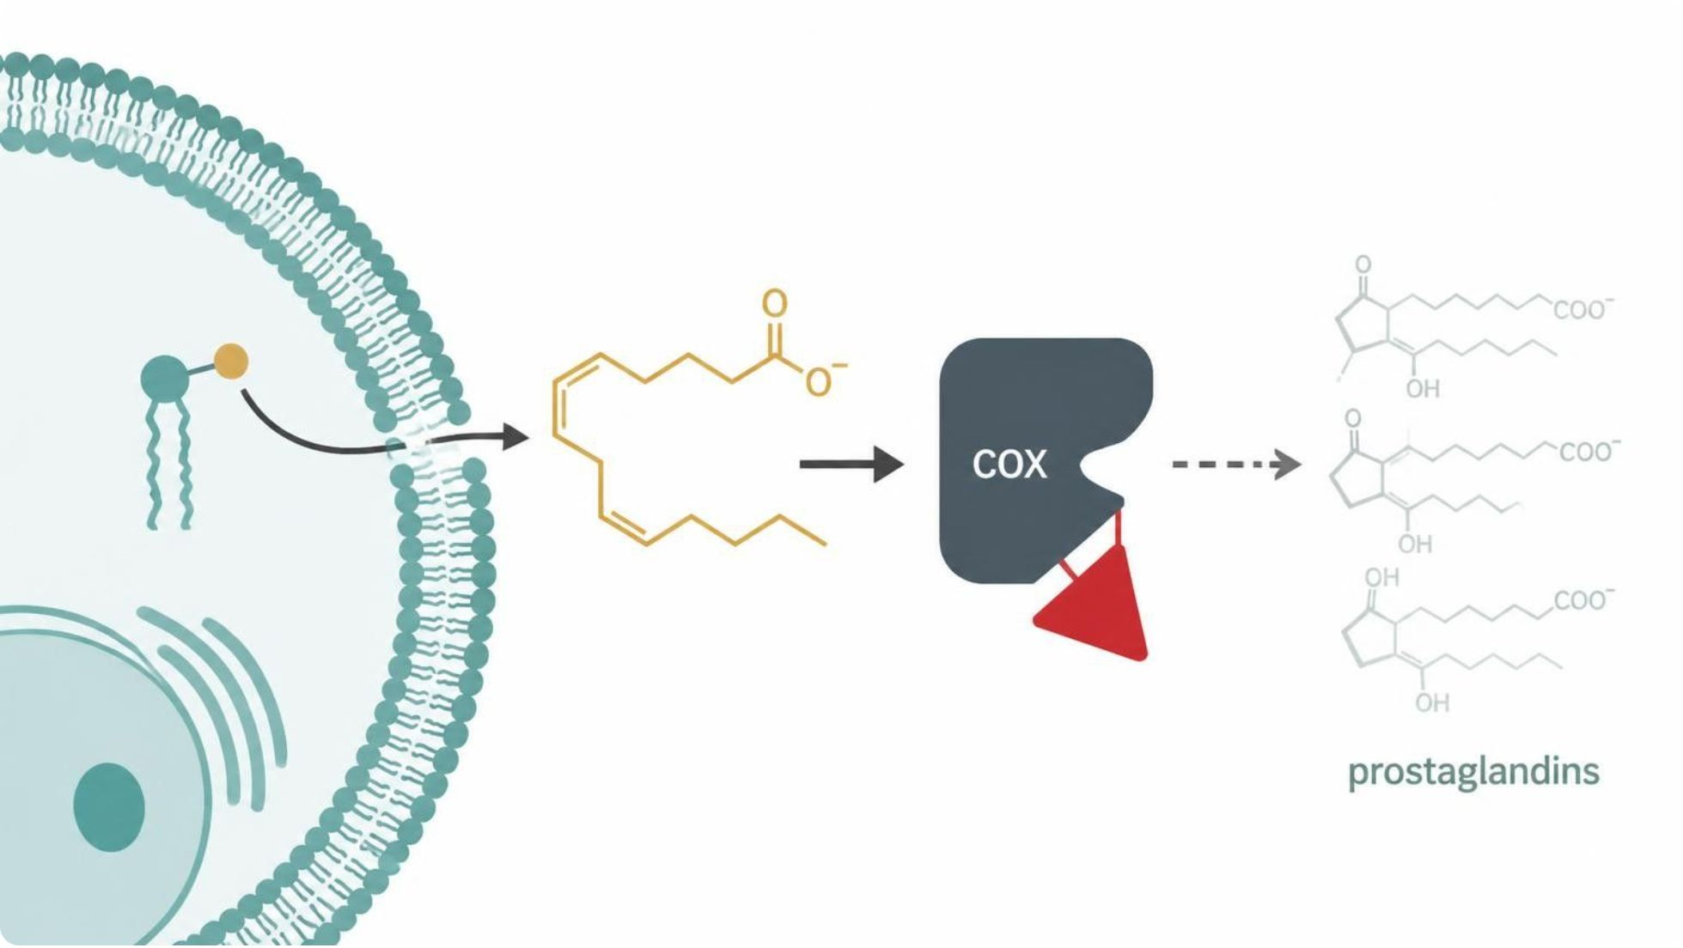
MECHANISM & DEPTH
NSAIDs Block COX and Prostaglandin Synthesis
Membrane phospholipids
↓
Arachidonic acid
↓
COX-1 / COX-2
↓
Prostaglandins and TXA2
↓
NSAIDs block COX
↓
Less prostaglandin: pain and fever fall
Less TXA2: bleeding risk
Pathway: COX turns arachidonic acid into prostaglandins and TXA2.
Effect: less pain, fever and inflammation.
Schematic (illustrative)
Figure 6. NSAIDs block COX, reducing prostaglandin and TXA2 synthesis.
Musculoskeletal Pharmacology — Session 1 of 2 — PA Program
25
Notes:
Explain the COX step first; every NSAID shares this mechanism, and the side effects follow from losing protective prostaglandins.
Say: "NSAIDs inhibit COX, so less arachidonic acid becomes prostaglandins and thromboxane. That gives less pain, inflammation and fever."

Slide 26
TWO ISOFORMS
COX-1 vs. COX-2
COX-1
COX-2
– "Housekeeping" enzyme
– Maintains gastric mucosal protection and normal renal blood flow
– Inhibition contributes to GI and renal adverse effects
– Induced mainly at sites of inflammation
– Primary source of inflammatory prostaglandins
– Selective inhibition targets inflammation with less GI toxicity
Musculoskeletal Pharmacology — Session 1 of 2 — PA Program
26
Notes:
Stress this is a simplified teaching model, not an absolute separation — COX-1 and COX-2 functions overlap, and COX-2 is also constitutively expressed in the kidney and elsewhere.
Say: "COX-1 is the housekeeper: stomach lining, platelets, kidney. COX-2 is induced at sites of inflammation."

Slide 27
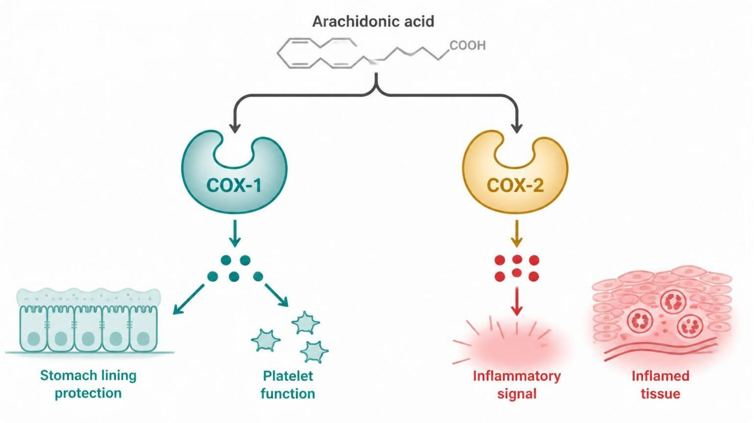
MECHANISM & DEPTH
COX-1 vs. COX-2: Constitutive vs. Inducible
Arachidonic acid
↓
COX-1 (constitutive)
Stomach mucosal protection Platelet TXA2 (clotting) Renal blood flow
↓
COX-2 (inducible, at inflamed tissue)
Inflammation Pain Fever
Nonselective NSAIDs block both COX-1 and COX-2 → GI and renal risk
COX-1: constitutive; gastric mucosa, platelets, kidney.
COX-2: inducible in inflamed tissue; pain, swelling, fever.
Nonselective NSAIDs block both, so GI injury is common.
Schematic (illustrative)
Figure 7. COX-1 protects; COX-2 is induced at inflamed sites.
Musculoskeletal Pharmacology — Session 1 of 2 — PA Program
27
Notes:
COX-1 keeps protective prostaglandins; COX-2 is induced by inflammation. Selectivity trades anti-inflammatory benefit against GI and platelet protection.
Say: "COX-1 is the housekeeper: stomach lining, platelets, kidney. COX-2 is induced at sites of inflammation."
Know: Nonselective NSAIDs block both, which is why GI injury is common.
Instructor script:
Know: COX-1 inhibition causes GI and platelet effects; COX-2 selectivity spares the stomach but not the cardiovascular risk.

Slide 28

AGENTS
Nonselective NSAIDs
Nonselective NSAIDs inhibit both COX-1 and COX-2.
Ibuprofen — common first-line choice for mild-moderate pain
Naproxen — longer half-life, twice-daily dosing
Diclofenac — available in oral and topical formulations
Indomethacin — more potent, more GI/CNS adverse effects
Ketorolac — short-term use only, significant GI/renal risk
Musculoskeletal Pharmacology — Session 1 of 2 — PA Program
28
Notes:
Nonselective NSAIDs: ibuprofen (first-line), naproxen (longer half-life), diclofenac, indomethacin (more GI/CNS effects), ketorolac (short-term only, significant GI/renal risk).

Slide 29

SELECTIVE AGENT
COX-2 Selective Inhibition: Celecoxib
Celecoxib selectively inhibits COX-2 over COX-1.
GI effects: lower risk of ulcer/bleeding than nonselective NSAIDs.
Cardiovascular risk: COX-2 selectivity is associated with increased cardiovascular event risk — a key trade-off.
Renal effects: similar renal risk to nonselective NSAIDs — COX-2 selectivity does not protect the kidney.
Musculoskeletal Pharmacology — Session 1 of 2 — PA Program
29
Notes:
This is a classic "trade one risk for another" teaching point — better GI profile, but not a free lunch cardiovascularly or renally.
Say: "Celecoxib spares COX-1, so the GI risk is lower. The trade-off is lower PGI2 without a matching drop in TXA2, which raises cardiovascular risk. The kidney is still affected."
Instructor script:
Know: Celecoxib is contraindicated with sulfonamide allergy.

Slide 30
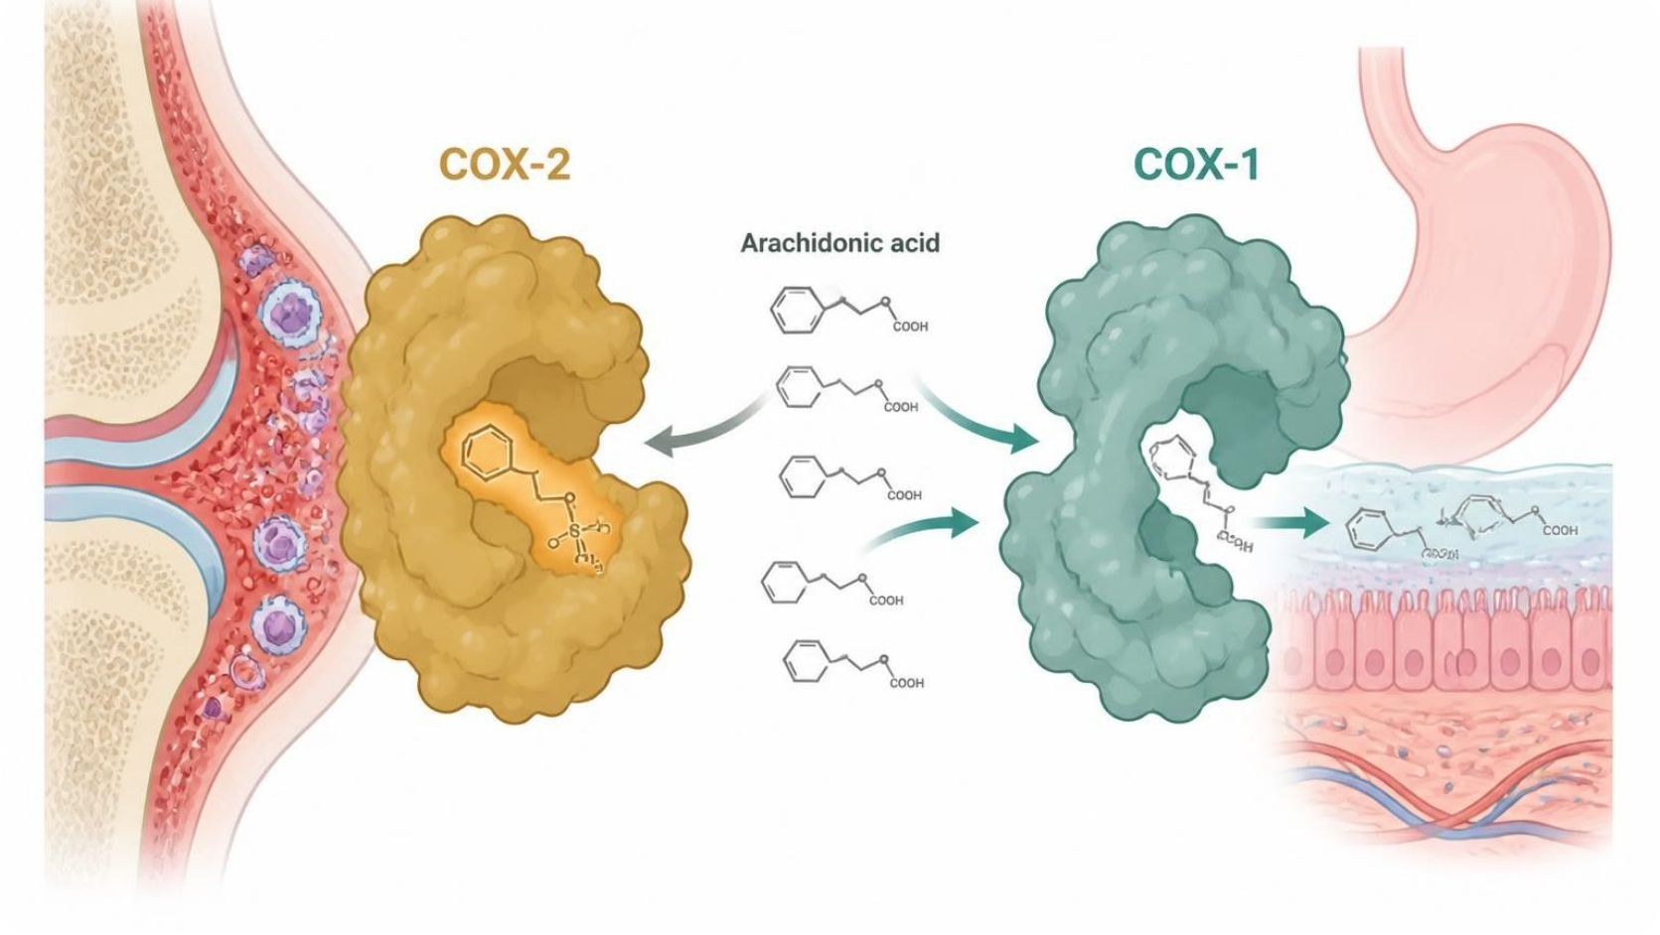
MECHANISM & DEPTH
Celecoxib: Sparing COX-1 While Blocking COX-2
Arachidonic acid
COX-2
COX-1
Blocked by celecoxib
Spared by celecoxib
↓ Fewer inflammatory prostaglandins → less pain and inflammation
↓ Stomach and platelet protection continues
↓ PGI₂ falls, TXA₂ kept → cardiovascular risk
Schematic (illustrative)
Figure 8. Celecoxib spares COX-1 while blocking COX-2.
Mechanism: blocks inflammatory COX-2.
GI benefit: stomach COX-1 is spared, lowering ulcer risk.
Trade-off: PGI2 falls, TXA2 kept, raising CV risk.
Musculoskeletal Pharmacology — Session 1 of 2 — PA Program
30
Notes:
Use the diagram to show that selectivity separates the GI benefit from the cardiovascular trade-off. Link back to the nonselective NSAID comparison on the previous slide.
Say: "Celecoxib spares COX-1, so the GI risk is lower. The trade-off is lower PGI2 without a matching drop in TXA2, which raises cardiovascular risk. The kidney is still affected."

Slide 31
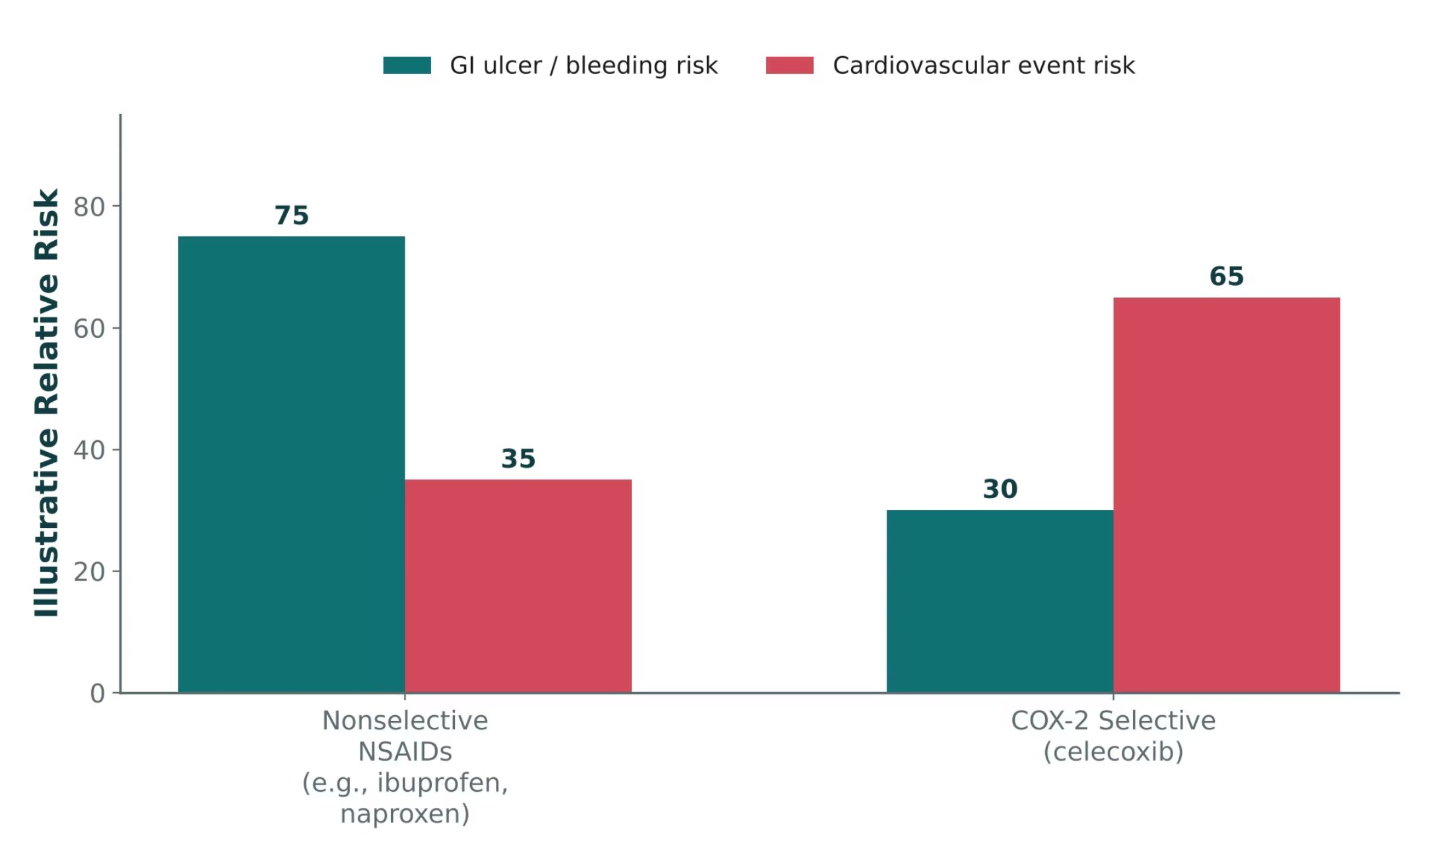
ORIGINAL ILLUSTRATION · FIGURE 2
Nonselective NSAIDs vs. COX-2 Selective Inhibition
Figure 2. Original illustrative comparison (illustrative relative-risk values, not from Katzung): nonselective NSAIDs (e.g., ibuprofen, naproxen) carry higher GI risk; celecoxib trades lower GI risk for higher cardiovascular risk.
Musculoskeletal Pharmacology — Session 1 of 2 — PA Program
31
Notes:
This is the graphical version of the trade-off just described in the celecoxib bullet slide — use it to reinforce that there is no risk-free NSAID choice, only a different risk profile.
Figure 2 and trade-off summary: lower GI risk, some increase in cardiovascular risk. These risk values are illustrative, not clinical data.

Slide 32
QUICK CHECK · FIGURE 2
Quick Check
Based on Figure 2, a patient with a history of GI ulcer but no cardiovascular disease is switched from ibuprofen to celecoxib. What is the most likely net effect on this patient’s risk profile?
A
Lower GI risk, with some increase in cardiovascular risk
B
Both GI and cardiovascular risk decrease
C
Both GI and cardiovascular risk increase
D
No change in either risk, since all NSAIDs carry identical risk profiles
Musculoskeletal Pharmacology — Session 1 of 2 — PA Program
32
Notes:
Quick check: give 30 seconds, take a show of hands, then reveal.
Instructor script:
Pause for the class to commit to an answer before you reveal it.

Slide 33
ANSWER · FIGURE 2
Answer
A
Lower GI risk, with some increase in cardiovascular risk.
Why: Figure 2 shows celecoxib’s illustrative GI-risk bar is lower than the nonselective NSAID bar, while its cardiovascular-risk bar is higher — exactly the trade-off described in the celecoxib bullet slide. For this GI-ulcer-history patient without cardiovascular disease, that trade may be favorable, but the increased cardiovascular risk should still be discussed.
Musculoskeletal Pharmacology — Session 1 of 2 — PA Program
33
Notes:
Answer: lower GI risk, with some increase in cardiovascular risk. These risk values are illustrative, not clinical data.
Instructor script:
Reveal the answer after the class has committed to one.

Slide 34
ORGANIZED BY SYSTEM · TABLE 1
NSAID Adverse Effects
System | Key Adverse Effects
Gastrointestinal | Gastritis, peptic ulcer, GI bleeding
Renal | Decreased renal perfusion, fluid retention, acute kidney injury
Cardiovascular | Hypertension, increased risk of cardiovascular events
Musculoskeletal Pharmacology — Session 1 of 2 — PA Program
34
Notes:
These three systems (GI, renal, CV) are the organizing framework for every NSAID contraindication and interaction discussion that follows. Table 1.
Say: "Lose prostaglandins and you lose mucosal protection, renal afferent dilation and normal platelet function."

Slide 35
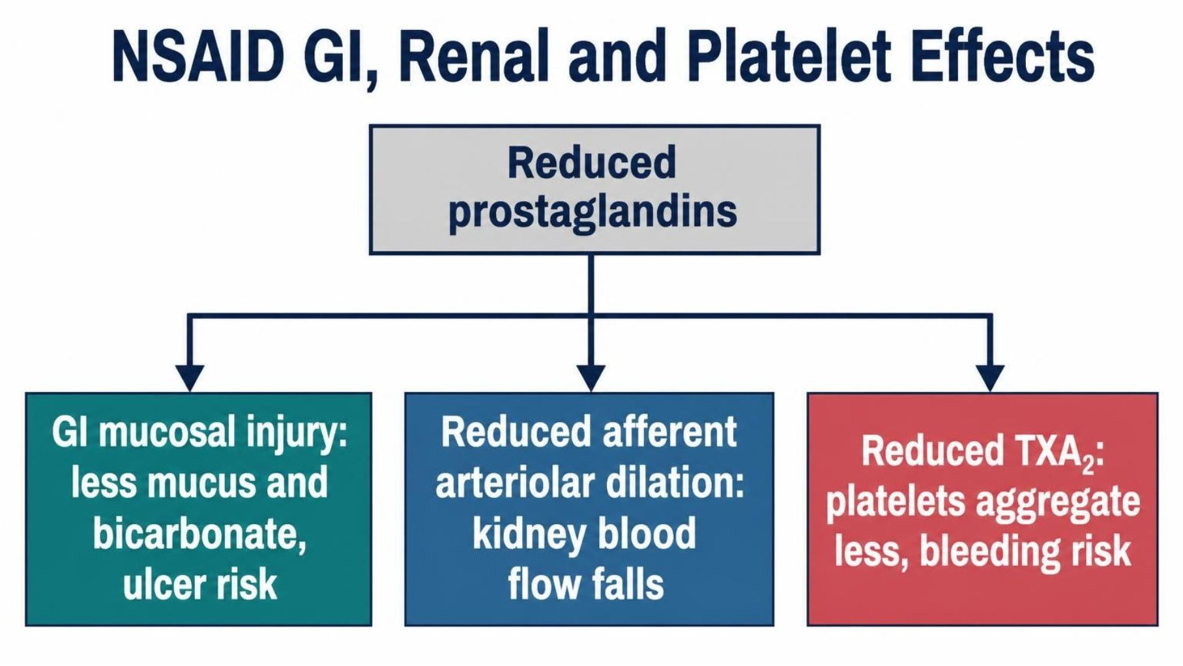
MECHANISM & DEPTH
NSAIDs: Prostaglandin Loss and Organ Effects
GI: less prostaglandin-driven mucus and bicarbonate leaves the mucosa open to injury.
Kidney: reduced afferent arteriolar dilation lowers renal blood flow.
Platelets: reduced TXA2 impairs aggregation, increasing bleeding risk.
Musculoskeletal Pharmacology — Session 1 of 2 — PA Program
35
Notes:
Say: "Lose prostaglandins and you lose mucosal protection, renal afferent dilation and normal platelet function."
Know: GI (ulcer, bleeding), renal (AKI, fluid retention), cardiovascular (hypertension, events).
Instructor script:
Prostaglandin loss in the kidney reduces afferent blood flow: stress the triple whammy with ACE inhibitors and diuretics.

Slide 36
PRESCRIBING SAFELY
NSAID Contraindications & Interactions
Use Caution / Avoid In
High-Yield Drug Interactions
– Active GI bleeding or ulcer history
– Chronic kidney disease
– Heart failure or cardiovascular disease
– Anticoagulant therapy
– Late pregnancy
– NSAIDs + anticoagulants → ↑ bleeding risk
– NSAIDs + ACE inhibitors/ARBs → ↑ AKI risk ("triple whammy" with diuretics)
– NSAIDs + diuretics → reduced diuretic effect, ↑ renal risk
– NSAIDs + corticosteroids → ↑ GI ulcer risk
Musculoskeletal Pharmacology — Session 1 of 2 — PA Program
36
Notes:
The "triple whammy" (NSAID + ACEi/ARB + diuretic) is a very high-yield acute kidney injury pattern to flag explicitly.
Avoid or use caution with active GI bleeding or ulcer history, CKD, heart failure, anticoagulants, and late pregnancy.
Know (interactions): NSAID plus anticoagulant means more bleeding. NSAID plus ACE inhibitor/ARB plus diuretic is the "triple whammy" for AKI. NSAID plus corticosteroid means more GI ulcer risk.

Slide 37
CLINICAL CASE
Is an NSAID the Right First Choice?
A 72-year-old patient with osteoarthritis also has chronic kidney disease, hypertension, and is taking an anticoagulant.
Ask yourself: Is an NSAID a good first-line choice for this patient’s pain? Why or why not?
Clinical pearl: This patient has three separate NSAID red flags at once (renal disease, anticoagulation, and age-related bleeding risk) — acetaminophen or a non-NSAID strategy is generally safer first-line.
Musculoskeletal Pharmacology — Session 1 of 2 — PA Program
37
Notes:
Excellent exam-style vignette — ask students to name all three risk factors independently before revealing the answer.
Ask: "72 years old, CKD, hypertension, on an anticoagulant. Is an NSAID a good first choice?"

Slide 38
QUICK CHECK · NSAIDS
Quick Check
A patient with CKD, hypertension, and anticoagulant use needs analgesia for osteoarthritis. Which class carries the highest combined renal and bleeding risk for this patient?
A
Acetaminophen
B
Oral NSAIDs
C
Topical capsaicin
D
Physical therapy alone
Musculoskeletal Pharmacology — Session 1 of 2 — PA Program
38
Notes:
Quick check: give 30 seconds, take a show of hands, then reveal.
Instructor script:
Pause for the class to commit to an answer before you reveal it.

Slide 39
ANSWER · NSAIDS
Answer
B
Oral NSAIDs.
Why: This patient has multiple NSAID red flags at once: CKD (renal risk), anticoagulant use (bleeding risk), and hypertension (cardiovascular risk) — oral NSAIDs carry the highest combined risk here.
Musculoskeletal Pharmacology — Session 1 of 2 — PA Program
39
Notes:
Answer: no. Oral NSAIDs carry the highest combined risk. Acetaminophen or a non-NSAID approach is generally safer.
Say: "Now the same drugs in the setting of arthritis."
Instructor script:
Reveal the answer after the class has committed to one.

Slide 40

SECTION
04
Osteoarthritis & Rheumatoid Arthritis
Two very different diseases that both affect the joint.
Notes:
Section transition.
Now we apply these drugs to osteoarthritis and rheumatoid arthritis.

Slide 41
TWO DIFFERENT DISEASES
Osteoarthritis vs. Rheumatoid Arthritis
Osteoarthritis (OA)
Rheumatoid Arthritis (RA)
– Primarily degenerative joint disease
– Cartilage breakdown with mechanical wear
– Treatment goal: pain control and function
– Autoimmune, systemic inflammatory disease
– Immune-mediated joint destruction
– Treatment goal: suppress disease activity, not just pain
Musculoskeletal Pharmacology — Session 1 of 2 — PA Program
41
Notes:
This distinction is the hinge the whole rest of the section turns on: OA is managed primarily with analgesics/NSAIDs, while RA requires disease-modifying therapy.
Say: "OA is degenerative and mechanical, with cartilage wear and bone remodeling. RA is autoimmune, with synovitis, pannus, and TNF-alpha and IL-6 driving erosion."

Slide 42
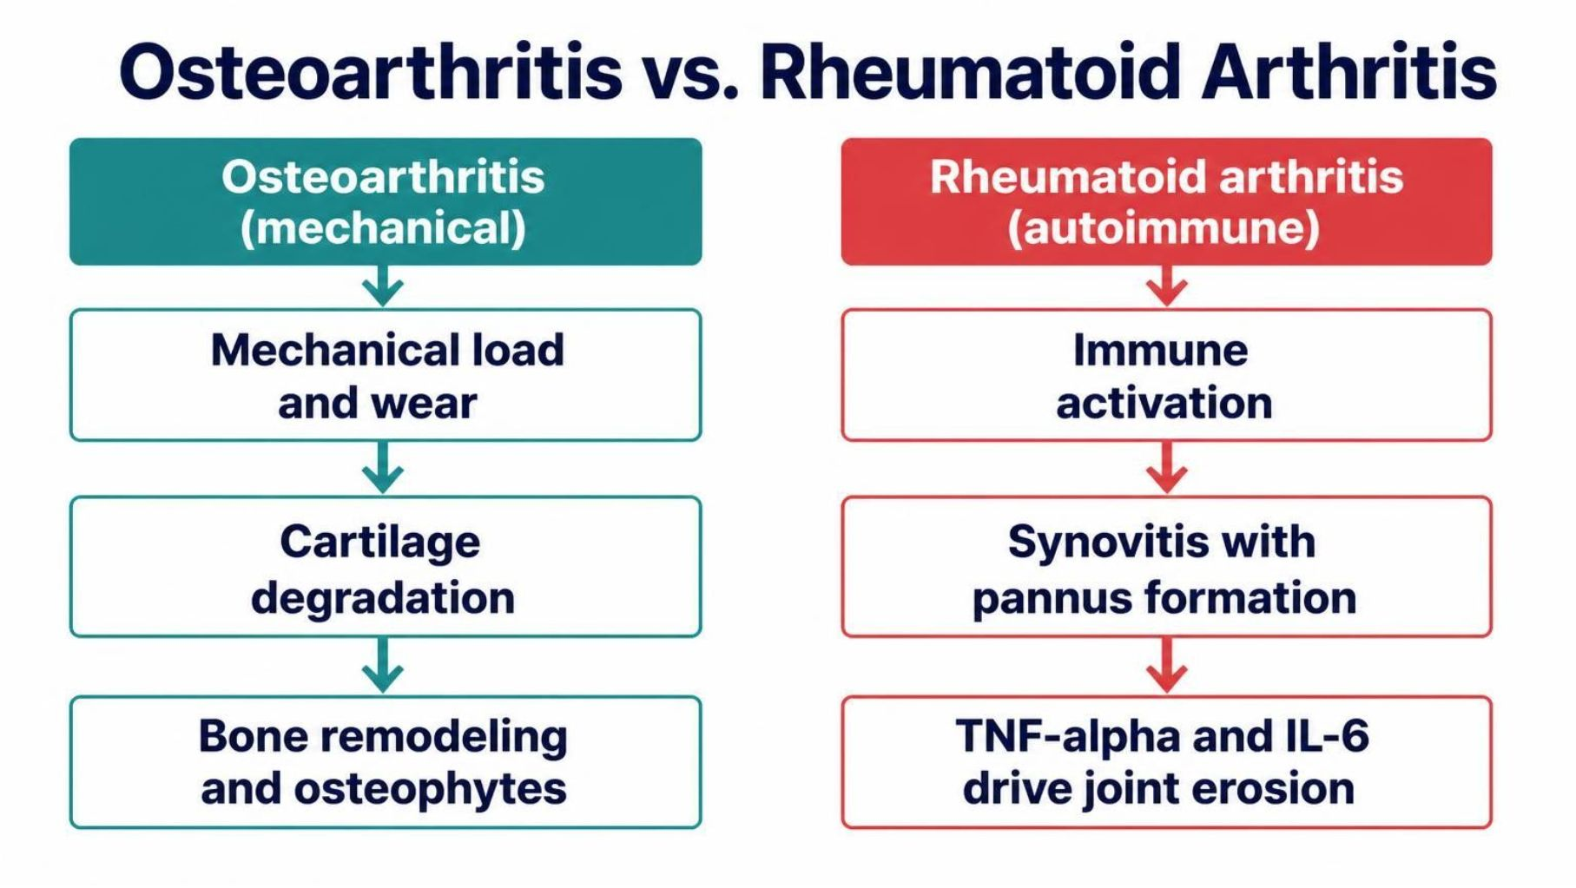
MECHANISM & DEPTH
Osteoarthritis vs. Rheumatoid Arthritis: Pathophysiology
OA: mechanical wear degrades cartilage; bone remodels with osteophytes.
RA: autoimmune synovitis forms a pannus that erodes cartilage and bone.
Key RA cytokines: TNF-α and IL-6 drive inflammation and joint damage.
Musculoskeletal Pharmacology — Session 1 of 2 — PA Program
42
Notes:
Say: "OA is degenerative and mechanical, with cartilage wear and bone remodeling. RA is autoimmune, with synovitis, pannus, and TNF-alpha and IL-6 driving erosion."
Instructor script:
Know: OA is mechanical and degenerative; RA is autoimmune.

Slide 43
OA MANAGEMENT
Pharmacologic Treatment of Osteoarthritis
Acetaminophen — reasonable first-line for mild OA pain
Oral NSAIDs — effective, but carry the systemic risks already discussed
Topical NSAIDs — effective local relief with much lower systemic exposure
Intra-articular corticosteroid injections — short-term relief for flares in a single joint
Other approaches — activity modification, physical therapy, weight management
Musculoskeletal Pharmacology — Session 1 of 2 — PA Program
43
Notes:
Acetaminophen is reasonable first-line for mild pain. Topical NSAIDs give effective relief with lower systemic exposure. Intra-articular corticosteroids give short-term relief for flares. Add activity modification, physical therapy and weight management.

Slide 44
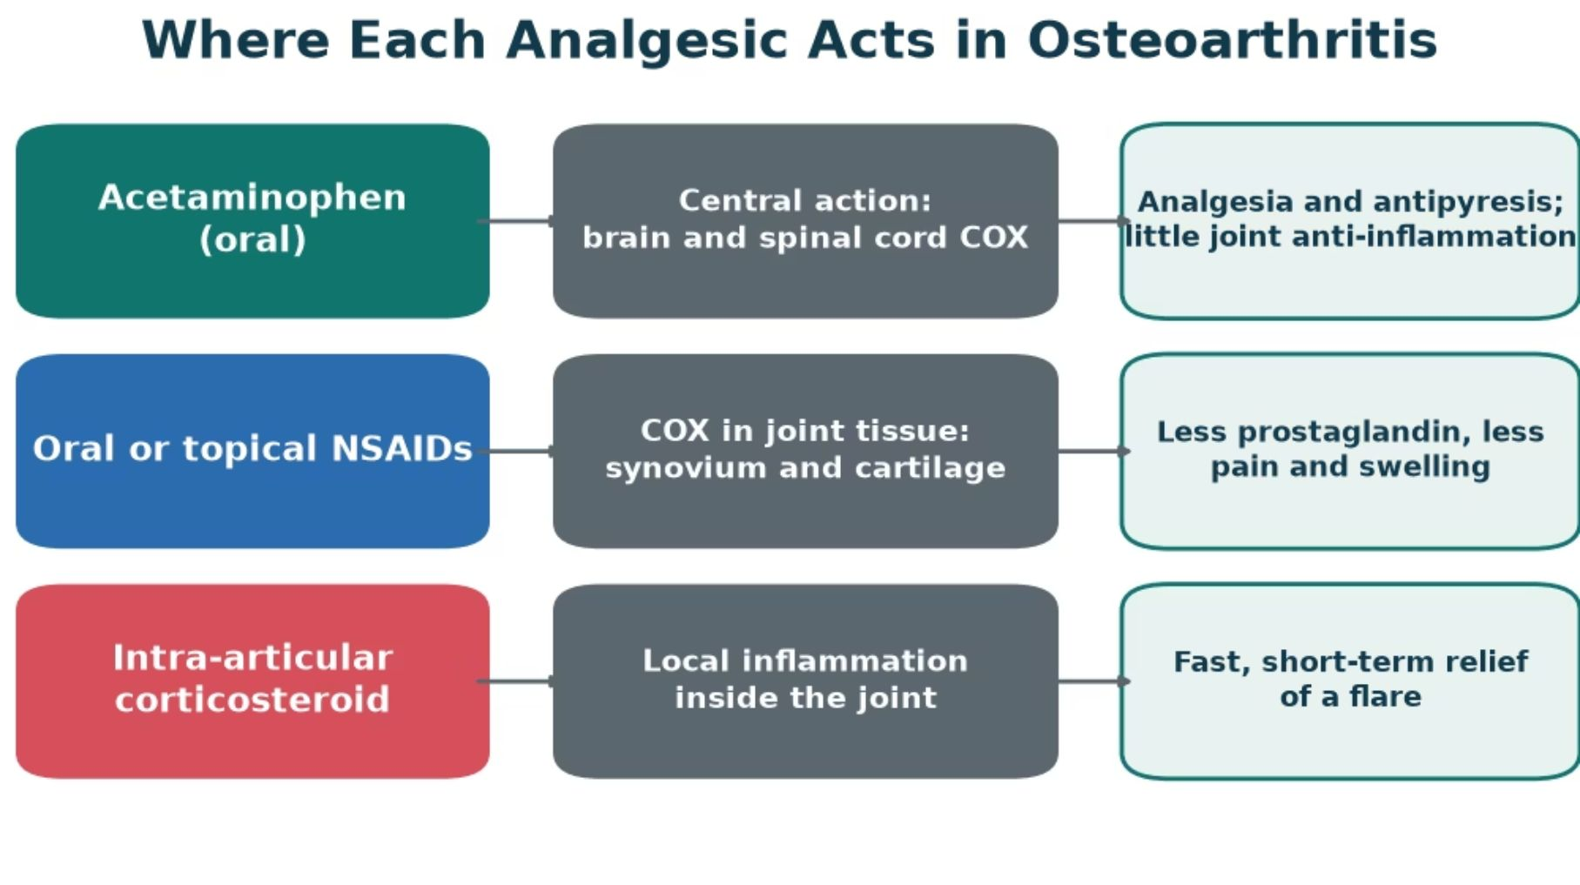
MECHANISM & DEPTH
Where Each Analgesic Acts in Osteoarthritis
Acetaminophen: acts centrally; little anti-inflammatory effect in the joint.
Oral or topical NSAIDs: block COX in joint tissue, lowering prostaglandins.
Intra-articular steroid: calms local inflammation for a short, fast flare relief.
Musculoskeletal Pharmacology — Session 1 of 2 — PA Program
44
Notes:
Match each option to its site: acetaminophen centrally, NSAIDs in synovium and cartilage, corticosteroids inside the joint. Choice depends on which tissue drives the pain.
Acetaminophen is reasonable first-line for mild pain. Topical NSAIDs give effective relief with lower systemic exposure. Intra-articular corticosteroids give short-term relief for flares. Add activity modification, physical therapy and weight management.

Slide 45

CONCEPT
What Makes a Drug "Disease-Modifying"?
● DMARD: Disease-Modifying Antirheumatic Drug — a drug intended to alter the course of RA, not just mask its symptoms.
● Goal of therapy: slow or halt joint destruction and systemic inflammation, rather than providing analgesia alone.
Musculoskeletal Pharmacology — Session 1 of 2 — PA Program
45
Notes:
Contrast explicitly with NSAIDs: an NSAID can make a patient feel better without changing the underlying disease trajectory — a DMARD is meant to change the trajectory itself.
Say: "A DMARD changes the course of RA. An NSAID only masks symptoms."

Slide 46
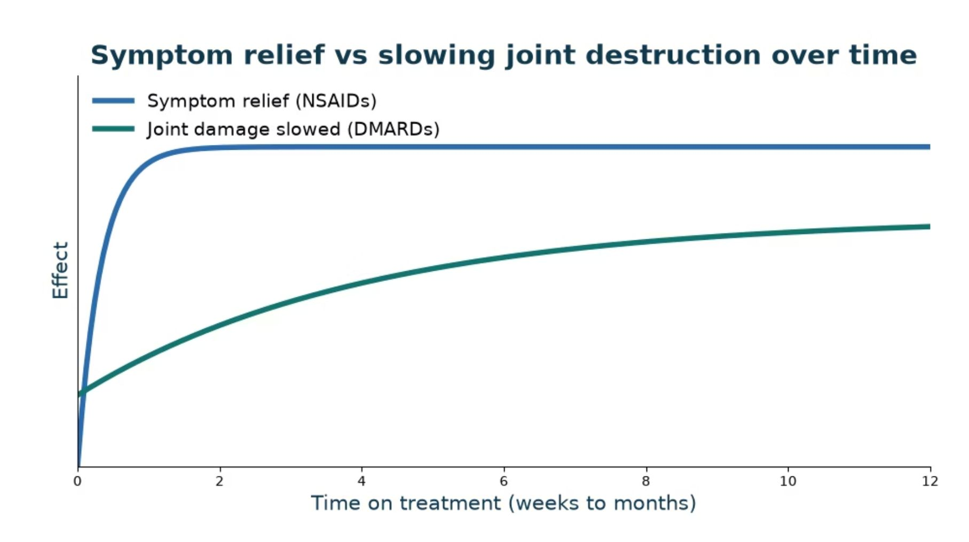
MECHANISM & DEPTH
Symptom Relief vs Slowing Joint Destruction
NSAIDs: relieve pain and swelling within days, but do not alter joint damage.
DMARDs: take weeks to months to act, then slow cartilage and bone destruction.
Timing: judge a DMARD over months, not after the first visit.
Goal: relief now with NSAIDs, protection later with DMARDs.
Musculoskeletal Pharmacology — Session 1 of 2 — PA Program
46
Notes:
Contrast the fast, symptomatic effect of NSAIDs with the slow, structure-modifying effect of DMARDs. Set expectations that DMARD benefit builds over months.
Say: "A DMARD changes the course of RA. An NSAID only masks symptoms."
Know: DMARDs take weeks to months to work. Judge them over months, not at the first visit. The curve is a schematic, not data.
Instructor script:
Know: Analgesics treat symptoms; DMARDs slow joint destruction.

Slide 47
CONVENTIONAL DMARDS
Conventional (Non-Biologic) DMARDs
Methotrexate — the anchor drug for most RA regimens (next slide)
Hydroxychloroquine — milder disease; relatively favorable safety profile
Sulfasalazine — often used in combination regimens
Leflunomide — alternative when methotrexate is not tolerated
Musculoskeletal Pharmacology — Session 1 of 2 — PA Program
47
Notes:
Methotrexate (anchor drug, blocks DHFR), hydroxychloroquine (milder disease), sulfasalazine, leflunomide (blocks DHODH, pyrimidine synthesis).
Instructor script:
Methotrexate once weekly with folic acid; hydroxychloroquine needs eye exams; sulfasalazine; leflunomide is teratogenic.

Slide 48
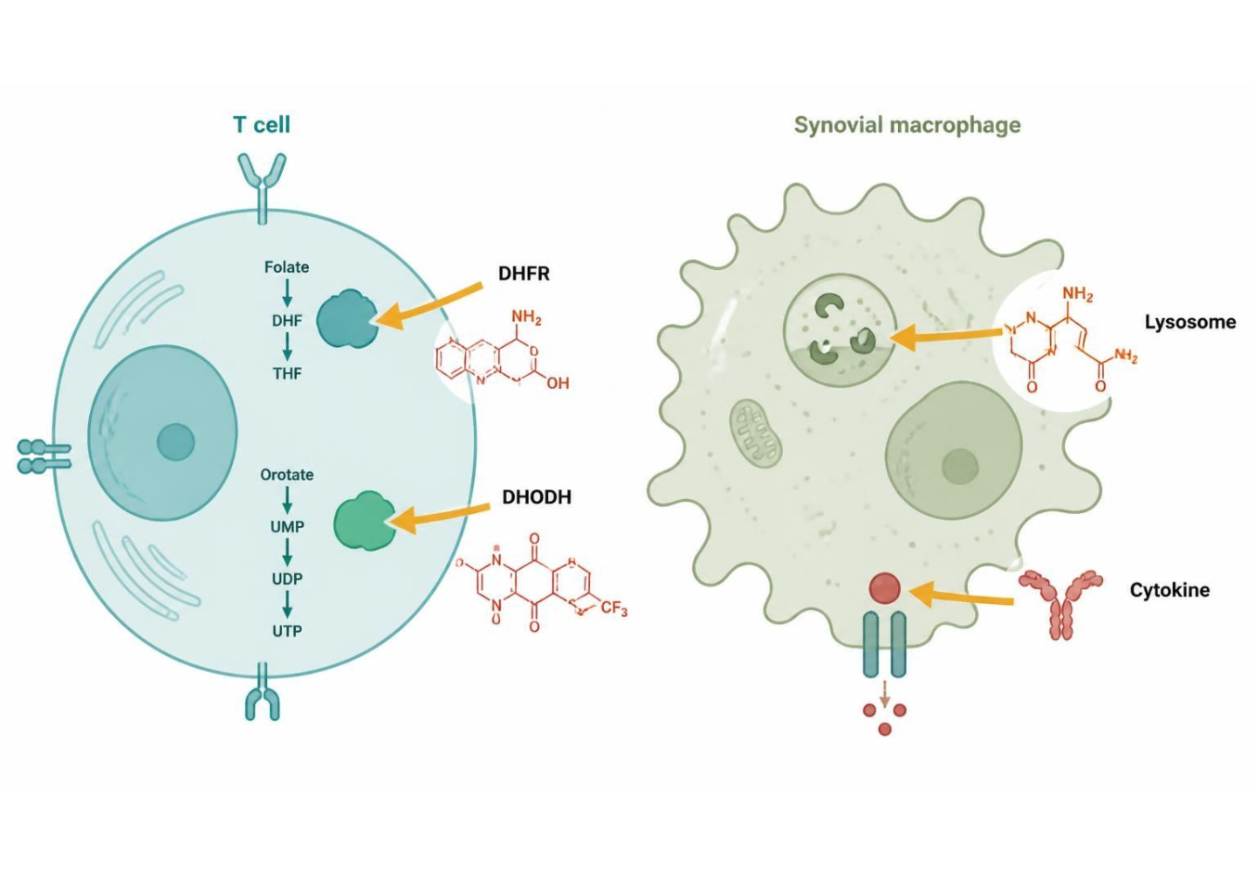
MECHANISM & DEPTH
Conventional DMARDs: Where Each Drug Acts
Drug | Target / action | Effect
Methotrexate | Inhibits DHFR (folate) | Slower immune-cell growth
Hydroxychloroquine | Alters lysosome, TLR signals | Less antigen signaling
Sulfasalazine | Cuts cytokines, prostaglandins | Less inflammation
Leflunomide | Inhibits DHODH | Slower T-cell growth
Methotrexate: blocks DHFR.
Hydroxychloroquine: alters lysosome and TLR signals.
Sulfasalazine: cuts cytokine output.
Schematic (illustrative)
Figure 14. Conventional DMARDs act at different intracellular and immune-pathway targets.
Musculoskeletal Pharmacology — Session 1 of 2 — PA Program
48
Notes:
These drugs act inside cells or on broad immune pathways, with a slower onset than biologics.
Methotrexate (anchor drug, blocks DHFR), hydroxychloroquine (milder disease), sulfasalazine, leflunomide (blocks DHODH, pyrimidine synthesis).

Slide 49
ANCHOR DRUG
Methotrexate
Mechanism: inhibits dihydrofolate reductase, reducing immune cell proliferation at low RA doses.
Dosed weekly (not daily) — a critical patient-safety point, since daily dosing can be fatal.
Folate supplementation is routinely co-prescribed to reduce toxicity.
Key adverse effects: hepatotoxicity, bone marrow suppression, pulmonary toxicity.
Contraindicated in pregnancy (teratogenic).
Musculoskeletal Pharmacology — Session 1 of 2 — PA Program
49
Notes:
Methotrexate’s weekly dosing is one of the highest-yield patient-safety teaching points in all of rheumatology pharmacology — emphasize it strongly.
Know: methotrexate is dosed WEEKLY, not daily. Daily dosing has caused fatal toxicity.

Slide 50
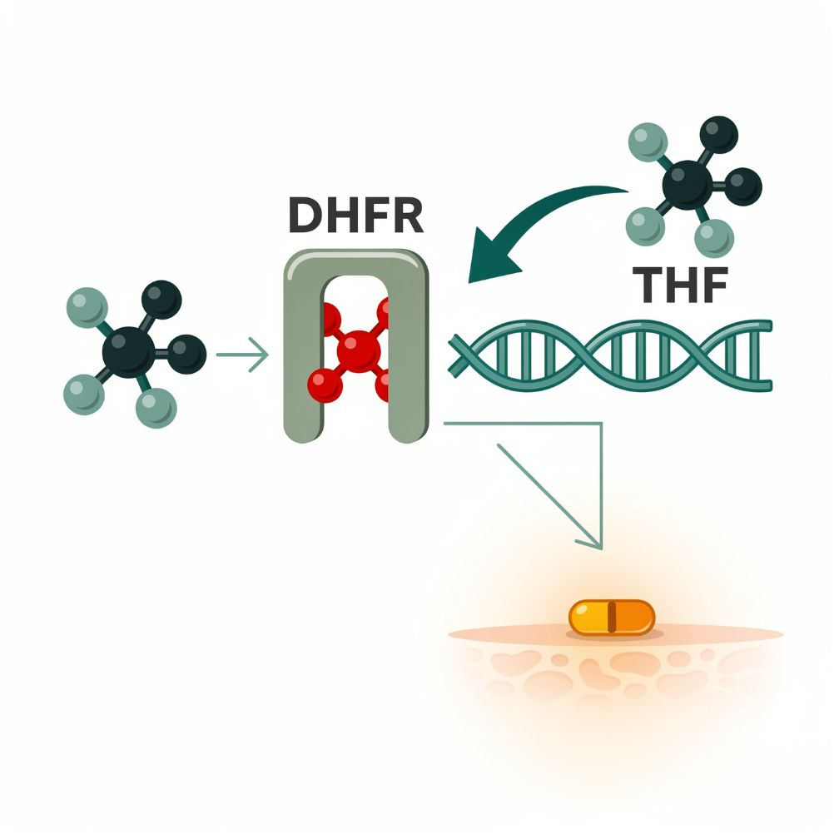
MECHANISM & DEPTH
Methotrexate: Folate Pathway and Low-Dose Action
Dihydrofolate (DHF) ↓
DHFR enzyme ↓
THF for DNA synthesis
Methotrexate blocks DHFR ↓
Low dose: anti-inflammatory ↓
Weekly dosing only
Target: inhibits dihydrofolate reductase (DHFR), blocking folate-dependent purine and thymidylate synthesis.
Low-dose RA effect: likely anti-inflammatory via adenosine release, not cytotoxicity.
Pearl: weekly dosing only; daily dosing has caused fatal toxicity.
Schematic (illustrative)
Figure 15. Methotrexate blocks DHFR in the folate pathway; low-dose action is anti-inflammatory.
Musculoskeletal Pharmacology — Session 1 of 2 — PA Program
50
Notes:
Walk through the diagram left to right: folate is reduced to THF through DHF, and methotrexate blocks the DHFR step. Emphasize the weekly-dosing safety point.
Give folic acid to reduce liver, marrow, lung and GI toxicity. Contraindicated in pregnancy (teratogenic).

Slide 51

TARGETED THERAPY
Biologic DMARDs
TNF Inhibitors
IL-6 Inhibitors
– Block tumor necrosis factor-alpha signaling
– Examples: adalimumab, etanercept, infliximab
– Block interleukin-6 receptor signaling
– Example: tocilizumab
B-Cell Targeted Therapy
T-Cell Costimulation Modulators
– Depletes or modulates B lymphocytes
– Example: rituximab
– Block the second signal needed for T-cell activation
– Example: abatacept
Musculoskeletal Pharmacology — Session 1 of 2 — PA Program
51
Notes:
Each biologic class corresponds to a different cytokine or cell type in the inflammatory cascade shown earlier in the lecture — tie this back to the mediator list from Section 1. The next slide shows these same four drug classes as a mechanism diagram.
Say: "Four classes by target." TNF inhibitors (infliximab, adalimumab, etanercept), IL-6 blockers (tocilizumab), abatacept (CTLA-4-Ig, blocks CD28 costimulation), rituximab (anti-CD20, depletes B cells).

Slide 52
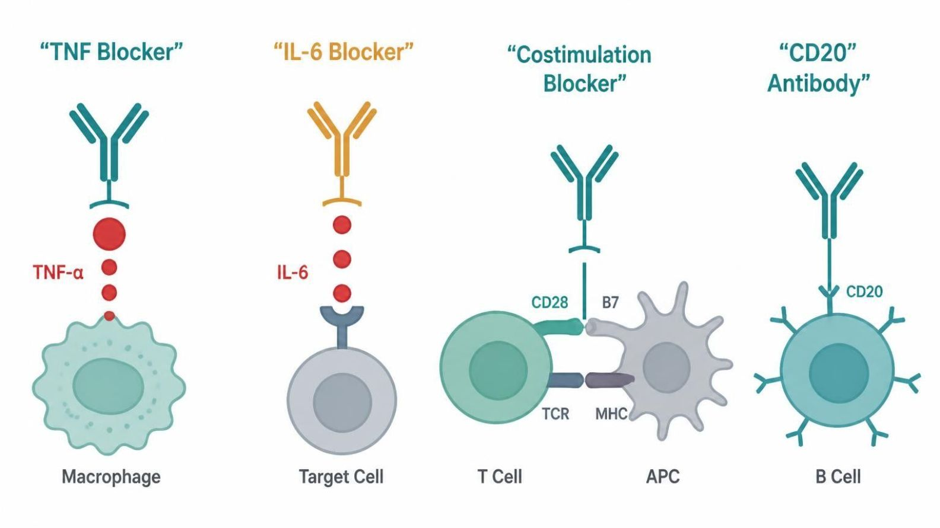
MECHANISM & DEPTH
Biologic DMARDs: Mechanism by Target
TNF inhibitors Infliximab, adalimumab, etanercept | Block soluble and membrane TNF-α.
IL-6 inhibitor Tocilizumab | Blocks the IL-6 receptor.
Abatacept CTLA-4-Ig | Blocks CD28 costimulation of T cells.
Rituximab Anti-CD20 | Binds CD20 and depletes B cells.
Schematic (illustrative)
Figure 16. Biologic DMARDs intercept distinct steps of the immune cascade.
TNF inhibitors: antibodies and etanercept neutralize soluble and membrane TNF-α. Watch for latent TB.
IL-6 blockers: tocilizumab blocks the IL-6 receptor. Can raise lipids and liver enzymes.
Abatacept: blocks costimulation at T-cell activation. Lower infection signal.
Musculoskeletal Pharmacology — Session 1 of 2 — PA Program
52
Notes:
Each biologic intercepts a different step of the immune cascade; match the target to the drug class.
Say: "Four classes by target." TNF inhibitors (infliximab, adalimumab, etanercept), IL-6 blockers (tocilizumab), abatacept (CTLA-4-Ig, blocks CD28 costimulation), rituximab (anti-CD20, depletes B cells).
Instructor script:
Know: TNF inhibitors, IL-6 blockade, abatacept and rituximab.

Slide 53
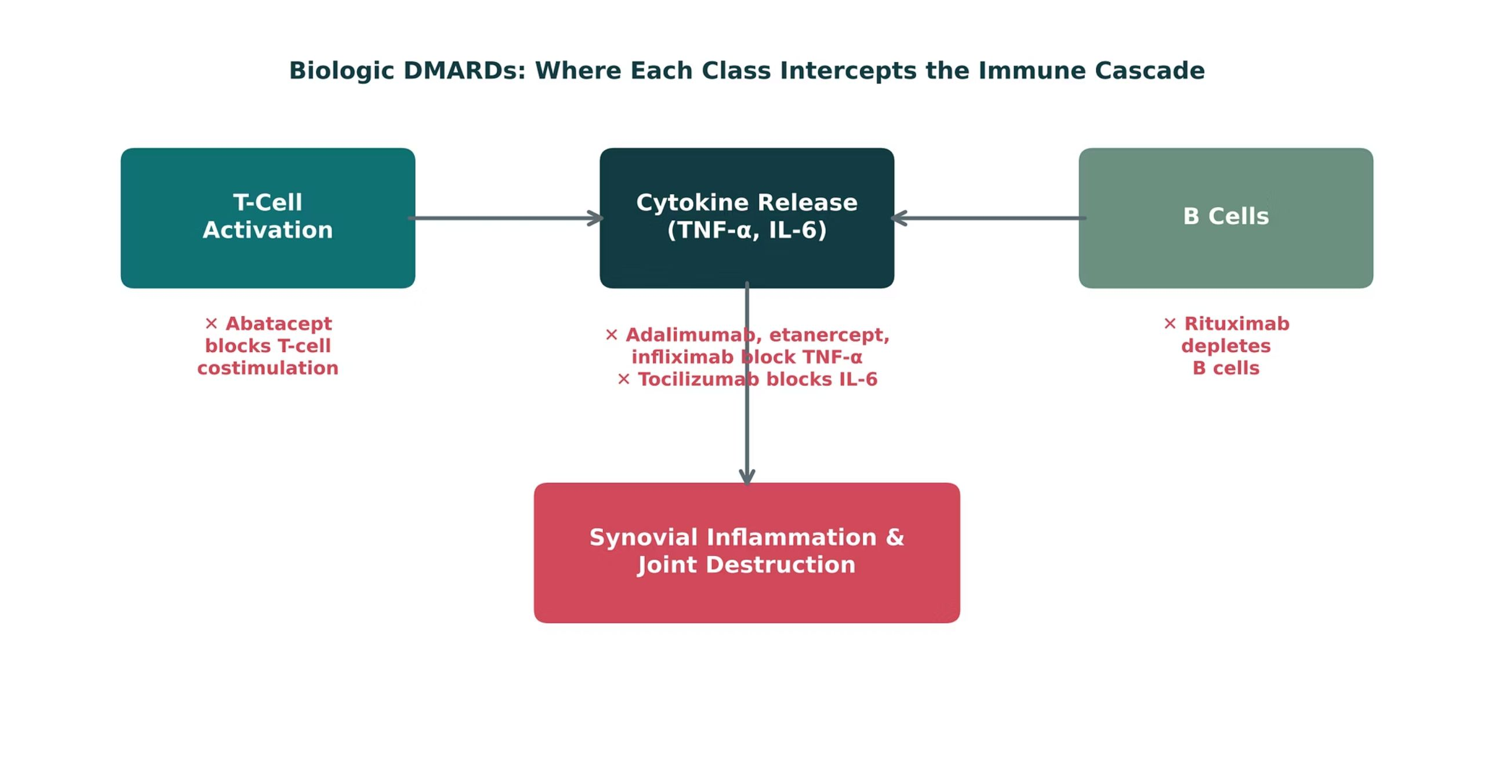
ORIGINAL ILLUSTRATION · FIGURE 3
Biologic DMARDs: Where Each Class Intercepts the Immune Cascade
Figure 3. Original illustrative diagram (not from Katzung): abatacept blocks T-cell costimulation, TNF inhibitors (adalimumab, etanercept, infliximab) and tocilizumab block cytokine signaling, and rituximab depletes B cells.
Musculoskeletal Pharmacology — Session 1 of 2 — PA Program
53
Notes:
This is the visual counterpart to the fourCard slide just shown — have students match each generic drug name to its box on this diagram before you reveal the answer.
Figure 3: walk the cascade from T-cell activation to cytokines to synovial damage. Abatacept acts earliest.

Slide 54
QUICK CHECK · FIGURE 3
Quick Check
In Figure 3, which biologic DMARD acts earliest in the cascade shown, before cytokines like TNF-α and IL-6 are even released?
A
Adalimumab
B
Tocilizumab
C
Abatacept
D
Rituximab
Musculoskeletal Pharmacology — Session 1 of 2 — PA Program
54
Notes:
Quick check: give 30 seconds, take a show of hands, then reveal.
Instructor script:
Pause for the class to commit to an answer before you reveal it.

Slide 55
ANSWER · FIGURE 3
Answer
C
Abatacept.
Why: Abatacept blocks T-cell costimulation — the step furthest upstream in the diagram, occurring before activated T cells drive cytokine release (blocked downstream by adalimumab/tocilizumab) or B-cell activity (blocked by rituximab).
Musculoskeletal Pharmacology — Session 1 of 2 — PA Program
55
Notes:
Answer: abatacept acts earliest.
Instructor script:
Reveal the answer after the class has committed to one.

Slide 56
SHARED RISK
DMARD Safety: Immunosuppression
The major safety theme across all DMARDs: immunosuppression → increased infection risk.
Baseline screening — e.g., tuberculosis and hepatitis B/C screening before starting biologics
Vaccination — update vaccines, especially live vaccines, before starting therapy
Ongoing monitoring — regular labs to catch cytopenias, hepatotoxicity, or infection early
Infection precautions — counsel patients to report fevers or infection symptoms promptly
Musculoskeletal Pharmacology — Session 1 of 2 — PA Program
56
Notes:
Say: "The theme is immunosuppression, so infection risk."
Instructor script:
Screen for TB and hepatitis B.

Slide 57
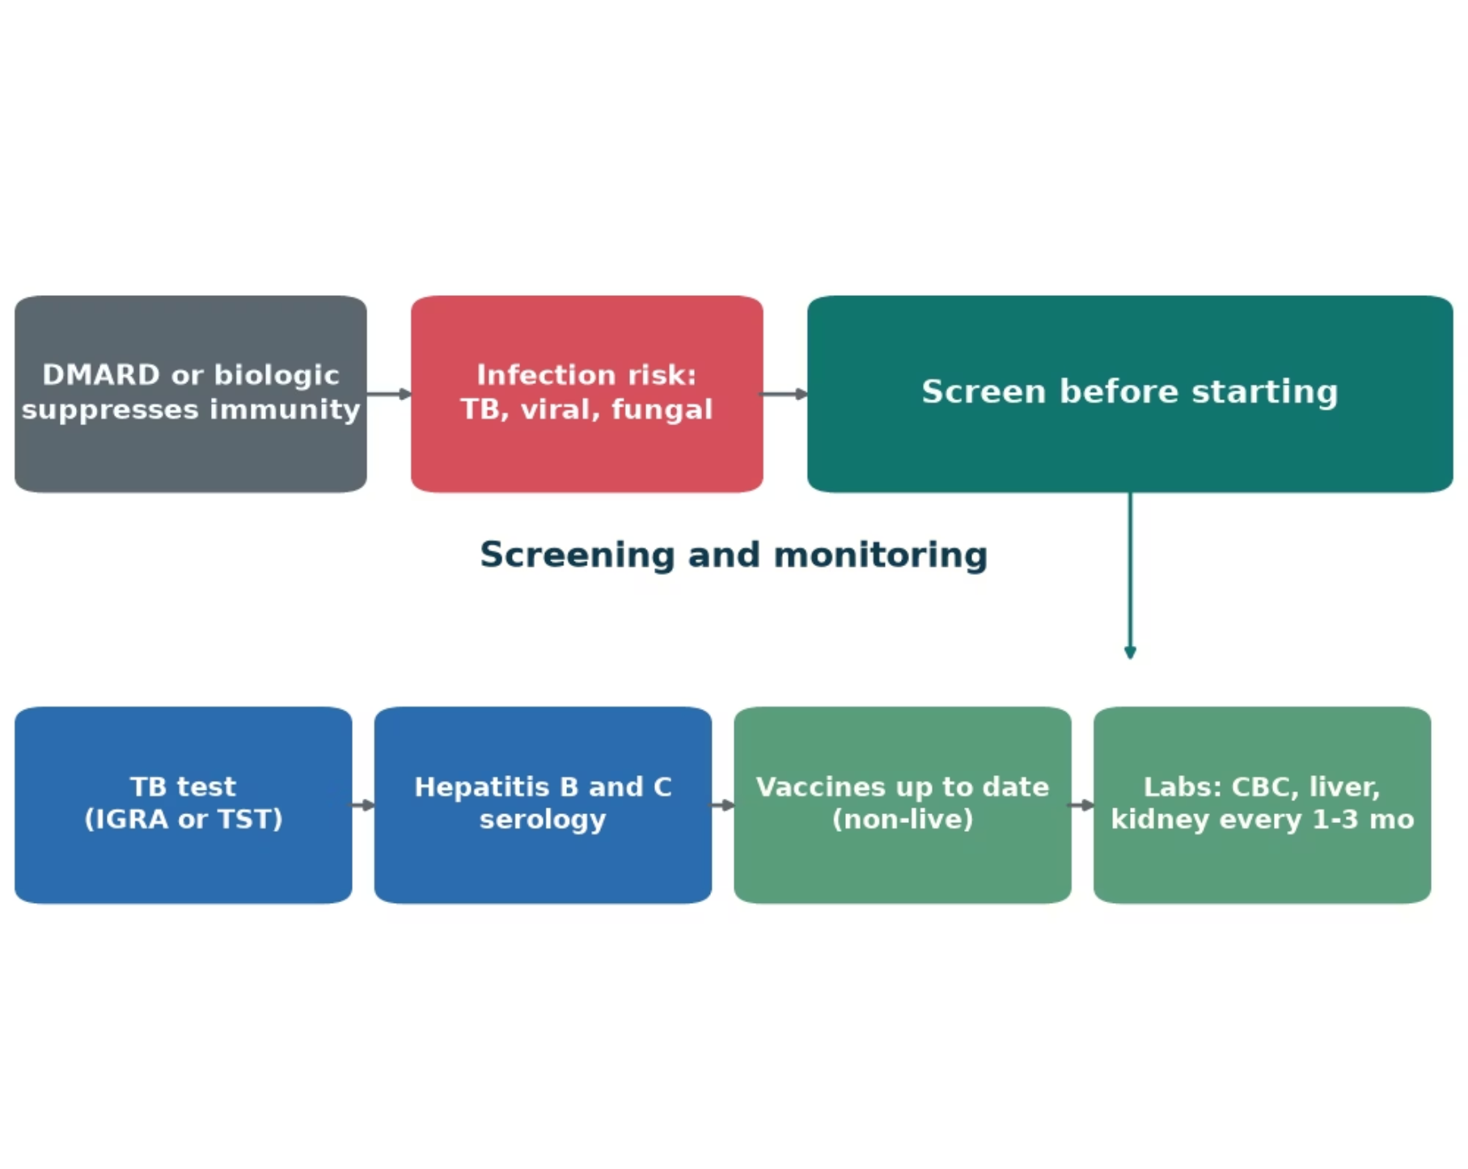
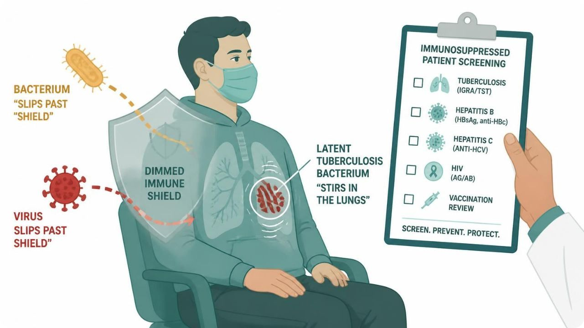
MECHANISM & DEPTH
Immune Suppression Raises Infection Risk
Schematic (illustrative)
Figure 18. Immunosuppression lowers defences against latent TB and opportunistic infection.
Risk: suppressed immunity lets latent TB and opportunistic infections emerge.
Screen first: TB test and hepatitis B and C serology before starting.
Vaccines: update non-live vaccines before treatment.
Musculoskeletal Pharmacology — Session 1 of 2 — PA Program
57
Notes:
Screen for TB and hepatitis B and C before starting; update non-live vaccines; monitor blood counts and organ function regularly, and act early on fever or infection signs.
Say: "The theme is immunosuppression, so infection risk."
Know: Screen for TB and hepatitis B/C before biologics. Update vaccines first, especially live vaccines. Monitor CBC and liver and kidney tests. Counsel patients to report fevers early.
Instructor script:
Fever is infection until proven otherwise.

Slide 58
QUICK CHECK · OSTEOARTHRITIS & RHEUMATOID ARTHRITIS
Quick Check
Which feature distinguishes a DMARD from an NSAID in the management of rheumatoid arthritis?
A
DMARDs provide faster pain relief than NSAIDs
B
NSAIDs suppress the immune system more potently than DMARDs
C
DMARDs are only available as biologic agents
D
DMARDs modify the underlying disease process rather than only masking symptoms
Musculoskeletal Pharmacology — Session 1 of 2 — PA Program
58
Notes:
Quick check: give 30 seconds, take a show of hands, then reveal.
Instructor script:
Pause for the class to commit to an answer before you reveal it.

Slide 59
ANSWER · OSTEOARTHRITIS & RHEUMATOID ARTHRITIS
Answer
D
DMARDs modify the underlying disease process rather than only masking symptoms.
Why: An NSAID can make a patient feel better without changing RA’s disease trajectory; a DMARD (conventional or biologic) is intended to slow or halt joint destruction and systemic inflammation itself.
Musculoskeletal Pharmacology — Session 1 of 2 — PA Program
59
Notes:
Answer: a DMARD modifies the disease process, while an NSAID only masks symptoms.
Instructor script:
Reveal the answer after the class has committed to one.

Slide 60
MECHANISM & DEPTH
Drug Names Reveal the Class: Read the Stem
Stem | Meaning | Example
-mab | Monoclonal antibody | Rituximab (anti-CD20)
-zumab | Humanized antibody | Tocilizumab (IL-6R)
-ximab | Chimeric antibody | Infliximab (TNF-α)
-umab | Fully human antibody | Adalimumab (TNF-α)
-cept | Receptor fusion protein | Etanercept, abatacept
-nib / -tinib | Kinase inhibitor | Tofacitinib (JAK)
-coxib | Selective COX-2 inhibitor | Celecoxib
-profen | Propionic-acid NSAID | Ibuprofen, naproxen
-fenac | Acetic-acid NSAID | Diclofenac
-oxicam | Oxicam NSAID | Meloxicam
Musculoskeletal Pharmacology — Session 1 of 2 — PA Program
60
Notes:
Teach students to read the stem first: it reveals mechanism class before the drug is recalled.
Say: "Read the stem and you know the class." -mab is a monoclonal antibody. -zumab is humanized, -ximab chimeric, -umab fully human. -cept is a receptor fusion protein. -nib/-tinib is a kinase inhibitor (for example tofacitinib, JAK). -coxib is COX-2 selective. -profen, -fenac and -oxicam are NSAID subclasses.
Instructor script:
Cue the suffixes: -coxib, -profen, -mab, -cept, -trexate.

Slide 61
BIG PICTURE
Session 1 Recap — To Be Continued
1
Musculoskeletal pain is driven by inflammatory mediators (prostaglandins, bradykinin, histamine, cytokines) — NSAIDs and corticosteroids intervene at different points along this cascade.
2
Acetaminophen treats pain and fever but is not a reliable anti-inflammatory agent; its overdose toxicity is mediated by NAPQI accumulation.
3
NSAIDs are effective but carry real GI, renal, and cardiovascular risk; celecoxib trades GI risk for cardiovascular risk.
4
DMARDs (conventional and biologic — methotrexate, adalimumab, etanercept, infliximab, tocilizumab, rituximab, abatacept) modify RA’s disease course rather than only masking symptoms.
5
Session 2 (Thursday, October 29) continues with gout, skeletal muscle relaxants, bone pharmacology, and the cumulative Lecture Recall Quiz.
Musculoskeletal Pharmacology — Session 1 of 2 — PA Program
Notes:
Close Session 1 by previewing Session 2 explicitly — students should leave knowing pain, acetaminophen, NSAIDs, and DMARDs are complete, and that gout, muscle relaxants, and bone pharmacology pick up first next time.
Recap: walk the five points.
Say: "Next time, Thursday October 29: gout, muscle relaxants, bone pharmacology, and the cumulative recall quiz."
Five points to repeat if time runs short:
1. Prostaglandins drive inflammatory pain, and COX makes them.
2. Acetaminophen is central, with no real anti-inflammatory effect. Overdose means NAPQI, and the antidote is NAC.
3. COX-1 protects the stomach, platelets and kidney. Nonselective NSAIDs block both isoforms.
4. Celecoxib cuts GI risk but raises cardiovascular risk, and does not spare the kidney.
5. DMARDs change disease. Methotrexate is weekly, and screen for TB and hepatitis before biologics.

Slide 62
STUDY REFERENCE
Drug Profiles
Study reference for the drugs covered in Session 1
Notes:
Abbreviation key for the drug profile slides: PO = by mouth; IV = intravenous; IM = intramuscular; SC = subcutaneous; BID = twice daily; TID = three times daily; ER = extended release; DR = delayed release; NSAID = nonsteroidal anti-inflammatory drug; COX = cyclooxygenase; GI = gastrointestinal; DMARD = disease-modifying antirheumatic drug; TNF = tumor necrosis factor; IL-6 = interleukin-6; DHFR = dihydrofolate reductase; DHODH = dihydroorotate dehydrogenase; CBC = complete blood count; TB = tuberculosis; CABG = coronary artery bypass graft; NAPQI = N-acetyl-p-benzoquinone imine; NAC = N-acetylcysteine; OTC = over the counter; CYP = cytochrome P450; eGFR/CrCl = renal function; JIA = juvenile idiopathic arthritis; PML = progressive multifocal leukoencephalopathy.
Instructor script:
Section transition. Move from the main lecture to the drug profiles as a study reference.
Use these as a study reference. Know the dose logic, the serious adverse effect, the contraindication that changes decisions and the toxicity you would need to recognize.
Class activity (10 minutes): Groups teach back two or three profiles in 60 seconds each.
Abbreviation key: Review DMARD, TNF, DHFR, NAPQI and NAC.
Teaching points: acetaminophen, NSAIDs, methotrexate, other conventional DMARDs, TNF inhibitors, other biologics.
Supporting drugs: PPIs, warfarin, ACE inhibitors, lithium, steroids and live vaccines explain interactions.
Bloom's prompts: Remember: state methotrexate dosing frequency. Understand: explain why NSAIDs cause ulcers. Apply: counsel a patient starting adalimumab. Analyze: explain methotrexate and TMP-SMX toxicity. Evaluate: choose analgesia for CKD with heart failure.

Slide 63
DRUG PROFILE
Acetaminophen (Tylenol)
ANALGESIC / ANTIPYRETIC
FORMULATION
DOSE (ADULT)
INDICATIONS
Tablets 325/500 mg; ER 650 mg; liquid; suppository; IV 1,000 mg
650-1,000 mg PO every 6 hours (maximum 3-4 g/day; 2-3 g/day with chronic alcohol use or liver disease)
Mild to moderate pain, fever, osteoarthritis pain
ADVERSE EFFECTS
CONTRAINDICATIONS
TOXICITY / OVERDOSE
Rare at therapeutic doses; rash; hepatotoxicity with excess
Severe hepatic impairment; caution with chronic alcohol use
Hepatotoxicity from NAPQI after overdose; treat with N-acetylcysteine, ideally within 8 hours; use the Rumack-Matthew nomogram
Standard adult dosing for teaching; verify against current prescribing information.
Musculoskeletal Pharmacology — Session 1 of 2 — PA Program
63
Notes:
Acetaminophen (Tylenol)|Analgesic / antipyretic|Tablets 325/500 mg; ER 650 mg; liquid; suppository; IV 1,000 mg|650-1,000 mg PO every 6 hours (maximum 3-4 g/day; 2-3 g/day with chronic alcohol use or liver disease)|Mild to moderate pain, fever, osteoarthritis pain|Rare at therapeutic doses; rash; hepatotoxicity with excess|Severe hepatic impairment; caution with chronic alcohol use|Hepatotoxicity from NAPQI after overdose; treat with N-acetylcysteine, ideally within 8 hours; use the Rumack-Matthew nomogram

Slide 64
DRUG PROFILE
Ibuprofen (Advil, Motrin)
NONSELECTIVE NSAID
FORMULATION
DOSE (ADULT)
INDICATIONS
Tablets 200/400/600/800 mg; suspension; IV
200-800 mg PO every 6-8 hours with food (maximum 3,200 mg/day Rx; 1,200 mg OTC)
Pain, inflammation, fever, osteoarthritis, rheumatoid arthritis, dysmenorrhea
ADVERSE EFFECTS
CONTRAINDICATIONS
TOXICITY / OVERDOSE
GI upset, ulcer and bleeding, renal injury, hypertension, fluid retention, platelet inhibition
Active GI bleed, NSAID-triggered asthma, CABG setting, advanced renal disease, third trimester pregnancy, heart failure (caution)
GI bleeding, acute kidney injury, metabolic acidosis, seizures in large overdose; supportive care
Standard adult dosing for teaching; verify against current prescribing information.
Musculoskeletal Pharmacology — Session 1 of 2 — PA Program
64
Notes:
Ibuprofen (Advil, Motrin)|Nonselective NSAID|Tablets 200/400/600/800 mg; suspension; IV|200-800 mg PO every 6-8 hours with food (maximum 3,200 mg/day Rx; 1,200 mg OTC)|Pain, inflammation, fever, osteoarthritis, rheumatoid arthritis, dysmenorrhea|GI upset, ulcer and bleeding, renal injury, hypertension, fluid retention, platelet inhibition|Active GI bleed, NSAID-triggered asthma, CABG setting, advanced renal disease, third trimester pregnancy, heart failure (caution)|GI bleeding, acute kidney injury, metabolic acidosis, seizures in large overdose; supportive care

Slide 65
DRUG PROFILE
Naproxen (Naprosyn, Aleve)
NONSELECTIVE NSAID
FORMULATION
DOSE (ADULT)
INDICATIONS
Tablets 220/250/375/500 mg; DR and ER forms; suspension
250-500 mg PO twice daily with food (maximum 1,250 mg/day)
Osteoarthritis, rheumatoid arthritis, gout flare, tendinitis, dysmenorrhea
ADVERSE EFFECTS
CONTRAINDICATIONS
TOXICITY / OVERDOSE
GI upset and bleeding, renal injury, hypertension, fluid retention, cardiovascular risk
Active GI bleed, NSAID-triggered asthma, CABG setting, severe renal impairment, third trimester
GI bleeding, renal injury, lethargy and seizures in overdose; activated charcoal and supportive care
Standard adult dosing for teaching; verify against current prescribing information.
Musculoskeletal Pharmacology — Session 1 of 2 — PA Program
65
Notes:
Naproxen (Naprosyn, Aleve)|Nonselective NSAID|Tablets 220/250/375/500 mg; DR and ER forms; suspension|250-500 mg PO twice daily with food (maximum 1,250 mg/day)|Osteoarthritis, rheumatoid arthritis, gout flare, tendinitis, dysmenorrhea|GI upset and bleeding, renal injury, hypertension, fluid retention, cardiovascular risk|Active GI bleed, NSAID-triggered asthma, CABG setting, severe renal impairment, third trimester|GI bleeding, renal injury, lethargy and seizures in overdose; activated charcoal and supportive care

Slide 66
DRUG PROFILE
Diclofenac (Voltaren, Cataflam)
NONSELECTIVE NSAID (COX-2 PREFERRING)
FORMULATION
DOSE (ADULT)
INDICATIONS
Tablets 50 mg; DR 75 mg; ER 100 mg; 1% gel; ophthalmic; patch
50 mg PO two to three times daily or 75 mg twice daily (maximum 150 mg/day); gel 2-4 g to joint up to four times daily
Osteoarthritis, rheumatoid arthritis, acute pain, topical for knee and hand osteoarthritis
ADVERSE EFFECTS
CONTRAINDICATIONS
TOXICITY / OVERDOSE
GI upset and bleeding, elevated liver enzymes, hypertension, renal injury, cardiovascular risk
Active GI bleed, CABG setting, severe renal or hepatic impairment, NSAID-triggered asthma
Hepatotoxicity, GI bleeding, renal injury; topical form has much lower systemic exposure
Standard adult dosing for teaching; verify against current prescribing information.
Musculoskeletal Pharmacology — Session 1 of 2 — PA Program
66
Notes:
Diclofenac (Voltaren, Cataflam)|Nonselective NSAID (COX-2 preferring)|Tablets 50 mg; DR 75 mg; ER 100 mg; 1% gel; ophthalmic; patch|50 mg PO two to three times daily or 75 mg twice daily (maximum 150 mg/day); gel 2-4 g to joint up to four times daily|Osteoarthritis, rheumatoid arthritis, acute pain, topical for knee and hand osteoarthritis|GI upset and bleeding, elevated liver enzymes, hypertension, renal injury, cardiovascular risk|Active GI bleed, CABG setting, severe renal or hepatic impairment, NSAID-triggered asthma|Hepatotoxicity, GI bleeding, renal injury; topical form has much lower systemic exposure

Slide 67
DRUG PROFILE
Ketorolac (Toradol)
NONSELECTIVE NSAID (SHORT-TERM, POTENT)
FORMULATION
DOSE (ADULT)
INDICATIONS
Tablets 10 mg; injection 15/30 mg; nasal spray
15-30 mg IV/IM every 6 hours (maximum 120 mg/day) or 10 mg PO every 4-6 hours; total course 5 days or less
Short-term management of moderately severe acute pain
ADVERSE EFFECTS
CONTRAINDICATIONS
TOXICITY / OVERDOSE
GI bleeding, renal injury, bleeding, hypertension
Active GI bleed, renal impairment, high bleeding risk, perioperative CABG, labor and delivery, pregnancy, age 65+ (reduce dose)
Boxed warnings for GI bleeding, renal failure, bleeding and cardiovascular events; limit to 5 days
Standard adult dosing for teaching; verify against current prescribing information.
Musculoskeletal Pharmacology — Session 1 of 2 — PA Program
67
Notes:
Ketorolac (Toradol)|Nonselective NSAID (short-term, potent)|Tablets 10 mg; injection 15/30 mg; nasal spray|15-30 mg IV/IM every 6 hours (maximum 120 mg/day) or 10 mg PO every 4-6 hours; total course 5 days or less|Short-term management of moderately severe acute pain|GI bleeding, renal injury, bleeding, hypertension|Active GI bleed, renal impairment, high bleeding risk, perioperative CABG, labor and delivery, pregnancy, age 65+ (reduce dose)|Boxed warnings for GI bleeding, renal failure, bleeding and cardiovascular events; limit to 5 days

Slide 68
DRUG PROFILE
Celecoxib (Celebrex)
SELECTIVE COX-2 INHIBITOR
FORMULATION
DOSE (ADULT)
INDICATIONS
Capsules 50/100/200/400 mg
200 mg PO once daily or 100 mg twice daily (rheumatoid arthritis 100-200 mg twice daily)
Osteoarthritis, rheumatoid arthritis, acute pain, ankylosing spondylitis
ADVERSE EFFECTS
CONTRAINDICATIONS
TOXICITY / OVERDOSE
Dyspepsia, hypertension, edema, renal injury, cardiovascular thrombotic risk
Sulfonamide allergy, CABG setting, active GI bleed, advanced renal disease, aspirin-triggered asthma (caution)
Boxed warning for cardiovascular and GI risk; renal injury in overdose; supportive care
Standard adult dosing for teaching; verify against current prescribing information.
Musculoskeletal Pharmacology — Session 1 of 2 — PA Program
68
Notes:
Celecoxib (Celebrex)|Selective COX-2 inhibitor|Capsules 50/100/200/400 mg|200 mg PO once daily or 100 mg twice daily (rheumatoid arthritis 100-200 mg twice daily)|Osteoarthritis, rheumatoid arthritis, acute pain, ankylosing spondylitis|Dyspepsia, hypertension, edema, renal injury, cardiovascular thrombotic risk|Sulfonamide allergy, CABG setting, active GI bleed, advanced renal disease, aspirin-triggered asthma (caution)|Boxed warning for cardiovascular and GI risk; renal injury in overdose; supportive care

Slide 69
DRUG PROFILE
Methotrexate (Trexall, Otrexup)
CONVENTIONAL DMARD (ANTIMETABOLITE, DHFR INHIBITOR)
FORMULATION
DOSE (ADULT)
INDICATIONS
Tablets 2.5 mg; subcutaneous autoinjector; injection
7.5-25 mg ONCE WEEKLY PO or SC, with folic acid 1 mg daily
Rheumatoid arthritis (anchor DMARD), psoriatic arthritis, psoriasis
ADVERSE EFFECTS
CONTRAINDICATIONS
TOXICITY / OVERDOSE
Nausea, mucositis, hepatotoxicity, myelosuppression, pneumonitis, teratogenicity
Pregnancy, significant liver disease, severe renal impairment, active infection, heavy alcohol use
Daily dosing by mistake causes severe toxicity; leucovorin rescue; monitor CBC, liver tests and creatinine
Standard adult dosing for teaching; verify against current prescribing information.
Musculoskeletal Pharmacology — Session 1 of 2 — PA Program
69
Notes:
Methotrexate (Trexall, Otrexup)|Conventional DMARD (antimetabolite, DHFR inhibitor)|Tablets 2.5 mg; subcutaneous autoinjector; injection|7.5-25 mg ONCE WEEKLY PO or SC, with folic acid 1 mg daily|Rheumatoid arthritis (anchor DMARD), psoriatic arthritis, psoriasis|Nausea, mucositis, hepatotoxicity, myelosuppression, pneumonitis, teratogenicity|Pregnancy, significant liver disease, severe renal impairment, active infection, heavy alcohol use|Daily dosing by mistake causes severe toxicity; leucovorin rescue; monitor CBC, liver tests and creatinine

Slide 70
DRUG PROFILE
Hydroxychloroquine (Plaquenil)
CONVENTIONAL DMARD (ANTIMALARIAL)
FORMULATION
DOSE (ADULT)
INDICATIONS
Tablets 200 mg
200-400 mg PO daily (maximum 5 mg/kg/day actual body weight)
Rheumatoid arthritis (mild), lupus, malaria
ADVERSE EFFECTS
CONTRAINDICATIONS
TOXICITY / OVERDOSE
Nausea, rash, headache, retinopathy with long use, QT prolongation
Known retinal disease, hypersensitivity; caution with QT-prolonging drugs
Retinal toxicity with long-term use (baseline and annual eye exams); cardiotoxicity and arrhythmia in overdose
Standard adult dosing for teaching; verify against current prescribing information.
Musculoskeletal Pharmacology — Session 1 of 2 — PA Program
70
Notes:
Hydroxychloroquine (Plaquenil)|Conventional DMARD (antimalarial)|Tablets 200 mg|200-400 mg PO daily (maximum 5 mg/kg/day actual body weight)|Rheumatoid arthritis (mild), lupus, malaria|Nausea, rash, headache, retinopathy with long use, QT prolongation|Known retinal disease, hypersensitivity; caution with QT-prolonging drugs|Retinal toxicity with long-term use (baseline and annual eye exams); cardiotoxicity and arrhythmia in overdose

Slide 71
DRUG PROFILE
Sulfasalazine (Azulfidine)
CONVENTIONAL DMARD
FORMULATION
DOSE (ADULT)
INDICATIONS
Tablets 500 mg; DR 500 mg
500 mg PO daily, titrate to 1,000 mg twice daily
Rheumatoid arthritis, ulcerative colitis
ADVERSE EFFECTS
CONTRAINDICATIONS
TOXICITY / OVERDOSE
Nausea, rash, headache, myelosuppression, hepatotoxicity, orange urine, reversible oligospermia
Sulfa or salicylate allergy, intestinal or urinary obstruction, porphyria; G6PD deficiency (caution)
Agranulocytosis and hemolysis; monitor CBC and liver tests
Standard adult dosing for teaching; verify against current prescribing information.
Musculoskeletal Pharmacology — Session 1 of 2 — PA Program
71
Notes:
Sulfasalazine (Azulfidine)|Conventional DMARD|Tablets 500 mg; DR 500 mg|500 mg PO daily, titrate to 1,000 mg twice daily|Rheumatoid arthritis, ulcerative colitis|Nausea, rash, headache, myelosuppression, hepatotoxicity, orange urine, reversible oligospermia|Sulfa or salicylate allergy, intestinal or urinary obstruction, porphyria; G6PD deficiency (caution)|Agranulocytosis and hemolysis; monitor CBC and liver tests

Slide 72
DRUG PROFILE
Leflunomide (Arava)
CONVENTIONAL DMARD (DHODH INHIBITOR)
FORMULATION
DOSE (ADULT)
INDICATIONS
Tablets 10/20 mg
20 mg PO daily (loading 100 mg daily for 3 days optional)
Rheumatoid arthritis
ADVERSE EFFECTS
CONTRAINDICATIONS
TOXICITY / OVERDOSE
Diarrhea, hepatotoxicity, hypertension, alopecia, neuropathy, teratogenicity
Pregnancy, severe liver disease, concurrent hepatotoxic drugs
Boxed warning for hepatotoxicity and embryo-fetal toxicity; cholestyramine washout
Standard adult dosing for teaching; verify against current prescribing information.
Musculoskeletal Pharmacology — Session 1 of 2 — PA Program
72
Notes:
Leflunomide (Arava)|Conventional DMARD (DHODH inhibitor)|Tablets 10/20 mg|20 mg PO daily (loading 100 mg daily for 3 days optional)|Rheumatoid arthritis|Diarrhea, hepatotoxicity, hypertension, alopecia, neuropathy, teratogenicity|Pregnancy, severe liver disease, concurrent hepatotoxic drugs|Boxed warning for hepatotoxicity and embryo-fetal toxicity; cholestyramine washout

Slide 73
DRUG PROFILE
Adalimumab (Humira)
BIOLOGIC DMARD (TNF INHIBITOR)
FORMULATION
DOSE (ADULT)
INDICATIONS
Prefilled syringe or pen 40 mg/0.8 mL
40 mg SC every other week (weekly for some patients)
Rheumatoid arthritis, psoriatic arthritis, ankylosing spondylitis, Crohn disease
ADVERSE EFFECTS
CONTRAINDICATIONS
TOXICITY / OVERDOSE
Injection-site reaction, infection, headache, rash, demyelination (rare), lymphoma (rare)
Active serious infection, untreated latent TB, demyelinating disease, NYHA III-IV heart failure
Boxed warning for serious infections and malignancy; screen for TB and hepatitis B before starting
Standard adult dosing for teaching; verify against current prescribing information.
Musculoskeletal Pharmacology — Session 1 of 2 — PA Program
73
Notes:
Adalimumab (Humira)|Biologic DMARD (TNF inhibitor)|Prefilled syringe or pen 40 mg/0.8 mL|40 mg SC every other week (weekly for some patients)|Rheumatoid arthritis, psoriatic arthritis, ankylosing spondylitis, Crohn disease|Injection-site reaction, infection, headache, rash, demyelination (rare), lymphoma (rare)|Active serious infection, untreated latent TB, demyelinating disease, NYHA III-IV heart failure|Boxed warning for serious infections and malignancy; screen for TB and hepatitis B before starting

Slide 74
DRUG PROFILE
Etanercept (Enbrel)
BIOLOGIC DMARD (SOLUBLE TNF RECEPTOR)
FORMULATION
DOSE (ADULT)
INDICATIONS
Prefilled syringe or pen 25/50 mg; vial
50 mg SC once weekly (or 25 mg twice weekly)
Rheumatoid arthritis, psoriatic arthritis, ankylosing spondylitis, plaque psoriasis
ADVERSE EFFECTS
CONTRAINDICATIONS
TOXICITY / OVERDOSE
Injection-site reaction, infection, headache, demyelination (rare)
Active serious infection, sepsis, untreated latent TB
Boxed warning for serious infections and malignancy; screen for TB and hepatitis B
Standard adult dosing for teaching; verify against current prescribing information.
Musculoskeletal Pharmacology — Session 1 of 2 — PA Program
74
Notes:
Etanercept (Enbrel)|Biologic DMARD (soluble TNF receptor)|Prefilled syringe or pen 25/50 mg; vial|50 mg SC once weekly (or 25 mg twice weekly)|Rheumatoid arthritis, psoriatic arthritis, ankylosing spondylitis, plaque psoriasis|Injection-site reaction, infection, headache, demyelination (rare)|Active serious infection, sepsis, untreated latent TB|Boxed warning for serious infections and malignancy; screen for TB and hepatitis B

Slide 75
DRUG PROFILE
Infliximab (Remicade)
BIOLOGIC DMARD (CHIMERIC TNF ANTIBODY)
FORMULATION
DOSE (ADULT)
INDICATIONS
IV vial 100 mg; biosimilars
3 mg/kg IV at weeks 0, 2 and 6, then every 8 weeks, with methotrexate
Rheumatoid arthritis, Crohn disease, ulcerative colitis, ankylosing spondylitis
ADVERSE EFFECTS
CONTRAINDICATIONS
TOXICITY / OVERDOSE
Infusion reaction, infection, headache, anti-drug antibodies, hepatotoxicity
Active serious infection, untreated latent TB, NYHA III-IV heart failure at high dose
Boxed warning for serious infections and malignancy; infusion reactions treated by slowing or stopping
Standard adult dosing for teaching; verify against current prescribing information.
Musculoskeletal Pharmacology — Session 1 of 2 — PA Program
75
Notes:
Infliximab (Remicade)|Biologic DMARD (chimeric TNF antibody)|IV vial 100 mg; biosimilars|3 mg/kg IV at weeks 0, 2 and 6, then every 8 weeks, with methotrexate|Rheumatoid arthritis, Crohn disease, ulcerative colitis, ankylosing spondylitis|Infusion reaction, infection, headache, anti-drug antibodies, hepatotoxicity|Active serious infection, untreated latent TB, NYHA III-IV heart failure at high dose|Boxed warning for serious infections and malignancy; infusion reactions treated by slowing or stopping

Slide 76
DRUG PROFILE
Tocilizumab (Actemra)
BIOLOGIC DMARD (IL-6 RECEPTOR ANTAGONIST)
FORMULATION
DOSE (ADULT)
INDICATIONS
IV 20 mg/mL; SC prefilled syringe or pen 162 mg
IV 4-8 mg/kg every 4 weeks; SC 162 mg every other week to weekly
Rheumatoid arthritis, giant cell arteritis, systemic JIA
ADVERSE EFFECTS
CONTRAINDICATIONS
TOXICITY / OVERDOSE
Infection, elevated liver enzymes, neutropenia, hyperlipidemia, GI perforation (rare)
Active serious infection, untreated latent TB; caution with diverticulitis
Boxed warning for serious infections; monitor CBC, liver enzymes and lipids
Standard adult dosing for teaching; verify against current prescribing information.
Musculoskeletal Pharmacology — Session 1 of 2 — PA Program
76
Notes:
Tocilizumab (Actemra)|Biologic DMARD (IL-6 receptor antagonist)|IV 20 mg/mL; SC prefilled syringe or pen 162 mg|IV 4-8 mg/kg every 4 weeks; SC 162 mg every other week to weekly|Rheumatoid arthritis, giant cell arteritis, systemic JIA|Infection, elevated liver enzymes, neutropenia, hyperlipidemia, GI perforation (rare)|Active serious infection, untreated latent TB; caution with diverticulitis|Boxed warning for serious infections; monitor CBC, liver enzymes and lipids

Slide 77
DRUG PROFILE
Abatacept (Orencia)
BIOLOGIC DMARD (T-CELL COSTIMULATION MODULATOR)
FORMULATION
DOSE (ADULT)
INDICATIONS
IV 250 mg vial; SC prefilled syringe 125 mg
IV by weight (500-1,000 mg) at weeks 0, 2, 4 then every 4 weeks; SC 125 mg weekly
Rheumatoid arthritis, psoriatic arthritis, polyarticular JIA
ADVERSE EFFECTS
CONTRAINDICATIONS
TOXICITY / OVERDOSE
Headache, infection, nasopharyngitis, infusion reaction
Active serious infection; caution in COPD
Infection risk; do not combine with TNF inhibitors; screen for TB and hepatitis B
Standard adult dosing for teaching; verify against current prescribing information.
Musculoskeletal Pharmacology — Session 1 of 2 — PA Program
77
Notes:
Abatacept (Orencia)|Biologic DMARD (T-cell costimulation modulator)|IV 250 mg vial; SC prefilled syringe 125 mg|IV by weight (500-1,000 mg) at weeks 0, 2, 4 then every 4 weeks; SC 125 mg weekly|Rheumatoid arthritis, psoriatic arthritis, polyarticular JIA|Headache, infection, nasopharyngitis, infusion reaction|Active serious infection; caution in COPD|Infection risk; do not combine with TNF inhibitors; screen for TB and hepatitis B

Slide 78
DRUG PROFILE
Rituximab (Rituxan)
BIOLOGIC DMARD (ANTI-CD20 ANTIBODY)
FORMULATION
DOSE (ADULT)
INDICATIONS
IV 100/500 mg vials
1,000 mg IV on days 1 and 15, repeated no sooner than every 16-24 weeks, with methotrexate
Rheumatoid arthritis (after TNF inhibitor failure), lymphoma, vasculitis
ADVERSE EFFECTS
CONTRAINDICATIONS
TOXICITY / OVERDOSE
Infusion reaction, infection, hypogammaglobulinemia, hepatitis B reactivation
Active serious infection, severe heart failure; screen hepatitis B first
Boxed warnings for infusion reactions, hepatitis B reactivation and PML; premedicate with acetaminophen, antihistamine and steroid
Standard adult dosing for teaching; verify against current prescribing information.
Musculoskeletal Pharmacology — Session 1 of 2 — PA Program
78
Notes:
Rituximab (Rituxan)|Biologic DMARD (anti-CD20 antibody)|IV 100/500 mg vials|1,000 mg IV on days 1 and 15, repeated no sooner than every 16-24 weeks, with methotrexate|Rheumatoid arthritis (after TNF inhibitor failure), lymphoma, vasculitis|Infusion reaction, infection, hypogammaglobulinemia, hepatitis B reactivation|Active serious infection, severe heart failure; screen hepatitis B first|Boxed warnings for infusion reactions, hepatitis B reactivation and PML; premedicate with acetaminophen, antihistamine and steroid

Slide 79
CONTEXT
Supporting Drugs at a Glance
PPIs and misoprostol
Warfarin and anticoagulants
ACE inhibitors, ARBs and diuretics
GI protection with long-term NSAIDs
NSAIDs raise bleeding risk
NSAIDs add kidney injury ("triple whammy")
Lithium
Systemic corticosteroids
Folic acid and leucovorin
NSAIDs raise lithium levels
Flare bridge; bone loss and GI risk with NSAIDs
Lower methotrexate toxicity
Isoniazid and rifampin
Tramadol and opioids
Live vaccines
Latent TB treatment before biologics
Add-on analgesia for osteoarthritis
Avoid on biologic or immunosuppressive therapy
Listed for context; not profiled in detail.
Musculoskeletal Pharmacology — Session 1 of 2 — PA Program
79
Notes:
Supporting drugs: PPIs, warfarin, ACE inhibitors, lithium, steroids and live vaccines explain interactions.

Slide 80
APPENDIX
Image Attribution
● Original figures in this deck: Figures 1–3 (The Arachidonic Acid Pathway: Where Analgesics Act; Nonselective NSAIDs vs. COX-2 Selective Inhibition; Biologic DMARDs: Where Each Class Intercepts the Immune Cascade) were generated by the course director using the AI tool Claude to illustrate standard, non-copyrighted pharmacologic concepts. The mechanism diagrams added for acetaminophen (including the Rumack-Matthew nomogram schematic), methotrexate and celecoxib, and the NSAID, COX-1 vs. COX-2, conventional DMARD, biologic DMARD and drug-name nomenclature diagrams, are also original illustrative diagrams, created with AI assistance for this course. Companion diagrams for inflammatory mediators, NSAID adverse effects, osteoarthritis vs. rheumatoid arthritis, osteoarthritis pharmacotherapy, disease-modifying drug concepts and DMARD immunosuppression are original illustrative diagrams created with AI assistance for this course as well. They are original diagrams, not reproduced from Katzung’s Basic and Clinical Pharmacology or any other copyrighted source.
● Reference: Anthropic. (2026). Claude (Sonnet 5) [Large language model]. https://claude.ai
Musculoskeletal Pharmacology — Session 1 of 2 — PA Program
80
Notes:
This slide documents AI-tool use for original figure generation per university citation requirements. It covers every original diagram in this deck (Figures 1–3); none are reproduced from any textbook.
Instructor script:
Point to the attribution: Figures 1–3 are original diagrams made with AI tools, not reproduced from any textbook.

