Slide 1

PA PHARMACOLOGY COURSE · LECTURE 2 · SESSION 2 OF 2
Musculoskeletal Pharmacology
Session 2: Gout, Skeletal Muscle Relaxants, and Bone Pharmacology | Thursday, October 29
Diane S. Allen-Gipson, Ph.D., M.S., Course Director

Slide 2

BY THE END OF THIS LECTURE
Learning Objectives — Session 2
Recap: Session 1 covered musculoskeletal pain pathways, acetaminophen, NSAIDs, and osteoarthritis/rheumatoid arthritis pharmacotherapy including DMARDs.
Explain the pharmacologic treatment of acute and chronic gout, including representative generic agents.
Classify skeletal muscle relaxants by mechanism and clinical use, including representative generic agents.
Explain the pharmacologic management of osteoporosis, including representative generic agents.
Identify key contraindications, adverse effects, and drug interactions throughout.
Apply the full musculoskeletal pharmacology toolkit to integrated clinical scenarios.
Musculoskeletal Pharmacology — Session 2 of 2 — PA Program
2
Notes:
Briefly recap Session 1 (Oct 27) before diving in: musculoskeletal pain, acetaminophen, NSAIDs, and OA/RA pharmacotherapy including DMARDs. Today picks up with gout (Section 5) and runs through bone pharmacology, integration, and the cumulative recall quiz.
Instructor script:
Recap Session 1 in a minute. Today has three stories: crystals, muscle tone and bone balance.

Slide 3

SECTION
05
Gout
A crystal-driven inflammatory arthritis with two very different treatment phases.
Notes:
Section transition.
Gout is a crystal-driven arthritis with two very different treatment phases, so we start with how uric acid becomes crystals.

Slide 4

PATHOPHYSIOLOGY
How Gout Develops
Purine
Metabolism
Uric Acid
Monosodium
Urate Crystals
Joint
Inflammation
Musculoskeletal Pharmacology — Session 2 of 2 — PA Program
4
Notes:
Everything downstream — colchicine, allopurinol, febuxostat, probenecid — targets a specific point along this chain. The next slide builds this out with the specific drugs and their targets.
Instructor script:
Purine metabolism to uric acid to urate crystals to inflammation.

Slide 5
MECHANISM & DEPTH
Uric Acid Crystals Trigger the Inflammatory Response
Purine breakdown
Diet rich in purines and fructose raises urate production
Alcohol, especially beer, raises uric acid and reduces renal excretion
Diuretics, especially thiazides and loop agents, reduce renal urate clearance
Chronic kidney disease lowers urate excretion and sustains hyperuricemia
Hypoxanthine
Xanthine
Uric acid (via xanthine oxidase)
Hyperuricemia
Monosodium urate crystals in joint
Neutrophil/macrophage activation (NLRP3, IL-1β)
Acute flare
Musculoskeletal Pharmacology — Session 2 of 2 — PA Program
5
Notes:
Walk the chain left to right, then top to bottom: each step sets up the next, and the flare is the end of the cascade.
Instructor script:
Each drug targets one step.

Slide 6
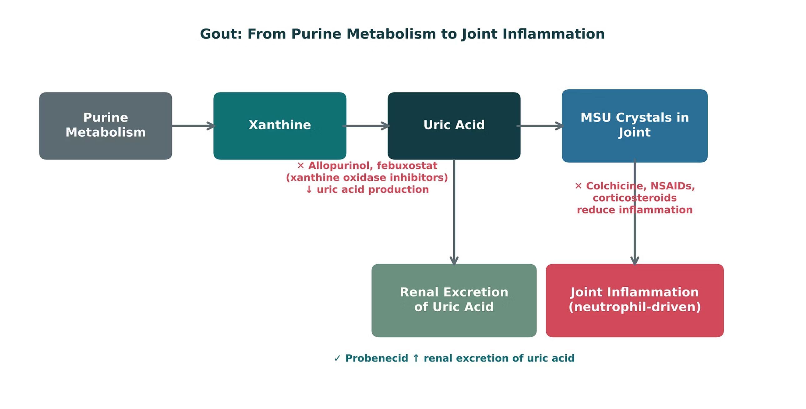
ORIGINAL ILLUSTRATION · FIGURE 4
Gout: From Purine Metabolism to Joint Inflammation
Figure 4. Original illustrative diagram (not from Katzung): allopurinol and febuxostat reduce uric acid production; probenecid increases renal excretion; colchicine, NSAIDs, and corticosteroids reduce joint inflammation.
Musculoskeletal Pharmacology — Session 2 of 2 — PA Program
6
Notes:
Walk the full chain and have students sort the drugs into two buckets: "lowers uric acid" (allopurinol, febuxostat, probenecid) vs. "treats the acute flare" (colchicine, NSAIDs, corticosteroids) — this is the same acute-vs-chronic distinction the next slide makes explicit.

Slide 7
QUICK CHECK · FIGURE 4
Quick Check
In Figure 4, probenecid and allopurinol both lower serum uric acid, but through different mechanisms. What is the key difference?
A
Probenecid increases renal excretion of uric acid; allopurinol decreases uric acid production
B
Both drugs block xanthine oxidase
C
Probenecid decreases uric acid production; allopurinol increases renal excretion
D
Neither drug affects serum uric acid levels
Musculoskeletal Pharmacology — Session 2 of 2 — PA Program
7
Notes:
Instructor script:
Prompt: have students decide which drug lowers uric acid production and which increases renal excretion before you reveal the answer.

Slide 8
ANSWER · FIGURE 4
Answer
A
Probenecid increases renal excretion of uric acid; allopurinol decreases uric acid production.
Why: Figure 4 shows allopurinol (and febuxostat) acting as xanthine oxidase inhibitors that reduce uric acid production, while probenecid acts at the kidney to increase renal excretion of uric acid that has already been produced — two different strategies for the same goal of lowering serum uric acid.
Musculoskeletal Pharmacology — Session 2 of 2 — PA Program
8
Notes:
Instructor script:
Probenecid raises excretion; allopurinol lowers production.

Slide 9
TWO DIFFERENT GOALS
Acute Gout vs. Chronic Urate-Lowering Therapy
Acute Flare
Chronic Management
– Goal: control pain and inflammation now
– Agents: colchicine, NSAIDs, corticosteroids
– Do NOT start urate-lowering therapy during an acute flare
– Goal: lower serum uric acid to prevent future flares
– Agents: allopurinol, febuxostat (↓ production); probenecid (↑ excretion)
– Started/adjusted only once the acute flare has resolved
Musculoskeletal Pharmacology — Session 2 of 2 — PA Program
9
Notes:
This acute-vs-chronic distinction is one of the single most testable concepts in gout pharmacology — starting or changing a urate-lowering drug during an acute flare can actually prolong it.
Instructor script:
Treat the flare first; do not start or change urate-lowering therapy during a flare.

Slide 10

ACUTE TREATMENT
Colchicine
Mechanism: disrupts microtubule formation in neutrophils.
Effect: reduces neutrophil migration and activation, lowering inflammation at the crystal site.
Most effective when started early in a flare.
Narrow therapeutic window — GI adverse effects are common and dose-limiting.
Musculoskeletal Pharmacology — Session 2 of 2 — PA Program
10
Notes:
Blocks microtubules in neutrophils; start early.

Slide 11
MECHANISM & DEPTH
Colchicine: Blocking Neutrophil Response
Best started within 24 hours of flare onset
GI diarrhea is the dose-limiting effect
Adjust the dose for renal or hepatic impairment
CYP3A4 and P-gp inhibitors (clarithromycin, cyclosporine, strong CYP3A4 inhibitors) raise toxicity
Colchicine binds tubulin
Blocks microtubule polymerization
Reduced neutrophil migration and NLRP3 activation
Less inflammation at the crystal site
Musculoskeletal Pharmacology — Session 2 of 2 — PA Program
11
Notes:
Colchicine works on the cell's cytoskeleton, so its effect builds in the early hours of a flare.
Instructor script:
Narrow window; CYP3A4 and P-gp interactions.

Slide 12

URATE-LOWERING THERAPY
Allopurinol vs. Febuxostat
Allopurinol
Febuxostat
– Xanthine oxidase inhibitor → ↓ uric acid production
– First-line for most patients
– HLA-B*5801 allele raises risk of severe hypersensitivity reaction
– Also a xanthine oxidase inhibitor, different chemical structure
– Alternative when allopurinol is not tolerated or contraindicated
– Carries its own cardiovascular safety considerations
Musculoskeletal Pharmacology — Session 2 of 2 — PA Program
12
Notes:
HLA-B*5801 is a direct callback to the pharmacogenomics section from Lecture 1 — ask students to make that connection themselves before you state it.
Instructor script:
HLA-B*58:01, renal dosing, azathioprine interaction.

Slide 13
MECHANISM & DEPTH
Xanthine Oxidase Inhibitors: Where They Act
Start low and titrate upward toward a serum urate target
Do not start during an acute flare; give colchicine or an NSAID prophylaxis for 3–6 months
Febuxostat carries a boxed warning for cardiovascular death
Allopurinol: HLA-B*58:01 raises severe cutaneous reaction risk; reduce dose in renal impairment and with azathioprine or mercaptopurine
Hypoxanthine
Xanthine
Uric acid
Allopurinol (via oxypurinol) and febuxostat block xanthine oxidase
Musculoskeletal Pharmacology — Session 2 of 2 — PA Program
13
Notes:
Both drugs sit on the same enzyme; the choice turns on safety profile and tolerability.
Instructor script:
Febuxostat boxed warning.

Slide 14
OTHER OPTIONS
Other Urate-Lowering & Refractory Gout Agents
Probenecid — mechanism: inhibits renal tubular reabsorption of uric acid, increasing its excretion.
A uricosuric agent, not a xanthine oxidase inhibitor — a different strategy than allopurinol/febuxostat.
Avoid in patients with a history of uric acid kidney stones or significant renal impairment.
Pegloticase — a recombinant uricase enzyme for severe, refractory gout not controlled by other agents.
Given by IV infusion; converts uric acid to a more water-soluble, easily excreted compound.
Reserved for refractory cases given its cost, infusion-reaction risk, and need for specialty administration.
Musculoskeletal Pharmacology — Session 2 of 2 — PA Program
14
Notes:
Probenecid and pegloticase round out the gout toolkit beyond allopurinol/febuxostat — probenecid is an older, second-line oral option, while pegloticase is reserved for the most difficult, refractory cases.

Slide 15
MECHANISM & DEPTH
Uricosurics and Uricases
Needs adequate hydration; avoid in patients with uric acid kidney stones
Pegloticase and rasburicase are contraindicated in G6PD deficiency (hemolysis risk)
Infusion reactions are common; anti-drug antibodies can reduce response
Probenecid is second-line; uricases are reserved for refractory gout
Probenecid
Blocks URAT1 transporter in renal tubule
Renal reabsorption falls, excretion rises
Pegloticase or rasburicase
Uricase converts uric acid to allantoin
Allantoin is soluble and excreted
Musculoskeletal Pharmacology — Session 2 of 2 — PA Program
15
Notes:
Uricosurics block reabsorption; uricases remove uric acid enzymatically, which is why they suit refractory disease.
Instructor script:
URAT1 blockade and kidney stones; pegloticase in refractory gout and G6PD.

Slide 16

CLINICAL CASE
Acute Treatment or Urate-Lowering Therapy?
A patient presents with sudden, severe pain, redness, and swelling of the first metatarsophalangeal joint, consistent with an acute gout flare.
Ask yourself: Is this the moment to start acute treatment, chronic urate-lowering therapy, or both?
Clinical pearl: Treat the acute flare first (colchicine, NSAID, or corticosteroid); urate-lowering therapy is deferred until the flare resolves, then used for long-term prevention.
Musculoskeletal Pharmacology — Session 2 of 2 — PA Program
16
Notes:
This question tests exactly the acute-vs-chronic distinction from two slides ago — a great checkpoint for whether the concept landed.

Slide 17
QUICK CHECK · GOUT
Quick Check
A patient presents with an acute gout flare. Which action is most appropriate at this visit?
A
Treat the acute flare (colchicine, NSAID, or corticosteroid) and defer urate-lowering therapy
B
Start allopurinol immediately to lower uric acid
C
Start febuxostat and allopurinol together
D
No treatment is needed until uric acid is measured
Musculoskeletal Pharmacology — Session 2 of 2 — PA Program
17

Slide 18
ANSWER · GOUT
Answer
A
Treat the acute flare and defer urate-lowering therapy.
Why: Starting or changing urate-lowering therapy during an acute flare can worsen or prolong it. Treat the flare first; urate-lowering therapy is started or adjusted only once it resolves.
Musculoskeletal Pharmacology — Session 2 of 2 — PA Program
18

Slide 19
MECHANISM & DEPTH
Drug Names Reveal the Class: Gout
Name pattern | Drug class | Examples
-ostat | Xanthine oxidase inhibitor | Allopurinol (exception), febuxostat
-ase | Enzyme (uricase) | Pegloticase, rasburicase
colchicine | Plant-derived alkaloid, no stem | Colchicine
probenecid, lesinurad-type | Uricosurics | Probenecid
-profen | Propionic-acid NSAIDs | Ibuprofen, naproxen
-sone, -olone | Corticosteroids | Prednisone, methylprednisolone
Suffixes often reveal the mechanism before you recall the drug
-ostat marks xanthine oxidase inhibitors; allopurinol is the exception
-ase names enzymes, so pegloticase and rasburicase are uricases
-sone and -olone mark corticosteroids used to treat flares
Musculoskeletal Pharmacology — Session 2 of 2 — PA Program
19
Notes:
Use the suffixes as memory hooks, then confirm each class before prescribing.

Slide 20

SECTION
06
Skeletal Muscle Relaxants
Different mechanisms for spasm, spasticity, and rigidity.
Notes:
Section transition.
Next, skeletal muscle relaxants: different drugs quiet spasm, spasticity and rigidity by acting at different sites.

Slide 21

NOT THE SAME THING
Spasm vs. Spasticity vs. Rigidity
Muscle Spasm
Spasticity & Rigidity
– Sudden, involuntary contraction
– Often from acute musculoskeletal injury
– Typically treated with centrally-acting relaxants
– Spasticity: velocity-dependent increased tone from upper motor neuron injury
– Rigidity: constant increased tone, independent of velocity
– Often require distinct pharmacologic approaches
Musculoskeletal Pharmacology — Session 2 of 2 — PA Program
21

Slide 22
MECHANISM & DEPTH
Where Muscle Tone Is Controlled
Upper motor neurons: descending inhibitory pathways
Baclofen and tizanidine act on spinal interneurons and afferents
Cyclobenzaprine acts in the brainstem
Botulinum toxin blocks ACh release at the junction
Dantrolene acts inside the fiber on RyR1
▼
Spinal interneurons (GABA, glycine, alpha-2)
▼
Alpha motor neuron
▼
Neuromuscular junction (ACh release)
▼
Muscle fiber contraction (SR Ca²⁺ release)
Musculoskeletal Pharmacology — Session 2 of 2 — PA Program
22
Notes:
Walk from upper motor neuron to muscle fiber.

Slide 23

CLASSIFICATION
Centrally vs. Peripherally Acting Agents
Centrally Acting
Peripherally / Locally Acting
– Cyclobenzaprine, tizanidine, baclofen — first-line agents
– Carisoprodol, methocarbamol, metaxalone, chlorzoxazone — other options
– Act within the CNS to reduce muscle tone
– Dantrolene — acts directly on skeletal muscle itself
– Botulinum toxin — acts at the neuromuscular junction
– Useful when a central mechanism is not desired (or not safe)
Musculoskeletal Pharmacology — Session 2 of 2 — PA Program
23
Notes:
Dantrolene is the peripheral exception.

Slide 24
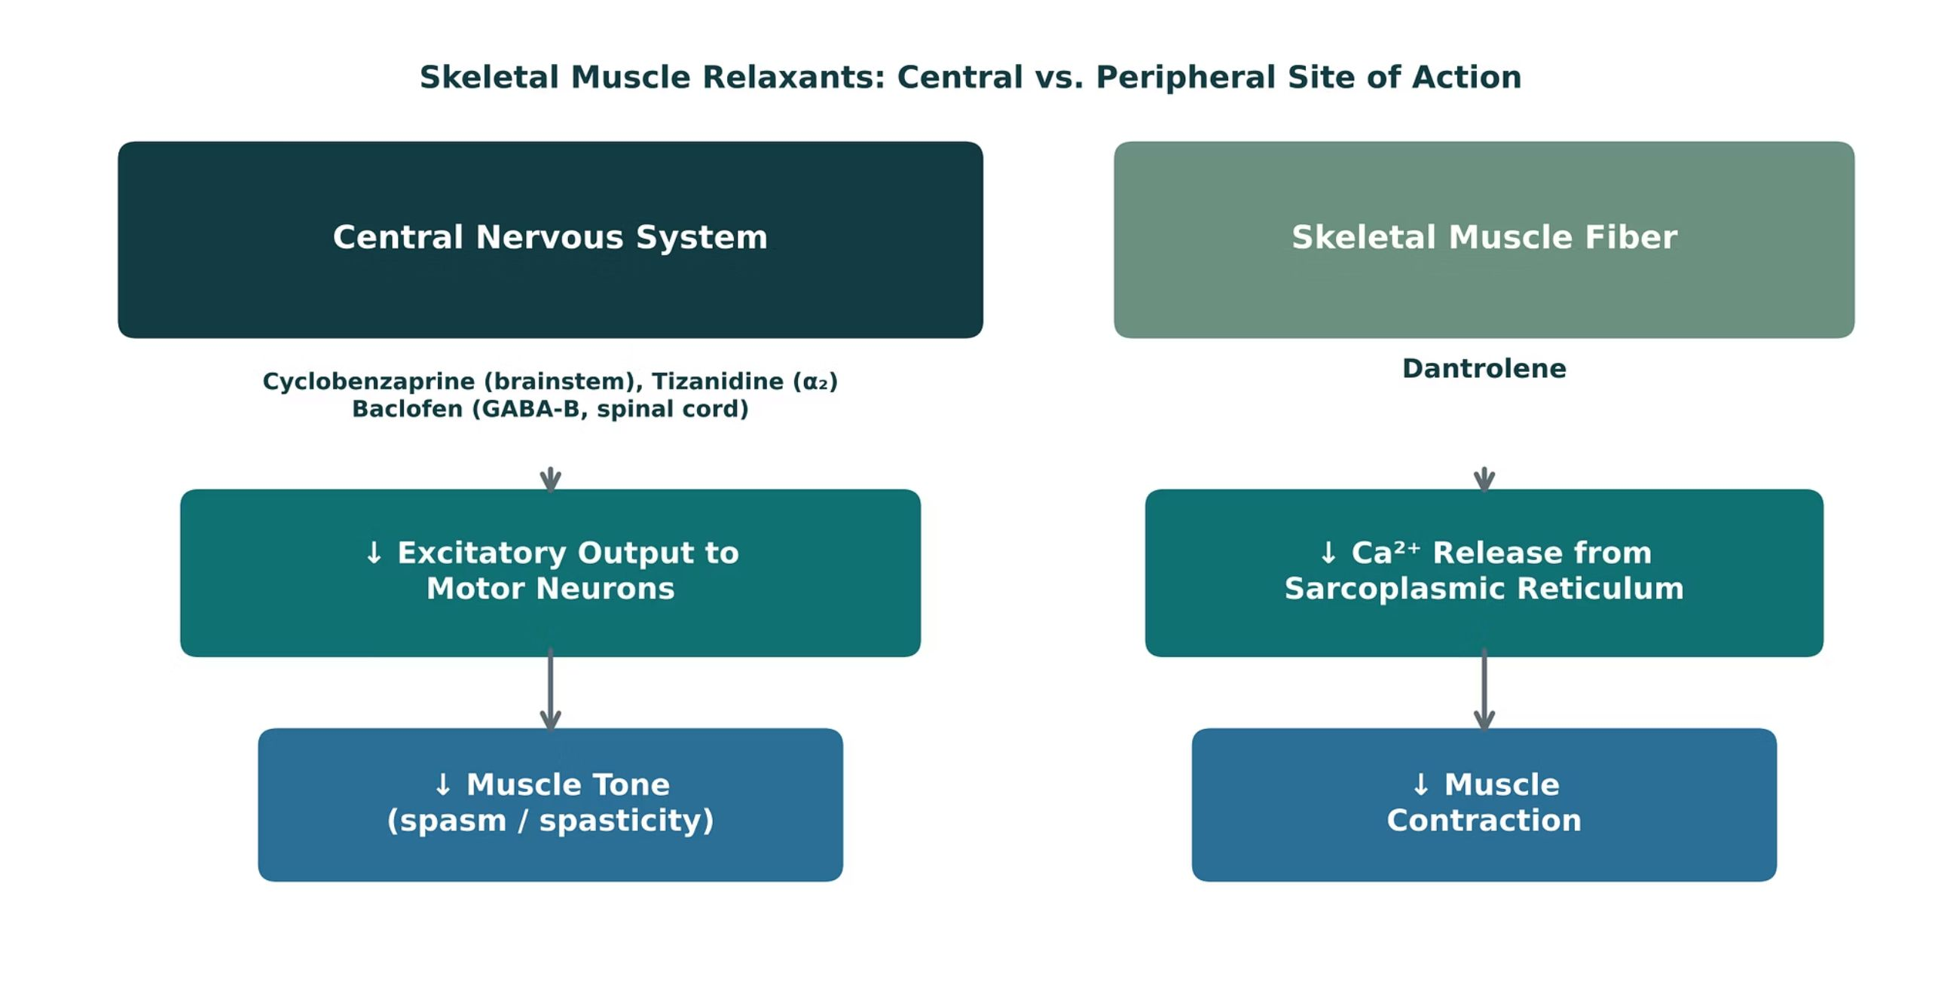
ORIGINAL ILLUSTRATION · FIGURE 5
Skeletal Muscle Relaxants: Central vs. Peripheral Site of Action
Figure 5. Original illustrative diagram (not from Katzung): cyclobenzaprine, tizanidine, and baclofen act within the CNS to reduce excitatory output to motor neurons, while dantrolene acts directly on the skeletal muscle fiber itself.
Musculoskeletal Pharmacology — Session 2 of 2 — PA Program
24
Notes:
This is the single highest-yield distinction in this section: "where does the drug act" sorts every agent into one of two buckets, and dantrolene is the only one in the peripheral bucket.

Slide 25
QUICK CHECK · FIGURE 5
Quick Check
In Figure 5, which agent is the odd one out, acting directly on the skeletal muscle fiber rather than within the central nervous system?
A
Cyclobenzaprine
B
Tizanidine
C
Baclofen
D
Dantrolene
Musculoskeletal Pharmacology — Session 2 of 2 — PA Program
25

Slide 26
ANSWER · FIGURE 5
Answer
D
Dantrolene.
Why: Dantrolene decreases calcium release from the skeletal muscle sarcoplasmic reticulum, acting directly on the muscle fiber — unlike cyclobenzaprine, tizanidine, and baclofen, which all act within the CNS to reduce excitatory output to motor neurons.
Musculoskeletal Pharmacology — Session 2 of 2 — PA Program
26

Slide 27
CENTRALLY ACTING
Baclofen
Mechanism: GABA-B receptor agonist in the spinal cord.
Clinical use: spasticity, particularly from spinal cord injury or multiple sclerosis.
Major concern: CNS depression — sedation, additive risk with other CNS depressants.
Abrupt discontinuation (especially intrathecal) can cause a dangerous withdrawal syndrome.
Musculoskeletal Pharmacology — Session 2 of 2 — PA Program
27
Notes:
GABA-B; never stop abruptly.

Slide 28
MECHANISM & DEPTH
Baclofen: GABA-B Agonism in the Spinal Cord
Baclofen binds GABA-B receptors
Abrupt withdrawal (especially intrathecal) can cause seizures, hyperthermia, rebound spasticity
Sedation and weakness
Renal dose adjustment
Intrathecal option for severe spasticity
▼
Opens K⁺ channels, closes Ca²⁺ channels: presynaptic inhibition
▼
Less excitatory neurotransmitter release
▼
Lower motor neuron firing: reduced spasticity
Musculoskeletal Pharmacology — Session 2 of 2 — PA Program
28

Slide 29
CENTRALLY ACTING
Tizanidine
Mechanism: central α2-adrenergic agonist.
Reduces excitatory input to motor neurons, lowering muscle tone.
Adverse effects: sedation, hypotension, dry mouth, hepatotoxicity.
Requires liver function monitoring with regular use.
Musculoskeletal Pharmacology — Session 2 of 2 — PA Program
29
Notes:
Alpha-2; CYP1A2 interactions and liver tests.

Slide 30
MECHANISM & DEPTH
Tizanidine: Central Alpha-2 Agonism
Tizanidine activates alpha-2 receptors
Hypotension and bradycardia; sedation and dry mouth
Monitor liver enzymes (LFTs) for hepatotoxicity
CYP1A2 interactions: ciprofloxacin and fluvoxamine strongly raise levels (contraindicated)
Additive effect with antihypertensives
▼
Reduced presynaptic release of excitatory amino acids
▼
Lower motor neuron activity
▼
Reduced muscle tone
Musculoskeletal Pharmacology — Session 2 of 2 — PA Program
30

Slide 31
CENTRALLY ACTING
Cyclobenzaprine
Structurally related to tricyclic antidepressants.
Primary use: short-term treatment of acute, localized muscle spasm.
Prominent sedation — commonly dosed at night.
Anticholinergic effects: dry mouth, blurred vision, urinary retention — use caution in older adults.
Musculoskeletal Pharmacology — Session 2 of 2 — PA Program
31
Notes:
Tricyclic-related; anticholinergic; serotonin syndrome.

Slide 32
MECHANISM & DEPTH
Cyclobenzaprine: Brainstem Action and Anticholinergic Effects
Anticholinergic effects: dry mouth, urinary retention, confusion (Beers list in older adults)
Sedation
Serotonin syndrome risk with SSRIs, SNRIs, tramadol; MAOIs contraindicated
Short-term use only, 2–3 weeks
Acts in the brainstem
▼
Antagonizes 5-HT2 and descending serotonergic and noradrenergic pathways
▼
Reduced tonic somatic motor activity
▼
Muscle relaxation
Musculoskeletal Pharmacology — Session 2 of 2 — PA Program
32

Slide 33
OTHER AGENTS
Other Centrally-Acting Relaxants & Botulinum Toxin
Carisoprodol — metabolized to meprobamate; Schedule IV controlled substance with dependence/misuse potential.
Methocarbamol — centrally-acting; generally less sedating than cyclobenzaprine.
Metaxalone — centrally-acting; relatively favorable sedation profile among this group.
Chlorzoxazone — centrally-acting; carries a rare but notable risk of hepatotoxicity.
Botulinum toxin — blocks presynaptic acetylcholine release at the neuromuscular junction.
Used for focal spasticity or dystonia; effect is local and temporary, requiring repeat injections.
Musculoskeletal Pharmacology — Session 2 of 2 — PA Program
33
Notes:
These agents round out the "centrally-acting" category beyond the three first-line drugs, and botulinum toxin introduces a third mechanism entirely — neuromuscular junction blockade — distinct from both the CNS-acting and dantrolene’s sarcoplasmic-reticulum mechanisms.
Instructor script:
Carisoprodol dependence.

Slide 34
PERIPHERALLY ACTING
Dantrolene
Mechanism: decreases calcium release from the skeletal muscle sarcoplasmic reticulum.
Acts directly on the muscle fiber, not the CNS — distinct from every centrally-acting agent in this section.
Clinical use #1: malignant hyperthermia (a true emergency indication).
Clinical use #2: chronic spasticity, when central agents are not appropriate.
Musculoskeletal Pharmacology — Session 2 of 2 — PA Program
34
Notes:
Dantrolene’s role in malignant hyperthermia is a must-know, high-stakes fact — a perioperative emergency where this drug is literally life-saving.
Instructor script:
RyR1; malignant hyperthermia.

Slide 35
MECHANISM & DEPTH
Dantrolene: Blocking Calcium Release at the Muscle
Nerve impulse: action potential, DHPR activated
Malignant hyperthermia (triggered by volatile anesthetics and succinylcholine) is the key indication
Hepatotoxicity
Generalized weakness
IV formulation for acute crisis; also used for neuroleptic malignant syndrome
▼
RyR1 opens: Ca²⁺ released from sarcoplasmic reticulum
▼
Contraction
▼
Dantrolene blocks RyR1 → less Ca²⁺ released
▼
Relaxation
Musculoskeletal Pharmacology — Session 2 of 2 — PA Program
35

Slide 36
QUICK CHECK · SKELETAL MUSCLE RELAXANTS
Quick Check
Which skeletal muscle relaxant acts directly on skeletal muscle itself (not the CNS), making it the agent of choice in malignant hyperthermia?
A
Baclofen
B
Dantrolene
C
Tizanidine
D
Cyclobenzaprine
Musculoskeletal Pharmacology — Session 2 of 2 — PA Program
36

Slide 37
ANSWER · SKELETAL MUSCLE RELAXANTS
Answer
B
Dantrolene.
Why: Dantrolene’s peripheral mechanism — decreasing calcium release from the skeletal muscle sarcoplasmic reticulum — is unique among these agents and is exactly why it is the emergency treatment for malignant hyperthermia.
Musculoskeletal Pharmacology — Session 2 of 2 — PA Program
37

Slide 38
NAMING CLUES
Drug Names Reveal the Class: Muscle Relaxants
Name clue | Class | Examples
-curonium / -curium | Nondepolarizing neuromuscular blockers | Vecuronium, atracurium, cisatracurium
succinylcholine (-choline) | Depolarizing neuromuscular blocker | Succinylcholine
-azepam | Benzodiazepine (GABA-A) | Diazepam
cyclo- (tricyclic ring) | Tricyclic-like central relaxant | Cyclobenzaprine
-idine (imidazoline) | Central alpha-2 agonist | Tizanidine
No shared stem | GABA-B agonist (GABA analog) | Baclofen
-trolene (hydantoin derivative) | Blocks RyR1 in the muscle fiber | Dantrolene
-toxin | Blocks presynaptic ACh release | Botulinum toxin
Musculoskeletal Pharmacology — Session 2 of 2 — PA Program
38
Notes:
Pair students: name the first-line class and the biggest safety check.

Slide 39

SECTION
07
Bone Pharmacology
Balancing bone formation and bone resorption.
Notes:
Section transition.
Last, bone pharmacology: balancing bone formation against bone resorption.

Slide 40

THE BASICS
Bone Remodeling
Osteoblasts
Osteoclasts
– Build new bone matrix
– Activity promoted by several osteoporosis therapies
– Resorb (break down) existing bone
– Activity suppressed by most osteoporosis therapies
Musculoskeletal Pharmacology — Session 2 of 2 — PA Program
40
Notes:
Nearly every osteoporosis drug on the following slides works by shifting this balance one way or the other — either slowing osteoclasts or stimulating osteoblasts.
Instructor script:
Osteoblasts build and osteoclasts resorb.

Slide 41
MECHANISM & DEPTH
RANKL/OPG Controls Osteoclast Activity
Osteoblast or stromal cell expresses RANKL
OPG is a decoy receptor that blocks RANKL
PTH: intermittent dosing favors formation; continuous exposure raises RANKL and resorption
Estrogen increases OPG; denosumab mimics OPG
Sclerostin inhibits Wnt signaling in osteoblasts
▼
RANKL binds RANK on osteoclast precursors
▼
Osteoclast differentiation and activation
▼
Bone resorption releases calcium
Musculoskeletal Pharmacology — Session 2 of 2 — PA Program
41

Slide 42
REGULATION
Calcium Homeostasis
Parathyroid Hormone (PTH)
Vitamin D
– Raises serum calcium; mobilizes bone calcium when levels drop
– Increases intestinal calcium absorption
Calcium
Calcitonin
– The substrate being regulated — intake, bone storage, excretion
– Lowers serum calcium; opposes PTH
Musculoskeletal Pharmacology — Session 2 of 2 — PA Program
42
Notes:
PTH, vitamin D and calcitonin.

Slide 43
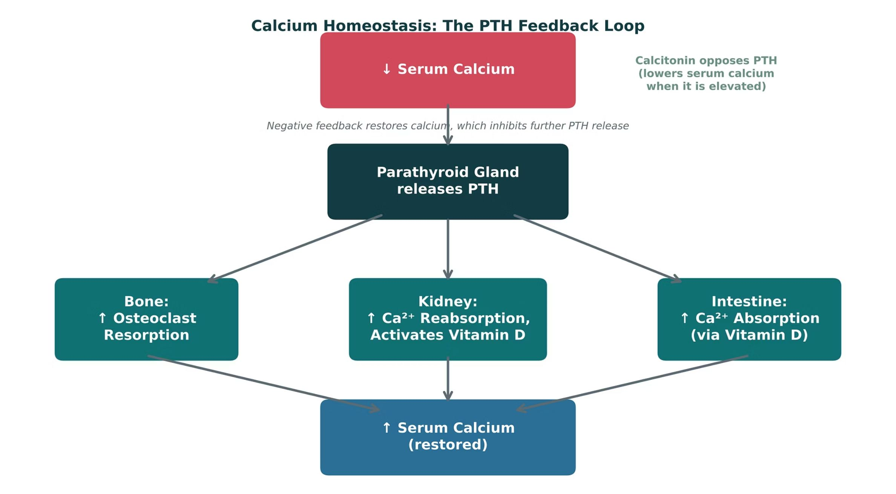
ORIGINAL ILLUSTRATION · FIGURE 6
Calcium Homeostasis: The PTH Feedback Loop
Figure 6. Original illustrative diagram (not from Katzung): falling serum calcium triggers PTH release, which raises calcium via bone resorption, renal reabsorption, and vitamin D-mediated intestinal absorption; calcitonin opposes this loop.
Musculoskeletal Pharmacology — Session 2 of 2 — PA Program
43
Notes:
Trace the three PTH arrows (bone, kidney, intestine) with your finger as you narrate — this negative feedback loop is the physiologic backdrop for every osteoporosis drug that follows.

Slide 44
QUICK CHECK · FIGURE 6
Quick Check
In Figure 6, PTH release raises serum calcium through three parallel actions. Which organ system is NOT one of the three direct targets of PTH shown in the diagram?
A
Bone
B
Kidney
C
Intestine (directly)
D
Lung
Musculoskeletal Pharmacology — Session 2 of 2 — PA Program
44

Slide 45
ANSWER · FIGURE 6
Answer
D
Lung.
Why: PTH acts directly on bone (↑ osteoclast resorption) and kidney (↑ calcium reabsorption, activates vitamin D); its effect on the intestine is indirect, mediated through activated vitamin D. The lung is not part of this feedback loop at all.
Musculoskeletal Pharmacology — Session 2 of 2 — PA Program
45

Slide 46

RISK ASSESSMENT
Osteoporosis Risk Factors
Aging
Estrogen deficiency (e.g., postmenopausal status)
Chronic glucocorticoid use
Low calcium or vitamin D intake
Low physical activity
Musculoskeletal Pharmacology — Session 2 of 2 — PA Program
46
Notes:
Glucocorticoid-induced osteoporosis is especially high-yield since it directly connects to the corticosteroid use already discussed for OA/RA in Session 1.

Slide 47
FIRST-LINE THERAPY
Bisphosphonates
Mechanism: inhibit osteoclast-mediated bone resorption.
Alendronate, risedronate — oral, typically weekly dosing
Ibandronate — oral, monthly dosing
Zoledronic acid — intravenous, as infrequently as once yearly
First-line for most patients with osteoporosis.
Musculoskeletal Pharmacology — Session 2 of 2 — PA Program
47
Notes:
Osteoclast apoptosis.

Slide 48
MECHANISM & DEPTH
Bisphosphonates: Osteoclast Apoptosis
Drug binds hydroxyapatite at resorption sites
Long skeletal half-life: effect persists after stopping
Ensure calcium and vitamin D repletion before starting
Contraindicated with severe renal impairment (CrCl below 30-35 mL/min)
Osteonecrosis of the jaw and atypical femur fracture with long-term use; consider a drug holiday after 3-5 years of oral therapy
▼
Osteoclast takes it up during resorption
▼
Nitrogen-containing bisphosphonates inhibit FPP synthase (mevalonate pathway)
▼
Loss of prenylation of small GTPases
▼
Osteoclast apoptosis, so less resorption
Musculoskeletal Pharmacology — Session 2 of 2 — PA Program
48

Slide 49
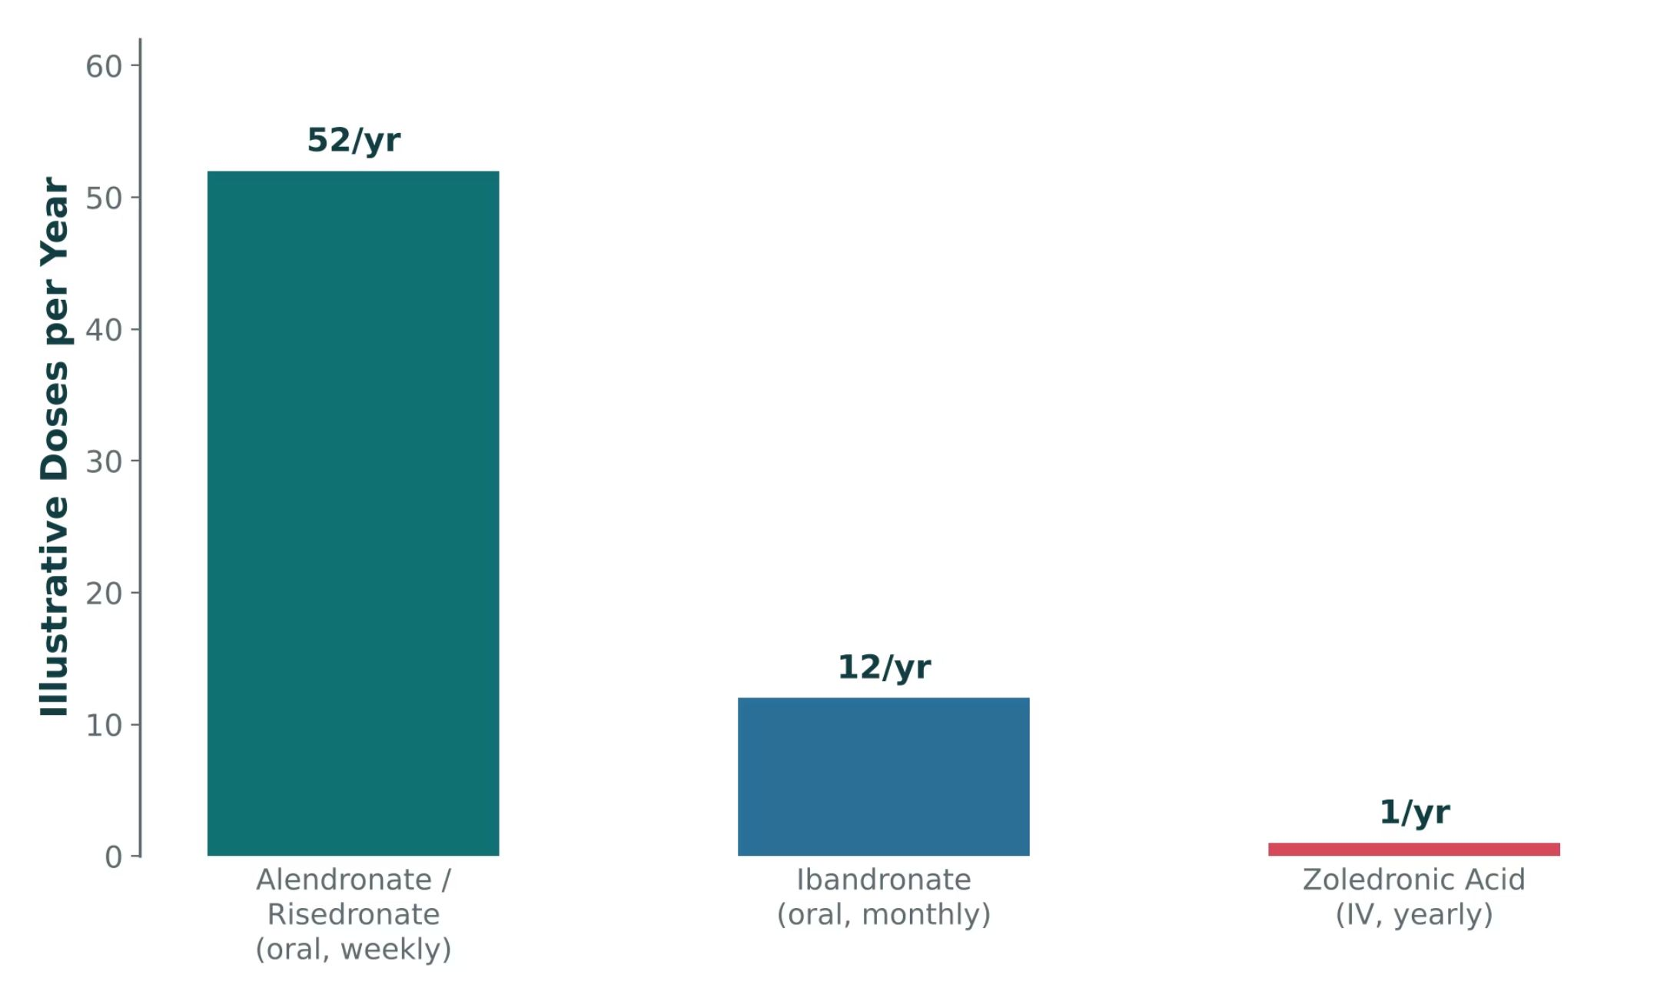
ORIGINAL ILLUSTRATION · FIGURE 7
Bisphosphonate Dosing Frequency
Figure 7. Original illustrative comparison (illustrative dosing-frequency values, not from Katzung): oral bisphosphonates range from weekly to monthly dosing, while IV zoledronic acid is given as infrequently as once yearly.
Musculoskeletal Pharmacology — Session 2 of 2 — PA Program
49
Notes:
Use this to set up the adherence discussion on the next slide — dosing frequency is a major real-world driver of which bisphosphonate a patient actually takes consistently.

Slide 50
QUICK CHECK · FIGURE 7
Quick Check
Based on Figure 7, which bisphosphonate requires the fewest doses per year, and by what route is it given?
A
Alendronate/risedronate, given orally
B
Ibandronate, given orally
C
Zoledronic acid, given intravenously
D
All bisphosphonates require the same number of annual doses
Musculoskeletal Pharmacology — Session 2 of 2 — PA Program
50

Slide 51
ANSWER · FIGURE 7
Answer
C
Zoledronic acid, given intravenously.
Why: Figure 7 shows zoledronic acid dosed as infrequently as once yearly by IV infusion, versus weekly oral dosing for alendronate/risedronate and monthly oral dosing for ibandronate — an important consideration for patients with adherence challenges.
Musculoskeletal Pharmacology — Session 2 of 2 — PA Program
51

Slide 52
SAFE USE
Bisphosphonate Administration & Adverse Effects
Patient Counseling (Oral)
Adverse Effects
– Take with a full glass of water, first thing in the morning
– Remain upright (sitting or standing) for the specified period after dosing
– Take on an empty stomach, well before food
– Esophageal irritation
– Hypocalcemia
– Osteonecrosis of the jaw (rare)
– Atypical femoral fractures (rare, with long-term use)
Musculoskeletal Pharmacology — Session 2 of 2 — PA Program
52
Notes:
The "remain upright" counseling point is extremely high-yield for both exams and real-world safety — esophageal injury is largely preventable with correct administration.
Instructor script:
Osteonecrosis of the jaw and atypical femur fracture.

Slide 53
MECHANISM & DEPTH
Why Oral Bisphosphonates Need Strict Administration Rules
Poor oral absorption (under 1%)
Avoid in esophageal stricture, achalasia, or inability to sit upright
IV zoledronic acid: acute-phase reaction (flu-like), mitigated with acetaminophen
Hypocalcemia risk; correct calcium and vitamin D first
▼
Food, calcium, coffee and antacids reduce it further
▼
Take fasting with plain water; stay upright 30 minutes
▼
Lowers esophageal irritation risk
Musculoskeletal Pharmacology — Session 2 of 2 — PA Program
53
Notes:
Administration rules.

Slide 54
BEYOND BISPHOSPHONATES
Other Osteoporosis Therapies
Denosumab
Teriparatide / Abaloparatide
– Monoclonal antibody; blocks osteoclast formation (RANKL inhibitor)
– PTH-analog "anabolic" agents that stimulate new bone formation
Romosozumab
SERMs
– Monoclonal antibody that both builds bone and limits resorption
– Selective estrogen receptor modulators — estrogen-like effect on bone
– Example: raloxifene — also reduces breast cancer risk
Musculoskeletal Pharmacology — Session 2 of 2 — PA Program
54
Notes:
Teriparatide/abaloparatide/romosozumab are the "anabolic" exception to the rule that most osteoporosis drugs just slow resorption — they actively build new bone. The next slide shows all of these (plus bisphosphonates) together on one balance diagram.
Instructor script:
Denosumab rebound; raloxifene VTE.

Slide 55
MECHANISM & DEPTH
Anabolic vs Antiresorptive Mechanisms
Antiresorptive: denosumab (RANKL antibody), raloxifene (SERM), calcitonin
Anabolic: teriparatide (PTH 1-34, daily injection) and abaloparatide
Teriparatide is limited to 2 years lifetime, then follow with an antiresorptive
Denosumab discontinuation causes rebound vertebral fractures; transition to a bisphosphonate
Raloxifene raises VTE risk and may reduce breast cancer risk; hot flashes
Romosozumab carries a boxed warning for MI, stroke, and CV death
▼
▼
Stimulate osteoblasts; romosozumab (sclerostin antibody)
Less osteoclast activity
▼
▼
Increases formation, decreases resorption
BMD up, fracture risk down
Musculoskeletal Pharmacology — Session 2 of 2 — PA Program
55
Notes:
Teriparatide 2 years; romosozumab boxed warning.

Slide 56
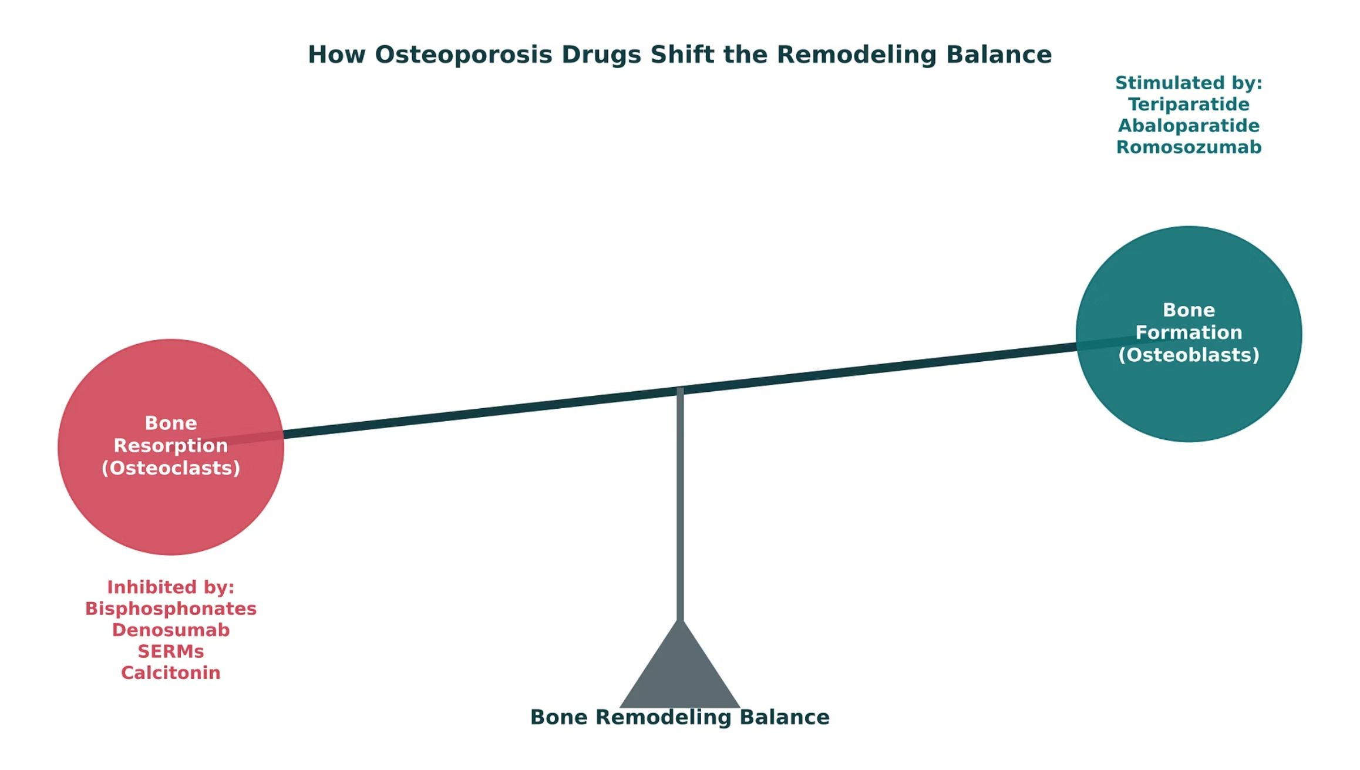
ORIGINAL ILLUSTRATION · FIGURE 8
How Osteoporosis Drugs Shift the Remodeling Balance
Figure 8. Original illustrative diagram (not from Katzung): bisphosphonates, denosumab, raloxifene (SERM), and calcitonin inhibit bone resorption; teriparatide, abaloparatide, and romosozumab stimulate bone formation.
Musculoskeletal Pharmacology — Session 2 of 2 — PA Program
56
Notes:
This is the capstone bone-pharmacology figure — every drug from the last three slides lands on one side of this seesaw or the other. Ask students to sort each named drug into "inhibits resorption" vs. "stimulates formation" before revealing the diagram’s labels.

Slide 57
QUICK CHECK · FIGURE 8
Quick Check
In Figure 8, teriparatide and romosozumab sit on the "bone formation" side of the balance, while alendronate and raloxifene sit on the "bone resorption" side. What does this grouping represent?
A
Teriparatide and romosozumab stimulate osteoblast activity, while alendronate and raloxifene inhibit osteoclast activity
B
All four drugs work through the identical mechanism
C
Teriparatide and romosozumab inhibit osteoclasts, while alendronate and raloxifene stimulate osteoblasts
D
This grouping reflects route of administration, not mechanism
Musculoskeletal Pharmacology — Session 2 of 2 — PA Program
57

Slide 58
ANSWER · FIGURE 8
Answer
A
Teriparatide and romosozumab stimulate osteoblast activity, while alendronate and raloxifene inhibit osteoclast activity.
Why: The "anabolic" agents (teriparatide, abaloparatide, romosozumab) sit on the bone-formation side because they stimulate osteoblasts, while bisphosphonates (alendronate), denosumab, SERMs (raloxifene), and calcitonin sit on the bone-resorption side because they inhibit osteoclasts — two different strategies for shifting the same remodeling balance.
Musculoskeletal Pharmacology — Session 2 of 2 — PA Program
58

Slide 59

INDIVIDUALIZING THERAPY
Choosing an Osteoporosis Therapy
Fracture risk — higher-risk patients may need an anabolic agent first
Renal function — some bisphosphonates are avoided in significant renal impairment
Previous fracture history
Glucocorticoid exposure
Adherence — weekly oral vs. yearly IV vs. injectable options
Route of administration preference
Musculoskeletal Pharmacology — Session 2 of 2 — PA Program
59
Notes:
This checklist is a direct echo of the clinical decision-making framework from Lecture 1 — point that out explicitly.

Slide 60
QUICK CHECK · BONE PHARMACOLOGY
Quick Check
A patient is counseled to take their oral bisphosphonate with a full glass of water and remain upright for a specified period. What complication is this counseling primarily meant to prevent?
A
Hypocalcemia
B
Atypical femoral fracture
C
Esophageal irritation or injury
D
Osteonecrosis of the jaw
Musculoskeletal Pharmacology — Session 2 of 2 — PA Program
60

Slide 61
ANSWER · BONE PHARMACOLOGY
Answer
C
Esophageal irritation or injury.
Why: Taking the tablet with a full glass of water and staying upright reduces the time the pill is in contact with the esophageal mucosa, lowering the risk of esophageal irritation or injury.
Musculoskeletal Pharmacology — Session 2 of 2 — PA Program
61

Slide 62
NAMING CLUES
Drug Names Reveal the Class: Bone
Name clue | Class | Examples
-dronate | Bisphosphonates (inhibit osteoclast resorption) | Alendronate, risedronate, ibandronate; zoledronic acid (zoledronate)
-sumab | Monoclonal antibodies (-mab) targeting bone | Denosumab (RANKL), romosozumab (sclerostin)
-fene | Selective estrogen receptor modulator (SERM) | Raloxifene
-tide (peptide) | PTH analogs (anabolic) | Teriparatide, abaloparatide
No shared stem | Calcitonin (hormone) | Calcitonin
Musculoskeletal Pharmacology — Session 2 of 2 — PA Program
62
Notes:
Pair students: name the first-line class and the biggest safety check.

Slide 63

SECTION
08
Putting It All Together
Applying the whole musculoskeletal pharmacology toolkit.

Slide 64
APPLY IT
Which Drug Would You Choose?
Patient A
Patient B
– Acute gout flare, first presentation
– Chronic rheumatoid arthritis, inadequately controlled
Patient C
Patient D
– Osteoarthritis + chronic kidney disease
– Postmenopausal osteoporosis, high fracture risk
Musculoskeletal Pharmacology — Session 2 of 2 — PA Program
64
Notes:
Have students work in pairs: for each patient, name a first-line drug class AND the single biggest safety concern to check before prescribing it.
Instructor script:
Pair students: name the first-line class and the biggest safety check.

Slide 65
QUICK CHECK · PUTTING IT ALL TOGETHER
Quick Check
A patient with osteoporosis has significant difficulty swallowing pills. Which administration route among osteoporosis therapies would best fit this patient?
A
Weekly oral alendronate
B
Daily oral risedronate
C
There is no alternative to oral bisphosphonates
D
Yearly IV zoledronic acid or a subcutaneous injectable agent
Musculoskeletal Pharmacology — Session 2 of 2 — PA Program
65

Slide 66
ANSWER · PUTTING IT ALL TOGETHER
Answer
D
Yearly IV zoledronic acid or a subcutaneous injectable agent.
Why: Route of administration and adherence are explicit factors in choosing osteoporosis therapy — IV zoledronic acid or an injectable agent (e.g., denosumab) avoids the swallowing difficulty that limits oral options.
Musculoskeletal Pharmacology — Session 2 of 2 — PA Program
66

Slide 67
BIG PICTURE
Key Takeaways
1
Pain and inflammation are related but distinct — treat them accordingly.
2
NSAIDs are effective for pain and inflammation, but carry real GI, renal, and cardiovascular risk.
3
DMARDs modify the underlying disease process in RA — they do more than mask symptoms.
4
Acute gout treatment and chronic urate-lowering therapy are different goals, started at different times.
5
Bone pharmacology is fundamentally about the balance between osteoblast and osteoclast activity.
Musculoskeletal Pharmacology — Session 2 of 2 — PA Program
Notes:
Close by connecting back to Lecture 1: every mechanism in this lecture (COX inhibition, CYP interactions, renal dosing, pharmacogenomics) was really just Lecture 1’s toolkit applied to one organ system.
Instructor script:
Pair students: name the first-line class and the biggest safety check.

Slide 68

SECTION
09
Lecture Recall Quiz
A cumulative self-test — use this to review before exams.
Notes:
Pair students: name the first-line class and the biggest safety check.

Slide 69
LECTURE RECALL QUIZ
Lecture Recall Quiz (1 of 2)
1. Why is acetaminophen not a reliable first-line choice for an inflammatory joint flare, despite being a good analgesic/antipyretic?
A. It strongly inhibits COX-2 only
B. It has minimal peripheral anti-inflammatory effect
C. It is contraindicated in all patients with joint pain
D. It is a DMARD and too strong for mild flares
2. A 70-year-old with CKD and heart failure needs osteoarthritis pain control. Considering systemic risk, which is generally the safest starting point?
A. Oral ibuprofen
B. Oral celecoxib
C. Acetaminophen or a topical NSAID
D. Ketorolac
3. Which pairing correctly matches a drug with its primary mechanism?
A. Allopurinol — microtubule disruption
B. Colchicine — xanthine oxidase inhibition
C. Baclofen — calcium channel blockade in skeletal muscle
D. Methotrexate — dihydrofolate reductase inhibition
Musculoskeletal Pharmacology — Session 2 of 2 — PA Program
69

Slide 70
LECTURE RECALL QUIZ
Lecture Recall Quiz (2 of 2)
4. A patient on a biologic DMARD develops a fever. What is the most important immediate concern?
A. Infection, given the drug’s immunosuppressive effect
B. A drug allergy only
C. Osteonecrosis of the jaw
D. Hepatotoxicity from Phase II metabolism
5. Which statement about gout pharmacology is correct?
A. Colchicine lowers uric acid production
B. Acute flares should always be treated with urate-lowering therapy first
C. Probenecid lowers uric acid by inhibiting renal tubular reabsorption of urate
D. Febuxostat and probenecid are both xanthine oxidase inhibitors
6. A patient with glucocorticoid-induced osteoporosis risk should be counseled that the risk is primarily related to which mechanism?
A. Increased osteoclast-mediated resorption and decreased bone formation
B. Increased osteoblast activity
C. Excess vitamin D
D. Increased calcitonin secretion
Musculoskeletal Pharmacology — Session 2 of 2 — PA Program
70

Slide 71
ANSWER KEY
Lecture Recall Quiz — Answer Key
1. B — Acetaminophen has minimal peripheral anti-inflammatory effect, unlike NSAIDs — it treats pain and fever, not inflammation itself.
2. C — Acetaminophen or a topical NSAID avoids the systemic renal/CV risk of oral NSAIDs in a patient with CKD and heart failure.
3. D — Methotrexate inhibits dihydrofolate reductase. Allopurinol inhibits xanthine oxidase; colchicine disrupts microtubules; baclofen is a GABA-B agonist.
4. A — Immunosuppression is the shared major risk across all DMARDs — a fever must be treated as a possible infection until proven otherwise.
5. C — Probenecid is a uricosuric agent that inhibits renal tubular reabsorption of uric acid, increasing its excretion. Colchicine does not lower uric acid; febuxostat (not probenecid) is a xanthine oxidase inhibitor; and urate-lowering therapy is deferred during an acute flare.
6. A — Glucocorticoids increase osteoclast-mediated bone resorption and suppress osteoblast-driven bone formation — shifting the remodeling balance toward bone loss.
Musculoskeletal Pharmacology — Session 2 of 2 — PA Program
Notes:
Encourage students to revisit this quiz on their own before the exam — it is designed as a standalone recall resource, separate from the in-lecture quick checks.

Slide 72
STUDY REFERENCE
Drug Profiles
Study reference for the drugs covered in Session 2
PO = by mouth
IV = intravenous
SC = subcutaneous
BID/TID = twice / three times daily
ER = extended release
CNS = central nervous system
GABA = gamma-aminobutyric acid
CYP = cytochrome P450
P-gp = P-glycoprotein
HLA = human leukocyte antigen
URAT1 = urate transporter 1
G6PD = glucose-6-phosphate dehydrogenase
RyR1 = ryanodine receptor 1
RANKL = receptor activator of nuclear factor kappa-B ligand
PTH = parathyroid hormone
SERM = selective estrogen receptor modulator
VTE = venous thromboembolism
SSRI = selective serotonin reuptake inhibitor
MAOI = monoamine oxidase inhibitor
CrCl = creatinine clearance
OTC = over the counter
Notes:
Abbreviation key: PO = by mouth; IV = intravenous; SC = subcutaneous; BID/TID = twice / three times daily; ER = extended release; CNS = central nervous system; GABA = gamma-aminobutyric acid; CYP = cytochrome P450; P-gp = P-glycoprotein; HLA = human leukocyte antigen; URAT1 = urate transporter 1; G6PD = glucose-6-phosphate dehydrogenase; RyR1 = ryanodine receptor 1; RANKL = receptor activator of nuclear factor kappa-B ligand; PTH = parathyroid hormone; SERM = selective estrogen receptor modulator; VTE = venous thromboembolism; SSRI = selective serotonin reuptake inhibitor; MAOI = monoamine oxidase inhibitor; CrCl = creatinine clearance; OTC = over the counter.
Instructor script:
These profiles are your study reference. Know the dose logic, the serious adverse effects, the contraindication that changes decisions and the toxicity you would need to recognize.
Class activity (10 minutes): groups teach back two or three profiles in 60 seconds each.
Abbreviation key: review RyR1, URAT1, RANKL, PTH and SERM.
Teaching points: gout agents, central relaxants, dantrolene, bisphosphonates, denosumab, teriparatide, raloxifene.
Bloom's prompts: Remember: state colchicine dosing. Understand: explain why allopurinol does not treat a flare. Apply: counsel on alendronate. Analyze: explain tizanidine with ciprofloxacin. Evaluate: choose osteoporosis therapy in CKD.

Slide 73
DRUG PROFILE
Colchicine (Colcrys, Mitigare)
ANTI-INFLAMMATORY (MICROTUBULE INHIBITOR)
FORMULATION
DOSE (ADULT)
INDICATIONS
Tablets 0.6 mg; capsules 0.6 mg
Flare: 1.2 mg PO then 0.6 mg one hour later, within 24 hours of onset; prophylaxis: 0.6 mg once or twice daily
Acute gout flare, flare prophylaxis, familial Mediterranean fever
ADVERSE EFFECTS
CONTRAINDICATIONS
TOXICITY / OVERDOSE
Diarrhea, nausea, vomiting, abdominal pain; myelosuppression and myopathy with toxicity
Severe renal or hepatic impairment with CYP3A4 or P-gp inhibitors; blood dyscrasias
Narrow therapeutic window: severe GI toxicity, bone marrow suppression, multi-organ failure; avoid clarithromycin and strong CYP3A4/P-gp inhibitors
Standard adult dosing for teaching; verify against current prescribing information.
Musculoskeletal Pharmacology — Session 2 of 2 — PA Program
73
Notes:
Colchicine (Colcrys, Mitigare)|Anti-inflammatory (microtubule inhibitor)|Tablets 0.6 mg; capsules 0.6 mg|Flare: 1.2 mg PO then 0.6 mg one hour later, within 24 hours of onset; prophylaxis: 0.6 mg once or twice daily|Acute gout flare, flare prophylaxis, familial Mediterranean fever|Diarrhea, nausea, vomiting, abdominal pain; myelosuppression and myopathy with toxicity|Severe renal or hepatic impairment with CYP3A4 or P-gp inhibitors; blood dyscrasias|Narrow therapeutic window: severe GI toxicity, bone marrow suppression, multi-organ failure; avoid clarithromycin and strong CYP3A4/P-gp inhibitors

Slide 74
DRUG PROFILE
Allopurinol (Zyloprim)
XANTHINE OXIDASE INHIBITOR
FORMULATION
DOSE (ADULT)
INDICATIONS
Tablets 100/300 mg
Start 50-100 mg PO daily, titrate every 2-5 weeks to serum urate under 6 mg/dL (usual 300-800 mg/day)
Chronic gout, hyperuricemia, uric acid stones, tumor lysis prophylaxis
ADVERSE EFFECTS
CONTRAINDICATIONS
TOXICITY / OVERDOSE
Rash, GI upset, flare at initiation, elevated liver enzymes
Prior severe reaction; HLA-B*58:01 carriers (higher risk); reduce dose in renal impairment
Allopurinol hypersensitivity syndrome (fever, rash, eosinophilia, organ injury); interacts with azathioprine and mercaptopurine
Standard adult dosing for teaching; verify against current prescribing information.
Musculoskeletal Pharmacology — Session 2 of 2 — PA Program
74
Notes:
Allopurinol (Zyloprim)|Xanthine oxidase inhibitor|Tablets 100/300 mg|Start 50-100 mg PO daily, titrate every 2-5 weeks to serum urate under 6 mg/dL (usual 300-800 mg/day)|Chronic gout, hyperuricemia, uric acid stones, tumor lysis prophylaxis|Rash, GI upset, flare at initiation, elevated liver enzymes|Prior severe reaction; HLA-B*58:01 carriers (higher risk); reduce dose in renal impairment|Allopurinol hypersensitivity syndrome (fever, rash, eosinophilia, organ injury); interacts with azathioprine and mercaptopurine

Slide 75
DRUG PROFILE
Febuxostat (Uloric)
XANTHINE OXIDASE INHIBITOR (NON-PURINE)
FORMULATION
DOSE (ADULT)
INDICATIONS
Tablets 40/80 mg
40 mg PO daily, increase to 80 mg if urate above 6 mg/dL after 2 weeks
Chronic gout when allopurinol fails or is not tolerated
ADVERSE EFFECTS
CONTRAINDICATIONS
TOXICITY / OVERDOSE
Gout flare at initiation, nausea, rash, elevated liver enzymes, cardiovascular death
Concurrent azathioprine or mercaptopurine; caution with cardiovascular disease
Boxed warning for cardiovascular death; monitor liver tests
Standard adult dosing for teaching; verify against current prescribing information.
Musculoskeletal Pharmacology — Session 2 of 2 — PA Program
75
Notes:
Febuxostat (Uloric)|Xanthine oxidase inhibitor (non-purine)|Tablets 40/80 mg|40 mg PO daily, increase to 80 mg if urate above 6 mg/dL after 2 weeks|Chronic gout when allopurinol fails or is not tolerated|Gout flare at initiation, nausea, rash, elevated liver enzymes, cardiovascular death|Concurrent azathioprine or mercaptopurine; caution with cardiovascular disease|Boxed warning for cardiovascular death; monitor liver tests

Slide 76
DRUG PROFILE
Probenecid
URICOSURIC (URAT1 INHIBITOR)
FORMULATION
DOSE (ADULT)
INDICATIONS
Tablets 500 mg
250 mg PO twice daily for 1 week, then 500 mg twice daily; maximum 2 g/day
Chronic gout with underexcretion of urate; adjunct to penicillin
ADVERSE EFFECTS
CONTRAINDICATIONS
TOXICITY / OVERDOSE
GI upset, rash, headache, kidney stones, flare at start
Uric acid kidney stones, significant renal impairment (eGFR under 30), blood dyscrasias, during acute flare
Renal colic and stones; hydrate well and alkalinize urine; raises levels of penicillins, methotrexate and NSAIDs
Standard adult dosing for teaching; verify against current prescribing information.
Musculoskeletal Pharmacology — Session 2 of 2 — PA Program
76
Notes:
Probenecid|Uricosuric (URAT1 inhibitor)|Tablets 500 mg|250 mg PO twice daily for 1 week, then 500 mg twice daily; maximum 2 g/day|Chronic gout with underexcretion of urate; adjunct to penicillin|GI upset, rash, headache, kidney stones, flare at start|Uric acid kidney stones, significant renal impairment (eGFR under 30), blood dyscrasias, during acute flare|Renal colic and stones; hydrate well and alkalinize urine; raises levels of penicillins, methotrexate and NSAIDs

Slide 77
DRUG PROFILE
Pegloticase (Krystexxa)
RECOMBINANT URICASE
FORMULATION
DOSE (ADULT)
INDICATIONS
IV 8 mg/mL vial
8 mg IV every 2 weeks over at least 2 hours, with methotrexate co-therapy
Refractory chronic gout
ADVERSE EFFECTS
CONTRAINDICATIONS
TOXICITY / OVERDOSE
Infusion reaction, gout flares, anaphylaxis, nausea, anti-drug antibodies
G6PD deficiency; uncontrolled hypertension (caution); stop other urate-lowering drugs
Boxed warning for anaphylaxis, infusion reactions, hemolysis and methemoglobinemia in G6PD deficiency; premedicate and monitor serum urate
Standard adult dosing for teaching; verify against current prescribing information.
Musculoskeletal Pharmacology — Session 2 of 2 — PA Program
77
Notes:
Pegloticase (Krystexxa)|Recombinant uricase|IV 8 mg/mL vial|8 mg IV every 2 weeks over at least 2 hours, with methotrexate co-therapy|Refractory chronic gout|Infusion reaction, gout flares, anaphylaxis, nausea, anti-drug antibodies|G6PD deficiency; uncontrolled hypertension (caution); stop other urate-lowering drugs|Boxed warning for anaphylaxis, infusion reactions, hemolysis and methemoglobinemia in G6PD deficiency; premedicate and monitor serum urate

Slide 78
DRUG PROFILE
Baclofen (Lioresal, Gablofen)
CENTRALLY ACTING RELAXANT (GABA-B AGONIST)
FORMULATION
DOSE (ADULT)
INDICATIONS
Tablets 5/10/20 mg; oral solution; intrathecal pump
5 mg PO three times daily, increase every 3 days to 40-80 mg/day in divided doses
Spasticity from spinal cord injury or multiple sclerosis
ADVERSE EFFECTS
CONTRAINDICATIONS
TOXICITY / OVERDOSE
Sedation, dizziness, weakness, nausea, confusion
Caution with renal impairment; avoid abrupt discontinuation
Overdose: coma, respiratory depression; abrupt withdrawal causes seizures, hyperthermia and rebound spasticity
Standard adult dosing for teaching; verify against current prescribing information.
Musculoskeletal Pharmacology — Session 2 of 2 — PA Program
78
Notes:
Baclofen (Lioresal, Gablofen)|Centrally acting relaxant (GABA-B agonist)|Tablets 5/10/20 mg; oral solution; intrathecal pump|5 mg PO three times daily, increase every 3 days to 40-80 mg/day in divided doses|Spasticity from spinal cord injury or multiple sclerosis|Sedation, dizziness, weakness, nausea, confusion|Caution with renal impairment; avoid abrupt discontinuation|Overdose: coma, respiratory depression; abrupt withdrawal causes seizures, hyperthermia and rebound spasticity

Slide 79
DRUG PROFILE
Tizanidine (Zanaflex)
CENTRALLY ACTING RELAXANT (ALPHA-2 AGONIST)
FORMULATION
DOSE (ADULT)
INDICATIONS
Tablets 2/4 mg; capsules 2/4/6 mg
2 mg PO every 6-8 hours, titrate to 4-8 mg every 6-8 hours (maximum 36 mg/day)
Spasticity, off-label for muscle spasm
ADVERSE EFFECTS
CONTRAINDICATIONS
TOXICITY / OVERDOSE
Sedation, dry mouth, hypotension, bradycardia, hepatotoxicity
Strong CYP1A2 inhibitors (ciprofloxacin, fluvoxamine); caution with antihypertensives and liver disease
Hypotension, bradycardia and CNS depression; check liver tests
Standard adult dosing for teaching; verify against current prescribing information.
Musculoskeletal Pharmacology — Session 2 of 2 — PA Program
79
Notes:
Tizanidine (Zanaflex)|Centrally acting relaxant (alpha-2 agonist)|Tablets 2/4 mg; capsules 2/4/6 mg|2 mg PO every 6-8 hours, titrate to 4-8 mg every 6-8 hours (maximum 36 mg/day)|Spasticity, off-label for muscle spasm|Sedation, dry mouth, hypotension, bradycardia, hepatotoxicity|Strong CYP1A2 inhibitors (ciprofloxacin, fluvoxamine); caution with antihypertensives and liver disease|Hypotension, bradycardia and CNS depression; check liver tests

Slide 80
DRUG PROFILE
Cyclobenzaprine (Flexeril)
CENTRALLY ACTING RELAXANT (TRICYCLIC-RELATED)
FORMULATION
DOSE (ADULT)
INDICATIONS
Tablets 5/7.5/10 mg; ER capsules 15/30 mg
5-10 mg PO three times daily for 2-3 weeks (ER 15-30 mg daily)
Acute muscle spasm from musculoskeletal conditions
ADVERSE EFFECTS
CONTRAINDICATIONS
TOXICITY / OVERDOSE
Sedation, dry mouth, dizziness, blurred vision, urinary retention, confusion
MAOIs within 14 days, arrhythmias, recent myocardial infarction, hyperthyroidism; Beers list for older adults
Serotonin syndrome with SSRIs and tramadol; tricyclic-type toxicity with arrhythmia, seizures in overdose
Standard adult dosing for teaching; verify against current prescribing information.
Musculoskeletal Pharmacology — Session 2 of 2 — PA Program
80
Notes:
Cyclobenzaprine (Flexeril)|Centrally acting relaxant (tricyclic-related)|Tablets 5/7.5/10 mg; ER capsules 15/30 mg|5-10 mg PO three times daily for 2-3 weeks (ER 15-30 mg daily)|Acute muscle spasm from musculoskeletal conditions|Sedation, dry mouth, dizziness, blurred vision, urinary retention, confusion|MAOIs within 14 days, arrhythmias, recent myocardial infarction, hyperthyroidism; Beers list for older adults|Serotonin syndrome with SSRIs and tramadol; tricyclic-type toxicity with arrhythmia, seizures in overdose

Slide 81
DRUG PROFILE
Carisoprodol (Soma)
CENTRALLY ACTING RELAXANT (MEPROBAMATE METABOLITE)
FORMULATION
DOSE (ADULT)
INDICATIONS
Tablets 250/350 mg
250-350 mg PO three times daily and at bedtime for up to 2-3 weeks
Acute painful musculoskeletal conditions
ADVERSE EFFECTS
CONTRAINDICATIONS
TOXICITY / OVERDOSE
Drowsiness, dizziness, headache, dependence
Acute intermittent porphyria; prior hypersensitivity; Schedule IV controlled substance
CNS depression, especially with opioids and alcohol; dependence and withdrawal
Standard adult dosing for teaching; verify against current prescribing information.
Musculoskeletal Pharmacology — Session 2 of 2 — PA Program
81
Notes:
Carisoprodol (Soma)|Centrally acting relaxant (meprobamate metabolite)|Tablets 250/350 mg|250-350 mg PO three times daily and at bedtime for up to 2-3 weeks|Acute painful musculoskeletal conditions|Drowsiness, dizziness, headache, dependence|Acute intermittent porphyria; prior hypersensitivity; Schedule IV controlled substance|CNS depression, especially with opioids and alcohol; dependence and withdrawal

Slide 82
DRUG PROFILE
Methocarbamol (Robaxin)
CENTRALLY ACTING RELAXANT
FORMULATION
DOSE (ADULT)
INDICATIONS
Tablets 500/750 mg; injection
1,500 mg PO four times daily for 2-3 days, then 750 mg four times daily
Acute painful musculoskeletal conditions
ADVERSE EFFECTS
CONTRAINDICATIONS
TOXICITY / OVERDOSE
Drowsiness, dizziness, nausea, urine discoloration
Hypersensitivity; IV form with renal impairment (polyethylene glycol)
CNS depression; supportive care
Standard adult dosing for teaching; verify against current prescribing information.
Musculoskeletal Pharmacology — Session 2 of 2 — PA Program
82
Notes:
Methocarbamol (Robaxin)|Centrally acting relaxant|Tablets 500/750 mg; injection|1,500 mg PO four times daily for 2-3 days, then 750 mg four times daily|Acute painful musculoskeletal conditions|Drowsiness, dizziness, nausea, urine discoloration|Hypersensitivity; IV form with renal impairment (polyethylene glycol)|CNS depression; supportive care

Slide 83
DRUG PROFILE
Dantrolene (Dantrium, Ryanodex)
DIRECT-ACTING RELAXANT (RYR1 BLOCKER)
FORMULATION
DOSE (ADULT)
INDICATIONS
Capsules 25/50/100 mg; IV powder
Spasticity: 25 mg PO daily, titrate to 100 mg up to four times daily; malignant hyperthermia: 2.5 mg/kg IV, repeat to 10 mg/kg
Malignant hyperthermia, chronic spasticity, neuroleptic malignant syndrome
ADVERSE EFFECTS
CONTRAINDICATIONS
TOXICITY / OVERDOSE
Weakness, drowsiness, hepatotoxicity, diarrhea
Active liver disease (oral use); caution with calcium channel blockers (IV)
Boxed warning for hepatotoxicity (oral); generalized weakness; monitor liver enzymes
Standard adult dosing for teaching; verify against current prescribing information.
Musculoskeletal Pharmacology — Session 2 of 2 — PA Program
83
Notes:
Dantrolene (Dantrium, Ryanodex)|Direct-acting relaxant (RyR1 blocker)|Capsules 25/50/100 mg; IV powder|Spasticity: 25 mg PO daily, titrate to 100 mg up to four times daily; malignant hyperthermia: 2.5 mg/kg IV, repeat to 10 mg/kg|Malignant hyperthermia, chronic spasticity, neuroleptic malignant syndrome|Weakness, drowsiness, hepatotoxicity, diarrhea|Active liver disease (oral use); caution with calcium channel blockers (IV)|Boxed warning for hepatotoxicity (oral); generalized weakness; monitor liver enzymes

Slide 84
DRUG PROFILE
Alendronate (Fosamax)
BISPHOSPHONATE
FORMULATION
DOSE (ADULT)
INDICATIONS
Tablets 5/10/35/70 mg; effervescent tablet; solution
70 mg PO once weekly (or 10 mg daily) fasting with 8 oz plain water, upright 30 minutes
Postmenopausal osteoporosis, glucocorticoid-induced osteoporosis, Paget disease
ADVERSE EFFECTS
CONTRAINDICATIONS
TOXICITY / OVERDOSE
Esophagitis, dyspepsia, musculoskeletal pain, hypocalcemia
Esophageal stricture or achalasia, inability to sit upright, hypocalcemia, CrCl below 35 mL/min
Esophageal injury, hypocalcemia; osteonecrosis of the jaw and atypical femur fracture with long-term use
Standard adult dosing for teaching; verify against current prescribing information.
Musculoskeletal Pharmacology — Session 2 of 2 — PA Program
84
Notes:
Alendronate (Fosamax)|Bisphosphonate|Tablets 5/10/35/70 mg; effervescent tablet; solution|70 mg PO once weekly (or 10 mg daily) fasting with 8 oz plain water, upright 30 minutes|Postmenopausal osteoporosis, glucocorticoid-induced osteoporosis, Paget disease|Esophagitis, dyspepsia, musculoskeletal pain, hypocalcemia|Esophageal stricture or achalasia, inability to sit upright, hypocalcemia, CrCl below 35 mL/min|Esophageal injury, hypocalcemia; osteonecrosis of the jaw and atypical femur fracture with long-term use

Slide 85
DRUG PROFILE
Zoledronic acid (Reclast, Zometa)
BISPHOSPHONATE (IV)
FORMULATION
DOSE (ADULT)
INDICATIONS
IV 5 mg/100 mL (Reclast); 4 mg (Zometa)
5 mg IV once yearly over at least 15 minutes (osteoporosis); once every 2 years for prevention
Osteoporosis, Paget disease, hypercalcemia of malignancy, skeletal metastases
ADVERSE EFFECTS
CONTRAINDICATIONS
TOXICITY / OVERDOSE
Flu-like acute-phase reaction, hypocalcemia, renal injury, osteonecrosis of the jaw
CrCl below 35 mL/min, uncorrected hypocalcemia, pregnancy
Acute kidney injury and hypocalcemia; hydrate; replete calcium and vitamin D first
Standard adult dosing for teaching; verify against current prescribing information.
Musculoskeletal Pharmacology — Session 2 of 2 — PA Program
85
Notes:
Zoledronic acid (Reclast, Zometa)|Bisphosphonate (IV)|IV 5 mg/100 mL (Reclast); 4 mg (Zometa)|5 mg IV once yearly over at least 15 minutes (osteoporosis); once every 2 years for prevention|Osteoporosis, Paget disease, hypercalcemia of malignancy, skeletal metastases|Flu-like acute-phase reaction, hypocalcemia, renal injury, osteonecrosis of the jaw|CrCl below 35 mL/min, uncorrected hypocalcemia, pregnancy|Acute kidney injury and hypocalcemia; hydrate; replete calcium and vitamin D first

Slide 86
DRUG PROFILE
Denosumab (Prolia, Xgeva)
RANKL INHIBITOR (MONOCLONAL ANTIBODY)
FORMULATION
DOSE (ADULT)
INDICATIONS
SC prefilled syringe 60 mg/mL (Prolia); 120 mg (Xgeva)
60 mg SC every 6 months (Prolia)
Postmenopausal osteoporosis, bone loss with androgen deprivation, skeletal events
ADVERSE EFFECTS
CONTRAINDICATIONS
TOXICITY / OVERDOSE
Back and joint pain, hypocalcemia, infection, osteonecrosis of the jaw, atypical femur fracture
Hypocalcemia, pregnancy; severe hypocalcemia boxed warning in advanced CKD
Rebound multiple vertebral fractures if stopped or doses missed; transition to a bisphosphonate
Standard adult dosing for teaching; verify against current prescribing information.
Musculoskeletal Pharmacology — Session 2 of 2 — PA Program
86
Notes:
Denosumab (Prolia, Xgeva)|RANKL inhibitor (monoclonal antibody)|SC prefilled syringe 60 mg/mL (Prolia); 120 mg (Xgeva)|60 mg SC every 6 months (Prolia)|Postmenopausal osteoporosis, bone loss with androgen deprivation, skeletal events|Back and joint pain, hypocalcemia, infection, osteonecrosis of the jaw, atypical femur fracture|Hypocalcemia, pregnancy; severe hypocalcemia boxed warning in advanced CKD|Rebound multiple vertebral fractures if stopped or doses missed; transition to a bisphosphonate

Slide 87
DRUG PROFILE
Teriparatide (Forteo)
ANABOLIC PTH(1-34) ANALOG
FORMULATION
DOSE (ADULT)
INDICATIONS
Prefilled pen 20 mcg/dose
20 mcg SC once daily in thigh or abdomen; lifetime use limited to 2 years
Severe osteoporosis, high fracture risk, glucocorticoid-induced osteoporosis
ADVERSE EFFECTS
CONTRAINDICATIONS
TOXICITY / OVERDOSE
Orthostatic hypotension, leg cramps, nausea, hypercalcemia, dizziness
Paget disease, prior skeletal radiation, bone metastases, hypercalcemia, open epiphyses
Hypercalcemia and orthostatic hypotension; follow with an antiresorptive to keep gains
Standard adult dosing for teaching; verify against current prescribing information.
Musculoskeletal Pharmacology — Session 2 of 2 — PA Program
87
Notes:
Teriparatide (Forteo)|Anabolic PTH(1-34) analog|Prefilled pen 20 mcg/dose|20 mcg SC once daily in thigh or abdomen; lifetime use limited to 2 years|Severe osteoporosis, high fracture risk, glucocorticoid-induced osteoporosis|Orthostatic hypotension, leg cramps, nausea, hypercalcemia, dizziness|Paget disease, prior skeletal radiation, bone metastases, hypercalcemia, open epiphyses|Hypercalcemia and orthostatic hypotension; follow with an antiresorptive to keep gains

Slide 88
DRUG PROFILE
Raloxifene (Evista)
SERM
FORMULATION
DOSE (ADULT)
INDICATIONS
Tablets 60 mg
60 mg PO once daily
Postmenopausal osteoporosis; reduction of invasive breast cancer risk
ADVERSE EFFECTS
CONTRAINDICATIONS
TOXICITY / OVERDOSE
Hot flashes, leg cramps, venous thromboembolism, peripheral edema
History of VTE, pregnancy, breastfeeding; stroke risk (caution)
Boxed warning for VTE and death from stroke; stop before prolonged immobilization
Standard adult dosing for teaching; verify against current prescribing information.
Musculoskeletal Pharmacology — Session 2 of 2 — PA Program
88
Notes:
Raloxifene (Evista)|SERM|Tablets 60 mg|60 mg PO once daily|Postmenopausal osteoporosis; reduction of invasive breast cancer risk|Hot flashes, leg cramps, venous thromboembolism, peripheral edema|History of VTE, pregnancy, breastfeeding; stroke risk (caution)|Boxed warning for VTE and death from stroke; stop before prolonged immobilization

Slide 89
CONTEXT
Supporting Drugs at a Glance
NSAIDs and corticosteroids
Azathioprine and mercaptopurine
Ciprofloxacin and fluvoxamine
Alternative acute gout flare treatment
Allopurinol raises levels; reduce dose
CYP1A2 inhibitors; avoid with tizanidine
Clarithromycin
Thiazide and loop diuretics
Opioids, benzodiazepines and alcohol
CYP3A4/P-gp inhibitor raises colchicine toxicity
Raise uric acid levels
Additive sedation with relaxants
Volatile anesthetics and succinylcholine
Calcium and vitamin D
Risedronate, ibandronate, romosozumab, abaloparatide, calcitonin
Triggers of malignant hyperthermia
Replete before and during osteoporosis therapy
Other osteoporosis agents
Listed for context; not profiled in detail.
Musculoskeletal Pharmacology — Session 2 of 2 — PA Program
89
Notes:
Supporting drugs at a glance. These drugs interact with or sit beside the profiled agents and are listed for context only: NSAIDs and corticosteroids for acute flares; azathioprine and mercaptopurine with allopurinol; ciprofloxacin and fluvoxamine with tizanidine; clarithromycin with colchicine; thiazide and loop diuretics raise uric acid; opioids, benzodiazepines and alcohol add sedation; volatile anesthetics and succinylcholine trigger malignant hyperthermia; calcium and vitamin D before osteoporosis therapy; other osteoporosis agents.
Instructor script:
Supporting drugs: clarithromycin, azathioprine, ciprofloxacin, diuretics, calcium and vitamin D explain interactions.

Slide 90
APPENDIX
Image Attribution
● Original figures in this deck: Figures 4–8 (Gout: From Purine Metabolism to Joint Inflammation; Skeletal Muscle Relaxants: Central vs. Peripheral Site of Action; Calcium Homeostasis: The PTH Feedback Loop; Bisphosphonate Dosing Frequency; How Osteoporosis Drugs Shift the Remodeling Balance) were generated by the course director using the AI tool Claude to illustrate standard, non-copyrighted pharmacologic concepts. They are original diagrams, not reproduced from Katzung’s Basic and Clinical Pharmacology or any other copyrighted source.
● Reference: Anthropic. (2026). Claude (Sonnet 5) [Large language model]. https://claude.ai
Musculoskeletal Pharmacology — Session 2 of 2 — PA Program
90
Notes:
This slide documents AI-tool use for original figure generation per university citation requirements. It covers every original diagram in this deck (Figures 4–8); none are reproduced from any textbook.
Instructor script:
Point out the AI-tool disclosure for the original figures before closing.

