Slide 1

PA PHARMACOLOGY COURSE · LECTURE 3 · SESSION 1 OF 2
GI & Nutrition Pharmacology
Session 1: Acid-Peptic Disease and Antiemetics | Tuesday, November 3 | 8:30–11:00 AM
Diane S. Allen-Gipson, Ph.D., M.S., Course Director
Notes:
Say: Today we follow two pathways. First, how the stomach makes acid and how we turn it down or protect the mucosa. Second, how the brain triggers vomiting and which receptor each antiemetic blocks.

Slide 2

BY THE END OF THIS LECTURE
Learning Objectives — Session 1
Identify the major pharmacologic classes used to manage acid-peptic disease and nausea/vomiting, and describe their mechanisms of action.
Describe the indications, contraindications, adverse effects, and clinically significant interactions of antisecretory and mucosal-protective agents.
Compare agents within and across these classes to distinguish clinically relevant differences in efficacy and safety.
Select appropriate therapy for acid-peptic disease and nausea/vomiting based on clinical presentation and patient-specific factors.
Identify dosing, administration, and monitoring considerations, and explain key medication-safety counseling points to patients.
Preview: GI motility disorders, IBD pharmacotherapy, and Nutrition/Dietary Supplements continue in Session 2 (Thursday, November 5).
GI & Nutrition Pharmacology — Session 1 of 2 — PA Program
2
Notes:
Orient students to the arc of this session: acid-peptic disease pathophysiology, antisecretory/mucosal-protective agents, H. pylori eradication, and antiemetics. This is the first of two sessions on GI & Nutrition Pharmacology — Session 2 picks up with lower-GI motility, IBD, and nutrition/dietary supplements on Nov 5.
Instructor script:
Objectives (2): Read them aloud. Then say: "Every drug today gets four answers: how it works, who it helps, what can go wrong, and what you tell the patient."

Slide 3

COURSE MATERIALS
Required & Recommended Readings — Unit 3
Required Text
Recommended Text (for additional support)
– Katzung's Basic and Clinical Pharmacology, 16th Edition
– Todd W. Vanderah · 2024/2025 · McGraw-Hill Education
– ISBN 1260463303 (eBook)
– AccessMedicine: accessmedicine.mhmedical.com/book.aspx?bookid=3382
– Unit 3 — GI & Nutrition: Chapter 62 (Drugs Used in the Treatment of Gastrointestinal Diseases) and Chapter 65 (Dietary Supplements & Herbal Medications)
– Pharmacotherapy Principles and Practice
– Chisholm-Burns, Schwinghammer, Malone, Kolesar, Lee · 2022 · McGraw-Hill Education
– Print ISBN 9781260460278 · eText ISBN 9781260460285
– Use as supplemental support alongside Katzung’s Chapters 62 and 65 for Unit 3
GI & Nutrition Pharmacology — Session 1 of 2 — PA Program
3
Notes:
Point students to the required and recommended texts for Unit 3 before diving into content. Katzung’s Chapters 62 and 65 are the required reading for this unit; Pharmacotherapy Principles and Practice is recommended as additional support, not a substitute.
Instructor script:
Readings (3): Point to Katzung and the course text. Everything on the slides is testable.

Slide 4

SECTION
01
Acid-Peptic Disease
A balance between mucosal defense and acid-driven aggression.
Notes:
Section transition.
Section 01: Acid-peptic disease (slides 4-10).

Slide 5
THE CORE CONCEPT
Mucosal Defense vs. Aggressive Factors
Aggressive Factors
Protective (Mucosal Defense) Factors
– Gastric acid (HCl)
– Pepsin
– H. pylori infection
– NSAID use — suppresses protective prostaglandins
– Mucus–bicarbonate layer
– Prostaglandins — stimulate mucus/bicarbonate, maintain mucosal blood flow
– Epithelial cell turnover
GI & Nutrition Pharmacology — Session 1 of 2 — PA Program
5
Notes:
Everything in this section — GERD, PUD, gastritis — comes down to this balance tipping toward aggression or away from defense. NSAIDs are the clearest example: they tip the balance by suppressing the very prostaglandins that defend the mucosa.
Instructor script:
Say: Think of a balance. Acid, pepsin, H. pylori and NSAIDs push one way. Mucus, bicarbonate, prostaglandin-driven blood flow and epithelial turnover push back.
Know: Disease appears when aggressive factors win or defenses fall.

Slide 6
MECHANISM & DEPTH
How Acid Injures the Mucosa
NSAIDs block COX-1 prostaglandins, removing mucosal protection
H. pylori urease makes ammonia, which injures the mucosa
Stress and critical illness raise the risk of stress ulceration
Gastrinoma (Zollinger-Ellison) causes severe acid hypersecretion
Aggressive factors: acid, pepsin, H. pylori, NSAIDs
▼
Overwhelm mucus, bicarbonate and prostaglandin-driven blood flow
▼
Mucosal injury
▼
GERD, ulcer or gastritis
GI & Nutrition Pharmacology — Session 1 of 2 — PA Program
6
Notes:
Say: Walk the four boxes top to bottom. NSAIDs block COX-1 prostaglandins, so defenses fall. H. pylori makes urease and ammonia. Critical illness raises stress-ulcer risk. A gastrinoma drives extreme acid output.

Slide 7
CLINICAL SPECTRUM
GERD, Peptic Ulcer Disease, and Gastritis
● GERD: reflux of gastric contents into the esophagus, causing heartburn/regurgitation and, over time, esophageal mucosal injury.
● Peptic ulcer disease (PUD): a break in the mucosa of the stomach or duodenum; most commonly caused by H. pylori infection or NSAID use.
● Gastritis: inflammation of the gastric mucosa, which can be acute (e.g., NSAID- or alcohol-related) or chronic (e.g., H. pylori-driven).
GI & Nutrition Pharmacology — Session 1 of 2 — PA Program
7
Notes:
These three diagnoses share the same drug toolkit — the therapeutic approach (reduce acid, protect mucosa, and/or eradicate H. pylori) is largely the same across all three.
Instructor script:
Say: Define each in one sentence. GERD is reflux of gastric contents into the esophagus. PUD is a break in the mucosa of the stomach or duodenum. Gastritis is mucosal inflammation.
Know: H. pylori and NSAIDs cause most PUD.

Slide 8
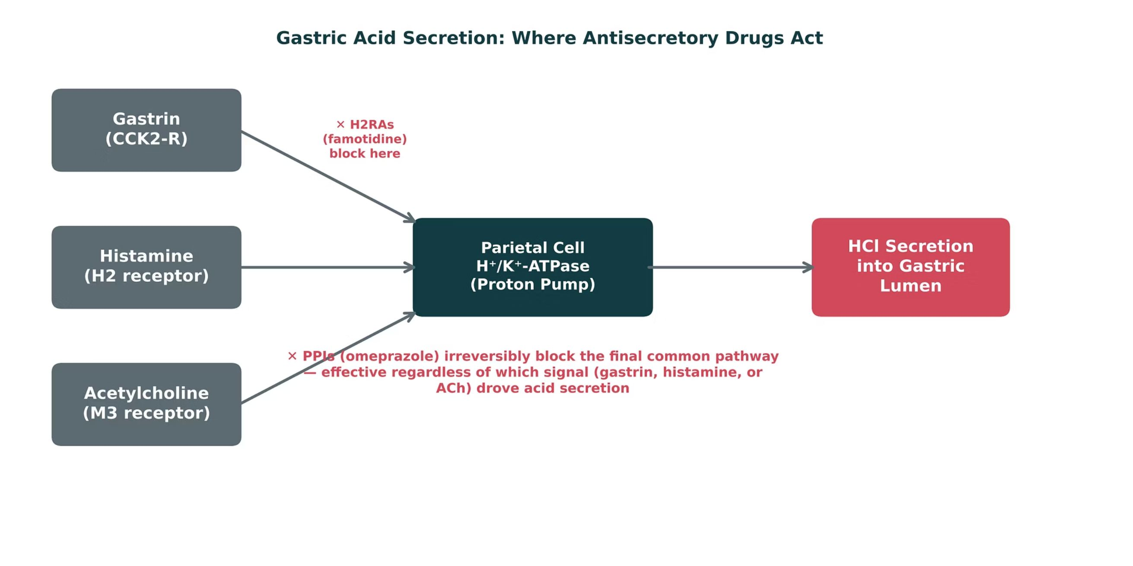
ORIGINAL ILLUSTRATION · FIGURE 1
Gastric Acid Secretion: Where Antisecretory Drugs Act
Figure 1. Original illustrative diagram (not from Katzung): gastrin, histamine, and acetylcholine all converge on the parietal cell proton pump; H2RAs block only the histamine pathway, while PPIs block the final common pathway itself.
GI & Nutrition Pharmacology — Session 1 of 2 — PA Program
8
Notes:
This is the conceptual spine for the whole antisecretory-agent section that follows. Make sure students can explain WHY PPIs are more complete acid suppressors than H2RAs using this diagram alone.
Instructor script:
Say: Gastrin, histamine and acetylcholine all converge on the parietal cell proton pump. H2 blockers cut one input. PPIs block the last step.

Slide 9
QUICK CHECK · FIGURE 1
Quick Check
Based on Figure 1, why do PPIs achieve more complete acid suppression than H2 receptor antagonists?
PPIs block the final common pathway (the proton pump itself), so they work regardless of which upstream signal is driving acid secretion
PPIs block only the gastrin pathway, which is the strongest stimulus
A
B
C
H2RAs block the proton pump directly, while PPIs act upstream
D
There is no mechanistic difference between the two classes
GI & Nutrition Pharmacology — Session 1 of 2 — PA Program
9
Notes:
Quick check: Give 30 seconds.

Slide 10
ANSWER · FIGURE 1
Answer
A
PPIs block the final common pathway itself, regardless of which upstream signal drove it.
Why: H2RAs block only one of three inputs to the parietal cell (histamine), so gastrin and acetylcholine can still drive acid secretion. PPIs irreversibly inhibit the H⁺/K⁺-ATPase proton pump — the single convergence point for all three signals — producing more complete and longer-lasting acid suppression.
GI & Nutrition Pharmacology — Session 1 of 2 — PA Program
10
Notes:
Answer A: PPIs block the final common pathway regardless of which signal drove it.

Slide 11

SECTION
02
Antisecretory & Mucosal-Protective Agents
Turning down acid production, or shielding the mucosa from it.
Notes:
Section transition.
Section 02: Antisecretory and mucosal-protective agents (slides 11-28).

Slide 12

FIRST-LINE, SHORT-TERM
Antacids
Mechanism: directly neutralize existing gastric acid (do not reduce acid production).
Onset is rapid, but duration of effect is short — best for intermittent, mild symptom relief.
Aluminum hydroxide — constipating
Magnesium hydroxide — can cause diarrhea; use caution in renal impairment (magnesium accumulation)
Calcium carbonate — can cause constipation; risk of milk-alkali syndrome with excessive use
Can impair absorption of many other oral drugs — counsel patients to separate dosing by at least 2 hours.
Acid in stomach
Antacid base (Al/Mg hydroxide, calcium carbonate) neutralizes H+
Higher gastric pH
Rapid but short relief; no effect on acid production
▶
▶
▶
GI & Nutrition Pharmacology — Session 1 of 2 — PA Program
12
Notes:
Antacids are the oldest and most "patient-directed" class here — good opening point to contrast with the receptor- and enzyme-targeted agents that follow.
Instructor script:
Say: They neutralize acid already made. They do not reduce acid production. Onset is fast and duration is short, so they suit mild, intermittent symptoms.
Know:
Aluminum constipates, magnesium causes diarrhea, calcium carbonate constipates and can cause milk-alkali syndrome with excess use.
They bind other drugs. Separate dosing by at least 2 hours.

Slide 13
REVERSIBLE BLOCKADE
H2 Receptor Antagonists
Mechanism: competitively block histamine at the H2 receptor on parietal cells.
Famotidine — the most commonly used agent; minimal CYP450 interaction.
Cimetidine — effective, but a potent CYP450 inhibitor (ties back to the drug-metabolism concepts from Lecture 1) and carries antiandrogenic effects (gynecomastia) with prolonged use.
Clinical use: mild-to-moderate GERD, maintenance therapy, adjunct for peptic ulcer healing.
Tolerance can develop with continuous use, reducing effectiveness over time.
Histamine
▼
H2 receptor on parietal cell blocked by famotidine
▼
Less cAMP
▼
Less pump activity
▼
Reduced acid
GI & Nutrition Pharmacology — Session 1 of 2 — PA Program
13
Notes:
Cimetidine’s CYP450 inhibition is a great callback to Lecture 1’s drug-metabolism/interaction framework — ask students to predict what happens to warfarin or phenytoin levels if cimetidine is added.
Instructor script:
Know:
Tolerance (tachyphylaxis) develops with continued use.
Best at controlling nocturnal acid.
Famotidine needs renal dose adjustment and can cause confusion in older adults with renal impairment.
Cimetidine inhibits CYP450 (1A2, 2C19, 3A4) and has antiandrogenic effects, including gynecomastia.

Slide 14
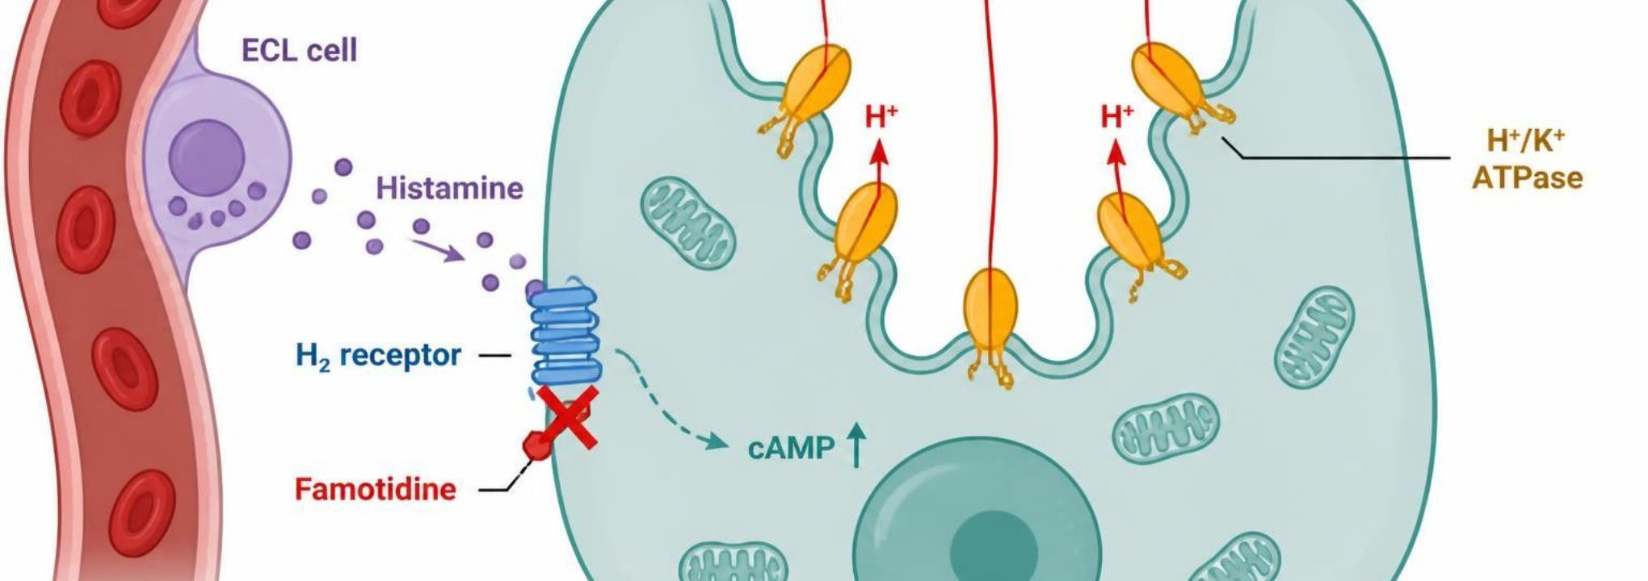
MECHANISM & DEPTH
H2 Blockers: Blocking the Histamine Signal
Schematic (illustrative)
Histamine released from ECL cells
▼
Binds H2 receptor on the parietal cell
▼
Raises cAMP
▼
Figure 2. ECL cell releases histamine (purple dots) → binds H2 receptor (blue) on the parietal cell → cAMP rises (dashed arrow) → H+/K+ ATPase pumps (orange) move H+ into the gastric lumen. Famotidine (red X) blocks the H2 receptor, so less acid is secreted.
Stimulates the proton pump
▼
Tachyphylaxis can develop with continued use
Best for nocturnal acid secretion
Famotidine: renal dose adjustment; confusion risk in older adults
Cimetidine inhibits CYP450 (1A2, 2C19, 3A4); antiandrogenic effects
H2 blocker occupies the receptor competitively, so less acid
GI & Nutrition Pharmacology — Session 1 of 2 — PA Program
14
Notes:
Say: Histamine from the ECL cell binds the H2 receptor, cAMP rises, and the pump turns on. Famotidine competes at that receptor.

Slide 15
MOST POTENT ACID SUPPRESSION
Proton Pump Inhibitors (PPIs)
Mechanism: irreversibly inhibit the H⁺/K⁺-ATPase proton pump — the final common pathway of acid secretion.
Omeprazole, esomeprazole, pantoprazole, lansoprazole, dexlansoprazole — first-line for GERD, PUD healing, and H. pylori regimens.
Best absorbed/effective when taken 30–60 minutes before a meal (timed to coincide with peak pump activity).
Long-term adverse effects: vitamin B12 deficiency, hypomagnesemia, increased fracture risk, and increased risk of Clostridioides difficile infection.
Interaction: omeprazole (a CYP2C19 inhibitor) can reduce the activation of clopidogrel, potentially blunting its antiplatelet effect.
Abrupt discontinuation after prolonged use can cause rebound acid hypersecretion.
PPI prodrug activated by acid
▼
Binds H⁺/K⁺ ATPase irreversibly
▼
Final step of acid secretion blocked
▼
Profound, prolonged acid suppression
GI & Nutrition Pharmacology — Session 1 of 2 — PA Program
15
Notes:
The long-term adverse-effect list is high-yield for both exams and real-world deprescribing conversations — many patients are on PPIs far longer than clinically necessary.
Instructor script:
Know:
Take 30-60 minutes before the first meal, because PPIs work on actively secreting pumps.
Long-term risks: C. difficile infection, fractures, hypomagnesemia, B12 deficiency, pneumonia, acute interstitial nephritis, and rebound acid hypersecretion on stopping.
Omeprazole and esomeprazole inhibit CYP2C19 and can blunt clopidogrel activation.
CYP2C19 genotype changes PPI exposure. Ultrarapid metabolizers may need higher doses.

Slide 16
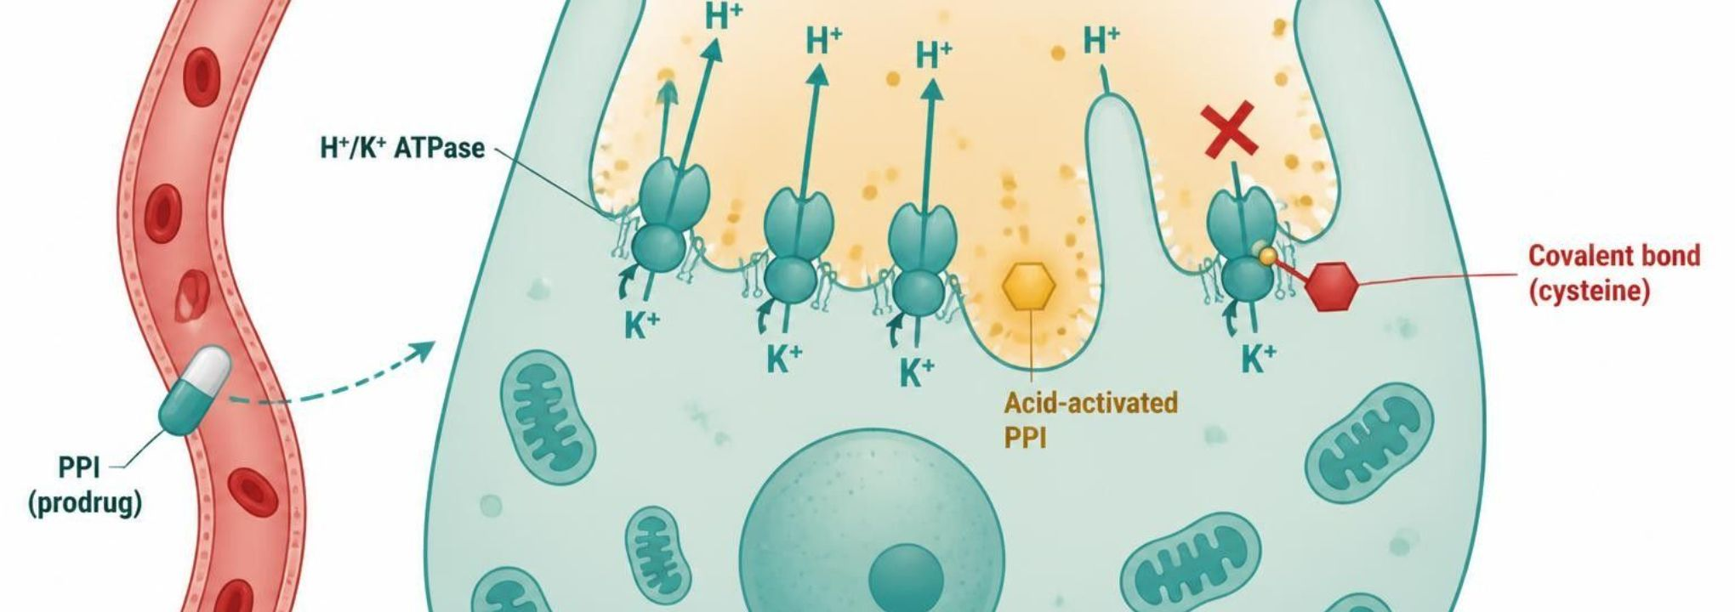
MECHANISM & DEPTH
PPIs: Irreversible Pump Inhibition
Schematic (illustrative)
Enteric-coated prodrug absorbed in the small intestine
▼
Reaches the parietal cell canaliculus
▼
Activated by acid
▼
Figure 3. The PPI prodrug (capsule) is absorbed and reaches the parietal cell. In the acidic canaliculus it is activated (yellow) and binds a cysteine on the H+/K+ ATPase pump (red marker, covalent bond). Open pumps (teal) move H+ toward the gastric lumen; the blocked pump (red X) does not.
Binds cysteine on H+/K+ ATPase covalently
▼
Take 30–60 minutes before the first meal; works best on actively secreting pumps
Long-term risks: C. difficile, fractures, hypomagnesemia, B12 deficiency, pneumonia, acute interstitial nephritis; rebound acid hypersecretion on stopping
Omeprazole and esomeprazole inhibit CYP2C19 (clopidogrel interaction)
CYP2C19 genotype alters exposure; ultrarapids may need higher doses
Pump irreversibly blocked until new pumps are made
GI & Nutrition Pharmacology — Session 1 of 2 — PA Program
16
Notes:
Say: A PPI is an enteric-coated prodrug. It reaches the canaliculus, acid activates it, and it binds a cysteine on the H+/K+ ATPase covalently. The pump stays off until the cell makes new pumps.

Slide 17
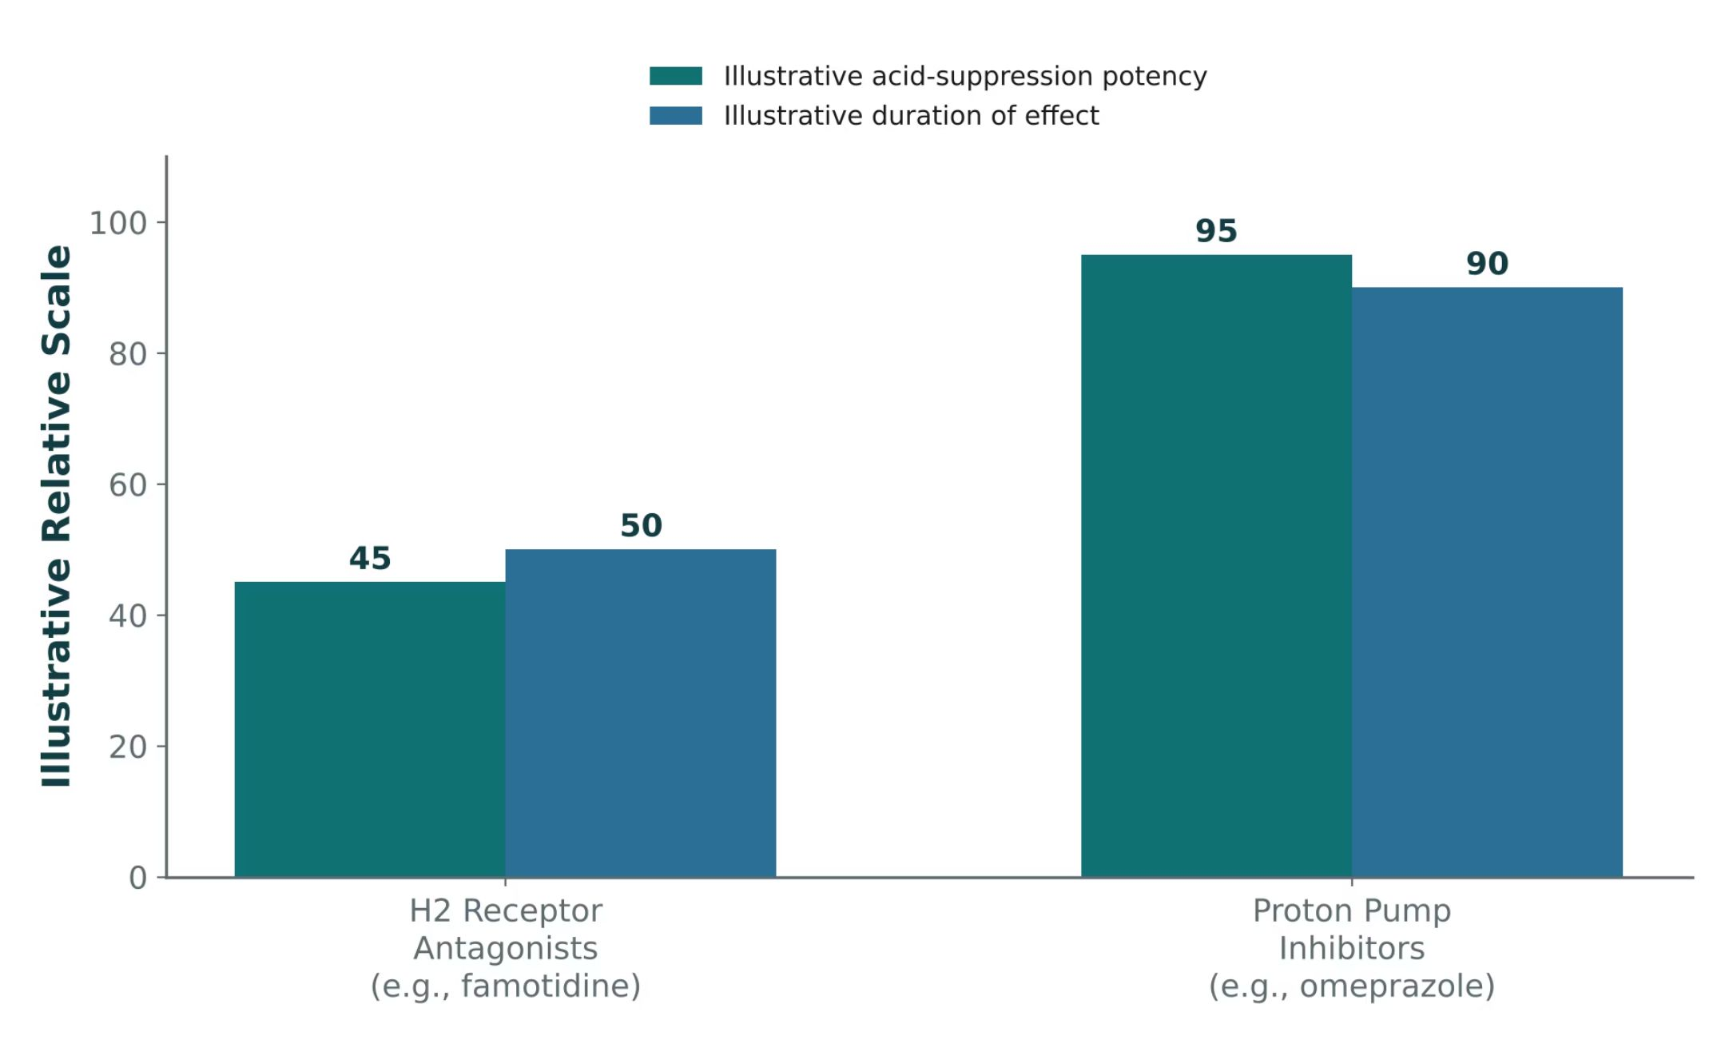
ORIGINAL ILLUSTRATION · FIGURE 4
PPIs vs. H2 Receptor Antagonists: Potency and Duration
Figure 4. Original illustrative comparison (illustrative relative values, not from Katzung): PPIs achieve substantially greater acid-suppression potency and longer duration of effect than H2 receptor antagonists.
GI & Nutrition Pharmacology — Session 1 of 2 — PA Program
17
Notes:
This is the quantified version of the mechanistic point just made — more complete blockade (Figure 1) translates into both higher potency and longer duration here.
Instructor script:
Figure 4: Remind the class that the bars are illustrative relative values, not trial data. PPIs give greater and longer suppression than H2 blockers.

Slide 18
QUICK CHECK · ANTISECRETORY AGENTS
Quick Check
A patient taking clopidogrel after a cardiac stent is started on omeprazole for GERD. What is the primary concern with this combination?
A
Omeprazole may reduce CYP2C19-mediated activation of clopidogrel, blunting its antiplatelet effect
B
Omeprazole increases clopidogrel absorption, raising bleeding risk
C
There is no clinically relevant interaction between these two drugs
D
Omeprazole should never be combined with any cardiac medication
GI & Nutrition Pharmacology — Session 1 of 2 — PA Program
18
Notes:
Quick check: Omeprazole plus clopidogrel.

Slide 19
ANSWER · ANTISECRETORY AGENTS
Answer
A
Omeprazole may reduce CYP2C19-mediated activation of clopidogrel.
Why: Clopidogrel is a prodrug that requires CYP2C19 activation. Omeprazole inhibits CYP2C19, which can reduce clopidogrel’s active metabolite and blunt its antiplatelet effect — a clinically important interaction, especially soon after stent placement.
GI & Nutrition Pharmacology — Session 1 of 2 — PA Program
19
Notes:
Answer A: omeprazole may reduce CYP2C19-mediated activation of clopidogrel. If a PPI is needed, pantoprazole is the usual choice.

Slide 20

SHIELDING THE MUCOSA
Mucosal Protective Agents
Sucralfate
Misoprostol
– Forms a protective barrier over the ulcer base
– Requires an acidic environment to activate — give on an empty stomach, separated from antacids/PPIs
– Minimal systemic absorption
– A prostaglandin E1 analog — restores the protective prostaglandin tone that NSAIDs suppress
– Used specifically to prevent NSAID-induced ulcers
– Contraindicated in pregnancy — potent uterotonic/abortifacient effect
– Common adverse effect: diarrhea
GI & Nutrition Pharmacology — Session 1 of 2 — PA Program
20
Notes:
Misoprostol’s pregnancy contraindication is a must-know, high-stakes safety point — this is also the drug’s other well-known clinical use (labor induction/medical abortion), so the mechanism-to-contraindication link should feel obvious once stated.
Instructor script:
Know:
Sucralfate: separate from other drugs by 2 hours, aluminum accumulates in CKD, constipation is common.
Misoprostol: contraindicated in pregnancy because it causes uterine contractions. Diarrhea and cramping are common.

Slide 21
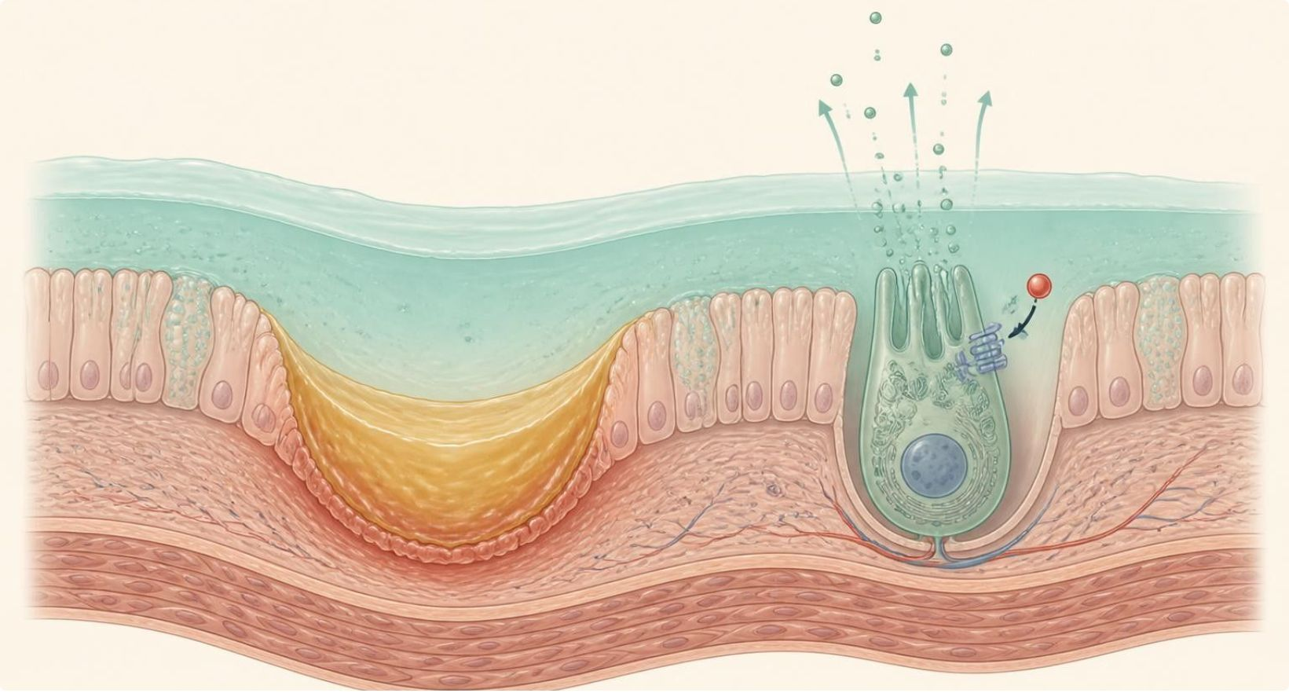
MECHANISM & DEPTH
Sucralfate and Misoprostol: Strengthening Defense
Sucralfate: in acid (pH below 4) it polymerizes
Gastric lumen (acid)
Misoprostol: PGE1 analog
▼
▼
Mucus and bicarbonate layer
Binds the ulcer base
Acts on EP receptors
EP receptor
Sucralfate barrier
▼
▼
Parietal cell
Forms a protective barrier
Less acid; more mucus and bicarbonate
Ulcer base
Misoprostol (PGE1 analog)
▼
▼
Schematic (illustrative)
Figure 5. Sucralfate polymerizes in acid and binds the ulcer base, forming a protective barrier. Misoprostol, a PGE1 analog, activates EP receptors on parietal cells to reduce acid and increases mucus and bicarbonate.
Ulcer heals
Prevents NSAID ulcers
Separate sucralfate from other drugs by 2 hours
Aluminum accumulates in CKD; constipation is common
Misoprostol is contraindicated in pregnancy (uterine contractions)
Diarrhea and cramping are common with misoprostol
GI & Nutrition Pharmacology — Session 1 of 2 — PA Program
21
Notes:
Say: Sucralfate polymerizes in acid, sticks to the ulcer base and forms a barrier. Misoprostol is a PGE1 analog. It acts on EP receptors to cut acid and raise mucus and bicarbonate.

Slide 22
HIGH-YIELD COMPARISON · TABLE 1
Acid-Peptic Disease Agents at a Glance
Class | Example Agent(s) | Key Teaching Point
Antacid | Calcium carbonate, magnesium hydroxide | Neutralizes existing acid; rapid onset, short duration
H2RA | Famotidine, cimetidine | Blocks histamine input only; cimetidine inhibits CYP450
PPI | Omeprazole, pantoprazole | Blocks final common pathway; most potent, long-term AE risks
Mucosal protectant | Sucralfate, misoprostol | Barrier/prostaglandin replacement; misoprostol contraindicated in pregnancy
GI & Nutrition Pharmacology — Session 1 of 2 — PA Program
22
Notes:
Use this table as the organizing summary before moving into H. pylori eradication, which combines several of these agents together.
Instructor script:
Slide at a glance: Read across the table row by row. This is a good review point.

Slide 23

TREATING THE CAUSE
H. pylori Eradication Therapy
H. pylori is the leading identifiable cause of peptic ulcer disease — eradication, not just acid suppression, is the goal.
Triple therapy: PPI + amoxicillin + clarithromycin for 10–14 days.
Bismuth quadruple therapy: PPI (or H2RA) + bismuth subsalicylate + metronidazole + tetracycline — preferred where clarithromycin resistance is a concern or with recent macrolide exposure.
Penicillin allergy: substitute metronidazole for amoxicillin in triple therapy.
Confirm eradication with testing (e.g., urea breath test or stool antigen) after completing therapy, not during PPI therapy, which can cause false negatives.
GI & Nutrition Pharmacology — Session 1 of 2 — PA Program
23
Notes:
Multi-drug regimens like this are a classic source of adherence problems — worth pausing to ask students what patient-counseling points would most improve completion of a 10–14 day, 3–4 drug regimen.
Instructor script:
Know:
Usual duration is 14 days.
Bismuth quadruple therapy: PPI plus bismuth plus tetracycline plus metronidazole. It is preferred with penicillin allergy or prior macrolide exposure.
Confirm eradication at least 4 weeks after therapy and with the PPI held for 2 weeks.
Clarithromycin inhibits CYP3A4 (statins). Metronidazole plus alcohol causes a disulfiram-like reaction. Avoid tetracycline in pregnancy and in children.

Slide 24
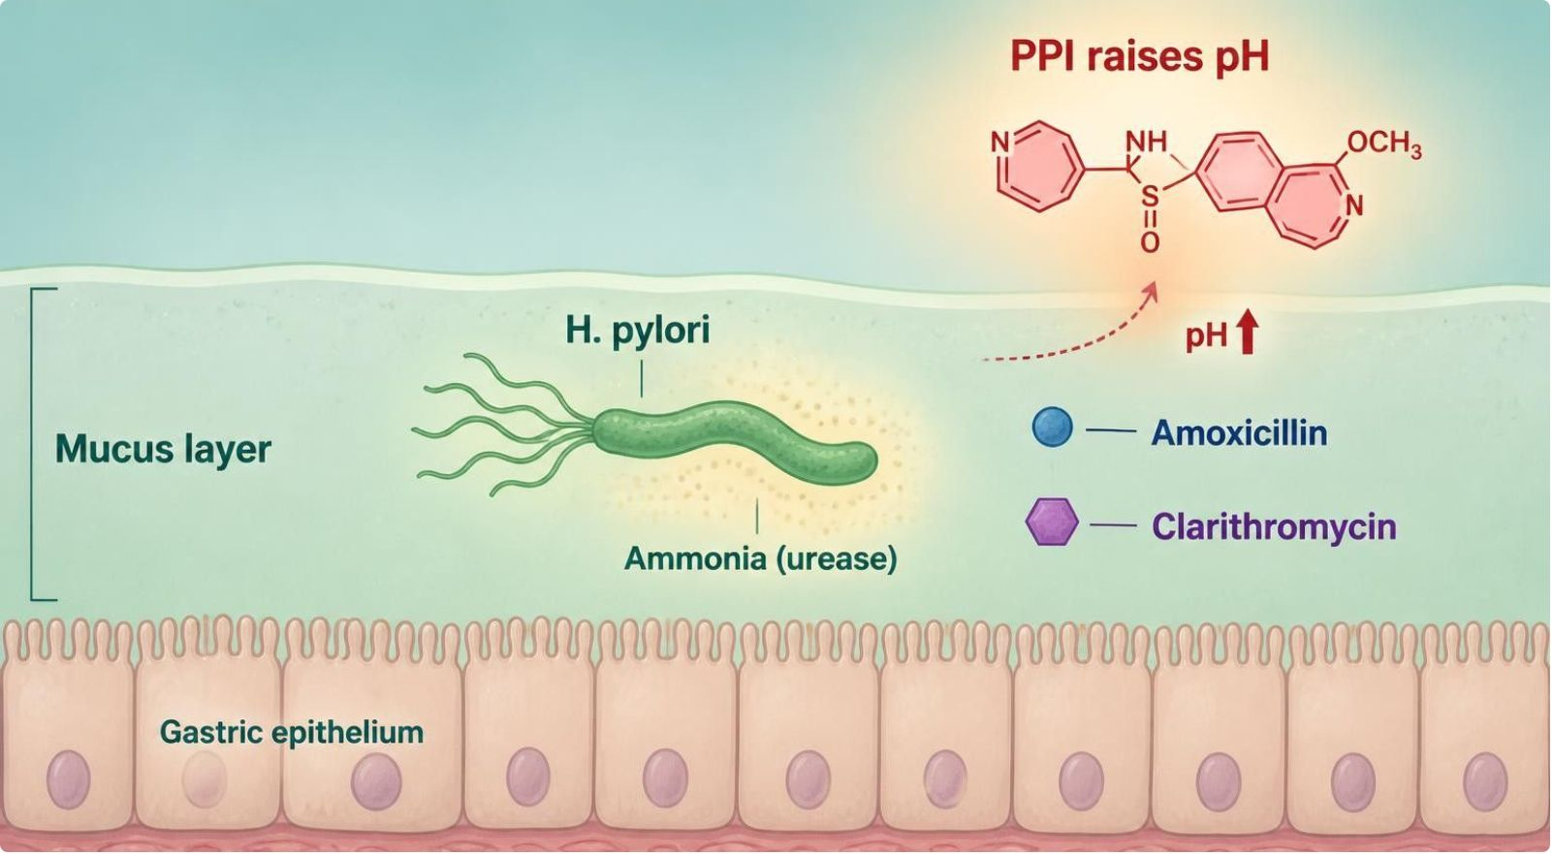
MECHANISM & DEPTH
Why H. pylori Needs Multiple Drugs
PPI raises gastric pH
▼
Bacteria enter a replicating state; antibiotics are more stable
▼
Amoxicillin blocks cell wall synthesis, plus clarithromycin or metronidazole
Schematic (illustrative)
Figure 6. H. pylori lives in the gastric mucus and buffers acid with urease-made ammonia. A PPI raises pH, amoxicillin blocks cell wall synthesis, and clarithromycin or metronidazole adds a second antibiotic; bismuth quadruple therapy is the alternative.
▼
Bismuth quadruple (alternative): PPI + bismuth + tetracycline + metronidazole
Usual duration 14 days; test of cure 4+ weeks after, off PPI 2 weeks
Clarithromycin resistance; penicillin allergy means bismuth quadruple
Interactions: CYP3A4 (statins), alcohol; avoid tetracycline in pregnancy
GI & Nutrition Pharmacology — Session 1 of 2 — PA Program
24
Notes:
Say: The goal is eradication, not only acid suppression. A PPI raises gastric pH, which makes antibiotics work better. Amoxicillin blocks the cell wall. Clarithromycin hits the 50S ribosome. Metronidazole adds another mechanism.

Slide 25

CLINICAL CASE
Choosing an H. pylori Regimen
A patient with confirmed H. pylori infection reports a penicillin allergy and received a macrolide antibiotic for a respiratory infection two months ago.
Ask yourself: Which eradication regimen is more appropriate for this patient, and why?
Clinical pearl: Recent macrolide exposure raises concern for clarithromycin resistance, and the penicillin allergy rules out standard triple therapy — bismuth quadruple therapy (PPI + bismuth + metronidazole + tetracycline) avoids both problems.
GI & Nutrition Pharmacology — Session 1 of 2 — PA Program
25
Notes:
This vignette forces students to apply two separate exclusion criteria at once — a good checkpoint for whether the regimen differences actually landed.
Instructor script:
Ask: "Penicillin allergy and a macrolide two months ago. Which regimen?" Answer: bismuth quadruple therapy.

Slide 26

QUICK CHECK · ACID-PEPTIC DISEASE
Quick Check
A patient is started on misoprostol for NSAID-induced ulcer prevention. What is the single most important question to ask before prescribing?
A
Is the patient taking any antacids?
B
Is there any possibility of pregnancy?
C
Does the patient have a penicillin allergy?
D
Is the patient on a PPI already?
GI & Nutrition Pharmacology — Session 1 of 2 — PA Program
26
Notes:
Quick check: Misoprostol.

Slide 27
ANSWER · ACID-PEPTIC DISEASE
Answer
B
Is there any possibility of pregnancy?
Why: Misoprostol is a potent uterotonic and is contraindicated in pregnancy due to abortifacient risk — pregnancy status must be ruled out (and reliable contraception confirmed) before starting therapy.
GI & Nutrition Pharmacology — Session 1 of 2 — PA Program
27
Notes:
Answer B: ask about possible pregnancy.

Slide 28
MECHANISM & DEPTH
Drug Names Reveal the Class: Acid-Peptic Disease
Stem | Drug class | Examples | Key point
-prazole | Proton pump inhibitors | Omeprazole, esomeprazole, pantoprazole, lansoprazole | Irreversibly block H+/K+ ATPase
-tidine | H2 receptor antagonists | Famotidine, ranitidine, cimetidine | Competitively block the H2 receptor
-prostol | Prostaglandin analogs | Misoprostol | PGE1 analog; protects the mucosa
-cillin | Penicillins | Amoxicillin | Blocks cell wall synthesis
-thromycin | Macrolides | Clarithromycin | -mycin alone is not reliable (e.g., gentamicin)
None shared | Mucosal protectants | Sucralfate, bismuth subsalicylate | Name does not reveal the class
GI & Nutrition Pharmacology — Session 1 of 2 — PA Program
28
Notes:
Drug-name stems: -prazole is a PPI, -tidine is an H2 blocker, -prostol is a prostaglandin analog, -cillin is a penicillin, -thromycin is a macrolide. Sucralfate and bismuth subsalicylate have no stem.

Slide 29

SECTION
03
Antiemetics
Four receptor systems feed one final common reflex.
Notes:
Section transition.
Section 03: Antiemetics (slides 29-43).

Slide 30

CLASSIFICATION BY TARGET
Antiemetic Drug Classes
5-HT3 Antagonists
D2 Antagonists
– Block serotonin at gut vagal afferents / CTZ
– Example: ondansetron
– Block dopamine at the CTZ
– Examples: metoclopramide, prochlorperazine
NK1 Antagonists
H1 / M1 Antagonists
– Block substance P/neurokinin at the CTZ
– Example: aprepitant
– Block histamine/acetylcholine from the vestibular system
– Examples: meclizine, scopolamine
GI & Nutrition Pharmacology — Session 1 of 2 — PA Program
30
Notes:
Each class corresponds to a different input feeding the vomiting center — the next slide shows these same four classes as a single mechanism diagram.
Instructor script:
Name the four target groups: 5-HT3, D2, NK1, and H1/M1.

Slide 31
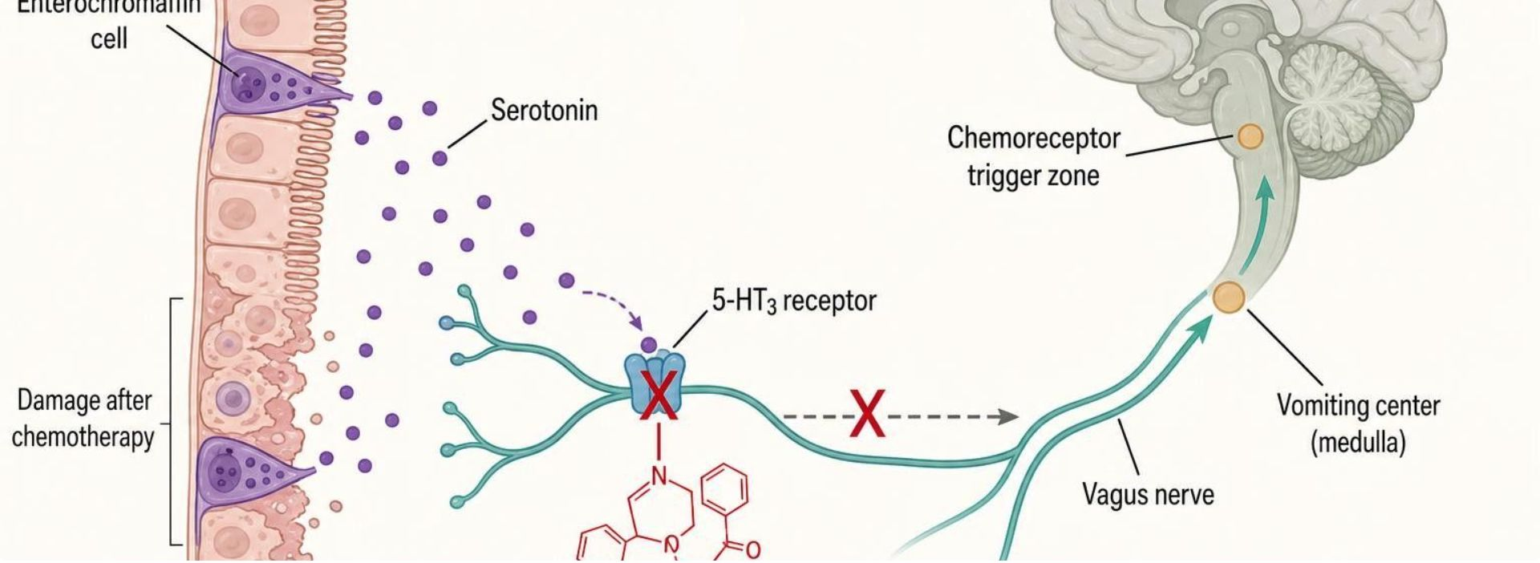
MECHANISM & DEPTH
Ondansetron: Blocking Serotonin at 5-HT3
Schematic (illustrative)
Chemotherapy or gut irritation damages enterochromaffin cells
▼
Serotonin released from enterochromaffin cells
▼
Serotonin binds 5-HT3 on vagal afferents and the chemoreceptor trigger zone
▼
Figure 7. Chemotherapy or gut irritation damages enterochromaffin cells, which release serotonin (purple dots). Serotonin normally binds 5-HT3 receptors on vagal afferents and the chemoreceptor trigger zone, sending signals to the vomiting center in the medulla. Ondansetron (red X) blocks the 5-HT3 receptor, so no signal reaches the vomiting center.
Signals reach the vomiting center in the medulla
▼
Give before chemo; oral ODT and IV forms are available
QT prolongation: caution with other QT-prolonging drugs and electrolyte problems
Common effects: constipation, headache; serotonin syndrome risk with serotonergic drugs
CYP2D6 ultrarapid metabolizers may respond less well
Ondansetron blocks 5-HT3, so no signal reaches the vomiting center
GI & Nutrition Pharmacology — Session 1 of 2 — PA Program
31
Notes:
Say: Chemotherapy injures enterochromaffin cells. They release serotonin. Serotonin binds 5-HT3 on vagal afferents and the chemoreceptor trigger zone. Ondansetron blocks that receptor.
Know:
Give before chemotherapy. Oral disintegrating and IV forms exist.
QT prolongation: caution with other QT-prolonging drugs and electrolyte problems.
Constipation and headache are common. Serotonin syndrome risk with other serotonergic drugs.
CYP2D6 ultrarapid metabolizers may respond less well.

Slide 32
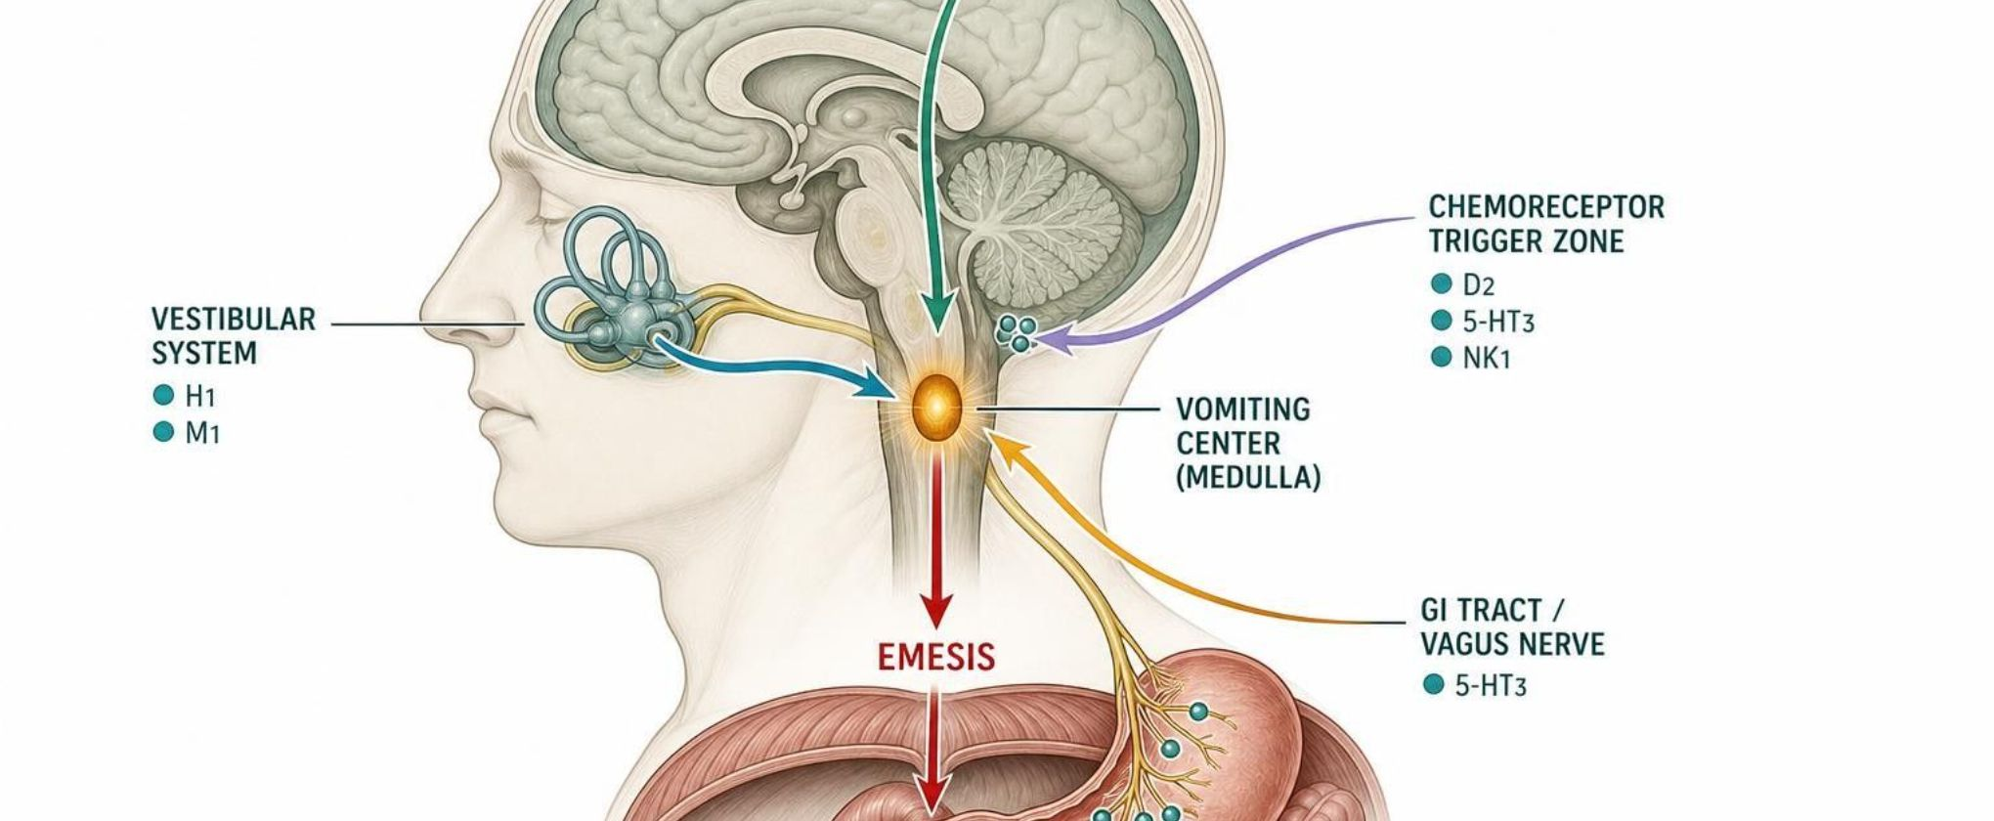
MECHANISM & DEPTH
Receptors in the Vomiting Pathway
Schematic (illustrative)
Gut and vagal (5-HT3)
5-HT3 antagonists
Chemoreceptor trigger zone (D2, 5-HT3, NK1)
D2, 5-HT3 and NK1 antagonists
Vestibular (H1, M1)
Antihistamines and scopolamine
Higher cortical (anxiety, anticipatory)
Benzodiazepines and cannabinoids
▼
Vomiting center in the medulla
Figure 8. Four inputs converge on the vomiting center in the medulla: the GI tract via the vagus nerve (5-HT3), the chemoreceptor trigger zone (D2, 5-HT3, NK1), the vestibular system (H1, M1) and the cerebral cortex (anxiety, anticipation). The vomiting center then triggers emesis.
▼
Combine classes with different targets: 5-HT3 and NK1 antagonists, dexamethasone
Match drug to cause: gut/vagal triggers respond to 5-HT3; CTZ to D2 or NK1
Avoid duplicating the same mechanism in one regimen
Emesis
GI & Nutrition Pharmacology — Session 1 of 2 — PA Program
32
Notes:
Say: Four inputs reach the vomiting center in the medulla: the gut through the vagus, the trigger zone, the vestibular system and the cortex. Match the drug to the cause.
Know: For chemotherapy, combine drugs with different targets, such as a 5-HT3 antagonist, an NK1 antagonist and dexamethasone. Do not duplicate the same mechanism.

Slide 33
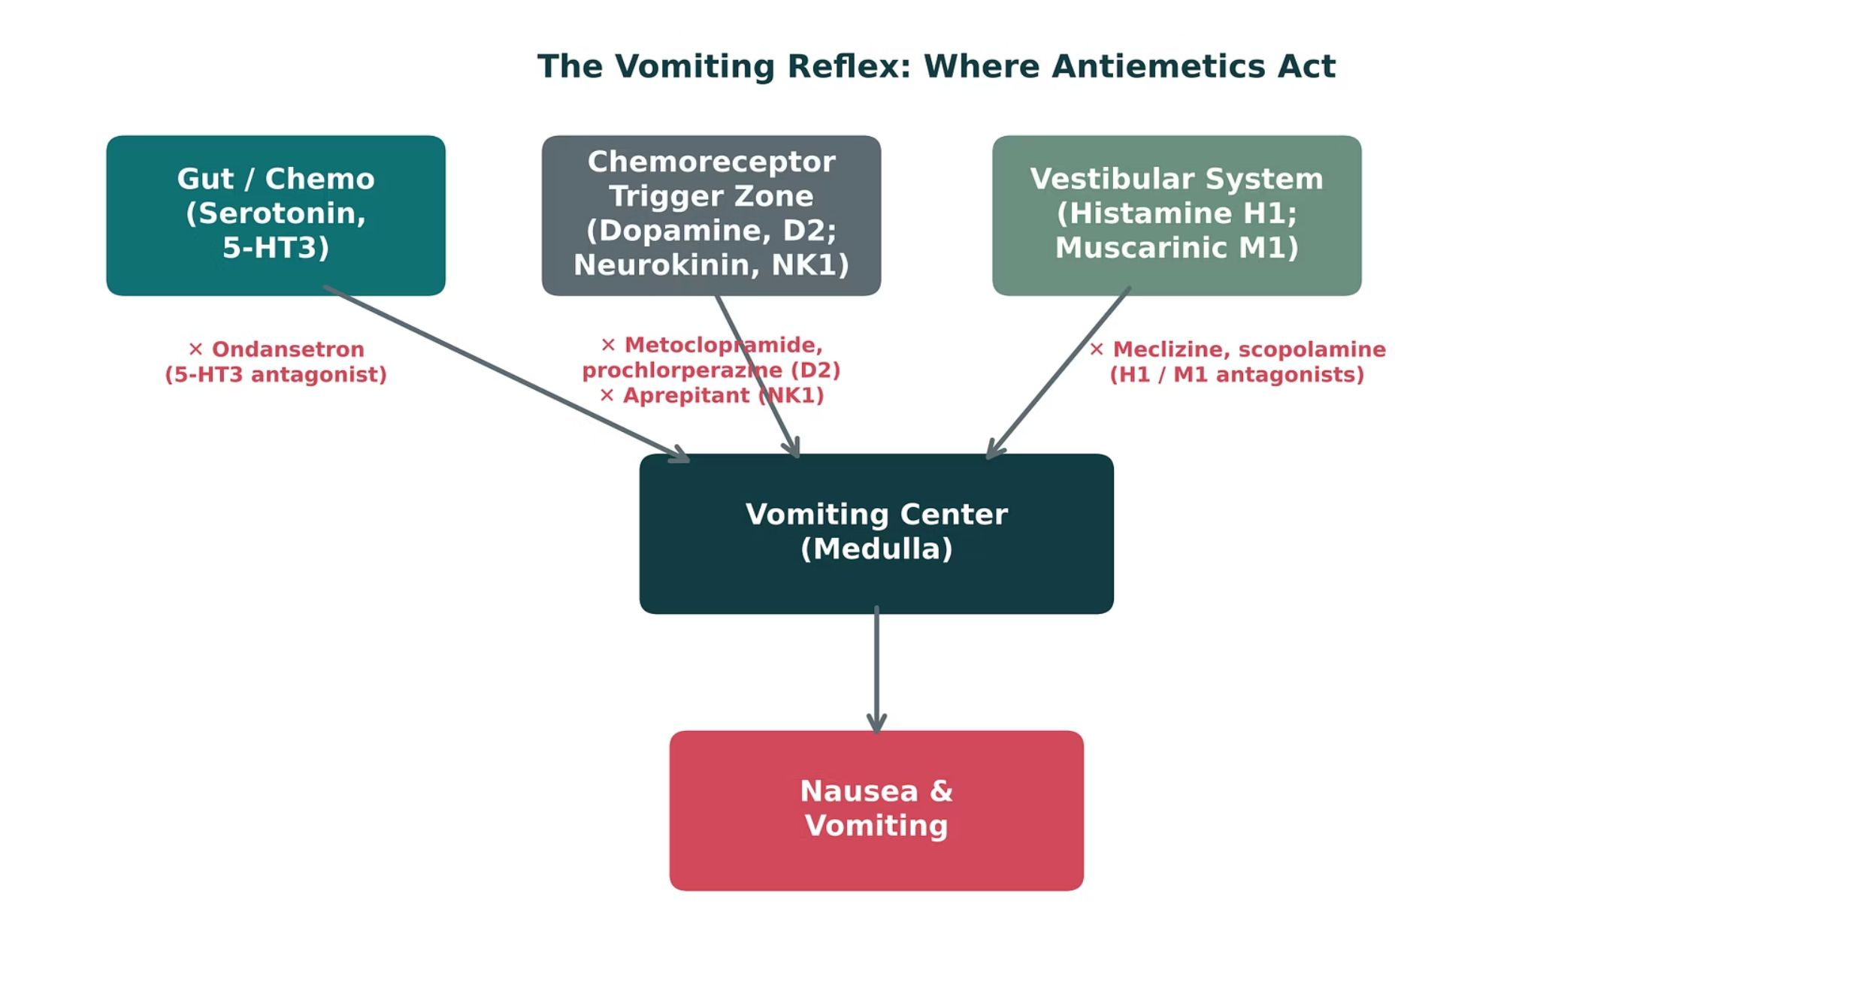
ORIGINAL ILLUSTRATION · FIGURE 9
The Vomiting Reflex: Where Antiemetics Act
Figure 9. Original illustrative diagram (not from Katzung): serotonin, dopamine/neurokinin, and histamine/acetylcholine signals converge on the vomiting center; ondansetron, metoclopramide/prochlorperazine/aprepitant, and meclizine/scopolamine each block a different input.
GI & Nutrition Pharmacology — Session 1 of 2 — PA Program
33
Notes:
Have students match each generic drug name to its input pathway on this diagram before revealing the labels — this is the single most testable concept in the antiemetic section.
Instructor script:
Motion sickness is vestibular.

Slide 34
QUICK CHECK · FIGURE 9
Quick Check
A patient with motion sickness needs prophylaxis before a cruise. Based on Figure 9, which drug class targets the pathway most relevant to this cause of nausea?
A
H1 / M1 antagonists (e.g., meclizine, scopolamine) — targeting the vestibular system
B
5-HT3 antagonists (e.g., ondansetron) — targeting gut/chemo input
C
NK1 antagonists (e.g., aprepitant) — targeting the CTZ
D
D2 antagonists (e.g., metoclopramide) — targeting the CTZ
GI & Nutrition Pharmacology — Session 1 of 2 — PA Program
34
Notes:
Quick check.

Slide 35
ANSWER · FIGURE 9
Answer
A
H1 / M1 antagonists (meclizine, scopolamine) — targeting the vestibular system.
Why: Motion sickness is driven primarily by vestibular system input, which signals through histamine (H1) and muscarinic (M1) receptors — exactly the pathway meclizine and scopolamine block in Figure 9. The other classes target gut/chemo (5-HT3) or CTZ (D2, NK1) inputs, which are not the primary driver here.
GI & Nutrition Pharmacology — Session 1 of 2 — PA Program
35
Notes:
Answer A: H1/M1 antagonists such as meclizine and scopolamine.

Slide 36
DUAL MECHANISM
Metoclopramide: Antiemetic and Prokinetic
Mechanism: D2 antagonism (antiemetic effect) plus enhancement of upper-GI motility (prokinetic effect).
Clinical uses: nausea/vomiting and diabetic gastroparesis.
Boxed warning: risk of tardive dyskinesia, particularly with prolonged use or high doses — limit duration of therapy.
Other extrapyramidal symptoms (acute dystonia, akathisia) can also occur.
D2 blockade in CTZ
▼
Less nausea and vomiting
D2 blockade plus 5-HT4 agonism in gut
▼
More acetylcholine
▼
Faster gastric emptying
GI & Nutrition Pharmacology — Session 1 of 2 — PA Program
36
Notes:
Metoclopramide’s boxed warning is one of the highest-yield patient-safety facts in this whole session — many students only remember "it helps nausea" without knowing why duration of use matters so much.
Instructor script:
Know:
Boxed warning: tardive dyskinesia. Avoid use beyond 12 weeks.
Acute dystonia is treated with diphenhydramine or benztropine.
Contraindicated in GI obstruction. Avoid in Parkinson disease.
Renal dose adjustment. CYP2D6 poor metabolizers have higher exposure.

Slide 37
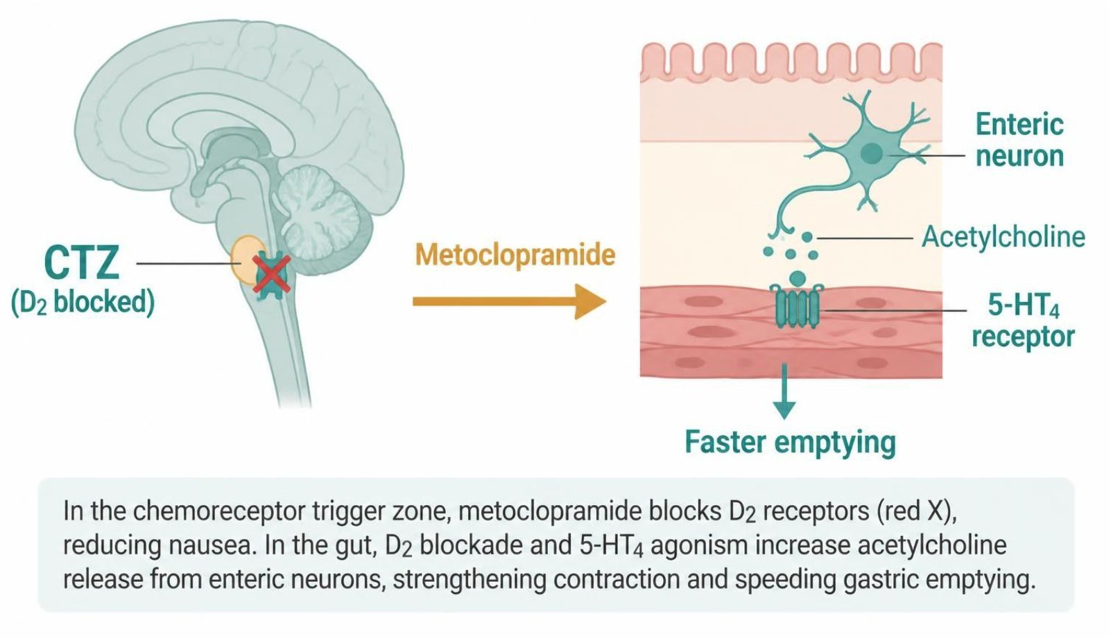
MECHANISM & DEPTH
Metoclopramide: D2 Blockade and 5-HT4 Agonism
D2 antagonism in the chemoreceptor trigger zone
5-HT4 agonism and D2 blockade in the gut
▼
▼
Less nausea and vomiting
More acetylcholine release
▼
▼
Faster gastric emptying and motility
Schematic (illustrative)
Figure 10. In the chemoreceptor trigger zone, metoclopramide blocks D2 receptors (red X), reducing nausea. In the gut, D2 blockade and 5-HT4 agonism increase acetylcholine release from enteric neurons, strengthening contraction and speeding gastric emptying.
Boxed warning for tardive dyskinesia; avoid use beyond 12 weeks
Acute dystonia is treated with diphenhydramine or benztropine
Contraindicated in GI obstruction; avoid in Parkinson disease
Renal dosing needed; CYP2D6 poor metabolizers need lower doses
GI & Nutrition Pharmacology — Session 1 of 2 — PA Program
37
Notes:
Say: D2 blockade in the trigger zone reduces nausea. In the gut, D2 blockade plus 5-HT4 agonism raises acetylcholine release and speeds gastric emptying.

Slide 38

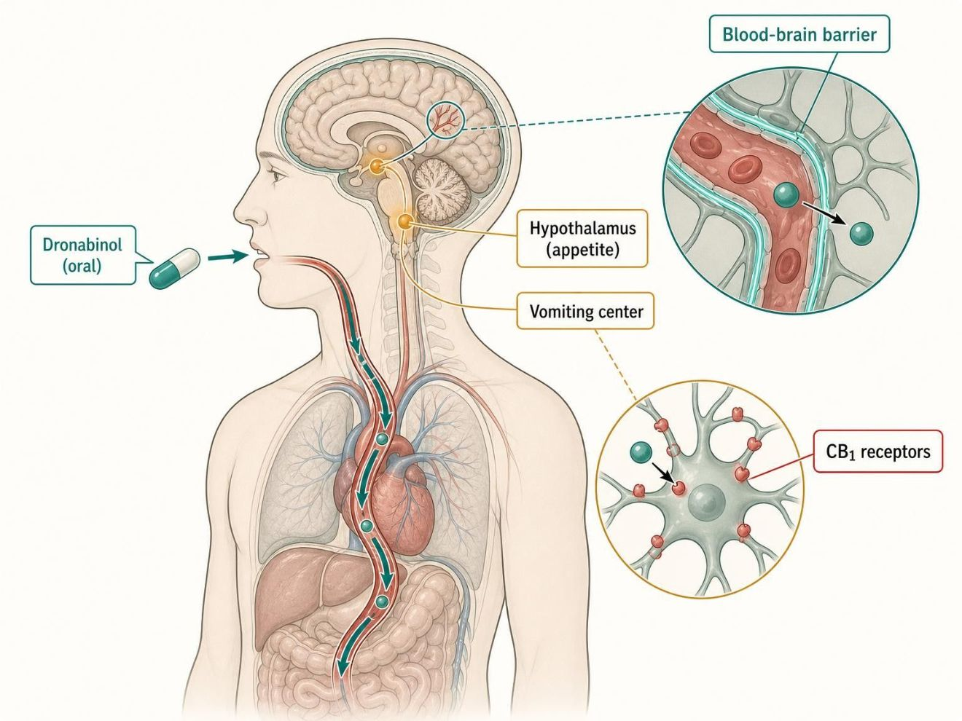
A THIRD PATHWAY
Cannabinoids for Chemotherapy-Induced Nausea
Dronabinol — a synthetic cannabinoid (CB1 receptor agonist) used for refractory chemotherapy-induced nausea/vomiting and appetite stimulation.
Mechanism is distinct from the four receptor pathways in Figure 9 — acts through the endocannabinoid system rather than 5-HT3, D2, NK1, or H1/M1.
Typically reserved for patients who do not respond adequately to standard antiemetics.
Adverse effects: sedation, dizziness, mood/perception changes — counsel patients accordingly.
Schematic (illustrative)
Figure 11. Oral dronabinol is absorbed, crosses the blood-brain barrier and activates CB1 receptors in the vomiting center and hypothalamus, reducing nausea and stimulating appetite.
GI & Nutrition Pharmacology — Session 1 of 2 — PA Program
38
Notes:
This is a good moment to flag that cannabinoid pharmacology is an expanding area in the newest edition of Katzung — worth a brief mention that this mechanism class is distinct from everything else in this lecture.
Instructor script:
Know:
Reserved for patients who do not respond to standard antiemetics.
Dizziness, euphoria or dysphoria, tachycardia, orthostatic hypotension, additive CNS depression.
Use caution in older adults. Dronabinol is Schedule III and nabilone is Schedule II.

Slide 39
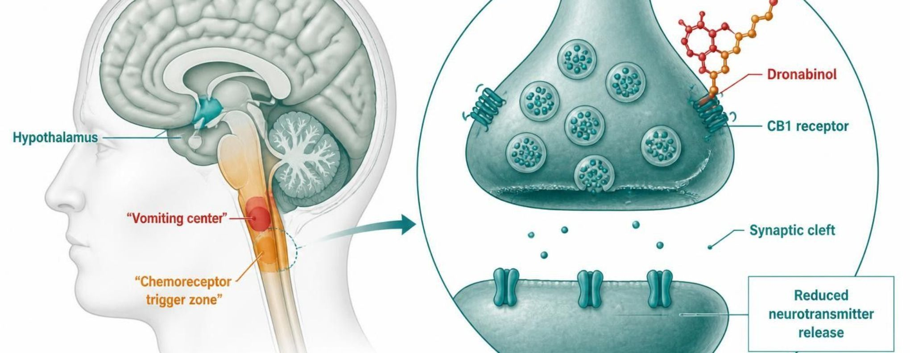
MECHANISM & DEPTH
Cannabinoids: CB1 Activation in the Brain
Schematic (illustrative)
Dronabinol or nabilone
▼
Activate CB1 receptors in the vomiting center and CTZ
▼
Reduce neurotransmitter release
▼
Figure 12. Dronabinol or nabilone binds CB1 receptors on presynaptic neurons in the vomiting center and chemoreceptor trigger zone. This reduces neurotransmitter release across the synaptic cleft, so less nausea and vomiting, and appetite increases.
Less nausea and more appetite
Dizziness, euphoria or dysphoria, and tachycardia
Orthostatic hypotension; additive CNS depression with sedatives and alcohol
Use with caution in older adults
Dronabinol is Schedule III; nabilone is Schedule II
GI & Nutrition Pharmacology — Session 1 of 2 — PA Program
39
Notes:
Say: Dronabinol and nabilone activate CB1 receptors in the vomiting center and trigger zone. They reduce neurotransmitter release. They also stimulate appetite.

Slide 40
CLINICAL CASE
Which Antiemetic for This Patient?
A patient in her first trimester of pregnancy presents with persistent nausea and vomiting that has not responded to dietary modification.
Ask yourself: Which antiemetic class has the most established safety profile for use in this patient?
Clinical pearl: Pyridoxine (vitamin B6), often combined with doxylamine, is typically first-line for nausea in pregnancy; ondansetron is commonly used as well, though data on first-trimester use continue to evolve — always weigh maternal benefit against fetal risk and consult current guidance.
GI & Nutrition Pharmacology — Session 1 of 2 — PA Program
40
Notes:
Use this to connect back to the Nutrition half of the unit (pyridoxine is a vitamin) — a preview of the Session 2 material on vitamins and supplements.
Instructor script:
First-trimester nausea unresponsive to diet. Let the class discuss. Pyridoxine (vitamin B6), often with doxylamine, is the usual first-line approach.

Slide 41
QUICK CHECK · ANTIEMETICS
Quick Check
A patient has been on metoclopramide for gastroparesis for several months. What is the primary long-term safety concern that should limit duration of therapy?
A
Hepatotoxicity
B
Tardive dyskinesia
C
QT prolongation
D
Nephrotoxicity
GI & Nutrition Pharmacology — Session 1 of 2 — PA Program
41
Notes:
Quick check: Long-term metoclopramide.

Slide 42
ANSWER · ANTIEMETICS
Answer
B
Tardive dyskinesia.
Why: Metoclopramide carries a boxed warning for tardive dyskinesia, with risk increasing with duration of use and cumulative dose — therapy should generally be limited to the shortest effective duration (typically no more than 12 weeks).
GI & Nutrition Pharmacology — Session 1 of 2 — PA Program
42
Notes:
Answer B: tardive dyskinesia.

Slide 43
MECHANISM & DEPTH
Drug Names Reveal the Class: Antiemetics
Stem | Drug class | Examples | Key point
-setron | 5-HT3 antagonists | Ondansetron, granisetron | Block serotonin at 5-HT3 receptors
-pitant | NK1 antagonists | Aprepitant, fosaprepitant | Block substance P at NK1 receptors
-azine | Phenothiazines | Prochlorperazine, promethazine | Block D2 receptors and other receptors
-izine | H1 antihistamines | Meclizine | Block H1 receptors in the vestibular system
-pramide | Benzamide D2 antagonists | Metoclopramide | Block D2; 5-HT4 agonism adds prokinetic effect
-sone | Corticosteroid | Dexamethasone | Adds to other antiemetics in chemotherapy
None shared | Cannabinoids | Nabilone, dronabinol | Activate CB1 receptors
None shared | Anticholinergic | Scopolamine | Block muscarinic receptors
GI & Nutrition Pharmacology — Session 1 of 2 — PA Program
43
Notes:
Drug-name stems: -setron is a 5-HT3 antagonist, -pitant is an NK1 antagonist, -azine is a phenothiazine, -izine is an H1 antihistamine, -pramide is a benzamide D2 antagonist, -sone is a corticosteroid. Dronabinol, nabilone and scopolamine have no shared stem.

Slide 44
BIG PICTURE
Session 1 Recap — To Be Continued
1
Acid-peptic disease reflects an imbalance between mucosal defense and aggressive factors (acid, pepsin, H. pylori, NSAIDs).
2
PPIs block the parietal cell’s final common pathway and are the most potent antisecretory agents, but carry real long-term risks (B12 deficiency, hypomagnesemia, fracture, C. difficile).
3
H. pylori eradication requires multi-drug regimens (triple or bismuth quadruple therapy), not acid suppression alone.
4
Antiemetics are organized by the receptor pathway they block — serotonin (5-HT3), dopamine/neurokinin (CTZ), or histamine/acetylcholine (vestibular) — all converging on the vomiting center.
5
Session 2 (Thursday, November 5) continues with lower-GI motility disorders, inflammatory bowel disease, and Nutrition & Dietary Supplements.
GI & Nutrition Pharmacology — Session 1 of 2 — PA Program
Notes:
Close Session 1 by previewing Session 2 explicitly — students should leave knowing acid-peptic disease and antiemetics are complete, and that laxatives/antidiarrheals, IBD, and nutrition pick up first next time.
Instructor script:
Recap: Read the five points. Acid-peptic disease is a balance. PPIs block the final common pathway. H. pylori needs multiple drugs. Antiemetics follow receptor systems. Session 2 continues with lower-GI motility and nutrition.

Slide 45
APPENDIX
Drug Profiles
DR = delayed-release
ER = extended-release
ODT = orally disintegrating tablet
OTC = over the counter
PO = by mouth
PR = by rectum
IV = intravenous
IM = intramuscular
BID / TID / QID = two / three / four times daily
CrCl = creatinine clearance
CKD = chronic kidney disease
CNS = central nervous system
GERD = gastroesophageal reflux disease
NSAID = nonsteroidal anti-inflammatory drug
CINV = chemotherapy-induced nausea and vomiting
PONV = postoperative nausea and vomiting
H2 = histamine-2
5-HT3 = serotonin type 3
D2 = dopamine type 2
NK1 = neurokinin-1
QT = QT interval on ECG
CYP / P-gp = cytochrome P450 / P-glycoprotein
BPH = benign prostatic hyperplasia
mcg = microgram
m2 = square meter of body surface area
Formulation, dose, indications, adverse effects, contraindications and toxicity for each drug in this lecture
Notes:
Section transition: appendix of drug profiles for the agents in this lecture.
Abbreviation key: DR = delayed-release; ER = extended-release; ODT = orally disintegrating tablet; OTC = over the counter; PO = by mouth; PR = by rectum; IV = intravenous; IM = intramuscular; BID / TID / QID = two / three / four times daily; CrCl = creatinine clearance; CKD = chronic kidney disease; CNS = central nervous system; GERD = gastroesophageal reflux disease; NSAID = nonsteroidal anti-inflammatory drug; CINV = chemotherapy-induced nausea and vomiting; PONV = postoperative nausea and vomiting; H2 = histamine-2; 5-HT3 = serotonin type 3; D2 = dopamine type 2; NK1 = neurokinin-1; QT = QT interval on ECG; CYP / P-gp = cytochrome P450 / P-glycoprotein; BPH = benign prostatic hyperplasia; mcg = microgram; m2 = square meter of body surface area.

Slide 46
DRUG PROFILE
Omeprazole (Prilosec)
Proton pump inhibitor
FORMULATION
DOSE (ADULT)
INDICATIONS
DR capsule 10/20/40 mg; OTC 20 mg tablet; oral suspension packets
20-40 mg PO once daily, 30-60 min before breakfast; GERD/ulcer courses 4-8 weeks
GERD, erosive esophagitis, peptic ulcer, H. pylori regimens, NSAID-ulcer prevention, Zollinger-Ellison
ADVERSE EFFECTS
CONTRAINDICATIONS
TOXICITY / OVERDOSE
Headache, diarrhea, abdominal pain, nausea; long-term: low B12 and Mg, fractures, C. difficile
Hypersensitivity to PPIs; rilpivirine co-use
Overdose rare (flushing, tachycardia, confusion); long-term hypomagnesemia; reduces clopidogrel activation (CYP2C19)
Standard adult dosing for teaching; verify against current prescribing information.
GI & Nutrition Pharmacology — Session 1 of 2 — PA Program
46
Notes:
Formulation: DR capsule 10/20/40 mg; OTC 20 mg tablet; oral suspension packets
Strength/recommended dose: 20-40 mg PO once daily, 30-60 min before breakfast; GERD/ulcer courses 4-8 weeks
Indications: GERD, erosive esophagitis, peptic ulcer, H. pylori regimens, NSAID-ulcer prevention, Zollinger-Ellison
Adverse effects: Headache, diarrhea, abdominal pain, nausea; long-term: low B12 and Mg, fractures, C. difficile
Contraindications: Hypersensitivity to PPIs; rilpivirine co-use
Toxicity: Overdose rare (flushing, tachycardia, confusion); long-term hypomagnesemia; reduces clopidogrel activation (CYP2C19)

Slide 47
DRUG PROFILE
Esomeprazole (Nexium)
Proton pump inhibitor
FORMULATION
DOSE (ADULT)
INDICATIONS
DR capsule 20/40 mg; granule packets; IV vial 20/40 mg
20-40 mg PO daily; IV 20-40 mg over 10-30 min daily when oral route is not possible
GERD, erosive esophagitis, H. pylori, NSAID-ulcer prevention, rebleeding risk reduction
ADVERSE EFFECTS
CONTRAINDICATIONS
TOXICITY / OVERDOSE
Headache, diarrhea, nausea; long-term: low B12 and Mg, fractures
Hypersensitivity to PPIs; rilpivirine co-use
Same class toxicities as omeprazole; hypomagnesemia, C. difficile; supportive care for overdose
Standard adult dosing for teaching; verify against current prescribing information.
GI & Nutrition Pharmacology — Session 1 of 2 — PA Program
47
Notes:
Formulation: DR capsule 20/40 mg; granule packets; IV vial 20/40 mg
Strength/recommended dose: 20-40 mg PO daily; IV 20-40 mg over 10-30 min daily when oral route is not possible
Indications: GERD, erosive esophagitis, H. pylori, NSAID-ulcer prevention, rebleeding risk reduction
Adverse effects: Headache, diarrhea, nausea; long-term: low B12 and Mg, fractures
Contraindications: Hypersensitivity to PPIs; rilpivirine co-use
Toxicity: Same class toxicities as omeprazole; hypomagnesemia, C. difficile; supportive care for overdose

Slide 48
DRUG PROFILE
Pantoprazole (Protonix)
Proton pump inhibitor
FORMULATION
DOSE (ADULT)
INDICATIONS
DR tablet 20/40 mg; granule packets; IV vial 40 mg
40 mg PO daily before a meal; IV 40 mg daily for up to 7-10 days
GERD, erosive esophagitis, Zollinger-Ellison; IV when oral therapy is not possible
ADVERSE EFFECTS
CONTRAINDICATIONS
TOXICITY / OVERDOSE
Headache, diarrhea, nausea; long-term: low B12 and Mg, fractures
Hypersensitivity to PPIs; rilpivirine co-use
Class toxicities; fewer CYP drug interactions than omeprazole; supportive care for overdose
Standard adult dosing for teaching; verify against current prescribing information.
GI & Nutrition Pharmacology — Session 1 of 2 — PA Program
48
Notes:
Formulation: DR tablet 20/40 mg; granule packets; IV vial 40 mg
Strength/recommended dose: 40 mg PO daily before a meal; IV 40 mg daily for up to 7-10 days
Indications: GERD, erosive esophagitis, Zollinger-Ellison; IV when oral therapy is not possible
Adverse effects: Headache, diarrhea, nausea; long-term: low B12 and Mg, fractures
Contraindications: Hypersensitivity to PPIs; rilpivirine co-use
Toxicity: Class toxicities; fewer CYP drug interactions than omeprazole; supportive care for overdose

Slide 49
DRUG PROFILE
Lansoprazole (Prevacid)
Proton pump inhibitor
FORMULATION
DOSE (ADULT)
INDICATIONS
DR capsule 15/30 mg; orally disintegrating tablet 15/30 mg
15-30 mg PO daily before a meal; courses 4-8 weeks
GERD, ulcers, H. pylori, NSAID-ulcer healing and prevention
ADVERSE EFFECTS
CONTRAINDICATIONS
TOXICITY / OVERDOSE
Diarrhea, abdominal pain, nausea, headache; long-term: low B12 and Mg
Hypersensitivity to PPIs; rilpivirine co-use
Class toxicities; ODT contains phenylalanine; supportive care for overdose
Standard adult dosing for teaching; verify against current prescribing information.
GI & Nutrition Pharmacology — Session 1 of 2 — PA Program
49
Notes:
Formulation: DR capsule 15/30 mg; orally disintegrating tablet 15/30 mg
Strength/recommended dose: 15-30 mg PO daily before a meal; courses 4-8 weeks
Indications: GERD, ulcers, H. pylori, NSAID-ulcer healing and prevention
Adverse effects: Diarrhea, abdominal pain, nausea, headache; long-term: low B12 and Mg
Contraindications: Hypersensitivity to PPIs; rilpivirine co-use
Toxicity: Class toxicities; ODT contains phenylalanine; supportive care for overdose

Slide 50
DRUG PROFILE
Dexlansoprazole (Dexilant)
Proton pump inhibitor
FORMULATION
DOSE (ADULT)
INDICATIONS
DR capsule 30/60 mg
30 mg daily for non-erosive GERD; 60 mg daily for up to 8 weeks for erosive esophagitis; with or without food
Erosive esophagitis healing and maintenance, non-erosive GERD heartburn
ADVERSE EFFECTS
CONTRAINDICATIONS
TOXICITY / OVERDOSE
Diarrhea, abdominal pain, nausea, headache; long-term: low B12 and Mg
Hypersensitivity to PPIs; rilpivirine co-use
Class toxicities; supportive care for overdose
Standard adult dosing for teaching; verify against current prescribing information.
GI & Nutrition Pharmacology — Session 1 of 2 — PA Program
50
Notes:
Formulation: DR capsule 30/60 mg
Strength/recommended dose: 30 mg daily for non-erosive GERD; 60 mg daily for up to 8 weeks for erosive esophagitis; with or without food
Indications: Erosive esophagitis healing and maintenance, non-erosive GERD heartburn
Adverse effects: Diarrhea, abdominal pain, nausea, headache; long-term: low B12 and Mg
Contraindications: Hypersensitivity to PPIs; rilpivirine co-use
Toxicity: Class toxicities; supportive care for overdose

Slide 51
DRUG PROFILE
Famotidine (Pepcid)
H2 receptor antagonist
FORMULATION
DOSE (ADULT)
INDICATIONS
Tablet 10 mg (OTC), 20/40 mg; IV 10 mg/mL; oral suspension
20 mg BID or 40 mg at bedtime; reduce dose when CrCl is below 60 mL/min
GERD, duodenal and gastric ulcer, hypersecretory states, heartburn prevention
ADVERSE EFFECTS
CONTRAINDICATIONS
TOXICITY / OVERDOSE
Headache, dizziness, constipation or diarrhea; confusion in older or renally impaired patients
Hypersensitivity to H2 blockers
Overdose rare: CNS effects, tachycardia, hypotension; accumulates in CKD; tolerance with continued use
Standard adult dosing for teaching; verify against current prescribing information.
GI & Nutrition Pharmacology — Session 1 of 2 — PA Program
51
Notes:
Formulation: Tablet 10 mg (OTC), 20/40 mg; IV 10 mg/mL; oral suspension
Strength/recommended dose: 20 mg BID or 40 mg at bedtime; reduce dose when CrCl is below 60 mL/min
Indications: GERD, duodenal and gastric ulcer, hypersecretory states, heartburn prevention
Adverse effects: Headache, dizziness, constipation or diarrhea; confusion in older or renally impaired patients
Contraindications: Hypersensitivity to H2 blockers
Toxicity: Overdose rare: CNS effects, tachycardia, hypotension; accumulates in CKD; tolerance with continued use

Slide 52
DRUG PROFILE
Cimetidine (Tagamet)
H2 receptor antagonist
FORMULATION
DOSE (ADULT)
INDICATIONS
Tablet 200/300/400/800 mg; oral liquid; IV
400 mg BID or 800 mg at bedtime; adjust for renal impairment
Duodenal and gastric ulcer, GERD, hypersecretory states
ADVERSE EFFECTS
CONTRAINDICATIONS
TOXICITY / OVERDOSE
Headache, dizziness, confusion, gynecomastia, impotence
Hypersensitivity to H2 blockers
Strong CYP inhibitor: raises warfarin, phenytoin, theophylline levels; CNS toxicity in older adults
Standard adult dosing for teaching; verify against current prescribing information.
GI & Nutrition Pharmacology — Session 1 of 2 — PA Program
52
Notes:
Formulation: Tablet 200/300/400/800 mg; oral liquid; IV
Strength/recommended dose: 400 mg BID or 800 mg at bedtime; adjust for renal impairment
Indications: Duodenal and gastric ulcer, GERD, hypersecretory states
Adverse effects: Headache, dizziness, confusion, gynecomastia, impotence
Contraindications: Hypersensitivity to H2 blockers
Toxicity: Strong CYP inhibitor: raises warfarin, phenytoin, theophylline levels; CNS toxicity in older adults

Slide 53
DRUG PROFILE
Calcium carbonate (Tums)
Antacid and calcium supplement
FORMULATION
DOSE (ADULT)
INDICATIONS
Chewable tablet 500-1,000 mg; suspension
500-1,500 mg PO as needed; respect label daily maximum (about 7,000-7,500 mg/day)
Occasional heartburn and indigestion; calcium supplementation
ADVERSE EFFECTS
CONTRAINDICATIONS
TOXICITY / OVERDOSE
Constipation, belching, gas; hypercalcemia with excess
Hypercalcemia, kidney stones (caution), severe renal impairment
Milk-alkali syndrome (hypercalcemia, alkalosis, AKI); acid rebound; binds levothyroxine, quinolones, tetracyclines, iron
Standard adult dosing for teaching; verify against current prescribing information.
GI & Nutrition Pharmacology — Session 1 of 2 — PA Program
53
Notes:
Formulation: Chewable tablet 500-1,000 mg; suspension
Strength/recommended dose: 500-1,500 mg PO as needed; respect label daily maximum (about 7,000-7,500 mg/day)
Indications: Occasional heartburn and indigestion; calcium supplementation
Adverse effects: Constipation, belching, gas; hypercalcemia with excess
Contraindications: Hypercalcemia, kidney stones (caution), severe renal impairment
Toxicity: Milk-alkali syndrome (hypercalcemia, alkalosis, AKI); acid rebound; binds levothyroxine, quinolones, tetracyclines, iron

Slide 54
DRUG PROFILE
Magnesium hydroxide (Milk of Magnesia)
Antacid and osmotic laxative
FORMULATION
DOSE (ADULT)
INDICATIONS
Suspension 400 mg/5 mL; chewable tablet
Antacid 5-15 mL PO up to four times daily; laxative 30-60 mL once daily
Occasional heartburn, short-term constipation
ADVERSE EFFECTS
CONTRAINDICATIONS
TOXICITY / OVERDOSE
Diarrhea, abdominal cramping
Severe renal impairment, bowel obstruction
Hypermagnesemia in CKD: hypotension, absent reflexes, respiratory depression, cardiac arrest
Standard adult dosing for teaching; verify against current prescribing information.
GI & Nutrition Pharmacology — Session 1 of 2 — PA Program
54
Notes:
Formulation: Suspension 400 mg/5 mL; chewable tablet
Strength/recommended dose: Antacid 5-15 mL PO up to four times daily; laxative 30-60 mL once daily
Indications: Occasional heartburn, short-term constipation
Adverse effects: Diarrhea, abdominal cramping
Contraindications: Severe renal impairment, bowel obstruction
Toxicity: Hypermagnesemia in CKD: hypotension, absent reflexes, respiratory depression, cardiac arrest

Slide 55
DRUG PROFILE
Aluminum hydroxide (Amphojel)
Antacid and phosphate binder
FORMULATION
DOSE (ADULT)
INDICATIONS
Suspension 320 mg/5 mL; tablet
5-10 mL PO several times daily between meals and at bedtime as labeled
Heartburn, indigestion; hyperphosphatemia in kidney disease
ADVERSE EFFECTS
CONTRAINDICATIONS
TOXICITY / OVERDOSE
Constipation, hypophosphatemia with prolonged use
Bowel obstruction; caution in CKD
Aluminum accumulation in CKD: osteomalacia, encephalopathy, anemia; binds other drugs
Standard adult dosing for teaching; verify against current prescribing information.
GI & Nutrition Pharmacology — Session 1 of 2 — PA Program
55
Notes:
Formulation: Suspension 320 mg/5 mL; tablet
Strength/recommended dose: 5-10 mL PO several times daily between meals and at bedtime as labeled
Indications: Heartburn, indigestion; hyperphosphatemia in kidney disease
Adverse effects: Constipation, hypophosphatemia with prolonged use
Contraindications: Bowel obstruction; caution in CKD
Toxicity: Aluminum accumulation in CKD: osteomalacia, encephalopathy, anemia; binds other drugs

Slide 56
DRUG PROFILE
Sucralfate (Carafate)
Mucosal protectant
FORMULATION
DOSE (ADULT)
INDICATIONS
Tablet 1 g; suspension 1 g/10 mL
1 g PO QID, 1 hour before meals and at bedtime, 4-8 weeks (duodenal ulcer); 1 g BID for maintenance
Active duodenal ulcer, ulcer maintenance, stress-ulcer prophylaxis (off-label)
ADVERSE EFFECTS
CONTRAINDICATIONS
TOXICITY / OVERDOSE
Constipation, dry mouth, nausea
Hypersensitivity; caution in CKD and dysphagia
Aluminum accumulation in CKD; bezoar risk; binds other drugs (separate by 2 hours); hyperglycemia in diabetes
Standard adult dosing for teaching; verify against current prescribing information.
GI & Nutrition Pharmacology — Session 1 of 2 — PA Program
56
Notes:
Formulation: Tablet 1 g; suspension 1 g/10 mL
Strength/recommended dose: 1 g PO QID, 1 hour before meals and at bedtime, 4-8 weeks (duodenal ulcer); 1 g BID for maintenance
Indications: Active duodenal ulcer, ulcer maintenance, stress-ulcer prophylaxis (off-label)
Adverse effects: Constipation, dry mouth, nausea
Contraindications: Hypersensitivity; caution in CKD and dysphagia
Toxicity: Aluminum accumulation in CKD; bezoar risk; binds other drugs (separate by 2 hours); hyperglycemia in diabetes

Slide 57
DRUG PROFILE
Misoprostol (Cytotec)
Prostaglandin E1 analog
FORMULATION
DOSE (ADULT)
INDICATIONS
Tablet 100/200 mcg
200 mcg PO QID with food and at bedtime during NSAID therapy
Prevention of NSAID-induced gastric ulcers
ADVERSE EFFECTS
CONTRAINDICATIONS
TOXICITY / OVERDOSE
Diarrhea, abdominal cramps, nausea, menstrual-type bleeding
Pregnancy (boxed warning), prostaglandin hypersensitivity
Miscarriage, uterine rupture and birth defects; overdose: fever, tachycardia, hypotension, seizures
Standard adult dosing for teaching; verify against current prescribing information.
GI & Nutrition Pharmacology — Session 1 of 2 — PA Program
57
Notes:
Formulation: Tablet 100/200 mcg
Strength/recommended dose: 200 mcg PO QID with food and at bedtime during NSAID therapy
Indications: Prevention of NSAID-induced gastric ulcers
Adverse effects: Diarrhea, abdominal cramps, nausea, menstrual-type bleeding
Contraindications: Pregnancy (boxed warning), prostaglandin hypersensitivity
Toxicity: Miscarriage, uterine rupture and birth defects; overdose: fever, tachycardia, hypotension, seizures

Slide 58
DRUG PROFILE
Bismuth subsalicylate (Pepto-Bismol)
Antisecretory, antimicrobial, mucosal agent
FORMULATION
DOSE (ADULT)
INDICATIONS
Chewable tablet 262 mg; suspension 262 or 525 mg/15 mL
524 mg every 30-60 min as needed, max 8 doses per day; H. pylori quadruple therapy 524 mg QID
Diarrhea, dyspepsia, nausea, H. pylori eradication
ADVERSE EFFECTS
CONTRAINDICATIONS
TOXICITY / OVERDOSE
Black stool and tongue, constipation
Salicylate allergy, bleeding disorders, anticoagulants, children or teens with viral illness (Reye syndrome)
Salicylism: tinnitus, rapid breathing; bismuth neurotoxicity with prolonged high use
Standard adult dosing for teaching; verify against current prescribing information.
GI & Nutrition Pharmacology — Session 1 of 2 — PA Program
58
Notes:
Formulation: Chewable tablet 262 mg; suspension 262 or 525 mg/15 mL
Strength/recommended dose: 524 mg every 30-60 min as needed, max 8 doses per day; H. pylori quadruple therapy 524 mg QID
Indications: Diarrhea, dyspepsia, nausea, H. pylori eradication
Adverse effects: Black stool and tongue, constipation
Contraindications: Salicylate allergy, bleeding disorders, anticoagulants, children or teens with viral illness (Reye syndrome)
Toxicity: Salicylism: tinnitus, rapid breathing; bismuth neurotoxicity with prolonged high use

Slide 59
DRUG PROFILE
Amoxicillin (Amoxil)
Aminopenicillin
FORMULATION
DOSE (ADULT)
INDICATIONS
Capsule/tablet 250/500/875 mg; suspension
H. pylori: 1 g PO BID for 14 days as part of combination therapy
H. pylori (combination), bacterial infections
ADVERSE EFFECTS
CONTRAINDICATIONS
TOXICITY / OVERDOSE
Diarrhea, nausea, rash; C. difficile infection
Penicillin allergy
Anaphylaxis in allergic patients; overdose causes GI upset; rarely crystalluria
Standard adult dosing for teaching; verify against current prescribing information.
GI & Nutrition Pharmacology — Session 1 of 2 — PA Program
59
Notes:
Formulation: Capsule/tablet 250/500/875 mg; suspension
Strength/recommended dose: H. pylori: 1 g PO BID for 14 days as part of combination therapy
Indications: H. pylori (combination), bacterial infections
Adverse effects: Diarrhea, nausea, rash; C. difficile infection
Contraindications: Penicillin allergy
Toxicity: Anaphylaxis in allergic patients; overdose causes GI upset; rarely crystalluria

Slide 60
DRUG PROFILE
Clarithromycin (Biaxin)
Macrolide antibiotic
FORMULATION
DOSE (ADULT)
INDICATIONS
Tablet 250/500 mg; ER tablet 500 mg; suspension
H. pylori: 500 mg PO BID for 14 days in triple therapy
H. pylori (where resistance is low), respiratory infections
ADVERSE EFFECTS
CONTRAINDICATIONS
TOXICITY / OVERDOSE
Taste change, nausea, diarrhea; QT prolongation
Macrolide allergy; QT history; co-use with simvastatin, lovastatin, ergotamine
Strong CYP3A4 and P-gp inhibitor; torsades, hepatotoxicity; avoid if prior macrolide exposure
Standard adult dosing for teaching; verify against current prescribing information.
GI & Nutrition Pharmacology — Session 1 of 2 — PA Program
60
Notes:
Formulation: Tablet 250/500 mg; ER tablet 500 mg; suspension
Strength/recommended dose: H. pylori: 500 mg PO BID for 14 days in triple therapy
Indications: H. pylori (where resistance is low), respiratory infections
Adverse effects: Taste change, nausea, diarrhea; QT prolongation
Contraindications: Macrolide allergy; QT history; co-use with simvastatin, lovastatin, ergotamine
Toxicity: Strong CYP3A4 and P-gp inhibitor; torsades, hepatotoxicity; avoid if prior macrolide exposure

Slide 61
DRUG PROFILE
Metronidazole (Flagyl)
Nitroimidazole antimicrobial
FORMULATION
DOSE (ADULT)
INDICATIONS
Tablet 250/500 mg; IV; topical/vaginal forms
H. pylori quadruple therapy: 500 mg PO TID-QID for 14 days
H. pylori (bismuth quadruple), anaerobic infections, C. difficile, trichomoniasis
ADVERSE EFFECTS
CONTRAINDICATIONS
TOXICITY / OVERDOSE
Metallic taste, nausea, headache; disulfiram-like reaction with alcohol
Alcohol use during and for 3 days after, recent disulfiram, Cockayne syndrome
Neurotoxicity: neuropathy, encephalopathy, seizures with prolonged or high dosing
Standard adult dosing for teaching; verify against current prescribing information.
GI & Nutrition Pharmacology — Session 1 of 2 — PA Program
61
Notes:
Formulation: Tablet 250/500 mg; IV; topical/vaginal forms
Strength/recommended dose: H. pylori quadruple therapy: 500 mg PO TID-QID for 14 days
Indications: H. pylori (bismuth quadruple), anaerobic infections, C. difficile, trichomoniasis
Adverse effects: Metallic taste, nausea, headache; disulfiram-like reaction with alcohol
Contraindications: Alcohol use during and for 3 days after, recent disulfiram, Cockayne syndrome
Toxicity: Neurotoxicity: neuropathy, encephalopathy, seizures with prolonged or high dosing

Slide 62
DRUG PROFILE
Tetracycline (Sumycin)
Tetracycline antibiotic
FORMULATION
DOSE (ADULT)
INDICATIONS
Capsule 250/500 mg
H. pylori quadruple therapy: 500 mg PO QID for 14 days
H. pylori (bismuth quadruple), acne, rickettsial infections
ADVERSE EFFECTS
CONTRAINDICATIONS
TOXICITY / OVERDOSE
Nausea, esophagitis, photosensitivity
Pregnancy, children under 8 years, hypersensitivity
Tooth discoloration and bone effects in children; hepatotoxicity at high dose; chelated by dairy, antacids, iron
Standard adult dosing for teaching; verify against current prescribing information.
GI & Nutrition Pharmacology — Session 1 of 2 — PA Program
62
Notes:
Formulation: Capsule 250/500 mg
Strength/recommended dose: H. pylori quadruple therapy: 500 mg PO QID for 14 days
Indications: H. pylori (bismuth quadruple), acne, rickettsial infections
Adverse effects: Nausea, esophagitis, photosensitivity
Contraindications: Pregnancy, children under 8 years, hypersensitivity
Toxicity: Tooth discoloration and bone effects in children; hepatotoxicity at high dose; chelated by dairy, antacids, iron

Slide 63
DRUG PROFILE
Ondansetron (Zofran)
5-HT3 receptor antagonist
FORMULATION
DOSE (ADULT)
INDICATIONS
Tablet 4/8 mg; ODT 4/8 mg; oral film; IV/IM 2 mg/mL
4-8 mg PO/ODT every 8 hours; IV 4 mg; chemotherapy regimens use 8-24 mg pre-dose; single IV dose max 16 mg
Chemotherapy, postoperative and radiation nausea; gastroenteritis and pregnancy nausea (off-label)
ADVERSE EFFECTS
CONTRAINDICATIONS
TOXICITY / OVERDOSE
Headache, constipation, dizziness; QT prolongation
Congenital long QT syndrome; apomorphine co-use
QT prolongation and torsades; serotonin syndrome (rare); transient vision loss
Standard adult dosing for teaching; verify against current prescribing information.
GI & Nutrition Pharmacology — Session 1 of 2 — PA Program
63
Notes:
Formulation: Tablet 4/8 mg; ODT 4/8 mg; oral film; IV/IM 2 mg/mL
Strength/recommended dose: 4-8 mg PO/ODT every 8 hours; IV 4 mg; chemotherapy regimens use 8-24 mg pre-dose; single IV dose max 16 mg
Indications: Chemotherapy, postoperative and radiation nausea; gastroenteritis and pregnancy nausea (off-label)
Adverse effects: Headache, constipation, dizziness; QT prolongation
Contraindications: Congenital long QT syndrome; apomorphine co-use
Toxicity: QT prolongation and torsades; serotonin syndrome (rare); transient vision loss

Slide 64
DRUG PROFILE
Metoclopramide (Reglan)
Dopamine D2 antagonist, prokinetic
FORMULATION
DOSE (ADULT)
INDICATIONS
Tablet 5/10 mg; ODT; oral solution; IV/IM 5 mg/mL
Gastroparesis: 10 mg PO 30 min before meals and at bedtime (max 40 mg/day); limit to 12 weeks; lower dose in renal impairment
Diabetic gastroparesis, GERD (short-term), chemotherapy and postoperative nausea
ADVERSE EFFECTS
CONTRAINDICATIONS
TOXICITY / OVERDOSE
Drowsiness, restlessness, diarrhea; depression
GI obstruction, perforation or bleeding; pheochromocytoma; seizure disorder; history of tardive dyskinesia
Boxed warning: tardive dyskinesia (may be irreversible); acute dystonia (diphenhydramine or benztropine); neuroleptic malignant syndrome
Standard adult dosing for teaching; verify against current prescribing information.
GI & Nutrition Pharmacology — Session 1 of 2 — PA Program
64
Notes:
Formulation: Tablet 5/10 mg; ODT; oral solution; IV/IM 5 mg/mL
Strength/recommended dose: Gastroparesis: 10 mg PO 30 min before meals and at bedtime (max 40 mg/day); limit to 12 weeks; lower dose in renal impairment
Indications: Diabetic gastroparesis, GERD (short-term), chemotherapy and postoperative nausea
Adverse effects: Drowsiness, restlessness, diarrhea; depression
Contraindications: GI obstruction, perforation or bleeding; pheochromocytoma; seizure disorder; history of tardive dyskinesia
Toxicity: Boxed warning: tardive dyskinesia (may be irreversible); acute dystonia (diphenhydramine or benztropine); neuroleptic malignant syndrome

Slide 65
DRUG PROFILE
Aprepitant (Emend)
NK1 receptor antagonist
FORMULATION
DOSE (ADULT)
INDICATIONS
Capsule 40/80/125 mg; IV fosaprepitant 150 mg
CINV: 125 mg PO day 1, then 80 mg days 2-3, with a 5-HT3 antagonist and dexamethasone; PONV: 40 mg pre-op
Prevention of chemotherapy and postoperative nausea and vomiting
ADVERSE EFFECTS
CONTRAINDICATIONS
TOXICITY / OVERDOSE
Fatigue, constipation, hiccups, raised liver enzymes
Pimozide co-use; hypersensitivity
CYP3A4 substrate and moderate inhibitor: lowers warfarin and hormonal contraceptive effect; overdose drowsiness, headache
Standard adult dosing for teaching; verify against current prescribing information.
GI & Nutrition Pharmacology — Session 1 of 2 — PA Program
65
Notes:
Formulation: Capsule 40/80/125 mg; IV fosaprepitant 150 mg
Strength/recommended dose: CINV: 125 mg PO day 1, then 80 mg days 2-3, with a 5-HT3 antagonist and dexamethasone; PONV: 40 mg pre-op
Indications: Prevention of chemotherapy and postoperative nausea and vomiting
Adverse effects: Fatigue, constipation, hiccups, raised liver enzymes
Contraindications: Pimozide co-use; hypersensitivity
Toxicity: CYP3A4 substrate and moderate inhibitor: lowers warfarin and hormonal contraceptive effect; overdose drowsiness, headache

Slide 66
DRUG PROFILE
Meclizine (Antivert)
H1 antihistamine, anticholinergic
FORMULATION
DOSE (ADULT)
INDICATIONS
Tablet 12.5/25/50 mg; chewable tablet
Motion sickness: 25-50 mg 1 hour before travel, repeat every 24 hours; vertigo: 25-100 mg/day divided
Motion sickness, vertigo
ADVERSE EFFECTS
CONTRAINDICATIONS
TOXICITY / OVERDOSE
Drowsiness, dry mouth, blurred vision, urinary retention
Hypersensitivity; caution in glaucoma, BPH, asthma, older adults
Anticholinergic toxicity: agitation, hallucinations, tachycardia, seizures; additive sedation
Standard adult dosing for teaching; verify against current prescribing information.
GI & Nutrition Pharmacology — Session 1 of 2 — PA Program
66
Notes:
Formulation: Tablet 12.5/25/50 mg; chewable tablet
Strength/recommended dose: Motion sickness: 25-50 mg 1 hour before travel, repeat every 24 hours; vertigo: 25-100 mg/day divided
Indications: Motion sickness, vertigo
Adverse effects: Drowsiness, dry mouth, blurred vision, urinary retention
Contraindications: Hypersensitivity; caution in glaucoma, BPH, asthma, older adults
Toxicity: Anticholinergic toxicity: agitation, hallucinations, tachycardia, seizures; additive sedation

Slide 67
DRUG PROFILE
Scopolamine (Transderm Scop)
Muscarinic antagonist
FORMULATION
DOSE (ADULT)
INDICATIONS
Transdermal patch 1.5 mg (about 1 mg over 3 days)
1 patch behind the ear at least 4 hours before travel; replace every 72 hours
Motion sickness, postoperative nausea
ADVERSE EFFECTS
CONTRAINDICATIONS
TOXICITY / OVERDOSE
Dry mouth, drowsiness, blurred vision, dizziness
Narrow-angle glaucoma; hypersensitivity
Anticholinergic toxicity; withdrawal nausea and dizziness; wash hands to avoid dilated pupils
Standard adult dosing for teaching; verify against current prescribing information.
GI & Nutrition Pharmacology — Session 1 of 2 — PA Program
67
Notes:
Formulation: Transdermal patch 1.5 mg (about 1 mg over 3 days)
Strength/recommended dose: 1 patch behind the ear at least 4 hours before travel; replace every 72 hours
Indications: Motion sickness, postoperative nausea
Adverse effects: Dry mouth, drowsiness, blurred vision, dizziness
Contraindications: Narrow-angle glaucoma; hypersensitivity
Toxicity: Anticholinergic toxicity; withdrawal nausea and dizziness; wash hands to avoid dilated pupils

Slide 68
DRUG PROFILE
Prochlorperazine (Compazine)
Phenothiazine D2 antagonist
FORMULATION
DOSE (ADULT)
INDICATIONS
Tablet 5/10 mg; suppository 25 mg; IV/IM 5 mg/mL
5-10 mg PO every 6-8 hours (max 40 mg/day); 25 mg PR every 12 hours; 5-10 mg IV/IM
Severe nausea and vomiting, psychosis
ADVERSE EFFECTS
CONTRAINDICATIONS
TOXICITY / OVERDOSE
Sedation, hypotension, dry mouth, extrapyramidal symptoms
Children under 2 years, coma, dementia-related psychosis (boxed warning)
Acute dystonia, tardive dyskinesia, neuroleptic malignant syndrome, QT prolongation, sedation
Standard adult dosing for teaching; verify against current prescribing information.
GI & Nutrition Pharmacology — Session 1 of 2 — PA Program
68
Notes:
Formulation: Tablet 5/10 mg; suppository 25 mg; IV/IM 5 mg/mL
Strength/recommended dose: 5-10 mg PO every 6-8 hours (max 40 mg/day); 25 mg PR every 12 hours; 5-10 mg IV/IM
Indications: Severe nausea and vomiting, psychosis
Adverse effects: Sedation, hypotension, dry mouth, extrapyramidal symptoms
Contraindications: Children under 2 years, coma, dementia-related psychosis (boxed warning)
Toxicity: Acute dystonia, tardive dyskinesia, neuroleptic malignant syndrome, QT prolongation, sedation

Slide 69
DRUG PROFILE
Dronabinol (Marinol) and nabilone (Cesamet)
Cannabinoids
FORMULATION
DOSE (ADULT)
INDICATIONS
Dronabinol capsule 2.5/5/10 mg, solution; nabilone capsule 1 mg
Dronabinol 5 mg/m2 1-3 hours before chemotherapy, then every 2-4 hours; appetite: 2.5 mg BID; nabilone 1-2 mg BID
Refractory chemotherapy nausea; anorexia in AIDS (dronabinol)
ADVERSE EFFECTS
CONTRAINDICATIONS
TOXICITY / OVERDOSE
Dizziness, euphoria, drowsiness, tachycardia
Hypersensitivity; sesame oil allergy (dronabinol capsule)
Psychoactive: anxiety, paranoia, tachycardia, hypotension; additive CNS depression; misuse potential
Standard adult dosing for teaching; verify against current prescribing information.
GI & Nutrition Pharmacology — Session 1 of 2 — PA Program
69
Notes:
Formulation: Dronabinol capsule 2.5/5/10 mg, solution; nabilone capsule 1 mg
Strength/recommended dose: Dronabinol 5 mg/m2 1-3 hours before chemotherapy, then every 2-4 hours; appetite: 2.5 mg BID; nabilone 1-2 mg BID
Indications: Refractory chemotherapy nausea; anorexia in AIDS (dronabinol)
Adverse effects: Dizziness, euphoria, drowsiness, tachycardia
Contraindications: Hypersensitivity; sesame oil allergy (dronabinol capsule)
Toxicity: Psychoactive: anxiety, paranoia, tachycardia, hypotension; additive CNS depression; misuse potential

Slide 70
DRUG PROFILE
Dexamethasone (Decadron)
Corticosteroid
FORMULATION
DOSE (ADULT)
INDICATIONS
Tablet 0.5-6 mg; oral solution; IV 4 mg/mL
CINV: 8-12 mg PO/IV on day 1, then 8 mg daily on days 2-4 depending on regimen
Antiemetic adjunct in chemotherapy; inflammation and allergy
ADVERSE EFFECTS
CONTRAINDICATIONS
TOXICITY / OVERDOSE
Insomnia, hyperglycemia, mood change, fluid retention
Systemic fungal infection; hypersensitivity
Adrenal suppression with prolonged use; infection, hyperglycemia, psychosis; taper after long courses
Standard adult dosing for teaching; verify against current prescribing information.
GI & Nutrition Pharmacology — Session 1 of 2 — PA Program
70
Notes:
Formulation: Tablet 0.5-6 mg; oral solution; IV 4 mg/mL
Strength/recommended dose: CINV: 8-12 mg PO/IV on day 1, then 8 mg daily on days 2-4 depending on regimen
Indications: Antiemetic adjunct in chemotherapy; inflammation and allergy
Adverse effects: Insomnia, hyperglycemia, mood change, fluid retention
Contraindications: Systemic fungal infection; hypersensitivity
Toxicity: Adrenal suppression with prolonged use; infection, hyperglycemia, psychosis; taper after long courses

Slide 71
DRUG PROFILE · SUPPORTING
Supporting Drugs at a Glance
Diphenhydramine and benztropine
Rescue for acute dystonia from metoclopramide or prochlorperazine
Simvastatin, lovastatin, ergotamine
CYP3A4 substrates that must not be combined with clarithromycin
Doxylamine plus pyridoxine (B6)
Nausea and vomiting of pregnancy
Disulfiram
Alcohol-aversion drug; metronidazole can cause a similar reaction with alcohol
Clopidogrel
Prodrug activated by CYP2C19; omeprazole and esomeprazole can blunt its effect
Levothyroxine and quinolones
Absorption falls when taken with antacids; separate doses
Rilpivirine
HIV drug that needs stomach acid, so PPIs are contraindicated
Penicillin
Allergy rules out amoxicillin in H. pylori regimens
Listed for context; not profiled in detail.
GI & Nutrition Pharmacology — Session 1 of 2 — PA Program
71
Notes:
Listed for context; not profiled in detail.

Slide 72
APPENDIX
Image Attribution
● Original figures in this deck: Figures 1, 4 and 9 (Gastric Acid Secretion: Where Antisecretory Drugs Act; PPIs vs. H2 Receptor Antagonists: Potency and Duration; The Vomiting Reflex: Where Antiemetics Act) were generated by the course director using the AI tool Claude to illustrate standard, non-copyrighted pharmacologic concepts. They are original diagrams, not reproduced from Katzung’s Basic and Clinical Pharmacology or any other copyrighted source.
● Reference: Anthropic. (2026). Claude (Sonnet 5) [Large language model]. https://claude.ai
● Mechanism illustrations: (AI-generated, illustrative, not reproduced from copyrighted sources): H2 blocker action on the parietal cell (Figure 2, slide 14); PPI irreversible pump inhibition (Figure 3, slide 16); sucralfate and misoprostol (Figure 5, slide 21); H. pylori multidrug rationale (Figure 6, slide 24); ondansetron and 5-HT3 blockade (Figure 7, slide 31); receptors in the vomiting pathway (Figure 8, slide 32); metoclopramide D2 blockade and 5-HT4 agonism (Figure 10, slide 37); cannabinoids for chemotherapy-induced nausea (Figure 11, slide 38); cannabinoid CB1 activation (Figure 12, slide 39). Created with an AI image generator under the course director’s direction for educational use; the pictures are schematic and not to scale.
GI & Nutrition Pharmacology — Session 1 of 2 — PA Program
72
Notes:
This slide documents AI-tool use for original figure generation per university citation requirements. It covers every original diagram in this deck (Figures 1, 4 and 9, plus the AI-generated mechanism illustrations on this slide); none are reproduced from any textbook.
Instructor script:
Figures 1, 4 and 9 are original diagrams. Figures 2, 3, 5-8 and 10-12 are AI-generated and schematic.

