Slide 1

PA PHARMACOLOGY COURSE · LECTURE 6 · SESSION 2 OF 2
Genitourinary & Reproductive Pharmacology
Session 2: Autonomic Pharmacology of the Bladder and Lower Urinary Tract | Tuesday, December 1 | 8:30–11:00 AM
Diane S. Allen-Gipson, Ph.D., M.S., Course Director

Slide 2

BY THE END OF THIS LECTURE
Learning Objectives — Session 2
Recap: Session 1 covered gonadal steroid pharmacology (estrogens, progestins, SERMs, aromatase inhibitors, androgens/antiandrogens) and the PCOS reproductive-metabolic overlap.
Describe the autonomic and somatic innervation of the bladder and lower urinary tract, and the receptor subtypes governing storage versus voiding.
Describe the mechanism, indications, and adverse effects of antimuscarinic agents and beta-3 agonists in overactive bladder and urinary incontinence.
Describe the mechanism and adverse effects of alpha1 blockers and 5-alpha-reductase inhibitors in benign prostatic hyperplasia (BPH).
Describe non-adrenergic, noncholinergic (NANC) neurotransmission and the NO-cGMP pathway underlying erectile function and PDE5 inhibitor pharmacology, including the absolute nitrate contraindication.
Integrate autonomic receptor pharmacology across the genitourinary and cardiovascular systems, and apply the full Unit 6 toolkit to integrated clinical scenarios with a cumulative recall quiz.
Genitourinary & Reproductive Pharmacology — Session 2 of 2 — PA Program
2
Notes:
Start with a genuine 1-2 minute recap of Session 1 — today's content is mechanistically distinct (autonomic pharmacology rather than steroid hormone pharmacology), so the connective tissue between the two sessions is mostly the finasteride/dutasteride callback and the shared organ system, not a continuous mechanism like Unit 5 had.
Instructor script:
Recap Session 1 in a minute. Today is autonomic pharmacology: three nerve supplies, three receptor families, and every drug maps to one receptor at one location.

Slide 3

SECTION
04
Autonomic Control of the Lower Urinary Tract
Three nerve supplies, three receptor families — the physiologic foundation for every drug in this session.
Notes:
Section transition. Autonomic control of the lower urinary tract: parasympathetic M3 contracts the detrusor, sympathetic alpha-1 closes the bladder neck and beta-3 relaxes the reservoir, and somatic nicotinic control holds the external sphincter.

Slide 4

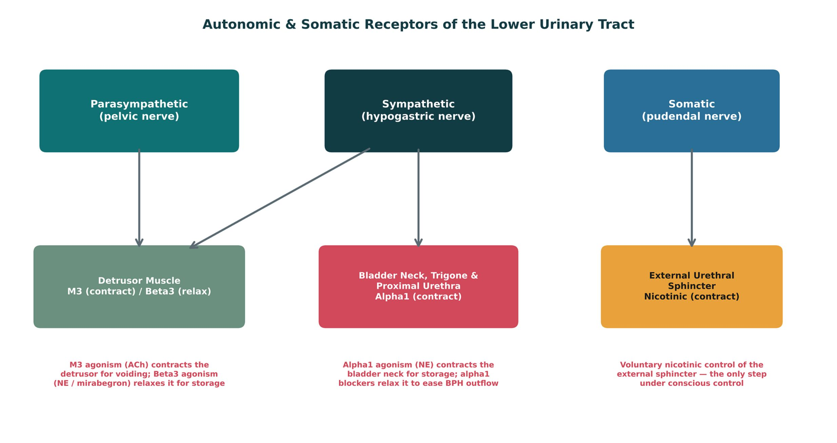
ORIGINAL ILLUSTRATION · FIGURE 9
Autonomic & Somatic Receptors of the Lower Urinary Tract
Figure 9. Original illustrative diagram (not from Katzung): the parasympathetic, sympathetic, and somatic nervous systems each innervate a different structure of the lower urinary tract through a distinct receptor family — the organizing map for every drug class covered this session.
Genitourinary & Reproductive Pharmacology — Session 2 of 2 — PA Program
4
Notes:
This is the conceptual spine for the entire session — every drug class that follows gets anchored back to its receptor and anatomic location on this diagram. Take the extra time here; it is what makes Sections 5 and 6 feel like "zooming in" on parts of this map rather than new, unrelated content.
Instructor script:
The spine of the session. Parasympathetic M3 contracts the detrusor; sympathetic alpha-1 closes the outlet and beta-3 relaxes the detrusor; somatic nicotinic control holds the external sphincter.

Slide 5
FROM CHAPTER 6
Cholinergic (Muscarinic) Control of the Detrusor
The parasympathetic pelvic nerve releases acetylcholine, which acts on M3 muscarinic receptors on the detrusor muscle to produce contraction — the primary driver of bladder emptying (voiding).
M3 is the dominant muscarinic subtype in the bladder, though M2 receptors are also present in high density (their functional contribution is smaller under normal conditions but may increase in certain disease states).
This is the same muscarinic receptor family (and the same general autonomic pharmacology framework from Chapter 6) that governs other smooth muscle and glandular targets throughout the body — the bladder is simply one more target organ.
Because M3 blockade reduces detrusor contraction, antimuscarinic drugs (Section 5) are a logical treatment for conditions of bladder overactivity.
Genitourinary & Reproductive Pharmacology — Session 2 of 2 — PA Program
5
Notes:
This slide is deliberately framed as applied Chapter 6 content — the goal is for students to see muscarinic receptor pharmacology not as bladder-specific trivia but as the same general principle from basic autonomic pharmacology, now applied to a specific organ.
Instructor script:
M3 is dominant; M2 is dense but less important.

Slide 6
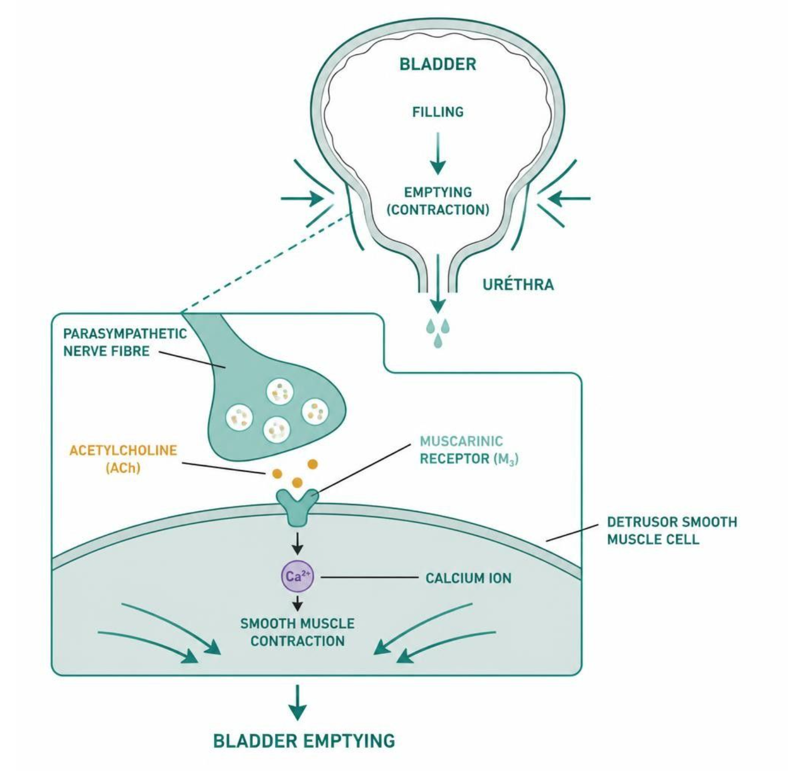
MECHANISM & DEPTH
M3 Receptor Signaling and Detrusor Contraction
Parasympathetic pelvic nerve releases acetylcholine
↓
ACh binds M3 receptor on the detrusor
↓
Gq activates phospholipase C; calcium rises
↓
Detrusor contracts and the bladder empties
M3 is the dominant bladder muscarinic subtype.
M2 is more abundant but contributes less to contraction.
Blocking M3 underlies antimuscarinic OAB treatment.
Schematic (illustrative)
Figure 10. Acetylcholine acting on M3 receptors drives detrusor contraction and bladder emptying.
Genitourinary & Reproductive Pharmacology — Session 2 of 2 — PA Program
6
Notes:
Acetylcholine, M3, Gq, phospholipase C, calcium, contraction.

Slide 7
FROM CHAPTER 6
Adrenergic Control of the Bladder Neck and Detrusor
The sympathetic hypogastric nerve releases norepinephrine, which acts on two different adrenergic receptor subtypes in two different locations, producing two different (and complementary) effects.
Alpha1 receptors at the bladder neck, trigone, and proximal urethra: norepinephrine causes contraction, helping maintain continence during the storage phase.
Beta3 receptors on the detrusor body: norepinephrine causes relaxation, allowing the bladder to fill without a premature urge to void.
Net effect during storage: sympathetic tone keeps the outlet closed (alpha1) while keeping the reservoir relaxed (beta3) — parasympathetic tone is low. During voiding, this pattern reverses.
Both of these receptor subtypes become specific drug targets later in this session: alpha1 blockers for BPH (Section 6), and beta3 agonists for overactive bladder (Section 5).
Genitourinary & Reproductive Pharmacology — Session 2 of 2 — PA Program
7
Notes:
Make sure students can state which receptor does what in which location before moving on — this exact distinction (alpha1 at the outlet vs. beta3 on the body of the detrusor) is what makes the rest of the session's pharmacology make sense.
Instructor script:
Norepinephrine acts on alpha-1 (outlet closes) and beta-3 (reservoir relaxes).

Slide 8
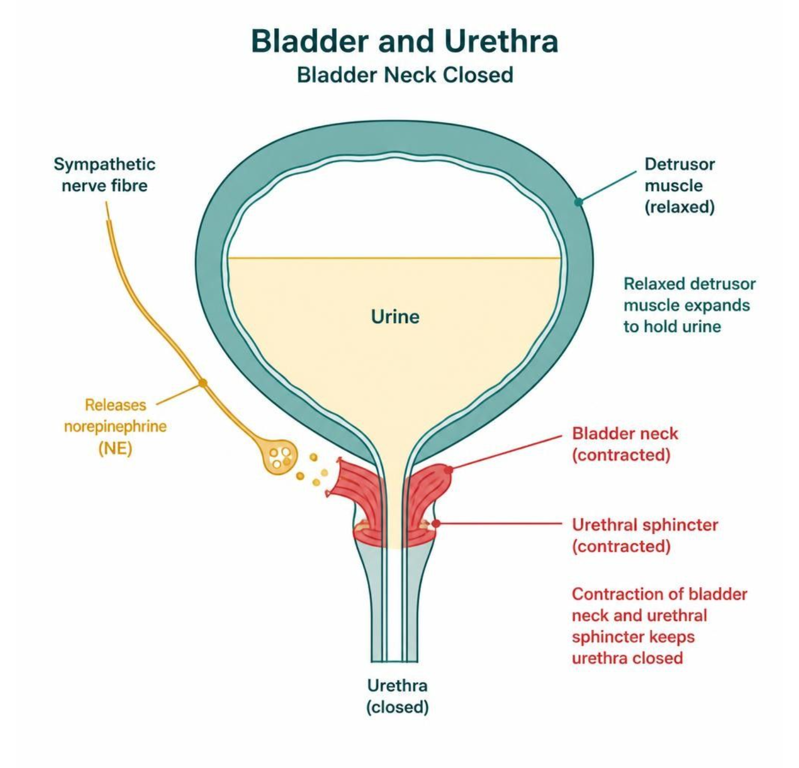
MECHANISM & DEPTH
Alpha-1 vs. Beta-3: Outlet Closed, Reservoir Relaxed
Sympathetic hypogastric nerve releases norepinephrine
↓
Alpha-1: outlet closed
Beta-3: reservoir relaxed
↓
Continence maintained during storage
Alpha-1 keeps the bladder neck closed while the bladder fills.
Beta-3 relaxes the detrusor so urine fills at low pressure.
Both arms work together in the storage phase.
Schematic (illustrative)
Figure 11. Alpha-1 contraction closes the outlet while beta-3 relaxation lets the bladder store urine.
Genitourinary & Reproductive Pharmacology — Session 2 of 2 — PA Program
8
Notes:
Together these produce continence during storage.

Slide 9
APPLYING THE PRINCIPLE
Storage Phase vs. Voiding Phase
Storage Phase
Voiding Phase
– Sympathetic tone dominates
– Beta3 agonism relaxes the detrusor body
– Alpha1 agonism contracts the bladder neck/urethra
– Somatic (pudendal) tone keeps the external sphincter closed
– Parasympathetic tone dominates
– M3 agonism contracts the detrusor body
– Sympathetic tone withdraws, bladder neck relaxes
– Voluntary relaxation of the external sphincter (somatic)
Genitourinary & Reproductive Pharmacology — Session 2 of 2 — PA Program
9
Notes:
Use this slide as the consolidating recap before the quick check — students should be able to generate this two-column comparison from memory by the end of the unit, and it is the direct physiologic basis for every drug covered afterward.
Instructor script:
Students should generate the two-column table from memory.

Slide 10
QUICK CHECK · AUTONOMIC CONTROL OF THE BLADDER
Quick Check
Which receptor and location combination is primarily responsible for keeping the bladder outlet closed during the storage phase?
A
Alpha1 receptors at the bladder neck and proximal urethra
B
M3 receptors on the detrusor muscle
C
Beta3 receptors on the detrusor muscle
D
Nicotinic receptors at the detrusor muscle
Genitourinary & Reproductive Pharmacology — Session 2 of 2 — PA Program
10
Notes:
Quick Check. Ask the class: which receptor closes the bladder neck during storage?

Slide 11
ANSWER · AUTONOMIC CONTROL OF THE BLADDER
Answer
A
Alpha1 receptors at the bladder neck and proximal urethra.
Why: Sympathetic norepinephrine acting on alpha1 receptors at the bladder neck and proximal urethra produces smooth muscle contraction, keeping the outlet closed during storage. Beta3 receptors, by contrast, relax the detrusor body (not the outlet) during this same phase.
Genitourinary & Reproductive Pharmacology — Session 2 of 2 — PA Program
11
Notes:
Answer: alpha-1 at the bladder neck.

Slide 12

SECTION
05
Overactive Bladder & Urinary Incontinence Pharmacology
Two mechanisms, one goal — calming an overactive detrusor to improve storage and reduce urgency.
Notes:
Section transition. Overactive bladder and urinary incontinence: antimuscarinics block the detrusor's muscarinic signal, while beta-3 agonists relax it.

Slide 13

BLOCKING THE CONTRACTION SIGNAL
Antimuscarinic Agents
Mechanism: block M3 (and, to a lesser extent, M2) muscarinic receptors on the detrusor, reducing involuntary contractions and increasing functional bladder capacity.
Agents: oxybutynin, tolterodine, solifenacin, darifenacin — differ mainly in receptor selectivity and anticholinergic side-effect burden rather than core mechanism.
Adverse effects follow directly from systemic antimuscarinic blockade: dry mouth, constipation, blurred vision, and — importantly — cognitive impairment and confusion, especially in older adults.
Anticholinergic burden is cumulative across all of a patient's medications — oxybutynin is generally considered to have the highest CNS anticholinergic burden of this class and is often avoided in older adults or those with dementia risk.
Caution/contraindication: narrow-angle glaucoma and significant urinary retention can be worsened by antimuscarinic therapy.
Genitourinary & Reproductive Pharmacology — Session 2 of 2 — PA Program
13
Notes:
The anticholinergic-burden-in-older-adults point is the highest-yield safety teaching point in this section — it directly sets up both the Quick Check and the upcoming clinical case.
Instructor script:
Oxybutynin, tolterodine, solifenacin, darifenacin. Dry mouth, constipation, blurred vision, confusion. Oxybutynin has the highest CNS burden.

Slide 14
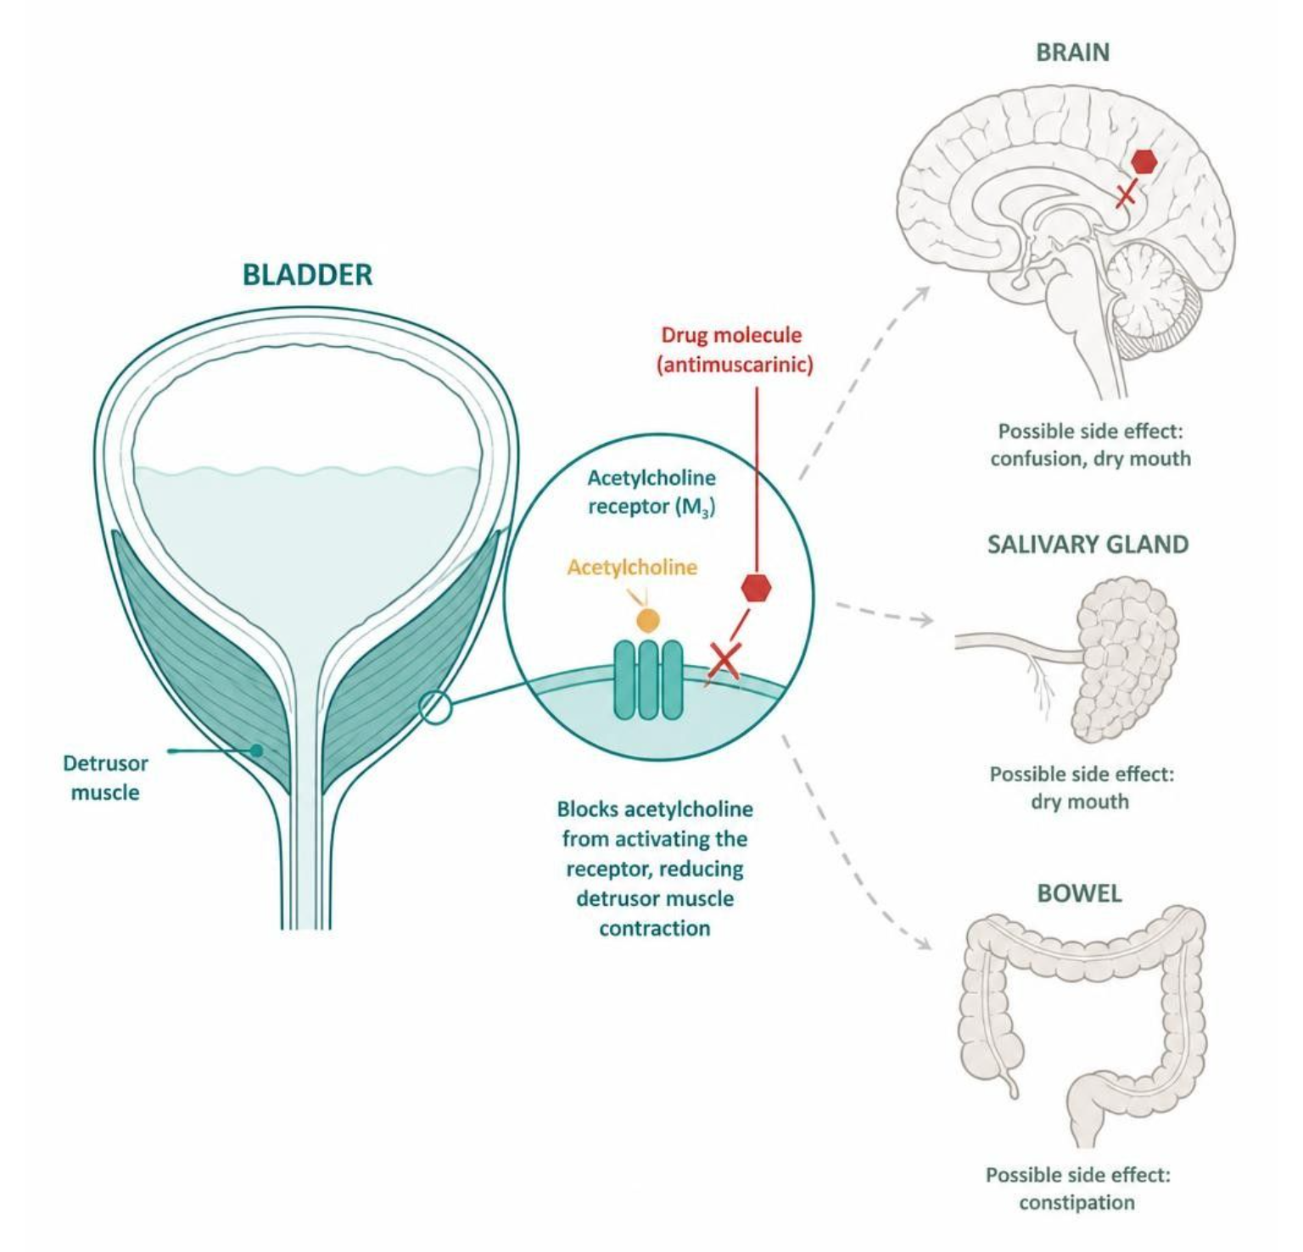
MECHANISM & DEPTH
Antimuscarinics: Bladder Benefit and Anticholinergic Burden
Drug blocks M3 receptors on the detrusor
↓
Fewer involuntary contractions, larger capacity
↓
Same blockade in brain, salivary gland and bowel
↓
Bladder relaxes, but dry mouth, constipation and confusion follow
Oxybutynin has the highest CNS anticholinergic burden.
Mirabegron, a beta-3 agonist, avoids this anticholinergic burden.
Schematic (illustrative)
Figure 12. Antimuscarinics relax the bladder but block the same receptors throughout the body.
Genitourinary & Reproductive Pharmacology — Session 2 of 2 — PA Program
14
Notes:
The same blockade in brain, gut and salivary glands causes the side effects.

Slide 15
ENHANCING THE RELAXATION SIGNAL
Beta-3 Agonists
Mechanism: stimulate beta3 adrenergic receptors on the detrusor, enhancing smooth muscle relaxation during the storage/filling phase.
Agent: mirabegron — the primary beta3 agonist in clinical use for overactive bladder.
Key advantage: lacks the systemic anticholinergic burden of antimuscarinics, making it a preferred option in older adults or patients already on multiple anticholinergic medications.
Adverse effects: can raise blood pressure (monitor in patients with uncontrolled hypertension) and may cause headache or nasopharyngitis; less commonly, urinary retention.
Mirabegron can be used alone or combined with an antimuscarinic for refractory symptoms, since the two act by complementary (not redundant) mechanisms.
Genitourinary & Reproductive Pharmacology — Session 2 of 2 — PA Program
15
Notes:
The "no anticholinergic burden" advantage is the single most important comparison point versus antimuscarinics — make sure students can articulate why that specifically matters in an older adult population.
Instructor script:
Mirabegron; may raise blood pressure; inhibits CYP2D6.

Slide 16

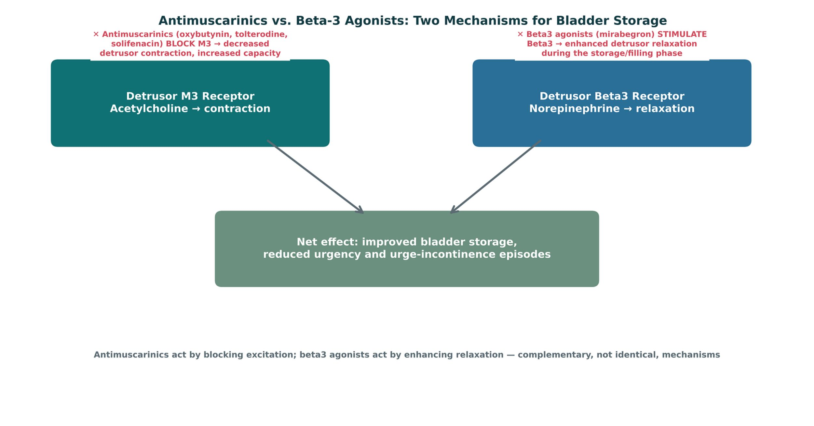
ORIGINAL ILLUSTRATION · FIGURE 13
Antimuscarinics vs. Beta-3 Agonists: Two Mechanisms for Bladder Storage
Figure 13. Original illustrative diagram (not from Katzung): antimuscarinics block the M3-mediated contraction signal, while beta3 agonists enhance the norepinephrine-mediated relaxation signal — two distinct mechanisms converging on the same clinical goal of improved bladder storage.
Genitourinary & Reproductive Pharmacology — Session 2 of 2 — PA Program
16
Notes:
Reinforce that these are complementary, not competing, mechanisms — this is the mechanistic basis for combination therapy mentioned on the previous slide.
Instructor script:
Complementary mechanisms.

Slide 17

CLINICAL CASE
Anticholinergic Burden in an Older Adult
An 78-year-old woman with mild cognitive impairment and urge incontinence is started on oxybutynin. Three weeks later, her family reports worsening confusion and new difficulty with daily tasks.
Ask yourself: What is the most likely explanation, and what change in therapy would you consider?
Clinical pearl: Oxybutynin carries a relatively high CNS anticholinergic burden, and in an older adult — especially one with pre-existing cognitive impairment — this can precipitate or worsen confusion. Switching to a beta3 agonist (mirabegron), which lacks anticholinergic activity, treats the same overactive bladder symptoms without this risk.
Genitourinary & Reproductive Pharmacology — Session 2 of 2 — PA Program
17
Notes:
This case is designed to make the Section 5 comparison concrete and clinical — a good checkpoint before the quick check, and a natural segue into discussing medication reconciliation for anticholinergic burden more broadly.
Instructor script:
Switch to mirabegron and review other anticholinergics.

Slide 18

QUICK CHECK · OVERACTIVE BLADDER PHARMACOLOGY
Quick Check
Which overactive bladder medication is generally preferred in an older adult already taking multiple anticholinergic medications?
A
Mirabegron, a beta3 agonist with no anticholinergic activity
B
Oxybutynin, for its high potency
C
Any antimuscarinic agent, since they are interchangeable
D
No pharmacologic therapy should be used in older adults
Genitourinary & Reproductive Pharmacology — Session 2 of 2 — PA Program
18
Notes:
Quick Check. Ask the class: which agent fits an older adult with OAB and high anticholinergic burden?

Slide 19
ANSWER · OVERACTIVE BLADDER PHARMACOLOGY
Answer
A
Mirabegron, a beta3 agonist with no anticholinergic activity.
Why: Because mirabegron works by enhancing beta3-mediated detrusor relaxation rather than blocking muscarinic receptors, it avoids adding to a patient's cumulative anticholinergic burden — a key consideration in older adults, who are more susceptible to anticholinergic-related confusion and cognitive impairment.
Genitourinary & Reproductive Pharmacology — Session 2 of 2 — PA Program
19
Notes:
Answer: mirabegron.

Slide 20

SECTION
06
BPH, Erectile Dysfunction & the NANC/PDE5 Pathway
Where genitourinary pharmacology meets the cardiovascular system — alpha1 blockade, nitric oxide signaling, and a life-threatening drug interaction.
Notes:
Section transition. BPH and erectile dysfunction: alpha1 blockers relax the prostate, and nitric oxide and cGMP drive erection.

Slide 21

RELAXING THE OUTFLOW TRACT
Alpha1 Blockers for BPH
Mechanism: block alpha1 receptors at the bladder neck, prostatic smooth muscle, and proximal urethra, relaxing outflow resistance and improving urinary flow in benign prostatic hyperplasia.
Agents: tamsulosin, silodosin (more uroselective, less vascular effect) vs. doxazosin, terazosin (less selective, more likely to lower blood pressure systemically).
Adverse effects: orthostatic hypotension and a "first-dose effect" (pronounced hypotension with the first dose) — because alpha1 receptors also mediate vascular smooth muscle tone, not just bladder neck tone.
This is the exact same receptor family targeted by alpha1-blocking antihypertensives and central agents discussed in Unit 5 — the difference here is clinical intent (urinary flow vs. blood pressure), not a different drug class.
Floppy iris syndrome is a recognized intraoperative complication during cataract surgery in patients on alpha1 blockers — relevant to preoperative medication reconciliation.
Genitourinary & Reproductive Pharmacology — Session 2 of 2 — PA Program
21
Notes:
The Unit 5 cross-reference here is deliberate and worth stating explicitly — tamsulosin and doxazosin are not new drug classes, they are the same alpha1-blocker pharmacology applied to a different primary indication.
Instructor script:
Tamsulosin and silodosin are uroselective; doxazosin and terazosin lower BP more. First-dose effect; floppy iris syndrome.

Slide 22
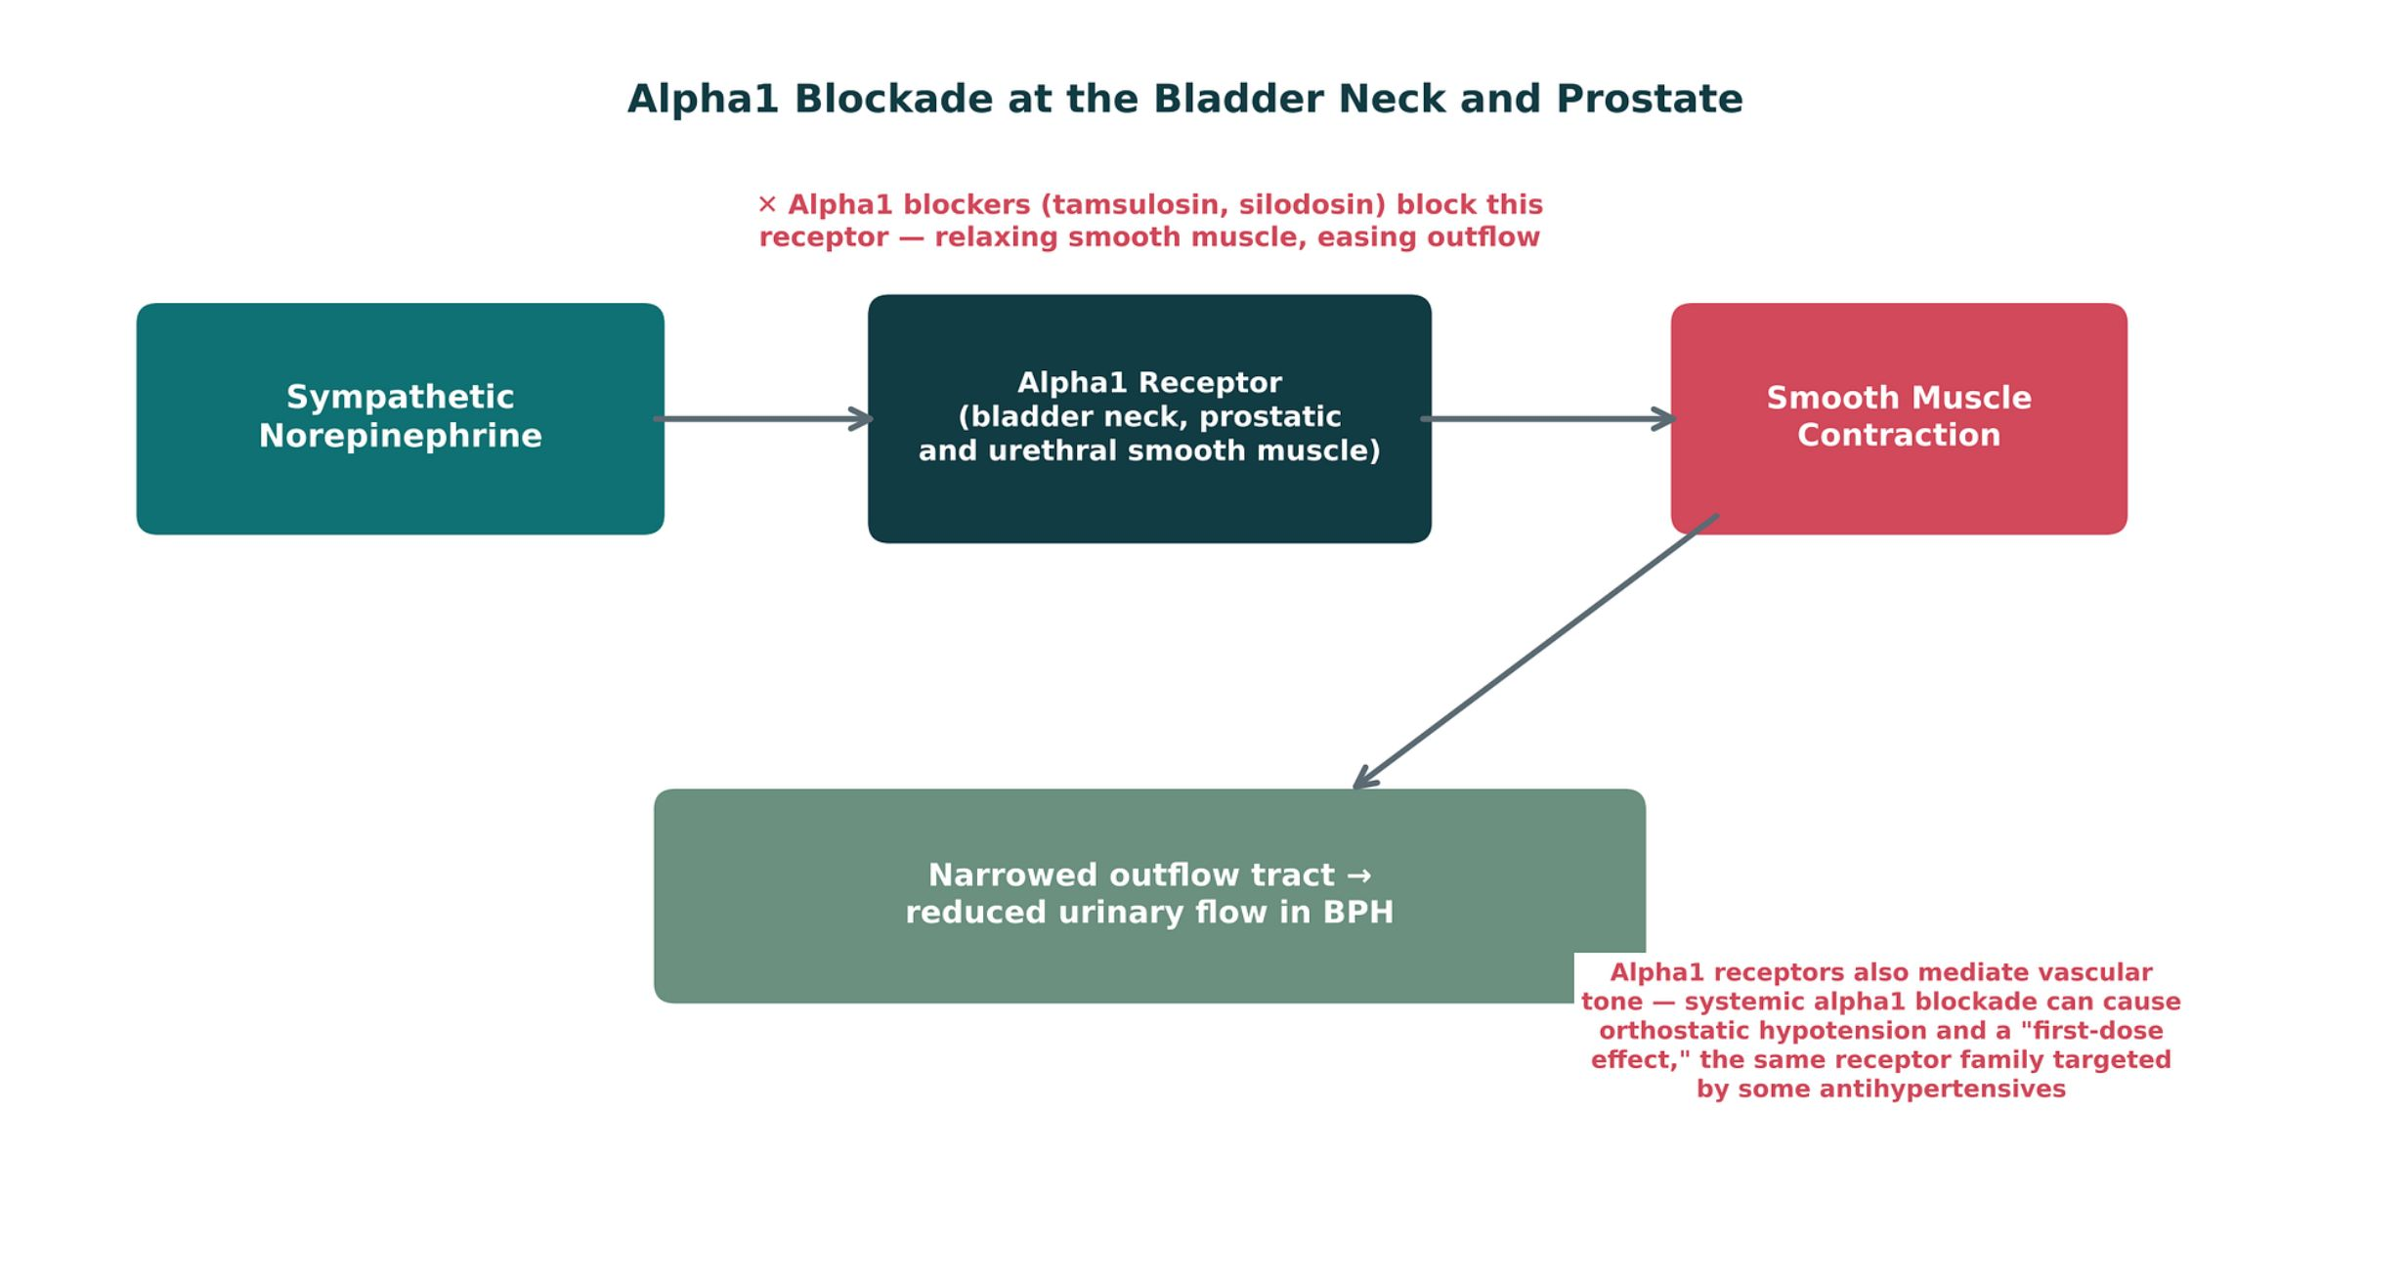
ORIGINAL ILLUSTRATION · FIGURE 14
Alpha1 Blockade at the Bladder Neck and Prostate
Figure 14. Original illustrative diagram (not from Katzung): sympathetic norepinephrine normally contracts bladder neck and prostatic smooth muscle via alpha1 receptors, narrowing the outflow tract; alpha1 blockers relax this same muscle to improve urinary flow — while the same receptor family elsewhere mediates vascular tone.
Genitourinary & Reproductive Pharmacology — Session 2 of 2 — PA Program
22
Notes:
Point explicitly to the side note about systemic alpha1 blockade and orthostatic hypotension — this is the figure's direct link back to Unit 5's antihypertensive content.
Instructor script:
Same receptor family as in blood vessels.

Slide 23

CALLBACK TO CHAPTER 40
5-Alpha-Reductase Inhibitors
Mechanism: block 5-alpha-reductase, the enzyme that converts testosterone to the more potent dihydrotestosterone (DHT) — the same mechanism introduced in Session 1 for hirsutism and androgenetic alopecia.
Agents: finasteride, dutasteride — in BPH, reducing DHT shrinks prostatic tissue over time, improving urinary symptoms.
Onset is slow: measurable symptomatic benefit typically takes 3–6 months, unlike the rapid onset of alpha1 blockers — the two classes are frequently combined for BPH, targeting both rapid symptom relief (alpha1 blocker) and long-term disease modification (5-ARI).
Adverse effects: decreased libido, erectile dysfunction, and — a key counseling point — these agents lower PSA levels by roughly half, which must be accounted for when interpreting PSA values in patients on long-term therapy.
Pregnancy caution: finasteride/dutasteride can cause ambiguous genitalia in a male fetus; pregnant partners should avoid handling crushed or broken tablets.
Genitourinary & Reproductive Pharmacology — Session 2 of 2 — PA Program
23
Notes:
Explicitly call back to Session 1 here — students met finasteride/dutasteride already for hirsutism; this slide is the same mechanism, same drugs, different clinical application, reinforcing the bridge between the two sessions.
Instructor script:
Finasteride, dutasteride; benefit takes 3-6 months; PSA falls by half; pregnancy caution.

Slide 24
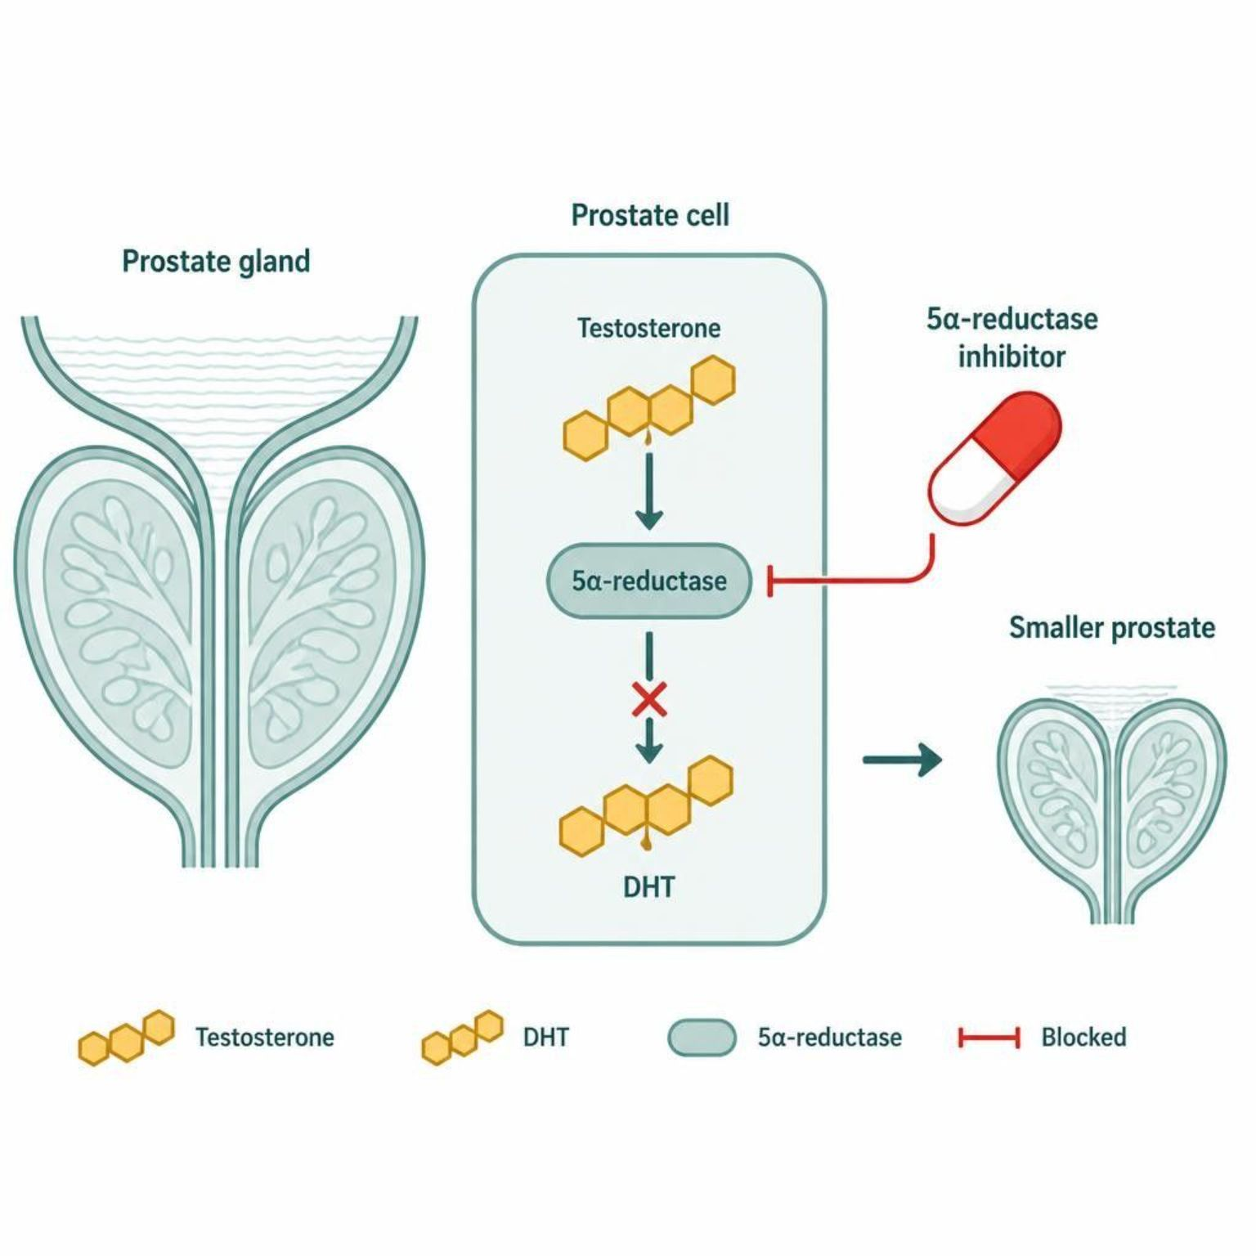
MECHANISM & DEPTH
5-ARIs: Shrinking the Prostate Slowly
Testosterone is converted by 5-alpha-reductase
↓
The enzyme makes dihydrotestosterone (DHT)
↓
DHT drives prostate growth
↓
Enzyme blocked, DHT falls, prostate shrinks slowly
Alpha1 blockers act in days; 5-ARIs take months, so combine them.
PSA falls about half on long-term therapy; read PSA accordingly.
Pregnant partners should avoid crushed or broken tablets.
Schematic (illustrative)
Figure 15. 5-ARIs block DHT production, so the prostate shrinks slowly over months.
Genitourinary & Reproductive Pharmacology — Session 2 of 2 — PA Program
24
Notes:
DHT falls and the prostate shrinks gradually; combine with an alpha-1 blocker.

Slide 25
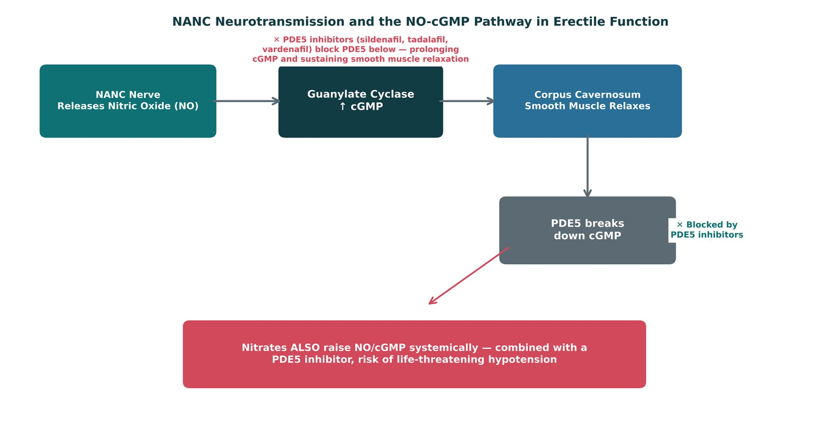
ORIGINAL ILLUSTRATION · FIGURE 16
NANC Neurotransmission and the NO-cGMP Pathway in Erectile Function
Figure 16. Original illustrative diagram (not from Katzung): non-adrenergic, noncholinergic (NANC) nerves release nitric oxide, raising cGMP and relaxing corpus cavernosum smooth muscle; PDE5 normally terminates this signal by breaking down cGMP, and nitrates independently raise NO/cGMP systemically — the mechanistic basis for the absolute nitrate/PDE5-inhibitor contraindication.
Genitourinary & Reproductive Pharmacology — Session 2 of 2 — PA Program
25
Notes:
This figure is the direct application of the Chapter 6 "non-adrenergic, noncholinergic neurons" content named in the reading assignment — point that out explicitly. Slow down on the nitrate warning box; it is the highest-stakes safety point in the entire unit.
Instructor script:
Slow down on the nitrate warning.

Slide 26
AN ABSOLUTE CONTRAINDICATION
PDE5 Inhibitors
Mechanism: block phosphodiesterase type 5 (PDE5), the enzyme that normally breaks down cGMP, prolonging smooth muscle relaxation in the corpus cavernosum and sustaining erectile function (Figure 16).
Agents: sildenafil, tadalafil (longer half-life, allows more flexible dosing), vardenafil.
Common adverse effects: headache, flushing, dyspepsia, and visual disturbances (blue-tinged vision, more notable with sildenafil).
Absolute contraindication: concurrent use with any nitrate — both raise NO/cGMP signaling, and together they can cause profound, life-threatening hypotension. This mirrors the identical nitrate/PDE5-inhibitor warning from Unit 5's angina content, now from the opposite side of the interaction.
Use caution with alpha1 blockers as well — the additive hypotensive risk, while less severe than with nitrates, still warrants spacing doses or careful monitoring when both are used.
Genitourinary & Reproductive Pharmacology — Session 2 of 2 — PA Program
26
Notes:
This is the single most important safety point in the session — students saw this exact contraindication from the nitrate side in Unit 5; today they see it from the PDE5-inhibitor side. Make the connection explicit rather than assuming they will make it themselves.
Instructor script:
Sildenafil, tadalafil, vardenafil. Absolute contraindication with nitrates.

Slide 27
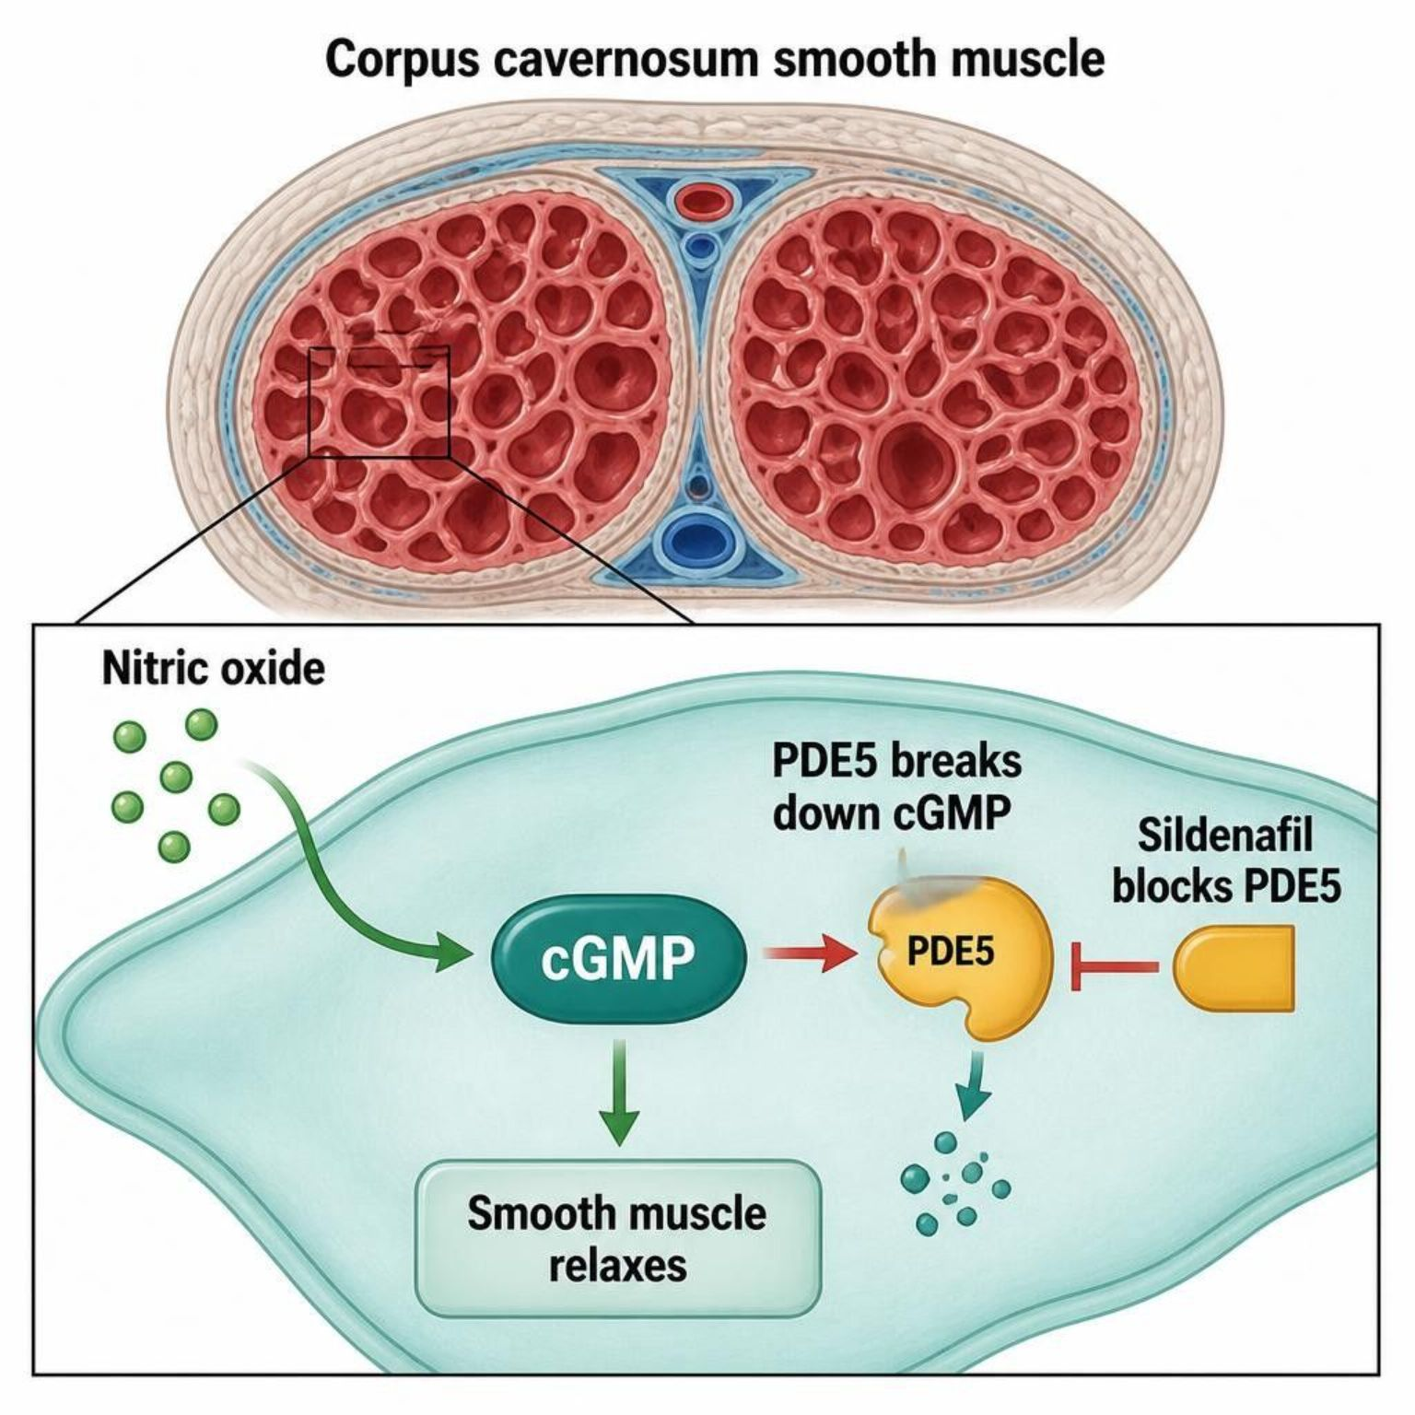
MECHANISM & DEPTH
PDE5 Inhibitors: NO, cGMP and Erection
Sexual stimulation
↓
NANC nerves release nitric oxide
↓
Guanylate cyclase makes cGMP
↓
cGMP relaxes corpus cavernosum smooth muscle
↓
Erection
PDE5 breaks down cGMP and ends the signal.
Sildenafil, tadalafil and vardenafil block PDE5 and prolong the signal.
An erection needs sexual stimulation to start the pathway.
Schematic (illustrative)
Figure 17. PDE5 inhibitors keep cGMP high, prolonging smooth muscle relaxation.
Genitourinary & Reproductive Pharmacology — Session 2 of 2 — PA Program
27
Notes:
They prolong cGMP but need sexual stimulation.

Slide 28
CLINICAL CASE
A Dangerous Combination
A 64-year-old man with stable angina on isosorbide mononitrate asks his PA for a prescription for erectile dysfunction, mentioning that a friend takes sildenafil "with no problems."
Ask yourself: What should the PA do, and why?
Clinical pearl: PDE5 inhibitors are absolutely contraindicated with any nitrate — both raise NO/cGMP signaling, and the combination can cause severe, life-threatening hypotension. This prescription should not be written while the patient remains on a nitrate; the conversation should include alternative angina management or alternative ED options that do not involve this interaction, in consultation with his cardiologist.
Genitourinary & Reproductive Pharmacology — Session 2 of 2 — PA Program
28
Notes:
This case is the capstone integration point for the unit — it deliberately pulls a Unit 5 drug (isosorbide mononitrate) into a Unit 6 clinical decision, making the shared NO-cGMP mechanism unmistakable.
Instructor script:
Never prescribe together.

Slide 29
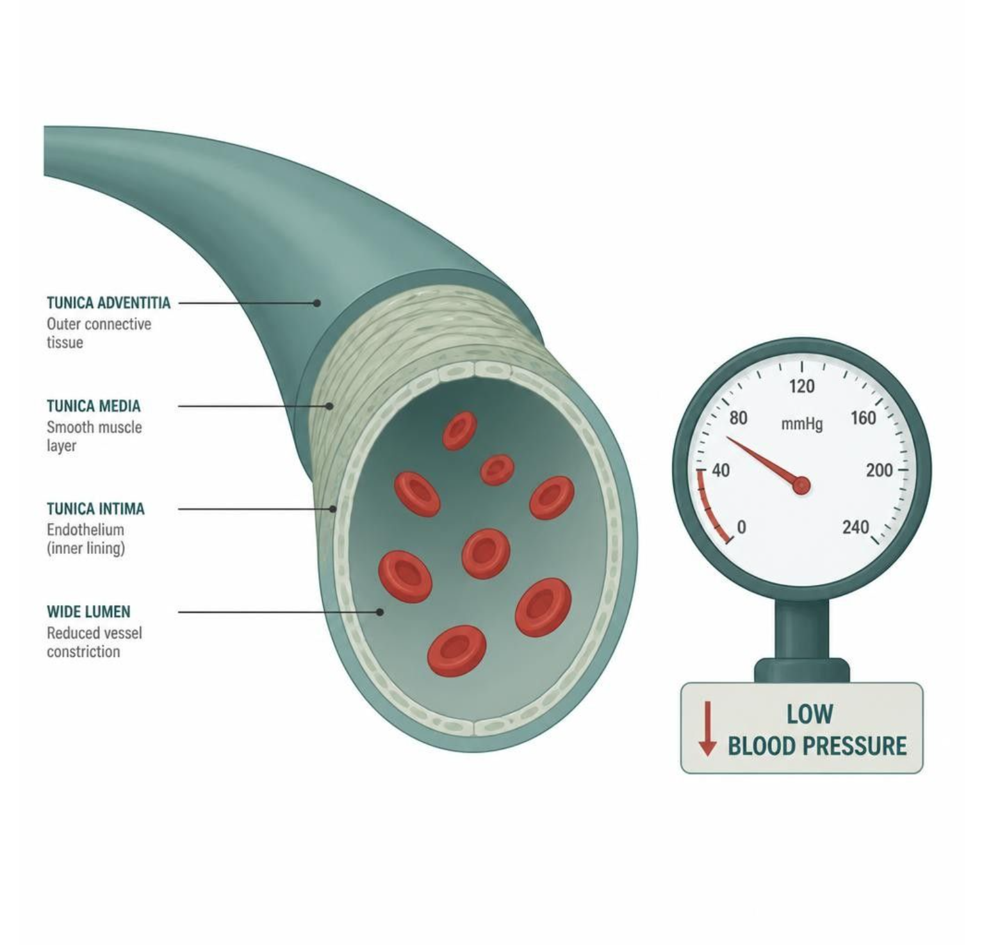
MECHANISM & DEPTH
Nitrate plus PDE5 Inhibitor: A Double Hit on cGMP
Nitrate raises NO and cGMP systemically
↓
PDE5 inhibitor stops cGMP breakdown
↓
Together, vasodilation becomes profound
↓
Severe hypotension and syncope
Absolute contraindication: never combine nitrates with a PDE5 inhibitor.
Use caution when alpha1 blockers are also prescribed.
Schematic (illustrative)
Figure 18. Nitrates and PDE5 inhibitors both raise cGMP, so vasodilation and hypotension stack.
Genitourinary & Reproductive Pharmacology — Session 2 of 2 — PA Program
29
Notes:
Nitrates and PDE5 inhibitors both raise cGMP; never prescribe together.

Slide 30
QUICK CHECK · BPH, ED & THE NANC/PDE5 PATHWAY
Quick Check
Why is the combination of a nitrate and a PDE5 inhibitor absolutely contraindicated?
A
Both drugs independently raise NO/cGMP signaling, and together can cause life-threatening hypotension
B
Nitrates block the PDE5 enzyme, making PDE5 inhibitors ineffective
C
The combination has no significant interaction and is commonly prescribed together
D
PDE5 inhibitors increase nitrate metabolism, reducing anti-anginal efficacy
Genitourinary & Reproductive Pharmacology — Session 2 of 2 — PA Program
30
Notes:
Quick Check. Ask the class what nitrates and PDE5 inhibitors have in common.

Slide 31
ANSWER · BPH, ED & THE NANC/PDE5 PATHWAY
Answer
A
Both drugs independently raise NO/cGMP signaling, and together can cause life-threatening hypotension.
Why: Nitrates raise NO/cGMP systemically (the mechanism behind their anti-anginal effect), while PDE5 inhibitors prevent cGMP breakdown. Combined, these two independent mechanisms produce profound vasodilation and can precipitate severe, potentially fatal hypotension — the same NO-cGMP pathway shown in Figure 16, now viewed as a drug-interaction risk rather than a therapeutic mechanism.
Genitourinary & Reproductive Pharmacology — Session 2 of 2 — PA Program
31
Notes:
Answer: both raise NO/cGMP signaling.

Slide 32
MECHANISM & DEPTH
Drug Names Reveal the Class: Urologic Agents
Stem
Class
Examples
Memory aid
-osin
Alpha1 blocker
tamsulosin, doxazosin, terazosin, silodosin
Opens the outlet
-terodine
Antimuscarinic
tolterodine, fesoterodine
Dampens detrusor M3 signal
-fenacin
Antimuscarinic
solifenacin, darifenacin
Same class, same target
oxybutynin / trospium
Antimuscarinic
oxybutynin, trospium
Older, higher CNS burden
-begron
Beta-3 agonist
mirabegron, vibegron
Relaxes the reservoir
-afil
PDE5 inhibitor
sildenafil, tadalafil, vardenafil
Keeps cGMP high
-steride
5-alpha-reductase inhibitor
finasteride, dutasteride
Lowers DHT, shrinks prostate
-nitrate / nitro-
Nitrate
isosorbide, nitroglycerin
Never with a PDE5 inhibitor
Genitourinary & Reproductive Pharmacology — Session 2 of 2 — PA Program
32
Notes:
Drug names reveal the class: -osin, -terodine, -fenacin, -begron, -afil, -steride, and nitrates.

Slide 33

SECTION
07
Putting It All Together
Applying the whole genitourinary and reproductive pharmacology toolkit, across both sessions.

Slide 34
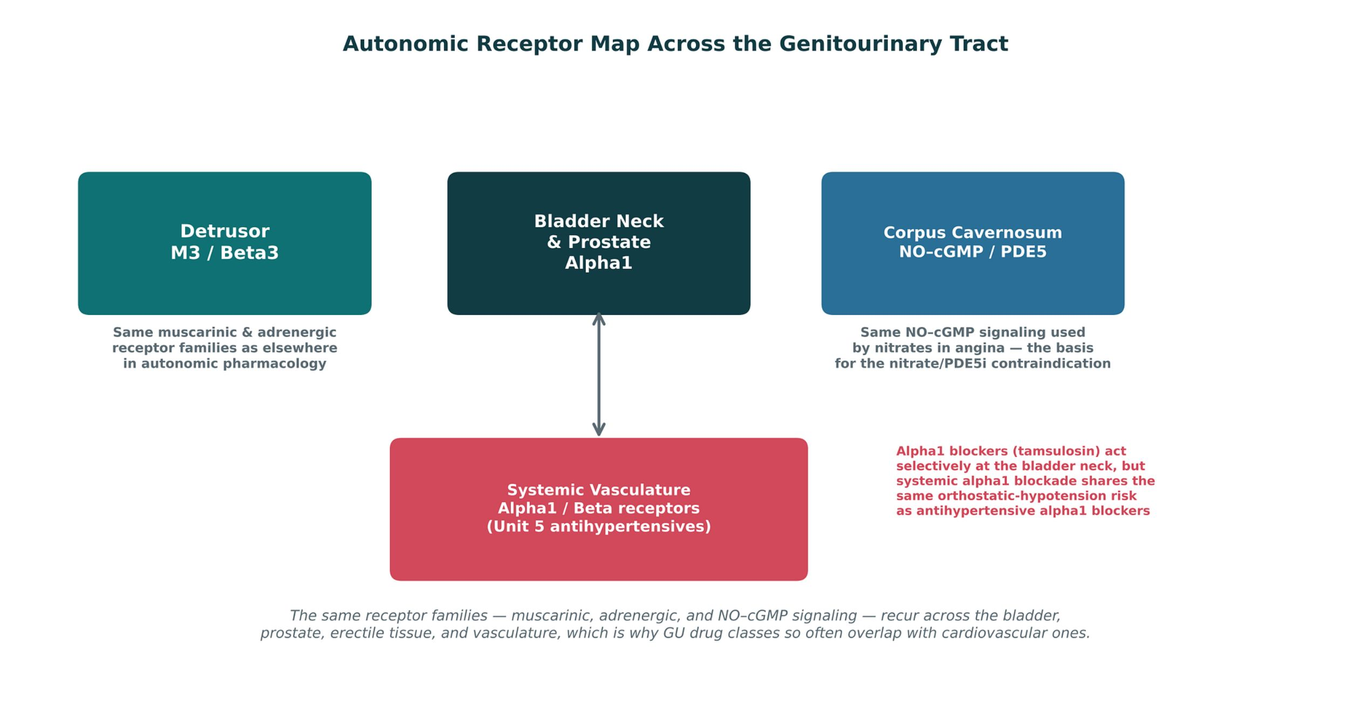
ORIGINAL ILLUSTRATION · FIGURE 19
Autonomic Receptor Map Across the Genitourinary Tract
Figure 19. Original illustrative diagram (not from Katzung): the detrusor, bladder neck/prostate, and corpus cavernosum each rely on receptor families — muscarinic, adrenergic, and NO-cGMP signaling — that recur in the systemic vasculature, explaining why so many genitourinary drug classes have direct cardiovascular counterparts or interactions.
Genitourinary & Reproductive Pharmacology — Session 2 of 2 — PA Program
34
Notes:
This capstone figure is the visual summary of the entire session's unifying theme — use it to set up the fourCard exercise and quick check that follow, both of which ask students to apply this cross-system receptor logic directly.
Instructor script:
Receptor families are shared with the vasculature.

Slide 35
APPLY IT
Which Approach Would You Choose?
Patient A
Patient B
– Older adult with urge incontinence and mild cognitive impairment, needs therapy that avoids anticholinergic burden
– Man with BPH and symptomatic bother, wants both rapid symptom relief and long-term disease modification
Patient C
Patient D
– Woman with PCOS, irregular cycles, and hirsutism, not currently trying to conceive
– Man with stable angina on a long-acting nitrate, requesting treatment for erectile dysfunction
Genitourinary & Reproductive Pharmacology — Session 2 of 2 — PA Program
35
Notes:
Work through these as a rapid-fire discussion. Patient A → mirabegron (Section 5). Patient B → combine an alpha1 blocker with a 5-alpha-reductase inhibitor (Section 6). Patient C → combined hormonal contraception ± metformin (Session 1). Patient D → PDE5 inhibitors are contraindicated; this requires a cardiology-involved conversation about alternatives (Section 6 case, revisited).
Instructor script:
Pairs: first-line approach and biggest safety check.

Slide 36

QUICK CHECK · PUTTING IT ALL TOGETHER
Quick Check
Across this unit, what is the common thread linking alpha1 blockers' orthostatic hypotension risk and the nitrate/PDE5-inhibitor contraindication?
Both reflect genitourinary drug classes acting on receptor families (adrenergic, NO-cGMP) that are shared with the systemic vasculature
Both are reasons to avoid all genitourinary pharmacology in older adults
A
B
C
Both are unrelated adverse effects with no shared mechanism
D
Both apply only to patients with no cardiovascular disease
Genitourinary & Reproductive Pharmacology — Session 2 of 2 — PA Program
36

Slide 37
ANSWER · PUTTING IT ALL TOGETHER
Answer
A
Both reflect genitourinary drug classes acting on receptor families (adrenergic, NO-cGMP) that are shared with the systemic vasculature.
Why: Alpha1 blockers act on the same receptor family in the bladder neck/prostate and in blood vessels, and PDE5 inhibitors/nitrates both converge on the same NO-cGMP signaling pathway used in both the corpus cavernosum and the vasculature. Recognizing receptor families as the shared variable — not organ system — is what ties genitourinary and cardiovascular pharmacology together across Units 5 and 6.
Genitourinary & Reproductive Pharmacology — Session 2 of 2 — PA Program
37

Slide 38
BIG PICTURE
Key Takeaways
Session 1's gonadal hormone pharmacology (Chapter 40) and PCOS content (Chapter 41 overlap) and Session 2's autonomic bladder pharmacology (Chapter 6) are mechanistically distinct, but connect through shared drug classes — 5-alpha-reductase inhibitors appear in both sessions for different indications.
1
2
The lower urinary tract is governed by three nerve supplies and three receptor families (Figure 9): parasympathetic/M3, sympathetic/alpha1 and beta3, and somatic/nicotinic.
3
Antimuscarinics and beta3 agonists treat overactive bladder through complementary mechanisms — blocking contraction vs. enhancing relaxation — with anticholinergic burden the key safety differentiator in older adults.
4
Alpha1 blockers and 5-alpha-reductase inhibitors treat BPH through different timescales and mechanisms, and are often combined; alpha1 blockade directly overlaps with Unit 5's antihypertensive pharmacology.
The NO-cGMP pathway (Figure 16) underlies both erectile function and nitrate-based angina therapy (Unit 5) — the same mechanism is therapeutic in one context and dangerous in combination in another, making the nitrate/PDE5-inhibitor contraindication one of the highest-stakes safety points in the course.
5
Genitourinary & Reproductive Pharmacology — Session 2 of 2 — PA Program
Notes:
Close the full two-session unit by explicitly naming the cross-unit integration — students should leave recognizing that genitourinary pharmacology is not an isolated topic but shares receptor families and drug classes with cardiovascular pharmacology covered earlier in the course.
Instructor script:
Common thread: receptor families shared with the systemic vasculature.

Slide 39

SECTION
08
Lecture Recall Quiz
A cumulative self-test spanning both sessions — use this to review before exams.

Slide 40
LECTURE RECALL QUIZ
Lecture Recall Quiz (1 of 2)
1. Why is unopposed estrogen avoided in a patient with an intact uterus?
A. It significantly increases the risk of endometrial hyperplasia and cancer
B. It has no effect on the endometrium
C. It always causes immediate heavy bleeding
D. It is only a concern in postmenopausal patients
2. Why does tamoxifen carry an increased risk of endometrial cancer while raloxifene largely does not?
A. Tamoxifen acts as an estrogen receptor agonist in the endometrium; raloxifene is essentially neutral there
B. Tamoxifen blocks the androgen receptor instead of the estrogen receptor
C. Raloxifene has no effect on the estrogen receptor anywhere in the body
D. Tamoxifen and raloxifene have identical endometrial effects
3. What is the central pathophysiologic driver linking insulin resistance to hyperandrogenism in PCOS?
A. Hyperinsulinemia stimulates ovarian androgen production and lowers hepatic SHBG, raising free testosterone
B. Insulin resistance has no mechanistic connection to androgen levels
C. Hyperandrogenism always precedes and causes insulin resistance, never the reverse
D. Metformin directly blocks the androgen receptor
Genitourinary & Reproductive Pharmacology — Session 2 of 2 — PA Program
40

Slide 41
LECTURE RECALL QUIZ
Lecture Recall Quiz (2 of 2)
4. A patient on an antimuscarinic for overactive bladder develops new confusion. What is the most appropriate next step?
A. Switch to a beta3 agonist (mirabegron), which lacks anticholinergic activity
B. Increase the antimuscarinic dose
C. Add a second antimuscarinic agent
D. Confusion is unrelated to antimuscarinic therapy
5. Why are alpha1 blockers used for BPH associated with orthostatic hypotension?
A. Alpha1 receptors also mediate vascular smooth muscle tone, not just bladder neck tone
B. Alpha1 blockers have no effect outside the bladder
C. Orthostatic hypotension only occurs with beta3 agonists
D. Alpha1 blockers directly block cardiac beta receptors
6. Why is the combination of a nitrate and a PDE5 inhibitor absolutely contraindicated?
A. Both independently raise NO/cGMP signaling, and together can cause life-threatening hypotension
B. PDE5 inhibitors inactivate nitrates before they reach the bloodstream
C. The combination has no significant interaction
D. Nitrates block PDE5 directly, making the combination redundant but safe
Genitourinary & Reproductive Pharmacology — Session 2 of 2 — PA Program
41

Slide 42
ANSWER KEY
Lecture Recall Quiz — Answer Key
1. A — Unopposed estrogen drives unchecked endometrial proliferation, significantly raising the risk of endometrial hyperplasia and cancer in a patient with a uterus — this is why a progestin is always paired with estrogen therapy unless the patient has had a hysterectomy.
2. A — Tamoxifen is a tissue-selective estrogen receptor modulator that acts as an agonist in the endometrium (raising cancer risk) while acting as an antagonist in breast tissue; raloxifene shares the breast antagonist and bone agonist effects but is essentially neutral at the endometrium.
3. A — Hyperinsulinemia stimulates ovarian theca-cell androgen production directly and lowers hepatic SHBG production, raising free testosterone — the mechanistic link at the center of the PCOS-insulin resistance cycle (Figure 7).
4. A — Mirabegron enhances beta3-mediated detrusor relaxation without blocking muscarinic receptors, avoiding the cumulative anticholinergic burden that can precipitate or worsen confusion in susceptible patients, particularly older adults.
5. A — Alpha1 receptors are not bladder-specific — the same receptor family mediates vascular smooth muscle tone throughout the body, so alpha1 blockade at the bladder neck also lowers systemic vascular resistance, producing orthostatic hypotension and a first-dose effect.
6. A — Nitrates and PDE5 inhibitors both raise NO/cGMP signaling through independent mechanisms; combined, the effect on vascular smooth muscle relaxation is additive to synergistic, producing profound and potentially fatal hypotension.
Genitourinary & Reproductive Pharmacology — Session 2 of 2 — PA Program

Slide 43
PA PHARMACOLOGY COURSE · SESSION 2
Drug Profiles
Study reference for the drugs covered in Session 2
PO = by mouth
TID = three times daily
IR / ER = immediate-release / extended-release
BPH = benign prostatic hyperplasia
PSA = prostate-specific antigen
ED = erectile dysfunction
PAH = pulmonary arterial hypertension
OAB = overactive bladder
CNS = central nervous system
QT = QT interval on ECG
BP = blood pressure
GI = gastrointestinal
ECG = electrocardiogram
NO / cGMP = nitric oxide / cyclic guanosine monophosphate
CYP = cytochrome P450
eGFR / CrCl = estimated glomerular filtration rate / creatinine clearance
PDE5 = phosphodiesterase type 5
GnRH = gonadotropin-releasing hormone
Notes:
PO = by mouth | TID = three times daily | IR / ER = immediate-release / extended-release | BPH = benign prostatic hyperplasia | PSA = prostate-specific antigen | ED = erectile dysfunction | PAH = pulmonary arterial hypertension | OAB = overactive bladder | CNS = central nervous system | QT = QT interval on ECG | CYP = cytochrome P450 | eGFR / CrCl = estimated glomerular filtration rate / creatinine clearance | PDE5 = phosphodiesterase type 5 | GnRH = gonadotropin-releasing hormone | BP = blood pressure | GI = gastrointestinal | ECG = electrocardiogram | NO / cGMP = nitric oxide / cyclic guanosine monophosphate
Instructor script:
Say: These profiles are your study reference. Know the dose logic, the serious adverse effects, the contraindication that changes decisions and the toxicity you would need to recognize.
Class activity (10 minutes): groups teach back two or three profiles in 60 seconds each.
Abbreviation key: review BPH, PSA, ED, PAH, QT, CYP and PDE5.
Teaching points: antimuscarinics (oxybutynin, tolterodine, solifenacin, darifenacin), mirabegron, alpha-1 blockers (tamsulosin, silodosin, doxazosin, terazosin), 5-ARIs, PDE5 inhibitors.
Bloom's prompts: Remember: state tamsulosin dosing. Understand: explain mirabegron versus oxybutynin. Apply: counsel a man starting doxazosin. Analyze: explain bradycardia on metoprolol plus mirabegron. Evaluate: choose therapy for an older adult with BPH and OAB.

Slide 44
DRUG PROFILE
Oxybutynin (Ditropan, Oxytrol)
ANTIMUSCARINIC (OVERACTIVE BLADDER)
FORMULATION
IR tablets 5 mg; ER tablets 5/10/15 mg; transdermal patch 3.9 mg/day; gel
DOSE (ADULT)
IR: 5 mg PO two to three times daily (maximum 20 mg/day); ER: 5-10 mg daily (maximum 30 mg)
INDICATIONS
Overactive bladder, urge incontinence, neurogenic bladder
ADVERSE EFFECTS
Dry mouth, constipation, blurred vision, drowsiness, confusion, urinary retention
CONTRAINDICATIONS
Narrow-angle glaucoma, urinary retention, gastric retention, severe ulcerative colitis; avoid in older adults with dementia
TOXICITY / OVERDOSE
Anticholinergic toxicity: confusion, hallucinations, tachycardia, hyperthermia, urinary retention; highest CNS burden in the class
Standard adult dosing for teaching; verify against current prescribing information.
Genitourinary & Reproductive Pharmacology — Session 2 of 2 — PA Program
44
Notes:
Oxybutynin (Ditropan, Oxytrol)|Antimuscarinic (overactive bladder)|IR tablets 5 mg; ER tablets 5/10/15 mg; transdermal patch 3.9 mg/day; gel|IR: 5 mg PO two to three times daily (maximum 20 mg/day); ER: 5-10 mg daily (maximum 30 mg)|Overactive bladder, urge incontinence, neurogenic bladder|Dry mouth, constipation, blurred vision, drowsiness, confusion, urinary retention|Narrow-angle glaucoma, urinary retention, gastric retention, severe ulcerative colitis; avoid in older adults with dementia|Anticholinergic toxicity: confusion, hallucinations, tachycardia, hyperthermia, urinary retention; highest CNS burden in the class

Slide 45
DRUG PROFILE
Tolterodine (Detrol)
ANTIMUSCARINIC
FORMULATION
Tablets 1/2 mg; ER capsules 2/4 mg
DOSE (ADULT)
IR: 2 mg PO twice daily (1 mg if hepatic impairment or strong CYP3A4 inhibitors); ER: 4 mg daily
INDICATIONS
Overactive bladder with urgency, frequency, and urge incontinence
ADVERSE EFFECTS
Dry mouth, constipation, headache, dizziness, dry eyes, QT prolongation (rare)
CONTRAINDICATIONS
Urinary retention, gastric retention, uncontrolled narrow-angle glaucoma
TOXICITY / OVERDOSE
Anticholinergic toxicity; reduce dose with CYP3A4 inhibitors or hepatic impairment
Standard adult dosing for teaching; verify against current prescribing information.
Genitourinary & Reproductive Pharmacology — Session 2 of 2 — PA Program
45
Notes:
Tolterodine (Detrol)|Antimuscarinic|Tablets 1/2 mg; ER capsules 2/4 mg|IR: 2 mg PO twice daily (1 mg if hepatic impairment or strong CYP3A4 inhibitors); ER: 4 mg daily|Overactive bladder with urgency, frequency, and urge incontinence|Dry mouth, constipation, headache, dizziness, dry eyes, QT prolongation (rare)|Urinary retention, gastric retention, uncontrolled narrow-angle glaucoma|Anticholinergic toxicity; reduce dose with CYP3A4 inhibitors or hepatic impairment

Slide 46
DRUG PROFILE
Solifenacin (Vesicare)
ANTIMUSCARINIC (M3-SELECTIVE)
FORMULATION
Tablets 5/10 mg
DOSE (ADULT)
5 mg PO once daily, may increase to 10 mg (maximum 5 mg with severe renal impairment or strong CYP3A4 inhibitors)
INDICATIONS
Overactive bladder
ADVERSE EFFECTS
Dry mouth, constipation, blurred vision, QT prolongation, urinary retention
CONTRAINDICATIONS
Urinary retention, gastric retention, uncontrolled narrow-angle glaucoma
TOXICITY / OVERDOSE
Anticholinergic toxicity and QT prolongation in overdose; adjust dose with kidney, liver, and CYP3A4 interactions
Standard adult dosing for teaching; verify against current prescribing information.
Genitourinary & Reproductive Pharmacology — Session 2 of 2 — PA Program
46
Notes:
Solifenacin (Vesicare)|Antimuscarinic (M3-selective)|Tablets 5/10 mg|5 mg PO once daily, may increase to 10 mg (maximum 5 mg with severe renal impairment or strong CYP3A4 inhibitors)|Overactive bladder|Dry mouth, constipation, blurred vision, QT prolongation, urinary retention|Urinary retention, gastric retention, uncontrolled narrow-angle glaucoma|Anticholinergic toxicity and QT prolongation in overdose; adjust dose with kidney, liver, and CYP3A4 interactions

Slide 47
DRUG PROFILE
Darifenacin (Enablex)
ANTIMUSCARINIC (M3-SELECTIVE)
FORMULATION
ER tablets 7.5/15 mg
DOSE (ADULT)
7.5 mg PO once daily, may increase to 15 mg after 2 weeks
INDICATIONS
Overactive bladder
ADVERSE EFFECTS
Constipation (prominent), dry mouth, dyspepsia, headache
CONTRAINDICATIONS
Urinary or gastric retention, uncontrolled narrow-angle glaucoma
TOXICITY / OVERDOSE
Anticholinergic toxicity; CYP2D6 and CYP3A4 interactions; limit dose with moderate CYP3A4 inhibitors
Standard adult dosing for teaching; verify against current prescribing information.
Genitourinary & Reproductive Pharmacology — Session 2 of 2 — PA Program
47
Notes:
Darifenacin (Enablex)|Antimuscarinic (M3-selective)|ER tablets 7.5/15 mg|7.5 mg PO once daily, may increase to 15 mg after 2 weeks|Overactive bladder|Constipation (prominent), dry mouth, dyspepsia, headache|Urinary or gastric retention, uncontrolled narrow-angle glaucoma|Anticholinergic toxicity; CYP2D6 and CYP3A4 interactions; limit dose with moderate CYP3A4 inhibitors

Slide 48
DRUG PROFILE
Mirabegron (Myrbetriq)
BETA-3 ADRENERGIC AGONIST
FORMULATION
ER tablets 25/50 mg; granules for suspension
DOSE (ADULT)
25 mg PO once daily, may increase to 50 mg after 4-8 weeks (maximum 25 mg with eGFR 15-29)
INDICATIONS
Overactive bladder (alone or with an antimuscarinic)
ADVERSE EFFECTS
Hypertension, nasopharyngitis, urinary tract infection, headache, urinary retention
CONTRAINDICATIONS
Severe uncontrolled hypertension, end-stage renal disease; caution with CYP2D6 substrates
TOXICITY / OVERDOSE
Raises blood pressure; inhibits CYP2D6, increasing metoprolol and desipramine levels; no anticholinergic burden
Standard adult dosing for teaching; verify against current prescribing information.
Genitourinary & Reproductive Pharmacology — Session 2 of 2 — PA Program
48
Notes:
Mirabegron (Myrbetriq)|Beta-3 adrenergic agonist|ER tablets 25/50 mg; granules for suspension|25 mg PO once daily, may increase to 50 mg after 4-8 weeks (maximum 25 mg with eGFR 15-29)|Overactive bladder (alone or with an antimuscarinic)|Hypertension, nasopharyngitis, urinary tract infection, headache, urinary retention|Severe uncontrolled hypertension, end-stage renal disease; caution with CYP2D6 substrates|Raises blood pressure; inhibits CYP2D6, increasing metoprolol and desipramine levels; no anticholinergic burden

Slide 49
DRUG PROFILE
Tamsulosin (Flomax)
ALPHA-1A SELECTIVE BLOCKER
FORMULATION
Capsules 0.4 mg
DOSE (ADULT)
0.4 mg PO once daily 30 minutes after the same meal, may increase to 0.8 mg
INDICATIONS
Benign prostatic hyperplasia symptoms, ureteral stone passage (off-label)
ADVERSE EFFECTS
Dizziness, orthostatic hypotension, retrograde ejaculation, rhinitis, intraoperative floppy iris syndrome
CONTRAINDICATIONS
Hypersensitivity (sulfonamide allergy caution); strong CYP3A4 inhibitors
TOXICITY / OVERDOSE
Orthostatic hypotension and syncope with first dose; floppy iris syndrome in cataract surgery
Standard adult dosing for teaching; verify against current prescribing information.
Genitourinary & Reproductive Pharmacology — Session 2 of 2 — PA Program
49
Notes:
Tamsulosin (Flomax)|Alpha-1A selective blocker|Capsules 0.4 mg|0.4 mg PO once daily 30 minutes after the same meal, may increase to 0.8 mg|Benign prostatic hyperplasia symptoms, ureteral stone passage (off-label)|Dizziness, orthostatic hypotension, retrograde ejaculation, rhinitis, intraoperative floppy iris syndrome|Hypersensitivity (sulfonamide allergy caution); strong CYP3A4 inhibitors|Orthostatic hypotension and syncope with first dose; floppy iris syndrome in cataract surgery

Slide 50
DRUG PROFILE
Silodosin (Rapaflo)
HIGHLY UROSELECTIVE ALPHA-1A BLOCKER
FORMULATION
Capsules 4/8 mg
DOSE (ADULT)
8 mg PO once daily with a meal (4 mg with moderate renal impairment)
INDICATIONS
Benign prostatic hyperplasia symptoms
ADVERSE EFFECTS
Retrograde ejaculation (common), dizziness, orthostatic hypotension, diarrhea
CONTRAINDICATIONS
Severe renal impairment (CrCl below 30 mL/min), severe hepatic impairment, strong CYP3A4 inhibitors
TOXICITY / OVERDOSE
Orthostatic hypotension; floppy iris syndrome; contraindicated with strong CYP3A4 inhibitors
Standard adult dosing for teaching; verify against current prescribing information.
Genitourinary & Reproductive Pharmacology — Session 2 of 2 — PA Program
50
Notes:
Silodosin (Rapaflo)|Highly uroselective alpha-1A blocker|Capsules 4/8 mg|8 mg PO once daily with a meal (4 mg with moderate renal impairment)|Benign prostatic hyperplasia symptoms|Retrograde ejaculation (common), dizziness, orthostatic hypotension, diarrhea|Severe renal impairment (CrCl below 30 mL/min), severe hepatic impairment, strong CYP3A4 inhibitors|Orthostatic hypotension; floppy iris syndrome; contraindicated with strong CYP3A4 inhibitors

Slide 51
DRUG PROFILE
Doxazosin (Cardura)
ALPHA-1 BLOCKER (NONSELECTIVE AMONG ALPHA-1 SUBTYPES)
FORMULATION
Tablets 1/2/4/8 mg; ER tablets 4/8 mg
DOSE (ADULT)
BPH: 1 mg PO daily at bedtime, titrate to 4-8 mg daily; hypertension: 1-16 mg daily
INDICATIONS
Benign prostatic hyperplasia, hypertension
ADVERSE EFFECTS
Dizziness, orthostatic hypotension, first-dose syncope, fatigue, edema, floppy iris syndrome
CONTRAINDICATIONS
Hypersensitivity to quinazolines; caution with PDE5 inhibitors
TOXICITY / OVERDOSE
First-dose syncope and profound hypotension; restart at 1 mg after interruption of several days
Standard adult dosing for teaching; verify against current prescribing information.
Genitourinary & Reproductive Pharmacology — Session 2 of 2 — PA Program
51
Notes:
Doxazosin (Cardura)|Alpha-1 blocker (nonselective among alpha-1 subtypes)|Tablets 1/2/4/8 mg; ER tablets 4/8 mg|BPH: 1 mg PO daily at bedtime, titrate to 4-8 mg daily; hypertension: 1-16 mg daily|Benign prostatic hyperplasia, hypertension|Dizziness, orthostatic hypotension, first-dose syncope, fatigue, edema, floppy iris syndrome|Hypersensitivity to quinazolines; caution with PDE5 inhibitors|First-dose syncope and profound hypotension; restart at 1 mg after interruption of several days

Slide 52
DRUG PROFILE
Terazosin (Hytrin)
ALPHA-1 BLOCKER
FORMULATION
Tablets 1/2/5/10 mg; capsules
DOSE (ADULT)
BPH: 1 mg PO at bedtime, titrate to 5-10 mg daily; hypertension: 1-5 mg daily (maximum 20 mg)
INDICATIONS
Benign prostatic hyperplasia, hypertension
ADVERSE EFFECTS
Dizziness, orthostatic hypotension, first-dose syncope, fatigue, peripheral edema, floppy iris syndrome
CONTRAINDICATIONS
Hypersensitivity to quinazolines; caution with PDE5 inhibitors
TOXICITY / OVERDOSE
First-dose hypotension and syncope; repeat titration after missed doses
Standard adult dosing for teaching; verify against current prescribing information.
Genitourinary & Reproductive Pharmacology — Session 2 of 2 — PA Program
52
Notes:
Terazosin (Hytrin)|Alpha-1 blocker|Tablets 1/2/5/10 mg; capsules|BPH: 1 mg PO at bedtime, titrate to 5-10 mg daily; hypertension: 1-5 mg daily (maximum 20 mg)|Benign prostatic hyperplasia, hypertension|Dizziness, orthostatic hypotension, first-dose syncope, fatigue, peripheral edema, floppy iris syndrome|Hypersensitivity to quinazolines; caution with PDE5 inhibitors|First-dose hypotension and syncope; repeat titration after missed doses

Slide 53
DRUG PROFILE
Finasteride (Proscar, Propecia)
5-ALPHA-REDUCTASE INHIBITOR
FORMULATION
Tablet 5 mg (BPH); 1 mg (hair loss)
DOSE (ADULT)
5 mg PO daily for BPH; 1 mg PO daily for male-pattern hair loss
INDICATIONS
BPH, androgenetic alopecia
ADVERSE EFFECTS
Decreased libido, erectile dysfunction, reduced ejaculate, gynecomastia
CONTRAINDICATIONS
Pregnancy and women who may be pregnant (do not handle crushed tablets), hypersensitivity
TOXICITY / OVERDOSE
Lowers PSA by about half; reports of depression; teratogenic to a male fetus
Standard adult dosing for teaching; verify against current prescribing information.
Genitourinary & Reproductive Pharmacology — Session 2 of 2 — PA Program
53
Notes:
Finasteride (Proscar, Propecia)|5-alpha-reductase inhibitor|Tablet 5 mg (BPH); 1 mg (hair loss)|5 mg PO daily for BPH; 1 mg PO daily for male-pattern hair loss|BPH, androgenetic alopecia|Decreased libido, erectile dysfunction, reduced ejaculate, gynecomastia|Pregnancy and women who may be pregnant (do not handle crushed tablets), hypersensitivity|Lowers PSA by about half; reports of depression; teratogenic to a male fetus

Slide 54
DRUG PROFILE
Dutasteride (Avodart)
5-ALPHA-REDUCTASE INHIBITOR (TYPES 1 AND 2)
FORMULATION
Capsules 0.5 mg; combination with tamsulosin (Jalyn)
DOSE (ADULT)
0.5 mg PO once daily for BPH; effects take 3-6 months
INDICATIONS
Benign prostatic hyperplasia, combination therapy with an alpha-1 blocker
ADVERSE EFFECTS
Decreased libido, erectile dysfunction, ejaculation disorders, breast tenderness, depression
CONTRAINDICATIONS
Pregnancy and women of childbearing potential handling capsules, severe hepatic impairment
TOXICITY / OVERDOSE
Lowers PSA by about half; pregnant partners must avoid handling capsules; monitor PSA
Standard adult dosing for teaching; verify against current prescribing information.
Genitourinary & Reproductive Pharmacology — Session 2 of 2 — PA Program
54
Notes:
Dutasteride (Avodart)|5-alpha-reductase inhibitor (types 1 and 2)|Capsules 0.5 mg; combination with tamsulosin (Jalyn)|0.5 mg PO once daily for BPH; effects take 3-6 months|Benign prostatic hyperplasia, combination therapy with an alpha-1 blocker|Decreased libido, erectile dysfunction, ejaculation disorders, breast tenderness, depression|Pregnancy and women of childbearing potential handling capsules, severe hepatic impairment|Lowers PSA by about half; pregnant partners must avoid handling capsules; monitor PSA

Slide 55
DRUG PROFILE
Sildenafil (Viagra, Revatio)
PDE5 INHIBITOR
FORMULATION
Tablets 25/50/100 mg (Viagra); 20 mg (Revatio)
DOSE (ADULT)
ED: 50 mg PO about 1 hour before activity (range 25-100 mg), no more than once daily; PAH: 20 mg TID
INDICATIONS
Erectile dysfunction, pulmonary arterial hypertension (Revatio)
ADVERSE EFFECTS
Headache, flushing, dyspepsia, nasal congestion, visual changes (blue tint), hypotension
CONTRAINDICATIONS
Concurrent nitrates or riociguat, hypersensitivity; caution with alpha-1 blockers and severe cardiovascular disease
TOXICITY / OVERDOSE
Profound hypotension with nitrates; priapism over 4 hours is an emergency; sudden vision or hearing loss
Standard adult dosing for teaching; verify against current prescribing information.
Genitourinary & Reproductive Pharmacology — Session 2 of 2 — PA Program
55
Notes:
Sildenafil (Viagra, Revatio)|PDE5 inhibitor|Tablets 25/50/100 mg (Viagra); 20 mg (Revatio)|ED: 50 mg PO about 1 hour before activity (range 25-100 mg), no more than once daily; PAH: 20 mg TID|Erectile dysfunction, pulmonary arterial hypertension (Revatio)|Headache, flushing, dyspepsia, nasal congestion, visual changes (blue tint), hypotension|Concurrent nitrates or riociguat, hypersensitivity; caution with alpha-1 blockers and severe cardiovascular disease|Profound hypotension with nitrates; priapism over 4 hours is an emergency; sudden vision or hearing loss

Slide 56
DRUG PROFILE
Tadalafil (Cialis, Adcirca)
PDE5 INHIBITOR (LONG-ACTING)
FORMULATION
Tablets 2.5/5/10/20 mg
DOSE (ADULT)
ED: 10 mg PO before activity (5-20 mg), or 2.5-5 mg daily; BPH: 5 mg daily
INDICATIONS
Erectile dysfunction, BPH symptoms, pulmonary arterial hypertension (Adcirca)
ADVERSE EFFECTS
Headache, dyspepsia, back pain, myalgia, flushing, nasal congestion
CONTRAINDICATIONS
Concurrent nitrates or riociguat; caution with alpha-1 blockers (except tamsulosin 0.4 mg) and strong CYP3A4 inhibitors
TOXICITY / OVERDOSE
Profound hypotension with nitrates for at least 48 hours after the last dose; priapism
Standard adult dosing for teaching; verify against current prescribing information.
Genitourinary & Reproductive Pharmacology — Session 2 of 2 — PA Program
56
Notes:
Tadalafil (Cialis, Adcirca)|PDE5 inhibitor (long-acting)|Tablets 2.5/5/10/20 mg|ED: 10 mg PO before activity (5-20 mg), or 2.5-5 mg daily; BPH: 5 mg daily|Erectile dysfunction, BPH symptoms, pulmonary arterial hypertension (Adcirca)|Headache, dyspepsia, back pain, myalgia, flushing, nasal congestion|Concurrent nitrates or riociguat; caution with alpha-1 blockers (except tamsulosin 0.4 mg) and strong CYP3A4 inhibitors|Profound hypotension with nitrates for at least 48 hours after the last dose; priapism

Slide 57
DRUG PROFILE
Vardenafil (Levitra, Staxyn)
PDE5 INHIBITOR
FORMULATION
Tablets 2.5/5/10/20 mg; orally disintegrating tablet 10 mg
DOSE (ADULT)
10 mg PO about 60 minutes before activity (5-20 mg), no more than once daily
INDICATIONS
Erectile dysfunction
ADVERSE EFFECTS
Headache, flushing, rhinitis, dyspepsia, QT prolongation, visual changes
CONTRAINDICATIONS
Concurrent nitrates or riociguat, congenital long QT, class IA or III antiarrhythmics
TOXICITY / OVERDOSE
Profound hypotension with nitrates; QT prolongation; priapism
Standard adult dosing for teaching; verify against current prescribing information.
Genitourinary & Reproductive Pharmacology — Session 2 of 2 — PA Program
57
Notes:
Vardenafil (Levitra, Staxyn)|PDE5 inhibitor|Tablets 2.5/5/10/20 mg; orally disintegrating tablet 10 mg|10 mg PO about 60 minutes before activity (5-20 mg), no more than once daily|Erectile dysfunction|Headache, flushing, rhinitis, dyspepsia, QT prolongation, visual changes|Concurrent nitrates or riociguat, congenital long QT, class IA or III antiarrhythmics|Profound hypotension with nitrates; QT prolongation; priapism

Slide 58
REFERENCE
Supporting Drugs at a Glance
Nitrates
Isosorbide, nitroglycerin: never combine with PDE5 inhibitors
Riociguat
Contraindicated with PDE5 inhibitors
Other anticholinergics
Diphenhydramine, tricyclic antidepressants: add to anticholinergic burden
Cholinesterase inhibitors
Donepezil: oppose antimuscarinics
Antihypertensives
Additive hypotension with alpha-1 blockers
Strong CYP3A4 inhibitors
Ketoconazole, clarithromycin: raise PDE5 inhibitor and solifenacin levels
Desmopressin
Nocturia, beyond this lecture
OnabotulinumtoxinA
Refractory overactive bladder, beyond this lecture
Duloxetine
Stress incontinence, beyond this lecture
Listed for context; not profiled in detail.
Genitourinary & Reproductive Pharmacology — Session 2 of 2 — PA Program
58
Notes:
Supporting drugs listed for context only: nitrates and riociguat with PDE5 inhibitors; other anticholinergics add to burden; cholinesterase inhibitors oppose antimuscarinics; antihypertensives add hypotension with alpha-1 blockers; strong CYP3A4 inhibitors raise PDE5 inhibitor and solifenacin levels.
Instructor script:
Supporting drugs: nitrates and riociguat, other anticholinergics, cholinesterase inhibitors and CYP3A4 inhibitors explain interactions.

Slide 59

APPENDIX
Image Attribution
● Original figures in this deck: Figures 9, 13, 14, 16 and 19 (Autonomic & Somatic Receptors of the Lower Urinary Tract; Antimuscarinics vs. Beta-3 Agonists: Two Mechanisms for Bladder Storage; Alpha1 Blockade at the Bladder Neck and Prostate; NANC Neurotransmission and the NO-cGMP Pathway in Erectile Function; Autonomic Receptor Map Across the Genitourinary Tract) were generated by the course director using the AI tool Claude to illustrate standard, non-copyrighted pharmacologic concepts. They are original diagrams, not reproduced from Katzung’s Basic and Clinical Pharmacology or any other copyrighted source.
● Mechanism illustrations: Figures 10, 11, 12, 15, 17 and 18 are illustrative AI-generated schematics, not reproduced from copyrighted sources.
● Reference: Anthropic. (2026). Claude (Sonnet 5) [Large language model]. https://claude.ai
Genitourinary & Reproductive Pharmacology — Session 2 of 2 — PA Program
59
Notes:
This slide documents AI-tool use for original figure generation per university citation requirements. It covers every original diagram in this deck (Figures 9, 12, 13, 15 and 18); none are reproduced from any textbook.
Instructor script:
Original Claude-generated diagrams and illustrative mechanism schematics.

