Slide 1

PA PHARMACOLOGY COURSE · LECTURE 2 · SESSION 2 OF 2
Musculoskeletal Pharmacology
Session 2: Gout, Skeletal Muscle Relaxants, and Bone Pharmacology | Thursday, October 29
Diane S. Allen-Gipson, Ph.D., M.S., Course Director

Slide 2

BY THE END OF THIS LECTURE
Learning Objectives — Session 2
Recap: Session 1 covered musculoskeletal pain pathways, acetaminophen, NSAIDs, and osteoarthritis/rheumatoid arthritis pharmacotherapy including DMARDs.
Explain the pharmacologic treatment of acute and chronic gout, including representative generic agents.
Classify skeletal muscle relaxants by mechanism and clinical use, including representative generic agents.
Explain the pharmacologic management of osteoporosis, including representative generic agents.
Identify key contraindications, adverse effects, and drug interactions throughout.
Apply the full musculoskeletal pharmacology toolkit to integrated clinical scenarios.
Musculoskeletal Pharmacology — Session 2 of 2 — PA Program
2
Notes:
Briefly recap Session 1 (Oct 27) before diving in: musculoskeletal pain, acetaminophen, NSAIDs, and OA/RA pharmacotherapy including DMARDs. Today picks up with gout (Section 5) and runs through bone pharmacology, integration, and the cumulative recall quiz.

Slide 3

SECTION
05
Gout
A crystal-driven inflammatory arthritis with two very different treatment phases.

Slide 4

PATHOPHYSIOLOGY
How Gout Develops
Purine
Metabolism
Uric Acid
Monosodium
Urate Crystals
Joint
Inflammation
Musculoskeletal Pharmacology — Session 2 of 2 — PA Program
4
Notes:
Everything downstream — colchicine, allopurinol, febuxostat, probenecid — targets a specific point along this chain. The next slide builds this out with the specific drugs and their targets.

Slide 5
MECHANISM & DEPTH
Uric Acid Crystals Trigger the Inflammatory Response
Purine breakdown
Diet rich in purines and fructose raises urate production
Alcohol, especially beer, raises uric acid and reduces renal excretion
Diuretics, especially thiazides and loop agents, reduce renal urate clearance
Chronic kidney disease lowers urate excretion and sustains hyperuricemia
Hypoxanthine
Xanthine
Uric acid (via xanthine oxidase)
Hyperuricemia
Monosodium urate crystals in joint
Neutrophil/macrophage activation (NLRP3, IL-1β)
Acute flare
Musculoskeletal Pharmacology — Session 2 of 2 — PA Program
5
Notes:
Walk the chain left to right, then top to bottom: each step sets up the next, and the flare is the end of the cascade.

Slide 6
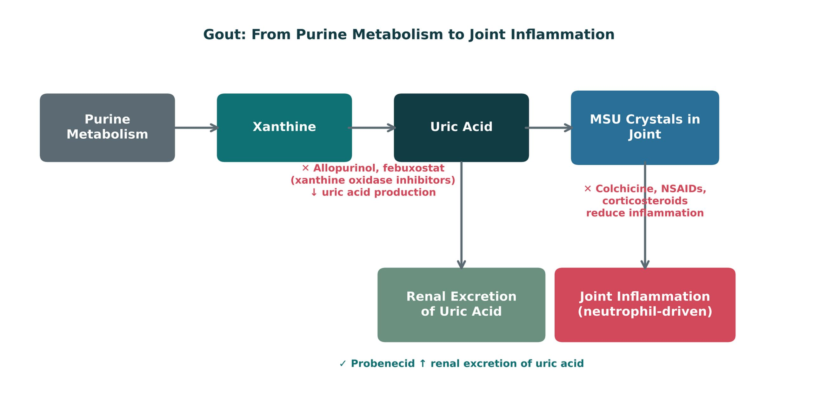
ORIGINAL ILLUSTRATION · FIGURE 4
Gout: From Purine Metabolism to Joint Inflammation
Figure 4. Original illustrative diagram (not from Katzung): allopurinol and febuxostat reduce uric acid production; probenecid increases renal excretion; colchicine, NSAIDs, and corticosteroids reduce joint inflammation.
Musculoskeletal Pharmacology — Session 2 of 2 — PA Program
6
Notes:
Walk the full chain and have students sort the drugs into two buckets: "lowers uric acid" (allopurinol, febuxostat, probenecid) vs. "treats the acute flare" (colchicine, NSAIDs, corticosteroids) — this is the same acute-vs-chronic distinction the next slide makes explicit.

Slide 7
TWO DIFFERENT GOALS
Acute Gout vs. Chronic Urate-Lowering Therapy
Acute Flare
Chronic Management
– Goal: control pain and inflammation now
– Agents: colchicine, NSAIDs, corticosteroids
– Do NOT start urate-lowering therapy during an acute flare
– Goal: lower serum uric acid to prevent future flares
– Agents: allopurinol, febuxostat (↓ production); probenecid (↑ excretion)
– Started/adjusted only once the acute flare has resolved
Musculoskeletal Pharmacology — Session 2 of 2 — PA Program
9
Notes:
This acute-vs-chronic distinction is one of the single most testable concepts in gout pharmacology — starting or changing a urate-lowering drug during an acute flare can actually prolong it.

Slide 8

ACUTE TREATMENT
Colchicine
Mechanism: disrupts microtubule formation in neutrophils.
Effect: reduces neutrophil migration and activation, lowering inflammation at the crystal site.
Most effective when started early in a flare.
Narrow therapeutic window — GI adverse effects are common and dose-limiting.
Musculoskeletal Pharmacology — Session 2 of 2 — PA Program
10

Slide 9
MECHANISM & DEPTH
Colchicine: Blocking Neutrophil Response
Best started within 24 hours of flare onset
GI diarrhea is the dose-limiting effect
Adjust the dose for renal or hepatic impairment
CYP3A4 and P-gp inhibitors (clarithromycin, cyclosporine, strong CYP3A4 inhibitors) raise toxicity
Colchicine binds tubulin
Blocks microtubule polymerization
Reduced neutrophil migration and NLRP3 activation
Less inflammation at the crystal site
Musculoskeletal Pharmacology — Session 2 of 2 — PA Program
11
Notes:
Colchicine works on the cell's cytoskeleton, so its effect builds in the early hours of a flare.

Slide 10

URATE-LOWERING THERAPY
Allopurinol vs. Febuxostat
Allopurinol
Febuxostat
– Xanthine oxidase inhibitor → ↓ uric acid production
– First-line for most patients
– HLA-B*5801 allele raises risk of severe hypersensitivity reaction
– Also a xanthine oxidase inhibitor, different chemical structure
– Alternative when allopurinol is not tolerated or contraindicated
– Carries its own cardiovascular safety considerations
Musculoskeletal Pharmacology — Session 2 of 2 — PA Program
12
Notes:
HLA-B*5801 is a direct callback to the pharmacogenomics section from Lecture 1 — ask students to make that connection themselves before you state it.

Slide 11
MECHANISM & DEPTH
Xanthine Oxidase Inhibitors: Where They Act
Start low and titrate upward toward a serum urate target
Do not start during an acute flare; give colchicine or an NSAID prophylaxis for 3–6 months
Febuxostat carries a boxed warning for cardiovascular death
Allopurinol: HLA-B*58:01 raises severe cutaneous reaction risk; reduce dose in renal impairment and with azathioprine or mercaptopurine
Hypoxanthine
Xanthine
Uric acid
Allopurinol (via oxypurinol) and febuxostat block xanthine oxidase
Musculoskeletal Pharmacology — Session 2 of 2 — PA Program
13
Notes:
Both drugs sit on the same enzyme; the choice turns on safety profile and tolerability.

Slide 12
OTHER OPTIONS
Other Urate-Lowering & Refractory Gout Agents
Probenecid — mechanism: inhibits renal tubular reabsorption of uric acid, increasing its excretion.
A uricosuric agent, not a xanthine oxidase inhibitor — a different strategy than allopurinol/febuxostat.
Avoid in patients with a history of uric acid kidney stones or significant renal impairment.
Pegloticase — a recombinant uricase enzyme for severe, refractory gout not controlled by other agents.
Given by IV infusion; converts uric acid to a more water-soluble, easily excreted compound.
Reserved for refractory cases given its cost, infusion-reaction risk, and need for specialty administration.
Musculoskeletal Pharmacology — Session 2 of 2 — PA Program
14
Notes:
Probenecid and pegloticase round out the gout toolkit beyond allopurinol/febuxostat — probenecid is an older, second-line oral option, while pegloticase is reserved for the most difficult, refractory cases.

Slide 13
MECHANISM & DEPTH
Uricosurics and Uricases
Needs adequate hydration; avoid in patients with uric acid kidney stones
Pegloticase and rasburicase are contraindicated in G6PD deficiency (hemolysis risk)
Infusion reactions are common; anti-drug antibodies can reduce response
Probenecid is second-line; uricases are reserved for refractory gout
Probenecid
Blocks URAT1 transporter in renal tubule
Renal reabsorption falls, excretion rises
Pegloticase or rasburicase
Uricase converts uric acid to allantoin
Allantoin is soluble and excreted
Musculoskeletal Pharmacology — Session 2 of 2 — PA Program
15
Notes:
Uricosurics block reabsorption; uricases remove uric acid enzymatically, which is why they suit refractory disease.

Slide 14

CLINICAL CASE
Acute Treatment or Urate-Lowering Therapy?
A patient presents with sudden, severe pain, redness, and swelling of the first metatarsophalangeal joint, consistent with an acute gout flare.
Ask yourself: Is this the moment to start acute treatment, chronic urate-lowering therapy, or both?
Clinical pearl: Treat the acute flare first (colchicine, NSAID, or corticosteroid); urate-lowering therapy is deferred until the flare resolves, then used for long-term prevention.
Musculoskeletal Pharmacology — Session 2 of 2 — PA Program
16
Notes:
This question tests exactly the acute-vs-chronic distinction from two slides ago — a great checkpoint for whether the concept landed.

Slide 15
MECHANISM & DEPTH
Drug Names Reveal the Class: Gout
Name pattern | Drug class | Examples
-ostat | Xanthine oxidase inhibitor | Allopurinol (exception), febuxostat
-ase | Enzyme (uricase) | Pegloticase, rasburicase
colchicine | Plant-derived alkaloid, no stem | Colchicine
probenecid, lesinurad-type | Uricosurics | Probenecid
-profen | Propionic-acid NSAIDs | Ibuprofen, naproxen
-sone, -olone | Corticosteroids | Prednisone, methylprednisolone
Suffixes often reveal the mechanism before you recall the drug
-ostat marks xanthine oxidase inhibitors; allopurinol is the exception
-ase names enzymes, so pegloticase and rasburicase are uricases
-sone and -olone mark corticosteroids used to treat flares
Musculoskeletal Pharmacology — Session 2 of 2 — PA Program
19
Notes:
Use the suffixes as memory hooks, then confirm each class before prescribing.

Slide 16

SECTION
06
Skeletal Muscle Relaxants
Different mechanisms for spasm, spasticity, and rigidity.

Slide 17

NOT THE SAME THING
Spasm vs. Spasticity vs. Rigidity
Muscle Spasm
Spasticity & Rigidity
– Sudden, involuntary contraction
– Often from acute musculoskeletal injury
– Typically treated with centrally-acting relaxants
– Spasticity: velocity-dependent increased tone from upper motor neuron injury
– Rigidity: constant increased tone, independent of velocity
– Often require distinct pharmacologic approaches
Musculoskeletal Pharmacology — Session 2 of 2 — PA Program
21

Slide 18
MECHANISM & DEPTH
Where Muscle Tone Is Controlled
Upper motor neurons: descending inhibitory pathways
Baclofen and tizanidine act on spinal interneurons and afferents
Cyclobenzaprine acts in the brainstem
Botulinum toxin blocks ACh release at the junction
Dantrolene acts inside the fiber on RyR1
▼
Spinal interneurons (GABA, glycine, alpha-2)
▼
Alpha motor neuron
▼
Neuromuscular junction (ACh release)
▼
Muscle fiber contraction (SR Ca²⁺ release)
Musculoskeletal Pharmacology — Session 2 of 2 — PA Program
22

Slide 19

CLASSIFICATION
Centrally vs. Peripherally Acting Agents
Centrally Acting
Peripherally / Locally Acting
– Cyclobenzaprine, tizanidine, baclofen — first-line agents
– Carisoprodol, methocarbamol, metaxalone, chlorzoxazone — other options
– Act within the CNS to reduce muscle tone
– Dantrolene — acts directly on skeletal muscle itself
– Botulinum toxin — acts at the neuromuscular junction
– Useful when a central mechanism is not desired (or not safe)
Musculoskeletal Pharmacology — Session 2 of 2 — PA Program
23

Slide 20
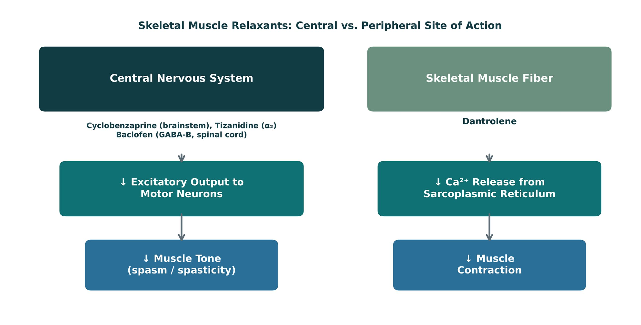
ORIGINAL ILLUSTRATION · FIGURE 5
Skeletal Muscle Relaxants: Central vs. Peripheral Site of Action
Figure 5. Original illustrative diagram (not from Katzung): cyclobenzaprine, tizanidine, and baclofen act within the CNS to reduce excitatory output to motor neurons, while dantrolene acts directly on the skeletal muscle fiber itself.
Musculoskeletal Pharmacology — Session 2 of 2 — PA Program
24
Notes:
This is the single highest-yield distinction in this section: "where does the drug act" sorts every agent into one of two buckets, and dantrolene is the only one in the peripheral bucket.

Slide 21
CENTRALLY ACTING
Baclofen
Mechanism: GABA-B receptor agonist in the spinal cord.
Clinical use: spasticity, particularly from spinal cord injury or multiple sclerosis.
Major concern: CNS depression — sedation, additive risk with other CNS depressants.
Abrupt discontinuation (especially intrathecal) can cause a dangerous withdrawal syndrome.
Musculoskeletal Pharmacology — Session 2 of 2 — PA Program
27

Slide 22
MECHANISM & DEPTH
Baclofen: GABA-B Agonism in the Spinal Cord
Baclofen binds GABA-B receptors
Abrupt withdrawal (especially intrathecal) can cause seizures, hyperthermia, rebound spasticity
Sedation and weakness
Renal dose adjustment
Intrathecal option for severe spasticity
▼
Opens K⁺ channels, closes Ca²⁺ channels: presynaptic inhibition
▼
Less excitatory neurotransmitter release
▼
Lower motor neuron firing: reduced spasticity
Musculoskeletal Pharmacology — Session 2 of 2 — PA Program
28

Slide 23
CENTRALLY ACTING
Tizanidine
Mechanism: central α2-adrenergic agonist.
Reduces excitatory input to motor neurons, lowering muscle tone.
Adverse effects: sedation, hypotension, dry mouth, hepatotoxicity.
Requires liver function monitoring with regular use.
Musculoskeletal Pharmacology — Session 2 of 2 — PA Program
29

Slide 24
MECHANISM & DEPTH
Tizanidine: Central Alpha-2 Agonism
Tizanidine activates alpha-2 receptors
Hypotension and bradycardia; sedation and dry mouth
Monitor liver enzymes (LFTs) for hepatotoxicity
CYP1A2 interactions: ciprofloxacin and fluvoxamine strongly raise levels (contraindicated)
Additive effect with antihypertensives
▼
Reduced presynaptic release of excitatory amino acids
▼
Lower motor neuron activity
▼
Reduced muscle tone
Musculoskeletal Pharmacology — Session 2 of 2 — PA Program
30

Slide 25
CENTRALLY ACTING
Cyclobenzaprine
Structurally related to tricyclic antidepressants.
Primary use: short-term treatment of acute, localized muscle spasm.
Prominent sedation — commonly dosed at night.
Anticholinergic effects: dry mouth, blurred vision, urinary retention — use caution in older adults.
Musculoskeletal Pharmacology — Session 2 of 2 — PA Program
31

Slide 26
MECHANISM & DEPTH
Cyclobenzaprine: Brainstem Action and Anticholinergic Effects
Anticholinergic effects: dry mouth, urinary retention, confusion (Beers list in older adults)
Sedation
Serotonin syndrome risk with SSRIs, SNRIs, tramadol; MAOIs contraindicated
Short-term use only, 2–3 weeks
Acts in the brainstem
▼
Antagonizes 5-HT2 and descending serotonergic and noradrenergic pathways
▼
Reduced tonic somatic motor activity
▼
Muscle relaxation
Musculoskeletal Pharmacology — Session 2 of 2 — PA Program
32

Slide 27
OTHER AGENTS
Other Centrally-Acting Relaxants & Botulinum Toxin
Carisoprodol — metabolized to meprobamate; Schedule IV controlled substance with dependence/misuse potential.
Methocarbamol — centrally-acting; generally less sedating than cyclobenzaprine.
Metaxalone — centrally-acting; relatively favorable sedation profile among this group.
Chlorzoxazone — centrally-acting; carries a rare but notable risk of hepatotoxicity.
Botulinum toxin — blocks presynaptic acetylcholine release at the neuromuscular junction.
Used for focal spasticity or dystonia; effect is local and temporary, requiring repeat injections.
Musculoskeletal Pharmacology — Session 2 of 2 — PA Program
33
Notes:
These agents round out the "centrally-acting" category beyond the three first-line drugs, and botulinum toxin introduces a third mechanism entirely — neuromuscular junction blockade — distinct from both the CNS-acting and dantrolene’s sarcoplasmic-reticulum mechanisms.

Slide 28
PERIPHERALLY ACTING
Dantrolene
Mechanism: decreases calcium release from the skeletal muscle sarcoplasmic reticulum.
Acts directly on the muscle fiber, not the CNS — distinct from every centrally-acting agent in this section.
Clinical use #1: malignant hyperthermia (a true emergency indication).
Clinical use #2: chronic spasticity, when central agents are not appropriate.
Musculoskeletal Pharmacology — Session 2 of 2 — PA Program
34
Notes:
Dantrolene’s role in malignant hyperthermia is a must-know, high-stakes fact — a perioperative emergency where this drug is literally life-saving.

Slide 29
MECHANISM & DEPTH
Dantrolene: Blocking Calcium Release at the Muscle
Nerve impulse: action potential, DHPR activated
Malignant hyperthermia (triggered by volatile anesthetics and succinylcholine) is the key indication
Hepatotoxicity
Generalized weakness
IV formulation for acute crisis; also used for neuroleptic malignant syndrome
▼
RyR1 opens: Ca²⁺ released from sarcoplasmic reticulum
▼
Contraction
▼
Dantrolene blocks RyR1 → less Ca²⁺ released
▼
Relaxation
Musculoskeletal Pharmacology — Session 2 of 2 — PA Program
35

Slide 30
NAMING CLUES
Drug Names Reveal the Class: Muscle Relaxants
Name clue | Class | Examples
-curonium / -curium | Nondepolarizing neuromuscular blockers | Vecuronium, atracurium, cisatracurium
succinylcholine (-choline) | Depolarizing neuromuscular blocker | Succinylcholine
-azepam | Benzodiazepine (GABA-A) | Diazepam
cyclo- (tricyclic ring) | Tricyclic-like central relaxant | Cyclobenzaprine
-idine (imidazoline) | Central alpha-2 agonist | Tizanidine
No shared stem | GABA-B agonist (GABA analog) | Baclofen
-trolene (hydantoin derivative) | Blocks RyR1 in the muscle fiber | Dantrolene
-toxin | Blocks presynaptic ACh release | Botulinum toxin
Musculoskeletal Pharmacology — Session 2 of 2 — PA Program
38

Slide 31

SECTION
07
Bone Pharmacology
Balancing bone formation and bone resorption.

Slide 32

THE BASICS
Bone Remodeling
Osteoblasts
Osteoclasts
– Build new bone matrix
– Activity promoted by several osteoporosis therapies
– Resorb (break down) existing bone
– Activity suppressed by most osteoporosis therapies
Musculoskeletal Pharmacology — Session 2 of 2 — PA Program
40
Notes:
Nearly every osteoporosis drug on the following slides works by shifting this balance one way or the other — either slowing osteoclasts or stimulating osteoblasts.

Slide 33
MECHANISM & DEPTH
RANKL/OPG Controls Osteoclast Activity
Osteoblast or stromal cell expresses RANKL
OPG is a decoy receptor that blocks RANKL
PTH: intermittent dosing favors formation; continuous exposure raises RANKL and resorption
Estrogen increases OPG; denosumab mimics OPG
Sclerostin inhibits Wnt signaling in osteoblasts
▼
RANKL binds RANK on osteoclast precursors
▼
Osteoclast differentiation and activation
▼
Bone resorption releases calcium
Musculoskeletal Pharmacology — Session 2 of 2 — PA Program
41

Slide 34
REGULATION
Calcium Homeostasis
Parathyroid Hormone (PTH)
Vitamin D
– Raises serum calcium; mobilizes bone calcium when levels drop
– Increases intestinal calcium absorption
Calcium
Calcitonin
– The substrate being regulated — intake, bone storage, excretion
– Lowers serum calcium; opposes PTH
Musculoskeletal Pharmacology — Session 2 of 2 — PA Program
42

Slide 35
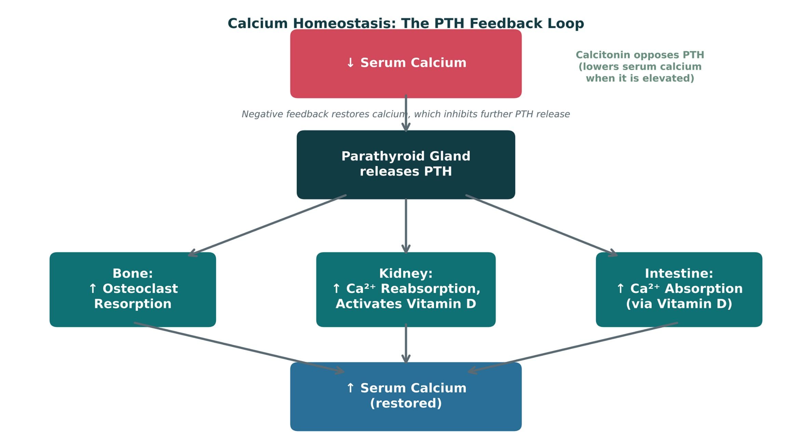
ORIGINAL ILLUSTRATION · FIGURE 6
Calcium Homeostasis: The PTH Feedback Loop
Figure 6. Original illustrative diagram (not from Katzung): falling serum calcium triggers PTH release, which raises calcium via bone resorption, renal reabsorption, and vitamin D-mediated intestinal absorption; calcitonin opposes this loop.
Musculoskeletal Pharmacology — Session 2 of 2 — PA Program
43
Notes:
Trace the three PTH arrows (bone, kidney, intestine) with your finger as you narrate — this negative feedback loop is the physiologic backdrop for every osteoporosis drug that follows.

Slide 36

RISK ASSESSMENT
Osteoporosis Risk Factors
Aging
Estrogen deficiency (e.g., postmenopausal status)
Chronic glucocorticoid use
Low calcium or vitamin D intake
Low physical activity
Musculoskeletal Pharmacology — Session 2 of 2 — PA Program
46
Notes:
Glucocorticoid-induced osteoporosis is especially high-yield since it directly connects to the corticosteroid use already discussed for OA/RA in Session 1.

Slide 37
FIRST-LINE THERAPY
Bisphosphonates
Mechanism: inhibit osteoclast-mediated bone resorption.
Alendronate, risedronate — oral, typically weekly dosing
Ibandronate — oral, monthly dosing
Zoledronic acid — intravenous, as infrequently as once yearly
First-line for most patients with osteoporosis.
Musculoskeletal Pharmacology — Session 2 of 2 — PA Program
47

Slide 38
MECHANISM & DEPTH
Bisphosphonates: Osteoclast Apoptosis
Drug binds hydroxyapatite at resorption sites
Long skeletal half-life: effect persists after stopping
Ensure calcium and vitamin D repletion before starting
Contraindicated with severe renal impairment (CrCl below 30-35 mL/min)
Osteonecrosis of the jaw and atypical femur fracture with long-term use; consider a drug holiday after 3-5 years of oral therapy
▼
Osteoclast takes it up during resorption
▼
Nitrogen-containing bisphosphonates inhibit FPP synthase (mevalonate pathway)
▼
Loss of prenylation of small GTPases
▼
Osteoclast apoptosis, so less resorption
Musculoskeletal Pharmacology — Session 2 of 2 — PA Program
48

Slide 39
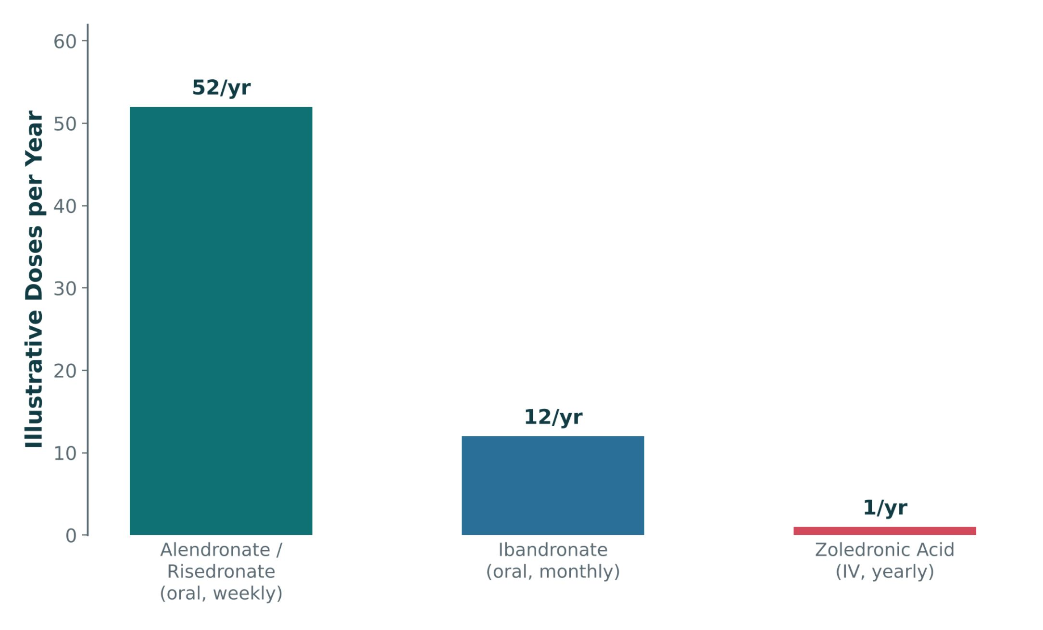
ORIGINAL ILLUSTRATION · FIGURE 7
Bisphosphonate Dosing Frequency
Figure 7. Original illustrative comparison (illustrative dosing-frequency values, not from Katzung): oral bisphosphonates range from weekly to monthly dosing, while IV zoledronic acid is given as infrequently as once yearly.
Musculoskeletal Pharmacology — Session 2 of 2 — PA Program
49
Notes:
Use this to set up the adherence discussion on the next slide — dosing frequency is a major real-world driver of which bisphosphonate a patient actually takes consistently.

Slide 40
SAFE USE
Bisphosphonate Administration & Adverse Effects
Patient Counseling (Oral)
Adverse Effects
– Take with a full glass of water, first thing in the morning
– Remain upright (sitting or standing) for the specified period after dosing
– Take on an empty stomach, well before food
– Esophageal irritation
– Hypocalcemia
– Osteonecrosis of the jaw (rare)
– Atypical femoral fractures (rare, with long-term use)
Musculoskeletal Pharmacology — Session 2 of 2 — PA Program
52
Notes:
The "remain upright" counseling point is extremely high-yield for both exams and real-world safety — esophageal injury is largely preventable with correct administration.

Slide 41
MECHANISM & DEPTH
Why Oral Bisphosphonates Need Strict Administration Rules
Poor oral absorption (under 1%)
Avoid in esophageal stricture, achalasia, or inability to sit upright
IV zoledronic acid: acute-phase reaction (flu-like), mitigated with acetaminophen
Hypocalcemia risk; correct calcium and vitamin D first
▼
Food, calcium, coffee and antacids reduce it further
▼
Take fasting with plain water; stay upright 30 minutes
▼
Lowers esophageal irritation risk
Musculoskeletal Pharmacology — Session 2 of 2 — PA Program
53

Slide 42
BEYOND BISPHOSPHONATES
Other Osteoporosis Therapies
Denosumab
Teriparatide / Abaloparatide
– Monoclonal antibody; blocks osteoclast formation (RANKL inhibitor)
– PTH-analog "anabolic" agents that stimulate new bone formation
Romosozumab
SERMs
– Monoclonal antibody that both builds bone and limits resorption
– Selective estrogen receptor modulators — estrogen-like effect on bone
– Example: raloxifene — also reduces breast cancer risk
Musculoskeletal Pharmacology — Session 2 of 2 — PA Program
54
Notes:
Teriparatide/abaloparatide/romosozumab are the "anabolic" exception to the rule that most osteoporosis drugs just slow resorption — they actively build new bone. The next slide shows all of these (plus bisphosphonates) together on one balance diagram.

Slide 43
MECHANISM & DEPTH
Anabolic vs Antiresorptive Mechanisms
Antiresorptive: denosumab (RANKL antibody), raloxifene (SERM), calcitonin
Anabolic: teriparatide (PTH 1-34, daily injection) and abaloparatide
Teriparatide is limited to 2 years lifetime, then follow with an antiresorptive
Denosumab discontinuation causes rebound vertebral fractures; transition to a bisphosphonate
Raloxifene raises VTE risk and may reduce breast cancer risk; hot flashes
Romosozumab carries a boxed warning for MI, stroke, and CV death
▼
▼
Stimulate osteoblasts; romosozumab (sclerostin antibody)
Less osteoclast activity
▼
▼
Increases formation, decreases resorption
BMD up, fracture risk down
Musculoskeletal Pharmacology — Session 2 of 2 — PA Program
55

Slide 44
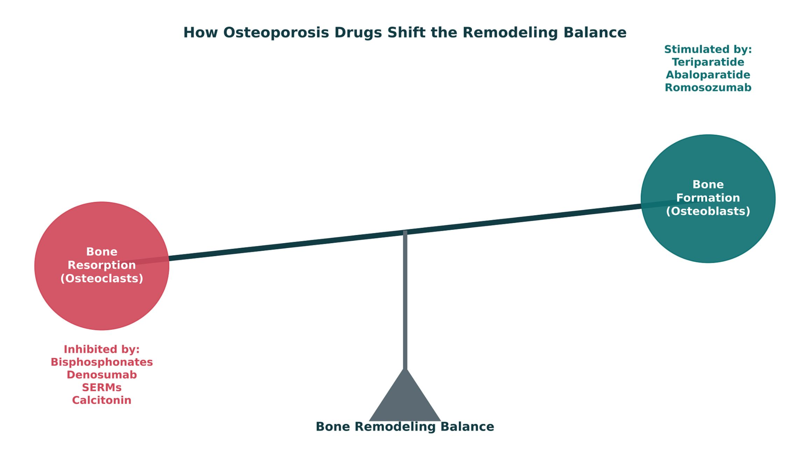
ORIGINAL ILLUSTRATION · FIGURE 8
How Osteoporosis Drugs Shift the Remodeling Balance
Figure 8. Original illustrative diagram (not from Katzung): bisphosphonates, denosumab, raloxifene (SERM), and calcitonin inhibit bone resorption; teriparatide, abaloparatide, and romosozumab stimulate bone formation.
Musculoskeletal Pharmacology — Session 2 of 2 — PA Program
56
Notes:
This is the capstone bone-pharmacology figure — every drug from the last three slides lands on one side of this seesaw or the other. Ask students to sort each named drug into "inhibits resorption" vs. "stimulates formation" before revealing the diagram’s labels.

Slide 45

INDIVIDUALIZING THERAPY
Choosing an Osteoporosis Therapy
Fracture risk — higher-risk patients may need an anabolic agent first
Renal function — some bisphosphonates are avoided in significant renal impairment
Previous fracture history
Glucocorticoid exposure
Adherence — weekly oral vs. yearly IV vs. injectable options
Route of administration preference
Musculoskeletal Pharmacology — Session 2 of 2 — PA Program
59
Notes:
This checklist is a direct echo of the clinical decision-making framework from Lecture 1 — point that out explicitly.

Slide 46
NAMING CLUES
Drug Names Reveal the Class: Bone
Name clue | Class | Examples
-dronate | Bisphosphonates (inhibit osteoclast resorption) | Alendronate, risedronate, ibandronate; zoledronic acid (zoledronate)
-sumab | Monoclonal antibodies (-mab) targeting bone | Denosumab (RANKL), romosozumab (sclerostin)
-fene | Selective estrogen receptor modulator (SERM) | Raloxifene
-tide (peptide) | PTH analogs (anabolic) | Teriparatide, abaloparatide
No shared stem | Calcitonin (hormone) | Calcitonin
Musculoskeletal Pharmacology — Session 2 of 2 — PA Program
62

Slide 47

SECTION
08
Putting It All Together
Applying the whole musculoskeletal pharmacology toolkit.

Slide 48
APPLY IT
Which Drug Would You Choose?
Patient A
Patient B
– Acute gout flare, first presentation
– Chronic rheumatoid arthritis, inadequately controlled
Patient C
Patient D
– Osteoarthritis + chronic kidney disease
– Postmenopausal osteoporosis, high fracture risk
Musculoskeletal Pharmacology — Session 2 of 2 — PA Program
64
Notes:
Have students work in pairs: for each patient, name a first-line drug class AND the single biggest safety concern to check before prescribing it.

Slide 49
BIG PICTURE
Key Takeaways
1
Pain and inflammation are related but distinct — treat them accordingly.
2
NSAIDs are effective for pain and inflammation, but carry real GI, renal, and cardiovascular risk.
3
DMARDs modify the underlying disease process in RA — they do more than mask symptoms.
4
Acute gout treatment and chronic urate-lowering therapy are different goals, started at different times.
5
Bone pharmacology is fundamentally about the balance between osteoblast and osteoclast activity.
Musculoskeletal Pharmacology — Session 2 of 2 — PA Program
Notes:
Close by connecting back to Lecture 1: every mechanism in this lecture (COX inhibition, CYP interactions, renal dosing, pharmacogenomics) was really just Lecture 1’s toolkit applied to one organ system.

Slide 50

SECTION
09
Lecture Recall Quiz
A cumulative self-test — use this to review before exams.

Slide 51
LECTURE RECALL QUIZ
Lecture Recall Quiz (1 of 2)
1. Why is acetaminophen not a reliable first-line choice for an inflammatory joint flare, despite being a good analgesic/antipyretic?
A. It strongly inhibits COX-2 only
B. It has minimal peripheral anti-inflammatory effect
C. It is contraindicated in all patients with joint pain
D. It is a DMARD and too strong for mild flares
2. A 70-year-old with CKD and heart failure needs osteoarthritis pain control. Considering systemic risk, which is generally the safest starting point?
A. Oral ibuprofen
B. Oral celecoxib
C. Acetaminophen or a topical NSAID
D. Ketorolac
3. Which pairing correctly matches a drug with its primary mechanism?
A. Allopurinol — microtubule disruption
B. Colchicine — xanthine oxidase inhibition
C. Baclofen — calcium channel blockade in skeletal muscle
D. Methotrexate — dihydrofolate reductase inhibition
Musculoskeletal Pharmacology — Session 2 of 2 — PA Program
69

Slide 52
LECTURE RECALL QUIZ
Lecture Recall Quiz (2 of 2)
4. A patient on a biologic DMARD develops a fever. What is the most important immediate concern?
A. Infection, given the drug’s immunosuppressive effect
B. A drug allergy only
C. Osteonecrosis of the jaw
D. Hepatotoxicity from Phase II metabolism
5. Which statement about gout pharmacology is correct?
A. Colchicine lowers uric acid production
B. Acute flares should always be treated with urate-lowering therapy first
C. Probenecid lowers uric acid by inhibiting renal tubular reabsorption of urate
D. Febuxostat and probenecid are both xanthine oxidase inhibitors
6. A patient with glucocorticoid-induced osteoporosis risk should be counseled that the risk is primarily related to which mechanism?
A. Increased osteoclast-mediated resorption and decreased bone formation
B. Increased osteoblast activity
C. Excess vitamin D
D. Increased calcitonin secretion
Musculoskeletal Pharmacology — Session 2 of 2 — PA Program
70

Slide 53
ANSWER KEY
Lecture Recall Quiz — Answer Key
1. B — Acetaminophen has minimal peripheral anti-inflammatory effect, unlike NSAIDs — it treats pain and fever, not inflammation itself.
2. C — Acetaminophen or a topical NSAID avoids the systemic renal/CV risk of oral NSAIDs in a patient with CKD and heart failure.
3. D — Methotrexate inhibits dihydrofolate reductase. Allopurinol inhibits xanthine oxidase; colchicine disrupts microtubules; baclofen is a GABA-B agonist.
4. A — Immunosuppression is the shared major risk across all DMARDs — a fever must be treated as a possible infection until proven otherwise.
5. C — Probenecid is a uricosuric agent that inhibits renal tubular reabsorption of uric acid, increasing its excretion. Colchicine does not lower uric acid; febuxostat (not probenecid) is a xanthine oxidase inhibitor; and urate-lowering therapy is deferred during an acute flare.
6. A — Glucocorticoids increase osteoclast-mediated bone resorption and suppress osteoblast-driven bone formation — shifting the remodeling balance toward bone loss.
Musculoskeletal Pharmacology — Session 2 of 2 — PA Program
Notes:
Encourage students to revisit this quiz on their own before the exam — it is designed as a standalone recall resource, separate from the in-lecture quick checks.

Slide 54
APPENDIX
Image Attribution
● Original figures in this deck: Figures 4–8 (Gout: From Purine Metabolism to Joint Inflammation; Skeletal Muscle Relaxants: Central vs. Peripheral Site of Action; Calcium Homeostasis: The PTH Feedback Loop; Bisphosphonate Dosing Frequency; How Osteoporosis Drugs Shift the Remodeling Balance) were generated by the course director using the AI tool Claude to illustrate standard, non-copyrighted pharmacologic concepts. They are original diagrams, not reproduced from Katzung’s Basic and Clinical Pharmacology or any other copyrighted source.
● Reference: Anthropic. (2026). Claude (Sonnet 5) [Large language model]. https://claude.ai
Musculoskeletal Pharmacology — Session 2 of 2 — PA Program
72
Notes:
This slide documents AI-tool use for original figure generation per university citation requirements. It covers every original diagram in this deck (Figures 4–8); none are reproduced from any textbook.

