Slide 1

Musculoskeletal Pharmacology
PA PHARMACOLOGY COURSE · LECTURE 2 · SESSION 1 OF 2
Session 1: Pain, Acetaminophen, NSAIDs, and Osteoarthritis/Rheumatoid Arthritis Pharmacotherapy | Tuesday, October 27
Diane S. Allen-Gipson, Ph.D., M.S., Course Director

Slide 2

Learning Objectives — Session 1
BY THE END OF THIS LECTURE
Explain the pharmacologic basis of musculoskeletal pain and inflammation.
Compare acetaminophen and NSAIDs, including COX-1 vs. COX-2 inhibition.
Identify major NSAID adverse effects and select therapy based on patient risk factors.
Explain the mechanisms of conventional vs. biologic DMARDs, including representative generic agents in each class.
Identify key contraindications, adverse effects, and drug interactions for analgesics and DMARDs.
Preview: gout, skeletal muscle relaxants, and bone pharmacology continue in Session 2 (Thursday, October 29).
Notes:
Orient students to the arc of this session: musculoskeletal pain pathways, acetaminophen, NSAIDs, and osteoarthritis/rheumatoid arthritis pharmacotherapy including DMARDs. Tell them this is the first of two sessions on Musculoskeletal Pharmacology — Session 2 picks up with gout, skeletal muscle relaxants, and bone pharmacology on Oct 29.

Slide 3
Required & Recommended Readings — Unit 2
COURSE MATERIALS
Required Text
Recommended Text (for additional support)
Katzung's Basic and Clinical Pharmacology, 16th Edition
Todd W. Vanderah · 2025 · McGraw-Hill Education
ISBN 1260463303 (eBook)
AccessMedicine: accessmedicine.mhmedical.com/book.aspx?bookid=3382
Unit 2 — Musculoskeletal: Chapters 27, 36, and 42
Pharmacotherapy Principles and Practice
Chisholm-Burns, Schwinghammer, Malone, Kolesar, Lee · 2022 · McGraw-Hill Education
Print ISBN 9781260460278 · eText ISBN 9781260460285
Use as supplemental support alongside Katzung’s Chapters 27, 36, and 42 for Unit 2
Notes:
Point students to the required and recommended texts for Unit 2 before diving into content. Katzung’s Chapters 27, 36, and 42 are the required reading for this unit; Pharmacotherapy Principles and Practice is recommended as additional support, not a substitute.

Slide 4

01
Understanding Musculoskeletal Pain
SECTION
Where the pain comes from shapes how we treat it.

Slide 5
What Causes Musculoskeletal Pain?
CLASSIFICATION
By Mechanism
By Time Course
Nociceptive — direct activation of pain receptors by tissue injury
Inflammatory — pain driven by inflammatory mediators
Neuropathic — pain from nerve injury or dysfunction
Acute — recent onset, often tied to identifiable injury or flare
Chronic — persists beyond expected healing time, often > 3 months
Treatment approach differs sharply between the two
Notes:
Most musculoskeletal pain in this lecture is a mix of nociceptive and inflammatory — pure neuropathic pain is more the territory of a separate pharmacology unit.

Slide 6
Inflammation Drives Pain
THE CASCADE
Tissue injury → release of inflammatory mediators → sensitization of nociceptors → pain.
Key mediators include:
  Prostaglandins
  Bradykinin
  Histamine
  Cytokines (e.g., TNF-α, IL-1, IL-6)
Notes:
This mediator list is the roadmap for the whole lecture — NSAIDs target prostaglandins, biologic DMARDs target specific cytokines.

Slide 7

Therapeutic Targets in the Pain Pathway
WHERE DRUGS INTERVENE
Arachidonic
Acid
COX
Enzyme
Prostaglandins
Pain &
Inflammation
NSAIDs and COX-2 inhibitors act here; glucocorticoids act further upstream; cytokine inhibitors and analgesics act through separate, parallel pathways.
Notes:
This single arrow chain is the conceptual spine for the acetaminophen, NSAID, and corticosteroid sections that follow. The next slide builds this out further with the specific drug classes that intervene at each step.

Slide 8
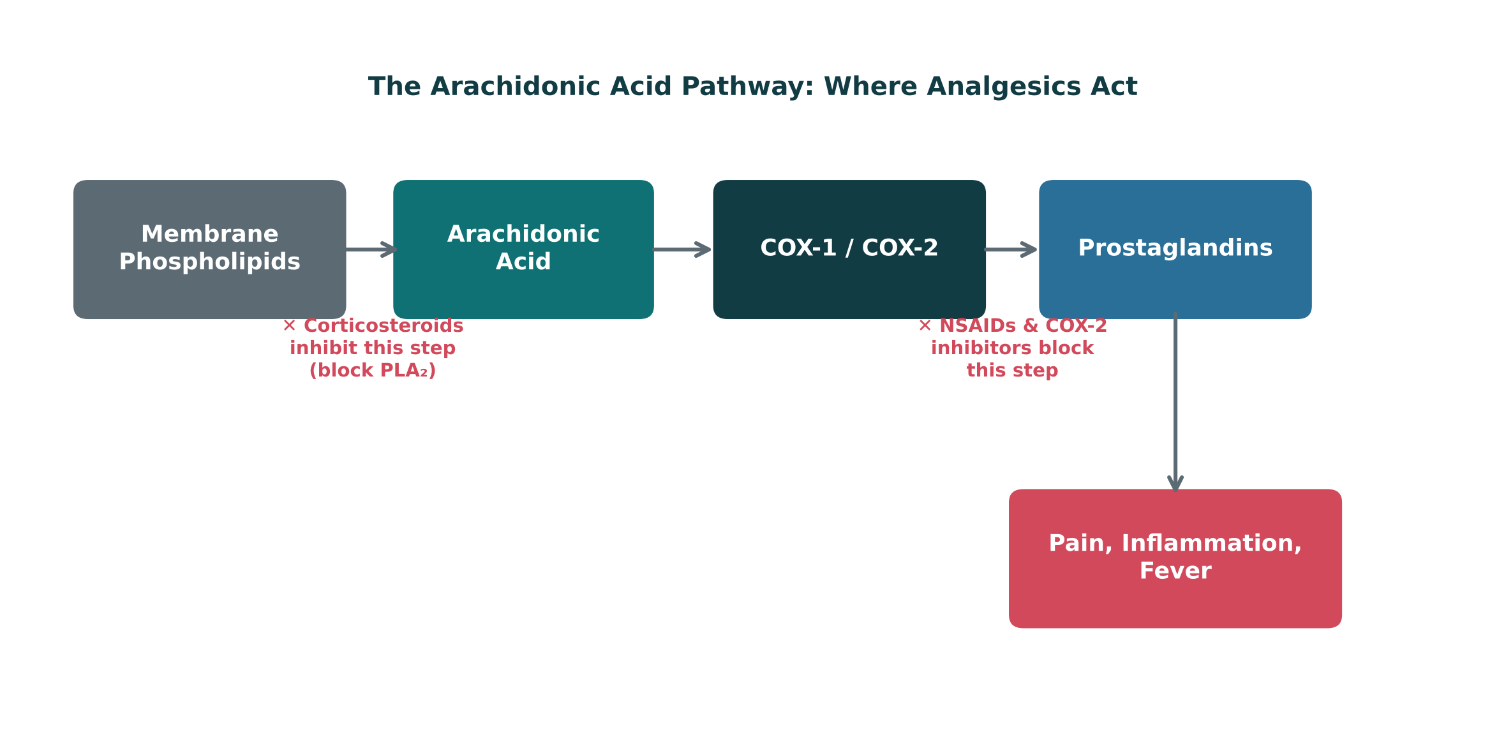
The Arachidonic Acid Pathway: Where Analgesics Act
ORIGINAL ILLUSTRATION · FIGURE 1
Figure 1. Original illustrative diagram (not from Katzung): corticosteroids block phospholipase A₂ upstream, while NSAIDs and COX-2 inhibitors block the COX step itself — two distinct points of pharmacologic intervention.
Notes:
This figure adds the drug layer on top of the previous flow slide: name the specific drug classes (corticosteroids vs. NSAIDs/COX-2 inhibitors) and exactly where each one interrupts the cascade.

Slide 9

02
Acetaminophen
SECTION
Effective analgesia, with a narrow margin in overdose.

Slide 10

Acetaminophen
MECHANISM & EFFECTS
● Analgesic effect: relieves mild-to-moderate pain, with a central mechanism that is still incompletely understood.
● Antipyretic effect: reduces fever via central effects on the hypothalamic temperature-regulating center.
● Anti-inflammatory effect: minimal at the periphery — unlike NSAIDs, acetaminophen is not a reliable anti-inflammatory agent.
Notes:
This is the single most important distinction students need: acetaminophen treats pain and fever well, but it is not an anti-inflammatory drug the way NSAIDs are.

Slide 11
Acetaminophen Toxicity
OVERDOSE MECHANISM
Acetaminophen
NAPQI
(toxic metabolite)
Glutathione
Conjugation
Safe
Excretion
In overdose, glutathione stores are depleted, NAPQI accumulates, and hepatocyte injury follows — this is why N-acetylcysteine (a glutathione precursor) is the antidote.
Notes:
NAPQI = N-acetyl-p-benzoquinone imine. Tie this directly back to the "toxic metabolite" bullet from Lecture 1’s drug metabolism section.

Slide 12

The Hidden Acetaminophen Overdose
CLINICAL CASE
A patient takes acetaminophen regularly for chronic back pain. For a cold, they also start an over-the-counter combination cold-and-flu medication.
Ask yourself: What is the hidden danger in this combination?
Clinical pearl: Many combination cold, flu, and sleep products also contain acetaminophen — unintentional double-dosing is a leading cause of acetaminophen-related liver injury. Always ask about ALL sources of acetaminophen.
Notes:
Good moment to reinforce generic-name awareness from Lecture 1 — patients often do not realize a product contains acetaminophen unless they check the label.

Slide 13

03
NSAIDs
SECTION
Powerful anti-inflammatory effect, with real systemic risk.

Slide 14
How NSAIDs Work
MECHANISM
NSAID
COX
Inhibition
↓ Prostaglandins
↓ Pain, Inflammation,
Fever

Slide 15
COX-1 vs. COX-2
TWO ISOFORMS
COX-1
COX-2
"Housekeeping" enzyme
Maintains gastric mucosal protection and normal renal blood flow
Inhibition contributes to GI and renal adverse effects
Induced mainly at sites of inflammation
Primary source of inflammatory prostaglandins
Selective inhibition targets inflammation with less GI toxicity
Notes:
Stress this is a simplified teaching model, not an absolute separation — COX-1 and COX-2 functions overlap, and COX-2 is also constitutively expressed in the kidney and elsewhere.

Slide 16

Nonselective NSAIDs
AGENTS
Nonselective NSAIDs inhibit both COX-1 and COX-2.
Ibuprofen — common first-line choice for mild-moderate pain
Naproxen — longer half-life, twice-daily dosing
Diclofenac — available in oral and topical formulations
Indomethacin — more potent, more GI/CNS adverse effects
Ketorolac — short-term use only, significant GI/renal risk

Slide 17

COX-2 Selective Inhibition: Celecoxib
SELECTIVE AGENT
Celecoxib selectively inhibits COX-2 over COX-1.
GI effects: lower risk of ulcer/bleeding than nonselective NSAIDs.
Cardiovascular risk: COX-2 selectivity is associated with increased cardiovascular event risk — a key trade-off.
Renal effects: similar renal risk to nonselective NSAIDs — COX-2 selectivity does not protect the kidney.
Notes:
This is a classic "trade one risk for another" teaching point — better GI profile, but not a free lunch cardiovascularly or renally.

Slide 18
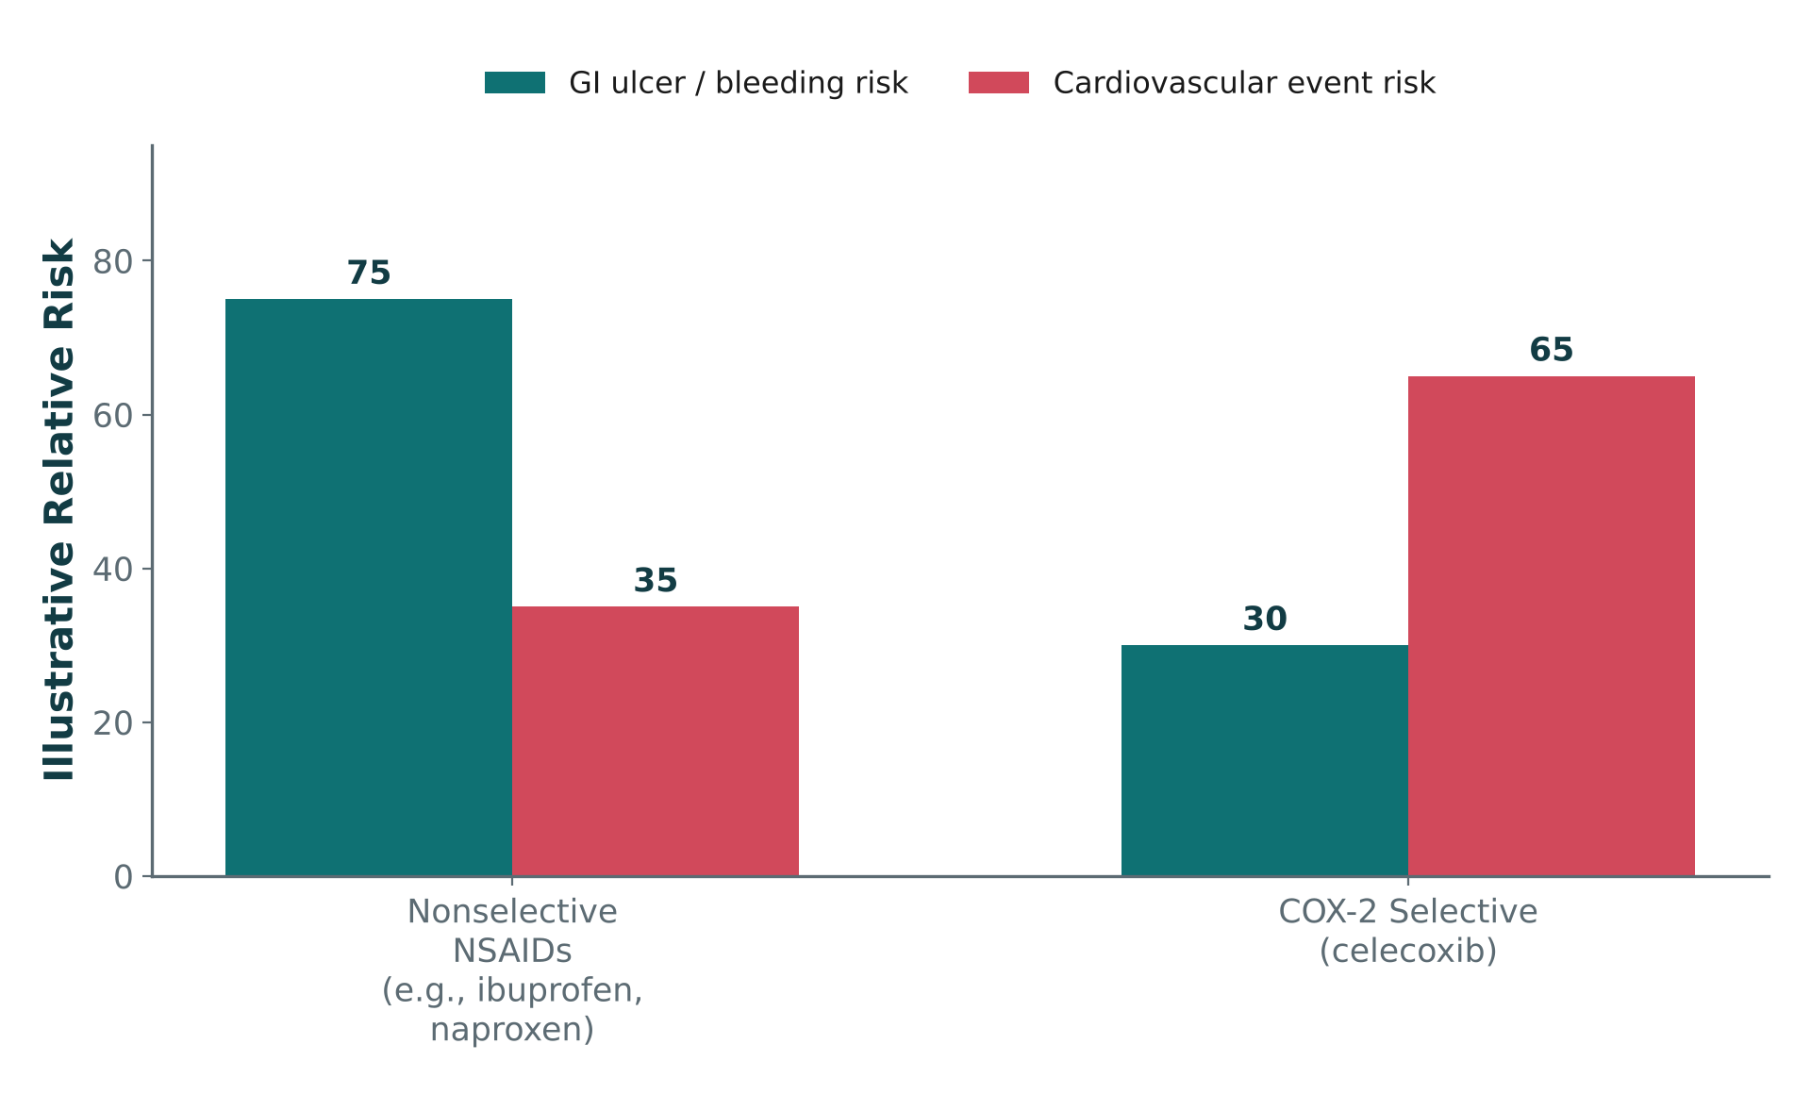
Nonselective NSAIDs vs. COX-2 Selective Inhibition
ORIGINAL ILLUSTRATION · FIGURE 2
Figure 2. Original illustrative comparison (illustrative relative-risk values, not from Katzung): nonselective NSAIDs (e.g., ibuprofen, naproxen) carry higher GI risk; celecoxib trades lower GI risk for higher cardiovascular risk.
Notes:
This is the graphical version of the trade-off just described in the celecoxib bullet slide — use it to reinforce that there is no risk-free NSAID choice, only a different risk profile.

Slide 19
NSAID Adverse Effects
ORGANIZED BY SYSTEM · TABLE 1
System | Key Adverse Effects
Gastrointestinal | Gastritis, peptic ulcer, GI bleeding
Renal | Decreased renal perfusion, fluid retention, acute kidney injury
Cardiovascular | Hypertension, increased risk of cardiovascular events
Notes:
These three systems (GI, renal, CV) are the organizing framework for every NSAID contraindication and interaction discussion that follows. Table 1.

Slide 20
NSAID Contraindications & Interactions
PRESCRIBING SAFELY
Use Caution / Avoid In
High-Yield Drug Interactions
Active GI bleeding or ulcer history
Chronic kidney disease
Heart failure or cardiovascular disease
Anticoagulant therapy
Late pregnancy
NSAIDs + anticoagulants → ↑ bleeding risk
NSAIDs + ACE inhibitors/ARBs → ↑ AKI risk ("triple whammy" with diuretics)
NSAIDs + diuretics → reduced diuretic effect, ↑ renal risk
NSAIDs + corticosteroids → ↑ GI ulcer risk
Notes:
The "triple whammy" (NSAID + ACEi/ARB + diuretic) is a very high-yield acute kidney injury pattern to flag explicitly.

Slide 21
Is an NSAID the Right First Choice?
CLINICAL CASE
A 72-year-old patient with osteoarthritis also has chronic kidney disease, hypertension, and is taking an anticoagulant.
Ask yourself: Is an NSAID a good first-line choice for this patient’s pain? Why or why not?
Clinical pearl: This patient has three separate NSAID red flags at once (renal disease, anticoagulation, and age-related bleeding risk) — acetaminophen or a non-NSAID strategy is generally safer first-line.
Notes:
Excellent exam-style vignette — ask students to name all three risk factors independently before revealing the answer.

Slide 22
04
Osteoarthritis & Rheumatoid Arthritis
SECTION
Two very different diseases that both affect the joint.

Slide 23
Osteoarthritis vs. Rheumatoid Arthritis
TWO DIFFERENT DISEASES
Osteoarthritis (OA)
Rheumatoid Arthritis (RA)
Primarily degenerative joint disease
Cartilage breakdown with mechanical wear
Treatment goal: pain control and function
Autoimmune, systemic inflammatory disease
Immune-mediated joint destruction
Treatment goal: suppress disease activity, not just pain
Notes:
This distinction is the hinge the whole rest of the section turns on: OA is managed primarily with analgesics/NSAIDs, while RA requires disease-modifying therapy.

Slide 24
Pharmacologic Treatment of Osteoarthritis
OA MANAGEMENT
Acetaminophen — reasonable first-line for mild OA pain
Oral NSAIDs — effective, but carry the systemic risks already discussed
Topical NSAIDs — effective local relief with much lower systemic exposure
Intra-articular corticosteroid injections — short-term relief for flares in a single joint
Other approaches — activity modification, physical therapy, weight management

Slide 25

What Makes a Drug "Disease-Modifying"?
CONCEPT
● DMARD: Disease-Modifying Antirheumatic Drug — a drug intended to alter the course of RA, not just mask its symptoms.
● Goal of therapy: slow or halt joint destruction and systemic inflammation, rather than providing analgesia alone.
Notes:
Contrast explicitly with NSAIDs: an NSAID can make a patient feel better without changing the underlying disease trajectory — a DMARD is meant to change the trajectory itself.

Slide 26
Conventional (Non-Biologic) DMARDs
CONVENTIONAL DMARDS
Methotrexate — the anchor drug for most RA regimens (next slide)
Hydroxychloroquine — milder disease; relatively favorable safety profile
Sulfasalazine — often used in combination regimens
Leflunomide — alternative when methotrexate is not tolerated

Slide 27
Methotrexate
ANCHOR DRUG
Mechanism: inhibits dihydrofolate reductase, reducing immune cell proliferation at low RA doses.
Dosed weekly (not daily) — a critical patient-safety point, since daily dosing can be fatal.
Folate supplementation is routinely co-prescribed to reduce toxicity.
Key adverse effects: hepatotoxicity, bone marrow suppression, pulmonary toxicity.
Contraindicated in pregnancy (teratogenic).
Notes:
Methotrexate’s weekly dosing is one of the highest-yield patient-safety teaching points in all of rheumatology pharmacology — emphasize it strongly.

Slide 28

Biologic DMARDs
TARGETED THERAPY
TNF Inhibitors
IL-6 Inhibitors
Block tumor necrosis factor-alpha signaling
Examples: adalimumab, etanercept, infliximab
Block interleukin-6 receptor signaling
Example: tocilizumab
B-Cell Targeted Therapy
T-Cell Costimulation Modulators
Depletes or modulates B lymphocytes
Example: rituximab
Block the second signal needed for T-cell activation
Example: abatacept
Notes:
Each biologic class corresponds to a different cytokine or cell type in the inflammatory cascade shown earlier in the lecture — tie this back to the mediator list from Section 1. The next slide shows these same four drug classes as a mechanism diagram.

Slide 29
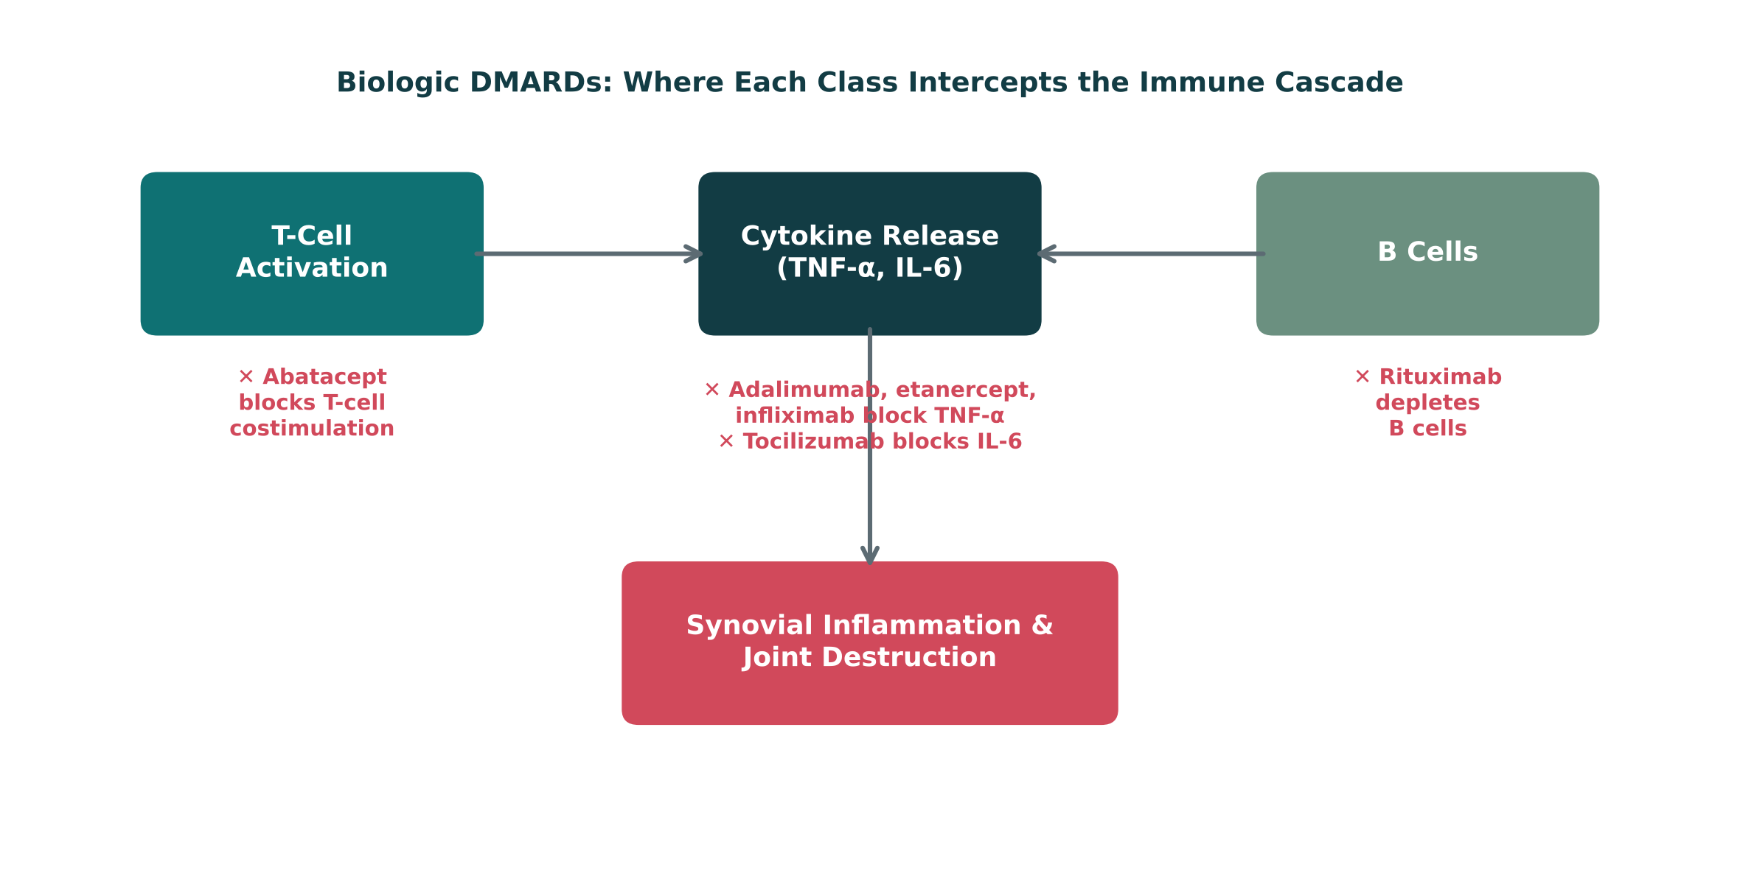
Biologic DMARDs: Where Each Class Intercepts the Immune Cascade
ORIGINAL ILLUSTRATION · FIGURE 3
Figure 3. Original illustrative diagram (not from Katzung): abatacept blocks T-cell costimulation, TNF inhibitors (adalimumab, etanercept, infliximab) and tocilizumab block cytokine signaling, and rituximab depletes B cells.
Notes:
This is the visual counterpart to the fourCard slide just shown — have students match each generic drug name to its box on this diagram before you reveal the answer.

Slide 30
DMARD Safety: Immunosuppression
SHARED RISK
The major safety theme across all DMARDs: immunosuppression → increased infection risk.
Baseline screening — e.g., tuberculosis and hepatitis B/C screening before starting biologics
Vaccination — update vaccines, especially live vaccines, before starting therapy
Ongoing monitoring — regular labs to catch cytopenias, hepatotoxicity, or infection early
Infection precautions — counsel patients to report fevers or infection symptoms promptly

Slide 31
Session 1 Recap — To Be Continued
BIG PICTURE
Musculoskeletal pain is driven by inflammatory mediators (prostaglandins, bradykinin, histamine, cytokines) — NSAIDs and corticosteroids intervene at different points along this cascade.
1
Acetaminophen treats pain and fever but is not a reliable anti-inflammatory agent; its overdose toxicity is mediated by NAPQI accumulation.
2
NSAIDs are effective but carry real GI, renal, and cardiovascular risk; celecoxib trades GI risk for cardiovascular risk.
3
DMARDs (conventional and biologic — methotrexate, adalimumab, etanercept, infliximab, tocilizumab, rituximab, abatacept) modify RA’s disease course rather than only masking symptoms.
4
Session 2 (Thursday, October 29) continues with gout, skeletal muscle relaxants, bone pharmacology, and the cumulative Lecture Recall Quiz.
5
Notes:
Close Session 1 by previewing Session 2 explicitly — students should leave knowing pain, acetaminophen, NSAIDs, and DMARDs are complete, and that gout, muscle relaxants, and bone pharmacology pick up first next time.

Slide 32
Image Attribution
APPENDIX
● Original figures in this deck: Figures 1–3 (The Arachidonic Acid Pathway: Where Analgesics Act; Nonselective NSAIDs vs. COX-2 Selective Inhibition; Biologic DMARDs: Where Each Class Intercepts the Immune Cascade) were generated by the course director using the AI tool Claude to illustrate standard, non-copyrighted pharmacologic concepts. They are original diagrams, not reproduced from Katzung’s Basic and Clinical Pharmacology or any other copyrighted source.
● Reference: Anthropic. (2026). Claude (Sonnet 5) [Large language model]. https://claude.ai
Notes:
This slide documents AI-tool use for original figure generation per university citation requirements. It covers every original diagram in this deck (Figures 1–3); none are reproduced from any textbook.

