Slide 1

Introduction to Pharmacology
PA PHARMACOLOGY COURSE · LECTURE 1 · SESSION 1 OF 2
Session 1: Foundations — Language, Drug Development, Pharmacodynamics, Dose-Response & ADME | Thursday, October 15
Diane S. Allen-Gipson, Ph.D., M.S., Course Director

Slide 2

Learning Objectives — Session 1
BY THE END OF THIS LECTURE
Define pharmacology, pharmacodynamics, and pharmacokinetics.
Describe the major stages of drug development and FDA approval.
Explain how drugs interact with receptors to produce an effect.
Interpret a dose-response curve, including potency and efficacy.
Explain absorption, distribution, metabolism, and excretion (ADME), including bioavailability and the first-pass effect.
Preview: metabolism/excretion detail, PK calculations, pharmacogenomics, and the integrated clinical framework continue in Session 2 (Thursday, October 22).
Notes:
Orient students to the arc of this session: definitions, drug development, pharmacodynamics, dose-response, and ADME through distribution. Tell them this is the first of two 2.5-hour sessions on Introduction to Pharmacology — Session 2 picks up with metabolism, excretion, PK math, pharmacogenomics, and the integrated clinical framework on Oct 22.

Slide 3

Required & Recommended Readings — Unit 1
COURSE MATERIALS
Required Text
Recommended Text (for additional support)
Katzung's Basic and Clinical Pharmacology, 16th Edition
Todd W. Vanderah · 2025 · McGraw-Hill Education
ISBN 1260463303 (eBook)
AccessMedicine: accessmedicine.mhmedical.com/book.aspx?bookid=3382
Unit 1 — Introduction to Pharmacology: Chapters 1, 2, 3, 4, and 5
Pharmacotherapy Principles and Practice
Chisholm-Burns, Schwinghammer, Malone, Kolesar, Lee · 2022 · McGraw-Hill Education
Print ISBN 9781260460278 · eText ISBN 9781260460285
Use as supplemental support alongside Katzung’s Chapters 1–5 for Unit 1
Notes:
Point students to the required and recommended texts for Unit 1 before diving into content. Katzung’s Chapters 1-5 is the required reading for this unit; Pharmacotherapy Principles and Practice is recommended as additional support, not a substitute.

Slide 4
01
The Language of Pharmacology
SECTION
Shared vocabulary before we talk mechanisms.

Slide 5

What Is Pharmacology?
DEFINITIONS
● Pharmacology: the scientific study of how drugs interact with living systems — from the molecular level to the whole patient.
● Drug (medication): any chemical substance used to diagnose, treat, cure, or prevent disease, or to alter a physiologic process.
● Pharmacologic effect: a measurable biological change a drug produces (e.g., lower blood pressure).
● Therapeutic effect: the intended, beneficial pharmacologic effect for a given condition.
● Adverse drug reaction (ADR): an unintended and harmful response occurring at normal therapeutic doses.
● Toxicity: harmful effects that occur as the dose or exposure exceeds the therapeutic range.
Notes:
Emphasize that "therapeutic effect" and "pharmacologic effect" are not synonyms — a drug can have pharmacologic effects that are not therapeutic (that is often exactly what an adverse effect is).

Slide 6

The Major Branches of Pharmacology
OVERVIEW
Pharmacokinetics
Pharmacodynamics
What the body does to the drug — ADME
What the drug does to the body — receptors & effect
Pharmacogenomics
Clinical Pharmacology / Toxicology
How genetic variation shapes individual drug response
Applying PK/PD to real patients, and the study of poisoning
Notes:
This slide is a map for the whole lecture — PK and PD are the two biggest buckets, and nearly everything else (toxicology, pharmacogenomics, therapeutics) sits on top of them.

Slide 7

Chemical, Generic, and Brand Names
NAMING A DRUG
● Chemical name: describes the exact molecular structure (rarely used in clinical practice).
● Generic name: the official, non-proprietary name assigned to the active drug — one generic name per drug, regardless of manufacturer.
● Brand (trade) name: the manufacturer’s marketed name; the same generic drug may have several brand names, and brand names change between countries.
Example: acetaminophen (generic) is sold as Tylenol and under many store brands.
PA students should learn and prescribe by generic name — it is unambiguous, international, and avoids confusing a patient’s multiple brand-name products for different drugs.
Notes:
Ask the class: if a patient says they take "Tylenol" and separately "acetaminophen," what should you check for? (Accidental double-dosing — this previews the acetaminophen toxicity discussion on Thursday.)

Slide 8
Quick Check
QUICK CHECK · THE LANGUAGE OF PHARMACOLOGY
A patient says they take no medications, but separately mentions using "Tylenol" for headaches and a combination cold-and-flu product. What does this scenario illustrate?
Brand names can obscure a shared generic ingredient, risking unintentional double-dosing
Chemical names are standardized internationally, so this mix-up could not happen
A
B
Generic names vary by manufacturer, which caused the confusion
Pharmacologic effect and therapeutic effect are simply two words for the same thing
C
D

Slide 9
Answer
ANSWER · THE LANGUAGE OF PHARMACOLOGY
A
Brand names can obscure a shared generic ingredient, risking unintentional double-dosing.
Why: Different brand-name products (Tylenol, many combination cold/flu products) can share the same active generic ingredient. Prescribing and counseling by generic name avoids hiding duplicate therapy — the reason PAs default to generic names.

Slide 10
02
Drug Development & Regulation
SECTION
How a molecule becomes a prescription.

Slide 11
Where Do New Drugs Come From?
ORIGINS
Natural Products
Synthetic & Biotech
Plants, fungi, microbes, marine organisms
Designed small molecules; recombinant proteins
Biologics
Drug Repurposing
Monoclonal antibodies, gene- and cell-based therapies
An existing approved drug found to treat a new condition
Notes:
Biologic DMARDs later in the MSK unit are a direct example of the "biotechnology" category here.

Slide 12
From Discovery to Patient
PROCESS
Discovery
Preclinical
Testing
Clinical
Trials
FDA
Review
Approval
Postmarket
Surveillance
Most candidate drugs fail somewhere along this pipeline — approval is the exception, not the rule.
Notes:
Postmarketing surveillance (Phase IV) is where rare adverse effects are often first detected, because trial populations are too small and too short in duration to catch 1-in-10,000 events.

Slide 13

Clinical Trial Phases
REFERENCE · TABLE 1
Phase | Primary Purpose | Typical Population
Phase I | Safety, tolerability, dose-finding | A small group of healthy volunteers
Phase II | Preliminary efficacy and side-effect profile | A few hundred patients with the target condition
Phase III | Confirm efficacy and monitor adverse effects at scale | Hundreds to thousands of patients, often multi-site
Phase IV | Postmarketing surveillance after approval | The general prescribed population
Notes:
Phase III is what most people picture as "the" clinical trial, but regulatory decisions already begin shaping the drug long before that.

Slide 14

Evidence-Based Drug Approval
JUDGMENT
● Efficacy: how well a drug works under ideal, controlled trial conditions.
● Effectiveness: how well a drug works in everyday clinical practice, with real-world adherence and comorbidities.
● Benefit vs. risk: the central question regulators and prescribers must weigh for every approval and every prescription.
● Adverse-event reporting: ongoing, voluntary and mandatory reporting systems (e.g., FDA MedWatch) that catch safety signals after approval.
Notes:
Efficacy vs. effectiveness is a favorite exam distinction — efficacy is the trial result, effectiveness is what happens once real patients with real adherence patterns use the drug.

Slide 15

Would You Prescribe It?
CLINICAL CASE
A new medication improves symptoms in 70% of patients with a chronic, non-life-threatening condition. In postmarketing data, it causes serious hepatotoxicity in about 1% of patients who take it.
Ask yourself: Would you prescribe it — and does your answer depend on what else is available?
Clinical pearl: Risk-benefit analysis is always comparative: a 1% serious-toxicity rate reads very differently if it is the only effective option versus if three safer alternatives already exist.
Notes:
Good discussion question — push students to ask "compared to what?" rather than judging the number in isolation.

Slide 16
Quick Check
QUICK CHECK · DRUG DEVELOPMENT & REGULATION
In which clinical trial phase is a drug first tested in a large patient population specifically to confirm efficacy and monitor for adverse effects at scale, just before approval?
Phase I
Phase II
A
B
Phase III
Phase IV
C
D

Slide 17
Answer
ANSWER · DRUG DEVELOPMENT & REGULATION
C
Phase III.
Why: Phase III trials enroll hundreds to thousands of patients, often at multiple sites, to confirm efficacy and monitor safety at scale before approval. Phase I is small-scale safety/dosing, Phase II is preliminary efficacy, and Phase IV is postmarketing surveillance after approval.

Slide 18
03
Pharmacodynamics
SECTION
What the drug does to the body.

Slide 19
Pharmacodynamics in One Pathway
OVERVIEW
● Drug target: the specific molecule a drug binds to produce its effect.
● Receptor: a protein target whose activation (or blockade) triggers a cellular response.
● Signal transduction: the chain of molecular events that converts receptor binding into a cellular effect.
● Pharmacologic response: the measurable downstream result — contraction, secretion, gene transcription, and so on.
Notes:
Write the chain on the board: drug -> target -> signal transduction -> response. Every pharmacodynamics topic for the rest of the course maps onto this chain somewhere.

Slide 20
The Five Major Drug Target Classes
TARGETS
Receptors
Ion Channels
G-protein-coupled, ligand-gated ion channel, enzyme-linked, nuclear
Directly gate the flow of ions across a membrane
Enzymes
Transporters & Nucleic Acids
Drugs can inhibit or, less commonly, activate an enzyme’s activity
Carrier proteins; or DNA/RNA for some antimicrobials & gene therapies
Notes:
Most drugs students will encounter target receptors or enzymes — ion channels and transporters matter especially for cardiac and CNS drugs.

Slide 21
The Receptor Concept
CORE CONCEPT
Drug
+ Receptor
Drug-Receptor
Complex
Cellular
Response
This single chain underlies agonism, antagonism, potency, and efficacy — all of which describe different features of this interaction.

Slide 22
Agonists vs. Antagonists
BINDING & ACTIVATION
Agonists (activate)
Antagonists (block)
Full agonist — maximal receptor activation
Partial agonist — submaximal activation, even at full receptor occupancy
Inverse agonist — reduces baseline (constitutive) receptor activity
Competitive — reversibly competes with agonist at the same site; overcome by more agonist
Noncompetitive — binds elsewhere or irreversibly reduces the maximal effect
Irreversible — permanently inactivates the receptor until new receptor is synthesized
Notes:
A classic exam trap: a competitive antagonist shifts the dose-response curve right (same Emax, more drug needed); a noncompetitive/irreversible antagonist lowers the Emax instead.

Slide 23
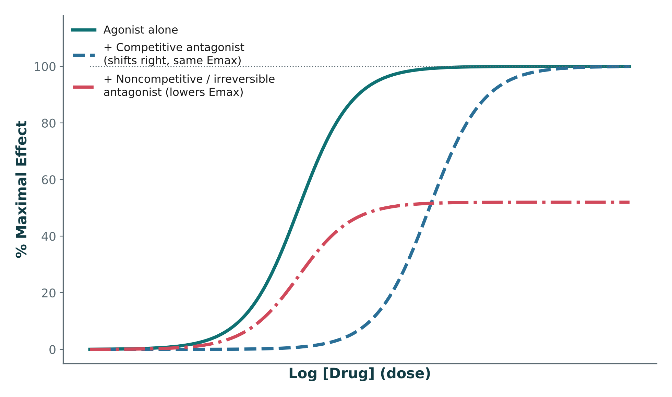
Visualizing Agonist & Antagonist Effects
ORIGINAL ILLUSTRATION · FIGURE 1
Figure 1. Original illustrative curves (not Katzung data): a competitive antagonist shifts the curve right with the same Emax; a noncompetitive/irreversible antagonist lowers Emax instead.
Notes:
Walk the curve left to right: agonist alone, then show how the competitive-antagonist curve shifts right (same ceiling), then how the noncompetitive curve lowers the ceiling instead. This is the same distinction from the previous slide, now shown graphically.

Slide 24
Quick Check
QUICK CHECK · FIGURE 1
In Figure 1 above, the dashed curve (+ Competitive antagonist) is shifted to the right of the agonist-alone curve but reaches the same plateau at the top. What does this pattern show?
More agonist is needed to reach the same effect, but the same maximal effect is still achievable
The competitive antagonist lowers the drug’s efficacy (Emax)
A
B
The competitive antagonist increases the drug’s potency
The competitive antagonist has no measurable effect on the agonist’s curve
C
D

Slide 25
Answer
ANSWER · FIGURE 1
A
More agonist is needed to reach the same effect, but the same maximal effect is still achievable.
Why: A rightward shift with an unchanged plateau is the graphical signature of competitive antagonism: it takes more drug to reach a given effect (potency falls), but because the antagonism is surmountable, enough agonist can still reach the original Emax. Contrast this with the noncompetitive/irreversible curve in the same figure, which plateaus lower instead of shifting right.

Slide 26

Agonism in Practice: Albuterol
CLINICAL TIE-IN
Albuterol is a selective β2-adrenergic receptor agonist.
Binding activates the β2 receptor → increases intracellular cAMP.
Rising cAMP relaxes bronchial smooth muscle → bronchodilation.
This is the same receptor-to-response logic you will reuse for every agonist drug this term.
Notes:
This bridges introductory pharmacodynamics into the pulmonary pharmacology they will see later in the curriculum, and reinforces the agonist definition from the previous slide.

Slide 27
Quick Check
QUICK CHECK · PHARMACODYNAMICS
A drug binds the same receptor as an endogenous agonist and lowers the tissue’s baseline (constitutive) activity below normal, without any agonist present. This drug is best classified as a(n):
Full agonist
Partial agonist
A
B
Competitive antagonist
Inverse agonist
C
D

Slide 28
Answer
ANSWER · PHARMACODYNAMICS
D
Inverse agonist.
Why: An inverse agonist actively reduces constitutive (baseline) receptor activity below normal — a true antagonist merely blocks the agonist without lowering baseline activity itself.

Slide 29

04
Dose-Response Relationships
SECTION
Quantifying how much drug produces how much effect.

Slide 30
The Dose-Response Curve
READING THE CURVE
● Potency: how much drug is required to produce a given effect — a more potent drug needs a lower dose.
● Efficacy (Emax): the maximum effect a drug can produce, no matter how high the dose goes.
● EC₅₀: the drug concentration producing 50% of the maximal effect — the standard measure of potency.
Notes:
Draw a sigmoidal dose-response curve on the board: x-axis = log(dose), y-axis = effect. Point out EC50 on the x-axis and Emax as the plateau.

Slide 31
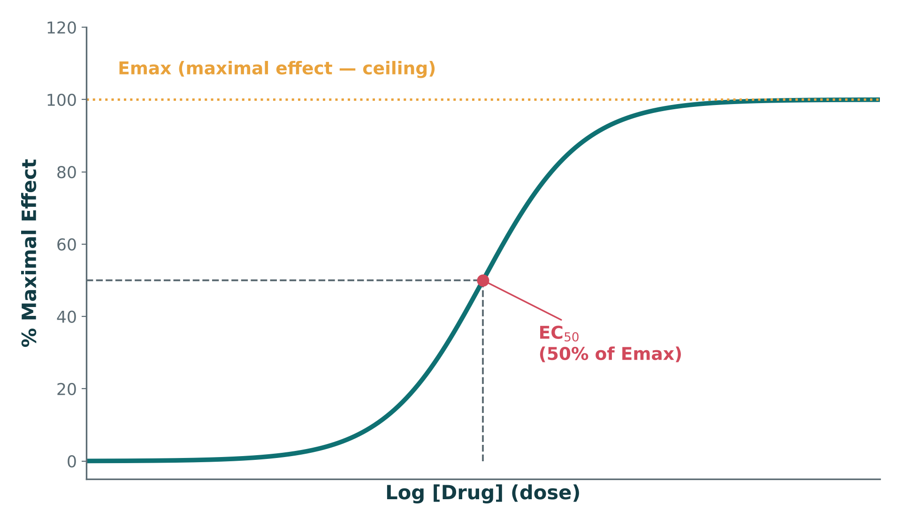
The Sigmoidal Dose-Response Curve
ORIGINAL ILLUSTRATION · FIGURE 2
Figure 2. Original illustrative curve (illustrative values, not from any textbook): EC₅₀ marks 50% of Emax; Emax is the plateau — the ceiling effect.
Notes:
Point to EC50 and Emax directly on the plotted curve — this is the same curve concept described on the previous slide, now shown graphically.

Slide 32
Quick Check
QUICK CHECK · FIGURE 2
On the dose-response curve in Figure 2, the point marked EC₅₀ sits exactly halfway up the rising part of the curve. What does this point represent?
The dose at which the drug becomes toxic
The concentration producing 50% of the drug’s maximal effect
A
B
The point where the drug has zero effect
The drug’s bioavailability
C
D

Slide 33
Answer
ANSWER · FIGURE 2
B
The concentration producing 50% of the drug’s maximal effect.
Why: EC₅₀ is read directly off the curve at the halfway point between baseline and Emax (the plateau) — it is the standard graphical measure of potency, not a measure of toxicity or bioavailability.

Slide 34
Potency vs. Efficacy
HIGH-YIELD DISTINCTION
Potency
Efficacy
How much drug is needed to get an effect
Lower EC50 = more potent
Clinically matters for dosing — not for choosing the "better" drug
The maximum effect the drug can produce
Higher Emax = more efficacious
Clinically matters much more than potency — a highly potent drug with low efficacy may be clinically useless
Notes:
Classic PA-exam framing: a drug can be very potent (tiny dose) but have low efficacy — potency alone never tells you whether a drug "works better."

Slide 35
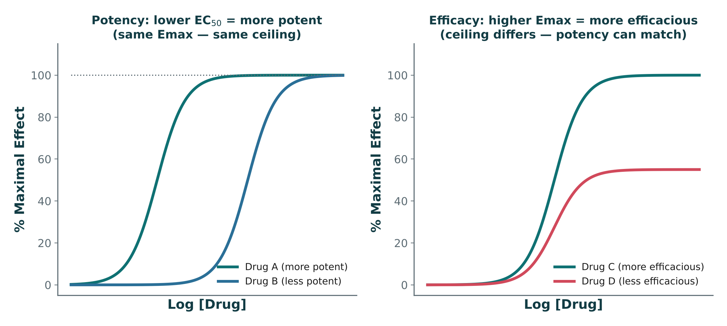
Potency vs. Efficacy, Side by Side
ORIGINAL ILLUSTRATION · FIGURE 3
Figure 3. Original illustrative curves: potency (left) and efficacy (right) are independent properties — a drug can differ in one without differing in the other.
Notes:
Left panel: two drugs with the same Emax but different EC50 (potency differs). Right panel: two drugs with the same EC50 but different Emax (efficacy differs). This is the graphical version of the table on the previous slide.

Slide 36
Quick Check
QUICK CHECK · FIGURE 3
In the left panel of Figure 3, Drug A’s curve sits to the left of Drug B’s curve, but both curves plateau at the same height. What does this tell you?
Drug A is more potent than Drug B, and both have equal efficacy
Drug A is more efficacious than Drug B
A
B
Drug A and Drug B have different Emax values
Drug B is more potent than Drug A
C
D

Slide 37
Answer
ANSWER · FIGURE 3
A
Drug A is more potent than Drug B, and both have equal efficacy.
Why: A curve positioned farther left reaches the same effect at a lower dose — that is greater potency. Because both curves reach the same plateau height, their Emax (efficacy) is identical; only potency differs, exactly as the right panel then shows the reverse case (same potency, different efficacy).

Slide 38

The Therapeutic Index
SAFETY MARGIN
Therapeutic Index (TI) = TD₅₀ ÷ ED₅₀ (toxic dose in 50% ÷ effective dose in 50%).
A wide TI means a large margin between an effective dose and a toxic dose — generally safer to dose.
A narrow TI means effective and toxic doses are close together — requires careful dosing and often blood-level monitoring.
Classic narrow-TI drugs: warfarin, lithium, digoxin, phenytoin.
Notes:
These four narrow-TI drugs are extremely high-yield — students should be able to name all four without hesitation and know that each requires therapeutic drug monitoring.

Slide 39
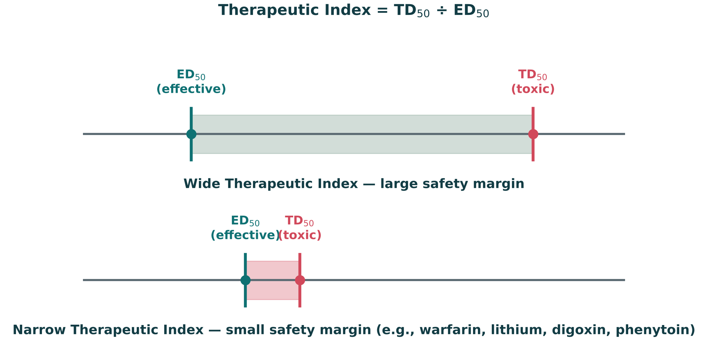
Wide vs. Narrow Therapeutic Index
ORIGINAL ILLUSTRATION · FIGURE 4
Figure 4. Original illustrative number-line comparison: a wide gap between ED₅₀ and TD₅₀ is safer to dose than a narrow one (illustrative values).
Notes:
Point out how close ED50 and TD50 sit for the narrow-TI example — this is exactly why warfarin, lithium, digoxin, and phenytoin require blood-level monitoring.

Slide 40
Quick Check
QUICK CHECK · FIGURE 4
Comparing the two number lines in Figure 4, the narrow-TI drug’s ED₅₀ and TD₅₀ markers sit much closer together than the wide-TI drug’s. What is the clinical implication?
The narrow-TI drug is safer because it requires a lower dose
The narrow-TI drug has a smaller margin between an effective and a toxic dose, requiring closer monitoring
A
B
The wide-TI drug is more likely to cause toxicity
Therapeutic index has no bearing on dosing safety
C
D

Slide 41
Answer
ANSWER · FIGURE 4
B
The narrow-TI drug has a smaller margin between an effective and a toxic dose, requiring closer monitoring.
Why: The distance between the ED₅₀ and TD₅₀ markers on the number line is the therapeutic index itself — a narrow gap (as with warfarin, lithium, digoxin, phenytoin) means a small dosing error can move a patient from effective to toxic, which is why these drugs require blood-level monitoring.

Slide 42
Quick Check
QUICK CHECK · DOSE-RESPONSE RELATIONSHIPS
Drug X requires a much lower dose than Drug Y to achieve the same effect, but both drugs achieve the same maximum effect (Emax). Which statement is correct?
Drug X is more efficacious than Drug Y
Drug X is more potent than Drug Y
A
B
Drug X has a narrower therapeutic index than Drug Y
Drug X and Drug Y have different Emax values
C
D

Slide 43
Answer
ANSWER · DOSE-RESPONSE RELATIONSHIPS
B
Drug X is more potent than Drug Y.
Why: Needing a lower dose for the same effect is the definition of greater potency. Since both drugs reach the same Emax, their efficacy is equal — potency and efficacy are independent properties.

Slide 44
05
Pharmacokinetics: ADME
SECTION
What the body does to the drug.

Slide 45
ADME
THE CORE FRAMEWORK
A — Absorption
D — Distribution
Movement of drug from the site of administration into the bloodstream
Movement of drug from blood into tissues
M — Metabolism
E — Excretion
Chemical transformation of drug, mainly in the liver
Removal of drug/metabolites from the body, mainly via the kidney
Notes:
Tell students ADME is the organizing skeleton for the rest of this lecture — each remaining pharmacokinetics section is really just one ADME letter in depth.

Slide 46
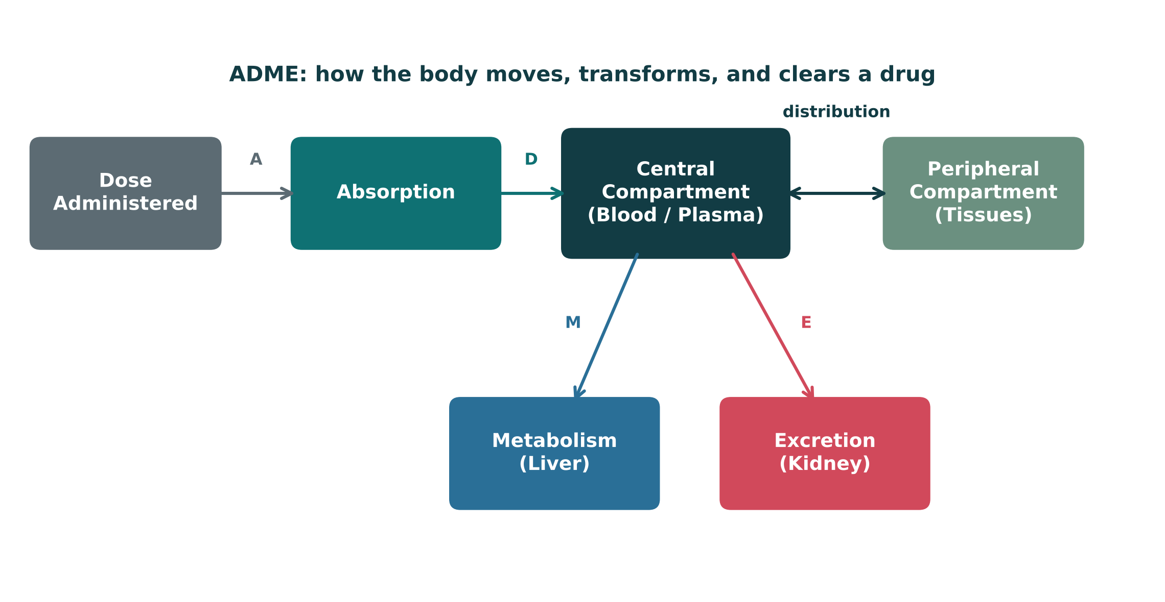
The ADME Compartment Model
ORIGINAL ILLUSTRATION · FIGURE 5
Figure 5. Original illustrative compartment diagram: how a dose moves from administration through distribution, metabolism, and excretion.
Notes:
Trace the arrows A-D-M-E with your finger as you narrate — this is the visual skeleton for the rest of the ADME discussion (and for the remaining PK sections in Session 2).

Slide 47
Quick Check
QUICK CHECK · FIGURE 5
In Figure 5, two separate arrows leave the Central Compartment box: one labeled "M" pointing to Metabolism (Liver), and one labeled "E" pointing to Excretion (Kidney). Together, these two arrows represent which part of ADME?
Absorption and Distribution
Distribution only
A
B
Metabolism and Excretion — how the drug is transformed and cleared
Only the Excretion step
C
D

Slide 48
Answer
ANSWER · FIGURE 5
C
Metabolism and Excretion — how the drug is transformed and cleared.
Why: The diagram shows drug leaving the Central Compartment by two separate routes: the "M" arrow to the liver (biotransformation) and the "E" arrow to the kidney (elimination). Together these are the back half of ADME — how the body gets rid of the drug, as opposed to Absorption and Distribution, which govern how the drug arrives and spreads.

Slide 49
Routes of Administration
COMPARISON · TABLE 2
Route | Key Feature
Oral (PO) | Convenient; subject to first-pass metabolism and variable absorption
Sublingual | Absorbed directly into systemic circulation; bypasses first-pass metabolism
Intravenous (IV) | 100% bioavailable; immediate onset; no absorption phase
Intramuscular (IM) | Faster than oral; good for depot/long-acting formulations
Subcutaneous (SC) | Slower, steady absorption; common for insulin, heparin
Inhaled | Rapid local effect in the lungs; minimizes systemic exposure for some drugs
Transdermal | Slow, sustained systemic absorption through the skin
Topical | Local effect at the site of application; minimal systemic absorption
Notes:
Ask students which routes bypass first-pass metabolism (IV, sublingual, inhaled, transdermal, topical, SC, IM — essentially everything except oral).

Slide 50
Bioavailability
ABSORPTION
Bioavailability (F) = the fraction of an administered dose that reaches systemic circulation unchanged.
By definition, an IV dose has 100% bioavailability — the entire dose enters the bloodstream directly.
Oral bioavailability is reduced by incomplete absorption and by first-pass hepatic metabolism.
Notes:
This naturally sets up the next slide on first-pass metabolism as the main reason oral bioavailability is less than 100%.

Slide 51

The First-Pass Effect
WHY ORAL DOSES DIFFER
Oral Drug
GI Tract
Portal
Circulation
Liver
Systemic
Circulation
Examples with a large first-pass effect: nitroglycerin, propranolol, morphine — all require higher oral doses (or a non-oral route) to achieve the same systemic exposure as IV.
Notes:
The liver can inactivate a large fraction of drug before it ever reaches systemic circulation — this is why some drugs are given sublingually or transdermally instead of orally.

Slide 52
Distribution
WHERE THE DRUG GOES
● Plasma protein binding: only unbound ("free") drug is pharmacologically active and able to cross membranes.
● Lipid solubility: lipophilic drugs cross membranes more readily and distribute into fatty tissue.
● Tissue perfusion: highly perfused organs (brain, heart, kidney) receive drug faster than poorly perfused tissue (fat, bone).
● Volume of distribution (Vd): a calculated value relating total drug in the body to plasma concentration — a high Vd suggests extensive tissue distribution.
Notes:
Vd is a theoretical volume, not a real anatomic space — a drug with a very high Vd (like digoxin) is telling you it is mostly sequestered in tissue, not floating around in plasma.

Slide 53

The Blood-Brain Barrier
DISCUSSION
Why can some drugs readily enter the CNS while others cannot?
Tight junctions between endothelial cells restrict paracellular movement.
Small, lipophilic, non-ionized drugs cross more easily than large, polar, or highly protein-bound drugs.
Efflux transporters (like P-glycoprotein) can actively pump some drugs back out of the CNS.
Notes:
Use this as a think-pair-share — ask students to predict whether a highly polar antibiotic would cross the BBB well (generally no, unless meninges are inflamed, as in meningitis).

Slide 54
Quick Check
QUICK CHECK · PHARMACOKINETICS: ADME
Which route of administration bypasses first-pass hepatic metabolism entirely, by entering systemic venous circulation directly?
Sublingual
Oral, taken on an empty stomach
A
B
All routes undergo first-pass metabolism equally
Oral, taken with food
C
D

Slide 55
Answer
ANSWER · PHARMACOKINETICS: ADME
A
Sublingual.
Why: Sublingual absorption enters systemic venous circulation directly, bypassing the portal vein and the liver’s first-pass metabolism — unlike oral dosing, which is absorbed into the portal circulation and passes through the liver first.

Slide 56
Session 1 Recap — To Be Continued
BIG PICTURE
Pharmacology connects a drug’s chemistry to its clinical effect — precise vocabulary (generic names, therapeutic vs. adverse effects) protects patients.
1
Every approved drug has passed through a structured development and regulatory pipeline (Phases I–IV).
2
Pharmacodynamics explains how drugs bind receptors to produce agonism or antagonism, and dose-response curves describe potency and efficacy.
3
ADME determines how much drug reaches its target and for how long — today we covered absorption, distribution, bioavailability, and the first-pass effect.
4
Session 2 (Thursday, October 22) continues with metabolism, excretion, PK calculations (half-life, steady state, clearance), pharmacogenomics, and the integrated clinical decision-making framework.
5
Notes:
Close Session 1 by previewing Session 2 explicitly — students should leave knowing ADME is half-finished (we stopped after Distribution) and that Metabolism/Excretion pick up first next time.

Slide 57
Image Attribution
APPENDIX
● Original figures in this deck: Figures 1–5 (Visualizing Agonist & Antagonist Effects; The Sigmoidal Dose-Response Curve; Potency vs. Efficacy, Side by Side; Wide vs. Narrow Therapeutic Index; The ADME Compartment Model) were generated by the course director using the AI tool Claude to illustrate standard, non-copyrighted pharmacologic concepts. They are original diagrams, not reproduced from Katzung’s Basic and Clinical Pharmacology or any other copyrighted source.
● Reference: Anthropic. (2026). Claude (Sonnet 5) [Large language model]. https://claude.ai
Notes:
This slide documents AI-tool use for original figure generation per university citation requirements. It covers every original diagram in this deck (Figures 1–5); none are reproduced from any textbook.

