Slide 1

Introduction to Pharmacology
PA PHARMACOLOGY COURSE · LECTURE 1 · SESSION 2 OF 2
Session 2: Metabolism, Excretion, PK Calculations, Pharmacogenomics & Clinical Integration | Thursday, October 22
Diane S. Allen-Gipson, Ph.D., M.S., Course Director

Slide 2

Learning Objectives — Session 2
BY THE END OF THIS LECTURE
Recap: Session 1 covered pharmacology vocabulary, drug development, pharmacodynamics, dose-response relationships, and ADME through distribution.
Explain drug biotransformation (Phase I/II metabolism) and the clinical impact of CYP450 enzyme inhibition and induction.
Explain mechanisms of drug excretion and how renal function affects dosing.
Calculate and apply basic pharmacokinetic parameters (half-life, steady state, clearance).
Describe how pharmacogenomic variation can alter drug response.
Apply a structured framework to clinical prescribing decisions.
Notes:
Briefly recap Session 1 (Oct 15) before diving in: language of pharmacology, drug development/regulation, pharmacodynamics, dose-response, and ADME through distribution. Today picks up with metabolism (Section 6) and runs through the integrated clinical framework and recall quiz.

Slide 3

06
Drug Metabolism
SECTION
How the body chemically transforms drugs.

Slide 4
Why Do We Metabolize Drugs?
PURPOSE
Inactivate an active drug, making it easier to excrete.
Activate a prodrug into its active form.
Produce an active metabolite that contributes to (or extends) the drug effect.
Occasionally produce a toxic metabolite — the basis of some drug-induced organ injury.
Notes:
Preview Thursday’s acetaminophen toxicity lecture here — NAPQI is the textbook example of a toxic metabolite produced by normal Phase I metabolism.

Slide 5

Phase I vs. Phase II Reactions
TWO PHASES
Phase I — Functionalization
Phase II — Conjugation
Oxidation, reduction, hydrolysis
Primarily carried out by cytochrome P450 (CYP450) enzymes
Often creates or unmasks a reactive functional group
Glucuronidation, sulfation, acetylation, methylation, glutathione conjugation
Attaches a polar group to the molecule
Produces a more water-soluble product for renal/biliary excretion
Notes:
Phase I often comes before Phase II, but not always — some drugs go straight to conjugation.

Slide 6

CYP450 Drug Interactions
CLINICALLY CRITICAL
● Enzyme inhibition: a drug slows a CYP enzyme, raising the blood level of any drug that CYP normally clears.
● Enzyme induction: a drug increases CYP enzyme production, lowering the blood level (and effect) of drugs that CYP clears.
Example: Drug A inhibits CYP3A4 → Drug B (a CYP3A4 substrate) accumulates → toxicity risk rises.
Notes:
This is one of the highest-yield concepts in all of pharmacology — nearly every major drug class has at least one clinically important CYP interaction.

Slide 7
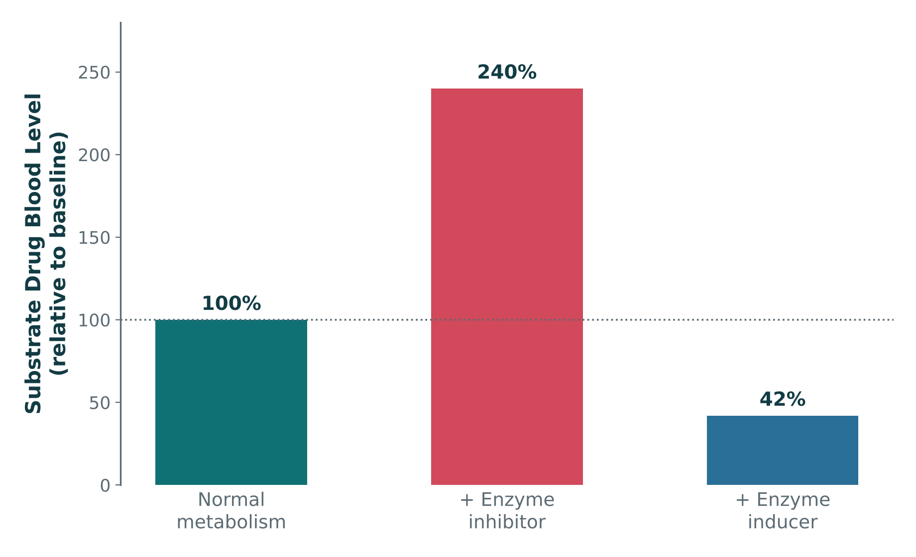
CYP450 Inhibition vs. Induction
ORIGINAL ILLUSTRATION · FIGURE 6
Figure 6. Original illustrative bar chart (illustrative values): a CYP450 inhibitor raises a substrate drug’s blood level; an inducer lowers it.
Notes:
This is the graphical version of the previous slide — point out how far inhibition pushes the level above 100% (toxicity risk) versus how far induction pushes it below 100% (therapeutic failure risk).

Slide 8
Quick Check
QUICK CHECK · FIGURE 6
In Figure 6, the "+ Enzyme inhibitor" bar rises to 240% of baseline, while the "+ Enzyme inducer" bar falls to 42%. For a patient on a stable dose of the substrate drug, which condition poses the greatest risk of toxicity?
Normal metabolism
Enzyme induction
A
B
Neither condition changes risk
Enzyme inhibition — because it raises the substrate drug’s blood level
C
D

Slide 9
Answer
ANSWER · FIGURE 6
D
Enzyme inhibition — because it raises the substrate drug’s blood level.
Why: The tallest bar in the chart is the enzyme-inhibitor condition at 240% of baseline — the substrate drug accumulates because it can no longer be cleared normally, raising toxicity risk. The inducer bar shows the opposite problem (42%, risking therapeutic failure), not toxicity.

Slide 10
Quick Check
QUICK CHECK · DRUG METABOLISM
A patient stable on a CYP3A4-substrate medication with a narrow therapeutic index is started on a new drug that is a strong CYP3A4 inhibitor. What is the most likely consequence?
No change, since CYP3A4 only affects Phase II metabolism
Decreased substrate drug level and reduced effect
A
B
Increased substrate drug level and increased toxicity risk
Increased renal clearance of the substrate drug
C
D

Slide 11
Answer
ANSWER · DRUG METABOLISM
C
Increased substrate drug level and increased toxicity risk.
Why: Inhibiting the CYP enzyme responsible for clearing the substrate drug slows its metabolism, raising its blood level — especially dangerous when the substrate has a narrow therapeutic index.

Slide 12

07
Drug Excretion
SECTION
Clearing drug from the body.

Slide 13
Routes of Drug Elimination
ROUTES
Kidney
Bile / Feces
The dominant route for most drugs and metabolites
Important for some large or protein-bound drugs
Lungs
Sweat / Breast Milk
Volatile agents (e.g., anesthetic gases)
Minor routes, but breast milk matters for lactating patients

Slide 14
Renal Elimination
THE KIDNEY IN DETAIL
● Glomerular filtration: free (unbound) drug passes from blood into the renal tubule based on molecular size.
● Tubular secretion: active transporters move additional drug from blood into the tubule.
● Tubular reabsorption: lipophilic, un-ionized drug can passively diffuse back into the blood, reducing net elimination.
Notes:
Urine pH manipulation (e.g., alkalinizing urine in aspirin overdose) works by trapping ionized drug in the tubule, blocking reabsorption.

Slide 15
Renal Disease and Drug Dosing
CLINICAL CONNECTION
Decreased renal function → decreased drug clearance → increased drug exposure and accumulation risk.
eGFR and creatinine clearance (CrCl) are the standard bedside estimates of renal function used to adjust dosing.
Any renally-cleared, narrow-therapeutic-index drug (think: many antibiotics, digoxin, lithium) needs a dose or interval adjustment in renal impairment.
Notes:
This is the pharmacokinetic foundation for the renal-impairment clinical case coming up next, and for the NSAID-in-CKD case on Thursday.

Slide 16
Quick Check
QUICK CHECK · DRUG EXCRETION
A patient’s eGFR drops significantly due to new chronic kidney disease. For a drug that is primarily renally eliminated, what dosing adjustment is most appropriate?
No adjustment is needed
Increase the dose
A
B
Switch to IV administration only
Decrease the dose and/or extend the dosing interval
C
D

Slide 17
Answer
ANSWER · DRUG EXCRETION
D
Decrease the dose and/or extend the dosing interval.
Why: Reduced renal clearance raises drug exposure for renally-eliminated drugs; the standard response is a lower dose, a longer interval, or both, guided by eGFR/CrCl.

Slide 18

08
Pharmacokinetic Calculations
SECTION
The math PAs actually use at the bedside.

Slide 19
Half-Life (t½)
CORE PARAMETER
Half-life (t½) = the time required for the plasma drug concentration to fall by 50%.
Half-life is determined by clearance and volume of distribution together — it is not a fixed drug "property" independent of physiology.
A drug is roughly 97% eliminated after about 5 half-lives.
Example 1: Basic decay:
Formula: C(t) = C_{o} x (1/2)^(t/t_{1/2})
A drug has a half-life of 6 hours. A Patient receives an IV dose giving a starting plasma concentration of 100mg/L
t = 6 h (1 half-life): 50mg/L (50% remains)
t = 12 h (2 half-life): 25 mg/L (75% eliminated)
t = 18 h (3 half-life): 12.5 mg/L (87.5% eliminated)
t = 24 h (4 half-life): 6.25 mg/L (93.75% eliminated)
t = 30 h (5 half-life): 3.125 mg/L (97% eliminated)
Example 2: Percentage-based half-life: Basic decay
Formula: % remaining = 100% x (1/2)^(number of half-life)
A drug has a half-life of 6 hours. A Patient receives an IV dose giving a starting plasma concentration of 100mg/L
1 half-life: 50% remains
2 half-life: 25% remains
3 half-life: 12.5% remains
4 half-life: 6.25% remains
5 half-life: 3.125% remains (estimated 97% “eliminated”

Slide 20
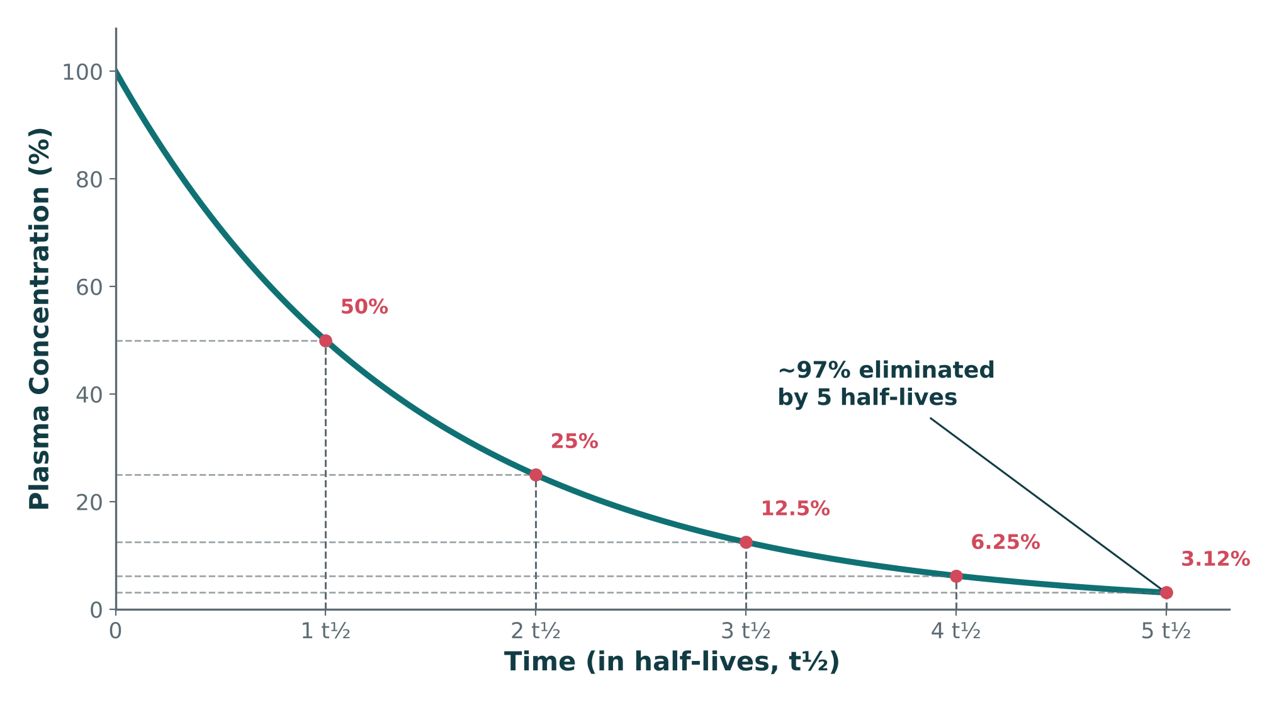
Exponential Decay Over Half-Lives
ORIGINAL ILLUSTRATION · FIGURE 7
Figure 7. Original illustrative decay curve: plasma concentration falls by 50% with each half-life, leaving ~3% remaining after 5 half-lives.
Notes:
Point out each marked half-life on the curve — this visual is what students should picture whenever a half-life-based elimination question comes up.

Slide 21
Quick Check
QUICK CHECK · FIGURE 7
Using Figure 7, approximately what percentage of the original drug concentration remains after 3 half-lives (3 t½)?
50%
25%
A
B
12.5%
3%
C
D

Slide 22
Answer
ANSWER · FIGURE 7
C
12.5%.
Why: Each half-life cuts the remaining concentration in half: 100% → 50% (1 t½) → 25% (2 t½) → 12.5% (3 t½), exactly as marked on the curve. By 5 half-lives the drug is roughly 97% eliminated (about 3% remaining).

Slide 23
Steady State, Loading, and Maintenance Dosing
DOSING IN PRACTICE
● Steady state: the point at which drug intake equals drug elimination; reached in about 4–5 half-lives with regular dosing.
● Loading dose: a larger initial dose used to rapidly reach a therapeutic concentration, without waiting for steady state.
● Maintenance dose: the regular, ongoing dose that keeps the drug within the therapeutic range once steady state is reached.
Notes:
Loading doses are based on Vd; maintenance doses are based on clearance — worth stating explicitly if students have seen the formulas.

Slide 24
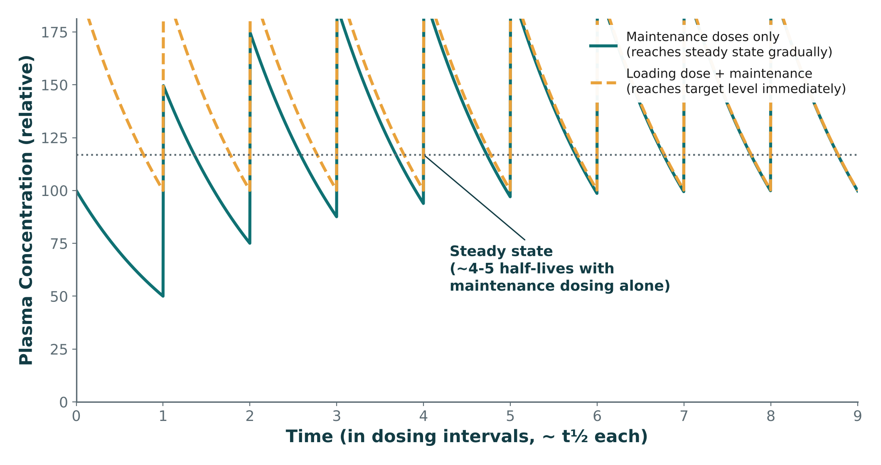
Reaching Steady State: With and Without a Loading Dose
ORIGINAL ILLUSTRATION · FIGURE 8
Figure 8. Original illustrative multi-dose simulation: maintenance dosing alone climbs gradually to steady state; adding a loading dose reaches the target level immediately.
Notes:
This is the graphical version of the previous slide’s three definitions — trace the sawtooth climb for maintenance-only dosing, then show how the loading dose starts at the target level right away.

Slide 25
Quick Check
QUICK CHECK · FIGURE 8
In Figure 8, the dashed orange line (loading dose + maintenance) starts at the target concentration immediately, while the solid teal line (maintenance only) climbs gradually over several doses. What is the clinical advantage of adding a loading dose?
It permanently lowers the maintenance dose needed
It eliminates the need for monitoring
A
B
It has no advantage over maintenance dosing alone
It reaches the therapeutic target immediately instead of waiting ~4–5 half-lives
C
D

Slide 26
Answer
ANSWER · FIGURE 8
D
It reaches the therapeutic target immediately instead of waiting ~4–5 half-lives.
Why: The dashed loading-dose curve starts at the dotted steady-state line from the very first dose, while the solid maintenance-only curve needs several dosing intervals (~4–5 half-lives) to climb to that same level — exactly as defined on the previous slide. A loading dose does not change the maintenance dose itself or remove the need for monitoring.

Slide 27
Clearance
EFFICIENCY OF ELIMINATION
Clearance = the volume of plasma from which drug is completely removed per unit time.
Clearance determines how efficiently a drug is removed from the body — and, along with Vd, determines half-life.
Total clearance is usually the sum of hepatic and renal clearance.

Slide 28

Renal Impairment and Drug Accumulation
CLINICAL CASE
A patient with significant chronic kidney disease is prescribed a medication that is primarily eliminated unchanged by the kidney.
Ask yourself: What happens to the drug’s concentration and half-life, and would you adjust the dose, the dosing interval, or both?
Clinical pearl: Reduced clearance raises drug concentration and prolongs half-life; many renally-cleared drugs are managed by extending the dosing interval, reducing the dose, or both, guided by eGFR/CrCl.
Notes:
Walk through the logic explicitly: clearance down -> half-life up -> time to steady state up -> accumulation risk up if the regimen is not adjusted.

Slide 29
Quick Check
QUICK CHECK · PHARMACOKINETIC CALCULATIONS
Approximately how many half-lives are required for a drug to reach steady state with regular, repeated dosing?
1–2
4–5
A
B
8–10
Steady state is reached immediately after the first dose
C
D

Slide 30
Answer
ANSWER · PHARMACOKINETIC CALCULATIONS
B
4–5 half-lives.
Why: Steady state — where drug intake equals drug elimination — is reached in roughly 4–5 half-lives, regardless of dose size. This is also why a drug is roughly 97% eliminated about 5 half-lives after stopping it.

Slide 31

09
Pharmacogenomics
SECTION
Why the same dose does not work the same way in everyone.

Slide 32
What Is Pharmacogenomics?
DEFINITION
Pharmacogenomics studies how genetic variation changes an individual’s response to a drug.
Genetic variation can alter:
  Drug metabolism (e.g., CYP enzyme activity)
  Drug transport across membranes
  Drug target structure or expression
  Overall drug response and risk of adverse reactions

Slide 33
Pharmacogenomics in Practice
HIGH-YIELD EXAMPLES
CYP2D6 Variation
CYP2C19 Variation
Alters metabolism of many antidepressants, opioids (e.g., codeine activation)
Affects clopidogrel activation and some antidepressant/PPI dosing
TPMT Variation
HLA-Associated Reactions
Deficiency raises toxicity risk with thiopurine drugs (e.g., azathioprine)
Certain HLA alleles sharply raise risk of severe hypersensitivity to specific drugs
Notes:
Students will see HLA-B*5801 and allopurinol again directly in Thursday’s gout lecture — flag that connection now.

Slide 34

Personalized Pharmacotherapy
PUTTING IT TOGETHER
Genotype
Phenotype
Disease
State
Other
Medications
Individualized
Therapy
Pharmacogenomics is one input among several — genotype alone never dictates therapy in isolation.

Slide 35
Quick Check
QUICK CHECK · PHARMACOGENOMICS
A patient is found to carry the HLA-B*5801 allele before starting allopurinol. Why does this matter clinically?
It identifies a sharply increased risk of a severe hypersensitivity reaction
It predicts reduced drug absorption
A
B
It only affects how the drug tastes
It has no bearing on drug selection
C
D

Slide 36
Answer
ANSWER · PHARMACOGENOMICS
A
It identifies a sharply increased risk of a severe hypersensitivity reaction.
Why: HLA-B*5801 is associated with severe hypersensitivity reactions to allopurinol — a textbook pharmacogenomic screening consideration you will see again in Thursday’s gout lecture.

Slide 37
10
Putting It All Together
SECTION
From concepts to clinical decisions.

Slide 38
One Integrated Pharmacology Pathway
THE COMPLETE MODEL
Dose
Absorption
Distribution
Receptor /
Target
Effect
Metabolism
Excretion
Every topic in this lecture is a stop somewhere along this pathway — use it as your mental checklist when you evaluate any drug.

Slide 39
A Clinical Decision-Making Checklist
BEFORE YOU PRESCRIBE
Indication — is there a clear reason to treat?
Contraindications and allergies
Renal and hepatic function
Drug interactions (including CYP450)
Age, pregnancy, and other patient-specific factors
Correct dose, route, and monitoring plan
Notes:
This list previews exactly the checklist students will apply in the Thursday MSK cases (NSAID in CKD, methotrexate in pregnancy, etc.) — tell them explicitly to memorize this list.

Slide 40
CYP Interaction in Action
INTEGRATED VIGNETTE
A patient stable on a CYP3A4-substrate medication is started on a new drug that is a potent CYP3A4 inhibitor.
Ask yourself: What happens to the first drug’s level, and what would you watch for clinically?
Clinical pearl: Always check for CYP450 interactions before adding a new drug to an existing regimen — this is one of the most preventable causes of toxicity.

Slide 41
Agonist or Antagonist?
INTEGRATED VIGNETTE
A patient is given a drug that binds the same receptor as their home medication, but their home medication’s effect becomes weaker after the new drug is started.
Ask yourself: Is the new drug most likely a competitive antagonist, and how could you confirm it pharmacologically?
Clinical pearl: A competitive antagonist can be overcome by increasing the agonist dose — if raising the home medication’s dose restores the effect, that supports competitive (rather than irreversible) antagonism.

Slide 42
Quick Check
QUICK CHECK · PUTTING IT ALL TOGETHER
Before prescribing any new medication, which single check is most directly aimed at preventing a toxic, often-predictable drug-drug interaction?
Confirming the drug’s brand name
Checking the drug’s chemical name
A
B
Reviewing the drug’s half-life alone
Reviewing CYP450 interactions with the patient’s current medications
C
D

Slide 43
Answer
ANSWER · PUTTING IT ALL TOGETHER
D
Reviewing CYP450 interactions with the patient’s current medications.
Why: CYP450 interaction screening is one of the single highest-yield steps for preventing predictable, preventable toxicity before adding any new drug to a regimen.

Slide 44
Key Takeaways
BIG PICTURE
Pharmacodynamics = what the drug does to the body (receptors, potency, efficacy).
1
Pharmacokinetics = what the body does to the drug (ADME).
2
Receptor interactions (agonism, antagonism) explain most drug effects.
3
ADME together determine how much drug reaches the target, and for how long.
4
Patient-specific factors — renal/hepatic function, genetics, interactions — determine the individual response.
5
Notes:
Close by telling students these five ideas are the toolkit they will use for every single drug class for the rest of the course, starting with musculoskeletal pharmacology next.

Slide 45
11
Lecture Recall Quiz
SECTION
A cumulative self-test covering both sessions — use this to review before exams.

Slide 46
Lecture Recall Quiz (1 of 2)
LECTURE RECALL QUIZ
1. A drug has high potency but low efficacy compared to an alternative. For a patient needing maximum symptom relief, which factor matters more when choosing between the two?
  A. Efficacy
  B. Potency
  C. Both matter equally
  D. Neither predicts clinical benefit
2. A patient with CKD is prescribed a renally-cleared, narrow-TI drug without dose adjustment. Which two consequences would you expect together?
  A. Decreased half-life and decreased concentration
  B. Increased clearance and decreased Vd
  C. Increased half-life and increased concentration
  D. No change in either parameter
3. Which best differentiates a competitive antagonist from a noncompetitive antagonist?
  A. Competitive lowers Emax; noncompetitive does not
  B. Noncompetitive lowers Emax; competitive shifts the curve right without changing Emax
  C. They are pharmacologically identical
  D. Only competitive antagonists cause adverse effects

Slide 47
Lecture Recall Quiz (2 of 2)
LECTURE RECALL QUIZ
4. Drug A, a CYP enzyme inducer, is started in a patient taking Drug B, a substrate of that same CYP enzyme. What happens to Drug B’s level and effect?
  A. Increases, raising toxicity risk
  B. No change
  C. Drug B’s route of elimination changes to biliary
  D. Decreases, risking therapeutic failure
5. A narrow-therapeutic-index medication requires monitoring. Which pharmacokinetic parameter most directly determines how long it takes to reach steady-state concentration?
  A. Half-life
  B. Bioavailability
  C. Route of administration
  D. Chemical name
6. A PA reviews indication, contraindications, renal/hepatic function, interactions, and a monitoring plan before prescribing. This process best reflects:
  A. Pharmacogenomic testing
  B. Receptor pharmacology alone
  C. The clinical decision-making framework
  D. Phase IV surveillance

Slide 48
Lecture Recall Quiz — Answer Key
ANSWER KEY
1. A — Efficacy (the maximum achievable effect) matters more than potency for most clinical outcomes.
2. C — Reduced renal clearance raises both drug concentration and half-life.
3. B — Noncompetitive/irreversible antagonists lower Emax; competitive antagonists shift the curve right without changing Emax.
4. D — Enzyme induction speeds substrate clearance, lowering its level and effect — the opposite of inhibition.
5. A — Time to steady state (about 4–5 half-lives) is governed by half-life.
6. C — This checklist is the clinical decision-making framework from the "Putting It All Together" section.
Notes:
Encourage students to revisit this quiz on their own before the exam — it is designed as a standalone recall resource, separate from the in-lecture quick checks, and now spans both Session 1 and Session 2 content.

Slide 49
Image Attribution
APPENDIX
● Original figures in this deck: Figures 6–8 (CYP450 Inhibition vs. Induction; Exponential Decay Over Half-Lives; Reaching Steady State: With and Without a Loading Dose) were generated by the course director using the AI tool Claude to illustrate standard, non-copyrighted pharmacologic concepts. They are original diagrams, not reproduced from Katzung’s Basic and Clinical Pharmacology or any other copyrighted source.
● Reference: Anthropic. (2026). Claude (Sonnet 5) [Large language model]. https://claude.ai
Notes:
This slide documents AI-tool use for original figure generation per university citation requirements. It covers every original diagram in this deck (Figures 6–8); none are reproduced from any textbook.

