Slide 1

PA PHARMACOLOGY COURSE · LECTURE 3 · SESSION 2 OF 2
GI & Nutrition Pharmacology
Session 2: Bowel Disorders, IBD, and Nutrition/Dietary Supplements | Thursday, November 5 | 8:30–11:00 AM
Diane S. Allen-Gipson, Ph.D., M.S., Course Director
Notes:
Say: "Session 1 followed acid and vomiting. Today we follow three new pathways: how the bowel moves water, how we step up IBD therapy, and how what patients take on their own changes their medicines."

Slide 2

BY THE END OF THIS LECTURE
Learning Objectives — Session 2
Recap: Session 1 covered acid-peptic disease pharmacotherapy and antiemetics.
Classify laxatives and antidiarrheal agents by mechanism and clinical use, including representative generic agents.
Explain the step-wise pharmacologic management of inflammatory bowel disease, including representative generic agents at each step.
Identify major pharmacologic classes used in nutrition support and describe clinically significant drug-nutrient and herbal-supplement interactions.
Identify key contraindications, adverse effects, and drug interactions throughout.
Apply the full GI & Nutrition pharmacology toolkit to integrated clinical scenarios.
GI & Nutrition Pharmacology — Session 2 of 2 — PA Program
2
Notes:
Briefly recap Session 1 (Nov 3) before diving in: acid-peptic disease and antiemetics. Today picks up with lower-GI motility (Section 4) and runs through IBD, nutrition/dietary supplements, integration, and the cumulative recall quiz.
Instructor script:
Objectives: Read them aloud. Recap Session 1 in one sentence: acid-peptic disease and antiemetics.

Slide 3

SECTION
04
Laxatives & Antidiarrheals
Opposite problems, each with its own family of mechanisms.
Notes:
Section transition.
Four buckets: bulk-forming, osmotic, stimulant, secretagogue. Sort any laxative name into one of them.

Slide 4

CLASSIFICATION BY MECHANISM
Laxative Classes
Bulk-Forming
Osmotic
– Psyllium, methylcellulose
– Absorb water, increase stool bulk and transit
– Slowest onset; generally safest for long-term use
– Polyethylene glycol, lactulose, magnesium hydroxide
– Draw water into the lumen
– Fast, reliable onset
Stimulant
Secretagogues
– Senna, bisacodyl
– Directly stimulate enteric nerves/motility
– Reserve for short-term or breakthrough use
– Lubiprostone, linaclotide
– Increase intestinal fluid secretion
– Used for chronic constipation, IBS-C
GI & Nutrition Pharmacology — Session 2 of 2 — PA Program
4
Notes:
This four-way split is the organizing scaffold for the whole laxative section — students should be able to sort any laxative name into one of these four buckets.
Instructor script:
Know: Bulk-forming (psyllium, methylcellulose) holds water. Slowest onset, safest long term. Needs fluids, avoid in obstruction.
Know: Osmotic (polyethylene glycol, lactulose, magnesium hydroxide) draws water into the lumen. Magnesium needs caution in CKD.
Know: Stimulant (senna, bisacodyl) activates enteric nerves. Short-term or breakthrough use. Cramping.
Know: Secretagogues (lubiprostone, linaclotide) increase fluid secretion. Used in chronic constipation and IBS-C. Lubiprostone causes nausea, linaclotide causes diarrhea. Avoid in mechanical obstruction.

Slide 5
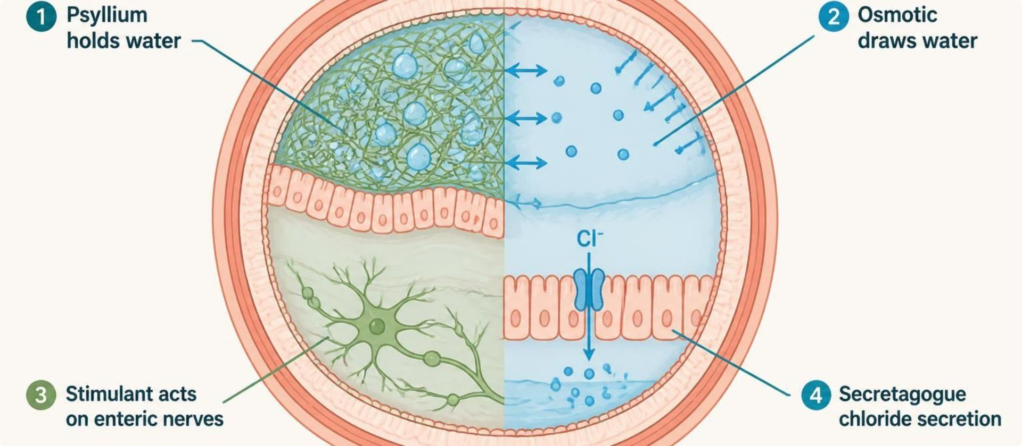
MECHANISM & DEPTH
Laxatives: How Each Class Works
Bulk-forming (psyllium): holds water, expands stool
▼
Osmotic (PEG, lactulose, magnesium): draws water into the lumen
▼
Stimulant (senna, bisacodyl): activates enteric nerves
▼
Secretagogue (lubiprostone, linaclotide): increases chloride and fluid secretion
▼
Schematic (illustrative)
Softer stool, faster transit
Figure 1. Colon lumen cross-section: bulk-forming, osmotic, stimulant and secretagogue laxatives act by different mechanisms.
Bulk-forming agents need adequate fluids and are avoided in obstruction.
PEG is first-line for chronic constipation; magnesium laxatives need caution in CKD.
Stimulants cause cramping and are for short-term use.
Lubiprostone causes nausea; linaclotide causes diarrhea and is contraindicated in mechanical obstruction and in children under 2.
GI & Nutrition Pharmacology — Session 2 of 2 — PA Program
5
Notes:
Say: "Four buckets: bulk-forming, osmotic, stimulant, secretagogue. Sort any laxative name into one of them."

Slide 6
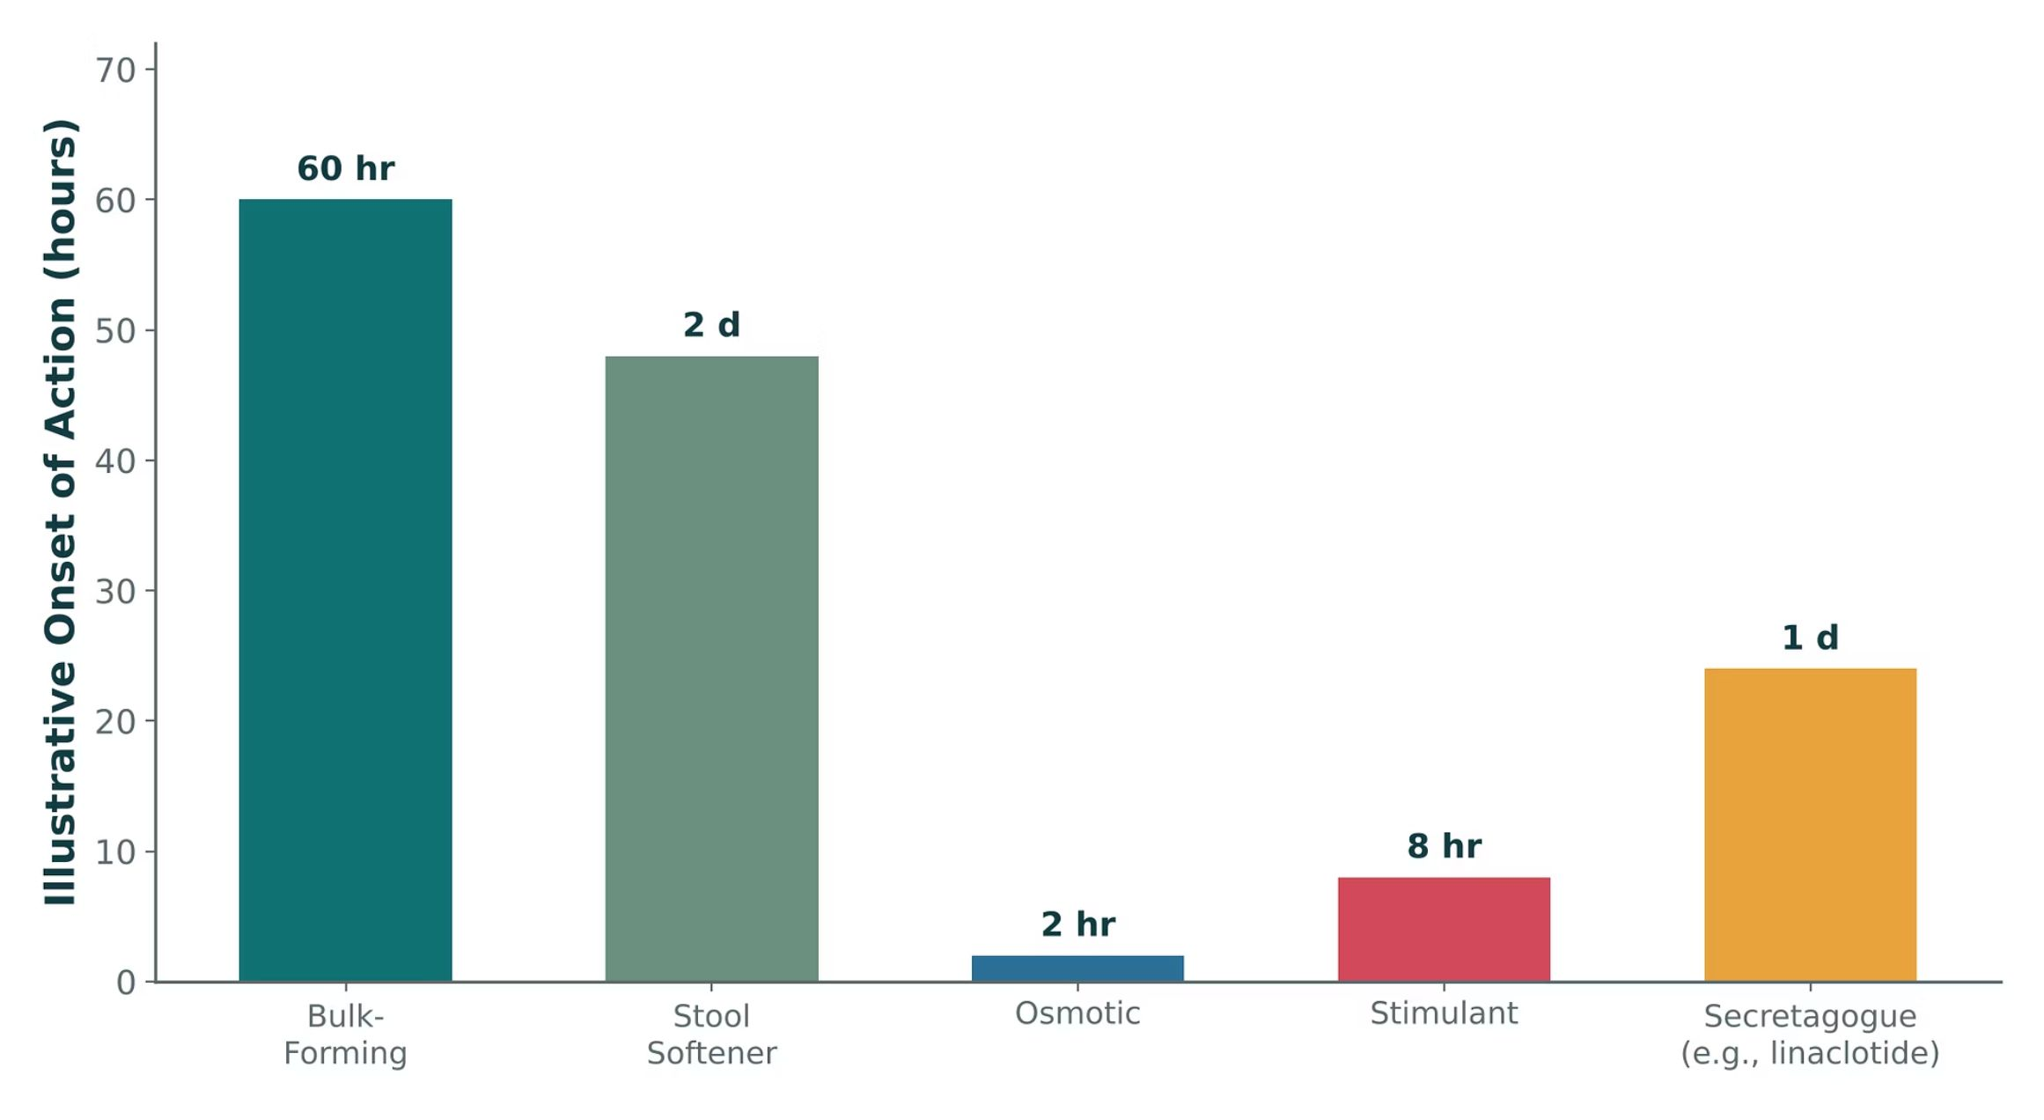
ORIGINAL ILLUSTRATION · FIGURE 2
Laxative Onset of Action by Mechanism
Figure 2. Original illustrative comparison (illustrative onset-of-action values, not from Katzung): osmotic and stimulant laxatives act fastest, while bulk-forming agents and stool softeners take the longest to produce an effect.
GI & Nutrition Pharmacology — Session 2 of 2 — PA Program
6
Notes:
Use this to connect mechanism to clinical choice: a patient who needs relief tonight is not a bulk-forming-laxative candidate, no matter how favorable its long-term safety profile is.
Instructor script:
Say: The values are illustrative onset times, not trial data.

Slide 7
QUICK CHECK · FIGURE 2
Quick Check
Based on Figure 2, a hospitalized patient needs constipation relief within a few hours. Which class is the most appropriate choice?
A
Bulk-forming
B
Stool softener
C
Osmotic or stimulant
D
None of these act quickly enough
GI & Nutrition Pharmacology — Session 2 of 2 — PA Program
7
Notes:
Quick check: pause for students to answer before revealing slide 8.

Slide 8
ANSWER · FIGURE 2
Answer
C
Osmotic or stimulant laxatives.
Why: Figure 2 shows osmotic agents (~2 hours) and stimulant agents (~8 hours) acting far faster than bulk-forming agents or stool softeners (~2–2.5 days) — appropriate choices when relief is needed within hours rather than days.
GI & Nutrition Pharmacology — Session 2 of 2 — PA Program
8
Notes:
Answer C: osmotic or stimulant for relief within hours.

Slide 9

STOPPING THE FLOW
Antidiarrheal Agents
Loperamide — a peripheral opioid-receptor agonist that slows GI motility without significant CNS (opioid) effects at normal doses.
Diphenoxylate/atropine — a combination opioid-receptor agonist; atropine is included at a subtherapeutic dose specifically to discourage misuse/overdose.
Bismuth subsalicylate — has antisecretory, mild antimicrobial, and anti-inflammatory effects; also used for dyspepsia.
Avoid antimotility agents (loperamide, diphenoxylate/atropine) in suspected infectious/inflammatory diarrhea (e.g., C. difficile, invasive bacterial infection) — can worsen outcomes by delaying toxin/pathogen clearance.
GI & Nutrition Pharmacology — Session 2 of 2 — PA Program
9
Notes:
The "avoid in infectious diarrhea" caution is one of the highest-yield safety points in this section — slowing transit in an infectious or inflammatory process can actually worsen the clinical picture (e.g., toxic megacolon risk in C. difficile).
Instructor script:
Know: Loperamide has limited CNS entry because of P-gp efflux. Very high doses can cause cardiac toxicity (QT prolongation).
Know: Diphenoxylate/atropine is Schedule V. Atropine is there at a low dose to discourage misuse. Avoid in children under 2.
Know: Bismuth subsalicylate: salicylate warning, can darken stool and tongue.
Know: Avoid antimotility agents in suspected C. difficile and in bloody or febrile diarrhea.

Slide 10
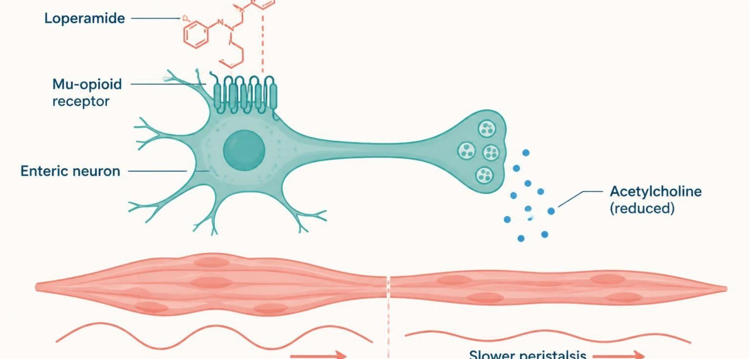
MECHANISM & DEPTH
Loperamide and Diphenoxylate: Opioid Brake on the Gut
Opioid agonist binds mu receptors on enteric neurons
▼
Less acetylcholine release
▼
Slower peristalsis, longer transit
▼
More water absorbed, firmer stool
Schematic (illustrative)
Figure 3. Loperamide binds mu-opioid receptors on myenteric neurons, reducing acetylcholine release and slowing peristalsis.
Loperamide enters the CNS poorly (P-gp efflux), but very high doses can cause cardiac toxicity (QT prolongation).
Diphenoxylate/atropine is Schedule V and is avoided in children under 6.
Avoid antimotility agents in C. difficile and in bloody or febrile diarrhea.
Bismuth subsalicylate: salicylate warning; can darken stool and tongue.
GI & Nutrition Pharmacology — Session 2 of 2 — PA Program
10
Notes:
Say: "Loperamide and diphenoxylate are opioid agonists. They bind mu receptors on enteric neurons, reduce acetylcholine release, slow peristalsis and give more time for water absorption."

Slide 11

CLINICAL CASE
Is an Antimotility Agent Safe Here?
A patient develops profuse watery diarrhea and fever three days after completing a course of clindamycin for a dental infection.
Ask yourself: Is loperamide an appropriate choice for symptomatic relief in this patient?
Clinical pearl: This presentation is concerning for C. difficile infection — antimotility agents should generally be avoided, since slowing transit can worsen toxin-mediated colonic injury. Treatment should target the underlying infection (e.g., oral vancomycin or fidaxomicin), not just the symptom.
GI & Nutrition Pharmacology — Session 2 of 2 — PA Program
11
Notes:
Great opportunity to connect back to the antibiotic-associated-diarrhea concept and reinforce that "stopping diarrhea" is not always the correct first move.
Instructor script:
Case: Diarrhea and fever after clindamycin. Ask: "Is loperamide appropriate?" Answer: no, think C. difficile and treat the infection (oral vancomycin or fidaxomicin).

Slide 12

QUICK CHECK · LAXATIVES & ANTIDIARRHEALS
Quick Check
Why is a subtherapeutic dose of atropine included in the diphenoxylate/atropine combination product?
A
To treat the underlying cause of diarrhea
B
To discourage intentional overdose/misuse of the opioid component
C
To increase the antidiarrheal effect of diphenoxylate
D
To prevent constipation
GI & Nutrition Pharmacology — Session 2 of 2 — PA Program
12
Notes:
Quick check: Atropine in diphenoxylate. Pause for students to answer before revealing slide 13.

Slide 13
ANSWER · LAXATIVES & ANTIDIARRHEALS
Answer
B
To discourage intentional overdose/misuse of the opioid component.
Why: At therapeutic doses, the atropine dose is too low to produce significant anticholinergic effects, but at supratherapeutic (misuse) doses, unpleasant anticholinergic effects (tachycardia, dry mouth, flushing) emerge — an intentional deterrent against abuse of the opioid agonist diphenoxylate.
GI & Nutrition Pharmacology — Session 2 of 2 — PA Program
13
Notes:
Answer B: it discourages overdose or misuse.

Slide 14

SECTION
05
Inflammatory Bowel Disease
Step therapy, escalating with disease severity.
Notes:
Section transition.
Step therapy. Match the drug to the severity: 5-ASA for mild, steroids for flares, immunomodulators for maintenance, biologics and small molecules for moderate to severe disease.

Slide 15

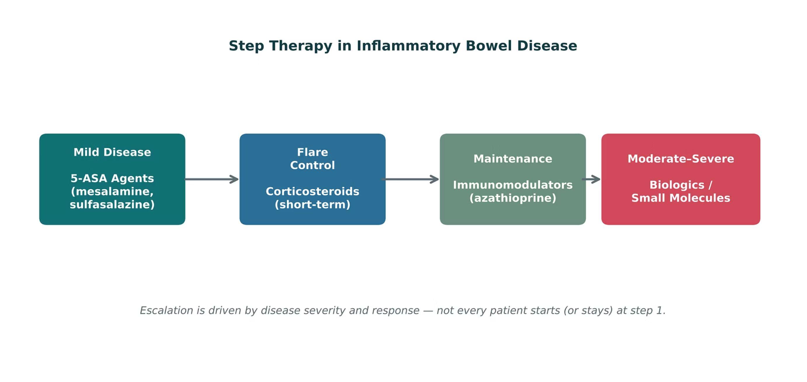
ORIGINAL ILLUSTRATION · FIGURE 4
Step Therapy in Inflammatory Bowel Disease
Figure 4. Original illustrative diagram (not from Katzung): therapy escalates from 5-ASA agents for mild disease, through short-term corticosteroids for flares and immunomodulators for maintenance, to biologics/small molecules for moderate-to-severe disease.
GI & Nutrition Pharmacology — Session 2 of 2 — PA Program
15
Notes:
This escalation ladder is the organizing framework for every drug class in this section — ask students where each drug they learn next "lives" on this ladder.
Instructor script:
Say: "Step therapy. Match the drug to the severity: 5-ASA for mild, steroids for flares, immunomodulators for maintenance, biologics and small molecules for moderate to severe disease."

Slide 16
STEP 1
Aminosalicylates (5-ASA Agents)
Mesalamine, sulfasalazine — anti-inflammatory action local to the GI mucosa.
First-line for mild-to-moderate ulcerative colitis; more limited role in Crohn disease.
Sulfasalazine is metabolized to mesalamine plus sulfapyridine — the sulfapyridine component is responsible for most adverse effects (and is why sulfa-allergic patients need caution).
Generally well tolerated; a favorable long-term safety profile relative to steroids and immunomodulators.
GI & Nutrition Pharmacology — Session 2 of 2 — PA Program
16
Notes:
Know: Sulfapyridine causes most adverse effects: rash, hemolysis in G6PD deficiency, agranulocytosis, folate deficiency (give folic acid). Caution in sulfa allergy.
Know: Mesalamine: monitor renal function (interstitial nephritis).
Know: Delayed-release forms target the ileum or colon. Enemas and suppositories treat distal disease.

Slide 17
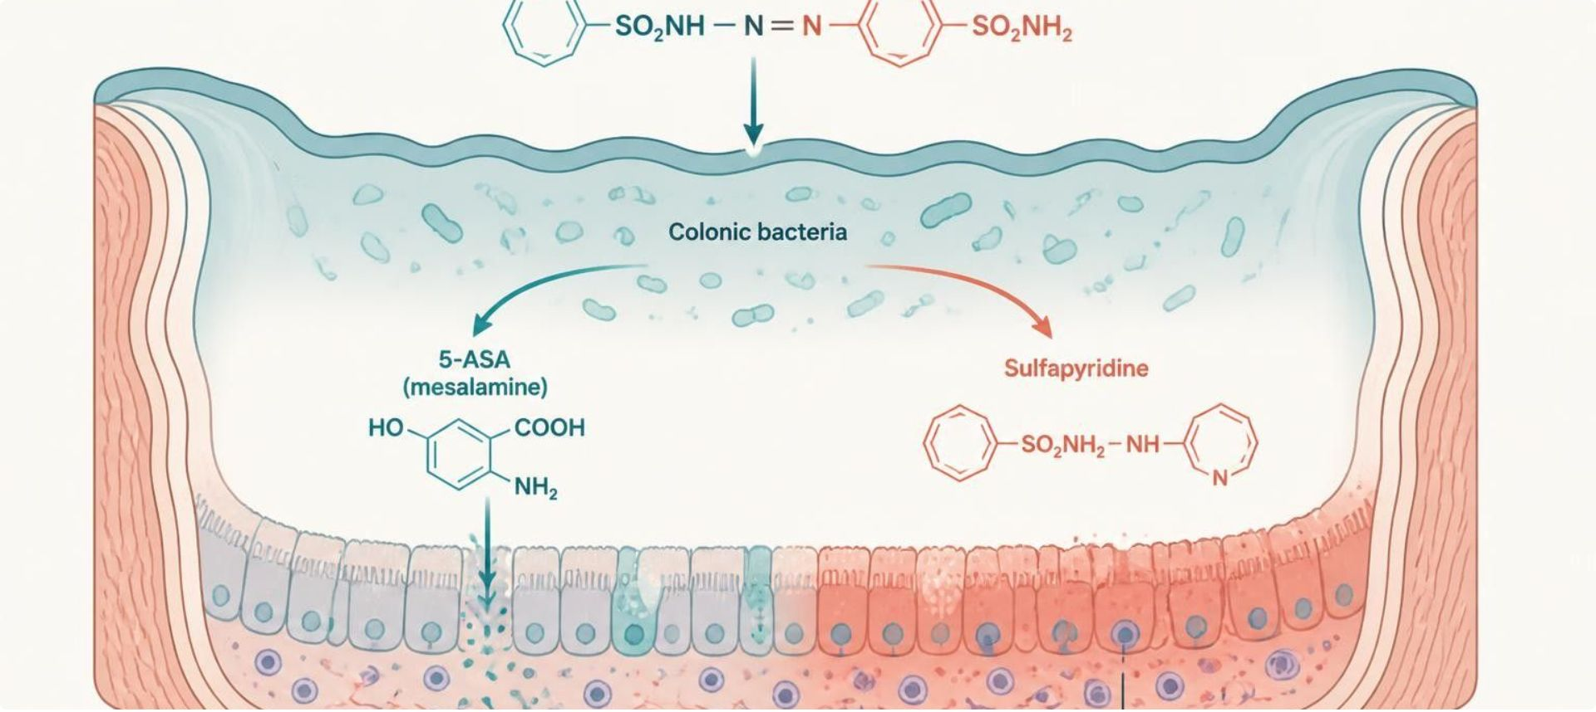
MECHANISM & DEPTH
5-ASA: Local Anti-Inflammatory Action
Sulfasalazine reaches the colon
▼
Colonic bacteria cleave the azo bond
▼
5-ASA (mesalamine) plus sulfapyridine released
▼
5-ASA acts on mucosa, reducing inflammatory mediators
▼
Schematic (illustrative)
Less mucosal inflammation
Figure 5. Sulfasalazine is cleaved by colonic bacteria; the released 5-ASA acts locally on the inflamed colonic mucosa.
Sulfapyridine causes most adverse effects (rash, hemolysis in G6PD deficiency, agranulocytosis); give folic acid for folate deficiency.
Mesalamine: monitor renal function for interstitial nephritis.
Delayed-release formulations target the ileum or colon.
Enemas and suppositories treat distal disease.
GI & Nutrition Pharmacology — Session 2 of 2 — PA Program
17
Notes:
Say: "Sulfasalazine reaches the colon. Bacteria cleave the azo bond and release 5-ASA and sulfapyridine. 5-ASA acts on the mucosa."

Slide 18
FLARE VS. MAINTENANCE
Corticosteroids and Immunomodulators
Corticosteroids (e.g., prednisone, budesonide)
Immunomodulators (e.g., azathioprine, 6-mercaptopurine)
– Used for short-term induction of remission during an acute flare
– Not appropriate for long-term maintenance given cumulative toxicity
– Budesonide has high first-pass metabolism — less systemic exposure than prednisone
– Used for long-term maintenance of remission
– Onset is slow (weeks to months) — not useful for acute flares
– Require monitoring for bone marrow suppression and hepatotoxicity
GI & Nutrition Pharmacology — Session 2 of 2 — PA Program
18
Notes:
The "fast but not for long-term" vs. "slow but sustainable" contrast here directly parallels the acute-vs-chronic gout framework from Lecture 2 — point that out explicitly if students took that unit.
Instructor script:
Say: "Fast but not for the long term versus slow but sustainable." Budesonide has high first-pass metabolism, so less systemic exposure than prednisone.

Slide 19
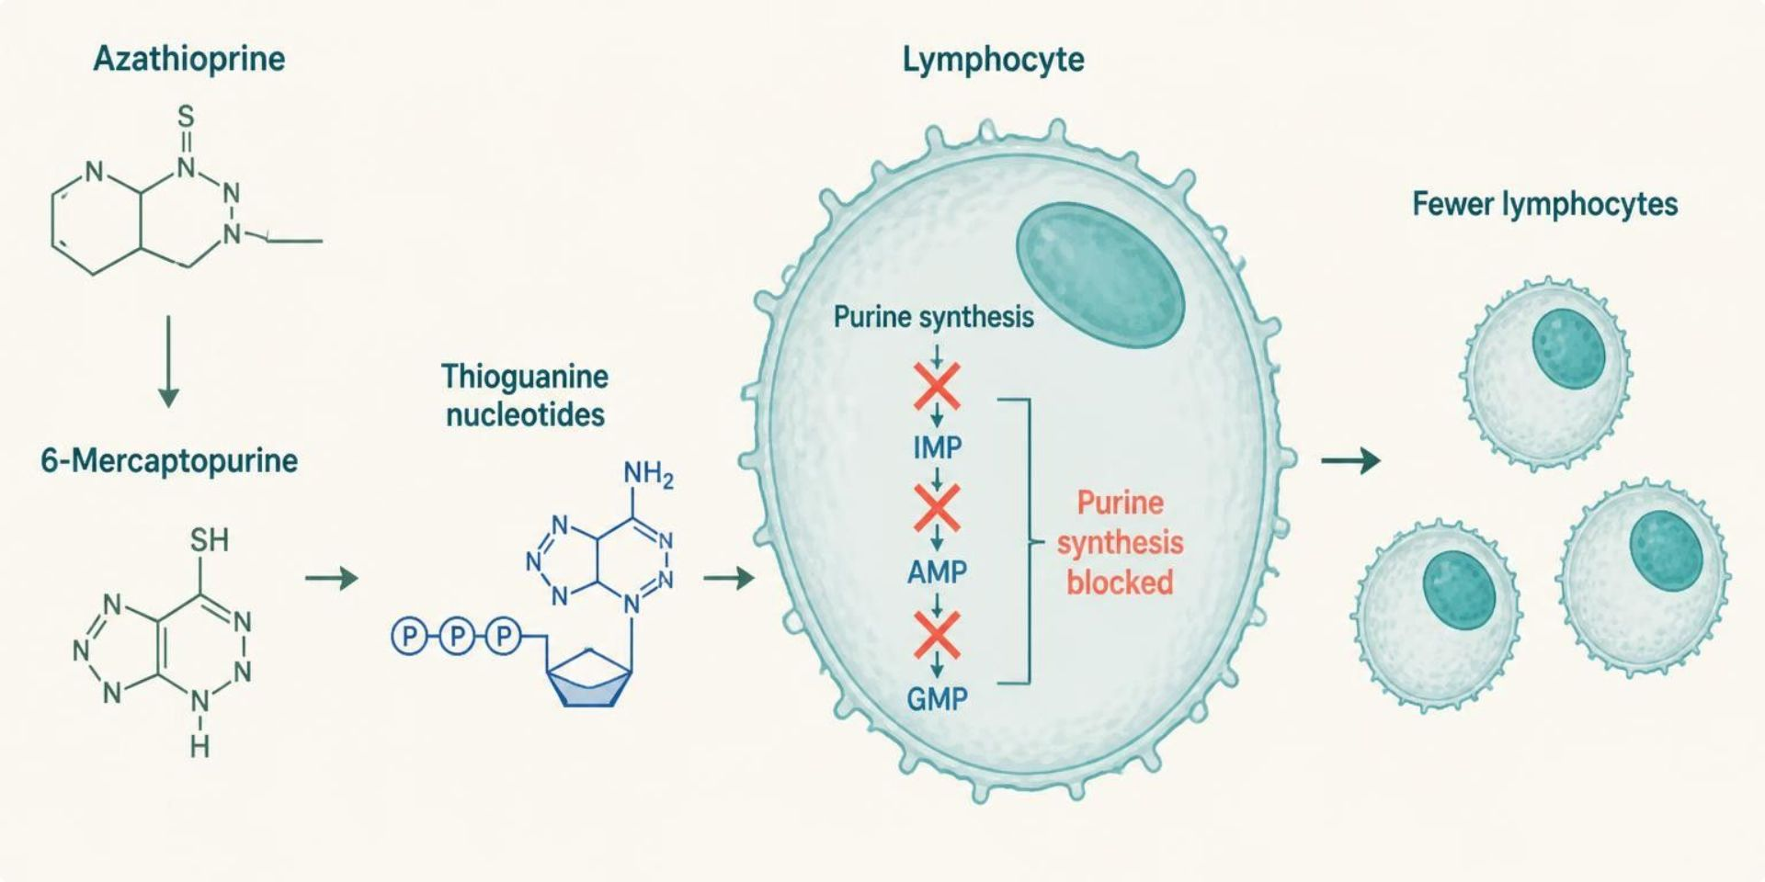
MECHANISM & DEPTH
Azathioprine and 6-MP: Purine Antimetabolites
Azathioprine converted to 6-mercaptopurine
▼
Metabolized to thioguanine nucleotides
▼
Block purine synthesis in lymphocytes
▼
Fewer proliferating T and B cells
▼
Slow, sustained remission
Schematic (illustrative)
Figure 6. Thiopurine metabolites block lymphocyte purine synthesis, so fewer lymphocytes proliferate.
Test TPMT and NUDT15 before starting; low activity raises myelosuppression risk.
Allopurinol blocks metabolism, so reduce the thiopurine dose by about two-thirds to three-quarters.
Monitor CBC and liver tests; onset takes weeks to months.
Increased infection and lymphoma risk.
GI & Nutrition Pharmacology — Session 2 of 2 — PA Program
19
Notes:
Say: "Azathioprine becomes 6-mercaptopurine, then thioguanine nucleotides, which block purine synthesis in lymphocytes."
Know: Test TPMT and NUDT15 before starting. Low activity raises myelosuppression risk.
Know: Allopurinol blocks metabolism. Reduce the thiopurine dose by about two-thirds to three-quarters.
Know: Monitor CBC and liver tests. Onset takes weeks to months. Infection and lymphoma risk rise.

Slide 20
STEP 4 — TARGETED THERAPY
Biologic & Small-Molecule Agents in IBD
TNF-α Inhibitors
Integrin Inhibitor
– Block tumor necrosis factor-alpha
– Examples: infliximab, adalimumab
– Blocks α4β7 integrin-mediated leukocyte gut-homing
– Example: vedolizumab
IL-12/23 Inhibitor
JAK Inhibitor
– Blocks interleukin-12 and -23 signaling
– Example: ustekinumab
– Blocks intracellular JAK signaling
– Example: tofacitinib
GI & Nutrition Pharmacology — Session 2 of 2 — PA Program
20
Notes:
TNF-α inhibitors are a direct callback to the biologic DMARDs from Lecture 2 — the same generic drugs (infliximab, adalimumab) reappear here treating a different organ system through the same mechanism. The next slide shows this full set as a mechanism diagram.
Instructor script:
Know: Targets: TNF-alpha (infliximab, adalimumab), integrin (vedolizumab), IL-12/23 (ustekinumab), JAK (tofacitinib).

Slide 21
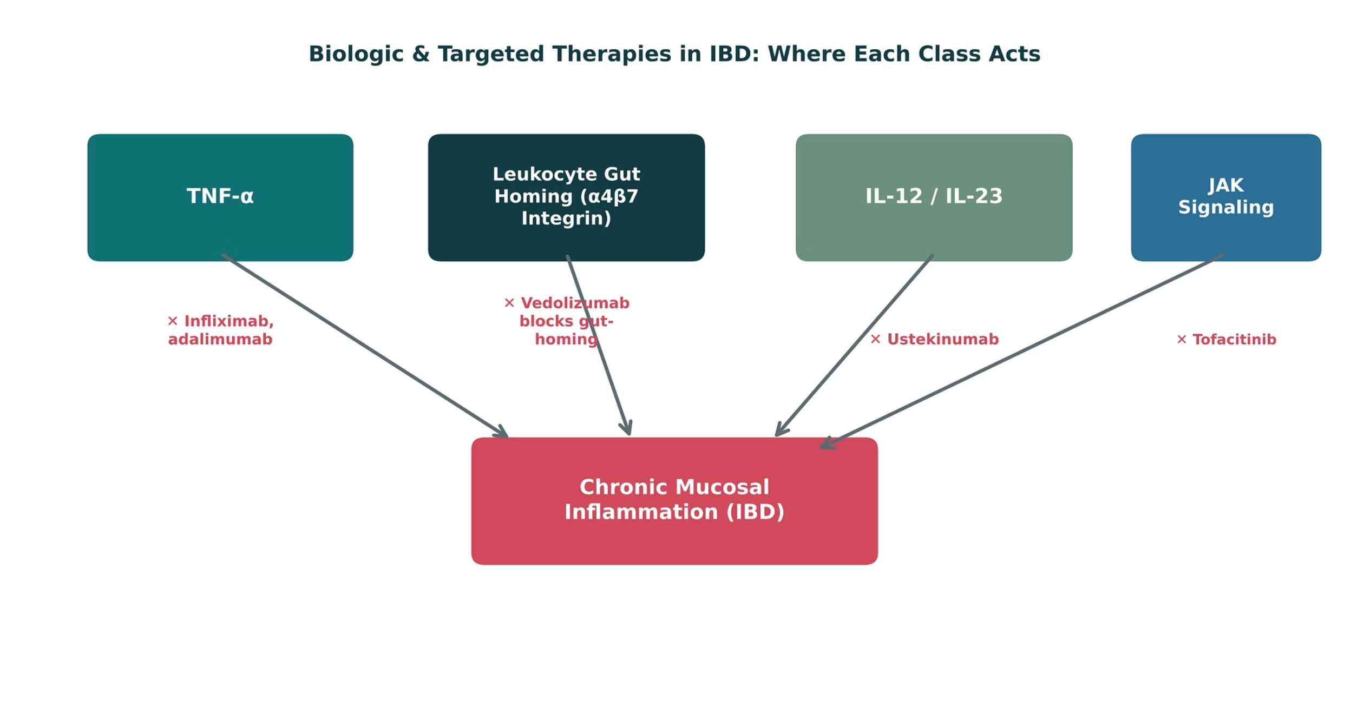
ORIGINAL ILLUSTRATION · FIGURE 7
Biologic & Targeted Therapies in IBD: Where Each Class Acts
Figure 7. Original illustrative diagram (not from Katzung): infliximab/adalimumab block TNF-α, vedolizumab blocks leukocyte gut-homing, ustekinumab blocks IL-12/23, and tofacitinib blocks JAK signaling — four distinct points of intervention in chronic mucosal inflammation.
GI & Nutrition Pharmacology — Session 2 of 2 — PA Program
21
Notes:
Have students sort each drug into its target before revealing labels — the s
ame exercise used for the DMARD figure in Lecture 2, now applied to a new organ system.
Instructor script:
Sort each drug into its target before revealing labels: TNF-alpha (infliximab, adalimumab), integrin (vedolizumab), IL-12/23 (ustekinumab), JAK (tofacitinib).

Slide 22
QUICK CHECK · FIGURE 7
Quick Check
In Figure 7, which biologic agent acts by a mechanism that is gut-selective rather than systemically immunosuppressive in the same way as the others?
A
Infliximab
B
Adalimumab
C
Vedolizumab
D
Tofacitinib
GI & Nutrition Pharmacology — Session 2 of 2 — PA Program
22
Notes:
Quick check: pause for students to answer before revealing slide 23.

Slide 23
ANSWER · FIGURE 7
Answer
C
Vedolizumab.
Why: Vedolizumab blocks α4β7 integrin, which is relatively selective for gut-homing leukocyte trafficking — giving it a more gut-selective safety profile compared with TNF-α inhibitors or JAK inhibitors, which act more broadly on systemic immune signaling.
GI & Nutrition Pharmacology — Session 2 of 2 — PA Program
23
Notes:
Answer C: vedolizumab is gut-selective because it blocks alpha4beta7 integrin.

Slide 24

SHARED RISK
IBD Therapy Safety: Immunosuppression
The major safety theme across immunomodulators and biologics: immunosuppression → increased infection risk.
Baseline screening — tuberculosis and hepatitis B/C screening before starting biologics.
Vaccination — update vaccines, especially live vaccines, before starting therapy.
Ongoing monitoring — regular labs to catch cytopenias, hepatotoxicity, or infection early.
This is the same safety framework covered for biologic DMARDs in Lecture 2 — the shared mechanism class carries a shared risk profile.
GI & Nutrition Pharmacology — Session 2 of 2 — PA Program
24
Notes:
This is almost a direct repeat of the DMARD-safety slide from Lecture 2 — a deliberate, explicit callback to reinforce that "biologic" as a drug category carries this risk profile regardless of the organ system being treated.
Instructor script:
Safety: Screen for TB and hepatitis B and C before starting a biologic. Update vaccines, especially live vaccines, first. Monitor labs.

Slide 25
CLINICAL CASE
Matching Therapy to Disease Severity
A patient with newly diagnosed, mild ulcerative colitis asks why their provider is starting mesalamine rather than one of the biologic drugs they read about online.
Ask yourself: How would you explain the step-therapy rationale to this patient?
Clinical pearl: Therapy is matched to disease severity: mild disease responds well to 5-ASA agents with a favorable safety profile, while biologics are reserved for moderate-to-severe or refractory disease given their cost, administration burden, and immunosuppression-related risks.
GI & Nutrition Pharmacology — Session 2 of 2 — PA Program
25
Notes:
A good patient-communication exercise (IO3.6) — have students practice explaining step therapy in plain language, not just reciting the drug ladder.
Instructor script:
Case: Mild ulcerative colitis starts with mesalamine, not a biologic.

Slide 26
QUICK CHECK · INFLAMMATORY BOWEL DISEASE
Quick Check
A patient with Crohn disease has been in remission on azathioprine for maintenance but now has an acute flare. What is the most appropriate immediate addition to therapy?
A
Increase the azathioprine dose only
B
Add a short course of corticosteroids to induce remission
C
Switch directly to a stimulant laxative
D
Discontinue all therapy until symptoms resolve on their own
GI & Nutrition Pharmacology — Session 2 of 2 — PA Program
26
Notes:
Quick check: pause for students to answer before revealing slide 27.

Slide 27
ANSWER · INFLAMMATORY BOWEL DISEASE
Answer
B
Add a short course of corticosteroids to induce remission.
Why: Immunomodulators like azathioprine have a slow onset and are not effective for acute flares. Corticosteroids provide faster induction of remission during a flare, while the immunomodulator continues for long-term maintenance.
GI & Nutrition Pharmacology — Session 2 of 2 — PA Program
27
Notes:
Answer B: Crohn flare on azathioprine: add a short steroid course.

Slide 28
MECHANISM & DEPTH
Drug Names Reveal the Class: Bowel Disorders and IBD
Stem
Drug class
Examples
Key point
-ximab
Monoclonal Ab (chimeric)
infliximab
Anti-TNF-α
-umab
Monoclonal Ab (human)
adalimumab, ustekinumab
Anti-TNF-α; anti-IL-12/23
-zumab
Monoclonal Ab (humanized)
vedolizumab
Blocks α4β7 integrin
-tinib
Kinase inhibitor
tofacitinib
JAK inhibitor
-sone
Corticosteroid
prednisone
Short-term induction
-tide
Peptide
linaclotide
GC-C agonist
None shared
5-ASA agents
mesalamine, sulfasalazine
Local mucosal action
None shared
Thiopurines
azathioprine, mercaptopurine
Slow maintenance
None shared
Opioid antidiarrheals
loperamide, diphenoxylate
Slows motility
A stem is a memory aid, not a rule: where no shared stem exists, learn the class name instead.
GI & Nutrition Pharmacology — Session 2 of 2 — PA Program
28
Notes:
Say: "-ximab chimeric, -umab human, -zumab humanized, -tinib kinase inhibitor, -sone corticosteroid, -tide peptide. 5-ASA agents, thiopurines and the opioid antidiarrheals share no stem."

Slide 29

SECTION
06
Nutrition & Dietary Supplements
What patients take on their own can change how their medications work.
Notes:
Section transition.
Ask one question about any vitamin: can it build up to toxic levels?

Slide 30

A KEY DISTINCTION
Fat-Soluble vs. Water-Soluble Vitamins
Fat-Soluble (A, D, E, K)
Water-Soluble (B-complex, C)
– Stored in adipose tissue and the liver
– Accumulate with excess intake — real toxicity risk
– Absorption depends on dietary fat and bile; impaired by fat-malabsorption conditions
– Not significantly stored — excreted renally
– Toxicity is rare except at very high supplemental doses
– Deficiency develops more quickly without ongoing intake
GI & Nutrition Pharmacology — Session 2 of 2 — PA Program
30
Notes:
This distinction is the organizing concept for the whole vitamin section — "can it accumulate to toxic levels" is the single most useful question to ask about any vitamin.
Instructor script:
Say: "Ask one question about any vitamin: can it build up to toxic levels? Fat-soluble A, D, E, K store and can accumulate. Water-soluble B and C are excreted."

Slide 31
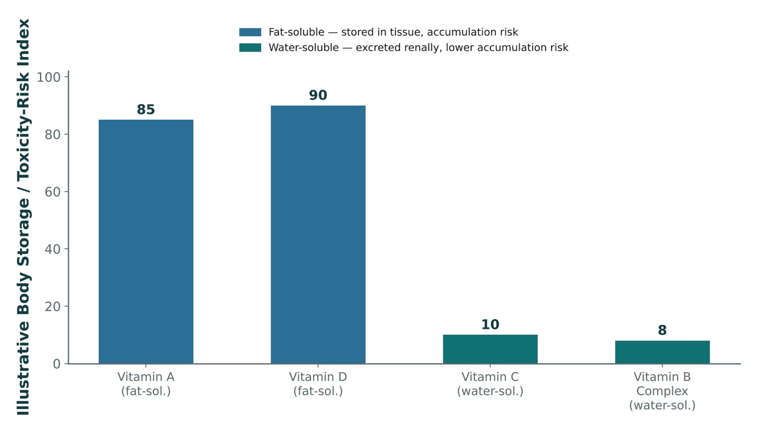
ORIGINAL ILLUSTRATION · FIGURE 8
Fat-Soluble vs. Water-Soluble Vitamins: Storage and Toxicity Risk
Figure 8. Original illustrative comparison (illustrative storage/toxicity-risk index, not from Katzung): fat-soluble vitamins A and D show substantially higher illustrative tissue-storage and toxicity-risk scores than water-soluble vitamins C and B-complex.
GI & Nutrition Pharmacology — Session 2 of 2 — PA Program
31
Notes:
Vitamin D and A toxicity (from excessive supplementation) are the clearest clinical examples to cite here — both are seen in real practice from over-the-counter supplement overuse.
Instructor script:
Say: The figure values are illustrative.

Slide 32
HIGH-YIELD DEFICIENCIES
Vitamin & Mineral Deficiency Syndromes
● Vitamin B12: deficiency causes megaloblastic anemia and neurologic symptoms; at risk with long-term PPI use, metformin use, or after bariatric surgery (ties back to the PPI adverse-effect discussion from Session 1).
● Folate: deficiency causes megaloblastic anemia; critical in pregnancy to prevent neural tube defects.
● Vitamin D: deficiency causes impaired bone mineralization (rickets in children, osteomalacia in adults) — connects directly to the bone pharmacology unit.
● Vitamin K: deficiency impairs synthesis of clotting factors II, VII, IX, and X, increasing bleeding risk.
● Iron: deficiency causes microcytic anemia; absorption is enhanced by vitamin C and impaired by concurrent antacid or PPI use.
GI & Nutrition Pharmacology — Session 2 of 2 — PA Program
32
Notes:
The B12/PPI link and the vitamin K/clotting-factor link are the two points most worth emphasizing, since both connect directly back to earlier drug classes in this very unit.
Instructor script:
Know: Deficiency causes megaloblastic anemia and neuropathy that can become irreversible.
Know: Folate: neural tube defects in pregnancy. Vitamin D: rickets and osteomalacia. Vitamin K: factors II, VII, IX, X. Iron: microcytic anemia, absorption helped by vitamin C and hurt by antacids and PPIs.

Slide 33
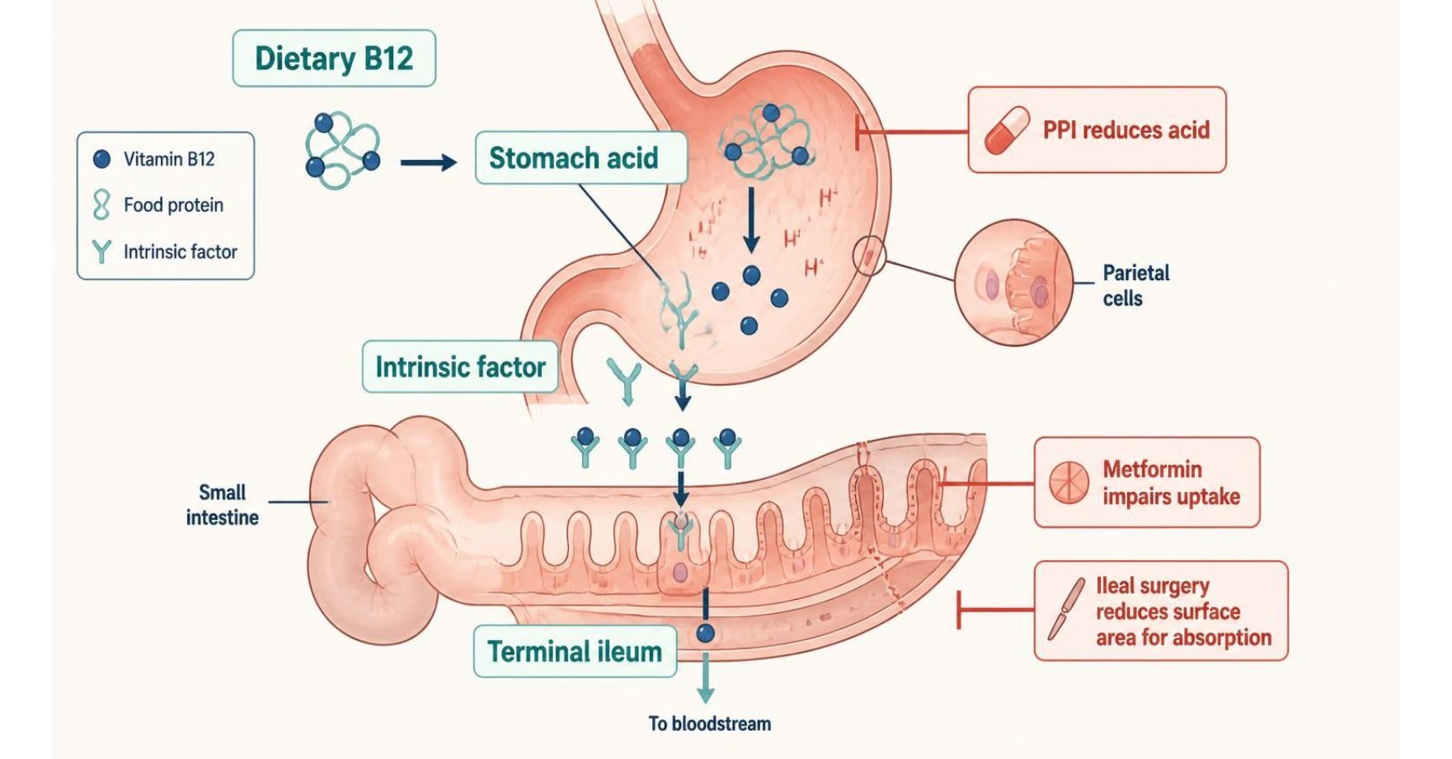
MECHANISM & DEPTH
Vitamin B12 Absorption: Where PPIs and Metformin Interfere
Dietary B12 is bound to food protein
▼
Stomach acid and pepsin release B12 from food
▼
Free B12 binds intrinsic factor from parietal cells
▼
The complex is absorbed in the terminal ileum
▼
Deficiency causes megaloblastic anemia and neuropathy
Schematic (illustrative)
Figure 9. Vitamin B12 absorption: acid and intrinsic factor are needed in the ileum; PPIs, metformin and ileal surgery impair it.
At risk with long-term PPI or H2 blocker use, metformin, bariatric surgery, older age and vegan diets.
Neurologic damage can become irreversible if treatment is delayed.
Monitor B12 in long-term PPI or metformin users.
Treat with intramuscular or high-dose oral B12.
GI & Nutrition Pharmacology — Session 2 of 2 — PA Program
33
Notes:
Say: "Dietary B12 is bound to protein. Stomach acid and pepsin release it. It binds intrinsic factor and is absorbed in the terminal ileum."
Know: PPIs and H2 blockers reduce acid. Metformin impairs ileal uptake. Bariatric surgery, older age and vegan diets add risk.
Know: Monitor B12 in long-term PPI or metformin users. Treat with intramuscular or high-dose oral B12.

Slide 34
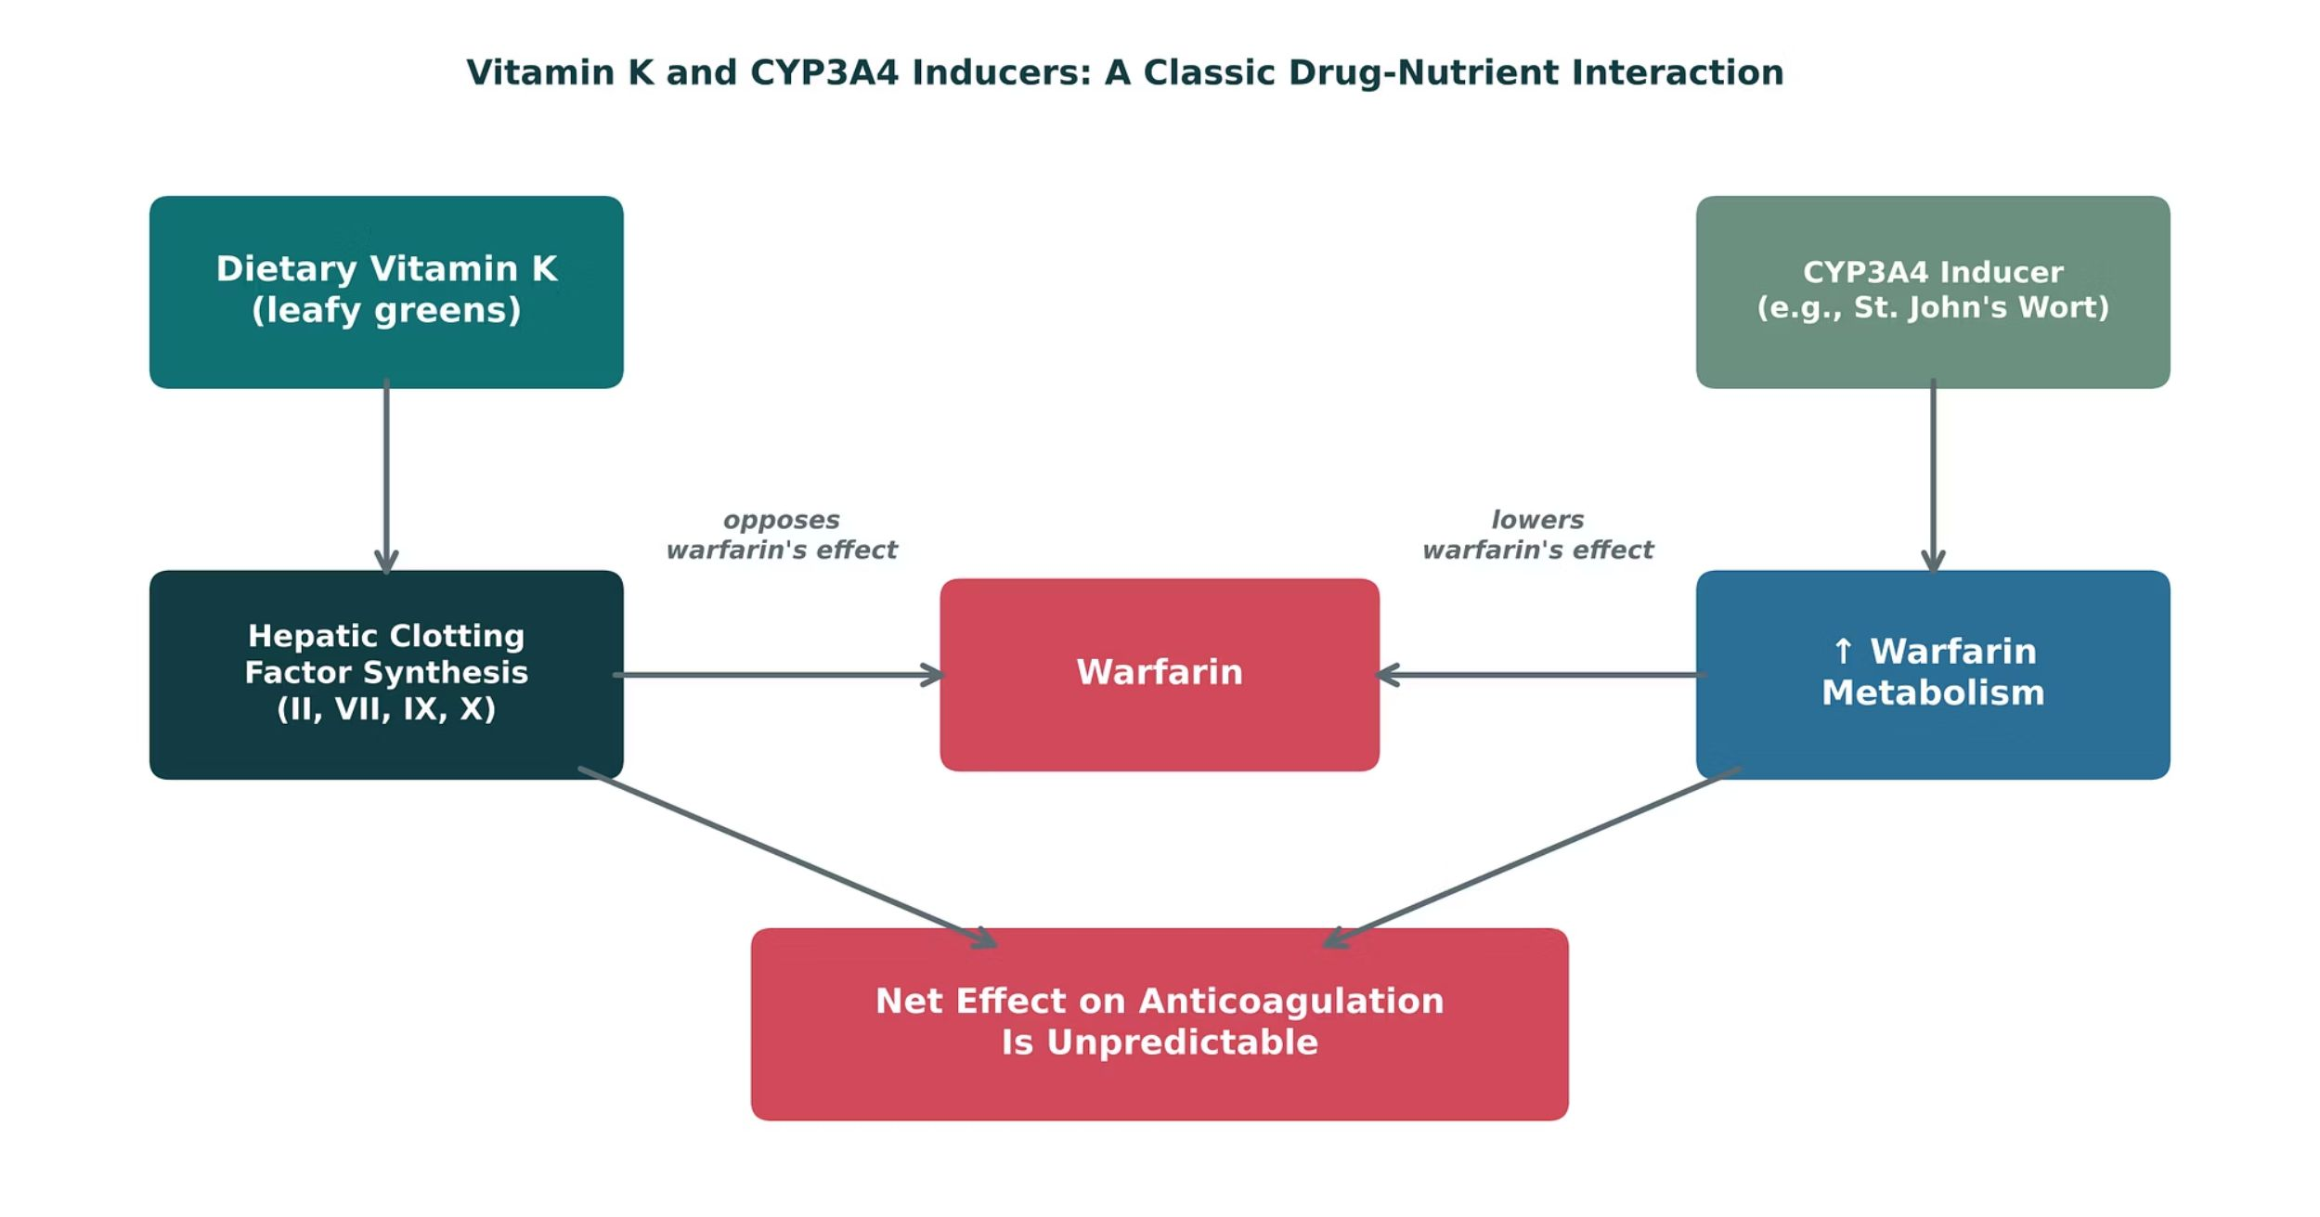
ORIGINAL ILLUSTRATION · FIGURE 10
Vitamin K and CYP3A4 Inducers: A Classic Drug-Nutrient Interaction
Figure 10. Original illustrative diagram (not from Katzung): dietary vitamin K opposes warfarin’s anticoagulant effect by supporting clotting factor synthesis, while CYP3A4-inducing herbal supplements (e.g., St. John’s Wort) increase warfarin metabolism — both lowering anticoagulant effect through different mechanisms.
GI & Nutrition Pharmacology — Session 2 of 2 — PA Program
34
Notes:
This figure ties the whole unit together: a dietary nutrient and an herbal supplement both working against the same drug, through two completely different mechanisms (pharmacodynamic antagonism vs. pharmacokinetic induction).
Instructor script:
Say: "Two different ways to lower warfarin's effect. Vitamin K opposes it pharmacodynamically. St. John's wort induces CYP enzymes and speeds clearance, a pharmacokinetic interaction."

Slide 35
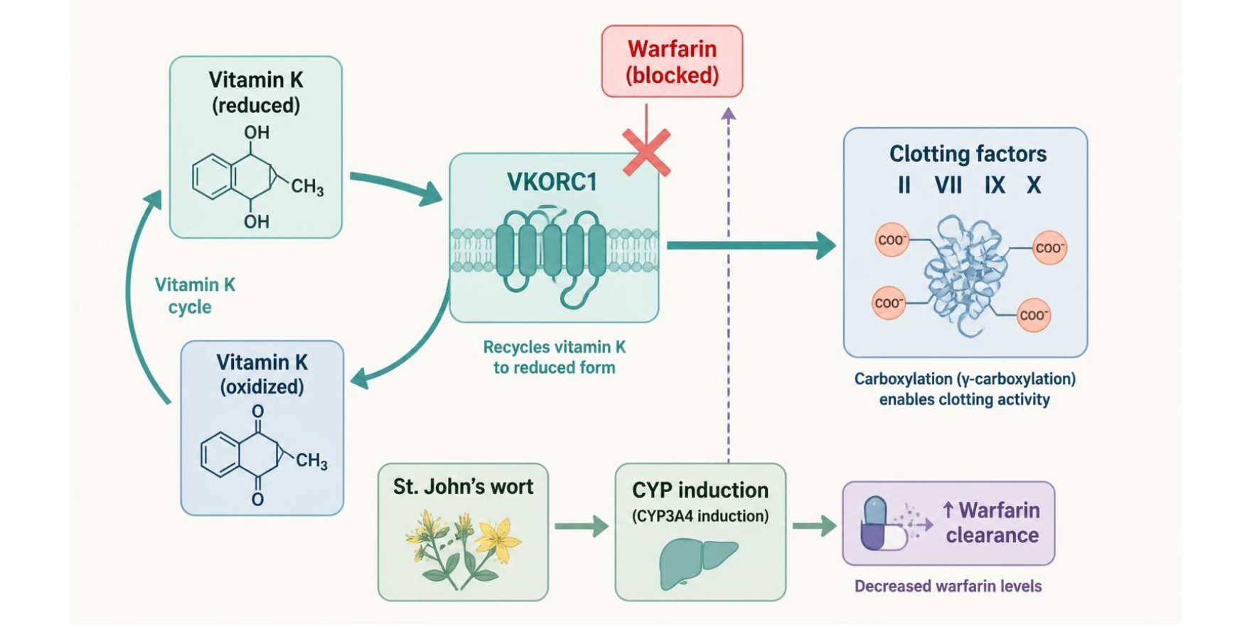
MECHANISM & DEPTH
Warfarin: Vitamin K Cycle and Herbal Interactions
Reduced vitamin K is recycled by VKORC1
▼
Active vitamin K carboxylates clotting factors II, VII, IX, X
▼
Warfarin blocks VKORC1, so fewer active factors
▼
St. John's wort induces CYP enzymes, so warfarin is cleared faster
▼
Result: lower INR and less anticoagulation
Schematic (illustrative)
Figure 11. Vitamin K cycle in a liver cell: warfarin blocks VKORC1, and St. John's wort speeds warfarin clearance.
Keep vitamin K intake consistent rather than avoiding it.
Check INR when starting or stopping any supplement; stopping St. John's wort can raise INR.
St. John's wort also lowers oral contraceptive and some antiretroviral levels.
Ginkgo and fish oil raise bleeding risk.
GI & Nutrition Pharmacology — Session 2 of 2 — PA Program
35
Notes:
Say: Warfarin blocks VKORC1, which recycles vitamin K.
Know: Keep vitamin K intake consistent. Do not tell patients to avoid it.
Know: Check INR when starting or stopping any supplement. Stopping St. John's wort can raise INR.
Know: St. John's wort also lowers oral contraceptive and some antiretroviral levels. Ginkgo and fish oil raise bleeding risk.

Slide 36
QUICK CHECK · FIGURE 10
Quick Check
Based on Figure 10, a patient stable on warfarin starts taking a St. John’s Wort supplement for mood. What is the expected effect on anticoagulation?
A
Decreased anticoagulant effect, due to increased warfarin metabolism via CYP3A4 induction
B
Increased anticoagulant effect, due to CYP3A4 inhibition
C
No effect, since herbal supplements do not interact with prescription drugs
D
Increased vitamin K levels directly counteracting warfarin
GI & Nutrition Pharmacology — Session 2 of 2 — PA Program
36
Notes:
Quick check: pause for students to answer before revealing slide 37.

Slide 37
ANSWER · FIGURE 10
Answer
A
Decreased anticoagulant effect, due to increased warfarin metabolism via CYP3A4 induction.
Why: St. John’s Wort is a well-known CYP3A4 inducer, which increases warfarin metabolism and lowers its anticoagulant effect (a pharmacokinetic interaction) — a distinct mechanism from dietary vitamin K, which opposes warfarin pharmacodynamically by supporting clotting factor synthesis.
GI & Nutrition Pharmacology — Session 2 of 2 — PA Program
37
Notes:
Answer A: decreased anticoagulant effect from CYP induction.

Slide 38
NUTRITION SUPPORT
Enteral & Parenteral Nutrition: The Basics
Enteral Nutrition
Parenteral Nutrition
– Delivered via the GI tract (oral or tube feeding)
– Preferred whenever the gut is functional — "if the gut works, use it"
– Lower infection/complication risk than parenteral routes
– Delivered intravenously, bypassing the GI tract entirely
– Reserved for patients with a non-functional or inaccessible GI tract
– Requires close monitoring — electrolyte shifts, refeeding syndrome, catheter-related infection risk
GI & Nutrition Pharmacology — Session 2 of 2 — PA Program
38
Notes:
The "if the gut works, use it" principle is a simple, memorable rule students can apply across many clinical contexts — worth stating explicitly as the single takeaway from this slide.
Instructor script:
Say: "If the gut works, use it."

Slide 39
MECHANISM & DEPTH
Choosing the Nutrition Route and Avoiding Refeeding Syndrome
Is the GI tract functional?
Yes ▼
No ▼
Enteral nutrition (oral or tube feeding): lower infection risk
Parenteral nutrition (IV): monitor electrolytes and line infection
Refeeding sequence in prolonged starvation
▶
▶
▶
Prolonged starvation
Carbohydrate feeding raises insulin
Phosphate, potassium and magnesium shift into cells
Dangerous low levels: heart, muscle and breathing problems
Start feeding slowly in malnourished patients.
Check phosphate, potassium and magnesium daily at the start.
Give thiamine before feeding begins.
Catheter-related infection is the main parenteral risk.
GI & Nutrition Pharmacology — Session 2 of 2 — PA Program
39
Notes:
Say: Refeeding: carbohydrate raises insulin, phosphate, potassium and magnesium shift into cells, and levels fall dangerously.
Know: Start slowly in malnourished patients. Check phosphate, potassium and magnesium daily at first. Give thiamine before feeding. Catheter infection is the main parenteral risk.

Slide 40
COUNSELING PATIENTS
Herbal & Dietary Supplement Safety Counseling
Supplements are not held to the same FDA premarket efficacy/safety standards as prescription drugs — potency and purity can vary by product.
Always ask patients specifically about supplement use — many do not think to mention it unless directly asked.
St. John’s Wort — CYP3A4 induction; reduces effectiveness of many drugs (warfarin, oral contraceptives, some antiretrovirals).
Ginkgo biloba and fish oil — can increase bleeding risk, especially combined with anticoagulants/antiplatelets.
Counsel patients to disclose all supplement use to every prescriber and pharmacist involved in their care.
GI & Nutrition Pharmacology — Session 2 of 2 — PA Program
40
Notes:
This slide operationalizes IO3.6 (patient communication/safety) directly — the counseling point about "ask specifically" is something students can apply in every future patient encounter, not just GI/nutrition cases.
Instructor script:
Say: Supplements are not held to premarket efficacy or safety standards. Always ask specifically. Have patients tell every prescriber and pharmacist.

Slide 41
CLINICAL CASE
The Supplement No One Asked About
A patient on warfarin for atrial fibrillation presents with a subtherapeutic INR despite consistent medication adherence. On further questioning, the patient mentions starting a St. John’s Wort supplement for mood three weeks ago.
Ask yourself: How does this explain the subtherapeutic INR, and what should happen next?
Clinical pearl: St. John’s Wort induces CYP3A4, increasing warfarin metabolism and lowering the INR — this is exactly why asking about supplement use is a required part of every medication reconciliation, not an optional extra.
GI & Nutrition Pharmacology — Session 2 of 2 — PA Program
41
Notes:
This case is the direct clinical application of Figure 10 — a great closing vignette for the nutrition section.
Instructor script:
Case: Subtherapeutic INR after starting St. John's wort.

Slide 42
QUICK CHECK · NUTRITION & DIETARY SUPPLEMENTS
Quick Check
A patient on long-term omeprazole therapy is found to have megaloblastic anemia and neurologic symptoms. Which deficiency is most likely, and why?
A
Vitamin B12 deficiency, due to reduced acid-dependent absorption
B
Vitamin C deficiency, due to increased renal excretion
C
Vitamin K deficiency, due to reduced dietary intake
D
Vitamin A deficiency, due to fat malabsorption
GI & Nutrition Pharmacology — Session 2 of 2 — PA Program
42
Notes:
Quick check: Long-term omeprazole with megaloblastic anemia and neurologic symptoms. Pause for students to answer before revealing slide 43.

Slide 43
ANSWER · NUTRITION & DIETARY SUPPLEMENTS
Answer
A
Vitamin B12 deficiency, due to reduced acid-dependent absorption.
Why: Long-term PPI use reduces gastric acid, which is needed to release B12 from dietary protein for absorption. This is one of the well-documented long-term PPI adverse effects covered in Session 1 and explains the megaloblastic anemia and neurologic symptoms here.
GI & Nutrition Pharmacology — Session 2 of 2 — PA Program
43
Notes:
Answer A: B12 deficiency.

Slide 44

SECTION
07
Putting It All Together
Applying the whole GI & Nutrition pharmacology toolkit.
Notes:
Section transition.
Pairs of students name a first-line approach and the biggest safety check for each patient.

Slide 45
APPLY IT
Which Drug Would You Choose?
Patient A
Patient B
– GERD symptoms, needs rapid occasional relief
– Confirmed H. pylori infection, penicillin allergy
Patient C
Patient D
– Moderate-to-severe Crohn disease, inadequately controlled on azathioprine
– Warfarin patient starting an herbal mood supplement
GI & Nutrition Pharmacology — Session 2 of 2 — PA Program
45
Notes:
Have students work in pairs: for each patient, name a first-line approach AND the single biggest safety concern to check before prescribing/counseling.
Instructor script:
Suggested answers: A, an antacid for occasional relief or an H2 blocker or PPI if frequent. B, bismuth quadruple therapy. C, a biologic or small molecule such as an anti-TNF agent. D, counsel on St. John's wort and check INR.

Slide 46

QUICK CHECK · PUTTING IT ALL TOGETHER
Quick Check
A patient with well-controlled GERD on a PPI for three years asks whether they should keep taking it indefinitely. What is the most appropriate response?
PPIs have no long-term risks, so continuing indefinitely is always fine
Periodically reassess the need for continued therapy, given long-term risks such as B12 deficiency, hypomagnesemia, fracture, and C. difficile risk
A
B
C
PPIs should never be used for more than one week
D
Switch immediately to an antacid with no further discussion
GI & Nutrition Pharmacology — Session 2 of 2 — PA Program
46
Notes:
Quick check: Long-term PPI for GERD. Pause for students to answer before revealing slide 47.

Slide 47
ANSWER · PUTTING IT ALL TOGETHER
Answer
B
Periodically reassess the need for continued therapy.
Why: Long-term PPI use carries real, well-documented risks. Best practice is not indefinite, unexamined continuation — it is periodic reassessment of ongoing need, attempting dose reduction or discontinuation when clinically appropriate, while still treating confirmed indications adequately.
GI & Nutrition Pharmacology — Session 2 of 2 — PA Program
47
Notes:
Answer B: reassess the need periodically.

Slide 48
BIG PICTURE
Key Takeaways
1
Acid-peptic disease and antiemetics are managed by targeting specific points along well-defined pathways (parietal cell secretion; the vomiting reflex).
2
PPIs are the most potent antisecretory agents, but long-term use carries real risks that warrant periodic reassessment.
3
IBD therapy follows a step-wise escalation matched to disease severity — from 5-ASA agents to biologics/small molecules.
4
Biologic agents share both their targeted mechanisms and their immunosuppression-related safety profile across organ systems (RA in Lecture 2, IBD here).
5
Nutrition and dietary supplements are not inert — vitamin status, drug-nutrient interactions, and herbal supplements can all meaningfully change drug therapy outcomes.
GI & Nutrition Pharmacology — Session 2 of 2 — PA Program
Notes:
Close by connecting back to earlier lectures: biologic mechanisms (Lecture 2) and drug-metabolism/interaction concepts (Lecture 1) both reappear here in a new organ system — pharmacology is cumulative, not siloed by unit.
Instructor script:
Read the five points. Link biologics back to the DMARD lecture and interactions back to the metabolism lecture.

Slide 49

SECTION
08
Lecture Recall Quiz
A cumulative self-test — use this to review before exams.
Notes:
Section transition.
Give students the six recall questions for self-testing and walk through the answer key.

Slide 50
LECTURE RECALL QUIZ
Lecture Recall Quiz (1 of 2)
1. Why do PPIs provide more complete acid suppression than H2 receptor antagonists?
A. They block only the gastrin pathway
B. They block the final common pathway (the proton pump) regardless of upstream signal
C. They neutralize acid directly, like antacids
D. They have no mechanistic advantage
2. A patient recently exposed to a macrolide antibiotic needs H. pylori eradication. Which regimen best avoids the concern this history raises?
A. Standard clarithromycin-based triple therapy
B. Bismuth quadruple therapy
C. Antacids alone
D. PPI monotherapy
3. Which pairing correctly matches an antiemetic with its receptor target?
A. Ondansetron — D2 receptor
B. Aprepitant — NK1 receptor
C. Meclizine — 5-HT3 receptor
D. Metoclopramide — H1 receptor
GI & Nutrition Pharmacology — Session 2 of 2 — PA Program
50
Notes:
Give students the six recall questions for self-testing.

Slide 51
LECTURE RECALL QUIZ
Lecture Recall Quiz (2 of 2)
4. A patient with suspected C. difficile infection asks for something to stop their diarrhea. What is the main concern with giving loperamide here?
A. Loperamide has no GI effects
B. Slowing transit can worsen toxin-mediated colonic injury
C. Loperamide treats the underlying infection
D. There is no concern in this scenario
5. Which IBD agent is most gut-selective in its mechanism, rather than broadly systemically immunosuppressive?
A. Infliximab
B. Vedolizumab
C. Tofacitinib
D. Azathioprine
6. A warfarin patient’s INR drops after starting St. John’s Wort. What mechanism explains this?
A. CYP3A4 induction, increasing warfarin metabolism
B. CYP3A4 inhibition, decreasing warfarin metabolism
C. Direct vitamin K supplementation
D. Increased GI absorption of warfarin
GI & Nutrition Pharmacology — Session 2 of 2 — PA Program
51
Notes:
Give students the six recall questions for self-testing.

Slide 52
ANSWER KEY
Lecture Recall Quiz — Answer Key
1. B — PPIs block the H⁺/K⁺-ATPase proton pump itself — the final common pathway for gastrin, histamine, and acetylcholine signals — unlike H2RAs, which block only the histamine input.
2. B — Recent macrolide exposure raises concern for clarithromycin resistance, favoring bismuth quadruple therapy over standard clarithromycin-based triple therapy.
3. B — Aprepitant blocks the NK1 receptor. Ondansetron blocks 5-HT3; meclizine blocks H1/M1; metoclopramide blocks D2.
4. B — Antimotility agents can worsen outcomes in infectious/inflammatory diarrhea like C. difficile by delaying clearance of toxin and slowing transit, raising risk of complications such as toxic megacolon.
5. B — Vedolizumab blocks α4β7 integrin-mediated leukocyte gut-homing, giving it a more gut-selective mechanism than TNF-α inhibitors, JAK inhibitors, or thiopurine immunomodulators.
6. A — St. John’s Wort is a CYP3A4 inducer, increasing warfarin metabolism and lowering its anticoagulant effect (and INR) — a pharmacokinetic drug-herb interaction.
GI & Nutrition Pharmacology — Session 2 of 2 — PA Program
Notes:
Encourage students to revisit this quiz on their own before the exam — it is designed as a standalone recall resource, separate from the in-lecture quick checks.
Instructor script:
Walk through the answer key.

Slide 53
APPENDIX
Drug Profiles
Formulation, dose, indications, adverse effects, contraindications and toxicity for each drug in this lecture
DR = delayed-release
ER / XR = extended-release
OTC = over the counter
PO = by mouth
PR = by rectum
IV = intravenous
IM = intramuscular
SC = subcutaneous
BID / TID / QID = two / three / four times daily
CrCl = creatinine clearance
CKD = chronic kidney disease
CNS = central nervous system
IBD = inflammatory bowel disease
UC = ulcerative colitis
IBS-C = irritable bowel syndrome with constipation
CIC = chronic idiopathic constipation
TNF = tumor necrosis factor
JAK = Janus kinase
TPMT / NUDT15 = thiopurine-metabolizing enzymes (tested before thiopurines)
G6PD = glucose-6-phosphate dehydrogenase
INR = international normalized ratio
PCC = prothrombin complex concentrate
MACE = major adverse cardiovascular events
PML = progressive multifocal leukoencephalopathy
CYP / P-gp = cytochrome P450 / P-glycoprotein
SSRI = selective serotonin reuptake inhibitor
NTD = neural tube defect
EPA / DHA = omega-3 fatty acids
C-V = DEA Schedule V
Notes:
Section transition.
Abbreviation key: DR = delayed-release; ER / XR = extended-release; OTC = over the counter; PO = by mouth; PR = by rectum; IV = intravenous; IM = intramuscular; SC = subcutaneous; BID / TID / QID = two / three / four times daily; CrCl = creatinine clearance; CKD = chronic kidney disease; CNS = central nervous system; IBD = inflammatory bowel disease; UC = ulcerative colitis; IBS-C = irritable bowel syndrome with constipation; CIC = chronic idiopathic constipation; TNF = tumor necrosis factor; JAK = Janus kinase; TPMT / NUDT15 = thiopurine-metabolizing enzymes (tested before thiopurines); G6PD = glucose-6-phosphate dehydrogenase; INR = international normalized ratio; PCC = prothrombin complex concentrate; MACE = major adverse cardiovascular events; PML = progressive multifocal leukoencephalopathy; CYP / P-gp = cytochrome P450 / P-glycoprotein; SSRI = selective serotonin reuptake inhibitor; NTD = neural tube defect; EPA / DHA = omega-3 fatty acids; C-V = DEA Schedule V.

Slide 54
DRUG PROFILE
Polyethylene glycol 3350 (MiraLAX)
Osmotic laxative
FORMULATION
DOSE (ADULT)
INDICATIONS
Powder for solution (17 g scoop); large-volume bowel-prep kits
17 g in 4-8 oz fluid PO once daily; OTC use up to 7 days
Chronic and occasional constipation; bowel preparation (higher volumes)
ADVERSE EFFECTS
CONTRAINDICATIONS
TOXICITY / OVERDOSE
Bloating, nausea, gas, loose stools
Bowel obstruction, perforation, ileus, toxic megacolon
Dehydration and electrolyte loss with excess or bowel-prep volumes; rare allergic reactions
Standard adult dosing for teaching; verify against current prescribing information.
GI & Nutrition Pharmacology — Session 2 of 2 — PA Program
54
Notes:
Drug: Polyethylene glycol 3350 (MiraLAX)
Class: Osmotic laxative
Formulation: Powder for solution (17 g scoop); large-volume bowel-prep kits
Dose (adult): 17 g in 4-8 oz fluid PO once daily; OTC use up to 7 days
Indications: Chronic and occasional constipation; bowel preparation (higher volumes)
Adverse effects: Bloating, nausea, gas, loose stools
Contraindications: Bowel obstruction, perforation, ileus, toxic megacolon
Toxicity / overdose: Dehydration and electrolyte loss with excess or bowel-prep volumes; rare allergic reactions

Slide 55
DRUG PROFILE
Psyllium (Metamucil)
Bulk-forming laxative
FORMULATION
DOSE (ADULT)
INDICATIONS
Powder, capsules, wafers
About 3.4-6 g PO 1-3 times daily with at least 8 oz water
Constipation, IBS, mild cholesterol lowering
ADVERSE EFFECTS
CONTRAINDICATIONS
TOXICITY / OVERDOSE
Bloating, gas, abdominal fullness
Bowel obstruction, fecal impaction, dysphagia
Esophageal or intestinal obstruction if taken with too little fluid; allergy; separate from other drugs by 2 hours
Standard adult dosing for teaching; verify against current prescribing information.
GI & Nutrition Pharmacology — Session 2 of 2 — PA Program
55
Notes:
Drug: Psyllium (Metamucil)
Class: Bulk-forming laxative
Formulation: Powder, capsules, wafers
Dose (adult): About 3.4-6 g PO 1-3 times daily with at least 8 oz water
Indications: Constipation, IBS, mild cholesterol lowering
Adverse effects: Bloating, gas, abdominal fullness
Contraindications: Bowel obstruction, fecal impaction, dysphagia
Toxicity / overdose: Esophageal or intestinal obstruction if taken with too little fluid; allergy; separate from other drugs by 2 hours

Slide 56
DRUG PROFILE
Methylcellulose (Citrucel)
Bulk-forming laxative
FORMULATION
INDICATIONS
Powder; caplets 500 mg
Constipation, stool bulking
DOSE (ADULT)
About 2 g PO in 8 oz water 1-3 times daily; onset 12-72 hours
ADVERSE EFFECTS
CONTRAINDICATIONS
TOXICITY / OVERDOSE
Bloating, gas
Bowel obstruction, dysphagia
Obstruction if taken without adequate fluid; may slow absorption of other drugs
Standard adult dosing for teaching; verify against current prescribing information.
GI & Nutrition Pharmacology — Session 2 of 2 — PA Program
56
Notes:
Drug: Methylcellulose (Citrucel)
Class: Bulk-forming laxative
Formulation: Powder; caplets 500 mg
Dose (adult): About 2 g PO in 8 oz water 1-3 times daily; onset 12-72 hours
Indications: Constipation, stool bulking
Adverse effects: Bloating, gas
Contraindications: Bowel obstruction, dysphagia
Toxicity / overdose: Obstruction if taken without adequate fluid; may slow absorption of other drugs

Slide 57
DRUG PROFILE
Lactulose
Osmotic laxative, ammonia-lowering agent
FORMULATION
DOSE (ADULT)
INDICATIONS
Oral solution 10 g/15 mL
Constipation: 15-30 mL PO daily; hepatic encephalopathy: 30-45 mL PO 3-4 times daily, titrated to 2-3 soft stools
Constipation, hepatic encephalopathy
ADVERSE EFFECTS
CONTRAINDICATIONS
TOXICITY / OVERDOSE
Gas, bloating, cramps, diarrhea
Galactosemia, bowel obstruction
Dehydration and hypernatremia with over-use; worsens diabetes control slightly
Standard adult dosing for teaching; verify against current prescribing information.
GI & Nutrition Pharmacology — Session 2 of 2 — PA Program
57
Notes:
Drug: Lactulose
Class: Osmotic laxative, ammonia-lowering agent
Formulation: Oral solution 10 g/15 mL
Dose (adult): Constipation: 15-30 mL PO daily; hepatic encephalopathy: 30-45 mL PO 3-4 times daily, titrated to 2-3 soft stools
Indications: Constipation, hepatic encephalopathy
Adverse effects: Gas, bloating, cramps, diarrhea
Contraindications: Galactosemia, bowel obstruction
Toxicity / overdose: Dehydration and hypernatremia with over-use; worsens diabetes control slightly

Slide 58
DRUG PROFILE
Senna (Senokot)
Stimulant laxative
FORMULATION
DOSE (ADULT)
INDICATIONS
Tablet 8.6 mg sennosides; liquid
8.6-17.2 mg PO at bedtime (max 34 mg/day); onset 6-12 hours
Short-term constipation, opioid-induced constipation
ADVERSE EFFECTS
CONTRAINDICATIONS
TOXICITY / OVERDOSE
Cramping, diarrhea, urine discoloration, melanosis coli
Bowel obstruction, appendicitis, undiagnosed abdominal pain
Hypokalemia and dehydration with chronic use; laxative dependence
Standard adult dosing for teaching; verify against current prescribing information.
GI & Nutrition Pharmacology — Session 2 of 2 — PA Program
58
Notes:
Drug: Senna (Senokot)
Class: Stimulant laxative
Formulation: Tablet 8.6 mg sennosides; liquid
Dose (adult): 8.6-17.2 mg PO at bedtime (max 34 mg/day); onset 6-12 hours
Indications: Short-term constipation, opioid-induced constipation
Adverse effects: Cramping, diarrhea, urine discoloration, melanosis coli
Contraindications: Bowel obstruction, appendicitis, undiagnosed abdominal pain
Toxicity / overdose: Hypokalemia and dehydration with chronic use; laxative dependence

Slide 59
DRUG PROFILE
Bisacodyl (Dulcolax)
Stimulant laxative
FORMULATION
DOSE (ADULT)
INDICATIONS
DR tablet 5 mg; suppository 10 mg
5-15 mg PO at bedtime; 10 mg PR once daily; PO onset 6-12 hours, PR 15-60 min
Constipation, bowel preparation
ADVERSE EFFECTS
CONTRAINDICATIONS
TOXICITY / OVERDOSE
Cramping, nausea, rectal irritation
Bowel obstruction, appendicitis, acute abdomen
Do not crush; avoid with antacids or milk; excess causes diarrhea, hypokalemia
Standard adult dosing for teaching; verify against current prescribing information.
GI & Nutrition Pharmacology — Session 2 of 2 — PA Program
59
Notes:
Drug: Bisacodyl (Dulcolax)
Class: Stimulant laxative
Formulation: DR tablet 5 mg; suppository 10 mg
Dose (adult): 5-15 mg PO at bedtime; 10 mg PR once daily; PO onset 6-12 hours, PR 15-60 min
Indications: Constipation, bowel preparation
Adverse effects: Cramping, nausea, rectal irritation
Contraindications: Bowel obstruction, appendicitis, acute abdomen
Toxicity / overdose: Do not crush; avoid with antacids or milk; excess causes diarrhea, hypokalemia

Slide 60
DRUG PROFILE
Lubiprostone (Amitiza)
Chloride channel (ClC-2) activator
FORMULATION
DOSE (ADULT)
INDICATIONS
Capsule 8/24 mcg
Chronic constipation: 24 mcg PO BID with food; IBS-C (women): 8 mcg BID
Chronic idiopathic constipation, IBS-C, opioid-induced constipation
ADVERSE EFFECTS
CONTRAINDICATIONS
TOXICITY / OVERDOSE
Nausea, diarrhea, headache, abdominal pain
Mechanical GI obstruction
Dizziness, syncope or dyspnea (rare); overdose: nausea, diarrhea; avoid in pregnancy unless needed
Standard adult dosing for teaching; verify against current prescribing information.
GI & Nutrition Pharmacology — Session 2 of 2 — PA Program
60
Notes:
Drug: Lubiprostone (Amitiza)
Class: Chloride channel (ClC-2) activator
Formulation: Capsule 8/24 mcg
Dose (adult): Chronic constipation: 24 mcg PO BID with food; IBS-C (women): 8 mcg BID
Indications: Chronic idiopathic constipation, IBS-C, opioid-induced constipation
Adverse effects: Nausea, diarrhea, headache, abdominal pain
Contraindications: Mechanical GI obstruction
Toxicity / overdose: Dizziness, syncope or dyspnea (rare); overdose: nausea, diarrhea; avoid in pregnancy unless needed

Slide 61
DRUG PROFILE
Linaclotide (Linzess)
Guanylate cyclase-C agonist
FORMULATION
DOSE (ADULT)
INDICATIONS
Capsule 72/145/290 mcg
CIC: 72-145 mcg PO daily; IBS-C: 290 mcg daily; 30 minutes before the first meal
Chronic idiopathic constipation, IBS-C
ADVERSE EFFECTS
CONTRAINDICATIONS
TOXICITY / OVERDOSE
Diarrhea, abdominal pain, gas, bloating
Boxed: children under 2 years; mechanical GI obstruction
Severe dehydration (deaths in young children); severe diarrhea; stop if severe or prolonged
Standard adult dosing for teaching; verify against current prescribing information.
GI & Nutrition Pharmacology — Session 2 of 2 — PA Program
61
Notes:
Drug: Linaclotide (Linzess)
Class: Guanylate cyclase-C agonist
Formulation: Capsule 72/145/290 mcg
Dose (adult): CIC: 72-145 mcg PO daily; IBS-C: 290 mcg daily; 30 minutes before the first meal
Indications: Chronic idiopathic constipation, IBS-C
Adverse effects: Diarrhea, abdominal pain, gas, bloating
Contraindications: Boxed: children under 2 years; mechanical GI obstruction
Toxicity / overdose: Severe dehydration (deaths in young children); severe diarrhea; stop if severe or prolonged

Slide 62
DRUG PROFILE
Loperamide (Imodium)
Peripheral mu-opioid agonist
FORMULATION
DOSE (ADULT)
INDICATIONS
Capsule 2 mg; tablet 2 mg; oral liquid
4 mg PO first dose, then 2 mg after each loose stool; max 16 mg/day Rx, 8 mg/day OTC
Acute and chronic diarrhea, traveler's diarrhea
ADVERSE EFFECTS
CONTRAINDICATIONS
TOXICITY / OVERDOSE
Constipation, cramps, dizziness, nausea
Bloody stool or high fever, C. difficile, children under 2, ileus
High doses: QT prolongation, torsades, cardiac arrest; CNS depression in overdose (naloxone, repeated)
Standard adult dosing for teaching; verify against current prescribing information.
GI & Nutrition Pharmacology — Session 2 of 2 — PA Program
62
Notes:
Drug: Loperamide (Imodium)
Class: Peripheral mu-opioid agonist
Formulation: Capsule 2 mg; tablet 2 mg; oral liquid
Dose (adult): 4 mg PO first dose, then 2 mg after each loose stool; max 16 mg/day Rx, 8 mg/day OTC
Indications: Acute and chronic diarrhea, traveler's diarrhea
Adverse effects: Constipation, cramps, dizziness, nausea
Contraindications: Bloody stool or high fever, C. difficile, children under 2, ileus
Toxicity / overdose: High doses: QT prolongation, torsades, cardiac arrest; CNS depression in overdose (naloxone, repeated)

Slide 63
DRUG PROFILE
Diphenoxylate/atropine (Lomotil)
Opioid antidiarrheal (C-V) plus anticholinergic
FORMULATION
DOSE (ADULT)
INDICATIONS
Tablet 2.5 mg/0.025 mg; oral liquid 2.5 mg/5 mL
5 mg (2 tablets) PO QID initially; max 20 mg/day; reduce as controlled
Adjunct for diarrhea
ADVERSE EFFECTS
CONTRAINDICATIONS
TOXICITY / OVERDOSE
Drowsiness, dry mouth, tachycardia, urinary retention
Children under 6 years, obstructive jaundice, C. difficile or infectious diarrhea
Respiratory depression (especially children) and anticholinergic toxicity; naloxone, with monitoring for relapse
Standard adult dosing for teaching; verify against current prescribing information.
GI & Nutrition Pharmacology — Session 2 of 2 — PA Program
63
Notes:
Drug: Diphenoxylate/atropine (Lomotil)
Class: Opioid antidiarrheal (C-V) plus anticholinergic
Formulation: Tablet 2.5 mg/0.025 mg; oral liquid 2.5 mg/5 mL
Dose (adult): 5 mg (2 tablets) PO QID initially; max 20 mg/day; reduce as controlled
Indications: Adjunct for diarrhea
Adverse effects: Drowsiness, dry mouth, tachycardia, urinary retention
Contraindications: Children under 6 years, obstructive jaundice, C. difficile or infectious diarrhea
Toxicity / overdose: Respiratory depression (especially children) and anticholinergic toxicity; naloxone, with monitoring for relapse

Slide 64
DRUG PROFILE
Mesalamine (Lialda, Asacol HD, Pentasa)
5-ASA aminosalicylate
FORMULATION
DOSE (ADULT)
INDICATIONS
DR tablet 800 mg/1.2 g; capsule; suppository 1,000 mg; enema 4 g/60 mL
Mild-moderate UC: 2.4-4.8 g/day PO once daily or divided; 1,000 mg PR at bedtime for proctitis
Induction and maintenance in ulcerative colitis; mild Crohn disease (some forms)
ADVERSE EFFECTS
CONTRAINDICATIONS
TOXICITY / OVERDOSE
Headache, nausea, abdominal pain, flatulence
Salicylate hypersensitivity
Interstitial nephritis (monitor creatinine); acute intolerance syndrome (cramps, bloody diarrhea); hepatotoxicity rare
Standard adult dosing for teaching; verify against current prescribing information.
GI & Nutrition Pharmacology — Session 2 of 2 — PA Program
64
Notes:
Drug: Mesalamine (Lialda, Asacol HD, Pentasa)
Class: 5-ASA aminosalicylate
Formulation: DR tablet 800 mg/1.2 g; capsule; suppository 1,000 mg; enema 4 g/60 mL
Dose (adult): Mild-moderate UC: 2.4-4.8 g/day PO once daily or divided; 1,000 mg PR at bedtime for proctitis
Indications: Induction and maintenance in ulcerative colitis; mild Crohn disease (some forms)
Adverse effects: Headache, nausea, abdominal pain, flatulence
Contraindications: Salicylate hypersensitivity
Toxicity / overdose: Interstitial nephritis (monitor creatinine); acute intolerance syndrome (cramps, bloody diarrhea); hepatotoxicity rare

Slide 65
DRUG PROFILE
Sulfasalazine (Azulfidine)
Sulfapyridine plus 5-ASA prodrug
FORMULATION
DOSE (ADULT)
INDICATIONS
Tablet 500 mg; EN-tabs DR 500 mg
Active UC: start 1-2 g/day, titrate to 3-4 g/day in divided doses; maintenance 2 g/day; folic acid 1 mg daily
Ulcerative colitis, rheumatoid arthritis (EN-tabs)
ADVERSE EFFECTS
CONTRAINDICATIONS
TOXICITY / OVERDOSE
Nausea, headache, rash, orange urine, reversible low sperm count
Sulfa or salicylate allergy, intestinal or urinary obstruction, porphyria
Agranulocytosis, hemolysis in G6PD deficiency, Stevens-Johnson syndrome, hepatitis; folate deficiency
Standard adult dosing for teaching; verify against current prescribing information.
GI & Nutrition Pharmacology — Session 2 of 2 — PA Program
65
Notes:
Drug: Sulfasalazine (Azulfidine)
Class: Sulfapyridine plus 5-ASA prodrug
Formulation: Tablet 500 mg; EN-tabs DR 500 mg
Dose (adult): Active UC: start 1-2 g/day, titrate to 3-4 g/day in divided doses; maintenance 2 g/day; folic acid 1 mg daily
Indications: Ulcerative colitis, rheumatoid arthritis (EN-tabs)
Adverse effects: Nausea, headache, rash, orange urine, reversible low sperm count
Contraindications: Sulfa or salicylate allergy, intestinal or urinary obstruction, porphyria
Toxicity / overdose: Agranulocytosis, hemolysis in G6PD deficiency, Stevens-Johnson syndrome, hepatitis; folate deficiency

Slide 66
DRUG PROFILE
Budesonide (Entocort EC, Uceris)
Locally acting corticosteroid
FORMULATION
DOSE (ADULT)
INDICATIONS
Capsule 3 mg; ER tablet 9 mg; foam
Crohn disease: 9 mg PO every morning for up to 8 weeks; UC: 9 mg ER tablet daily for 8 weeks
Mild-moderate ileocecal Crohn disease, mild-moderate UC
ADVERSE EFFECTS
CONTRAINDICATIONS
TOXICITY / OVERDOSE
Headache, nausea, acne, adrenal suppression with long courses
Hypersensitivity
Hypercortisolism with CYP3A4 inhibitors (ketoconazole, grapefruit juice); infection risk
Standard adult dosing for teaching; verify against current prescribing information.
GI & Nutrition Pharmacology — Session 2 of 2 — PA Program
66
Notes:
Drug: Budesonide (Entocort EC, Uceris)
Class: Locally acting corticosteroid
Formulation: Capsule 3 mg; ER tablet 9 mg; foam
Dose (adult): Crohn disease: 9 mg PO every morning for up to 8 weeks; UC: 9 mg ER tablet daily for 8 weeks
Indications: Mild-moderate ileocecal Crohn disease, mild-moderate UC
Adverse effects: Headache, nausea, acne, adrenal suppression with long courses
Contraindications: Hypersensitivity
Toxicity / overdose: Hypercortisolism with CYP3A4 inhibitors (ketoconazole, grapefruit juice); infection risk

Slide 67
DRUG PROFILE
Prednisone
Systemic corticosteroid
FORMULATION
DOSE (ADULT)
INDICATIONS
Tablet 1/2.5/5/10/20/50 mg; oral solution
Flare: 40-60 mg PO daily, then taper over weeks; short-term induction only
Induction of remission in IBD flares; many inflammatory conditions
ADVERSE EFFECTS
CONTRAINDICATIONS
TOXICITY / OVERDOSE
Hyperglycemia, insomnia, mood change, weight gain, infection risk
Systemic fungal infection; live vaccines at high dose
Adrenal suppression and adrenal crisis on abrupt stopping; osteoporosis, cataracts, Cushingoid features
Standard adult dosing for teaching; verify against current prescribing information.
GI & Nutrition Pharmacology — Session 2 of 2 — PA Program
67
Notes:
Drug: Prednisone
Class: Systemic corticosteroid
Formulation: Tablet 1/2.5/5/10/20/50 mg; oral solution
Dose (adult): Flare: 40-60 mg PO daily, then taper over weeks; short-term induction only
Indications: Induction of remission in IBD flares; many inflammatory conditions
Adverse effects: Hyperglycemia, insomnia, mood change, weight gain, infection risk
Contraindications: Systemic fungal infection; live vaccines at high dose
Toxicity / overdose: Adrenal suppression and adrenal crisis on abrupt stopping; osteoporosis, cataracts, Cushingoid features

Slide 68
DRUG PROFILE
Azathioprine (Imuran)
Purine antimetabolite
FORMULATION
DOSE (ADULT)
INDICATIONS
Tablet 50/75/100 mg; IV
IBD maintenance: 1.5-2.5 mg/kg PO daily after TPMT/NUDT15 testing; onset 8-12 weeks
Maintenance of remission in Crohn disease and UC (off-label), organ transplant
ADVERSE EFFECTS
CONTRAINDICATIONS
TOXICITY / OVERDOSE
Nausea, leukopenia, hepatotoxicity, pancreatitis, infection
Hypersensitivity; prior alkylating therapy; use with febuxostat
Myelosuppression (higher with low TPMT), lymphoma and hepatosplenic T-cell lymphoma; allopurinol requires major dose cut
Standard adult dosing for teaching; verify against current prescribing information.
GI & Nutrition Pharmacology — Session 2 of 2 — PA Program
68
Notes:
Drug: Azathioprine (Imuran)
Class: Purine antimetabolite
Formulation: Tablet 50/75/100 mg; IV
Dose (adult): IBD maintenance: 1.5-2.5 mg/kg PO daily after TPMT/NUDT15 testing; onset 8-12 weeks
Indications: Maintenance of remission in Crohn disease and UC (off-label), organ transplant
Adverse effects: Nausea, leukopenia, hepatotoxicity, pancreatitis, infection
Contraindications: Hypersensitivity; prior alkylating therapy; use with febuxostat
Toxicity / overdose: Myelosuppression (higher with low TPMT), lymphoma and hepatosplenic T-cell lymphoma; allopurinol requires major dose cut

Slide 69
DRUG PROFILE
Mercaptopurine (6-MP, Purinethol)
Purine antimetabolite
FORMULATION
DOSE (ADULT)
INDICATIONS
Tablet 50 mg; oral suspension
IBD (off-label): 1-1.5 mg/kg PO daily after TPMT/NUDT15 testing
Maintenance in Crohn disease and UC; acute lymphoblastic leukemia
ADVERSE EFFECTS
CONTRAINDICATIONS
TOXICITY / OVERDOSE
Nausea, leukopenia, hepatotoxicity, pancreatitis
Hypersensitivity; use with febuxostat
Myelosuppression, hepatotoxicity, lymphoma risk; reduce dose with allopurinol
Standard adult dosing for teaching; verify against current prescribing information.
GI & Nutrition Pharmacology — Session 2 of 2 — PA Program
69
Notes:
Drug: Mercaptopurine (6-MP, Purinethol)
Class: Purine antimetabolite
Formulation: Tablet 50 mg; oral suspension
Dose (adult): IBD (off-label): 1-1.5 mg/kg PO daily after TPMT/NUDT15 testing
Indications: Maintenance in Crohn disease and UC; acute lymphoblastic leukemia
Adverse effects: Nausea, leukopenia, hepatotoxicity, pancreatitis
Contraindications: Hypersensitivity; use with febuxostat
Toxicity / overdose: Myelosuppression, hepatotoxicity, lymphoma risk; reduce dose with allopurinol

Slide 70
DRUG PROFILE
Infliximab (Remicade)
Chimeric anti-TNF-alpha antibody
FORMULATION
DOSE (ADULT)
INDICATIONS
IV 100 mg vial; SC 120 mg syringe (Zymfentra)
Induction 5 mg/kg IV at weeks 0, 2, 6, then every 8 weeks; dose may be escalated
Crohn disease, ulcerative colitis, rheumatoid arthritis, psoriasis
ADVERSE EFFECTS
CONTRAINDICATIONS
TOXICITY / OVERDOSE
Infusion reactions, headache, infections, rash
Hypersensitivity to murine proteins; high doses in moderate-severe heart failure
TB and hepatitis B reactivation, serious infections, demyelination, hepatosplenic T-cell lymphoma; anti-drug antibodies
Standard adult dosing for teaching; verify against current prescribing information.
GI & Nutrition Pharmacology — Session 2 of 2 — PA Program
70
Notes:
Drug: Infliximab (Remicade)
Class: Chimeric anti-TNF-alpha antibody
Formulation: IV 100 mg vial; SC 120 mg syringe (Zymfentra)
Dose (adult): Induction 5 mg/kg IV at weeks 0, 2, 6, then every 8 weeks; dose may be escalated
Indications: Crohn disease, ulcerative colitis, rheumatoid arthritis, psoriasis
Adverse effects: Infusion reactions, headache, infections, rash
Contraindications: Hypersensitivity to murine proteins; high doses in moderate-severe heart failure
Toxicity / overdose: TB and hepatitis B reactivation, serious infections, demyelination, hepatosplenic T-cell lymphoma; anti-drug antibodies

Slide 71
DRUG PROFILE
Adalimumab (Humira)
Human anti-TNF-alpha antibody
FORMULATION
DOSE (ADULT)
INDICATIONS
SC pen or syringe 40 mg/0.4 mL
Crohn disease and UC: 160 mg SC day 1, 80 mg day 15, then 40 mg every 2 weeks
Crohn disease, ulcerative colitis, rheumatoid arthritis, psoriasis
ADVERSE EFFECTS
CONTRAINDICATIONS
TOXICITY / OVERDOSE
Injection-site reactions, infections, headache, rash
Hypersensitivity; active serious infection
TB and hepatitis B reactivation, serious infections, malignancy, demyelination, lupus-like syndrome
Standard adult dosing for teaching; verify against current prescribing information.
GI & Nutrition Pharmacology — Session 2 of 2 — PA Program
71
Notes:
Drug: Adalimumab (Humira)
Class: Human anti-TNF-alpha antibody
Formulation: SC pen or syringe 40 mg/0.4 mL
Dose (adult): Crohn disease and UC: 160 mg SC day 1, 80 mg day 15, then 40 mg every 2 weeks
Indications: Crohn disease, ulcerative colitis, rheumatoid arthritis, psoriasis
Adverse effects: Injection-site reactions, infections, headache, rash
Contraindications: Hypersensitivity; active serious infection
Toxicity / overdose: TB and hepatitis B reactivation, serious infections, malignancy, demyelination, lupus-like syndrome

Slide 72
DRUG PROFILE
Vedolizumab (Entyvio)
Humanized alpha4beta7 integrin antibody
FORMULATION
DOSE (ADULT)
INDICATIONS
IV 300 mg vial; SC pen 108 mg
300 mg IV at weeks 0, 2, 6, then every 8 weeks; SC 108 mg every 2 weeks after IV induction
Moderate-severe ulcerative colitis and Crohn disease
ADVERSE EFFECTS
CONTRAINDICATIONS
TOXICITY / OVERDOSE
Nasopharyngitis, headache, arthralgia, infusion reactions
Hypersensitivity
Infections and rare liver injury; PML not reported to date but vigilance advised; gut-selective with less systemic immunosuppression
Standard adult dosing for teaching; verify against current prescribing information.
GI & Nutrition Pharmacology — Session 2 of 2 — PA Program
72
Notes:
Drug: Vedolizumab (Entyvio)
Class: Humanized alpha4beta7 integrin antibody
Formulation: IV 300 mg vial; SC pen 108 mg
Dose (adult): 300 mg IV at weeks 0, 2, 6, then every 8 weeks; SC 108 mg every 2 weeks after IV induction
Indications: Moderate-severe ulcerative colitis and Crohn disease
Adverse effects: Nasopharyngitis, headache, arthralgia, infusion reactions
Contraindications: Hypersensitivity
Toxicity / overdose: Infections and rare liver injury; PML not reported to date but vigilance advised; gut-selective with less systemic immunosuppression

Slide 73
DRUG PROFILE
Ustekinumab (Stelara)
Human anti-IL-12/23 antibody
FORMULATION
DOSE (ADULT)
INDICATIONS
IV 130 mg/26 mL vial; SC 45/90 mg
IV induction by weight (260 mg under 55 kg, 390 mg 55-85 kg, 520 mg over 85 kg), then 90 mg SC every 8 weeks
Crohn disease, ulcerative colitis, psoriasis
ADVERSE EFFECTS
CONTRAINDICATIONS
TOXICITY / OVERDOSE
Nasopharyngitis, injection-site reactions, headache, fatigue
Hypersensitivity
Serious infections, TB, reversible posterior leukoencephalopathy (rare), hypersensitivity
Standard adult dosing for teaching; verify against current prescribing information.
GI & Nutrition Pharmacology — Session 2 of 2 — PA Program
73
Notes:
Drug: Ustekinumab (Stelara)
Class: Human anti-IL-12/23 antibody
Formulation: IV 130 mg/26 mL vial; SC 45/90 mg
Dose (adult): IV induction by weight (260 mg under 55 kg, 390 mg 55-85 kg, 520 mg over 85 kg), then 90 mg SC every 8 weeks
Indications: Crohn disease, ulcerative colitis, psoriasis
Adverse effects: Nasopharyngitis, injection-site reactions, headache, fatigue
Contraindications: Hypersensitivity
Toxicity / overdose: Serious infections, TB, reversible posterior leukoencephalopathy (rare), hypersensitivity

Slide 74
DRUG PROFILE
Tofacitinib (Xeljanz)
JAK inhibitor
FORMULATION
DOSE (ADULT)
INDICATIONS
Tablet 5/10 mg; XR tablet 11/22 mg
UC: 10 mg PO BID for at least 8 weeks, then 5 mg BID (lowest effective dose)
Ulcerative colitis, rheumatoid arthritis, psoriatic arthritis
ADVERSE EFFECTS
CONTRAINDICATIONS
TOXICITY / OVERDOSE
Headache, nasopharyngitis, raised lipids, herpes zoster
Hypersensitivity; severe hepatic impairment; active serious infection
Boxed: serious infections, mortality, malignancy, MACE, thrombosis; cytopenias, GI perforation; use after TNF-inhibitor failure
Standard adult dosing for teaching; verify against current prescribing information.
GI & Nutrition Pharmacology — Session 2 of 2 — PA Program
74
Notes:
Drug: Tofacitinib (Xeljanz)
Class: JAK inhibitor
Formulation: Tablet 5/10 mg; XR tablet 11/22 mg
Dose (adult): UC: 10 mg PO BID for at least 8 weeks, then 5 mg BID (lowest effective dose)
Indications: Ulcerative colitis, rheumatoid arthritis, psoriatic arthritis
Adverse effects: Headache, nasopharyngitis, raised lipids, herpes zoster
Contraindications: Hypersensitivity; severe hepatic impairment; active serious infection
Toxicity / overdose: Boxed: serious infections, mortality, malignancy, MACE, thrombosis; cytopenias, GI perforation; use after TNF-inhibitor failure

Slide 75
DRUG PROFILE
Warfarin (Coumadin, Jantoven)
Vitamin K antagonist (VKORC1 inhibitor)
FORMULATION
DOSE (ADULT)
INDICATIONS
Tablet 1/2/2.5/3/4/5/6/7.5/10 mg
Start 2-5 mg PO daily, adjust to INR goal (usually 2-3)
Venous thromboembolism, atrial fibrillation, mechanical heart valves
ADVERSE EFFECTS
CONTRAINDICATIONS
TOXICITY / OVERDOSE
Bleeding, bruising, hair loss, skin necrosis (rare)
Pregnancy (most cases), active bleeding, recent CNS surgery, uncontrolled hypertension
Hemorrhage; reversal with vitamin K and 4-factor PCC; many interactions (St. John's wort lowers INR)
Standard adult dosing for teaching; verify against current prescribing information.
GI & Nutrition Pharmacology — Session 2 of 2 — PA Program
75
Notes:
Drug: Warfarin (Coumadin, Jantoven)
Class: Vitamin K antagonist (VKORC1 inhibitor)
Formulation: Tablet 1/2/2.5/3/4/5/6/7.5/10 mg
Dose (adult): Start 2-5 mg PO daily, adjust to INR goal (usually 2-3)
Indications: Venous thromboembolism, atrial fibrillation, mechanical heart valves
Adverse effects: Bleeding, bruising, hair loss, skin necrosis (rare)
Contraindications: Pregnancy (most cases), active bleeding, recent CNS surgery, uncontrolled hypertension
Toxicity / overdose: Hemorrhage; reversal with vitamin K and 4-factor PCC; many interactions (St. John's wort lowers INR)

Slide 76
DRUG PROFILE
Cyanocobalamin (vitamin B12)
Vitamin
FORMULATION
DOSE (ADULT)
INDICATIONS
Tablet 100-1,000 mcg; IM injection 1,000 mcg/mL; nasal gel
Deficiency: 1,000 mcg IM daily for 1 week, then weekly, then monthly; or 1,000-2,000 mcg PO daily
B12 deficiency, pernicious anemia, PPI or metformin-related deficiency
ADVERSE EFFECTS
CONTRAINDICATIONS
TOXICITY / OVERDOSE
Injection-site pain, mild diarrhea, itching; early low potassium when treating severe anemia
Cobalt allergy, Leber hereditary optic neuropathy
Low toxicity; excess is excreted; folate alone can mask B12 anemia while neuropathy progresses
Standard adult dosing for teaching; verify against current prescribing information.
GI & Nutrition Pharmacology — Session 2 of 2 — PA Program
76
Notes:
Drug: Cyanocobalamin (vitamin B12)
Class: Vitamin
Formulation: Tablet 100-1,000 mcg; IM injection 1,000 mcg/mL; nasal gel
Dose (adult): Deficiency: 1,000 mcg IM daily for 1 week, then weekly, then monthly; or 1,000-2,000 mcg PO daily
Indications: B12 deficiency, pernicious anemia, PPI or metformin-related deficiency
Adverse effects: Injection-site pain, mild diarrhea, itching; early low potassium when treating severe anemia
Contraindications: Cobalt allergy, Leber hereditary optic neuropathy
Toxicity / overdose: Low toxicity; excess is excreted; folate alone can mask B12 anemia while neuropathy progresses

Slide 77
DRUG PROFILE
Folic acid (vitamin B9)
Water-soluble vitamin
FORMULATION
DOSE (ADULT)
INDICATIONS
Tablet 0.4/0.8/1 mg; injection
Deficiency 1 mg PO daily; 0.4 mg daily for neural tube defect prevention (4 mg if prior NTD)
Megaloblastic anemia, pregnancy, sulfasalazine and methotrexate therapy
ADVERSE EFFECTS
CONTRAINDICATIONS
TOXICITY / OVERDOSE
Nausea, bloating, rash (rare)
Untreated B12 deficiency (can mask anemia)
Low toxicity; high doses may mask B12 deficiency and worsen neurologic injury
Standard adult dosing for teaching; verify against current prescribing information.
GI & Nutrition Pharmacology — Session 2 of 2 — PA Program
77
Notes:
Drug: Folic acid (vitamin B9)
Class: Water-soluble vitamin
Formulation: Tablet 0.4/0.8/1 mg; injection
Dose (adult): Deficiency 1 mg PO daily; 0.4 mg daily for neural tube defect prevention (4 mg if prior NTD)
Indications: Megaloblastic anemia, pregnancy, sulfasalazine and methotrexate therapy
Adverse effects: Nausea, bloating, rash (rare)
Contraindications: Untreated B12 deficiency (can mask anemia)
Toxicity / overdose: Low toxicity; high doses may mask B12 deficiency and worsen neurologic injury

Slide 78
DRUG PROFILE
Vitamin D (cholecalciferol)
Fat-soluble vitamin
FORMULATION
DOSE (ADULT)
INDICATIONS
Capsule/tablet 400-5,000 IU; 50,000 IU capsule
Maintenance 600-800 IU PO daily; deficiency 50,000 IU weekly for about 8 weeks
Rickets, osteomalacia, osteoporosis support, deficiency
ADVERSE EFFECTS
CONTRAINDICATIONS
TOXICITY / OVERDOSE
Usually none; nausea and constipation with excess
Hypercalcemia, hypervitaminosis D
Toxicity: hypercalcemia, kidney stones, calcification; fat-soluble so accumulates
Standard adult dosing for teaching; verify against current prescribing information.
GI & Nutrition Pharmacology — Session 2 of 2 — PA Program
78
Notes:
Drug: Vitamin D (cholecalciferol)
Class: Fat-soluble vitamin
Formulation: Capsule/tablet 400-5,000 IU; 50,000 IU capsule
Dose (adult): Maintenance 600-800 IU PO daily; deficiency 50,000 IU weekly for about 8 weeks
Indications: Rickets, osteomalacia, osteoporosis support, deficiency
Adverse effects: Usually none; nausea and constipation with excess
Contraindications: Hypercalcemia, hypervitaminosis D
Toxicity / overdose: Toxicity: hypercalcemia, kidney stones, calcification; fat-soluble so accumulates

Slide 79
DRUG PROFILE
Phytonadione (vitamin K1)
Fat-soluble vitamin
FORMULATION
DOSE (ADULT)
INDICATIONS
Tablet 5 mg; injection 10 mg/mL
Warfarin over-anticoagulation: 1-10 mg PO or slow IV by INR; newborn prophylaxis 0.5-1 mg IM
Warfarin reversal, vitamin K deficiency bleeding, malabsorption
ADVERSE EFFECTS
CONTRAINDICATIONS
TOXICITY / OVERDOSE
Injection-site reactions; flushing
Hypersensitivity
IV: boxed warning for anaphylaxis (infuse slowly); overcorrection causes warfarin resistance
Standard adult dosing for teaching; verify against current prescribing information.
GI & Nutrition Pharmacology — Session 2 of 2 — PA Program
79
Notes:
Drug: Phytonadione (vitamin K1)
Class: Fat-soluble vitamin
Formulation: Tablet 5 mg; injection 10 mg/mL
Dose (adult): Warfarin over-anticoagulation: 1-10 mg PO or slow IV by INR; newborn prophylaxis 0.5-1 mg IM
Indications: Warfarin reversal, vitamin K deficiency bleeding, malabsorption
Adverse effects: Injection-site reactions; flushing
Contraindications: Hypersensitivity
Toxicity / overdose: IV: boxed warning for anaphylaxis (infuse slowly); overcorrection causes warfarin resistance

Slide 80
DRUG PROFILE
Ferrous sulfate
Iron supplement
FORMULATION
DOSE (ADULT)
INDICATIONS
Tablet 325 mg (65 mg elemental); liquid
325 mg PO once daily or every other day, ideally with vitamin C
Iron-deficiency anemia
ADVERSE EFFECTS
CONTRAINDICATIONS
TOXICITY / OVERDOSE
Constipation, nausea, dark stools, abdominal pain
Hemochromatosis, hemosiderosis, hemolytic anemia
Acute iron overdose is a pediatric emergency: GI bleeding, shock, liver failure; chelate with deferoxamine
Standard adult dosing for teaching; verify against current prescribing information.
GI & Nutrition Pharmacology — Session 2 of 2 — PA Program
80
Notes:
Drug: Ferrous sulfate
Class: Iron supplement
Formulation: Tablet 325 mg (65 mg elemental); liquid
Dose (adult): 325 mg PO once daily or every other day, ideally with vitamin C
Indications: Iron-deficiency anemia
Adverse effects: Constipation, nausea, dark stools, abdominal pain
Contraindications: Hemochromatosis, hemosiderosis, hemolytic anemia
Toxicity / overdose: Acute iron overdose is a pediatric emergency: GI bleeding, shock, liver failure; chelate with deferoxamine

Slide 81
DRUG PROFILE
St. John's wort (Hypericum perforatum)
Herbal supplement (CYP/P-gp inducer)
FORMULATION
DOSE (ADULT)
INDICATIONS
Capsule/tablet 300 mg (0.3% hypericin); tea
Commonly 300 mg PO TID; not FDA-approved for treatment
Self-treated mild depression (limited evidence)
ADVERSE EFFECTS
CONTRAINDICATIONS
TOXICITY / OVERDOSE
Photosensitivity, GI upset, dizziness, dry mouth
With SSRIs, transplant drugs, HIV protease inhibitors, oral contraceptives, warfarin
Serotonin syndrome with serotonergic drugs; lowers levels of warfarin, cyclosporine, contraceptives
Standard adult dosing for teaching; verify against current prescribing information.
GI & Nutrition Pharmacology — Session 2 of 2 — PA Program
81
Notes:
Drug: St. John's wort (Hypericum perforatum)
Class: Herbal supplement (CYP/P-gp inducer)
Formulation: Capsule/tablet 300 mg (0.3% hypericin); tea
Dose (adult): Commonly 300 mg PO TID; not FDA-approved for treatment
Indications: Self-treated mild depression (limited evidence)
Adverse effects: Photosensitivity, GI upset, dizziness, dry mouth
Contraindications: With SSRIs, transplant drugs, HIV protease inhibitors, oral contraceptives, warfarin
Toxicity / overdose: Serotonin syndrome with serotonergic drugs; lowers levels of warfarin, cyclosporine, contraceptives

Slide 82
DRUG PROFILE
Ginkgo biloba
Herbal supplement
FORMULATION
DOSE (ADULT)
INDICATIONS
Capsule/tablet 40-120 mg
120-240 mg/day PO in divided doses; not FDA-approved for treatment
Self-treated memory complaints (limited evidence)
ADVERSE EFFECTS
CONTRAINDICATIONS
TOXICITY / OVERDOSE
Headache, GI upset, dizziness
Bleeding disorders; stop before surgery
Increased bleeding with warfarin, antiplatelets, NSAIDs; seizures with seed ingestion
Standard adult dosing for teaching; verify against current prescribing information.
GI & Nutrition Pharmacology — Session 2 of 2 — PA Program
82
Notes:
Drug: Ginkgo biloba
Class: Herbal supplement
Formulation: Capsule/tablet 40-120 mg
Dose (adult): 120-240 mg/day PO in divided doses; not FDA-approved for treatment
Indications: Self-treated memory complaints (limited evidence)
Adverse effects: Headache, GI upset, dizziness
Contraindications: Bleeding disorders; stop before surgery
Toxicity / overdose: Increased bleeding with warfarin, antiplatelets, NSAIDs; seizures with seed ingestion

Slide 83
DRUG PROFILE
Fish oil (omega-3 fatty acids)
Dietary supplement
FORMULATION
DOSE (ADULT)
INDICATIONS
Capsule 300-1,000 mg EPA/DHA; Rx icosapent ethyl 1 g
1-4 g/day EPA plus DHA PO; Rx forms for hypertriglyceridemia
Hypertriglyceridemia, cardiovascular risk reduction (Rx)
ADVERSE EFFECTS
CONTRAINDICATIONS
TOXICITY / OVERDOSE
Fishy aftertaste, belching, diarrhea
Fish or shellfish allergy (caution)
Bleeding risk at high doses with anticoagulants; atrial fibrillation at high doses
Standard adult dosing for teaching; verify against current prescribing information.
GI & Nutrition Pharmacology — Session 2 of 2 — PA Program
83
Notes:
Drug: Fish oil (omega-3 fatty acids)
Class: Dietary supplement
Formulation: Capsule 300-1,000 mg EPA/DHA; Rx icosapent ethyl 1 g
Dose (adult): 1-4 g/day EPA plus DHA PO; Rx forms for hypertriglyceridemia
Indications: Hypertriglyceridemia, cardiovascular risk reduction (Rx)
Adverse effects: Fishy aftertaste, belching, diarrhea
Contraindications: Hypersensitivity; fish or shellfish allergy (caution)
Toxicity / overdose: Bleeding risk at high doses with anticoagulants; atrial fibrillation at high doses

Slide 84
DRUG PROFILE · SUPPORTING
Supporting Drugs at a Glance
Vancomycin and fidaxomicin — oral treatment for C. difficile infection
Vitamin K and 4-factor PCC — reverse warfarin
Clindamycin — antibiotic classically linked to C. difficile
Metformin and PPIs — long-term use linked to low B12
Naloxone — reverses opioid effects in loperamide or diphenoxylate overdose
Cyclosporine, oral contraceptives, SSRIs — interact with St. John's wort
Allopurinol and febuxostat — block thiopurine metabolism; allopurinol needs a major dose cut, febuxostat is avoided
Methotrexate — folate antagonist; folic acid is given alongside
Deferoxamine — chelator used for iron overdose
Ketoconazole — CYP3A4 inhibitor that raises budesonide exposure
Listed for context; not profiled in detail.
GI & Nutrition Pharmacology — Session 2 of 2 — PA Program
84
Notes:
Listed for context; not profiled in detail.
Ten compact rows cover the supporting drugs: antibiotics and antidotes for C. difficile, opioid overdose, iron and warfarin reversal, thiopurine and B12 interactions, St. John's wort interactions, folate antagonism, and CYP3A4 inhibition of budesonide.

Slide 85

APPENDIX
Image Attribution
● Original figures in this deck: Figures 2, 4, 7, 8 and 10 (Laxative Onset of Action by Mechanism; Step Therapy in Inflammatory Bowel Disease; Biologic & Targeted Therapies in IBD: Where Each Class Acts; Fat-Soluble vs. Water-Soluble Vitamins: Storage and Toxicity Risk; Vitamin K and CYP3A4 Inducers: A Classic Drug-Nutrient Interaction) were generated by the course director using the AI tool Claude to illustrate standard, non-copyrighted pharmacologic concepts. They are original diagrams, not reproduced from Katzung’s Basic and Clinical Pharmacology or any other copyrighted source.
● Mechanism illustrations (AI-generated, illustrative, not reproduced from copyrighted sources; schematic and not to scale): laxative classes (Figure 1, slide 5); loperamide and diphenoxylate (Figure 3, slide 10); 5-ASA (Figure 5, slide 17); azathioprine and 6-MP (Figure 6, slide 19); vitamin B12 absorption (Figure 9, slide 33); warfarin and vitamin K cycle (Figure 11, slide 35).
● Reference: Anthropic. (2026). Claude (Sonnet 5) [Large language model]. https://claude.ai
GI & Nutrition Pharmacology — Session 2 of 2 — PA Program
85
Notes:
This slide documents AI-tool use for original figure generation per university citation requirements. It covers every original diagram in this deck (Figures 2, 4, 7, 8 and 10); none are reproduced from any textbook.
Instructor script:
Figures 2, 4, 7, 8 and 10 are original diagrams. Figures 1, 3, 5, 6, 9 and 11 are AI-generated and schematic.

