Slide 1

PA PHARMACOLOGY COURSE · LECTURE 2 · SESSION 1 OF 2
Musculoskeletal Pharmacology
Session 1: Pain, Acetaminophen, NSAIDs, and Osteoarthritis/Rheumatoid Arthritis Pharmacotherapy | Tuesday, October 27
Diane S. Allen-Gipson, Ph.D., M.S., Course Director
Notes:
Opening. Say: "Today's question is simple: how do we treat musculoskeletal pain safely? We'll follow one pathway, arachidonic acid, and see where each drug class steps in."

Slide 2

BY THE END OF THIS LECTURE
Learning Objectives — Session 1
Explain the pharmacologic basis of musculoskeletal pain and inflammation.
Compare acetaminophen and NSAIDs, including COX-1 vs. COX-2 inhibition.
Identify major NSAID adverse effects and select therapy based on patient risk factors.
Explain the mechanisms of conventional vs. biologic DMARDs, including representative generic agents in each class.
Identify key contraindications, adverse effects, and drug interactions for analgesics and DMARDs.
Preview: gout, skeletal muscle relaxants, and bone pharmacology continue in Session 2 (Thursday, October 29).
Musculoskeletal Pharmacology — Session 1 of 2 — PA Program
2
Notes:
Orient students to the arc of this session: musculoskeletal pain pathways, acetaminophen, NSAIDs, and osteoarthritis/rheumatoid arthritis pharmacotherapy including DMARDs. Tell them this is the first of two sessions on Musculoskeletal Pharmacology — Session 2 picks up with gout, skeletal muscle relaxants, and bone pharmacology on Oct 29.
Objectives. Read them aloud, then say: "By the end you should be able to choose between acetaminophen, an NSAID, and a DMARD, and defend the choice."

Slide 3

COURSE MATERIALS
Required & Recommended Readings — Unit 2
Required Text
Recommended Text (for additional support)
– Katzung's Basic and Clinical Pharmacology, 16th Edition
– Todd W. Vanderah · 2025 · McGraw-Hill Education
– ISBN 1260463303 (eBook)
– AccessMedicine: accessmedicine.mhmedical.com/book.aspx?bookid=3382
– Unit 2 — Musculoskeletal: Chapters 27, 36, and 42
– Pharmacotherapy Principles and Practice
– Chisholm-Burns, Schwinghammer, Malone, Kolesar, Lee · 2022 · McGraw-Hill Education
– Print ISBN 9781260460278 · eText ISBN 9781260460285
– Use as supplemental support alongside Katzung’s Chapters 27, 36, and 42 for Unit 2
Musculoskeletal Pharmacology — Session 1 of 2 — PA Program
3
Notes:
Point students to the required and recommended texts for Unit 2 before diving into content. Katzung’s Chapters 27, 36, and 42 are the required reading for this unit; Pharmacotherapy Principles and Practice is recommended as additional support, not a substitute.
Readings: Katzung 16th ed.; the Unit 2 chapters. One sentence only.

Slide 4

SECTION
01
Understanding Musculoskeletal Pain
Where the pain comes from shapes how we treat it.

Slide 5

CLASSIFICATION
What Causes Musculoskeletal Pain?
By Mechanism
By Time Course
– Nociceptive — direct activation of pain receptors by tissue injury
– Inflammatory — pain driven by inflammatory mediators
– Neuropathic — pain from nerve injury or dysfunction
– Acute — recent onset, often tied to identifiable injury or flare
– Chronic — persists beyond expected healing time, often > 3 months
– Treatment approach differs sharply between the two
Musculoskeletal Pharmacology — Session 1 of 2 — PA Program
5
Notes:
Most musculoskeletal pain in this lecture is a mix of nociceptive and inflammatory — pure neuropathic pain is more the territory of a separate pharmacology unit.
Say: "Pain is classified by mechanism (nociceptive, inflammatory, neuropathic) and by time (acute vs. chronic)."

Slide 6
THE CASCADE
Inflammation Drives Pain
Tissue injury → release of inflammatory mediators → sensitization of nociceptors → pain.
Key mediators include:
– Prostaglandins
– Bradykinin
– Histamine
– Cytokines (e.g., TNF-α, IL-1, IL-6)
Musculoskeletal Pharmacology — Session 1 of 2 — PA Program
6
Notes:
This mediator list is the roadmap for the whole lecture — NSAIDs target prostaglandins, biologic DMARDs target specific cytokines.
Say: "Injury releases prostaglandins, bradykinin, histamine and cytokines. These lower the nociceptor threshold, so normally harmless stimuli hurt."

Slide 7
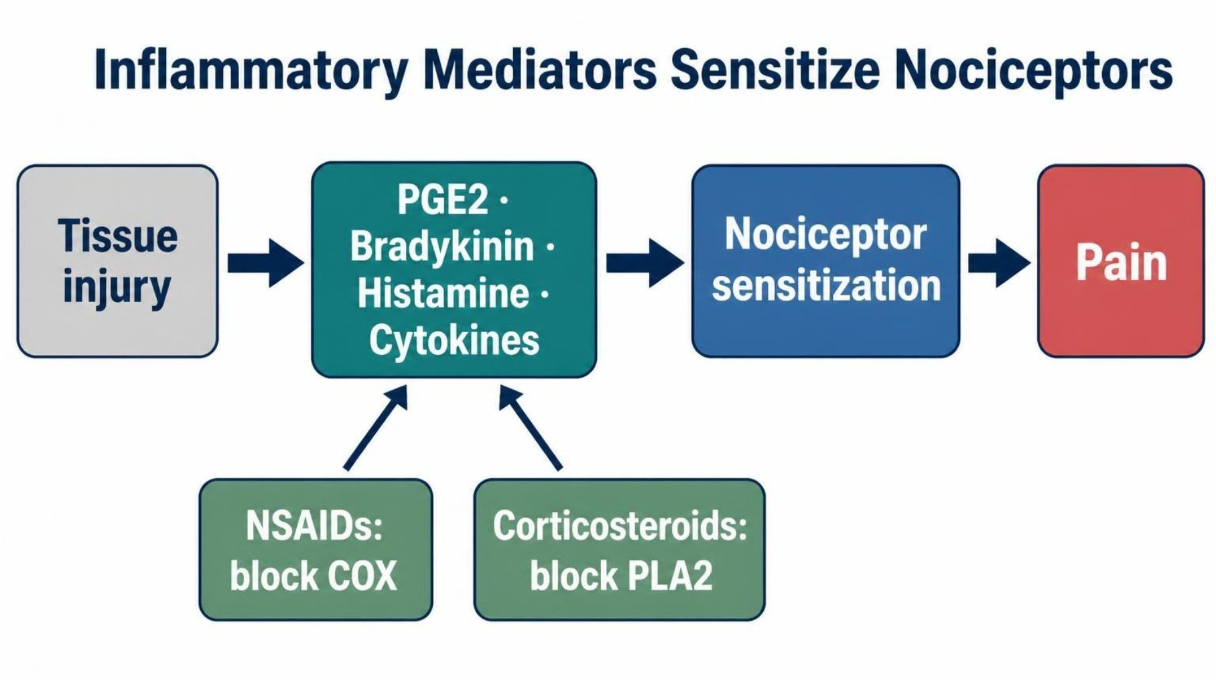
MECHANISM & DEPTH
Inflammatory Mediators Sensitize Nociceptors
Injury releases mediators: PGE2, bradykinin, histamine, and cytokines.
Nociceptor sensitization: mediators lower the pain threshold.
Where drugs act: NSAIDs block COX; corticosteroids block PLA2 upstream.
Musculoskeletal Pharmacology — Session 1 of 2 — PA Program
7
Notes:
Say: "Injury releases prostaglandins, bradykinin, histamine and cytokines. These lower the nociceptor threshold, so normally harmless stimuli hurt."
Know: Prostaglandins sensitize nociceptors, so they are the main NSAID target.
Know: Bradykinin, histamine and cytokines are not blocked by NSAIDs.

Slide 8

WHERE DRUGS INTERVENE
Therapeutic Targets in the Pain Pathway
Arachidonic
Acid
COX
Enzyme
Prostaglandins
Pain &
Inflammation
NSAIDs and COX-2 inhibitors act here; glucocorticoids act further upstream; cytokine inhibitors and analgesics act through separate, parallel pathways.
Musculoskeletal Pharmacology — Session 1 of 2 — PA Program
8
Notes:
This single arrow chain is the conceptual spine for the acetaminophen, NSAID, and corticosteroid sections that follow. The next slide builds this out further with the specific drug classes that intervene at each step.
Say: "Corticosteroids block phospholipase A2 upstream. NSAIDs block COX one step later."

Slide 9
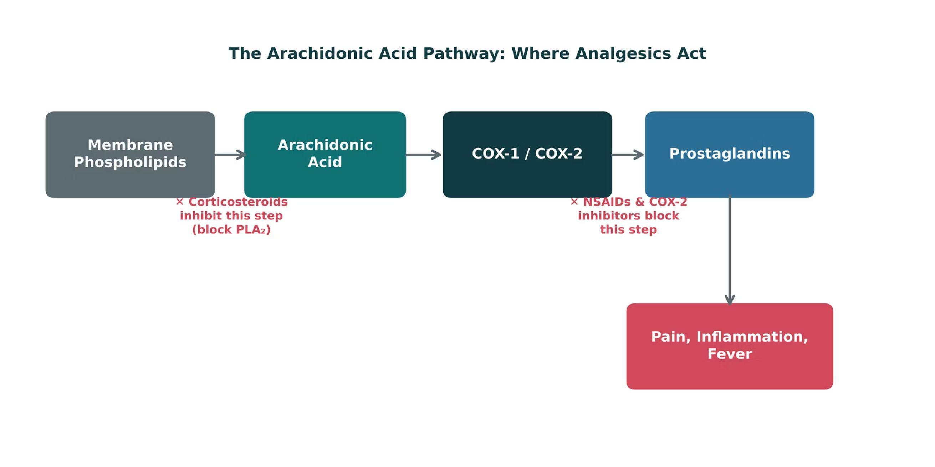
ORIGINAL ILLUSTRATION · FIGURE 1
The Arachidonic Acid Pathway: Where Analgesics Act
Figure 1. Original illustrative diagram (not from Katzung): corticosteroids block phospholipase A₂ upstream, while NSAIDs and COX-2 inhibitors block the COX step itself — two distinct points of pharmacologic intervention.
Musculoskeletal Pharmacology — Session 1 of 2 — PA Program
9
Notes:
This figure adds the drug layer on top of the previous flow slide: name the specific drug classes (corticosteroids vs. NSAIDs/COX-2 inhibitors) and exactly where each one interrupts the cascade.
Figure 1: Corticosteroids block phospholipase A2 upstream. NSAIDs block COX one step later.

Slide 10
QUICK CHECK · FIGURE 1
Quick Check
In Figure 1, corticosteroids are shown blocking the pathway at the "Membrane Phospholipids → Arachidonic Acid" step, while NSAIDs act one step later. What does this positioning explain?
Corticosteroids act upstream of NSAIDs, which is why they can suppress a broader range of inflammatory mediators, not just prostaglandins
A
B
Corticosteroids and NSAIDs block the exact same enzyme
C
NSAIDs act upstream of corticosteroids
D
Neither drug class affects the arachidonic acid pathway
Musculoskeletal Pharmacology — Session 1 of 2 — PA Program
10
Notes:
Quick check: give 30 seconds, take a show of hands, then reveal.

Slide 11
ANSWER · FIGURE 1
Answer
A
Corticosteroids act upstream of NSAIDs, broadly suppressing inflammatory mediator production.
Why: By inhibiting phospholipase A₂, corticosteroids block the release of arachidonic acid itself — upstream of COX — which is why they suppress a broader range of inflammatory mediators (not just prostaglandins) than NSAIDs, which act only at the COX step.
Musculoskeletal Pharmacology — Session 1 of 2 — PA Program
11
Notes:
Answer: corticosteroids act upstream of NSAIDs.

Slide 12
QUICK CHECK · UNDERSTANDING MUSCULOSKELETAL PAIN
Quick Check
Which mediator is the primary target of NSAID therapy within the inflammatory pain pathway?
A
Prostaglandins
B
Histamine
C
Bradykinin
D
Cytokines broadly (e.g., all of TNF-α, IL-1, IL-6)
Musculoskeletal Pharmacology — Session 1 of 2 — PA Program
12
Notes:
Quick check: give 30 seconds, take a show of hands, then reveal.

Slide 13
ANSWER · UNDERSTANDING MUSCULOSKELETAL PAIN
Answer
A
Prostaglandins.
Why: NSAIDs inhibit COX enzymes, directly reducing prostaglandin synthesis. Histamine, bradykinin, and cytokines are important inflammatory mediators too, but they are not the primary target of NSAID mechanism.
Musculoskeletal Pharmacology — Session 1 of 2 — PA Program
13
Notes:
Answer: prostaglandins are the NSAID target.
Say: "That's the pathway. Now the simplest drug on it: acetaminophen."

Slide 14

SECTION
02
Acetaminophen
Effective analgesia, with a narrow margin in overdose.

Slide 15

MECHANISM & EFFECTS
Acetaminophen
● Analgesic effect: relieves mild-to-moderate pain, with a central mechanism that is still incompletely understood.
● Antipyretic effect: reduces fever via central effects on the hypothalamic temperature-regulating center.
● Anti-inflammatory effect: minimal at the periphery — unlike NSAIDs, acetaminophen is not a reliable anti-inflammatory agent.
Musculoskeletal Pharmacology — Session 1 of 2 — PA Program
15
Notes:
This is the single most important distinction students need: acetaminophen treats pain and fever well, but it is not an anti-inflammatory drug the way NSAIDs are.
Say: "Acetaminophen is mainly central, with analgesic and antipyretic effects and minimal peripheral anti-inflammatory action."
Know: It is not an anti-inflammatory drug.

Slide 16
MECHANISM & DEPTH
Acetaminophen: Safe vs. Toxic Metabolism
Oral acetaminophen → Liver
Mechanism: analgesia and antipyresis are mainly central via reduced CNS prostaglandin synthesis; peripheral anti-inflammatory action is minimal.
Major route: glucuronidation and sulfation handle about 90% of the dose, giving safe urinary excretion.
Minor route: CYP2E1 converts a small fraction to NAPQI (N-acetyl-p-benzoquinone-imine), normally neutralized by glutathione.
Major route (~90%)
Minor route (~5–10%)
↓
↓
Glucuronidation and sulfation
CYP2E1 oxidation
↓
↓
Safe urinary excretion
NAPQI (toxic metabolite)
↓
GSH conjugation → safe excretion (at therapeutic doses)
Musculoskeletal Pharmacology — Session 1 of 2 — PA Program
16
Notes:
Explain the major safe route first, then the minor CYP2E1 route, where NAPQI is normally neutralized by glutathione conjugation at therapeutic doses.
Say: "About 90% goes down the safe route of glucuronidation and sulfation. A small fraction goes through CYP2E1 to NAPQI, which glutathione neutralizes at normal doses."

Slide 17
MECHANISM & DEPTH
Acetaminophen Overdose and NAC Rescue
Overdose: saturated glucuronidation/sulfation
Overdose: glutathione is exhausted, so NAPQI injures hepatocytes.
Antidote: NAC replenishes glutathione; give early for best effect.
Pearl: chronic alcohol use and fasting lower GSH and raise risk; both also induce CYP2E1.
Monitoring: plot the acetaminophen level on the Rumack-Matthew nomogram for acute single ingestion; check AST/ALT.
↓
More drug shunted to CYP2E1
↓
More NAPQI; glutathione (GSH) depleted
N-acetylcysteine (NAC) replenishes GSH
←
↓
NAPQI binds hepatocyte proteins
↓
Centrilobular liver necrosis
Musculoskeletal Pharmacology — Session 1 of 2 — PA Program
17
Notes:
Overdose saturates glucuronidation and sulfation, shunting more drug to CYP2E1 and producing more NAPQI. Once glutathione is depleted, NAPQI injures hepatocytes. Give N-acetylcysteine early.
Say: "In overdose the safe route saturates, more drug goes to CYP2E1, glutathione runs out, and NAPQI injures hepatocytes."
Know: The antidote is N-acetylcysteine (NAC), given early.
Know: Chronic alcohol use and fasting raise the risk.
Know: Use the Rumack-Matthew nomogram for acute single ingestions, and check AST/ALT.

Slide 18
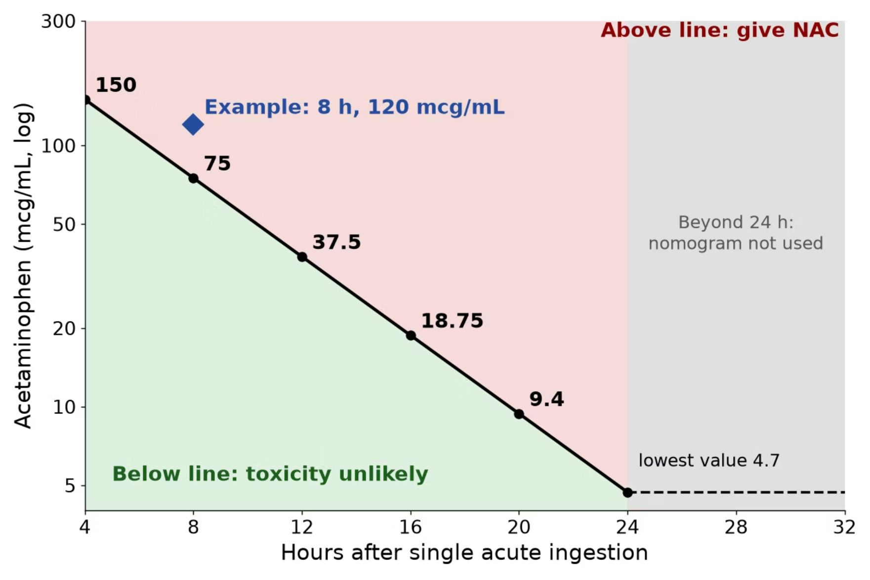
MECHANISM & DEPTH
Rumack-Matthew Nomogram: Assessing Toxicity
Illustrative schematic, single acute ingestion.
How to use: draw a level at 4 hours or later after a single acute ingestion and plot it against time since ingestion.
Above the treatment line: give NAC.
Below the line: toxicity unlikely.
Limits: not valid before 4 hours, for unknown ingestion time, staggered or repeated supratherapeutic ingestion, or chronic use; treat these using clinical judgment, AST/ALT and poison control.
Example: 8 h, 120 mcg/mL is above the line, so start NAC.
Musculoskeletal Pharmacology — Session 1 of 2 — PA Program
18
Notes:
The nomogram predicts hepatotoxicity risk after a single acute ingestion; if time of ingestion is unknown or ingestion is chronic, do not rely on it. Start NAC without waiting if presentation is late or the level is unavailable and ingestion is significant.
After 24 hours the nomogram is not used: 4.7 mcg/mL is only where the treatment line ends, not a safe cutoff. Get AST/ALT; a detectable level or elevated AST/ALT guides NAC, per protocol or poison control.

Slide 19

OVERDOSE MECHANISM
Acetaminophen Toxicity
Acetaminophen
NAPQI
(toxic metabolite)
Glutathione
Conjugation
Safe
Excretion
In overdose, glutathione stores are depleted, NAPQI accumulates, and hepatocyte injury follows — this is why N-acetylcysteine (a glutathione precursor) is the antidote.
Musculoskeletal Pharmacology — Session 1 of 2 — PA Program
19
Notes:
NAPQI = N-acetyl-p-benzoquinone imine. Tie this directly back to the "toxic metabolite" bullet from Lecture 1’s drug metabolism section.
Ask: "What is the danger of a cold-and-flu product on top of regular acetaminophen?" Look for: unintentional double dosing from combination products.

Slide 20

CLINICAL CASE
The Hidden Acetaminophen Overdose
A patient takes acetaminophen regularly for chronic back pain. For a cold, they also start an over-the-counter combination cold-and-flu medication.
Ask yourself: What is the hidden danger in this combination?
Clinical pearl: Many combination cold, flu, and sleep products also contain acetaminophen — unintentional double-dosing is a leading cause of acetaminophen-related liver injury. Always ask about ALL sources of acetaminophen.
Musculoskeletal Pharmacology — Session 1 of 2 — PA Program
20
Notes:
Good moment to reinforce generic-name awareness from Lecture 1 — patients often do not realize a product contains acetaminophen unless they check the label.
Hidden overdose case (slides 18-19): see the Ask on the previous slide.

Slide 21
QUICK CHECK · ACETAMINOPHEN
Quick Check
In acetaminophen overdose, hepatotoxicity results primarily from which mechanism?
A
Direct COX inhibition in the liver
B
Excess Phase II glucuronidation
C
Accumulation of NAPQI after glutathione stores are depleted
D
Renal crystal formation
Musculoskeletal Pharmacology — Session 1 of 2 — PA Program
21
Notes:
Quick check: give 30 seconds, take a show of hands, then reveal.

Slide 22
ANSWER · ACETAMINOPHEN
Answer
C
Accumulation of NAPQI after glutathione stores are depleted.
Why: NAPQI, normally detoxified by conjugation with glutathione, accumulates once glutathione stores are exhausted in overdose, causing hepatocyte injury — which is why N-acetylcysteine (a glutathione precursor) is the antidote.
Musculoskeletal Pharmacology — Session 1 of 2 — PA Program
22
Notes:
Answer: NAPQI accumulation after glutathione depletion.
Say: "Acetaminophen leaves inflammation alone. NSAIDs go after it directly."

Slide 23

SECTION
03
NSAIDs
Powerful anti-inflammatory effect, with real systemic risk.

Slide 24

MECHANISM
How NSAIDs Work
NSAID
COX
Inhibition
↓ Prostaglandins
↓ Pain, Inflammation,
Fever
Musculoskeletal Pharmacology — Session 1 of 2 — PA Program
24
Notes:
Say: "NSAIDs inhibit COX, so less arachidonic acid becomes prostaglandins and thromboxane. That gives less pain, inflammation and fever."

Slide 25
MECHANISM & DEPTH
NSAIDs Block COX and Prostaglandin Synthesis
Membrane phospholipids
Pathway: arachidonic acid is converted by COX to prostaglandins and thromboxane A2.
Effect: reduced prostaglandins give analgesia, antipyresis and anti-inflammation.
Adverse effects: GI injury, platelet inhibition and renal effects.
↓
Arachidonic acid
↓
COX-1 / COX-2
↓
Prostaglandins and TXA2
↓
NSAIDs block COX
↓
Less prostaglandin: pain and fever fall
Less TXA2: bleeding risk
Musculoskeletal Pharmacology — Session 1 of 2 — PA Program
25
Notes:
Explain the COX step first; every NSAID shares this mechanism, and the side effects follow from losing protective prostaglandins.
Say: "NSAIDs inhibit COX, so less arachidonic acid becomes prostaglandins and thromboxane. That gives less pain, inflammation and fever."

Slide 26
TWO ISOFORMS
COX-1 vs. COX-2
COX-1
COX-2
– "Housekeeping" enzyme
– Maintains gastric mucosal protection and normal renal blood flow
– Inhibition contributes to GI and renal adverse effects
– Induced mainly at sites of inflammation
– Primary source of inflammatory prostaglandins
– Selective inhibition targets inflammation with less GI toxicity
Musculoskeletal Pharmacology — Session 1 of 2 — PA Program
26
Notes:
Stress this is a simplified teaching model, not an absolute separation — COX-1 and COX-2 functions overlap, and COX-2 is also constitutively expressed in the kidney and elsewhere.
Say: "COX-1 is the housekeeper: stomach lining, platelets, kidney. COX-2 is induced at sites of inflammation."

Slide 27
MECHANISM & DEPTH
COX-1 vs. COX-2: Constitutive vs. Inducible
Arachidonic acid
COX-1: constitutive; gastric mucosa, platelets, kidney.
COX-2: inducible in inflamed tissue; pain, swelling, fever.
Nonselective NSAIDs block both, so GI injury is common.
Celecoxib spares COX-1 at therapeutic doses.
↓
COX-1 (constitutive)
Stomach mucosal protection
Platelet TXA2 (clotting)
Renal blood flow
↓
COX-2 (inducible, at inflamed tissue)
Inflammation
Pain
Fever
Nonselective NSAIDs block both COX-1 and COX-2 → GI and renal risk
Musculoskeletal Pharmacology — Session 1 of 2 — PA Program
27
Notes:
COX-1 keeps protective prostaglandins; COX-2 is induced by inflammation. Selectivity trades anti-inflammatory benefit against GI and platelet protection.
Say: "COX-1 is the housekeeper: stomach lining, platelets, kidney. COX-2 is induced at sites of inflammation."
Know: Nonselective NSAIDs block both, which is why GI injury is common.

Slide 28

AGENTS
Nonselective NSAIDs
Nonselective NSAIDs inhibit both COX-1 and COX-2.
Ibuprofen — common first-line choice for mild-moderate pain
Naproxen — longer half-life, twice-daily dosing
Diclofenac — available in oral and topical formulations
Indomethacin — more potent, more GI/CNS adverse effects
Ketorolac — short-term use only, significant GI/renal risk
Musculoskeletal Pharmacology — Session 1 of 2 — PA Program
28
Notes:
Nonselective NSAIDs: ibuprofen (first-line), naproxen (longer half-life), diclofenac, indomethacin (more GI/CNS effects), ketorolac (short-term only, significant GI/renal risk).

Slide 29

SELECTIVE AGENT
COX-2 Selective Inhibition: Celecoxib
Celecoxib selectively inhibits COX-2 over COX-1.
GI effects: lower risk of ulcer/bleeding than nonselective NSAIDs.
Cardiovascular risk: COX-2 selectivity is associated with increased cardiovascular event risk — a key trade-off.
Renal effects: similar renal risk to nonselective NSAIDs — COX-2 selectivity does not protect the kidney.
Musculoskeletal Pharmacology — Session 1 of 2 — PA Program
29
Notes:
This is a classic "trade one risk for another" teaching point — better GI profile, but not a free lunch cardiovascularly or renally.
Say: "Celecoxib spares COX-1, so the GI risk is lower. The trade-off is lower PGI2 without a matching drop in TXA2, which raises cardiovascular risk. The kidney is still affected."

Slide 30
MECHANISM & DEPTH
Celecoxib: Sparing COX-1 While Blocking COX-2
Mechanism: selectively inhibits inducible COX-2, the main source of inflammatory prostaglandins.
GI benefit: COX-1 in gastric mucosa is largely spared, lowering ulcer and bleeding risk.
Trade-off: suppressed PGI2 without matched TXA2 loss raises cardiovascular event risk.
Renal: kidney prostaglandins are still affected; renal risk is not eliminated.
Arachidonic acid
COX-2
COX-1
Blocked by celecoxib
Spared by celecoxib
↓ Fewer inflammatory prostaglandins → less pain and inflammation
↓ Stomach and platelet protection continues
↓ PGI₂ falls, TXA₂ preserved → cardiovascular risk
Musculoskeletal Pharmacology — Session 1 of 2 — PA Program
30
Notes:
Use the diagram to show that selectivity separates the GI benefit from the cardiovascular trade-off. Link back to the nonselective NSAID comparison on the previous slide.
Say: "Celecoxib spares COX-1, so the GI risk is lower. The trade-off is lower PGI2 without a matching drop in TXA2, which raises cardiovascular risk. The kidney is still affected."

Slide 31
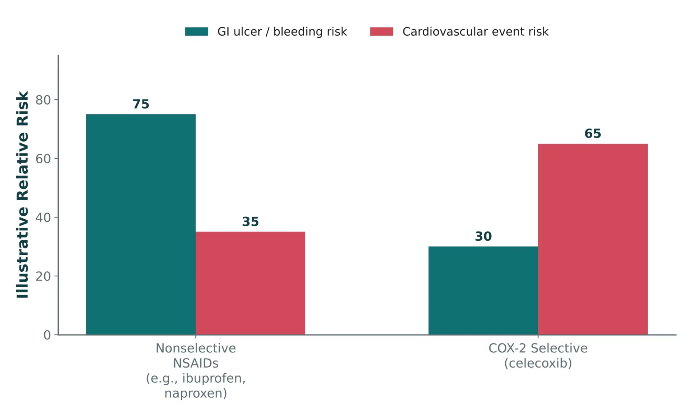
ORIGINAL ILLUSTRATION · FIGURE 2
Nonselective NSAIDs vs. COX-2 Selective Inhibition
Figure 2. Original illustrative comparison (illustrative relative-risk values, not from Katzung): nonselective NSAIDs (e.g., ibuprofen, naproxen) carry higher GI risk; celecoxib trades lower GI risk for higher cardiovascular risk.
Musculoskeletal Pharmacology — Session 1 of 2 — PA Program
31
Notes:
This is the graphical version of the trade-off just described in the celecoxib bullet slide — use it to reinforce that there is no risk-free NSAID choice, only a different risk profile.
Figure 2 and trade-off summary: lower GI risk, some increase in cardiovascular risk. These risk values are illustrative, not clinical data.

Slide 32
QUICK CHECK · FIGURE 2
Quick Check
Based on Figure 2, a patient with a history of GI ulcer but no cardiovascular disease is switched from ibuprofen to celecoxib. What is the most likely net effect on this patient’s risk profile?
A
Lower GI risk, with some increase in cardiovascular risk
B
Both GI and cardiovascular risk decrease
C
Both GI and cardiovascular risk increase
D
No change in either risk, since all NSAIDs carry identical risk profiles
Musculoskeletal Pharmacology — Session 1 of 2 — PA Program
32
Notes:
Quick check: give 30 seconds, take a show of hands, then reveal.

Slide 33
ANSWER · FIGURE 2
Answer
A
Lower GI risk, with some increase in cardiovascular risk.
Why: Figure 2 shows celecoxib’s illustrative GI-risk bar is lower than the nonselective NSAID bar, while its cardiovascular-risk bar is higher — exactly the trade-off described in the celecoxib bullet slide. For this GI-ulcer-history patient without cardiovascular disease, that trade may be favorable, but the increased cardiovascular risk should still be discussed.
Musculoskeletal Pharmacology — Session 1 of 2 — PA Program
33
Notes:
Answer: lower GI risk, with some increase in cardiovascular risk. These risk values are illustrative, not clinical data.

Slide 34
ORGANIZED BY SYSTEM · TABLE 1
NSAID Adverse Effects
System | Key Adverse Effects
Gastrointestinal | Gastritis, peptic ulcer, GI bleeding
Renal | Decreased renal perfusion, fluid retention, acute kidney injury
Cardiovascular | Hypertension, increased risk of cardiovascular events
Musculoskeletal Pharmacology — Session 1 of 2 — PA Program
34
Notes:
These three systems (GI, renal, CV) are the organizing framework for every NSAID contraindication and interaction discussion that follows. Table 1.
Say: "Lose prostaglandins and you lose mucosal protection, renal afferent dilation and normal platelet function."

Slide 35
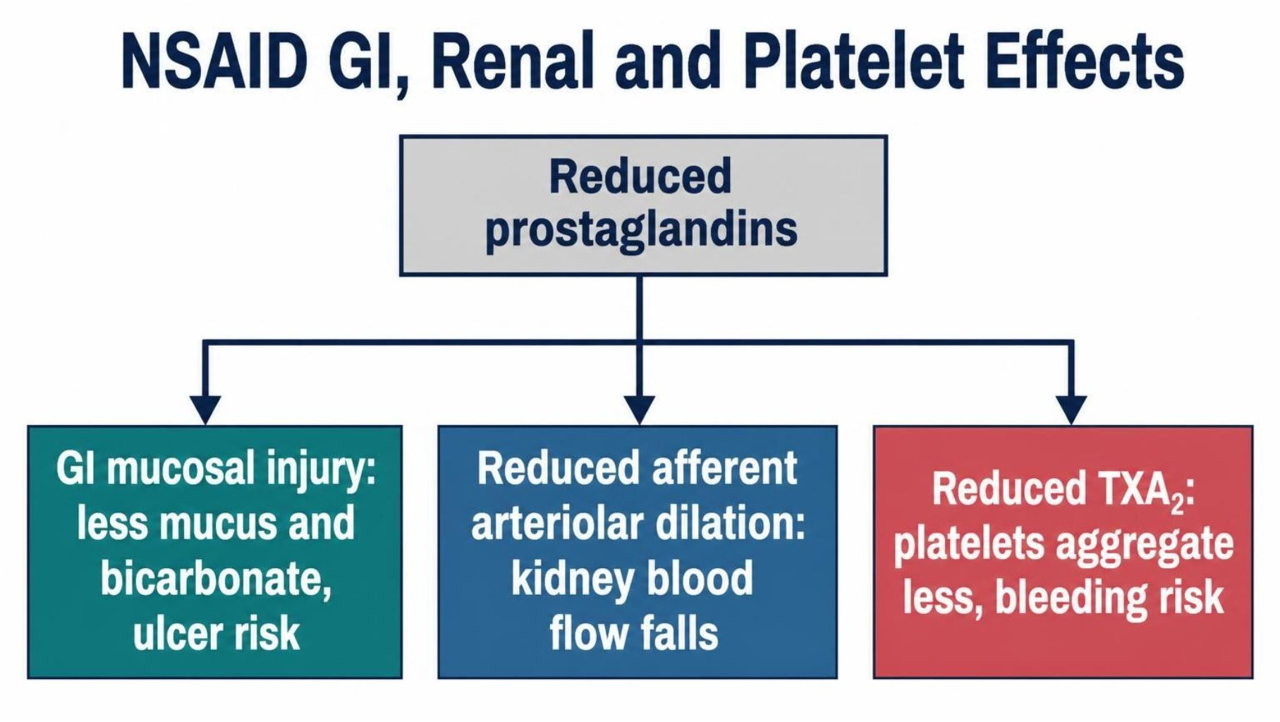
MECHANISM & DEPTH
NSAIDs: Prostaglandin Loss and Organ Effects
GI: less prostaglandin-driven mucus and bicarbonate leaves the mucosa open to injury.
Kidney: reduced afferent arteriolar dilation lowers renal blood flow.
Platelets: reduced TXA2 impairs aggregation, increasing bleeding risk.
Musculoskeletal Pharmacology — Session 1 of 2 — PA Program
35
Notes:
Say: "Lose prostaglandins and you lose mucosal protection, renal afferent dilation and normal platelet function."
Know: GI (ulcer, bleeding), renal (AKI, fluid retention), cardiovascular (hypertension, events).

Slide 36
PRESCRIBING SAFELY
NSAID Contraindications & Interactions
Use Caution / Avoid In
High-Yield Drug Interactions
– Active GI bleeding or ulcer history
– Chronic kidney disease
– Heart failure or cardiovascular disease
– Anticoagulant therapy
– Late pregnancy
– NSAIDs + anticoagulants → ↑ bleeding risk
– NSAIDs + ACE inhibitors/ARBs → ↑ AKI risk ("triple whammy" with diuretics)
– NSAIDs + diuretics → reduced diuretic effect, ↑ renal risk
– NSAIDs + corticosteroids → ↑ GI ulcer risk
Musculoskeletal Pharmacology — Session 1 of 2 — PA Program
36
Notes:
The "triple whammy" (NSAID + ACEi/ARB + diuretic) is a very high-yield acute kidney injury pattern to flag explicitly.
Avoid or use caution with active GI bleeding or ulcer history, CKD, heart failure, anticoagulants, and late pregnancy.
Know (interactions): NSAID plus anticoagulant means more bleeding. NSAID plus ACE inhibitor/ARB plus diuretic is the "triple whammy" for AKI. NSAID plus corticosteroid means more GI ulcer risk.

Slide 37
CLINICAL CASE
Is an NSAID the Right First Choice?
A 72-year-old patient with osteoarthritis also has chronic kidney disease, hypertension, and is taking an anticoagulant.
Ask yourself: Is an NSAID a good first-line choice for this patient’s pain? Why or why not?
Clinical pearl: This patient has three separate NSAID red flags at once (renal disease, anticoagulation, and age-related bleeding risk) — acetaminophen or a non-NSAID strategy is generally safer first-line.
Musculoskeletal Pharmacology — Session 1 of 2 — PA Program
37
Notes:
Excellent exam-style vignette — ask students to name all three risk factors independently before revealing the answer.
Ask: "72 years old, CKD, hypertension, on an anticoagulant. Is an NSAID a good first choice?"

Slide 38
QUICK CHECK · NSAIDS
Quick Check
A patient with CKD, hypertension, and anticoagulant use needs analgesia for osteoarthritis. Which class carries the highest combined renal and bleeding risk for this patient?
A
Acetaminophen
B
Oral NSAIDs
C
Topical capsaicin
D
Physical therapy alone
Musculoskeletal Pharmacology — Session 1 of 2 — PA Program
38
Notes:
Quick check: give 30 seconds, take a show of hands, then reveal.

Slide 39
ANSWER · NSAIDS
Answer
B
Oral NSAIDs.
Why: This patient has multiple NSAID red flags at once: CKD (renal risk), anticoagulant use (bleeding risk), and hypertension (cardiovascular risk) — oral NSAIDs carry the highest combined risk here.
Musculoskeletal Pharmacology — Session 1 of 2 — PA Program
39
Notes:
Answer: no. Oral NSAIDs carry the highest combined risk. Acetaminophen or a non-NSAID approach is generally safer.
Say: "Now the same drugs in the setting of arthritis."

Slide 40

SECTION
04
Osteoarthritis & Rheumatoid Arthritis
Two very different diseases that both affect the joint.

Slide 41
TWO DIFFERENT DISEASES
Osteoarthritis vs. Rheumatoid Arthritis
Osteoarthritis (OA)
Rheumatoid Arthritis (RA)
– Primarily degenerative joint disease
– Cartilage breakdown with mechanical wear
– Treatment goal: pain control and function
– Autoimmune, systemic inflammatory disease
– Immune-mediated joint destruction
– Treatment goal: suppress disease activity, not just pain
Musculoskeletal Pharmacology — Session 1 of 2 — PA Program
41
Notes:
This distinction is the hinge the whole rest of the section turns on: OA is managed primarily with analgesics/NSAIDs, while RA requires disease-modifying therapy.
Say: "OA is degenerative and mechanical, with cartilage wear and bone remodeling. RA is autoimmune, with synovitis, pannus, and TNF-alpha and IL-6 driving erosion."

Slide 42
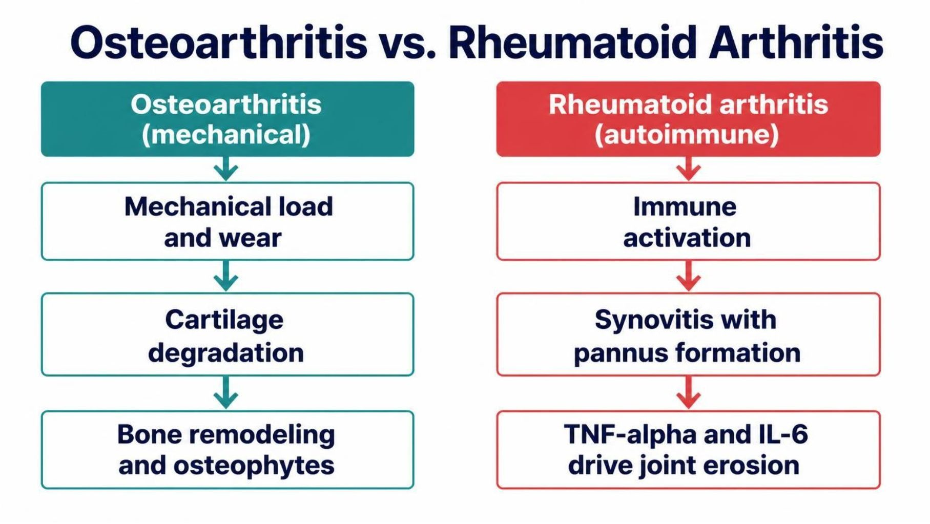
MECHANISM & DEPTH
Osteoarthritis vs. Rheumatoid Arthritis: Pathophysiology
OA: mechanical wear degrades cartilage; bone remodels with osteophytes.
RA: autoimmune synovitis forms a pannus that erodes cartilage and bone.
Key RA cytokines: TNF-α and IL-6 drive inflammation and joint damage.
Musculoskeletal Pharmacology — Session 1 of 2 — PA Program
42
Notes:
Say: "OA is degenerative and mechanical, with cartilage wear and bone remodeling. RA is autoimmune, with synovitis, pannus, and TNF-alpha and IL-6 driving erosion."

Slide 43
OA MANAGEMENT
Pharmacologic Treatment of Osteoarthritis
Acetaminophen — reasonable first-line for mild OA pain
Oral NSAIDs — effective, but carry the systemic risks already discussed
Topical NSAIDs — effective local relief with much lower systemic exposure
Intra-articular corticosteroid injections — short-term relief for flares in a single joint
Other approaches — activity modification, physical therapy, weight management
Musculoskeletal Pharmacology — Session 1 of 2 — PA Program
43
Notes:
Acetaminophen is reasonable first-line for mild pain. Topical NSAIDs give effective relief with lower systemic exposure. Intra-articular corticosteroids give short-term relief for flares. Add activity modification, physical therapy and weight management.

Slide 44
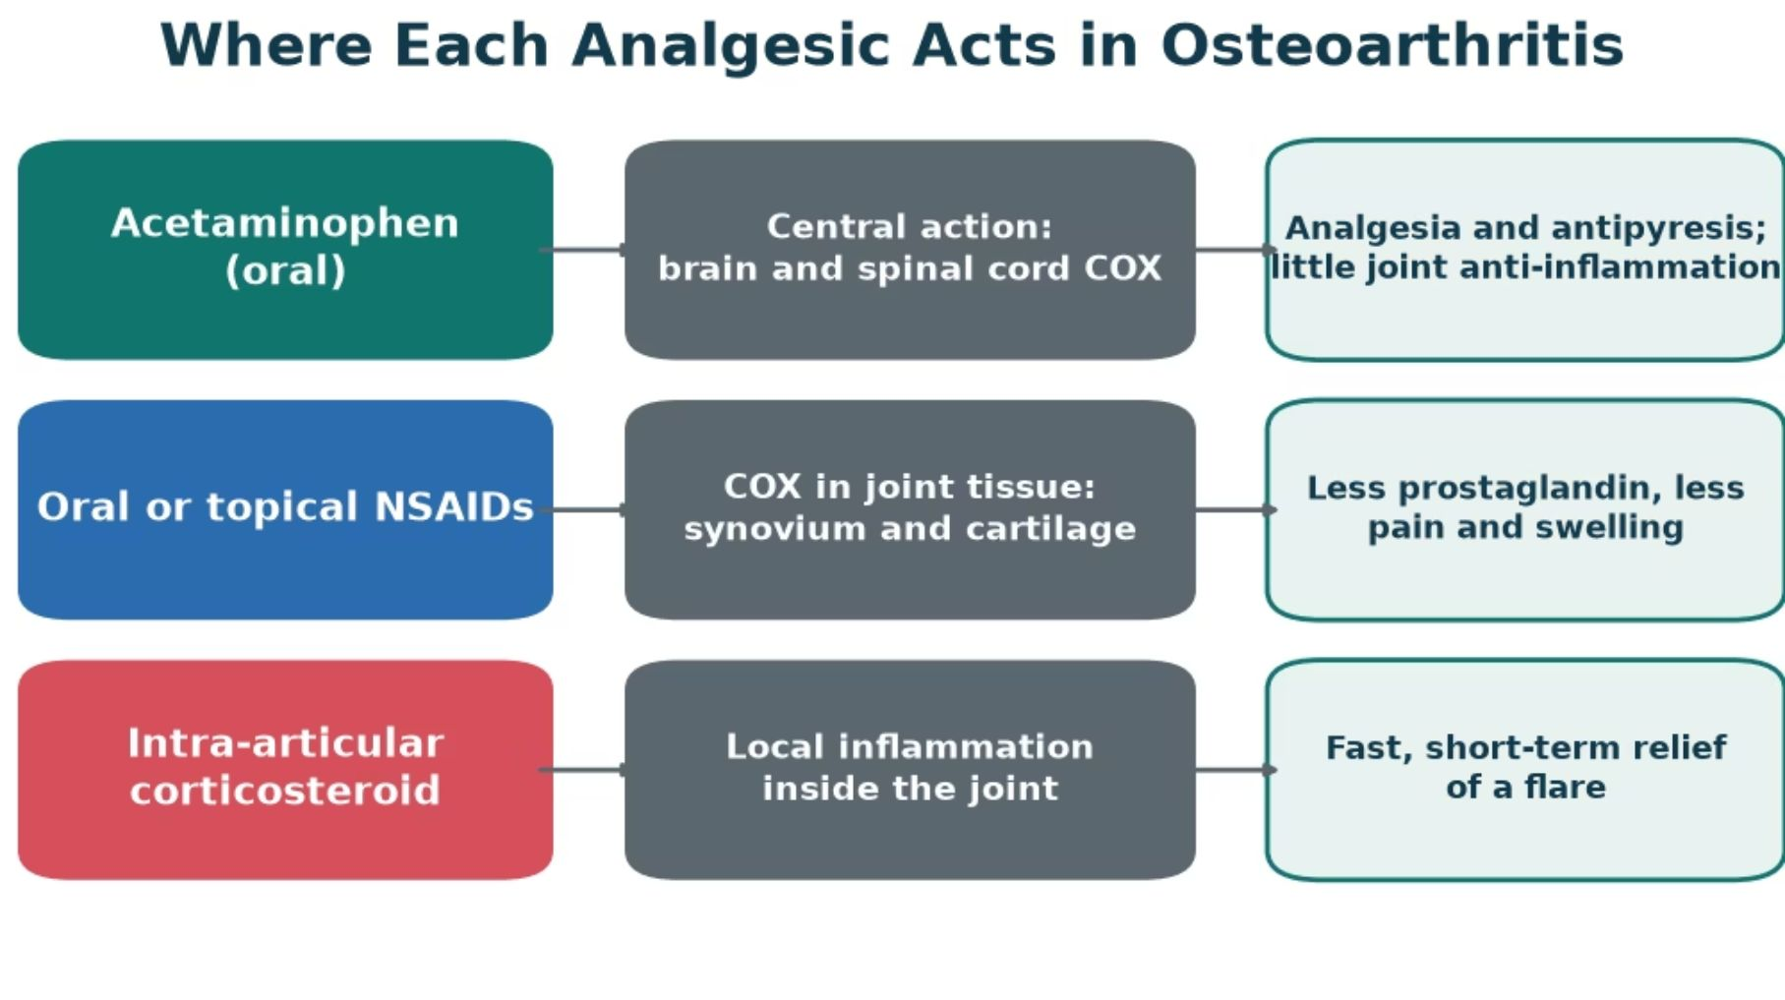
MECHANISM & DEPTH
Where Each Analgesic Acts in Osteoarthritis
Acetaminophen: acts centrally; little anti-inflammatory effect in the joint.
Oral or topical NSAIDs: block COX in joint tissue, lowering prostaglandins.
Intra-articular steroid: calms local inflammation for a short, fast flare relief.
Musculoskeletal Pharmacology — Session 1 of 2 — PA Program
44
Notes:
Match each option to its site: acetaminophen centrally, NSAIDs in synovium and cartilage, corticosteroids inside the joint. Choice depends on which tissue drives the pain.
Acetaminophen is reasonable first-line for mild pain. Topical NSAIDs give effective relief with lower systemic exposure. Intra-articular corticosteroids give short-term relief for flares. Add activity modification, physical therapy and weight management.

Slide 45

CONCEPT
What Makes a Drug "Disease-Modifying"?
● DMARD: Disease-Modifying Antirheumatic Drug — a drug intended to alter the course of RA, not just mask its symptoms.
● Goal of therapy: slow or halt joint destruction and systemic inflammation, rather than providing analgesia alone.
Musculoskeletal Pharmacology — Session 1 of 2 — PA Program
45
Notes:
Contrast explicitly with NSAIDs: an NSAID can make a patient feel better without changing the underlying disease trajectory — a DMARD is meant to change the trajectory itself.
Say: "A DMARD changes the course of RA. An NSAID only masks symptoms."

Slide 46
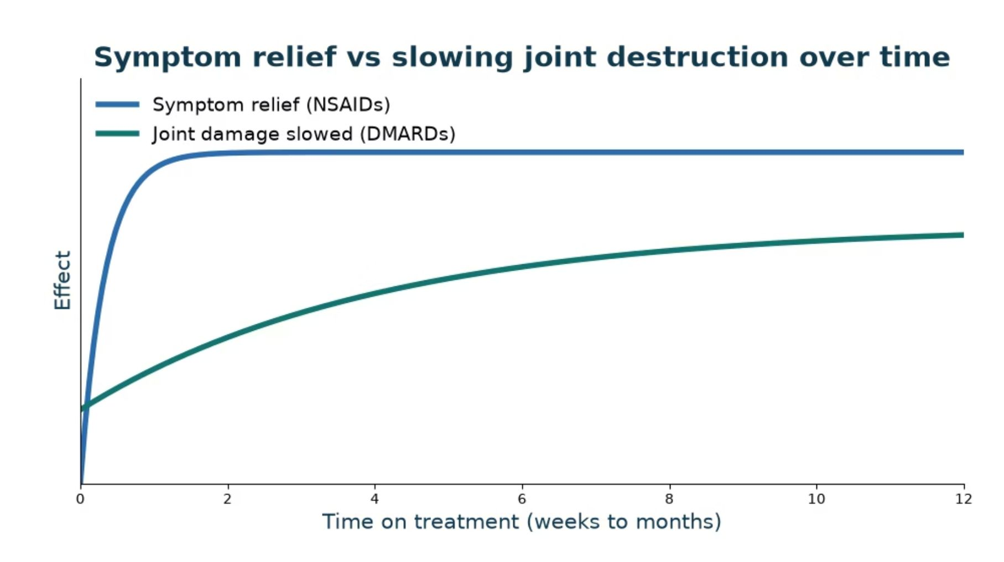
MECHANISM & DEPTH
Symptom Relief vs Slowing Joint Destruction
NSAIDs: relieve pain and swelling within days, but do not alter joint damage.
DMARDs: take weeks to months to act, then slow cartilage and bone destruction.
Timing: judge a DMARD over months, not after the first visit.
Goal: relief now with NSAIDs, protection later with DMARDs.
Musculoskeletal Pharmacology — Session 1 of 2 — PA Program
46
Notes:
Contrast the fast, symptomatic effect of NSAIDs with the slow, structure-modifying effect of DMARDs. Set expectations that DMARD benefit builds over months.
Say: "A DMARD changes the course of RA. An NSAID only masks symptoms."
Know: DMARDs take weeks to months to work. Judge them over months, not at the first visit. The curve is a schematic, not data.

Slide 47
CONVENTIONAL DMARDS
Conventional (Non-Biologic) DMARDs
Methotrexate — the anchor drug for most RA regimens (next slide)
Hydroxychloroquine — milder disease; relatively favorable safety profile
Sulfasalazine — often used in combination regimens
Leflunomide — alternative when methotrexate is not tolerated
Musculoskeletal Pharmacology — Session 1 of 2 — PA Program
47
Notes:
Methotrexate (anchor drug, blocks DHFR), hydroxychloroquine (milder disease), sulfasalazine, leflunomide (blocks DHODH, pyrimidine synthesis).

Slide 48
MECHANISM & DEPTH
Conventional DMARDs: Where Each Drug Acts
Drug | Target / action | Effect
Methotrexate | Inhibits DHFR; disrupts folate metabolism | Slower immune-cell growth
Hydroxychloroquine | Alters lysosomal and TLR signaling | Less antigen signaling
Sulfasalazine | Reduces cytokine and prostaglandin production | Less inflammation
Leflunomide | Inhibits DHODH; limits pyrimidine synthesis | Slower T-cell growth
Methotrexate: blocks DHFR and folate metabolism.
Hydroxychloroquine: alters lysosomal and TLR signaling.
Sulfasalazine: reduces cytokine and prostaglandin production.
Leflunomide: inhibits DHODH, blocking pyrimidine synthesis.
Musculoskeletal Pharmacology — Session 1 of 2 — PA Program
48
Notes:
These drugs act inside cells or on broad immune pathways, with a slower onset than biologics.
Methotrexate (anchor drug, blocks DHFR), hydroxychloroquine (milder disease), sulfasalazine, leflunomide (blocks DHODH, pyrimidine synthesis).

Slide 49
ANCHOR DRUG
Methotrexate
Mechanism: inhibits dihydrofolate reductase, reducing immune cell proliferation at low RA doses.
Dosed weekly (not daily) — a critical patient-safety point, since daily dosing can be fatal.
Folate supplementation is routinely co-prescribed to reduce toxicity.
Key adverse effects: hepatotoxicity, bone marrow suppression, pulmonary toxicity.
Contraindicated in pregnancy (teratogenic).
Musculoskeletal Pharmacology — Session 1 of 2 — PA Program
49
Notes:
Methotrexate’s weekly dosing is one of the highest-yield patient-safety teaching points in all of rheumatology pharmacology — emphasize it strongly.
Know: methotrexate is dosed WEEKLY, not daily. Daily dosing has caused fatal toxicity.

Slide 50
MECHANISM & DEPTH
Methotrexate: Folate Pathway and Low-Dose Action
Dihydrofolate (DHF) ↓
Target: inhibits dihydrofolate reductase (DHFR), blocking folate-dependent purine and thymidylate synthesis.
Low-dose RA effect: likely anti-inflammatory via adenosine release, not cytotoxicity.
Pearl: weekly dosing only; daily dosing has caused fatal toxicity.
Toxicity: folic acid co-therapy reduces liver, marrow, lung and GI effects.
DHFR enzyme ↓
THF for DNA synthesis
Methotrexate blocks DHFR ↓
Low dose: anti-inflammatory ↓
Weekly dosing only
Musculoskeletal Pharmacology — Session 1 of 2 — PA Program
50
Notes:
Walk through the diagram left to right: folate is reduced to THF through DHF, and methotrexate blocks the DHFR step. Emphasize the weekly-dosing safety point.
Give folic acid to reduce liver, marrow, lung and GI toxicity. Contraindicated in pregnancy (teratogenic).

Slide 51

TARGETED THERAPY
Biologic DMARDs
TNF Inhibitors
IL-6 Inhibitors
– Block tumor necrosis factor-alpha signaling
– Examples: adalimumab, etanercept, infliximab
– Block interleukin-6 receptor signaling
– Example: tocilizumab
B-Cell Targeted Therapy
T-Cell Costimulation Modulators
– Depletes or modulates B lymphocytes
– Example: rituximab
– Block the second signal needed for T-cell activation
– Example: abatacept
Musculoskeletal Pharmacology — Session 1 of 2 — PA Program
51
Notes:
Each biologic class corresponds to a different cytokine or cell type in the inflammatory cascade shown earlier in the lecture — tie this back to the mediator list from Section 1. The next slide shows these same four drug classes as a mechanism diagram.
Say: "Four classes by target." TNF inhibitors (infliximab, adalimumab, etanercept), IL-6 blockers (tocilizumab), abatacept (CTLA-4-Ig, blocks CD28 costimulation), rituximab (anti-CD20, depletes B cells).

Slide 52
MECHANISM & DEPTH
Biologic DMARDs: Mechanism by Target
TNF inhibitors Infliximab, adalimumab, etanercept | Bind soluble or membrane TNF-α, preventing TNFR activation.
IL-6 inhibitor Tocilizumab | Blocks the IL-6 receptor, reducing inflammatory signaling.
Abatacept CTLA-4-Ig | Binds CD80/86; blocks CD28 costimulation of T cells.
Rituximab Anti-CD20 | Binds CD20 and depletes B cells.
TNF inhibitors: antibodies and etanercept, a receptor fusion, neutralize soluble and membrane TNF-α. First-line biologic; watch for reactivation of latent TB.
IL-6 blockers: tocilizumab blocks both membrane and soluble IL-6 receptor, and works as monotherapy. Can raise lipids and liver enzymes.
Abatacept: selective costimulation modulator that acts early, at T-cell activation. Generally a lower infection signal.
Rituximab: anti-CD20 depletes B cells for months. Used after TNF-inhibitor failure; check hepatitis B before starting.
Musculoskeletal Pharmacology — Session 1 of 2 — PA Program
52
Notes:
Each biologic intercepts a different step of the immune cascade; match the target to the drug class.
Say: "Four classes by target." TNF inhibitors (infliximab, adalimumab, etanercept), IL-6 blockers (tocilizumab), abatacept (CTLA-4-Ig, blocks CD28 costimulation), rituximab (anti-CD20, depletes B cells).

Slide 53
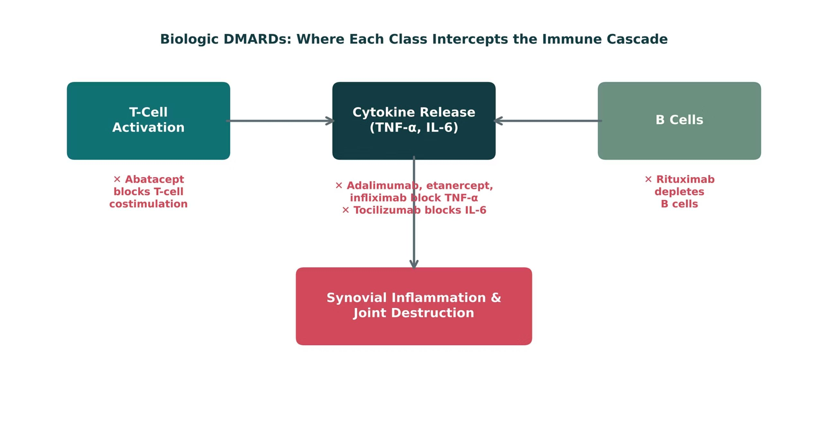
ORIGINAL ILLUSTRATION · FIGURE 3
Biologic DMARDs: Where Each Class Intercepts the Immune Cascade
Figure 3. Original illustrative diagram (not from Katzung): abatacept blocks T-cell costimulation, TNF inhibitors (adalimumab, etanercept, infliximab) and tocilizumab block cytokine signaling, and rituximab depletes B cells.
Musculoskeletal Pharmacology — Session 1 of 2 — PA Program
53
Notes:
This is the visual counterpart to the fourCard slide just shown — have students match each generic drug name to its box on this diagram before you reveal the answer.
Figure 3: walk the cascade from T-cell activation to cytokines to synovial damage. Abatacept acts earliest.

Slide 54
QUICK CHECK · FIGURE 3
Quick Check
In Figure 3, which biologic DMARD acts earliest in the cascade shown, before cytokines like TNF-α and IL-6 are even released?
A
Adalimumab
B
Tocilizumab
C
Abatacept
D
Rituximab
Musculoskeletal Pharmacology — Session 1 of 2 — PA Program
54
Notes:
Quick check: give 30 seconds, take a show of hands, then reveal.

Slide 55
ANSWER · FIGURE 3
Answer
C
Abatacept.
Why: Abatacept blocks T-cell costimulation — the step furthest upstream in the diagram, occurring before activated T cells drive cytokine release (blocked downstream by adalimumab/tocilizumab) or B-cell activity (blocked by rituximab).
Musculoskeletal Pharmacology — Session 1 of 2 — PA Program
55
Notes:
Answer: abatacept acts earliest.

Slide 56
SHARED RISK
DMARD Safety: Immunosuppression
The major safety theme across all DMARDs: immunosuppression → increased infection risk.
Baseline screening — e.g., tuberculosis and hepatitis B/C screening before starting biologics
Vaccination — update vaccines, especially live vaccines, before starting therapy
Ongoing monitoring — regular labs to catch cytopenias, hepatotoxicity, or infection early
Infection precautions — counsel patients to report fevers or infection symptoms promptly
Musculoskeletal Pharmacology — Session 1 of 2 — PA Program
56
Notes:
Say: "The theme is immunosuppression, so infection risk."

Slide 57
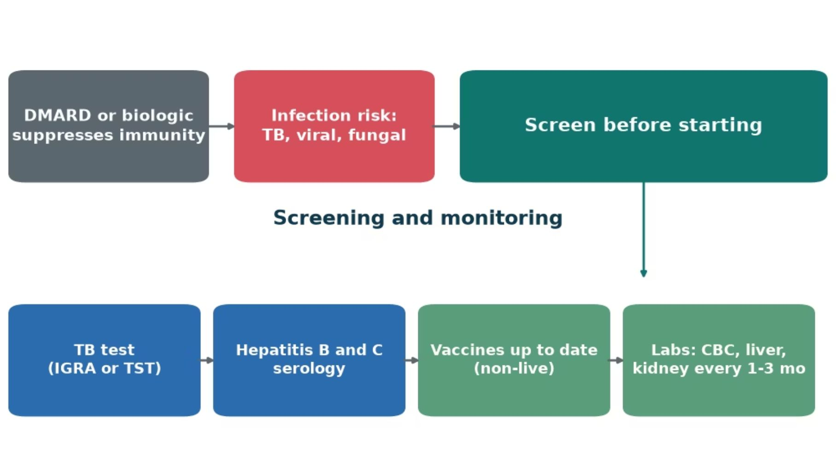
MECHANISM & DEPTH
Immune Suppression Raises Infection Risk
Risk: suppressed immunity lets latent TB and opportunistic infections emerge.
Screen first: TB test and hepatitis B and C serology before starting.
Vaccines: update non-live vaccines before treatment.
Monitor: CBC and liver and kidney labs every 1–3 months.
Musculoskeletal Pharmacology — Session 1 of 2 — PA Program
57
Notes:
Screen for TB and hepatitis B and C before starting; update non-live vaccines; monitor blood counts and organ function regularly, and act early on fever or infection signs.
Say: "The theme is immunosuppression, so infection risk."
Know: Screen for TB and hepatitis B/C before biologics. Update vaccines first, especially live vaccines. Monitor CBC and liver and kidney tests. Counsel patients to report fevers early.

Slide 58
QUICK CHECK · OSTEOARTHRITIS & RHEUMATOID ARTHRITIS
Quick Check
Which feature distinguishes a DMARD from an NSAID in the management of rheumatoid arthritis?
A
DMARDs provide faster pain relief than NSAIDs
B
NSAIDs suppress the immune system more potently than DMARDs
C
DMARDs are only available as biologic agents
D
DMARDs modify the underlying disease process rather than only masking symptoms
Musculoskeletal Pharmacology — Session 1 of 2 — PA Program
58
Notes:
Quick check: give 30 seconds, take a show of hands, then reveal.

Slide 59
ANSWER · OSTEOARTHRITIS & RHEUMATOID ARTHRITIS
Answer
D
DMARDs modify the underlying disease process rather than only masking symptoms.
Why: An NSAID can make a patient feel better without changing RA’s disease trajectory; a DMARD (conventional or biologic) is intended to slow or halt joint destruction and systemic inflammation itself.
Musculoskeletal Pharmacology — Session 1 of 2 — PA Program
59
Notes:
Answer: a DMARD modifies the disease process, while an NSAID only masks symptoms.

Slide 60
MECHANISM & DEPTH
Drug Names Reveal the Class: Read the Stem
Stem | Meaning | Example
-mab | Monoclonal antibody | Rituximab (anti-CD20)
-zumab | Humanized antibody | Tocilizumab (IL-6R)
-ximab | Chimeric antibody | Infliximab (TNF-α)
-umab | Fully human antibody | Adalimumab (TNF-α)
-cept | Receptor fusion protein | Etanercept, abatacept
-nib / -tinib | Kinase inhibitor | Tofacitinib (JAK)
-coxib | Selective COX-2 inhibitor | Celecoxib
-profen | Propionic-acid NSAID | Ibuprofen, naproxen
-fenac | Acetic-acid NSAID | Diclofenac
-oxicam | Oxicam NSAID | Meloxicam
Musculoskeletal Pharmacology — Session 1 of 2 — PA Program
60
Notes:
Teach students to read the stem first: it reveals mechanism class before the drug is recalled.
Say: "Read the stem and you know the class." -mab is a monoclonal antibody. -zumab is humanized, -ximab chimeric, -umab fully human. -cept is a receptor fusion protein. -nib/-tinib is a kinase inhibitor (for example tofacitinib, JAK). -coxib is COX-2 selective. -profen, -fenac and -oxicam are NSAID subclasses.

Slide 61
BIG PICTURE
Session 1 Recap — To Be Continued
1
Musculoskeletal pain is driven by inflammatory mediators (prostaglandins, bradykinin, histamine, cytokines) — NSAIDs and corticosteroids intervene at different points along this cascade.
2
Acetaminophen treats pain and fever but is not a reliable anti-inflammatory agent; its overdose toxicity is mediated by NAPQI accumulation.
3
NSAIDs are effective but carry real GI, renal, and cardiovascular risk; celecoxib trades GI risk for cardiovascular risk.
4
DMARDs (conventional and biologic — methotrexate, adalimumab, etanercept, infliximab, tocilizumab, rituximab, abatacept) modify RA’s disease course rather than only masking symptoms.
5
Session 2 (Thursday, October 29) continues with gout, skeletal muscle relaxants, bone pharmacology, and the cumulative Lecture Recall Quiz.
Musculoskeletal Pharmacology — Session 1 of 2 — PA Program
Notes:
Close Session 1 by previewing Session 2 explicitly — students should leave knowing pain, acetaminophen, NSAIDs, and DMARDs are complete, and that gout, muscle relaxants, and bone pharmacology pick up first next time.
Recap: walk the five points.
Say: "Next time, Thursday October 29: gout, muscle relaxants, bone pharmacology, and the cumulative recall quiz."
Five points to repeat if time runs short:
1. Prostaglandins drive inflammatory pain, and COX makes them.
2. Acetaminophen is central, with no real anti-inflammatory effect. Overdose means NAPQI, and the antidote is NAC.
3. COX-1 protects the stomach, platelets and kidney. Nonselective NSAIDs block both isoforms.
4. Celecoxib cuts GI risk but raises cardiovascular risk, and does not spare the kidney.
5. DMARDs change disease. Methotrexate is weekly, and screen for TB and hepatitis before biologics.

Slide 62
APPENDIX
Image Attribution
● Original figures in this deck: Figures 1–3 (The Arachidonic Acid Pathway: Where Analgesics Act; Nonselective NSAIDs vs. COX-2 Selective Inhibition; Biologic DMARDs: Where Each Class Intercepts the Immune Cascade) were generated by the course director using the AI tool Claude to illustrate standard, non-copyrighted pharmacologic concepts. The mechanism diagrams added for acetaminophen (including the Rumack-Matthew nomogram schematic), methotrexate and celecoxib, and the NSAID, COX-1 vs. COX-2, conventional DMARD, biologic DMARD and drug-name nomenclature diagrams, are also original illustrative diagrams, created with AI assistance for this course. Companion diagrams for inflammatory mediators, NSAID adverse effects, osteoarthritis vs. rheumatoid arthritis, osteoarthritis pharmacotherapy, disease-modifying drug concepts and DMARD immunosuppression are original illustrative diagrams created with AI assistance for this course as well. They are original diagrams, not reproduced from Katzung’s Basic and Clinical Pharmacology or any other copyrighted source.
● Reference: Anthropic. (2026). Claude (Sonnet 5) [Large language model]. https://claude.ai
Musculoskeletal Pharmacology — Session 1 of 2 — PA Program
62
Notes:
This slide documents AI-tool use for original figure generation per university citation requirements. It covers every original diagram in this deck (Figures 1–3); none are reproduced from any textbook.

