Slide 1
L06 · Thu, Nov 5, 2026
GI & Nutrition Pharmacology — Session 2
Pharmacology study deck · organized by drug class
How to read this deck
TB = textbook only (not on the lecture slides)
SG = course study guide only (not on the lecture slides)
Bold = emphasized on the lecture slides
S12 = lecture slide 12 · p. 245 = textbook page 245 · SG U1-R3 = study guide item

Slide 2
START HERE
Learning objectives
IO3.1
Identify major pharmacologic classes used in GI and nutrition conditions and describe their mechanisms of action.
Laxatives & Antidiarrheals, Inflammatory Bowel Disease, Nutrition, Vitamins & Dietary Supplements
IO3.2
Describe the indications, contraindications, adverse effects, and clinically significant interactions of GI and nutrition medications.
Laxatives & Antidiarrheals, Inflammatory Bowel Disease, Nutrition, Vitamins & Dietary Supplements
IO3.3
Compare agents within and across these classes to distinguish clinically relevant differences in efficacy, safety, and use.
Laxatives & Antidiarrheals, Inflammatory Bowel Disease, Putting It All Together: GI & Nutrition Toolkit
IO3.4
Select appropriate pharmacologic therapy for common GI and nutrition conditions based on clinical presentation and patient-specific factors.
Laxatives & Antidiarrheals, Inflammatory Bowel Disease, Nutrition, Vitamins & Dietary Supplements, Putting It All Together: GI & Nutrition Toolkit
L06 · GI & Nutrition Pharmacology — Session 2
2

Slide 3
START HERE
Learning objectives (cont.)
IO3.5
Identify appropriate dosing, administration, and monitoring considerations for GI and nutrition medications.
Inflammatory Bowel Disease, Nutrition, Vitamins & Dietary Supplements
IO3.6
Explain important medication-use and safety information to patients receiving GI and nutrition pharmacotherapy.
Laxatives & Antidiarrheals, Nutrition, Vitamins & Dietary Supplements
SO1
Classify laxatives and antidiarrheal agents by mechanism and clinical use, including representative generic agents.
Laxatives & Antidiarrheals
SO2
Explain the step-wise pharmacologic management of inflammatory bowel disease, including representative generic agents at each step.
Inflammatory Bowel Disease
L06 · GI & Nutrition Pharmacology — Session 2
3

Slide 4
START HERE
Learning objectives (cont.)
SO3
Identify major pharmacologic classes used in nutrition support and describe clinically significant drug-nutrient and herbal-supplement interactions.
Nutrition, Vitamins & Dietary Supplements
SO4
Identify key contraindications, adverse effects, and drug interactions throughout.
Laxatives & Antidiarrheals, Inflammatory Bowel Disease, Nutrition, Vitamins & Dietary Supplements
SO5
Apply the full GI & Nutrition pharmacology toolkit to integrated clinical scenarios.
Putting It All Together: GI & Nutrition Toolkit
L06 · GI & Nutrition Pharmacology — Session 2
4

Slide 5

START HERE
About this lecture
Scope, readings & sources
PA Pharmacology Course · Lecture 3 · Session 2 of 2 — GI & Nutrition Pharmacology. Session 2: Bowel Disorders, IBD, and Nutrition/Dietary Supplements (Thursday, November 5, 8:30–11:00 AM). S1
Session 1 followed acid and vomiting. Today follows three new pathways: how the bowel moves water, how we step up IBD therapy, and how what patients take on their own changes their medicines. S1 (notes)
L06 · GI & Nutrition Pharmacology — Session 2
5

Slide 6
START HERE
About this lecture (cont.)
Scope, readings & sources
Recap: Session 1 (Nov 3) covered acid-peptic disease pharmacotherapy and antiemetics. Today picks up with lower-GI motility (Section 4) and runs through IBD, nutrition/dietary supplements, integration, and the cumulative recall quiz. S2; S2 (notes)
Abbreviations used in the drug profiles: DR delayed-release; ER/XR extended-release; OTC over the counter; PO by mouth; PR by rectum; IV intravenous; IM intramuscular; SC subcutaneous; BID/TID/QID; CrCl creatinine clearance; CKD chronic kidney disease; CNS central nervous system; IBD inflammatory bowel disease; UC ulcerative colitis; IBS-C irritable bowel syndrome with constipation; CIC chronic idiopathic constipation; TNF tumor necrosis factor; JAK Janus kinase; TPMT/NUDT15 thiopurine-metabolizing enzymes (tested before thiopurines); G6PD; INR international normalized ratio; PCC prothrombin complex concentrate; MACE major adverse cardiovascular events; PML progressive multifocal leukoencephalopathy; CYP/P-gp; SSRI; NTD neural tube defect; EPA/DHA omega-3 fatty acids; C-V DEA Schedule V. The appendix gives formulation, dose, indications, adverse effects, contraindications and toxicity for each drug in this lecture. S39; S39 (notes)
L06 · GI & Nutrition Pharmacology — Session 2
6

Slide 7
START HERE
About this lecture (cont.)
Scope, readings & sources
Original figures in this deck: Figures 2, 4, 7, 8 and 10 (Laxative Onset of Action by Mechanism; Step Therapy in Inflammatory Bowel Disease; Biologic & Targeted Therapies in IBD: Where Each Class Acts; Fat-Soluble vs. Water-Soluble Vitamins: Storage and Toxicity Risk; Vitamin K and CYP3A4 Inducers: A Classic Drug-Nutrient Interaction) were generated by the course director using the AI tool Claude to illustrate standard, non-copyrighted pharmacologic concepts. They are original diagrams, not reproduced from Katzung’s Basic and Clinical Pharmacology or any other copyrighted source. Mechanism illustrations (AI-generated, illustrative, not reproduced from copyrighted sources; schematic and not to scale): laxative classes (Figure 1, slide 5); loperamide and diphenoxylate (Figure 3, slide 10); 5-ASA (Figure 5, slide 17); azathioprine and 6-MP (Figure 6, slide 19); vitamin B12 absorption (Figure 9, slide 33); warfarin and vitamin K cycle (Figure 11, slide 35). Figures 1, 3, 5, 6, 9 and 11 are AI-generated and schematic. Reference: Anthropic. (2026). Claude (Sonnet 5) [Large language model]. https://claude.ai S71; S71 (notes)
L06 · GI & Nutrition Pharmacology — Session 2
7

Slide 8
ROADMAP
Drug classes in this lecture
Laxatives & Antidiarrheals
Objectives: SO1, SO4, IO3.1, IO3.2, IO3.3, IO3.4, IO3.6
1
Inflammatory Bowel Disease
Objectives: SO2, SO4, IO3.1, IO3.2, IO3.3, IO3.4, IO3.5
2
Nutrition, Vitamins & Dietary Supplements
Objectives: SO3, SO4, IO3.1, IO3.2, IO3.4, IO3.5, IO3.6
3
Putting It All Together: GI & Nutrition Toolkit
Objectives: SO5, IO3.3, IO3.4
4
L06 · GI & Nutrition Pharmacology — Session 2
8

Slide 9










Drug class 1 of 4
Laxatives & Antidiarrheals
Covers objectives: SO1 · SO4 · IO3.1 · IO3.2 · IO3.3 · IO3.4 · IO3.6
Class
Prototype
Mechanism of action
Indications
Adverse effects
Contraindications
Drug interactions
Pharmacokinetics
Monitoring
Clinical pearls
9

Slide 10
LAXATIVES & ANTIDIARRHEALS
Objectives: SO1 · SO4 · IO3.1 · IO3.2 · IO3.3 · IO3.4 · IO3.6
Class
Class
Opposite problems, each with its own family of mechanisms. Four laxative buckets: bulk-forming, osmotic, stimulant, secretagogue — sort any laxative name into one of them. S3; S3 (notes); S4 (notes); S5 (notes)
Bulk-forming (psyllium, methylcellulose): absorb water, increase stool bulk and transit; slowest onset; generally safest for long-term use. S4
Osmotic (polyethylene glycol, lactulose, magnesium hydroxide): draw water into the lumen; fast, reliable onset. S4
Stimulant (senna, bisacodyl): directly stimulate enteric nerves/motility; reserve for short-term or breakthrough use. S4
Secretagogues (lubiprostone, linaclotide): increase intestinal chloride and fluid secretion; used for chronic constipation, IBS-C. S4; S5
L06 · GI & Nutrition Pharmacology — Session 2
10

Slide 11
LAXATIVES & ANTIDIARRHEALS
Objectives: SO1 · SO4 · IO3.1 · IO3.2 · IO3.3 · IO3.4 · IO3.6
Prototype + other drugs named
Prototype + other drugs named
Polyethylene glycol 3350 — osmotic; first-line for chronic constipation. S5
Psyllium — bulk-forming. Senna — stimulant. Linaclotide — secretagogue. S4
Loperamide — antidiarrheal (peripheral opioid agonist). S7
L06 · GI & Nutrition Pharmacology — Session 2
11

Slide 12
LAXATIVES & ANTIDIARRHEALS
Objectives: SO1 · SO4 · IO3.1 · IO3.2 · IO3.3 · IO3.4 · IO3.6
Mechanism of action
Mechanism of action (1/2)
Laxative mechanisms: bulk-forming holds water and expands stool; osmotic draws water into the lumen; stimulant activates enteric nerves; secretagogue increases chloride and fluid secretion → softer stool, faster transit. S5
Loperamide — a peripheral opioid-receptor agonist that slows GI motility without significant CNS (opioid) effects at normal doses. S7
Opioid brake on the gut: opioid agonist binds mu receptors on enteric neurons → less acetylcholine release → slower peristalsis, longer transit → more water absorbed, firmer stool. S8; S8 (notes)
L06 · GI & Nutrition Pharmacology — Session 2
12

Slide 13
LAXATIVES & ANTIDIARRHEALS
Objectives: SO1 · SO4 · IO3.1 · IO3.2 · IO3.3 · IO3.4 · IO3.6
Mechanism of action (cont.)
Mechanism of action (2/2)
Diphenoxylate/atropine — a combination opioid-receptor agonist; atropine is included at a subtherapeutic dose specifically to discourage misuse/overdose. S7; SG U3-R10
Bismuth subsalicylate — antisecretory, mild antimicrobial, and anti-inflammatory effects; also used for dyspepsia. S7
TB Opioid receptor antagonists (methylnaltrexone, naloxegol, naldemedine, alvimopan) block gut μ-receptors without entering the CNS, so analgesia is kept. p. 1166
L06 · GI & Nutrition Pharmacology — Session 2
13

Slide 14
LAXATIVES & ANTIDIARRHEALS
Objectives: SO1 · SO4 · IO3.1 · IO3.2 · IO3.3 · IO3.4 · IO3.6
Indications
Indications
PEG is first-line for chronic constipation; magnesium laxatives need caution in CKD. S5
Onset (Figure 2, illustrative): osmotic ~2 h and stimulant ~8 h act fastest; secretagogue ~1 day; stool softener ~2 days and bulk-forming ~60 h take longest. A patient who needs relief tonight is not a bulk-forming candidate. S6; S6 (notes); SG U3-R9
L06 · GI & Nutrition Pharmacology — Session 2
14

Slide 15
LAXATIVES & ANTIDIARRHEALS
Objectives: SO1 · SO4 · IO3.1 · IO3.2 · IO3.3 · IO3.4 · IO3.6
Adverse effects (boxed warnings first)
Adverse effects (boxed warnings first)
Stimulants cause cramping and are for short-term use. Lubiprostone causes nausea; linaclotide causes diarrhea. S4 (notes); S5
Loperamide enters the CNS poorly (P-gp efflux), but very high doses can cause cardiac toxicity (QT prolongation). S7 (notes); S8
Bismuth subsalicylate: salicylate warning; can darken stool and tongue. S7 (notes); S8
TB Mineral oil: aspiration causes lipid pneumonitis; long-term use impairs fat-soluble vitamin absorption. p. 1164
TB Sodium phosphate purgatives risk electrolyte shifts and acute renal failure — avoid in frail, elderly or renal patients. p. 1165
L06 · GI & Nutrition Pharmacology — Session 2
15

Slide 16
LAXATIVES & ANTIDIARRHEALS
Objectives: SO1 · SO4 · IO3.1 · IO3.2 · IO3.3 · IO3.4 · IO3.6
Contraindications
Contraindications
Avoid antimotility agents (loperamide, diphenoxylate/atropine) in suspected infectious/inflammatory diarrhea (e.g., C. difficile, invasive bacterial infection) — can worsen outcomes by delaying toxin/pathogen clearance. Also avoid in bloody or febrile diarrhea. S7; S7 (notes); S8; SG U3-R10
Bulk-forming agents need adequate fluids and are avoided in obstruction. Linaclotide: contraindicated in mechanical obstruction and in children under 2; secretagogues avoided in mechanical obstruction. S4 (notes); S5
Diphenoxylate/atropine is Schedule V; avoided in young children (the slides give under 2 and under 6; the profile says under 6). S7 (notes); S8; S49
TB Antidiarrheals should not be used with bloody diarrhea, high fever, or systemic toxicity. p. 1166
L06 · GI & Nutrition Pharmacology — Session 2
16

Slide 17
LAXATIVES & ANTIDIARRHEALS
Objectives: SO1 · SO4 · IO3.1 · IO3.2 · IO3.3 · IO3.4 · IO3.6
Drug interactions · Pharmacokinetics
Drug interactions
Pharmacokinetics
Psyllium: separate from other drugs by 2 hours. S41
Bisacodyl: do not crush; avoid with antacids or milk. S45
Loperamide has limited CNS entry because of P-gp efflux. S7 (notes)
TB Senna works in 6–12 hours orally; bisacodyl in 6–10 hours orally and 30–60 minutes rectally. p. 1165
L06 · GI & Nutrition Pharmacology — Session 2
17

Slide 18
LAXATIVES & ANTIDIARRHEALS
Objectives: SO1 · SO4 · IO3.1 · IO3.2 · IO3.3 · IO3.4 · IO3.6
Monitoring · Clinical pearls / "why" hook
Monitoring
Clinical pearls / "why" hook
Slowing transit in an infectious or inflammatory process can worsen the picture (toxic megacolon risk in C. difficile) — “stopping diarrhea” is not always the right first move. S7 (notes); S9 (notes)
Case: profuse watery diarrhea and fever three days after clindamycin. Is loperamide an appropriate choice for symptomatic relief in this patient? No — think C. difficile; avoid antimotility agents and treat the infection (oral vancomycin or fidaxomicin). S9; S9 (notes)
L06 · GI & Nutrition Pharmacology — Session 2
18

Slide 19
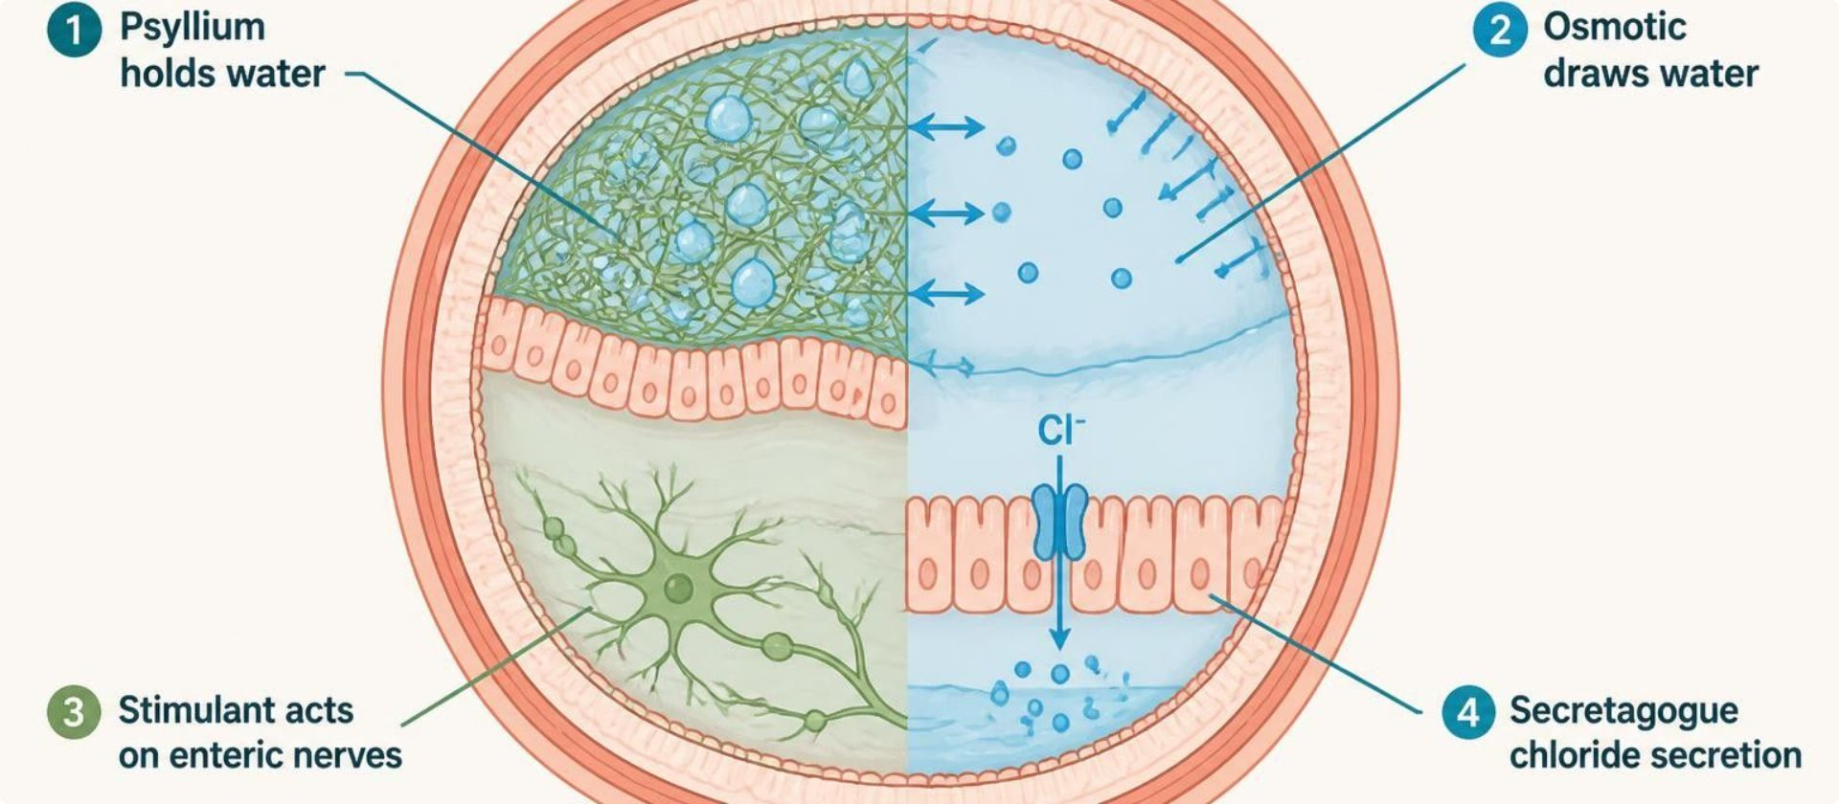
LAXATIVES & ANTIDIARRHEALS
Objectives: SO1 · SO4 · IO3.1 · IO3.2 · IO3.3 · IO3.4 · IO3.6
Figure 1 · Laxatives: how each class works
Schematic (illustrative): colon lumen cross-section — bulk-forming (psyllium) holds water and expands stool; osmotic (PEG, lactulose, magnesium) draws water into the lumen; stimulant (senna, bisacodyl) activates enteric nerves; secretagogue (lubiprostone, linaclotide) increases chloride and fluid secretion → softer stool, faster transit. S5; S5 (notes)
L06 · GI & Nutrition Pharmacology — Session 2
19

Slide 20
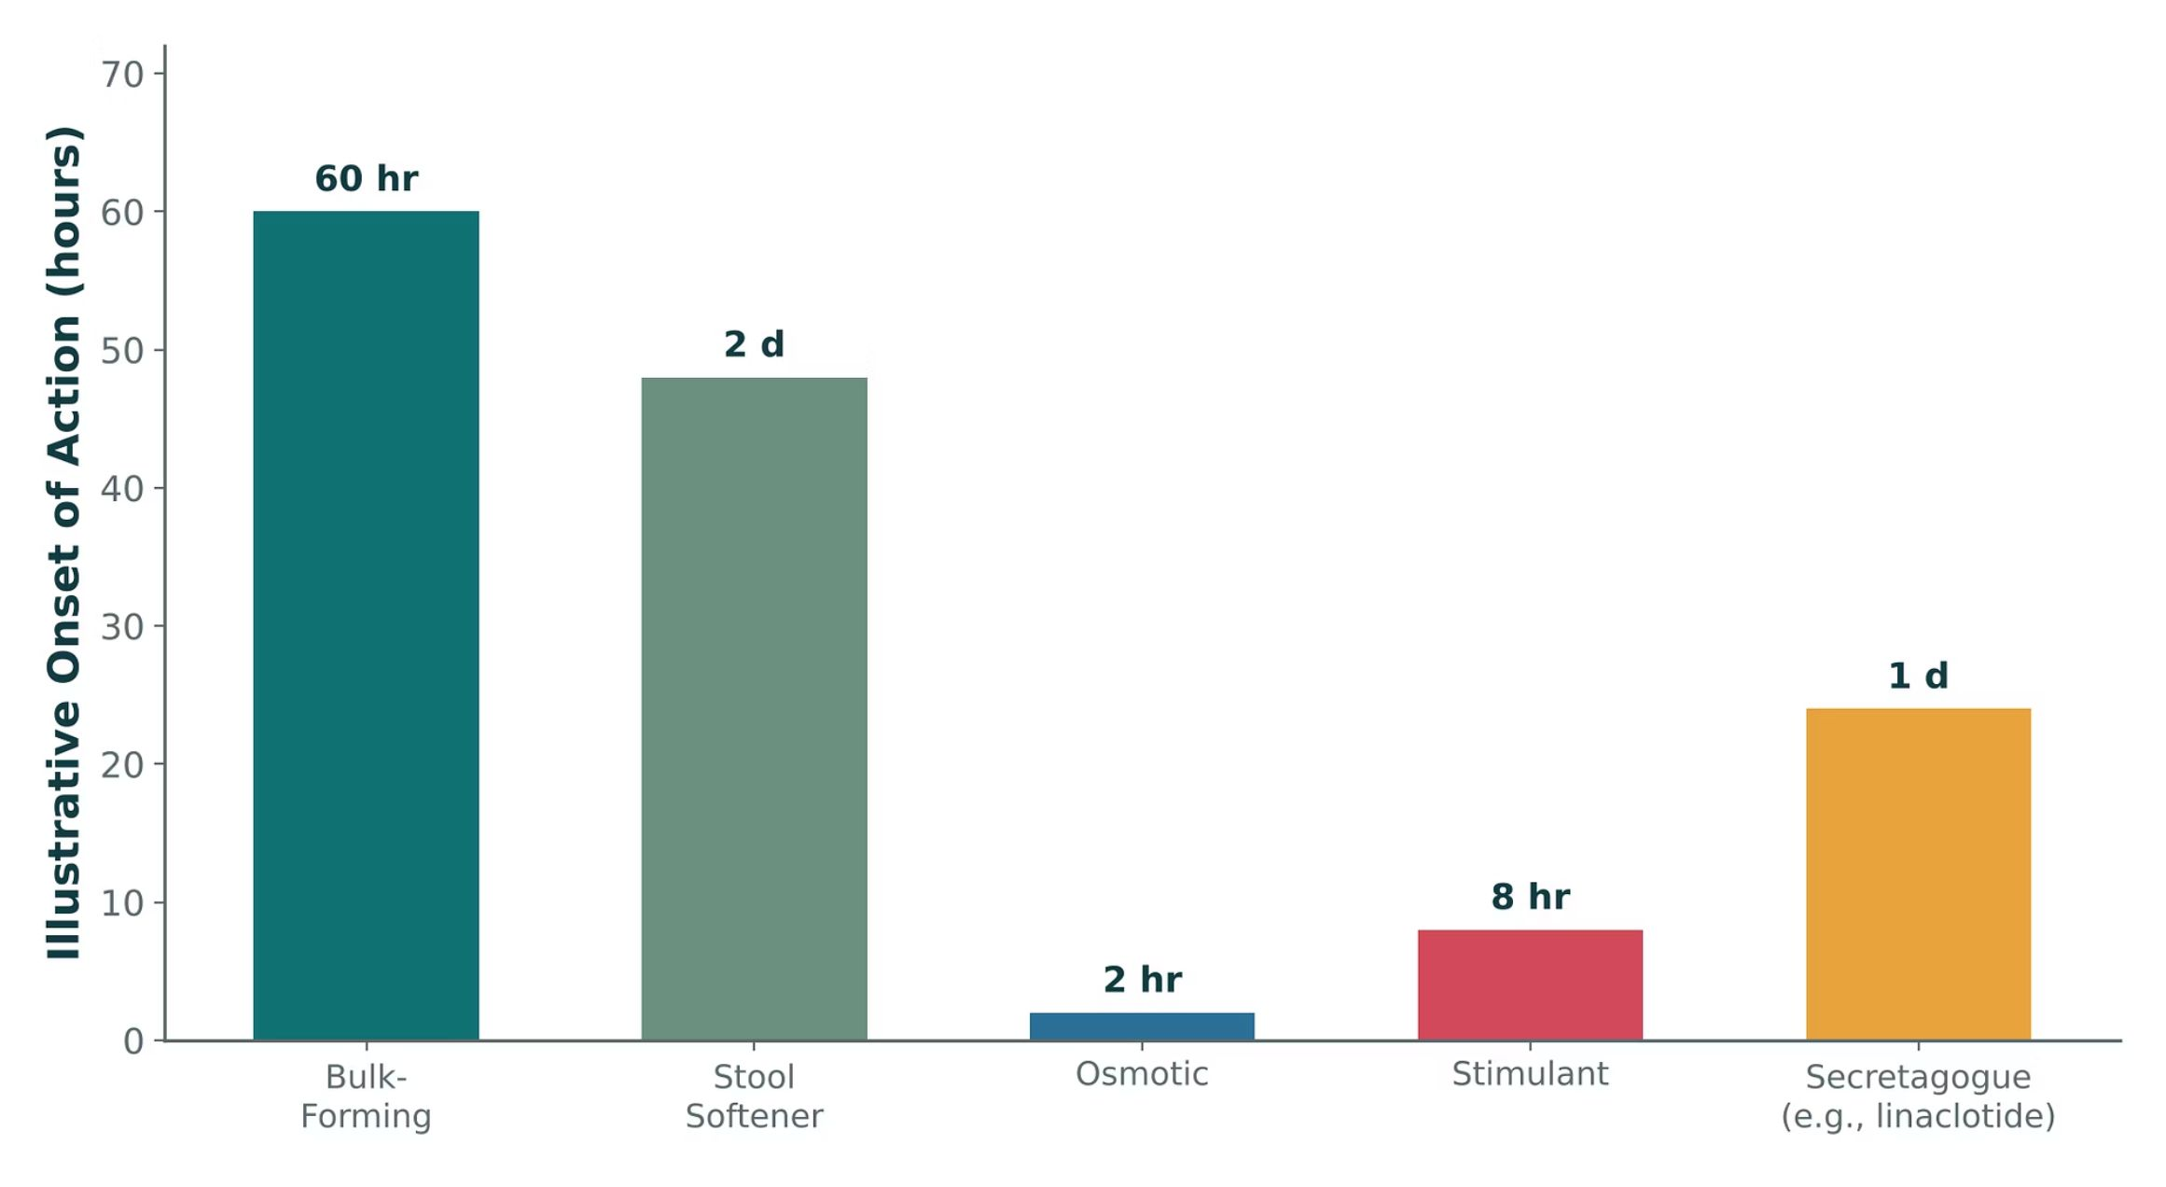
LAXATIVES & ANTIDIARRHEALS
Objectives: SO1 · SO4 · IO3.1 · IO3.2 · IO3.3 · IO3.4 · IO3.6
Figure 2 · Laxative onset of action by mechanism
Original illustrative comparison (illustrative onset-of-action values, not from Katzung; not trial data): bulk-forming 60 hr, stool softener 2 d, osmotic 2 hr, stimulant 8 hr, secretagogue (e.g., linaclotide) 1 d — osmotic and stimulant laxatives act fastest, while bulk-forming agents and stool softeners take the longest to produce an effect. S6; S6 (notes)
L06 · GI & Nutrition Pharmacology — Session 2
20

Slide 21
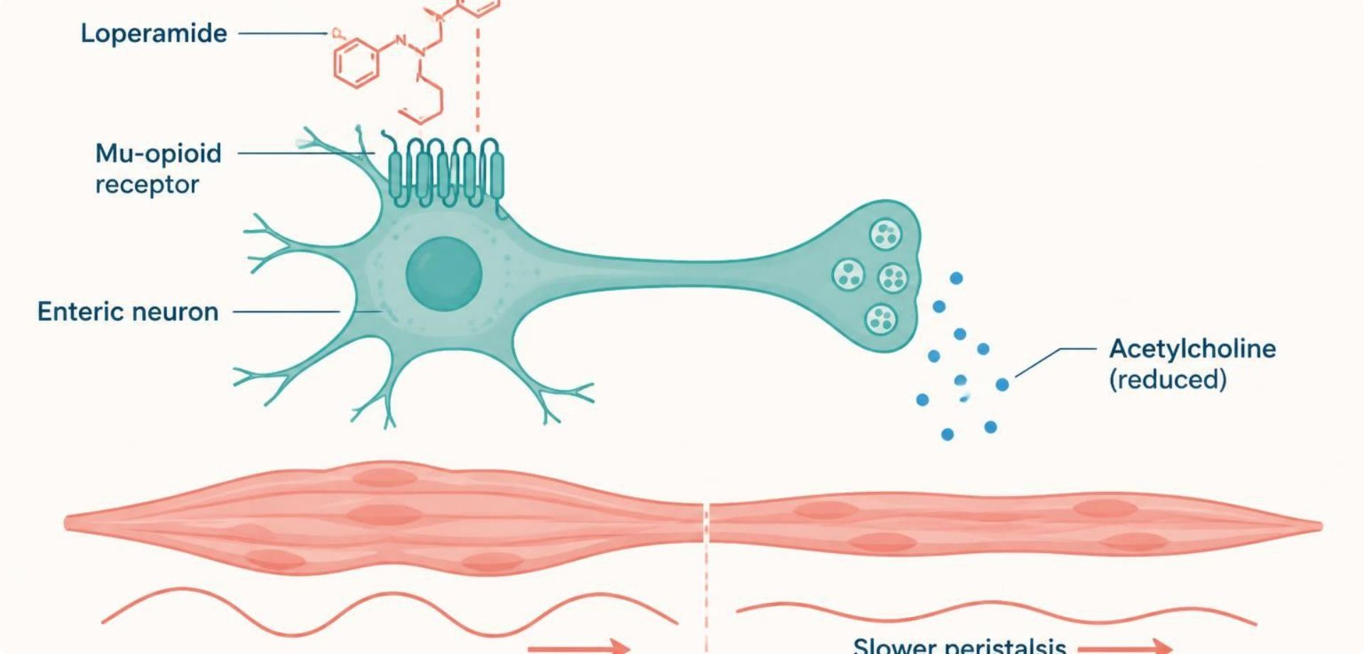
LAXATIVES & ANTIDIARRHEALS
Objectives: SO1 · SO4 · IO3.1 · IO3.2 · IO3.3 · IO3.4 · IO3.6
Figure 3 · Loperamide and diphenoxylate: opioid brake on the gut
Schematic (illustrative): loperamide binds mu-opioid receptors on myenteric neurons, reducing acetylcholine release and slowing peristalsis. S8; S8 (notes)
L06 · GI & Nutrition Pharmacology — Session 2
21

Slide 22


LAXATIVES & ANTIDIARRHEALS
Objectives: SO1 · SO4 · IO3.1 · IO3.2 · IO3.3 · IO3.4 · IO3.6
⚠ Sources disagree: Age cutoff for diphenoxylate/atropine
Lecture slides say
Textbook says
Avoid in children under 2 (S7 notes); under 6 (S8, S49). S7 (notes); S8; S49
TB Small amounts of atropine are added to discourage overdosage (no age cutoff given). p. 1166
L06 · GI & Nutrition Pharmacology — Session 2
22

Slide 23
LAXATIVES & ANTIDIARRHEALS
Objectives: SO1 · SO4 · IO3.1 · IO3.2 · IO3.3 · IO3.4 · IO3.6
Compare: Laxative classes
Class | Examples | How | Use / caution
Bulk-forming | Psyllium, methylcellulose | Hold water, expand stool | Slowest, safest long term; fluids; no obstruction
Osmotic | PEG, lactulose, magnesium hydroxide | Draw water into lumen | Fast; PEG first-line chronic; magnesium caution in CKD
Stimulant | Senna, bisacodyl | Activate enteric nerves | Short-term/breakthrough; cramping
Secretagogue | Lubiprostone, linaclotide | ↑ Chloride and fluid secretion | Chronic constipation, IBS-C; no obstruction
Focus: what tells these apart. Sources: S4; S5; SG U3-R9
L06 · GI & Nutrition Pharmacology — Session 2
23

Slide 24
LAXATIVES & ANTIDIARRHEALS
Objectives: SO1 · SO4 · IO3.1 · IO3.2 · IO3.3 · IO3.4 · IO3.6
Compare: Laxative drug profiles: formulation, dose, indications
Drug | Class | Formulation | Adult dose | Indications
Polyethylene glycol 3350 (MiraLAX) | Osmotic laxative | Powder for solution (17 g scoop); large-volume bowel-prep kits | 17 g in 4-8 oz fluid PO once daily; OTC use up to 7 days | Chronic and occasional constipation; bowel preparation (higher volumes)
Psyllium (Metamucil) | Bulk-forming laxative | Powder, capsules, wafers | About 3.4-6 g PO 1-3 times daily with at least 8 oz water | Constipation, IBS, mild cholesterol lowering
Methylcellulose (Citrucel) | Bulk-forming laxative | Powder; caplets 500 mg | About 2 g PO in 8 oz water 1-3 times daily; onset 12-72 hours | Constipation, stool bulking
Lactulose | Osmotic laxative, ammonia-lowering agent | Oral solution 10 g/15 mL | Constipation: 15-30 mL PO daily; hepatic encephalopathy: 30-45 mL PO 3-4 times daily, titrated to 2-3 soft stools | Constipation, hepatic encephalopathy
Focus: what tells these apart. Sources: S40; S41; S42; S43; S44; S45; S46; S47
L06 · GI & Nutrition Pharmacology — Session 2
24

Slide 25
LAXATIVES & ANTIDIARRHEALS
Objectives: SO1 · SO4 · IO3.1 · IO3.2 · IO3.3 · IO3.4 · IO3.6
Compare: Laxative drug profiles: formulation, dose, indications (cont.)
Drug | Class | Formulation | Adult dose | Indications
Senna (Senokot) | Stimulant laxative | Tablet 8.6 mg sennosides; liquid | 8.6-17.2 mg PO at bedtime (max 34 mg/day); onset 6-12 hours | Short-term constipation, opioid-induced constipation
Bisacodyl (Dulcolax) | Stimulant laxative | DR tablet 5 mg; suppository 10 mg | 5-15 mg PO at bedtime; 10 mg PR once daily; PO onset 6-12 hours, PR 15-60 min | Constipation, bowel preparation
Lubiprostone (Amitiza) | Chloride channel (ClC-2) activator | Capsule 8/24 mcg | Chronic constipation: 24 mcg PO BID with food; IBS-C (women): 8 mcg BID | Chronic idiopathic constipation, IBS-C, opioid-induced constipation
Linaclotide (Linzess) | Guanylate cyclase-C agonist | Capsule 72/145/290 mcg | CIC: 72-145 mcg PO daily; IBS-C: 290 mcg daily; 30 minutes before the first meal | Chronic idiopathic constipation, IBS-C
Focus: what tells these apart. Sources: S40; S41; S42; S43; S44; S45; S46; S47
L06 · GI & Nutrition Pharmacology — Session 2
25

Slide 26
LAXATIVES & ANTIDIARRHEALS
Objectives: SO1 · SO4 · IO3.1 · IO3.2 · IO3.3 · IO3.4 · IO3.6
Compare: Laxative drug profiles: adverse effects, contraindications, toxicity
Drug | Adverse effects | Contraindications | Toxicity / overdose
Polyethylene glycol 3350 (MiraLAX) | Bloating, nausea, gas, loose stools | Bowel obstruction, perforation, ileus, toxic megacolon | Dehydration and electrolyte loss with excess or bowel-prep volumes; rare allergic reactions
Psyllium (Metamucil) | Bloating, gas, abdominal fullness | Bowel obstruction, fecal impaction, dysphagia | Esophageal or intestinal obstruction if taken with too little fluid; allergy; separate from other drugs by 2 hours
Methylcellulose (Citrucel) | Bloating, gas | Bowel obstruction, dysphagia | Obstruction if taken without adequate fluid; may slow absorption of other drugs
Lactulose | Gas, bloating, cramps, diarrhea | Galactosemia, bowel obstruction | Dehydration and hypernatremia with over-use; worsens diabetes control slightly
Focus: what tells these apart. Sources: S40; S41; S42; S43; S44; S45; S46; S47
L06 · GI & Nutrition Pharmacology — Session 2
26

Slide 27
LAXATIVES & ANTIDIARRHEALS
Objectives: SO1 · SO4 · IO3.1 · IO3.2 · IO3.3 · IO3.4 · IO3.6
Compare: Laxative drug profiles: adverse effects, contraindications, toxicity (cont.)
Drug | Adverse effects | Contraindications | Toxicity / overdose
Senna (Senokot) | Cramping, diarrhea, urine discoloration, melanosis coli | Bowel obstruction, appendicitis, undiagnosed abdominal pain | Hypokalemia and dehydration with chronic use; laxative dependence
Bisacodyl (Dulcolax) | Cramping, nausea, rectal irritation | Bowel obstruction, appendicitis, acute abdomen | Do not crush; avoid with antacids or milk; excess causes diarrhea, hypokalemia
Lubiprostone (Amitiza) | Nausea, diarrhea, headache, abdominal pain | Mechanical GI obstruction | Dizziness, syncope or dyspnea (rare); overdose: nausea, diarrhea; avoid in pregnancy unless needed
Linaclotide (Linzess) | Diarrhea, abdominal pain, gas, bloating | Boxed: children under 2 years; mechanical GI obstruction | Severe dehydration (deaths in young children); severe diarrhea; stop if severe or prolonged
Focus: what tells these apart. Sources: S40; S41; S42; S43; S44; S45; S46; S47
L06 · GI & Nutrition Pharmacology — Session 2
27

Slide 28
LAXATIVES & ANTIDIARRHEALS
Objectives: SO1 · SO4 · IO3.1 · IO3.2 · IO3.3 · IO3.4 · IO3.6
Compare: Antidiarrheal drug profiles: formulation, dose, indications
Drug | Class | Formulation | Adult dose | Indications
Loperamide (Imodium) | Peripheral mu-opioid agonist | Capsule 2 mg; tablet 2 mg; oral liquid | 4 mg PO first dose, then 2 mg after each loose stool; max 16 mg/day Rx, 8 mg/day OTC | Acute and chronic diarrhea, traveler's diarrhea
Diphenoxylate/atropine (Lomotil) | Opioid antidiarrheal (C-V) plus anticholinergic | Tablet 2.5 mg/0.025 mg; oral liquid 2.5 mg/5 mL | 5 mg (2 tablets) PO QID initially; max 20 mg/day; reduce as controlled | Adjunct for diarrhea
Focus: what tells these apart. Sources: S48; S49
L06 · GI & Nutrition Pharmacology — Session 2
28

Slide 29
LAXATIVES & ANTIDIARRHEALS
Objectives: SO1 · SO4 · IO3.1 · IO3.2 · IO3.3 · IO3.4 · IO3.6
Compare: Antidiarrheal drug profiles: adverse effects, contraindications, toxicity
Drug | Adverse effects | Contraindications | Toxicity / overdose
Loperamide (Imodium) | Constipation, cramps, dizziness, nausea | Bloody stool or high fever, C. difficile, children under 2, ileus | High doses: QT prolongation, torsades, cardiac arrest; CNS depression in overdose (naloxone, repeated)
Diphenoxylate/atropine (Lomotil) | Drowsiness, dry mouth, tachycardia, urinary retention | Children under 6 years, obstructive jaundice, C. difficile or infectious diarrhea | Respiratory depression (especially children) and anticholinergic toxicity; naloxone, with monitoring for relapse
Focus: what tells these apart. Sources: S48; S49
L06 · GI & Nutrition Pharmacology — Session 2
29

Slide 30
LAXATIVES & ANTIDIARRHEALS
Objectives: SO1 · SO4 · IO3.1 · IO3.2 · IO3.3 · IO3.4 · IO3.6
Compare: Other bowel drugs in the reading (textbook)
Group | Drugs | Point
Bulk-forming laxatives | Psyllium, methylcellulose, polycarbophil | Hydrophilic gel distends colon; bloating, flatus
Stool surfactant agents (softeners) | Docusate, glycerin, mineral oil | Mineral oil: lipid pneumonitis if aspirated
Osmotic laxatives; balanced polyethylene glycol | Magnesium, sorbitol, lactulose; PEG lavage | PEG causes no significant cramps or flatus; bowel prep 1–2 L
Stimulant laxatives: anthraquinone and diphenylmethane derivatives | Senna, cascara (melanosis coli); bisacodyl | Long-term use probably safe in most
Chloride secretion activators | Lubiprostone (ClC-2); linaclotide, plecanatide (GC-C) | Nausea up to 30% (lubiprostone); diarrhea up to 20% (linaclotide)
Opioid receptor antagonists | Methylnaltrexone, naloxegol, naldemedine, alvimopan | Opioid-induced constipation; alvimopan postoperative ileus only
Serotonin 5-HT4-receptor agonists | Prucalopride | Chronic constipation; 1 mg/day if CrCl < 30
Focus: what tells these apart. Sources: p. 1164; p. 1165; p. 1166; p. 1167; p. 1168
L06 · GI & Nutrition Pharmacology — Session 2
30

Slide 31
LAXATIVES & ANTIDIARRHEALS
Objectives: SO1 · SO4 · IO3.1 · IO3.2 · IO3.3 · IO3.4 · IO3.6
Compare: Other bowel drugs in the reading (textbook) (cont.)
Group | Drugs | Point
Antidiarrheal agents: opioid agonists | Loperamide, diphenoxylate, eluxadoline | Eluxadoline: IBS-D; sphincter of Oddi spasm
Colloidal bismuth compounds | Bismuth subsalicylate | Traveler’s diarrhea
Bile salt-binding resins | Cholestyramine, colestipol, colesevelam | Bile-acid diarrhea; separate other drugs by 2 hours
Octreotide | Somatostatin analog | Secretory tumor diarrhea; gallstones with long-term use
IBS: antispasmodics (anticholinergics) | Dicyclomine, hyoscyamine | Short-term pain relief; anticholinergic effects
IBS: serotonin 5-HT3-receptor antagonists | Alosetron | Women with severe IBS-D; ischemic colitis, severe constipation
IBS: chloride channel activators | Lubiprostone 8 mcg twice daily; linaclotide 290 mcg | IBS-C
Focus: what tells these apart. Sources: p. 1164; p. 1165; p. 1166; p. 1167; p. 1168
L06 · GI & Nutrition Pharmacology — Session 2
31

Slide 32
LAXATIVES & ANTIDIARRHEALS
Objectives: SO1 · SO4 · IO3.1 · IO3.2 · IO3.3 · IO3.4 · IO3.6
Memory hooks
Why it happens
Why it happens
Why is atropine in Lomotil? At the tiny dose given it does nothing — but anyone taking big doses to get high gets unpleasant anticholinergic effects. S7; SG U3-R10
Why not loperamide in C. difficile? Slowing transit keeps toxin in the colon longer — toxic megacolon risk. S7 (notes); SG U3-R10
L06 · GI & Nutrition Pharmacology — Session 2
32

Slide 33

LAXATIVES & ANTIDIARRHEALS
Objectives: SO1 · SO4 · IO3.1 · IO3.2 · IO3.3 · IO3.4 · IO3.6
High-yield summary
If you remember nothing else
Four laxative buckets: bulk-forming (slowest, safest), osmotic (fast; PEG first-line), stimulant (short-term), secretagogue (IBS-C). S4; S5
No antimotility agents in C. difficile or bloody/febrile diarrhea. S7; SG U3-R10
L06 · GI & Nutrition Pharmacology — Session 2
33

Slide 34
CLINICAL VIGNETTE · LECTURE QUICK CHECK S9
Objectives: SO1 · SO4 · IO3.1 · IO3.2 · IO3.3 · IO3.4 · IO3.6
Question 1
A patient develops profuse watery diarrhea and fever three days after clindamycin. Is loperamide an appropriate choice?
A
No — use bisacodyl to flush the colon
B
No — suspect C. difficile and treat the infection
C
Yes — at very high doses for a few days
D
Yes — slowing transit clears the toxin faster
E
Yes — combined with diphenoxylate/atropine
L06 · GI & Nutrition Pharmacology — Session 2
34
Notes:
Answer on the next slide. Source: S9; SG U3-R10

Slide 35

CLINICAL VIGNETTE · ANSWER
Objectives: SO1 · SO4 · IO3.1 · IO3.2 · IO3.3 · IO3.4 · IO3.6
Answer 1: B
B. No — suspect C. difficile and treat the infection
This is concerning for C. difficile; antimotility agents can worsen toxin-mediated colonic injury. Treat with oral vancomycin or fidaxomicin (S9). S9; SG U3-R10
Why the other choices are wrong
A. No — use bisacodyl to flush the colon — A laxative is not the treatment (S9).
C. Yes — at very high doses for a few days — High doses also risk QT prolongation (S8).
D. Yes — slowing transit clears the toxin faster — Slowing transit delays clearance (S7).
E. Yes — combined with diphenoxylate/atropine — Both are antimotility agents (S7).
L06 · GI & Nutrition Pharmacology — Session 2
35

Slide 36
CLINICAL VIGNETTE
Objectives: SO1 · SO4 · IO3.1 · IO3.2 · IO3.3 · IO3.4 · IO3.6
Question 5
A patient needs relief from constipation tonight before a trip. Which class fits worst?
A
Stimulant (bisacodyl suppository)
B
Stimulant senna at bedtime
C
Osmotic polyethylene glycol
D
Osmotic magnesium hydroxide
E
Bulk-forming psyllium
L06 · GI & Nutrition Pharmacology — Session 2
36
Notes:
Answer on the next slide. Source: S6

Slide 37
CLINICAL VIGNETTE · ANSWER
Objectives: SO1 · SO4 · IO3.1 · IO3.2 · IO3.3 · IO3.4 · IO3.6
Answer 5: E
E. Bulk-forming psyllium
Bulk-forming agents take the longest; a patient who needs relief tonight is not a bulk-forming candidate (S6 notes). S6
Why the other choices are wrong
A. Stimulant (bisacodyl suppository) — Rectal bisacodyl works in 15–60 min (S45).
B. Stimulant senna at bedtime — 6–12 hours (S44).
C. Osmotic polyethylene glycol — Fast, reliable (S4).
D. Osmotic magnesium hydroxide — Fast osmotic (S4).
L06 · GI & Nutrition Pharmacology — Session 2
37

Slide 38
Drug class 2 of 4
Inflammatory Bowel Disease
Covers objectives: SO2 · SO4 · IO3.1 · IO3.2 · IO3.3 · IO3.4 · IO3.5
Class
Prototype
Mechanism of action
Indications
Adverse effects
Contraindications
Drug interactions
Pharmacokinetics
Monitoring
Clinical pearls
38

Slide 39
INFLAMMATORY BOWEL DISEASE
Objectives: SO2 · SO4 · IO3.1 · IO3.2 · IO3.3 · IO3.4 · IO3.5
Class · Prototype + other drugs named
Class
Prototype + other drugs named
Step therapy, escalating with disease severity: 5-ASA agents for mild disease → short-term corticosteroids for flares → immunomodulators for maintenance → biologics/small molecules for moderate-to-severe disease. S10; S10 (notes); S11; SG U3-R11
This escalation ladder is the organizing framework for every IBD drug — ask where each drug “lives” on it. S11 (notes)
Mesalamine — 5-ASA (step 1). S12
Prednisone, budesonide — corticosteroids (flares). S14
Azathioprine, 6-mercaptopurine — immunomodulators (maintenance). S14
Infliximab, adalimumab, vedolizumab, ustekinumab, tofacitinib — targeted therapy. S16
L06 · GI & Nutrition Pharmacology — Session 2
39

Slide 40
INFLAMMATORY BOWEL DISEASE
Objectives: SO2 · SO4 · IO3.1 · IO3.2 · IO3.3 · IO3.4 · IO3.5
Mechanism of action
Mechanism of action (1/2)
Mesalamine, sulfasalazine — anti-inflammatory action local to the GI mucosa. Sulfasalazine reaches the colon → colonic bacteria cleave the azo bond → 5-ASA (mesalamine) plus sulfapyridine released → 5-ASA acts on mucosa, reducing inflammatory mediators → less mucosal inflammation. S12; S13; S13 (notes)
Azathioprine is converted to 6-mercaptopurine → metabolized to thioguanine nucleotides → block purine synthesis in lymphocytes → fewer proliferating T and B cells → slow, sustained remission. S15; S15 (notes)
Targeted therapy: TNF-α inhibitors block tumor necrosis factor-alpha (infliximab, adalimumab); the integrin inhibitor blocks α4β7 integrin-mediated leukocyte gut-homing (vedolizumab); the IL-12/23 inhibitor blocks interleukin-12 and -23 signaling (ustekinumab); the JAK inhibitor blocks intracellular JAK signaling (tofacitinib). S16; S16 (notes); S17
L06 · GI & Nutrition Pharmacology — Session 2
40

Slide 41
INFLAMMATORY BOWEL DISEASE
Objectives: SO2 · SO4 · IO3.1 · IO3.2 · IO3.3 · IO3.4 · IO3.5
Mechanism of action (cont.)
Mechanism of action (2/2)
Vedolizumab is the most gut-selective agent — less systemic immunosuppression than TNF inhibitors, JAK inhibitors, or thiopurines. S38; SG U3-R11
TB Chemistry & formulations: azo compounds (sulfasalazine, balsalazide, olsalazine) are cleaved by colonic bacteria; mesalamine formulations release 5-ASA at set pH or times. p. 1173
L06 · GI & Nutrition Pharmacology — Session 2
41

Slide 42
INFLAMMATORY BOWEL DISEASE
Objectives: SO2 · SO4 · IO3.1 · IO3.2 · IO3.3 · IO3.4 · IO3.5
Indications
Indications
5-ASA: first-line for mild-to-moderate ulcerative colitis; more limited role in Crohn disease. S12
Corticosteroids: short-term induction of remission during an acute flare; not appropriate for long-term maintenance given cumulative toxicity. S14
Immunomodulators: long-term maintenance of remission; onset is slow (weeks to months) — not useful for acute flares. S14
Delayed-release forms target the ileum or colon; enemas and suppositories treat distal disease. S12 (notes); S13
TB Corticosteroids: prednisone 40–60 mg/d for flares, tapered after response; rectal forms for distal disease; not for maintenance. p. 1174; p. 1175
L06 · GI & Nutrition Pharmacology — Session 2
42

Slide 43
INFLAMMATORY BOWEL DISEASE
Objectives: SO2 · SO4 · IO3.1 · IO3.2 · IO3.3 · IO3.4 · IO3.5
Adverse effects (boxed warnings first)
Adverse effects (boxed warnings first) (1/2)
The major safety theme across immunomodulators and biologics: immunosuppression → increased infection risk. S18; S18 (notes)
Sulfasalazine: the sulfapyridine component causes most adverse effects — rash, hemolysis in G6PD deficiency, agranulocytosis, folate deficiency (give folic acid); caution in sulfa allergy. S12; S12 (notes); S13
Mesalamine: monitor renal function (interstitial nephritis). 5-ASA agents are generally well tolerated — a favorable long-term safety profile relative to steroids and immunomodulators. S12; S12 (notes); S13
Thiopurines: increased infection and lymphoma risk; monitor CBC and liver tests (bone marrow suppression, hepatotoxicity). S14; S15
L06 · GI & Nutrition Pharmacology — Session 2
43

Slide 44
INFLAMMATORY BOWEL DISEASE
Objectives: SO2 · SO4 · IO3.1 · IO3.2 · IO3.3 · IO3.4 · IO3.5
Adverse effects (boxed warnings first) (cont.)
Adverse effects (boxed warnings first) (2/2)
TB Up to 40% cannot tolerate therapeutic sulfasalazine doses; give 1 mg/d folic acid; reversible oligospermia. p. 1174
TB Anti-TNF: TB reactivation — test before starting; antibodies to the drug reduce response; infliximab infusion reactions in up to 10%. p. 1177
TB Tofacitinib: fourfold herpes zoster reactivation (vaccinate first); check lipids at 8 weeks. p. 1178
L06 · GI & Nutrition Pharmacology — Session 2
44

Slide 45
INFLAMMATORY BOWEL DISEASE
Objectives: SO2 · SO4 · IO3.1 · IO3.2 · IO3.3 · IO3.4 · IO3.5
Contraindications · Drug interactions
Contraindications
Drug interactions
Sulfasalazine: caution in sulfa allergy (sulfapyridine). S12
TB No azathioprine/6-MP with absent TPMT activity (low in 11%, absent in 0.3%). p. 1175
Allopurinol blocks thiopurine metabolism — reduce the thiopurine dose by about two-thirds to three-quarters; febuxostat is avoided. S15; S70
Ketoconazole (CYP3A4 inhibitor) raises budesonide exposure. S52; S70
L06 · GI & Nutrition Pharmacology — Session 2
45

Slide 46
INFLAMMATORY BOWEL DISEASE
Objectives: SO2 · SO4 · IO3.1 · IO3.2 · IO3.3 · IO3.4 · IO3.5
Pharmacokinetics · Monitoring
Pharmacokinetics
Monitoring
Budesonide has high first-pass metabolism — less systemic exposure than prednisone. S14; S14 (notes)
TB Thiopurines take a median 17 weeks to benefit; budesonide bioavailability about 10% (CYP3A4 inhibitors raise it). p. 1174; p. 1175
Test TPMT and NUDT15 before starting thiopurines; low activity raises myelosuppression risk. S15; S15 (notes)
Before biologics: tuberculosis and hepatitis B/C screening; update vaccines, especially live vaccines, before starting; regular labs to catch cytopenias, hepatotoxicity, or infection early. S18; S18 (notes)
L06 · GI & Nutrition Pharmacology — Session 2
46

Slide 47
INFLAMMATORY BOWEL DISEASE
Objectives: SO2 · SO4 · IO3.1 · IO3.2 · IO3.3 · IO3.4 · IO3.5
Clinical pearls / "why" hook
Clinical pearls / "why" hook (1/2)
Infliximab and adalimumab are the same TNF-α inhibitors as the RA biologic DMARDs in Lecture 2 — same mechanism, same risk profile in a new organ system. S16 (notes); S18; S18 (notes)
“Fast but not for the long term” (steroids) vs. “slow but sustainable” (immunomodulators) parallels the acute-vs-chronic gout framework. S14 (notes)
Case: newly diagnosed mild UC asks why mesalamine, not a biologic. How would you explain the step-therapy rationale to this patient? S19
L06 · GI & Nutrition Pharmacology — Session 2
47

Slide 48
INFLAMMATORY BOWEL DISEASE
Objectives: SO2 · SO4 · IO3.1 · IO3.2 · IO3.3 · IO3.4 · IO3.5
Clinical pearls / "why" hook (cont.)
Clinical pearls / "why" hook (2/2)
Therapy is matched to severity: mild disease responds to 5-ASA with a favorable safety profile; biologics are reserved for moderate-to-severe or refractory disease given cost, administration burden, and immunosuppression risks. S19; S19 (notes)
Name stems: -ximab chimeric (infliximab, anti-TNF-α); -umab human (adalimumab, ustekinumab); -zumab humanized (vedolizumab, α4β7 integrin). S20
More stems: -tinib kinase inhibitor (tofacitinib, JAK); -sone corticosteroid (prednisone, short-term induction); -tide peptide (linaclotide, GC-C agonist). 5-ASA agents, thiopurines and opioid antidiarrheals share no stem. A stem is a memory aid, not a rule. S20; S20 (notes)
L06 · GI & Nutrition Pharmacology — Session 2
48

Slide 49
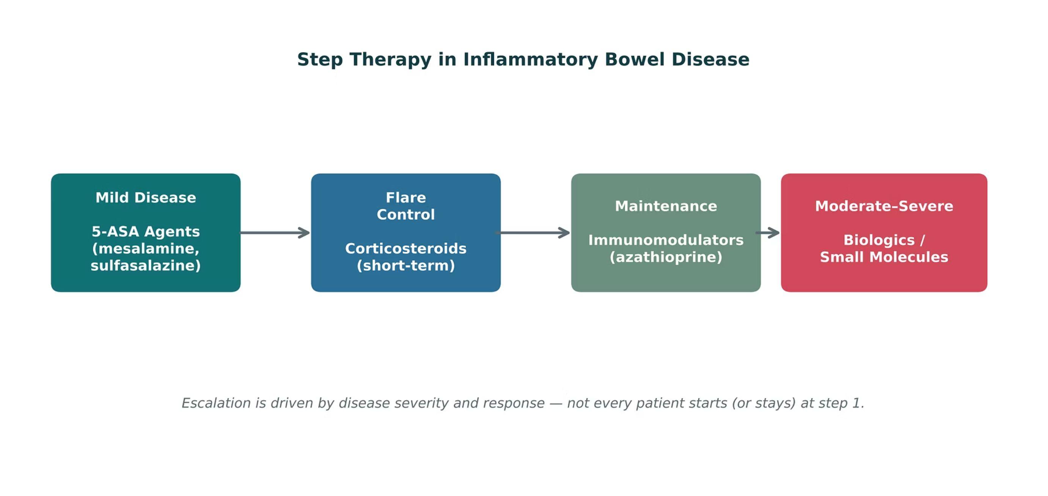
INFLAMMATORY BOWEL DISEASE
Objectives: SO2 · SO4 · IO3.1 · IO3.2 · IO3.3 · IO3.4 · IO3.5
Figure 4 · Step therapy in inflammatory bowel disease
Original illustrative diagram (not from Katzung): therapy escalates from 5-ASA agents for mild disease, through short-term corticosteroids for flares and immunomodulators for maintenance, to biologics/small molecules for moderate-to-severe disease. S11; S11 (notes)
L06 · GI & Nutrition Pharmacology — Session 2
49

Slide 50
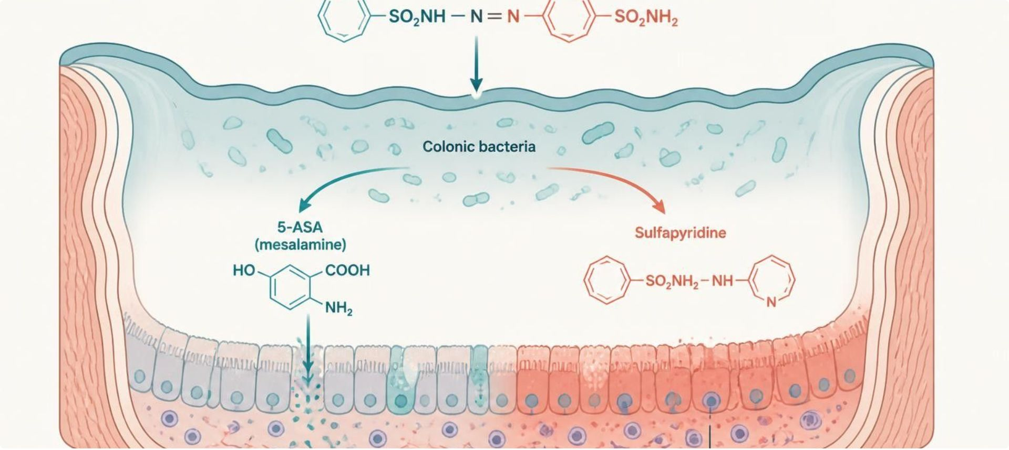
INFLAMMATORY BOWEL DISEASE
Objectives: SO2 · SO4 · IO3.1 · IO3.2 · IO3.3 · IO3.4 · IO3.5
Figure 5 · 5-ASA: local anti-inflammatory action
Schematic (illustrative): sulfasalazine is cleaved by colonic bacteria; the released 5-ASA acts locally on the inflamed colonic mucosa. S13; S13 (notes)
L06 · GI & Nutrition Pharmacology — Session 2
50

Slide 51
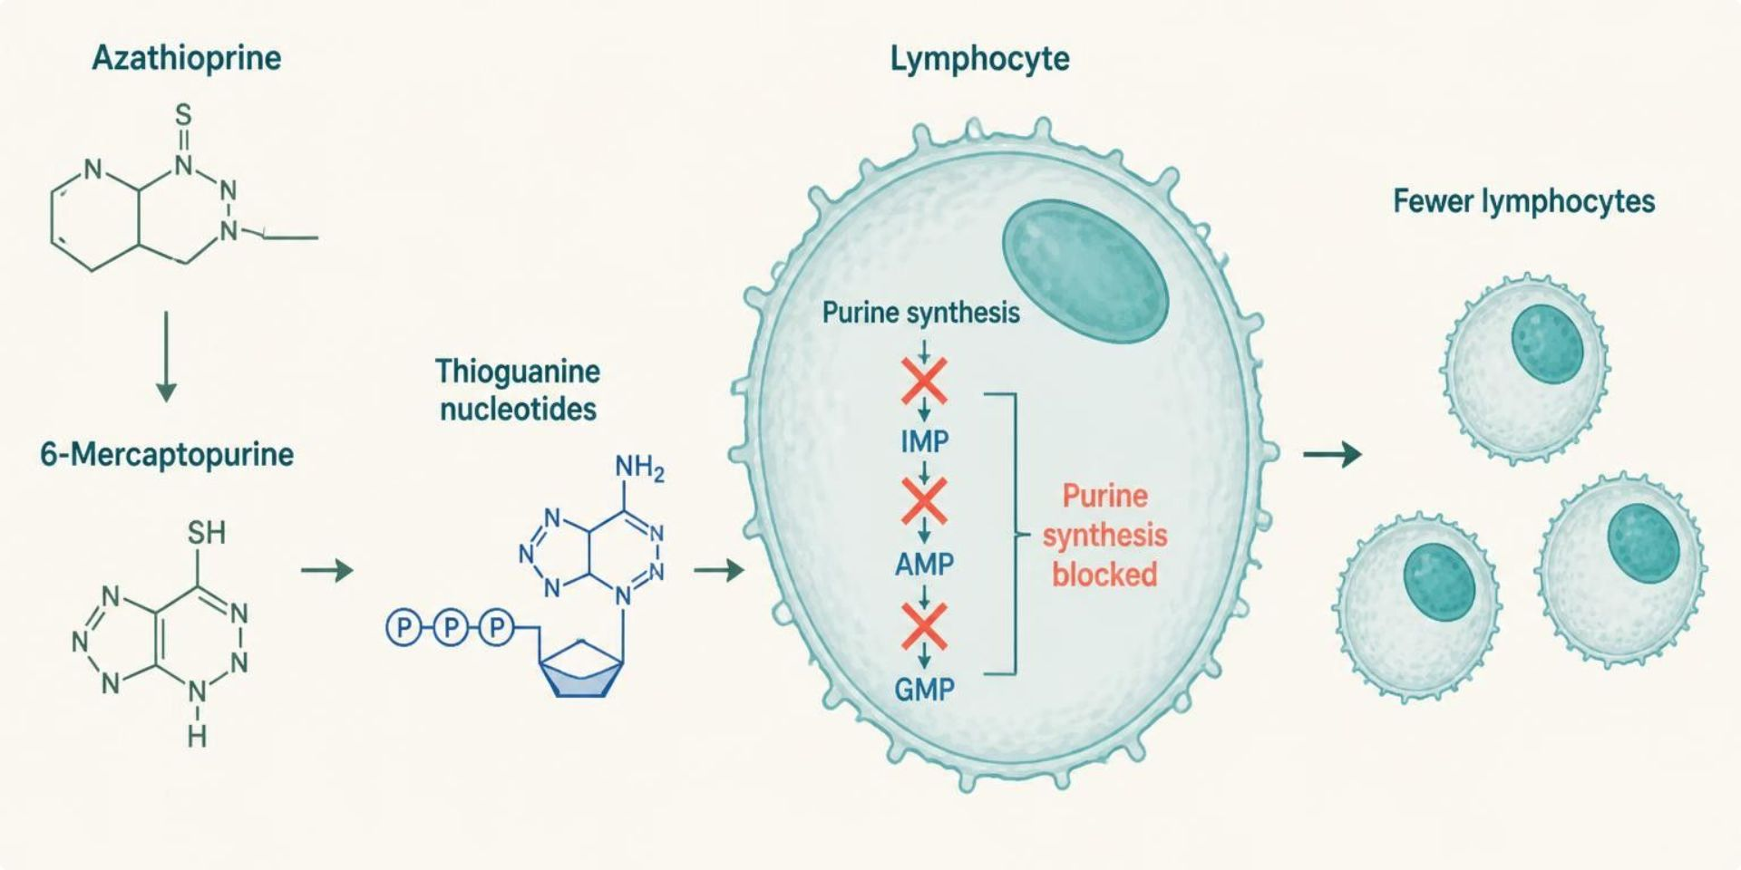
INFLAMMATORY BOWEL DISEASE
Objectives: SO2 · SO4 · IO3.1 · IO3.2 · IO3.3 · IO3.4 · IO3.5
Figure 6 · Azathioprine and 6-MP: purine antimetabolites
Schematic (illustrative): thiopurine metabolites block lymphocyte purine synthesis, so fewer lymphocytes proliferate. S15; S15 (notes)
L06 · GI & Nutrition Pharmacology — Session 2
51

Slide 52
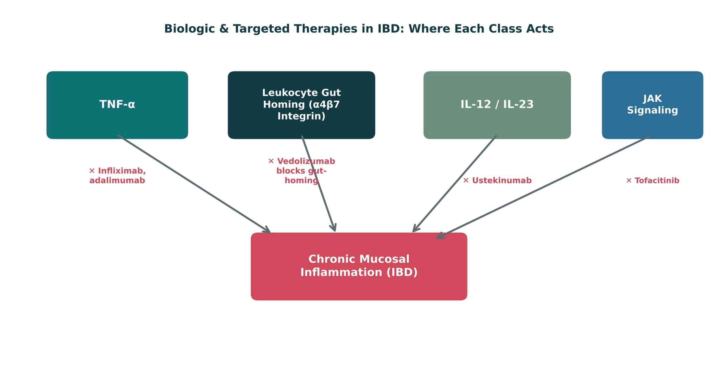
INFLAMMATORY BOWEL DISEASE
Objectives: SO2 · SO4 · IO3.1 · IO3.2 · IO3.3 · IO3.4 · IO3.5
Figure 7 · Biologic & targeted therapies in IBD: where each class acts
Original illustrative diagram (not from Katzung): infliximab/adalimumab block TNF-α, vedolizumab blocks leukocyte gut-homing, ustekinumab blocks IL-12/23, and tofacitinib blocks JAK signaling — four distinct points of intervention in chronic mucosal inflammation. S17; S17 (notes)
L06 · GI & Nutrition Pharmacology — Session 2
52

Slide 53
INFLAMMATORY BOWEL DISEASE
Objectives: SO2 · SO4 · IO3.1 · IO3.2 · IO3.3 · IO3.4 · IO3.5
⚠ Sources disagree: Thiopurine onset
Lecture slides say
Textbook says
Onset takes weeks to months (azathioprine 8–12 weeks). S15; S54
TB A median delay of 17 weeks before benefit. p. 1175
L06 · GI & Nutrition Pharmacology — Session 2
53

Slide 54
INFLAMMATORY BOWEL DISEASE
Objectives: SO2 · SO4 · IO3.1 · IO3.2 · IO3.3 · IO3.4 · IO3.5
Compare: IBD drug classes
Step | Drugs | Role | Key safety
1 · 5-ASA | Mesalamine, sulfasalazine | Mild-moderate UC (induction + maintenance) | Sulfapyridine AEs; renal monitoring (mesalamine)
Flare | Prednisone, budesonide | Short-term induction | Cumulative toxicity; not maintenance
Maintenance | Azathioprine, 6-MP | Slow, sustained remission | TPMT/NUDT15; CBC, LFTs; allopurinol interaction
Targeted | Infliximab, adalimumab, vedolizumab, ustekinumab, tofacitinib | Moderate-severe or refractory | Infection: TB/hepatitis screen, vaccines first
Focus: what tells these apart. Sources: S11; S12; S14; S15; S16; S18
L06 · GI & Nutrition Pharmacology — Session 2
54

Slide 55
INFLAMMATORY BOWEL DISEASE
Objectives: SO2 · SO4 · IO3.1 · IO3.2 · IO3.3 · IO3.4 · IO3.5
Compare: Name clues: bowel disorders and IBD
Stem | Drug class | Examples | Key point
-ximab | Monoclonal Ab (chimeric) | Infliximab | Anti-TNF-α
-umab | Monoclonal Ab (human) | Adalimumab, ustekinumab | Anti-TNF-α; anti-IL-12/23
-zumab | Monoclonal Ab (humanized) | Vedolizumab | Blocks α4β7 integrin
-tinib | Kinase inhibitor | Tofacitinib | JAK inhibitor
-sone | Corticosteroid | Prednisone | Short-term induction
-tide | Peptide | Linaclotide | GC-C agonist
None shared | 5-ASA agents | Mesalamine, sulfasalazine | Local mucosal action
None shared | Thiopurines | Azathioprine, mercaptopurine | Slow maintenance
None shared | Opioid antidiarrheals | Loperamide, diphenoxylate | Slows motility
Focus: what tells these apart. Sources: S20; S20 (notes)
L06 · GI & Nutrition Pharmacology — Session 2
55

Slide 56
INFLAMMATORY BOWEL DISEASE
Objectives: SO2 · SO4 · IO3.1 · IO3.2 · IO3.3 · IO3.4 · IO3.5
Compare: 5-ASA, steroid and thiopurine profiles: formulation, dose, indications
Drug | Class | Formulation | Adult dose | Indications
Mesalamine (Lialda, Asacol HD, Pentasa) | 5-ASA aminosalicylate | DR tablet 800 mg/1.2 g; capsule; suppository 1,000 mg; enema 4 g/60 mL | Mild-moderate UC: 2.4-4.8 g/day PO once daily or divided; 1,000 mg PR at bedtime for proctitis | Induction and maintenance in ulcerative colitis; mild Crohn disease (some forms)
Sulfasalazine (Azulfidine) | Sulfapyridine plus 5-ASA prodrug | Tablet 500 mg; EN-tabs DR 500 mg | Active UC: start 1-2 g/day, titrate to 3-4 g/day in divided doses; maintenance 2 g/day; folic acid 1 mg daily | Ulcerative colitis, rheumatoid arthritis (EN-tabs)
Budesonide (Entocort EC, Uceris) | Locally acting corticosteroid | Capsule 3 mg; ER tablet 9 mg; foam | Crohn disease: 9 mg PO every morning for up to 8 weeks; UC: 9 mg ER tablet daily for 8 weeks | Mild-moderate ileocecal Crohn disease, mild-moderate UC
Focus: what tells these apart. Sources: S50; S51; S52; S53; S54; S55
L06 · GI & Nutrition Pharmacology — Session 2
56

Slide 57
INFLAMMATORY BOWEL DISEASE
Objectives: SO2 · SO4 · IO3.1 · IO3.2 · IO3.3 · IO3.4 · IO3.5
Compare: 5-ASA, steroid and thiopurine profiles: formulation, dose, indications (cont.)
Drug | Class | Formulation | Adult dose | Indications
Prednisone | Systemic corticosteroid | Tablet 1/2.5/5/10/20/50 mg; oral solution | Flare: 40-60 mg PO daily, then taper over weeks; short-term induction only | Induction of remission in IBD flares; many inflammatory conditions
Azathioprine (Imuran) | Purine antimetabolite | Tablet 50/75/100 mg; IV | IBD maintenance: 1.5-2.5 mg/kg PO daily after TPMT/NUDT15 testing; onset 8-12 weeks | Maintenance of remission in Crohn disease and UC (off-label), organ transplant
Mercaptopurine (6-MP, Purinethol) | Purine antimetabolite | Tablet 50 mg; oral suspension | IBD (off-label): 1-1.5 mg/kg PO daily after TPMT/NUDT15 testing | Maintenance in Crohn disease and UC; acute lymphoblastic leukemia
Focus: what tells these apart. Sources: S50; S51; S52; S53; S54; S55
L06 · GI & Nutrition Pharmacology — Session 2
57

Slide 58
INFLAMMATORY BOWEL DISEASE
Objectives: SO2 · SO4 · IO3.1 · IO3.2 · IO3.3 · IO3.4 · IO3.5
Compare: 5-ASA, steroid and thiopurine profiles: adverse effects, contraindications, toxicity
Drug | Adverse effects | Contraindications | Toxicity / overdose
Mesalamine (Lialda, Asacol HD, Pentasa) | Headache, nausea, abdominal pain, flatulence | Salicylate hypersensitivity | Interstitial nephritis (monitor creatinine); acute intolerance syndrome (cramps, bloody diarrhea); hepatotoxicity rare
Sulfasalazine (Azulfidine) | Nausea, headache, rash, orange urine, reversible low sperm count | Sulfa or salicylate allergy, intestinal or urinary obstruction, porphyria | Agranulocytosis, hemolysis in G6PD deficiency, Stevens-Johnson syndrome, hepatitis; folate deficiency
Budesonide (Entocort EC, Uceris) | Headache, nausea, acne, adrenal suppression with long courses | Hypersensitivity | Hypercortisolism with CYP3A4 inhibitors (ketoconazole, grapefruit juice); infection risk
Focus: what tells these apart. Sources: S50; S51; S52; S53; S54; S55
L06 · GI & Nutrition Pharmacology — Session 2
58

Slide 59
INFLAMMATORY BOWEL DISEASE
Objectives: SO2 · SO4 · IO3.1 · IO3.2 · IO3.3 · IO3.4 · IO3.5
Compare: 5-ASA, steroid and thiopurine profiles: adverse effects, contraindications, toxicity (cont.)
Drug | Adverse effects | Contraindications | Toxicity / overdose
Prednisone | Hyperglycemia, insomnia, mood change, weight gain, infection risk | Systemic fungal infection; live vaccines at high dose | Adrenal suppression and adrenal crisis on abrupt stopping; osteoporosis, cataracts, Cushingoid features
Azathioprine (Imuran) | Nausea, leukopenia, hepatotoxicity, pancreatitis, infection | Hypersensitivity; prior alkylating therapy; use with febuxostat | Myelosuppression (higher with low TPMT), lymphoma and hepatosplenic T-cell lymphoma; allopurinol requires major dose cut
Mercaptopurine (6-MP, Purinethol) | Nausea, leukopenia, hepatotoxicity, pancreatitis | Hypersensitivity; use with febuxostat | Myelosuppression, hepatotoxicity, lymphoma risk; reduce dose with allopurinol
Focus: what tells these apart. Sources: S50; S51; S52; S53; S54; S55
L06 · GI & Nutrition Pharmacology — Session 2
59

Slide 60
INFLAMMATORY BOWEL DISEASE
Objectives: SO2 · SO4 · IO3.1 · IO3.2 · IO3.3 · IO3.4 · IO3.5
Compare: Biologic and JAK inhibitor profiles: formulation, dose, indications
Drug | Class | Formulation | Adult dose | Indications
Infliximab (Remicade) | Chimeric anti-TNF-alpha antibody | IV 100 mg vial; SC 120 mg syringe (Zymfentra) | Induction 5 mg/kg IV at weeks 0, 2, 6, then every 8 weeks; dose may be escalated | Crohn disease, ulcerative colitis, rheumatoid arthritis, psoriasis
Adalimumab (Humira) | Human anti-TNF-alpha antibody | SC pen or syringe 40 mg/0.4 mL | Crohn disease and UC: 160 mg SC day 1, 80 mg day 15, then 40 mg every 2 weeks | Crohn disease, ulcerative colitis, rheumatoid arthritis, psoriasis
Vedolizumab (Entyvio) | Humanized alpha4beta7 integrin antibody | IV 300 mg vial; SC pen 108 mg | 300 mg IV at weeks 0, 2, 6, then every 8 weeks; SC 108 mg every 2 weeks after IV induction | Moderate-severe ulcerative colitis and Crohn disease
Focus: what tells these apart. Sources: S56; S57; S58; S59; S60
L06 · GI & Nutrition Pharmacology — Session 2
60

Slide 61
INFLAMMATORY BOWEL DISEASE
Objectives: SO2 · SO4 · IO3.1 · IO3.2 · IO3.3 · IO3.4 · IO3.5
Compare: Biologic and JAK inhibitor profiles: formulation, dose, indications (cont.)
Drug | Class | Formulation | Adult dose | Indications
Ustekinumab (Stelara) | Human anti-IL-12/23 antibody | IV 130 mg/26 mL vial; SC 45/90 mg | IV induction by weight (260 mg under 55 kg, 390 mg 55-85 kg, 520 mg over 85 kg), then 90 mg SC every 8 weeks | Crohn disease, ulcerative colitis, psoriasis
Tofacitinib (Xeljanz) | JAK inhibitor | Tablet 5/10 mg; XR tablet 11/22 mg | UC: 10 mg PO BID for at least 8 weeks, then 5 mg BID (lowest effective dose) | Ulcerative colitis, rheumatoid arthritis, psoriatic arthritis
Focus: what tells these apart. Sources: S56; S57; S58; S59; S60
L06 · GI & Nutrition Pharmacology — Session 2
61

Slide 62
INFLAMMATORY BOWEL DISEASE
Objectives: SO2 · SO4 · IO3.1 · IO3.2 · IO3.3 · IO3.4 · IO3.5
Compare: Biologic and JAK inhibitor profiles: adverse effects, contraindications, toxicity
Drug | Adverse effects | Contraindications | Toxicity / overdose
Infliximab (Remicade) | Infusion reactions, headache, infections, rash | Hypersensitivity to murine proteins; high doses in moderate-severe heart failure | TB and hepatitis B reactivation, serious infections, demyelination, hepatosplenic T-cell lymphoma; anti-drug antibodies
Adalimumab (Humira) | Injection-site reactions, infections, headache, rash | Hypersensitivity; active serious infection | TB and hepatitis B reactivation, serious infections, malignancy, demyelination, lupus-like syndrome
Vedolizumab (Entyvio) | Nasopharyngitis, headache, arthralgia, infusion reactions | Hypersensitivity | Infections and rare liver injury; PML not reported to date but vigilance advised; gut-selective with less systemic immunosuppression
Focus: what tells these apart. Sources: S56; S57; S58; S59; S60
L06 · GI & Nutrition Pharmacology — Session 2
62

Slide 63
INFLAMMATORY BOWEL DISEASE
Objectives: SO2 · SO4 · IO3.1 · IO3.2 · IO3.3 · IO3.4 · IO3.5
Compare: Biologic and JAK inhibitor profiles: adverse effects, contraindications, toxicity (cont.)
Drug | Adverse effects | Contraindications | Toxicity / overdose
Ustekinumab (Stelara) | Nasopharyngitis, injection-site reactions, headache, fatigue | Hypersensitivity | Serious infections, TB, reversible posterior leukoencephalopathy (rare), hypersensitivity
Tofacitinib (Xeljanz) | Headache, nasopharyngitis, raised lipids, herpes zoster | Hypersensitivity; severe hepatic impairment; active serious infection | Boxed: serious infections, mortality, malignancy, MACE, thrombosis; cytopenias, GI perforation; use after TNF-inhibitor failure
Focus: what tells these apart. Sources: S56; S57; S58; S59; S60
L06 · GI & Nutrition Pharmacology — Session 2
63

Slide 64
INFLAMMATORY BOWEL DISEASE
Objectives: SO2 · SO4 · IO3.1 · IO3.2 · IO3.3 · IO3.4 · IO3.5
Compare: IBD and other GI drugs in the reading (textbook)
Drug / group | Mechanism | Point
Infliximab, adalimumab, certolizumab, golimumab | Anti-TNF antibodies | Screen TB first; certolizumab lacks an Fc portion
Anti-integrin therapy: vedolizumab (natalizumab) | α4β7 (α4) integrin block | Natalizumab risks PML; vedolizumab PML risk extremely low
Anti-IL-23 therapy: ustekinumab, risankizumab | IL-12/23 p40; IL-23 p19 | Risankizumab: drug-induced liver injury (check LFTs)
Janus kinase inhibitors: tofacitinib, upadacitinib | JAK-STAT | Boxed: heart attack, stroke, thrombosis, cancer, death
Ozanimod | Sphingosine-1-phosphate receptor agonist | Bradyarrhythmia, macular edema; ECG first
Pancreatic enzyme supplements (pancrelipase) | Lipase, amylase, protease replacement | With every meal; swallow, don’t chew
Focus: what tells these apart. Sources: p. 1176; p. 1177; p. 1178; p. 1179; p. 1180
L06 · GI & Nutrition Pharmacology — Session 2
64

Slide 65
INFLAMMATORY BOWEL DISEASE
Objectives: SO2 · SO4 · IO3.1 · IO3.2 · IO3.3 · IO3.4 · IO3.5
Compare: IBD and other GI drugs in the reading (textbook) (cont.)
Drug / group | Mechanism | Point
Glucagon-like peptide 2 analog for short-bowel syndrome (teduglutide) | Mucosal growth | Cuts parenteral support; neoplasia risk
Bile acid agents: ursodiol, obeticholic acid | Lower bile cholesterol; FXR ligand | Gallstone dissolution; primary biliary cirrhosis
Drugs used to treat variceal hemorrhage: somatostatin & octreotide | Reduce portal blood flow | Acute variceal bleeding for 3–5 days
Vasopressin & terlipressin | Splanchnic vasoconstriction | Vasopressin: ischemia, hyponatremia
Beta-receptor-blocking drugs (propranolol, nadolol) | Nonselective β block lowers portal inflow | Prevent variceal bleeding (15% vs 25%)
Focus: what tells these apart. Sources: p. 1176; p. 1177; p. 1178; p. 1179; p. 1180
L06 · GI & Nutrition Pharmacology — Session 2
65

Slide 66
INFLAMMATORY BOWEL DISEASE
Objectives: SO2 · SO4 · IO3.1 · IO3.2 · IO3.3 · IO3.4 · IO3.5
Memory hooks
Why it happens
Why it happens
Why is vedolizumab gut-selective? α4β7 integrin is the gut-homing address tag; block it and leukocytes can’t enter the bowel, while immunity elsewhere is spared. S16; SG U3-R11
Why give folic acid with sulfasalazine? Sulfapyridine causes folate deficiency. S12 (notes); S13
L06 · GI & Nutrition Pharmacology — Session 2
66

Slide 67
INFLAMMATORY BOWEL DISEASE
Objectives: SO2 · SO4 · IO3.1 · IO3.2 · IO3.3 · IO3.4 · IO3.5
High-yield summary
If you remember nothing else
IBD therapy follows a step-wise escalation matched to disease severity — from 5-ASA agents to biologics/small molecules. S34; S11
Biologic agents share both their targeted mechanisms and their immunosuppression-related safety profile across organ systems (RA in Lecture 2, IBD here). S34; S18
TPMT/NUDT15 before thiopurines; allopurinol → cut dose by 2/3–3/4. S15
L06 · GI & Nutrition Pharmacology — Session 2
67

Slide 68
CLINICAL VIGNETTE · LECTURE QUICK CHECK S19
Objectives: SO2 · SO4 · IO3.1 · IO3.2 · IO3.3 · IO3.4 · IO3.5
Question 6
A patient with newly diagnosed mild ulcerative colitis asks why they are starting mesalamine instead of a biologic. What is the best explanation?
A
Mesalamine cures UC after a single course
B
Therapy matches severity; biologics are for severe disease
C
Biologics must always follow 5 years of steroids
D
Insurance rules, not pharmacology, decide the order
E
Biologics don’t work in ulcerative colitis at all
L06 · GI & Nutrition Pharmacology — Session 2
68
Notes:
Answer on the next slide. Source: S19

Slide 69
CLINICAL VIGNETTE · ANSWER
Objectives: SO2 · SO4 · IO3.1 · IO3.2 · IO3.3 · IO3.4 · IO3.5
Answer 6: B
B. Therapy matches severity; biologics are for severe disease
Mild disease responds well to 5-ASA agents with a favorable safety profile; biologics are reserved for moderate-to-severe or refractory disease given cost, burden, and immunosuppression risks (S19). S19
Why the other choices are wrong
A. Mesalamine cures UC after a single course — It induces and maintains remission (S12).
C. Biologics must always follow 5 years of steroids — Steroids are short-term only (S14).
D. Insurance rules, not pharmacology, decide the order — Step therapy is pharmacologic (S19).
E. Biologics don’t work in ulcerative colitis at all — Several are approved for UC (S16).
L06 · GI & Nutrition Pharmacology — Session 2
69

Slide 70
MECHANISM · LECTURE QUICK CHECK S37; S38
Objectives: SO2 · SO4 · IO3.1 · IO3.2 · IO3.3 · IO3.4 · IO3.5
Question 7
Which IBD agent is most gut-selective rather than broadly immunosuppressive?
A
Azathioprine
B
Infliximab
C
Tofacitinib
D
Vedolizumab
E
Prednisone
L06 · GI & Nutrition Pharmacology — Session 2
70
Notes:
Answer on the next slide. Source: S37; S38; SG U3-R11

Slide 71
MECHANISM · ANSWER
Objectives: SO2 · SO4 · IO3.1 · IO3.2 · IO3.3 · IO3.4 · IO3.5
Answer 7: D
D. Vedolizumab
Vedolizumab blocks α4β7 integrin-mediated leukocyte gut-homing (S38; SG U3-R11). S37; S38; SG U3-R11
Why the other choices are wrong
A. Azathioprine — Systemic thiopurine (S15).
B. Infliximab — Systemic anti-TNF-α (S16).
C. Tofacitinib — Systemic JAK inhibitor (S16).
E. Prednisone — Systemic corticosteroid (S14).
L06 · GI & Nutrition Pharmacology — Session 2
71

Slide 72
CLINICAL VIGNETTE
Objectives: SO2 · SO4 · IO3.1 · IO3.2 · IO3.3 · IO3.4 · IO3.5
Question 8
A Crohn patient on azathioprine develops gout and is started on allopurinol. What must happen?
A
Cut the azathioprine dose by two-thirds to three-quarters
B
No change — they use different enzymes
C
Switch allopurinol to febuxostat freely
D
Stop azathioprine and start prednisone long term
E
Double the azathioprine to keep remission
L06 · GI & Nutrition Pharmacology — Session 2
72
Notes:
Answer on the next slide. Source: S15; S70

Slide 73
CLINICAL VIGNETTE · ANSWER
Objectives: SO2 · SO4 · IO3.1 · IO3.2 · IO3.3 · IO3.4 · IO3.5
Answer 8: A
A. Cut the azathioprine dose by two-thirds to three-quarters
Allopurinol blocks thiopurine metabolism; reduce the thiopurine dose by about two-thirds to three-quarters (S15). S15; S70
Why the other choices are wrong
B. No change — they use different enzymes — Xanthine oxidase clears thiopurines (S15).
C. Switch allopurinol to febuxostat freely — Febuxostat is avoided too (S70).
D. Stop azathioprine and start prednisone long term — Steroids aren’t maintenance (S14).
E. Double the azathioprine to keep remission — Exposure rises, not falls (S15).
L06 · GI & Nutrition Pharmacology — Session 2
73

Slide 74
Drug class 3 of 4
Nutrition, Vitamins & Dietary Supplements
Covers objectives: SO3 · SO4 · IO3.1 · IO3.2 · IO3.4 · IO3.5 · IO3.6
Class
Prototype
Mechanism of action
Indications
Adverse effects
Contraindications
Drug interactions
Pharmacokinetics
Monitoring
Clinical pearls
74

Slide 75
NUTRITION, VITAMINS & DIETARY SUPPLEMENTS
Objectives: SO3 · SO4 · IO3.1 · IO3.2 · IO3.4 · IO3.5 · IO3.6
Class
Class
What patients take on their own can change how their medications work. Ask one question about any vitamin: can it build up to toxic levels? S21; S21 (notes); S22 (notes)
Fat-soluble (A, D, E, K): stored in adipose tissue and the liver; accumulate with excess intake — real toxicity risk; absorption depends on dietary fat and bile, impaired by fat-malabsorption conditions. S22; SG U3-R12
Water-soluble (B-complex, C): not significantly stored — excreted renally; toxicity is rare except at very high supplemental doses; deficiency develops more quickly without ongoing intake. S22; SG U3-R12
Figure 8 (illustrative storage/toxicity-risk index): vitamin A 85 and D 90 (fat-soluble) vs. C 10 and B-complex 8 (water-soluble). Vitamin D and A toxicity from OTC overuse are the clearest real examples. S23; S23 (notes)
L06 · GI & Nutrition Pharmacology — Session 2
75

Slide 76
NUTRITION, VITAMINS & DIETARY SUPPLEMENTS
Objectives: SO3 · SO4 · IO3.1 · IO3.2 · IO3.4 · IO3.5 · IO3.6
Prototype + other drugs named
Prototype + other drugs named
Cyanocobalamin (B12), folic acid, vitamin D, phytonadione (K1), ferrous sulfate. S62; S63; S64; S65; S66
St. John’s wort, ginkgo biloba, fish oil — supplements with drug interactions. S30
L06 · GI & Nutrition Pharmacology — Session 2
76

Slide 77
NUTRITION, VITAMINS & DIETARY SUPPLEMENTS
Objectives: SO3 · SO4 · IO3.1 · IO3.2 · IO3.4 · IO3.5 · IO3.6
Mechanism of action
Mechanism of action
B12 absorption: dietary B12 is bound to food protein → stomach acid and pepsin release it → free B12 binds intrinsic factor from parietal cells → the complex is absorbed in the terminal ileum. S25; S25 (notes)
Reduced vitamin K is recycled by VKORC1; warfarin blocks VKORC1, so fewer active factors — active vitamin K carboxylates clotting factors II, VII, IX, X — so fewer active factors. S27; S27 (notes)
Two ways to lower warfarin’s effect: dietary vitamin K opposes it pharmacodynamically (supports clotting factor synthesis); St. John’s wort induces CYP enzymes and speeds clearance — a pharmacokinetic interaction. Result: lower INR and less anticoagulation. S26; S26 (notes); S27
L06 · GI & Nutrition Pharmacology — Session 2
77

Slide 78
NUTRITION, VITAMINS & DIETARY SUPPLEMENTS
Objectives: SO3 · SO4 · IO3.1 · IO3.2 · IO3.4 · IO3.5 · IO3.6
Indications
Indications
Enteral nutrition (oral or tube feeding) is preferred whenever the gut is functional — “if the gut works, use it”; lower infection/complication risk. S28; S28 (notes); S29
Parenteral nutrition is delivered intravenously, bypassing the GI tract entirely; reserved for a non-functional or inaccessible GI tract; requires close monitoring — electrolyte shifts, refeeding syndrome, catheter-related infection (the main parenteral risk). S28; S29
Treat B12 deficiency with intramuscular or high-dose oral B12. S25; S25 (notes)
L06 · GI & Nutrition Pharmacology — Session 2
78

Slide 79
NUTRITION, VITAMINS & DIETARY SUPPLEMENTS
Objectives: SO3 · SO4 · IO3.1 · IO3.2 · IO3.4 · IO3.5 · IO3.6
Adverse effects (boxed warnings first)
Adverse effects (boxed warnings first)
Vitamin B12 deficiency: megaloblastic anemia and neurologic symptoms/neuropathy that can become irreversible if treatment is delayed. S24; S24 (notes); S25
Folate: deficiency causes megaloblastic anemia; critical in pregnancy to prevent neural tube defects. S24; S24 (notes)
Vitamin D: deficiency impairs bone mineralization (rickets in children, osteomalacia in adults). Vitamin K: deficiency impairs synthesis of clotting factors II, VII, IX, and X, increasing bleeding risk. S24; S24 (notes)
Iron: deficiency causes microcytic anemia; absorption is enhanced by vitamin C and impaired by concurrent antacid or PPI use. S24; S24 (notes)
Refeeding sequence in prolonged starvation: carbohydrate feeding raises insulin → phosphate, potassium and magnesium shift into cells → dangerously low levels: heart, muscle and breathing problems. S29; S29 (notes)
L06 · GI & Nutrition Pharmacology — Session 2
79

Slide 80
NUTRITION, VITAMINS & DIETARY SUPPLEMENTS
Objectives: SO3 · SO4 · IO3.1 · IO3.2 · IO3.4 · IO3.5 · IO3.6
Contraindications
Contraindications
St. John’s wort: avoid with SSRIs, transplant drugs, HIV protease inhibitors, oral contraceptives, warfarin. S67
L06 · GI & Nutrition Pharmacology — Session 2
80

Slide 81
NUTRITION, VITAMINS & DIETARY SUPPLEMENTS
Objectives: SO3 · SO4 · IO3.1 · IO3.2 · IO3.4 · IO3.5 · IO3.6
Drug interactions
Drug interactions (1/2)
St. John’s Wort — CYP3A4 induction; reduces effectiveness of many drugs (warfarin, oral contraceptives, some antiretrovirals). S30; S27; SG U3-R13
Ginkgo biloba and fish oil — can increase bleeding risk, especially combined with anticoagulants/antiplatelets. S30; S27
At risk for B12 deficiency: long-term PPI or H2 blocker use, metformin (impairs ileal uptake), bariatric surgery, older age, vegan diets. S24; S25; S25 (notes); SG U3-R12
L06 · GI & Nutrition Pharmacology — Session 2
81

Slide 82
NUTRITION, VITAMINS & DIETARY SUPPLEMENTS
Objectives: SO3 · SO4 · IO3.1 · IO3.2 · IO3.4 · IO3.5 · IO3.6
Drug interactions (cont.)
Drug interactions (2/2)
TB St. John’s wort activates PXR, inducing CYP 3A4, 2C9, 1A2 and P-glycoprotein: lowers digoxin, birth control, cyclosporine, HIV drugs, warfarin; serotonin syndrome with antidepressants. p. 1214
TB Garlic, ginkgo and ginseng have antiplatelet effects — avoid or monitor with anticoagulants and around surgery. p. 1208; p. 1210; p. 1211
TB Coenzyme Q10 and melatonin may decrease warfarin’s effect; glucosamine may increase the INR. p. 1216; p. 1218
L06 · GI & Nutrition Pharmacology — Session 2
82

Slide 83
NUTRITION, VITAMINS & DIETARY SUPPLEMENTS
Objectives: SO3 · SO4 · IO3.1 · IO3.2 · IO3.4 · IO3.5 · IO3.6
Pharmacokinetics · Monitoring
Pharmacokinetics
Monitoring
Fat-soluble vitamin absorption depends on dietary fat and bile. S22
Monitor B12 in long-term PPI or metformin users. S25
Keep vitamin K intake consistent rather than avoiding it. Check INR when starting or stopping any supplement; stopping St. John’s wort can raise INR. S27; S27 (notes)
Refeeding: start feeding slowly in malnourished patients; check phosphate, potassium and magnesium daily at the start; give thiamine before feeding begins. S29; S29 (notes)
L06 · GI & Nutrition Pharmacology — Session 2
83

Slide 84
NUTRITION, VITAMINS & DIETARY SUPPLEMENTS
Objectives: SO3 · SO4 · IO3.1 · IO3.2 · IO3.4 · IO3.5 · IO3.6
Clinical pearls / "why" hook
Clinical pearls / "why" hook
Supplements are not held to the same FDA premarket efficacy/safety standards as prescription drugs — potency and purity can vary by product. S30; S30 (notes)
Always ask patients specifically about supplement use — many don’t mention it unless asked; counsel them to disclose all supplement use to every prescriber and pharmacist. S30; S30 (notes)
Case: warfarin for atrial fibrillation, subtherapeutic INR despite adherence; started St. John’s Wort for mood three weeks ago. How does this explain the subtherapeutic INR, and what should happen next? S31
CYP3A4 induction speeds warfarin metabolism — asking about supplements is a required part of every medication reconciliation. S31; S31 (notes); SG U3-R13
The B12/PPI link and the vitamin K/clotting-factor link tie back to earlier drug classes in this unit. S24 (notes)
TB Under DSHEA (1994), supplements are regulated as foods: the FDA must prove a product harmful before restricting it. p. 1204
L06 · GI & Nutrition Pharmacology — Session 2
84

Slide 85
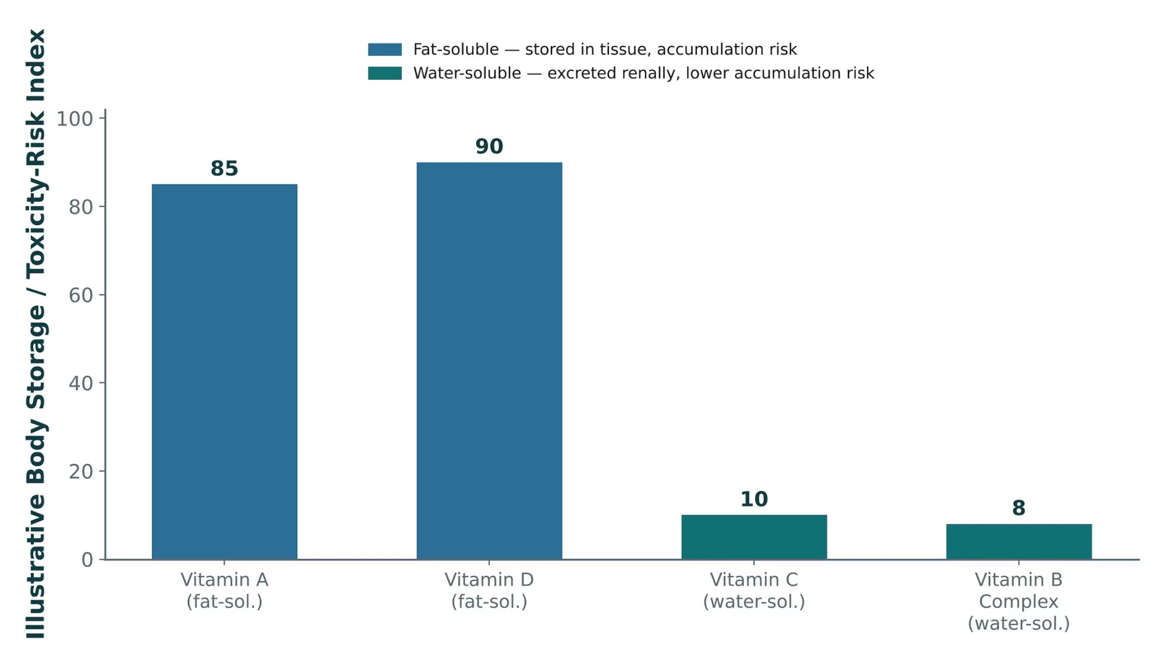
NUTRITION, VITAMINS & DIETARY SUPPLEMENTS
Objectives: SO3 · SO4 · IO3.1 · IO3.2 · IO3.4 · IO3.5 · IO3.6
Figure 8 · Fat-soluble vs. water-soluble vitamins: storage and toxicity risk
Original illustrative comparison (illustrative storage/toxicity-risk index, not from Katzung): fat-soluble vitamins A (85) and D (90) show substantially higher tissue-storage and toxicity-risk scores than water-soluble vitamins C (10) and B-complex (8). S23; S23 (notes)
L06 · GI & Nutrition Pharmacology — Session 2
85

Slide 86
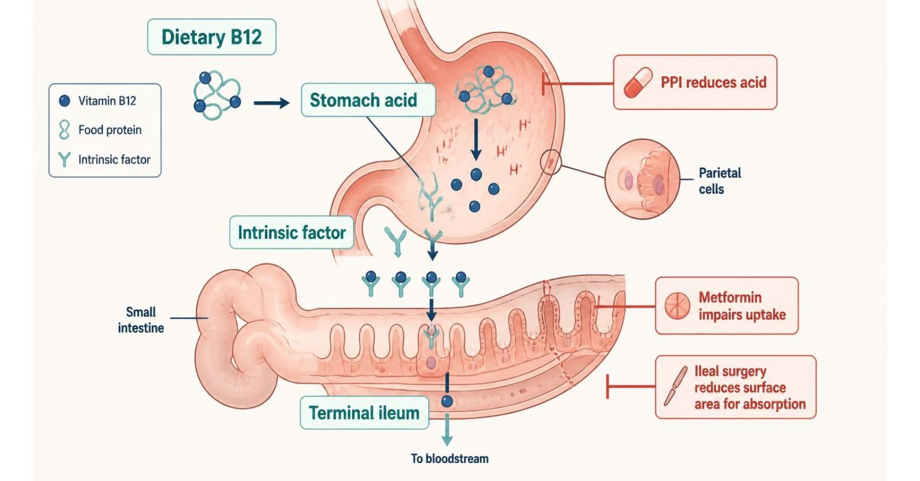
NUTRITION, VITAMINS & DIETARY SUPPLEMENTS
Objectives: SO3 · SO4 · IO3.1 · IO3.2 · IO3.4 · IO3.5 · IO3.6
Figure 9 · Vitamin B12 absorption: where PPIs and metformin interfere
Schematic (illustrative): vitamin B12 absorption needs acid and intrinsic factor and occurs in the ileum; PPIs, metformin and ileal surgery impair it. S25; S25 (notes)
L06 · GI & Nutrition Pharmacology — Session 2
86

Slide 87
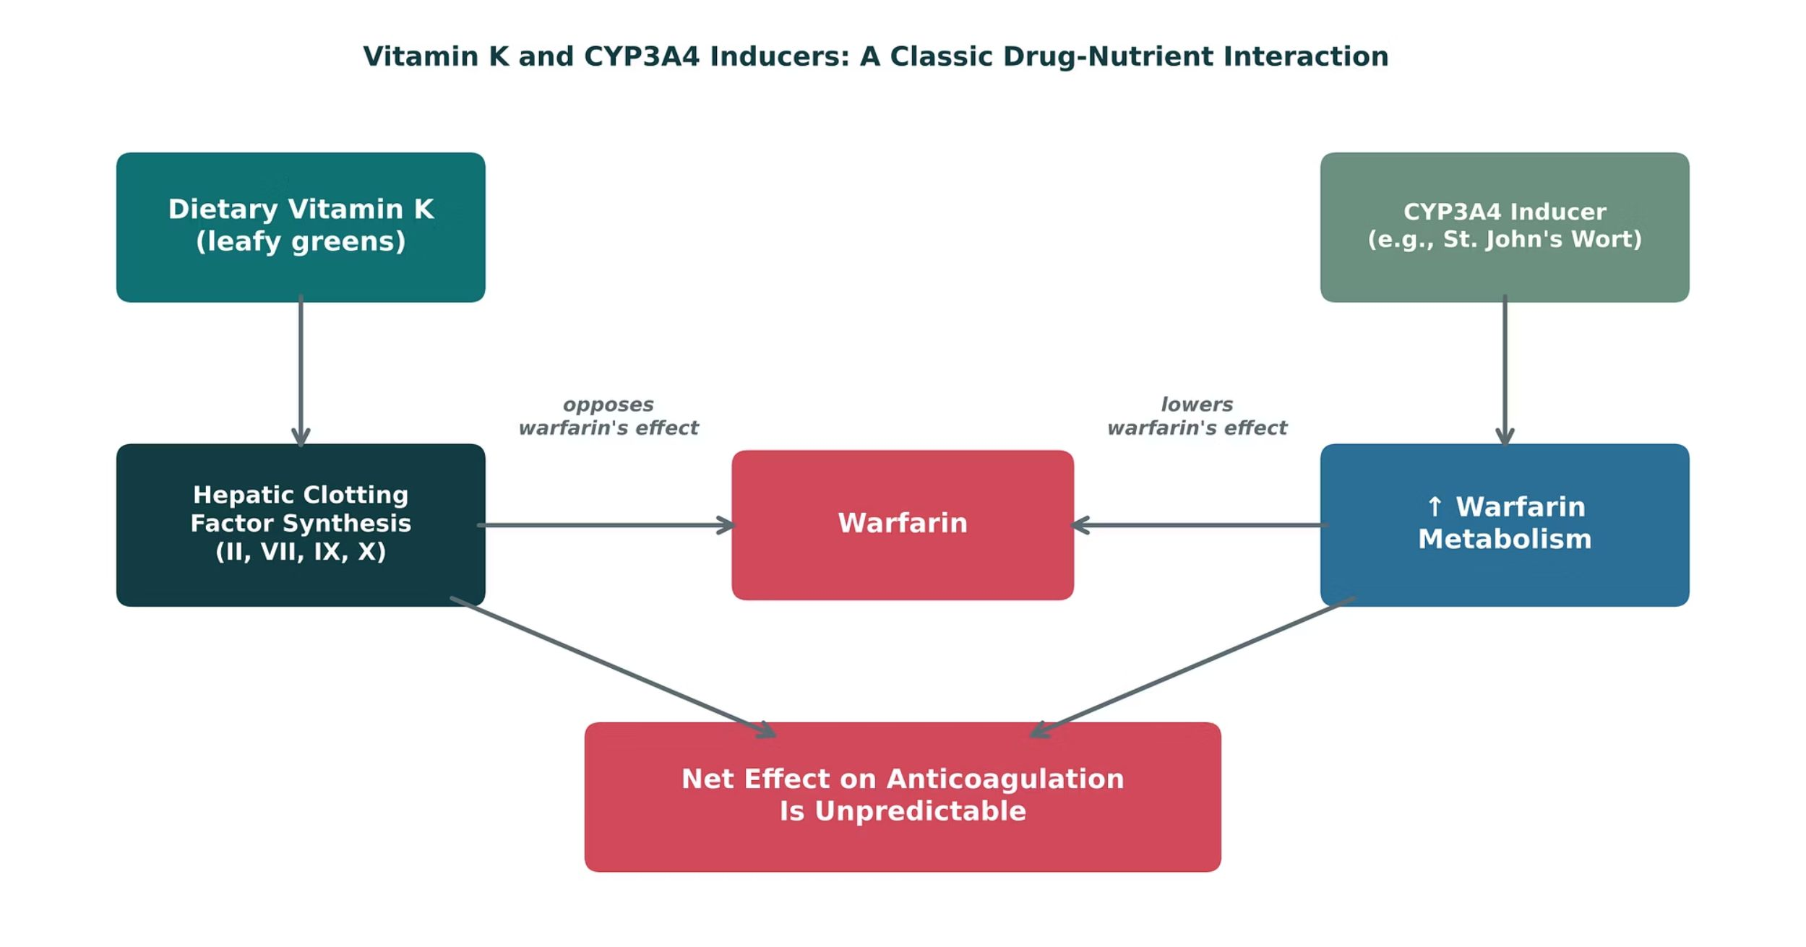
NUTRITION, VITAMINS & DIETARY SUPPLEMENTS
Objectives: SO3 · SO4 · IO3.1 · IO3.2 · IO3.4 · IO3.5 · IO3.6
Figure 10 · Vitamin K and CYP3A4 inducers: a classic drug-nutrient interaction
Original illustrative diagram (not from Katzung): dietary vitamin K opposes warfarin’s anticoagulant effect by supporting clotting factor synthesis, while CYP3A4-inducing herbal supplements (e.g., St. John’s Wort) increase warfarin metabolism — both lowering anticoagulant effect through different mechanisms (pharmacodynamic antagonism vs. pharmacokinetic induction). S26; S26 (notes)
L06 · GI & Nutrition Pharmacology — Session 2
87

Slide 88
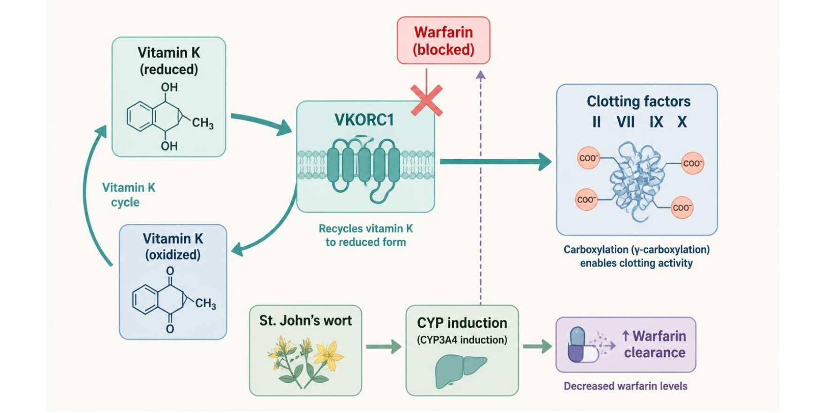
NUTRITION, VITAMINS & DIETARY SUPPLEMENTS
Objectives: SO3 · SO4 · IO3.1 · IO3.2 · IO3.4 · IO3.5 · IO3.6
Figure 11 · Warfarin: vitamin K cycle and herbal interactions
Schematic (illustrative): vitamin K cycle in a liver cell — warfarin blocks VKORC1, and St. John’s wort speeds warfarin clearance. S27; S27 (notes)
L06 · GI & Nutrition Pharmacology — Session 2
88

Slide 89
NUTRITION, VITAMINS & DIETARY SUPPLEMENTS
Objectives: SO3 · SO4 · IO3.1 · IO3.2 · IO3.4 · IO3.5 · IO3.6
Compare: Vitamin and mineral deficiency syndromes
Nutrient | Deficiency | Drug link
Vitamin B12 | Megaloblastic anemia, neuropathy (can be irreversible) | Long-term PPI/H2 blocker, metformin, bariatric surgery
Folate | Megaloblastic anemia; neural tube defects in pregnancy | Sulfasalazine, methotrexate (give folic acid)
Vitamin D | Rickets (children), osteomalacia (adults) | Bone pharmacology unit
Vitamin K | ↓ Factors II, VII, IX, X → bleeding | Warfarin opposes it
Iron | Microcytic anemia | Antacids/PPIs ↓ absorption; vitamin C ↑
Focus: what tells these apart. Sources: S24; S25; S63; SG U3-R12
L06 · GI & Nutrition Pharmacology — Session 2
89

Slide 90
NUTRITION, VITAMINS & DIETARY SUPPLEMENTS
Objectives: SO3 · SO4 · IO3.1 · IO3.2 · IO3.4 · IO3.5 · IO3.6
Compare: Enteral vs. parenteral nutrition
 | Enteral | Parenteral
Route | GI tract (oral or tube feeding) | Intravenous, bypassing the GI tract
Use when | Gut is functional (“if the gut works, use it”) | Gut non-functional or inaccessible
Main risk | Lower infection/complication risk | Catheter infection; electrolyte shifts; refeeding syndrome
Focus: what tells these apart. Sources: S28; S29
L06 · GI & Nutrition Pharmacology — Session 2
90

Slide 91
NUTRITION, VITAMINS & DIETARY SUPPLEMENTS
Objectives: SO3 · SO4 · IO3.1 · IO3.2 · IO3.4 · IO3.5 · IO3.6
Compare: Warfarin, vitamin and mineral profiles: formulation, dose, indications
Drug | Class | Formulation | Adult dose | Indications
Warfarin (Coumadin, Jantoven) | Vitamin K antagonist (VKORC1 inhibitor) | Tablet 1/2/2.5/3/4/5/6/7.5/10 mg | Start 2-5 mg PO daily, adjust to INR goal (usually 2-3) | Venous thromboembolism, atrial fibrillation, mechanical heart valves
Cyanocobalamin (vitamin B12) | Vitamin | Tablet 100-1,000 mcg; IM injection 1,000 mcg/mL; nasal gel | Deficiency: 1,000 mcg IM daily for 1 week, then weekly, then monthly; or 1,000-2,000 mcg PO daily | B12 deficiency, pernicious anemia, PPI or metformin-related deficiency
Folic acid (vitamin B9) | Water-soluble vitamin | Tablet 0.4/0.8/1 mg; injection | Deficiency 1 mg PO daily; 0.4 mg daily for neural tube defect prevention (4 mg if prior NTD) | Megaloblastic anemia, pregnancy, sulfasalazine and methotrexate therapy
Focus: what tells these apart. Sources: S61; S62; S63; S64; S65; S66
L06 · GI & Nutrition Pharmacology — Session 2
91

Slide 92
NUTRITION, VITAMINS & DIETARY SUPPLEMENTS
Objectives: SO3 · SO4 · IO3.1 · IO3.2 · IO3.4 · IO3.5 · IO3.6
Compare: Warfarin, vitamin and mineral profiles: formulation, dose, indications (cont.)
Drug | Class | Formulation | Adult dose | Indications
Vitamin D (cholecalciferol) | Fat-soluble vitamin | Capsule/tablet 400-5,000 IU; 50,000 IU capsule | Maintenance 600-800 IU PO daily; deficiency 50,000 IU weekly for about 8 weeks | Rickets, osteomalacia, osteoporosis support, deficiency
Phytonadione (vitamin K1) | Fat-soluble vitamin | Tablet 5 mg; injection 10 mg/mL | Warfarin over-anticoagulation: 1-10 mg PO or slow IV by INR; newborn prophylaxis 0.5-1 mg IM | Warfarin reversal, vitamin K deficiency bleeding, malabsorption
Ferrous sulfate | Iron supplement | Tablet 325 mg (65 mg elemental); liquid | 325 mg PO once daily or every other day, ideally with vitamin C | Iron-deficiency anemia
Focus: what tells these apart. Sources: S61; S62; S63; S64; S65; S66
L06 · GI & Nutrition Pharmacology — Session 2
92

Slide 93
NUTRITION, VITAMINS & DIETARY SUPPLEMENTS
Objectives: SO3 · SO4 · IO3.1 · IO3.2 · IO3.4 · IO3.5 · IO3.6
Compare: Warfarin, vitamin and mineral profiles: adverse effects, contraindications, toxicity
Drug | Adverse effects | Contraindications | Toxicity / overdose
Warfarin (Coumadin, Jantoven) | Bleeding, bruising, hair loss, skin necrosis (rare) | Pregnancy (most cases), active bleeding, recent CNS surgery, uncontrolled hypertension | Hemorrhage; reversal with vitamin K and 4-factor PCC; many interactions (St. John's wort lowers INR)
Cyanocobalamin (vitamin B12) | Injection-site pain, mild diarrhea, itching; early low potassium when treating severe anemia | Cobalt allergy, Leber hereditary optic neuropathy | Low toxicity; excess is excreted; folate alone can mask B12 anemia while neuropathy progresses
Folic acid (vitamin B9) | Nausea, bloating, rash (rare) | Untreated B12 deficiency (can mask anemia) | Low toxicity; high doses may mask B12 deficiency and worsen neurologic injury
Focus: what tells these apart. Sources: S61; S62; S63; S64; S65; S66
L06 · GI & Nutrition Pharmacology — Session 2
93

Slide 94
NUTRITION, VITAMINS & DIETARY SUPPLEMENTS
Objectives: SO3 · SO4 · IO3.1 · IO3.2 · IO3.4 · IO3.5 · IO3.6
Compare: Warfarin, vitamin and mineral profiles: adverse effects, contraindications, toxicity (cont.)
Drug | Adverse effects | Contraindications | Toxicity / overdose
Vitamin D (cholecalciferol) | Usually none; nausea and constipation with excess | Hypercalcemia, hypervitaminosis D | Toxicity: hypercalcemia, kidney stones, calcification; fat-soluble so accumulates
Phytonadione (vitamin K1) | Injection-site reactions; flushing | Hypersensitivity | IV: boxed warning for anaphylaxis (infuse slowly); overcorrection causes warfarin resistance
Ferrous sulfate | Constipation, nausea, dark stools, abdominal pain | Hemochromatosis, hemosiderosis, hemolytic anemia | Acute iron overdose is a pediatric emergency: GI bleeding, shock, liver failure; chelate with deferoxamine
Focus: what tells these apart. Sources: S61; S62; S63; S64; S65; S66
L06 · GI & Nutrition Pharmacology — Session 2
94

Slide 95
NUTRITION, VITAMINS & DIETARY SUPPLEMENTS
Objectives: SO3 · SO4 · IO3.1 · IO3.2 · IO3.4 · IO3.5 · IO3.6
Compare: Herbal and dietary supplement profiles: formulation, dose, indications
Drug | Class | Formulation | Adult dose | Indications
St. John's wort (Hypericum perforatum) | Herbal supplement (CYP/P-gp inducer) | Capsule/tablet 300 mg (0.3% hypericin); tea | Commonly 300 mg PO TID; not FDA-approved for treatment | Self-treated mild depression (limited evidence)
Ginkgo biloba | Herbal supplement | Capsule/tablet 40-120 mg | 120-240 mg/day PO in divided doses; not FDA-approved for treatment | Self-treated memory complaints (limited evidence)
Fish oil (omega-3 fatty acids) | Dietary supplement | Capsule 300-1,000 mg EPA/DHA; Rx icosapent ethyl 1 g | 1-4 g/day EPA plus DHA PO; Rx forms for hypertriglyceridemia | Hypertriglyceridemia, cardiovascular risk reduction (Rx)
Focus: what tells these apart. Sources: S67; S68; S69
L06 · GI & Nutrition Pharmacology — Session 2
95

Slide 96
NUTRITION, VITAMINS & DIETARY SUPPLEMENTS
Objectives: SO3 · SO4 · IO3.1 · IO3.2 · IO3.4 · IO3.5 · IO3.6
Compare: Herbal and dietary supplement profiles: adverse effects, contraindications, toxicity
Drug | Adverse effects | Contraindications | Toxicity / overdose
St. John's wort (Hypericum perforatum) | Photosensitivity, GI upset, dizziness, dry mouth | With SSRIs, transplant drugs, HIV protease inhibitors, oral contraceptives, warfarin | Serotonin syndrome with serotonergic drugs; lowers levels of warfarin, cyclosporine, contraceptives
Ginkgo biloba | Headache, GI upset, dizziness | Bleeding disorders; stop before surgery | Increased bleeding with warfarin, antiplatelets, NSAIDs; seizures with seed ingestion
Fish oil (omega-3 fatty acids) | Fishy aftertaste, belching, diarrhea | Hypersensitivity; fish or shellfish allergy (caution) | Bleeding risk at high doses with anticoagulants; atrial fibrillation at high doses
Focus: what tells these apart. Sources: S67; S68; S69
L06 · GI & Nutrition Pharmacology — Session 2
96

Slide 97
NUTRITION, VITAMINS & DIETARY SUPPLEMENTS
Objectives: SO3 · SO4 · IO3.1 · IO3.2 · IO3.4 · IO3.5 · IO3.6
Compare: Supporting drugs at a glance (listed for context; not profiled in detail)
Drug(s) | Why it matters
Vancomycin and fidaxomicin | Oral treatment for C. difficile infection
Vitamin K and 4-factor PCC | Reverse warfarin
Clindamycin | Antibiotic classically linked to C. difficile
Metformin and PPIs | Long-term use linked to low B12
Naloxone | Reverses opioid effects in loperamide or diphenoxylate overdose
Cyclosporine, oral contraceptives, SSRIs | Interact with St. John’s wort
Allopurinol and febuxostat | Block thiopurine metabolism; allopurinol needs a major dose cut, febuxostat is avoided
Methotrexate | Folate antagonist; folic acid is given alongside
Deferoxamine | Chelator used for iron overdose
Ketoconazole | CYP3A4 inhibitor that raises budesonide exposure
Focus: what tells these apart. Sources: S70; S70 (notes)
L06 · GI & Nutrition Pharmacology — Session 2
97

Slide 98
NUTRITION, VITAMINS & DIETARY SUPPLEMENTS
Objectives: SO3 · SO4 · IO3.1 · IO3.2 · IO3.4 · IO3.5 · IO3.6
Compare: Dietary supplements in the reading (textbook)
Supplement | Pharmacologic effects & clinical uses (clinical trials) | Drug interactions, precautions & dosage
Historic & regulatory factors | DSHEA (1994): regulated as foods; GMP rule only in 2007 | FDA must prove harm to restrict; serious adverse events must be reported
Echinacea | Cold prevention (mixed trials) | Avoid in immune deficiency, autoimmune disease, immunosuppression; ≤ 10–14 days
Garlic | Modest lipid lowering | Antiplatelet: caution with warfarin, aspirin, ibuprofen
Ginkgo | Dementia (240 mg/d extract) | Antiplatelet: avoid with anticoagulants; avoid in seizure disorders
Ginseng | Glucose, fatigue | Antiplatelet; mania with phenelzine, lithium, neuroleptics
Milk thistle | Liver disease (no proven benefit) | No significant drug interactions
Focus: what tells these apart. Sources: p. 1204; p. 1207; p. 1208; p. 1210; p. 1211; p. 1213; p. 1214; p. 1215; p. 1216; p. 1217; p. 1218
L06 · GI & Nutrition Pharmacology — Session 2
98

Slide 99
NUTRITION, VITAMINS & DIETARY SUPPLEMENTS
Objectives: SO3 · SO4 · IO3.1 · IO3.2 · IO3.4 · IO3.5 · IO3.6
Compare: Dietary supplements in the reading (textbook) (cont.)
Supplement | Pharmacologic effects & clinical uses (clinical trials) | Drug interactions, precautions & dosage
St. John’s wort | Mild-moderate depression (900 mg/d) | CYP/P-gp induction; serotonin syndrome
Saw palmetto | BPH symptoms (160 mg twice daily) | No drug interactions reported
Purified nutritional supplements: coenzyme Q10 | Low endogenous levels; heart failure | Vitamin K–like: may decrease warfarin effect
Glucosamine | Osteoarthritis (1500 mg daily) | May increase INR with warfarin
Melatonin | Jet lag (0.5–5 mg), insomnia | CYP1A2 (fluvoxamine); may decrease warfarin effect
Focus: what tells these apart. Sources: p. 1204; p. 1207; p. 1208; p. 1210; p. 1211; p. 1213; p. 1214; p. 1215; p. 1216; p. 1217; p. 1218
L06 · GI & Nutrition Pharmacology — Session 2
99

Slide 100

NUTRITION, VITAMINS & DIETARY SUPPLEMENTS
Objectives: SO3 · SO4 · IO3.1 · IO3.2 · IO3.4 · IO3.5 · IO3.6
Memory hooks
Why it happens
Mnemonic (memory aid)
Why tell warfarin patients to keep vitamin K steady rather than avoid it? INR is dosed against their usual intake; swings, not the vitamin itself, cause trouble. S27
Fat-soluble ADEK stay; water-soluble B and C wash away. S22; SG U3-R12
L06 · GI & Nutrition Pharmacology — Session 2
100

Slide 101
NUTRITION, VITAMINS & DIETARY SUPPLEMENTS
Objectives: SO3 · SO4 · IO3.1 · IO3.2 · IO3.4 · IO3.5 · IO3.6
High-yield summary
If you remember nothing else
Nutrition and dietary supplements are not inert — vitamin status, drug-nutrient interactions, and herbal supplements can all meaningfully change drug therapy outcomes. S34; S30
St. John’s wort induces CYP3A4 → warfarin cleared faster → lower INR. S26; SG U3-R13
Long-term PPI or metformin → check B12. S25; SG U3-R12
Refeeding: start slowly, check phosphate/potassium/magnesium, thiamine first. S29
L06 · GI & Nutrition Pharmacology — Session 2
101

Slide 102
CLINICAL VIGNETTE · LECTURE QUICK CHECK S31; S37; S38
Objectives: SO3 · SO4 · IO3.1 · IO3.2 · IO3.4 · IO3.5 · IO3.6
Question 11
A patient on warfarin for atrial fibrillation has a subtherapeutic INR despite good adherence; three weeks ago they started St. John’s Wort for mood. What explains this?
A
CYP3A4 inhibition slows warfarin metabolism
B
It increases warfarin absorption from the gut
C
Poor adherence the patient is hiding
D
Direct vitamin K supplementation
E
CYP3A4 induction speeds warfarin metabolism
L06 · GI & Nutrition Pharmacology — Session 2
102
Notes:
Answer on the next slide. Source: S31; SG U3-R13

Slide 103
CLINICAL VIGNETTE · ANSWER
Objectives: SO3 · SO4 · IO3.1 · IO3.2 · IO3.4 · IO3.5 · IO3.6
Answer 11: E
E. CYP3A4 induction speeds warfarin metabolism
St. John’s Wort induces CYP3A4, increasing warfarin metabolism and lowering INR — ask about supplements at every medication reconciliation (S31; SG U3-R13). S31; SG U3-R13
Why the other choices are wrong
A. CYP3A4 inhibition slows warfarin metabolism — Reversed — that would raise INR (S31).
B. It increases warfarin absorption from the gut — Not the taught mechanism (S31).
C. Poor adherence the patient is hiding — The supplement explains it (S31).
D. Direct vitamin K supplementation — The mechanism is CYP3A4 induction (S38).
L06 · GI & Nutrition Pharmacology — Session 2
103

Slide 104
CLINICAL VIGNETTE
Objectives: SO3 · SO4 · IO3.1 · IO3.2 · IO3.4 · IO3.5 · IO3.6
Question 13
A severely malnourished patient is about to start feeding. Which plan prevents refeeding syndrome?
A
Check electrolytes once at discharge
B
Start at full calories to correct deficits fast
C
Start slowly, give thiamine, check phosphate/K/Mg daily
D
Withhold thiamine until after feeding
E
Use parenteral nutrition even though the gut works
L06 · GI & Nutrition Pharmacology — Session 2
104
Notes:
Answer on the next slide. Source: S29

Slide 105
CLINICAL VIGNETTE · ANSWER
Objectives: SO3 · SO4 · IO3.1 · IO3.2 · IO3.4 · IO3.5 · IO3.6
Answer 13: C
C. Start slowly, give thiamine, check phosphate/K/Mg daily
Start feeding slowly, give thiamine before feeding, and check phosphate, potassium and magnesium daily at first (S29). S29
Why the other choices are wrong
A. Check electrolytes once at discharge — Daily checks at the start (S29).
B. Start at full calories to correct deficits fast — Rapid carbohydrate load triggers the shifts (S29).
D. Withhold thiamine until after feeding — Thiamine goes before feeding (S29).
E. Use parenteral nutrition even though the gut works — If the gut works, use it (S28).
L06 · GI & Nutrition Pharmacology — Session 2
105

Slide 106


Topic 4 of 4
Putting It All Together: GI & Nutrition Toolkit
Covers objectives: SO5 · IO3.3 · IO3.4
Key definitions
How it works
Clinical relevance
Drugs named as examples
Exam traps
106

Slide 107
PUTTING IT ALL TOGETHER: GI & NUTRITION TOOLKIT
Objectives: SO5 · IO3.3 · IO3.4
Key definitions
Key definitions
Applying the whole GI & Nutrition toolkit: for each patient, name a first-line approach AND the single biggest safety concern to check before prescribing/counseling. S32; S32 (notes); S33 (notes)
L06 · GI & Nutrition Pharmacology — Session 2
107

Slide 108
PUTTING IT ALL TOGETHER: GI & NUTRITION TOOLKIT
Objectives: SO5 · IO3.3 · IO3.4
How it works
How it works
1. Acid-peptic disease and antiemetics are managed by targeting specific points along well-defined pathways (parietal cell secretion; the vomiting reflex). S34
2. PPIs are the most potent antisecretory agents, but long-term use carries real risks that warrant periodic reassessment. S34
3. IBD therapy follows a step-wise escalation matched to disease severity. 4. Biologic agents share mechanisms and immunosuppression risk across organ systems. 5. Nutrition and supplements are not inert. S34
Pharmacology is cumulative, not siloed by unit: biologic mechanisms (Lecture 2) and drug-metabolism/interaction concepts (Lecture 1) reappear here in a new organ system. S34 (notes)
L06 · GI & Nutrition Pharmacology — Session 2
108

Slide 109
PUTTING IT ALL TOGETHER: GI & NUTRITION TOOLKIT
Objectives: SO5 · IO3.3 · IO3.4
Clinical relevance
Clinical relevance
Patient A — GERD symptoms, needs rapid occasional relief: an antacid for occasional relief; an H2 blocker or PPI if frequent. S33; S33 (notes)
Patient B — confirmed H. pylori, penicillin allergy: bismuth quadruple therapy. S33; S33 (notes)
Patient C — moderate-to-severe Crohn disease, inadequately controlled on azathioprine: a biologic or small molecule such as an anti-TNF agent. S33; S33 (notes)
Patient D — warfarin patient starting an herbal mood supplement: counsel on St. John’s wort and check INR. S33; S33 (notes)
L06 · GI & Nutrition Pharmacology — Session 2
109

Slide 110
PUTTING IT ALL TOGETHER: GI & NUTRITION TOOLKIT
Objectives: SO5 · IO3.3 · IO3.4
Drugs named as examples
Drugs named as examples
Recall Q1: PPIs block the H⁺/K⁺-ATPase proton pump itself — the final common pathway for gastrin, histamine, and acetylcholine — unlike H2RAs, which block only the histamine input. S36; S38
Recall Q2: recent macrolide exposure raises clarithromycin-resistance concern, favoring bismuth quadruple therapy over standard clarithromycin-based triple therapy. S36; S38
Recall Q3: aprepitant blocks NK1; ondansetron 5-HT3; meclizine H1/M1; metoclopramide D2. S36; S38
Recall Q4: antimotility agents can worsen infectious/inflammatory diarrhea like C. difficile by delaying toxin clearance and slowing transit — toxic megacolon risk. S37; S38
Recall Q5–6: vedolizumab blocks α4β7 gut-homing (most gut-selective); St. John’s Wort induces CYP3A4, increasing warfarin metabolism and lowering INR — a pharmacokinetic drug-herb interaction. S37; S38
L06 · GI & Nutrition Pharmacology — Session 2
110

Slide 111
PUTTING IT ALL TOGETHER: GI & NUTRITION TOOLKIT
Objectives: SO5 · IO3.3 · IO3.4
Exam traps
Exam traps
Integrated case: H. pylori + penicillin allergy + macrolide two months ago → bismuth quadruple therapy (allergy rules out amoxicillin triple therapy; macrolide exposure raises clarithromycin-resistance concern). SG U3-S
Her subtherapeutic INR is St. John’s Wort inducing CYP3A4 — stop the supplement (or adjust warfarin) with close INR monitoring. SG U3-S
L06 · GI & Nutrition Pharmacology — Session 2
111

Slide 112
PUTTING IT ALL TOGETHER: GI & NUTRITION TOOLKIT
Objectives: SO5 · IO3.3 · IO3.4
Compare: Which drug would you choose? (S33)
Patient | First-line approach | Biggest safety check
A · GERD, rapid occasional relief | Antacid (H2 blocker or PPI if frequent) | Separate antacids from other drugs by 2 h; long-term PPI risks
B · H. pylori, penicillin allergy | Bismuth quadruple therapy | No amoxicillin; test of cure off PPI
C · Moderate-severe Crohn on azathioprine | Biologic or small molecule (anti-TNF) | TB and hepatitis screening; vaccines first
D · Warfarin + herbal mood supplement | Counsel on St. John’s wort | Check INR
Focus: what tells these apart. Sources: S33; S33 (notes)
L06 · GI & Nutrition Pharmacology — Session 2
112

Slide 113
PUTTING IT ALL TOGETHER: GI & NUTRITION TOOLKIT
Objectives: SO5 · IO3.3 · IO3.4
Memory hooks
Mnemonic (memory aid)
Every case, two answers: the approach and the one thing to check. S33 (notes)
L06 · GI & Nutrition Pharmacology — Session 2
113

Slide 114
PUTTING IT ALL TOGETHER: GI & NUTRITION TOOLKIT
Objectives: SO5 · IO3.3 · IO3.4
High-yield summary
If you remember nothing else
Five takeaways: pathway targets · PPI risks · IBD step therapy · shared biologic risk · supplements matter. S34
L06 · GI & Nutrition Pharmacology — Session 2
114

Slide 115
MECHANISM · LECTURE QUICK CHECK S36; S38
Objectives: SO5 · IO3.3 · IO3.4
Question 17
Why do PPIs provide more complete acid suppression than H2 receptor antagonists?
A
They block only the gastrin pathway
B
They block histamine more strongly than H2RAs
C
They block the final common pathway, the proton pump
D
They neutralize acid directly, like antacids
E
They have no mechanistic advantage
L06 · GI & Nutrition Pharmacology — Session 2
115
Notes:
Answer on the next slide. Source: S36; S38

Slide 116
MECHANISM · ANSWER
Objectives: SO5 · IO3.3 · IO3.4
Answer 17: C
C. They block the final common pathway, the proton pump
PPIs block the H⁺/K⁺-ATPase itself — the final common pathway for gastrin, histamine, and acetylcholine — unlike H2RAs (S38). S36; S38
Why the other choices are wrong
A. They block only the gastrin pathway — Not the mechanism (S38).
B. They block histamine more strongly than H2RAs — They act at the pump (S38).
D. They neutralize acid directly, like antacids — That is antacids (S38).
E. They have no mechanistic advantage — They do (S38).
L06 · GI & Nutrition Pharmacology — Session 2
116

Slide 117
CLINICAL VIGNETTE · LECTURE QUICK CHECK S36; S38
Objectives: SO5 · IO3.3 · IO3.4
Question 18
A patient recently exposed to a macrolide needs H. pylori eradication. Which regimen best avoids the concern this raises?
A
PPI monotherapy for 8 weeks
B
Bismuth quadruple therapy
C
Antacids alone, as needed
D
Sucralfate plus a daily PPI
E
Clarithromycin-based triple therapy
L06 · GI & Nutrition Pharmacology — Session 2
117
Notes:
Answer on the next slide. Source: S36; S38

Slide 118
CLINICAL VIGNETTE · ANSWER
Objectives: SO5 · IO3.3 · IO3.4
Answer 18: B
B. Bismuth quadruple therapy
Recent macrolide exposure raises clarithromycin-resistance concern, favoring bismuth quadruple therapy (S38). S36; S38
Why the other choices are wrong
A. PPI monotherapy for 8 weeks — No eradication (S38).
C. Antacids alone, as needed — No eradication (S38).
D. Sucralfate plus a daily PPI — No antibiotics (S38).
E. Clarithromycin-based triple therapy — Resistance concern (S38).
L06 · GI & Nutrition Pharmacology — Session 2
118

Slide 119
MECHANISM · LECTURE QUICK CHECK S36; S38
Objectives: SO5 · IO3.3 · IO3.4
Question 19
Which pairing correctly matches an antiemetic with its receptor target?
A
Aprepitant — NK1 receptor
B
Ondansetron — D2 receptor
C
Metoclopramide — H1 receptor
D
Scopolamine — NK1 receptor
E
Meclizine — 5-HT3 receptor
L06 · GI & Nutrition Pharmacology — Session 2
119
Notes:
Answer on the next slide. Source: S36; S38

Slide 120
MECHANISM · ANSWER
Objectives: SO5 · IO3.3 · IO3.4
Answer 19: A
A. Aprepitant — NK1 receptor
Aprepitant blocks NK1; ondansetron 5-HT3; meclizine H1/M1; metoclopramide D2 (S38). S36; S38
Why the other choices are wrong
B. Ondansetron — D2 receptor — 5-HT3 (S38).
C. Metoclopramide — H1 receptor — D2 (S38).
D. Scopolamine — NK1 receptor — Muscarinic (S38).
E. Meclizine — 5-HT3 receptor — H1/M1 (S38).
L06 · GI & Nutrition Pharmacology — Session 2
120

Slide 121
CLINICAL VIGNETTE · LECTURE QUICK CHECK S37; S38
Objectives: SO5 · IO3.3 · IO3.4
Question 20
A patient with suspected C. difficile asks for something to stop the diarrhea. What is the main concern with loperamide?
A
There is no concern in this scenario
B
Loperamide causes C. difficile directly
C
Loperamide treats the underlying infection
D
Slowing transit can worsen toxin-mediated injury
E
Loperamide has no GI effects
L06 · GI & Nutrition Pharmacology — Session 2
121
Notes:
Answer on the next slide. Source: S37; S38

Slide 122
CLINICAL VIGNETTE · ANSWER
Objectives: SO5 · IO3.3 · IO3.4
Answer 20: D
D. Slowing transit can worsen toxin-mediated injury
Antimotility agents delay toxin clearance and raise risk of complications such as toxic megacolon (S38). S37; S38
Why the other choices are wrong
A. There is no concern in this scenario — There is (S38).
B. Loperamide causes C. difficile directly — Clindamycin is the classic cause (S70).
C. Loperamide treats the underlying infection — It does not (S38).
E. Loperamide has no GI effects — It slows motility (S38).
L06 · GI & Nutrition Pharmacology — Session 2
122

