Slide 1
L05 · Tue, Nov 3, 2026
GI & Nutrition Pharmacology — Session 1
Pharmacology study deck · organized by drug class
How to read this deck
TB = textbook only (not on the lecture slides)
SG = course study guide only (not on the lecture slides)
Bold = emphasized on the lecture slides
S12 = lecture slide 12 · p. 245 = textbook page 245 · SG U1-R3 = study guide item

Slide 2
START HERE
Learning objectives
IO3.1
Identify major pharmacologic classes used in GI and nutrition conditions and describe their mechanisms of action.
Acid-Peptic Disease & Gastric Acid Secretion, Antacids, H2 Blockers & Proton Pump Inhibitors, Mucosal Protectants & H. pylori Eradication, Antiemetics
IO3.2
Describe the indications, contraindications, adverse effects, and clinically significant interactions of GI and nutrition medications.
Antacids, H2 Blockers & Proton Pump Inhibitors, Mucosal Protectants & H. pylori Eradication, Antiemetics
IO3.3
Compare agents within and across these classes to distinguish clinically relevant differences in efficacy, safety, and use.
Antacids, H2 Blockers & Proton Pump Inhibitors, Antiemetics
IO3.4
Select appropriate pharmacologic therapy for common GI and nutrition conditions based on clinical presentation and patient-specific factors.
Mucosal Protectants & H. pylori Eradication, Antiemetics
L05 · GI & Nutrition Pharmacology — Session 1
2

Slide 3
START HERE
Learning objectives (cont.)
IO3.5
Identify appropriate dosing, administration, and monitoring considerations for GI and nutrition medications.
Antacids, H2 Blockers & Proton Pump Inhibitors
IO3.6
Explain important medication-use and safety information to patients receiving GI and nutrition pharmacotherapy.
Mucosal Protectants & H. pylori Eradication, Antiemetics
SO1
Identify the major pharmacologic classes used to manage acid-peptic disease and nausea/vomiting, and describe their mechanisms of action.
Acid-Peptic Disease & Gastric Acid Secretion, Antacids, H2 Blockers & Proton Pump Inhibitors, Mucosal Protectants & H. pylori Eradication, Antiemetics
SO2
Describe the indications, contraindications, adverse effects, and clinically significant interactions of antisecretory and mucosal-protective agents.
Antacids, H2 Blockers & Proton Pump Inhibitors, Mucosal Protectants & H. pylori Eradication
L05 · GI & Nutrition Pharmacology — Session 1
3

Slide 4
START HERE
Learning objectives (cont.)
SO3
Compare agents within and across these classes to distinguish clinically relevant differences in efficacy and safety.
Antacids, H2 Blockers & Proton Pump Inhibitors, Antiemetics
SO4
Select appropriate therapy for acid-peptic disease and nausea/vomiting based on clinical presentation and patient-specific factors.
Mucosal Protectants & H. pylori Eradication, Antiemetics
SO5
Identify dosing, administration, and monitoring considerations, and explain key medication-safety counseling points to patients.
Antacids, H2 Blockers & Proton Pump Inhibitors, Mucosal Protectants & H. pylori Eradication, Antiemetics
SO6
Preview: GI motility disorders, IBD pharmacotherapy, and Nutrition/Dietary Supplements continue in Session 2 (Thursday, November 5).
⚠ Thin coverage
Preview only — taught in Session 2 (L06) · No section covers this
L05 · GI & Nutrition Pharmacology — Session 1
4

Slide 5

START HERE
About this lecture
Scope, readings & sources
PA Pharmacology Course · Lecture 3 · Session 1 of 2 — GI & Nutrition Pharmacology. Session 1: Acid-Peptic Disease and Antiemetics (Tuesday, November 3, 8:30–11:00 AM). S1
Two pathways today: how the stomach makes acid and how we turn it down or protect the mucosa; then how the brain triggers vomiting and which receptor each antiemetic blocks. S1 (notes); S2 (notes)
Every drug today gets four answers: how it works, who it helps, what can go wrong, and what you tell the patient. S2 (notes)
Session 2 (Thursday, November 5) picks up with lower-GI motility, IBD, and nutrition/dietary supplements. S2; S2 (notes); S34
L05 · GI & Nutrition Pharmacology — Session 1
5

Slide 6
START HERE
About this lecture (cont.)
Scope, readings & sources
Required text: Katzung’s Basic and Clinical Pharmacology, 16th Edition (Todd W. Vanderah, 2024/2025, McGraw-Hill Education; ISBN 1260463303 eBook; AccessMedicine: accessmedicine.mhmedical.com/book.aspx?bookid=3382). Unit 3 — GI & Nutrition: Chapter 62 (Drugs Used in the Treatment of Gastrointestinal Diseases) and Chapter 65 (Dietary Supplements & Herbal Medications). S3; S3 (notes)
Recommended text (additional support, not a substitute): Pharmacotherapy Principles and Practice (Chisholm-Burns, Schwinghammer, Malone, Kolesar, Lee, 2022, McGraw-Hill Education; Print ISBN 9781260460278, eText ISBN 9781260460285) — supplemental support alongside Katzung’s Chapters 62 and 65 for Unit 3. Everything on the slides is testable. S3; S3 (notes)
L05 · GI & Nutrition Pharmacology — Session 1
6

Slide 7
START HERE
About this lecture (cont.)
Scope, readings & sources
Abbreviations used in the drug profiles: DR delayed-release; ER extended-release; ODT orally disintegrating tablet; OTC over the counter; PO by mouth; PR by rectum; IV intravenous; IM intramuscular; BID/TID/QID two/three/four times daily; CrCl creatinine clearance; CKD chronic kidney disease; CNS central nervous system; GERD gastroesophageal reflux disease; NSAID nonsteroidal anti-inflammatory drug; CINV chemotherapy-induced nausea and vomiting; PONV postoperative nausea and vomiting; H2 histamine-2; 5-HT3 serotonin type 3; D2 dopamine type 2; NK1 neurokinin-1; QT QT interval on ECG; CYP/P-gp cytochrome P450/P-glycoprotein; BPH benign prostatic hyperplasia; mcg microgram; m2 square meter of body surface area. S35; S35 (notes)
L05 · GI & Nutrition Pharmacology — Session 1
7

Slide 8
START HERE
About this lecture (cont.)
Scope, readings & sources
Original figures in this deck: Figures 1, 4 and 9 (Gastric Acid Secretion: Where Antisecretory Drugs Act; PPIs vs. H2 Receptor Antagonists: Potency and Duration; The Vomiting Reflex: Where Antiemetics Act) were generated by the course director using the AI tool Claude to illustrate standard, non-copyrighted pharmacologic concepts. They are original diagrams, not reproduced from Katzung’s Basic and Clinical Pharmacology or any other copyrighted source. Reference: Anthropic. (2026). Claude (Sonnet 5) [Large language model]. https://claude.ai. Mechanism illustrations (AI-generated, illustrative, not reproduced from copyrighted sources): H2 blocker action on the parietal cell (Figure 2, slide 14); PPI irreversible pump inhibition (Figure 3, slide 16); sucralfate and misoprostol (Figure 5, slide 21); H. pylori multidrug rationale (Figure 6, slide 24); ondansetron and 5-HT3 blockade (Figure 7, slide 31); receptors in the vomiting pathway (Figure 8, slide 32); metoclopramide D2 blockade and 5-HT4 agonism (Figure 10, slide 37); cannabinoids for chemotherapy-induced nausea (Figure 11, slide 38); cannabinoid CB1 activation (Figure 12, slide 39). Created with an AI image generator under the course director’s direction for educational use; the pictures are schematic and not to scale. Figures 2, 3, 5-8 and 10-12 are AI-generated and schematic. S62; S62 (notes)
L05 · GI & Nutrition Pharmacology — Session 1
8

Slide 9
ROADMAP
Drug classes in this lecture
Acid-Peptic Disease & Gastric Acid Secretion
Objectives: SO1, IO3.1
1
Antacids, H2 Blockers & Proton Pump Inhibitors
Objectives: SO1, SO2, SO3, SO5, IO3.1, IO3.2, IO3.3, IO3.5
2
Mucosal Protectants & H. pylori Eradication
Objectives: SO1, SO2, SO4, SO5, IO3.1, IO3.2, IO3.4, IO3.6
3
Antiemetics
Objectives: SO1, SO3, SO4, SO5, IO3.1, IO3.2, IO3.3, IO3.4, IO3.6
4
L05 · GI & Nutrition Pharmacology — Session 1
9

Slide 10





Topic 1 of 4
Acid-Peptic Disease & Gastric Acid Secretion
Covers objectives: SO1 · IO3.1
Key definitions
How it works
Clinical relevance
Drugs named as examples
Exam traps
10

Slide 11
ACID-PEPTIC DISEASE & GASTRIC ACID SECRETION
Objectives: SO1 · IO3.1
Key definitions
Key definitions (1/2)
Acid-peptic disease is a balance between mucosal defense and acid-driven aggression. S4
Aggressive factors: gastric acid (HCl), pepsin, H. pylori infection, NSAID use (suppresses protective prostaglandins). S5; SG U3-R1
Protective (mucosal defense) factors: mucus–bicarbonate layer; prostaglandins (stimulate mucus/bicarbonate, maintain mucosal blood flow); epithelial cell turnover. S5; SG U3-R1
GERD: reflux of gastric contents into the esophagus, causing heartburn/regurgitation and, over time, esophageal mucosal injury. S7
L05 · GI & Nutrition Pharmacology — Session 1
11

Slide 12
ACID-PEPTIC DISEASE & GASTRIC ACID SECRETION
Objectives: SO1 · IO3.1
Key definitions (cont.)
Key definitions (2/2)
Peptic ulcer disease (PUD): a break in the mucosa of the stomach or duodenum; most commonly caused by H. pylori infection or NSAID use. S7
Gastritis: inflammation of the gastric mucosa — acute (e.g., NSAID- or alcohol-related) or chronic (e.g., H. pylori-driven). S7
TB Over 90% of peptic ulcers are caused by H. pylori infection or NSAIDs; bile also counts as an aggressive factor. p. 1153
L05 · GI & Nutrition Pharmacology — Session 1
12

Slide 13
ACID-PEPTIC DISEASE & GASTRIC ACID SECRETION
Objectives: SO1 · IO3.1
How it works
How it works (1/2)
Disease appears when aggressive factors win or defenses fall: aggressive factors (acid, pepsin, H. pylori, NSAIDs) overwhelm mucus, bicarbonate and prostaglandin-driven blood flow → mucosal injury → GERD, ulcer or gastritis. S5 (notes); S6
NSAIDs block COX-1 prostaglandins, removing mucosal protection — the clearest example of tipping the balance. S5 (notes); S6
H. pylori urease makes ammonia, which injures the mucosa. S6
Stress and critical illness raise the risk of stress ulceration. S6
L05 · GI & Nutrition Pharmacology — Session 1
13

Slide 14
ACID-PEPTIC DISEASE & GASTRIC ACID SECRETION
Objectives: SO1 · IO3.1
How it works (cont.)
How it works (2/2)
Gastrinoma (Zollinger-Ellison) causes severe acid hypersecretion. S6
Gastrin, histamine, and acetylcholine all converge on the parietal cell proton pump. H2 blockers cut one input (histamine); PPIs block the last step itself. S8; S8 (notes)
TB Physiology of acid secretion: gastrin acts mainly by releasing histamine from ECL cells; acetylcholine (M3) stimulates the parietal cell directly; somatostatin from antral D cells turns gastrin off. p. 1154
L05 · GI & Nutrition Pharmacology — Session 1
14

Slide 15
ACID-PEPTIC DISEASE & GASTRIC ACID SECRETION
Objectives: SO1 · IO3.1
Clinical relevance · Drugs named as examples
Clinical relevance
Drugs named as examples
GERD, PUD and gastritis share the same drug toolkit: reduce acid, protect the mucosa, and/or eradicate H. pylori. S7 (notes)
H. pylori and NSAIDs cause most PUD. S7 (notes)
Figure 1 is the conceptual spine of the antisecretory section: be able to explain why PPIs are more complete acid suppressors than H2RAs from the diagram alone. S8 (notes)
L05 · GI & Nutrition Pharmacology — Session 1
15

Slide 16
ACID-PEPTIC DISEASE & GASTRIC ACID SECRETION
Objectives: SO1 · IO3.1
Exam traps
Exam traps
H2RAs block only the histamine input; gastrin and acetylcholine still drive the pump — PPIs block the final common pathway regardless of which input is active. S8; SG U3-R2
L05 · GI & Nutrition Pharmacology — Session 1
16

Slide 17
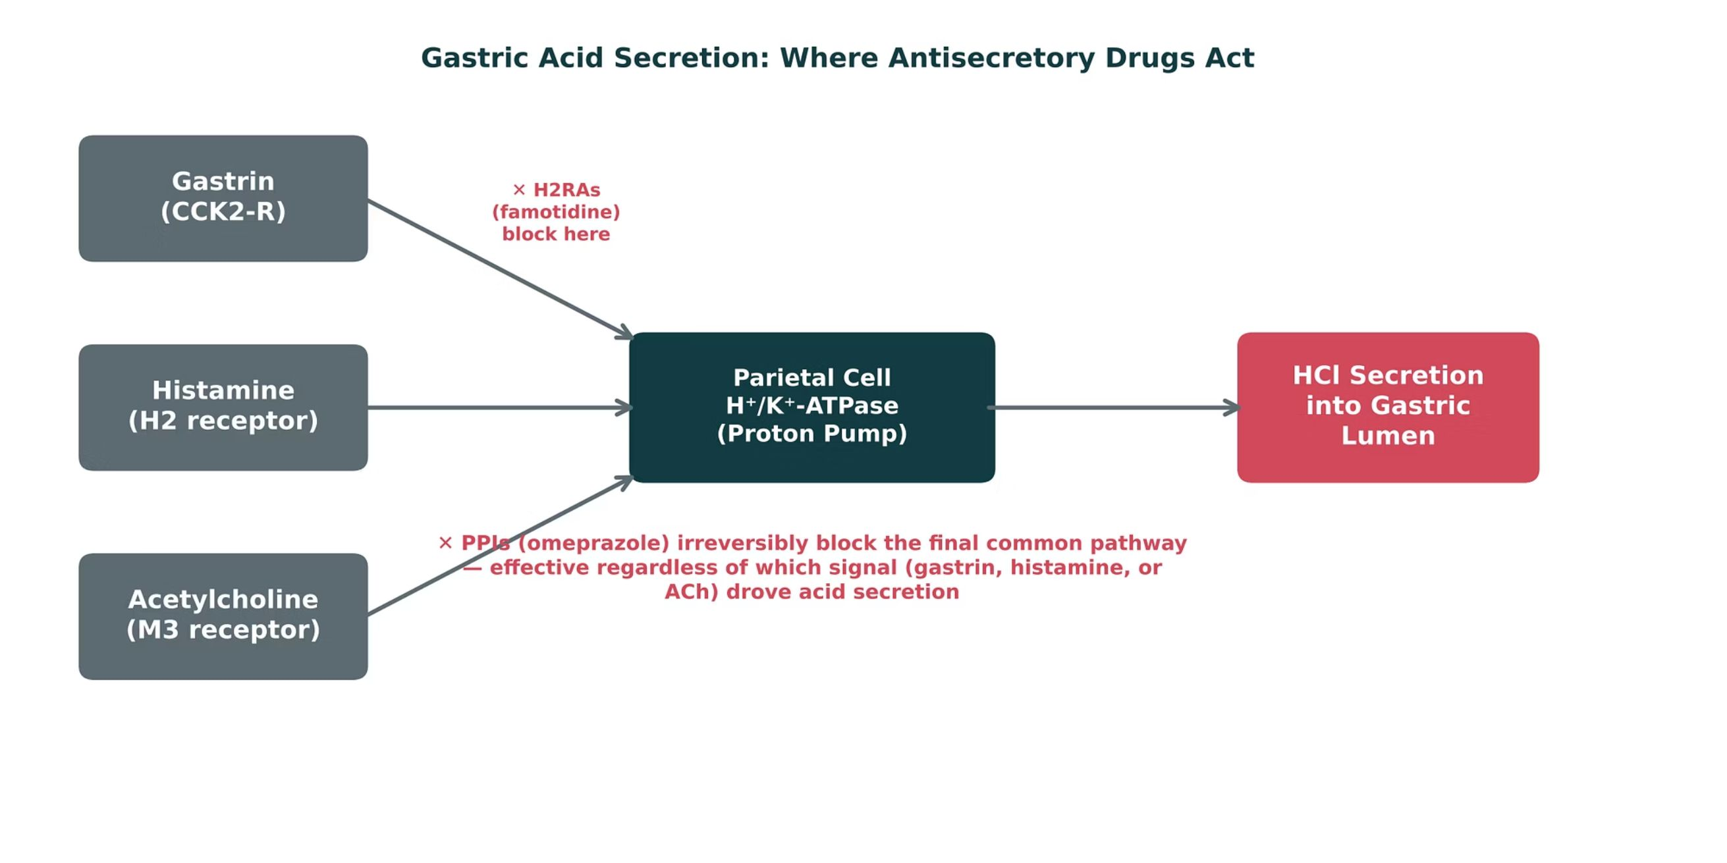
ACID-PEPTIC DISEASE & GASTRIC ACID SECRETION
Objectives: SO1 · IO3.1
Figure 1 · Gastric acid secretion: where antisecretory drugs act
Original illustrative diagram (not from Katzung): gastrin, histamine, and acetylcholine all converge on the parietal cell proton pump; H2RAs block only the histamine pathway, while PPIs block the final common pathway itself. S8; S8 (notes)
L05 · GI & Nutrition Pharmacology — Session 1
17

Slide 18
ACID-PEPTIC DISEASE & GASTRIC ACID SECRETION
Objectives: SO1 · IO3.1
Compare: Aggressive vs. protective factors
Aggressive | Protective
Gastric acid (HCl) | Mucus–bicarbonate layer
Pepsin | Prostaglandins (mucus, bicarbonate, mucosal blood flow)
H. pylori (urease → ammonia) | Epithelial cell turnover
NSAIDs (block COX-1 prostaglandins) | —
Focus: what tells these apart. Sources: S5; S6; SG U3-R1
L05 · GI & Nutrition Pharmacology — Session 1
18

Slide 19


ACID-PEPTIC DISEASE & GASTRIC ACID SECRETION
Objectives: SO1 · IO3.1
Memory hooks
Why it happens
Mnemonic (memory aid)
Why do NSAIDs cause ulcers? They block the COX-1 prostaglandins that make mucus and bicarbonate and keep mucosal blood flow up — they take the defense away. S5 (notes); S6
Three keys, one lock: gastrin, histamine, ACh all turn the pump; PPIs change the lock. S8
L05 · GI & Nutrition Pharmacology — Session 1
19

Slide 20

ACID-PEPTIC DISEASE & GASTRIC ACID SECRETION
Objectives: SO1 · IO3.1
High-yield summary
If you remember nothing else
Acid-peptic disease reflects an imbalance between mucosal defense and aggressive factors (acid, pepsin, H. pylori, NSAIDs). S34; S5
H. pylori and NSAIDs cause most PUD. S7
L05 · GI & Nutrition Pharmacology — Session 1
20

Slide 21
MECHANISM
Objectives: SO1 · IO3.1
Question 1
Which set lists only protective (mucosal defense) factors?
A
Mucus–bicarbonate layer, prostaglandins, epithelial turnover
B
Pepsin, gastrin, histamine, acetylcholine
C
Acid, pepsin, prostaglandins, epithelial turnover
D
NSAIDs, urease, ammonia, bicarbonate
E
H. pylori, mucus, bicarbonate, NSAIDs
L05 · GI & Nutrition Pharmacology — Session 1
21
Notes:
Answer on the next slide. Source: S5; SG U3-R1

Slide 22

MECHANISM · ANSWER
Objectives: SO1 · IO3.1
Answer 1: A
A. Mucus–bicarbonate layer, prostaglandins, epithelial turnover
Protective factors are the mucus–bicarbonate layer, prostaglandins, and epithelial cell turnover (S5; SG U3-R1). S5; SG U3-R1
Why the other choices are wrong
B. Pepsin, gastrin, histamine, acetylcholine — These drive acid secretion or digestion (S5; S8).
C. Acid, pepsin, prostaglandins, epithelial turnover — Acid and pepsin are aggressive factors (S5).
D. NSAIDs, urease, ammonia, bicarbonate — NSAIDs, urease and ammonia injure the mucosa (S6).
E. H. pylori, mucus, bicarbonate, NSAIDs — H. pylori and NSAIDs are aggressive (S5).
L05 · GI & Nutrition Pharmacology — Session 1
22

Slide 23






Drug class 2 of 4
Antacids, H2 Blockers & Proton Pump Inhibitors
Covers objectives: SO1 · SO2 · SO3 · SO5 · IO3.1 · IO3.2 · IO3.3 · IO3.5
Class
Prototype
Mechanism of action
Indications
Adverse effects
Contraindications
Drug interactions
Pharmacokinetics
Monitoring
Clinical pearls
23

Slide 24
ANTACIDS, H2 BLOCKERS & PROTON PUMP INHIBITORS
Objectives: SO1 · SO2 · SO3 · SO5 · IO3.1 · IO3.2 · IO3.3 · IO3.5
Class · Prototype + other drugs named
Class
Prototype + other drugs named
Turning down acid production, or shielding the mucosa from it. S9
Antacids neutralize acid already made; H2 blockers block the histamine input; PPIs block the final common pathway — the most potent acid suppression. S10; S11; S13; S18
Antacids are the oldest and most “patient-directed” class — a contrast to the receptor- and enzyme-targeted agents. S10 (notes)
Omeprazole — PPI prototype (esomeprazole, pantoprazole, lansoprazole, dexlansoprazole). S13
Famotidine — most commonly used H2 blocker; cimetidine the CYP-inhibiting one. S11
Calcium carbonate, magnesium hydroxide, aluminum hydroxide — antacids. S10
L05 · GI & Nutrition Pharmacology — Session 1
24

Slide 25
ANTACIDS, H2 BLOCKERS & PROTON PUMP INHIBITORS
Objectives: SO1 · SO2 · SO3 · SO5 · IO3.1 · IO3.2 · IO3.3 · IO3.5
Mechanism of action
Mechanism of action (1/2)
Antacids — mechanism: directly neutralize existing gastric acid (do not reduce acid production). Acid in stomach → antacid base (Al/Mg hydroxide, calcium carbonate) neutralizes H+ → higher gastric pH → rapid but short relief. S10
H2RAs — mechanism: competitively block histamine at the H2 receptor on parietal cells. Histamine from ECL cells → H2 receptor → cAMP rises → stimulates the proton pump; famotidine occupies the receptor competitively, so less acid. S11; S12
PPIs — mechanism: irreversibly inhibit the H⁺/K⁺-ATPase proton pump — the final common pathway of acid secretion. S13; SG U3-R2
PPI prodrug activated by acid → binds H⁺/K⁺ ATPase irreversibly → final step of acid secretion blocked. S13
L05 · GI & Nutrition Pharmacology — Session 1
25

Slide 26
ANTACIDS, H2 BLOCKERS & PROTON PUMP INHIBITORS
Objectives: SO1 · SO2 · SO3 · SO5 · IO3.1 · IO3.2 · IO3.3 · IO3.5
Mechanism of action (cont.)
Mechanism of action (2/2)
Pathway: enteric-coated prodrug absorbed in the small intestine → reaches the parietal cell canaliculus → activated by acid → binds a cysteine on H⁺/K⁺-ATPase covalently → pump irreversibly blocked until new pumps are made. S14; S14 (notes)
PPIs achieve substantially greater acid-suppression potency and longer duration of effect than H2RAs (Figure 4: potency 95 vs. 45; duration 90 vs. 50, illustrative). S15; S15 (notes)
TB H2 blockers inhibit 60–70% of 24-hour acid secretion; PPIs inhibit 90–98% because they block the final common pathway. p. 1156; p. 1159
L05 · GI & Nutrition Pharmacology — Session 1
26

Slide 27
ANTACIDS, H2 BLOCKERS & PROTON PUMP INHIBITORS
Objectives: SO1 · SO2 · SO3 · SO5 · IO3.1 · IO3.2 · IO3.3 · IO3.5
Indications
Indications
Antacids: onset is rapid, but duration is short — best for intermittent, mild symptom relief. S10
H2RAs: mild-to-moderate GERD, maintenance therapy, adjunct for peptic ulcer healing; best at controlling nocturnal acid. S11; S12
PPIs: first-line for GERD, PUD healing, and H. pylori regimens. S13
TB Infrequent heartburn (fewer than three times per week): antacids or as-needed H2 blockers; antacids act faster but last 1–2 hours vs. 6–10 hours. p. 1156
TB PPIs heal over 90% of duodenal ulcers within 4 weeks; GERD recurs in over 80% within 6 months of stopping. p. 1159
TB Stress-related bleeding prophylaxis in high-risk ICU patients: an oral PPI if enteral meds are possible, otherwise IV H2 blocker or PPI. p. 1157
L05 · GI & Nutrition Pharmacology — Session 1
27

Slide 28
ANTACIDS, H2 BLOCKERS & PROTON PUMP INHIBITORS
Objectives: SO1 · SO2 · SO3 · SO5 · IO3.1 · IO3.2 · IO3.3 · IO3.5
Adverse effects (boxed warnings first)
Adverse effects (boxed warnings first) (1/2)
PPI long-term adverse effects: vitamin B12 deficiency, hypomagnesemia, increased fracture risk, and increased risk of Clostridioides difficile infection — also pneumonia and acute interstitial nephritis. S13; S14; SG U3-R3
Abrupt PPI discontinuation after prolonged use can cause rebound acid hypersecretion. S13
Aluminum hydroxide — constipating. Magnesium hydroxide — can cause diarrhea; use caution in renal impairment (magnesium accumulation). Calcium carbonate — can cause constipation; risk of milk-alkali syndrome with excessive use. S10
Cimetidine: antiandrogenic effects (gynecomastia) with prolonged use. S11; S12
L05 · GI & Nutrition Pharmacology — Session 1
28

Slide 29
ANTACIDS, H2 BLOCKERS & PROTON PUMP INHIBITORS
Objectives: SO1 · SO2 · SO3 · SO5 · IO3.1 · IO3.2 · IO3.3 · IO3.5
Adverse effects (boxed warnings first) (cont.)
Adverse effects (boxed warnings first) (2/2)
Famotidine: confusion risk in older adults with renal impairment. S11 (notes); S12
H2RAs: tolerance (tachyphylaxis) can develop with continuous use, reducing effectiveness over time. S11; S12
TB PPIs carry an FDA warning for hip, spine and wrist fractures and for life-threatening hypomagnesemia; 2–3-fold more C. difficile infection. p. 1160
TB Sodium bicarbonate causes belching and metabolic alkalosis; excess calcium carbonate with dairy causes hypercalcemia, renal insufficiency and alkalosis (milk-alkali). p. 1155
L05 · GI & Nutrition Pharmacology — Session 1
29

Slide 30
ANTACIDS, H2 BLOCKERS & PROTON PUMP INHIBITORS
Objectives: SO1 · SO2 · SO3 · SO5 · IO3.1 · IO3.2 · IO3.3 · IO3.5
Contraindications
Contraindications
PPIs: contraindicated with rilpivirine (an HIV drug that needs stomach acid). S36; S61
TB Magnesium and aluminum antacids are renally excreted: avoid long-term use in renal insufficiency. p. 1155
L05 · GI & Nutrition Pharmacology — Session 1
30

Slide 31
ANTACIDS, H2 BLOCKERS & PROTON PUMP INHIBITORS
Objectives: SO1 · SO2 · SO3 · SO5 · IO3.1 · IO3.2 · IO3.3 · IO3.5
Drug interactions
Drug interactions
Antacids can impair absorption of many other oral drugs — separate dosing by at least 2 hours. They bind levothyroxine, quinolones, tetracyclines, and iron. S10; S43; S61
Omeprazole (a CYP2C19 inhibitor) can reduce clopidogrel activation, blunting its antiplatelet effect. Omeprazole and esomeprazole both inhibit CYP2C19. S13; S14; SG U3-R4
Cimetidine is a potent CYP450 inhibitor (1A2, 2C19, 3A4) — a callback to Lecture 1: it raises warfarin, phenytoin, and theophylline levels. S11; S11 (notes); S12; S42
Famotidine has minimal CYP450 interaction. S11
TB Antacids should not be given within 2 hours of tetracyclines, fluoroquinolones, itraconazole, and iron. p. 1155
TB With clopidogrel, prefer pantoprazole or rabeprazole (minimal CYP2C19 inhibition). p. 1161
TB Less acid lowers absorption of ketoconazole, itraconazole, digoxin, and atazanavir. p. 1161
L05 · GI & Nutrition Pharmacology — Session 1
31

Slide 32
ANTACIDS, H2 BLOCKERS & PROTON PUMP INHIBITORS
Objectives: SO1 · SO2 · SO3 · SO5 · IO3.1 · IO3.2 · IO3.3 · IO3.5
Pharmacokinetics
Pharmacokinetics
PPIs are best absorbed/effective when taken 30–60 minutes before a meal (timed to peak pump activity) — they work best on actively secreting pumps. S13; S14
CYP2C19 genotype alters PPI exposure; ultrarapid metabolizers may need higher doses. S13 (notes); S14
Famotidine needs renal dose adjustment. S11 (notes); S12
TB PPIs: food cuts bioavailability by about 50%; half-life about 1.5 hours yet acid inhibition lasts up to 24 hours; full effect takes 3–4 days. p. 1158
TB PPIs need no renal dose reduction; consider reduction in severe liver impairment. p. 1159
L05 · GI & Nutrition Pharmacology — Session 1
32

Slide 33
ANTACIDS, H2 BLOCKERS & PROTON PUMP INHIBITORS
Objectives: SO1 · SO2 · SO3 · SO5 · IO3.1 · IO3.2 · IO3.3 · IO3.5
Monitoring · Clinical pearls / "why" hook
Monitoring
Clinical pearls / "why" hook
Many patients stay on PPIs far longer than necessary — the long-term adverse-effect list drives deprescribing conversations. S13 (notes)
Ask: what happens to warfarin or phenytoin levels if cimetidine is added? They rise (CYP inhibition). S11 (notes)
Name stems: -prazole PPIs (irreversibly block H+/K+ ATPase); -tidine H2 receptor antagonists (famotidine, ranitidine, cimetidine; competitively block the H2 receptor). S22
L05 · GI & Nutrition Pharmacology — Session 1
33

Slide 34
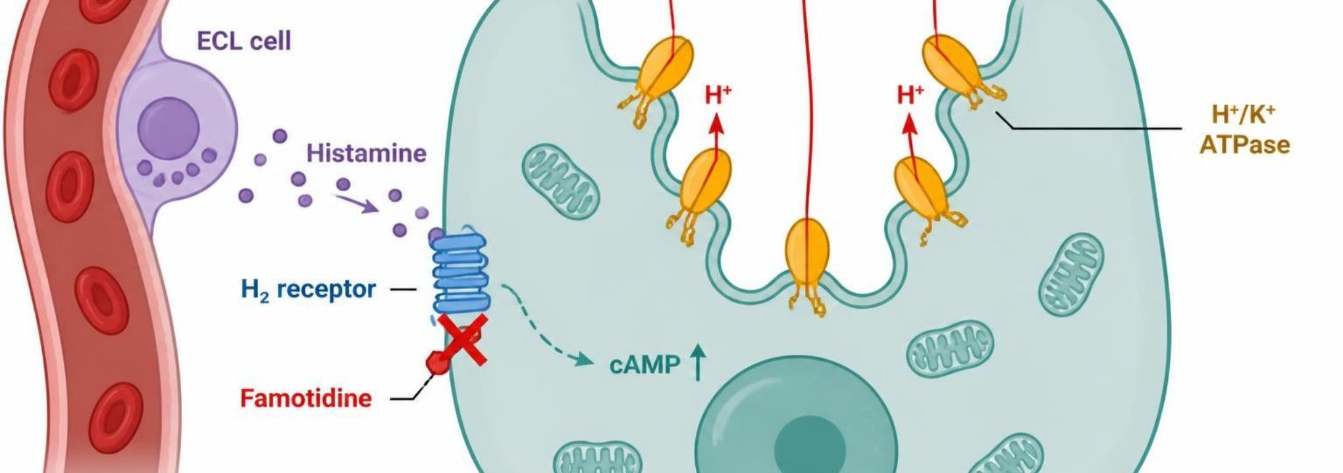
ANTACIDS, H2 BLOCKERS & PROTON PUMP INHIBITORS
Objectives: SO1 · SO2 · SO3 · SO5 · IO3.1 · IO3.2 · IO3.3 · IO3.5
Figure 2 · H2 blockers: blocking the histamine signal
Schematic (illustrative): ECL cell releases histamine → binds the H2 receptor on the parietal cell → cAMP rises → H+/K+ ATPase pumps move H+ into the gastric lumen. Famotidine blocks the H2 receptor, so less acid is secreted. S12; S12 (notes)
L05 · GI & Nutrition Pharmacology — Session 1
34

Slide 35
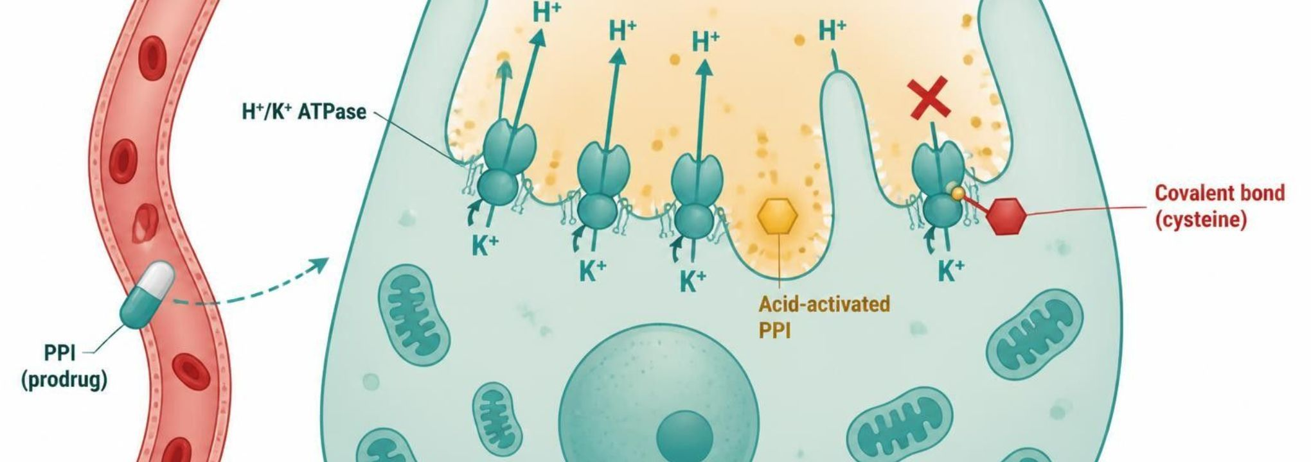
ANTACIDS, H2 BLOCKERS & PROTON PUMP INHIBITORS
Objectives: SO1 · SO2 · SO3 · SO5 · IO3.1 · IO3.2 · IO3.3 · IO3.5
Figure 3 · PPIs: irreversible pump inhibition
Schematic (illustrative): the PPI prodrug (capsule) is absorbed and reaches the parietal cell. In the acidic canaliculus it is activated and binds a cysteine on the H+/K+ ATPase pump (covalent bond). Open pumps move H+ toward the gastric lumen; the blocked pump does not. S14; S14 (notes)
L05 · GI & Nutrition Pharmacology — Session 1
35

Slide 36
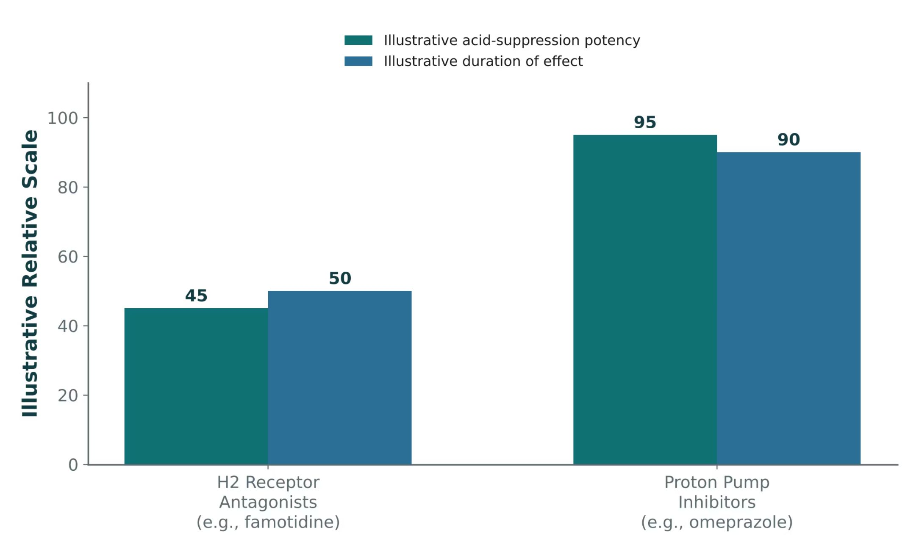
ANTACIDS, H2 BLOCKERS & PROTON PUMP INHIBITORS
Objectives: SO1 · SO2 · SO3 · SO5 · IO3.1 · IO3.2 · IO3.3 · IO3.5
Figure 4 · PPIs vs. H2 receptor antagonists: potency and duration
Original illustrative comparison (illustrative relative values, not from Katzung; not trial data): H2 receptor antagonists (e.g., famotidine) acid-suppression potency 45, duration 50; proton pump inhibitors (e.g., omeprazole) potency 95, duration 90. S15; S15 (notes)
L05 · GI & Nutrition Pharmacology — Session 1
36

Slide 37
ANTACIDS, H2 BLOCKERS & PROTON PUMP INHIBITORS
Objectives: SO1 · SO2 · SO3 · SO5 · IO3.1 · IO3.2 · IO3.3 · IO3.5
Compare: Table 1 · Acid-peptic disease agents at a glance
Class | Example agent(s) | Key teaching point
Antacid | Calcium carbonate, magnesium hydroxide | Neutralizes existing acid; rapid onset, short duration
H2RA | Famotidine, cimetidine | Blocks histamine input only; cimetidine inhibits CYP450
PPI | Omeprazole, pantoprazole | Blocks final common pathway; most potent, long-term AE risks
Mucosal protectant | Sucralfate, misoprostol | Barrier/prostaglandin replacement; misoprostol contraindicated in pregnancy
Focus: what tells these apart. Sources: S18; S18 (notes)
L05 · GI & Nutrition Pharmacology — Session 1
37

Slide 38
ANTACIDS, H2 BLOCKERS & PROTON PUMP INHIBITORS
Objectives: SO1 · SO2 · SO3 · SO5 · IO3.1 · IO3.2 · IO3.3 · IO3.5
Compare: PPI drug profiles: formulation, dose, indications
Drug | Class | Formulation | Adult dose | Indications
Omeprazole (Prilosec) | Proton pump inhibitor | DR capsule 10/20/40 mg; OTC 20 mg tablet; oral suspension packets | 20-40 mg PO once daily, 30-60 min before breakfast; GERD/ulcer courses 4-8 weeks | GERD, erosive esophagitis, peptic ulcer, H. pylori regimens, NSAID-ulcer prevention, Zollinger-Ellison
Esomeprazole (Nexium) | Proton pump inhibitor | DR capsule 20/40 mg; granule packets; IV vial 20/40 mg | 20-40 mg PO daily; IV 20-40 mg over 10-30 min daily when oral route is not possible | GERD, erosive esophagitis, H. pylori, NSAID-ulcer prevention, rebleeding risk reduction
Pantoprazole (Protonix) | Proton pump inhibitor | DR tablet 20/40 mg; granule packets; IV vial 40 mg | 40 mg PO daily before a meal; IV 40 mg daily for up to 7-10 days | GERD, erosive esophagitis, Zollinger-Ellison; IV when oral therapy is not possible
Focus: what tells these apart. Sources: S36; S37; S38; S39; S40
L05 · GI & Nutrition Pharmacology — Session 1
38

Slide 39
ANTACIDS, H2 BLOCKERS & PROTON PUMP INHIBITORS
Objectives: SO1 · SO2 · SO3 · SO5 · IO3.1 · IO3.2 · IO3.3 · IO3.5
Compare: PPI drug profiles: formulation, dose, indications (cont.)
Drug | Class | Formulation | Adult dose | Indications
Lansoprazole (Prevacid) | Proton pump inhibitor | DR capsule 15/30 mg; orally disintegrating tablet 15/30 mg | 15-30 mg PO daily before a meal; courses 4-8 weeks | GERD, ulcers, H. pylori, NSAID-ulcer healing and prevention
Dexlansoprazole (Dexilant) | Proton pump inhibitor | DR capsule 30/60 mg | 30 mg daily for non-erosive GERD; 60 mg daily for up to 8 weeks for erosive esophagitis; with or without food | Erosive esophagitis healing and maintenance, non-erosive GERD heartburn
Focus: what tells these apart. Sources: S36; S37; S38; S39; S40
L05 · GI & Nutrition Pharmacology — Session 1
39

Slide 40
ANTACIDS, H2 BLOCKERS & PROTON PUMP INHIBITORS
Objectives: SO1 · SO2 · SO3 · SO5 · IO3.1 · IO3.2 · IO3.3 · IO3.5
Compare: PPI drug profiles: adverse effects, contraindications, toxicity
Drug | Adverse effects | Contraindications | Toxicity / overdose
Omeprazole (Prilosec) | Headache, diarrhea, abdominal pain, nausea; long-term: low B12 and Mg, fractures, C. difficile | Hypersensitivity to PPIs; rilpivirine co-use | Overdose rare (flushing, tachycardia, confusion); long-term hypomagnesemia; reduces clopidogrel activation (CYP2C19)
Esomeprazole (Nexium) | Headache, diarrhea, nausea; long-term: low B12 and Mg, fractures | Hypersensitivity to PPIs; rilpivirine co-use | Same class toxicities as omeprazole; hypomagnesemia, C. difficile; supportive care for overdose
Pantoprazole (Protonix) | Headache, diarrhea, nausea; long-term: low B12 and Mg, fractures | Hypersensitivity to PPIs; rilpivirine co-use | Class toxicities; fewer CYP drug interactions than omeprazole; supportive care for overdose
Lansoprazole (Prevacid) | Diarrhea, abdominal pain, nausea, headache; long-term: low B12 and Mg | Hypersensitivity to PPIs; rilpivirine co-use | Class toxicities; ODT contains phenylalanine; supportive care for overdose
Dexlansoprazole (Dexilant) | Diarrhea, abdominal pain, nausea, headache; long-term: low B12 and Mg | Hypersensitivity to PPIs; rilpivirine co-use | Class toxicities; supportive care for overdose
Focus: what tells these apart. Sources: S36; S37; S38; S39; S40
L05 · GI & Nutrition Pharmacology — Session 1
40

Slide 41
ANTACIDS, H2 BLOCKERS & PROTON PUMP INHIBITORS
Objectives: SO1 · SO2 · SO3 · SO5 · IO3.1 · IO3.2 · IO3.3 · IO3.5
Compare: H2 blocker and antacid drug profiles: formulation, dose, indications
Drug | Class | Formulation | Adult dose | Indications
Famotidine (Pepcid) | H2 receptor antagonist | Tablet 10 mg (OTC), 20/40 mg; IV 10 mg/mL; oral suspension | 20 mg BID or 40 mg at bedtime; reduce dose when CrCl is below 60 mL/min | GERD, duodenal and gastric ulcer, hypersecretory states, heartburn prevention
Cimetidine (Tagamet) | H2 receptor antagonist | Tablet 200/300/400/800 mg; oral liquid; IV | 400 mg BID or 800 mg at bedtime; adjust for renal impairment | Duodenal and gastric ulcer, GERD, hypersecretory states
Calcium carbonate (Tums) | Antacid and calcium supplement | Chewable tablet 500-1,000 mg; suspension | 500-1,500 mg PO as needed; respect label daily maximum (about 7,000-7,500 mg/day) | Occasional heartburn and indigestion; calcium supplementation
Focus: what tells these apart. Sources: S41; S42; S43; S44; S45
L05 · GI & Nutrition Pharmacology — Session 1
41

Slide 42
ANTACIDS, H2 BLOCKERS & PROTON PUMP INHIBITORS
Objectives: SO1 · SO2 · SO3 · SO5 · IO3.1 · IO3.2 · IO3.3 · IO3.5
Compare: H2 blocker and antacid drug profiles: formulation, dose, indications (cont.)
Drug | Class | Formulation | Adult dose | Indications
Magnesium hydroxide (Milk of Magnesia) | Antacid and osmotic laxative | Suspension 400 mg/5 mL; chewable tablet | Antacid 5-15 mL PO up to four times daily; laxative 30-60 mL once daily | Occasional heartburn, short-term constipation
Aluminum hydroxide (Amphojel) | Antacid and phosphate binder | Suspension 320 mg/5 mL; tablet | 5-10 mL PO several times daily between meals and at bedtime as labeled | Heartburn, indigestion; hyperphosphatemia in kidney disease
Focus: what tells these apart. Sources: S41; S42; S43; S44; S45
L05 · GI & Nutrition Pharmacology — Session 1
42

Slide 43
ANTACIDS, H2 BLOCKERS & PROTON PUMP INHIBITORS
Objectives: SO1 · SO2 · SO3 · SO5 · IO3.1 · IO3.2 · IO3.3 · IO3.5
Compare: H2 blocker and antacid drug profiles: adverse effects, contraindications, toxicity
Drug | Adverse effects | Contraindications | Toxicity / overdose
Famotidine (Pepcid) | Headache, dizziness, constipation or diarrhea; confusion in older or renally impaired patients | Hypersensitivity to H2 blockers | Overdose rare: CNS effects, tachycardia, hypotension; accumulates in CKD; tolerance with continued use
Cimetidine (Tagamet) | Headache, dizziness, confusion, gynecomastia, impotence | Hypersensitivity to H2 blockers | Strong CYP inhibitor: raises warfarin, phenytoin, theophylline levels; CNS toxicity in older adults
Calcium carbonate (Tums) | Constipation, belching, gas; hypercalcemia with excess | Hypercalcemia, kidney stones (caution), severe renal impairment | Milk-alkali syndrome (hypercalcemia, alkalosis, AKI); acid rebound; binds levothyroxine, quinolones, tetracyclines, iron
Focus: what tells these apart. Sources: S41; S42; S43; S44; S45
L05 · GI & Nutrition Pharmacology — Session 1
43

Slide 44
ANTACIDS, H2 BLOCKERS & PROTON PUMP INHIBITORS
Objectives: SO1 · SO2 · SO3 · SO5 · IO3.1 · IO3.2 · IO3.3 · IO3.5
Compare: H2 blocker and antacid drug profiles: adverse effects, contraindications, toxicity (cont.)
Drug | Adverse effects | Contraindications | Toxicity / overdose
Magnesium hydroxide (Milk of Magnesia) | Diarrhea, abdominal cramping | Severe renal impairment, bowel obstruction | Hypermagnesemia in CKD: hypotension, absent reflexes, respiratory depression, cardiac arrest
Aluminum hydroxide (Amphojel) | Constipation, hypophosphatemia with prolonged use | Bowel obstruction; caution in CKD | Aluminum accumulation in CKD: osteomalacia, encephalopathy, anemia; binds other drugs
Focus: what tells these apart. Sources: S41; S42; S43; S44; S45
L05 · GI & Nutrition Pharmacology — Session 1
44

Slide 45
ANTACIDS, H2 BLOCKERS & PROTON PUMP INHIBITORS
Objectives: SO1 · SO2 · SO3 · SO5 · IO3.1 · IO3.2 · IO3.3 · IO3.5
Memory hooks
Why it happens
Why it happens
Why before breakfast? PPIs only hit pumps that are actively secreting; a meal switches pumps on, so the drug should be peaking when they turn on. S13; S14
Why does PPI use cause B12 deficiency? Acid frees B12 from food protein; less acid, less B12 released. SG U3-R3
Mnemonic (memory aid)
Antacid bowel effects: Aluminum always constipates; Mg = more going (diarrhea). S10
L05 · GI & Nutrition Pharmacology — Session 1
45

Slide 46
ANTACIDS, H2 BLOCKERS & PROTON PUMP INHIBITORS
Objectives: SO1 · SO2 · SO3 · SO5 · IO3.1 · IO3.2 · IO3.3 · IO3.5
High-yield summary
If you remember nothing else
PPIs block the parietal cell’s final common pathway and are the most potent antisecretory agents, but carry real long-term risks (B12 deficiency, hypomagnesemia, fracture, C. difficile). S34; S13
Antacids: fast, short, don’t reduce production; separate other drugs by 2 hours. S10
Cimetidine: CYP inhibitor + gynecomastia; famotidine: renal dosing, minimal CYP. S11; S12
Omeprazole + clopidogrel: CYP2C19 inhibition blunts activation. S13; SG U3-R4
L05 · GI & Nutrition Pharmacology — Session 1
46

Slide 47
CLINICAL VIGNETTE
Objectives: SO1 · SO2 · SO3 · SO5 · IO3.1 · IO3.2 · IO3.3 · IO3.5
Question 4
A patient with a coronary stent on clopidogrel needs a PPI for GERD. Why is omeprazole a concern?
A
It causes rebound acid that inactivates clopidogrel
B
It inhibits CYP2C19, blunting clopidogrel activation
C
It binds clopidogrel in the gut and blocks absorption
D
It adds antiplatelet effect, causing bleeding
E
It induces CYP3A4, speeding clopidogrel clearance
L05 · GI & Nutrition Pharmacology — Session 1
47
Notes:
Answer on the next slide. Source: S13; SG U3-R4

Slide 48
CLINICAL VIGNETTE · ANSWER
Objectives: SO1 · SO2 · SO3 · SO5 · IO3.1 · IO3.2 · IO3.3 · IO3.5
Answer 4: B
B. It inhibits CYP2C19, blunting clopidogrel activation
Omeprazole (and esomeprazole) inhibit CYP2C19, which activates the prodrug clopidogrel (S13; SG U3-R4). S13; SG U3-R4
Why the other choices are wrong
A. It causes rebound acid that inactivates clopidogrel — Rebound acid follows stopping a PPI (S13).
C. It binds clopidogrel in the gut and blocks absorption — Binding is the antacid problem (S10).
D. It adds antiplatelet effect, causing bleeding — The effect is blunted, not enhanced (S13).
E. It induces CYP3A4, speeding clopidogrel clearance — The taught interaction is CYP2C19 inhibition (S13).
L05 · GI & Nutrition Pharmacology — Session 1
48

Slide 49
Drug class 3 of 4
Mucosal Protectants & H. pylori Eradication
Covers objectives: SO1 · SO2 · SO4 · SO5 · IO3.1 · IO3.2 · IO3.4 · IO3.6
Class
Prototype
Mechanism of action
Indications
Adverse effects
Contraindications
Drug interactions
Pharmacokinetics
Monitoring
Clinical pearls
49

Slide 50
MUCOSAL PROTECTANTS & H. PYLORI ERADICATION
Objectives: SO1 · SO2 · SO4 · SO5 · IO3.1 · IO3.2 · IO3.4 · IO3.6
Class · Prototype + other drugs named
Class
Prototype + other drugs named
Shielding the mucosa (sucralfate, misoprostol, bismuth) and treating the cause (H. pylori eradication). S9; S16; S19
H. pylori is the leading identifiable cause of peptic ulcer disease — eradication, not just acid suppression, is the goal. S19; S20 (notes)
Sucralfate — barrier over the ulcer base. S16
Misoprostol — PGE1 analog for NSAID-ulcer prevention. S16
Bismuth quadruple and PPI-based triple therapy for H. pylori. S19
L05 · GI & Nutrition Pharmacology — Session 1
50

Slide 51
MUCOSAL PROTECTANTS & H. PYLORI ERADICATION
Objectives: SO1 · SO2 · SO4 · SO5 · IO3.1 · IO3.2 · IO3.4 · IO3.6
Mechanism of action
Mechanism of action
Sucralfate: in acid (pH below 4) it polymerizes, binds the ulcer base and forms a protective barrier; requires an acidic environment to activate; minimal systemic absorption. S16; S17; SG U3-R5
Misoprostol: a prostaglandin E1 analog — acts on EP receptors to reduce acid and increase mucus and bicarbonate, restoring the protective prostaglandin tone that NSAIDs suppress. S16; S17; SG U3-R5
Why H. pylori needs multiple drugs: it lives in gastric mucus and buffers acid with urease-made ammonia. S20
A PPI raises gastric pH so bacteria enter a replicating state and antibiotics are more stable; amoxicillin blocks cell wall synthesis; clarithromycin (50S ribosome) or metronidazole adds a second antibiotic. S20; S20 (notes)
TB Sucralfate is sucrose complexed to sulfated aluminum hydroxide; less than 3% is absorbed. p. 1161
TB Bismuth coats ulcers, has direct antimicrobial effects and binds enterotoxins (traveler’s diarrhea). p. 1162
L05 · GI & Nutrition Pharmacology — Session 1
51

Slide 52
MUCOSAL PROTECTANTS & H. PYLORI ERADICATION
Objectives: SO1 · SO2 · SO4 · SO5 · IO3.1 · IO3.2 · IO3.4 · IO3.6
Indications
Indications
Triple therapy: PPI + amoxicillin + clarithromycin for 10–14 days (usual duration 14 days). S19; S19 (notes)
Bismuth quadruple therapy: PPI (or H2RA) + bismuth subsalicylate + metronidazole + tetracycline — preferred where clarithromycin resistance is a concern, with recent macrolide exposure, or with penicillin allergy. S19; S19 (notes); S20; SG U3-R6
Penicillin allergy: substitute metronidazole for amoxicillin in triple therapy. S19
Misoprostol is used specifically to prevent NSAID-induced ulcers. S16
TB Misoprostol cuts NSAID-induced ulcers to less than 3% and ulcer complications by 50%, but dosing 3–4 times daily and diarrhea limit use. p. 1162
L05 · GI & Nutrition Pharmacology — Session 1
52

Slide 53
MUCOSAL PROTECTANTS & H. PYLORI ERADICATION
Objectives: SO1 · SO2 · SO4 · SO5 · IO3.1 · IO3.2 · IO3.4 · IO3.6
Adverse effects (boxed warnings first) · Contraindications
Adverse effects (boxed warnings first)
Contraindications
Misoprostol: contraindicated in pregnancy — potent uterotonic/abortifacient effect (boxed warning). Common adverse effects: diarrhea and cramping. S16; S17; S47; SG U3-R5
Sucralfate: constipation is common; aluminum accumulates in CKD. S16 (notes); S17
TB Bismuth blackens stool (can mimic GI bleeding) and darkens the tongue; avoid in renal insufficiency. p. 1162
Avoid tetracycline in pregnancy and in children. S19 (notes); S20
Penicillin allergy rules out amoxicillin in H. pylori regimens. S19; S61
L05 · GI & Nutrition Pharmacology — Session 1
53

Slide 54
MUCOSAL PROTECTANTS & H. PYLORI ERADICATION
Objectives: SO1 · SO2 · SO4 · SO5 · IO3.1 · IO3.2 · IO3.4 · IO3.6
Drug interactions · Pharmacokinetics
Drug interactions
Pharmacokinetics
Separate sucralfate from other drugs by 2 hours (give on an empty stomach, separated from antacids/PPIs). S16; S17
Clarithromycin inhibits CYP3A4 — must not be combined with simvastatin, lovastatin, or ergotamine. S19 (notes); S20; S61
Metronidazole plus alcohol causes a disulfiram-like reaction. S19 (notes); S20; S61
Sucralfate has minimal systemic absorption. S16
L05 · GI & Nutrition Pharmacology — Session 1
54

Slide 55
MUCOSAL PROTECTANTS & H. PYLORI ERADICATION
Objectives: SO1 · SO2 · SO4 · SO5 · IO3.1 · IO3.2 · IO3.4 · IO3.6
Monitoring
Monitoring
Confirm eradication with testing (urea breath test or stool antigen) after completing therapy — at least 4 weeks after, with the PPI held for 2 weeks (PPIs cause false negatives). S19; S19 (notes); S20
Counsel on completing a 10–14 day, 3–4 drug regimen — multi-drug regimens are a classic adherence problem. S19 (notes)
TB After antibiotics, continue the PPI once daily for a total of 4–6 weeks to complete ulcer healing. p. 1159
L05 · GI & Nutrition Pharmacology — Session 1
55

Slide 56
MUCOSAL PROTECTANTS & H. PYLORI ERADICATION
Objectives: SO1 · SO2 · SO4 · SO5 · IO3.1 · IO3.2 · IO3.4 · IO3.6
Clinical pearls / "why" hook
Clinical pearls / "why" hook
Case: confirmed H. pylori, penicillin allergy, and a macrolide two months ago. Which eradication regimen is more appropriate for this patient, and why? S21
Answer: bismuth quadruple therapy — recent macrolide exposure raises clarithromycin-resistance concern and the allergy rules out standard triple therapy. S21; S21 (notes); SG U3-S
Misoprostol’s pregnancy contraindication links to its other use (labor induction/medical abortion) — mechanism explains the contraindication. S16 (notes)
Name stems: -prostol prostaglandin analogs (misoprostol); -cillin penicillins (amoxicillin; blocks cell wall synthesis); -thromycin macrolides (clarithromycin; -mycin alone is not reliable, e.g., gentamicin); sucralfate and bismuth subsalicylate share no stem. S22; S22 (notes)
L05 · GI & Nutrition Pharmacology — Session 1
56

Slide 57
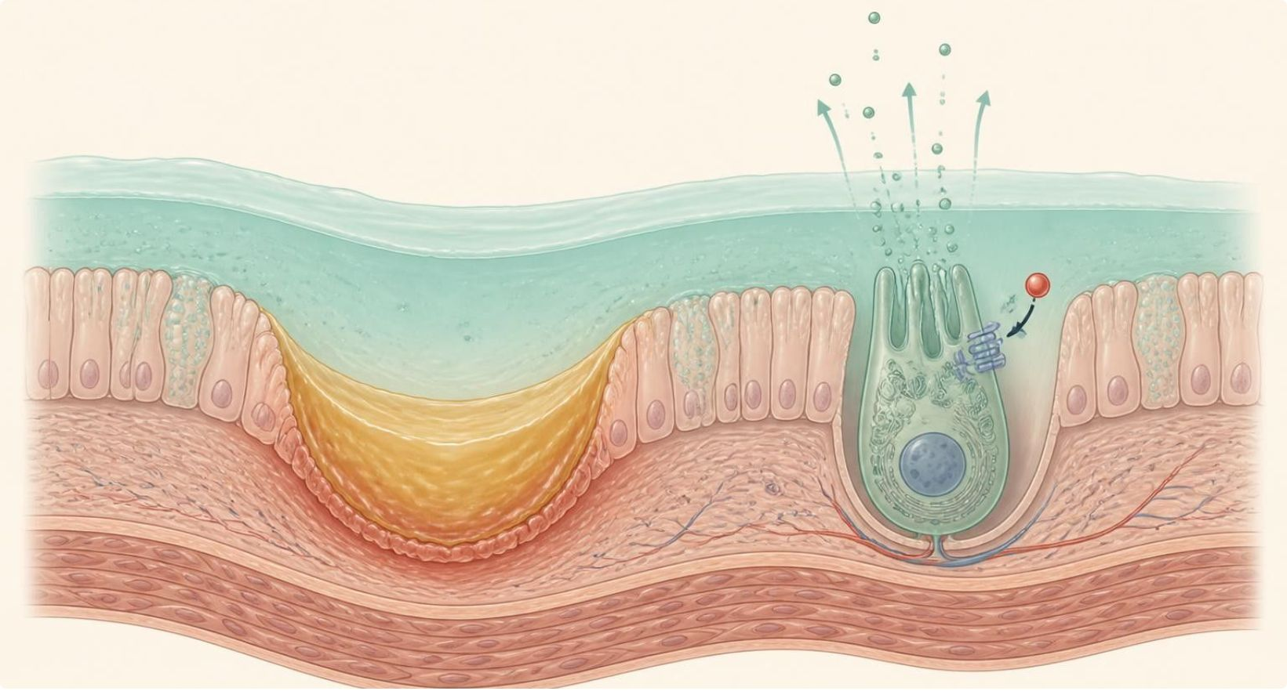
MUCOSAL PROTECTANTS & H. PYLORI ERADICATION
Objectives: SO1 · SO2 · SO4 · SO5 · IO3.1 · IO3.2 · IO3.4 · IO3.6
Figure 5 · Sucralfate and misoprostol: strengthening defense
Schematic (illustrative): sucralfate polymerizes in acid and binds the ulcer base, forming a protective barrier. Misoprostol, a PGE1 analog, activates EP receptors on parietal cells to reduce acid and increases mucus and bicarbonate. S17; S17 (notes)
L05 · GI & Nutrition Pharmacology — Session 1
57

Slide 58
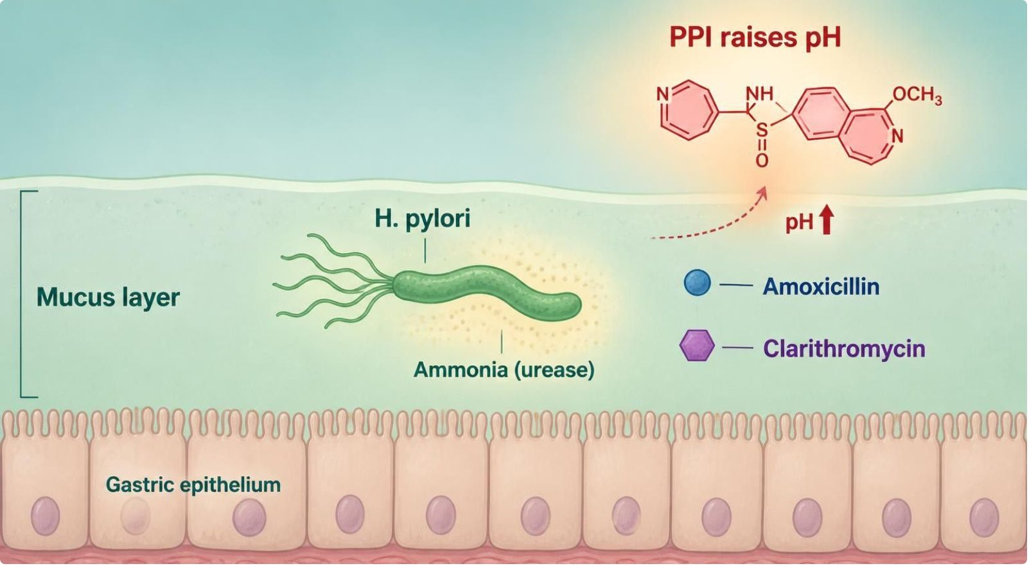
MUCOSAL PROTECTANTS & H. PYLORI ERADICATION
Objectives: SO1 · SO2 · SO4 · SO5 · IO3.1 · IO3.2 · IO3.4 · IO3.6
Figure 6 · Why H. pylori needs multiple drugs
Schematic (illustrative): H. pylori lives in the gastric mucus and buffers acid with urease-made ammonia. A PPI raises pH, amoxicillin blocks cell wall synthesis, and clarithromycin or metronidazole adds a second antibiotic; bismuth quadruple therapy (PPI + bismuth + tetracycline + metronidazole) is the alternative. S20; S20 (notes)
L05 · GI & Nutrition Pharmacology — Session 1
58

Slide 59


MUCOSAL PROTECTANTS & H. PYLORI ERADICATION
Objectives: SO1 · SO2 · SO4 · SO5 · IO3.1 · IO3.2 · IO3.4 · IO3.6
⚠ Sources disagree: H. pylori triple therapy duration
Lecture slides say
Textbook says
Triple therapy: PPI + amoxicillin + clarithromycin for 10–14 days (usual duration 14 days). S19; S19 (notes)
TB A 14-day regimen is recommended; quadruple therapy is now first-line where clarithromycin resistance is likely. p. 1159
L05 · GI & Nutrition Pharmacology — Session 1
59

Slide 60
MUCOSAL PROTECTANTS & H. PYLORI ERADICATION
Objectives: SO1 · SO2 · SO4 · SO5 · IO3.1 · IO3.2 · IO3.4 · IO3.6
Compare: H. pylori regimens
Regimen | Drugs | Use when
Triple therapy | PPI + amoxicillin + clarithromycin, 10–14 days | Low clarithromycin resistance, no penicillin allergy
Triple, penicillin-allergic | PPI + metronidazole + clarithromycin | Penicillin allergy (substitute metronidazole for amoxicillin)
Bismuth quadruple | PPI (or H2RA) + bismuth subsalicylate + metronidazole + tetracycline | Clarithromycin resistance, recent macrolide, penicillin allergy
Test of cure | Urea breath test or stool antigen | ≥ 4 weeks after therapy, PPI held 2 weeks
Focus: what tells these apart. Sources: S19; S19 (notes); S20; SG U3-R6
L05 · GI & Nutrition Pharmacology — Session 1
60

Slide 61
MUCOSAL PROTECTANTS & H. PYLORI ERADICATION
Objectives: SO1 · SO2 · SO4 · SO5 · IO3.1 · IO3.2 · IO3.4 · IO3.6
Compare: Mucosal protectant drug profiles: formulation, dose, indications
Drug | Class | Formulation | Adult dose | Indications
Sucralfate (Carafate) | Mucosal protectant | Tablet 1 g; suspension 1 g/10 mL | 1 g PO QID, 1 hour before meals and at bedtime, 4-8 weeks (duodenal ulcer); 1 g BID for maintenance | Active duodenal ulcer, ulcer maintenance, stress-ulcer prophylaxis (off-label)
Misoprostol (Cytotec) | Prostaglandin E1 analog | Tablet 100/200 mcg | 200 mcg PO QID with food and at bedtime during NSAID therapy | Prevention of NSAID-induced gastric ulcers
Bismuth subsalicylate (Pepto-Bismol) | Antisecretory, antimicrobial, mucosal agent | Chewable tablet 262 mg; suspension 262 or 525 mg/15 mL | 524 mg every 30-60 min as needed, max 8 doses per day; H. pylori quadruple therapy 524 mg QID | Diarrhea, dyspepsia, nausea, H. pylori eradication
Focus: what tells these apart. Sources: S46; S47; S48
L05 · GI & Nutrition Pharmacology — Session 1
61

Slide 62
MUCOSAL PROTECTANTS & H. PYLORI ERADICATION
Objectives: SO1 · SO2 · SO4 · SO5 · IO3.1 · IO3.2 · IO3.4 · IO3.6
Compare: Mucosal protectant drug profiles: adverse effects, contraindications, toxicity
Drug | Adverse effects | Contraindications | Toxicity / overdose
Sucralfate (Carafate) | Constipation, dry mouth, nausea | Hypersensitivity; caution in CKD and dysphagia | Aluminum accumulation in CKD; bezoar risk; binds other drugs (separate by 2 hours); hyperglycemia in diabetes
Misoprostol (Cytotec) | Diarrhea, abdominal cramps, nausea, menstrual-type bleeding | Pregnancy (boxed warning), prostaglandin hypersensitivity | Miscarriage, uterine rupture and birth defects; overdose: fever, tachycardia, hypotension, seizures
Bismuth subsalicylate (Pepto-Bismol) | Black stool and tongue, constipation | Salicylate allergy, bleeding disorders, anticoagulants, children or teens with viral illness (Reye syndrome) | Salicylism: tinnitus, rapid breathing; bismuth neurotoxicity with prolonged high use
Focus: what tells these apart. Sources: S46; S47; S48
L05 · GI & Nutrition Pharmacology — Session 1
62

Slide 63
MUCOSAL PROTECTANTS & H. PYLORI ERADICATION
Objectives: SO1 · SO2 · SO4 · SO5 · IO3.1 · IO3.2 · IO3.4 · IO3.6
Compare: H. pylori antibiotic profiles: formulation, dose, indications
Drug | Class | Formulation | Adult dose | Indications
Amoxicillin (Amoxil) | Aminopenicillin | Capsule/tablet 250/500/875 mg; suspension | H. pylori: 1 g PO BID for 14 days as part of combination therapy | H. pylori (combination), bacterial infections
Clarithromycin (Biaxin) | Macrolide antibiotic | Tablet 250/500 mg; ER tablet 500 mg; suspension | H. pylori: 500 mg PO BID for 14 days in triple therapy | H. pylori (where resistance is low), respiratory infections
Metronidazole (Flagyl) | Nitroimidazole antimicrobial | Tablet 250/500 mg; IV; topical/vaginal forms | H. pylori quadruple therapy: 500 mg PO TID-QID for 14 days | H. pylori (bismuth quadruple), anaerobic infections, C. difficile, trichomoniasis
Tetracycline (Sumycin) | Tetracycline antibiotic | Capsule 250/500 mg | H. pylori quadruple therapy: 500 mg PO QID for 14 days | H. pylori (bismuth quadruple), acne, rickettsial infections
Focus: what tells these apart. Sources: S49; S50; S51; S52
L05 · GI & Nutrition Pharmacology — Session 1
63

Slide 64
MUCOSAL PROTECTANTS & H. PYLORI ERADICATION
Objectives: SO1 · SO2 · SO4 · SO5 · IO3.1 · IO3.2 · IO3.4 · IO3.6
Compare: H. pylori antibiotic profiles: adverse effects, contraindications, toxicity
Drug | Adverse effects | Contraindications | Toxicity / overdose
Amoxicillin (Amoxil) | Diarrhea, nausea, rash; C. difficile infection | Penicillin allergy | Anaphylaxis in allergic patients; overdose causes GI upset; rarely crystalluria
Clarithromycin (Biaxin) | Taste change, nausea, diarrhea; QT prolongation | Macrolide allergy; QT history; co-use with simvastatin, lovastatin, ergotamine | Strong CYP3A4 and P-gp inhibitor; torsades, hepatotoxicity; avoid if prior macrolide exposure
Metronidazole (Flagyl) | Metallic taste, nausea, headache; disulfiram-like reaction with alcohol | Alcohol use during and for 3 days after, recent disulfiram, Cockayne syndrome | Neurotoxicity: neuropathy, encephalopathy, seizures with prolonged or high dosing
Tetracycline (Sumycin) | Nausea, esophagitis, photosensitivity | Pregnancy, children under 8 years, hypersensitivity | Tooth discoloration and bone effects in children; hepatotoxicity at high dose; chelated by dairy, antacids, iron
Focus: what tells these apart. Sources: S49; S50; S51; S52
L05 · GI & Nutrition Pharmacology — Session 1
64

Slide 65
MUCOSAL PROTECTANTS & H. PYLORI ERADICATION
Objectives: SO1 · SO2 · SO4 · SO5 · IO3.1 · IO3.2 · IO3.4 · IO3.6
Memory hooks
Why it happens
Mnemonic (memory aid)
Why is misoprostol forbidden in pregnancy? It is a prostaglandin — the same uterotonic effect that makes it a labor-induction drug. S16; S16 (notes)
Allergic to penicillin or recently on a macrolide? Go Bismuth (quadruple). S21; SG U3-R6
L05 · GI & Nutrition Pharmacology — Session 1
65

Slide 66
MUCOSAL PROTECTANTS & H. PYLORI ERADICATION
Objectives: SO1 · SO2 · SO4 · SO5 · IO3.1 · IO3.2 · IO3.4 · IO3.6
High-yield summary
If you remember nothing else
H. pylori eradication requires multi-drug regimens (triple or bismuth quadruple therapy), not acid suppression alone. S34; S19
Misoprostol: PGE1 analog, NSAID-ulcer prevention, never in pregnancy. S16; SG U3-R5
Sucralfate needs acid; separate from other drugs by 2 hours. S16; S17
L05 · GI & Nutrition Pharmacology — Session 1
66

Slide 67
CLINICAL VIGNETTE · LECTURE QUICK CHECK S21
Objectives: SO1 · SO2 · SO4 · SO5 · IO3.1 · IO3.2 · IO3.4 · IO3.6
Question 11
A patient with confirmed H. pylori has a penicillin allergy and took a macrolide for a respiratory infection two months ago. Which regimen is most appropriate?
A
Sucralfate plus an antacid
B
Double-dose PPI monotherapy
C
PPI + metronidazole + clarithromycin
D
PPI + amoxicillin + clarithromycin
E
Bismuth quadruple therapy
L05 · GI & Nutrition Pharmacology — Session 1
67
Notes:
Answer on the next slide. Source: S21; SG U3-R6

Slide 68
CLINICAL VIGNETTE · ANSWER
Objectives: SO1 · SO2 · SO4 · SO5 · IO3.1 · IO3.2 · IO3.4 · IO3.6
Answer 11: E
E. Bismuth quadruple therapy
Recent macrolide exposure raises clarithromycin-resistance concern and the penicillin allergy rules out standard triple therapy — bismuth quadruple therapy avoids both (S21; SG U3-R6). S21; SG U3-R6
Why the other choices are wrong
A. Sucralfate plus an antacid — Neither eradicates H. pylori (S19).
B. Double-dose PPI monotherapy — Eradication needs antibiotics (S19).
C. PPI + metronidazole + clarithromycin — Still clarithromycin after recent macrolide exposure (S21).
D. PPI + amoxicillin + clarithromycin — Penicillin allergy and macrolide exposure both rule it out (S21).
L05 · GI & Nutrition Pharmacology — Session 1
68

Slide 69
CLINICAL VIGNETTE
Objectives: SO1 · SO2 · SO4 · SO5 · IO3.1 · IO3.2 · IO3.4 · IO3.6
Question 13
A patient finishes H. pylori therapy and wants a test of cure next week while still on the PPI. What is the right advice?
A
Test ≥ 4 weeks after therapy, PPI held 2 weeks
B
Test during therapy to adjust antibiotics
C
Test now; the PPI improves test accuracy
D
No testing is ever needed after therapy
E
Repeat the full regimen without testing
L05 · GI & Nutrition Pharmacology — Session 1
69
Notes:
Answer on the next slide. Source: S19; S20

Slide 70
CLINICAL VIGNETTE · ANSWER
Objectives: SO1 · SO2 · SO4 · SO5 · IO3.1 · IO3.2 · IO3.4 · IO3.6
Answer 13: A
A. Test ≥ 4 weeks after therapy, PPI held 2 weeks
Confirm eradication at least 4 weeks after therapy and off the PPI for 2 weeks — PPIs cause false negatives (S19; S20). S19; S20
Why the other choices are wrong
B. Test during therapy to adjust antibiotics — Test after completion (S19).
C. Test now; the PPI improves test accuracy — PPIs cause false negatives (S19).
D. No testing is ever needed after therapy — Confirm eradication (S19).
E. Repeat the full regimen without testing — Test first (S19).
L05 · GI & Nutrition Pharmacology — Session 1
70

Slide 71
Drug class 4 of 4
Antiemetics
Covers objectives: SO1 · SO3 · SO4 · SO5 · IO3.1 · IO3.2 · IO3.3 · IO3.4 · IO3.6
Class
Prototype
Mechanism of action
Indications
Adverse effects
Contraindications
Drug interactions
Pharmacokinetics
Monitoring
Clinical pearls
71

Slide 72
ANTIEMETICS
Objectives: SO1 · SO3 · SO4 · SO5 · IO3.1 · IO3.2 · IO3.3 · IO3.4 · IO3.6
Class
Class
Four receptor systems feed one final common reflex. S23
Four inputs converge on the vomiting center in the medulla: gut and vagal (5-HT3), the chemoreceptor trigger zone (D2, 5-HT3, NK1), the vestibular (H1, M1) system, and higher cortical (anxiety, anticipatory) input — benzodiazepines and cannabinoids. S26; S26 (notes)
Motion sickness is vestibular — H1/M1 blockers (meclizine, scopolamine) fit it. S27 (notes); SG U3-R7
Matching each drug to its input pathway (Figure 9) is the single most testable concept in this section. S27 (notes)
L05 · GI & Nutrition Pharmacology — Session 1
72

Slide 73
ANTIEMETICS
Objectives: SO1 · SO3 · SO4 · SO5 · IO3.1 · IO3.2 · IO3.3 · IO3.4 · IO3.6
Prototype + other drugs named
Prototype + other drugs named
Ondansetron — 5-HT3 antagonist. S24
Metoclopramide, prochlorperazine — D2 antagonists. S24
Aprepitant — NK1 antagonist. S24
Meclizine, scopolamine — H1/M1 antagonists. S24
Dronabinol, nabilone — cannabinoids (CB1). S30
L05 · GI & Nutrition Pharmacology — Session 1
73

Slide 74
ANTIEMETICS
Objectives: SO1 · SO3 · SO4 · SO5 · IO3.1 · IO3.2 · IO3.3 · IO3.4 · IO3.6
Mechanism of action
Mechanism of action (1/2)
5-HT3 antagonists block serotonin at gut vagal afferents/CTZ. S24
Chemotherapy or gut irritation damages enterochromaffin cells → serotonin binds 5-HT3 on vagal afferents and the CTZ → signal to the vomiting center; ondansetron blocks 5-HT3, so no signal reaches the vomiting center. S24; S25; S25 (notes)
D2 antagonists block dopamine at the CTZ (metoclopramide, prochlorperazine). S24
NK1 antagonists block substance P/neurokinin at the CTZ (aprepitant). S24
H1/M1 antagonists block histamine/acetylcholine from the vestibular system (meclizine, scopolamine). S24
L05 · GI & Nutrition Pharmacology — Session 1
74

Slide 75
ANTIEMETICS
Objectives: SO1 · SO3 · SO4 · SO5 · IO3.1 · IO3.2 · IO3.3 · IO3.4 · IO3.6
Mechanism of action (cont.)
Mechanism of action (2/2)
Metoclopramide — mechanism: D2 antagonism (antiemetic effect) plus enhancement of upper-GI motility (prokinetic effect). D2 blockade in the CTZ → less nausea; D2 blockade plus 5-HT4 agonism in the gut → more acetylcholine → faster gastric emptying. S28; S29; S29 (notes)
Dronabinol (CB1 agonist) crosses the blood-brain barrier and activates CB1 receptors in the vomiting center, CTZ and hypothalamus, reducing neurotransmitter release → less nausea, more appetite. S30; S31; S31 (notes)
Mechanism is distinct from the four pathways (5-HT3, D2, NK1, H1/M1). S30; S31; S31 (notes); SG U3-M
TB Pathophysiology of vomiting: the vomiting center sits in the lateral medullary reticular formation; the CTZ (area postrema) lies outside the blood-brain barrier. p. 1169
L05 · GI & Nutrition Pharmacology — Session 1
75

Slide 76
ANTIEMETICS
Objectives: SO1 · SO3 · SO4 · SO5 · IO3.1 · IO3.2 · IO3.3 · IO3.4 · IO3.6
Indications
Indications (1/2)
Ondansetron: give before chemotherapy; oral ODT and IV forms are available. S25
Metoclopramide clinical uses: nausea/vomiting and diabetic gastroparesis. S28
Dronabinol — a synthetic cannabinoid (CB1 receptor agonist) used for refractory chemotherapy-induced nausea/vomiting and appetite stimulation. Typically reserved for patients who do not respond adequately to standard antiemetics. S30; S30 (notes)
Chemotherapy: combine classes with different targets — a 5-HT3 antagonist, an NK1 antagonist, and dexamethasone; avoid duplicating the same mechanism. S26; S26 (notes)
Match drug to cause: gut/vagal triggers respond to 5-HT3 antagonists; the CTZ to D2 or NK1 antagonists. S26
L05 · GI & Nutrition Pharmacology — Session 1
76

Slide 77
ANTIEMETICS
Objectives: SO1 · SO3 · SO4 · SO5 · IO3.1 · IO3.2 · IO3.3 · IO3.4 · IO3.6
Indications (cont.)
Indications (2/2)
TB 5-HT3 antagonists control vagal and chemotherapy emesis but poorly control motion sickness; palonosetron also prevents delayed emesis. p. 1170
TB Pharmacokinetics & pharmacodynamics (5-HT3): first-generation agents have half-lives of 4–9 hours; palonosetron 40 hours; no dose cut in renal insufficiency. p. 1170
TB NK1 antagonist + 5-HT3 antagonist + dexamethasone prevents acute emesis in 80–90% of highly emetogenic chemotherapy patients. p. 1171
TB Benzodiazepines (lorazepam, diazepam) prevent anticipatory vomiting before chemotherapy. p. 1172
L05 · GI & Nutrition Pharmacology — Session 1
77

Slide 78
ANTIEMETICS
Objectives: SO1 · SO3 · SO4 · SO5 · IO3.1 · IO3.2 · IO3.3 · IO3.4 · IO3.6
Adverse effects (boxed warnings first)
Adverse effects (boxed warnings first)
Metoclopramide — boxed warning: risk of tardive dyskinesia, particularly with prolonged use or high doses — limit duration of therapy. Avoid beyond 12 weeks. S28; S29; SG U3-R8
Other extrapyramidal symptoms (acute dystonia, akathisia) can also occur; acute dystonia is treated with diphenhydramine or benztropine. S28; S29; S61
Ondansetron: QT prolongation — caution with other QT-prolonging drugs and electrolyte problems. Common effects: constipation, headache; serotonin syndrome risk with serotonergic drugs. S25
Cannabinoids: sedation, dizziness, mood/perception changes (euphoria or dysphoria), tachycardia, orthostatic hypotension — counsel patients accordingly. S30; S30 (notes); S31
TB Metoclopramide: restlessness, drowsiness and agitation in 10–20%; extrapyramidal effects in 25% at high doses; prolactin rises (galactorrhea, gynecomastia). p. 1164
TB Droperidol prolongs the QT interval (rare fatal torsades) — only if alternatives fail. p. 1172
L05 · GI & Nutrition Pharmacology — Session 1
78

Slide 79
ANTIEMETICS
Objectives: SO1 · SO3 · SO4 · SO5 · IO3.1 · IO3.2 · IO3.3 · IO3.4 · IO3.6
Contraindications · Drug interactions
Contraindications
Drug interactions
Metoclopramide: contraindicated in GI obstruction; avoid in Parkinson disease. S28 (notes); S29
Ondansetron: serotonin syndrome risk with other serotonergic drugs; QT risk with other QT-prolonging drugs. S25
Cannabinoids: additive CNS depression with sedatives and alcohol. S30 (notes); S31
TB Aprepitant is a CYP3A4 substrate/inhibitor: lowers INR with warfarin; dexamethasone dose is often reduced with it. p. 1171
L05 · GI & Nutrition Pharmacology — Session 1
79

Slide 80
ANTIEMETICS
Objectives: SO1 · SO3 · SO4 · SO5 · IO3.1 · IO3.2 · IO3.3 · IO3.4 · IO3.6
Pharmacokinetics · Monitoring
Pharmacokinetics
Monitoring
CYP2D6 ultrarapid metabolizers may respond less well to ondansetron. S25
Metoclopramide: renal dosing needed; CYP2D6 poor metabolizers need lower doses (higher exposure). S28 (notes); S29
Dronabinol is Schedule III; nabilone is Schedule II. Use with caution in older adults. S30 (notes); S31
Metoclopramide duration matters — many students remember only that it helps nausea. S28 (notes)
L05 · GI & Nutrition Pharmacology — Session 1
80

Slide 81
ANTIEMETICS
Objectives: SO1 · SO3 · SO4 · SO5 · IO3.1 · IO3.2 · IO3.3 · IO3.4 · IO3.6
Clinical pearls / "why" hook
Clinical pearls / "why" hook
Case: first-trimester nausea and vomiting not helped by dietary changes. Which antiemetic class has the most established safety profile for use in this patient? S32
Pyridoxine (vitamin B6), often with doxylamine, is typically first-line; ondansetron is commonly used too, though first-trimester data continue to evolve — weigh maternal benefit against fetal risk and consult current guidance. S32; S32 (notes); S61
Pyridoxine is a vitamin — a preview of Session 2’s vitamins and supplements. S32 (notes)
Cannabinoid pharmacology is an expanding area in the newest Katzung edition. S30 (notes)
L05 · GI & Nutrition Pharmacology — Session 1
81

Slide 82
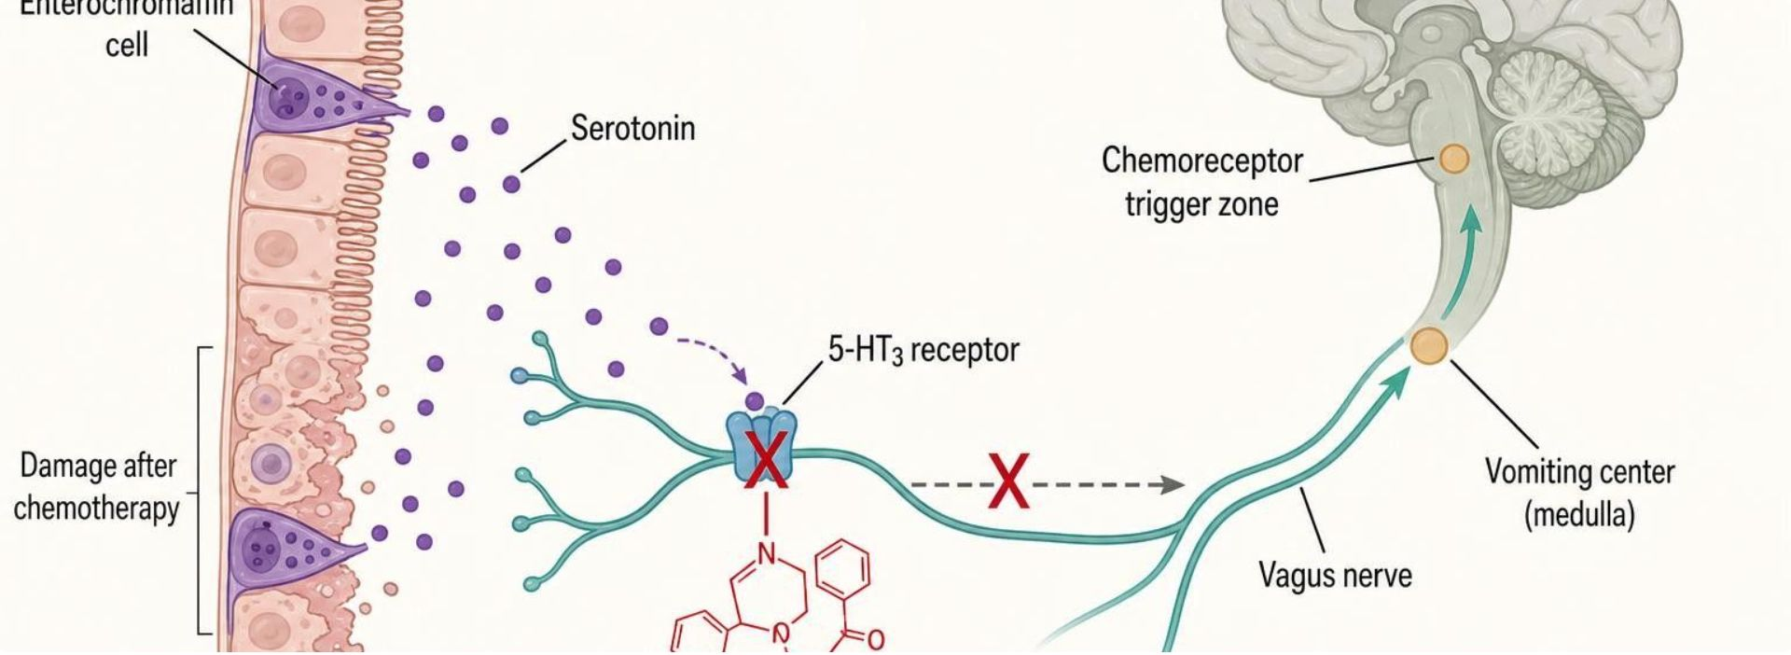
ANTIEMETICS
Objectives: SO1 · SO3 · SO4 · SO5 · IO3.1 · IO3.2 · IO3.3 · IO3.4 · IO3.6
Figure 7 · Ondansetron: blocking serotonin at 5-HT3
Schematic (illustrative): chemotherapy or gut irritation damages enterochromaffin cells, which release serotonin. Serotonin normally binds 5-HT3 receptors on vagal afferents and the chemoreceptor trigger zone, signaling the vomiting center in the medulla. Ondansetron blocks the 5-HT3 receptor, so no signal reaches the vomiting center. S25; S25 (notes)
L05 · GI & Nutrition Pharmacology — Session 1
82

Slide 83
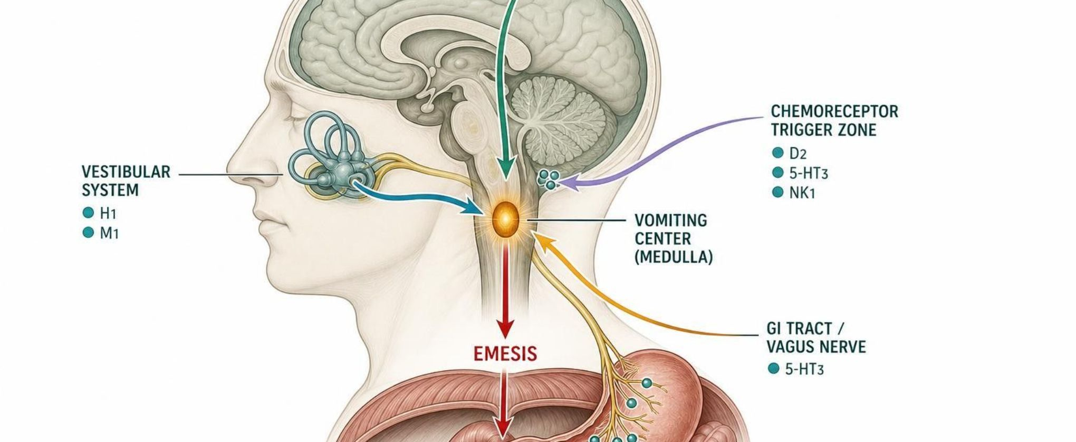
ANTIEMETICS
Objectives: SO1 · SO3 · SO4 · SO5 · IO3.1 · IO3.2 · IO3.3 · IO3.4 · IO3.6
Figure 8 · Receptors in the vomiting pathway
Schematic (illustrative): four inputs converge on the vomiting center in the medulla — the GI tract via the vagus nerve (5-HT3), the chemoreceptor trigger zone (D2, 5-HT3, NK1), the vestibular system (H1, M1) and the cerebral cortex (anxiety, anticipation). The vomiting center then triggers emesis. S26; S26 (notes)
L05 · GI & Nutrition Pharmacology — Session 1
83

Slide 84
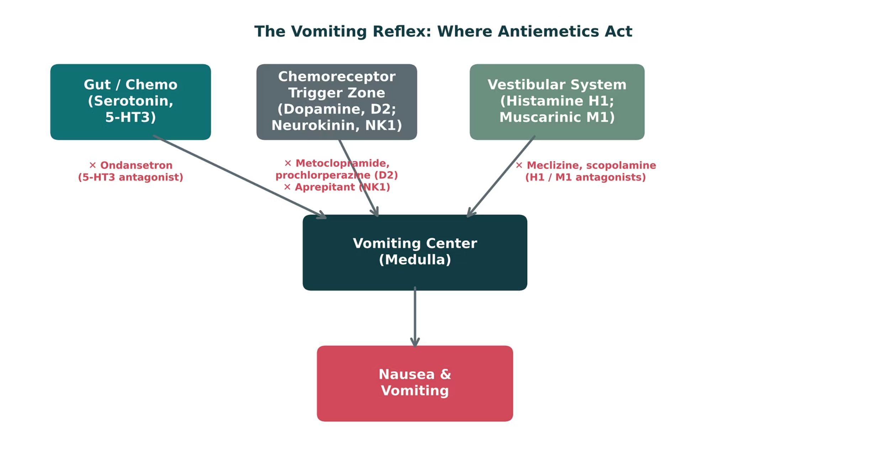
ANTIEMETICS
Objectives: SO1 · SO3 · SO4 · SO5 · IO3.1 · IO3.2 · IO3.3 · IO3.4 · IO3.6
Figure 9 · The vomiting reflex: where antiemetics act
Original illustrative diagram (not from Katzung): serotonin, dopamine/neurokinin, and histamine/acetylcholine signals converge on the vomiting center; ondansetron, metoclopramide/prochlorperazine/aprepitant, and meclizine/scopolamine each block a different input. S27; S27 (notes)
L05 · GI & Nutrition Pharmacology — Session 1
84

Slide 85
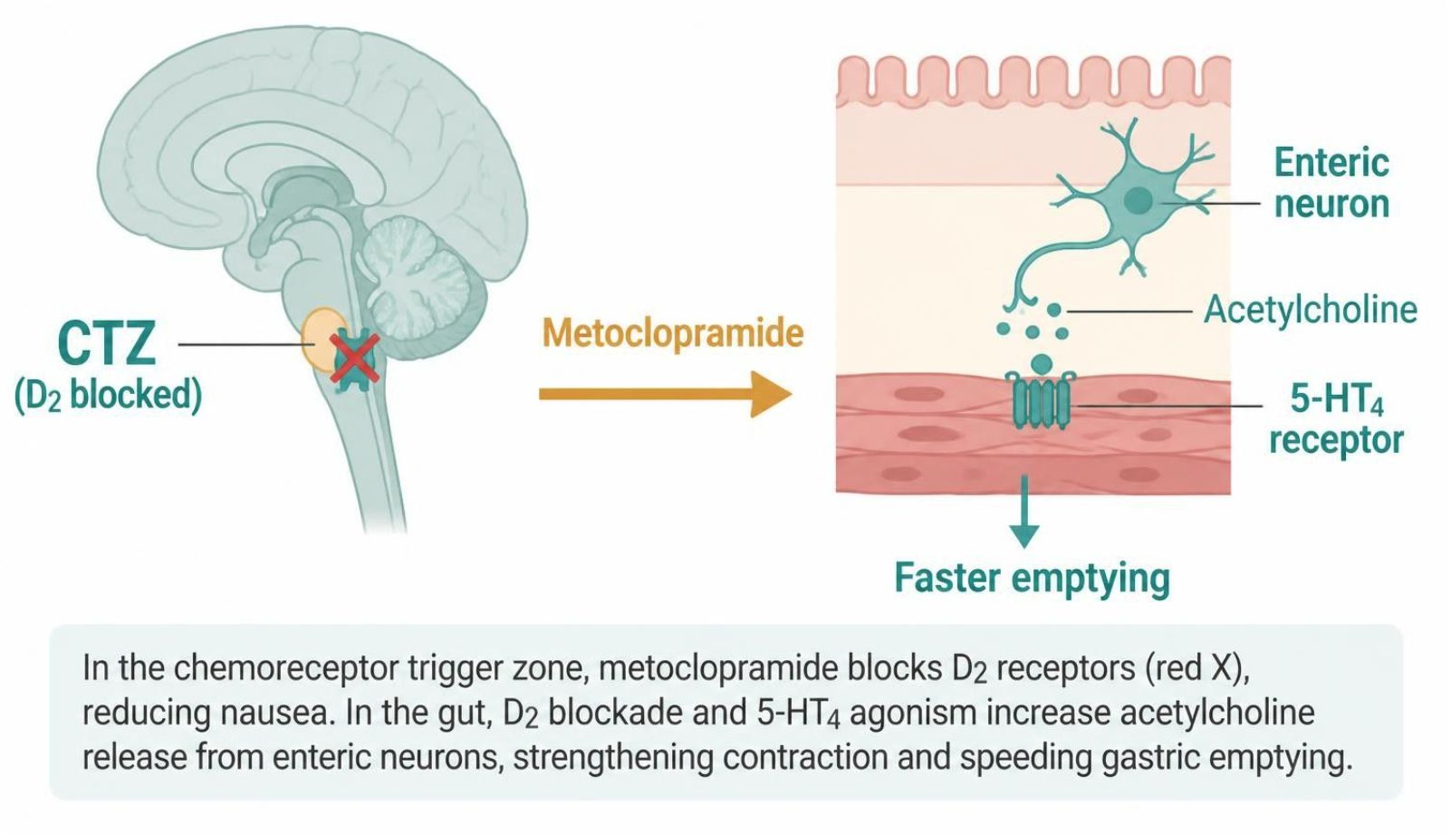
ANTIEMETICS
Objectives: SO1 · SO3 · SO4 · SO5 · IO3.1 · IO3.2 · IO3.3 · IO3.4 · IO3.6
Figure 10 · Metoclopramide: D2 blockade and 5-HT4 agonism
Schematic (illustrative): in the chemoreceptor trigger zone, metoclopramide blocks D2 receptors, reducing nausea. In the gut, D2 blockade and 5-HT4 agonism increase acetylcholine release from enteric neurons, strengthening contraction and speeding gastric emptying. S29; S29 (notes)
L05 · GI & Nutrition Pharmacology — Session 1
85

Slide 86
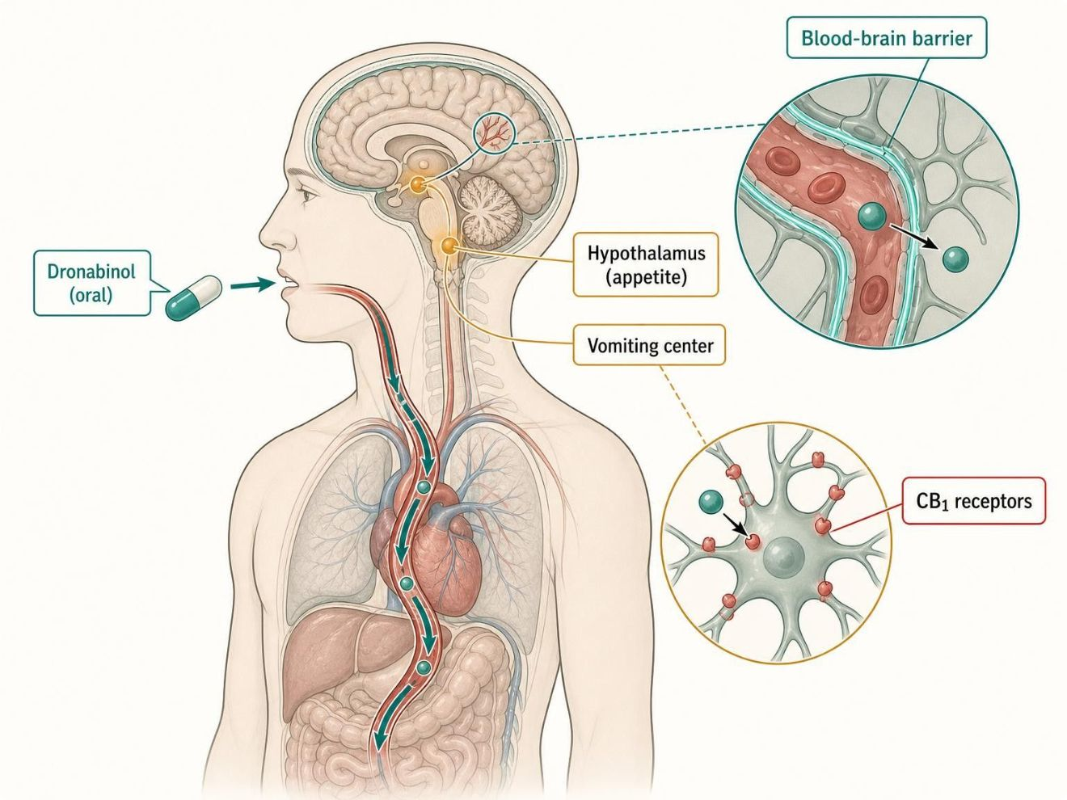
ANTIEMETICS
Objectives: SO1 · SO3 · SO4 · SO5 · IO3.1 · IO3.2 · IO3.3 · IO3.4 · IO3.6
Figure 11 · Cannabinoids for chemotherapy-induced nausea
Schematic (illustrative): oral dronabinol is absorbed, crosses the blood-brain barrier and activates CB1 receptors in the vomiting center and hypothalamus, reducing nausea and stimulating appetite. S30
L05 · GI & Nutrition Pharmacology — Session 1
86

Slide 87
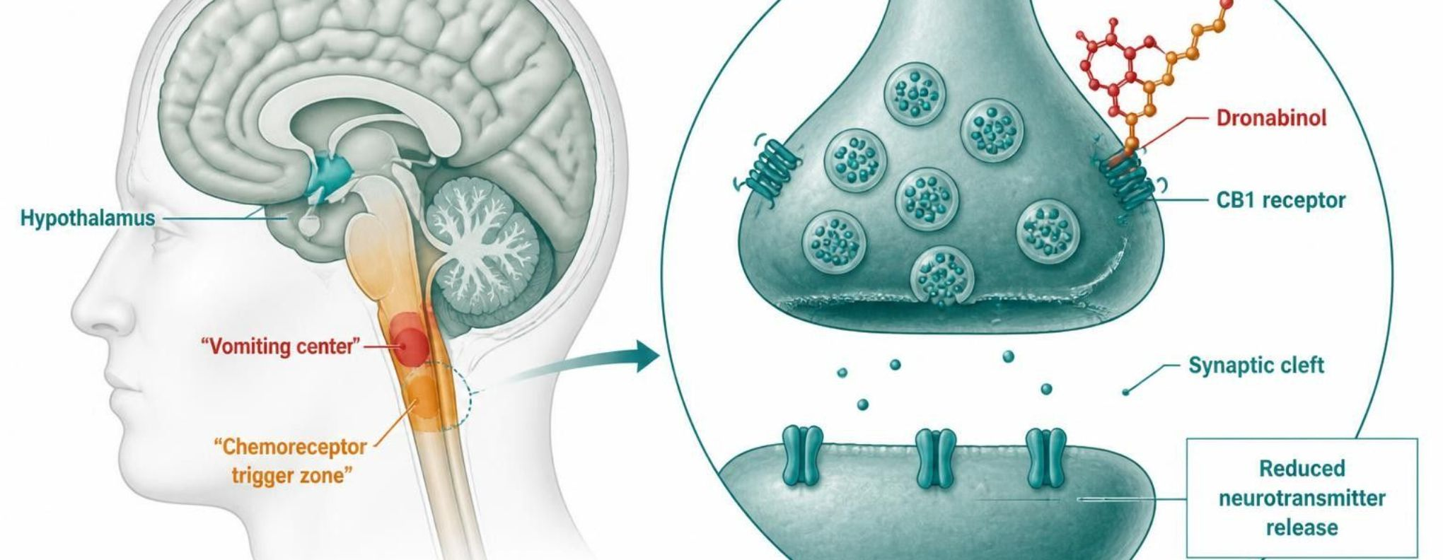
ANTIEMETICS
Objectives: SO1 · SO3 · SO4 · SO5 · IO3.1 · IO3.2 · IO3.3 · IO3.4 · IO3.6
Figure 12 · Cannabinoids: CB1 activation in the brain
Schematic (illustrative): dronabinol or nabilone binds CB1 receptors on presynaptic neurons in the vomiting center and chemoreceptor trigger zone. This reduces neurotransmitter release across the synaptic cleft, so less nausea and vomiting, and appetite increases. S31; S31 (notes)
L05 · GI & Nutrition Pharmacology — Session 1
87

Slide 88
ANTIEMETICS
Objectives: SO1 · SO3 · SO4 · SO5 · IO3.1 · IO3.2 · IO3.3 · IO3.4 · IO3.6
Compare: Antiemetic classes by target
Target | Where | Examples | Watch for
5-HT3 | Gut vagal afferents, CTZ | Ondansetron, granisetron | QT, constipation, headache, serotonin syndrome
D2 | CTZ | Metoclopramide, prochlorperazine | Extrapyramidal effects; tardive dyskinesia (metoclopramide boxed)
NK1 | CTZ | Aprepitant, fosaprepitant | CYP3A4 interactions
H1 / M1 | Vestibular | Meclizine, scopolamine | Anticholinergic effects; best for motion sickness
CB1 | Vomiting center, CTZ, hypothalamus | Dronabinol, nabilone | Psychoactive; Schedule III / II
Focus: what tells these apart. Sources: S24; S26; S30; SG U3-R7; SG U3-M
L05 · GI & Nutrition Pharmacology — Session 1
88

Slide 89
ANTIEMETICS
Objectives: SO1 · SO3 · SO4 · SO5 · IO3.1 · IO3.2 · IO3.3 · IO3.4 · IO3.6
Compare: Name clues: antiemetics
Stem | Drug class | Examples | Key point
-setron | 5-HT3 antagonists | Ondansetron, granisetron | Block serotonin at 5-HT3 receptors
-pitant | NK1 antagonists | Aprepitant, fosaprepitant | Block substance P at NK1 receptors
-azine | Phenothiazines | Prochlorperazine, promethazine | Block D2 receptors and other receptors
-izine | H1 antihistamines | Meclizine | Block H1 receptors in the vestibular system
-pramide | Benzamide D2 antagonists | Metoclopramide | Block D2; 5-HT4 agonism adds prokinetic effect
-sone | Corticosteroid | Dexamethasone | Adds to other antiemetics in chemotherapy
None shared | Cannabinoids | Nabilone, dronabinol | Activate CB1 receptors
None shared | Anticholinergic | Scopolamine | Block muscarinic receptors
Focus: what tells these apart. Sources: S33; S33 (notes)
L05 · GI & Nutrition Pharmacology — Session 1
89

Slide 90
ANTIEMETICS
Objectives: SO1 · SO3 · SO4 · SO5 · IO3.1 · IO3.2 · IO3.3 · IO3.4 · IO3.6
Compare: Antiemetic drug profiles: formulation, dose, indications
Drug | Class | Formulation | Adult dose | Indications
Ondansetron (Zofran) | 5-HT3 receptor antagonist | Tablet 4/8 mg; ODT 4/8 mg; oral film; IV/IM 2 mg/mL | 4-8 mg PO/ODT every 8 hours; IV 4 mg; chemotherapy regimens use 8-24 mg pre-dose; single IV dose max 16 mg | Chemotherapy, postoperative and radiation nausea; gastroenteritis and pregnancy nausea (off-label)
Metoclopramide (Reglan) | Dopamine D2 antagonist, prokinetic | Tablet 5/10 mg; ODT; oral solution; IV/IM 5 mg/mL | Gastroparesis: 10 mg PO 30 min before meals and at bedtime (max 40 mg/day); limit to 12 weeks; lower dose in renal impairment | Diabetic gastroparesis, GERD (short-term), chemotherapy and postoperative nausea
Aprepitant (Emend) | NK1 receptor antagonist | Capsule 40/80/125 mg; IV fosaprepitant 150 mg | CINV: 125 mg PO day 1, then 80 mg days 2-3, with a 5-HT3 antagonist and dexamethasone; PONV: 40 mg pre-op | Prevention of chemotherapy and postoperative nausea and vomiting
Focus: what tells these apart. Sources: S53; S54; S55; S56; S57; S58; S59; S60
L05 · GI & Nutrition Pharmacology — Session 1
90

Slide 91
ANTIEMETICS
Objectives: SO1 · SO3 · SO4 · SO5 · IO3.1 · IO3.2 · IO3.3 · IO3.4 · IO3.6
Compare: Antiemetic drug profiles: formulation, dose, indications (cont.)
Drug | Class | Formulation | Adult dose | Indications
Meclizine (Antivert) | H1 antihistamine, anticholinergic | Tablet 12.5/25/50 mg; chewable tablet | Motion sickness: 25-50 mg 1 hour before travel, repeat every 24 hours; vertigo: 25-100 mg/day divided | Motion sickness, vertigo
Scopolamine (Transderm Scop) | Muscarinic antagonist | Transdermal patch 1.5 mg (about 1 mg over 3 days) | 1 patch behind the ear at least 4 hours before travel; replace every 72 hours | Motion sickness, postoperative nausea
Prochlorperazine (Compazine) | Phenothiazine D2 antagonist | Tablet 5/10 mg; suppository 25 mg; IV/IM 5 mg/mL | 5-10 mg PO every 6-8 hours (max 40 mg/day); 25 mg PR every 12 hours; 5-10 mg IV/IM | Severe nausea and vomiting, psychosis
Focus: what tells these apart. Sources: S53; S54; S55; S56; S57; S58; S59; S60
L05 · GI & Nutrition Pharmacology — Session 1
91

Slide 92
ANTIEMETICS
Objectives: SO1 · SO3 · SO4 · SO5 · IO3.1 · IO3.2 · IO3.3 · IO3.4 · IO3.6
Compare: Antiemetic drug profiles: formulation, dose, indications (cont.)
Drug | Class | Formulation | Adult dose | Indications
Dronabinol (Marinol) and nabilone (Cesamet) | Cannabinoids | Dronabinol capsule 2.5/5/10 mg, solution; nabilone capsule 1 mg | Dronabinol 5 mg/m2 1-3 hours before chemotherapy, then every 2-4 hours; appetite: 2.5 mg BID; nabilone 1-2 mg BID | Refractory chemotherapy nausea; anorexia in AIDS (dronabinol)
Dexamethasone (Decadron) | Corticosteroid | Tablet 0.5-6 mg; oral solution; IV 4 mg/mL | CINV: 8-12 mg PO/IV on day 1, then 8 mg daily on days 2-4 depending on regimen | Antiemetic adjunct in chemotherapy; inflammation and allergy
Focus: what tells these apart. Sources: S53; S54; S55; S56; S57; S58; S59; S60
L05 · GI & Nutrition Pharmacology — Session 1
92

Slide 93
ANTIEMETICS
Objectives: SO1 · SO3 · SO4 · SO5 · IO3.1 · IO3.2 · IO3.3 · IO3.4 · IO3.6
Compare: Antiemetic drug profiles: adverse effects, contraindications, toxicity
Drug | Adverse effects | Contraindications | Toxicity / overdose
Ondansetron (Zofran) | Headache, constipation, dizziness; QT prolongation | Congenital long QT syndrome; apomorphine co-use | QT prolongation and torsades; serotonin syndrome (rare); transient vision loss
Metoclopramide (Reglan) | Drowsiness, restlessness, diarrhea; depression | GI obstruction, perforation or bleeding; pheochromocytoma; seizure disorder; history of tardive dyskinesia | Boxed warning: tardive dyskinesia (may be irreversible); acute dystonia (diphenhydramine or benztropine); neuroleptic malignant syndrome
Aprepitant (Emend) | Fatigue, constipation, hiccups, raised liver enzymes | Pimozide co-use; hypersensitivity | CYP3A4 substrate and moderate inhibitor: lowers warfarin and hormonal contraceptive effect; overdose drowsiness, headache
Meclizine (Antivert) | Drowsiness, dry mouth, blurred vision, urinary retention | Hypersensitivity; caution in glaucoma, BPH, asthma, older adults | Anticholinergic toxicity: agitation, hallucinations, tachycardia, seizures; additive sedation
Focus: what tells these apart. Sources: S53; S54; S55; S56; S57; S58; S59; S60
L05 · GI & Nutrition Pharmacology — Session 1
93

Slide 94
ANTIEMETICS
Objectives: SO1 · SO3 · SO4 · SO5 · IO3.1 · IO3.2 · IO3.3 · IO3.4 · IO3.6
Compare: Antiemetic drug profiles: adverse effects, contraindications, toxicity (cont.)
Drug | Adverse effects | Contraindications | Toxicity / overdose
Scopolamine (Transderm Scop) | Dry mouth, drowsiness, blurred vision, dizziness | Narrow-angle glaucoma; hypersensitivity | Anticholinergic toxicity; withdrawal nausea and dizziness; wash hands to avoid dilated pupils
Prochlorperazine (Compazine) | Sedation, hypotension, dry mouth, extrapyramidal symptoms | Children under 2 years, coma, dementia-related psychosis (boxed warning) | Acute dystonia, tardive dyskinesia, neuroleptic malignant syndrome, QT prolongation, sedation
Dronabinol (Marinol) and nabilone (Cesamet) | Dizziness, euphoria, drowsiness, tachycardia | Hypersensitivity; sesame oil allergy (dronabinol capsule) | Psychoactive: anxiety, paranoia, tachycardia, hypotension; additive CNS depression; misuse potential
Dexamethasone (Decadron) | Insomnia, hyperglycemia, mood change, fluid retention | Systemic fungal infection; hypersensitivity | Adrenal suppression with prolonged use; infection, hyperglycemia, psychosis; taper after long courses
Focus: what tells these apart. Sources: S53; S54; S55; S56; S57; S58; S59; S60
L05 · GI & Nutrition Pharmacology — Session 1
94

Slide 95
ANTIEMETICS
Objectives: SO1 · SO3 · SO4 · SO5 · IO3.1 · IO3.2 · IO3.3 · IO3.4 · IO3.6
Compare: Supporting drugs at a glance (listed for context; not profiled in detail)
Drug(s) | Why it matters
Diphenhydramine and benztropine | Rescue for acute dystonia from metoclopramide or prochlorperazine
Simvastatin, lovastatin, ergotamine | CYP3A4 substrates that must not be combined with clarithromycin
Doxylamine plus pyridoxine (B6) | Nausea and vomiting of pregnancy
Disulfiram | Alcohol-aversion drug; metronidazole can cause a similar reaction with alcohol
Clopidogrel | Prodrug activated by CYP2C19; omeprazole and esomeprazole can blunt its effect
Levothyroxine and quinolones | Absorption falls when taken with antacids; separate doses
Rilpivirine | HIV drug that needs stomach acid, so PPIs are contraindicated
Penicillin | Allergy rules out amoxicillin in H. pylori regimens
Focus: what tells these apart. Sources: S61; S61 (notes)
L05 · GI & Nutrition Pharmacology — Session 1
95

Slide 96
ANTIEMETICS
Objectives: SO1 · SO3 · SO4 · SO5 · IO3.1 · IO3.2 · IO3.3 · IO3.4 · IO3.6
Compare: Prokinetic agents in the reading (textbook)
Drug | How it speeds the gut | Point
Metoclopramide, domperidone | D2 blockade removes dopamine’s brake on cholinergic stimulation | Gastroparesis first-line; domperidone barely enters the brain
Cholinomimetic agents: bethanechol, neostigmine | M3 agonist; acetylcholinesterase inhibitor | Bethanechol seldom used; IV neostigmine for acute colonic pseudo-obstruction
Macrolides (erythromycin) | Motilin receptor agonist | Gastroparesis trial; tolerance develops rapidly
Focus: what tells these apart. Sources: p. 1163; p. 1164
L05 · GI & Nutrition Pharmacology — Session 1
96

Slide 97
ANTIEMETICS
Objectives: SO1 · SO3 · SO4 · SO5 · IO3.1 · IO3.2 · IO3.3 · IO3.4 · IO3.6
Memory hooks
Why it happens
Why it happens
Why does ondansetron fail for motion sickness? Motion sickness comes through the vestibular system (H1/M1), not the gut’s serotonin pathway. S26; S27 (notes)
Why combine ondansetron, aprepitant and dexamethasone? Each hits a different target; stacking different mechanisms beats doubling one. S26
Mnemonic (memory aid)
SeT-D-NK-HM: ondansetron 5-HT3 · metoclopramide D2 · aprepitant NK1 · meclizine/scopolamine H1/M1 — plus dronabinol CB1. S24; SG U3-M
L05 · GI & Nutrition Pharmacology — Session 1
97

Slide 98
ANTIEMETICS
Objectives: SO1 · SO3 · SO4 · SO5 · IO3.1 · IO3.2 · IO3.3 · IO3.4 · IO3.6
High-yield summary
If you remember nothing else
Antiemetics are organized by the receptor pathway they block — serotonin (5-HT3), dopamine/neurokinin (CTZ), or histamine/acetylcholine (vestibular) — all converging on the vomiting center. S34; S24
Metoclopramide: boxed tardive dyskinesia; avoid beyond 12 weeks. S28; SG U3-R8
Ondansetron: QT prolongation; give before chemo. S25
L05 · GI & Nutrition Pharmacology — Session 1
98

Slide 99
CLINICAL VIGNETTE · LECTURE QUICK CHECK S32
Objectives: SO1 · SO3 · SO4 · SO5 · IO3.1 · IO3.2 · IO3.3 · IO3.4 · IO3.6
Question 17
A patient in her first trimester has persistent nausea and vomiting despite dietary changes. Which option has the most established safety profile?
A
Metoclopramide for 6 months
B
Misoprostol to protect the stomach
C
Scopolamine patch every 72 hours
D
Pyridoxine (B6), often with doxylamine
E
Dronabinol as first-line
L05 · GI & Nutrition Pharmacology — Session 1
99
Notes:
Answer on the next slide. Source: S32

Slide 100
CLINICAL VIGNETTE · ANSWER
Objectives: SO1 · SO3 · SO4 · SO5 · IO3.1 · IO3.2 · IO3.3 · IO3.4 · IO3.6
Answer 17: D
D. Pyridoxine (B6), often with doxylamine
Pyridoxine, often combined with doxylamine, is typically first-line for nausea in pregnancy; ondansetron data in the first trimester continue to evolve (S32). S32
Why the other choices are wrong
A. Metoclopramide for 6 months — Boxed tardive dyskinesia limits duration (S28).
B. Misoprostol to protect the stomach — Contraindicated in pregnancy (S16).
C. Scopolamine patch every 72 hours — A motion-sickness drug, not the taught first-line here (S57).
E. Dronabinol as first-line — Reserved for refractory CINV (S30).
L05 · GI & Nutrition Pharmacology — Session 1
100

Slide 101
CLINICAL VIGNETTE
Objectives: SO1 · SO3 · SO4 · SO5 · IO3.1 · IO3.2 · IO3.3 · IO3.4 · IO3.6
Question 19
A patient with diabetic gastroparesis has taken metoclopramide for 6 months and now has involuntary lip-smacking movements. What explains this?
A
Tardive dyskinesia (boxed warning)
B
CB1 activation causing dysphoria
C
Serotonin syndrome from 5-HT3 blockade
D
Hypomagnesemia from long-term use
E
Acute dystonia that resolves with time
L05 · GI & Nutrition Pharmacology — Session 1
101
Notes:
Answer on the next slide. Source: S28; S29; SG U3-R8

Slide 102
CLINICAL VIGNETTE · ANSWER
Objectives: SO1 · SO3 · SO4 · SO5 · IO3.1 · IO3.2 · IO3.3 · IO3.4 · IO3.6
Answer 19: A
A. Tardive dyskinesia (boxed warning)
Metoclopramide carries a boxed warning for tardive dyskinesia with prolonged use or high doses; avoid beyond 12 weeks (S28–S29; SG U3-R8). S28; S29; SG U3-R8
Why the other choices are wrong
B. CB1 activation causing dysphoria — A cannabinoid effect (S30).
C. Serotonin syndrome from 5-HT3 blockade — Ondansetron’s interaction (S25).
D. Hypomagnesemia from long-term use — A PPI risk (S13).
E. Acute dystonia that resolves with time — Acute dystonia occurs early; this is late and long-term (S28).
L05 · GI & Nutrition Pharmacology — Session 1
102

