Slide 1
L01 · Thu, Oct 15, 2026
Introduction to Pharmacology — Session 1
Pharmacology study deck · organized by topic
How to read this deck
TB = textbook only (not on the lecture slides)
SG = course study guide only (not on the lecture slides)
Bold = emphasized on the lecture slides
S12 = lecture slide 12 · p. 245 = textbook page 245 · SG U1-R3 = study guide item

Slide 2
START HERE
Learning objectives
IO1.1
Define and describe fundamental pharmacologic concepts, including pharmacokinetics, pharmacodynamics, drug-receptor interactions, dose-response relationships, therapeutic index, half-life, and steady state.
⚠ Thin coverage
Half-life and steady state are taught in Session 2 (L02) · The Language of Pharmacology, Pharmacodynamics: Targets & Receptors, Dose-Response Relationships
IO1.2
Describe the processes of drug absorption, distribution, metabolism, and excretion and factors that influence these processes.
⚠ Thin coverage
This session: absorption + distribution; metabolism + excretion detail in Session 2 (L02) · Pharmacokinetics: ADME — Absorption & Distribution
IO1.3
Explain how patient-specific factors, including age, pregnancy, renal and hepatic function, and pharmacogenetic variation, may affect medication response.
⚠ Thin coverage
Barely covered this session; pharmacogenomics and renal dosing in Session 2 (L02) · Pharmacokinetics: ADME — Absorption & Distribution
IO1.4
Identify common types and mechanisms of adverse drug reactions, drug-drug interactions, and drug-disease interactions.
⚠ Thin coverage
Only ADR definition + adverse-event reporting this session; drug interactions in Session 2 (L02) · The Language of Pharmacology, Drug Development & Regulation
L01 · Introduction to Pharmacology — Session 1
2

Slide 3
START HERE
Learning objectives (cont.)
IO1.5
Interpret common components of medication orders and prescriptions, including drug name, dose, route, frequency, and duration.
⚠ Thin coverage
Only drug names (generic vs brand) and routes this session · The Language of Pharmacology, Pharmacokinetics: ADME — Absorption & Distribution
SO1
Define pharmacology, pharmacodynamics, and pharmacokinetics.
The Language of Pharmacology
SO2
Describe the major stages of drug development and FDA approval.
Drug Development & Regulation
SO3
Explain how drugs interact with receptors to produce an effect.
Pharmacodynamics: Targets & Receptors
SO4
Interpret a dose-response curve, including potency and efficacy.
Dose-Response Relationships
SO5
Explain absorption, distribution, metabolism, and excretion (ADME), including bioavailability and the first-pass effect.
Pharmacokinetics: ADME — Absorption & Distribution
L01 · Introduction to Pharmacology — Session 1
3

Slide 4

START HERE
About this lecture
Scope, readings & sources
Session 1 of 2 on Introduction to Pharmacology (Thursday, October 15): language, drug development, pharmacodynamics, dose-response, and ADME through distribution. S1; S2 (notes)
Session 2 (Thursday, October 22) continues with metabolism, excretion, PK calculations (half-life, steady state, clearance), pharmacogenomics, and the integrated clinical decision-making framework. S2; S56
ADME is only half-finished after Session 1 — the lecture stopped after Distribution; Metabolism and Excretion pick up first in Session 2. S56 (notes)
L01 · Introduction to Pharmacology — Session 1
4

Slide 5
START HERE
About this lecture (cont.)
Scope, readings & sources
Required text: Katzung's Basic and Clinical Pharmacology, 16th Edition (Todd W. Vanderah · 2025 · McGraw-Hill Education · ISBN 1260463303 eBook) — Unit 1 reading: Chapters 1, 2, 3, 4, and 5. AccessMedicine: accessmedicine.mhmedical.com/book.aspx?bookid=3382 S3
Recommended text: Pharmacotherapy Principles and Practice (Chisholm-Burns, Schwinghammer, Malone, Kolesar, Lee · 2022 · McGraw-Hill Education · Print ISBN 9781260460278 · eText ISBN 9781260460285) — use as supplemental support alongside Katzung's Chapters 1–5, not a substitute. S3; S3 (notes)
Original figures in this deck: the lecture's Figures 1–5 (agonist & antagonist effects; sigmoidal dose-response curve; potency vs. efficacy; wide vs. narrow therapeutic index; ADME compartment model) are original diagrams generated by the course director using the AI tool Claude (Anthropic, 2026, Claude Sonnet 5) to illustrate standard, non-copyrighted pharmacologic concepts — not reproduced from Katzung or any other copyrighted source. Reference: Anthropic. (2026). Claude (Sonnet 5) [Large language model]. S57; S57 (notes)
L01 · Introduction to Pharmacology — Session 1
5

Slide 6
ROADMAP
Topics in this lecture
The Language of Pharmacology
Objectives: SO1, IO1.1, IO1.4, IO1.5
Dose-Response Relationships
Objectives: SO4, IO1.1
1
4
Drug Development & Regulation
Objectives: SO2, IO1.4
Pharmacokinetics: ADME — Absorption & Distribution
Objectives: SO5, IO1.2, IO1.3, IO1.5
2
5
Pharmacodynamics: Targets & Receptors
Objectives: SO3, IO1.1
3
L01 · Introduction to Pharmacology — Session 1
6

Slide 7





Topic 1 of 5
The Language of Pharmacology
Covers objectives: SO1 · IO1.1 · IO1.4 · IO1.5
Key definitions
How it works
Clinical relevance
Drugs named as examples
Exam traps
7

Slide 8
THE LANGUAGE OF PHARMACOLOGY
Objectives: SO1 · IO1.1 · IO1.4 · IO1.5
Key definitions
Key definitions (1/2)
Pharmacology: the scientific study of how drugs interact with living systems — from the molecular level to the whole patient. S5
Drug (medication): any chemical substance used to diagnose, treat, cure, or prevent disease, or to alter a physiologic process. S5
Pharmacologic effect: a measurable biological change a drug produces (e.g., lower blood pressure). S5
Therapeutic effect: the intended, beneficial pharmacologic effect for a given condition. S5
Adverse drug reaction (ADR): an unintended and harmful response occurring at normal therapeutic doses. S5
Toxicity: harmful effects that occur as the dose or exposure exceeds the therapeutic range. S5
L01 · Introduction to Pharmacology — Session 1
8

Slide 9
THE LANGUAGE OF PHARMACOLOGY
Objectives: SO1 · IO1.1 · IO1.4 · IO1.5
Key definitions (cont.)
Key definitions (2/2)
Chemical name: describes the exact molecular structure (rarely used in clinical practice). S7
Generic name: the official, non-proprietary name assigned to the active drug — one generic name per drug, regardless of manufacturer. S7
Brand (trade) name: the manufacturer's marketed name; the same generic drug may have several brand names, and brand names change between countries. S7
TB Prodrug: an inactive precursor converted to the active drug in the body (usually by metabolism). p. 8
TB Poisons are drugs with almost exclusively harmful effects — but "the dose makes the poison" (Paracelsus): any substance can harm at the wrong dose. p. 3
L01 · Introduction to Pharmacology — Session 1
9

Slide 10
THE LANGUAGE OF PHARMACOLOGY
Objectives: SO1 · IO1.1 · IO1.4 · IO1.5
How it works
How it works
Pharmacokinetics = what the body does to the drug — ADME. S6; SG U1-R1
Pharmacodynamics = what the drug does to the body — receptors & effect. S6; SG U1-R1
Pharmacogenomics = how genetic variation shapes individual drug response. S6
Clinical Pharmacology / Toxicology = applying PK/PD to real patients, and the study of poisoning. S6
This map covers the whole lecture: PK and PD are the two biggest buckets, and nearly everything else (toxicology, pharmacogenomics, therapeutics) sits on top of them. S6 (notes)
TB Drugs bind receptors by covalent bonds (strong, often irreversible), electrostatic bonds (most common) or hydrophobic bonds (weak). p. 4
TB Chirality: over half of drugs are mirror-image pairs (enantiomers); one is usually much more potent, yet most are sold as 50:50 mixtures. p. 4; p. 5
L01 · Introduction to Pharmacology — Session 1
10

Slide 11
THE LANGUAGE OF PHARMACOLOGY
Objectives: SO1 · IO1.1 · IO1.4 · IO1.5
Clinical relevance
Clinical relevance (1/2)
PA students should learn and prescribe by generic name — it is unambiguous, international, and avoids confusing a patient's multiple brand-name products for different drugs. S7; SG U1-R2
Different brand-name products (Tylenol, many combination cold/flu products) can share the same active generic ingredient. S9; SG U1-R2
Prescribing and counseling by generic name avoids hiding duplicate therapy — the reason PAs default to generic names. S9; SG U1-R2
If a patient says they take "Tylenol" and separately "acetaminophen," check for accidental double-dosing — this previews the acetaminophen toxicity discussion. S7 (notes)
L01 · Introduction to Pharmacology — Session 1
11

Slide 12
THE LANGUAGE OF PHARMACOLOGY
Objectives: SO1 · IO1.1 · IO1.4 · IO1.5
Clinical relevance (cont.)
Clinical relevance (2/2)
Precise vocabulary (generic names, therapeutic vs. adverse effects) protects patients. S56
TB More than half of prescriptions in the USA are for generic drugs. p. 18
TB Weak bonds need a precise fit, so they are more selective. Aspirin’s covalent bond to platelet cyclooxygenase lasts until new platelets are made. p. 4
L01 · Introduction to Pharmacology — Session 1
12

Slide 13
THE LANGUAGE OF PHARMACOLOGY
Objectives: SO1 · IO1.1 · IO1.4 · IO1.5
Drugs named as examples · Exam traps
Drugs named as examples
Exam traps
Acetaminophen (generic) is sold as Tylenol and under many store brands. S7
"Therapeutic effect" and "pharmacologic effect" are not synonyms — a drug can have pharmacologic effects that are not therapeutic (that is often exactly what an adverse effect is). S5 (notes)
ADR vs. toxicity: an ADR happens at normal therapeutic doses; toxicity happens when dose or exposure exceeds the therapeutic range. S5
Generic names do NOT vary by manufacturer (one per drug); brand names DO vary — and change between countries. S7
L01 · Introduction to Pharmacology — Session 1
13

Slide 14
THE LANGUAGE OF PHARMACOLOGY
Objectives: SO1 · IO1.1 · IO1.4 · IO1.5
Compare: Chemical vs. generic vs. brand name
Name type | What it is | How many per drug | How to tell apart / clinical use
Chemical | Exact molecular structure | Not covered in materials | Rarely used in clinical practice
Generic | Official, non-proprietary name of the active drug | One — regardless of manufacturer | Learn and prescribe by it — unambiguous, international
Brand (trade) | Manufacturer's marketed name | Several possible; change between countries | Can hide a shared generic ingredient (e.g., Tylenol = acetaminophen)
Focus: what tells these apart. Sources: S7; S9
L01 · Introduction to Pharmacology — Session 1
14

Slide 15
THE LANGUAGE OF PHARMACOLOGY
Objectives: SO1 · IO1.1 · IO1.4 · IO1.5
Compare: Pharmacologic effect vs. therapeutic effect vs. ADR vs. toxicity
Term | Intended? | Harmful? | Dose
Pharmacologic effect | Not necessarily | Not necessarily | Any measurable biological change
Therapeutic effect | Yes — intended, beneficial | No | For a given condition
Adverse drug reaction (ADR) | No — unintended | Yes | Normal therapeutic doses
Toxicity | No | Yes | Dose or exposure exceeds the therapeutic range
Focus: what tells these apart. Sources: S5; S5 (notes)
L01 · Introduction to Pharmacology — Session 1
15

Slide 16


THE LANGUAGE OF PHARMACOLOGY
Objectives: SO1 · IO1.1 · IO1.4 · IO1.5
Memory hooks
Why it happens
Mnemonic (memory aid)
Why prescribe by generic name? One drug has ONE generic name but can hide under SEVERAL brand names — so brand-name products can conceal duplicate therapy and cause double-dosing. S7; S9
PharmacoKinetics = the body Keeps the drug moving (ADME). PharmacoDynamics = what the Drug Does to the body. S6
Mnemonic (memory aid)
ADR = At normal Doses, Reaction is harmful. Toxicity = Too much (exceeds the therapeutic range). S5
L01 · Introduction to Pharmacology — Session 1
16

Slide 17

THE LANGUAGE OF PHARMACOLOGY
Objectives: SO1 · IO1.1 · IO1.4 · IO1.5
High-yield summary
If you remember nothing else
PK = what the body does to the drug (ADME); PD = what the drug does to the body (receptors & effect). S6; SG U1-R1
ADR = unintended, harmful, at normal therapeutic doses; toxicity = dose/exposure exceeds the therapeutic range. S5
Learn, prescribe, and counsel by generic name — brand names can hide a shared ingredient → double-dosing. S7; S9
Pharmacology connects a drug's chemistry to its clinical effect. S56
L01 · Introduction to Pharmacology — Session 1
17

Slide 18
CLINICAL VIGNETTE · LECTURE QUICK CHECK S8-9
Objectives: SO1 · IO1.1 · IO1.4 · IO1.5
Question 1
A patient says they take no medications, but separately mentions using "Tylenol" for headaches and a combination cold-and-flu product. What does this scenario illustrate?
A
Pharmacologic effect and therapeutic effect are simply two words for one thing
B
Brand names are identical worldwide, so the two products must contain different drugs
C
Chemical names are standardized internationally, so this mix-up could not happen
D
Brand names can obscure a shared generic ingredient, risking unintentional double-dosing
E
Generic names vary by manufacturer, which caused the confusion here
L01 · Introduction to Pharmacology — Session 1
18
Notes:
Answer on the next slide. Source: S7; S8-9

Slide 19

CLINICAL VIGNETTE · ANSWER
Objectives: SO1 · IO1.1 · IO1.4 · IO1.5
Answer 1: D
D. Brand names can obscure a shared generic ingredient, risking unintentional double-dosing
Different brand-name products (Tylenol, many combination cold/flu products) can share the same active generic ingredient; prescribing and counseling by generic name avoids hiding duplicate therapy (S9). S7; S8-9
Why the other choices are wrong
A. Pharmacologic effect and therapeutic effect are simply two words for one thing — They are not synonyms — a pharmacologic effect may not be therapeutic (S5 notes); it also doesn't explain this case.
B. Brand names are identical worldwide, so the two products must contain different drugs — Brand names change between countries, and one generic drug may have several brand names (S7).
C. Chemical names are standardized internationally, so this mix-up could not happen — Chemical names describe exact molecular structure and are rarely used clinically (S7); they do not prevent brand-name confusion.
E. Generic names vary by manufacturer, which caused the confusion here — There is one generic name per drug, regardless of manufacturer (S7).
L01 · Introduction to Pharmacology — Session 1
19

Slide 20
CLINICAL VIGNETTE
Objectives: SO1 · IO1.1 · IO1.4 · IO1.5
Question 2
A 45-year-old patient takes a new medication exactly as prescribed. Drug levels are within the therapeutic range, yet the patient develops an unintended, harmful response. Which term best describes this event?
A
Toxicity, because any harmful drug response counts as toxicity
B
An adverse drug reaction, because it occurred at a normal therapeutic dose
C
A therapeutic effect, because the drug was taken exactly as prescribed
D
A pharmacologic effect only, because it was a measurable biological change
E
Irreversible antagonism, because the receptor was permanently inactivated
L01 · Introduction to Pharmacology — Session 1
20
Notes:
Answer on the next slide. Source: S5

Slide 21
CLINICAL VIGNETTE · ANSWER
Objectives: SO1 · IO1.1 · IO1.4 · IO1.5
Answer 2: B
B. An adverse drug reaction, because it occurred at a normal therapeutic dose
An ADR is an unintended and harmful response occurring at normal therapeutic doses (S5). S5
Why the other choices are wrong
A. Toxicity, because any harmful drug response counts as toxicity — Toxicity is harm that occurs as dose or exposure exceeds the therapeutic range (S5); here levels were within range.
C. A therapeutic effect, because the drug was taken exactly as prescribed — A therapeutic effect is the intended, beneficial effect (S5); this response was unintended and harmful.
D. A pharmacologic effect only, because it was a measurable biological change — Every ADR is a pharmacologic effect, but 'unintended and harmful at normal doses' is the more specific, best answer (S5).
E. Irreversible antagonism, because the receptor was permanently inactivated — Irreversible antagonism describes receptor inactivation until new receptor is synthesized (S22) — not a type of adverse event.
L01 · Introduction to Pharmacology — Session 1
21

Slide 22
Topic 2 of 5
Drug Development & Regulation
Covers objectives: SO2 · IO1.4
Key definitions
How it works
Clinical relevance
Drugs named as examples
Exam traps
22

Slide 23
DRUG DEVELOPMENT & REGULATION
Objectives: SO2 · IO1.4
Key definitions
Key definitions (1/2)
Efficacy: how well a drug works under ideal, controlled trial conditions. S14
Effectiveness: how well a drug works in everyday clinical practice, with real-world adherence and comorbidities. S14
SG Drug interactions can also reduce real-world effectiveness below trial efficacy. SG U1-R4
Benefit vs. risk: the central question regulators and prescribers must weigh for every approval and every prescription. S14
L01 · Introduction to Pharmacology — Session 1
23

Slide 24
DRUG DEVELOPMENT & REGULATION
Objectives: SO2 · IO1.4
Key definitions (cont.)
Key definitions (2/2)
Adverse-event reporting: ongoing, voluntary and mandatory reporting systems (e.g., FDA MedWatch) that catch safety signals after approval. S14
TB Double-blind: neither subjects nor evaluators know who gets drug or placebo. Crossover: each subject gets every treatment in turn. p. 14; p. 15
TB IRB: the committee at each trial site that approves the ethics of the study; participants give informed consent. p. 17
L01 · Introduction to Pharmacology — Session 1
24

Slide 25
DRUG DEVELOPMENT & REGULATION
Objectives: SO2 · IO1.4
How it works
How it works (1/3)
Where new drugs come from — Natural products: plants, fungi, microbes, marine organisms. S11
Synthetic & biotech: designed small molecules; recombinant proteins. S11
Biologics: monoclonal antibodies, gene- and cell-based therapies. S11
Drug repurposing: an existing approved drug found to treat a new condition. S11
From discovery to patient: Discovery → Preclinical testing → Clinical trials → FDA review → Approval → Postmarket surveillance. S12
Most candidate drugs fail somewhere along this pipeline — approval is the exception, not the rule. S12
L01 · Introduction to Pharmacology — Session 1
25

Slide 26
DRUG DEVELOPMENT & REGULATION
Objectives: SO2 · IO1.4
How it works (cont.)
How it works (2/3)
Phase I: safety, tolerability, dose-finding — a small group of healthy volunteers. S13; SG U1-R3
Phase II: preliminary efficacy and side-effect profile — a few hundred patients with the target condition. S13; SG U1-R3
Phase III: confirm efficacy and monitor adverse effects at scale — hundreds to thousands of patients, often multi-site. S13; SG U1-R3
Phase IV: postmarketing surveillance after approval — the general prescribed population. S13; SG U1-R3
Every approved drug has passed through a structured development and regulatory pipeline (Phases I–IV). S56
TB Phase II has the highest failure rate — only about 25% of new drugs move on to Phase III. p. 17
L01 · Introduction to Pharmacology — Session 1
26

Slide 27
DRUG DEVELOPMENT & REGULATION
Objectives: SO2 · IO1.4
How it works (cont.)
How it works (3/3)
TB Phase III usually enrolls thousands of patients (Figure 1–6: 1000–6000), often double-blind and crossover, in settings like the drug's eventual use. p. 12; p. 17
TB Less than one-third of drugs studied in humans survive clinical trials and reach the market. p. 14
TB To see one case of a toxicity occurring 1 in 10,000, several hundred thousand patients may need exposure — so rare effects usually surface only in Phase IV, which has no fixed duration. p. 18
TB Marketing requires a New Drug Application (NDA) after Phase III; human testing starts only after an IND (Investigational New Drug) application. p. 12; p. 17
TB Strength of evidence: case reports < cohort and case-control studies < randomized controlled trials (the gold standard: randomization balances confounders). p. 15
L01 · Introduction to Pharmacology — Session 1
27

Slide 28
DRUG DEVELOPMENT & REGULATION
Objectives: SO2 · IO1.4
Clinical relevance
Clinical relevance (1/2)
Postmarketing surveillance (Phase IV) is where rare adverse effects are often first detected — trial populations are too small and too short in duration to catch 1-in-10,000 events. S12 (notes)
Case: a new medication improves symptoms in 70% of patients with a chronic, non-life-threatening condition, but postmarketing data show serious hepatotoxicity in about 1%. Would you prescribe it — and does your answer depend on what else is available? S15
Clinical pearl: risk-benefit analysis is always comparative — a 1% serious-toxicity rate reads very differently if it is the only effective option versus if three safer alternatives already exist. S15
Ask "compared to what?" rather than judging the number in isolation. S15 (notes)
L01 · Introduction to Pharmacology — Session 1
28

Slide 29
DRUG DEVELOPMENT & REGULATION
Objectives: SO2 · IO1.4
Clinical relevance (cont.)
Clinical relevance (2/2)
TB A patent lasts 20 years; after it expires, generics are approved through an abbreviated new drug application (ANDA) that requires bioequivalence data. p. 16; p. 18
TB Placebo responses can occur in as many as 30–40% of subjects — the reason controlled, blinded trials are needed. p. 14
TB Adverse events that are both serious and unexpected must be reported to the FDA within 15 days; clinicians can report through MedWatch. p. 18; p. 19
TB Dietary supplements are regulated as food under DSHEA (1994), so they get no full FDA drug review. p. 3; p. 16
L01 · Introduction to Pharmacology — Session 1
29

Slide 30
DRUG DEVELOPMENT & REGULATION
Objectives: SO2 · IO1.4
Drugs named as examples
Drugs named as examples
FDA MedWatch — an adverse-event reporting system. S14
Biologic DMARDs (MSK unit, later) are a direct example of the "biotechnology" drug source. S11 (notes)
TB Thalidomide (sold in Europe as a "nontoxic" hypnotic) caused about 10,000 birth defects and led to the Kefauver-Harris Amendments (1962), which required proof of efficacy as well as safety. p. 16
TB The Orphan Drug Amendment (1983) gives incentives for drugs treating diseases with fewer than 200,000 US patients. p. 16
L01 · Introduction to Pharmacology — Session 1
30

Slide 31
DRUG DEVELOPMENT & REGULATION
Objectives: SO2 · IO1.4
Exam traps
Exam traps
Efficacy vs. effectiveness is a favorite exam distinction: efficacy is the trial result; effectiveness is what happens once real patients with real adherence patterns use the drug. S14 (notes)
Phase III — not Phase I, II, or IV — is the large pre-approval trial that confirms efficacy and monitors safety at scale. S17
Phase III is what most people picture as "the" clinical trial, but regulatory decisions already begin shaping the drug long before that. S13 (notes)
L01 · Introduction to Pharmacology — Session 1
31

Slide 32


DRUG DEVELOPMENT & REGULATION
Objectives: SO2 · IO1.4
⚠ Sources disagree: Phase I population
Lecture slides say
Textbook says
Phase I: a small group of healthy volunteers. S13
TB Phase I: 20–100 healthy volunteers — but if significant toxicity is expected (cancer, AIDS therapy), volunteer patients with the disease are used instead. p. 17
L01 · Introduction to Pharmacology — Session 1
32

Slide 33
DRUG DEVELOPMENT & REGULATION
Objectives: SO2 · IO1.4
⚠ Sources disagree: Phase II size
Lecture slides say
Textbook says
Phase II: a few hundred patients with the target condition. S13
TB Phase II: a modest number of patients (100–200) with the target disease. p. 17
L01 · Introduction to Pharmacology — Session 1
33

Slide 34
DRUG DEVELOPMENT & REGULATION
Objectives: SO2 · IO1.4
Compare: Clinical trial phases
Phase | Primary purpose | Typical population | How to tell apart
Phase I | Safety, tolerability, dose-finding | A small group of healthy volunteers | Only phase in healthy volunteers
Phase II | Preliminary efficacy and side-effect profile | A few hundred patients with the target condition | First look at whether it works
Phase III | Confirm efficacy and monitor adverse effects at scale | Hundreds to thousands, often multi-site | Largest pre-approval trial
Phase IV | Postmarketing surveillance after approval | The general prescribed population | After approval; catches rare effects
Focus: what tells these apart. Sources: S13; S12 (notes)
L01 · Introduction to Pharmacology — Session 1
34

Slide 35
DRUG DEVELOPMENT & REGULATION
Objectives: SO2 · IO1.4
Compare: Efficacy vs. effectiveness
 | Efficacy | Effectiveness
Setting | Ideal, controlled trial conditions | Everyday clinical practice
What changes it | Not covered in materials | Real-world adherence, comorbidities (and drug interactions — SG)
Shorthand | The trial result | What happens with real patients
Focus: what tells these apart. Sources: S14; S14 (notes); SG U1-R4
L01 · Introduction to Pharmacology — Session 1
35

Slide 36
DRUG DEVELOPMENT & REGULATION
Objectives: SO2 · IO1.4
Compare: Major US drug laws (textbook Table 1–6)
Law | What it did
Food, Drug, and Cosmetic Act (1938) | New drugs must be safe (not yet proven effective); followed sulfanilamide deaths
Durham-Humphrey Act (1952) | FDA decides which drugs need a prescription
Kefauver-Harris Amendments (1962) | Proof of efficacy as well as safety; adverse-reaction reporting (after thalidomide)
Comprehensive Drug Abuse Prevention and Control Act (1970) | Drug schedules and controls for habit-forming drugs
TB Focus: what tells these apart. Sources: p. 16
L01 · Introduction to Pharmacology — Session 1
36

Slide 37
DRUG DEVELOPMENT & REGULATION
Objectives: SO2 · IO1.4
Compare: Major US drug laws (textbook Table 1–6) (cont.)
Law | What it did
Orphan Drug Amendment (1983) | Incentives for diseases with fewer than 200,000 US patients
Drug Price Competition and Patent Restoration Act (1984) | Abbreviated applications for generics; bioequivalence data required
Dietary Supplement Health and Education Act (1994) | Supplements treated as food; no full FDA drug review
Biologics Price Competition and Innovation Act (2009) | Abbreviated pathway for biosimilars
TB Focus: what tells these apart. Sources: p. 16
L01 · Introduction to Pharmacology — Session 1
37

Slide 38
DRUG DEVELOPMENT & REGULATION
Objectives: SO2 · IO1.4
Memory hooks
Why it happens
Mnemonic (memory aid)
Why are rare adverse effects found after approval? Trials are too small and too short to catch 1-in-10,000 events — so they show up in Phase IV, in the general prescribed population. S12 (notes); S13
Phases by question: I = Is it safe (healthy volunteers)? II = Is there an effect? III = Is it confirmed at scale? IV = Is it still safe in everyone? S13
Mnemonic (memory aid)
EfficaCy = Controlled conditions. EffectiVeness = real-world Variables (adherence, comorbidities). S14
L01 · Introduction to Pharmacology — Session 1
38

Slide 39
DRUG DEVELOPMENT & REGULATION
Objectives: SO2 · IO1.4
High-yield summary
If you remember nothing else
Efficacy = ideal trial conditions; effectiveness = everyday practice (adherence, comorbidities). S14
Phase I healthy volunteers → II few hundred patients → III hundreds–thousands (confirm) → IV postmarketing. S13
Rare adverse effects (1 in 10,000) are often first found in Phase IV. S12 (notes)
Risk-benefit is always comparative — ask "compared to what?" S15; S15 (notes)
L01 · Introduction to Pharmacology — Session 1
39

Slide 40
MECHANISM · LECTURE QUICK CHECK S16-17
Objectives: SO2 · IO1.4
Question 4
In which clinical trial phase is a drug first tested in a large patient population specifically to confirm efficacy and monitor for adverse effects at scale, just before approval?
A
Phase I
B
Phase III
C
Phase II
D
FDA review
E
Phase IV
L01 · Introduction to Pharmacology — Session 1
40
Notes:
Answer on the next slide. Source: S13; S16-17

Slide 41
MECHANISM · ANSWER
Objectives: SO2 · IO1.4
Answer 4: B
B. Phase III
Phase III trials enroll hundreds to thousands of patients, often at multiple sites, to confirm efficacy and monitor safety at scale before approval (S17). S13; S16-17
Why the other choices are wrong
A. Phase I — Phase I is small-scale safety/dosing in healthy volunteers (S17).
C. Phase II — Phase II is preliminary efficacy in a few hundred patients (S17).
D. FDA review — FDA review comes after clinical trials are complete, before approval (S12).
E. Phase IV — Phase IV is postmarketing surveillance after approval (S17).
L01 · Introduction to Pharmacology — Session 1
41

Slide 42
CLINICAL VIGNETTE
Objectives: SO2 · IO1.4
Question 5
A drug relieved symptoms in most participants of a controlled multi-site trial. In your clinic, far fewer patients improve; many miss doses and have several comorbidities. Which concept best explains the gap?
A
A narrow therapeutic index that appeared after approval
B
Lower potency than was measured during trial dose-finding
C
Extensive first-pass metabolism in the clinic's patients
D
Competitive antagonism of the drug by the comorbid conditions
E
Real-world effectiveness falling below the drug's trial efficacy
L01 · Introduction to Pharmacology — Session 1
42
Notes:
Answer on the next slide. Source: S14; S14 (notes)

Slide 43
CLINICAL VIGNETTE · ANSWER
Objectives: SO2 · IO1.4
Answer 5: E
E. Real-world effectiveness falling below the drug's trial efficacy
Efficacy is performance under ideal trial conditions; effectiveness is performance in everyday practice with real-world adherence and comorbidities (S14). S14; S14 (notes)
Why the other choices are wrong
A. A narrow therapeutic index that appeared after approval — TI describes the gap between effective and toxic doses (S38), not missed doses or comorbidities.
B. Lower potency than was measured during trial dose-finding — Potency is the dose needed for an effect and matters for dosing, not for whether patients improve (S34).
C. Extensive first-pass metabolism in the clinic's patients — First-pass effect lowers oral bioavailability (S50-51); it doesn't explain adherence- and comorbidity-driven differences.
D. Competitive antagonism of the drug by the comorbid conditions — Competitive antagonism is a drug competing at the same receptor site (S22), not a disease effect.
L01 · Introduction to Pharmacology — Session 1
43

Slide 44
Topic 3 of 5
Pharmacodynamics: Targets & Receptors
Covers objectives: SO3 · IO1.1
Key definitions
How it works
Clinical relevance
Drugs named as examples
Exam traps
44

Slide 45
PHARMACODYNAMICS: TARGETS & RECEPTORS
Objectives: SO3 · IO1.1
Key definitions
Key definitions (1/2)
Drug target: the specific molecule a drug binds to produce its effect. S19
Receptor: a protein target whose activation (or blockade) triggers a cellular response. S19
Signal transduction: the chain of molecular events that converts receptor binding into a cellular effect. S19
Pharmacologic response: the measurable downstream result — contraction, secretion, gene transcription, and so on. S19
Full agonist — maximal receptor activation. S22; SG U1-M
Partial agonist — submaximal activation, even at full receptor occupancy. S22; SG U1-M
L01 · Introduction to Pharmacology — Session 1
45

Slide 46
PHARMACODYNAMICS: TARGETS & RECEPTORS
Objectives: SO3 · IO1.1
Key definitions (cont.)
Key definitions (2/2)
Inverse agonist — reduces baseline (constitutive) receptor activity. S22; SG U1-M
Competitive antagonist — reversibly competes with agonist at the same site; overcome by more agonist. S22; SG U1-M
Noncompetitive antagonist — binds elsewhere or irreversibly reduces the maximal effect. S22; SG U1-M
Irreversible antagonist — permanently inactivates the receptor until new receptor is synthesized. S22; SG U1-M
TB Kd: the drug concentration that fills half the receptors; a low Kd means high affinity. p. 23
L01 · Introduction to Pharmacology — Session 1
46

Slide 47
PHARMACODYNAMICS: TARGETS & RECEPTORS
Objectives: SO3 · IO1.1
How it works
How it works (1/3)
The pathway: drug → target → signal transduction → response. Every pharmacodynamics topic for the rest of the course maps onto this chain. S19 (notes)
Receptor concept: Drug + Receptor → Drug-Receptor Complex → Cellular Response. S21
This single chain underlies agonism, antagonism, potency, and efficacy — all describe different features of this interaction. S21
Five major drug target classes: receptors, ion channels, enzymes, transporters, nucleic acids. S20; SG U1-R5
Receptors: G-protein-coupled, ligand-gated ion channel, enzyme-linked, nuclear. S20
Ion channels: directly gate the flow of ions across a membrane. S20
L01 · Introduction to Pharmacology — Session 1
47

Slide 48
PHARMACODYNAMICS: TARGETS & RECEPTORS
Objectives: SO3 · IO1.1
How it works (cont.)
How it works (2/3)
Enzymes: drugs can inhibit or, less commonly, activate an enzyme's activity. S20
Transporters & nucleic acids: carrier proteins; or DNA/RNA for some antimicrobials & gene therapies. S20
Most drugs target receptors or enzymes — ion channels and transporters matter especially for cardiac and CNS drugs. S20 (notes)
An inverse agonist actively reduces constitutive (baseline) receptor activity below normal; a true antagonist merely blocks the agonist without lowering baseline activity itself. S28
TB Spare receptors: a maximal response can occur without occupying every receptor (e.g., about 90% of cardiac β receptors can be blocked and maximal inotropic response still preserved). p. 23
TB Irreversible antagonist effects last until new receptors are made — duration depends on receptor turnover, not drug elimination (phenoxybenzamine for pheochromocytoma). p. 25
L01 · Introduction to Pharmacology — Session 1
48

Slide 49
PHARMACODYNAMICS: TARGETS & RECEPTORS
Objectives: SO3 · IO1.1
How it works (cont.)
How it works (3/3)
TB A partial agonist's lower maximal effect is not due to lower affinity — it can occupy all receptors and still produce less response. p. 26
TB Allosteric modulators bind a different site from the agonist (e.g., benzodiazepines enhance GABA's effect). p. 25
TB Agonist-induced desensitization (tachyphylaxis) and downregulation reduce response with continued exposure. p. 39
TB Targets beyond receptors: enzymes (statins on HMG-CoA reductase), transporters (digitalis on Na⁺/K⁺-ATPase; antidepressants) and structural proteins (colchicine on tubulin). p. 22
TB Five signaling mechanisms carry a drug’s message into the cell: intracellular receptor, receptor tyrosine kinase, cytokine receptor (JAK-STAT), ion channel and G protein (compared in the table). p. 28-32
L01 · Introduction to Pharmacology — Session 1
49

Slide 50
PHARMACODYNAMICS: TARGETS & RECEPTORS
Objectives: SO3 · IO1.1
Clinical relevance
Clinical relevance (1/2)
Albuterol is a selective β2-adrenergic receptor agonist. S26
Binding activates the β2 receptor → increases intracellular cAMP. S26
Rising cAMP relaxes bronchial smooth muscle → bronchodilation. S26
This is the same receptor-to-response logic you will reuse for every agonist drug this term. S26
Albuterol bridges introductory pharmacodynamics into the pulmonary pharmacology seen later in the curriculum. S26 (notes)
L01 · Introduction to Pharmacology — Session 1
50

Slide 51
PHARMACODYNAMICS: TARGETS & RECEPTORS
Objectives: SO3 · IO1.1
Clinical relevance (cont.)
Clinical relevance (2/2)
TB Competitive antagonism is surmountable in real life: exercise or stress raises catecholamines enough to overcome a fixed propranolol dose. p. 25
TB Propranolol markedly slows the heart rate in pheochromocytoma (high catecholamines) but not the resting rate of a trained marathon runner. p. 39
TB Glucocorticoids will not stop an acute asthma attack within minutes: gene-acting drugs need hours to make new proteins. p. 28
TB Phosphodiesterase inhibitors prolong second messengers: milrinone (cAMP) and sildenafil (cGMP). p. 34; p. 35
L01 · Introduction to Pharmacology — Session 1
51

Slide 52
PHARMACODYNAMICS: TARGETS & RECEPTORS
Objectives: SO3 · IO1.1
Drugs named as examples
Drugs named as examples
Albuterol — selective β2-adrenergic agonist (example of agonism). S26
TB Chemical antagonism needs no receptor: positively charged protamine binds and neutralizes negatively charged heparin. p. 26
TB Physiologic antagonism: two drugs act on different receptors with opposing effects (e.g., insulin opposes glucocorticoid-induced hyperglycemia). p. 27
L01 · Introduction to Pharmacology — Session 1
52

Slide 53
PHARMACODYNAMICS: TARGETS & RECEPTORS
Objectives: SO3 · IO1.1
Exam traps
Exam traps
Classic exam trap: a competitive antagonist shifts the dose-response curve right (same Emax, more drug needed); a noncompetitive/irreversible antagonist lowers the Emax instead. S22 (notes)
A rightward shift with an unchanged plateau is the graphical signature of competitive antagonism — potency falls, but because the antagonism is surmountable, enough agonist can still reach the original Emax. S25
Inverse agonist ≠ antagonist: only the inverse agonist lowers baseline activity below normal, without any agonist present. S27-28
SG Study-guide distractor: "has no effect on receptor activity whatsoever" matches none of the agonist/antagonist types. SG U1-M
L01 · Introduction to Pharmacology — Session 1
53

Slide 54
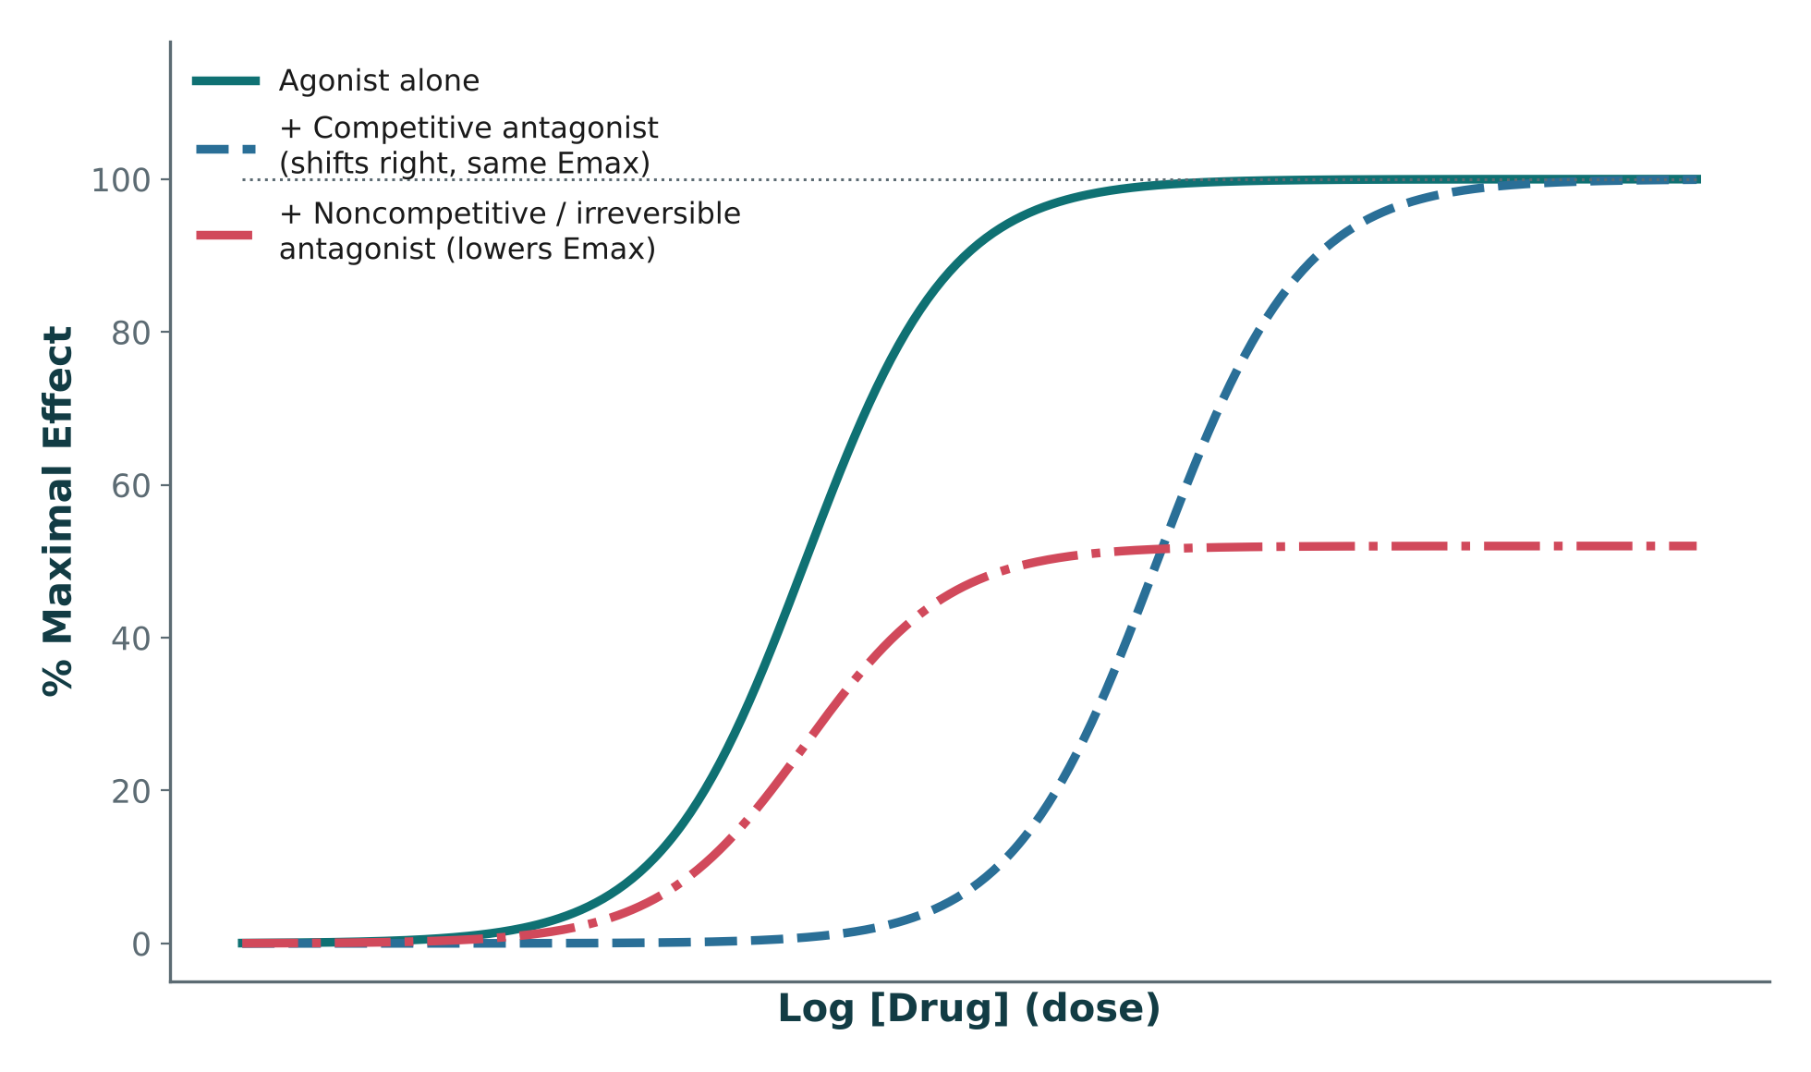
PHARMACODYNAMICS: TARGETS & RECEPTORS
Objectives: SO3 · IO1.1
Figure 1 · Agonist & antagonist effects
Original illustrative curves (not Katzung data): a competitive antagonist shifts the curve right with the same Emax; a noncompetitive/irreversible antagonist lowers Emax instead. Read left to right: agonist alone → competitive (shifted right, same ceiling) → noncompetitive (lower ceiling). S23; S23 (notes)
L01 · Introduction to Pharmacology — Session 1
54

Slide 55
PHARMACODYNAMICS: TARGETS & RECEPTORS
Objectives: SO3 · IO1.1
Compare: Agonists vs. antagonists
Type | What it does at the receptor | Dose-response curve | How to tell apart
Full agonist | Maximal receptor activation | Not covered in materials | Reaches maximal activation
Partial agonist | Submaximal activation | Not covered in materials | Submaximal even at full occupancy
Inverse agonist | Reduces baseline (constitutive) activity | Not covered in materials | Lowers activity below normal with no agonist present
Competitive antagonist | Reversibly competes at the same site | Shifts right, same Emax | Overcome by more agonist (surmountable)
Noncompetitive antagonist | Binds elsewhere or irreversibly | Lowers Emax | Plateaus lower instead of shifting right
Irreversible antagonist | Permanently inactivates the receptor | Lowers Emax | Lasts until new receptor is synthesized
Focus: what tells these apart. Sources: S22; S22 (notes); S25; S27-28
L01 · Introduction to Pharmacology — Session 1
55

Slide 56
PHARMACODYNAMICS: TARGETS & RECEPTORS
Objectives: SO3 · IO1.1
Compare: The five major drug target classes
Target | What it is / does | Note
Receptors | G-protein-coupled, ligand-gated ion channel, enzyme-linked, nuclear | Most common target (with enzymes)
Ion channels | Directly gate the flow of ions across a membrane | Especially cardiac and CNS drugs
Enzymes | Drugs inhibit or, less commonly, activate them | Most common target (with receptors)
Transporters | Carrier proteins | Especially cardiac and CNS drugs
Nucleic acids | DNA/RNA | Some antimicrobials & gene therapies
Focus: what tells these apart. Sources: S20; S20 (notes)
L01 · Introduction to Pharmacology — Session 1
56

Slide 57
PHARMACODYNAMICS: TARGETS & RECEPTORS
Objectives: SO3 · IO1.1
Compare: Five ways a signal crosses the membrane (textbook Ch. 2)
Mechanism | Examples | How it signals | Clinical point
Intracellular receptor | Corticosteroids, sex steroids, vitamin D, thyroid hormone | Lipid-soluble ligand enters the cell; receptor changes gene transcription | Effects lag 30 min to hours and persist after the drug is gone
Receptor tyrosine kinase | Insulin, EGF, PDGF | Receptors dimerize and phosphorylate tyrosines | Blocked in cancer (trastuzumab, gefitinib)
Cytokine receptor | Growth hormone, erythropoietin, interferons | Separate JAK kinase activates STATs, which enter the nucleus | Same pattern as tyrosine kinases, kinase is a separate protein
Ion channel | Nicotinic ACh, GABA, glutamate; voltage-gated Ca²⁺ and Na⁺ channels | Opens or blocks ion flow, changing membrane potential | Fastest signal (milliseconds); verapamil, local anesthetics
G protein–coupled receptor | β and α adrenoceptors, muscarinic ACh, opioids | G protein (GTP) changes an effector, which changes a second messenger | Largest family; desensitizes with continued agonist
TB Focus: what tells these apart. Sources: p. 28-32
L01 · Introduction to Pharmacology — Session 1
57

Slide 58
PHARMACODYNAMICS: TARGETS & RECEPTORS
Objectives: SO3 · IO1.1
Compare: G proteins and their second messengers (textbook Table 2–1)
G protein | Receptors for | Effect
Gs | β-adrenergic amines, histamine, glucagon | ↑ adenylyl cyclase → ↑ cAMP
Gi | α₂-adrenergic amines, muscarinic ACh, opioids | ↓ cAMP; opens cardiac K⁺ channels → ↓ heart rate
Gq | Muscarinic ACh, serotonin (5-HT₂) | ↑ phospholipase C → IP₃, DAG, ↑ cytoplasmic Ca²⁺
TB Focus: what tells these apart. Sources: p. 32
L01 · Introduction to Pharmacology — Session 1
58

Slide 59
PHARMACODYNAMICS: TARGETS & RECEPTORS
Objectives: SO3 · IO1.1
Memory hooks
Why it happens
Why it happens
Why can more agonist overcome a competitive antagonist? Both compete reversibly for the same site — flood the site with agonist and it wins, so the curve shifts right but the same Emax is still reached. S22; S25
Why does albuterol open the airways? β2 activation → ↑ intracellular cAMP → bronchial smooth muscle relaxes → bronchodilation. S26
Mnemonic (memory aid)
Competitive = Can be outcompeted (shift right). Noncompetitive = No full ceiling (lower Emax). S22 (notes)
L01 · Introduction to Pharmacology — Session 1
59

Slide 60
PHARMACODYNAMICS: TARGETS & RECEPTORS
Objectives: SO3 · IO1.1
High-yield summary
If you remember nothing else
Drug → target → signal transduction → response. S19 (notes)
Five target classes: receptors, ion channels, enzymes, transporters, nucleic acids. S20; SG U1-R5
Competitive antagonist = curve shifts right, same Emax; noncompetitive/irreversible = lower Emax. S22 (notes)
Inverse agonist lowers baseline activity below normal; an antagonist only blocks. S28
Pharmacodynamics explains how drugs bind receptors to produce agonism or antagonism. S56
L01 · Introduction to Pharmacology — Session 1
60

Slide 61
MECHANISM · LECTURE QUICK CHECK S24-25
Objectives: SO3 · IO1.1
Question 8
In Figure 1, the dashed curve (+ competitive antagonist) is shifted to the right of the agonist-alone curve but reaches the same plateau at the top. What does this pattern show?
A
The competitive antagonist increases the agonist's potency at every dose given
B
The competitive antagonist turns the agonist into a partial agonist at the receptor
C
More agonist is needed to reach the same effect, but the same maximal effect is still achievable
D
The competitive antagonist has no measurable effect on the agonist's curve
E
The competitive antagonist lowers the agonist's efficacy, so its Emax falls
L01 · Introduction to Pharmacology — Session 1
61
Notes:
Answer on the next slide. Source: S23; S24-25

Slide 62
MECHANISM · ANSWER
Objectives: SO3 · IO1.1
Answer 8: C
C. More agonist is needed to reach the same effect, but the same maximal effect is still achievable
A rightward shift with an unchanged plateau is the signature of competitive antagonism: potency falls, but because the antagonism is surmountable, enough agonist can still reach the original Emax (S25). S23; S24-25
Why the other choices are wrong
A. The competitive antagonist increases the agonist's potency at every dose given — A rightward shift means MORE drug is needed — potency falls (S25).
B. The competitive antagonist turns the agonist into a partial agonist at the receptor — A partial agonist gives submaximal activation even at full occupancy (S22); here the full plateau is still reached.
D. The competitive antagonist has no measurable effect on the agonist's curve — The curve is clearly shifted right (S24-25).
E. The competitive antagonist lowers the agonist's efficacy, so its Emax falls — Lowering Emax is the noncompetitive/irreversible pattern, which plateaus lower instead of shifting right (S25).
L01 · Introduction to Pharmacology — Session 1
62

Slide 63
MECHANISM · LECTURE QUICK CHECK S27-28
Objectives: SO3 · IO1.1
Question 9
A drug binds the same receptor as an endogenous agonist and lowers the tissue's baseline (constitutive) activity below normal, without any agonist present. This drug is best classified as a(n):
A
Irreversible antagonist
B
Full agonist
C
Competitive antagonist
D
Inverse agonist
E
Partial agonist
L01 · Introduction to Pharmacology — Session 1
63
Notes:
Answer on the next slide. Source: S22; S27-28

Slide 64
MECHANISM · ANSWER
Objectives: SO3 · IO1.1
Answer 9: D
D. Inverse agonist
An inverse agonist actively reduces constitutive (baseline) receptor activity below normal (S28). S22; S27-28
Why the other choices are wrong
A. Irreversible antagonist — An irreversible antagonist permanently inactivates the receptor (S22); it does not lower baseline activity with no agonist present.
B. Full agonist — A full agonist produces maximal receptor activation (S22).
C. Competitive antagonist — A true antagonist merely blocks the agonist without lowering baseline activity itself (S28).
E. Partial agonist — A partial agonist produces submaximal activation, not activity below baseline (S22).
L01 · Introduction to Pharmacology — Session 1
64

Slide 65
CLINICAL VIGNETTE
Objectives: SO3 · IO1.1
Question 10
A 22-year-old patient inhales albuterol, and within minutes the bronchial smooth muscle relaxes. Which sequence best explains this effect?
A
β2 receptor blockade → falling intracellular cAMP → smooth muscle relaxation
B
Enzyme inhibition → falling intracellular cAMP → bronchial smooth muscle dilation
C
β2 receptor activation → rising intracellular cAMP → smooth muscle relaxation
D
Ion channel opening → rising intracellular cAMP → smooth muscle contraction
E
Inverse agonism at β2 → lowered baseline activity → smooth muscle relaxation
L01 · Introduction to Pharmacology — Session 1
65
Notes:
Answer on the next slide. Source: S26

Slide 66
CLINICAL VIGNETTE · ANSWER
Objectives: SO3 · IO1.1
Answer 10: C
C. β2 receptor activation → rising intracellular cAMP → smooth muscle relaxation
Albuterol is a selective β2 agonist: binding activates β2 → increases cAMP → relaxes bronchial smooth muscle → bronchodilation (S26). S26
Why the other choices are wrong
A. β2 receptor blockade → falling intracellular cAMP → smooth muscle relaxation — Albuterol is an agonist — it activates, not blocks, β2, and cAMP rises (S26).
B. Enzyme inhibition → falling intracellular cAMP → bronchial smooth muscle dilation — The mechanism is receptor activation with rising cAMP (S26).
D. Ion channel opening → rising intracellular cAMP → smooth muscle contraction — Albuterol acts on the β2 receptor, and the result is relaxation, not contraction (S26).
E. Inverse agonism at β2 → lowered baseline activity → smooth muscle relaxation — Inverse agonists reduce baseline activity (S22); albuterol is a selective β2 agonist (S26).
L01 · Introduction to Pharmacology — Session 1
66

Slide 67
Topic 4 of 5
Dose-Response Relationships
Covers objectives: SO4 · IO1.1
Key definitions
How it works
Clinical relevance
Drugs named as examples
Exam traps
67

Slide 68
DOSE-RESPONSE RELATIONSHIPS
Objectives: SO4 · IO1.1
Key definitions
Key definitions
Potency: how much drug is required to produce a given effect — a more potent drug needs a lower dose. S30; SG U1-R6
Efficacy (Emax): the maximum effect a drug can produce, no matter how high the dose goes. S30; SG U1-R6
EC₅₀: the drug concentration producing 50% of the maximal effect — the standard measure of potency. S30
Therapeutic Index (TI) = TD₅₀ ÷ ED₅₀ (toxic dose in 50% ÷ effective dose in 50%). S38; SG U1-R7
TB Quantal dose-response: ED₅₀ (effective in 50%), TD₅₀ (toxic in 50%), LD₅₀ (lethal in 50% of animals). p. 38
TB Therapeutic window: the range between the minimum therapeutic dose and the minimum toxic dose — more practical than TI for dosing a patient. p. 38
L01 · Introduction to Pharmacology — Session 1
68

Slide 69
DOSE-RESPONSE RELATIONSHIPS
Objectives: SO4 · IO1.1
How it works
How it works (1/2)
The sigmoidal dose-response curve: x-axis = log(dose), y-axis = effect. EC₅₀ is on the x-axis; Emax is the plateau — the ceiling effect. S30 (notes); S31
EC₅₀ is read off the curve at the halfway point between baseline and Emax. S33
Lower EC₅₀ = more potent. Higher Emax = more efficacious. S34
Potency and efficacy are independent properties — a drug can differ in one without differing in the other. S35
A curve farther left reaches the same effect at a lower dose (greater potency); curves reaching the same plateau height have identical Emax (efficacy). S37
L01 · Introduction to Pharmacology — Session 1
69

Slide 70
DOSE-RESPONSE RELATIONSHIPS
Objectives: SO4 · IO1.1
How it works (cont.)
How it works (2/2)
A wide TI means a large margin between an effective dose and a toxic dose — generally safer to dose. S38
A narrow TI means effective and toxic doses are close together — requires careful dosing and often blood-level monitoring. S38; SG U1-R7
The distance between the ED₅₀ and TD₅₀ markers is the therapeutic index itself. S41
Dose-response curves describe potency and efficacy. S56
L01 · Introduction to Pharmacology — Session 1
70

Slide 71
DOSE-RESPONSE RELATIONSHIPS
Objectives: SO4 · IO1.1
Clinical relevance
Clinical relevance
Potency clinically matters for dosing — not for choosing the "better" drug. S34
Efficacy clinically matters much more than potency — a highly potent drug with low efficacy may be clinically useless. S34
With a narrow TI, a small dosing error can move a patient from effective to toxic — which is why these drugs require blood-level monitoring. S41; S39 (notes)
Students should be able to name all four narrow-TI drugs without hesitation and know that each requires therapeutic drug monitoring. S38 (notes)
TB No drug causes only a single specific effect — drugs are selective, not specific. p. 40
TB Asthma + hypertension on propranolol: nonselective β blockade can cause bronchoconstriction; a β₁-selective blocker (metoprolol) is an alternative. p. 41
L01 · Introduction to Pharmacology — Session 1
71

Slide 72
DOSE-RESPONSE RELATIONSHIPS
Objectives: SO4 · IO1.1
Drugs named as examples · Exam traps
Drugs named as examples
Exam traps
Classic narrow-TI drugs: warfarin, lithium, digoxin, phenytoin. S38; SG U1-R7
A drug can be very potent (tiny dose) but have low efficacy — potency alone never tells you whether a drug "works better." S34 (notes)
Same Emax + lower dose needed = MORE POTENT, EQUALLY efficacious — not "more efficacious." S43; SG U1-R6
EC₅₀ measures potency — not toxicity and not bioavailability. S33
A narrow-TI drug is not "safer because it needs a lower dose" — it has a smaller margin and needs closer monitoring. S40-41
L01 · Introduction to Pharmacology — Session 1
72

Slide 73
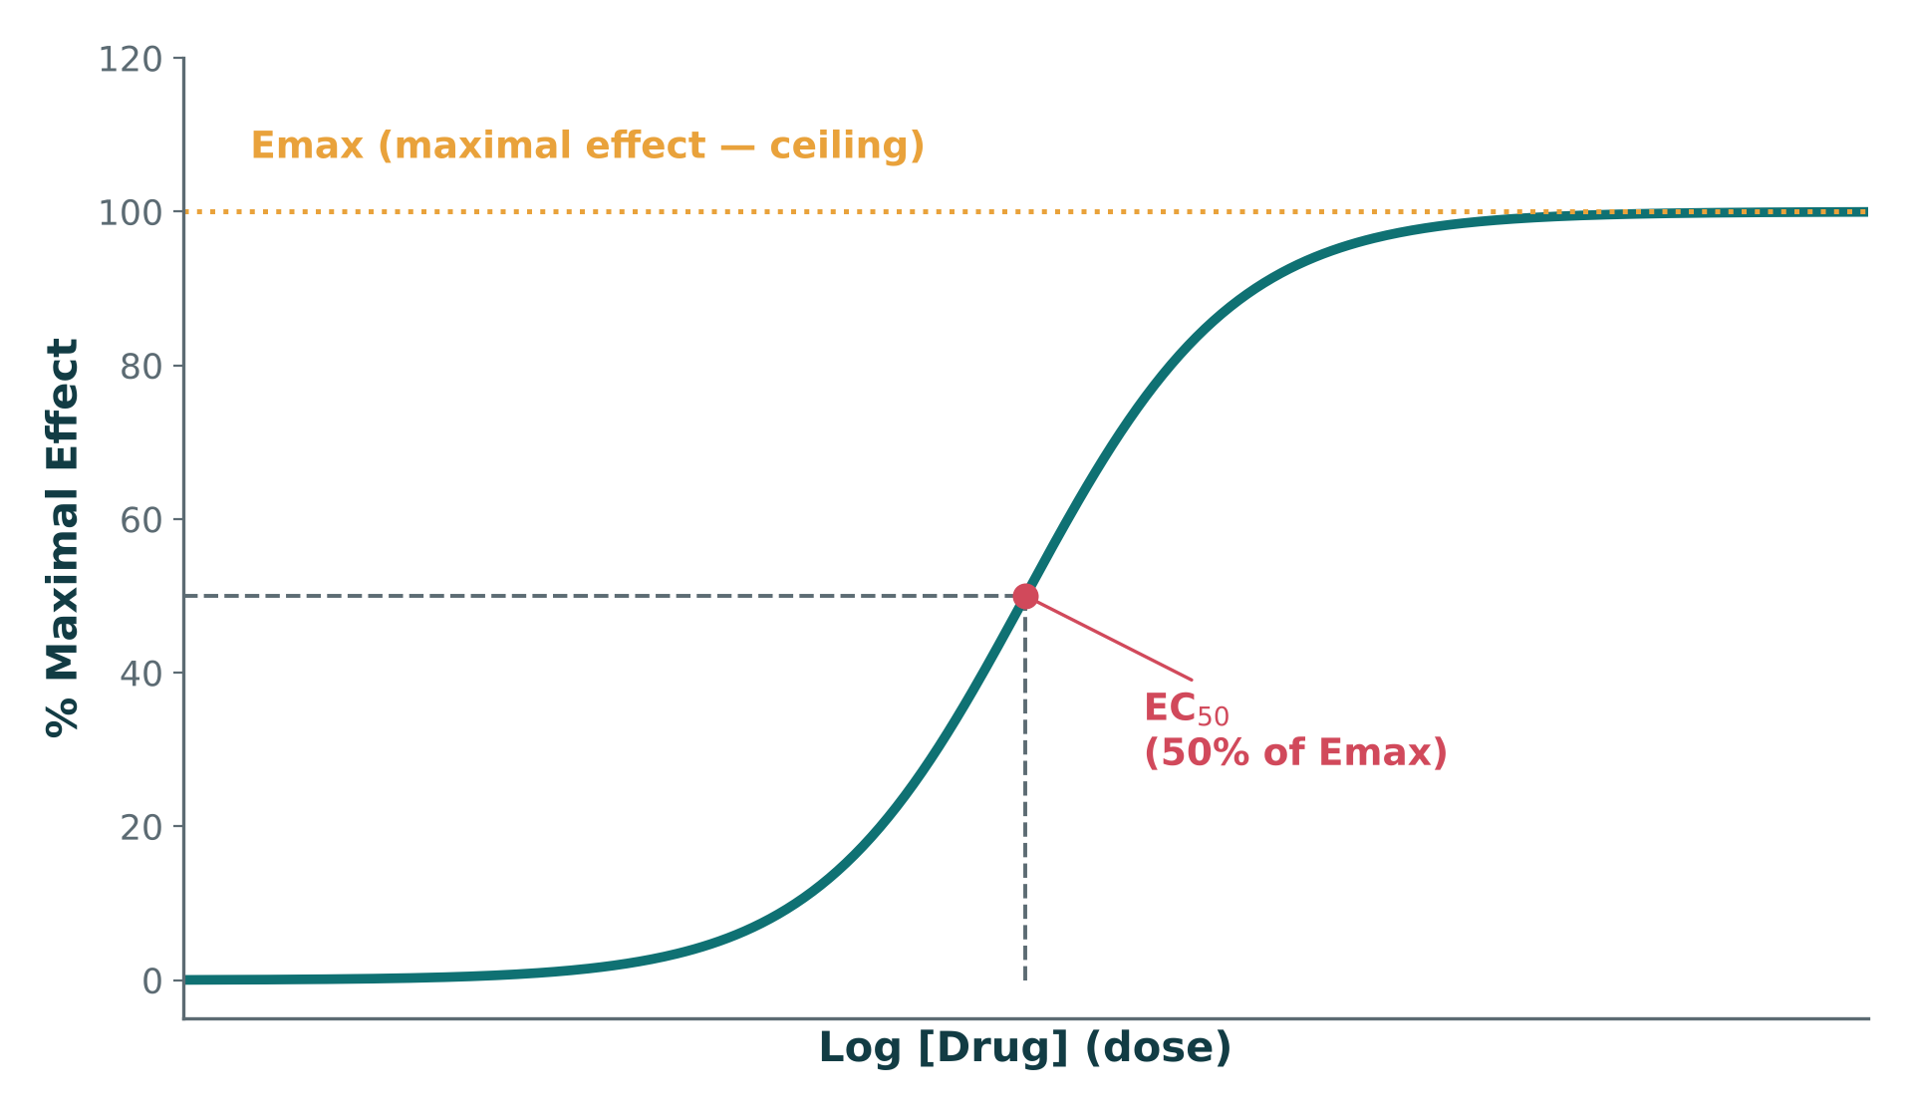
DOSE-RESPONSE RELATIONSHIPS
Objectives: SO4 · IO1.1
Figure 2 · The sigmoidal dose-response curve
Original illustrative curve (illustrative values, not from any textbook): EC₅₀ marks 50% of Emax; Emax is the plateau — the ceiling effect. S31; S31 (notes)
L01 · Introduction to Pharmacology — Session 1
73

Slide 74
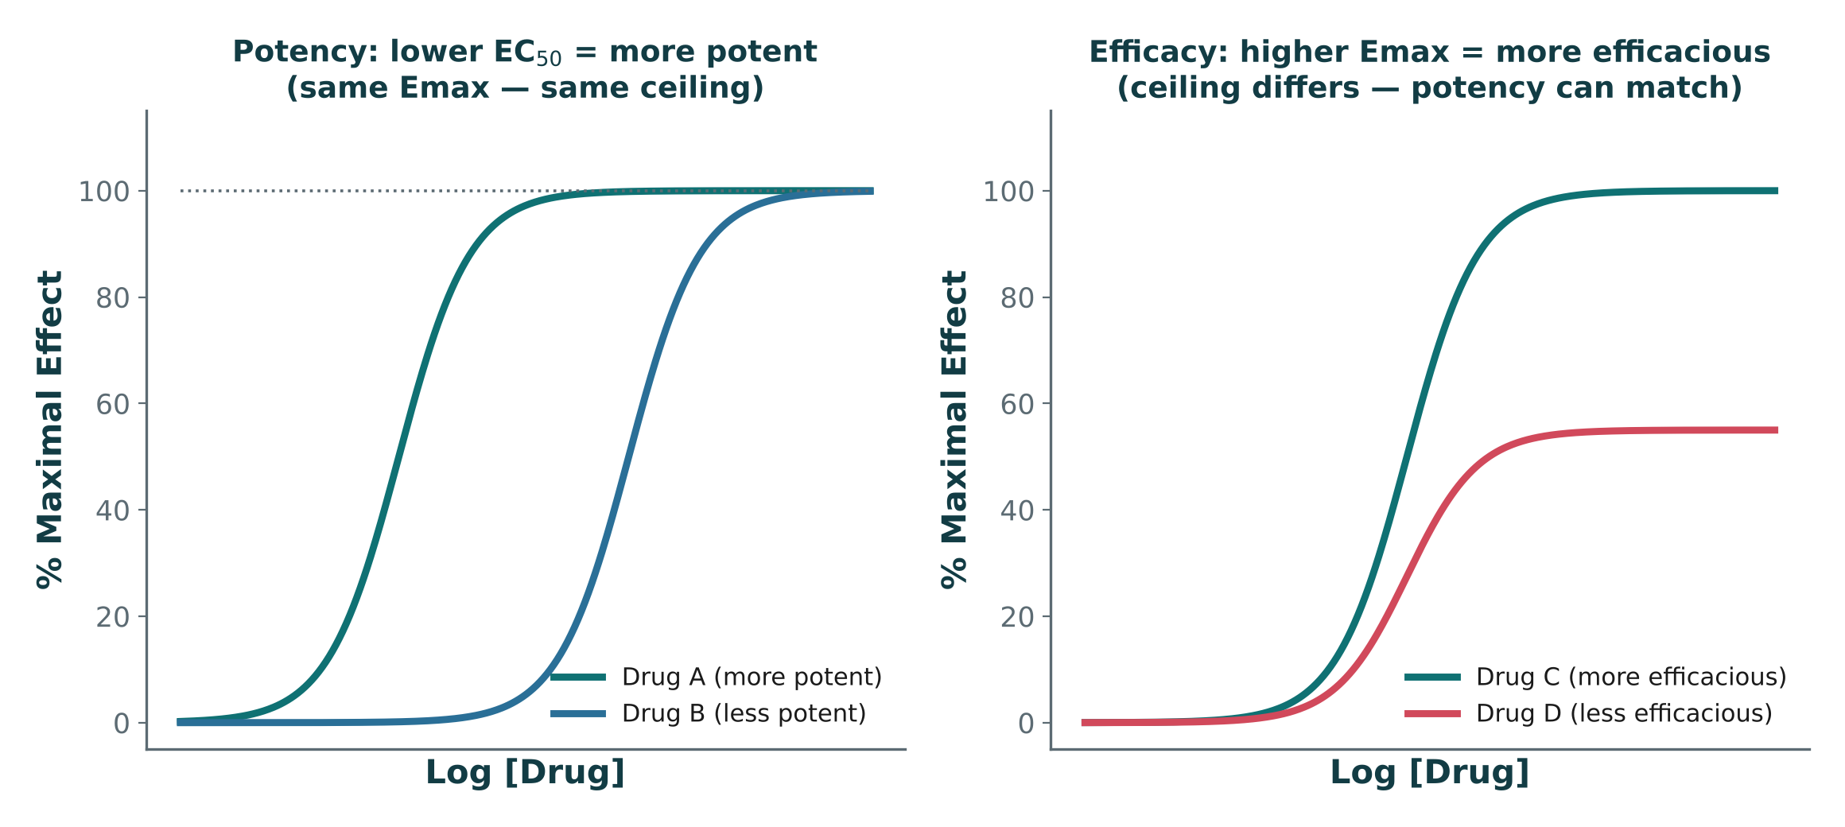
DOSE-RESPONSE RELATIONSHIPS
Objectives: SO4 · IO1.1
Figure 3 · Potency vs. efficacy, side by side
Left panel: two drugs with the same Emax but different EC₅₀ (potency differs). Right panel: two drugs with the same EC₅₀ but different Emax (efficacy differs). Potency and efficacy are independent properties. S35; S35 (notes)
L01 · Introduction to Pharmacology — Session 1
74

Slide 75
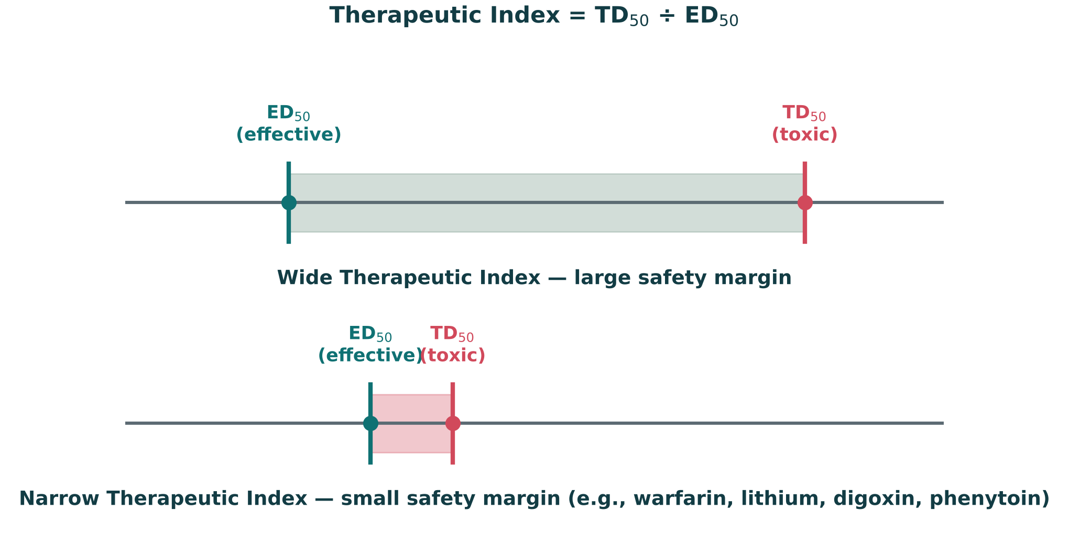
DOSE-RESPONSE RELATIONSHIPS
Objectives: SO4 · IO1.1
Figure 4 · Wide vs. narrow therapeutic index
Original illustrative number-line comparison: a wide gap between ED₅₀ and TD₅₀ is safer to dose than a narrow one (illustrative values). Note how close ED₅₀ and TD₅₀ sit for the narrow-TI example (e.g., warfarin, lithium, digoxin, phenytoin). S39; S39 (notes)
L01 · Introduction to Pharmacology — Session 1
75

Slide 76
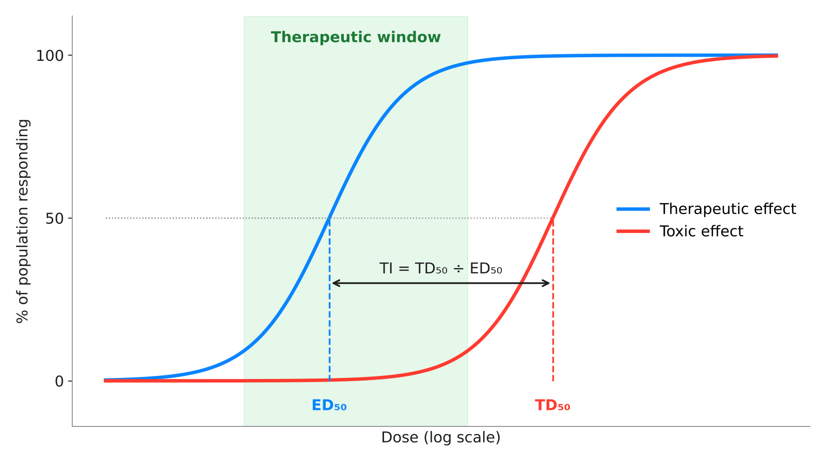
DOSE-RESPONSE RELATIONSHIPS
Objectives: SO4 · IO1.1
Textbook concept · Quantal dose-response and the therapeutic window
Original diagram (illustrative values) of a textbook concept: the % of a population showing the therapeutic effect (blue) or a toxic effect (red) as dose rises. ED₅₀ and TD₅₀ give TI = TD₅₀ ÷ ED₅₀ (an animal-study measure); the therapeutic window — minimum therapeutic dose to minimum toxic dose — is the more practical range for dosing a patient. p. 38
L01 · Introduction to Pharmacology — Session 1
76

Slide 77
DOSE-RESPONSE RELATIONSHIPS
Objectives: SO4 · IO1.1
Compare: Potency vs. efficacy
 | Potency | Efficacy (Emax)
Definition | How much drug is needed to get an effect | The maximum effect the drug can produce
Measured by | EC₅₀ — lower EC₅₀ = more potent | Plateau height — higher Emax = more efficacious
On the curve | Curve farther left | Curve plateaus higher
Clinical weight | Matters for dosing, not for picking the "better" drug | Matters much more — potent + low efficacy may be useless
Focus: what tells these apart. Sources: S30; S34; S37
L01 · Introduction to Pharmacology — Session 1
77

Slide 78
DOSE-RESPONSE RELATIONSHIPS
Objectives: SO4 · IO1.1
Compare: Wide vs. narrow therapeutic index
 | Wide TI | Narrow TI
ED₅₀ vs. TD₅₀ | Far apart — large safety margin | Close together — small safety margin
Dosing | Generally safer to dose | Careful dosing; small errors → toxic
Monitoring | Not covered in materials | Often blood-level monitoring
Examples | Not covered in materials | Warfarin, lithium, digoxin, phenytoin
Focus: what tells these apart. Sources: S38; S39; S41
L01 · Introduction to Pharmacology — Session 1
78

Slide 79
DOSE-RESPONSE RELATIONSHIPS
Objectives: SO4 · IO1.1
Compare: The narrow-TI drugs in numbers (textbook Table 3–1)
Drug | Half-life | Target level | Toxic above | Worth knowing
Digoxin | 39 h | 1 ng/mL | 2 ng/mL | Vd ~500 L (sequestered in tissue); 67% excreted in urine
Lithium | 22 h | 0.7 mEq/L | 2 mEq/L | 95% excreted in urine, 0% protein-bound — renal function rules
Phenytoin | Concentration-dependent | 10 mg/L | 20 mg/L | Saturable (capacity-limited) elimination; 89% protein-bound
Warfarin | 37 h | Not in table | Not in table | 99% protein-bound
TB Focus: what tells these apart. Sources: p. 44; p. 45
L01 · Introduction to Pharmacology — Session 1
79

Slide 80
DOSE-RESPONSE RELATIONSHIPS
Objectives: SO4 · IO1.1
Memory hooks
Why it happens
Why it happens
Why do narrow-TI drugs need blood levels? The effective dose and the toxic dose sit so close together that a small dosing error can push the patient from effective to toxic. S38; S41
Why does efficacy beat potency clinically? Potency only changes the dose you give; efficacy sets the ceiling of what the drug can achieve at any dose. S30; S34
Mnemonic (memory aid)
Mnemonic (memory aid)
Narrow-TI drugs — "Watch Levels During Prescribing": Warfarin, Lithium, Digoxin, Phenytoin. S38
TI = Toxic over Effective → TD₅₀ ÷ ED₅₀ (toxic on top). S38
L01 · Introduction to Pharmacology — Session 1
80

Slide 81
DOSE-RESPONSE RELATIONSHIPS
Objectives: SO4 · IO1.1
High-yield summary
If you remember nothing else
Potency = dose needed (EC₅₀, lower = more potent); efficacy = Emax (ceiling). S30; S34
Potency and efficacy are independent; efficacy matters more clinically. S34; S35
TI = TD₅₀ ÷ ED₅₀; narrow TI → careful dosing + blood-level monitoring. S38
Narrow-TI drugs: warfarin, lithium, digoxin, phenytoin. S38
L01 · Introduction to Pharmacology — Session 1
81

Slide 82
MECHANISM · LECTURE QUICK CHECK S32-33
Objectives: SO4 · IO1.1
Question 15
On the dose-response curve in Figure 2, the point marked EC₅₀ sits exactly halfway up the rising part of the curve. What does this point represent?
A
The concentration producing 50% of the drug's maximal effect
B
The concentration producing the drug's maximal effect
C
The point at which the drug has no effect at all
D
The dose at which the drug first becomes toxic
E
The fraction of the dose reaching circulation
L01 · Introduction to Pharmacology — Session 1
82
Notes:
Answer on the next slide. Source: S31; S32-33

Slide 83
MECHANISM · ANSWER
Objectives: SO4 · IO1.1
Answer 15: A
A. The concentration producing 50% of the drug's maximal effect
EC₅₀ is read at the halfway point between baseline and Emax — the standard graphical measure of potency (S33). S31; S32-33
Why the other choices are wrong
B. The concentration producing the drug's maximal effect — The maximal effect is Emax — the plateau (S30-31).
C. The point at which the drug has no effect at all — EC₅₀ is halfway to Emax, not zero effect (S33).
D. The dose at which the drug first becomes toxic — EC₅₀ is a measure of potency, not toxicity (S33).
E. The fraction of the dose reaching circulation — That is bioavailability (S50), not EC₅₀ (S33).
L01 · Introduction to Pharmacology — Session 1
83

Slide 84
MECHANISM · LECTURE QUICK CHECK S36-37
Objectives: SO4 · IO1.1
Question 16
In the left panel of Figure 3, Drug A's curve sits to the left of Drug B's curve, but both curves plateau at the same height. What does this tell you?
A
Drug A is more efficacious than Drug B at every dose
B
Drug A and Drug B have different Emax values here
C
Drug A is more potent than Drug B, and both have equal efficacy
D
Drug A has a wider therapeutic index than Drug B
E
Drug B is more potent than Drug A in this panel
L01 · Introduction to Pharmacology — Session 1
84
Notes:
Answer on the next slide. Source: S35; S36-37

Slide 85
MECHANISM · ANSWER
Objectives: SO4 · IO1.1
Answer 16: C
C. Drug A is more potent than Drug B, and both have equal efficacy
A curve farther left reaches the same effect at a lower dose (greater potency); the same plateau height means identical Emax (S37). S35; S36-37
Why the other choices are wrong
A. Drug A is more efficacious than Drug B at every dose — Efficacy is the plateau height, and the plateaus are equal (S37).
B. Drug A and Drug B have different Emax values here — Both curves reach the same plateau, so Emax is the same (S37).
D. Drug A has a wider therapeutic index than Drug B — TI compares TD₅₀ with ED₅₀ (S38); the figure shows only effect curves.
E. Drug B is more potent than Drug A in this panel — The curve farther LEFT (Drug A) is more potent (S37).
L01 · Introduction to Pharmacology — Session 1
85

Slide 86
MECHANISM · LECTURE QUICK CHECK S40-41
Objectives: SO4 · IO1.1
Question 17
Comparing the two number lines in Figure 4, the narrow-TI drug's ED₅₀ and TD₅₀ markers sit much closer together than the wide-TI drug's. What is the clinical implication?
A
The narrow-TI drug is safer because it requires a lower dose
B
The wide-TI drug is the one more likely to cause toxicity
C
Therapeutic index has no real bearing on dosing safety
D
The narrow-TI drug must have lower efficacy (Emax) overall
E
Smaller effective-to-toxic margin, so closer monitoring is needed
L01 · Introduction to Pharmacology — Session 1
86
Notes:
Answer on the next slide. Source: S39; S40-41

Slide 87
MECHANISM · ANSWER
Objectives: SO4 · IO1.1
Answer 17: E
E. Smaller effective-to-toxic margin, so closer monitoring is needed
The ED₅₀–TD₅₀ gap is the therapeutic index; a narrow gap means a small dosing error can move a patient from effective to toxic, so these drugs need blood-level monitoring (S41). S39; S40-41
Why the other choices are wrong
A. The narrow-TI drug is safer because it requires a lower dose — A narrow TI means a SMALLER safety margin, not a safer drug (S38, S41).
B. The wide-TI drug is the one more likely to cause toxicity — A wide TI means a large margin — generally safer to dose (S38).
C. Therapeutic index has no real bearing on dosing safety — TI is exactly the margin between effective and toxic dosing (S38).
D. The narrow-TI drug must have lower efficacy (Emax) overall — TI compares toxic vs. effective doses; it says nothing about Emax (S30, S38).
L01 · Introduction to Pharmacology — Session 1
87

Slide 88
MECHANISM · LECTURE QUICK CHECK S42-43
Objectives: SO4 · IO1.1
Question 18
Drug X requires a much lower dose than Drug Y to achieve the same effect, but both drugs achieve the same maximum effect (Emax). Which statement is correct?
A
Drug X is more potent than Drug Y
B
Drug Y is more potent than Drug X
C
Drug X and Drug Y have different Emax values
D
Drug X has a narrower therapeutic index
E
Drug X is more efficacious than Drug Y
L01 · Introduction to Pharmacology — Session 1
88
Notes:
Answer on the next slide. Source: S42-43; SG U1-R6

Slide 89
MECHANISM · ANSWER
Objectives: SO4 · IO1.1
Answer 18: A
A. Drug X is more potent than Drug Y
Needing a lower dose for the same effect is greater potency; since both reach the same Emax, efficacy is equal (S43). S42-43; SG U1-R6
Why the other choices are wrong
B. Drug Y is more potent than Drug X — The drug needing the LOWER dose (X) is more potent (S30).
C. Drug X and Drug Y have different Emax values — The stem states both reach the same Emax (S43).
D. Drug X has a narrower therapeutic index — Nothing about toxic doses is given; TI = TD₅₀ ÷ ED₅₀ (S38).
E. Drug X is more efficacious than Drug Y — Both reach the same Emax, so efficacy is equal (S43).
L01 · Introduction to Pharmacology — Session 1
89

Slide 90
CLINICAL VIGNETTE
Objectives: SO4 · IO1.1
Question 19
A PA is starting a patient on lithium. Compared with a drug that has a wide therapeutic index, what does lithium's narrow therapeutic index mean for this patient's care?
A
Lithium is more potent, so it can be dosed without monitoring levels
B
Lithium has a higher Emax, so lower doses than usual are always enough
C
Lithium is 100% bioavailable, so blood levels never need to be checked
D
Effective and toxic doses are close, so dose carefully and monitor blood levels
E
Lithium has a large safety margin, so dosing errors are well tolerated
L01 · Introduction to Pharmacology — Session 1
90
Notes:
Answer on the next slide. Source: S38; S38 (notes)

Slide 91
CLINICAL VIGNETTE · ANSWER
Objectives: SO4 · IO1.1
Answer 19: D
D. Effective and toxic doses are close, so dose carefully and monitor blood levels
A narrow TI means effective and toxic doses are close together — requiring careful dosing and often blood-level monitoring; lithium is a classic narrow-TI drug (S38). S38; S38 (notes)
Why the other choices are wrong
A. Lithium is more potent, so it can be dosed without monitoring levels — Potency matters for dosing amount, not safety margin; narrow-TI drugs need monitoring (S34, S38).
B. Lithium has a higher Emax, so lower doses than usual are always enough — TI is about toxic vs. effective doses, not Emax (S30, S38).
C. Lithium is 100% bioavailable, so blood levels never need to be checked — Bioavailability is a different concept (S50); narrow-TI drugs need monitoring (S38).
E. Lithium has a large safety margin, so dosing errors are well tolerated — That describes a WIDE TI (S38).
L01 · Introduction to Pharmacology — Session 1
91

Slide 92
Topic 5 of 5
Pharmacokinetics: ADME — Absorption & Distribution
Covers objectives: SO5 · IO1.2 · IO1.3 · IO1.5
Key definitions
How it works
Clinical relevance
Drugs named as examples
Exam traps
92

Slide 93
PHARMACOKINETICS: ADME — ABSORPTION & DISTRIBUTION
Objectives: SO5 · IO1.2 · IO1.3 · IO1.5
Key definitions
Key definitions (1/2)
A — Absorption: movement of drug from the site of administration into the bloodstream. S45
D — Distribution: movement of drug from blood into tissues. S45
M — Metabolism: chemical transformation of drug, mainly in the liver. S45
E — Excretion: removal of drug/metabolites from the body, mainly via the kidney. S45
L01 · Introduction to Pharmacology — Session 1
93

Slide 94
PHARMACOKINETICS: ADME — ABSORPTION & DISTRIBUTION
Objectives: SO5 · IO1.2 · IO1.3 · IO1.5
Key definitions (cont.)
Key definitions (2/2)
Bioavailability (F) = the fraction of an administered dose that reaches systemic circulation unchanged. S50; SG U1-R8
First-pass effect: the liver metabolizes (can inactivate a large fraction of) an orally absorbed drug before it reaches systemic circulation. S51; S51 (notes); SG U1-R9
Volume of distribution (Vd): a calculated value relating total drug in the body to plasma concentration — a high Vd suggests extensive tissue distribution. S52
TB pKa: the pH at which a drug is half ionized and half nonionized. p. 10
L01 · Introduction to Pharmacology — Session 1
94

Slide 95
PHARMACOKINETICS: ADME — ABSORPTION & DISTRIBUTION
Objectives: SO5 · IO1.2 · IO1.3 · IO1.5
How it works
How it works (1/3)
ADME is the organizing skeleton for the rest of the lecture — each remaining pharmacokinetics section is one ADME letter in depth. S45 (notes)
ADME determines how much drug reaches its target and for how long. S56
Metabolism (M arrow → liver) and Excretion (E arrow → kidney) are the back half of ADME — how the body gets rid of the drug; Absorption and Distribution govern how the drug arrives and spreads. S46; S48
First-pass route: oral drug → GI tract → portal circulation → liver → systemic circulation. S51
By definition, an IV dose has 100% bioavailability — the entire dose enters the bloodstream directly (no absorption step). S50; SG U1-R8
Oral bioavailability is reduced by incomplete absorption and by first-pass hepatic metabolism. S50
L01 · Introduction to Pharmacology — Session 1
95

Slide 96
PHARMACOKINETICS: ADME — ABSORPTION & DISTRIBUTION
Objectives: SO5 · IO1.2 · IO1.3 · IO1.5
How it works (cont.)
How it works (2/3)
Plasma protein binding: only unbound ("free") drug is pharmacologically active and able to cross membranes. S52
Lipid solubility: lipophilic drugs cross membranes more readily and distribute into fatty tissue. S52
Tissue perfusion: highly perfused organs (brain, heart, kidney) receive drug faster than poorly perfused tissue (fat, bone). S52
Vd is a theoretical volume, not a real anatomic space. S52 (notes)
Blood-brain barrier — Why can some drugs readily enter the CNS while others cannot? Tight junctions between endothelial cells restrict paracellular movement. S53
Small, lipophilic, non-ionized drugs cross the BBB more easily than large, polar, or highly protein-bound drugs. S53
L01 · Introduction to Pharmacology — Session 1
96

Slide 97
PHARMACOKINETICS: ADME — ABSORPTION & DISTRIBUTION
Objectives: SO5 · IO1.2 · IO1.3 · IO1.5
How it works (cont.)
How it works (3/3)
Efflux transporters (like P-glycoprotein) can actively pump some drugs back out of the CNS. S53
TB First-pass loss can happen in the gut wall (e.g., intestinal CYP3A4) as well as the liver; grapefruit juice inhibits gut-wall metabolism and P-glycoprotein, raising absorption of some drugs. p. 48
TB P-glycoprotein (MDR1) pumps drugs out of cells in brain, testes, and gut; inhibiting it raises digoxin blood levels. p. 9
TB Ion trapping: weak acids are excreted faster in alkaline urine; weak bases faster in acidic urine. p. 10; p. 11
TB Drugs cross membranes by lipid diffusion (the main route), aqueous pores, carriers (saturable) or endocytosis (vitamin B₁₂, iron). p. 8; p. 9
TB Only the nonionized form crosses lipid membranes: a weak acid is mostly nonionized when pH < pKa, a weak base when pH > pKa (Henderson-Hasselbalch). p. 9; p. 10
L01 · Introduction to Pharmacology — Session 1
97

Slide 98
PHARMACOKINETICS: ADME — ABSORPTION & DISTRIBUTION
Objectives: SO5 · IO1.2 · IO1.3 · IO1.5
Clinical relevance
Clinical relevance
Routes that bypass first-pass metabolism: essentially everything except oral — IV, sublingual, inhaled, transdermal, topical, SC, IM. S49 (notes)
Sublingual absorption enters systemic venous circulation directly, bypassing the portal vein and the liver's first-pass metabolism; oral dosing passes through the liver first. S55; SG U1-R9
Because the liver can inactivate a large fraction of drug first, some drugs are given sublingually or transdermally instead of orally. S51 (notes)
A highly polar antibiotic would generally not cross the BBB well — unless the meninges are inflamed, as in meningitis. S53 (notes)
TB Aspirin overdose: sodium bicarbonate alkalinizes blood and urine, reducing aspirin entry into tissues and speeding its renal excretion. p. 20
L01 · Introduction to Pharmacology — Session 1
98

Slide 99
PHARMACOKINETICS: ADME — ABSORPTION & DISTRIBUTION
Objectives: SO5 · IO1.2 · IO1.3 · IO1.5
Drugs named as examples
Drugs named as examples
Large first-pass effect: nitroglycerin, propranolol, morphine — all require higher oral doses (or a non-oral route) to achieve the same systemic exposure as IV. S51; SG U1-R9
Very high Vd: digoxin — mostly sequestered in tissue, not floating around in plasma. S52 (notes)
Subcutaneous route is common for insulin and heparin. S49
P-glycoprotein — an efflux transporter at the BBB. S53
TB Weak acids: aspirin (pKa 3.5), warfarin (5.0). Weak bases: morphine (7.9), propranolol (9.4). p. 10
L01 · Introduction to Pharmacology — Session 1
99

Slide 100
PHARMACOKINETICS: ADME — ABSORPTION & DISTRIBUTION
Objectives: SO5 · IO1.2 · IO1.3 · IO1.5
Exam traps
Exam traps
IV = 100% bioavailable with no absorption phase; oral is less than 100%. S49; S50
Taking an oral drug with food or on an empty stomach does not bypass first-pass metabolism — sublingual does. S54-55
A very high Vd does not mean a big anatomic space — it means the drug is mostly in tissue, not plasma. S52 (notes)
Only free (unbound) drug is active and can cross membranes — protein-bound drug cannot. S52
L01 · Introduction to Pharmacology — Session 1
100

Slide 101
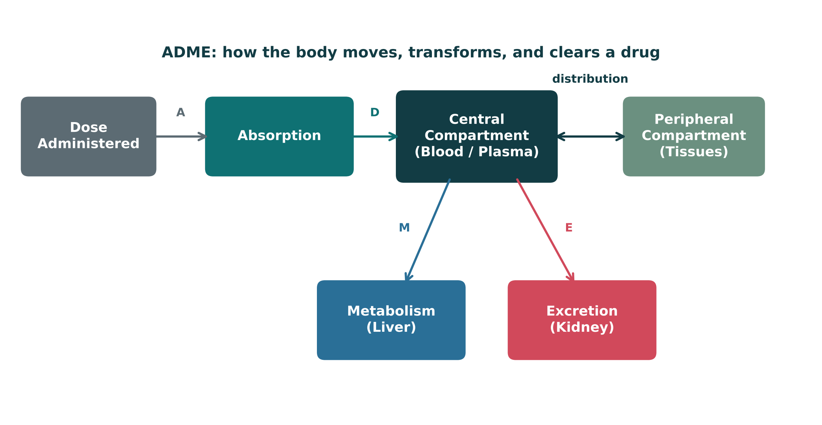
PHARMACOKINETICS: ADME — ABSORPTION & DISTRIBUTION
Objectives: SO5 · IO1.2 · IO1.3 · IO1.5
Figure 5 · The ADME compartment model
Original illustrative compartment diagram: how a dose moves from administration through distribution, metabolism, and excretion. Dose → Absorption → Central compartment (blood/plasma) ⇄ Peripheral compartment (tissues); M arrow → Metabolism (liver), E arrow → Excretion (kidney). S46; S46 (notes)
L01 · Introduction to Pharmacology — Session 1
101

Slide 102
PHARMACOKINETICS: ADME — ABSORPTION & DISTRIBUTION
Objectives: SO5 · IO1.2 · IO1.3 · IO1.5
Compare: Routes of administration
Route | Key feature | Bypasses first-pass?
Oral (PO) | Convenient; subject to first-pass metabolism and variable absorption | No
Sublingual | Absorbed directly into systemic circulation | Yes
Intravenous (IV) | 100% bioavailable; immediate onset; no absorption phase | Yes
Intramuscular (IM) | Faster than oral; good for depot/long-acting formulations | Yes
Subcutaneous (SC) | Slower, steady absorption; common for insulin, heparin | Yes
Inhaled | Rapid local effect in the lungs; minimizes systemic exposure for some drugs | Yes
Transdermal | Slow, sustained systemic absorption through the skin | Yes
Topical | Local effect at the site of application; minimal systemic absorption | Yes
Focus: what tells these apart. Sources: S49; S49 (notes)
L01 · Introduction to Pharmacology — Session 1
102

Slide 103
PHARMACOKINETICS: ADME — ABSORPTION & DISTRIBUTION
Objectives: SO5 · IO1.2 · IO1.3 · IO1.5
Compare: Who crosses the blood-brain barrier?
 | Crosses more easily | Crosses less easily
Size | Small | Large
Chemistry | Lipophilic, non-ionized | Polar
Protein binding | Not covered in materials | Highly protein-bound
Other | Not covered in materials | Pumped out by efflux transporters (P-glycoprotein)
Focus: what tells these apart. Sources: S53
L01 · Introduction to Pharmacology — Session 1
103

Slide 104
PHARMACOKINETICS: ADME — ABSORPTION & DISTRIBUTION
Objectives: SO5 · IO1.2 · IO1.3 · IO1.5
Compare: Bioavailability by route (textbook Table 3–3)
Route | Bioavailability (%) | Note
Intravenous (IV) | 100 | Most rapid onset
Intramuscular (IM) | 75 to ≤100 | Large volumes often feasible; may be painful
Subcutaneous (SC) | 75 to ≤100 | Smaller volumes than IM; may be painful
Oral (PO) | 5 to <100 | Most convenient; first-pass effect may be important
Rectal (PR) | 30 to <100 | Less first-pass effect than oral
Inhalation | 5 to <100 | Often very rapid onset
Transdermal | 80 to ≤100 | Usually very slow absorption; prolonged duration
TB Focus: what tells these apart. Sources: p. 48
L01 · Introduction to Pharmacology — Session 1
104

Slide 105
PHARMACOKINETICS: ADME — ABSORPTION & DISTRIBUTION
Objectives: SO5 · IO1.2 · IO1.3 · IO1.5
Memory hooks
Why it happens
Why it happens
Why is IV bioavailability 100%? The whole dose enters the bloodstream directly — there is no absorption step and no trip through the liver first. S50; S49
Why does sublingual skip first-pass? It drains into systemic veins, not the portal vein — so the drug reaches the body before the liver can inactivate it. S55; S51
Why it happens
Mnemonic (memory aid)
Why do highly protein-bound drugs act less and cross the BBB poorly? Only free (unbound) drug is active and able to cross membranes. S52; S53
Big first-pass drugs "Need Plenty More by mouth": Nitroglycerin, Propranolol, Morphine. S51
L01 · Introduction to Pharmacology — Session 1
105

Slide 106
PHARMACOKINETICS: ADME — ABSORPTION & DISTRIBUTION
Objectives: SO5 · IO1.2 · IO1.3 · IO1.5
High-yield summary
If you remember nothing else
F = fraction of dose reaching systemic circulation unchanged; IV = 100%. S50
First-pass: oral → GI → portal → liver → systemic; big examples nitroglycerin, propranolol, morphine. S51
Every route except oral bypasses first-pass (sublingual = direct to systemic veins). S49 (notes); S55
Only free (unbound) drug is active; high Vd = drug mostly in tissue (e.g., digoxin). S52; S52 (notes)
BBB: small, lipophilic, non-ionized drugs cross; P-glycoprotein pumps some back out. S53
L01 · Introduction to Pharmacology — Session 1
106

Slide 107
MECHANISM · LECTURE QUICK CHECK S47-48
Objectives: SO5 · IO1.2 · IO1.3 · IO1.5
Question 21
In Figure 5, two separate arrows leave the Central Compartment box: one labeled "M" pointing to Metabolism (Liver), and one labeled "E" pointing to Excretion (Kidney). Together, these two arrows represent which part of ADME?
A
Only the excretion step — removal of the drug via the kidney
B
Absorption only — movement from the dose site into the blood
C
Distribution only — how the drug moves out into the tissues
D
Absorption and distribution — how the drug arrives and spreads
E
Metabolism and excretion — how the drug is transformed and cleared
L01 · Introduction to Pharmacology — Session 1
107
Notes:
Answer on the next slide. Source: S46; S47-48

Slide 108
MECHANISM · ANSWER
Objectives: SO5 · IO1.2 · IO1.3 · IO1.5
Answer 21: E
E. Metabolism and excretion — how the drug is transformed and cleared
The M arrow (liver, biotransformation) and E arrow (kidney, elimination) are the back half of ADME — how the body gets rid of the drug (S48). S46; S47-48
Why the other choices are wrong
A. Only the excretion step — removal of the drug via the kidney — The figure shows TWO arrows: M (liver) and E (kidney) (S47-48).
B. Absorption only — movement from the dose site into the blood — Absorption is how the dose enters the bloodstream (S45), before the central compartment.
C. Distribution only — how the drug moves out into the tissues — Distribution is the arrow to the peripheral compartment, not to the liver/kidney (S46).
D. Absorption and distribution — how the drug arrives and spreads — Absorption and distribution govern how the drug arrives and spreads, not how it leaves (S48).
L01 · Introduction to Pharmacology — Session 1
108

Slide 109
MECHANISM · LECTURE QUICK CHECK S54-55
Objectives: SO5 · IO1.2 · IO1.3 · IO1.5
Question 22
Which route of administration bypasses first-pass hepatic metabolism entirely, by entering systemic venous circulation directly?
A
Every route equally
B
Oral, taken with food
C
Sublingual route
D
Oral, empty stomach
E
Oral, crushed tablet
L01 · Introduction to Pharmacology — Session 1
109
Notes:
Answer on the next slide. Source: S54-55

Slide 110
MECHANISM · ANSWER
Objectives: SO5 · IO1.2 · IO1.3 · IO1.5
Answer 22: C
C. Sublingual route
Sublingual absorption enters systemic venous circulation directly, bypassing the portal vein and liver (S55). S54-55
Why the other choices are wrong
A. Every route equally — Essentially every route except oral bypasses first-pass metabolism (S49 notes).
B. Oral, taken with food — Food doesn't change the oral route's path through the portal vein and liver (S55).
D. Oral, empty stomach — Oral drugs are absorbed into the portal circulation and pass through the liver first (S55).
E. Oral, crushed tablet — Any oral dose goes GI → portal circulation → liver (S51).
L01 · Introduction to Pharmacology — Session 1
110

Slide 111
CLINICAL VIGNETTE
Objectives: SO5 · IO1.2 · IO1.3 · IO1.5
Question 23
A patient stable on IV propranolol is switched to the oral form and needs a much higher oral dose to reach the same systemic exposure. Which best explains this?
A
Propranolol has a narrow therapeutic index, so oral doses must be higher
B
Extensive first-pass hepatic metabolism lowers the drug's oral bioavailability
C
Propranolol is highly protein-bound, so the oral form is inactive in plasma
D
The IV form was less than 100% bioavailable, so less drug reached the blood
E
Oral propranolol cannot cross the blood-brain barrier, so more must be given
L01 · Introduction to Pharmacology — Session 1
111
Notes:
Answer on the next slide. Source: S50; S51

Slide 112
CLINICAL VIGNETTE · ANSWER
Objectives: SO5 · IO1.2 · IO1.3 · IO1.5
Answer 23: B
B. Extensive first-pass hepatic metabolism lowers the drug's oral bioavailability
Propranolol has a large first-pass effect; oral doses pass GI → portal → liver before systemic circulation, so higher oral doses are needed to match IV exposure (S51, S50). S50; S51
Why the other choices are wrong
A. Propranolol has a narrow therapeutic index, so oral doses must be higher — Narrow TI calls for careful dosing and monitoring (S38); propranolol is named for first-pass, not narrow TI (S51).
C. Propranolol is highly protein-bound, so the oral form is inactive in plasma — Protein binding affects free drug in plasma regardless of route (S52); the IV-to-oral gap is the first-pass effect (S51).
D. The IV form was less than 100% bioavailable, so less drug reached the blood — IV has 100% bioavailability by definition (S50).
E. Oral propranolol cannot cross the blood-brain barrier, so more must be given — BBB crossing relates to CNS entry (S53), not systemic exposure after an oral dose.
L01 · Introduction to Pharmacology — Session 1
112

