Slide 1
L07 · Tue, Nov 10, 2026
Endocrine Pharmacotherapy — Session 1
Pharmacology study deck · organized by drug class
How to read this deck
TB = textbook only (not on the lecture slides)
SG = course study guide only (not on the lecture slides)
Bold = emphasized on the lecture slides
S12 = lecture slide 12 · p. 245 = textbook page 245 · SG U1-R3 = study guide item

Slide 2
START HERE
Learning objectives
IO4.1
Identify major pharmacologic classes used in the management of endocrine conditions and describe their mechanisms of action.
Pituitary: GH, Prolactin & ADH, Thyroid & Antithyroid Drugs, Adrenocorticosteroids & Antagonists
IO4.2
Describe the indications, contraindications, adverse effects, and clinically significant interactions associated with medications used to treat endocrine conditions.
Pituitary: GH, Prolactin & ADH, Thyroid & Antithyroid Drugs, Adrenocorticosteroids & Antagonists
IO4.3
Compare pharmacologic agents within and across therapeutic classes to distinguish clinically relevant differences in efficacy, safety, and use.
Thyroid & Antithyroid Drugs, Adrenocorticosteroids & Antagonists
IO4.4
Select appropriate pharmacologic therapy for common endocrine conditions based on clinical presentation and patient-specific factors.
Pituitary: GH, Prolactin & ADH, Thyroid & Antithyroid Drugs, Adrenocorticosteroids & Antagonists
L07 · Endocrine Pharmacotherapy — Session 1
2

Slide 3
START HERE
Learning objectives (cont.)
IO4.5
Identify appropriate dosing, administration, and monitoring considerations for medications used in endocrine conditions.
Pituitary: GH, Prolactin & ADH, Thyroid & Antithyroid Drugs, Adrenocorticosteroids & Antagonists
IO4.6
Explain important medication-use and safety information to patients receiving pharmacotherapy for endocrine conditions.
Thyroid & Antithyroid Drugs, Adrenocorticosteroids & Antagonists
SO1
Describe the hypothalamic-pituitary-target gland axis as a shared regulatory template, and identify where drug therapy intervenes at each level.
Pituitary: GH, Prolactin & ADH
SO2
Identify the major agents used for growth hormone disorders, hyperprolactinemia, and disorders of antidiuretic hormone (diabetes insipidus, SIADH).
Pituitary: GH, Prolactin & ADH
L07 · Endocrine Pharmacotherapy — Session 1
3

Slide 4
START HERE
Learning objectives (cont.)
SO3
Describe the mechanisms, indications, and monitoring of thyroid hormone replacement and antithyroid drug therapy, including management of thyroid storm.
Thyroid & Antithyroid Drugs
SO4
Compare glucocorticoid and mineralocorticoid pharmacology, and identify agents used to block adrenocortical hormone synthesis or action.
Adrenocorticosteroids & Antagonists
SO5
Identify dosing, administration, and monitoring considerations, and explain key medication-safety counseling points to patients, including HPA-axis suppression and the need to taper chronic glucocorticoids.
Thyroid & Antithyroid Drugs, Adrenocorticosteroids & Antagonists
L07 · Endocrine Pharmacotherapy — Session 1
4

Slide 5

START HERE
About this lecture
Scope, readings & sources
PA PHARMACOLOGY COURSE · LECTURE 4 · SESSION 1 OF 2 — Endocrine Pharmacotherapy. Session 1: Pituitary, Thyroid, and Adrenal Pharmacology | Tuesday, November 10 | 8:30–11:00 AM S1
One template runs this whole unit: hypothalamus drives the pituitary, the pituitary drives a target gland, and the gland’s hormone feeds back to turn the levels above it down. Every drug today replaces a hormone, blocks one, or interrupts that loop. S1 (notes); S4 (notes)
Arc: the shared HPA-template concept, then pituitary, thyroid and adrenal in turn. Preview: gonadal hormones, pancreatic/diabetes pharmacology, and parathyroid disorders continue in Session 2 (Thursday, November 12). S2
Orient to the arc: the shared HPA-template concept, then three organ systems in turn (pituitary, thyroid, adrenal) that all follow the same hypothalamic-pituitary-target gland logic of Figure 1; Session 2 continues with gonadal hormones, diabetes, and parathyroid disorders on Nov 12. S2 (notes)
L07 · Endocrine Pharmacotherapy — Session 1
5

Slide 6
START HERE
About this lecture (cont.)
Scope, readings & sources
Readings: Katzung’s Chapters 37–42 are required for Unit 4 (Hypothalamic & Pituitary Hormones; Thyroid & Antithyroid Drugs; Adrenocorticosteroids & Adrenocortical Antagonists; Gonadal Hormones & Inhibitors; Pancreatic Hormones & Glucose-Lowering Drugs; Agents That Affect Bone Mineral Homeostasis). S3; S3 (notes)
Session 1 covers Chapters 37–39; Session 2 covers Chapters 40–42. Recommended: Pharmacotherapy Principles and Practice (Chisholm-Burns, Schwinghammer, Malone, Kolesar, Lee, 2022, McGraw-Hill; print ISBN 9781260460278, eText ISBN 9781260460285) as supplemental support, not a substitute. S3; S3 (notes)
Required text: Katzung’s Basic and Clinical Pharmacology, 16th Edition (Todd W. Vanderah, 2024/2025, McGraw-Hill Education; ISBN 1260463303 eBook). S3
APPENDIX 1 gives Formulation, dose, indications, adverse effects, contraindications and toxicity — your study reference: know the dose logic, the one or two serious adverse effects, the contraindication that changes the decision, and the toxicity you would need to recognize. S29; S29 (notes); S30-51
L07 · Endocrine Pharmacotherapy — Session 1
6

Slide 7
START HERE
About this lecture (cont.)
Scope, readings & sources
Abbreviation key PO = by mouth SC = subcutaneous IM = intramuscular IV = intravenous ER = extended-release ODT = orally disintegrating tablet LAR = long-acting release BID / TID / QID = two / three / four times daily mcg = microgram S29; S29 (notes)
GH = growth hormone IGF-1 = insulin-like growth factor 1 TSH = thyroid-stimulating hormone T4 / T3 = thyroxine / triiodothyronine DI = diabetes insipidus SIADH = syndrome of inappropriate ADH secretion HPA = hypothalamic-pituitary-adrenal S29; S29 (notes)
CBC = complete blood count LFT = liver function tests QT = QT interval on ECG CYP = cytochrome P450 MI = myocardial infarction MRI = magnetic resonance imaging ARB = angiotensin receptor blocker AV = atrioventricular CNS = central nervous system S29; S29 (notes)
Appendix 2: DRUG PROFILE · SUPPORTING — supporting drugs explain interactions, not doses. Listed for context; not profiled in detail. S52; S52 (notes)
L07 · Endocrine Pharmacotherapy — Session 1
7

Slide 8
START HERE
About this lecture (cont.)
Scope, readings & sources
Original figures in this deck: Figures 1, 6 and 9 (The Hypothalamic-Pituitary-Target Gland Axis; Thyroid Hormone Synthesis: Where Antithyroid Drugs Act; Exogenous Corticosteroids and HPA Axis Suppression) were generated by the course director using the AI tool Claude to illustrate standard, non-copyrighted pharmacologic concepts. S53
They are original diagrams, not reproduced from Katzung’s Basic and Clinical Pharmacology or any other copyrighted source. Mechanism illustrations: (AI-generated, illustrative, not reproduced from copyrighted sources; schematic and not to scale): somatostatin analogs and pegvisomant (Figure 2, slide 7); dopamine agonists (Figure 3, slide 9); S53; S53 (notes)
ADH, desmopressin and tolvaptan (Figure 4, slide 10); levothyroxine absorption (Figure 5, slide 15); thyroid storm targets (Figure 7, slide 19); glucocorticoid receptor signaling (Figure 8, slide 25); steroid synthesis and receptor blockade (Figure 10, slide 30). Reference: Anthropic. (2026). Claude (Sonnet 5) [Large language model]. https://claude.ai S53
L07 · Endocrine Pharmacotherapy — Session 1
8

Slide 9
ROADMAP
Drug classes in this lecture
Pituitary: GH, Prolactin & ADH
Objectives: SO1, SO2, IO4.1, IO4.2, IO4.4, IO4.5
1
Thyroid & Antithyroid Drugs
Objectives: SO3, SO5, IO4.1, IO4.2, IO4.3, IO4.4, IO4.5, IO4.6
2
Adrenocorticosteroids & Antagonists
Objectives: SO4, SO5, IO4.1, IO4.2, IO4.3, IO4.4, IO4.5, IO4.6
3
L07 · Endocrine Pharmacotherapy — Session 1
9

Slide 10










Drug class 1 of 3
Pituitary: GH, Prolactin & ADH
Covers objectives: SO1 · SO2 · IO4.1 · IO4.2 · IO4.4 · IO4.5
Class
Prototype
Mechanism of action
Indications
Adverse effects
Contraindications
Drug interactions
Pharmacokinetics
Monitoring
Clinical pearls
10

Slide 11
PITUITARY: GH, PROLACTIN & ADH
Objectives: SO1 · SO2 · IO4.1 · IO4.2 · IO4.4 · IO4.5
Class
Class
One regulatory template governs thyroid, adrenal, and gonadal control alike. S4
Figure 1. Original illustrative diagram (not from Katzung): the hypothalamus drives the anterior pituitary, which drives a target endocrine gland, whose peripheral hormone produces end-organ effects and negatively feeds back to suppress the levels above it. S5
This is the conceptual spine for the unit — thyroid, adrenal and gonadal pharmacology all map onto this three-level axis; return to it every time a new gland appears. S5 (notes); SG U4-R1
The peripheral hormone negatively feeds back on the hypothalamus/pituitary above it — which explains why every exogenous hormone therapy in the unit suppresses the levels above it. SG U4-R1
L07 · Endocrine Pharmacotherapy — Session 1
11

Slide 12
PITUITARY: GH, PROLACTIN & ADH
Objectives: SO1 · SO2 · IO4.1 · IO4.2 · IO4.4 · IO4.5
Prototype + other drugs named
Prototype + other drugs named
Somatropin (GH deficiency); octreotide, lanreotide, pegvisomant (GH excess); cabergoline, bromocriptine (prolactin); desmopressin (DI); tolvaptan, demeclocycline (SIADH). S6; S8
L07 · Endocrine Pharmacotherapy — Session 1
12

Slide 13
PITUITARY: GH, PROLACTIN & ADH
Objectives: SO1 · SO2 · IO4.1 · IO4.2 · IO4.4 · IO4.5
Mechanism of action
Mechanism of action (1/2)
GH axis (Figure 2): pituitary somatotroph releases GH → GH drives liver IGF-1 production → octreotide and lanreotide bind somatostatin receptors and lower GH release. S7; S7 (notes)
Pegvisomant blocks the GH receptor so IGF-1 falls → acromegaly symptoms improve (monitor IGF-1). GH rises on pegvisomant, so GH is not used to monitor it. S7; S7 (notes)
Dopamine normally inhibits prolactin release — dopamine agonists restore that inhibitory tone. Hypothalamic dopamine is the brake on lactotrophs; prolactinoma or drugs (antipsychotics, metoclopramide) lift the brake. S8; S9; S8 (notes); SG U4-R3
Cabergoline or bromocriptine activate D2 receptors → prolactin release falls and the tumor often shrinks → cycles and fertility return; galactorrhea resolves. S9; S9 (notes)
L07 · Endocrine Pharmacotherapy — Session 1
13

Slide 14
PITUITARY: GH, PROLACTIN & ADH
Objectives: SO1 · SO2 · IO4.1 · IO4.2 · IO4.4 · IO4.5
Mechanism of action (cont.)
Mechanism of action (2/2)
ADH (Figure 4): ADH binds the V2 receptor in the collecting duct → aquaporin-2 channels insert → water is reabsorbed and urine concentrates. S10
Desmopressin boosts this (diabetes insipidus); tolvaptan or demeclocycline blunt it (SIADH) → free water retained in DI therapy, excreted in SIADH therapy. S10; S10 (notes)
TB Anterior pituitary hormones & their hypothalamic regulators: continuous (not pulsatile) GnRH analogs down-regulate GnRH receptors and suppress LH and FSH. p. 705
L07 · Endocrine Pharmacotherapy — Session 1
14

Slide 15
PITUITARY: GH, PROLACTIN & ADH
Objectives: SO1 · SO2 · IO4.1 · IO4.2 · IO4.4 · IO4.5
Indications
Indications (1/2)
● GH deficiency: treated with recombinant human growth hormone (somatropin); monitor growth velocity in children and IGF-1 levels in adults. S6; S7; S6 (notes); SG U4-R2
● GH excess (acromegaly): treated with somatostatin analogs (octreotide, lanreotide — suppress GH release), the GH-receptor antagonist pegvisomant, or dopamine agonists (cabergoline) in select cases. S6; SG U4-R2
● Clinical pearl: octreotide also has major uses outside the pituitary axis — variceal bleeding and carcinoid syndrome — worth flagging as a cross-system agent. S6; S6 (notes)
● Indication: octreotide and lanreotide treat acromegaly; octreotide also treats carcinoid syndrome and variceal bleeding. S7
L07 · Endocrine Pharmacotherapy — Session 1
15

Slide 16
PITUITARY: GH, PROLACTIN & ADH
Objectives: SO1 · SO2 · IO4.1 · IO4.2 · IO4.4 · IO4.5
Indications (cont.)
Indications (2/2)
Hyperprolactinemia: dopamine agonists are first-line — cabergoline, bromocriptine — used for prolactinomas and drug-induced hyperprolactinemia. S8
Diabetes insipidus (ADH deficiency/resistance): desmopressin (DDAVP) for central DI. SIADH (ADH excess): fluid restriction first-line; vasopressin-receptor antagonists (tolvaptan) or demeclocycline for refractory cases. S8; S10; SG U4-R4
● Somatropin (GH deficiency): monitor growth velocity or IGF-1. S7
L07 · Endocrine Pharmacotherapy — Session 1
16

Slide 17
PITUITARY: GH, PROLACTIN & ADH
Objectives: SO1 · SO2 · IO4.1 · IO4.2 · IO4.4 · IO4.5
Adverse effects (boxed warnings first)
Adverse effects (boxed warnings first) (1/2)
● Adverse effects: GI upset, gallstones and bradycardia with octreotide and lanreotide (also glucose changes). S7; S7 (notes)
● Limitation: pegvisomant does not shrink the tumor; monitor IGF-1 and liver tests. S7
● Adverse effects: nausea, orthostatic hypotension and dizziness (dopamine agonists). S9
Cabergoline is twice weekly and better tolerated; high doses link to valvulopathy. S9 (notes)
● Caution: high-dose cabergoline in Parkinson patients is linked to cardiac valve fibrosis; use caution with severe psychiatric disease and avoid unmonitored antipsychotic changes. S9; S9 (notes)
● Desmopressin: risk is hyponatremia; monitor sodium and limit fluids. S10; S10 (notes)
L07 · Endocrine Pharmacotherapy — Session 1
17

Slide 18
PITUITARY: GH, PROLACTIN & ADH
Objectives: SO1 · SO2 · IO4.1 · IO4.2 · IO4.4 · IO4.5
Adverse effects (boxed warnings first) (cont.)
Adverse effects (boxed warnings first) (2/2)
● Tolvaptan: can overcorrect sodium (osmotic demyelination) and cause liver injury; start in hospital. S10; S10 (notes)
● SIADH: first-line is fluid restriction; demeclocycline causes photosensitivity and nephrotoxicity. S10
TB Short stature from GH deficiency, Turner syndrome and other growth disorders is the main somatropin use; long-acting weekly forms (somapacitan) exist. p. 707; p. 721
TB Growth hormone (somatropin) adverse effects are rare: pseudotumor cerebri, slipped capital femoral epiphysis, scoliosis progression, edema, hyperglycemia. p. 708
TB Mecasermin (recombinant IGF-I for GH-unresponsive growth failure) causes hypoglycemia — give with a carbohydrate meal within 20 minutes. p. 708
TB Octreotide: nausea, cramps, steatorrhea, gallstones, and vitamin B12 deficiency with long-term use. p. 709
L07 · Endocrine Pharmacotherapy — Session 1
18

Slide 19
PITUITARY: GH, PROLACTIN & ADH
Objectives: SO1 · SO2 · IO4.1 · IO4.2 · IO4.4 · IO4.5
Contraindications · Drug interactions
Contraindications
Drug interactions
Not covered in materials
Antipsychotics and metoclopramide raise prolactin by blocking dopamine. S9 (notes); S52
L07 · Endocrine Pharmacotherapy — Session 1
19

Slide 20
PITUITARY: GH, PROLACTIN & ADH
Objectives: SO1 · SO2 · IO4.1 · IO4.2 · IO4.4 · IO4.5
Pharmacokinetics · Monitoring
Pharmacokinetics
Monitoring
● Dosing: cabergoline is better tolerated and given twice weekly; bromocriptine is daily. S9; S9 (notes)
TB Octreotide is 45 times more potent than somatostatin at inhibiting GH; somatostatin analogs come as long-acting monthly depots. Cabergoline’s half-life is about 65 hours. p. 709; p. 716
● Monitoring: pregnancy testing and prolactin monitoring (dopamine agonists). Monitor IGF-1 for acromegaly therapy. S9; S7 (notes)
TB Pegvisomant does not lower GH secretion and may let the adenoma grow — monitor IGF-I and yearly pituitary MRI. p. 709
L07 · Endocrine Pharmacotherapy — Session 1
20

Slide 21
PITUITARY: GH, PROLACTIN & ADH
Objectives: SO1 · SO2 · IO4.1 · IO4.2 · IO4.4 · IO4.5
Clinical pearls / "why" hook
Clinical pearls / "why" hook
DI vs. SIADH is a classic exam pairing — opposite problems; anchor it to "which way does free water move" rather than drug names in isolation. S8; S8 (notes)
Octreotide reappears in GI/variceal contexts — drug classes are not siloed by organ system. S6 (notes)
TB Hyperprolactinemia causes hypogonadism — infertility, amenorrhea, galactorrhea in women; low libido and ED in men; macroadenomas can compress the optic nerves. p. 715
TB Oxytocin (posterior pituitary) is given IV to start or augment labor; it also triggers milk letdown. Its half-life is about 5 minutes. p. 717
L07 · Endocrine Pharmacotherapy — Session 1
21

Slide 22
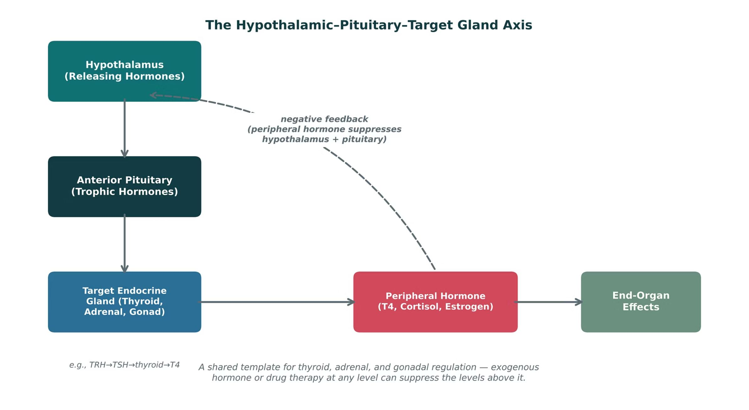
PITUITARY: GH, PROLACTIN & ADH
Objectives: SO1 · SO2 · IO4.1 · IO4.2 · IO4.4 · IO4.5
Figure 1 · The hypothalamic-pituitary-target gland axis
Original illustrative diagram (not from Katzung): hypothalamus → anterior pituitary → target gland → peripheral hormone and end-organ effects, with negative feedback to the levels above. Trace the axis and the feedback arrows. S5; S5 (notes)
L07 · Endocrine Pharmacotherapy — Session 1
22

Slide 23
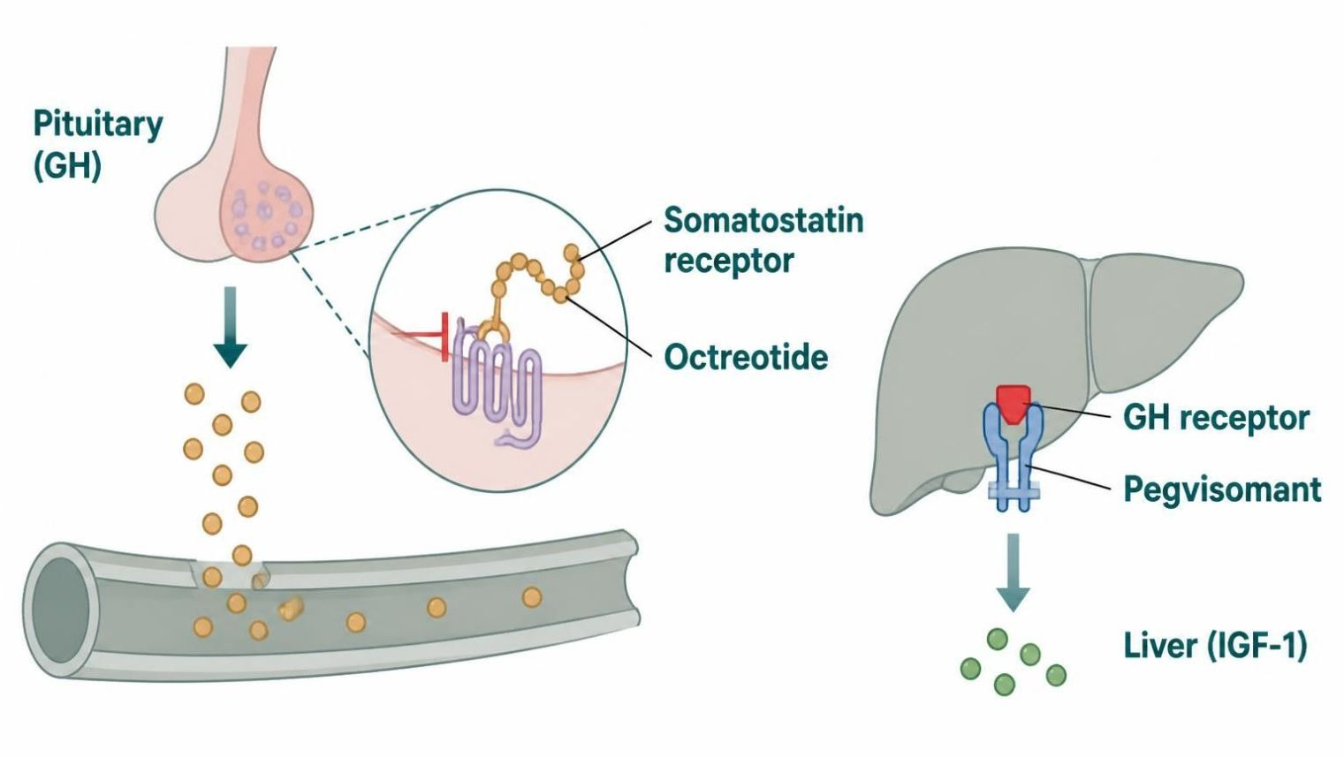
PITUITARY: GH, PROLACTIN & ADH
Objectives: SO1 · SO2 · IO4.1 · IO4.2 · IO4.4 · IO4.5
Figure 2 · Somatostatin analogs and pegvisomant
Schematic (illustrative) — Figure 2. Octreotide and lanreotide lower GH release; pegvisomant blocks the GH receptor so IGF-1 falls; acromegaly improves — monitor IGF-1. S7; S7 (notes)
L07 · Endocrine Pharmacotherapy — Session 1
23

Slide 24
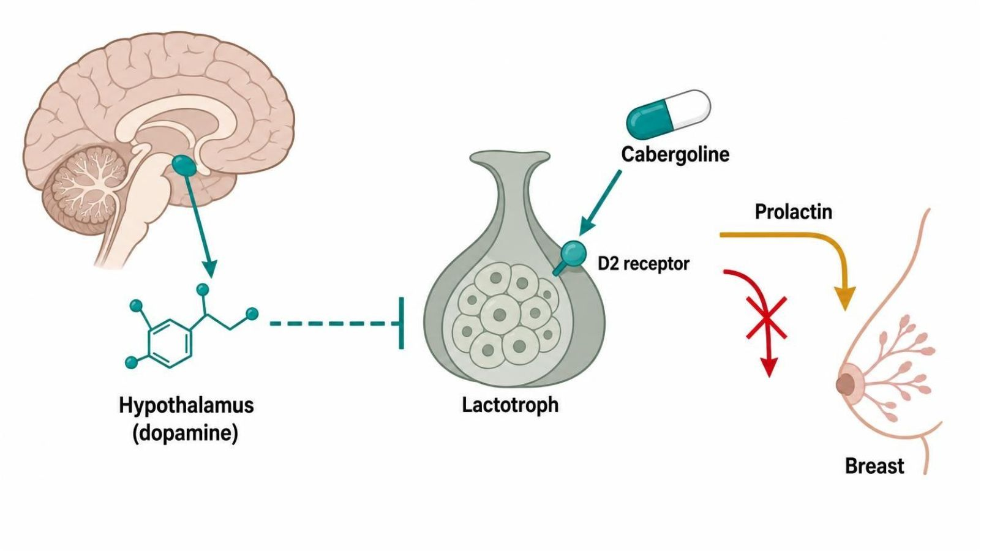
PITUITARY: GH, PROLACTIN & ADH
Objectives: SO1 · SO2 · IO4.1 · IO4.2 · IO4.4 · IO4.5
Figure 3 · Dopamine agonists: restoring the brake on prolactin
Schematic (illustrative) — Figure 3. Dopamine is the brake on prolactin; prolactinomas or dopamine blockers lift it; cabergoline and bromocriptine (D2 agonists) restore it — prolactin falls, cycles and fertility return. S9; S9 (notes)
L07 · Endocrine Pharmacotherapy — Session 1
24

Slide 25
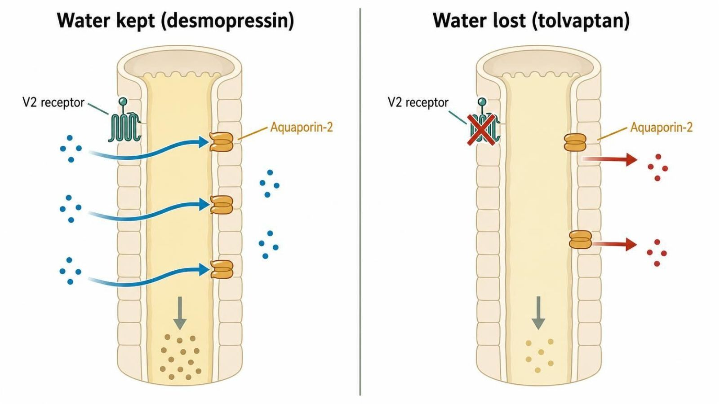
PITUITARY: GH, PROLACTIN & ADH
Objectives: SO1 · SO2 · IO4.1 · IO4.2 · IO4.4 · IO4.5
Figure 4 · ADH, desmopressin and tolvaptan
Schematic (illustrative) — Figure 4. ADH → V2 → aquaporin-2 → water reabsorbed. Desmopressin keeps water in (DI; hyponatremia risk); tolvaptan lets it pass out (SIADH; overcorrection risk). S10; S10 (notes)
L07 · Endocrine Pharmacotherapy — Session 1
25

Slide 26
PITUITARY: GH, PROLACTIN & ADH
Objectives: SO1 · SO2 · IO4.1 · IO4.2 · IO4.4 · IO4.5
Compare: Opposite ADH problems (S8; S10)
 | Diabetes insipidus | SIADH
Problem | ADH deficiency/resistance — water lost | ADH excess — water retained
Drug | Desmopressin (central DI) | Fluid restriction; tolvaptan or demeclocycline if refractory
Watch for | Hyponatremia — limit fluids | Overcorrection (osmotic demyelination); liver injury; photosensitivity
Focus: what tells these apart. Sources: S8; S10; SG U4-R4
L07 · Endocrine Pharmacotherapy — Session 1
26

Slide 27
PITUITARY: GH, PROLACTIN & ADH
Objectives: SO1 · SO2 · IO4.1 · IO4.2 · IO4.4 · IO4.5
Compare: GH-axis profiles: formulation, dose, indications
Drug | Class | Formulation | Adult dose | Indications
Somatropin (Genotropin, Norditropin) | Recombinant human growth hormone | SC injection pens and cartridges (several mg strengths) | Adults: start about 0.2 mg SC daily and titrate by IGF-1; children: weight-based daily SC dosing | GH deficiency (children and adults), Turner syndrome, other growth disorders
Octreotide (Sandostatin) | Somatostatin analog | SC injection 50/100/500 mcg/mL; LAR depot IM 10/20/30 mg; oral capsule | Acromegaly: 50 mcg SC TID, titrate to 100-200 mcg TID; LAR 20 mg IM every 4 weeks | Acromegaly, carcinoid syndrome, VIPoma, esophageal variceal bleeding
Lanreotide (Somatuline Depot) | Somatostatin analog | Deep SC injection 60/90/120 mg prefilled syringe | 90 mg deep SC every 4 weeks for 3 months, then adjust between 60 and 120 mg | Acromegaly, neuroendocrine tumors, carcinoid syndrome
Pegvisomant (Somavert) | GH receptor antagonist | SC injection vials 10/15/20/25/30 mg | Load 40 mg SC, then 10 mg SC daily, titrate by IGF-1 (max 30 mg/day) | Acromegaly not controlled by surgery or somatostatin analogs
Focus: what tells these apart. Sources: S30; S31; S32; S33
L07 · Endocrine Pharmacotherapy — Session 1
27

Slide 28
PITUITARY: GH, PROLACTIN & ADH
Objectives: SO1 · SO2 · IO4.1 · IO4.2 · IO4.4 · IO4.5
Compare: GH-axis profiles: adverse effects, contraindications, toxicity
Drug | Adverse effects | Contraindications | Toxicity / overdose
Somatropin (Genotropin, Norditropin) | Injection-site reaction, edema, joint pain, headache, hyperglycemia | Active malignancy, closed epiphyses (for growth promotion), acute critical illness | Fluid retention, glucose intolerance, intracranial hypertension, slipped capital femoral epiphysis; titrate by IGF-1
Octreotide (Sandostatin) | GI upset, diarrhea, gallstones, bradycardia, glucose changes | Hypersensitivity | Gallstones, hypo- or hyperglycemia, bradycardia and conduction block; monitor IGF-1, glucose, gallbladder
Lanreotide (Somatuline Depot) | Diarrhea, abdominal pain, gallstones, injection-site reaction, bradycardia | Hypersensitivity | Gallstones, glucose dysregulation, bradycardia; monitor GH and IGF-1
Pegvisomant (Somavert) | Injection-site reaction, headache, raised liver enzymes, flu-like symptoms | Hypersensitivity | Liver injury; monitor tumor size by MRI; GH levels rise and are not used for monitoring
Focus: what tells these apart. Sources: S30; S31; S32; S33
L07 · Endocrine Pharmacotherapy — Session 1
28

Slide 29
PITUITARY: GH, PROLACTIN & ADH
Objectives: SO1 · SO2 · IO4.1 · IO4.2 · IO4.4 · IO4.5
Compare: Prolactin and ADH profiles: formulation, dose, indications
Drug | Class | Formulation | Adult dose | Indications
Cabergoline (Dostinex) | Dopamine D2 agonist (ergot-derived) | Tablet 0.5 mg | 0.25 mg PO twice weekly, increase by 0.25 mg every 4 weeks to usual max 1 mg twice weekly | Hyperprolactinemia, prolactinoma
Bromocriptine (Parlodel, Cycloset) | Dopamine D2 agonist (ergot-derived) | Tablet 2.5 mg; capsule 5 mg; Cycloset 0.8 mg tablet | 1.25-2.5 mg PO at bedtime, titrate to 2.5 mg BID-TID for prolactinoma (max 15 mg/day) | Hyperprolactinemia, acromegaly (adjunct), Parkinson disease, type 2 diabetes (Cycloset)
Desmopressin (DDAVP) | Synthetic vasopressin V2 agonist | Tablet 0.1/0.2 mg; nasal spray; SC/IV 4 mcg/mL; ODT 60 mcg | Central DI: 0.05-0.2 mg PO BID, or 10-40 mcg intranasal daily in divided doses; titrate to urine output | Central diabetes insipidus, nocturnal enuresis, hemophilia A and von Willebrand disease (IV)
Focus: what tells these apart. Sources: S34; S35; S36; S37; S38
L07 · Endocrine Pharmacotherapy — Session 1
29

Slide 30
PITUITARY: GH, PROLACTIN & ADH
Objectives: SO1 · SO2 · IO4.1 · IO4.2 · IO4.4 · IO4.5
Compare: Prolactin and ADH profiles: formulation, dose, indications (cont.)
Drug | Class | Formulation | Adult dose | Indications
Tolvaptan (Samsca) | Vasopressin V2 receptor antagonist | Tablet 15/30 mg | 15 mg PO once daily, titrate to 30-60 mg; start in hospital | Hyponatremia from SIADH or heart failure
Demeclocycline | Tetracycline with ADH-antagonist effect | Tablet 150/300 mg | 150-300 mg PO 3-4 times daily for SIADH (off-label) | Refractory SIADH (off-label), bacterial infections
Focus: what tells these apart. Sources: S34; S35; S36; S37; S38
L07 · Endocrine Pharmacotherapy — Session 1
30

Slide 31
PITUITARY: GH, PROLACTIN & ADH
Objectives: SO1 · SO2 · IO4.1 · IO4.2 · IO4.4 · IO4.5
Compare: Prolactin and ADH profiles: adverse effects, contraindications, toxicity
Drug | Adverse effects | Contraindications | Toxicity / overdose
Cabergoline (Dostinex) | Nausea, dizziness, headache, orthostatic hypotension | Uncontrolled hypertension, cardiac valvulopathy, ergot hypersensitivity | Cardiac valve fibrosis at high doses; impulse-control and psychiatric effects; overdose causes hypotension and nausea
Bromocriptine (Parlodel, Cycloset) | Nausea, orthostatic hypotension, dizziness, headache, nasal congestion | Uncontrolled hypertension, pregnancy-related hypertension, ergot hypersensitivity | Hypotension and syncope, psychosis, fibrosis with long-term high doses; take with food
Desmopressin (DDAVP) | Headache, nausea, flushing, hyponatremia | Hyponatremia history, polydipsia, eGFR below 50, heart failure | Water intoxication with severe hyponatremia and seizures; limit fluids and monitor sodium
Tolvaptan (Samsca) | Thirst, dry mouth, polyuria, hypernatremia, liver injury | Urgent need to raise sodium, hypovolemia, anuria, strong CYP3A4 inhibitors | Overly rapid sodium correction (osmotic demyelination); liver injury; limit therapy to 30 days
Demeclocycline | Photosensitivity, nausea, nephrogenic diabetes insipidus | Pregnancy, children under 8 years, hypersensitivity, severe renal impairment | Nephrotoxicity, photosensitivity, tooth discoloration; separate from calcium and antacids
Focus: what tells these apart. Sources: S34; S35; S36; S37; S38
L07 · Endocrine Pharmacotherapy — Session 1
31

Slide 32
PITUITARY: GH, PROLACTIN & ADH
Objectives: SO1 · SO2 · IO4.1 · IO4.2 · IO4.4 · IO4.5
Memory hooks
Why it happens
Why is GH useless for monitoring pegvisomant? The drug blocks the receptor, not the release — GH actually rises; IGF-1 is what falls. S7 (notes)
L07 · Endocrine Pharmacotherapy — Session 1
32

Slide 33

PITUITARY: GH, PROLACTIN & ADH
Objectives: SO1 · SO2 · IO4.1 · IO4.2 · IO4.4 · IO4.5
High-yield summary
If you remember nothing else
Acromegaly: octreotide/lanreotide or pegvisomant (monitor IGF-1); prolactinoma: cabergoline; DI: desmopressin (hyponatremia); SIADH: fluid restriction, then tolvaptan. S6; S8; S10
L07 · Endocrine Pharmacotherapy — Session 1
33

Slide 34
CLINICAL VIGNETTE
Objectives: SO1 · SO2 · IO4.1 · IO4.2 · IO4.4 · IO4.5
Question 1
A patient with acromegaly starts pegvisomant. Which lab best tracks the response?
A
IGF-1
B
Prolactin
C
Sodium
D
Cortisol
E
Serum GH
L07 · Endocrine Pharmacotherapy — Session 1
34
Notes:
Answer on the next slide. Source: S7

Slide 35

CLINICAL VIGNETTE · ANSWER
Objectives: SO1 · SO2 · IO4.1 · IO4.2 · IO4.4 · IO4.5
Answer 1: A
A. IGF-1
Pegvisomant blocks the GH receptor so IGF-1 falls; GH rises and is not used to monitor it (S7). S7
Why the other choices are wrong
B. Prolactin — Not the target (S9).
C. Sodium — ADH drugs (S10).
D. Cortisol — Adrenal axis (S22).
E. Serum GH — GH rises on pegvisomant (S7).
L07 · Endocrine Pharmacotherapy — Session 1
35

Slide 36
Drug class 2 of 3
Thyroid & Antithyroid Drugs
Covers objectives: SO3 · SO5 · IO4.1 · IO4.2 · IO4.3 · IO4.4 · IO4.5 · IO4.6
Class
Prototype
Mechanism of action
Indications
Adverse effects
Contraindications
Drug interactions
Pharmacokinetics
Monitoring
Clinical pearls
36

Slide 37
THYROID & ANTITHYROID DRUGS
Objectives: SO3 · SO5 · IO4.1 · IO4.2 · IO4.3 · IO4.4 · IO4.5 · IO4.6
Class · Prototype + other drugs named
Class
Prototype + other drugs named
Replacing a deficient gland, or slowing down an overactive one. S11
Figure 6. Original illustrative diagram (not from Katzung): iodide trapping, organification, and coupling produce T3/T4, which undergo peripheral T4-to-T3 conversion; methimazole and PTU block organification and coupling, while PTU additionally blocks peripheral conversion. S14
Figure 6 is the key to the next slides: PTU, not methimazole, is preferred in thyroid storm because it blocks an extra step. S14 (notes)
Levothyroxine (replacement); methimazole, propylthiouracil (thionamides); propranolol; potassium iodide. S12; S15; S16
L07 · Endocrine Pharmacotherapy — Session 1
37

Slide 38
THYROID & ANTITHYROID DRUGS
Objectives: SO3 · SO5 · IO4.1 · IO4.2 · IO4.3 · IO4.4 · IO4.5 · IO4.6
Mechanism of action
Mechanism of action (1/2)
Mechanism: synthetic T4, converted peripherally to active T3. S12
Levothyroxine path (Figure 5): tablet taken on an empty stomach → absorbed in the small intestine; calcium, iron and antacid binders block it. S13
T4 converted to active T3 in tissues → T3 binds nuclear receptors and restores metabolism → TSH falls to the target range (recheck at 6–8 weeks). S13
Methimazole and PTU block organification and coupling; PTU also blocks peripheral T4→T3 conversion — a faster symptomatic effect in crisis. S14; S15
L07 · Endocrine Pharmacotherapy — Session 1
38

Slide 39
THYROID & ANTITHYROID DRUGS
Objectives: SO3 · SO5 · IO4.1 · IO4.2 · IO4.3 · IO4.4 · IO4.5 · IO4.6
Mechanism of action (cont.)
Mechanism of action (2/2)
Storm targets (Figure 7): Graves thyroid makes excess hormone — PTU blocks synthesis; hormone is released — iodine (after PTU) blocks release. S17
T4 converts to T3 in tissues — PTU, propranolol and steroids block conversion; T3 stimulates beta receptors — propranolol blunts tachycardia and tremor; crisis settles with fluids, cooling and support. S17; S17 (notes)
TB Thyroid physiology: large doses of iodine inhibit organification (Wolff-Chaikoff block); amiodarone, contrast, β blockers and corticosteroids inhibit T4-to-T3 conversion. p. 724; p. 725
L07 · Endocrine Pharmacotherapy — Session 1
39

Slide 40
THYROID & ANTITHYROID DRUGS
Objectives: SO3 · SO5 · IO4.1 · IO4.2 · IO4.3 · IO4.4 · IO4.5 · IO4.6
Indications
Indications (1/2)
Levothyroxine: first-line for hypothyroidism; narrow therapeutic index — dose titrated using TSH (primary hypothyroidism) with repeat labs every 6–8 weeks after a dose change. S12; S12 (notes)
About 1.6 mcg/kg/day is full replacement; estrogen raises needs. ● Pregnancy: often raises dose needs; monitor TSH closely. S12 (notes); S13
Methimazole: first-line for most non-pregnant patients — once-daily dosing, more convenient; avoid in the first trimester of pregnancy (teratogenic risk). S15; S15 (notes)
PTU: preferred in the first trimester of pregnancy and in thyroid storm. PTU first trimester (lower teratogenic risk) and thyroid storm (also blocks peripheral T4→T3 conversion). S15; SG U4-R6
A life-threatening hyperthyroid crisis requiring rapid, multi-pronged therapy. Thyroid storm is treated with four drugs that hit four targets. S16; S16 (notes)
L07 · Endocrine Pharmacotherapy — Session 1
40

Slide 41
THYROID & ANTITHYROID DRUGS
Objectives: SO3 · SO5 · IO4.1 · IO4.2 · IO4.3 · IO4.4 · IO4.5 · IO4.6
Indications (cont.)
Indications (2/2)
Beta-blockers (propranolol) — control adrenergic symptoms (tachycardia, tremor) and blunt peripheral T4-to-T3 conversion. PTU (preferred over methimazole) — blocks new hormone synthesis and peripheral conversion. S16
Iodine solution (given after PTU/methimazole) — acutely blocks hormone release; must follow the antithyroid drug to avoid providing substrate for new synthesis. Corticosteroids — blunt peripheral conversion and treat relative adrenal insufficiency. S16
TB Laboratory diagnosis of Graves disease: suppressed TSH with high free thyroid hormone. Management of Graves disease: antithyroid drugs, radioactive iodine, or thyroidectomy; methimazole preferred except in pregnancy and storm. p. 734
TB Pregnant hypothyroid patients often need about 25–30% more levothyroxine; add two extra doses a week as soon as pregnancy is confirmed. p. 734
L07 · Endocrine Pharmacotherapy — Session 1
41

Slide 42
THYROID & ANTITHYROID DRUGS
Objectives: SO3 · SO5 · IO4.1 · IO4.2 · IO4.3 · IO4.4 · IO4.5 · IO4.6
Adverse effects (boxed warnings first)
Adverse effects (boxed warnings first)
Methimazole boxed warning: agranulocytosis, hepatotoxicity. PTU boxed warning: severe hepatotoxicity (more than methimazole) — reserve for specific indications. S15; S17
TB Thioamide agranulocytosis occurs in 0.1–0.5%, usually within the first 90 days; PTU’s severe hepatitis (boxed warning) restricts it to the first trimester, thyroid storm, or methimazole reactions. p. 730; p. 731
Both thionamides carry agranulocytosis and liver warnings; PTU has the greater liver risk. Fever or sore throat on a thionamide means stop and check a CBC. S15 (notes)
● Over-replacement: tachycardia, atrial fibrillation and bone loss. S13; S12 (notes)
TB Iodides given alone can escape in 2–8 weeks and worsen thyrotoxicosis; avoid chronic iodide in pregnancy (fetal goiter). p. 732
L07 · Endocrine Pharmacotherapy — Session 1
42

Slide 43
THYROID & ANTITHYROID DRUGS
Objectives: SO3 · SO5 · IO4.1 · IO4.2 · IO4.3 · IO4.4 · IO4.5 · IO4.6
Contraindications
Contraindications
Older adults and patients with cardiac disease: start at lower doses and titrate slowly to avoid precipitating angina/arrhythmia. S12; S13; S12 (notes)
● Propranolol: avoided in decompensated heart failure and asthma. S17
TB Radioactive iodine (131I) is avoided in pregnancy and breastfeeding — it destroys the fetal thyroid. p. 732
L07 · Endocrine Pharmacotherapy — Session 1
43

Slide 44
THYROID & ANTITHYROID DRUGS
Objectives: SO3 · SO5 · IO4.1 · IO4.2 · IO4.3 · IO4.4 · IO4.5 · IO4.6
Drug interactions
Drug interactions
Significant absorption interactions: calcium, iron, and antacids can all reduce absorption — separate dosing by at least 4 hours. S12; SG U4-R5
● Timing: separate from calcium, iron, antacids, PPIs and bile acid binders by 4 hours. S13
Amiodarone and lithium can cause hypo- or hyperthyroidism. Estrogens raise thyroid-binding globulin, so levothyroxine needs rise. Rifampin, phenytoin, carbamazepine speed clearance of levothyroxine and steroids. S52; S52 (notes)
● Steroids: also treat relative adrenal insufficiency; avoid aspirin in thyroid storm (it frees bound hormone). S17
L07 · Endocrine Pharmacotherapy — Session 1
44

Slide 45
THYROID & ANTITHYROID DRUGS
Objectives: SO3 · SO5 · IO4.1 · IO4.2 · IO4.3 · IO4.4 · IO4.5 · IO4.6
Pharmacokinetics · Monitoring
Pharmacokinetics
Monitoring
Take on an empty stomach, 30–60 minutes before breakfast, consistently relative to other medications and food. S12; S13 (notes)
TB T4 has a 7-day half-life (allows once-daily dosing); T3 about 1 day. Enzyme inducers (rifampin, phenytoin, carbamazepine) speed thyroid hormone metabolism. p. 725; p. 726; p. 733
● Start low: in older adults and in cardiac disease. Check TSH at 6–8 weeks. S13; S12 (notes)
L07 · Endocrine Pharmacotherapy — Session 1
45

Slide 46
THYROID & ANTITHYROID DRUGS
Objectives: SO3 · SO5 · IO4.1 · IO4.2 · IO4.3 · IO4.4 · IO4.5 · IO4.6
Clinical pearls / "why" hook
Clinical pearls / "why" hook (1/2)
The absorption-interaction list is extremely high-yield — many patients also take calcium or iron, so timing counseling matters as much as the drug itself. S12 (notes)
The pregnancy-trimester switch (PTU in first trimester, methimazole after) is a frequently tested nuance — worth stating explicitly rather than assuming one drug is simply "better." S15 (notes)
● Sequence: start PTU and beta-blocker first; give iodine at least an hour later. ● PTU: boxed warning for hepatotoxicity. S17
Case: fever, tachycardia, and altered mental status in untreated Graves disease. What is the correct sequence of pharmacologic therapy, and why does the order matter? S18
L07 · Endocrine Pharmacotherapy — Session 1
46

Slide 47
THYROID & ANTITHYROID DRUGS
Objectives: SO3 · SO5 · IO4.1 · IO4.2 · IO4.3 · IO4.4 · IO4.5 · IO4.6
Clinical pearls / "why" hook (cont.)
Clinical pearls / "why" hook (2/2)
Beta-blockade and PTU are started first; iodine solution is given only after PTU, since giving iodine first would supply additional substrate for thyroid hormone synthesis before the gland’s synthetic machinery is blocked — potentially worsening the crisis. S18; S16 (notes); SG U4-R7
Iodine-first sequencing is the classic high-yield detail: giving iodine first can worsen the crisis by supplying substrate before synthesis is blocked. S16 (notes); S18 (notes)
TB Subclinical hypothyroidism (high TSH, normal hormones) affects 4–10%; amiodarone causes hypo- or hyperthyroidism (about 3% thyrotoxicosis) that persists after stopping. p. 734; p. 736
TB Subacute thyroiditis releases stored hormone transiently; nontoxic goiter in the US is most often Hashimoto thyroiditis; neonatal Graves comes from maternal antibodies. p. 735; p. 736
L07 · Endocrine Pharmacotherapy — Session 1
47

Slide 48
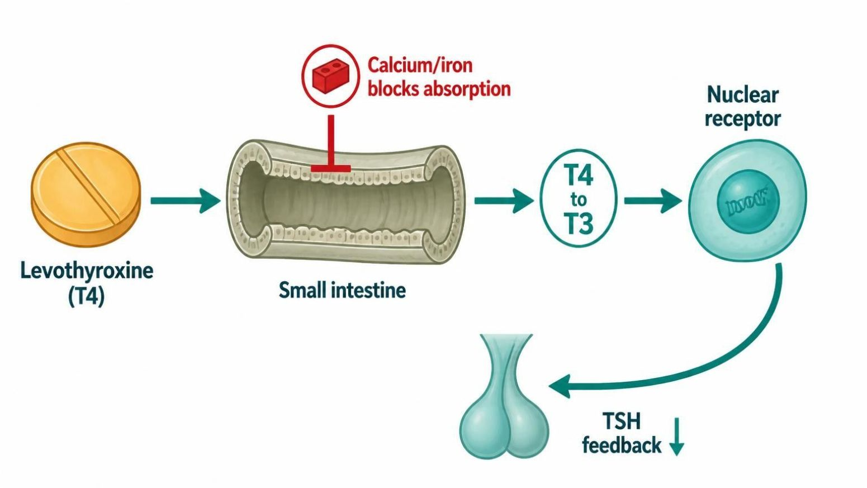
THYROID & ANTITHYROID DRUGS
Objectives: SO3 · SO5 · IO4.1 · IO4.2 · IO4.3 · IO4.4 · IO4.5 · IO4.6
Figure 5 · Levothyroxine: absorption, conversion and timing
Schematic (illustrative) — Figure 5. Red X marks absorption blocked by calcium, iron or antacids. Blue steps show T4 to T3 conversion and receptor action. Red outcome: TSH falls to target. S13; S13 (notes)
L07 · Endocrine Pharmacotherapy — Session 1
48

Slide 49
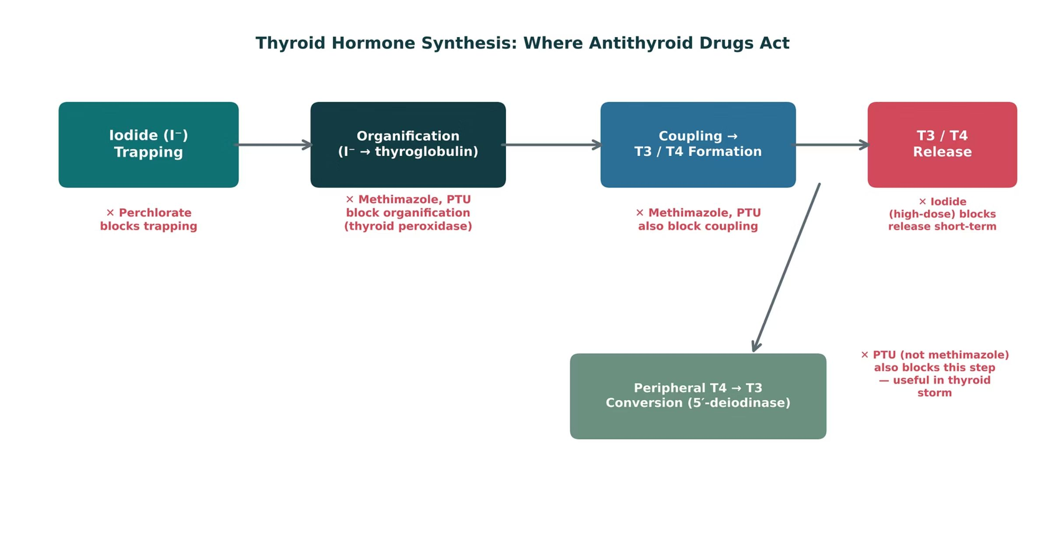
THYROID & ANTITHYROID DRUGS
Objectives: SO3 · SO5 · IO4.1 · IO4.2 · IO4.3 · IO4.4 · IO4.5 · IO4.6
Figure 6 · Thyroid hormone synthesis: where antithyroid drugs act
Original illustrative diagram (not from Katzung): iodide trapping → organification → coupling → T3/T4 release → peripheral T4-to-T3 conversion. Methimazole and PTU block organification and coupling; PTU also blocks conversion. S14; S14 (notes)
L07 · Endocrine Pharmacotherapy — Session 1
49

Slide 50
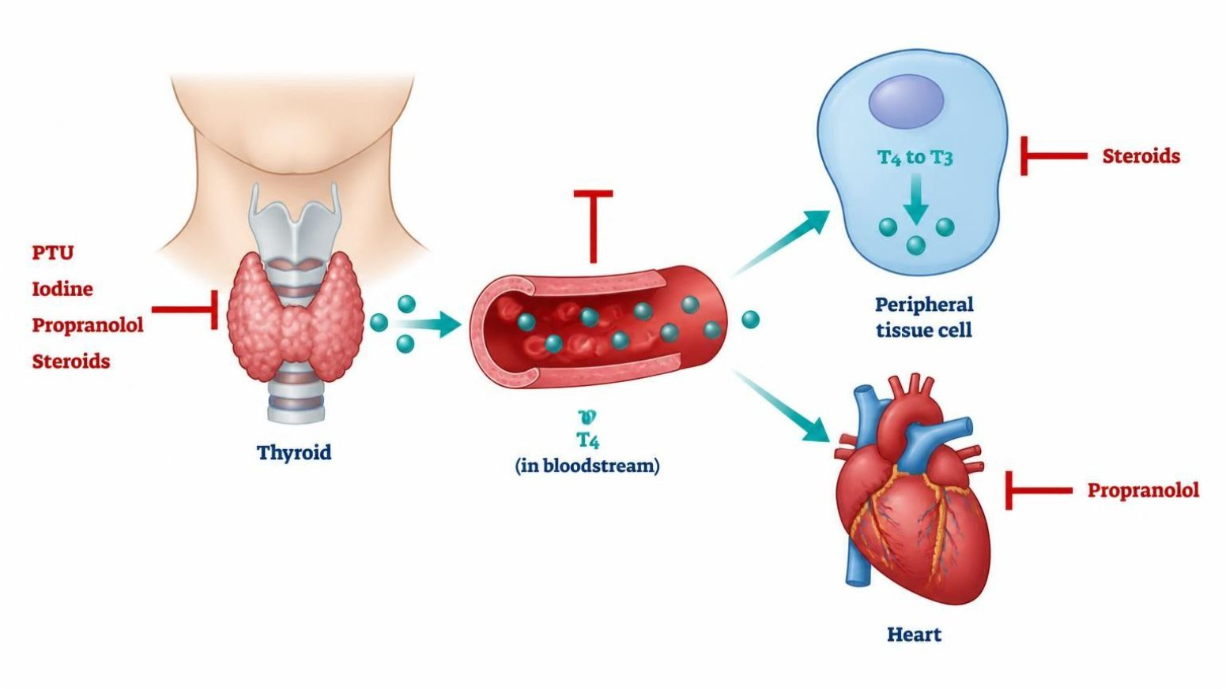
THYROID & ANTITHYROID DRUGS
Objectives: SO3 · SO5 · IO4.1 · IO4.2 · IO4.3 · IO4.4 · IO4.5 · IO4.6
Figure 7 · Thyroid storm: four drugs, four targets
Schematic (illustrative) — Figure 7. Red bars mark where PTU (synthesis), iodine (release, after PTU), propranolol and steroids (conversion, symptoms) act. S17; S17 (notes)
L07 · Endocrine Pharmacotherapy — Session 1
50

Slide 51
THYROID & ANTITHYROID DRUGS
Objectives: SO3 · SO5 · IO4.1 · IO4.2 · IO4.3 · IO4.4 · IO4.5 · IO4.6
Compare: Methimazole vs. propylthiouracil (S15)
 | Methimazole | Propylthiouracil (PTU)
Use | First-line for most non-pregnant patients; once daily | First trimester of pregnancy; thyroid storm
Extra action | — | Also blocks peripheral T4→T3 conversion
Pregnancy | Avoid in first trimester (teratogenic) | Preferred in first trimester
Boxed warning | Agranulocytosis, hepatotoxicity | Severe hepatotoxicity (more than methimazole)
Focus: what tells these apart. Sources: S15; SG U4-R6
L07 · Endocrine Pharmacotherapy — Session 1
51

Slide 52
THYROID & ANTITHYROID DRUGS
Objectives: SO3 · SO5 · IO4.1 · IO4.2 · IO4.3 · IO4.4 · IO4.5 · IO4.6
Compare: Thyroid drug profiles: formulation, dose, indications
Drug | Class | Formulation | Adult dose | Indications
Levothyroxine (Synthroid, Levoxyl) | Synthetic thyroid hormone (T4) | Tablet 25-300 mcg (12 strengths); IV 100-500 mcg vial; liquid and capsule | Full replacement about 1.6 mcg/kg/day PO; start 12.5-50 mcg in older adults or heart disease; recheck TSH in 6-8 weeks | Hypothyroidism, myxedema coma (IV), TSH suppression in thyroid cancer
Methimazole (Tapazole) | Thionamide antithyroid drug | Tablet 5/10 mg | Graves disease: start 10-30 mg PO once daily; adjust to free T4 every 4-6 weeks | Graves disease, toxic nodular goiter, pre-operative control
Propylthiouracil (PTU) | Thionamide antithyroid drug (also blocks T4 to T3) | Tablet 50 mg | Start 100 mg PO TID (up to 300-400 mg/day); thyroid storm: 500-1,000 mg load, then 250 mg every 4 hours | First-trimester Graves disease, thyroid storm, methimazole intolerance
Focus: what tells these apart. Sources: S39; S40; S41; S42; S43
L07 · Endocrine Pharmacotherapy — Session 1
52

Slide 53
THYROID & ANTITHYROID DRUGS
Objectives: SO3 · SO5 · IO4.1 · IO4.2 · IO4.3 · IO4.4 · IO4.5 · IO4.6
Compare: Thyroid drug profiles: formulation, dose, indications (cont.)
Drug | Class | Formulation | Adult dose | Indications
Propranolol (Inderal) | Nonselective beta-blocker | Tablet 10/20/40/60/80 mg; ER capsule; IV 1 mg/mL | Thyrotoxic symptoms: 20-40 mg PO every 6-8 hours; thyroid storm: 60-80 mg PO every 4 hours or 0.5-1 mg IV | Thyrotoxic symptoms, thyroid storm, hypertension, tremor
Potassium iodide (SSKI, Lugol solution) | Iodine (blocks hormone release) | SSKI 1 g/mL solution; Lugol 5% solution; tablets 65/130 mg | Thyroid storm: 5 drops (about 250 mg) SSKI PO every 6 hours, at least 1 hour after a thionamide | Thyroid storm, pre-thyroidectomy preparation, radiation protection
Focus: what tells these apart. Sources: S39; S40; S41; S42; S43
L07 · Endocrine Pharmacotherapy — Session 1
53

Slide 54
THYROID & ANTITHYROID DRUGS
Objectives: SO3 · SO5 · IO4.1 · IO4.2 · IO4.3 · IO4.4 · IO4.5 · IO4.6
Compare: Thyroid drug profiles: adverse effects, contraindications, toxicity
Drug | Adverse effects | Contraindications | Toxicity / overdose
Levothyroxine (Synthroid, Levoxyl) | Usually none at the right dose; over-replacement causes tachycardia, tremor, insomnia, bone loss | Uncorrected adrenal insufficiency, acute MI, hypersensitivity | Over-replacement: atrial fibrillation, angina, osteoporosis; separate from calcium, iron and antacids by 4 hours
Methimazole (Tapazole) | Rash, itching, joint pain, taste change; agranulocytosis (rare) | First trimester of pregnancy; prior methimazole agranulocytosis | Agranulocytosis (fever or sore throat: stop and check CBC), hepatotoxicity, teratogenicity
Propylthiouracil (PTU) | Rash, nausea, taste change, joint pain | Prior PTU liver injury; avoid in children | Boxed warning: severe liver failure; agranulocytosis; ANCA-positive vasculitis
Propranolol (Inderal) | Bradycardia, fatigue, bronchospasm, masks hypoglycemia | Asthma, decompensated heart failure, high-grade AV block, severe bradycardia | Bradycardia, hypotension, bronchospasm; avoid abrupt stopping; may mask hypoglycemia
Potassium iodide (SSKI, Lugol solution) | Metallic taste, GI upset, salivary gland swelling, rash | Giving before a thionamide; iodine allergy | Iodism (rash, swelling, fever); thyroid escape after about 10 days; hypo- or hyperthyroidism
Focus: what tells these apart. Sources: S39; S40; S41; S42; S43
L07 · Endocrine Pharmacotherapy — Session 1
54

Slide 55

THYROID & ANTITHYROID DRUGS
Objectives: SO3 · SO5 · IO4.1 · IO4.2 · IO4.3 · IO4.4 · IO4.5 · IO4.6
Memory hooks
Mnemonic (memory aid)
Storm order: Block (beta-blocker), then Block synthesis (PTU), then Block release (iodine) — iodine never first. S16; S18
L07 · Endocrine Pharmacotherapy — Session 1
55

Slide 56
THYROID & ANTITHYROID DRUGS
Objectives: SO3 · SO5 · IO4.1 · IO4.2 · IO4.3 · IO4.4 · IO4.5 · IO4.6
High-yield summary
If you remember nothing else
Levothyroxine: empty stomach, separate calcium/iron/antacids by 4 h, TSH at 6–8 weeks, start low in older/cardiac patients. S12; S13; SG U4-R5
PTU for storm and first trimester; methimazole otherwise; fever/sore throat → stop, CBC. S15; SG U4-R6
L07 · Endocrine Pharmacotherapy — Session 1
56

Slide 57
CLINICAL VIGNETTE · LECTURE QUICK CHECK S18
Objectives: SO3 · SO5 · IO4.1 · IO4.2 · IO4.3 · IO4.4 · IO4.5 · IO4.6
Question 6
A patient with untreated Graves disease presents with fever, tachycardia and confusion. What is the correct order of therapy?
A
Aspirin for the fever first
B
Beta-blocker and PTU first, iodine after
C
Methimazole alone, no beta-blocker
D
Iodine first, then PTU
E
Levothyroxine to reset feedback
L07 · Endocrine Pharmacotherapy — Session 1
57
Notes:
Answer on the next slide. Source: S16; S18; SG U4-R7

Slide 58
CLINICAL VIGNETTE · ANSWER
Objectives: SO3 · SO5 · IO4.1 · IO4.2 · IO4.3 · IO4.4 · IO4.5 · IO4.6
Answer 6: B
B. Beta-blocker and PTU first, iodine after
Iodine is given only after PTU; giving it first supplies substrate for new hormone synthesis (S18). S16; S18; SG U4-R7
Why the other choices are wrong
A. Aspirin for the fever first — Frees bound hormone (S17).
C. Methimazole alone, no beta-blocker — Propranolol controls symptoms (S16).
D. Iodine first, then PTU — Worsens the crisis (S18).
E. Levothyroxine to reset feedback — Wrong direction (S12).
L07 · Endocrine Pharmacotherapy — Session 1
58

Slide 59
CLINICAL VIGNETTE
Objectives: SO3 · SO5 · IO4.1 · IO4.2 · IO4.3 · IO4.4 · IO4.5 · IO4.6
Question 7
A woman taking levothyroxine with her calcium and iron each morning has a high TSH. Best advice?
A
Separate them by at least 4 hours
B
Stop calcium permanently
C
Double the levothyroxine dose
D
Switch to methimazole
E
Take it with breakfast instead
L07 · Endocrine Pharmacotherapy — Session 1
59
Notes:
Answer on the next slide. Source: S12; S13; SG U4-R5

Slide 60
CLINICAL VIGNETTE · ANSWER
Objectives: SO3 · SO5 · IO4.1 · IO4.2 · IO4.3 · IO4.4 · IO4.5 · IO4.6
Answer 7: A
A. Separate them by at least 4 hours
Calcium, iron and antacids reduce absorption — separate by at least 4 hours; take it 30–60 minutes before breakfast (S12–S13). S12; S13; SG U4-R5
Why the other choices are wrong
B. Stop calcium permanently — Separation is enough (S13).
C. Double the levothyroxine dose — Fix the timing first (S12).
D. Switch to methimazole — Antithyroid drug (S15).
E. Take it with breakfast instead — Empty stomach (S12).
L07 · Endocrine Pharmacotherapy — Session 1
60

Slide 61
Drug class 3 of 3
Adrenocorticosteroids & Antagonists
Covers objectives: SO4 · SO5 · IO4.1 · IO4.2 · IO4.3 · IO4.4 · IO4.5 · IO4.6
Class
Prototype
Mechanism of action
Indications
Adverse effects
Contraindications
Drug interactions
Pharmacokinetics
Monitoring
Clinical pearls
61

Slide 62
ADRENOCORTICOSTEROIDS & ANTAGONISTS
Objectives: SO4 · SO5 · IO4.1 · IO4.2 · IO4.3 · IO4.4 · IO4.5 · IO4.6
Class
Class
Glucocorticoid power and mineralocorticoid balance — and what happens when therapy stops. S19
Figure 9. Original illustrative diagram (not from Katzung): chronic exogenous glucocorticoid use suppresses CRH and ACTH via negative feedback, reducing endogenous cortisol production — abrupt withdrawal can precipitate adrenal insufficiency. S22
This is the single most clinically important concept in the glucocorticoid section — it explains why tapering (not stopping) is the standard of care. S22 (notes)
L07 · Endocrine Pharmacotherapy — Session 1
62

Slide 63
ADRENOCORTICOSTEROIDS & ANTAGONISTS
Objectives: SO4 · SO5 · IO4.1 · IO4.2 · IO4.3 · IO4.4 · IO4.5 · IO4.6
Prototype + other drugs named
Prototype + other drugs named
Prednisone, dexamethasone, hydrocortisone (glucocorticoids); fludrocortisone (mineralocorticoid); ketoconazole, metyrapone, mifepristone, spironolactone (antagonists). S20; S23
L07 · Endocrine Pharmacotherapy — Session 1
63

Slide 64
ADRENOCORTICOSTEROIDS & ANTAGONISTS
Objectives: SO4 · SO5 · IO4.1 · IO4.2 · IO4.3 · IO4.4 · IO4.5 · IO4.6
Mechanism of action
Mechanism of action (1/2)
Glucocorticoids (e.g., prednisone, dexamethasone): anti-inflammatory and immunosuppressive effects, with a spectrum of relative potency and mineralocorticoid activity across agents. S20
Signaling (Figure 8): prednisone or cortisol crosses the cell membrane → binds the cytoplasmic glucocorticoid receptor → the complex moves into the nucleus → switches on anti-inflammatory genes and represses NF-kB cytokines → fewer inflammatory cells and mediators. S21; S21 (notes)
Mineralocorticoids (fludrocortisone): promote renal sodium retention and potassium excretion. S20
L07 · Endocrine Pharmacotherapy — Session 1
64

Slide 65
ADRENOCORTICOSTEROIDS & ANTAGONISTS
Objectives: SO4 · SO5 · IO4.1 · IO4.2 · IO4.3 · IO4.4 · IO4.5 · IO4.6
Mechanism of action (cont.)
Mechanism of action (2/2)
Synthesis chain (Figure 10): cholesterol enters the adrenal cortex → CYP enzymes convert it to cortisol and aldosterone → ketoconazole blocks several enzymes; metyrapone blocks the last cortisol step (11-beta-hydroxylase). S24
Then cortisol or aldosterone binds its receptor → mifepristone blocks the glucocorticoid receptor; spironolactone blocks the mineralocorticoid receptor. Receptor blockers leave hormone levels high. S24; S24 (notes)
L07 · Endocrine Pharmacotherapy — Session 1
65

Slide 66
ADRENOCORTICOSTEROIDS & ANTAGONISTS
Objectives: SO4 · SO5 · IO4.1 · IO4.2 · IO4.3 · IO4.4 · IO4.5 · IO4.6
Indications
Indications (1/2)
Glucocorticoids are used across nearly every organ system for inflammatory/autoimmune disease. S20
Fludrocortisone: replacement therapy in primary adrenal insufficiency (Addison disease), alongside a glucocorticoid — primary adrenal insufficiency needs BOTH hormone classes replaced, not just cortisol. S20; S20 (notes)
● Ketoconazole: inhibits multiple steps in steroidogenesis (CYP enzymes); used for Cushing syndrome; significant drug-interaction and hepatotoxicity concerns. S23; SG U4-R9
● Metyrapone: blocks the final step of cortisol synthesis (11-β-hydroxylase); used diagnostically and for Cushing syndrome. S23; SG U4-R9
L07 · Endocrine Pharmacotherapy — Session 1
66

Slide 67
ADRENOCORTICOSTEROIDS & ANTAGONISTS
Objectives: SO4 · SO5 · IO4.1 · IO4.2 · IO4.3 · IO4.4 · IO4.5 · IO4.6
Indications (cont.)
Indications (2/2)
● Mifepristone: a glucocorticoid-receptor antagonist; used for hyperglycemia associated with Cushing syndrome when surgery is not an option (distinct from its progesterone-receptor antagonist use in pregnancy termination). S23; S23 (notes); SG U4-R9
● Spironolactone: a mineralocorticoid-receptor antagonist; used for hyperaldosteronism and as a potassium-sparing diuretic — ties back to the diuretic pharmacology concepts from earlier coursework. S23; SG U4-R9
TB Addison disease: hydrocortisone 20–30 mg daily (more during stress) plus fludrocortisone 0.05–0.2 mg/d. p. 747
TB Dexamethasone suppression test diagnoses Cushing syndrome; antenatal glucocorticoids reduce neonatal respiratory distress. p. 748
L07 · Endocrine Pharmacotherapy — Session 1
67

Slide 68
ADRENOCORTICOSTEROIDS & ANTAGONISTS
Objectives: SO4 · SO5 · IO4.1 · IO4.2 · IO4.3 · IO4.4 · IO4.5 · IO4.6
Adverse effects (boxed warnings first)
Adverse effects (boxed warnings first)
● Adverse effects: hyperglycemia, osteoporosis, infection, mood change, cataracts, adrenal suppression. S21; S20 (notes)
● Ketoconazole: hepatotoxicity, QT prolongation, strong CYP3A4 inhibition. S24; S23 (notes)
● Metyrapone: raises androgens and deoxycorticosterone (hirsutism, hypertension). S24; S23 (notes)
● Mifepristone: contraindicated in pregnancy; causes hypokalemia; cortisol levels rise, so monitor clinically. ● Spironolactone: hyperkalemia and gynecomastia. S24; S24 (notes)
TB Adrenal suppression can occur after more than 2 weeks of corticosteroids; ACTH does not speed recovery. p. 750
TB Long-term steroids: Cushingoid changes, myopathy, osteoporosis, peptic ulcer, masked infection, hypomania or psychosis, posterior subcapsular cataracts. p. 745; p. 750
L07 · Endocrine Pharmacotherapy — Session 1
68

Slide 69
ADRENOCORTICOSTEROIDS & ANTAGONISTS
Objectives: SO4 · SO5 · IO4.1 · IO4.2 · IO4.3 · IO4.4 · IO4.5 · IO4.6
Contraindications · Drug interactions
Contraindications
Drug interactions
Not covered in materials
Azole antifungals raise corticosteroid exposure through CYP3A4. ACE inhibitors, ARBs and potassium add to spironolactone hyperkalemia. Insulin and oral agents need adjusting during steroid therapy. S52; S52 (notes)
L07 · Endocrine Pharmacotherapy — Session 1
69

Slide 70
ADRENOCORTICOSTEROIDS & ANTAGONISTS
Objectives: SO4 · SO5 · IO4.1 · IO4.2 · IO4.3 · IO4.4 · IO4.5 · IO4.6
Pharmacokinetics
Pharmacokinetics
● Potency vs. hydrocortisone: prednisone about 4x, dexamethasone about 25-30x. ● Mineralocorticoid action: fludrocortisone has it; hydrocortisone has both. S21; S20 (notes)
● Dosing: take in the morning with food; consider bone and GI protection. S21
TB Synthetic corticosteroids — pharmacokinetics & pharmacodynamics: potency and salt-retaining activity differ by agent (equivalent-dose table). p. 746; p. 747
TB Selection of drug & dosage schedule: give steroids as a single morning dose; alternate-day dosing lessens suppression when disease control allows. p. 750; p. 751
L07 · Endocrine Pharmacotherapy — Session 1
70

Slide 71
ADRENOCORTICOSTEROIDS & ANTAGONISTS
Objectives: SO4 · SO5 · IO4.1 · IO4.2 · IO4.3 · IO4.4 · IO4.5 · IO4.6
Monitoring
Monitoring
Fludrocortisone: monitor blood pressure and potassium. S20
Chronic steroids suppress CRH and ACTH — abrupt withdrawal risks adrenal crisis; taper. Chronic suppression leaves the axis unable to resume adequate cortisol quickly — taper, don’t stop abruptly. S22 (notes); SG U4-R8
L07 · Endocrine Pharmacotherapy — Session 1
71

Slide 72
ADRENOCORTICOSTEROIDS & ANTAGONISTS
Objectives: SO4 · SO5 · IO4.1 · IO4.2 · IO4.3 · IO4.4 · IO4.5 · IO4.6
Clinical pearls / "why" hook
Clinical pearls / "why" hook (1/4)
Case: chronic high-dose prednisone for a rheumatologic condition, stopped abruptly after running out of refills; now hypotension, weakness, nausea, confusion. What is the most likely cause of this presentation, and how should it be managed? S27
This presentation is consistent with acute adrenal insufficiency (adrenal crisis) from abrupt glucocorticoid withdrawal after HPA-axis suppression. S27
Management requires immediate IV hydrocortisone (which has both glucocorticoid and mineralocorticoid activity) and IV fluids — this is a medical emergency, not a routine medication-refill issue. S27; S27 (notes)
The fix for a missed refill here is not "just restart the pill" — it is emergent IV steroid replacement; tapering protects against it. S27 (notes)
L07 · Endocrine Pharmacotherapy — Session 1
72

Slide 73
ADRENOCORTICOSTEROIDS & ANTAGONISTS
Objectives: SO4 · SO5 · IO4.1 · IO4.2 · IO4.3 · IO4.4 · IO4.5 · IO4.6
Clinical pearls / "why" hook (cont.)
Clinical pearls / "why" hook (2/4)
Mifepristone’s dual identity (glucocorticoid-receptor antagonist here vs. progesterone-receptor antagonist elsewhere) is worth flagging explicitly — don’t conflate the two uses or assume a single mechanism. S23 (notes)
Drug names reveal the class: -tide somatostatin analog (octreotide, lanreotide; lowers GH release); -pressin vasopressin analog (desmopressin; central diabetes insipidus); -vaptan V2 antagonist (tolvaptan; SIADH). S26; S26 (notes)
-ergoline dopamine agonist, ergot-derived (cabergoline; lowers prolactin); -thyroxine thyroid hormone (levothyroxine; replacement, titrate to TSH); -imazole / -thiouracil thionamide antithyroid (methimazole, propylthiouracil; blocks hormone synthesis). S26
-sone / -solone corticosteroid (prednisone, dexamethasone; anti-inflammatory, taper); -conazole azole steroidogenesis inhibitor (ketoconazole; Cushing syndrome); -pristone receptor antagonist (mifepristone; glucocorticoid-receptor block); -lactone mineralocorticoid antagonist (spironolactone; hyperkalemia risk). S26
L07 · Endocrine Pharmacotherapy — Session 1
73

Slide 74
ADRENOCORTICOSTEROIDS & ANTAGONISTS
Objectives: SO4 · SO5 · IO4.1 · IO4.2 · IO4.3 · IO4.4 · IO4.5 · IO4.6
Clinical pearls / "why" hook (cont.)
Clinical pearls / "why" hook (3/4)
A stem is a memory aid, not a rule: where no shared stem exists, learn the class name instead. S26
Recap: 1. The hypothalamic-pituitary-target gland axis (Figure 1) is a shared regulatory template across thyroid, adrenal, and gonadal systems — drug therapy can intervene at any level. S28
2. Thyroid hormone synthesis has distinct, drug-targetable steps (Figure 6); PTU uniquely blocks peripheral T4-to-T3 conversion, making it preferred in thyroid storm and first-trimester pregnancy. S28
3. Chronic exogenous glucocorticoid use suppresses the HPA axis (Figure 9) — abrupt withdrawal risks adrenal crisis, so chronic therapy is tapered, not stopped. S28
L07 · Endocrine Pharmacotherapy — Session 1
74

Slide 75
ADRENOCORTICOSTEROIDS & ANTAGONISTS
Objectives: SO4 · SO5 · IO4.1 · IO4.2 · IO4.3 · IO4.4 · IO4.5 · IO4.6
Clinical pearls / "why" hook (cont.)
Clinical pearls / "why" hook (4/4)
4. Adrenocortical antagonists (ketoconazole, metyrapone, mifepristone, spironolactone) block cortisol or aldosterone synthesis/action at different points for Cushing syndrome and hyperaldosteronism. 5. Session 2 (Thursday, November 12) continues with gonadal hormones, diabetes, and parathyroid disorders. S28; S28 (notes)
TB Older synthesis inhibitors — aminoglutethimide and trilostane — and the adrenolytic mitotane are rarely used; mifepristone (RU-486) is the receptor antagonist. p. 752; p. 753; p. 754
TB Synthesis inhibitors & glucocorticoid antagonists: metyrapone is the only adrenal inhibitor usable in pregnancy; abiraterone treats refractory prostate cancer; mifepristone half-life about 20 hours. p. 754
L07 · Endocrine Pharmacotherapy — Session 1
75

Slide 76
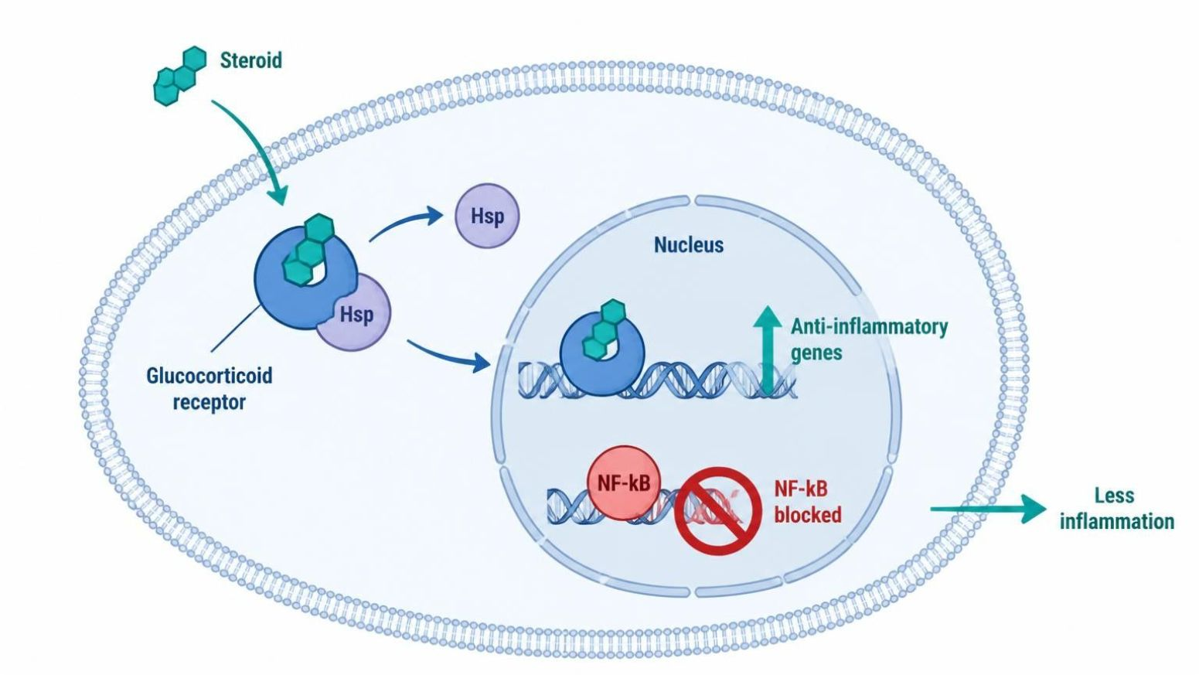
ADRENOCORTICOSTEROIDS & ANTAGONISTS
Objectives: SO4 · SO5 · IO4.1 · IO4.2 · IO4.3 · IO4.4 · IO4.5 · IO4.6
Figure 8 · Glucocorticoid receptor signaling
Schematic (illustrative) — Figure 8. A steroid enters the cell, binds its cytoplasmic receptor, and the complex switches genes on and off in the nucleus; NF-kB-driven cytokines are repressed. S21; S21 (notes)
L07 · Endocrine Pharmacotherapy — Session 1
76

Slide 77
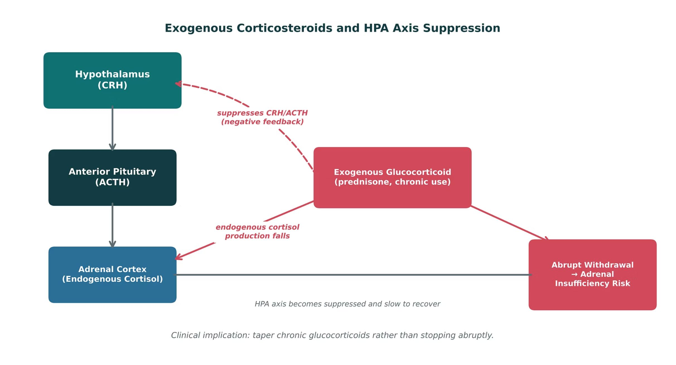
ADRENOCORTICOSTEROIDS & ANTAGONISTS
Objectives: SO4 · SO5 · IO4.1 · IO4.2 · IO4.3 · IO4.4 · IO4.5 · IO4.6
Figure 9 · Exogenous corticosteroids and HPA suppression
Original illustrative diagram (not from Katzung): chronic exogenous glucocorticoid suppresses CRH and ACTH via negative feedback; endogenous cortisol falls; abrupt withdrawal → adrenal insufficiency. Taper. S22; S22 (notes)
L07 · Endocrine Pharmacotherapy — Session 1
77

Slide 78
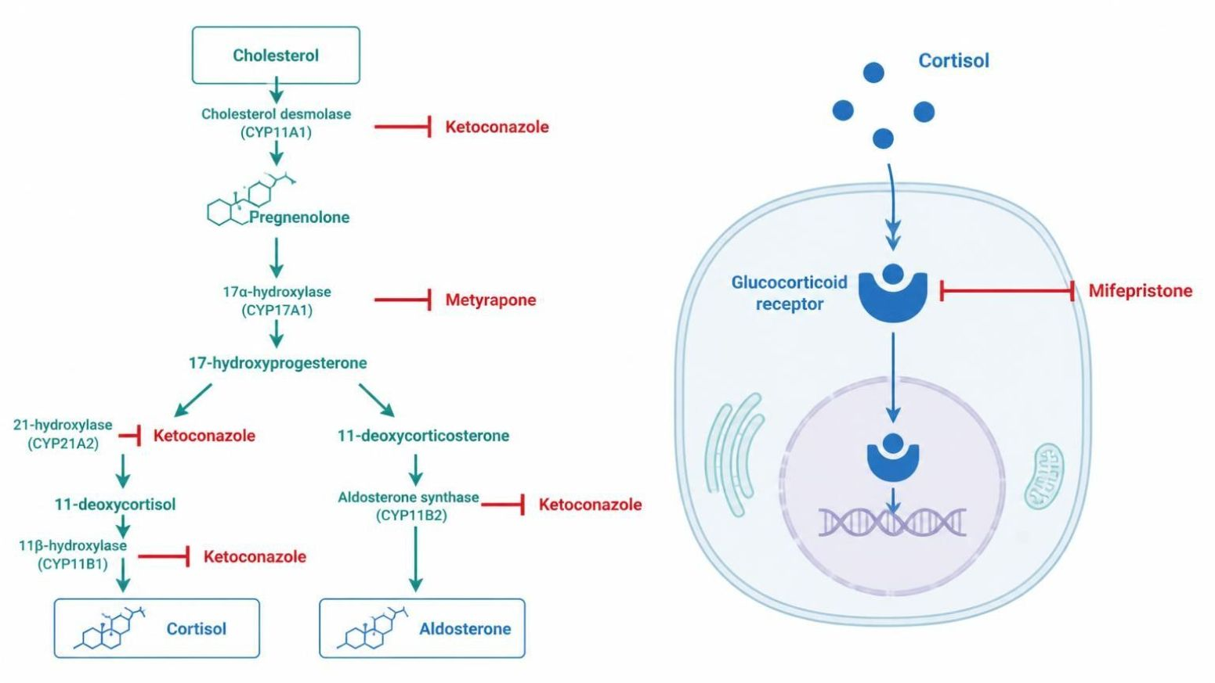
ADRENOCORTICOSTEROIDS & ANTAGONISTS
Objectives: SO4 · SO5 · IO4.1 · IO4.2 · IO4.3 · IO4.4 · IO4.5 · IO4.6
Figure 10 · Blocking steroid synthesis vs. blocking the receptor
Schematic (illustrative) — Figure 10. Left: enzyme blocks on the cortisol pathway (ketoconazole, metyrapone). Right: receptor blocks (mifepristone at the glucocorticoid receptor, spironolactone at the mineralocorticoid receptor). S24; S24 (notes)
L07 · Endocrine Pharmacotherapy — Session 1
78

Slide 79
ADRENOCORTICOSTEROIDS & ANTAGONISTS
Objectives: SO4 · SO5 · IO4.1 · IO4.2 · IO4.3 · IO4.4 · IO4.5 · IO4.6
Compare: Glucocorticoids vs. mineralocorticoids (S20)
 | Glucocorticoids (prednisone, dexamethasone) | Mineralocorticoids (fludrocortisone)
Main effect | Anti-inflammatory, immunosuppressive | Renal sodium retention, potassium excretion
Use | Inflammatory/autoimmune disease in nearly every organ system | Addison disease replacement, with a glucocorticoid
Monitor | Glucose, bone, infection, mood; taper chronic use | Blood pressure and potassium
Focus: what tells these apart. Sources: S20
L07 · Endocrine Pharmacotherapy — Session 1
79

Slide 80
ADRENOCORTICOSTEROIDS & ANTAGONISTS
Objectives: SO4 · SO5 · IO4.1 · IO4.2 · IO4.3 · IO4.4 · IO4.5 · IO4.6
Compare: Table 1 · Adrenal pharmacology at a glance
Agent | Category | Key teaching point
Prednisone, dexamethasone | Glucocorticoid | Anti-inflammatory; chronic use risks HPA suppression — taper, don’t stop abruptly
Fludrocortisone | Mineralocorticoid | Sodium retention/potassium excretion; replacement in Addison disease
Ketoconazole, metyrapone | Steroidogenesis inhibitor | Block cortisol synthesis at different steps; used in Cushing syndrome
Mifepristone | Glucocorticoid-receptor antagonist | Hyperglycemia in Cushing syndrome when surgery isn’t an option
Focus: what tells these apart. Sources: S25; S25 (notes)
L07 · Endocrine Pharmacotherapy — Session 1
80

Slide 81
ADRENOCORTICOSTEROIDS & ANTAGONISTS
Objectives: SO4 · SO5 · IO4.1 · IO4.2 · IO4.3 · IO4.4 · IO4.5 · IO4.6
Compare: Supporting drugs at a glance (S52)
Drug(s) | Why it matters here
Antipsychotics and metoclopramide | Raise prolactin by blocking dopamine
Calcium, iron and antacids | Block levothyroxine absorption; separate by 4 hours
Amiodarone and lithium | Can cause hypo- or hyperthyroidism
Estrogens | Raise thyroid-binding globulin, so levothyroxine needs rise
Rifampin, phenytoin, carbamazepine | Speed clearance of levothyroxine and steroids
Azole antifungals | Raise corticosteroid exposure through CYP3A4
ACE inhibitors, ARBs and potassium | Add to spironolactone hyperkalemia
Insulin and oral agents | Doses need adjusting during steroid therapy
Focus: what tells these apart. Sources: S52; S52 (notes)
L07 · Endocrine Pharmacotherapy — Session 1
81

Slide 82
ADRENOCORTICOSTEROIDS & ANTAGONISTS
Objectives: SO4 · SO5 · IO4.1 · IO4.2 · IO4.3 · IO4.4 · IO4.5 · IO4.6
Compare: Corticosteroid profiles: formulation, dose, indications
Drug | Class | Formulation | Adult dose | Indications
Prednisone | Glucocorticoid (prodrug of prednisolone) | Tablet 1/2.5/5/10/20/50 mg; oral solution | 5-60 mg PO daily depending on indication; taper after more than 3 weeks of therapy | Inflammatory and autoimmune disease, allergic reactions
Dexamethasone (Decadron) | Long-acting glucocorticoid | Tablet 0.5-6 mg; oral solution; IV 4/10 mg/mL | 0.5-9 mg PO or IV daily by indication; cerebral edema 10 mg IV load, then 4 mg every 6 hours; thyroid storm 2 mg IV every 6 hours | Cerebral edema, antiemetic, severe inflammation, Cushing screening test
Focus: what tells these apart. Sources: S44; S45; S46; S47
L07 · Endocrine Pharmacotherapy — Session 1
82

Slide 83
ADRENOCORTICOSTEROIDS & ANTAGONISTS
Objectives: SO4 · SO5 · IO4.1 · IO4.2 · IO4.3 · IO4.4 · IO4.5 · IO4.6
Compare: Corticosteroid profiles: formulation, dose, indications (cont.)
Drug | Class | Formulation | Adult dose | Indications
Hydrocortisone (Cortef, Solu-Cortef) | Glucocorticoid with mineralocorticoid activity | Tablet 5/10/20 mg; IV 100 mg vial | Replacement 15-25 mg/day PO in 2-3 divided doses; adrenal crisis 100 mg IV, then 200 mg over 24 hours | Adrenal insufficiency, adrenal crisis, inflammatory conditions
Fludrocortisone (Florinef) | Mineralocorticoid | Tablet 0.1 mg | 0.05-0.2 mg PO once daily | Primary adrenal insufficiency (with a glucocorticoid), orthostatic hypotension
Focus: what tells these apart. Sources: S44; S45; S46; S47
L07 · Endocrine Pharmacotherapy — Session 1
83

Slide 84
ADRENOCORTICOSTEROIDS & ANTAGONISTS
Objectives: SO4 · SO5 · IO4.1 · IO4.2 · IO4.3 · IO4.4 · IO4.5 · IO4.6
Compare: Corticosteroid profiles: adverse effects, contraindications, toxicity
Drug | Adverse effects | Contraindications | Toxicity / overdose
Prednisone | Hyperglycemia, insomnia, mood change, weight gain, infection, osteoporosis | Systemic fungal infection; live vaccines at high dose | Adrenal suppression and crisis on abrupt stopping; Cushingoid features, cataracts, avascular necrosis
Dexamethasone (Decadron) | Insomnia, hyperglycemia, mood change, immune suppression | Systemic fungal infection, hypersensitivity | Potency about 25-30 times hydrocortisone with no mineralocorticoid effect; adrenal suppression, psychosis
Hydrocortisone (Cortef, Solu-Cortef) | Hyperglycemia, fluid retention, mood change, infection risk | Systemic fungal infection | Excess causes Cushingoid features, hypertension, hypokalemia; stress-dose during illness and surgery
Fludrocortisone (Florinef) | Hypertension, edema, hypokalemia, headache | Systemic fungal infection; caution in heart failure | Hypokalemia, fluid overload, supine hypertension; monitor blood pressure and potassium
Focus: what tells these apart. Sources: S44; S45; S46; S47
L07 · Endocrine Pharmacotherapy — Session 1
84

Slide 85
ADRENOCORTICOSTEROIDS & ANTAGONISTS
Objectives: SO4 · SO5 · IO4.1 · IO4.2 · IO4.3 · IO4.4 · IO4.5 · IO4.6
Compare: Adrenal antagonist profiles: formulation, dose, indications
Drug | Class | Formulation | Adult dose | Indications
Ketoconazole | Azole antifungal and steroidogenesis inhibitor | Tablet 200 mg | Cushing syndrome (off-label): start 200 mg PO BID, usual 400-1,200 mg/day divided | Cushing syndrome (off-label), fungal infections
Metyrapone (Metopirone) | 11-beta-hydroxylase inhibitor | Capsule 250 mg | Cushing syndrome: start 250 mg PO TID-QID, titrate to cortisol (up to 6 g/day); diagnostic test: 30 mg/kg once at midnight | Cushing syndrome, diagnostic test of the HPA axis
Focus: what tells these apart. Sources: S48; S49; S50; S51
L07 · Endocrine Pharmacotherapy — Session 1
85

Slide 86
ADRENOCORTICOSTEROIDS & ANTAGONISTS
Objectives: SO4 · SO5 · IO4.1 · IO4.2 · IO4.3 · IO4.4 · IO4.5 · IO4.6
Compare: Adrenal antagonist profiles: formulation, dose, indications (cont.)
Drug | Class | Formulation | Adult dose | Indications
Mifepristone (Korlym) | Glucocorticoid-receptor antagonist | Tablet 300 mg (Cushing); 200 mg (pregnancy termination) | Cushing hyperglycemia: 300 mg PO daily with a meal, titrate up to 1,200 mg/day | Hyperglycemia with Cushing syndrome when surgery is not an option
Spironolactone (Aldactone) | Mineralocorticoid-receptor antagonist | Tablet 25/50/100 mg | Hyperaldosteronism: 25-100 mg PO daily (up to 400 mg); heart failure 12.5-50 mg daily | Primary hyperaldosteronism, heart failure, resistant hypertension, edema, hirsutism (off-label)
Focus: what tells these apart. Sources: S48; S49; S50; S51
L07 · Endocrine Pharmacotherapy — Session 1
86

Slide 87
ADRENOCORTICOSTEROIDS & ANTAGONISTS
Objectives: SO4 · SO5 · IO4.1 · IO4.2 · IO4.3 · IO4.4 · IO4.5 · IO4.6
Compare: Adrenal antagonist profiles: adverse effects, contraindications, toxicity
Drug | Adverse effects | Contraindications | Toxicity / overdose
Ketoconazole | Nausea, abdominal pain, headache, gynecomastia, adrenal insufficiency | Liver disease, QT prolongation or interacting QT drugs, pregnancy | Boxed hepatotoxicity and QT prolongation; strong CYP3A4 inhibitor; monitor LFTs and ECG
Metyrapone (Metopirone) | Nausea, dizziness, hypertension, edema, hirsutism | Adrenal insufficiency, hypersensitivity | Adrenal insufficiency, hypokalemia, hypertension from deoxycorticosterone, androgen excess
Mifepristone (Korlym) | Fatigue, nausea, headache, hypokalemia, edema, endometrial thickening | Pregnancy (boxed warning), simvastatin or lovastatin, need for long-term corticosteroids | Pregnancy loss; adrenal insufficiency (cortisol rises so labs mislead); hypokalemia
Spironolactone (Aldactone) | Hyperkalemia, gynecomastia, menstrual irregularity, dizziness | Hyperkalemia, Addison disease, severe renal impairment | Life-threatening hyperkalemia (with ACE inhibitors, ARBs, potassium); monitor potassium and creatinine
Focus: what tells these apart. Sources: S48; S49; S50; S51
L07 · Endocrine Pharmacotherapy — Session 1
87

Slide 88
ADRENOCORTICOSTEROIDS & ANTAGONISTS
Objectives: SO4 · SO5 · IO4.1 · IO4.2 · IO4.3 · IO4.4 · IO4.5 · IO4.6
Memory hooks
Why it happens
Why IV hydrocortisone in adrenal crisis, not just prednisone? Hydrocortisone replaces both glucocorticoid and mineralocorticoid action — and the patient is in shock. S21; S27
L07 · Endocrine Pharmacotherapy — Session 1
88

Slide 89
ADRENOCORTICOSTEROIDS & ANTAGONISTS
Objectives: SO4 · SO5 · IO4.1 · IO4.2 · IO4.3 · IO4.4 · IO4.5 · IO4.6
High-yield summary
If you remember nothing else
Chronic steroids suppress CRH/ACTH → taper; abrupt stop → adrenal crisis → IV hydrocortisone + fluids. S22; S27; SG U4-R8
Addison disease needs a glucocorticoid plus fludrocortisone. S20
L07 · Endocrine Pharmacotherapy — Session 1
89

Slide 90
CLINICAL VIGNETTE · LECTURE QUICK CHECK S27
Objectives: SO4 · SO5 · IO4.1 · IO4.2 · IO4.3 · IO4.4 · IO4.5 · IO4.6
Question 14
A patient on chronic high-dose prednisone ran out of refills and now has hypotension, weakness and confusion. Best management?
A
Give fludrocortisone alone
B
Restart oral prednisone at home
C
Observe; symptoms will pass
D
IV hydrocortisone and IV fluids now
E
Give IV dexamethasone only, no fluids
L07 · Endocrine Pharmacotherapy — Session 1
90
Notes:
Answer on the next slide. Source: S22; S27; SG U4-R8

Slide 91
CLINICAL VIGNETTE · ANSWER
Objectives: SO4 · SO5 · IO4.1 · IO4.2 · IO4.3 · IO4.4 · IO4.5 · IO4.6
Answer 14: D
D. IV hydrocortisone and IV fluids now
Adrenal crisis from abrupt withdrawal after HPA suppression — emergent IV hydrocortisone and fluids (S27). S22; S27; SG U4-R8
Why the other choices are wrong
A. Give fludrocortisone alone — Needs glucocorticoid too (S27).
B. Restart oral prednisone at home — This is an emergency (S27).
C. Observe; symptoms will pass — Life-threatening (S27).
E. Give IV dexamethasone only, no fluids — Fluids and hydrocortisone (S27).
L07 · Endocrine Pharmacotherapy — Session 1
91

Slide 92
CLINICAL VIGNETTE
Objectives: SO4 · SO5 · IO4.1 · IO4.2 · IO4.3 · IO4.4 · IO4.5 · IO4.6
Question 16
A patient with primary adrenal insufficiency is on hydrocortisone but has low BP and high potassium. What should be added?
A
Dexamethasone
B
Potassium supplement
C
Spironolactone
D
Ketoconazole
E
Fludrocortisone
L07 · Endocrine Pharmacotherapy — Session 1
92
Notes:
Answer on the next slide. Source: S20; S47

Slide 93
CLINICAL VIGNETTE · ANSWER
Objectives: SO4 · SO5 · IO4.1 · IO4.2 · IO4.3 · IO4.4 · IO4.5 · IO4.6
Answer 16: E
E. Fludrocortisone
Addison disease needs mineralocorticoid replacement alongside a glucocorticoid (S20). S20; S47
Why the other choices are wrong
A. Dexamethasone — Little mineralocorticoid action (S21).
B. Potassium supplement — Wrong direction (S20).
C. Spironolactone — Blocks mineralocorticoid action (S23).
D. Ketoconazole — Blocks steroid synthesis (S23).
L07 · Endocrine Pharmacotherapy — Session 1
93

