Slide 1

PA PHARMACOLOGY COURSE · LECTURE 4 · SESSION 1 OF 2
Endocrine Pharmacotherapy
Session 1: Pituitary, Thyroid, and Adrenal Pharmacology | Tuesday, November 10 | 8:30–11:00 AM
Diane S. Allen-Gipson, Ph.D., M.S., Course Director
Notes:
Say: "One template runs this whole unit: hypothalamus drives the pituitary, the pituitary drives a target gland, and the gland's hormone feeds back to turn the levels above it down. Every drug today either replaces a hormone, blocks one, or interrupts that loop."

Slide 2

BY THE END OF THIS LECTURE
Learning Objectives — Session 1
Describe the hypothalamic-pituitary-target gland axis as a shared regulatory template, and identify where drug therapy intervenes at each level.
Identify the major agents used for growth hormone disorders, hyperprolactinemia, and disorders of antidiuretic hormone (diabetes insipidus, SIADH).
Describe the mechanisms, indications, and monitoring of thyroid hormone replacement and antithyroid drug therapy, including management of thyroid storm.
Compare glucocorticoid and mineralocorticoid pharmacology, and identify agents used to block adrenocortical hormone synthesis or action.
Identify dosing, administration, and monitoring considerations, and explain key medication-safety counseling points to patients, including HPA-axis suppression and the need to taper chronic glucocorticoids.
Preview: Gonadal hormones, pancreatic/diabetes pharmacology, and parathyroid disorders continue in Session 2 (Thursday, November 12).
Endocrine Pharmacotherapy — Session 1 of 2 — PA Program
2
Notes:
Orient students to the arc of this session: the shared HPA-template concept, then three organ systems in turn (pituitary, thyroid, adrenal) that all follow the same hypothalamic-pituitary-target gland logic introduced in Figure 1. Session 2 continues with gonadal hormones, diabetes, and parathyroid disorders on Nov 12.
Instructor script:
Objectives: Read them aloud.

Slide 3

COURSE MATERIALS
Required & Recommended Readings — Unit 4
Required Text
Recommended Text (for additional support)
– Katzung's Basic and Clinical Pharmacology, 16th Edition
– Todd W. Vanderah · 2024/2025 · McGraw-Hill Education
– ISBN 1260463303 (eBook)
– AccessMedicine: accessmedicine.mhmedical.com/book.aspx?bookid=3382
– Unit 4 — Endocrine: Chapters 37–42 (Hypothalamic & Pituitary Hormones; Thyroid & Antithyroid Drugs; Adrenocorticosteroids & Adrenocortical Antagonists; Gonadal Hormones & Inhibitors; Pancreatic Hormones & Glucose-Lowering Drugs; Agents That Affect Bone Mineral Homeostasis)
– Pharmacotherapy Principles and Practice
– Chisholm-Burns, Schwinghammer, Malone, Kolesar, Lee · 2022 · McGraw-Hill Education
– Print ISBN 9781260460278 · eText ISBN 9781260460285
– Use as supplemental support alongside Katzung’s Chapters 37–42 for Unit 4
Endocrine Pharmacotherapy — Session 1 of 2 — PA Program
3
Notes:
Point students to the required and recommended texts for Unit 4 before diving into content. Katzung’s Chapters 37–42 are the required reading for this unit; Pharmacotherapy Principles and Practice is recommended as additional support, not a substitute. Session 1 covers Chapters 37–39; Session 2 covers Chapters 40–42.
Instructor script:
Readings: Katzung chapters 37-39 cover this session.

Slide 4

SECTION
01
The Hypothalamic-Pituitary Axis
One regulatory template governs thyroid, adrenal, and gonadal control alike.
Notes:
Section transition.
Section 01: the hypothalamic-pituitary axis, where every drug either replaces a hormone, blocks one, or interrupts the loop.

Slide 5
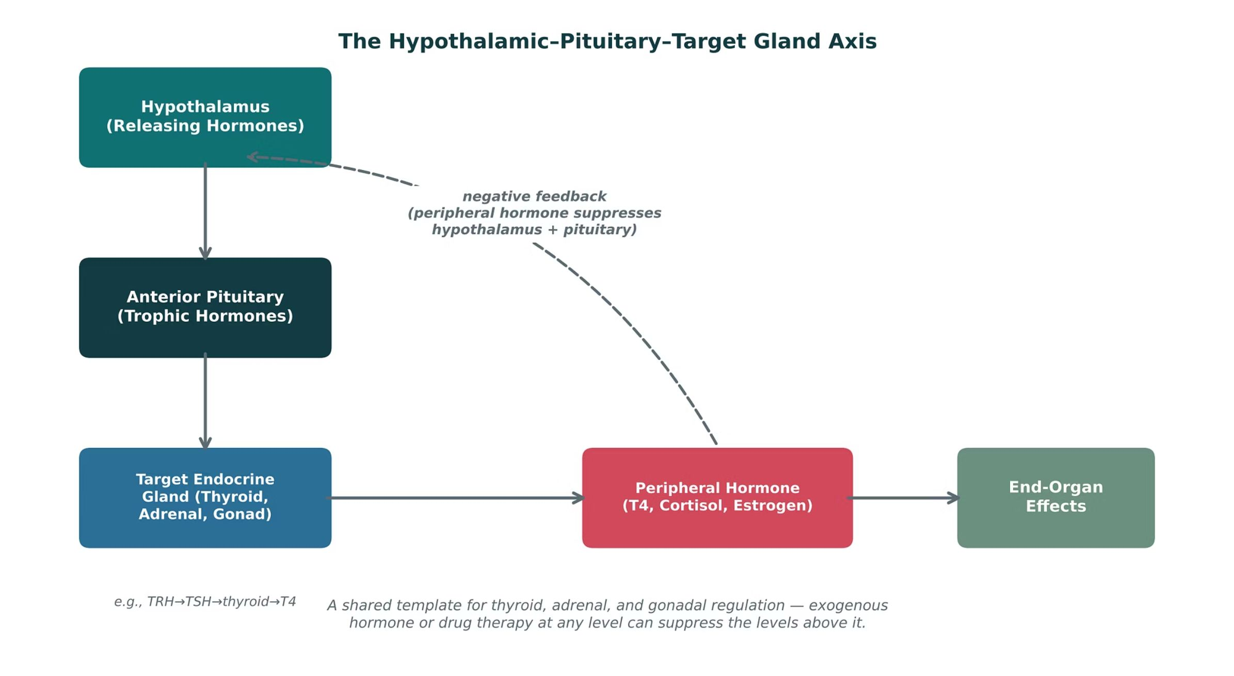
ORIGINAL ILLUSTRATION · FIGURE 1
The Hypothalamic-Pituitary-Target Gland Axis
Figure 1. Original illustrative diagram (not from Katzung): the hypothalamus drives the anterior pituitary, which drives a target endocrine gland, whose peripheral hormone produces end-organ effects and negatively feeds back to suppress the levels above it.
Endocrine Pharmacotherapy — Session 1 of 2 — PA Program
5
Notes:
This is the conceptual spine for the entire unit — thyroid (Section 2), adrenal (Section 3), and gonadal (Session 2) pharmacology all map onto this same three-level axis. Keep returning to this diagram as each new system is introduced.
Instructor script:
Figure 1: Trace the axis and the negative-feedback arrows. Return to this figure every time we meet a new gland.

Slide 6

GROWTH HORMONE AXIS
Growth Hormone Disorders
● GH deficiency: treated with recombinant human growth hormone (somatropin); monitor growth velocity in children and IGF-1 levels in adults.
● GH excess (acromegaly): treated with somatostatin analogs (octreotide, lanreotide — suppress GH release), the GH-receptor antagonist pegvisomant, or dopamine agonists (cabergoline) in select cases.
● Clinical pearl: octreotide also has major uses outside the pituitary axis — variceal bleeding and carcinoid syndrome — worth flagging as a cross-system agent.
Endocrine Pharmacotherapy — Session 1 of 2 — PA Program
6
Notes:
Acromegaly pharmacology is a good place to preview that octreotide will reappear later in GI/variceal contexts — reinforces that these drug classes are not siloed by organ system.
Instructor script:
Know: Somatropin treats GH deficiency; monitor growth velocity in children and IGF-1 in adults.

Slide 7
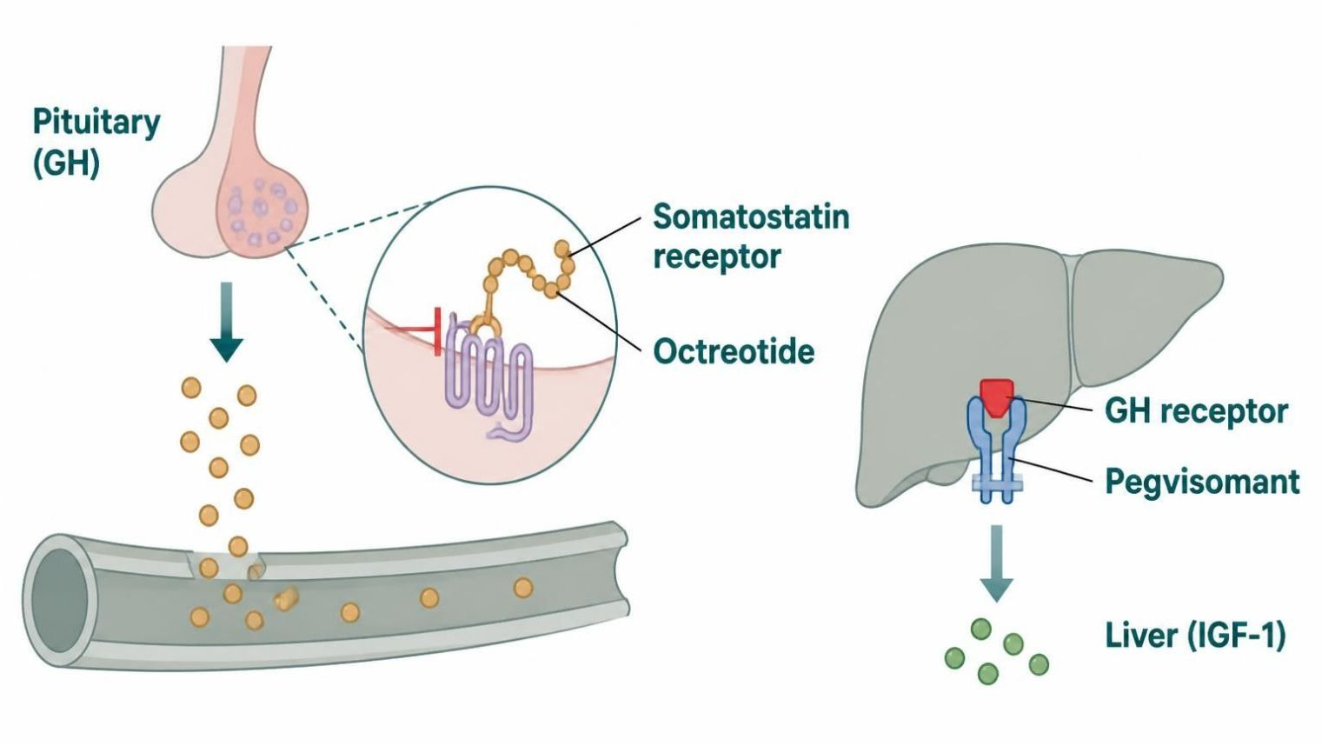
MECHANISM & DEPTH
Somatostatin Analogs and Pegvisomant: Controlling GH Excess
Pituitary somatotroph releases GH
▼
GH drives liver IGF-1 production
▼
Octreotide and lanreotide bind somatostatin receptors and lower GH release
▼
Pegvisomant blocks the GH receptor so IGF-1 falls
▼
Schematic (illustrative)
Acromegaly symptoms improve (monitor IGF-1)
Figure 2. Teal starts the axis; blue steps are GH and IGF-1 signalling and drug blocks. Red bar marks a blocked signal; red outcome: acromegaly symptoms improve.
● Indication: octreotide and lanreotide treat acromegaly; octreotide also treats carcinoid syndrome and variceal bleeding.
● Adverse effects: GI upset, gallstones and bradycardia with octreotide and lanreotide.
● Limitation: pegvisomant does not shrink the tumor; monitor IGF-1 and liver tests.
● Somatropin (GH deficiency): monitor growth velocity or IGF-1.
Endocrine Pharmacotherapy — Session 1 of 2 — PA Program
7
Notes:
Figure 2: Octreotide and lanreotide bind somatostatin receptors and lower GH release. Pegvisomant blocks the GH receptor, so IGF-1 falls.
Know: Monitor IGF-1 for acromegaly therapy. GH rises on pegvisomant and is not used to monitor it. Octreotide: gallstones, GI upset, bradycardia, glucose changes. Also used for carcinoid syndrome and variceal bleeding.

Slide 8
PROLACTIN & POSTERIOR PITUITARY
Hyperprolactinemia and ADH Disorders
Hyperprolactinemia
ADH Disorders
– Dopamine agonists are first-line: cabergoline, bromocriptine
– Dopamine normally inhibits prolactin release — agonists restore that inhibitory tone
– Used for prolactinomas and drug-induced hyperprolactinemia
– Diabetes insipidus (ADH deficiency/resistance): desmopressin (DDAVP) for central DI
– SIADH (ADH excess): fluid restriction first-line; vasopressin-receptor antagonists (tolvaptan) or demeclocycline for refractory cases
– Opposite problems — know which direction each drug moves free water
Endocrine Pharmacotherapy — Session 1 of 2 — PA Program
8
Notes:
The DI vs. SIADH contrast is a classic exam pairing — anchor it to "which way does free water move" rather than memorizing drug names in isolation.
Instructor script:
Prolactin: dopamine is the brake on prolactin, shown on the next slide.
Ask: "Which way does free water move?" (ADH, covered on the following slides.)

Slide 9
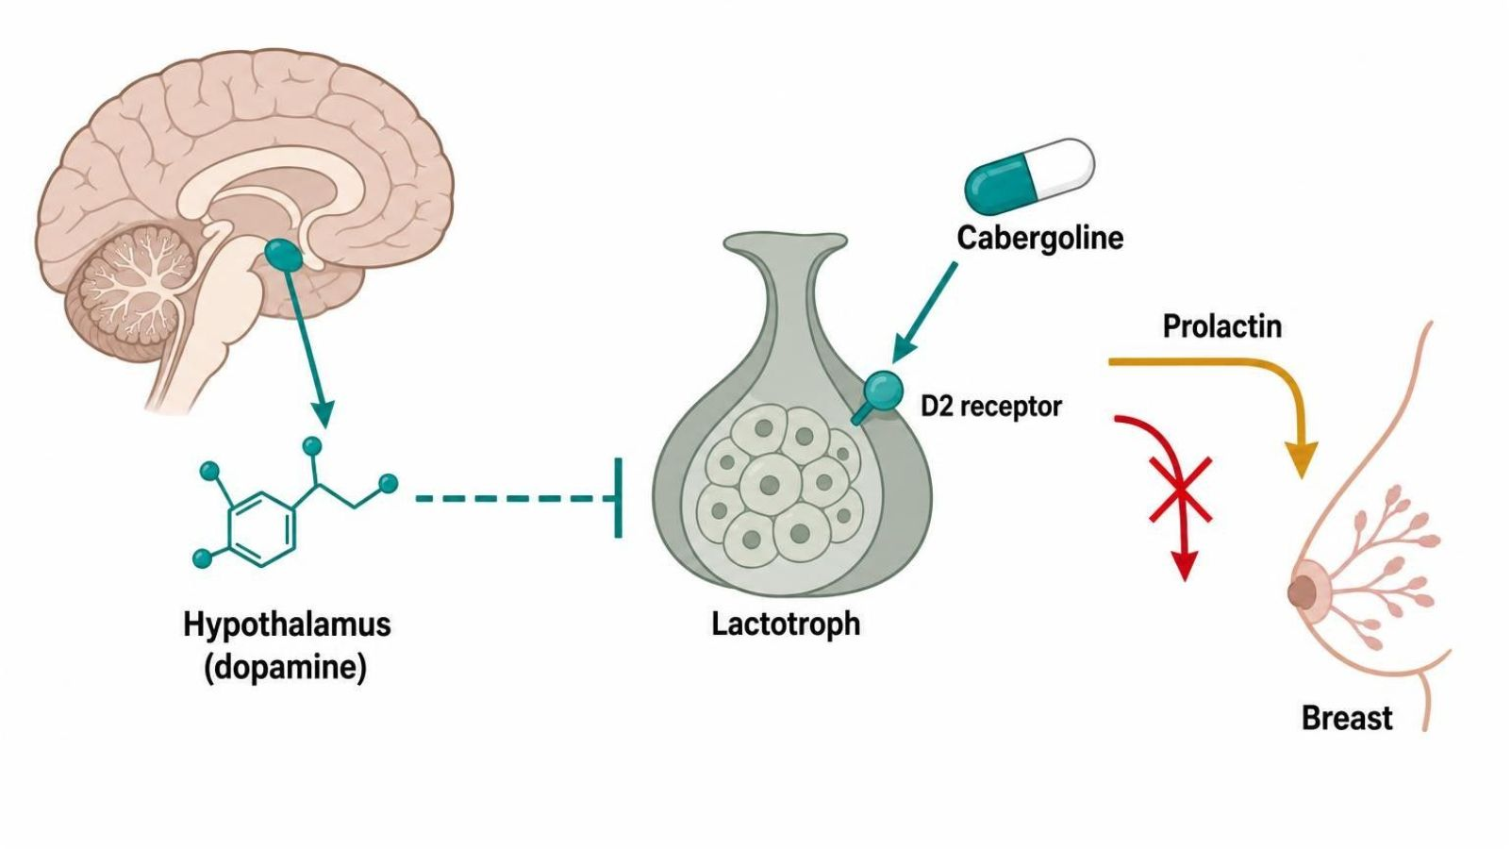
MECHANISM & DEPTH
Dopamine Agonists: Restoring the Brake on Prolactin
Hypothalamic dopamine normally inhibits lactotrophs
▼
Prolactinoma or drugs (antipsychotics, metoclopramide) lift the brake; prolactin rises
▼
Cabergoline or bromocriptine activate D2 receptors
▼
Prolactin release falls and the tumor often shrinks
▼
Schematic (illustrative)
Cycles and fertility return; galactorrhea resolves
Figure 3. Teal is dopamine's inhibitory brake; blue steps are D2 agonist action. Red outcome: prolactin falls, cycles and fertility return.
● Dosing: cabergoline is better tolerated and given twice weekly; bromocriptine is daily.
● Adverse effects: nausea, orthostatic hypotension and dizziness.
● Caution: high-dose cabergoline in Parkinson patients is linked to cardiac valve fibrosis; use caution with severe psychiatric disease and avoid unmonitored antipsychotic changes.
● Monitoring: pregnancy testing and prolactin monitoring.
Endocrine Pharmacotherapy — Session 1 of 2 — PA Program
9
Notes:
Figure 3: Dopamine is the brake on prolactin. Cabergoline and bromocriptine restore it and shrink prolactinomas.
Know: Cabergoline is twice weekly and better tolerated. High doses link to valvulopathy. Antipsychotics and metoclopramide raise prolactin.

Slide 10
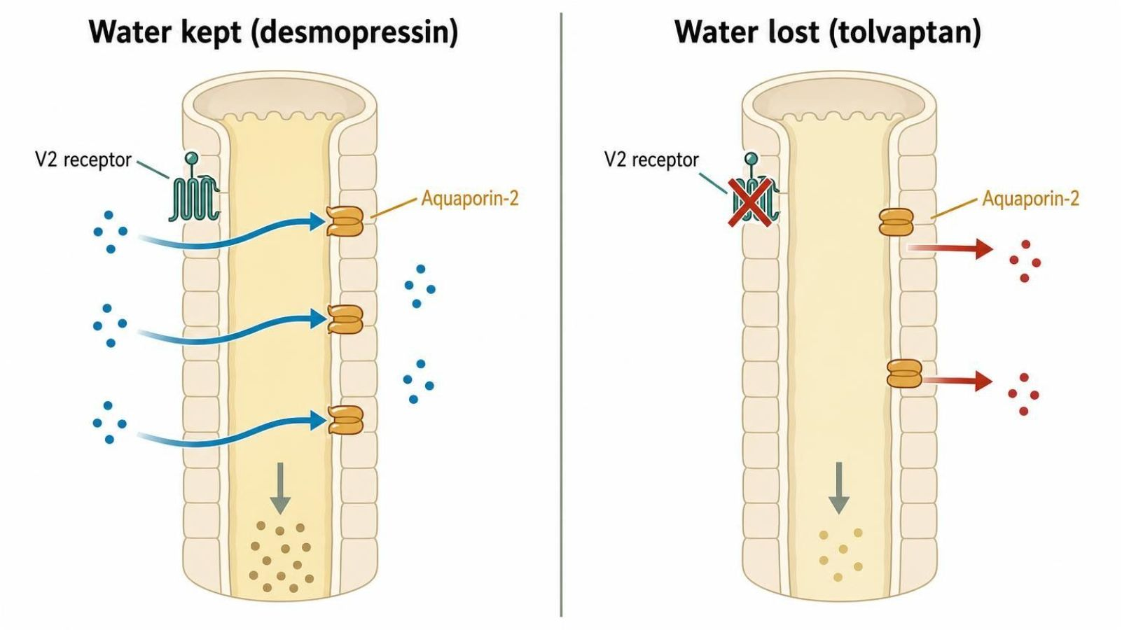
MECHANISM & DEPTH
ADH, Desmopressin and Tolvaptan: Which Way Does Water Move?
ADH binds the V2 receptor in the collecting duct
▼
Aquaporin-2 channels insert into the membrane
▼
Water is reabsorbed and urine concentrates
▼
Desmopressin boosts this (diabetes insipidus); tolvaptan or demeclocycline blunt it (SIADH)
▼
Schematic (illustrative)
Free water retained in DI therapy, excreted in SIADH therapy
Figure 4. Blue arrows show water movement. Desmopressin keeps water in; tolvaptan lets it pass out. Red outcome: free water retained or excreted.
● Desmopressin: risk is hyponatremia; monitor sodium and limit fluids.
● Tolvaptan: can overcorrect sodium (osmotic demyelination) and cause liver injury; start in hospital.
● SIADH: first-line is fluid restriction; demeclocycline causes photosensitivity and nephrotoxicity.
Endocrine Pharmacotherapy — Session 1 of 2 — PA Program
10
Notes:
Figure 4: Desmopressin activates V2 receptors and keeps water. Tolvaptan and demeclocycline let water go.
Know: Desmopressin risks hyponatremia. Tolvaptan overcorrection risks osmotic demyelination, so start in hospital.

Slide 11

SECTION
02
Thyroid & Antithyroid Drugs
Replacing a deficient gland, or slowing down an overactive one.
Notes:
Section transition.
Section 02: thyroid and antithyroid drugs.

Slide 12
REPLACEMENT THERAPY
Levothyroxine for Hypothyroidism
Mechanism: synthetic T4, converted peripherally to active T3.
First-line for hypothyroidism; narrow therapeutic index — dose titrated using TSH (primary hypothyroidism) with repeat labs every 6–8 weeks after a dose change.
Take on an empty stomach, 30–60 minutes before breakfast, consistently relative to other medications and food.
Significant absorption interactions: calcium, iron, and antacids can all reduce absorption — separate dosing by at least 4 hours.
Older adults and patients with cardiac disease: start at lower doses and titrate slowly to avoid precipitating angina/arrhythmia.
Endocrine Pharmacotherapy — Session 1 of 2 — PA Program
14
Notes:
The absorption-interaction list is extremely high-yield — many patients are also on calcium or iron supplements, so timing counseling matters as much as the drug itself.
Instructor script:
Know: About 1.6 mcg/kg/day is full replacement. Start low in older adults and cardiac disease. Check TSH at 6-8 weeks. Estrogen and pregnancy raise needs. Over-replacement causes atrial fibrillation and bone loss.

Slide 13
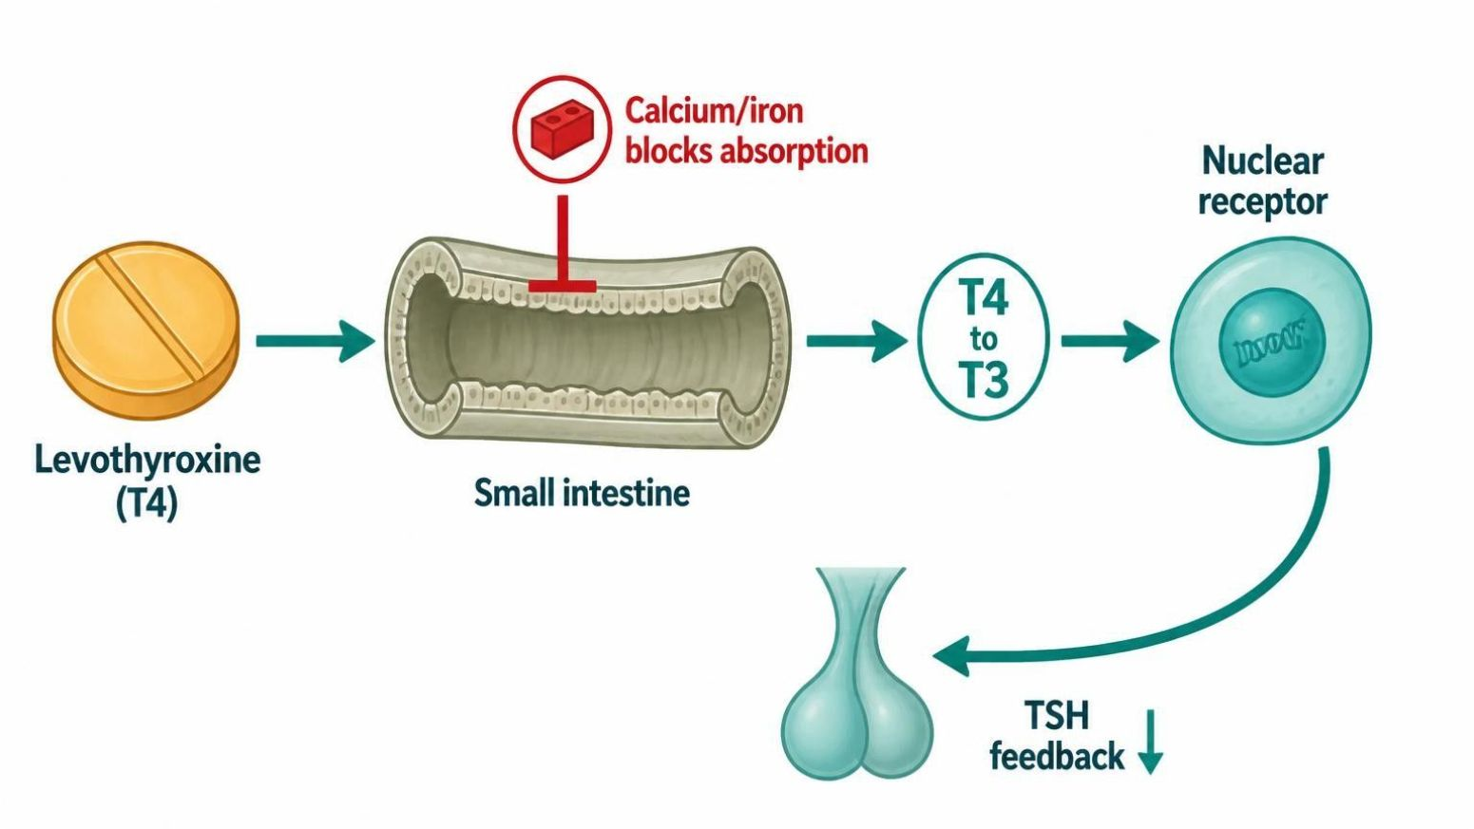
MECHANISM & DEPTH
Levothyroxine: Absorption, Conversion and Timing
Tablet taken on an empty stomach
▼
Absorbed in the small intestine; calcium, iron and antacid binders block it
▼
T4 converted to active T3 in tissues
▼
T3 binds nuclear receptors and restores metabolism
▼
Schematic (illustrative)
TSH falls to the target range (recheck at 6-8 weeks)
Figure 5. Red X marks absorption blocked by calcium, iron or antacids. Blue steps show T4 to T3 conversion and receptor action. Red outcome: TSH falls to target.
● Timing: separate from calcium, iron, antacids, PPIs and bile acid binders by 4 hours.
● Over-replacement: tachycardia, atrial fibrillation and bone loss.
● Start low: in older adults and in cardiac disease.
● Pregnancy: often raises dose needs; monitor TSH closely.
Endocrine Pharmacotherapy — Session 1 of 2 — PA Program
15
Notes:
Figure 5: Take levothyroxine on an empty stomach, 30-60 minutes before breakfast, and separate calcium, iron and antacids by 4 hours.

Slide 14
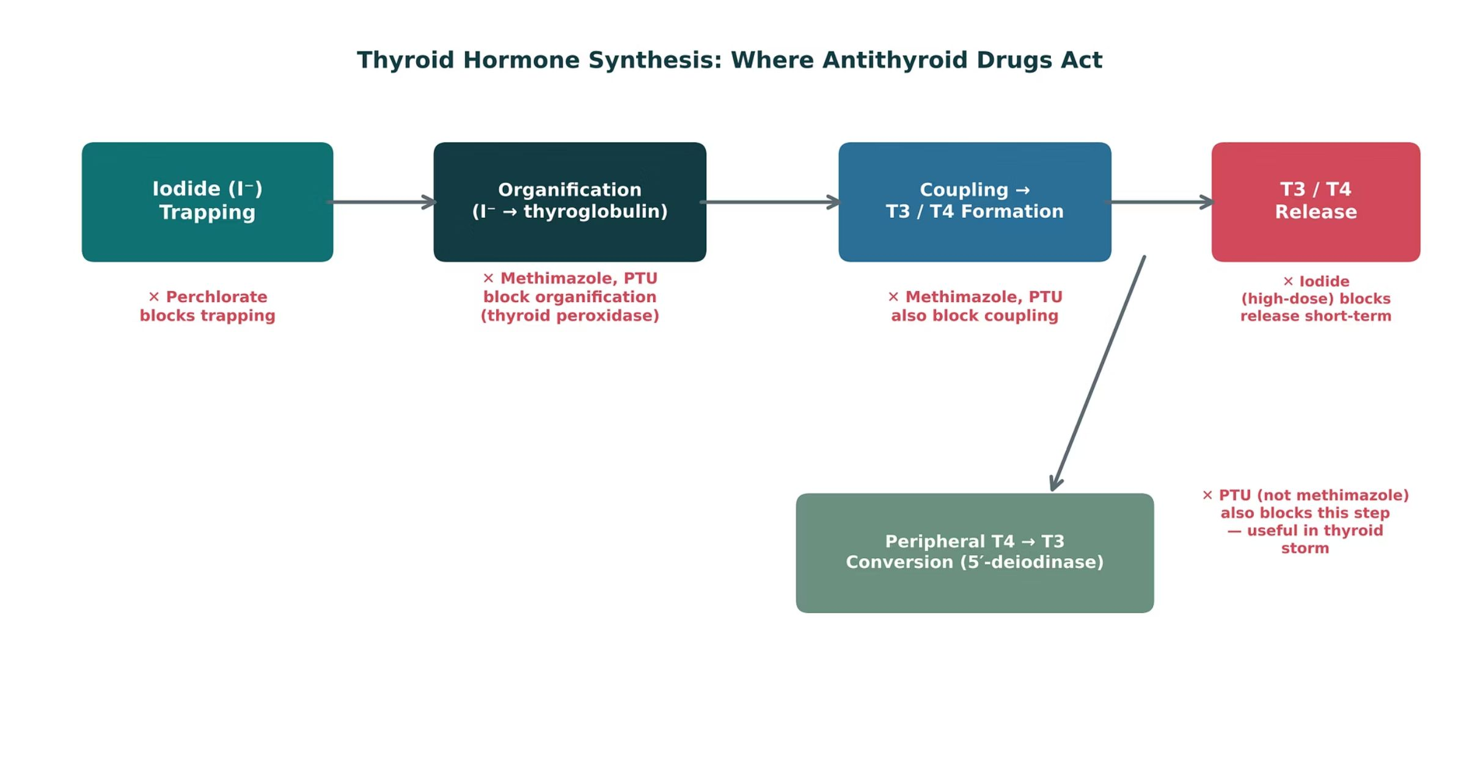
ORIGINAL ILLUSTRATION · FIGURE 6
Thyroid Hormone Synthesis: Where Antithyroid Drugs Act
Figure 6. Original illustrative diagram (not from Katzung): iodide trapping, organification, and coupling produce T3/T4, which undergo peripheral T4-to-T3 conversion; methimazole and PTU block organification and coupling, while PTU additionally blocks peripheral conversion.
Endocrine Pharmacotherapy — Session 1 of 2 — PA Program
16
Notes:
This diagram is the mechanistic key to the next several slides — make sure students can explain why PTU, not methimazole, is preferred in thyroid storm using this figure alone (it blocks an extra step).
Instructor script:
Figure 6: Iodide trapping, organification, coupling and peripheral conversion. Methimazole and PTU block organification and coupling. PTU also blocks conversion.

Slide 15

HYPERTHYROIDISM
Methimazole vs. Propylthiouracil (PTU)
Methimazole
Propylthiouracil (PTU)
– First-line for most non-pregnant patients — once-daily dosing, more convenient
– Avoid in first trimester of pregnancy (teratogenic risk)
– Boxed warning: agranulocytosis, hepatotoxicity
– Preferred in first trimester of pregnancy and in thyroid storm
– Also blocks peripheral T4→T3 conversion — faster symptomatic effect in crisis
– Boxed warning: severe hepatotoxicity (more than methimazole) — reserve for specific indications
Endocrine Pharmacotherapy — Session 1 of 2 — PA Program
17
Notes:
The pregnancy-trimester switch (PTU in first trimester, methimazole after) is a frequently tested nuance — worth stating explicitly rather than letting students assume one drug is simply "better."
Instructor script:
Methimazole is first-line for most patients and is avoided in the first trimester. PTU is preferred in the first trimester and in storm.
Know: Both carry agranulocytosis and liver warnings; PTU has the greater liver risk. Fever or sore throat on a thionamide means stop and check a CBC.

Slide 16
ENDOCRINE EMERGENCY
Thyroid Storm: A Multi-Drug Approach
A life-threatening hyperthyroid crisis requiring rapid, multi-pronged therapy.
Beta-blockers (propranolol) — control adrenergic symptoms (tachycardia, tremor) and also blunt peripheral T4-to-T3 conversion.
PTU (preferred over methimazole) — blocks new hormone synthesis and peripheral conversion.
Iodine solution (given after PTU/methimazole) — acutely blocks hormone release; must follow antithyroid drug to avoid providing substrate for new synthesis.
Corticosteroids — also blunt peripheral T4-to-T3 conversion and treat relative adrenal insufficiency.
Endocrine Pharmacotherapy — Session 1 of 2 — PA Program
18
Notes:
The "iodine after PTU, not before" sequencing is a classic high-yield detail — giving iodine first can actually worsen the crisis by providing more substrate for hormone synthesis before synthesis is blocked.
Instructor script:
Thyroid storm is treated with four drugs that hit four targets; the next two slides show the mechanism and the sequence.

Slide 17
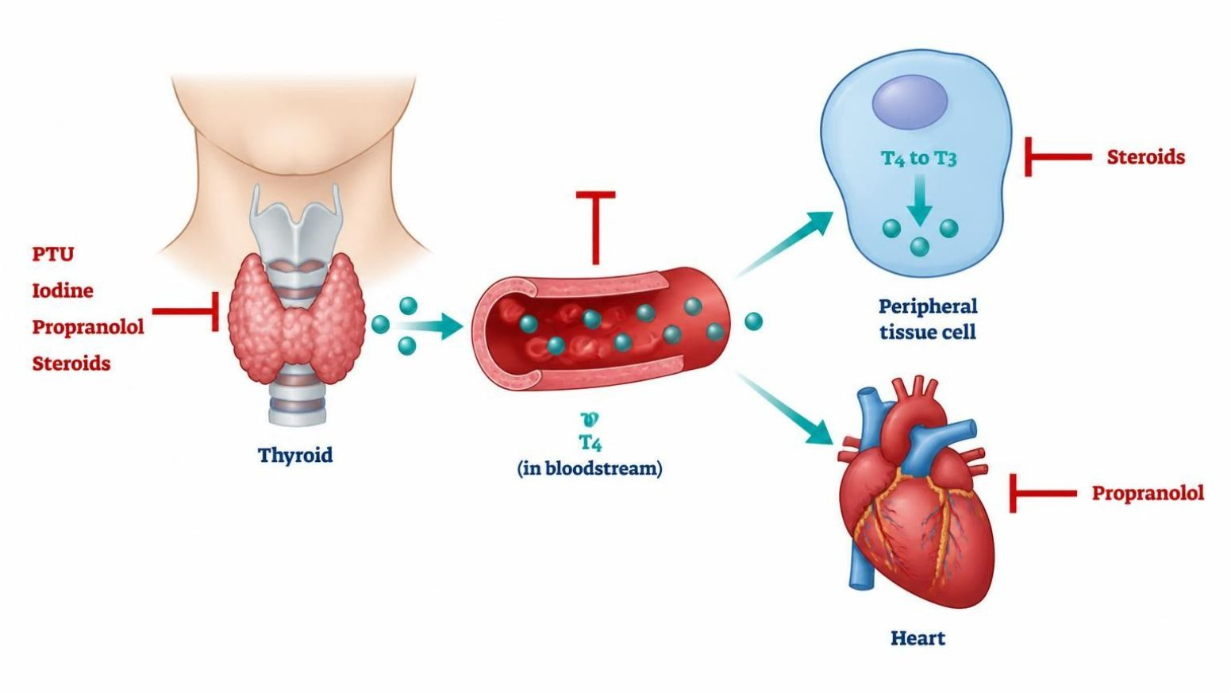
MECHANISM & DEPTH
Thyroid Storm: Four Drugs, Four Targets
Graves thyroid makes excess hormone; PTU blocks synthesis
▼
Hormone is released into blood; iodine (given after PTU) blocks release
▼
T4 converts to T3 in tissues; PTU, propranolol and steroids block conversion
▼
T3 stimulates beta receptors; propranolol blunts tachycardia and tremor
▼
Schematic (illustrative)
Crisis settles with fluids, cooling and support
Figure 7. Red bars mark where PTU, iodine, propranolol and steroids block hormone synthesis, release, conversion or action.
● Sequence: start PTU and beta-blocker first; give iodine at least an hour later.
● Propranolol: avoided in decompensated heart failure and asthma.
● Steroids: also treat relative adrenal insufficiency; avoid aspirin (it frees bound hormone).
● PTU: boxed warning for hepatotoxicity.
Endocrine Pharmacotherapy — Session 1 of 2 — PA Program
19
Notes:
Figure 7: Four drugs, four targets: PTU blocks synthesis, iodine blocks release (after PTU), propranolol blunts symptoms, steroids blunt conversion.

Slide 18

CLINICAL CASE
Sequencing Therapy in Thyroid Storm
A patient presents to the emergency department with fever, tachycardia, and altered mental status in the setting of untreated Graves disease.
Ask yourself: What is the correct sequence of pharmacologic therapy, and why does the order matter?
Clinical pearl: Beta-blockade and PTU are started first; iodine solution is given only after PTU, since giving iodine first would supply additional substrate for thyroid hormone synthesis before the gland’s synthetic machinery is blocked — potentially worsening the crisis.
Endocrine Pharmacotherapy — Session 1 of 2 — PA Program
20
Notes:
This case reinforces Figure 6 and the sequencing point from the prior slide — a good checkpoint for whether the mechanism actually landed, not just the drug names.
Instructor script:
Ask: "Why must iodine come after the thionamide?" Answer: iodine first provides substrate for new hormone.

Slide 19

SECTION
03
Adrenocorticosteroids & Adrenocortical Antagonists
Glucocorticoid power and mineralocorticoid balance — and what happens when therapy stops.
Notes:
Section transition.
Section 03: adrenal drugs.

Slide 20

TWO HORMONE FAMILIES
Glucocorticoids vs. Mineralocorticoids
Glucocorticoids (e.g., prednisone, dexamethasone)
Mineralocorticoids (fludrocortisone)
– Anti-inflammatory and immunosuppressive effects
– Spectrum of relative potency and mineralocorticoid activity across agents
– Used across nearly every organ system for inflammatory/autoimmune disease
– Promotes renal sodium retention and potassium excretion
– Used as replacement therapy in primary adrenal insufficiency (Addison disease), alongside a glucocorticoid
– Monitor blood pressure and potassium
Endocrine Pharmacotherapy — Session 1 of 2 — PA Program
24
Notes:
Fludrocortisone is often under-emphasized relative to glucocorticoids — make the point explicitly that primary adrenal insufficiency needs BOTH hormone classes replaced, not just cortisol.
Instructor script:
Know: Potency versus hydrocortisone: prednisone about 4x, dexamethasone about 25-30x. Hydrocortisone has both glucocorticoid and mineralocorticoid action. Fludrocortisone replaces mineralocorticoid effect in Addison disease. Adverse effects: hyperglycemia, osteoporosis, infection, mood change, cataracts, adrenal suppression.

Slide 21
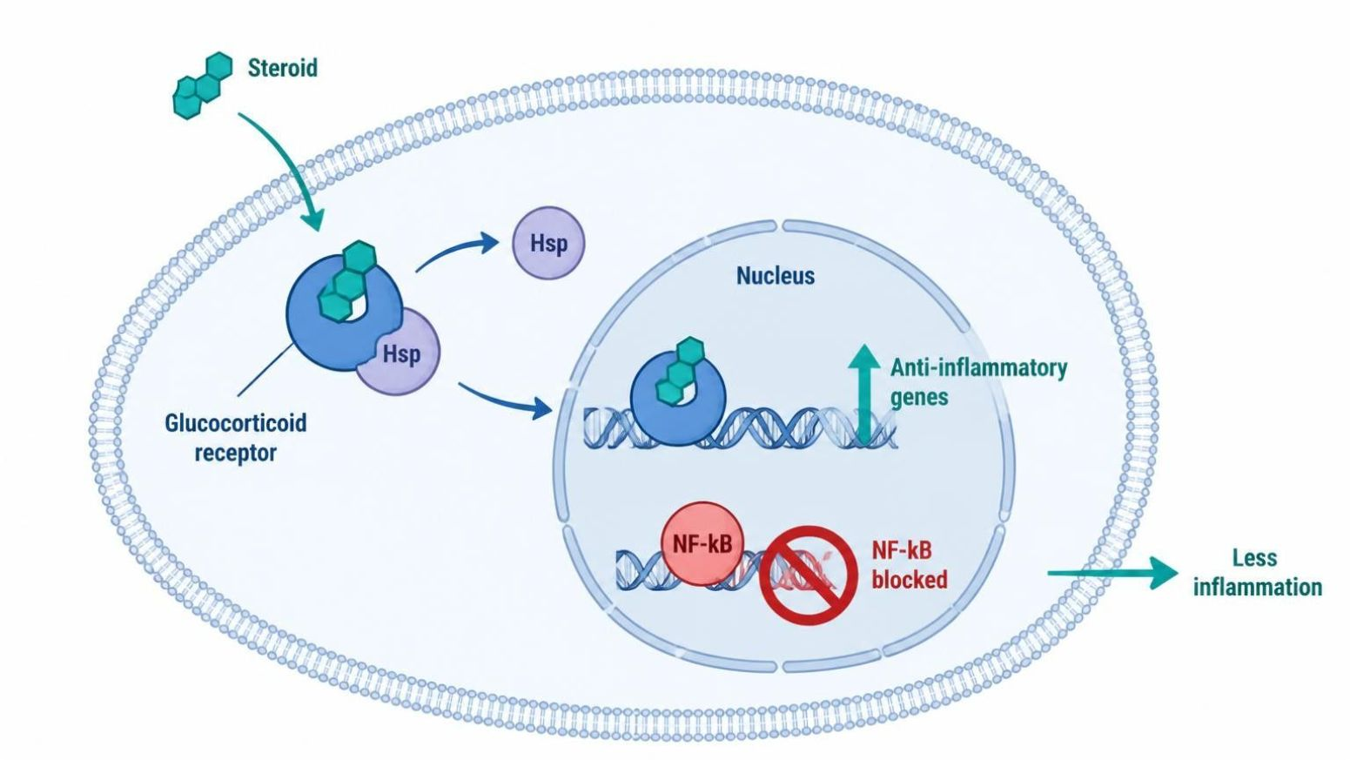
MECHANISM & DEPTH
Glucocorticoid Receptor Signaling: How Steroids Quiet Inflammation
Prednisone or cortisol crosses the cell membrane
▼
Binds the cytoplasmic glucocorticoid receptor
▼
The complex moves into the nucleus
▼
Switches on anti-inflammatory genes and represses NF-kB cytokines
▼
Schematic (illustrative)
Fewer inflammatory cells and mediators; metabolic effects over time
Figure 8. A steroid enters the cell, binds its receptor, and the complex switches genes on and off in the nucleus.
● Potency vs. hydrocortisone: prednisone about 4x, dexamethasone about 25-30x.
● Adverse effects: hyperglycemia, osteoporosis, infection, mood change, cataracts, adrenal suppression.
● Dosing: take in the morning with food; consider bone and GI protection.
● Mineralocorticoid action: fludrocortisone has it; hydrocortisone has both.
Endocrine Pharmacotherapy — Session 1 of 2 — PA Program
25
Notes:
Figure 8: The steroid binds the cytoplasmic receptor, enters the nucleus, and changes transcription; NF-kB driven cytokines are repressed.

Slide 22
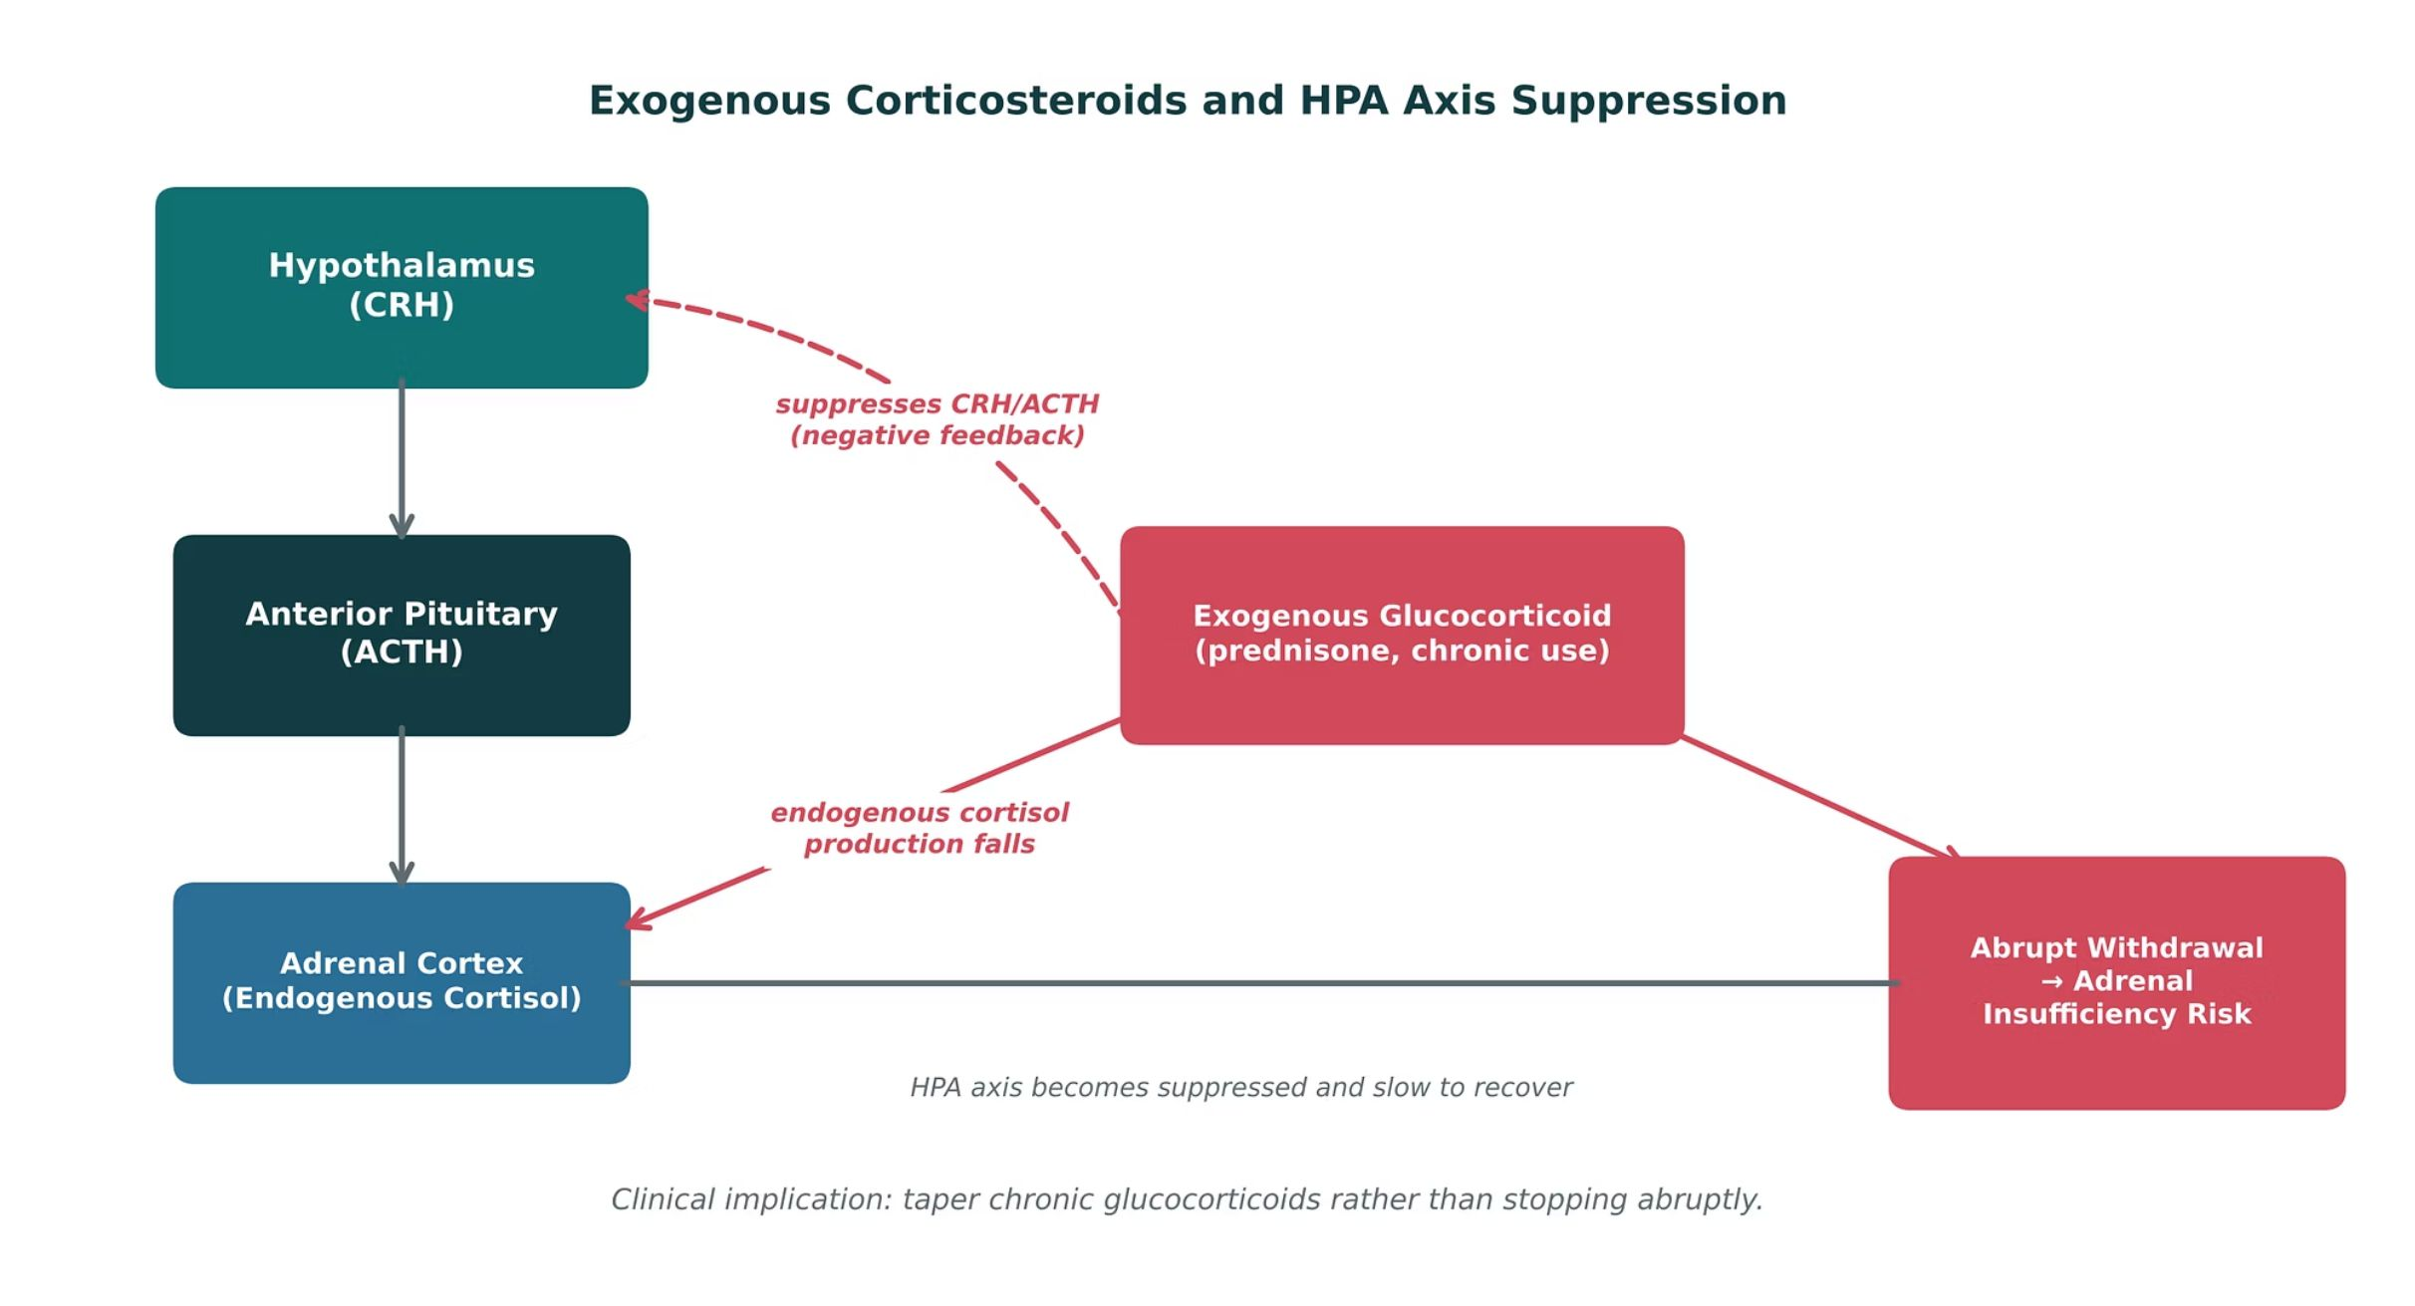
ORIGINAL ILLUSTRATION · FIGURE 9
Exogenous Corticosteroids and HPA Axis Suppression
Figure 9. Original illustrative diagram (not from Katzung): chronic exogenous glucocorticoid use suppresses CRH and ACTH via negative feedback, reducing endogenous cortisol production — abrupt withdrawal can precipitate adrenal insufficiency.
Endocrine Pharmacotherapy — Session 1 of 2 — PA Program
26
Notes:
This is the single most clinically important concept in the glucocorticoid section — every patient on chronic steroids is at risk of this, and it directly explains why tapering (not stopping) is the standard of care.
Instructor script:
Figure 9: Chronic steroids suppress CRH and ACTH. Abrupt withdrawal risks adrenal crisis; taper.

Slide 23

BLOCKING ADRENAL HORMONES
Adrenocortical Antagonists
● Ketoconazole: inhibits multiple steps in steroidogenesis (CYP enzymes); used for Cushing syndrome; significant drug-interaction and hepatotoxicity concerns.
● Metyrapone: blocks the final step of cortisol synthesis (11-β-hydroxylase); used diagnostically and for Cushing syndrome.
● Mifepristone: a glucocorticoid-receptor antagonist; used for hyperglycemia associated with Cushing syndrome when surgery is not an option (distinct from its progesterone-receptor antagonist use in pregnancy termination).
● Spironolactone: a mineralocorticoid-receptor antagonist; used for hyperaldosteronism and as a potassium-sparing diuretic — ties back to the diuretic pharmacology concepts from earlier coursework.
Endocrine Pharmacotherapy — Session 1 of 2 — PA Program
29
Notes:
Mifepristone’s dual identity (glucocorticoid-receptor antagonist here vs. progesterone-receptor antagonist elsewhere) is worth flagging explicitly so students don’t conflate the two uses or assume a single mechanism.
Instructor script:
Enzyme blockers (ketoconazole, metyrapone) lower cortisol.
Know: Ketoconazole: hepatotoxicity, QT, strong CYP3A4 inhibition. Metyrapone: androgen and deoxycorticosterone excess.

Slide 24
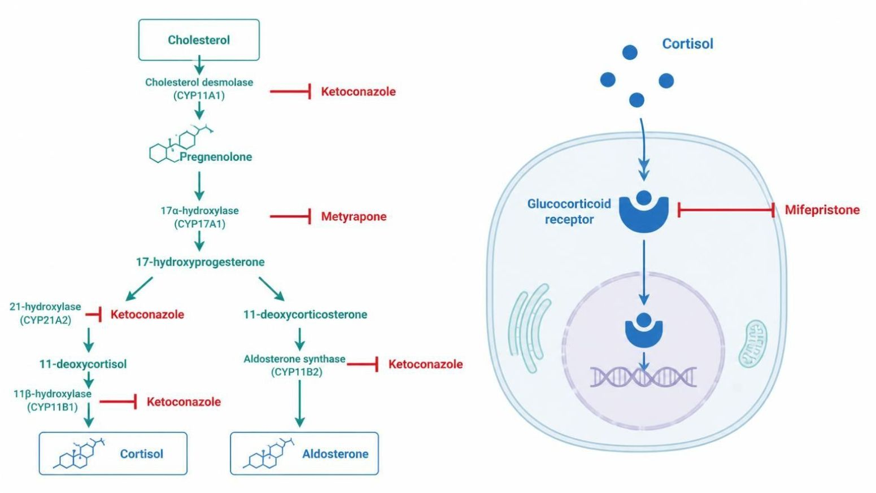
MECHANISM & DEPTH
Blocking Steroid Synthesis vs. Blocking the Receptor
Cholesterol enters the adrenal cortex
▼
CYP enzymes convert it step by step to cortisol and aldosterone
▼
Ketoconazole blocks several enzymes; metyrapone blocks the last cortisol step (11-beta-hydroxylase)
▼
Cortisol or aldosterone binds its receptor
▼
Schematic (illustrative)
Mifepristone blocks the glucocorticoid receptor; spironolactone blocks the mineralocorticoid receptor
Figure 10. Left: enzyme blocks on the cortisol pathway. Right: receptor blocks at the glucocorticoid and mineralocorticoid receptors.
● Ketoconazole: hepatotoxicity, QT prolongation, strong CYP3A4 inhibition.
● Metyrapone: raises androgens and deoxycorticosterone (hirsutism, hypertension).
● Mifepristone: contraindicated in pregnancy; causes hypokalemia; cortisol levels rise, so monitor clinically.
● Spironolactone: hyperkalemia and gynecomastia.
Endocrine Pharmacotherapy — Session 1 of 2 — PA Program
30
Notes:
Figure 10: Receptor blockers (mifepristone, spironolactone) leave hormone levels high.
Know: Mifepristone: pregnancy contraindication, hypokalemia, misleading cortisol levels. Spironolactone: hyperkalemia.

Slide 25
HIGH-YIELD COMPARISON · TABLE 1
Adrenal Pharmacology at a Glance
Agent | Category | Key Teaching Point
Prednisone, dexamethasone | Glucocorticoid | Anti-inflammatory; chronic use risks HPA suppression — taper, don’t stop abruptly
Fludrocortisone | Mineralocorticoid | Sodium retention/potassium excretion; replacement in Addison disease
Ketoconazole, metyrapone | Steroidogenesis inhibitor | Block cortisol synthesis at different steps; used in Cushing syndrome
Mifepristone | Glucocorticoid-receptor antagonist | Hyperglycemia in Cushing syndrome when surgery isn’t an option
Endocrine Pharmacotherapy — Session 1 of 2 — PA Program
31
Notes:
Use this table to consolidate the adrenal section before the case vignette — a good moment to pause for questions before applying the concepts clinically.
Instructor script:
Walk the four rows of the table.

Slide 26
MECHANISM & DEPTH
Drug Names Reveal the Class: Endocrine Agents
Stem
Drug class
Examples
Key point
-tide
Somatostatin analog
octreotide, lanreotide
Lowers GH release
-pressin
Vasopressin analog
desmopressin
Central diabetes insipidus
-vaptan
Vasopressin V2 antagonist
tolvaptan
SIADH
-ergoline
Dopamine agonist (ergot-derived)
cabergoline
Lowers prolactin
-thyroxine
Thyroid hormone
levothyroxine
Replacement, titrate to TSH
-imazole / -thiouracil
Thionamide antithyroid
methimazole, propylthiouracil
Blocks hormone synthesis
-sone / -solone
Corticosteroid
prednisone, dexamethasone
Anti-inflammatory; taper
-conazole
Azole steroidogenesis inhibitor
ketoconazole
Cushing syndrome
-pristone
Receptor antagonist
mifepristone
Glucocorticoid-receptor block
-lactone
Mineralocorticoid antagonist
spironolactone
Hyperkalemia risk
A stem is a memory aid, not a rule: where no shared stem exists, learn the class name instead.
Endocrine Pharmacotherapy — Session 1 of 2 — PA Program
32
Notes:
Drug-name stems: -tide, -pressin, -vaptan, -ergoline, -thyroxine, -imazole/-thiouracil, -sone, -conazole, -pristone, -lactone.

Slide 27
CLINICAL CASE
Recognizing Adrenal Crisis
A patient who has been on chronic high-dose prednisone for a rheumatologic condition abruptly stops the medication after running out of refills, then presents with hypotension, weakness, nausea, and confusion.
Ask yourself: What is the most likely cause of this presentation, and how should it be managed?
Clinical pearl: This presentation is consistent with acute adrenal insufficiency (adrenal crisis) from abrupt glucocorticoid withdrawal after HPA-axis suppression. Management requires immediate IV hydrocortisone (which has both glucocorticoid and mineralocorticoid activity) and IV fluids — this is a medical emergency, not a routine medication-refill issue.
Endocrine Pharmacotherapy — Session 1 of 2 — PA Program
33
Notes:
This case is the direct clinical payoff of Figure 9 — emphasize that the fix for a missed refill here is not "just restart the pill," it’s emergent IV steroid replacement.
Instructor script:
Missed refills with hypotension and confusion is adrenal crisis. Treat with IV hydrocortisone and fluids. Tapering protects against it.

Slide 28
BIG PICTURE
Session 1 Recap — To Be Continued
1
The hypothalamic-pituitary-target gland axis (Figure 1) is a shared regulatory template across thyroid, adrenal, and gonadal systems — drug therapy can intervene at any level.
2
Thyroid hormone synthesis has distinct, drug-targetable steps (Figure 6); PTU uniquely blocks peripheral T4-to-T3 conversion, making it preferred in thyroid storm and first-trimester pregnancy.
3
Chronic exogenous glucocorticoid use suppresses the HPA axis (Figure 9) — abrupt withdrawal risks adrenal crisis, so chronic therapy is tapered, not stopped.
4
Adrenocortical antagonists (ketoconazole, metyrapone, mifepristone, spironolactone) block cortisol or aldosterone synthesis/action at different points for Cushing syndrome and hyperaldosteronism.
5
Session 2 (Thursday, November 12) continues with gonadal hormones, pancreatic hormones/diabetes pharmacotherapy, and parathyroid disorders.
Endocrine Pharmacotherapy — Session 1 of 2 — PA Program
Notes:
Close Session 1 by previewing Session 2 explicitly — students should leave knowing the pituitary-thyroid-adrenal axis is complete, and that reproductive hormones, diabetes, and bone/calcium pharmacology pick up first next time.
Instructor script:
Read the five points and preview Session 2.

Slide 29
APPENDIX 1
Drug Profiles
Formulation, dose, indications, adverse effects, contraindications and toxicity
Abbreviation key
PO = by mouth
SC = subcutaneous
IM = intramuscular
IV = intravenous
ER = extended-release
ODT = orally disintegrating tablet
LAR = long-acting release
BID / TID / QID = two / three / four times daily
mcg = microgram
GH = growth hormone
IGF-1 = insulin-like growth factor 1
TSH = thyroid-stimulating hormone
T4 / T3 = thyroxine / triiodothyronine
DI = diabetes insipidus
SIADH = syndrome of inappropriate ADH secretion
HPA = hypothalamic-pituitary-adrenal
CBC = complete blood count
LFT = liver function tests
QT = QT interval on ECG
CYP = cytochrome P450
MI = myocardial infarction
MRI = magnetic resonance imaging
ARB = angiotensin receptor blocker
AV = atrioventricular
CNS = central nervous system
Endocrine Pharmacotherapy — Session 1 of 2 — PA Program
37
Notes:
Abbreviation key: PO = by mouth; SC = subcutaneous; IM = intramuscular; IV = intravenous; ER = extended-release; ODT = orally disintegrating tablet; LAR = long-acting release; BID / TID / QID = two / three / four times daily; mcg = microgram; GH = growth hormone; IGF-1 = insulin-like growth factor 1; TSH = thyroid-stimulating hormone; T4 / T3 = thyroxine / triiodothyronine; DI = diabetes insipidus; SIADH = syndrome of inappropriate ADH secretion; HPA = hypothalamic-pituitary-adrenal; CBC = complete blood count; LFT = liver function tests; QT = QT interval on ECG; CYP = cytochrome P450; MI = myocardial infarction; MRI = magnetic resonance imaging; ARB = angiotensin receptor blocker; AV = atrioventricular; CNS = central nervous system.
Instructor script:
Say: "The profiles are your study reference. Know the dose logic, the one or two serious adverse effects, the contraindication that changes the decision, and the toxicity you would need to recognize."
How to use in class (10 minutes): Give each group two or three profiles and have them teach back dose, key contraindication and toxicity in 60 seconds each.
Abbreviation key: Review PO, SC, IM, IV, LAR, DI, SIADH, HPA, CYP and QT.
Teaching points by class: Pituitary: somatostatin analogs, pegvisomant, dopamine agonists, desmopressin, tolvaptan, demeclocycline. Thyroid: levothyroxine, methimazole, PTU, propranolol, potassium iodide. Adrenal: prednisone, dexamethasone, hydrocortisone, fludrocortisone, ketoconazole, metyrapone, mifepristone, spironolactone.
Bloom's prompts: Remember: state the levothyroxine dose logic. Understand: explain why iodine follows PTU. Apply: counsel a patient out of prednisone refills. Analyze: explain the cortisol rise on mifepristone. Evaluate: choose therapy for storm in a patient with asthma and defend it.

Slide 30
DRUG PROFILE
Somatropin (Genotropin, Norditropin)
Recombinant human growth hormone
FORMULATION
DOSE (ADULT)
INDICATIONS
SC injection pens and cartridges (several mg strengths)
Adults: start about 0.2 mg SC daily and titrate by IGF-1; children: weight-based daily SC dosing
GH deficiency (children and adults), Turner syndrome, other growth disorders
ADVERSE EFFECTS
CONTRAINDICATIONS
TOXICITY / OVERDOSE
Injection-site reaction, edema, joint pain, headache, hyperglycemia
Active malignancy, closed epiphyses (for growth promotion), acute critical illness
Fluid retention, glucose intolerance, intracranial hypertension, slipped capital femoral epiphysis; titrate by IGF-1
Standard adult dosing for teaching; verify against current prescribing information.
Endocrine Pharmacotherapy — Session 1 of 2 — PA Program
38
Notes:
Somatropin (Genotropin, Norditropin). Class: Recombinant human growth hormone. Formulation: SC injection pens and cartridges (several mg strengths). Dose (adult): Adults: start about 0.2 mg SC daily and titrate by IGF-1; children: weight-based daily SC dosing. Indications: GH deficiency (children and adults), Turner syndrome, other growth disorders. Adverse effects: Injection-site reaction, edema, joint pain, headache, hyperglycemia. Contraindications: Active malignancy, closed epiphyses (for growth promotion), acute critical illness. Toxicity / overdose: Fluid retention, glucose intolerance, intracranial hypertension, slipped capital femoral epiphysis; titrate by IGF-1.

Slide 31
DRUG PROFILE
Octreotide (Sandostatin)
Somatostatin analog
FORMULATION
DOSE (ADULT)
INDICATIONS
SC injection 50/100/500 mcg/mL; LAR depot IM 10/20/30 mg; oral capsule
Acromegaly: 50 mcg SC TID, titrate to 100-200 mcg TID; LAR 20 mg IM every 4 weeks
Acromegaly, carcinoid syndrome, VIPoma, esophageal variceal bleeding
ADVERSE EFFECTS
CONTRAINDICATIONS
TOXICITY / OVERDOSE
GI upset, diarrhea, gallstones, bradycardia, glucose changes
Hypersensitivity
Gallstones, hypo- or hyperglycemia, bradycardia and conduction block; monitor IGF-1, glucose, gallbladder
Standard adult dosing for teaching; verify against current prescribing information.
Endocrine Pharmacotherapy — Session 1 of 2 — PA Program
39
Notes:
Octreotide (Sandostatin). Class: Somatostatin analog. Formulation: SC injection 50/100/500 mcg/mL; LAR depot IM 10/20/30 mg; oral capsule. Dose (adult): Acromegaly: 50 mcg SC TID, titrate to 100-200 mcg TID; LAR 20 mg IM every 4 weeks. Indications: Acromegaly, carcinoid syndrome, VIPoma, esophageal variceal bleeding. Adverse effects: GI upset, diarrhea, gallstones, bradycardia, glucose changes. Contraindications: Hypersensitivity. Toxicity / overdose: Gallstones, hypo- or hyperglycemia, bradycardia and conduction block; monitor IGF-1, glucose, gallbladder.

Slide 32
DRUG PROFILE
Lanreotide (Somatuline Depot)
Somatostatin analog
FORMULATION
DOSE (ADULT)
INDICATIONS
Deep SC injection 60/90/120 mg prefilled syringe
90 mg deep SC every 4 weeks for 3 months, then adjust between 60 and 120 mg
Acromegaly, neuroendocrine tumors, carcinoid syndrome
ADVERSE EFFECTS
CONTRAINDICATIONS
TOXICITY / OVERDOSE
Diarrhea, abdominal pain, gallstones, injection-site reaction, bradycardia
Hypersensitivity
Gallstones, glucose dysregulation, bradycardia; monitor GH and IGF-1
Standard adult dosing for teaching; verify against current prescribing information.
Endocrine Pharmacotherapy — Session 1 of 2 — PA Program
40
Notes:
Lanreotide (Somatuline Depot). Class: Somatostatin analog. Formulation: Deep SC injection 60/90/120 mg prefilled syringe. Dose (adult): 90 mg deep SC every 4 weeks for 3 months, then adjust between 60 and 120 mg. Indications: Acromegaly, neuroendocrine tumors, carcinoid syndrome. Adverse effects: Diarrhea, abdominal pain, gallstones, injection-site reaction, bradycardia. Contraindications: Hypersensitivity. Toxicity / overdose: Gallstones, glucose dysregulation, bradycardia; monitor GH and IGF-1.

Slide 33
DRUG PROFILE
Pegvisomant (Somavert)
GH receptor antagonist
FORMULATION
DOSE (ADULT)
INDICATIONS
SC injection vials 10/15/20/25/30 mg
Load 40 mg SC, then 10 mg SC daily, titrate by IGF-1 (max 30 mg/day)
Acromegaly not controlled by surgery or somatostatin analogs
ADVERSE EFFECTS
CONTRAINDICATIONS
TOXICITY / OVERDOSE
Injection-site reaction, headache, raised liver enzymes, flu-like symptoms
Hypersensitivity
Liver injury; monitor tumor size by MRI; GH levels rise and are not used for monitoring
Standard adult dosing for teaching; verify against current prescribing information.
Endocrine Pharmacotherapy — Session 1 of 2 — PA Program
41
Notes:
Pegvisomant (Somavert). Class: GH receptor antagonist. Formulation: SC injection vials 10/15/20/25/30 mg. Dose (adult): Load 40 mg SC, then 10 mg SC daily, titrate by IGF-1 (max 30 mg/day). Indications: Acromegaly not controlled by surgery or somatostatin analogs. Adverse effects: Injection-site reaction, headache, raised liver enzymes, flu-like symptoms. Contraindications: Hypersensitivity. Toxicity / overdose: Liver injury; monitor tumor size by MRI; GH levels rise and are not used for monitoring.

Slide 34
DRUG PROFILE
Cabergoline (Dostinex)
Dopamine D2 agonist (ergot-derived)
FORMULATION
DOSE (ADULT)
INDICATIONS
Tablet 0.5 mg
0.25 mg PO twice weekly, increase by 0.25 mg every 4 weeks to usual max 1 mg twice weekly
Hyperprolactinemia, prolactinoma
ADVERSE EFFECTS
CONTRAINDICATIONS
TOXICITY / OVERDOSE
Nausea, dizziness, headache, orthostatic hypotension
Uncontrolled hypertension, cardiac valvulopathy, ergot hypersensitivity
Cardiac valve fibrosis at high doses; impulse-control and psychiatric effects; overdose causes hypotension and nausea
Standard adult dosing for teaching; verify against current prescribing information.
Endocrine Pharmacotherapy — Session 1 of 2 — PA Program
42
Notes:
Cabergoline (Dostinex). Class: Dopamine D2 agonist (ergot-derived). Formulation: Tablet 0.5 mg. Dose (adult): 0.25 mg PO twice weekly, increase by 0.25 mg every 4 weeks to usual max 1 mg twice weekly. Indications: Hyperprolactinemia, prolactinoma. Adverse effects: Nausea, dizziness, headache, orthostatic hypotension. Contraindications: Uncontrolled hypertension, cardiac valvulopathy, ergot hypersensitivity. Toxicity / overdose: Cardiac valve fibrosis at high doses; impulse-control and psychiatric effects; overdose causes hypotension and nausea.

Slide 35
DRUG PROFILE
Bromocriptine (Parlodel, Cycloset)
Dopamine D2 agonist (ergot-derived)
FORMULATION
DOSE (ADULT)
INDICATIONS
Tablet 2.5 mg; capsule 5 mg; Cycloset 0.8 mg tablet
1.25-2.5 mg PO at bedtime, titrate to 2.5 mg BID-TID for prolactinoma (max 15 mg/day)
Hyperprolactinemia, acromegaly (adjunct), Parkinson disease, type 2 diabetes (Cycloset)
ADVERSE EFFECTS
CONTRAINDICATIONS
TOXICITY / OVERDOSE
Nausea, orthostatic hypotension, dizziness, headache, nasal congestion
Uncontrolled hypertension, pregnancy-related hypertension, ergot hypersensitivity
Hypotension and syncope, psychosis, fibrosis with long-term high doses; take with food
Standard adult dosing for teaching; verify against current prescribing information.
Endocrine Pharmacotherapy — Session 1 of 2 — PA Program
43
Notes:
Bromocriptine (Parlodel, Cycloset). Class: Dopamine D2 agonist (ergot-derived). Formulation: Tablet 2.5 mg; capsule 5 mg; Cycloset 0.8 mg tablet. Dose (adult): 1.25-2.5 mg PO at bedtime, titrate to 2.5 mg BID-TID for prolactinoma (max 15 mg/day). Indications: Hyperprolactinemia, acromegaly (adjunct), Parkinson disease, type 2 diabetes (Cycloset). Adverse effects: Nausea, orthostatic hypotension, dizziness, headache, nasal congestion. Contraindications: Uncontrolled hypertension, pregnancy-related hypertension, ergot hypersensitivity. Toxicity / overdose: Hypotension and syncope, psychosis, fibrosis with long-term high doses; take with food.

Slide 36
DRUG PROFILE
Desmopressin (DDAVP)
Synthetic vasopressin V2 agonist
FORMULATION
DOSE (ADULT)
INDICATIONS
Tablet 0.1/0.2 mg; nasal spray; SC/IV 4 mcg/mL; ODT 60 mcg
Central DI: 0.05-0.2 mg PO BID, or 10-40 mcg intranasal daily in divided doses; titrate to urine output
Central diabetes insipidus, nocturnal enuresis, hemophilia A and von Willebrand disease (IV)
ADVERSE EFFECTS
CONTRAINDICATIONS
TOXICITY / OVERDOSE
Headache, nausea, flushing, hyponatremia
Hyponatremia history, polydipsia, eGFR below 50, heart failure
Water intoxication with severe hyponatremia and seizures; limit fluids and monitor sodium
Standard adult dosing for teaching; verify against current prescribing information.
Endocrine Pharmacotherapy — Session 1 of 2 — PA Program
44
Notes:
Desmopressin (DDAVP). Class: Synthetic vasopressin V2 agonist. Formulation: Tablet 0.1/0.2 mg; nasal spray; SC/IV 4 mcg/mL; ODT 60 mcg. Dose (adult): Central DI: 0.05-0.2 mg PO BID, or 10-40 mcg intranasal daily in divided doses; titrate to urine output. Indications: Central diabetes insipidus, nocturnal enuresis, hemophilia A and von Willebrand disease (IV). Adverse effects: Headache, nausea, flushing, hyponatremia. Contraindications: Hyponatremia history, polydipsia, eGFR below 50, heart failure. Toxicity / overdose: Water intoxication with severe hyponatremia and seizures; limit fluids and monitor sodium.

Slide 37
DRUG PROFILE
Tolvaptan (Samsca)
Vasopressin V2 receptor antagonist
FORMULATION
DOSE (ADULT)
INDICATIONS
Tablet 15/30 mg
15 mg PO once daily, titrate to 30-60 mg; start in hospital
Hyponatremia from SIADH or heart failure
ADVERSE EFFECTS
CONTRAINDICATIONS
TOXICITY / OVERDOSE
Thirst, dry mouth, polyuria, hypernatremia, liver injury
Urgent need to raise sodium, hypovolemia, anuria, strong CYP3A4 inhibitors
Overly rapid sodium correction (osmotic demyelination); liver injury; limit therapy to 30 days
Standard adult dosing for teaching; verify against current prescribing information.
Endocrine Pharmacotherapy — Session 1 of 2 — PA Program
45
Notes:
Tolvaptan (Samsca). Class: Vasopressin V2 receptor antagonist. Formulation: Tablet 15/30 mg. Dose (adult): 15 mg PO once daily, titrate to 30-60 mg; start in hospital. Indications: Hyponatremia from SIADH or heart failure. Adverse effects: Thirst, dry mouth, polyuria, hypernatremia, liver injury. Contraindications: Urgent need to raise sodium, hypovolemia, anuria, strong CYP3A4 inhibitors. Toxicity / overdose: Overly rapid sodium correction (osmotic demyelination); liver injury; limit therapy to 30 days.

Slide 38
DRUG PROFILE
Demeclocycline
Tetracycline with ADH-antagonist effect
FORMULATION
DOSE (ADULT)
INDICATIONS
Tablet 150/300 mg
150-300 mg PO 3-4 times daily for SIADH (off-label)
Refractory SIADH (off-label), bacterial infections
ADVERSE EFFECTS
CONTRAINDICATIONS
TOXICITY / OVERDOSE
Photosensitivity, nausea, nephrogenic diabetes insipidus
Pregnancy, children under 8 years, hypersensitivity, severe renal impairment
Nephrotoxicity, photosensitivity, tooth discoloration; separate from calcium and antacids
Standard adult dosing for teaching; verify against current prescribing information.
Endocrine Pharmacotherapy — Session 1 of 2 — PA Program
46
Notes:
Demeclocycline. Class: Tetracycline with ADH-antagonist effect. Formulation: Tablet 150/300 mg. Dose (adult): 150-300 mg PO 3-4 times daily for SIADH (off-label). Indications: Refractory SIADH (off-label), bacterial infections. Adverse effects: Photosensitivity, nausea, nephrogenic diabetes insipidus. Contraindications: Pregnancy, children under 8 years, hypersensitivity, severe renal impairment. Toxicity / overdose: Nephrotoxicity, photosensitivity, tooth discoloration; separate from calcium and antacids.

Slide 39
DRUG PROFILE
Levothyroxine (Synthroid, Levoxyl)
Synthetic thyroid hormone (T4)
FORMULATION
DOSE (ADULT)
INDICATIONS
Tablet 25-300 mcg (12 strengths); IV 100-500 mcg vial; liquid and capsule
Full replacement about 1.6 mcg/kg/day PO; start 12.5-50 mcg in older adults or heart disease; recheck TSH in 6-8 weeks
Hypothyroidism, myxedema coma (IV), TSH suppression in thyroid cancer
ADVERSE EFFECTS
CONTRAINDICATIONS
TOXICITY / OVERDOSE
Usually none at the right dose; over-replacement causes tachycardia, tremor, insomnia, bone loss
Uncorrected adrenal insufficiency, acute MI, hypersensitivity
Over-replacement: atrial fibrillation, angina, osteoporosis; separate from calcium, iron and antacids by 4 hours
Standard adult dosing for teaching; verify against current prescribing information.
Endocrine Pharmacotherapy — Session 1 of 2 — PA Program
47
Notes:
Levothyroxine (Synthroid, Levoxyl). Class: Synthetic thyroid hormone (T4). Formulation: Tablet 25-300 mcg (12 strengths); IV 100-500 mcg vial; liquid and capsule. Dose (adult): Full replacement about 1.6 mcg/kg/day PO; start 12.5-50 mcg in older adults or heart disease; recheck TSH in 6-8 weeks. Indications: Hypothyroidism, myxedema coma (IV), TSH suppression in thyroid cancer. Adverse effects: Usually none at the right dose; over-replacement causes tachycardia, tremor, insomnia, bone loss. Contraindications: Uncorrected adrenal insufficiency, acute MI, hypersensitivity. Toxicity / overdose: Over-replacement: atrial fibrillation, angina, osteoporosis; separate from calcium, iron and antacids by 4 hours.

Slide 40
DRUG PROFILE
Methimazole (Tapazole)
Thionamide antithyroid drug
FORMULATION
DOSE (ADULT)
INDICATIONS
Tablet 5/10 mg
Graves disease: start 10-30 mg PO once daily; adjust to free T4 every 4-6 weeks
Graves disease, toxic nodular goiter, pre-operative control
ADVERSE EFFECTS
CONTRAINDICATIONS
TOXICITY / OVERDOSE
Rash, itching, joint pain, taste change; agranulocytosis (rare)
First trimester of pregnancy; prior methimazole agranulocytosis
Agranulocytosis (fever or sore throat: stop and check CBC), hepatotoxicity, teratogenicity
Standard adult dosing for teaching; verify against current prescribing information.
Endocrine Pharmacotherapy — Session 1 of 2 — PA Program
48
Notes:
Methimazole (Tapazole). Class: Thionamide antithyroid drug. Formulation: Tablet 5/10 mg. Dose (adult): Graves disease: start 10-30 mg PO once daily; adjust to free T4 every 4-6 weeks. Indications: Graves disease, toxic nodular goiter, pre-operative control. Adverse effects: Rash, itching, joint pain, taste change; agranulocytosis (rare). Contraindications: First trimester of pregnancy; prior methimazole agranulocytosis. Toxicity / overdose: Agranulocytosis (fever or sore throat: stop and check CBC), hepatotoxicity, teratogenicity.

Slide 41
DRUG PROFILE
Propylthiouracil (PTU)
Thionamide antithyroid drug (also blocks T4 to T3)
FORMULATION
DOSE (ADULT)
INDICATIONS
Tablet 50 mg
Start 100 mg PO TID (up to 300-400 mg/day); thyroid storm: 500-1,000 mg load, then 250 mg every 4 hours
First-trimester Graves disease, thyroid storm, methimazole intolerance
ADVERSE EFFECTS
CONTRAINDICATIONS
TOXICITY / OVERDOSE
Rash, nausea, taste change, joint pain
Prior PTU liver injury; avoid in children
Boxed warning: severe liver failure; agranulocytosis; ANCA-positive vasculitis
Standard adult dosing for teaching; verify against current prescribing information.
Endocrine Pharmacotherapy — Session 1 of 2 — PA Program
49
Notes:
Propylthiouracil (PTU). Class: Thionamide antithyroid drug (also blocks T4 to T3). Formulation: Tablet 50 mg. Dose (adult): Start 100 mg PO TID (up to 300-400 mg/day); thyroid storm: 500-1,000 mg load, then 250 mg every 4 hours. Indications: First-trimester Graves disease, thyroid storm, methimazole intolerance. Adverse effects: Rash, nausea, taste change, joint pain. Contraindications: Prior PTU liver injury; avoid in children. Toxicity / overdose: Boxed warning: severe liver failure; agranulocytosis; ANCA-positive vasculitis.

Slide 42
DRUG PROFILE
Propranolol (Inderal)
Nonselective beta-blocker
FORMULATION
DOSE (ADULT)
INDICATIONS
Tablet 10/20/40/60/80 mg; ER capsule; IV 1 mg/mL
Thyrotoxic symptoms: 20-40 mg PO every 6-8 hours; thyroid storm: 60-80 mg PO every 4 hours or 0.5-1 mg IV
Thyrotoxic symptoms, thyroid storm, hypertension, tremor
ADVERSE EFFECTS
CONTRAINDICATIONS
TOXICITY / OVERDOSE
Bradycardia, fatigue, bronchospasm, masks hypoglycemia
Asthma, decompensated heart failure, high-grade AV block, severe bradycardia
Bradycardia, hypotension, bronchospasm; avoid abrupt stopping; may mask hypoglycemia
Standard adult dosing for teaching; verify against current prescribing information.
Endocrine Pharmacotherapy — Session 1 of 2 — PA Program
50
Notes:
Propranolol (Inderal). Class: Nonselective beta-blocker. Formulation: Tablet 10/20/40/60/80 mg; ER capsule; IV 1 mg/mL. Dose (adult): Thyrotoxic symptoms: 20-40 mg PO every 6-8 hours; thyroid storm: 60-80 mg PO every 4 hours or 0.5-1 mg IV. Indications: Thyrotoxic symptoms, thyroid storm, hypertension, tremor. Adverse effects: Bradycardia, fatigue, bronchospasm, masks hypoglycemia. Contraindications: Asthma, decompensated heart failure, high-grade AV block, severe bradycardia. Toxicity / overdose: Bradycardia, hypotension, bronchospasm; avoid abrupt stopping; may mask hypoglycemia.

Slide 43
DRUG PROFILE
Potassium iodide (SSKI, Lugol solution)
Iodine (blocks hormone release)
FORMULATION
DOSE (ADULT)
INDICATIONS
SSKI 1 g/mL solution; Lugol 5% solution; tablets 65/130 mg
Thyroid storm: 5 drops (about 250 mg) SSKI PO every 6 hours, at least 1 hour after a thionamide
Thyroid storm, pre-thyroidectomy preparation, radiation protection
ADVERSE EFFECTS
CONTRAINDICATIONS
TOXICITY / OVERDOSE
Metallic taste, GI upset, salivary gland swelling, rash
Giving before a thionamide; iodine allergy
Iodism (rash, swelling, fever); thyroid escape after about 10 days; hypo- or hyperthyroidism
Standard adult dosing for teaching; verify against current prescribing information.
Endocrine Pharmacotherapy — Session 1 of 2 — PA Program
51
Notes:
Potassium iodide (SSKI, Lugol solution). Class: Iodine (blocks hormone release). Formulation: SSKI 1 g/mL solution; Lugol 5% solution; tablets 65/130 mg. Dose (adult): Thyroid storm: 5 drops (about 250 mg) SSKI PO every 6 hours, at least 1 hour after a thionamide. Indications: Thyroid storm, pre-thyroidectomy preparation, radiation protection. Adverse effects: Metallic taste, GI upset, salivary gland swelling, rash. Contraindications: Giving before a thionamide; iodine allergy. Toxicity / overdose: Iodism (rash, swelling, fever); thyroid escape after about 10 days; hypo- or hyperthyroidism.

Slide 44
DRUG PROFILE
Prednisone
Glucocorticoid (prodrug of prednisolone)
FORMULATION
DOSE (ADULT)
INDICATIONS
Tablet 1/2.5/5/10/20/50 mg; oral solution
5-60 mg PO daily depending on indication; taper after more than 3 weeks of therapy
Inflammatory and autoimmune disease, allergic reactions
ADVERSE EFFECTS
CONTRAINDICATIONS
TOXICITY / OVERDOSE
Hyperglycemia, insomnia, mood change, weight gain, infection, osteoporosis
Systemic fungal infection; live vaccines at high dose
Adrenal suppression and crisis on abrupt stopping; Cushingoid features, cataracts, avascular necrosis
Standard adult dosing for teaching; verify against current prescribing information.
Endocrine Pharmacotherapy — Session 1 of 2 — PA Program
52
Notes:
Prednisone. Class: Glucocorticoid (prodrug of prednisolone). Formulation: Tablet 1/2.5/5/10/20/50 mg; oral solution. Dose (adult): 5-60 mg PO daily depending on indication; taper after more than 3 weeks of therapy. Indications: Inflammatory and autoimmune disease, allergic reactions. Adverse effects: Hyperglycemia, insomnia, mood change, weight gain, infection, osteoporosis. Contraindications: Systemic fungal infection; live vaccines at high dose. Toxicity / overdose: Adrenal suppression and crisis on abrupt stopping; Cushingoid features, cataracts, avascular necrosis.

Slide 45
DRUG PROFILE
Dexamethasone (Decadron)
Long-acting glucocorticoid
FORMULATION
DOSE (ADULT)
INDICATIONS
Tablet 0.5-6 mg; oral solution; IV 4/10 mg/mL
0.5-9 mg PO or IV daily by indication; cerebral edema 10 mg IV load, then 4 mg every 6 hours; thyroid storm 2 mg IV every 6 hours
Cerebral edema, antiemetic, severe inflammation, Cushing screening test
ADVERSE EFFECTS
CONTRAINDICATIONS
TOXICITY / OVERDOSE
Insomnia, hyperglycemia, mood change, immune suppression
Systemic fungal infection, hypersensitivity
Potency about 25-30 times hydrocortisone with no mineralocorticoid effect; adrenal suppression, psychosis
Standard adult dosing for teaching; verify against current prescribing information.
Endocrine Pharmacotherapy — Session 1 of 2 — PA Program
53
Notes:
Dexamethasone (Decadron). Class: Long-acting glucocorticoid. Formulation: Tablet 0.5-6 mg; oral solution; IV 4/10 mg/mL. Dose (adult): 0.5-9 mg PO or IV daily by indication; cerebral edema 10 mg IV load, then 4 mg every 6 hours; thyroid storm 2 mg IV every 6 hours. Indications: Cerebral edema, antiemetic, severe inflammation, Cushing screening test. Adverse effects: Insomnia, hyperglycemia, mood change, immune suppression. Contraindications: Systemic fungal infection, hypersensitivity. Toxicity / overdose: Potency about 25-30 times hydrocortisone with no mineralocorticoid effect; adrenal suppression, psychosis.

Slide 46
DRUG PROFILE
Hydrocortisone (Cortef, Solu-Cortef)
Glucocorticoid with mineralocorticoid activity
FORMULATION
DOSE (ADULT)
INDICATIONS
Tablet 5/10/20 mg; IV 100 mg vial
Replacement 15-25 mg/day PO in 2-3 divided doses; adrenal crisis 100 mg IV, then 200 mg over 24 hours
Adrenal insufficiency, adrenal crisis, inflammatory conditions
ADVERSE EFFECTS
CONTRAINDICATIONS
TOXICITY / OVERDOSE
Hyperglycemia, fluid retention, mood change, infection risk
Systemic fungal infection
Excess causes Cushingoid features, hypertension, hypokalemia; stress-dose during illness and surgery
Standard adult dosing for teaching; verify against current prescribing information.
Endocrine Pharmacotherapy — Session 1 of 2 — PA Program
54
Notes:
Hydrocortisone (Cortef, Solu-Cortef). Class: Glucocorticoid with mineralocorticoid activity. Formulation: Tablet 5/10/20 mg; IV 100 mg vial. Dose (adult): Replacement 15-25 mg/day PO in 2-3 divided doses; adrenal crisis 100 mg IV, then 200 mg over 24 hours. Indications: Adrenal insufficiency, adrenal crisis, inflammatory conditions. Adverse effects: Hyperglycemia, fluid retention, mood change, infection risk. Contraindications: Systemic fungal infection. Toxicity / overdose: Excess causes Cushingoid features, hypertension, hypokalemia; stress-dose during illness and surgery.

Slide 47
DRUG PROFILE
Fludrocortisone (Florinef)
Mineralocorticoid
FORMULATION
DOSE (ADULT)
INDICATIONS
Tablet 0.1 mg
0.05-0.2 mg PO once daily
Primary adrenal insufficiency (with a glucocorticoid), orthostatic hypotension
ADVERSE EFFECTS
CONTRAINDICATIONS
TOXICITY / OVERDOSE
Hypertension, edema, hypokalemia, headache
Systemic fungal infection; caution in heart failure
Hypokalemia, fluid overload, supine hypertension; monitor blood pressure and potassium
Standard adult dosing for teaching; verify against current prescribing information.
Endocrine Pharmacotherapy — Session 1 of 2 — PA Program
55
Notes:
Fludrocortisone (Florinef). Class: Mineralocorticoid. Formulation: Tablet 0.1 mg. Dose (adult): 0.05-0.2 mg PO once daily. Indications: Primary adrenal insufficiency (with a glucocorticoid), orthostatic hypotension. Adverse effects: Hypertension, edema, hypokalemia, headache. Contraindications: Systemic fungal infection; caution in heart failure. Toxicity / overdose: Hypokalemia, fluid overload, supine hypertension; monitor blood pressure and potassium.

Slide 48
DRUG PROFILE
Ketoconazole
Azole antifungal and steroidogenesis inhibitor
FORMULATION
DOSE (ADULT)
INDICATIONS
Tablet 200 mg
Cushing syndrome (off-label): start 200 mg PO BID, usual 400-1,200 mg/day divided
Cushing syndrome (off-label), fungal infections
ADVERSE EFFECTS
CONTRAINDICATIONS
TOXICITY / OVERDOSE
Nausea, abdominal pain, headache, gynecomastia, adrenal insufficiency
Liver disease, QT prolongation or interacting QT drugs, pregnancy
Boxed hepatotoxicity and QT prolongation; strong CYP3A4 inhibitor; monitor LFTs and ECG
Standard adult dosing for teaching; verify against current prescribing information.
Endocrine Pharmacotherapy — Session 1 of 2 — PA Program
56
Notes:
Ketoconazole. Class: Azole antifungal and steroidogenesis inhibitor. Formulation: Tablet 200 mg. Dose (adult): Cushing syndrome (off-label): start 200 mg PO BID, usual 400-1,200 mg/day divided. Indications: Cushing syndrome (off-label), fungal infections. Adverse effects: Nausea, abdominal pain, headache, gynecomastia, adrenal insufficiency. Contraindications: Liver disease, QT prolongation or interacting QT drugs, pregnancy. Toxicity / overdose: Boxed hepatotoxicity and QT prolongation; strong CYP3A4 inhibitor; monitor LFTs and ECG.

Slide 49
DRUG PROFILE
Metyrapone (Metopirone)
11-beta-hydroxylase inhibitor
FORMULATION
DOSE (ADULT)
INDICATIONS
Capsule 250 mg
Cushing syndrome: start 250 mg PO TID-QID, titrate to cortisol (up to 6 g/day); diagnostic test: 30 mg/kg once at midnight
Cushing syndrome, diagnostic test of the HPA axis
ADVERSE EFFECTS
CONTRAINDICATIONS
TOXICITY / OVERDOSE
Nausea, dizziness, hypertension, edema, hirsutism
Adrenal insufficiency, hypersensitivity
Adrenal insufficiency, hypokalemia, hypertension from deoxycorticosterone, androgen excess
Standard adult dosing for teaching; verify against current prescribing information.
Endocrine Pharmacotherapy — Session 1 of 2 — PA Program
57
Notes:
Metyrapone (Metopirone). Class: 11-beta-hydroxylase inhibitor. Formulation: Capsule 250 mg. Dose (adult): Cushing syndrome: start 250 mg PO TID-QID, titrate to cortisol (up to 6 g/day); diagnostic test: 30 mg/kg once at midnight. Indications: Cushing syndrome, diagnostic test of the HPA axis. Adverse effects: Nausea, dizziness, hypertension, edema, hirsutism. Contraindications: Adrenal insufficiency, hypersensitivity. Toxicity / overdose: Adrenal insufficiency, hypokalemia, hypertension from deoxycorticosterone, androgen excess.

Slide 50
DRUG PROFILE
Mifepristone (Korlym)
Glucocorticoid-receptor antagonist
FORMULATION
DOSE (ADULT)
INDICATIONS
Tablet 300 mg (Cushing); 200 mg (pregnancy termination)
Cushing hyperglycemia: 300 mg PO daily with a meal, titrate up to 1,200 mg/day
Hyperglycemia with Cushing syndrome when surgery is not an option
ADVERSE EFFECTS
CONTRAINDICATIONS
TOXICITY / OVERDOSE
Fatigue, nausea, headache, hypokalemia, edema, endometrial thickening
Pregnancy (boxed warning), simvastatin or lovastatin, need for long-term corticosteroids
Pregnancy loss; adrenal insufficiency (cortisol rises so labs mislead); hypokalemia
Standard adult dosing for teaching; verify against current prescribing information.
Endocrine Pharmacotherapy — Session 1 of 2 — PA Program
58
Notes:
Mifepristone (Korlym). Class: Glucocorticoid-receptor antagonist. Formulation: Tablet 300 mg (Cushing); 200 mg (pregnancy termination). Dose (adult): Cushing hyperglycemia: 300 mg PO daily with a meal, titrate up to 1,200 mg/day. Indications: Hyperglycemia with Cushing syndrome when surgery is not an option. Adverse effects: Fatigue, nausea, headache, hypokalemia, edema, endometrial thickening. Contraindications: Pregnancy (boxed warning), simvastatin or lovastatin, need for long-term corticosteroids. Toxicity / overdose: Pregnancy loss; adrenal insufficiency (cortisol rises so labs mislead); hypokalemia.

Slide 51
DRUG PROFILE
Spironolactone (Aldactone)
Mineralocorticoid-receptor antagonist
FORMULATION
DOSE (ADULT)
INDICATIONS
Tablet 25/50/100 mg
Hyperaldosteronism: 25-100 mg PO daily (up to 400 mg); heart failure 12.5-50 mg daily
Primary hyperaldosteronism, heart failure, resistant hypertension, edema, hirsutism (off-label)
ADVERSE EFFECTS
CONTRAINDICATIONS
TOXICITY / OVERDOSE
Hyperkalemia, gynecomastia, menstrual irregularity, dizziness
Hyperkalemia, Addison disease, severe renal impairment
Life-threatening hyperkalemia (with ACE inhibitors, ARBs, potassium); monitor potassium and creatinine
Standard adult dosing for teaching; verify against current prescribing information.
Endocrine Pharmacotherapy — Session 1 of 2 — PA Program
59
Notes:
Spironolactone (Aldactone). Class: Mineralocorticoid-receptor antagonist. Formulation: Tablet 25/50/100 mg. Dose (adult): Hyperaldosteronism: 25-100 mg PO daily (up to 400 mg); heart failure 12.5-50 mg daily. Indications: Primary hyperaldosteronism, heart failure, resistant hypertension, edema, hirsutism (off-label). Adverse effects: Hyperkalemia, gynecomastia, menstrual irregularity, dizziness. Contraindications: Hyperkalemia, Addison disease, severe renal impairment. Toxicity / overdose: Life-threatening hyperkalemia (with ACE inhibitors, ARBs, potassium); monitor potassium and creatinine.

Slide 52
Appendix 2: DRUG PROFILE · SUPPORTING
Supporting Drugs at a Glance
Antipsychotics and metoclopramide
Raise prolactin by blocking dopamine
Calcium, iron and antacids
Block levothyroxine absorption; separate by 4 hours
Amiodarone and lithium
Can cause hypo- or hyperthyroidism
Estrogens
Raise thyroid-binding globulin, so levothyroxine needs rise
Rifampin, phenytoin, carbamazepine
Speed clearance of levothyroxine and steroids
Azole antifungals
Raise corticosteroid exposure through CYP3A4
ACE inhibitors, ARBs and potassium
Add to spironolactone hyperkalemia
Insulin and oral agents
Doses need adjusting during steroid therapy
Listed for context; not profiled in detail.
Endocrine Pharmacotherapy — Session 1 of 2 — PA Program
60
Notes:
Supporting drugs at a glance. Antipsychotics and metoclopramide — Raise prolactin by blocking dopamine. Calcium, iron and antacids — Block levothyroxine absorption; separate by 4 hours. Amiodarone and lithium — Can cause hypo- or hyperthyroidism. Estrogens — Raise thyroid-binding globulin, so levothyroxine needs rise. Rifampin, phenytoin, carbamazepine — Speed clearance of levothyroxine and steroids. Azole antifungals — Raise corticosteroid exposure through CYP3A4. ACE inhibitors, ARBs and potassium — Add to spironolactone hyperkalemia. Insulin and oral agents — Doses need adjusting during steroid therapy. Listed for context; not profiled in detail.
Instructor script:
Supporting drugs: Read quickly; these explain interactions, not doses.

Slide 53
APPENDIX 3
Image Attribution
● Original figures in this deck: Figures 1, 6 and 9 (The Hypothalamic-Pituitary-Target Gland Axis; Thyroid Hormone Synthesis: Where Antithyroid Drugs Act; Exogenous Corticosteroids and HPA Axis Suppression) were generated by the course director using the AI tool Claude to illustrate standard, non-copyrighted pharmacologic concepts. They are original diagrams, not reproduced from Katzung’s Basic and Clinical Pharmacology or any other copyrighted source.
● Mechanism illustrations: (AI-generated, illustrative, not reproduced from copyrighted sources; schematic and not to scale): somatostatin analogs and pegvisomant (Figure 2, slide 7); dopamine agonists (Figure 3, slide 9); ADH, desmopressin and tolvaptan (Figure 4, slide 10); levothyroxine absorption (Figure 5, slide 15); thyroid storm targets (Figure 7, slide 19); glucocorticoid receptor signaling (Figure 8, slide 25); steroid synthesis and receptor blockade (Figure 10, slide 30).
● Reference: Anthropic. (2026). Claude (Sonnet 5) [Large language model]. https://claude.ai
Endocrine Pharmacotherapy — Session 1 of 2 — PA Program
61
Notes:
This slide documents AI-tool use for original figure generation per university citation requirements. It covers every original diagram in this deck (Figures 1, 6 and 9); none are reproduced from any textbook.
Instructor script:
Original figures 1, 6 and 9 and the AI mechanism illustrations are credited on this slide.

