Slide 1
L10 · Thu, Nov 19, 2026
Renal Pharmacotherapeutics — Session 2
Pharmacology study deck · organized by drug class
How to read this deck
TB = textbook only (not on the lecture slides)
SG = course study guide only (not on the lecture slides)
Bold = emphasized on the lecture slides
S12 = lecture slide 12 · p. 245 = textbook page 245 · SG U1-R3 = study guide item

Slide 2
START HERE
Learning objectives
IO5.1
Identify major pharmacologic classes used in the management of renal conditions and describe their mechanisms of action.
RAAS Blockers, Other Antihypertensives & Resistant Hypertension, Nitrates, Angina & the Triple Whammy
IO5.2
Describe the indications, contraindications, adverse effects, and clinically significant interactions associated with medications used to treat renal conditions.
RAAS Blockers, Other Antihypertensives & Resistant Hypertension, Nitrates, Angina & the Triple Whammy
IO5.3
Compare pharmacologic agents within and across therapeutic classes to distinguish clinically relevant differences in efficacy, safety, and use.
Other Antihypertensives & Resistant Hypertension, Nitrates, Angina & the Triple Whammy, Putting It All Together: Renal Toolkit
IO5.4
Select appropriate pharmacologic therapy for common renal conditions based on clinical presentation and patient-specific factors.
RAAS Blockers, Other Antihypertensives & Resistant Hypertension, Putting It All Together: Renal Toolkit
L10 · Renal Pharmacotherapeutics — Session 2
2

Slide 3
START HERE
Learning objectives (cont.)
IO5.5
Identify appropriate dosing, administration, and monitoring considerations for medications used in renal conditions.
RAAS Blockers
IO5.6
Explain important medication-use and safety information to patients receiving pharmacotherapy for renal.
Nitrates, Angina & the Triple Whammy, Putting It All Together: Renal Toolkit
SO1
Describe the renin-angiotensin-aldosterone system (RAAS) and identify where each antihypertensive drug class acts.
RAAS Blockers
SO2
Explain why ACE inhibitors and ARBs are preferred first-line therapy for hypertension in chronic kidney disease, including their renoprotective mechanism.
RAAS Blockers
L10 · Renal Pharmacotherapeutics — Session 2
3

Slide 4
START HERE
Learning objectives (cont.)
SO3
Identify major antihypertensive drug classes beyond RAAS blockers, their mechanisms, and their role in CKD-specific management.
Other Antihypertensives & Resistant Hypertension
SO4
Describe vasodilator pharmacology (nitrates, calcium channel blockers) in angina pectoris and its mechanistic overlap with cardiovascular-renal disease management.
Nitrates, Angina & the Triple Whammy
SO5
Identify high-risk drug combinations and monitoring needs at the cardiorenal interface, including the "triple whammy," and apply the full renal/cardiorenal toolkit to integrated clinical scenarios with a cumulative recall quiz.
Nitrates, Angina & the Triple Whammy, Putting It All Together: Renal Toolkit
L10 · Renal Pharmacotherapeutics — Session 2
4

Slide 5

START HERE
About this lecture
Scope, readings & sources
PA PHARMACOLOGY COURSE · LECTURE 5 · SESSION 2 OF 2 — Renal Pharmacotherapeutics. Session 2: Hypertension in CKD and the Cardiovascular-Renal Overlap | Thursday, November 19 | 8:30–11:00 AM S1
Recap: Session 1 covered renal dosing principles and the five diuretic classes, organized by nephron site — Session 1 gave us nephron sites — plus the hyperkalemia-with-ACEi/ARB preview from the closing case. S1 (notes); S2; S2 (notes)
Today we follow one pathway, the renin-angiotensin-aldosterone system, then see where it intersects with angina drugs and with the most preventable cause of AKI, the triple whammy — closing with a cumulative recall quiz spanning both sessions. S2 (notes)
Appendix 1 abbreviation key: PO = by mouth; IV = intravenous; SL = sublingual; BID / TID / QID = two / three / four times daily; ER / SR = extended-release / sustained-release; IR = immediate-release; HF = heart failure; MI = myocardial infarction. S36; S36 (notes)
L10 · Renal Pharmacotherapeutics — Session 2
5

Slide 6
START HERE
About this lecture (cont.)
Scope, readings & sources
LV = left ventricular; EF = ejection fraction; AV = atrioventricular; SVT = supraventricular tachycardia; WPW = Wolff-Parkinson-White; CAD = coronary artery disease; ECG = electrocardiogram; ICP = intracranial pressure; CBC = complete blood count. S36; S36 (notes)
ACE = angiotensin-converting enzyme; ARB = angiotensin receptor blocker; AKI = acute kidney injury; CKD = chronic kidney disease; CrCl = creatinine clearance; eGFR = estimated glomerular filtration rate; PDE5 = phosphodiesterase type 5; CYP = cytochrome P450. S36; S36 (notes); S55 (notes)
The profiles give Formulation, dose, indications, adverse effects, contraindications and toxicity — your study reference: know the dose logic, the serious adverse effects, the contraindication that changes decisions and the toxicity you would need to recognize. Standard adult dosing for teaching; verify against current prescribing information. S36; S36 (notes); S37-54
Appendix 2: DRUG PROFILE · SUPPORTING — supporting drugs explain interactions, not doses. Listed for context; not profiled in detail. S55; S55 (notes)
L10 · Renal Pharmacotherapeutics — Session 2
6

Slide 7
START HERE
About this lecture (cont.)
Scope, readings & sources
Original figures in this deck: Figures 8, 12, 15, 16 and 18 (The Renin-Angiotensin-Aldosterone System: Where Antihypertensives Act; Antihypertensive Classes: BP-Lowering Efficacy vs. Renoprotection in CKD; Angina Pathophysiology: Where Nitrates and Calcium Channel Blockers Act; S56
The "Triple Whammy": A Classic Preventable Cause of AKI; The Cardiorenal-Hypertension Cycle) were generated by the course director using the AI tool Claude to illustrate standard, non-copyrighted pharmacologic concepts — original diagrams, not reproduced from Katzung’s Basic and Clinical Pharmacology or any other copyrighted source. S56; S56 (notes)
Mechanism illustrations: Figures 9, 10, 11, 13, 14 and 17 are illustrative AI-generated schematics of drug mechanisms, not reproduced from any copyrighted source. Reference: Anthropic. (2026). Claude (Sonnet 5) [Large language model]. https://claude.ai S56; S56 (notes)
L10 · Renal Pharmacotherapeutics — Session 2
7

Slide 8
ROADMAP
Drug classes in this lecture
RAAS Blockers
Objectives: SO1, SO2, IO5.1, IO5.2, IO5.4, IO5.5
1
Other Antihypertensives & Resistant Hypertension
Objectives: SO3, IO5.1, IO5.2, IO5.3, IO5.4
2
Nitrates, Angina & the Triple Whammy
Objectives: SO4, SO5, IO5.1, IO5.2, IO5.3, IO5.6
3
Putting It All Together: Renal Toolkit
Objectives: SO5, IO5.3, IO5.4, IO5.6
4
L10 · Renal Pharmacotherapeutics — Session 2
8

Slide 9










Drug class 1 of 4
RAAS Blockers
Covers objectives: SO1 · SO2 · IO5.1 · IO5.2 · IO5.4 · IO5.5
Class
Prototype
Mechanism of action
Indications
Adverse effects
Contraindications
Drug interactions
Pharmacokinetics
Monitoring
Clinical pearls
9

Slide 10
RAAS BLOCKERS
Objectives: SO1 · SO2 · IO5.1 · IO5.2 · IO5.4 · IO5.5
Class
Class
One pathway, four drug classes, and the preferred therapy for hypertension in CKD. Today we follow the renin-angiotensin-aldosterone system, the pathway these drugs act on. S3; S3 (notes)
Figure 8. Original illustrative diagram (not from Katzung): angiotensinogen is converted to angiotensin I by renin, then to angiotensin II by ACE; angiotensin II drives both vasoconstriction and aldosterone release. S4; SG U5-R7
Direct renin inhibitors, ACE inhibitors, ARBs, and aldosterone antagonists each block a different point in this cascade. S4; SG U5-R7
This is the conceptual spine for the session: walk the cascade before naming drugs — angiotensinogen, renin, angiotensin I, ACE, angiotensin II, vasoconstriction and aldosterone. S4 (notes)
L10 · Renal Pharmacotherapeutics — Session 2
10

Slide 11
RAAS BLOCKERS
Objectives: SO1 · SO2 · IO5.1 · IO5.2 · IO5.4 · IO5.5
Prototype + other drugs named
Prototype + other drugs named
ACE inhibitors: captopril, lisinopril, enalapril — "-pril" suffix across the class. ARBs: losartan, valsartan — "-sartan" suffix. Direct renin inhibitor: aliskiren. S5; S7
L10 · Renal Pharmacotherapeutics — Session 2
11

Slide 12
RAAS BLOCKERS
Objectives: SO1 · SO2 · IO5.1 · IO5.2 · IO5.4 · IO5.5
Mechanism of action
Mechanism of action (1/2)
Mechanism: block the conversion of angiotensin I to angiotensin II, reducing both vasoconstriction and aldosterone release (Figure 8). S5
ACE also breaks down bradykinin: ACE inhibitor blocks ACE → less angiotensin II (less vasoconstriction and aldosterone) → less bradykinin breakdown, so bradykinin accumulates → cough or angioedema → switch to an ARB for cough. S6; S6 (notes)
ARBs block the AT1 receptor directly, rather than preventing angiotensin II formation. Aliskiren blocks the rate-limiting first step of the entire cascade. S7
L10 · Renal Pharmacotherapeutics — Session 2
12

Slide 13
RAAS BLOCKERS
Objectives: SO1 · SO2 · IO5.1 · IO5.2 · IO5.4 · IO5.5
Mechanism of action (cont.)
Mechanism of action (2/2)
Renoprotection: by reducing angiotensin II, these drugs preferentially dilate the efferent (outflow) arteriole of the glomerulus, lowering intraglomerular pressure and reducing proteinuria — a direct, structural renoprotective effect beyond systemic BP control. S8; SG U5-R8
Chain (Figure 10): angiotensin II normally constricts the efferent arteriole → ACE inhibitor or ARB removes that signal → efferent arteriole dilates; intraglomerular pressure falls → proteinuria falls; creatinine rises up to ~30%. S9
L10 · Renal Pharmacotherapeutics — Session 2
13

Slide 14
RAAS BLOCKERS
Objectives: SO1 · SO2 · IO5.1 · IO5.2 · IO5.4 · IO5.5
Indications
Indications
ACE inhibitors and ARBs are first-line antihypertensive therapy in CKD, especially with proteinuria — not simply because they lower blood pressure. S8
ARBs: no bradykinin-related cough — preferred alternative when ACE inhibitor cough is intolerable. ARBs do not raise bradykinin, so they are the usual switch. S6; S7
Aliskiren: limited clinical use; useful mainly as a teaching example of where a drug could act upstream of ACE — included for conceptual completeness on Figure 8. S7; S7 (notes)
The drug class students might expect to avoid in kidney disease is actually the preferred therapy, precisely because of how it works at the glomerulus. S8 (notes)
L10 · Renal Pharmacotherapeutics — Session 2
14

Slide 15
RAAS BLOCKERS
Objectives: SO1 · SO2 · IO5.1 · IO5.2 · IO5.4 · IO5.5
Adverse effects (boxed warnings first)
Adverse effects (boxed warnings first)
Adverse effects: dry cough (bradykinin accumulation — the single most common reason for switching to an ARB), angioedema (rare but potentially life-threatening), and hyperkalemia. S5
Cough is bradykinin-mediated, not allergic. Angioedema is rare but can be life-threatening: stop the drug. S6
An initial rise in serum creatinine of up to ~30% after starting therapy is expected and acceptable — reflects reduced intraglomerular pressure, not drug-induced kidney injury; a larger rise warrants evaluation for renal artery stenosis. S5; SG U5-R9
Students frequently get the creatinine point wrong: many want to stop the ACE inhibitor at the first rise. It is a predictable hemodynamic effect, not toxicity — the mechanism and the "side effect" are two faces of the same action. S5 (notes); S8; S9 (notes)
L10 · Renal Pharmacotherapeutics — Session 2
15

Slide 16
RAAS BLOCKERS
Objectives: SO1 · SO2 · IO5.1 · IO5.2 · IO5.4 · IO5.5
Contraindications · Drug interactions
Contraindications
Drug interactions
Contraindicated in pregnancy — fetal renal toxicity; avoid in women who are or may become pregnant. ARBs share the same pregnancy contraindication and hyperkalemia risk as ACE inhibitors. S5; S7
Aliskiren: generally not combined with an ACE inhibitor or ARB due to additive hyperkalemia/hypotension risk with no added benefit — never in diabetes. S7; S7 (notes)
Potassium supplements, potassium-sparing diuretics and trimethoprim: hyperkalemia with ACE inhibitors and ARBs. NSAIDs blunt antihypertensives and raise AKI risk with an ACE inhibitor or ARB plus diuretic. S55; S55 (notes)
TB Hyperkalemia with potassium-sparing diuretics rises with drugs that cut renin or angiotensin II: β blockers, NSAIDs, aliskiren, ACE inhibitors, ARBs. p. 275
L10 · Renal Pharmacotherapeutics — Session 2
16

Slide 17
RAAS BLOCKERS
Objectives: SO1 · SO2 · IO5.1 · IO5.2 · IO5.4 · IO5.5
Pharmacokinetics
Pharmacokinetics
TB Enalapril’s ACE-inhibition half-life is about 4 hours, yet once-daily dosing works: concentrations stay far above the C50, so ACE stays inhibited. p. 50
L10 · Renal Pharmacotherapeutics — Session 2
17

Slide 18
RAAS BLOCKERS
Objectives: SO1 · SO2 · IO5.1 · IO5.2 · IO5.4 · IO5.5
Monitoring
Monitoring
Monitor potassium and renal function within 1–2 weeks of starting or up-titrating therapy, and periodically thereafter. S8; S9 (notes)
Hold or use with caution during acute illness causing volume depletion ("sick day rules") — combined with reduced renal perfusion, RAAS blockade can precipitate acute kidney injury. S8
Sick-day rules: hold the ACE inhibitor or ARB during vomiting, diarrhea or dehydration. An early creatinine rise is expected and hemodynamic, not nephrotoxicity; a larger rise warrants checking for volume depletion or renal artery stenosis. S9; SG U5-R9
L10 · Renal Pharmacotherapeutics — Session 2
18

Slide 19
RAAS BLOCKERS
Objectives: SO1 · SO2 · IO5.1 · IO5.2 · IO5.4 · IO5.5
Clinical pearls / "why" hook
Clinical pearls / "why" hook
Case: a patient with hypertension and diabetic nephropathy is started on lisinopril; two weeks later serum creatinine has risen from 1.1 to 1.4 mg/dL. Is this an indication to stop the ACE inhibitor? S10
A rise of roughly 27% is within the expected range for ACE inhibitor initiation, reflecting reduced intraglomerular pressure from efferent arteriolar dilation — not drug toxicity. S10; S10 (notes)
Therapy should generally continue with ongoing monitoring; a rise beyond approximately 30%, or a much sharper increase, should prompt evaluation for renal artery stenosis or volume depletion. S10
A student who reflexively says "stop the drug" has missed that this creatinine rise is expected and even reflects the mechanism working as intended. S10 (notes)
L10 · Renal Pharmacotherapeutics — Session 2
19

Slide 20
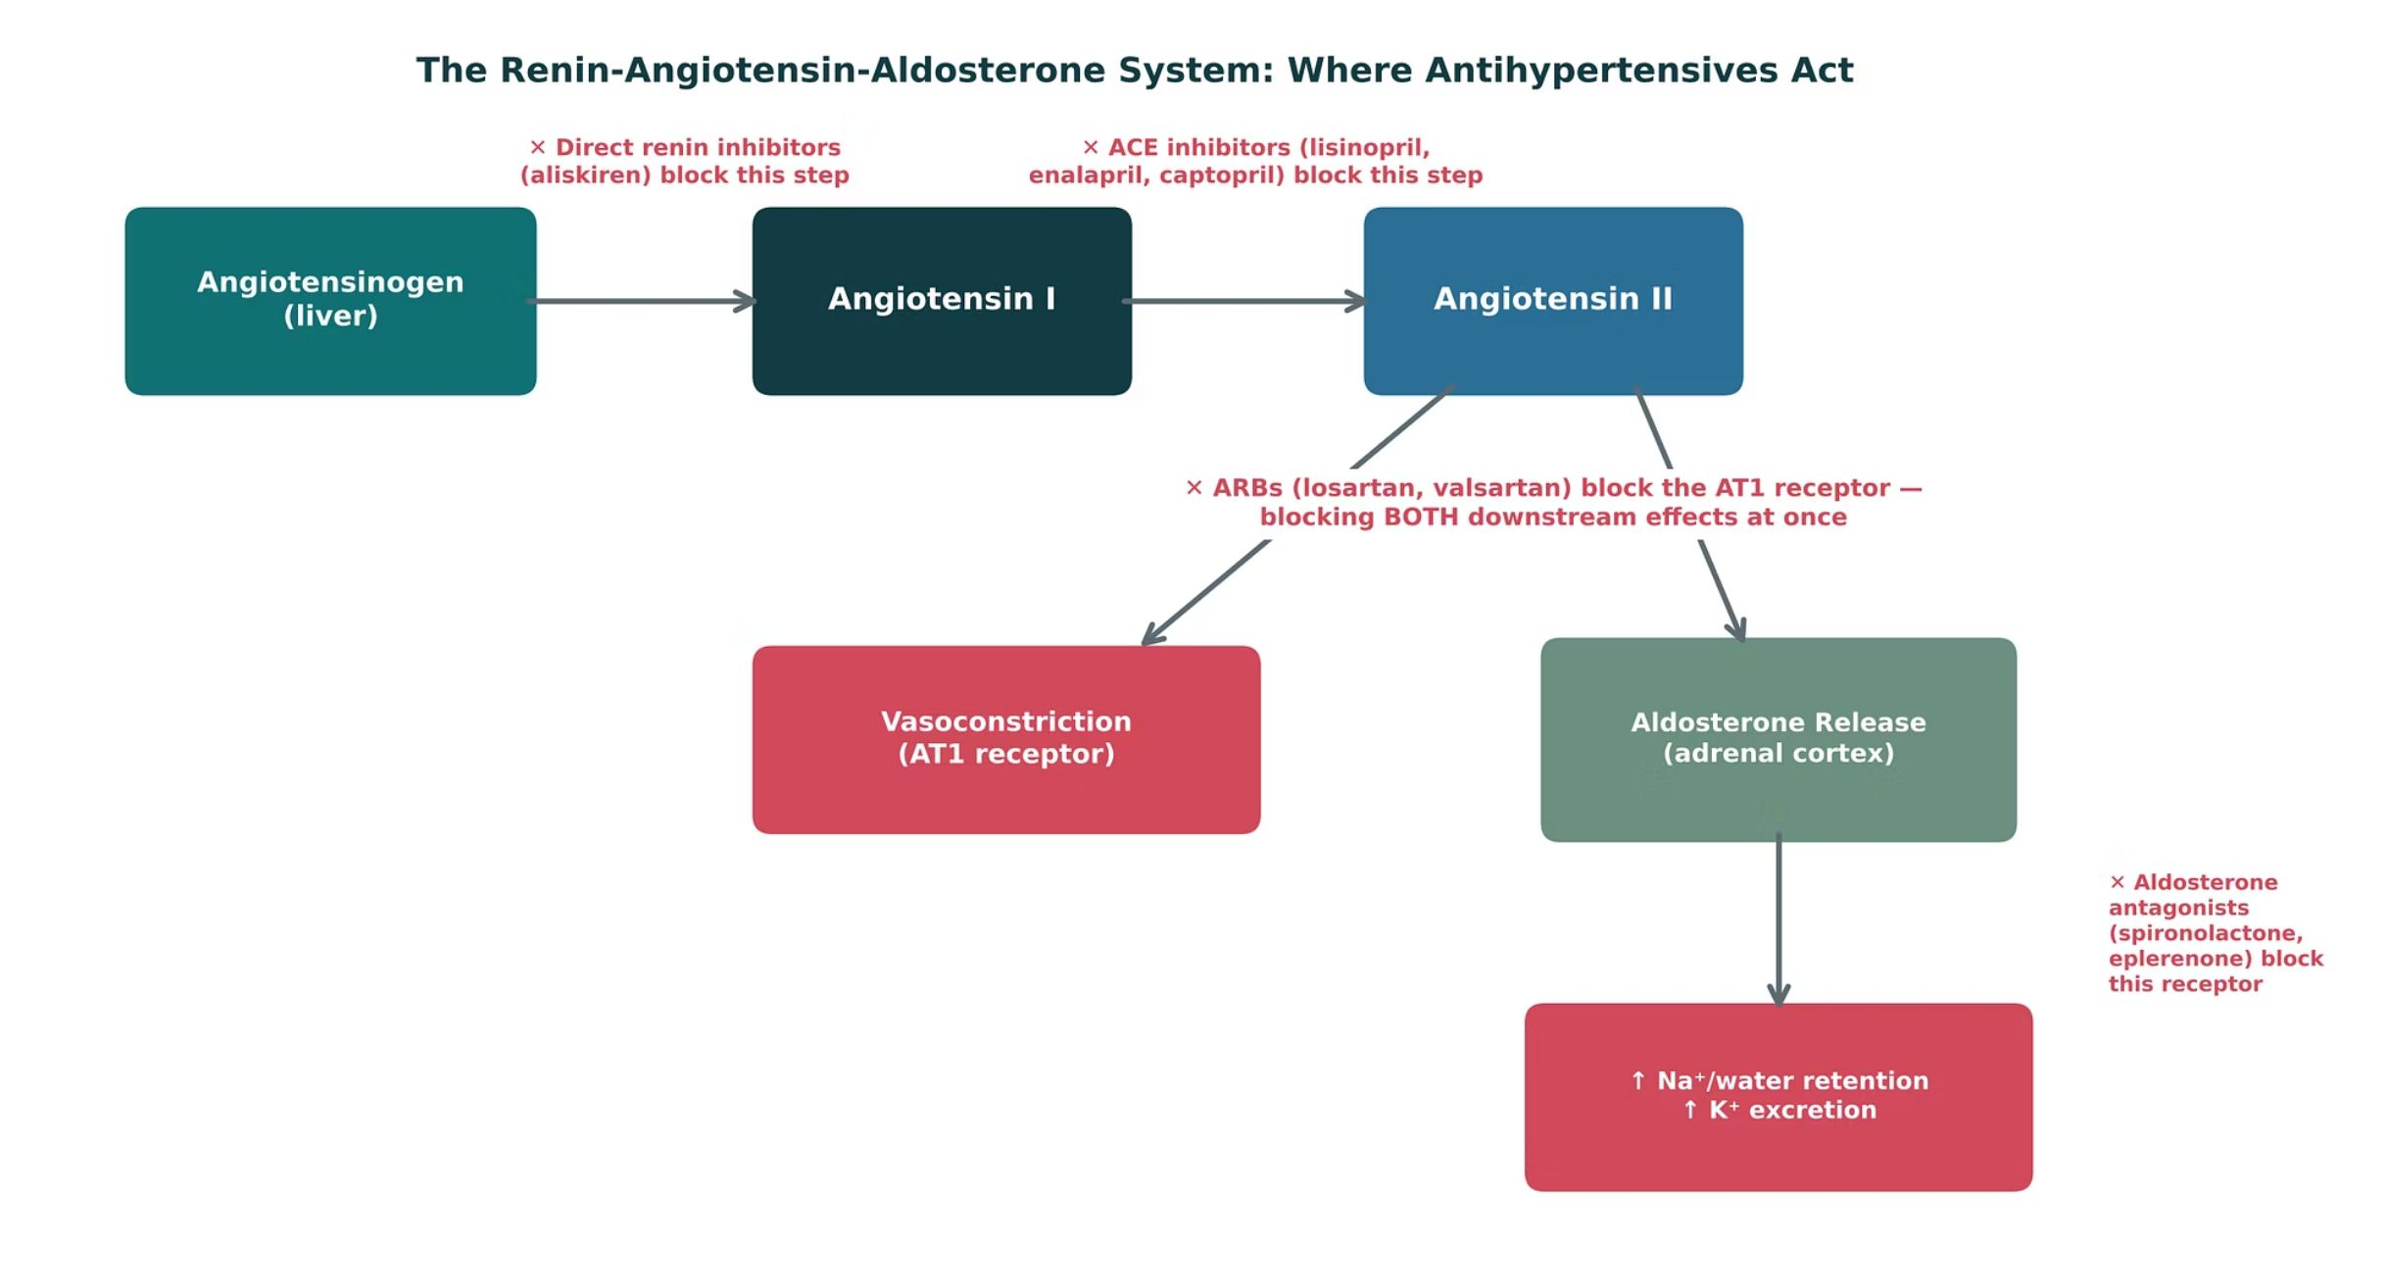
RAAS BLOCKERS
Objectives: SO1 · SO2 · IO5.1 · IO5.2 · IO5.4 · IO5.5
Figure 8 · The RAAS: where antihypertensives act
Original illustrative diagram (not from Katzung): angiotensinogen → (renin) → angiotensin I → (ACE) → angiotensin II → vasoconstriction and aldosterone. Direct renin inhibitors, ACE inhibitors, ARBs and aldosterone antagonists each block a different step. S4; S4 (notes)
L10 · Renal Pharmacotherapeutics — Session 2
20

Slide 21
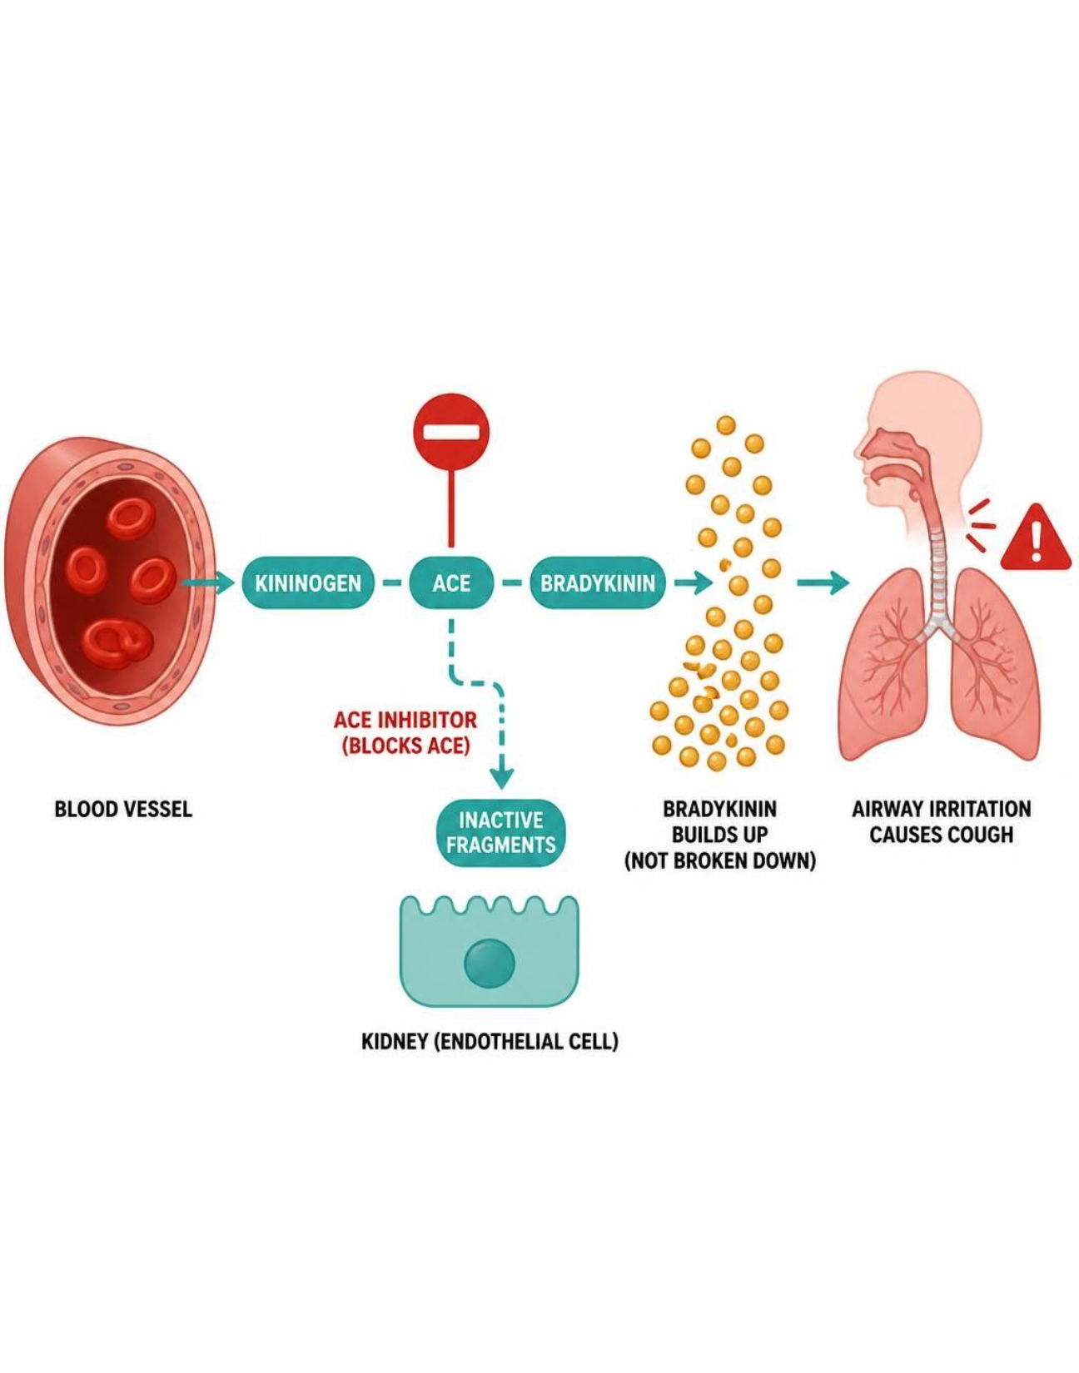
RAAS BLOCKERS
Objectives: SO1 · SO2 · IO5.1 · IO5.2 · IO5.4 · IO5.5
Figure 9 · ACE inhibitors: bradykinin, cough and angioedema
Schematic (illustrative) — Figure 9. ACE inhibition and bradykinin accumulation: ACE also breaks down bradykinin, so blocking it raises bradykinin (cough, angioedema); ARBs spare bradykinin. S6; S6 (notes)
L10 · Renal Pharmacotherapeutics — Session 2
21

Slide 22
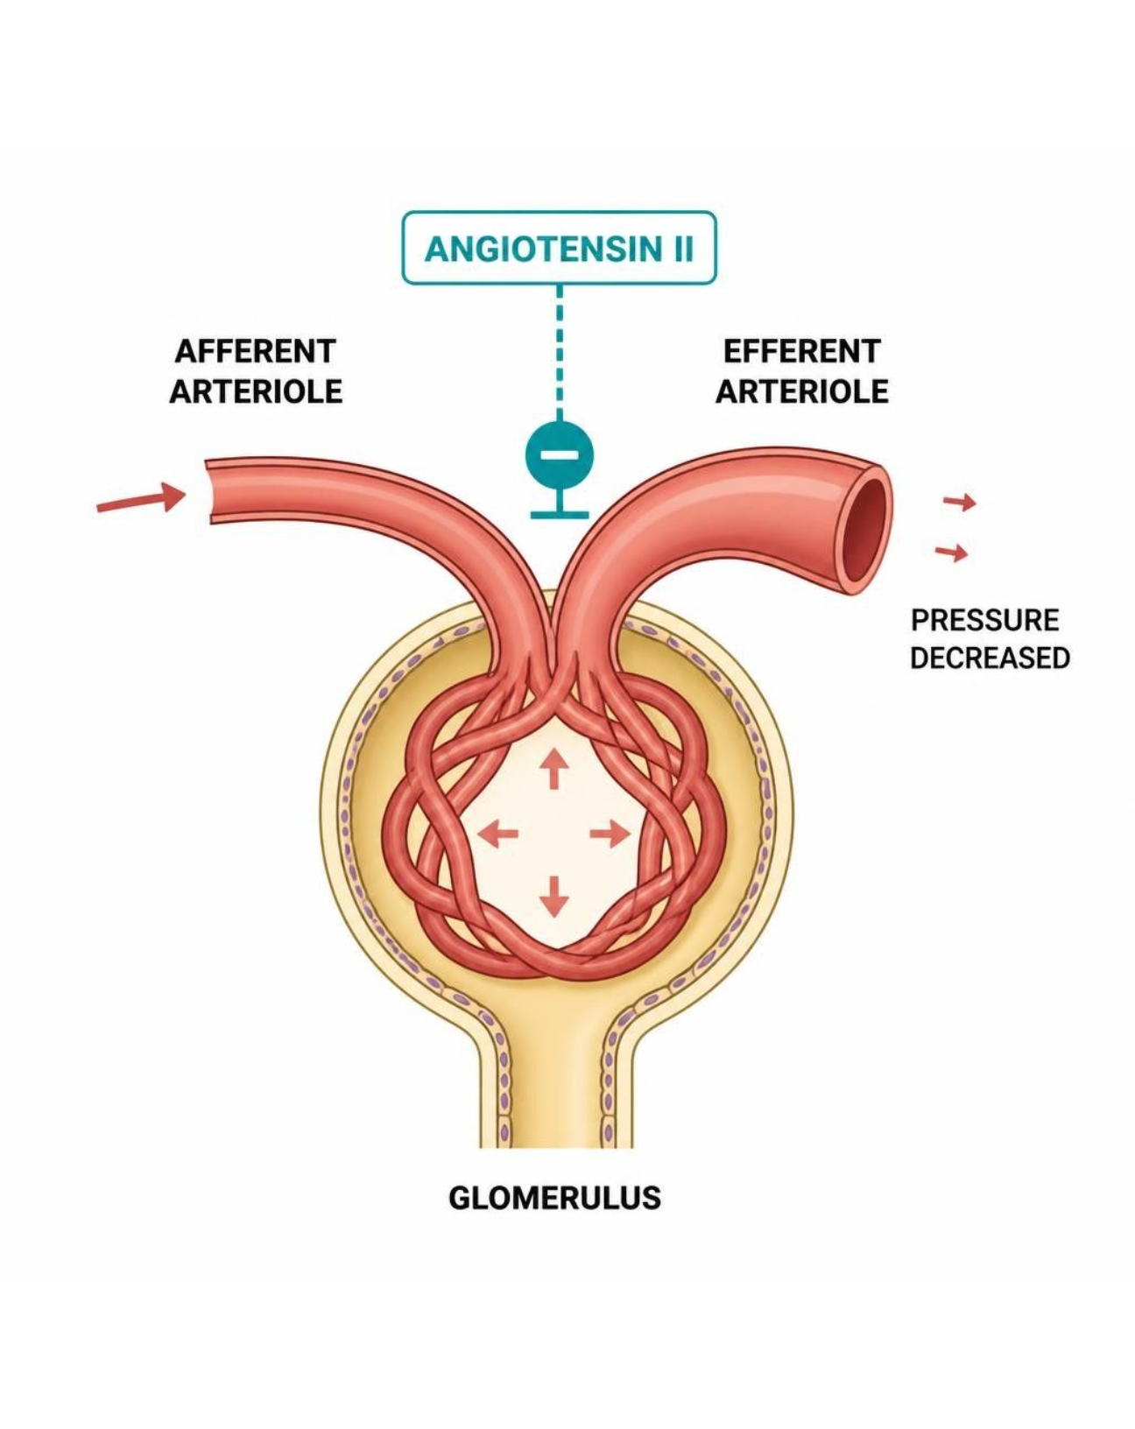
RAAS BLOCKERS
Objectives: SO1 · SO2 · IO5.1 · IO5.2 · IO5.4 · IO5.5
Figure 10 · Efferent arteriole dilation: why creatinine rises
Schematic (illustrative) — Figure 10. Efferent arteriole dilation and intraglomerular pressure: removing angiotensin II’s efferent constriction lowers glomerular pressure — less proteinuria, and an expected creatinine rise of up to ~30%. S9; S9 (notes)
L10 · Renal Pharmacotherapeutics — Session 2
22

Slide 23
RAAS BLOCKERS
Objectives: SO1 · SO2 · IO5.1 · IO5.2 · IO5.4 · IO5.5
Compare: ACE inhibitors vs. ARBs vs. aliskiren
 | ACE inhibitors (-pril) | ARBs (-sartan) | Aliskiren (-kiren)
Block | Angiotensin I → II conversion | AT1 receptor | Renin (first step)
Cough / bradykinin | Yes — most common reason to switch | No | Cough listed on profile
Pregnancy | Contraindicated | Contraindicated | Contraindicated
Use | First-line HTN in proteinuric CKD | First-line; ACEi cough alternative | Limited; never with ACEi/ARB in diabetes
Focus: what tells these apart. Sources: S5; S7; S37-42
L10 · Renal Pharmacotherapeutics — Session 2
23

Slide 24
RAAS BLOCKERS
Objectives: SO1 · SO2 · IO5.1 · IO5.2 · IO5.4 · IO5.5
Compare: ACE inhibitor profiles: formulation, dose, indications
Drug | Class | Formulation | Adult dose | Indications
Captopril (Capoten) | ACE inhibitor | Tablets 12.5/25/50/100 mg | Hypertension: 12.5-25 mg PO BID-TID (maximum 450 mg/day); heart failure: 6.25-12.5 mg TID | Hypertension, heart failure, post-MI, diabetic nephropathy
Lisinopril (Zestril, Prinivil) | ACE inhibitor | Tablets 2.5/5/10/20/30/40 mg | Hypertension: 10 mg PO daily, titrate to 40 mg (maximum 80 mg); heart failure: start 2.5-5 mg daily | Hypertension, heart failure, post-MI, diabetic nephropathy
Enalapril (Vasotec) | ACE inhibitor (prodrug) | Tablets 2.5/5/10/20 mg; IV enalaprilat | Hypertension: 5 mg PO daily, titrate to 40 mg daily or divided; heart failure: 2.5 mg BID | Hypertension, heart failure, asymptomatic LV dysfunction
Focus: what tells these apart. Sources: S37; S38; S39
L10 · Renal Pharmacotherapeutics — Session 2
24

Slide 25
RAAS BLOCKERS
Objectives: SO1 · SO2 · IO5.1 · IO5.2 · IO5.4 · IO5.5
Compare: ACE inhibitor profiles: adverse effects, contraindications, toxicity
Drug | Adverse effects | Contraindications | Toxicity / overdose
Captopril (Capoten) | Cough, hyperkalemia, hypotension, taste change, rash, angioedema | Pregnancy, history of angioedema with ACE inhibitors, bilateral renal artery stenosis, concomitant aliskiren in diabetes | Angioedema, hyperkalemia, hypotension, AKI; take 1 hour before meals; monitor potassium and creatinine
Lisinopril (Zestril, Prinivil) | Dry cough, dizziness, hyperkalemia, creatinine rise up to 30%, angioedema | Pregnancy, angioedema history, bilateral renal artery stenosis, concomitant aliskiren in diabetes | Angioedema, hyperkalemia, symptomatic hypotension, AKI during volume depletion
Enalapril (Vasotec) | Cough, hyperkalemia, dizziness, hypotension, angioedema | Pregnancy, angioedema history, bilateral renal artery stenosis | Hypotension, hyperkalemia, angioedema, AKI; reduce dose when CrCl is below 30 mL/min
Focus: what tells these apart. Sources: S37; S38; S39
L10 · Renal Pharmacotherapeutics — Session 2
25

Slide 26
RAAS BLOCKERS
Objectives: SO1 · SO2 · IO5.1 · IO5.2 · IO5.4 · IO5.5
Compare: ARB and renin inhibitor profiles: formulation, dose, indications
Drug | Class | Formulation | Adult dose | Indications
Losartan (Cozaar) | Angiotensin receptor blocker (ARB) | Tablets 25/50/100 mg | Hypertension: 50 mg PO daily, up to 100 mg; diabetic nephropathy: 50 mg daily, increase to 100 mg | Hypertension, diabetic nephropathy, stroke risk reduction with LV hypertrophy, heart failure alternative
Valsartan (Diovan) | Angiotensin receptor blocker (ARB) | Tablets 40/80/160/320 mg | Hypertension: 80-160 mg PO daily (maximum 320 mg); heart failure: 40 mg BID, titrate to 160 mg BID | Hypertension, heart failure, post-MI
Aliskiren (Tekturna) | Direct renin inhibitor | Tablets 150/300 mg | 150 mg PO daily, may increase to 300 mg daily; take consistently with respect to meals | Hypertension (rarely first-line)
Focus: what tells these apart. Sources: S40; S41; S42
L10 · Renal Pharmacotherapeutics — Session 2
26

Slide 27
RAAS BLOCKERS
Objectives: SO1 · SO2 · IO5.1 · IO5.2 · IO5.4 · IO5.5
Compare: ARB and renin inhibitor profiles: adverse effects, contraindications, toxicity
Drug | Adverse effects | Contraindications | Toxicity / overdose
Losartan (Cozaar) | Dizziness, hyperkalemia, creatinine rise, rare angioedema | Pregnancy, concomitant aliskiren in diabetes, bilateral renal artery stenosis | Hypotension, hyperkalemia, fetal toxicity; no bradykinin cough
Valsartan (Diovan) | Dizziness, hyperkalemia, fatigue, creatinine rise | Pregnancy, concomitant aliskiren in diabetes, bilateral renal artery stenosis | Hypotension, hyperkalemia, fetal toxicity
Aliskiren (Tekturna) | Diarrhea, cough, hyperkalemia, angioedema, hypotension | Pregnancy; do not combine with ACE inhibitors or ARBs in diabetes or with eGFR below 60 mL/min | Hypotension, hyperkalemia, AKI when combined with ACE inhibitors or ARBs
Focus: what tells these apart. Sources: S40; S41; S42
L10 · Renal Pharmacotherapeutics — Session 2
27

Slide 28

RAAS BLOCKERS
Objectives: SO1 · SO2 · IO5.1 · IO5.2 · IO5.4 · IO5.5
Memory hooks
Why it happens
Mnemonic (memory aid)
Why does creatinine rise on an ACE inhibitor? The drug lowers glomerular pressure on purpose — that same drop protects the kidney from proteinuria. S8; S9; SG U5-R8
Thirty is fine, more is a sign: up to ~30% creatinine rise → continue; more → look for renal artery stenosis or volume depletion. S5; S10; SG U5-R9
L10 · Renal Pharmacotherapeutics — Session 2
28

Slide 29

RAAS BLOCKERS
Objectives: SO1 · SO2 · IO5.1 · IO5.2 · IO5.4 · IO5.5
High-yield summary
If you remember nothing else
ACEi/ARB first-line in proteinuric CKD: efferent dilation lowers intraglomerular pressure and proteinuria. S8; SG U5-R8
Creatinine rise up to ~30% is expected; check K⁺ and creatinine in 1–2 weeks; sick-day rules; never in pregnancy. S5; S8; S9; SG U5-R9
L10 · Renal Pharmacotherapeutics — Session 2
29

Slide 30
CLINICAL VIGNETTE · LECTURE QUICK CHECK S10
Objectives: SO1 · SO2 · IO5.1 · IO5.2 · IO5.4 · IO5.5
Question 1
Two weeks after starting lisinopril for diabetic nephropathy, creatinine rose from 1.1 to 1.4 mg/dL. What is the best response?
A
Switch to an NSAID for blood pressure
B
Double the lisinopril dose today
C
Stop lisinopril for nephrotoxicity
D
Add aliskiren to protect the kidney
E
Continue lisinopril and keep monitoring
L10 · Renal Pharmacotherapeutics — Session 2
30
Notes:
Answer on the next slide. Source: S10; SG U5-R9

Slide 31

CLINICAL VIGNETTE · ANSWER
Objectives: SO1 · SO2 · IO5.1 · IO5.2 · IO5.4 · IO5.5
Answer 1: E
E. Continue lisinopril and keep monitoring
A ~27% rise is within the expected range, reflecting reduced intraglomerular pressure; continue with monitoring (S10). S10; SG U5-R9
Why the other choices are wrong
A. Switch to an NSAID for blood pressure — NSAIDs raise AKI risk (S55).
B. Double the lisinopril dose today — Not the response (S10).
C. Stop lisinopril for nephrotoxicity — This is expected, not toxicity (S10).
D. Add aliskiren to protect the kidney — Never with ACEi in diabetes (S7).
L10 · Renal Pharmacotherapeutics — Session 2
31

Slide 32
CLINICAL VIGNETTE
Objectives: SO1 · SO2 · IO5.1 · IO5.2 · IO5.4 · IO5.5
Question 3
A woman of reproductive age with proteinuric CKD needs antihypertensive therapy. What must be addressed first with an ACE inhibitor?
A
Rebound hypertension if stopped
B
Bradykinin cough risk only
C
Pregnancy risk — fetal renal toxicity
D
Ototoxicity with loop diuretics
E
Gynecomastia with long-term use
L10 · Renal Pharmacotherapeutics — Session 2
32
Notes:
Answer on the next slide. Source: S5; S7

Slide 33
CLINICAL VIGNETTE · ANSWER
Objectives: SO1 · SO2 · IO5.1 · IO5.2 · IO5.4 · IO5.5
Answer 3: C
C. Pregnancy risk — fetal renal toxicity
ACE inhibitors (and ARBs) are contraindicated in pregnancy; avoid in women who are or may become pregnant (S5; S7). S5; S7
Why the other choices are wrong
A. Rebound hypertension if stopped — Clonidine (S16).
B. Bradykinin cough risk only — Pregnancy is the contraindication (S5).
D. Ototoxicity with loop diuretics — Not an ACEi issue (L09).
E. Gynecomastia with long-term use — Spironolactone (L09).
L10 · Renal Pharmacotherapeutics — Session 2
33

Slide 34
Drug class 2 of 4
Other Antihypertensives & Resistant Hypertension
Covers objectives: SO3 · IO5.1 · IO5.2 · IO5.3 · IO5.4
Class
Prototype
Mechanism of action
Indications
Adverse effects
Contraindications
Drug interactions
Pharmacokinetics
Monitoring
Clinical pearls
34

Slide 35
OTHER ANTIHYPERTENSIVES & RESISTANT HYPERTENSION
Objectives: SO3 · IO5.1 · IO5.2 · IO5.3 · IO5.4
Class · Prototype + other drugs named
Class
Prototype + other drugs named
RAAS blockers are first-line — but rarely the whole story. Other major classes: CCBs, beta-blockers, diuretics, central agents and direct vasodilators. S11; S11 (notes); S12 (notes)
This four-card slide is a brief classification recap — CCBs and beta-blockers get fuller treatment later this session (angina) and in cardiovascular coursework. S12 (notes)
Calcium channel blockers: dihydropyridines (amlodipine) and non-dihydropyridines (diltiazem, verapamil). Beta-blockers: metoprolol, atenolol. Central α2 agonists: clonidine, methyldopa. Direct arteriolar vasodilator: hydralazine. S12; S28
L10 · Renal Pharmacotherapeutics — Session 2
35

Slide 36
OTHER ANTIHYPERTENSIVES & RESISTANT HYPERTENSION
Objectives: SO3 · IO5.1 · IO5.2 · IO5.3 · IO5.4
Mechanism of action
Mechanism of action
Dihydropyridines (amlodipine): arteriolar dilation. Non-dihydropyridines (diltiazem, verapamil): also ↓ HR/contractility. S12
Beta-blockers: ↓ heart rate, ↓ contractility, ↓ renin release. S12
Chain (Figure 11): dihydropyridine arteriolar dilation → afterload falls; blood pressure lowers. Non-DHP CCB or beta-blocker: heart rate and contractility fall → renin release falls. S13; S13 (notes)
Clonidine or methyldopa stimulates central α2 receptors → sympathetic outflow falls, so BP falls. Hydralazine dilates arterioles directly → reflex tachycardia and fluid retention. S16; S16 (notes)
L10 · Renal Pharmacotherapeutics — Session 2
36

Slide 37
OTHER ANTIHYPERTENSIVES & RESISTANT HYPERTENSION
Objectives: SO3 · IO5.1 · IO5.2 · IO5.3 · IO5.4
Indications
Indications (1/2)
Beta-blockers: not generally first-line for uncomplicated HTN, but compelling indications include concurrent CAD/heart failure/arrhythmia. S12
If all these classes lower blood pressure similarly, why are RAAS blockers preferred in CKD? Similar BP lowering; ACE inhibitors and ARBs add renoprotection — the renoprotective gap in Figure 12, not a difference in BP control. S14; S14 (notes)
Thiazide / loop diuretics (covered in depth in Session 1): thiazides first-line with preserved renal function; loops preferred as GFR falls. S12
L10 · Renal Pharmacotherapeutics — Session 2
37

Slide 38
OTHER ANTIHYPERTENSIVES & RESISTANT HYPERTENSION
Objectives: SO3 · IO5.1 · IO5.2 · IO5.3 · IO5.4
Indications (cont.)
Indications (2/2)
Central agents (clonidine, methyldopa) and hydralazine: reserved for resistant hypertension or specific situations (e.g., methyldopa in pregnancy). S12; S16
TB Diuretics enhance the efficacy of many agents, particularly ACE inhibitors; hydralazine and minoxidil need a diuretic because they cause salt and water retention. p. 280
TB Spironolactone may be the most effective single agent for drug-resistant hypertension. p. 280
L10 · Renal Pharmacotherapeutics — Session 2
38

Slide 39
OTHER ANTIHYPERTENSIVES & RESISTANT HYPERTENSION
Objectives: SO3 · IO5.1 · IO5.2 · IO5.3 · IO5.4
Adverse effects (boxed warnings first) · Contraindications
Adverse effects (boxed warnings first)
Contraindications
Peripheral edema is a CCB class adverse effect. S12
Hydralazine: reflex tachycardia and fluid retention — must be paired with a beta-blocker and a diuretic. S16; S16 (notes)
Abrupt clonidine withdrawal causes rebound hypertension. S16; S16 (notes)
Atenolol accumulates in renal impairment (reduce dose when CrCl is below 35 mL/min); beta-blockers: do not stop abruptly. S47; S48
L10 · Renal Pharmacotherapeutics — Session 2
39

Slide 40
OTHER ANTIHYPERTENSIVES & RESISTANT HYPERTENSION
Objectives: SO3 · IO5.1 · IO5.2 · IO5.3 · IO5.4
Drug interactions · Pharmacokinetics
Drug interactions
Pharmacokinetics
Diltiazem or verapamil with a beta-blocker risks bradycardia and AV block; dihydropyridines pair with beta-blockers without that conduction risk. S13; S13 (notes)
Verapamil and diltiazem raise digoxin levels. Rifampin and carbamazepine lower CCB levels; grapefruit juice raises dihydropyridine levels. S55; S55 (notes)
Not covered in materials
L10 · Renal Pharmacotherapeutics — Session 2
40

Slide 41
OTHER ANTIHYPERTENSIVES & RESISTANT HYPERTENSION
Objectives: SO3 · IO5.1 · IO5.2 · IO5.3 · IO5.4
Monitoring
Monitoring
Resistant hypertension (BP above goal despite three or more antihypertensive classes, including a diuretic) is common in CKD, often driven by volume overload. S15
First step: confirm diuretic therapy is adequate — a thiazide may simply no longer be effective at the patient’s current GFR (Session 1’s loop-vs-thiazide cutoff). S15; S15 (notes)
Switching from a thiazide to a loop diuretic, or increasing loop diuretic dosing, is often the most effective single change in advanced CKD. S15
Aldosterone antagonists (spironolactone) can be added for resistant hypertension, but require close potassium and renal-function monitoring, especially on top of an ACE inhibitor or ARB. S15
L10 · Renal Pharmacotherapeutics — Session 2
41

Slide 42
OTHER ANTIHYPERTENSIVES & RESISTANT HYPERTENSION
Objectives: SO3 · IO5.1 · IO5.2 · IO5.3 · IO5.4
Clinical pearls / "why" hook
Clinical pearls / "why" hook
"Resistant hypertension in CKD" is often really a diuretic-selection problem, not a need for an entirely new drug class — check diuretic adequacy first; thiazide to loop switch; add spironolactone with close monitoring. S15 (notes)
Case: CKD (eGFR 28 mL/min), still hypertensive despite lisinopril, amlodipine, and hydrochlorothiazide. What is the most likely contributor to inadequate control, and what change would you suggest first? S17
At this GFR, hydrochlorothiazide has largely lost its natriuretic efficacy (Session 1). Switching to a loop diuretic such as furosemide or torsemide is usually the most effective next step before adding an entirely new drug class. S17
This case is a direct callback to the Session 1 "Choosing a Diuretic for Advancing CKD" case — point out the parallel if you remember it. S17 (notes)
L10 · Renal Pharmacotherapeutics — Session 2
42

Slide 43
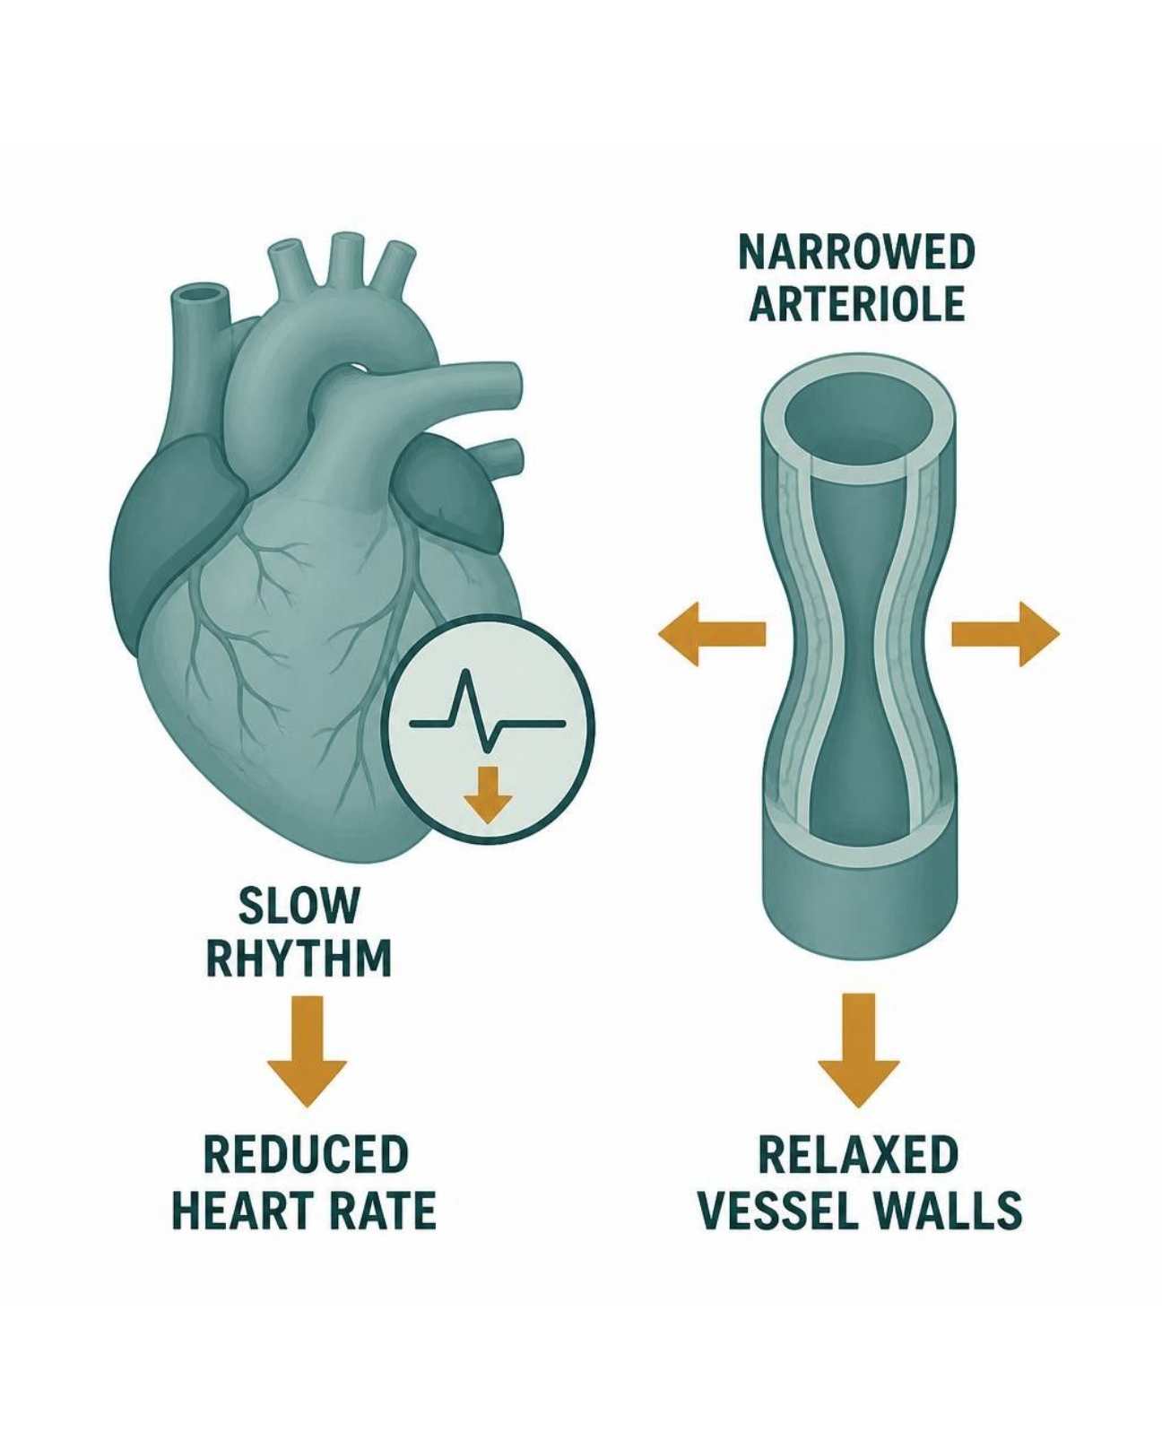
OTHER ANTIHYPERTENSIVES & RESISTANT HYPERTENSION
Objectives: SO3 · IO5.1 · IO5.2 · IO5.3 · IO5.4
Figure 11 · CCBs and beta-blockers: different targets
Schematic (illustrative) — Figure 11. Vascular versus cardiac targets of antihypertensive drugs: dihydropyridines dilate arterioles (afterload falls); non-dihydropyridines and beta-blockers slow heart rate and contractility (beta-blockers also cut renin). S13; S13 (notes)
L10 · Renal Pharmacotherapeutics — Session 2
43

Slide 44
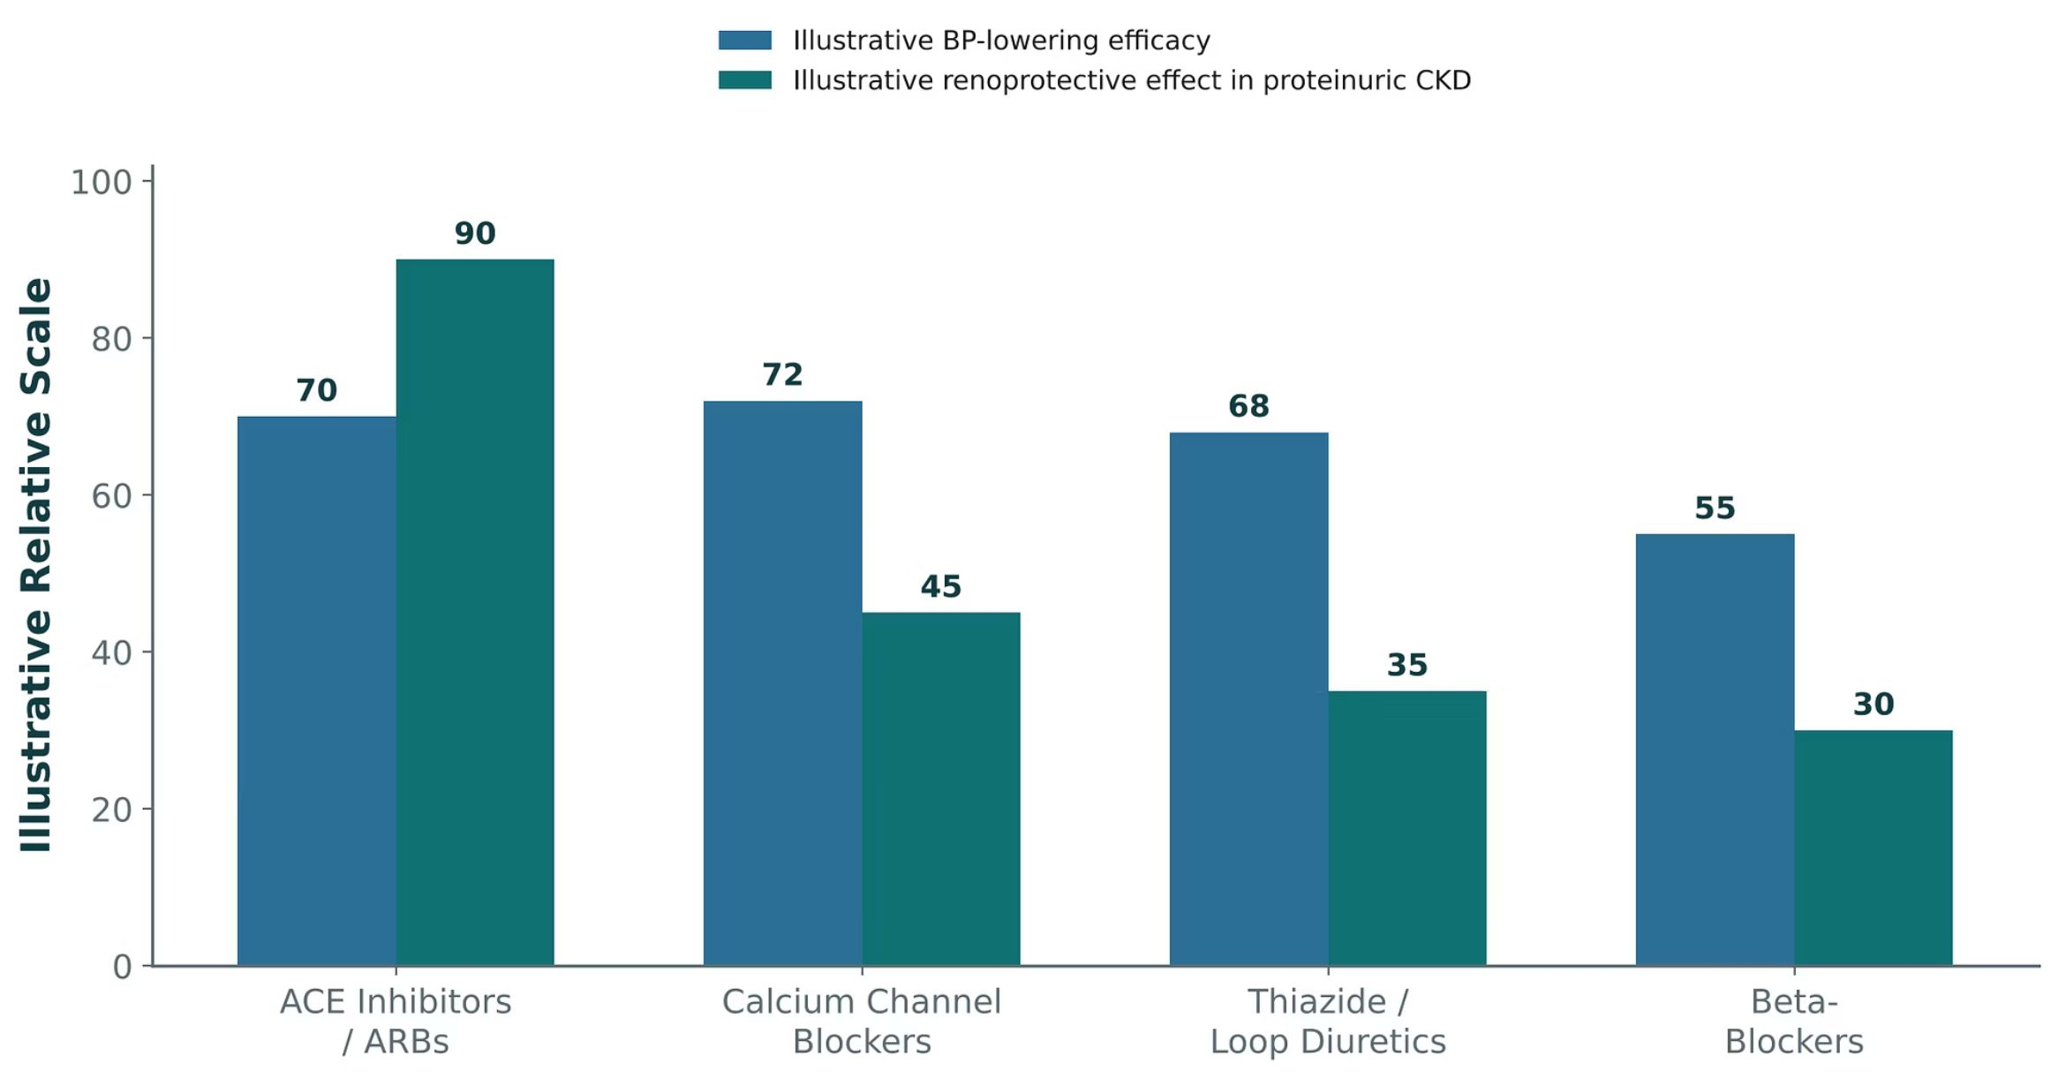
OTHER ANTIHYPERTENSIVES & RESISTANT HYPERTENSION
Objectives: SO3 · IO5.1 · IO5.2 · IO5.3 · IO5.4
Figure 12 · BP-lowering efficacy vs. renoprotection in CKD
Original illustrative comparison (illustrative relative values, not from Katzung): BP-lowering efficacy is broadly comparable — ACEi/ARBs 70, CCBs 72, thiazide/loop diuretics 68, beta-blockers 55 — but renoprotection in proteinuric CKD is far greater with ACEi/ARBs (90) than CCBs (45), diuretics (35) or beta-blockers (30). S14; S14 (notes)
L10 · Renal Pharmacotherapeutics — Session 2
44

Slide 45
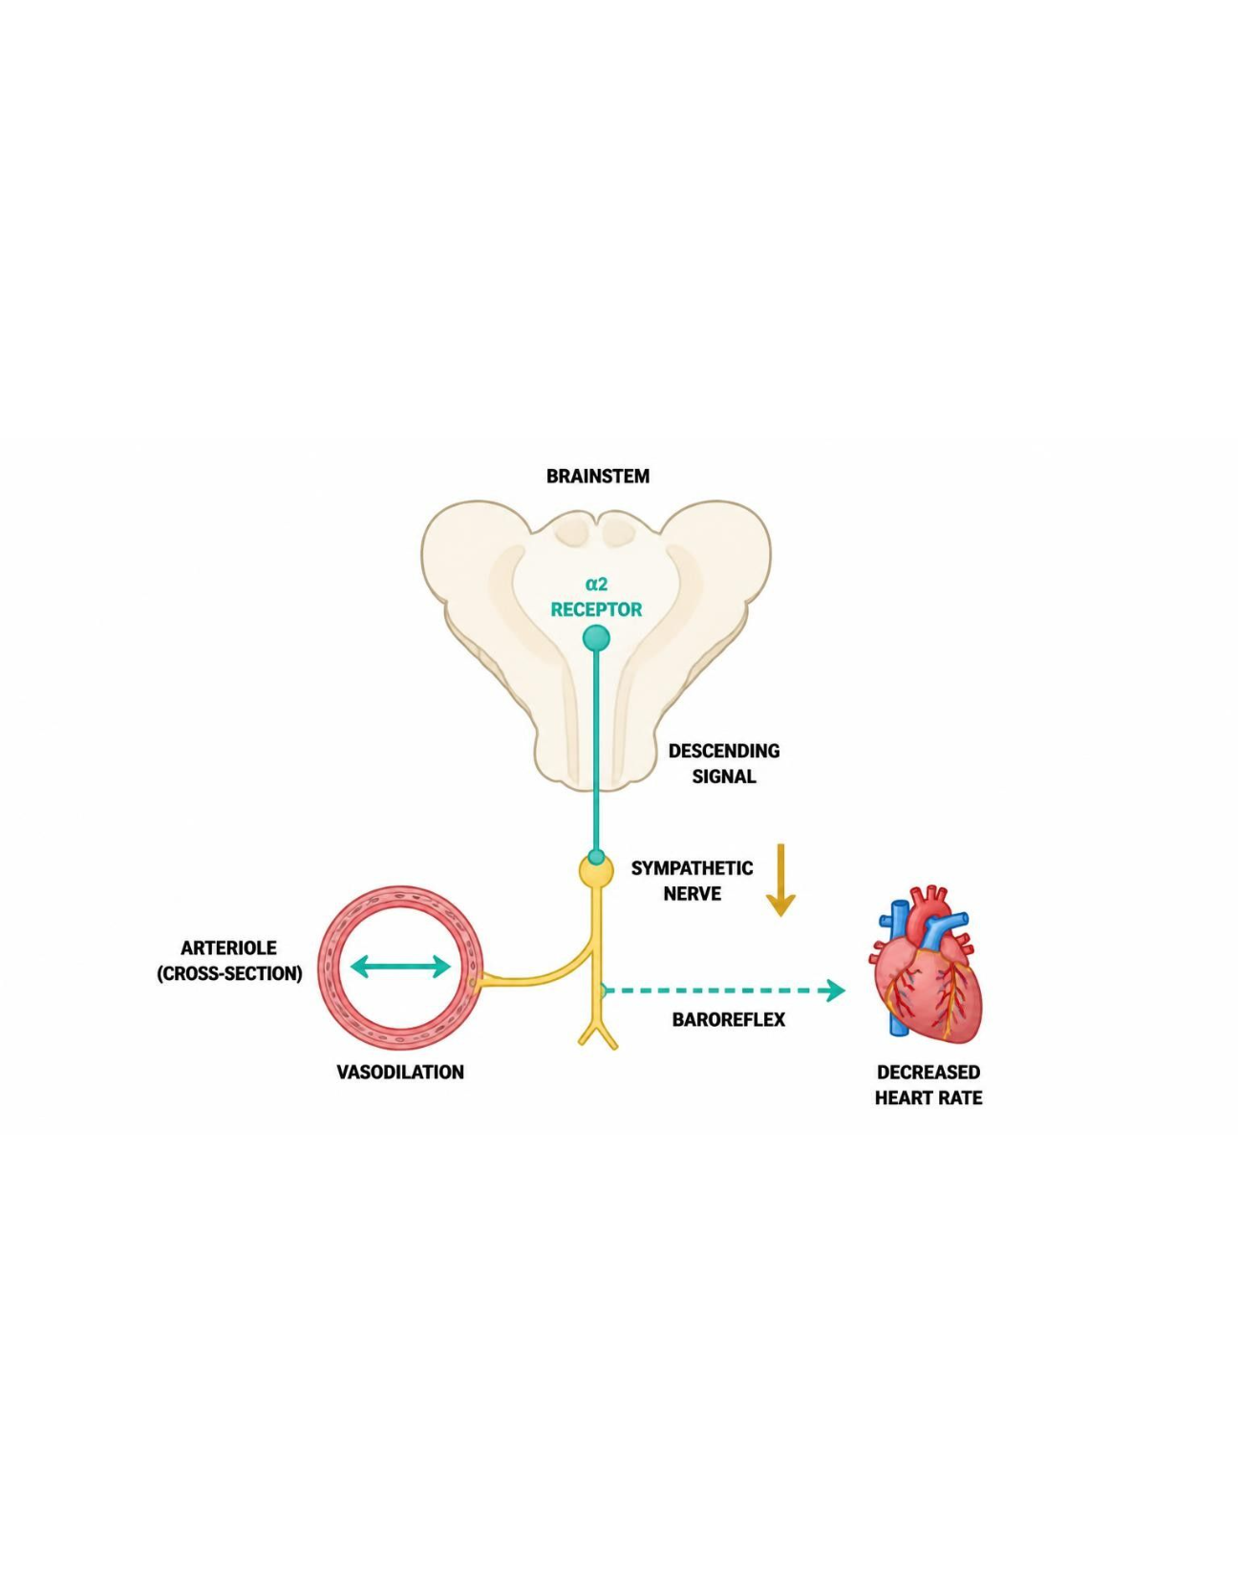
OTHER ANTIHYPERTENSIVES & RESISTANT HYPERTENSION
Objectives: SO3 · IO5.1 · IO5.2 · IO5.3 · IO5.4
Figure 13 · Central agents and hydralazine
Schematic (illustrative) — Figure 13. Central agents and direct arteriolar vasodilation: clonidine and methyldopa reduce sympathetic outflow; hydralazine dilates arterioles directly, triggering reflex tachycardia and fluid retention. S16; S16 (notes)
L10 · Renal Pharmacotherapeutics — Session 2
45

Slide 46
OTHER ANTIHYPERTENSIVES & RESISTANT HYPERTENSION
Objectives: SO3 · IO5.1 · IO5.2 · IO5.3 · IO5.4
Compare: Other major antihypertensive classes (S12)
Class | Examples | Mechanism | Key point
Calcium channel blockers | Amlodipine; diltiazem, verapamil | Arteriolar dilation; non-DHP also ↓ HR/contractility | Peripheral edema
Beta-blockers | Metoprolol, atenolol | ↓ HR, contractility, renin | Compelling: CAD, HF, arrhythmia
Thiazide / loop diuretics | HCTZ; furosemide | Session 1 | Loops as GFR falls
Central agents & direct vasodilators | Clonidine, methyldopa; hydralazine | Central α2; direct arteriolar | Resistant HTN; methyldopa in pregnancy
Focus: what tells these apart. Sources: S12
L10 · Renal Pharmacotherapeutics — Session 2
46

Slide 47
OTHER ANTIHYPERTENSIVES & RESISTANT HYPERTENSION
Objectives: SO3 · IO5.1 · IO5.2 · IO5.3 · IO5.4
Compare: Calcium channel blocker profiles: formulation, dose, indications
Drug | Class | Formulation | Adult dose | Indications
Amlodipine (Norvasc) | Dihydropyridine calcium channel blocker | Tablets 2.5/5/10 mg; oral suspension | Hypertension or angina: 5 mg PO daily, up to 10 mg daily; start 2.5 mg in older or frail patients | Hypertension, chronic stable angina, vasospastic angina
Nifedipine ER (Procardia XL, Adalat CC) | Dihydropyridine calcium channel blocker | Extended-release tablets 30/60/90 mg | 30-60 mg PO daily, titrate to 90-120 mg daily; avoid immediate-release capsules for hypertension | Hypertension, chronic stable angina, vasospastic angina
Diltiazem (Cardizem) | Non-dihydropyridine calcium channel blocker | Tablets 30/60/90/120 mg; ER capsules 120-420 mg; IV injection | Hypertension: ER 120-240 mg PO daily up to 360 mg; angina: 30 mg QID (immediate-release) or ER daily | Hypertension, angina, atrial fibrillation rate control
Verapamil (Calan, Isoptin) | Non-dihydropyridine calcium channel blocker | Tablets 40/80/120 mg; ER tablets 120/180/240 mg; IV injection | Hypertension: SR 180-240 mg PO daily up to 480 mg; angina: 80-120 mg TID | Hypertension, angina, atrial fibrillation and SVT rate control
Focus: what tells these apart. Sources: S43; S44; S45; S46
L10 · Renal Pharmacotherapeutics — Session 2
47

Slide 48
OTHER ANTIHYPERTENSIVES & RESISTANT HYPERTENSION
Objectives: SO3 · IO5.1 · IO5.2 · IO5.3 · IO5.4
Compare: Calcium channel blocker profiles: adverse effects, contraindications, toxicity
Drug | Adverse effects | Contraindications | Toxicity / overdose
Amlodipine (Norvasc) | Peripheral edema, flushing, headache, dizziness, gingival hyperplasia | Hypersensitivity, severe aortic stenosis (caution), cardiogenic shock | Profound hypotension with reflex tachycardia, prolonged vasodilation; slow onset and long half-life
Nifedipine ER (Procardia XL, Adalat CC) | Peripheral edema, headache, flushing, reflex tachycardia, constipation | Cardiogenic shock, hypersensitivity; avoid immediate-release forms in acute coronary syndrome | Severe hypotension, reflex tachycardia, edema; swallow ER tablet whole
Diltiazem (Cardizem) | Bradycardia, AV block, edema, constipation, dizziness, CYP3A4 interactions | Sick sinus syndrome, second- or third-degree AV block, severe hypotension, acute MI with pulmonary congestion, reduced EF | Bradycardia, AV block, heart failure exacerbation; strongly interacts with beta-blockers
Verapamil (Calan, Isoptin) | Constipation, bradycardia, AV block, edema, dizziness, gingival hyperplasia | Sick sinus syndrome, AV block, severe LV dysfunction, WPW with atrial fibrillation, cardiogenic shock | Severe bradycardia, AV block, heart failure; avoid with beta-blockers; raises digoxin levels
Focus: what tells these apart. Sources: S43; S44; S45; S46
L10 · Renal Pharmacotherapeutics — Session 2
48

Slide 49
OTHER ANTIHYPERTENSIVES & RESISTANT HYPERTENSION
Objectives: SO3 · IO5.1 · IO5.2 · IO5.3 · IO5.4
Compare: Beta-blocker profiles: formulation, dose, indications
Drug | Class | Formulation | Adult dose | Indications
Metoprolol (Lopressor, Toprol-XL) | Beta-1 selective beta-blocker | Tartrate tablets 25/50/100 mg; succinate ER tablets 25-200 mg; IV injection | Hypertension: tartrate 50 mg PO BID or succinate 50-100 mg daily (maximum 400 mg/day); heart failure: succinate 12.5-25 mg daily, titrate | Hypertension with CAD or HF, angina, post-MI, atrial fibrillation
Atenolol (Tenormin) | Beta-1 selective beta-blocker | Tablets 25/50/100 mg | Hypertension: 25-50 mg PO daily (maximum 100 mg); reduce dose when CrCl is below 35 mL/min | Hypertension, angina, post-MI
Focus: what tells these apart. Sources: S47; S48
L10 · Renal Pharmacotherapeutics — Session 2
49

Slide 50
OTHER ANTIHYPERTENSIVES & RESISTANT HYPERTENSION
Objectives: SO3 · IO5.1 · IO5.2 · IO5.3 · IO5.4
Compare: Beta-blocker profiles: adverse effects, contraindications, toxicity
Drug | Adverse effects | Contraindications | Toxicity / overdose
Metoprolol (Lopressor, Toprol-XL) | Fatigue, bradycardia, dizziness, cold extremities, sexual dysfunction, bronchospasm at high dose | Severe bradycardia, high-grade AV block, decompensated HF, cardiogenic shock; do not stop abruptly | Bradycardia, hypotension, heart block, bronchospasm; rebound tachycardia with abrupt withdrawal
Atenolol (Tenormin) | Fatigue, bradycardia, cold extremities, depression, erectile dysfunction | Severe bradycardia, high-grade AV block, decompensated HF; do not stop abruptly | Accumulates in renal impairment, causing bradycardia and hypotension; rebound after abrupt withdrawal
Focus: what tells these apart. Sources: S47; S48
L10 · Renal Pharmacotherapeutics — Session 2
50

Slide 51
OTHER ANTIHYPERTENSIVES & RESISTANT HYPERTENSION
Objectives: SO3 · IO5.1 · IO5.2 · IO5.3 · IO5.4
Compare: Central agent and hydralazine profiles: formulation, dose, indications
Drug | Class | Formulation | Adult dose | Indications
Clonidine (Catapres) | Central alpha-2 agonist | Tablets 0.1/0.2/0.3 mg; transdermal patch 0.1-0.3 mg/day weekly | Hypertension: 0.1 mg PO BID, titrate (usual maximum 2.4 mg/day); patch 0.1 mg/day weekly | Resistant hypertension, hypertensive urgency adjunct, opioid withdrawal adjunct
Methyldopa (Aldomet) | Central alpha-2 agonist | Tablets 250/500 mg | 250 mg PO BID-TID, titrate (maximum 3 g/day); preferred oral option for hypertension in pregnancy | Hypertension in pregnancy, resistant hypertension
Hydralazine (Apresoline) | Direct arteriolar vasodilator | Tablets 10/25/50/100 mg; IV injection | Hypertension: 10 mg PO QID, titrate to 25-50 mg QID (maximum 300 mg/day); heart failure with isosorbide dinitrate: 25-75 mg TID | Resistant hypertension, hypertensive emergency in pregnancy, heart failure (with nitrate)
Focus: what tells these apart. Sources: S49; S50; S51
L10 · Renal Pharmacotherapeutics — Session 2
51

Slide 52
OTHER ANTIHYPERTENSIVES & RESISTANT HYPERTENSION
Objectives: SO3 · IO5.1 · IO5.2 · IO5.3 · IO5.4
Compare: Central agent and hydralazine profiles: adverse effects, contraindications, toxicity
Drug | Adverse effects | Contraindications | Toxicity / overdose
Clonidine (Catapres) | Sedation, dry mouth, bradycardia, constipation, rebound hypertension | Hypersensitivity; use caution in bradycardia and AV block | Rebound hypertension with abrupt withdrawal; overdose causes bradycardia, hypotension, coma and miosis
Methyldopa (Aldomet) | Sedation, depression, dry mouth, positive Coombs test, hepatotoxicity | Active liver disease, concomitant MAO inhibitors, history of methyldopa hepatitis | Hemolytic anemia, hepatitis, drug fever; monitor liver tests and CBC
Hydralazine (Apresoline) | Headache, reflex tachycardia, fluid retention, flushing, drug-induced lupus | Coronary artery disease without beta-blocker, mitral valve rheumatic disease, hypersensitivity | Reflex tachycardia, angina, lupus-like syndrome with high dose or slow acetylators; pair with beta-blocker and diuretic
Focus: what tells these apart. Sources: S49; S50; S51
L10 · Renal Pharmacotherapeutics — Session 2
52

Slide 53
OTHER ANTIHYPERTENSIVES & RESISTANT HYPERTENSION
Objectives: SO3 · IO5.1 · IO5.2 · IO5.3 · IO5.4
Memory hooks
Why it happens
Why pair hydralazine with a beta-blocker and a diuretic? Direct dilation triggers reflex tachycardia and fluid retention; the partners cancel both. S16
L10 · Renal Pharmacotherapeutics — Session 2
53

Slide 54
OTHER ANTIHYPERTENSIVES & RESISTANT HYPERTENSION
Objectives: SO3 · IO5.1 · IO5.2 · IO5.3 · IO5.4
High-yield summary
If you remember nothing else
Non-DHP CCB + beta-blocker → bradycardia/AV block; DHP + beta-blocker is fine. S13
Resistant HTN in CKD: fix the diuretic first (thiazide → loop), then spironolactone with K⁺ monitoring. S15; S17
L10 · Renal Pharmacotherapeutics — Session 2
54

Slide 55
CLINICAL VIGNETTE · LECTURE QUICK CHECK S17
Objectives: SO3 · IO5.1 · IO5.2 · IO5.3 · IO5.4
Question 5
A patient with eGFR 28 mL/min stays hypertensive on lisinopril, amlodipine and hydrochlorothiazide. What change comes first?
A
Stop lisinopril because of CKD
B
Add clonidine as a fourth drug class
C
Double the hydrochlorothiazide dose
D
Add aliskiren to the lisinopril
E
Switch hydrochlorothiazide to a loop diuretic
L10 · Renal Pharmacotherapeutics — Session 2
55
Notes:
Answer on the next slide. Source: S15; S17

Slide 56
CLINICAL VIGNETTE · ANSWER
Objectives: SO3 · IO5.1 · IO5.2 · IO5.3 · IO5.4
Answer 5: E
E. Switch hydrochlorothiazide to a loop diuretic
At this GFR HCTZ has largely lost efficacy; switching to furosemide or torsemide is usually the most effective next step (S17). S15; S17
Why the other choices are wrong
A. Stop lisinopril because of CKD — First-line in CKD (S8).
B. Add clonidine as a fourth drug class — Fix the diuretic first (S15).
C. Double the hydrochlorothiazide dose — The site has too little filtrate (S17).
D. Add aliskiren to the lisinopril — Hyperkalemia/hypotension, no benefit (S7).
L10 · Renal Pharmacotherapeutics — Session 2
56

Slide 57
CLINICAL VIGNETTE
Objectives: SO3 · IO5.1 · IO5.2 · IO5.3 · IO5.4
Question 6
A patient on metoprolol develops heart block after a second drug is added for blood pressure. Which drug most likely?
A
Losartan
B
Lisinopril
C
Verapamil
D
Amlodipine
E
Hydralazine
L10 · Renal Pharmacotherapeutics — Session 2
57
Notes:
Answer on the next slide. Source: S13; S46

Slide 58
CLINICAL VIGNETTE · ANSWER
Objectives: SO3 · IO5.1 · IO5.2 · IO5.3 · IO5.4
Answer 6: C
C. Verapamil
Non-dihydropyridines (diltiazem, verapamil) with a beta-blocker risk bradycardia and AV block (S13). S13; S46
Why the other choices are wrong
A. Losartan — No conduction effect (S7).
B. Lisinopril — No conduction effect (S5).
D. Amlodipine — DHPs pair safely with beta-blockers (S13).
E. Hydralazine — Causes reflex tachycardia (S16).
L10 · Renal Pharmacotherapeutics — Session 2
58

Slide 59
Drug class 3 of 4
Nitrates, Angina & the Triple Whammy
Covers objectives: SO4 · SO5 · IO5.1 · IO5.2 · IO5.3 · IO5.6
Class
Prototype
Mechanism of action
Indications
Adverse effects
Contraindications
Drug interactions
Pharmacokinetics
Monitoring
Clinical pearls
59

Slide 60
NITRATES, ANGINA & THE TRIPLE WHAMMY
Objectives: SO4 · SO5 · IO5.1 · IO5.2 · IO5.3 · IO5.6
Class
Class
Where cardiovascular and renal pharmacology converge — and where that convergence can go wrong. This section covers vasodilators and angina, then the cardiorenal overlap. S18; S18 (notes)
Figure 15. Original illustrative diagram (not from Katzung): angina results when myocardial oxygen demand exceeds supply; nitrates reduce preload, dihydropyridine CCBs reduce afterload, S21
non-dihydropyridine CCBs also reduce heart rate/contractility and increase coronary flow, and beta-blockers reduce heart rate and contractility. S21
This figure organizes every antianginal drug class by exactly which side of the supply/demand equation it affects — sort nitrates, each CCB subtype, and beta-blockers onto it from memory. S21 (notes)
L10 · Renal Pharmacotherapeutics — Session 2
60

Slide 61
NITRATES, ANGINA & THE TRIPLE WHAMMY
Objectives: SO4 · SO5 · IO5.1 · IO5.2 · IO5.3 · IO5.6
Prototype + other drugs named
Prototype + other drugs named
Nitroglycerin (sublingual for acute angina; IV/patch for sustained use), isosorbide mononitrate/dinitrate (oral, longer-acting). S19
L10 · Renal Pharmacotherapeutics — Session 2
61

Slide 62
NITRATES, ANGINA & THE TRIPLE WHAMMY
Objectives: SO4 · SO5 · IO5.1 · IO5.2 · IO5.3 · IO5.6
Mechanism of action
Mechanism of action
Mechanism: release nitric oxide, activating guanylate cyclase and increasing cGMP, producing smooth muscle relaxation — predominantly venodilation at usual doses, reducing preload and myocardial oxygen demand. S19; SG U5-R11
Chain (Figure 14): nitrate donates nitric oxide (NO) → NO activates guanylate cyclase, so cGMP rises → cGMP relaxes smooth muscle: venodilation → preload and oxygen demand fall. S20; S20 (notes)
Dihydropyridines (amlodipine, nifedipine) — predominantly arteriolar dilation, reducing afterload; the same mechanism used for hypertension (Section 5). S22; SG U5-R10
Non-dihydropyridines (diltiazem, verapamil) — also reduce heart rate and contractility and increase coronary blood flow; avoid combining with beta-blockers due to additive bradycardia/AV block risk. S22
L10 · Renal Pharmacotherapeutics — Session 2
62

Slide 63
NITRATES, ANGINA & THE TRIPLE WHAMMY
Objectives: SO4 · SO5 · IO5.1 · IO5.2 · IO5.3 · IO5.6
Indications · Adverse effects (boxed warnings first)
Indications
Adverse effects (boxed warnings first)
CCBs are the clearest example in the unit of the same drug class, same mechanism, treating two different conditions (hypertension and angina). S22; SG U5-R10
This is the deliberate cardiovascular-renal "overlap" moment the lecture title promises — calcium channel blockers are not a separate topic from the antihypertensive content in Section 5; they are the same drugs doing double duty. S22 (notes)
Adverse effects: headache (vasodilation), reflex tachycardia, orthostatic hypotension. S19
Adverse effects: peripheral edema and reflex tachycardia (dihydropyridines); bradycardia, AV block, and constipation (non-dihydropyridines, especially verapamil). S22
L10 · Renal Pharmacotherapeutics — Session 2
63

Slide 64
NITRATES, ANGINA & THE TRIPLE WHAMMY
Objectives: SO4 · SO5 · IO5.1 · IO5.2 · IO5.3 · IO5.6
Contraindications
Contraindications
Absolute contraindication: concurrent use with PDE5 inhibitors (sildenafil and similar) — the combination can cause life-threatening hypotension. S19; SG U5-R11
PDE5 inhibitors such as sildenafil block cGMP breakdown, causing severe hypotension with nitrates. S20; S20 (notes)
The PDE5-inhibitor interaction is one of the highest-stakes medication-safety points in this whole unit — a real-world, repeatedly tested safety question worth a memorable callout. S19 (notes)
L10 · Renal Pharmacotherapeutics — Session 2
64

Slide 65
NITRATES, ANGINA & THE TRIPLE WHAMMY
Objectives: SO4 · SO5 · IO5.1 · IO5.2 · IO5.3 · IO5.6
Drug interactions
Drug interactions
Figure 16. Original illustrative diagram (not from Katzung): an NSAID (afferent arteriolar constriction), an ACE inhibitor or ARB (efferent arteriolar dilation), and a diuretic (volume depletion) each independently reduce glomerular filtration pressure — S23; SG U5-R12
combined, the effect on kidney perfusion is additive to synergistic, substantially raising acute kidney injury risk. An extremely common, often missed, entirely preventable cause of AKI. S23; S23 (notes); SG U5-R12
Three hits (Figure 17): NSAID constricts the afferent arteriole → ACE inhibitor or ARB dilates the efferent arteriole → diuretic causes volume depletion → filtration pressure collapses: AKI. S24; S24 (notes)
TB NSAIDs blunt loop and thiazide action by reducing renal prostaglandins — significant in nephrotic syndrome or cirrhosis. p. 270; p. 272
L10 · Renal Pharmacotherapeutics — Session 2
65

Slide 66
NITRATES, ANGINA & THE TRIPLE WHAMMY
Objectives: SO4 · SO5 · IO5.1 · IO5.2 · IO5.3 · IO5.6
Pharmacokinetics · Monitoring
Pharmacokinetics
Monitoring
Not covered in materials
Tolerance develops with continuous exposure — a nitrate-free interval (typically overnight) is required to maintain efficacy with long-acting formulations. S19; S20
Prevention: counsel patients about over-the-counter NSAIDs — ask which OTC NSAIDs they commonly take. S24; S24 (notes)
L10 · Renal Pharmacotherapeutics — Session 2
66

Slide 67
NITRATES, ANGINA & THE TRIPLE WHAMMY
Objectives: SO4 · SO5 · IO5.1 · IO5.2 · IO5.3 · IO5.6
Clinical pearls / "why" hook
Clinical pearls / "why" hook (1/3)
The triple whammy is the capstone cardiorenal interaction: Session 1’s diuretics + this session’s RAAS blockers + NSAIDs students will meet constantly in practice. S23 (notes)
Hypertension → CKD: uncontrolled blood pressure causes glomerular capillary injury and nephrosclerosis over time — a leading cause of CKD progression, alongside diabetes. S25; S25 (notes)
CKD → hypertension: reduced renal function causes volume overload and RAAS activation, which worsens and complicates blood pressure control, often requiring multiple drug classes. S25; S25 (notes)
Figure 18. Original illustrative diagram (not from Katzung): hypertension and chronic kidney disease drive one another in a self-reinforcing cycle — uncontrolled blood pressure causes glomerular injury and CKD progression, S26
L10 · Renal Pharmacotherapeutics — Session 2
67

Slide 68
NITRATES, ANGINA & THE TRIPLE WHAMMY
Objectives: SO4 · SO5 · IO5.1 · IO5.2 · IO5.3 · IO5.6
Clinical pearls / "why" hook (cont.)
Clinical pearls / "why" hook (2/3)
while CKD causes volume overload and RAAS activation that worsens hypertension. S26
Figure 18 is the conceptual closer for the whole unit — tie it back to Figure 8: RAAS blockade is effective precisely because it intervenes in both directions of this cycle at once. S26 (notes)
Case: an older adult on lisinopril and hydrochlorothiazide starts a regular OTC NSAID for a knee injury; one week later, lethargy and an acute rise in creatinine. What is the most likely explanation, and how could this have been prevented? S27
This is a classic "triple whammy" presentation (Figure 16) — the NSAID, ACE inhibitor, and diuretic each independently reduced glomerular filtration pressure, and together precipitated acute kidney injury. S27; SG U5-S
L10 · Renal Pharmacotherapeutics — Session 2
68

Slide 69
NITRATES, ANGINA & THE TRIPLE WHAMMY
Objectives: SO4 · SO5 · IO5.1 · IO5.2 · IO5.3 · IO5.6
Clinical pearls / "why" hook (cont.)
Clinical pearls / "why" hook (3/3)
Prevention requires counseling patients on RAAS blockers and diuretics to avoid regular NSAID use and to seek guidance before starting one, even an over-the-counter product. S27; SG U5-S
This case is the direct clinical application of Figure 16 and reinforces IO5.6 (patient counseling): the preventable element is entirely what the patient was or wasn’t told about OTC NSAID use. S27 (notes)
Same patient, eGFR now 25: hydrochlorothiazide has likely lost much of its efficacy — switching to a loop diuretic (furosemide, torsemide) is more effective for blood pressure regardless of the NSAID issue. SG U5-S
Counsel the patient to avoid regular OTC NSAID use and to check with a prescriber or pharmacist before starting any new OTC product, given the RAAS blocker + diuretic combination already in place. SG U5-S
L10 · Renal Pharmacotherapeutics — Session 2
69

Slide 70
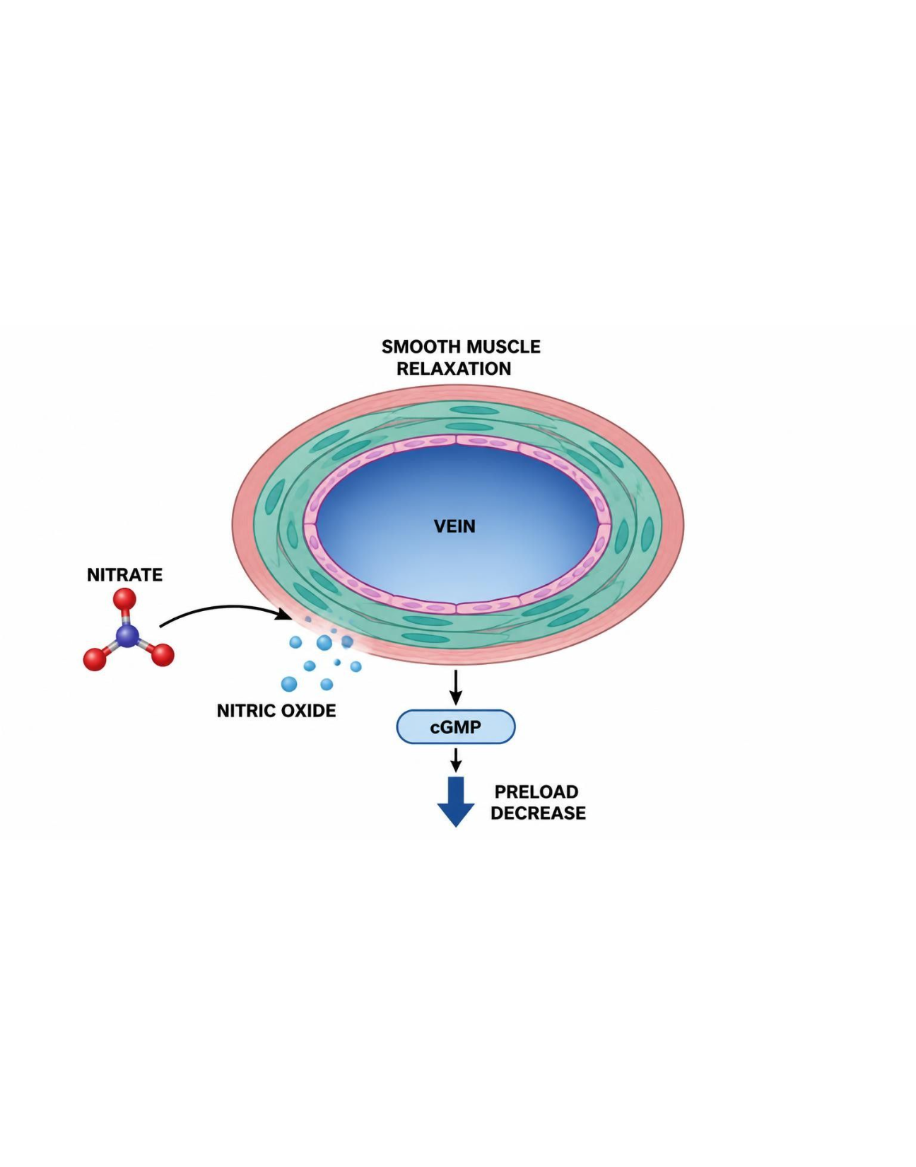
NITRATES, ANGINA & THE TRIPLE WHAMMY
Objectives: SO4 · SO5 · IO5.1 · IO5.2 · IO5.3 · IO5.6
Figure 14 · Nitrates: NO, cGMP and venodilation
Schematic (illustrative) — Figure 14. Nitrate action: NO → guanylate cyclase → cGMP → smooth-muscle relaxation (venodilation) → lower preload and oxygen demand. PDE5 inhibitors block cGMP breakdown — severe hypotension with nitrates. S20; S20 (notes)
L10 · Renal Pharmacotherapeutics — Session 2
70

Slide 71
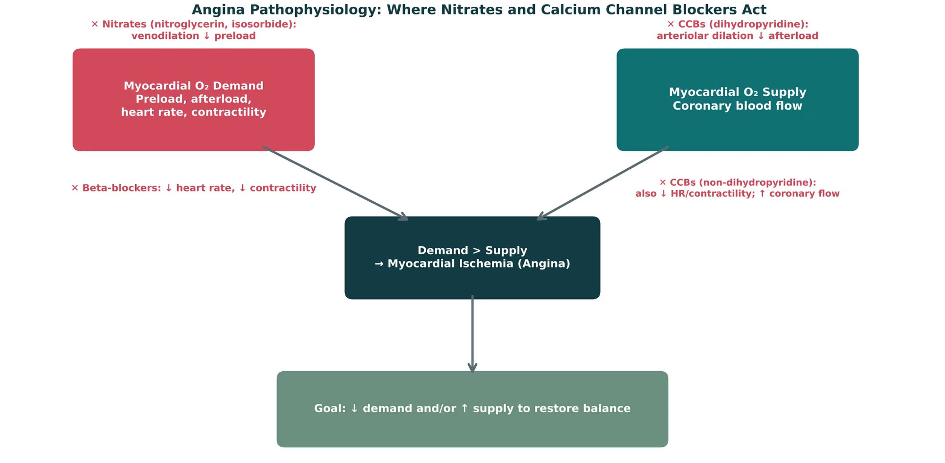
NITRATES, ANGINA & THE TRIPLE WHAMMY
Objectives: SO4 · SO5 · IO5.1 · IO5.2 · IO5.3 · IO5.6
Figure 15 · Angina: where nitrates and CCBs act
Original illustrative diagram (not from Katzung): angina results when myocardial oxygen demand exceeds supply. Nitrates reduce preload; dihydropyridine CCBs reduce afterload; non-dihydropyridine CCBs also reduce heart rate/contractility and increase coronary flow; beta-blockers reduce heart rate and contractility. S21; S21 (notes)
L10 · Renal Pharmacotherapeutics — Session 2
71

Slide 72
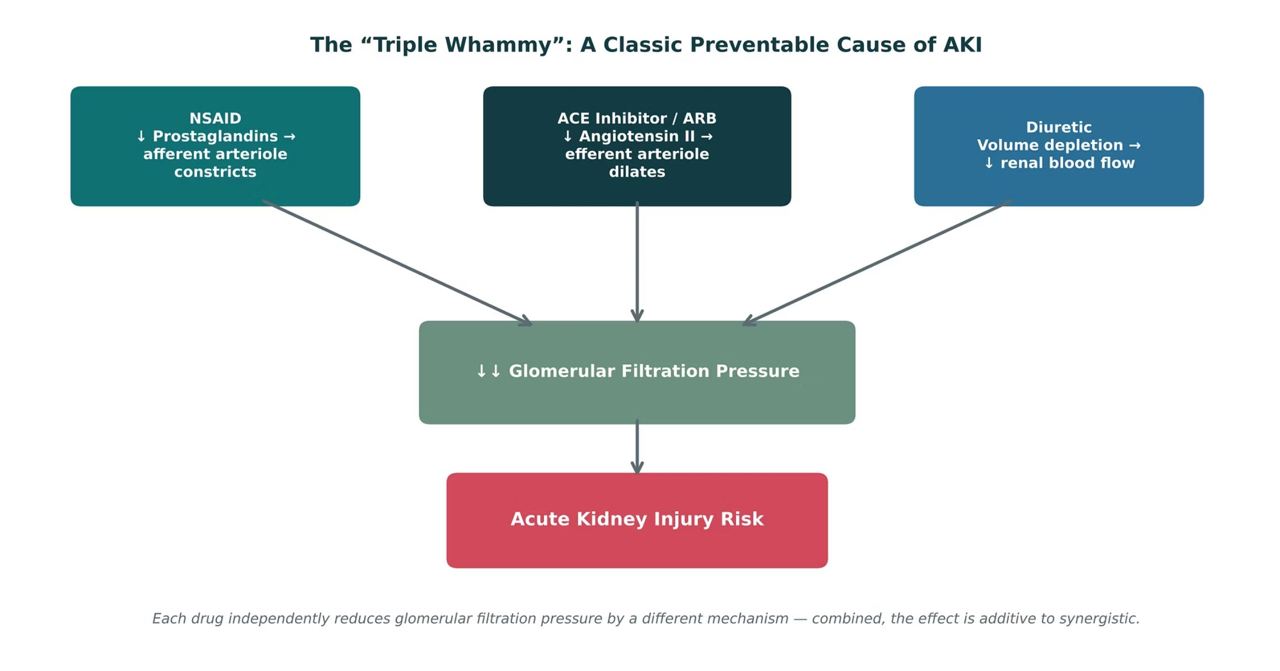
NITRATES, ANGINA & THE TRIPLE WHAMMY
Objectives: SO4 · SO5 · IO5.1 · IO5.2 · IO5.3 · IO5.6
Figure 16 · The triple whammy
Original illustrative diagram (not from Katzung): NSAID (afferent constriction) + ACE inhibitor or ARB (efferent dilation) + diuretic (volume depletion) each independently lower glomerular filtration pressure — combined, additive to synergistic AKI risk. S23; S23 (notes)
L10 · Renal Pharmacotherapeutics — Session 2
72

Slide 73
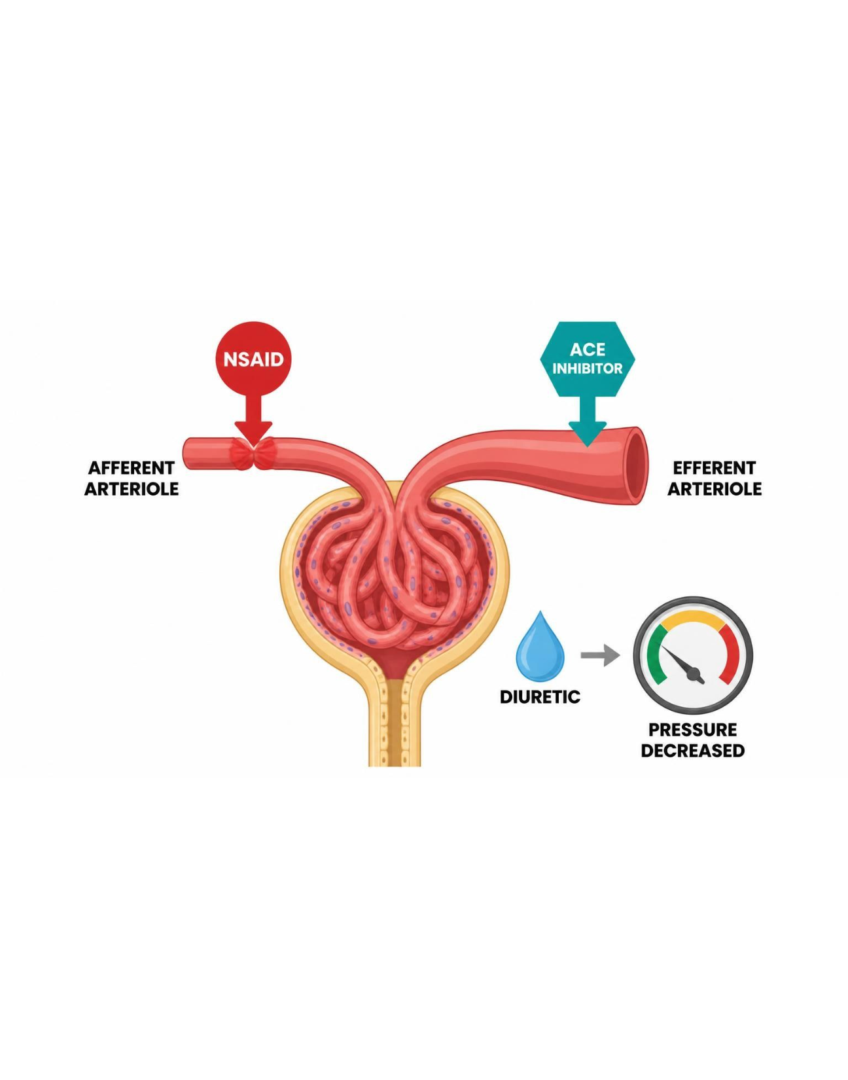
NITRATES, ANGINA & THE TRIPLE WHAMMY
Objectives: SO4 · SO5 · IO5.1 · IO5.2 · IO5.3 · IO5.6
Figure 17 · Three hits on glomerular pressure
Schematic (illustrative) — Figure 17. Three hits on glomerular filtration pressure: afferent constriction (NSAID), efferent dilation (ACE inhibitor or ARB), volume depletion (diuretic) → filtration pressure collapses: AKI. Prevention: counsel patients about OTC NSAIDs. S24; S24 (notes)
L10 · Renal Pharmacotherapeutics — Session 2
73

Slide 74
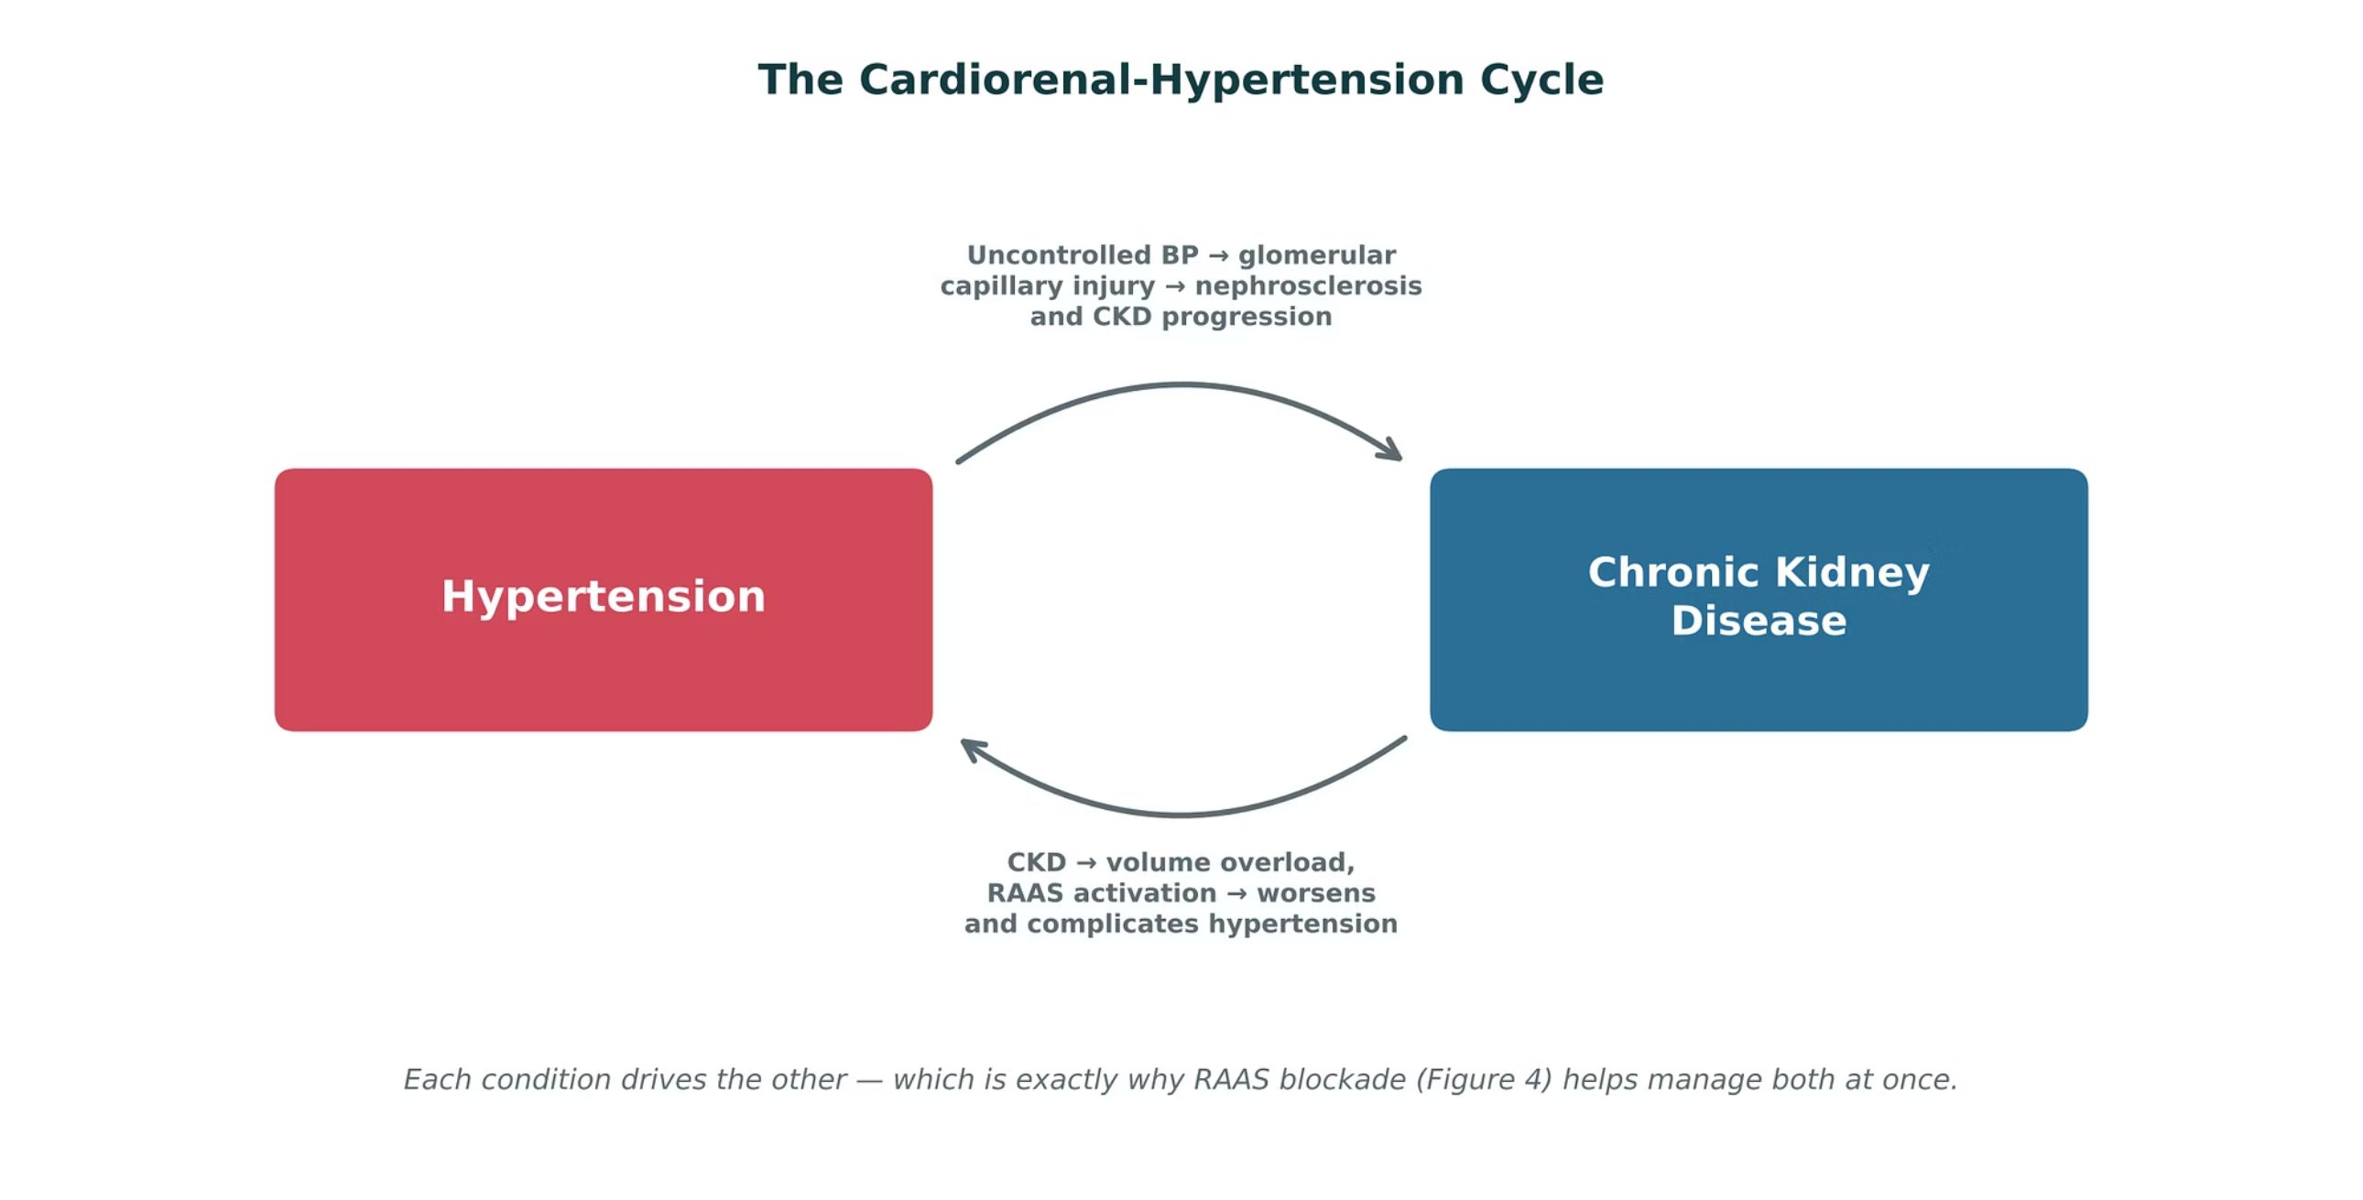
NITRATES, ANGINA & THE TRIPLE WHAMMY
Objectives: SO4 · SO5 · IO5.1 · IO5.2 · IO5.3 · IO5.6
Figure 18 · The cardiorenal-hypertension cycle
Original illustrative diagram (not from Katzung): uncontrolled blood pressure causes glomerular injury and CKD progression, while CKD causes volume overload and RAAS activation that worsens hypertension — a self-reinforcing cycle that RAAS blockade interrupts in both directions. S26; S26 (notes)
L10 · Renal Pharmacotherapeutics — Session 2
74

Slide 75
NITRATES, ANGINA & THE TRIPLE WHAMMY
Objectives: SO4 · SO5 · IO5.1 · IO5.2 · IO5.3 · IO5.6
Compare: Calcium channel blockers: DHP vs. non-DHP (S22)
 | Dihydropyridines | Non-dihydropyridines
Examples | Amlodipine, nifedipine | Diltiazem, verapamil
Main action | Arteriolar dilation → ↓ afterload | ↓ HR, contractility; ↑ coronary flow
Adverse effects | Peripheral edema, reflex tachycardia | Bradycardia, AV block, constipation (verapamil)
With a beta-blocker | Safe pairing | Avoid — bradycardia/AV block
Focus: what tells these apart. Sources: S13; S22
L10 · Renal Pharmacotherapeutics — Session 2
75

Slide 76
NITRATES, ANGINA & THE TRIPLE WHAMMY
Objectives: SO4 · SO5 · IO5.1 · IO5.2 · IO5.3 · IO5.6
Compare: Drug names reveal the class: cardiorenal agents (S28)
Stem | Class | Examples | Memory aid
-pril | ACE inhibitor | Lisinopril, enalapril, captopril | Angiotensin-converting enzyme
-sartan | ARB | Losartan, valsartan | Angiotensin receptor blocker
-kiren | Direct renin inhibitor | Aliskiren | Renin is the top of the cascade
-dipine | Dihydropyridine CCB | Amlodipine, nifedipine | Arteriolar dilation
-olol | Beta-blocker | Metoprolol, atenolol | Heart rate and renin down
-azine / -alazine | Hydralazine vasodilator | Hydralazine | Pair with beta-blocker and diuretic
-onidine | Central alpha-2 agonist | Clonidine | Central, so sympathetic outflow falls
-nitrate / nitro- | Nitrates | Isosorbide, nitroglycerin | Venodilation, preload down
-afil | PDE5 inhibitor | Sildenafil | Never combine with nitrates
-semide | Loop diuretic | Furosemide | Loop of Henle
Focus: what tells these apart. Sources: S28; S28 (notes)
L10 · Renal Pharmacotherapeutics — Session 2
76

Slide 77
NITRATES, ANGINA & THE TRIPLE WHAMMY
Objectives: SO4 · SO5 · IO5.1 · IO5.2 · IO5.3 · IO5.6
Compare: Supporting drugs at a glance (S55)
Drug(s) | Why it matters here
NSAIDs | Blunt antihypertensives; raise AKI risk with ACE inhibitor or ARB plus diuretic
PDE5 inhibitors (such as sildenafil) | Never combine with nitrates
Potassium supplements and potassium-sparing diuretics | Hyperkalemia with ACE inhibitors and ARBs
Trimethoprim | Hyperkalemia
Loop and thiazide diuretics | Covered in Session 1
Statins and aspirin | Cardiovascular risk reduction
Digoxin | Verapamil and diltiazem raise digoxin levels
Rifampin and carbamazepine | Lower calcium channel blocker levels
Grapefruit juice | Raises dihydropyridine calcium channel blocker levels
Focus: what tells these apart. Sources: S55; S55 (notes)
L10 · Renal Pharmacotherapeutics — Session 2
77

Slide 78
NITRATES, ANGINA & THE TRIPLE WHAMMY
Objectives: SO4 · SO5 · IO5.1 · IO5.2 · IO5.3 · IO5.6
Compare: Nitrate profiles: formulation, dose, indications
Drug | Class | Formulation | Adult dose | Indications
Nitroglycerin (Nitrostat, Nitro-Dur) | Organic nitrate | Sublingual tablet 0.3/0.4/0.6 mg; spray 0.4 mg; patch 0.1-0.8 mg/h; IV infusion | Acute angina: 0.4 mg SL every 5 minutes up to 3 doses; patch 0.2-0.8 mg/h applied 12-14 hours per day; IV 5-10 mcg/min titrated | Acute angina, angina prophylaxis, acute heart failure, hypertensive emergency
Isosorbide mononitrate (Imdur) | Organic nitrate (long-acting) | ER tablets 30/60/120 mg; immediate-release tablets 10/20 mg | ER: 30-60 mg PO every morning, up to 240 mg/day; immediate-release: 20 mg BID given 7 hours apart | Angina prophylaxis
Isosorbide dinitrate (Isordil) | Organic nitrate | Tablets 5/10/20/30/40 mg; ER capsules 40 mg; combination with hydralazine (BiDil) | Angina: 10-40 mg PO TID with a 14-hour nitrate-free interval; heart failure: 20-40 mg TID with hydralazine | Angina prophylaxis, heart failure in Black patients (with hydralazine)
Focus: what tells these apart. Sources: S52; S53; S54
L10 · Renal Pharmacotherapeutics — Session 2
78

Slide 79
NITRATES, ANGINA & THE TRIPLE WHAMMY
Objectives: SO4 · SO5 · IO5.1 · IO5.2 · IO5.3 · IO5.6
Compare: Nitrate profiles: adverse effects, contraindications, toxicity
Drug | Adverse effects | Contraindications | Toxicity / overdose
Nitroglycerin (Nitrostat, Nitro-Dur) | Headache, flushing, hypotension, reflex tachycardia, dizziness | Concurrent PDE5 inhibitors (sildenafil, tadalafil) or riociguat, severe anemia, increased intracranial pressure, right ventricular infarction | Severe hypotension and syncope, especially with PDE5 inhibitors; tolerance without a nitrate-free interval; methemoglobinemia at very high doses
Isosorbide mononitrate (Imdur) | Headache, dizziness, hypotension, flushing | Concurrent PDE5 inhibitors or riociguat, severe anemia, increased intracranial pressure | Hypotension, headache; tolerance requires nitrate-free interval
Isosorbide dinitrate (Isordil) | Headache, flushing, hypotension, reflex tachycardia | Concurrent PDE5 inhibitors or riociguat, severe anemia, increased intracranial pressure | Hypotension, syncope, headache; tolerance without a nitrate-free interval
Focus: what tells these apart. Sources: S52; S53; S54
L10 · Renal Pharmacotherapeutics — Session 2
79

Slide 80
NITRATES, ANGINA & THE TRIPLE WHAMMY
Objectives: SO4 · SO5 · IO5.1 · IO5.2 · IO5.3 · IO5.6
Memory hooks
Mnemonic (memory aid)
Why it happens
Stems: -pril, -sartan, -kiren, -dipine, -olol, -azine / -alazine, -onidine, -nitrate / nitro-, -afil, -semide. Read the Stem, name the Class, recall the Examples and the Memory aid. S28; S28 (notes)
Why are nitrates + sildenafil deadly? Nitrates make cGMP; sildenafil stops its breakdown — cGMP piles up and blood pressure collapses. S20
L10 · Renal Pharmacotherapeutics — Session 2
80

Slide 81
NITRATES, ANGINA & THE TRIPLE WHAMMY
Objectives: SO4 · SO5 · IO5.1 · IO5.2 · IO5.3 · IO5.6
High-yield summary
If you remember nothing else
Nitrates: NO → cGMP → venodilation, ↓ preload; nitrate-free interval; never with PDE5 inhibitors. S19; S20; SG U5-R11
Triple whammy: NSAID (afferent) + ACEi/ARB (efferent) + diuretic (volume) → AKI; counsel on OTC NSAIDs. S23; S27; SG U5-R12
L10 · Renal Pharmacotherapeutics — Session 2
81

Slide 82
CLINICAL VIGNETTE · LECTURE QUICK CHECK S27
Objectives: SO4 · SO5 · IO5.1 · IO5.2 · IO5.3 · IO5.6
Question 10
An older adult on lisinopril and hydrochlorothiazide starts daily OTC ibuprofen for a knee injury. A week later creatinine is up acutely. Best explanation?
A
Triple whammy: three hits on filtration pressure
B
Allergic interstitial nephritis from lisinopril
C
Thiazide-induced hypercalcemia
D
Expected creatinine rise from starting lisinopril
E
Contrast nephropathy from imaging
L10 · Renal Pharmacotherapeutics — Session 2
82
Notes:
Answer on the next slide. Source: S27; SG U5-S

Slide 83
CLINICAL VIGNETTE · ANSWER
Objectives: SO4 · SO5 · IO5.1 · IO5.2 · IO5.3 · IO5.6
Answer 10: A
A. Triple whammy: three hits on filtration pressure
The NSAID, ACE inhibitor and diuretic each independently reduce glomerular filtration pressure, together precipitating AKI (S27). S27; SG U5-S
Why the other choices are wrong
B. Allergic interstitial nephritis from lisinopril — Not the taught picture (S27).
C. Thiazide-induced hypercalcemia — Not the mechanism (S27).
D. Expected creatinine rise from starting lisinopril — He is not newly started (S27).
E. Contrast nephropathy from imaging — No contrast given (S27).
L10 · Renal Pharmacotherapeutics — Session 2
83

Slide 84
CLINICAL VIGNETTE
Objectives: SO4 · SO5 · IO5.1 · IO5.2 · IO5.3 · IO5.6
Question 11
A man using sildenafil asks for a nitroglycerin prescription for chest pain. What is the key concern?
A
Severe hyperkalemia
B
Faster nitrate tolerance only
C
Life-threatening hypotension
D
Bradykinin-mediated cough
E
Reflex bradycardia and AV block
L10 · Renal Pharmacotherapeutics — Session 2
84
Notes:
Answer on the next slide. Source: S19; S20; SG U5-R11

Slide 85
CLINICAL VIGNETTE · ANSWER
Objectives: SO4 · SO5 · IO5.1 · IO5.2 · IO5.3 · IO5.6
Answer 11: C
C. Life-threatening hypotension
Concurrent PDE5 inhibitors are an absolute contraindication to nitrates — severe hypotension (S19–S20). S19; S20; SG U5-R11
Why the other choices are wrong
A. Severe hyperkalemia — Not a nitrate effect (S19).
B. Faster nitrate tolerance only — The interaction is the danger (S19).
D. Bradykinin-mediated cough — ACE inhibitors (S6).
E. Reflex bradycardia and AV block — Nitrates cause reflex tachycardia (S19).
L10 · Renal Pharmacotherapeutics — Session 2
85

Slide 86


Topic 4 of 4
Putting It All Together: Renal Toolkit
Covers objectives: SO5 · IO5.3 · IO5.4 · IO5.6
Key definitions
How it works
Clinical relevance
Drugs named as examples
Exam traps
86

Slide 87
PUTTING IT ALL TOGETHER: RENAL TOOLKIT
Objectives: SO5 · IO5.3 · IO5.4 · IO5.6
Key definitions
Key definitions
Applying the whole Renal pharmacology toolkit. Integration: put the drug classes together — for each patient, name a first-line approach AND the single biggest safety concern to check before prescribing or counseling. S29; S29 (notes); S30 (notes)
L10 · Renal Pharmacotherapeutics — Session 2
87

Slide 88
PUTTING IT ALL TOGETHER: RENAL TOOLKIT
Objectives: SO5 · IO5.3 · IO5.4 · IO5.6
How it works
How it works (1/2)
1. Diuretic classes (Session 1) and RAAS-blocking antihypertensives both map onto specific, drug-targetable points in renal physiology — the nephron (Figure 1) and the RAAS cascade (Figure 8), respectively. S31
2. ACE inhibitors and ARBs are preferred first-line therapy for hypertension in CKD because of their renoprotective efferent-arteriolar mechanism, not just their blood-pressure-lowering effect. S31
3. Calcium channel blockers exemplify the cardiovascular-renal overlap directly — the same drug class, same mechanism, treats both hypertension and angina. S31
4. The "triple whammy" (NSAID + ACEi/ARB + diuretic) is a classic, common, and preventable cause of acute kidney injury that draws on content from both sessions at once. S31
L10 · Renal Pharmacotherapeutics — Session 2
88

Slide 89
PUTTING IT ALL TOGETHER: RENAL TOOLKIT
Objectives: SO5 · IO5.3 · IO5.4 · IO5.6
How it works (cont.)
How it works (2/2)
5. Hypertension and chronic kidney disease exist in a bidirectional, self-reinforcing cycle (Figure 18) — which is exactly why managing one well so often means managing the other. S31
All three threads center on glomerular filtration pressure. S31 (notes)
Connecting back to earlier units: drug-metabolism/dosing concepts (Unit 1) and the biologic-mechanism callbacks from Units 2–4 all reinforce that pharmacology is cumulative — the cardiorenal interface is where several organ-system units visibly intersect. S31 (notes)
L10 · Renal Pharmacotherapeutics — Session 2
89

Slide 90
PUTTING IT ALL TOGETHER: RENAL TOOLKIT
Objectives: SO5 · IO5.3 · IO5.4 · IO5.6
Clinical relevance
Clinical relevance
Patient A — advancing CKD, hypertension no longer controlled on a thiazide: switch to a loop diuretic; check potassium and volume status. S30; S15; S17
Patient B — proteinuric CKD, needs first-line antihypertensive therapy: ACE inhibitor or ARB; check potassium and creatinine in 1–2 weeks and pregnancy potential. S30; S5; S8
Patient C — on an ACE inhibitor and a diuretic, about to start a daily OTC NSAID: counsel against regular NSAID use — triple whammy AKI risk. S30; S27
Patient D — stable angina, already on a beta-blocker, needs additional symptom control: add a dihydropyridine CCB or a long-acting nitrate; avoid diltiazem/verapamil (AV block) and PDE5 inhibitors with nitrates. S30; S13; S19; S22
L10 · Renal Pharmacotherapeutics — Session 2
90

Slide 91
PUTTING IT ALL TOGETHER: RENAL TOOLKIT
Objectives: SO5 · IO5.3 · IO5.4 · IO5.6
Drugs named as examples
Drugs named as examples
A cumulative self-test spanning both sessions — use this to review before exams. The recall quiz is a standalone resource, separate from in-lecture quick checks. S32; S32 (notes); S35 (notes)
Recall Q1–2: loops collapse the lumen-positive potential (↑ Ca²⁺ excretion), thiazides increase distal Ca²⁺ reabsorption; at eGFR 22 switch the thiazide to a loop. S33; S35
Recall Q3–4: a creatinine rise up to ~30% on an ACE inhibitor is expected — continue with monitoring; ACEi/ARBs dilate the efferent arteriole, lowering intraglomerular pressure and proteinuria. S33; S34; S35
Recall Q5: the triple whammy is three independent reductions in filtration pressure combining additively to synergistically, precipitating AKI. S34; S35
Recall Q6: CCBs treat hypertension via arteriolar dilation (reducing afterload/systemic vascular resistance) and angina via the same mechanism (reducing afterload and myocardial oxygen demand) — one drug class, one mechanism, two indications. S34; S35
L10 · Renal Pharmacotherapeutics — Session 2
91

Slide 92
PUTTING IT ALL TOGETHER: RENAL TOOLKIT
Objectives: SO5 · IO5.3 · IO5.4 · IO5.6
Exam traps
Exam traps
Reflexively stopping an ACE inhibitor for a ≤30% creatinine rise is the classic trap. S5 (notes); S10 (notes)
Adding a new drug class when the real problem is a thiazide at low GFR. S15 (notes); S17
L10 · Renal Pharmacotherapeutics — Session 2
92

Slide 93
PUTTING IT ALL TOGETHER: RENAL TOOLKIT
Objectives: SO5 · IO5.3 · IO5.4 · IO5.6
Compare: Which approach would you choose? (S30)
Patient | First-line approach | Biggest safety check
A · Advancing CKD, BP no longer controlled on a thiazide | Switch to a loop diuretic | Potassium, volume status
B · Proteinuric CKD, first-line therapy | ACE inhibitor or ARB | K⁺ and creatinine in 1–2 weeks; pregnancy
C · ACEi + diuretic, about to start daily OTC NSAID | Counsel to avoid the NSAID | Triple whammy AKI
D · Stable angina on a beta-blocker | Add DHP CCB or long-acting nitrate | No non-DHP with BB; no PDE5 with nitrates
Focus: what tells these apart. Sources: S30; S13; S15; S19; S27
L10 · Renal Pharmacotherapeutics — Session 2
93

Slide 94
PUTTING IT ALL TOGETHER: RENAL TOOLKIT
Objectives: SO5 · IO5.3 · IO5.4 · IO5.6
Memory hooks
Mnemonic (memory aid)
Every case, two answers: the approach and the one thing to check. S30 (notes)
L10 · Renal Pharmacotherapeutics — Session 2
94

Slide 95
PUTTING IT ALL TOGETHER: RENAL TOOLKIT
Objectives: SO5 · IO5.3 · IO5.4 · IO5.6
High-yield summary
If you remember nothing else
Five takeaways: two targetable maps · ACEi/ARB renoprotection · CCB overlap · triple whammy · HTN–CKD cycle. S31
L10 · Renal Pharmacotherapeutics — Session 2
95

Slide 96
MECHANISM · LECTURE QUICK CHECK S33; S35
Objectives: SO5 · IO5.3 · IO5.4 · IO5.6
Question 15
Why do loop diuretics increase calcium excretion while thiazide diuretics decrease it?
A
Loops collapse the lumen-positive potential
B
There is no mechanistic difference
C
Thiazides block the Na-K-2Cl cotransporter
D
Thiazides act in the proximal tubule
E
Loops act in the collecting duct
L10 · Renal Pharmacotherapeutics — Session 2
96
Notes:
Answer on the next slide. Source: S33; S35

Slide 97
MECHANISM · ANSWER
Objectives: SO5 · IO5.3 · IO5.4 · IO5.6
Answer 15: A
A. Loops collapse the lumen-positive potential
Loops block NKCC2, collapsing the lumen-positive potential driving paracellular Ca²⁺/Mg²⁺ reabsorption; thiazides increase distal Ca²⁺ reabsorption (S35). S33; S35
Why the other choices are wrong
B. There is no mechanistic difference — There is (S35).
C. Thiazides block the Na-K-2Cl cotransporter — Loops do (S35).
D. Thiazides act in the proximal tubule — Distal tubule (S35).
E. Loops act in the collecting duct — Loops act at the thick ascending limb (S35).
L10 · Renal Pharmacotherapeutics — Session 2
97

Slide 98
CLINICAL VIGNETTE · LECTURE QUICK CHECK S33; S35
Objectives: SO5 · IO5.3 · IO5.4 · IO5.6
Question 16
A patient’s thiazide stops controlling blood pressure as CKD advances to eGFR 22 mL/min. What is the best change?
A
Switch to acetazolamide
B
Switch to a loop diuretic
C
Increase the thiazide dose
D
Add a second thiazide
E
Stop all diuretic therapy
L10 · Renal Pharmacotherapeutics — Session 2
98
Notes:
Answer on the next slide. Source: S33; S35

Slide 99
CLINICAL VIGNETTE · ANSWER
Objectives: SO5 · IO5.3 · IO5.4 · IO5.6
Answer 16: B
B. Switch to a loop diuretic
Thiazides lose most natriuretic efficacy below GFR ~30; loops act upstream and remain effective (S35). S33; S35
Why the other choices are wrong
A. Switch to acetazolamide — Weak; not the answer (S35).
C. Increase the thiazide dose — Too little filtrate reaches the site (S35).
D. Add a second thiazide — Same failing site (S35).
E. Stop all diuretic therapy — A loop remains effective (S35).
L10 · Renal Pharmacotherapeutics — Session 2
99

Slide 100
CLINICAL VIGNETTE · LECTURE QUICK CHECK S33; S35
Objectives: SO5 · IO5.3 · IO5.4 · IO5.6
Question 17
A patient starts lisinopril for proteinuric CKD; creatinine rises 25% in two weeks. What is the best response?
A
Continue with monitoring; this is expected
B
Stop the ACE inhibitor immediately
C
Add aliskiren for renoprotection
D
Double the lisinopril dose
E
Switch to an NSAID instead
L10 · Renal Pharmacotherapeutics — Session 2
100
Notes:
Answer on the next slide. Source: S33; S35

Slide 101
CLINICAL VIGNETTE · ANSWER
Objectives: SO5 · IO5.3 · IO5.4 · IO5.6
Answer 17: A
A. Continue with monitoring; this is expected
A rise up to ~30% reflects reduced intraglomerular pressure — an expected hemodynamic effect (S35). S33; S35
Why the other choices are wrong
B. Stop the ACE inhibitor immediately — Expected, not toxicity (S35).
C. Add aliskiren for renoprotection — Avoid the combination (S7).
D. Double the lisinopril dose — Not the response (S35).
E. Switch to an NSAID instead — NSAIDs raise AKI risk (S35).
L10 · Renal Pharmacotherapeutics — Session 2
101

Slide 102
MECHANISM · LECTURE QUICK CHECK S34; S35
Objectives: SO5 · IO5.3 · IO5.4 · IO5.6
Question 18
Why are ACE inhibitors and ARBs preferred first-line therapy in proteinuric CKD?
A
They have no renal effects at all
B
They are the only class usable in CKD
C
They constrict the afferent arteriole
D
They dilate the efferent arteriole
E
They increase aldosterone release
L10 · Renal Pharmacotherapeutics — Session 2
102
Notes:
Answer on the next slide. Source: S34; S35

Slide 103
MECHANISM · ANSWER
Objectives: SO5 · IO5.3 · IO5.4 · IO5.6
Answer 18: D
D. They dilate the efferent arteriole
They preferentially dilate the efferent arteriole, lowering intraglomerular pressure and proteinuria (S35). S34; S35
Why the other choices are wrong
A. They have no renal effects at all — They do (S35).
B. They are the only class usable in CKD — Other classes are used (S35).
C. They constrict the afferent arteriole — That is NSAIDs (S23).
E. They increase aldosterone release — They reduce it (S35).
L10 · Renal Pharmacotherapeutics — Session 2
103

Slide 104
MECHANISM · LECTURE QUICK CHECK S34; S35
Objectives: SO5 · IO5.3 · IO5.4 · IO5.6
Question 19
A patient on an ACE inhibitor and a diuretic starts a daily OTC NSAID and develops AKI. What is the mechanism?
A
The ACE inhibitor inactivates the NSAID
B
Three reductions in filtration pressure add up
C
The diuretic causes allergic nephritis
D
This combination has no extra risk
E
NSAIDs have no renal effects
L10 · Renal Pharmacotherapeutics — Session 2
104
Notes:
Answer on the next slide. Source: S34; S35

Slide 105
MECHANISM · ANSWER
Objectives: SO5 · IO5.3 · IO5.4 · IO5.6
Answer 19: B
B. Three reductions in filtration pressure add up
NSAID afferent constriction + ACEi efferent dilation + diuretic volume depletion combine additively to synergistically (S35). S34; S35
Why the other choices are wrong
A. The ACE inhibitor inactivates the NSAID — Not a mechanism (S35).
C. The diuretic causes allergic nephritis — Not the mechanism (S35).
D. This combination has no extra risk — It is the triple whammy (S35).
E. NSAIDs have no renal effects — They constrict the afferent arteriole (S35).
L10 · Renal Pharmacotherapeutics — Session 2
105

Slide 106
MECHANISM · LECTURE QUICK CHECK S34; S35
Objectives: SO5 · IO5.3 · IO5.4 · IO5.6
Question 20
Which drug class treats BOTH hypertension and angina pectoris via the same mechanism?
A
Thiazide diuretics
B
Loop diuretics
C
Aldosterone antagonists
D
Carbonic anhydrase inhibitors
E
Calcium channel blockers
L10 · Renal Pharmacotherapeutics — Session 2
106
Notes:
Answer on the next slide. Source: S34; S35

Slide 107
MECHANISM · ANSWER
Objectives: SO5 · IO5.3 · IO5.4 · IO5.6
Answer 20: E
E. Calcium channel blockers
CCBs treat hypertension and angina via the same arteriolar-dilation mechanism (S35). S34; S35
Why the other choices are wrong
A. Thiazide diuretics — Hypertension only (S35).
B. Loop diuretics — Edema, not angina (S35).
C. Aldosterone antagonists — Not antianginal (S35).
D. Carbonic anhydrase inhibitors — Not antianginal (S35).
L10 · Renal Pharmacotherapeutics — Session 2
107

