Slide 1

PA PHARMACOLOGY COURSE · LECTURE 4 · SESSION 2 OF 2
Endocrine Pharmacotherapy
Session 2: Reproductive Hormones, Diabetes, and Bone Mineral Homeostasis | Thursday, November 12 | 8:30–11:00 AM
Diane S. Allen-Gipson, Ph.D., M.S., Course Director
Notes:
Say: Session 1 gave us the axis. Today the same negative-feedback logic explains contraception, then we cover the many ways to lower glucose, and finish with the two opposite parathyroid problems.

Slide 2

BY THE END OF THIS LECTURE
Learning Objectives — Session 2
Recap: Session 1 covered the hypothalamic-pituitary axis, thyroid/antithyroid drugs, and adrenocorticosteroid pharmacology.
Describe the mechanisms and clinical uses of gonadal hormone agents, including combined hormonal contraception, SERMs, and androgens/antiandrogens.
Classify glucose-lowering drugs by mechanism and site of action, and compare agents on efficacy, hypoglycemia risk, and key adverse effects.
Distinguish hyperparathyroidism from hypoparathyroidism and identify the drug strategy used for each.
Identify key contraindications, adverse effects, and drug interactions throughout.
Apply the full Endocrine pharmacology toolkit to integrated clinical scenarios, and complete a cumulative recall quiz spanning both sessions.
Endocrine Pharmacotherapy — Session 2 of 2 — PA Program
2
Notes:
Briefly recap Session 1 (Nov 10) before diving in: pituitary, thyroid, and adrenal pharmacology. Today picks up with gonadal hormones (Section 4) and runs through diabetes, parathyroid disorders, integration, and the cumulative recall quiz.
Instructor script:
Read the two objectives aloud and recap Session 1 in one sentence.

Slide 3

SECTION
04
Gonadal Hormones & Inhibitors
Suppressing, replacing, or selectively modulating the reproductive axis.
Notes:
Section transition. Today the same negative-feedback logic explains contraception.

Slide 4

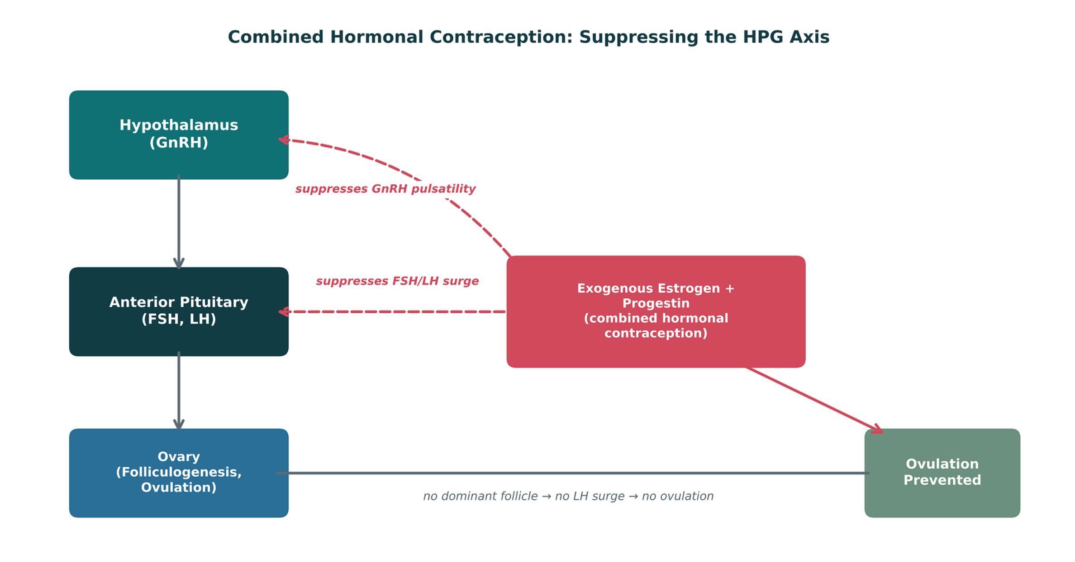
ORIGINAL ILLUSTRATION · FIGURE 11
Combined Hormonal Contraception: Suppressing the HPG Axis
Figure 11. Original illustrative diagram (not from Katzung): exogenous estrogen and progestin suppress GnRH pulsatility and the FSH/LH surge, preventing the dominant-follicle development and LH surge required for ovulation.
Endocrine Pharmacotherapy — Session 2 of 2 — PA Program
4
Notes:
This is the same negative-feedback template from Figure 1 (Session 1), now applied to the HPG axis — point that out explicitly as a callback.
Instructor script:
Estrogen plus progestin suppress GnRH, FSH and LH, so no follicle matures and no LH surge occurs. Figure 11 shows this feedback loop.

Slide 5
ESTROGENS, PROGESTINS, AND CONTRACEPTION
Combined Hormonal Contraception
Mechanism: estrogen + progestin suppress GnRH/FSH/LH, preventing ovulation (Figure 11); progestin also thickens cervical mucus and thins the endometrium.
Available as oral pills, transdermal patch, or vaginal ring.
Contraindications: history of VTE/stroke, estrogen-sensitive cancer, uncontrolled hypertension, migraine with aura, and smokers age 35 or older (increased thromboembolic risk).
Progestin-only options (e.g., the "minipill," depot medroxyprogesterone, levonorgestrel IUD) avoid estrogen-related thromboembolic risk and are preferred when estrogen is contraindicated.
Endocrine Pharmacotherapy — Session 2 of 2 — PA Program
5
Notes:
The contraindication list is the highest-yield content here — "smoker over 35" and "migraine with aura" are classic exam triggers for choosing a progestin-only method instead.
Instructor script:
Know: contraindications to estrogen are VTE or stroke history, smoker aged 35 or older, migraine with aura, estrogen-sensitive cancer, uncontrolled hypertension and liver disease. Enzyme inducers (rifampin, some antiepileptics, St. John's wort) lower efficacy.

Slide 6
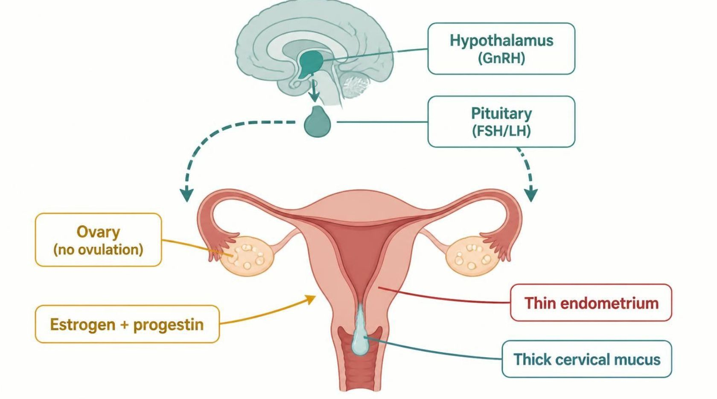
MECHANISM & DEPTH
Combined Pills: Ovulation Block and Backup Barriers
Ethinyl estradiol plus progestin enter the bloodstream
▼
Hypothalamus lowers GnRH pulses; pituitary lowers FSH and LH
▼
No follicle maturation and no LH surge, so no ovulation
▼
Progestin also thickens cervical mucus and thins the endometrium
▼
Result: pregnancy prevented (over 99% with perfect use)
Schematic (illustrative)
Figure 12. Teal: hormone entry; blue: brain and ovary signaling; grey-green: local cervical and endometrial effects; red: outcome. Arrows show negative feedback.
Risks include venous thromboembolism, hypertension and stroke; smokers 35 or older, migraine with aura and prior VTE rule out estrogen.
Common effects: nausea, breast tenderness, breakthrough bleeding.
Enzyme inducers (rifampin, St. John's wort, some antiepileptics) lower efficacy; use backup contraception.
Progestin-only options are preferred when estrogen is contraindicated.
Endocrine Pharmacotherapy — Session 2 of 2 — PA Program
6
Notes:
Progestin also thickens cervical mucus and thins the endometrium. Progestin-only options: minipill, DMPA (bone density warning), levonorgestrel IUD.

Slide 7

SELECTIVE MODULATION
SERMs and Androgen Pharmacology
Selective Estrogen-Receptor Modulators (SERMs)
Androgens & Antiandrogens
– Tamoxifen — antagonist in breast tissue (breast cancer treatment/prevention), agonist in endometrium (raises endometrial cancer risk)
– Raloxifene — antagonist in breast/endometrium, agonist in bone (osteoporosis prevention) — ties back to Unit 2 bone pharmacology
– Tissue-selective activity is the defining feature of this class
– Testosterone — replacement for hypogonadism; monitor hematocrit (erythrocytosis risk) and lipids
– Finasteride — 5-α-reductase inhibitor; reduces conversion of testosterone to DHT (BPH, androgenetic alopecia)
– Spironolactone — antiandrogen effect at high doses; used off-label for hirsutism/acne (same drug as the mineralocorticoid antagonist from Session 1)
Endocrine Pharmacotherapy — Session 2 of 2 — PA Program
7
Notes:
Spironolactone reappearing here (after its Session 1 mineralocorticoid-antagonist role) is a deliberate callback — same molecule, different receptor, different clinical use.
Instructor script:
One receptor, different tissue effects. Tamoxifen blocks breast and stimulates endometrium. Raloxifene stimulates bone and blocks breast and endometrium.

Slide 8
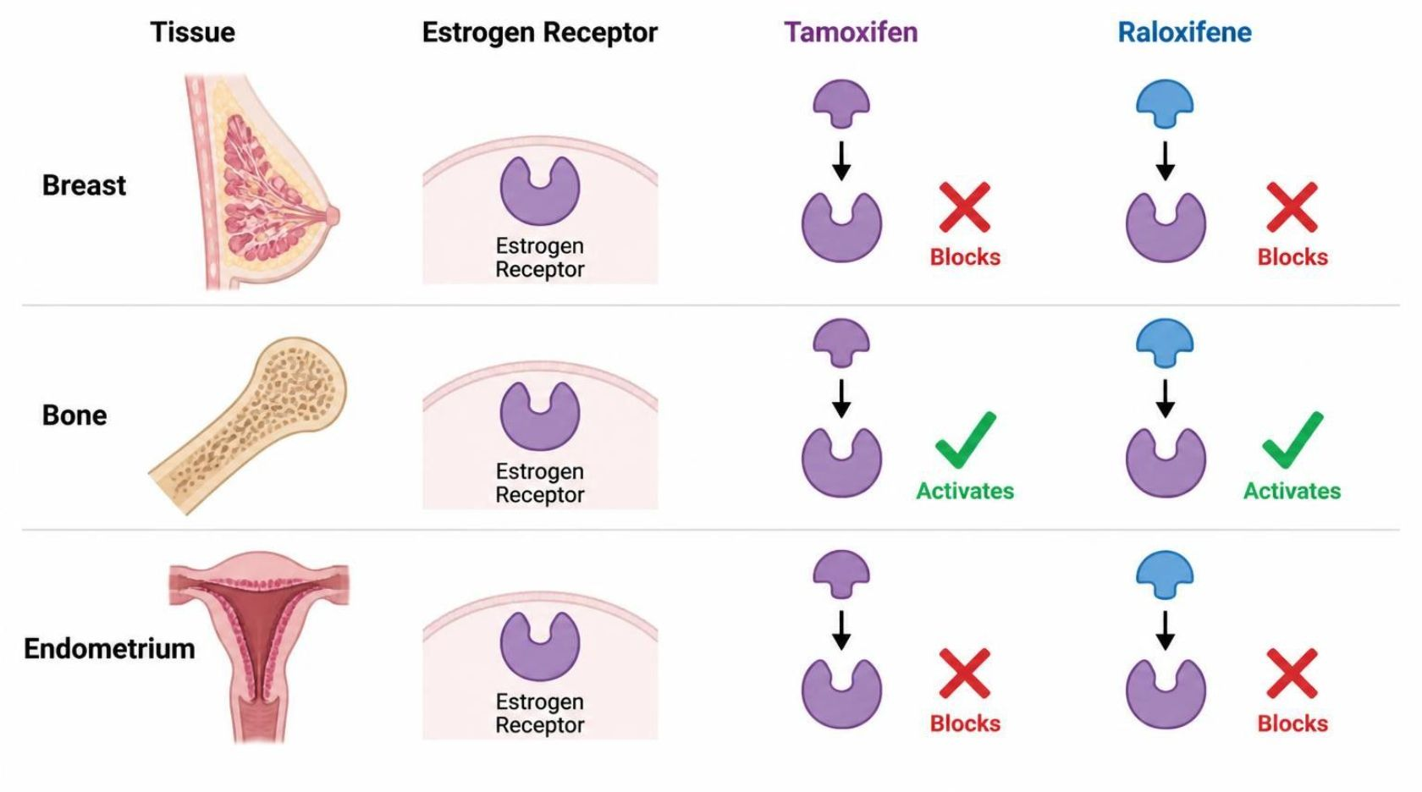
MECHANISM & DEPTH
SERMs: One Receptor, Different Tissue Effects
Tamoxifen or raloxifene bind the estrogen receptor
▼
The receptor shape recruits different co-factors in each tissue
▼
Breast: blocked (antagonist), so cancer growth is slowed
▼
Bone: activated (agonist), so bone density is kept
▼
Endometrium: tamoxifen activates (cancer risk); raloxifene blocks
Schematic (illustrative)
Figure 13. Teal: receptor binding; blue and grey-green: tissue responses; green check = agonist, red X = antagonist; red outcome = risk in endometrium.
Tamoxifen raises endometrial cancer and VTE risk and causes hot flashes.
Raloxifene prevents osteoporosis and vertebral fracture and does not increase endometrial cancer, but raises VTE risk and hot flashes.
Both are contraindicated with prior VTE; raloxifene is not used to treat breast cancer.
Endocrine Pharmacotherapy — Session 2 of 2 — PA Program
8
Notes:
Figure 13 shows one receptor with different tissue effects. Both drugs raise VTE risk. Know: tamoxifen raises endometrial cancer risk, so students should report vaginal bleeding; CYP2D6 inhibitors blunt tamoxifen.

Slide 9
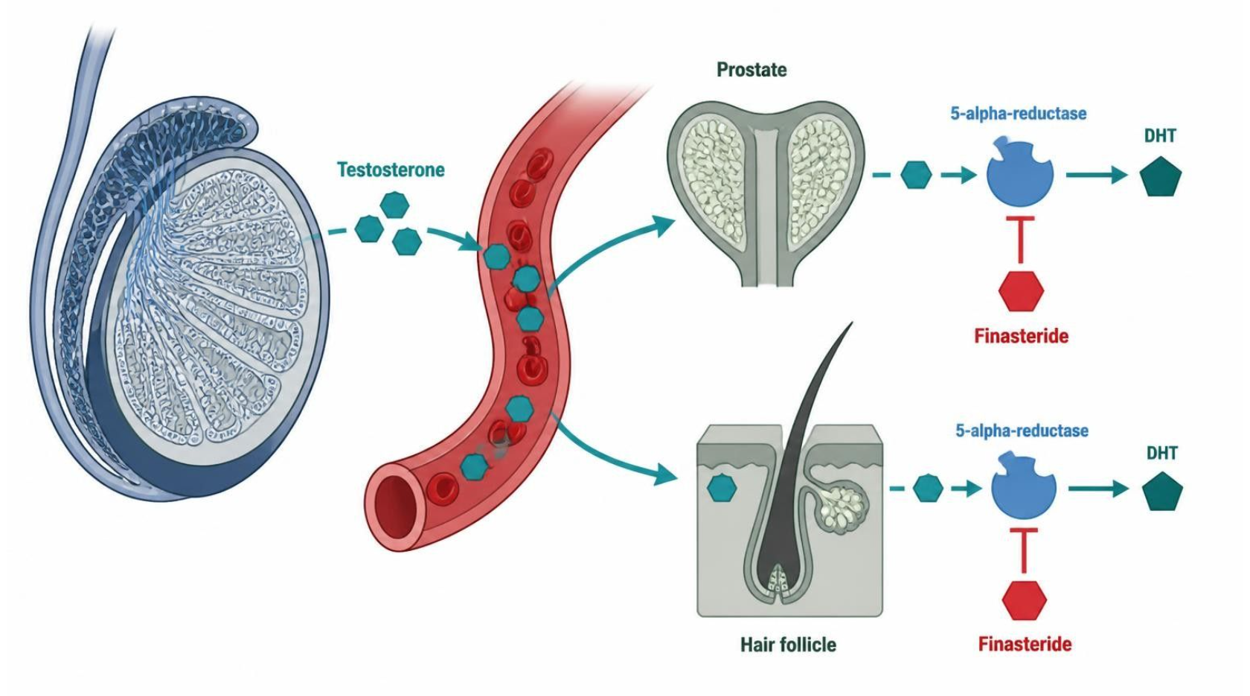
MECHANISM & DEPTH
Testosterone, DHT and 5-alpha-Reductase Inhibitors
Testes make testosterone
▼
5-alpha-reductase converts it to DHT in prostate and skin
▼
DHT drives prostate growth and hair loss
▼
Finasteride blocks 5-alpha-reductase
▼
Lower DHT: smaller prostate, less hair loss
Schematic (illustrative)
Figure 14. Teal: start; blue: enzyme and hormone steps; green-grey: blocking drug; red: outcome, lower DHT.
Finasteride lowers PSA by about half, so double the PSA value when screening; sexual side effects occur.
Finasteride is teratogenic: pregnant women should not handle crushed or broken tablets.
Testosterone replacement: monitor hematocrit, PSA and lipids; avoid in prostate cancer. Spironolactone is an antiandrogen at high dose.
Endocrine Pharmacotherapy — Session 2 of 2 — PA Program
9
Notes:
Figure 14: testosterone is converted to DHT by 5-alpha-reductase. Finasteride blocks it; PSA falls by about half; pregnant women must not handle crushed tablets. Testosterone replacement: monitor hematocrit, PSA and lipids.

Slide 10

SECTION
05
Pancreatic Hormones & Glucose-Lowering Drugs
Many mechanisms, one shared goal: glycemic control without excess hypoglycemia.
Notes:
Section transition. Today we cover the many ways to lower glucose.

Slide 11

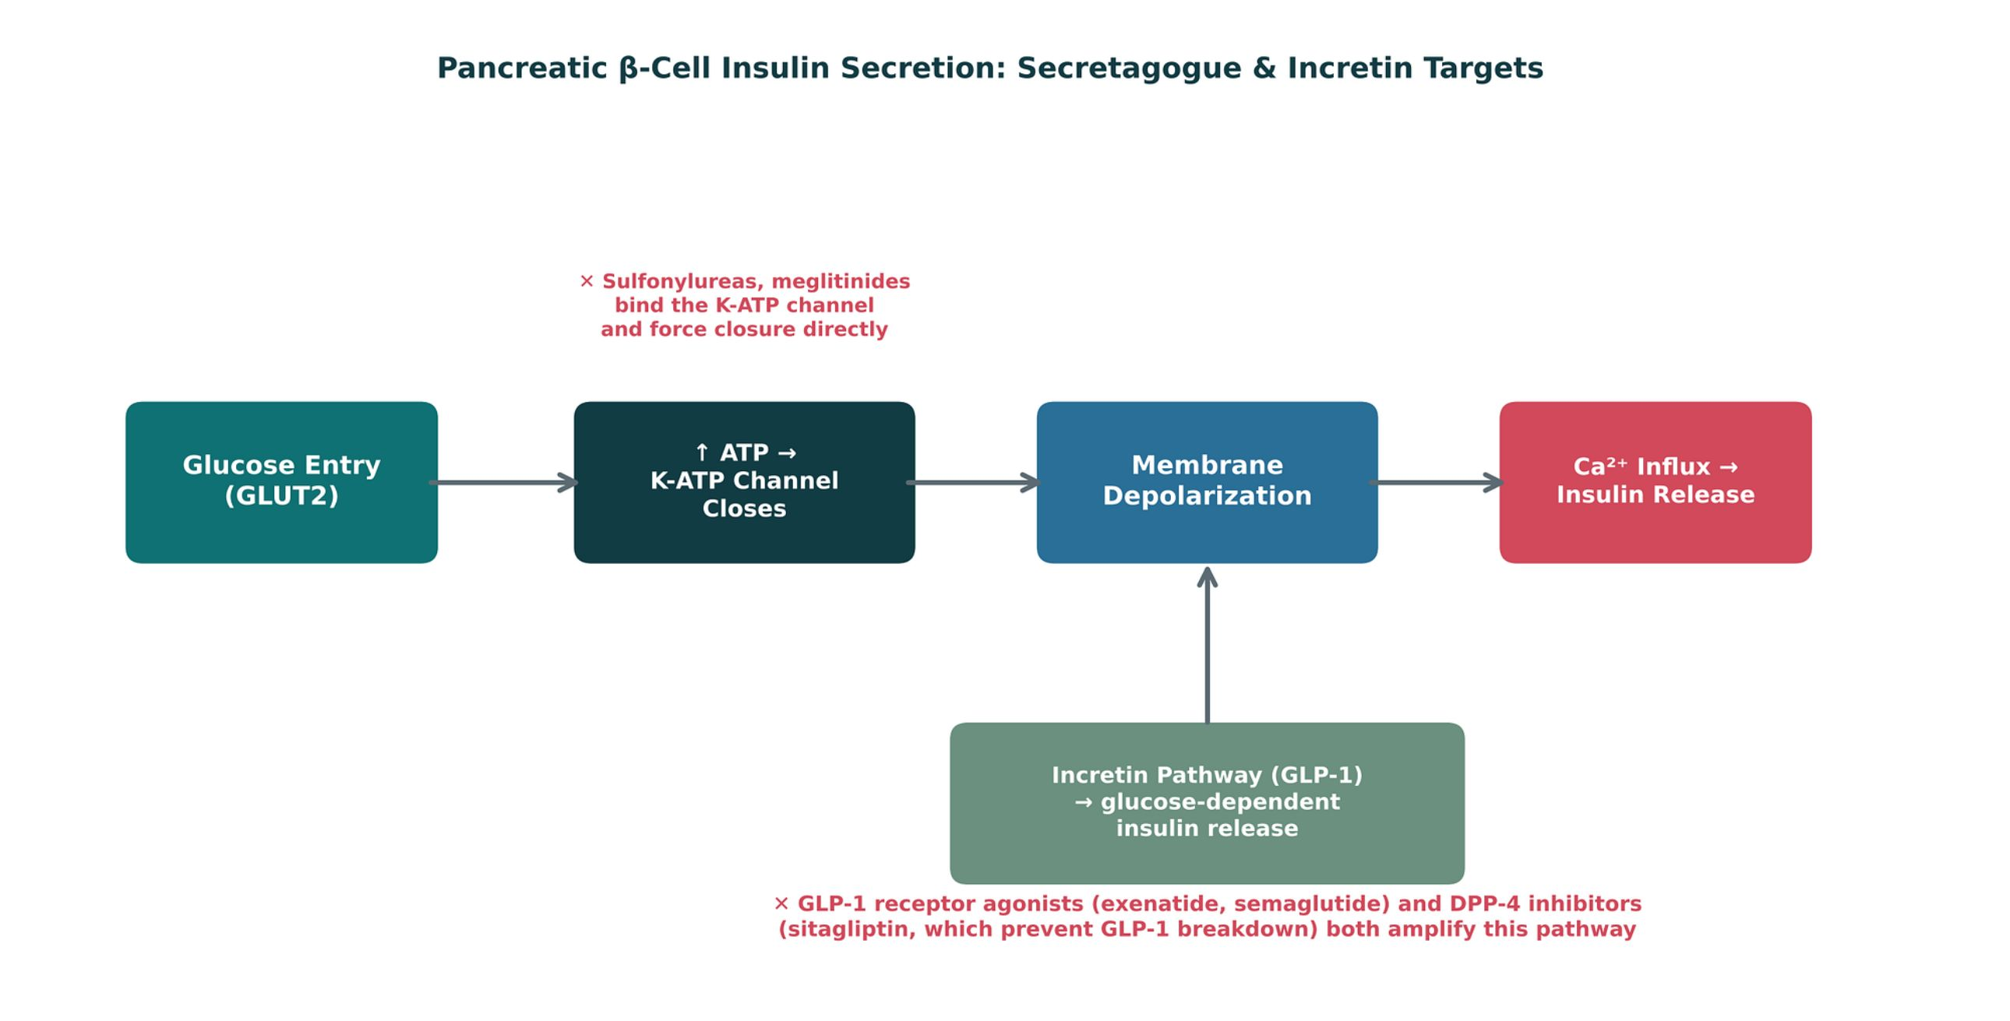
ORIGINAL ILLUSTRATION · FIGURE 15
Pancreatic β-Cell Insulin Secretion: Secretagogue & Incretin Targets
Figure 15. Original illustrative diagram (not from Katzung): glucose entry raises ATP, closing K-ATP channels and triggering depolarization and calcium-dependent insulin release; sulfonylureas/meglitinides force channel closure directly, while GLP-1 receptor agonists and DPP-4 inhibitors amplify glucose-dependent release via the incretin pathway.
Endocrine Pharmacotherapy — Session 2 of 2 — PA Program
13
Notes:
This is the mechanistic foundation for the insulin secretagogue and incretin-based drug classes that follow — the "glucose-dependent" nature of incretin-based therapy is exactly why these agents carry lower hypoglycemia risk than sulfonylureas.
Instructor script:
Figure 15: glucose raises ATP, closes K-ATP channels, and triggers insulin release. Sulfonylureas force closure; GLP-1 agents amplify glucose-dependent release.

Slide 12
EXOGENOUS REPLACEMENT
Insulin Therapy
Mechanism: exogenous insulin activates the insulin receptor, promoting cellular glucose uptake and suppressing hepatic gluconeogenesis.
Rapid-acting (lispro, aspart) — mealtime dosing; onset ~15 minutes.
Short-acting (regular) — onset ~30 minutes.
Intermediate-acting (NPH) — cloudy suspension; more variable absorption.
Long-acting (glargine, detemir, degludec) — basal coverage; relatively peakless profile.
Primary adverse effect across all insulins: hypoglycemia — counsel patients on recognition and treatment (rapid-acting carbohydrate).
Endocrine Pharmacotherapy — Session 2 of 2 — PA Program
14
Notes:
The rapid/short/intermediate/long-acting framework is the organizing scaffold for every insulin regimen question — have students sort any named insulin product into one of these four buckets before discussing regimens.
Instructor script:
Sort insulins into rapid, short, intermediate and long-acting. Know: hypoglycemia is the main adverse effect; teach the rule of 15; beta-blockers mask warning symptoms. Only regular insulin is given IV.

Slide 13
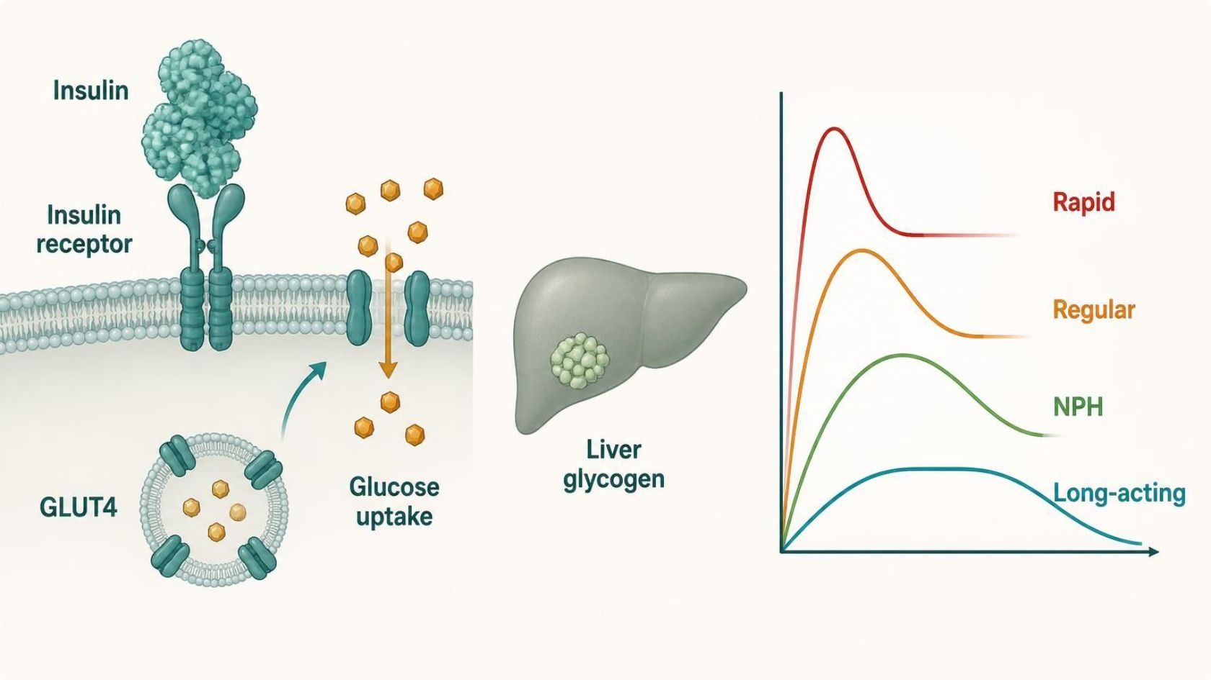
MECHANISM & DEPTH
Insulin: Receptor Signaling and Time-Action Profiles
Insulin binds the insulin receptor on muscle, fat and liver cells
▼
Receptor autophosphorylation starts the signal cascade
▼
GLUT4 moves to the cell surface so glucose enters
▼
Liver stores glycogen and stops making glucose
▼
Blood glucose falls (hypoglycemia is the main risk)
Schematic (illustrative)
Figure 16. Teal: insulin binding; blue: intracellular signaling and glucose uptake; grey-green: liver; red: outcome. Right panel shows onset, peak and duration by insulin type.
Rapid-acting (lispro, aspart) is given with meals; regular 30 minutes before. NPH peaks at about 4–10 hours; glargine, detemir and degludec are basal.
Adverse effects: hypoglycemia, weight gain, lipohypertrophy, hypokalemia. Never share pens.
Rule of 15 for hypoglycemia: 15 g carbohydrate, recheck in 15 minutes. Beta-blockers can mask warning symptoms.
Endocrine Pharmacotherapy — Session 2 of 2 — PA Program
15
Notes:
Figure 16: receptor activation moves GLUT4 to the membrane.

Slide 14
ORAL & INJECTABLE NON-INSULIN AGENTS
Glucose-Lowering Drug Classes
Metformin
Sulfonylureas / Meglitinides
– Decreases hepatic gluconeogenesis
– First-line for type 2 diabetes
– Avoid in significant renal impairment — lactic acidosis risk
– Force K-ATP channel closure, insulin secretagogues
– Highest hypoglycemia risk among oral agents
– Examples: glipizide, glyburide, repaglinide
TZDs
SGLT2 Inhibitors
– Increase peripheral insulin sensitivity
– Risk: fluid retention/heart failure, weight gain
– Example: pioglitazone
– Block renal glucose reabsorption
– Cardiorenal benefit; risk of genital mycotic infections, euglycemic DKA
– Example: empagliflozin
Endocrine Pharmacotherapy — Session 2 of 2 — PA Program
16
Notes:
This four-card split covers the non-incretin oral agents; the next slide adds the incretin-based classes (GLP-1 RAs, DPP-4 inhibitors) and the site-of-action figure ties everything together.
Instructor script:
Classes overview. Metformin, SGLT2 inhibitors and incretin drugs are covered on the next slides.

Slide 15
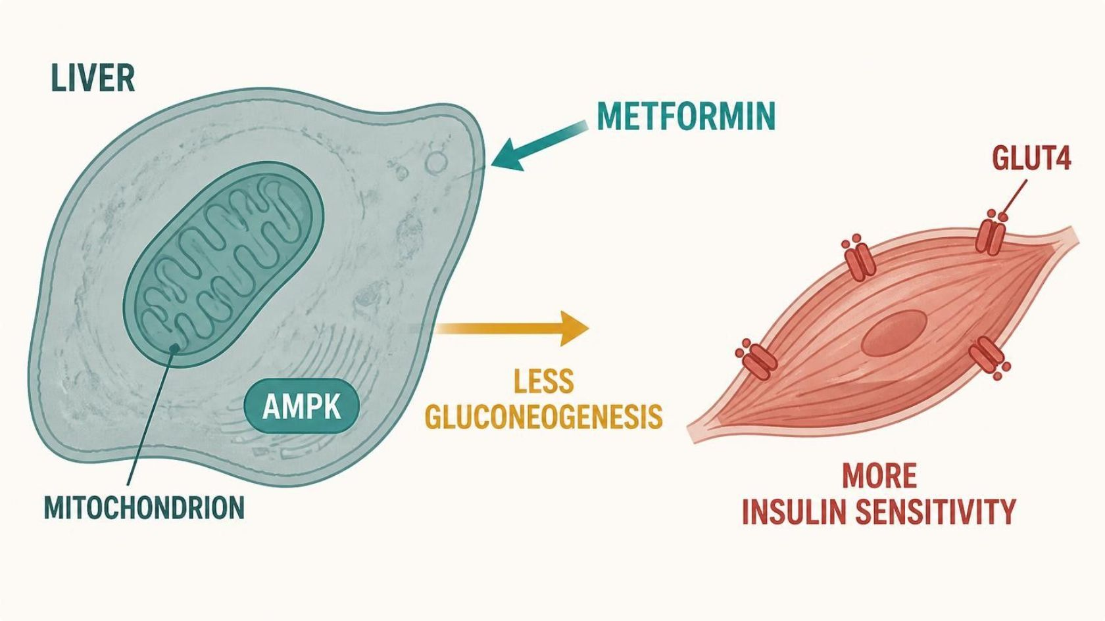
MECHANISM & DEPTH
Metformin: Hepatic Glucose Output and AMPK
Metformin enters hepatocytes through OCT1
▼
Inhibits mitochondrial complex I and activates AMPK
▼
Gluconeogenesis falls
▼
Insulin sensitivity improves in muscle
▼
Fasting glucose falls without hypoglycemia
Schematic (illustrative)
Figure 17. Teal: drug entry; blue: AMPK signaling and glucose output; grey-green: muscle; short arrow = reduced gluconeogenesis; red: outcome.
GI upset is common: start low and take with food.
Vitamin B12 deficiency with long-term use; monitor B12 levels.
Hold for contrast dye with reduced kidney function; avoid when eGFR is below 30 (lactic acidosis risk).
No weight gain and low hypoglycemia risk.
Endocrine Pharmacotherapy — Session 2 of 2 — PA Program
17
Notes:
Metformin lowers hepatic gluconeogenesis through AMPK. First line, low hypoglycemia risk. Watch for B12 deficiency, hold for contrast, and avoid at eGFR below 30.

Slide 16
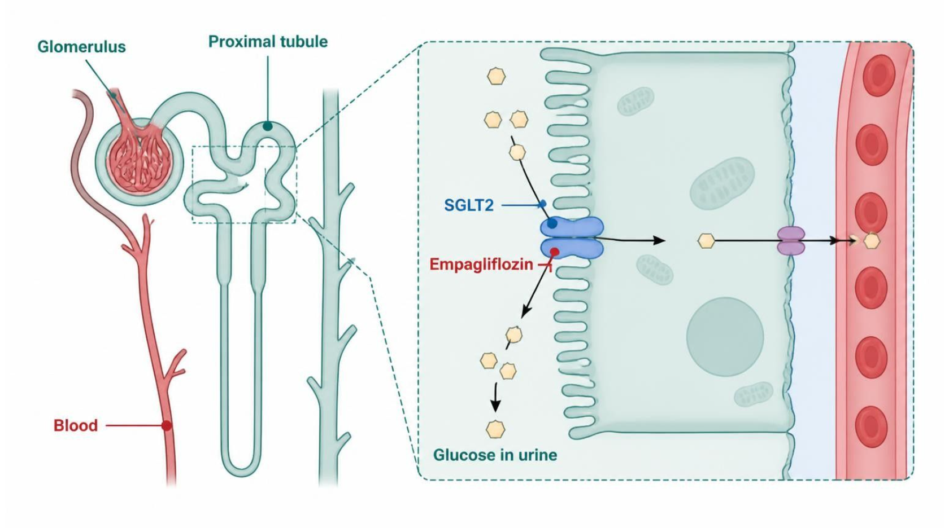
MECHANISM & DEPTH
SGLT2 Inhibitors: Glucose Lost in the Urine
Glucose is filtered at the glomerulus
▼
SGLT2 in the proximal tubule normally reabsorbs about 90%
▼
Empagliflozin blocks SGLT2
▼
Glucose and water are lost in the urine
▼
Glucose, weight and blood pressure fall; infection risk rises
Schematic (illustrative)
Figure 18. Teal: filtration; blue: tubule transport; green-grey: drug block; red: outcome, glucose lost in urine.
Benefits in heart failure and chronic kidney disease, beyond glucose lowering.
Genital yeast infections, volume depletion, euglycemic DKA: hold when ill or before surgery.
Avoid for glycemic effect when eGFR is low; rare Fournier gangrene.
Endocrine Pharmacotherapy — Session 2 of 2 — PA Program
18
Notes:
Figure 18: SGLT2 inhibitors cause glucosuria. Benefits in heart failure and CKD. Watch for genital yeast infections, volume depletion and euglycemic DKA.

Slide 17
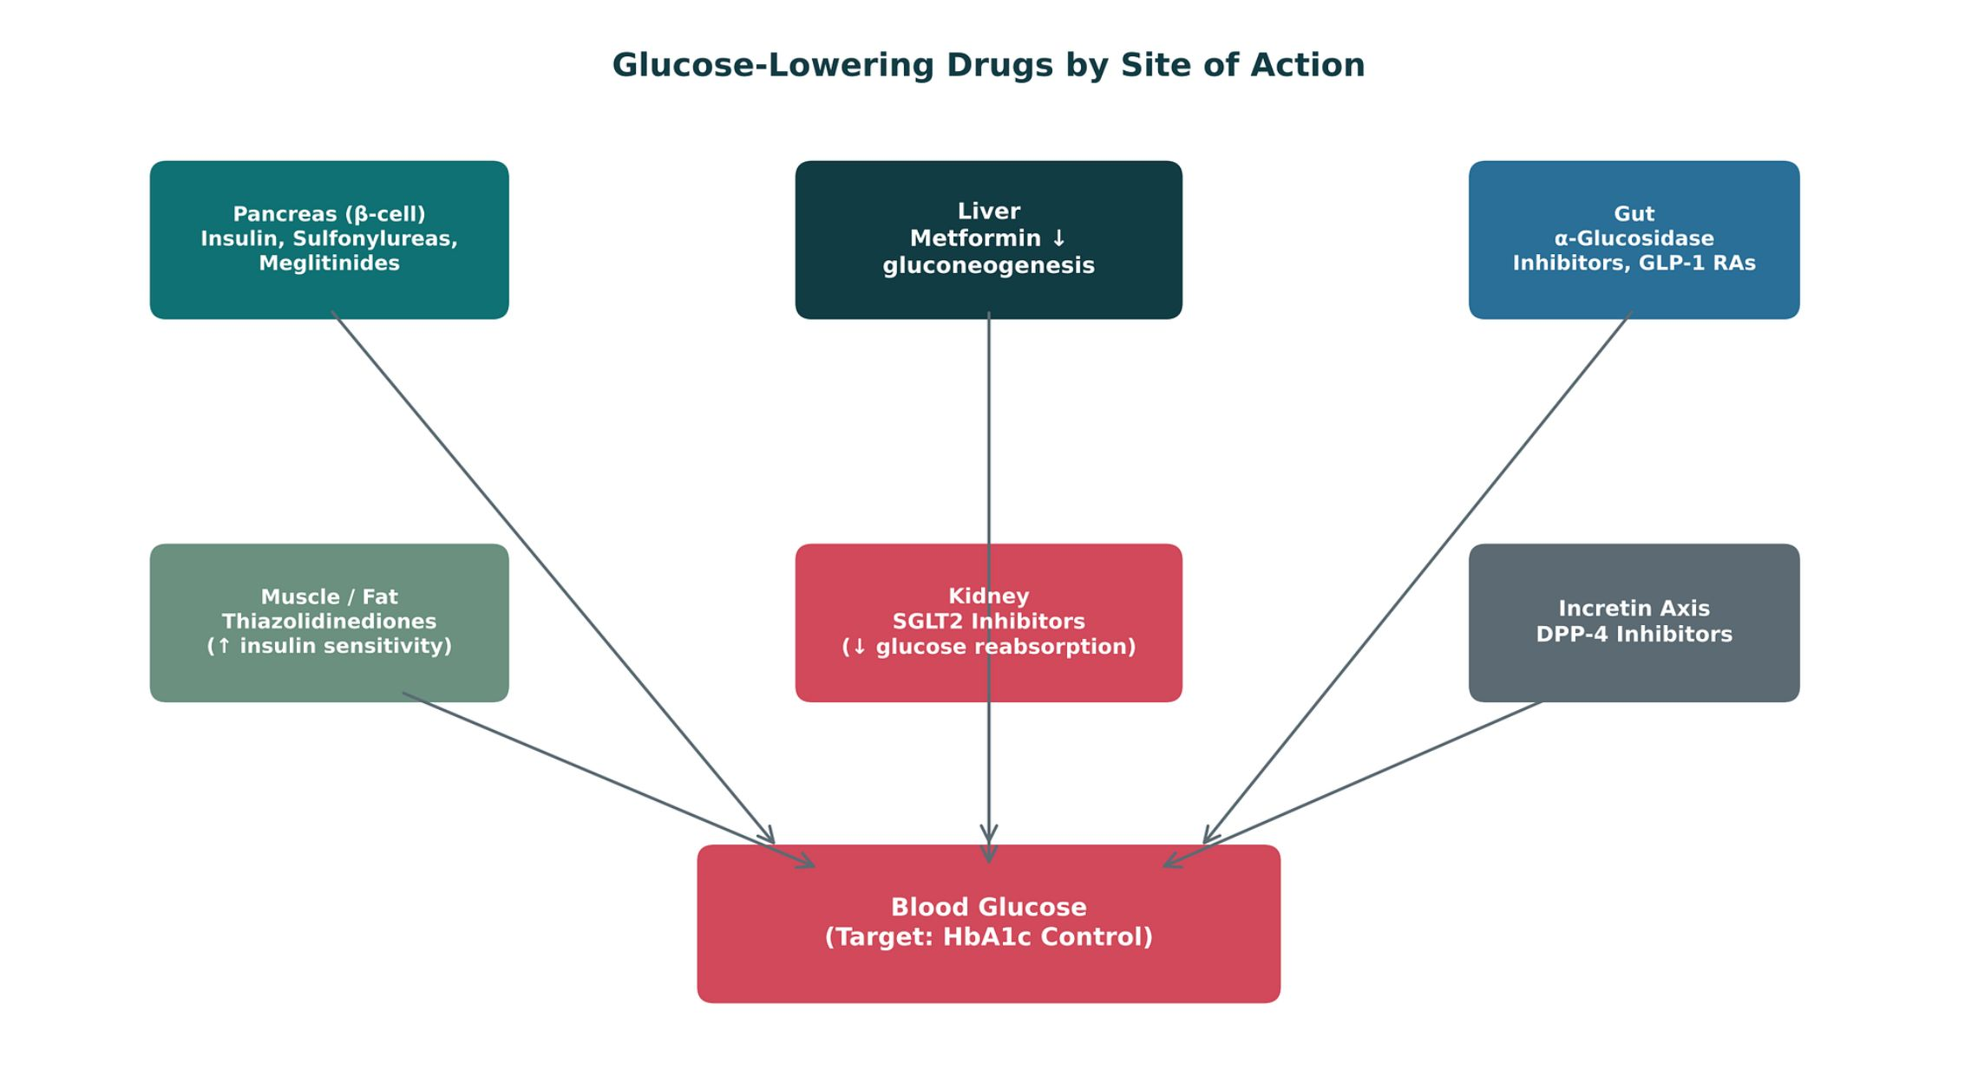
ORIGINAL ILLUSTRATION · FIGURE 19
Glucose-Lowering Drugs by Site of Action
Figure 19. Original illustrative diagram (not from Katzung): glucose-lowering drug classes act at distinct sites — pancreatic β-cell, liver, muscle/fat, kidney, gut, and the incretin axis — each converging on overall blood glucose control.
Endocrine Pharmacotherapy — Session 2 of 2 — PA Program
19
Notes:
Use this as the capstone organizing diagram for the whole drug-class discussion — ask students to place each class from the prior fourCard slide onto this map from memory.
Instructor script:
Place each class on the site-of-action map from memory.

Slide 18
INCRETIN-BASED THERAPY
GLP-1 Receptor Agonists and DPP-4 Inhibitors
GLP-1 Receptor Agonists
DPP-4 Inhibitors
– Examples: exenatide, liraglutide, semaglutide
– Glucose-dependent insulin release, slows gastric emptying, promotes satiety/weight loss
– Adverse effects: nausea/GI upset; caution with personal/family history of medullary thyroid carcinoma
– Examples: sitagliptin, linagliptin
– Prevent breakdown of endogenous GLP-1, prolonging its glucose-dependent effect
– Generally weight-neutral; well tolerated; low hypoglycemia risk
Endocrine Pharmacotherapy — Session 2 of 2 — PA Program
20
Notes:
The "glucose-dependent" mechanism from Figure 15 is why both of these classes carry low intrinsic hypoglycemia risk — tie this slide directly back to that figure rather than presenting it as a new, unrelated fact.
Instructor script:
GLP-1 agonists mimic the hormone; DPP-4 inhibitors protect it. Know: GLP-1 agonists cause GI effects and pancreatitis, and carry a thyroid C-cell warning (MTC, MEN2).

Slide 19
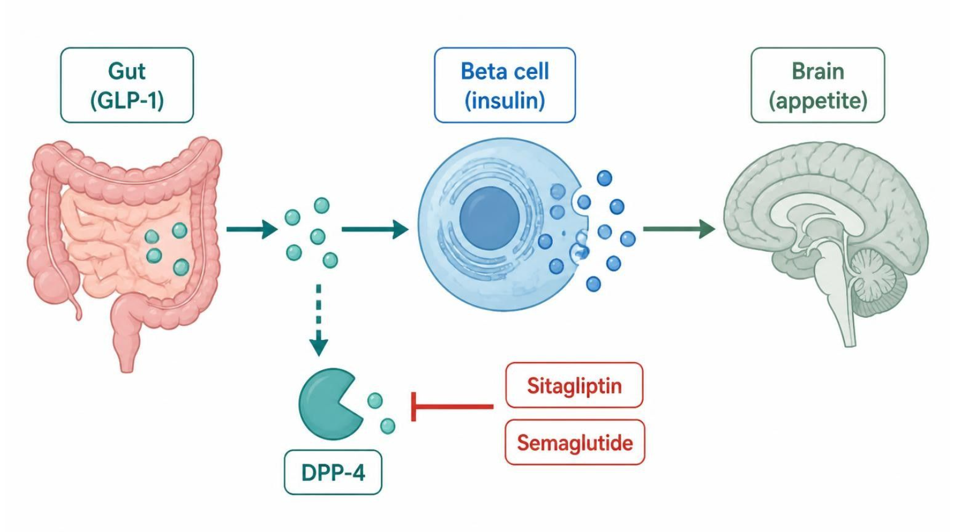
MECHANISM & DEPTH
Incretin Drugs: Gut, Pancreas and Brain
Food in the gut releases GLP-1
▼
GLP-1 acts on the beta cell: glucose-dependent insulin release, less glucagon
▼
DPP-4 normally breaks GLP-1 down quickly
▼
Sitagliptin blocks DPP-4; semaglutide and liraglutide mimic GLP-1
▼
Lower glucose, slower gastric emptying and less appetite
Schematic (illustrative)
Figure 20. Teal: gut signal; blue: beta-cell and enzyme steps; green-grey: drugs; red: clinical outcome.
GLP-1 RAs cause nausea, vomiting, pancreatitis risk and gallstones.
Contraindicated with personal or family history of medullary thyroid carcinoma or MEN2.
DPP-4 inhibitors are weight neutral with low hypoglycemia risk; do not combine a GLP-1 RA with a DPP-4 inhibitor.
Endocrine Pharmacotherapy — Session 2 of 2 — PA Program
21
Notes:
Figure 20: incretin drugs act on the gut, pancreas and brain.

Slide 20

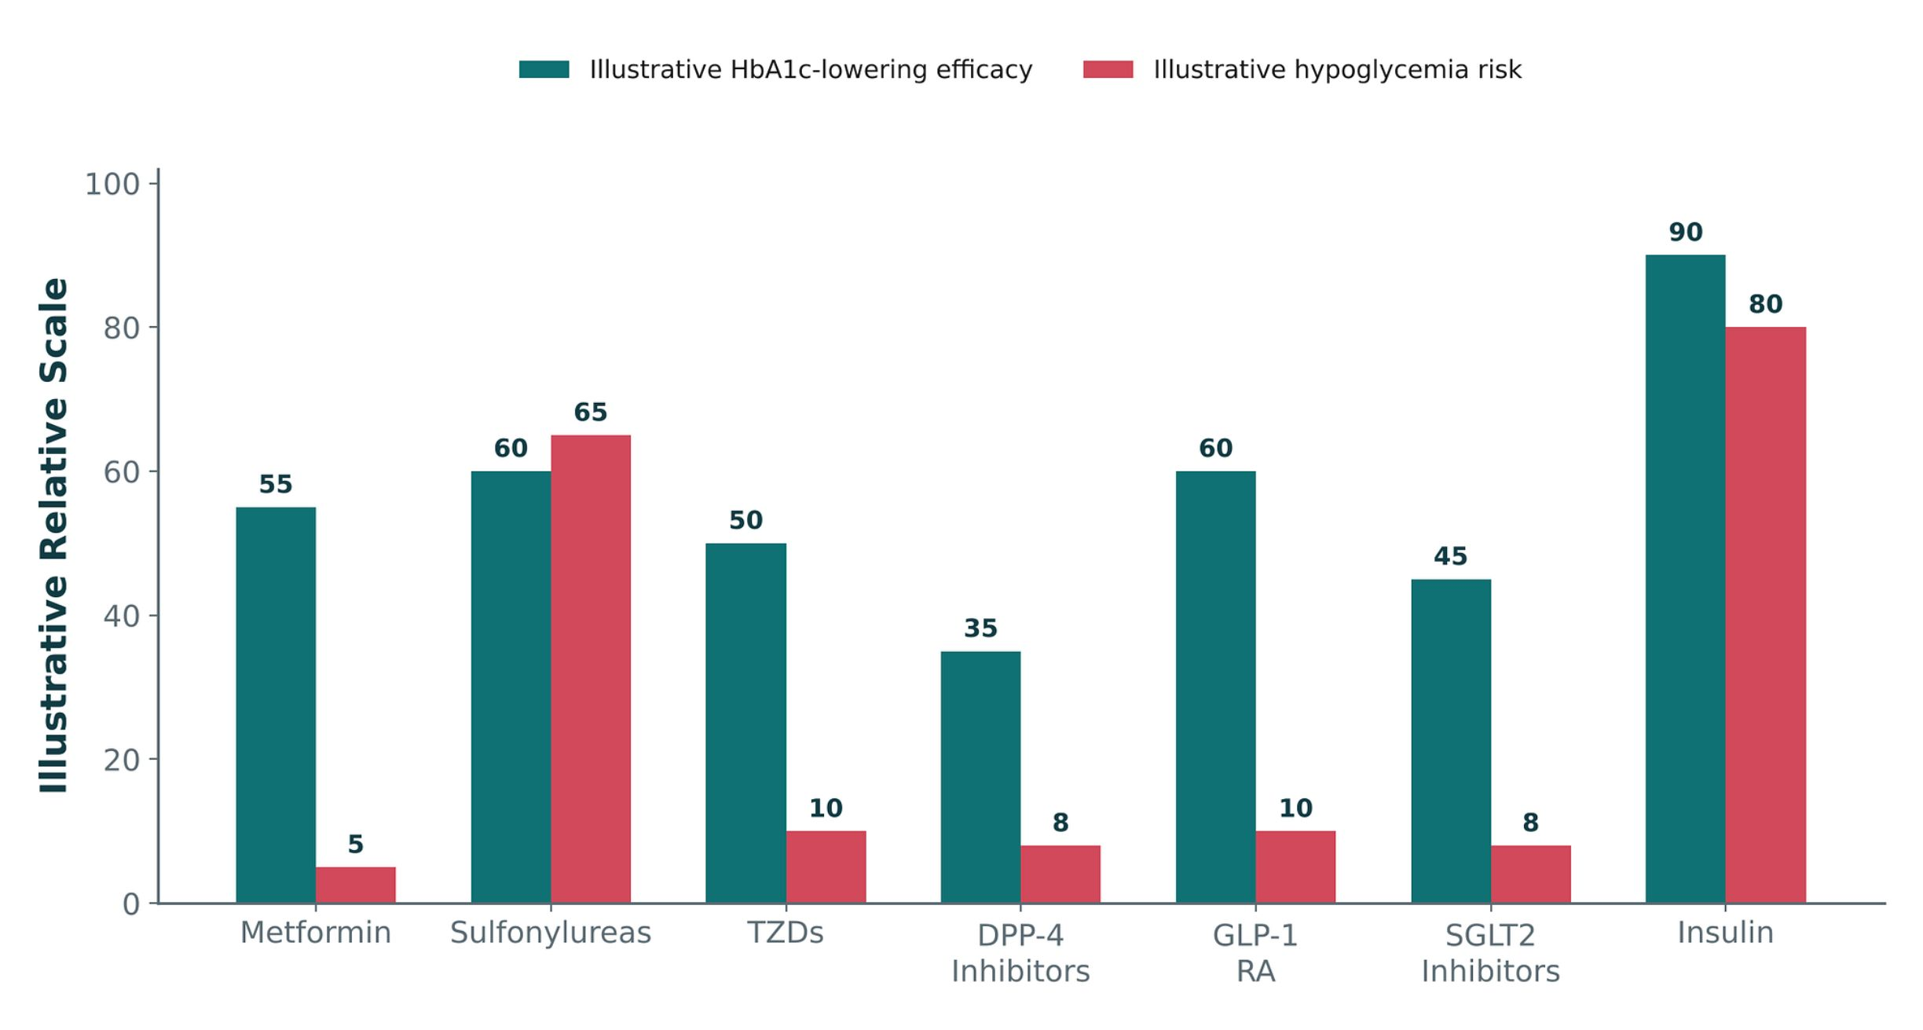
ORIGINAL ILLUSTRATION · FIGURE 21
HbA1c-Lowering Efficacy vs. Hypoglycemia Risk by Class
Figure 21. Original illustrative comparison (illustrative relative values, not from Katzung): insulin and sulfonylureas show the greatest HbA1c-lowering efficacy but also carry the highest hypoglycemia risk, while metformin, DPP-4 inhibitors, and SGLT2 inhibitors show a more favorable efficacy-to-hypoglycemia-risk balance.
Endocrine Pharmacotherapy — Session 2 of 2 — PA Program
22
Notes:
This figure is the quantified summary of the entire drug-class discussion — use it to drive the "why is metformin still first-line" conversation: not because it is the most potent, but because of its favorable risk profile.
Instructor script:
Figure 21: efficacy against hypoglycemia by class.

Slide 21

CLINICAL CASE
Choosing a Second Agent for Type 2 Diabetes
A 72-year-old patient with type 2 diabetes on metformin monotherapy has an HbA1c above goal. The patient lives alone and has had a prior fall.
Ask yourself: Which class of add-on therapy best balances efficacy and safety for this patient, and why?
Clinical pearl: Given the fall history and the risks of hypoglycemia-induced falls, a DPP-4 inhibitor or SGLT2 inhibitor (low intrinsic hypoglycemia risk) is generally preferable to a sulfonylurea in an older adult living alone — matching drug choice to patient-specific risk, not just HbA1c-lowering potency.
Endocrine Pharmacotherapy — Session 2 of 2 — PA Program
25
Notes:
This vignette applies Figure 21 directly to a geriatric safety scenario — a good opportunity to discuss that "most potent" and "most appropriate" are not always the same answer.
Instructor script:
Case: a 72-year-old living alone with a fall. Choose a low-hypoglycemia add-on and ask the class which class balances efficacy and safety.

Slide 22

SECTION
06
Calcium-Regulating Hormones — Parathyroid Disorders
A brief recap of bone pharmacology, then a new angle: PTH itself.
Notes:
Section transition. Today we finish with the two opposite parathyroid problems.

Slide 23

CONNECTING BACK
Recap: Calcium & Bone Pharmacology from Unit 2
Unit 2 covered osteoporosis drug therapy in depth: bisphosphonates, denosumab, teriparatide, and raloxifene (a SERM, also discussed again this session).
That therapy targets bone remodeling directly, generally in patients with normal parathyroid function.
This section takes a different angle: what happens — and what drugs are used — when parathyroid hormone secretion itself is the primary problem.
If you need a refresher on bisphosphonate dosing or denosumab safety, revisit the Unit 2, Session 2 materials — that content is not repeated here.
Endocrine Pharmacotherapy — Session 2 of 2 — PA Program
29
Notes:
Be explicit that this section is intentionally NOT re-teaching osteoporosis pharmacotherapy — it is new content on parathyroid pathology, so students should not expect bisphosphonate-level detail repeated here.
Instructor script:
Recap of calcium and bone pharmacology from Unit 2. This section does not repeat osteoporosis drugs.

Slide 24
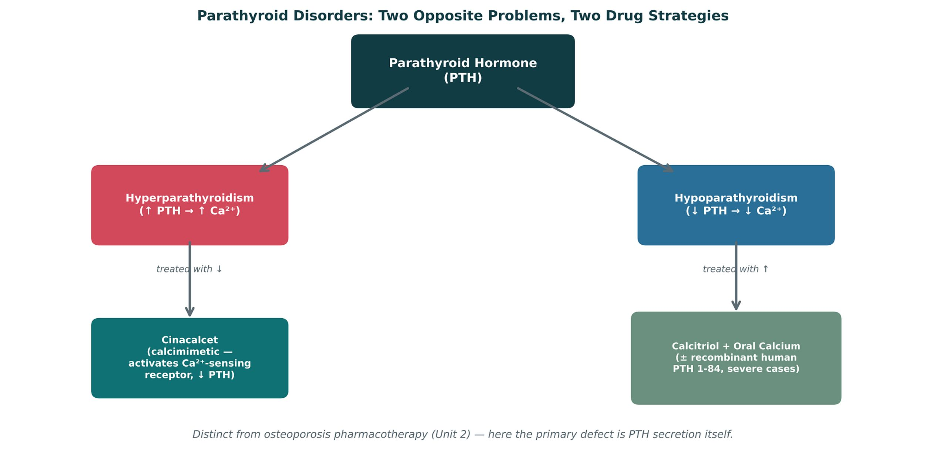
ORIGINAL ILLUSTRATION · FIGURE 22
Parathyroid Disorders: Two Opposite Problems, Two Drug Strategies
Figure 22. Original illustrative diagram (not from Katzung): hyperparathyroidism (excess PTH, high calcium) is treated with cinacalcet to lower PTH, while hypoparathyroidism (deficient PTH, low calcium) is treated with calcitriol and oral calcium, sometimes with recombinant PTH 1-84 in severe cases.
Endocrine Pharmacotherapy — Session 2 of 2 — PA Program
30
Notes:
This figure is the organizing concept for the whole section — two opposite pathologies, two opposite drug strategies, both targeting the same hormone axis.
Instructor script:
Figure 22: two opposite problems, two opposite strategies.

Slide 25
OPPOSITE PROBLEMS
Hyperparathyroidism vs. Hypoparathyroidism Therapy
Hyperparathyroidism
Hypoparathyroidism
– Cinacalcet — a calcimimetic; activates the calcium-sensing receptor on parathyroid cells, reducing PTH secretion
– Used for secondary hyperparathyroidism (e.g., in chronic kidney disease) and parathyroid carcinoma
– Monitor for hypocalcemia with therapy
– Calcitriol (active vitamin D) plus oral calcium — mainstay of therapy, since PTH deficiency impairs vitamin D activation
– Recombinant human PTH 1-84 — reserved for patients not adequately controlled on calcium/calcitriol alone
– Monitor for hypercalcemia/hypercalciuria with therapy
Endocrine Pharmacotherapy — Session 2 of 2 — PA Program
31
Notes:
The "opposite monitoring parameter" point (watch for hypocalcemia with cinacalcet, hypercalcemia with calcitriol/PTH replacement) is a nice symmetry to draw out explicitly for students.
Instructor script:
Hyperparathyroidism vs. hypoparathyroidism. Calcitriol bypasses the PTH activation step; watch for hypercalcemia.

Slide 26
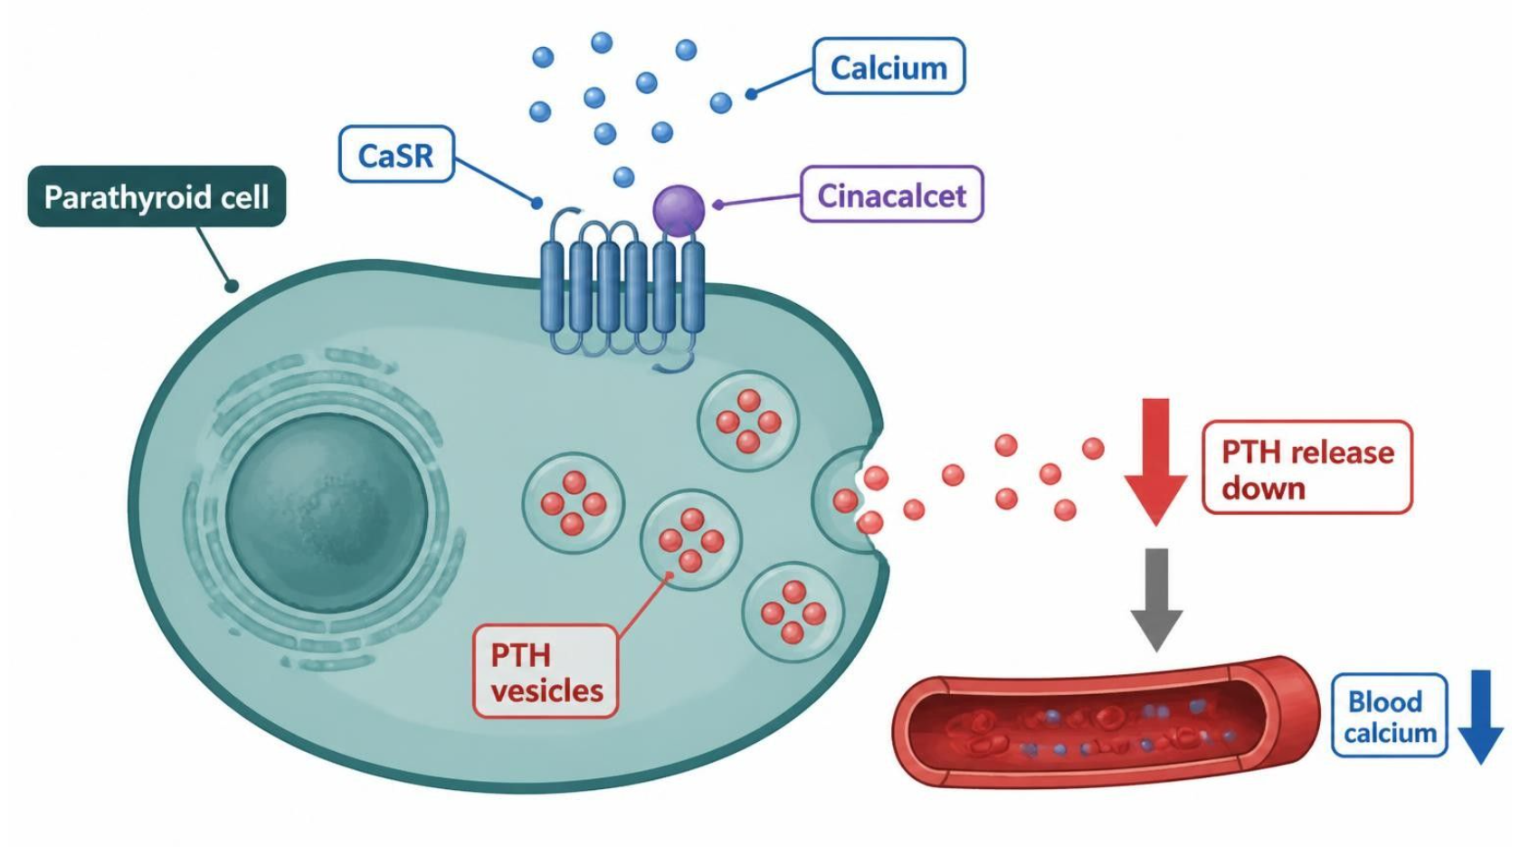
MECHANISM & DEPTH
Cinacalcet: Tricking the Calcium-Sensing Receptor
Parathyroid cells sense calcium through the CaSR
▼
Low calcium keeps PTH release high
▼
Cinacalcet makes the receptor more sensitive to calcium
▼
The cell reads calcium as high and lowers PTH
▼
PTH and serum calcium fall
Schematic (illustrative)
Figure 23. Teal: sensing; blue: PTH steps; green-grey: drug; red: outcome, PTH and calcium fall.
Used in secondary hyperparathyroidism in CKD on dialysis and in parathyroid carcinoma.
Adverse effects: nausea, hypocalcemia and QT prolongation, so monitor calcium.
CYP2D6 inhibitor; calcitriol plus calcium for hypoparathyroidism has the opposite monitoring target (hypercalcemia).
Endocrine Pharmacotherapy — Session 2 of 2 — PA Program
32
Notes:
Figure 23: cinacalcet sensitizes the calcium-sensing receptor so PTH falls; watch calcium.

Slide 27
CLINICAL CASE
Distinguishing the Two Parathyroid Disorders
A patient with chronic kidney disease is found to have an elevated PTH level with low-normal serum calcium. A second, unrelated patient who underwent recent thyroidectomy develops perioral numbness and low serum calcium with a low PTH level.
Ask yourself: How does drug therapy differ between these two patients?
Clinical pearl: The CKD patient has secondary hyperparathyroidism and may benefit from cinacalcet to reduce PTH secretion. The post-thyroidectomy patient has surgical hypoparathyroidism (inadvertent parathyroid gland injury) and needs calcitriol plus calcium replacement — the opposite pharmacologic strategy for the opposite underlying problem.
Endocrine Pharmacotherapy — Session 2 of 2 — PA Program
33
Notes:
Post-thyroidectomy hypoparathyroidism is a classic, testable clinical scenario and a good bridge back to the thyroid surgery context from Session 2 — Section 2 (antithyroid drugs can also precede surgical management).
Instructor script:
Case: elevated PTH with CKD versus low PTH after thyroidectomy.

Slide 28
MECHANISM & DEPTH
Drug Names Reveal the Class: Endocrine Agents
Stem
Drug class
Examples
Key point
-gliptin
DPP-4 inhibitor
sitagliptin, linagliptin
Low hypoglycemia risk
-glutide
GLP-1 receptor agonist
liraglutide, semaglutide
Weight loss, GI upset
-gliflozin
SGLT2 inhibitor
empagliflozin
Genital infections, euglycemic DKA
-glitazone
Thiazolidinedione
pioglitazone
Fluid retention, heart failure
-glinide
Meglitinide
repaglinide
Mealtime insulin secretagogue
gli- (prefix)
Sulfonylurea
glipizide, glyburide
K-ATP closure, hypoglycemia
-ifene
SERM
tamoxifen, raloxifene
Tissue-selective estrogen action
-steride
5-alpha-reductase inhibitor
finasteride
Lowers DHT
-gestrel
Progestin
levonorgestrel
Contraception
-calcet
Calcimimetic
cinacalcet
Activates the CaSR, lowers PTH
A stem is a memory aid, not a rule: where no shared stem exists, learn the class name instead.
Endocrine Pharmacotherapy — Session 2 of 2 — PA Program
36
Notes:
Drug name stems: -gliptin, -glutide, -gliflozin, -glitazone, -glinide, gli- prefix, -ifene, -steride, -gestrel, -calcet.

Slide 29

SECTION
07
Putting It All Together
Applying the whole Endocrine pharmacology toolkit.
Notes:
Section transition. The shared principle is negative feedback suppression by exogenous hormone.

Slide 30
APPLY IT
Which Drug Would You Choose?
Patient A
Patient B
– Graves disease, in thyroid storm
– Chronic prednisone user, abruptly out of refills
Patient C
Patient D
– Type 2 diabetes, older adult with fall history, needs add-on therapy
– Post-thyroidectomy, perioral numbness and low calcium
Endocrine Pharmacotherapy — Session 2 of 2 — PA Program
38
Notes:
Have students work in pairs: for each patient, name a first-line approach AND the single biggest safety concern to check before prescribing/counseling.
Instructor script:
Pairs name a first-line approach and the biggest safety check for each patient.

Slide 31
BIG PICTURE
Key Takeaways
1
The hypothalamic-pituitary-target gland axis is a shared template across thyroid, adrenal, and gonadal pharmacology — exogenous hormone therapy suppresses the levels above it via negative feedback.
2
Antithyroid drug selection (methimazole vs. PTU) and glucocorticoid tapering both hinge on understanding exactly where and how each drug intervenes in its pathway.
3
Glucose-lowering drugs act at distinct sites (pancreas, liver, muscle/fat, kidney, gut, incretin axis) — drug selection balances efficacy against hypoglycemia and other class-specific risks.
4
Hyperparathyroidism and hypoparathyroidism require opposite drug strategies (lowering vs. raising effective PTH activity) — a new angle distinct from, but related to, the osteoporosis pharmacotherapy of Unit 2.
5
Endocrine pharmacology is deeply interconnected — spironolactone, dopamine agonists, and SERMs each reappear across more than one organ system in this unit alone.
Endocrine Pharmacotherapy — Session 2 of 2 — PA Program
Notes:
Close by connecting back to earlier units: osteoporosis pharmacology (Unit 2) and drug-metabolism/interaction concepts (Unit 1) both reappear here — pharmacology is cumulative, not siloed by unit.
Instructor script:
Read the takeaways aloud.

Slide 32

SECTION
08
Lecture Recall Quiz
A cumulative self-test spanning both sessions — use this to review before exams.
Notes:
Section transition. Use the recall quiz and key for self-testing.

Slide 33
LECTURE RECALL QUIZ
Lecture Recall Quiz (1 of 2)
1. Why is PTU, rather than methimazole, preferred in the management of thyroid storm?
A. PTU is better absorbed orally
B. PTU additionally blocks peripheral T4-to-T3 conversion
C. PTU has no hepatotoxicity risk
D. PTU works faster at the level of iodide trapping
2. A patient on chronic glucocorticoid therapy abruptly stops the medication and develops hypotension and weakness. What is the underlying mechanism?
A. Direct adrenal gland destruction by the drug
B. HPA-axis suppression leaving endogenous cortisol production unable to resume quickly
C. An allergic reaction to the glucocorticoid
D. Excess aldosterone production
3. Which contraceptive counseling point reflects a true contraindication to estrogen-containing combined hormonal contraception?
A. Age under 20
B. Smoking at age 35 or older
C. Mild seasonal allergies
D. A family history of type 2 diabetes
Endocrine Pharmacotherapy — Session 2 of 2 — PA Program
43
Notes:
Students work the recall quiz (1 of 2) on their own, then check against the key on slide 45.

Slide 34
LECTURE RECALL QUIZ
Lecture Recall Quiz (2 of 2)
4. Why do sulfonylureas carry a higher hypoglycemia risk than DPP-4 inhibitors?
A. Sulfonylureas force K-ATP channel closure and insulin release independent of glucose level, unlike the glucose-dependent incretin pathway
B. DPP-4 inhibitors have no effect on insulin secretion
C. Sulfonylureas work only in type 1 diabetes
D. There is no difference in hypoglycemia risk between these classes
5. A patient with hypoparathyroidism after thyroid surgery needs pharmacologic treatment. Which combination is the mainstay of therapy?
A. Cinacalcet alone
B. Calcitriol plus oral calcium
C. Bisphosphonate plus denosumab
D. Levothyroxine plus methimazole
6. A patient taking an SGLT2 inhibitor develops a genital yeast infection. What is the mechanistic explanation?
A. Direct immunosuppression
B. Increased urinary glucose excretion promoting fungal overgrowth
C. Decreased renal blood flow
D. Systemic candidemia from the drug itself
Endocrine Pharmacotherapy — Session 2 of 2 — PA Program
44
Notes:
Students work the recall quiz (2 of 2) on their own, then check against the key on slide 45.

Slide 35
ANSWER KEY
Lecture Recall Quiz — Answer Key
1. B — PTU blocks both new thyroid hormone synthesis and peripheral T4-to-T3 conversion, giving it a faster effect on circulating active hormone than methimazole — important in the acute setting of thyroid storm.
2. B — Chronic exogenous glucocorticoid exposure suppresses CRH/ACTH via negative feedback (Figure 9), reducing the adrenal cortex’s stimulus to produce cortisol; abrupt withdrawal does not give the axis time to recover, precipitating adrenal insufficiency.
3. B — Smoking at age 35 or older is a well-established contraindication to estrogen-containing contraception due to substantially increased thromboembolic and cardiovascular risk.
4. A — Sulfonylureas bind the K-ATP channel directly and force closure regardless of glucose level (Figure 15), while incretin-based agents amplify insulin release only when glucose is already elevated — explaining the difference in hypoglycemia risk.
5. B — Because PTH is required to activate vitamin D, hypoparathyroidism impairs that activation step; calcitriol (already-active vitamin D) bypasses it, and is given together with oral calcium as first-line therapy.
6. B — SGLT2 inhibitors block renal glucose reabsorption, increasing urinary glucose concentration and creating a favorable environment for genital fungal overgrowth — a mechanism-based, well-known adverse effect.
Endocrine Pharmacotherapy — Session 2 of 2 — PA Program
Notes:
Encourage students to revisit this quiz on their own before the exam — it is designed as a standalone recall resource spanning both Unit 4 sessions, separate from the in-lecture quick checks.
Instructor script:
Use the answer key for self-testing.

Slide 36
APPENDIX 1
Drug Profiles
Formulation, dose, indications, adverse effects, contraindications and toxicity
ABBREVIATION KEY
PO = by mouth
SC = subcutaneous
IM = intramuscular
IV = intravenous
ER / XL = extended-release
BID = twice daily
mcg = microgram
U-100 etc. = units of insulin per mL
IUD = intrauterine device
DCIS = ductal carcinoma in situ
VTE / DVT / PE = venous thromboembolism / deep vein thrombosis / pulmonary embolism
MI = myocardial infarction
BPH = benign prostatic hyperplasia
PSA = prostate-specific antigen
PCOS = polycystic ovary syndrome
DKA = diabetic ketoacidosis
eGFR / CrCl = estimated glomerular filtration rate / creatinine clearance
CKD = chronic kidney disease
NPH = neutral protamine Hagedorn
SGLT2 = sodium-glucose cotransporter 2
DPP-4 = dipeptidyl peptidase-4
GLP-1 = glucagon-like peptide 1
MEN2 = multiple endocrine neoplasia type 2
CaSR = calcium-sensing receptor
PTH = parathyroid hormone
NYHA = New York Heart Association
CV = cardiovascular
CYP = cytochrome P450
QT = QT interval on ECG
Notes:
Abbreviation key: PO = by mouth; SC = subcutaneous; IM = intramuscular; IV = intravenous; ER / XL = extended-release; BID = twice daily; mcg = microgram; U-100 etc. = units of insulin per mL; IUD = intrauterine device; DCIS = ductal carcinoma in situ; VTE / DVT / PE = venous thromboembolism / deep vein thrombosis / pulmonary embolism; MI = myocardial infarction; BPH = benign prostatic hyperplasia; PSA = prostate-specific antigen; PCOS = polycystic ovary syndrome; DKA = diabetic ketoacidosis; eGFR / CrCl = estimated glomerular filtration rate / creatinine clearance; CKD = chronic kidney disease; NPH = neutral protamine Hagedorn; SGLT2 = sodium-glucose cotransporter 2; DPP-4 = dipeptidyl peptidase-4; GLP-1 = glucagon-like peptide 1; MEN2 = multiple endocrine neoplasia type 2; CaSR = calcium-sensing receptor; PTH = parathyroid hormone; NYHA = New York Heart Association; CV = cardiovascular; CYP = cytochrome P450; QT = QT interval on ECG
Instructor script:
Say: These profiles are your study reference. Know the dose logic, the serious adverse effects, the contraindication that changes your decision, and the toxicity you would need to recognize.
How to use in class (10 minutes): give each group two or three profiles and have them teach back dose, key contraindication and toxicity in 60 seconds each.
Teaching points by class: contraceptives and hormones; insulins; non-insulin agents; parathyroid and calcium.
Bloom's prompts: Remember, state metformin titration and the eGFR limit. Understand, explain why incretin therapy rarely causes hypoglycemia. Apply, counsel a patient starting empagliflozin. Analyze, explain why hypoglycemia lacked tremor on propranolol. Evaluate, justify an add-on for a 72-year-old with heart failure who has fallen.

Slide 37
DRUG PROFILE
Combined oral contraceptives (ethinyl estradiol plus a progestin)
Estrogen plus progestin
FORMULATION
DOSE (ADULT)
INDICATIONS
Tablets (21/28-day packs); patch; vaginal ring
Ethinyl estradiol 20-35 mcg plus a progestin PO daily; patch weekly for 3 weeks; ring 3 weeks in, 1 week out
Contraception, cycle control, dysmenorrhea, acne
ADVERSE EFFECTS
CONTRAINDICATIONS
TOXICITY / OVERDOSE
Nausea, breast tenderness, breakthrough bleeding, headache
VTE or stroke history, smoker 35 or older, migraine with aura, estrogen-sensitive cancer, uncontrolled hypertension, liver disease
VTE, stroke and MI risk; hyperkalemia with drospirenone; rifampin and some antiepileptics lower efficacy
Standard adult dosing for teaching; verify against current prescribing information.
Endocrine Pharmacotherapy — Session 2 of 2 — PA Program
47
Notes:
Drug: Combined oral contraceptives (ethinyl estradiol plus a progestin). Class: Estrogen plus progestin. Formulation: Tablets (21/28-day packs); patch; vaginal ring. Dose (adult): Ethinyl estradiol 20-35 mcg plus a progestin PO daily; patch weekly for 3 weeks; ring 3 weeks in, 1 week out. Indications: Contraception, cycle control, dysmenorrhea, acne. Adverse effects: Nausea, breast tenderness, breakthrough bleeding, headache. Contraindications: VTE or stroke history, smoker 35 or older, migraine with aura, estrogen-sensitive cancer, uncontrolled hypertension, liver disease. Toxicity / overdose: VTE, stroke and MI risk; hyperkalemia with drospirenone; rifampin and some antiepileptics lower efficacy.

Slide 38
DRUG PROFILE
Norethindrone (progestin-only pill)
Progestin
FORMULATION
DOSE (ADULT)
INDICATIONS
Tablet 0.35 mg
0.35 mg PO daily at the same time, with no pill-free days
Contraception when estrogen is contraindicated, breastfeeding
ADVERSE EFFECTS
CONTRAINDICATIONS
TOXICITY / OVERDOSE
Irregular bleeding, headache, acne, breast tenderness
Breast cancer, undiagnosed vaginal bleeding, liver tumor
Efficacy falls if a dose is more than 3 hours late; ectopic pregnancy risk if it fails
Standard adult dosing for teaching; verify against current prescribing information.
Endocrine Pharmacotherapy — Session 2 of 2 — PA Program
48
Notes:
Drug: Norethindrone (progestin-only pill). Class: Progestin. Formulation: Tablet 0.35 mg. Dose (adult): 0.35 mg PO daily at the same time, with no pill-free days. Indications: Contraception when estrogen is contraindicated, breastfeeding. Adverse effects: Irregular bleeding, headache, acne, breast tenderness. Contraindications: Breast cancer, undiagnosed vaginal bleeding, liver tumor. Toxicity / overdose: Efficacy falls if a dose is more than 3 hours late; ectopic pregnancy risk if it fails.

Slide 39
DRUG PROFILE
Medroxyprogesterone depot (Depo-Provera)
Injectable progestin
FORMULATION
DOSE (ADULT)
INDICATIONS
IM 150 mg/mL; SC 104 mg/0.65 mL
150 mg IM (or 104 mg SC) every 12-13 weeks
Contraception, endometriosis pain, endometrial protection
ADVERSE EFFECTS
CONTRAINDICATIONS
TOXICITY / OVERDOSE
Irregular bleeding, weight gain, delayed return of fertility
Breast cancer, pregnancy, unexplained vaginal bleeding
Boxed warning: loss of bone mineral density; limit prolonged use; VTE
Standard adult dosing for teaching; verify against current prescribing information.
Endocrine Pharmacotherapy — Session 2 of 2 — PA Program
49
Notes:
Drug: Medroxyprogesterone depot (Depo-Provera). Class: Injectable progestin. Formulation: IM 150 mg/mL; SC 104 mg/0.65 mL. Dose (adult): 150 mg IM (or 104 mg SC) every 12-13 weeks. Indications: Contraception, endometriosis pain, endometrial protection. Adverse effects: Irregular bleeding, weight gain, delayed return of fertility. Contraindications: Breast cancer, pregnancy, unexplained vaginal bleeding. Toxicity / overdose: Boxed warning: loss of bone mineral density; limit prolonged use; VTE.

Slide 40
DRUG PROFILE
Levonorgestrel IUD (Mirena)
Intrauterine progestin
FORMULATION
DOSE (ADULT)
INDICATIONS
Intrauterine system 52 mg (about 20 mcg/day)
One system placed in the uterus; effective up to 8 years for contraception
Contraception, heavy menstrual bleeding, endometrial protection
ADVERSE EFFECTS
CONTRAINDICATIONS
TOXICITY / OVERDOSE
Irregular spotting, amenorrhea, ovarian cysts, pelvic pain
Pregnancy, pelvic infection, uterine anomaly, breast cancer
Uterine perforation, expulsion, infection; check strings
Standard adult dosing for teaching; verify against current prescribing information.
Endocrine Pharmacotherapy — Session 2 of 2 — PA Program
50
Notes:
Drug: Levonorgestrel IUD (Mirena). Class: Intrauterine progestin. Formulation: Intrauterine system 52 mg (about 20 mcg/day). Dose (adult): One system placed in the uterus; effective up to 8 years for contraception. Indications: Contraception, heavy menstrual bleeding, endometrial protection. Adverse effects: Irregular spotting, amenorrhea, ovarian cysts, pelvic pain. Contraindications: Pregnancy, pelvic infection, uterine anomaly, breast cancer. Toxicity / overdose: Uterine perforation, expulsion, infection; check strings.

Slide 41
DRUG PROFILE
Tamoxifen (Nolvadex)
Selective estrogen-receptor modulator
FORMULATION
DOSE (ADULT)
INDICATIONS
Tablet 10/20 mg
20 mg PO daily for 5-10 years in breast cancer
Breast cancer treatment and risk reduction, DCIS
ADVERSE EFFECTS
CONTRAINDICATIONS
TOXICITY / OVERDOSE
Hot flashes, vaginal discharge, menstrual irregularity
History of DVT or PE, pregnancy, warfarin (for risk-reduction use)
Endometrial cancer, VTE, stroke, cataracts; CYP2D6 inhibitors (paroxetine, fluoxetine) reduce activation
Standard adult dosing for teaching; verify against current prescribing information.
Endocrine Pharmacotherapy — Session 2 of 2 — PA Program
51
Notes:
Drug: Tamoxifen (Nolvadex). Class: Selective estrogen-receptor modulator. Formulation: Tablet 10/20 mg. Dose (adult): 20 mg PO daily for 5-10 years in breast cancer. Indications: Breast cancer treatment and risk reduction, DCIS. Adverse effects: Hot flashes, vaginal discharge, menstrual irregularity. Contraindications: History of DVT or PE, pregnancy, warfarin (for risk-reduction use). Toxicity / overdose: Endometrial cancer, VTE, stroke, cataracts; CYP2D6 inhibitors (paroxetine, fluoxetine) reduce activation.

Slide 42
DRUG PROFILE
Raloxifene (Evista)
Selective estrogen-receptor modulator
FORMULATION
DOSE (ADULT)
INDICATIONS
Tablet 60 mg
60 mg PO daily
Postmenopausal osteoporosis treatment and prevention, breast cancer risk reduction
ADVERSE EFFECTS
CONTRAINDICATIONS
TOXICITY / OVERDOSE
Hot flashes, leg cramps, peripheral edema
VTE history, pregnancy
Boxed warning: VTE and fatal stroke risk; does not stimulate the endometrium
Standard adult dosing for teaching; verify against current prescribing information.
Endocrine Pharmacotherapy — Session 2 of 2 — PA Program
52
Notes:
Drug: Raloxifene (Evista). Class: Selective estrogen-receptor modulator. Formulation: Tablet 60 mg. Dose (adult): 60 mg PO daily. Indications: Postmenopausal osteoporosis treatment and prevention, breast cancer risk reduction. Adverse effects: Hot flashes, leg cramps, peripheral edema. Contraindications: VTE history, pregnancy. Toxicity / overdose: Boxed warning: VTE and fatal stroke risk; does not stimulate the endometrium.

Slide 43
DRUG PROFILE
Testosterone (cypionate, gel, patch)
Androgen
FORMULATION
DOSE (ADULT)
INDICATIONS
IM cypionate or enanthate 100-200 mg/mL; gel; patch; pellets
Cypionate 100-200 mg IM every 2 weeks (or 50-100 mg weekly); gel 50-100 mg daily
Male hypogonadism, delayed puberty
ADVERSE EFFECTS
CONTRAINDICATIONS
TOXICITY / OVERDOSE
Acne, erythrocytosis, sleep apnea, gynecomastia, testicular atrophy
Prostate or breast cancer, polycythemia, pregnancy
Erythrocytosis, thrombosis, secondary exposure with gels; monitor hematocrit, PSA, lipids
Standard adult dosing for teaching; verify against current prescribing information.
Endocrine Pharmacotherapy — Session 2 of 2 — PA Program
53
Notes:
Drug: Testosterone (cypionate, gel, patch). Class: Androgen. Formulation: IM cypionate or enanthate 100-200 mg/mL; gel; patch; pellets. Dose (adult): Cypionate 100-200 mg IM every 2 weeks (or 50-100 mg weekly); gel 50-100 mg daily. Indications: Male hypogonadism, delayed puberty. Adverse effects: Acne, erythrocytosis, sleep apnea, gynecomastia, testicular atrophy. Contraindications: Prostate or breast cancer, polycythemia, pregnancy. Toxicity / overdose: Erythrocytosis, thrombosis, secondary exposure with gels; monitor hematocrit, PSA, lipids.

Slide 44
DRUG PROFILE
Finasteride (Proscar, Propecia)
5-alpha-reductase inhibitor
FORMULATION
DOSE (ADULT)
INDICATIONS
Tablet 5 mg (BPH); 1 mg (hair loss)
5 mg PO daily for BPH; 1 mg PO daily for male-pattern hair loss
BPH, androgenetic alopecia
ADVERSE EFFECTS
CONTRAINDICATIONS
TOXICITY / OVERDOSE
Decreased libido, erectile dysfunction, reduced ejaculate, gynecomastia
Pregnancy and women who may be pregnant (do not handle crushed tablets), hypersensitivity
Lowers PSA by about half; reports of depression; teratogenic to a male fetus
Standard adult dosing for teaching; verify against current prescribing information.
Endocrine Pharmacotherapy — Session 2 of 2 — PA Program
54
Notes:
Drug: Finasteride (Proscar, Propecia). Class: 5-alpha-reductase inhibitor. Formulation: Tablet 5 mg (BPH); 1 mg (hair loss). Dose (adult): 5 mg PO daily for BPH; 1 mg PO daily for male-pattern hair loss. Indications: BPH, androgenetic alopecia. Adverse effects: Decreased libido, erectile dysfunction, reduced ejaculate, gynecomastia. Contraindications: Pregnancy and women who may be pregnant (do not handle crushed tablets), hypersensitivity. Toxicity / overdose: Lowers PSA by about half; reports of depression; teratogenic to a male fetus.

Slide 45
DRUG PROFILE
Insulin lispro (Humalog)
Rapid-acting insulin analog
FORMULATION
DOSE (ADULT)
INDICATIONS
SC or IV vial or pen 100 or 200 units/mL
Mealtime dose 0-15 minutes before eating; total daily insulin about 0.5-1 unit/kg; onset about 15 minutes
Type 1 and type 2 diabetes
ADVERSE EFFECTS
CONTRAINDICATIONS
TOXICITY / OVERDOSE
Hypoglycemia, weight gain, lipohypertrophy, hypokalemia
Hypoglycemia, hypersensitivity
Severe hypoglycemia, hypokalemia; dose errors with concentrated pens; rotate sites
Standard adult dosing for teaching; verify against current prescribing information.
Endocrine Pharmacotherapy — Session 2 of 2 — PA Program
55
Notes:
Drug: Insulin lispro (Humalog). Class: Rapid-acting insulin analog. Formulation: SC or IV vial or pen 100 or 200 units/mL. Dose (adult): Mealtime dose 0-15 minutes before eating; total daily insulin about 0.5-1 unit/kg; onset about 15 minutes. Indications: Type 1 and type 2 diabetes. Adverse effects: Hypoglycemia, weight gain, lipohypertrophy, hypokalemia. Contraindications: Hypoglycemia, hypersensitivity. Toxicity / overdose: Severe hypoglycemia, hypokalemia; dose errors with concentrated pens; rotate sites.

Slide 46
DRUG PROFILE
Insulin aspart (NovoLog)
Rapid-acting insulin analog
FORMULATION
DOSE (ADULT)
INDICATIONS
SC or IV vial and pen cartridges 100 units/mL
Mealtime dose 0-15 minutes before eating; part of total daily insulin 0.5-1 unit/kg
Type 1 and type 2 diabetes, pump therapy
ADVERSE EFFECTS
CONTRAINDICATIONS
TOXICITY / OVERDOSE
Hypoglycemia, weight gain, injection-site reactions
Hypoglycemia, hypersensitivity
Severe hypoglycemia; hypokalemia; do not mix in a pump with other insulins
Standard adult dosing for teaching; verify against current prescribing information.
Endocrine Pharmacotherapy — Session 2 of 2 — PA Program
56
Notes:
Drug: Insulin aspart (NovoLog). Class: Rapid-acting insulin analog. Formulation: SC or IV vial and pen cartridges 100 units/mL. Dose (adult): Mealtime dose 0-15 minutes before eating; part of total daily insulin 0.5-1 unit/kg. Indications: Type 1 and type 2 diabetes, pump therapy. Adverse effects: Hypoglycemia, weight gain, injection-site reactions. Contraindications: Hypoglycemia, hypersensitivity. Toxicity / overdose: Severe hypoglycemia; hypokalemia; do not mix in a pump with other insulins.

Slide 47
DRUG PROFILE
Regular insulin (Humulin R, Novolin R)
Short-acting human insulin
FORMULATION
DOSE (ADULT)
INDICATIONS
Vial 100 units/mL; U-500 concentrate; IV
SC 30 minutes before meals; IV infusion for DKA about 0.1 units/kg/hour
Diabetes mellitus, DKA and hyperkalemia (IV)
ADVERSE EFFECTS
CONTRAINDICATIONS
TOXICITY / OVERDOSE
Hypoglycemia, weight gain, hypokalemia (IV)
Hypoglycemia
Only regular insulin may be given IV; U-500 dosing errors; monitor potassium
Standard adult dosing for teaching; verify against current prescribing information.
Endocrine Pharmacotherapy — Session 2 of 2 — PA Program
57
Notes:
Drug: Regular insulin (Humulin R, Novolin R). Class: Short-acting human insulin. Formulation: Vial 100 units/mL; U-500 concentrate; IV. Dose (adult): SC 30 minutes before meals; IV infusion for DKA about 0.1 units/kg/hour. Indications: Diabetes mellitus, DKA and hyperkalemia (IV). Adverse effects: Hypoglycemia, weight gain, hypokalemia (IV). Contraindications: Hypoglycemia. Toxicity / overdose: Only regular insulin may be given IV; U-500 dosing errors; monitor potassium.

Slide 48
DRUG PROFILE
NPH insulin (Humulin N, Novolin N)
Intermediate-acting human insulin
FORMULATION
DOSE (ADULT)
INDICATIONS
Vial or pen 100 units/mL (cloudy suspension)
SC once or twice daily; basal start about 0.1-0.2 units/kg; peaks at 4-10 hours
Type 1 and type 2 diabetes, steroid-induced hyperglycemia
ADVERSE EFFECTS
CONTRAINDICATIONS
TOXICITY / OVERDOSE
Hypoglycemia (nocturnal), weight gain, variable absorption
Hypoglycemia
Nocturnal hypoglycemia at the peak; mix suspension gently before use
Standard adult dosing for teaching; verify against current prescribing information.
Endocrine Pharmacotherapy — Session 2 of 2 — PA Program
58
Notes:
Drug: NPH insulin (Humulin N, Novolin N). Class: Intermediate-acting human insulin. Formulation: Vial or pen 100 units/mL (cloudy suspension). Dose (adult): SC once or twice daily; basal start about 0.1-0.2 units/kg; peaks at 4-10 hours. Indications: Type 1 and type 2 diabetes, steroid-induced hyperglycemia. Adverse effects: Hypoglycemia (nocturnal), weight gain, variable absorption. Contraindications: Hypoglycemia. Toxicity / overdose: Nocturnal hypoglycemia at the peak; mix suspension gently before use.

Slide 49
DRUG PROFILE
Insulin glargine (Lantus, Basaglar, Toujeo)
Long-acting basal insulin analog
FORMULATION
DOSE (ADULT)
INDICATIONS
SC pen or vial 100 or 300 units/mL
Start 10 units SC daily (or 0.1-0.2 units/kg) and titrate to fasting glucose
Type 1 and type 2 diabetes (basal)
ADVERSE EFFECTS
CONTRAINDICATIONS
TOXICITY / OVERDOSE
Hypoglycemia, weight gain, injection-site reactions
Hypoglycemia, hypersensitivity
Hypoglycemia; do not mix with other insulins; U-300 is not interchangeable unit for unit
Standard adult dosing for teaching; verify against current prescribing information.
Endocrine Pharmacotherapy — Session 2 of 2 — PA Program
59
Notes:
Drug: Insulin glargine (Lantus, Basaglar, Toujeo). Class: Long-acting basal insulin analog. Formulation: SC pen or vial 100 or 300 units/mL. Dose (adult): Start 10 units SC daily (or 0.1-0.2 units/kg) and titrate to fasting glucose. Indications: Type 1 and type 2 diabetes (basal). Adverse effects: Hypoglycemia, weight gain, injection-site reactions. Contraindications: Hypoglycemia, hypersensitivity. Toxicity / overdose: Hypoglycemia; do not mix with other insulins; U-300 is not interchangeable unit for unit.

Slide 50
DRUG PROFILE
Insulin detemir (Levemir)
Long-acting basal insulin analog
FORMULATION
DOSE (ADULT)
INDICATIONS
SC pen or vial 100 units/mL
10 units (or 0.1-0.2 units/kg) once or twice daily, titrated to fasting glucose
Type 1 and type 2 diabetes (basal)
ADVERSE EFFECTS
CONTRAINDICATIONS
TOXICITY / OVERDOSE
Hypoglycemia, weight gain, injection-site reactions
Hypoglycemia
Hypoglycemia; duration depends on dose; availability varies, so verify
Standard adult dosing for teaching; verify against current prescribing information.
Endocrine Pharmacotherapy — Session 2 of 2 — PA Program
60
Notes:
Drug: Insulin detemir (Levemir). Class: Long-acting basal insulin analog. Formulation: SC pen or vial 100 units/mL. Dose (adult): 10 units (or 0.1-0.2 units/kg) once or twice daily, titrated to fasting glucose. Indications: Type 1 and type 2 diabetes (basal). Adverse effects: Hypoglycemia, weight gain, injection-site reactions. Contraindications: Hypoglycemia. Toxicity / overdose: Hypoglycemia; duration depends on dose; availability varies, so verify.

Slide 51
DRUG PROFILE
Insulin degludec (Tresiba)
Ultra-long-acting basal insulin analog
FORMULATION
DOSE (ADULT)
INDICATIONS
SC pen 100 or 200 units/mL
10 units (or 0.1-0.2 units/kg) once daily; dosing interval flexible if at least 8 hours apart
Type 1 and type 2 diabetes (basal)
ADVERSE EFFECTS
CONTRAINDICATIONS
TOXICITY / OVERDOSE
Hypoglycemia, weight gain, injection-site reactions
Hypoglycemia
Lower nocturnal hypoglycemia than glargine; steady state in 3-4 days; check pen strength
Standard adult dosing for teaching; verify against current prescribing information.
Endocrine Pharmacotherapy — Session 2 of 2 — PA Program
61
Notes:
Drug: Insulin degludec (Tresiba). Class: Ultra-long-acting basal insulin analog. Formulation: SC pen 100 or 200 units/mL. Dose (adult): 10 units (or 0.1-0.2 units/kg) once daily; dosing interval flexible if at least 8 hours apart. Indications: Type 1 and type 2 diabetes (basal). Adverse effects: Hypoglycemia, weight gain, injection-site reactions. Contraindications: Hypoglycemia. Toxicity / overdose: Lower nocturnal hypoglycemia than glargine; steady state in 3-4 days; check pen strength.

Slide 52
DRUG PROFILE
Metformin (Glucophage)
Biguanide
FORMULATION
DOSE (ADULT)
INDICATIONS
Tablet 500/850/1,000 mg; ER tablet; oral solution
Start 500 mg PO daily or BID with meals, titrate to 1,000 mg BID (max 2,550 mg/day)
Type 2 diabetes, prediabetes, PCOS (off-label)
ADVERSE EFFECTS
CONTRAINDICATIONS
TOXICITY / OVERDOSE
Nausea, diarrhea, metallic taste, vitamin B12 deficiency
eGFR below 30, acute metabolic acidosis, hypersensitivity
Lactic acidosis (renal impairment, contrast, alcohol, sepsis); hold around iodinated contrast; monitor B12
Standard adult dosing for teaching; verify against current prescribing information.
Endocrine Pharmacotherapy — Session 2 of 2 — PA Program
62
Notes:
Drug: Metformin (Glucophage). Class: Biguanide. Formulation: Tablet 500/850/1,000 mg; ER tablet; oral solution. Dose (adult): Start 500 mg PO daily or BID with meals, titrate to 1,000 mg BID (max 2,550 mg/day). Indications: Type 2 diabetes, prediabetes, PCOS (off-label). Adverse effects: Nausea, diarrhea, metallic taste, vitamin B12 deficiency. Contraindications: eGFR below 30, acute metabolic acidosis, hypersensitivity. Toxicity / overdose: Lactic acidosis (renal impairment, contrast, alcohol, sepsis); hold around iodinated contrast; monitor B12.

Slide 53
DRUG PROFILE
Glipizide (Glucotrol)
Sulfonylurea (second generation)
FORMULATION
DOSE (ADULT)
INDICATIONS
Tablet 5/10 mg; XL 2.5/5/10 mg
5 mg PO daily 30 minutes before breakfast, titrate (max 40 mg/day; XL 20 mg)
Type 2 diabetes
ADVERSE EFFECTS
CONTRAINDICATIONS
TOXICITY / OVERDOSE
Hypoglycemia, weight gain, nausea, rash
Type 1 diabetes, DKA, severe liver disease; caution in sulfonamide allergy
Prolonged hypoglycemia (older adults, renal impairment); alcohol and beta-blockers worsen or mask it
Standard adult dosing for teaching; verify against current prescribing information.
Endocrine Pharmacotherapy — Session 2 of 2 — PA Program
63
Notes:
Drug: Glipizide (Glucotrol). Class: Sulfonylurea (second generation). Formulation: Tablet 5/10 mg; XL 2.5/5/10 mg. Dose (adult): 5 mg PO daily 30 minutes before breakfast, titrate (max 40 mg/day; XL 20 mg). Indications: Type 2 diabetes. Adverse effects: Hypoglycemia, weight gain, nausea, rash. Contraindications: Type 1 diabetes, DKA, severe liver disease; caution in sulfonamide allergy. Toxicity / overdose: Prolonged hypoglycemia (older adults, renal impairment); alcohol and beta-blockers worsen or mask it.

Slide 54
DRUG PROFILE
Glyburide (Diabeta, Micronase)
Sulfonylurea (second generation)
FORMULATION
DOSE (ADULT)
INDICATIONS
Tablet 1.25/2.5/5 mg; micronized 1.5/3/6 mg
2.5-5 mg PO daily with breakfast, titrate (max 20 mg/day)
Type 2 diabetes
ADVERSE EFFECTS
CONTRAINDICATIONS
TOXICITY / OVERDOSE
Hypoglycemia, weight gain, nausea
Type 1 diabetes, DKA, bosentan co-use
Active metabolites cause prolonged hypoglycemia; avoid in older adults and CKD
Standard adult dosing for teaching; verify against current prescribing information.
Endocrine Pharmacotherapy — Session 2 of 2 — PA Program
64
Notes:
Drug: Glyburide (Diabeta, Micronase). Class: Sulfonylurea (second generation). Formulation: Tablet 1.25/2.5/5 mg; micronized 1.5/3/6 mg. Dose (adult): 2.5-5 mg PO daily with breakfast, titrate (max 20 mg/day). Indications: Type 2 diabetes. Adverse effects: Hypoglycemia, weight gain, nausea. Contraindications: Type 1 diabetes, DKA, bosentan co-use. Toxicity / overdose: Active metabolites cause prolonged hypoglycemia; avoid in older adults and CKD.

Slide 55
DRUG PROFILE
Repaglinide (Prandin)
Meglitinide
FORMULATION
DOSE (ADULT)
INDICATIONS
Tablet 0.5/1/2 mg
0.5-2 mg PO before each meal (skip if the meal is skipped), max 16 mg/day
Type 2 diabetes (mealtime)
ADVERSE EFFECTS
CONTRAINDICATIONS
TOXICITY / OVERDOSE
Hypoglycemia, weight gain, upper respiratory infection
Type 1 diabetes, DKA, gemfibrozil co-use
Hypoglycemia; gemfibrozil markedly raises levels (CYP2C8); CYP3A4 interactions
Standard adult dosing for teaching; verify against current prescribing information.
Endocrine Pharmacotherapy — Session 2 of 2 — PA Program
65
Notes:
Drug: Repaglinide (Prandin). Class: Meglitinide. Formulation: Tablet 0.5/1/2 mg. Dose (adult): 0.5-2 mg PO before each meal (skip if the meal is skipped), max 16 mg/day. Indications: Type 2 diabetes (mealtime). Adverse effects: Hypoglycemia, weight gain, upper respiratory infection. Contraindications: Type 1 diabetes, DKA, gemfibrozil co-use. Toxicity / overdose: Hypoglycemia; gemfibrozil markedly raises levels (CYP2C8); CYP3A4 interactions.

Slide 56
DRUG PROFILE
Pioglitazone (Actos)
Thiazolidinedione (PPAR-gamma agonist)
FORMULATION
DOSE (ADULT)
INDICATIONS
Tablet 15/30/45 mg
15-30 mg PO daily, max 45 mg
Type 2 diabetes
ADVERSE EFFECTS
CONTRAINDICATIONS
TOXICITY / OVERDOSE
Edema, weight gain, fractures, upper respiratory infection
NYHA class III-IV heart failure (boxed), active bladder cancer, liver disease
Heart failure exacerbation, fractures in women, possible bladder cancer; monitor weight and edema
Standard adult dosing for teaching; verify against current prescribing information.
Endocrine Pharmacotherapy — Session 2 of 2 — PA Program
66
Notes:
Drug: Pioglitazone (Actos). Class: Thiazolidinedione (PPAR-gamma agonist). Formulation: Tablet 15/30/45 mg. Dose (adult): 15-30 mg PO daily, max 45 mg. Indications: Type 2 diabetes. Adverse effects: Edema, weight gain, fractures, upper respiratory infection. Contraindications: NYHA class III-IV heart failure (boxed), active bladder cancer, liver disease. Toxicity / overdose: Heart failure exacerbation, fractures in women, possible bladder cancer; monitor weight and edema.

Slide 57
DRUG PROFILE
Empagliflozin (Jardiance)
SGLT2 inhibitor
FORMULATION
DOSE (ADULT)
INDICATIONS
Tablet 10/25 mg
10 mg PO once daily in the morning, may increase to 25 mg
Type 2 diabetes with cardiorenal benefit, heart failure, CKD
ADVERSE EFFECTS
CONTRAINDICATIONS
TOXICITY / OVERDOSE
Genital yeast infections, UTI, volume depletion
Dialysis, hypersensitivity; not indicated in type 1 diabetes
Euglycemic DKA (hold when ill or fasting), Fournier gangrene, hypotension
Standard adult dosing for teaching; verify against current prescribing information.
Endocrine Pharmacotherapy — Session 2 of 2 — PA Program
67
Notes:
Drug: Empagliflozin (Jardiance). Class: SGLT2 inhibitor. Formulation: Tablet 10/25 mg. Dose (adult): 10 mg PO once daily in the morning, may increase to 25 mg. Indications: Type 2 diabetes with cardiorenal benefit, heart failure, CKD. Adverse effects: Genital yeast infections, UTI, volume depletion. Contraindications: Dialysis, hypersensitivity; not indicated in type 1 diabetes. Toxicity / overdose: Euglycemic DKA (hold when ill or fasting), Fournier gangrene, hypotension.

Slide 58
DRUG PROFILE
Exenatide (Byetta, Bydureon)
GLP-1 receptor agonist
FORMULATION
DOSE (ADULT)
INDICATIONS
SC pen 5/10 mcg (Byetta); 2 mg weekly (Bydureon)
Byetta 5 mcg BID within 60 minutes before meals, then 10 mcg BID; Bydureon 2 mg SC once weekly
Type 2 diabetes
ADVERSE EFFECTS
CONTRAINDICATIONS
TOXICITY / OVERDOSE
Nausea, vomiting, diarrhea, injection-site nodules
Medullary thyroid cancer or MEN2 (Bydureon), CrCl below 30, severe gastroparesis
Pancreatitis, thyroid C-cell tumor warning (Bydureon), renal injury
Standard adult dosing for teaching; verify against current prescribing information.
Endocrine Pharmacotherapy — Session 2 of 2 — PA Program
68
Notes:
Drug: Exenatide (Byetta, Bydureon). Class: GLP-1 receptor agonist. Formulation: SC pen 5/10 mcg (Byetta); 2 mg weekly (Bydureon). Dose (adult): Byetta 5 mcg BID within 60 minutes before meals, then 10 mcg BID; Bydureon 2 mg SC once weekly. Indications: Type 2 diabetes. Adverse effects: Nausea, vomiting, diarrhea, injection-site nodules. Contraindications: Medullary thyroid cancer or MEN2 (Bydureon), CrCl below 30, severe gastroparesis. Toxicity / overdose: Pancreatitis, thyroid C-cell tumor warning (Bydureon), renal injury.

Slide 59
DRUG PROFILE
Liraglutide (Victoza, Saxenda)
GLP-1 receptor agonist
FORMULATION
DOSE (ADULT)
INDICATIONS
SC pen 18 mg/3 mL
Victoza 0.6 mg daily for 1 week, then 1.2-1.8 mg daily; Saxenda up to 3 mg daily
Type 2 diabetes, CV risk reduction, chronic weight management (Saxenda)
ADVERSE EFFECTS
CONTRAINDICATIONS
TOXICITY / OVERDOSE
Nausea, vomiting, diarrhea, constipation, headache
Personal or family medullary thyroid cancer, MEN2, pancreatitis history
Boxed thyroid C-cell tumors, pancreatitis, gallbladder disease, dehydration with kidney injury
Standard adult dosing for teaching; verify against current prescribing information.
Endocrine Pharmacotherapy — Session 2 of 2 — PA Program
69
Notes:
Drug: Liraglutide (Victoza, Saxenda). Class: GLP-1 receptor agonist. Formulation: SC pen 18 mg/3 mL. Dose (adult): Victoza 0.6 mg daily for 1 week, then 1.2-1.8 mg daily; Saxenda up to 3 mg daily. Indications: Type 2 diabetes, CV risk reduction, chronic weight management (Saxenda). Adverse effects: Nausea, vomiting, diarrhea, constipation, headache. Contraindications: Personal or family medullary thyroid cancer, MEN2, pancreatitis history. Toxicity / overdose: Boxed thyroid C-cell tumors, pancreatitis, gallbladder disease, dehydration with kidney injury.

Slide 60
DRUG PROFILE
Semaglutide (Ozempic, Wegovy, Rybelsus)
GLP-1 receptor agonist
FORMULATION
DOSE (ADULT)
INDICATIONS
SC pen weekly; oral tablet 3/7/14 mg
Ozempic 0.25 mg weekly for 4 weeks, then 0.5-2 mg weekly; Rybelsus 3 mg daily, then 7-14 mg
Type 2 diabetes, CV risk reduction, obesity (Wegovy)
ADVERSE EFFECTS
CONTRAINDICATIONS
TOXICITY / OVERDOSE
Nausea, vomiting, diarrhea, constipation, abdominal pain
Personal or family medullary thyroid cancer, MEN2, hypersensitivity
Boxed thyroid C-cell tumors, pancreatitis, retinopathy complications, gallbladder disease, aspiration risk with anesthesia
Standard adult dosing for teaching; verify against current prescribing information.
Endocrine Pharmacotherapy — Session 2 of 2 — PA Program
70
Notes:
Drug: Semaglutide (Ozempic, Wegovy, Rybelsus). Class: GLP-1 receptor agonist. Formulation: SC pen weekly; oral tablet 3/7/14 mg. Dose (adult): Ozempic 0.25 mg weekly for 4 weeks, then 0.5-2 mg weekly; Rybelsus 3 mg daily, then 7-14 mg. Indications: Type 2 diabetes, CV risk reduction, obesity (Wegovy). Adverse effects: Nausea, vomiting, diarrhea, constipation, abdominal pain. Contraindications: Personal or family medullary thyroid cancer, MEN2, hypersensitivity. Toxicity / overdose: Boxed thyroid C-cell tumors, pancreatitis, retinopathy complications, gallbladder disease, aspiration risk with anesthesia.

Slide 61
DRUG PROFILE
Sitagliptin (Januvia)
DPP-4 inhibitor
FORMULATION
DOSE (ADULT)
INDICATIONS
Tablet 25/50/100 mg
100 mg PO daily; 50 mg if eGFR 30-45; 25 mg if below 30
Type 2 diabetes
ADVERSE EFFECTS
CONTRAINDICATIONS
TOXICITY / OVERDOSE
Upper respiratory infection, headache, nasopharyngitis
Hypersensitivity (anaphylaxis, angioedema)
Pancreatitis, severe joint pain; low hypoglycemia risk when used alone
Standard adult dosing for teaching; verify against current prescribing information.
Endocrine Pharmacotherapy — Session 2 of 2 — PA Program
71
Notes:
Drug: Sitagliptin (Januvia). Class: DPP-4 inhibitor. Formulation: Tablet 25/50/100 mg. Dose (adult): 100 mg PO daily; 50 mg if eGFR 30-45; 25 mg if below 30. Indications: Type 2 diabetes. Adverse effects: Upper respiratory infection, headache, nasopharyngitis. Contraindications: Hypersensitivity (anaphylaxis, angioedema). Toxicity / overdose: Pancreatitis, severe joint pain; low hypoglycemia risk when used alone.

Slide 62
DRUG PROFILE
Linagliptin (Tradjenta)
DPP-4 inhibitor
FORMULATION
DOSE (ADULT)
INDICATIONS
Tablet 5 mg
5 mg PO daily; no renal adjustment
Type 2 diabetes
ADVERSE EFFECTS
CONTRAINDICATIONS
TOXICITY / OVERDOSE
Nasopharyngitis, cough, diarrhea
Hypersensitivity
Pancreatitis, bullous pemphigoid, arthralgia; eliminated mainly through bile
Standard adult dosing for teaching; verify against current prescribing information.
Endocrine Pharmacotherapy — Session 2 of 2 — PA Program
72
Notes:
Drug: Linagliptin (Tradjenta). Class: DPP-4 inhibitor. Formulation: Tablet 5 mg. Dose (adult): 5 mg PO daily; no renal adjustment. Indications: Type 2 diabetes. Adverse effects: Nasopharyngitis, cough, diarrhea. Contraindications: Hypersensitivity. Toxicity / overdose: Pancreatitis, bullous pemphigoid, arthralgia; eliminated mainly through bile.

Slide 63
DRUG PROFILE
Cinacalcet (Sensipar)
Calcimimetic (CaSR activator)
FORMULATION
DOSE (ADULT)
INDICATIONS
Tablet 30/60/90 mg
30 mg PO daily with food, titrate every 2-4 weeks (up to 180 mg/day) by PTH and calcium
Secondary hyperparathyroidism on dialysis, parathyroid carcinoma, primary hyperparathyroidism when surgery is not possible
ADVERSE EFFECTS
CONTRAINDICATIONS
TOXICITY / OVERDOSE
Nausea, vomiting, diarrhea, paresthesias, hypocalcemia
Hypocalcemia at start
Severe hypocalcemia (QT prolongation, seizures); CYP2D6 inhibitor; monitor calcium and PTH
Standard adult dosing for teaching; verify against current prescribing information.
Endocrine Pharmacotherapy — Session 2 of 2 — PA Program
73
Notes:
Drug: Cinacalcet (Sensipar). Class: Calcimimetic (CaSR activator). Formulation: Tablet 30/60/90 mg. Dose (adult): 30 mg PO daily with food, titrate every 2-4 weeks (up to 180 mg/day) by PTH and calcium. Indications: Secondary hyperparathyroidism on dialysis, parathyroid carcinoma, primary hyperparathyroidism when surgery is not possible. Adverse effects: Nausea, vomiting, diarrhea, paresthesias, hypocalcemia. Contraindications: Hypocalcemia at start. Toxicity / overdose: Severe hypocalcemia (QT prolongation, seizures); CYP2D6 inhibitor; monitor calcium and PTH.

Slide 64
DRUG PROFILE
Calcitriol (Rocaltrol)
Active vitamin D (1,25-dihydroxy)
FORMULATION
DOSE (ADULT)
INDICATIONS
Capsule 0.25/0.5 mcg; solution 1 mcg/mL; IV
Hypoparathyroidism: 0.25-2 mcg PO daily, titrated to calcium
Hypoparathyroidism, CKD secondary hyperparathyroidism, hypocalcemia
ADVERSE EFFECTS
CONTRAINDICATIONS
TOXICITY / OVERDOSE
Hypercalcemia, hypercalciuria, nausea, constipation
Hypercalcemia, vitamin D toxicity
Hypercalcemia, kidney stones, calcification; monitor calcium, phosphate, urine calcium
Standard adult dosing for teaching; verify against current prescribing information.
Endocrine Pharmacotherapy — Session 2 of 2 — PA Program
74
Notes:
Drug: Calcitriol (Rocaltrol). Class: Active vitamin D (1,25-dihydroxy). Formulation: Capsule 0.25/0.5 mcg; solution 1 mcg/mL; IV. Dose (adult): Hypoparathyroidism: 0.25-2 mcg PO daily, titrated to calcium. Indications: Hypoparathyroidism, CKD secondary hyperparathyroidism, hypocalcemia. Adverse effects: Hypercalcemia, hypercalciuria, nausea, constipation. Contraindications: Hypercalcemia, vitamin D toxicity. Toxicity / overdose: Hypercalcemia, kidney stones, calcification; monitor calcium, phosphate, urine calcium.

Slide 65
DRUG PROFILE
Recombinant PTH 1-84 (Natpara)
Parathyroid hormone replacement
FORMULATION
DOSE (ADULT)
INDICATIONS
SC pen cartridges 25/50/75/100 mcg
50 mcg SC daily in the thigh, adjusted by 25 mcg up to 100 mcg
Hypoparathyroidism not controlled on calcium and vitamin D
ADVERSE EFFECTS
CONTRAINDICATIONS
TOXICITY / OVERDOSE
Hypercalcemia, hypocalcemia, paresthesias, headache
Hypersensitivity; caution with osteosarcoma risk factors
Boxed osteosarcoma warning; severe hypocalcemia if stopped abruptly; availability is restricted, so verify current status
Standard adult dosing for teaching; verify against current prescribing information.
Endocrine Pharmacotherapy — Session 2 of 2 — PA Program
75
Notes:
Drug: Recombinant PTH 1-84 (Natpara). Class: Parathyroid hormone replacement. Formulation: SC pen cartridges 25/50/75/100 mcg. Dose (adult): 50 mcg SC daily in the thigh, adjusted by 25 mcg up to 100 mcg. Indications: Hypoparathyroidism not controlled on calcium and vitamin D. Adverse effects: Hypercalcemia, hypocalcemia, paresthesias, headache. Contraindications: Hypersensitivity; caution with osteosarcoma risk factors. Toxicity / overdose: Boxed osteosarcoma warning; severe hypocalcemia if stopped abruptly; availability is restricted, so verify current status.

Slide 66
DRUG PROFILE
Calcium carbonate or citrate
Calcium supplement
FORMULATION
DOSE (ADULT)
INDICATIONS
Carbonate 500-1,250 mg tablets; citrate tablets
1,000-2,000 mg elemental calcium daily in divided doses (500-600 mg per dose)
Hypocalcemia, hypoparathyroidism, osteoporosis
ADVERSE EFFECTS
CONTRAINDICATIONS
TOXICITY / OVERDOSE
Constipation, bloating, hypercalcemia
Hypercalcemia, hypercalciuria, kidney stones
Hypercalcemia (especially with calcitriol); carbonate needs food and acid (citrate for PPI users); separate from levothyroxine
Standard adult dosing for teaching; verify against current prescribing information.
Endocrine Pharmacotherapy — Session 2 of 2 — PA Program
76
Notes:
Drug: Calcium carbonate or citrate. Class: Calcium supplement. Formulation: Carbonate 500-1,250 mg tablets; citrate tablets. Dose (adult): 1,000-2,000 mg elemental calcium daily in divided doses (500-600 mg per dose). Indications: Hypocalcemia, hypoparathyroidism, osteoporosis. Adverse effects: Constipation, bloating, hypercalcemia. Contraindications: Hypercalcemia, hypercalciuria, kidney stones. Toxicity / overdose: Hypercalcemia (especially with calcitriol); carbonate needs food and acid (citrate for PPI users); separate from levothyroxine.

Slide 67
Appendix 2: DRUG PROFILE · SUPPORTING
Supporting Drugs at a Glance
Rifampin, carbamazepine, phenytoin
CYP inducers that lower contraceptive efficacy
Paroxetine and fluoxetine
CYP2D6 inhibitors that blunt tamoxifen activation
Glucagon and dextrose
Rescue for severe hypoglycemia
Beta-blockers
Can mask hypoglycemia symptoms
Iodinated contrast
Hold metformin in reduced kidney function
Gemfibrozil
Raises repaglinide levels (CYP2C8)
Bisphosphonates and denosumab
Osteoporosis agents covered in Unit 2
Thiazide and loop diuretics
Thiazides raise calcium, loops lower it
Vitamin D (cholecalciferol)
Replaces or supports calcitriol in deficiency
Listed for context; not profiled in detail.
Endocrine Pharmacotherapy — Session 2 of 2 — PA Program
77
Notes:
Rifampin, carbamazepine, phenytoin — CYP inducers that lower contraceptive efficacy
Paroxetine and fluoxetine — CYP2D6 inhibitors that blunt tamoxifen activation
Glucagon and dextrose — rescue for severe hypoglycemia
Beta-blockers — can mask hypoglycemia symptoms
Iodinated contrast — hold metformin in reduced kidney function
Gemfibrozil — raises repaglinide levels (CYP2C8)
Bisphosphonates and denosumab — osteoporosis agents covered in Unit 2
Thiazide and loop diuretics — thiazides raise calcium, loops lower it
Vitamin D (cholecalciferol) — replaces or supports calcitriol in deficiency
Listed for context; not profiled in detail.
Instructor script:
Read quickly; they explain interactions and rescue.

Slide 68
APPENDIX 3
Image Attribution
● Original figures in this deck: Figures 11, 15, 19, 21 and 22 (Combined Hormonal Contraception: Suppressing the HPG Axis; Pancreatic β-Cell Insulin Secretion: Secretagogue & Incretin Targets; Glucose-Lowering Drugs by Site of Action; HbA1c-Lowering Efficacy vs. Hypoglycemia Risk by Class; Parathyroid Disorders: Two Opposite Problems, Two Drug Strategies) were generated by the course director using the AI tool Claude to illustrate standard, non-copyrighted pharmacologic concepts. They are original diagrams, not reproduced from Katzung’s Basic and Clinical Pharmacology or any other copyrighted source.
● Mechanism illustrations (AI-generated, illustrative, not reproduced from copyrighted sources; schematic and not to scale): combined pills (Figure 12, slide 6); SERMs (Figure 13, slide 8); testosterone and 5-alpha-reductase inhibitors (Figure 14, slide 9); insulin signaling (Figure 16, slide 15); metformin (Figure 17, slide 17); SGLT2 inhibitors (Figure 18, slide 18); incretin drugs (Figure 20, slide 21); cinacalcet and the calcium-sensing receptor (Figure 23, slide 32).
● Reference: Anthropic. (2026). Claude (Sonnet 5) [Large language model]. https://claude.ai
Endocrine Pharmacotherapy — Session 2 of 2 — PA Program
78
Notes:
This slide documents AI-tool use for original figure generation per university citation requirements. It covers every original diagram in this deck (Figures 11, 15, 19, 21 and 22); none are reproduced from any textbook.
Instructor script:
Figures 11, 15, 19, 21 and 22 are original; the AI mechanism illustrations are documented here.

