Slide 1

PA PHARMACOLOGY COURSE · LECTURE 5 · SESSION 1 OF 2
Renal Pharmacotherapeutics
Session 1: Renal Physiology, Dosing Principles, and Diuretic Pharmacology | Tuesday, November 17 | 8:30–11:00 AM
Diane S. Allen-Gipson, Ph.D., M.S., Course Director
Notes:
Instructor script:
Say: "Two ideas run through this unit. First, the kidney clears many drugs, so renal function changes dosing."

Slide 2

BY THE END OF THIS LECTURE
Learning Objectives — Session 1
Identify the major pharmacologic classes used in the management of renal conditions — diuretics — and describe their mechanisms of action at specific nephron sites.
Apply basic pharmacokinetic principles to drug dosing in renal impairment, including creatinine clearance/GFR-based dose and interval adjustment.
Describe the indications, contraindications, adverse effects, and clinically significant interactions of loop, thiazide, potassium-sparing, carbonic anhydrase inhibitor, and osmotic diuretics.
Compare diuretic classes to distinguish clinically relevant differences in efficacy, electrolyte effects, and clinical use.
Identify dosing, administration, and monitoring considerations, and explain key medication-safety counseling points for patients on diuretic therapy.
Preview: antihypertensive therapy in chronic kidney disease and the cardiovascular-renal overlap continue in Session 2 (Thursday, November 19).
Renal Pharmacotherapeutics — Session 1 of 2 — PA Program
2
Notes:
Orient students to the arc of this session: renal physiology and dosing principles first, then the five diuretic classes organized by where they act along the nephron. Session 2 builds directly on this foundation — RAAS-blocking antihypertensives are, mechanistically, the natural next step after today's diuretic content.
Instructor script:
Say: "Second, every diuretic works at one specific nephron segment, and that location predicts its effects, its adverse effects and its interactions."

Slide 3

COURSE MATERIALS
Required & Recommended Readings — Unit 5
Required Text
Supplemental Reading — Session 2
– Katzung's Basic and Clinical Pharmacology, 16th Edition
– Todd W. Vanderah · 2024/2025 · McGraw-Hill Education
– ISBN 1260463303 (eBook)
– AccessMedicine: accessmedicine.mhmedical.com/book.aspx?bookid=3382
– Unit 5 — Renal: Chapter 15 (Diuretic Agents) and Chapter 3 (Pharmacokinetics & Pharmacodynamics: Rational Dosing and the Time Course of Drug Action)
– Chapter 11 (Antihypertensive Agents) — hypertension management in chronic kidney disease
– Chapter 12 (Vasodilators & the Treatment of Angina Pectoris) — the cardiovascular-renal overlap
– Both supplemental chapters are covered in Session 2 (Thursday, November 19), not today
– Pharmacotherapy Principles and Practice (Chisholm-Burns et al., 2022) remains available as additional support alongside all four chapters
Renal Pharmacotherapeutics — Session 1 of 2 — PA Program
3
Notes:
Point students to the required readings for today — Chapters 15 and 3 — and flag that Chapters 11 and 12 are supplemental reading specifically for Session 2, where they will frame hypertension management in CKD and the cardiorenal overlap with angina pharmacology.
Instructor script:
Readings: Katzung chapters 15 and 3 for today; chapters 11 and 12 are supplemental for Session 2.

Slide 4

SECTION
01
Renal Physiology & Pharmacokinetic Principles
Where diuretics act, and why renal function changes how every drug is dosed.
Notes:
Section transition.
Renal physiology and pharmacokinetic principles set the dosing logic for everything that follows.

Slide 5
FROM CHAPTER 3
Renal Drug Clearance and Dosing
The kidney is a major route of elimination for many drugs and active metabolites — renal function directly determines how long a drug stays in the body.
Glomerular filtration rate (GFR) and creatinine clearance (CrCl) are the standard measures used to estimate renal drug-elimination capacity.
As GFR falls, renally cleared drugs accumulate — dosing must be adjusted by reducing the dose, extending the interval, or both.
Examples of drugs requiring renal dose adjustment: most antibiotics (e.g., vancomycin, many beta-lactams), digoxin, many direct oral anticoagulants, metformin, and the diuretics covered later in this session.
Renal impairment also raises drug-interaction risk — drugs that are individually safe can become dangerous in combination when renal clearance is already reduced (a theme that returns explicitly in Session 2's "triple whammy" discussion).
Renal Pharmacotherapeutics — Session 1 of 2 — PA Program
5
Notes:
This is foundational Chapter 3 content applied specifically to the renal unit — the goal is for students to see renal dosing not as a separate topic but as the lens through which every other drug in this unit (and this course) should be viewed.
Instructor script:
GFR and creatinine clearance estimate elimination capacity. As GFR falls, renally cleared drugs accumulate. Examples: vancomycin, many beta-lactams, digoxin, DOACs, metformin.

Slide 6
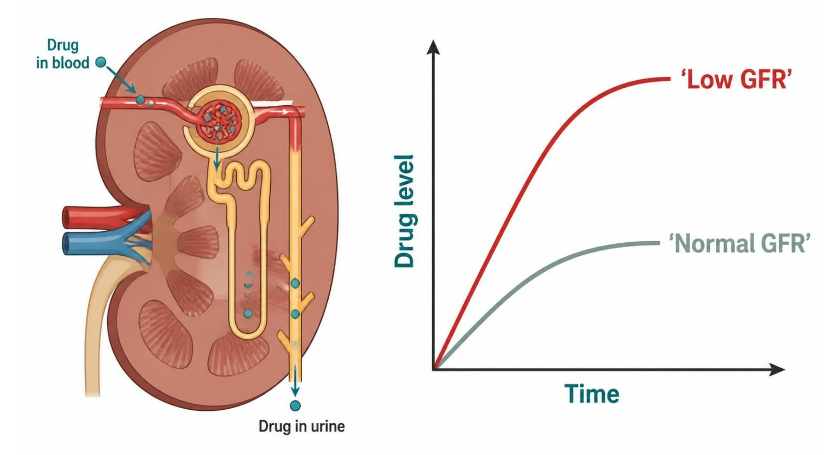
MECHANISM & DEPTH
Renal Dose Adjustment: Dose, Interval, or Both
GFR falls
▼
Renally cleared drug or active metabolite accumulates
▼
Schematic (illustrative)
Figure 1. Reduced GFR slows clearance, so a renally cleared drug accumulates to higher levels (illustrative schematic).
Toxicity
▼
Check creatinine clearance before dosing any renally cleared drug
Reduce the maintenance dose when the drug's effect is concentration-dependent
Extend the dosing interval when the drug has a long half-life; monitor for toxicity after each dose change
Lower maintenance dose, extend the interval, or check CrCl
Renal Pharmacotherapeutics — Session 1 of 2 — PA Program
6
Notes:
Walk the flow from falling GFR to toxicity, then ask students which lever to pull: dose, interval, or both. This sets up the renal dosing content that follows.
Instructor script:
Walk the flow: GFR falls, drug or active metabolite accumulates, toxicity. Fixes: lower the maintenance dose, extend the interval, or both. Loading doses are often unchanged.

Slide 7
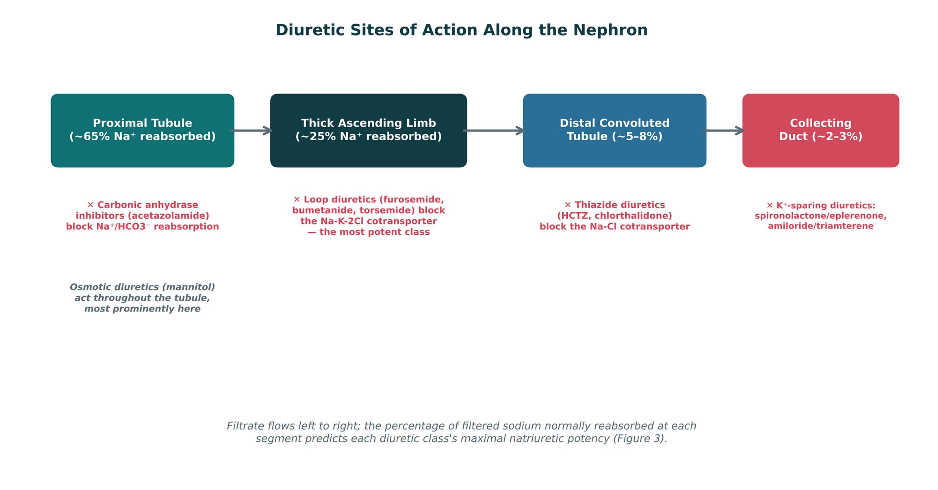
ORIGINAL ILLUSTRATION · FIGURE 2
Diuretic Sites of Action Along the Nephron
Figure 2. Original illustrative diagram (not from Katzung): filtrate flows through the proximal tubule, thick ascending limb, distal convoluted tubule, and collecting duct — each diuretic class blocks sodium reabsorption at a different, specific segment.
Renal Pharmacotherapeutics — Session 1 of 2 — PA Program
7
Notes:
This is the conceptual spine for the rest of the session — every diuretic class that follows gets anchored back to its segment on this diagram. Point out that the percentage of filtered sodium normally reabsorbed at each site previews the potency ranking in Figure 7.
Instructor script:
Name the segment and the share of filtered sodium: proximal tubule about 65%, thick ascending limb about 25%, distal tubule 5-8%, collecting duct 2-3%.

Slide 8

APPLYING THE PRINCIPLE
Dosing Adjustment in Renal Impairment
What Changes
Practical Considerations
– Reduce the dose, extend the dosing interval, or both — the specific approach depends on the drug
– Loading doses are often unchanged; maintenance doses are what get adjusted
– Active or toxic metabolites that are renally cleared matter just as much as the parent drug
– Estimate renal function (CrCl or eGFR) before dosing any renally cleared drug, especially in older adults
– Reassess as renal function changes — acute illness, dehydration, or new nephrotoxic drugs can drop GFR quickly
– When in doubt, consult dosing references or clinical pharmacy — this is not a "memorize every number" exercise
Renal Pharmacotherapeutics — Session 1 of 2 — PA Program
8
Notes:
Keep this practical rather than exhaustive — the point is the habit of checking renal function before dosing, not memorizing specific adjustment tables for every drug.
Instructor script:
Know: Estimate CrCl or eGFR before dosing; reassess when illness, dehydration or nephrotoxic drugs change GFR.

Slide 9

SECTION
02
Loop & Thiazide Diuretics
The two workhorse classes — one for potent natriuresis, one for everyday hypertension control.
Notes:
Section transition.
Loop and thiazide diuretics are the two classes that act on the thick ascending limb and the distal tubule.

Slide 10

THE MOST POTENT CLASS
Loop Diuretics
Mechanism: block the Na-K-2Cl cotransporter (NKCC2) in the thick ascending limb — the site responsible for ~25% of filtered sodium reabsorption.
Furosemide, bumetanide, torsemide — used for edema (heart failure, cirrhosis, renal disease) and, at times, hypertension when a thiazide alone is insufficient (e.g., significant renal impairment).
Adverse effects: hypokalemia, hypomagnesemia, metabolic alkalosis, ototoxicity (especially with rapid IV administration or high doses), and hyperuricemia.
Furosemide carries a sulfonamide-related structure — historical cross-reactivity concern with sulfa allergy, though the clinical risk is now considered low; still worth a careful allergy history.
Loop diuretics increase calcium excretion — useful in hypercalcemia, and the opposite effect of thiazides (Figure 2 explains the mechanism).
Renal Pharmacotherapeutics — Session 1 of 2 — PA Program
12
Notes:
The calcium-handling difference between loops and thiazides is one of the highest-yield comparison points in this whole unit — make sure students can state it both ways (loops increase Ca2+ excretion, thiazides decrease it) before moving to Figure 2.
Instructor script:
Furosemide, bumetanide, torsemide block NKCC2 in the thick ascending limb. Most potent. Adverse effects: hypokalemia, hypomagnesemia, metabolic alkalosis, ototoxicity, hyperuricemia.
Know: Increase calcium excretion (useful in hypercalcemia). Sulfonamide allergy cross-reactivity is low.

Slide 11
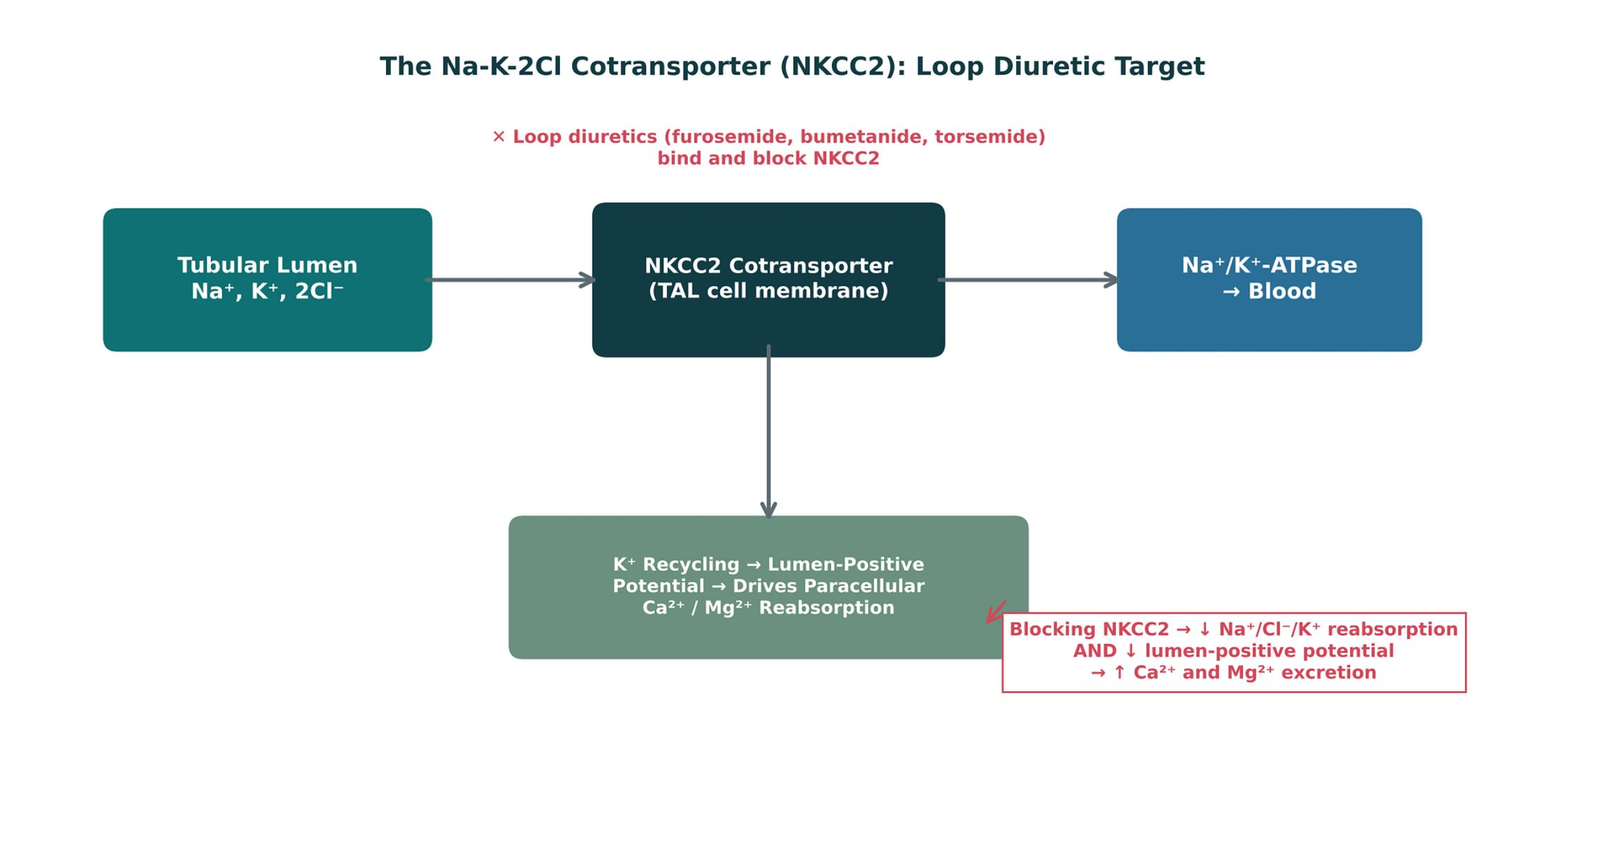
ORIGINAL ILLUSTRATION · FIGURE 3
The Na-K-2Cl Cotransporter (NKCC2): Loop Diuretic Target
Figure 3. Original illustrative diagram (not from Katzung): loop diuretics block NKCC2 in the thick ascending limb, reducing Na+/Cl-/K+ reabsorption and collapsing the lumen-positive potential that normally drives paracellular calcium and magnesium reabsorption — explaining the increased calcium and magnesium excretion seen with this class.
Renal Pharmacotherapeutics — Session 1 of 2 — PA Program
13
Notes:
Walk the diagram left to right, then down to the K+ recycling box — the lumen-positive potential is the mechanistic link between NKCC2 blockade and increased Ca2+/Mg2+ excretion. This is the piece students most often skip when they memorize "loops cause hypocalcemia" without understanding why.
Instructor script:
Left to right, then the potassium recycling box. Blocking NKCC2 collapses the lumen-positive potential that drives paracellular calcium and magnesium reabsorption.

Slide 12
FIRST-LINE FOR HYPERTENSION
Thiazide Diuretics
Mechanism: block the Na-Cl cotransporter in the distal convoluted tubule — a less potent natriuretic site (~5–8% of filtered sodium) than the loop.
Hydrochlorothiazide, chlorthalidone — first-line agents for essential hypertension; chlorthalidone has a longer half-life and is often preferred for 24-hour BP control.
Adverse effects: hyponatremia (can be significant, especially in older adults), hypokalemia, hyperglycemia, hyperuricemia (can precipitate gout), and hypercalcemia.
Thiazides decrease calcium excretion (opposite of loop diuretics) — can be therapeutically useful in patients with osteoporosis and recurrent calcium-containing kidney stones.
Lose efficacy as GFR falls below approximately 30 mL/min — loop diuretics are generally preferred once renal function is significantly reduced.
Renal Pharmacotherapeutics — Session 1 of 2 — PA Program
14
Notes:
The "thiazides lose efficacy in advanced CKD" point sets up a direct bridge to Session 2's hypertension-in-CKD content — flag that connection explicitly here.
Instructor script:
Block NCC in the distal tubule. First-line in hypertension. Adverse effects: hyponatremia, hypokalemia, hyperglycemia, hyperuricemia, hypercalcemia. Lose efficacy at GFR below about 30.

Slide 13
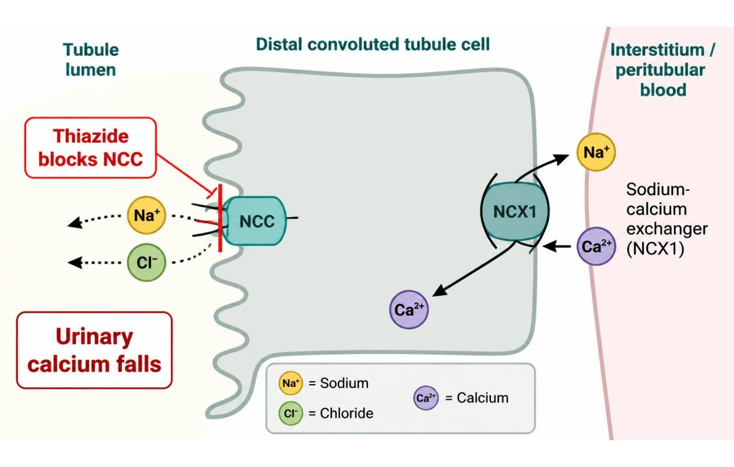
MECHANISM & DEPTH
Thiazides: Distal Tubule NCC Block and Calcium Reabsorption
Thiazide blocks the Na-Cl cotransporter (NCC) in the DCT ▼
More Na and water lost; intracellular Na falls ▼
More Ca2+ reabsorbed by the NCX exchanger ▼
Urinary calcium falls
Loses efficacy when GFR falls below about 30 mL/min
Hyponatremia, gout, and hypokalemia are common adverse effects
Lower urinary calcium helps prevent calcium-containing kidney stones
Schematic (illustrative)
Figure 4. Distal convoluted tubule: thiazide block of NCC and reduced urinary calcium (illustrative schematic).
Renal Pharmacotherapeutics — Session 1 of 2 — PA Program
15
Notes:
Students should follow the chain step by step: NCC block, sodium loss, lower intracellular sodium, calcium retained through the exchanger, and falling urinary calcium. Contrast this with loop diuretics, which raise urinary calcium (Figure 3).
Instructor script:
NCC block lowers intracellular sodium, which favors NCX calcium reabsorption, so urinary calcium falls. Useful for calcium stones and osteoporosis.

Slide 14
HIGH-YIELD COMPARISON
Loop vs. Thiazide Diuretics
Loop Diuretics
Thiazide Diuretics
– Act at the thick ascending limb — most potent natriuresis (~25%)
– Increase Ca²⁺ excretion
– Preferred in edematous states and advanced CKD
– Greater risk of ototoxicity, more pronounced electrolyte shifts
– Act at the distal convoluted tubule — modest natriuresis (~5–8%)
– Decrease Ca²⁺ excretion
– First-line for essential hypertension with preserved renal function
– Lose efficacy as GFR falls below ~30 mL/min
Renal Pharmacotherapeutics — Session 1 of 2 — PA Program
16
Notes:
Use this slide as the consolidating recap before the case — students should be able to generate this table from memory by the end of the unit.
Instructor script:
Students should reproduce this table from memory.

Slide 15

CLINICAL CASE
Choosing a Diuretic for Advancing CKD
A patient with hypertension and progressively worsening chronic kidney disease (eGFR now 25 mL/min) has been well controlled on chlorthalidone for years, but blood pressure has crept up over the last several visits.
Ask yourself: What is the most likely explanation, and what change in therapy would you consider?
Clinical pearl: Thiazide diuretics lose much of their natriuretic efficacy once GFR falls below roughly 30 mL/min, because there is too little filtered sodium reaching the distal tubule for the drug to act on meaningfully. A loop diuretic, which acts upstream at the thick ascending limb, remains effective even in advanced CKD and is the more appropriate choice here.
Renal Pharmacotherapeutics — Session 1 of 2 — PA Program
17
Notes:
This case makes the loop-vs-thiazide GFR cutoff concrete and clinical rather than an isolated fact to memorize — a good checkpoint before the quick check.
Instructor script:
At eGFR 25 a thiazide has too little filtrate to act on; switch to a loop.

Slide 16

SECTION
03
Potassium-Sparing, Carbonic Anhydrase Inhibitor & Osmotic Diuretics
Smaller in potency, but each with a distinct and important clinical niche.
Notes:
Section transition.
Potassium-sparing, carbonic anhydrase inhibitor and osmotic diuretics act on the collecting duct and the proximal tubule.

Slide 17

PROTECTING POTASSIUM
Potassium-Sparing Diuretics
Two mechanistically distinct subgroups acting at the collecting duct, both reducing potassium and hydrogen ion secretion.
Aldosterone receptor antagonists: spironolactone, eplerenone — block aldosterone's effect directly; spironolactone also has antiandrogen effects (gynecomastia, menstrual irregularities) that eplerenone largely avoids.
Epithelial sodium channel (ENaC) blockers: amiloride, triamterene — block sodium channels independent of aldosterone.
Primary adverse effect across the class: hyperkalemia — the risk rises sharply when combined with ACE inhibitors, ARBs, or in renal impairment (a direct preview of Session 2's cardiorenal drug-interaction content).
Often used in combination with a loop or thiazide diuretic specifically to offset potassium loss from the more potent class.
Renal Pharmacotherapeutics — Session 1 of 2 — PA Program
21
Notes:
Flag the hyperkalemia-with-ACEi/ARB interaction explicitly as a preview — this exact combination becomes a major theme in Session 2 when RAAS blockers are introduced.
Instructor script:
Aldosterone antagonists (spironolactone, eplerenone) and ENaC blockers (amiloride, triamterene). Hyperkalemia is the main risk, especially with ACE inhibitors, ARBs and CKD.

Slide 18
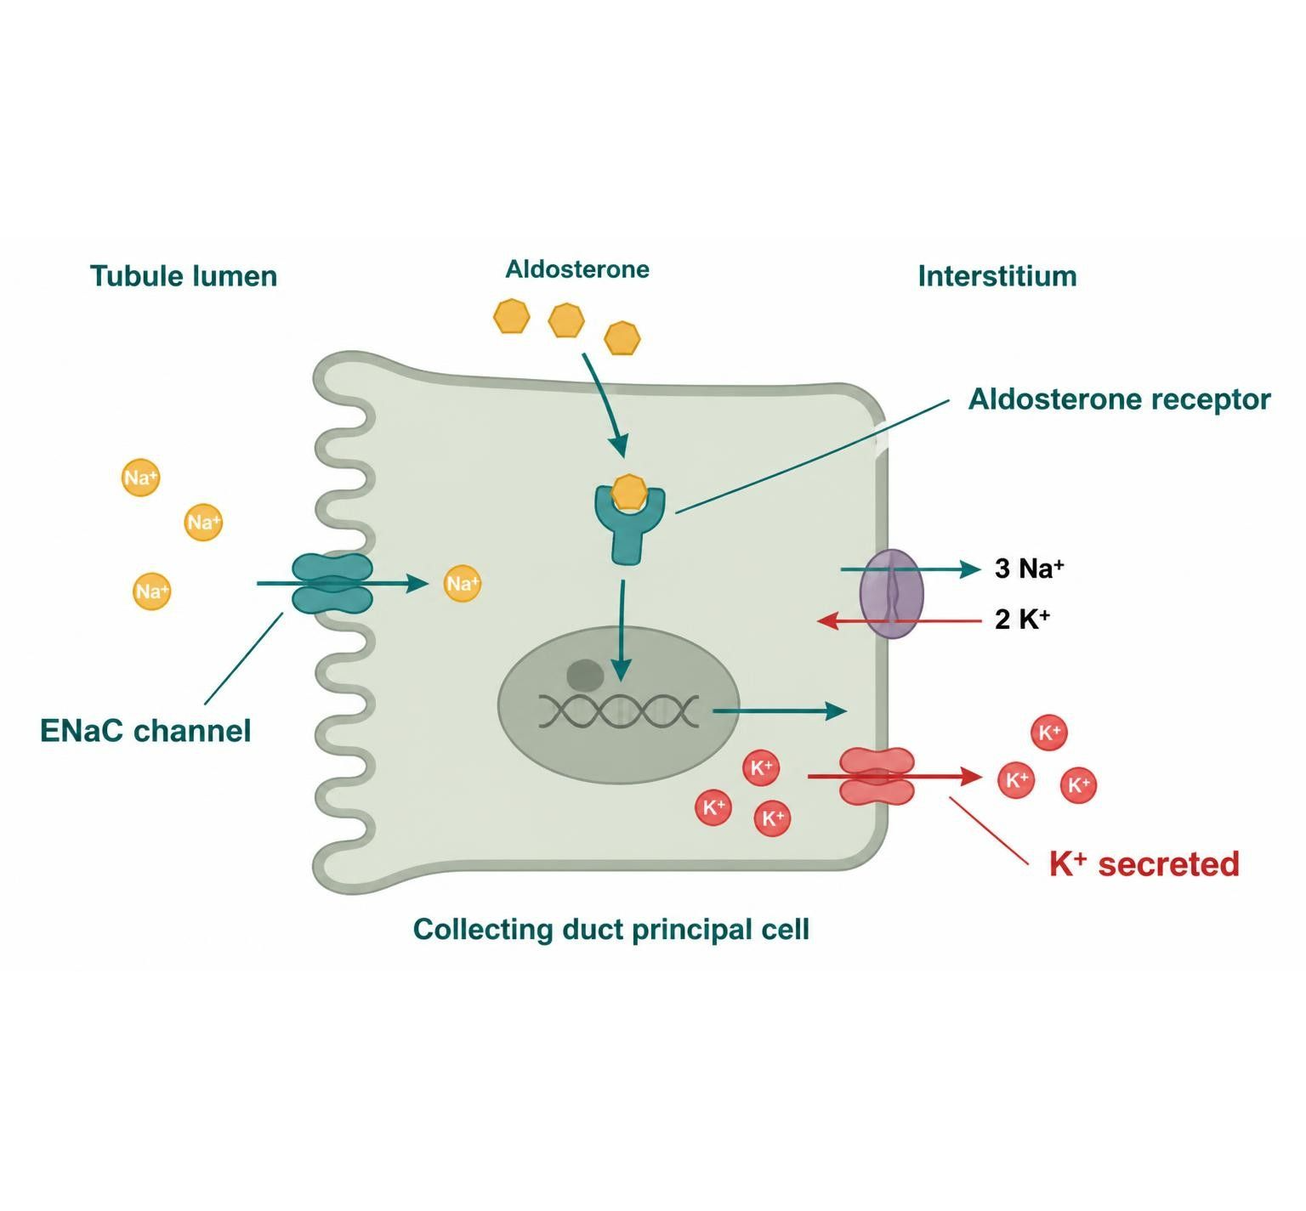
MECHANISM & DEPTH
Collecting Duct: Aldosterone Blockers vs. ENaC Blockers
Aldosterone binds the mineralocorticoid receptor
▼
Increases ENaC and Na/K pump activity
▼
K+ and H+ secreted into the tubule
Spironolactone and eplerenone block the receptor
Amiloride and triamterene block ENaC directly
Hyperkalemia risk rises with ACE inhibitors, ARBs, or CKD
Schematic (illustrative)
Figure 5. Collecting duct: aldosterone-receptor blockers and ENaC blockers act at different steps (illustrative schematic).
Renal Pharmacotherapeutics — Session 1 of 2 — PA Program
22
Notes:
Anchor the two classes to the same segment: one blocks the hormone's receptor, the other blocks the channel the hormone turns on. Both raise potassium when used alone, which is why they are combined carefully with ACE inhibitors and ARBs.
Instructor script:
Aldosterone drives ENaC and the sodium-potassium pump; blocking either reduces potassium and hydrogen secretion.

Slide 19
NICHE BUT IMPORTANT
Carbonic Anhydrase Inhibitors & Osmotic Diuretics
● Acetazolamide (carbonic anhydrase inhibitor): blocks Na+/HCO3- reabsorption in the proximal tubule; weak diuretic effect but valued for non-diuretic uses — glaucoma (reduces aqueous humor production), altitude sickness prophylaxis, and metabolic alkalosis correction. Causes a mild metabolic acidosis as a predictable adverse effect.
● Mannitol (osmotic diuretic): an inert, filtered but poorly reabsorbed solute that holds water in the tubule lumen osmotically. Used to reduce elevated intracranial or intraocular pressure and in certain cases of rhabdomyolysis-associated kidney injury prevention. Requires intact renal perfusion to be effective and can worsen volume overload if used inappropriately.
Renal Pharmacotherapeutics — Session 1 of 2 — PA Program
23
Notes:
Both of these classes are "know the niche use, not the everyday one" — students should walk away knowing acetazolamide = glaucoma/altitude sickness and mannitol = ICP/IOP reduction, more than thinking of either as a mainstream diuretic.
Instructor script:
Acetazolamide for glaucoma, altitude sickness and alkalosis. Mannitol for raised ICP and IOP.

Slide 20
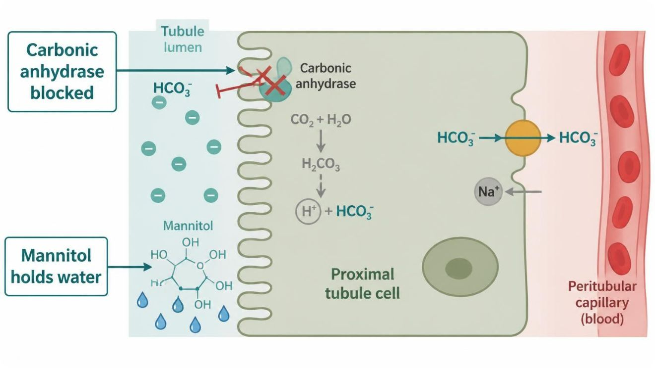
MECHANISM & DEPTH
Proximal Tubule: Acetazolamide and Mannitol
Acetazolamide blocks carbonic anhydrase
▼
Less HCO3- reabsorbed
▼
Bicarbonate diuresis, metabolic acidosis
▼
Mannitol is filtered, not reabsorbed
▼
Water held in lumen, osmotic diuresis
Schematic (illustrative)
Acetazolamide uses: glaucoma, altitude sickness, and raised intracranial pressure
Acetazolamide causes metabolic acidosis and potassium loss; watch for kidney stones
Mannitol expands extracellular volume; avoid it in heart failure and volume depletion
Figure 6. Proximal tubule: carbonic anhydrase inhibition and osmotic holding of water (illustrative schematic).
Renal Pharmacotherapeutics — Session 1 of 2 — PA Program
24
Notes:
Explain the two proximal mechanisms side by side: acetazolamide removes bicarbonate reabsorption, mannitol removes water reabsorption by staying in the lumen. Both act before the loop, which is why their effect is modest in natriuretic potency.
Instructor script:
Bicarbonate diuresis with metabolic acidosis; mannitol holds water in the lumen and needs renal perfusion.

Slide 21
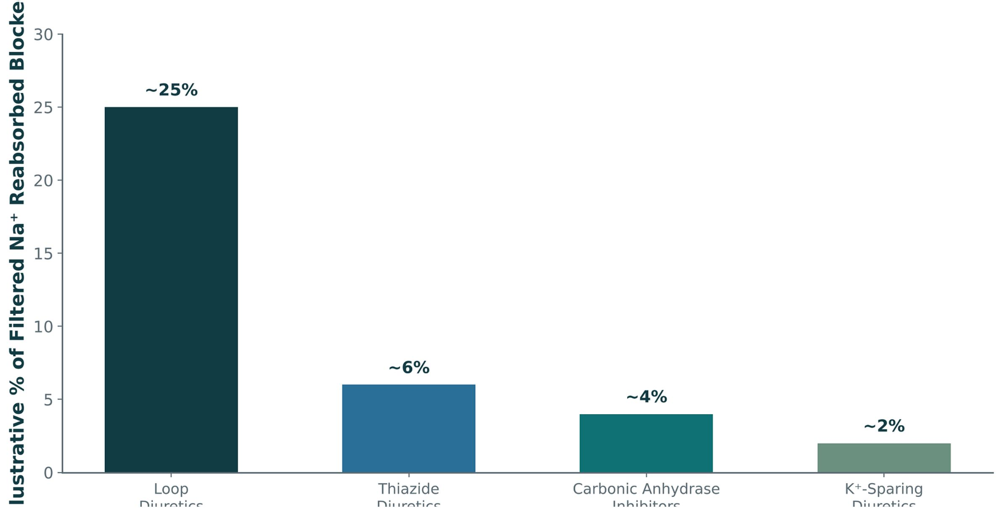
ORIGINAL ILLUSTRATION · FIGURE 7
Diuretic Class Comparison: Natriuretic Potency
Figure 7. Original illustrative comparison (illustrative values, not from Katzung): loop diuretics block roughly 25% of filtered sodium reabsorption, substantially more than thiazides, carbonic anhydrase inhibitors, or potassium-sparing diuretics — directly reflecting the percentage normally reabsorbed at each nephron segment in Figure 2.
Renal Pharmacotherapeutics — Session 1 of 2 — PA Program
25
Notes:
This figure closes the loop (so to speak) on Figure 2 — the same nephron-segment logic, now quantified. Use it to reinforce why loop diuretics are reached for first when potent natriuresis is the clinical goal.
Instructor script:
Close the loop with Figure 2.

Slide 22
HIGH-YIELD COMPARISON · TABLE 1
Diuretic Classes at a Glance
Class | Example Agent(s) | Key Teaching Point
Loop | Furosemide, bumetanide, torsemide | Most potent; blocks NKCC2; ↑ Ca²⁺ excretion; ototoxicity risk
Thiazide | Hydrochlorothiazide, chlorthalidone | First-line for HTN; ↓ Ca²⁺ excretion; loses efficacy at low GFR
K⁺-sparing | Spironolactone, eplerenone, amiloride, triamterene | Hyperkalemia risk, especially with ACEi/ARB
CAI / Osmotic | Acetazolamide / mannitol | Niche uses: glaucoma, altitude sickness / ↑ ICP, ↑ IOP
Renal Pharmacotherapeutics — Session 1 of 2 — PA Program
26
Notes:
Use this table as the organizing summary for the whole diuretic section before the closing case — a good anchor point for the recall quiz questions students will see in Session 2.
Instructor script:
Close the loop with Figure 2.

Slide 23
CLINICAL CASE
The Hyperkalemia Setup
A patient with stage 3 chronic kidney disease and heart failure is taking an ACE inhibitor and is started on spironolactone for additional heart-failure benefit. Two weeks later, a routine basic metabolic panel shows a potassium of 6.1 mEq/L.
Ask yourself: What is the mechanistic explanation for this finding, and what does it suggest about future drug combinations in this unit?
Clinical pearl: Both the ACE inhibitor (by reducing aldosterone) and spironolactone (by directly blocking the aldosterone receptor) independently reduce potassium excretion — combined, and in the setting of CKD (which already impairs potassium excretion), the hyperkalemia risk compounds. This is the same additive-risk logic that will reappear as the "triple whammy" in Session 2.
Renal Pharmacotherapeutics — Session 1 of 2 — PA Program
27
Notes:
This case is a deliberate bridge to Session 2 — point out explicitly that the ACEi/aldosterone-antagonist combination here is one of three "whammies" that will be formalized next session.
Instructor script:
ACE inhibitor plus spironolactone in CKD, potassium 6.1. Both reduce aldosterone effect.

Slide 24
DRUG NAMES
Drug Names Reveal the Class: Renal Agents
Stem
Class
Examples
Memory aid
-semide
Loop
Furosemide, torsemide
Works at the thick ascending limb; strongest class
-tanide
Loop
Bumetanide
About 40× furosemide potency, mg for mg
-thiazide
Thiazide
Hydrochlorothiazide
Acts at the distal convoluted tubule
-thalidone
Thiazide-like
Chlorthalidone
Same site, longer action
-onolactone / -erenone
Aldosterone antagonist
Spironolactone, eplerenone
Blocks the mineralocorticoid receptor
-ride
ENaC blocker
Amiloride
Blocks the sodium channel directly
-zolamide
Carbonic anhydrase inhibitor
Acetazolamide
Proximal tubule; bicarbonate diuresis
mannitol / -itol
Osmotic diuretic
Mannitol
Filtered, holds water in the lumen
Renal Pharmacotherapeutics — Session 1 of 2 — PA Program
30
Notes:
Instructor script:
-semide, -tanide, -thiazide, -thalidone, -onolactone and -erenone, -ride, -zolamide, mannitol.

Slide 25
BIG PICTURE
Session 1 Recap — To Be Continued
1
Renal function determines drug dosing broadly, not just for diuretics — GFR/creatinine clearance should be checked before dosing any renally cleared drug (Chapter 3).
2
Diuretic classes are organized by nephron site (Figure 2): loop diuretics (thick ascending limb) are most potent, followed by thiazides (distal tubule), then potassium-sparing and carbonic anhydrase inhibitors.
3
Loop and thiazide diuretics have opposite effects on calcium excretion (Figure 3) — a classic, high-yield distinguishing fact.
4
Potassium-sparing diuretics carry a hyperkalemia risk that compounds significantly when combined with ACE inhibitors or ARBs — a theme that returns, formalized, in Session 2.
5
Session 2 (Thursday, November 19) continues with antihypertensive therapy in chronic kidney disease and the cardiovascular-renal overlap, including vasodilators and angina pharmacology.
Renal Pharmacotherapeutics — Session 1 of 2 — PA Program
Notes:
Close Session 1 by previewing Session 2 explicitly — students should leave knowing diuretic pharmacology is complete, and that RAAS-blocking antihypertensives, other antihypertensive classes, and the cardiorenal overlap pick up first next time.
Instructor script:
Preview Session 2: RAAS blockers and the triple whammy.

Slide 26
APPENDIX 1
Drug Profiles
Formulation, dose, indications, adverse effects, contraindications and toxicity
PO = by mouth
IV = intravenous
IM = intramuscular
SL = sublingual
BID / TID / QID = two / three / four times daily
ER = extended-release
ICP = intracranial pressure
IOP = intraocular pressure
CKD = chronic kidney disease
AKI = acute kidney injury
GFR = glomerular filtration rate
CrCl = creatinine clearance
ENaC = epithelial sodium channel
ACE = angiotensin-converting enzyme
ARB = angiotensin receptor blocker
MI = myocardial infarction
HF = heart failure
CYP = cytochrome P450
NSAID = nonsteroidal anti-inflammatory drug
CBC = complete blood count
Renal Pharmacotherapeutics — Session 1 of 2 — PA Program
32
Notes:
Abbreviation key: PO = by mouth; IV = intravenous; IM = intramuscular; SL = sublingual; BID / TID / QID = two / three / four times daily; ER = extended-release; ICP = intracranial pressure; IOP = intraocular pressure; CKD = chronic kidney disease; AKI = acute kidney injury; GFR = glomerular filtration rate; CrCl = creatinine clearance; ENaC = epithelial sodium channel; ACE = angiotensin-converting enzyme; ARB = angiotensin receptor blocker; MI = myocardial infarction; HF = heart failure; CYP = cytochrome P450; NSAID = nonsteroidal anti-inflammatory drug; CBC = complete blood count.
Instructor script:
Say: "Use these as a study reference. For each drug know the dose logic, the key adverse effect, the contraindication that changes decisions and the toxicity you would need to recognize."
Class activity (10 minutes): Give groups two or three profiles to teach back in 60 seconds each.
Teaching points: Loops (furosemide, bumetanide, torsemide), thiazides (hydrochlorothiazide, chlorthalidone), potassium-sparing (spironolactone, eplerenone, amiloride, triamterene), acetazolamide, mannitol.
Bloom's prompts: Remember: state the hydrochlorothiazide dose. Understand: explain why loops waste calcium. Apply: choose a diuretic at eGFR 25. Analyze: explain why digoxin toxicity follows loop diuretic hypokalemia. Evaluate: choose a diuretic for a patient with gout and heart failure.

Slide 27
DRUG PROFILE
Furosemide (Lasix)
LOOP DIURETIC
FORMULATION
Tablets 20/40/80 mg; oral solution; IV injection 10 mg/mL
DOSE (ADULT)
Edema: 20-80 mg PO once or BID, titrate to response (up to 600 mg/day in severe CKD or HF); IV 20-40 mg slowly (no faster than 4 mg/min)
INDICATIONS
Edema (heart failure, cirrhosis, kidney disease), hypertension, acute pulmonary edema, hypercalcemia
ADVERSE EFFECTS
Hypokalemia, hypomagnesemia, metabolic alkalosis, volume depletion, hyperuricemia, ototoxicity
CONTRAINDICATIONS
Anuria, hypersensitivity; use caution with sulfonamide allergy (low cross-reactivity), hepatic coma
TOXICITY / OVERDOSE
Ototoxicity with rapid IV or high doses, severe volume and electrolyte depletion, AKI; monitor potassium, magnesium, creatinine
Standard adult dosing for teaching; verify against current prescribing information.
Renal Pharmacotherapeutics — Session 1 of 2 — PA Program
33
Notes:
Furosemide (Lasix)|Loop diuretic|Tablets 20/40/80 mg; oral solution; IV injection 10 mg/mL|Edema: 20-80 mg PO once or BID, titrate to response (up to 600 mg/day in severe CKD or HF); IV 20-40 mg slowly (no faster than 4 mg/min)|Edema (heart failure, cirrhosis, kidney disease), hypertension, acute pulmonary edema, hypercalcemia|Hypokalemia, hypomagnesemia, metabolic alkalosis, volume depletion, hyperuricemia, ototoxicity|Anuria, hypersensitivity; use caution with sulfonamide allergy (low cross-reactivity), hepatic coma|Ototoxicity with rapid IV or high doses, severe volume and electrolyte depletion, AKI; monitor potassium, magnesium, creatinine

Slide 28
DRUG PROFILE
Bumetanide (Bumex)
LOOP DIURETIC
FORMULATION
Tablets 0.5/1/2 mg; IV injection 0.25 mg/mL
DOSE (ADULT)
Edema: 0.5-2 mg PO once or BID (maximum 10 mg/day); IV 0.5-1 mg
INDICATIONS
Edema in heart failure, hepatic and renal disease
ADVERSE EFFECTS
Hypokalemia, hyponatremia, hypomagnesemia, muscle cramps, dizziness, ototoxicity
CONTRAINDICATIONS
Anuria, hepatic coma, severe electrolyte depletion, hypersensitivity
TOXICITY / OVERDOSE
About 40 times more potent than furosemide mg for mg; profound diuresis, hypokalemia, ototoxicity
Standard adult dosing for teaching; verify against current prescribing information.
Renal Pharmacotherapeutics — Session 1 of 2 — PA Program
34
Notes:
Bumetanide (Bumex)|Loop diuretic|Tablets 0.5/1/2 mg; IV injection 0.25 mg/mL|Edema: 0.5-2 mg PO once or BID (maximum 10 mg/day); IV 0.5-1 mg|Edema in heart failure, hepatic and renal disease|Hypokalemia, hyponatremia, hypomagnesemia, muscle cramps, dizziness, ototoxicity|Anuria, hepatic coma, severe electrolyte depletion, hypersensitivity|About 40 times more potent than furosemide mg for mg; profound diuresis, hypokalemia, ototoxicity

Slide 29
DRUG PROFILE
Torsemide (Demadex)
LOOP DIURETIC
FORMULATION
Tablets 5/10/20/100 mg
DOSE (ADULT)
Edema: 10-20 mg PO daily (up to 200 mg/day); hypertension: 5 mg daily
INDICATIONS
Edema in heart failure, kidney disease, cirrhosis; hypertension
ADVERSE EFFECTS
Hypokalemia, dizziness, headache, hyperuricemia, ototoxicity (less than furosemide)
CONTRAINDICATIONS
Anuria, hypersensitivity (sulfonylurea or sulfonamide allergy caution)
TOXICITY / OVERDOSE
Volume depletion, hypokalemia, hypotension; longer half-life and more predictable absorption than furosemide
Standard adult dosing for teaching; verify against current prescribing information.
Renal Pharmacotherapeutics — Session 1 of 2 — PA Program
35
Notes:
Torsemide (Demadex)|Loop diuretic|Tablets 5/10/20/100 mg|Edema: 10-20 mg PO daily (up to 200 mg/day); hypertension: 5 mg daily|Edema in heart failure, kidney disease, cirrhosis; hypertension|Hypokalemia, dizziness, headache, hyperuricemia, ototoxicity (less than furosemide)|Anuria, hypersensitivity (sulfonylurea or sulfonamide allergy caution)|Volume depletion, hypokalemia, hypotension; longer half-life and more predictable absorption than furosemide

Slide 30
DRUG PROFILE
Hydrochlorothiazide (Microzide)
THIAZIDE DIURETIC
FORMULATION
Tablets 12.5/25/50 mg; capsules 12.5 mg; many fixed combinations
DOSE (ADULT)
Hypertension: 12.5-25 mg PO daily (maximum 50 mg); edema: 25-100 mg daily
INDICATIONS
First-line hypertension, mild edema, calcium kidney stones, nephrogenic diabetes insipidus
ADVERSE EFFECTS
Hyponatremia, hypokalemia, hypercalcemia, hyperglycemia, hyperuricemia and gout, photosensitivity
CONTRAINDICATIONS
Anuria, sulfonamide allergy; less effective when GFR is below about 30 mL/min
TOXICITY / OVERDOSE
Severe hyponatremia and hypokalemia, volume depletion, hypercalcemia; monitor sodium, potassium, calcium, glucose
Standard adult dosing for teaching; verify against current prescribing information.
Renal Pharmacotherapeutics — Session 1 of 2 — PA Program
36
Notes:
Hydrochlorothiazide (Microzide)|Thiazide diuretic|Tablets 12.5/25/50 mg; capsules 12.5 mg; many fixed combinations|Hypertension: 12.5-25 mg PO daily (maximum 50 mg); edema: 25-100 mg daily|First-line hypertension, mild edema, calcium kidney stones, nephrogenic diabetes insipidus|Hyponatremia, hypokalemia, hypercalcemia, hyperglycemia, hyperuricemia and gout, photosensitivity|Anuria, sulfonamide allergy; less effective when GFR is below about 30 mL/min|Severe hyponatremia and hypokalemia, volume depletion, hypercalcemia; monitor sodium, potassium, calcium, glucose

Slide 31
DRUG PROFILE
Chlorthalidone (Thalitone)
THIAZIDE-LIKE DIURETIC
FORMULATION
Tablets 12.5/25/50 mg
DOSE (ADULT)
Hypertension: 12.5-25 mg PO daily (maximum 50 mg); edema: 50-100 mg daily
INDICATIONS
Hypertension (longer duration, often preferred), edema
ADVERSE EFFECTS
Hypokalemia, hyponatremia, hyperuricemia, hyperglycemia, erectile dysfunction
CONTRAINDICATIONS
Anuria, sulfonamide allergy, severe hypokalemia
TOXICITY / OVERDOSE
Profound hypokalemia and hyponatremia (more than hydrochlorothiazide at equal dose); long half-life of 40-60 hours
Standard adult dosing for teaching; verify against current prescribing information.
Renal Pharmacotherapeutics — Session 1 of 2 — PA Program
37
Notes:
Chlorthalidone (Thalitone)|Thiazide-like diuretic|Tablets 12.5/25/50 mg|Hypertension: 12.5-25 mg PO daily (maximum 50 mg); edema: 50-100 mg daily|Hypertension (longer duration, often preferred), edema|Hypokalemia, hyponatremia, hyperuricemia, hyperglycemia, erectile dysfunction|Anuria, sulfonamide allergy, severe hypokalemia|Profound hypokalemia and hyponatremia (more than hydrochlorothiazide at equal dose); long half-life of 40-60 hours

Slide 32
DRUG PROFILE
Spironolactone (Aldactone)
ALDOSTERONE RECEPTOR ANTAGONIST (POTASSIUM-SPARING)
FORMULATION
Tablets 25/50/100 mg; oral suspension
DOSE (ADULT)
Hypertension: 25-100 mg daily; heart failure: 12.5-25 mg daily; primary hyperaldosteronism: 100-400 mg daily
INDICATIONS
Heart failure, resistant hypertension, primary hyperaldosteronism, edema, ascites
ADVERSE EFFECTS
Hyperkalemia, gynecomastia, menstrual irregularity, breast tenderness, GI upset
CONTRAINDICATIONS
Hyperkalemia, Addison disease, anuria; avoid with potassium supplements and caution with ACE inhibitors or ARBs
TOXICITY / OVERDOSE
Life-threatening hyperkalemia, especially in CKD or with ACE inhibitor/ARB; monitor potassium and creatinine within 1 week
Standard adult dosing for teaching; verify against current prescribing information.
Renal Pharmacotherapeutics — Session 1 of 2 — PA Program
38
Notes:
Spironolactone (Aldactone)|Aldosterone receptor antagonist (potassium-sparing)|Tablets 25/50/100 mg; oral suspension|Hypertension: 25-100 mg daily; heart failure: 12.5-25 mg daily; primary hyperaldosteronism: 100-400 mg daily|Heart failure, resistant hypertension, primary hyperaldosteronism, edema, ascites|Hyperkalemia, gynecomastia, menstrual irregularity, breast tenderness, GI upset|Hyperkalemia, Addison disease, anuria; avoid with potassium supplements and caution with ACE inhibitors or ARBs|Life-threatening hyperkalemia, especially in CKD or with ACE inhibitor/ARB; monitor potassium and creatinine within 1 week

Slide 33
DRUG PROFILE
Eplerenone (Inspra)
SELECTIVE ALDOSTERONE RECEPTOR ANTAGONIST
FORMULATION
Tablets 25/50 mg
DOSE (ADULT)
Heart failure post-MI: 25 mg daily, increase to 50 mg; hypertension: 50 mg daily, may increase to BID
INDICATIONS
Heart failure after myocardial infarction, hypertension
ADVERSE EFFECTS
Hyperkalemia, dizziness, hypertriglyceridemia, fewer antiandrogen effects
CONTRAINDICATIONS
Potassium above 5.5 mEq/L, CrCl below 30 mL/min, strong CYP3A4 inhibitors (such as ketoconazole)
TOXICITY / OVERDOSE
Hyperkalemia; levels rise sharply with CYP3A4 inhibitors; monitor potassium and creatinine
Standard adult dosing for teaching; verify against current prescribing information.
Renal Pharmacotherapeutics — Session 1 of 2 — PA Program
39
Notes:
Eplerenone (Inspra)|Selective aldosterone receptor antagonist|Tablets 25/50 mg|Heart failure post-MI: 25 mg daily, increase to 50 mg; hypertension: 50 mg daily, may increase to BID|Heart failure after myocardial infarction, hypertension|Hyperkalemia, dizziness, hypertriglyceridemia, fewer antiandrogen effects|Potassium above 5.5 mEq/L, CrCl below 30 mL/min, strong CYP3A4 inhibitors (such as ketoconazole)|Hyperkalemia; levels rise sharply with CYP3A4 inhibitors; monitor potassium and creatinine

Slide 34
DRUG PROFILE
Amiloride (Midamor)
ENAC BLOCKER (POTASSIUM-SPARING)
FORMULATION
Tablets 5 mg
DOSE (ADULT)
5 mg PO daily, may increase to 10 mg (maximum 20 mg/day)
INDICATIONS
Adjunct to loop or thiazide to preserve potassium, lithium-induced nephrogenic diabetes insipidus
ADVERSE EFFECTS
Hyperkalemia, nausea, headache, weakness
CONTRAINDICATIONS
Potassium above 5.5 mEq/L, anuria, significant renal impairment, concomitant potassium supplements
TOXICITY / OVERDOSE
Hyperkalemia with arrhythmias, especially in diabetes and CKD; monitor potassium
Standard adult dosing for teaching; verify against current prescribing information.
Renal Pharmacotherapeutics — Session 1 of 2 — PA Program
40
Notes:
Amiloride (Midamor)|ENaC blocker (potassium-sparing)|Tablets 5 mg|5 mg PO daily, may increase to 10 mg (maximum 20 mg/day)|Adjunct to loop or thiazide to preserve potassium, lithium-induced nephrogenic diabetes insipidus|Hyperkalemia, nausea, headache, weakness|Potassium above 5.5 mEq/L, anuria, significant renal impairment, concomitant potassium supplements|Hyperkalemia with arrhythmias, especially in diabetes and CKD; monitor potassium

Slide 35
DRUG PROFILE
Triamterene (Dyrenium; Maxzide and Dyazide combinations)
ENAC BLOCKER (POTASSIUM-SPARING)
FORMULATION
Capsules 50/100 mg; combination tablets with hydrochlorothiazide (37.5/25 and 75/50 mg)
DOSE (ADULT)
Alone: 100 mg PO BID (maximum 300 mg/day); combination: 37.5/25 to 75/50 mg daily
INDICATIONS
Edema, hypertension, hypokalemia prevention
ADVERSE EFFECTS
Hyperkalemia, nausea, kidney stones, blue urine, folate antagonism
CONTRAINDICATIONS
Hyperkalemia, severe renal impairment, anuria, concomitant potassium supplements
TOXICITY / OVERDOSE
Hyperkalemia, nephrolithiasis, AKI with NSAIDs; monitor potassium and creatinine
Standard adult dosing for teaching; verify against current prescribing information.
Renal Pharmacotherapeutics — Session 1 of 2 — PA Program
41
Notes:
Triamterene (Dyrenium; Maxzide and Dyazide combinations)|ENaC blocker (potassium-sparing)|Capsules 50/100 mg; combination tablets with hydrochlorothiazide (37.5/25 and 75/50 mg)|Alone: 100 mg PO BID (maximum 300 mg/day); combination: 37.5/25 to 75/50 mg daily|Edema, hypertension, hypokalemia prevention|Hyperkalemia, nausea, kidney stones, blue urine, folate antagonism|Hyperkalemia, severe renal impairment, anuria, concomitant potassium supplements|Hyperkalemia, nephrolithiasis, AKI with NSAIDs; monitor potassium and creatinine

Slide 36
DRUG PROFILE
Acetazolamide (Diamox)
CARBONIC ANHYDRASE INHIBITOR
FORMULATION
Tablets 125/250 mg; extended-release capsules 500 mg; IV 500 mg
DOSE (ADULT)
Glaucoma: 250 mg PO 1-4 times daily; altitude sickness: 125-250 mg BID starting a day before ascent; edema: 250-375 mg daily
INDICATIONS
Glaucoma, altitude sickness prophylaxis, metabolic alkalosis, idiopathic intracranial hypertension
ADVERSE EFFECTS
Metabolic acidosis, paresthesias, hypokalemia, kidney stones, taste changes
CONTRAINDICATIONS
Sulfonamide allergy, severe renal or hepatic disease, hyponatremia, hypokalemia, adrenal failure
TOXICITY / OVERDOSE
Severe metabolic acidosis, hypokalemia, confusion, bone marrow suppression (rare)
Standard adult dosing for teaching; verify against current prescribing information.
Renal Pharmacotherapeutics — Session 1 of 2 — PA Program
42
Notes:
Acetazolamide (Diamox)|Carbonic anhydrase inhibitor|Tablets 125/250 mg; extended-release capsules 500 mg; IV 500 mg|Glaucoma: 250 mg PO 1-4 times daily; altitude sickness: 125-250 mg BID starting a day before ascent; edema: 250-375 mg daily|Glaucoma, altitude sickness prophylaxis, metabolic alkalosis, idiopathic intracranial hypertension|Metabolic acidosis, paresthesias, hypokalemia, kidney stones, taste changes|Sulfonamide allergy, severe renal or hepatic disease, hyponatremia, hypokalemia, adrenal failure|Severe metabolic acidosis, hypokalemia, confusion, bone marrow suppression (rare)

Slide 37
DRUG PROFILE
Mannitol (Osmitrol)
OSMOTIC DIURETIC
FORMULATION
IV solutions 10%, 15%, 20% and 25%
DOSE (ADULT)
Raised ICP or IOP: 0.25-1 g/kg IV over 30-60 minutes; repeat 0.25-0.5 g/kg every 4-8 hours as needed
INDICATIONS
Raised intracranial pressure, raised intraocular pressure, oliguria prevention in selected cases
ADVERSE EFFECTS
Fluid and electrolyte shifts, headache, nausea, thirst, hyponatremia
CONTRAINDICATIONS
Anuria, severe dehydration, active intracranial bleeding, severe pulmonary edema, heart failure
TOXICITY / OVERDOSE
Volume overload with pulmonary edema, hyperosmolality, AKI, hypo- or hypernatremia; monitor osmolality and electrolytes
Standard adult dosing for teaching; verify against current prescribing information.
Renal Pharmacotherapeutics — Session 1 of 2 — PA Program
43
Notes:
Mannitol (Osmitrol)|Osmotic diuretic|IV solutions 10%, 15%, 20% and 25%|Raised ICP or IOP: 0.25-1 g/kg IV over 30-60 minutes; repeat 0.25-0.5 g/kg every 4-8 hours as needed|Raised intracranial pressure, raised intraocular pressure, oliguria prevention in selected cases|Fluid and electrolyte shifts, headache, nausea, thirst, hyponatremia|Anuria, severe dehydration, active intracranial bleeding, severe pulmonary edema, heart failure|Volume overload with pulmonary edema, hyperosmolality, AKI, hypo- or hypernatremia; monitor osmolality and electrolytes

Slide 38
Appendix 2: DRUG PROFILE · SUPPORTING
Supporting Drugs at a Glance
ACE inhibitors and ARBs
NSAIDs
Hyperkalemia with potassium-sparing diuretics
Blunt diuretic effect; raise AKI risk
Lithium
Digoxin
Levels rise with thiazides
Hypokalemia from loops increases toxicity
Aminoglycosides
Potassium supplements and trimethoprim
Additive ototoxicity with loops
Hyperkalemia with potassium-sparing diuretics
Sulfonamide allergy
Metformin, vancomycin, DOACs
Caution with loops, thiazides, acetazolamide
Renally cleared; need dose adjustment
Listed for context; not profiled in detail.
Renal Pharmacotherapeutics — Session 1 of 2 — PA Program
44
Notes:
Supporting drugs, context only (no dosing): ACE inhibitors and ARBs (hyperkalemia with potassium-sparing diuretics); NSAIDs (blunt diuretic effect, raise AKI risk); lithium (levels rise with thiazides); digoxin (hypokalemia from loops increases toxicity); aminoglycosides (additive ototoxicity with loops); potassium supplements and trimethoprim (hyperkalemia with potassium-sparing diuretics); sulfonamide allergy (caution with loops, thiazides, acetazolamide); metformin, vancomycin, DOACs (renally cleared, need dose adjustment).
Instructor script:
ACE inhibitors, ARBs, NSAIDs, lithium, digoxin, aminoglycosides and potassium supplements explain interactions, not doses.

Slide 39
APPENDIX 3
Image Attribution
● Original figures in this deck: Figures 1–7 (Renal Dose Adjustment: Dose, Interval, or Both; Diuretic Sites of Action Along the Nephron; The Na-K-2Cl Cotransporter (NKCC2): Loop Diuretic Target; Thiazides: Distal Tubule NCC Block and Calcium Reabsorption; Collecting Duct: Aldosterone Blockers vs. ENaC Blockers; Proximal Tubule: Acetazolamide and Mannitol; Diuretic Class Comparison: Natriuretic Potency). Figures 2, 3, and 7 were generated by the course director using the AI tool Claude to illustrate standard, non-copyrighted pharmacologic concepts. They are original diagrams, not reproduced from Katzung’s Basic and Clinical Pharmacology or any other copyrighted source. Figures 1, 4, 5, and 6 are illustrative AI-generated schematics of standard mechanisms, not reproduced from any copyrighted source.
● Reference: Anthropic. (2026). Claude (Sonnet 5) [Large language model]. https://claude.ai
Renal Pharmacotherapeutics — Session 1 of 2 — PA Program
45
Notes:
This slide documents AI-tool use for original figure generation per university citation requirements. It covers every original diagram in this deck (Figures 2, 3, and 7), and the illustrative AI-generated mechanism schematics (Figures 1, 4, 5, and 6); none are reproduced from any textbook.
Instructor script:
The original diagrams (Figures 2, 3 and 7) were generated with Claude; the mechanism schematics (Figures 1, 4, 5 and 6) are illustrative.

