Slide 1

PA PHARMACOLOGY COURSE · LECTURE 5 · SESSION 2 OF 2
Renal Pharmacotherapeutics
Session 2: Hypertension in CKD and the Cardiovascular-Renal Overlap | Thursday, November 19 | 8:30–11:00 AM
Diane S. Allen-Gipson, Ph.D., M.S., Course Director
Notes:
Session 1 gave us nephron sites.

Slide 2

BY THE END OF THIS LECTURE
Learning Objectives — Session 2
Recap: Session 1 covered renal dosing principles and the five diuretic classes, organized by nephron site.
Describe the renin-angiotensin-aldosterone system (RAAS) and identify where each antihypertensive drug class acts.
Explain why ACE inhibitors and ARBs are preferred first-line therapy for hypertension in chronic kidney disease, including their renoprotective mechanism.
Identify major antihypertensive drug classes beyond RAAS blockers, their mechanisms, and their role in CKD-specific management.
Describe vasodilator pharmacology (nitrates, calcium channel blockers) in angina pectoris and its mechanistic overlap with cardiovascular-renal disease management.
Identify high-risk drug combinations and monitoring needs at the cardiorenal interface, including the "triple whammy," and apply the full renal/cardiorenal toolkit to integrated clinical scenarios with a cumulative recall quiz.
Renal Pharmacotherapeutics — Session 2 of 2 — PA Program
2
Notes:
Briefly recap Session 1 before diving in: diuretic pharmacology by nephron site, and the hyperkalemia-with-ACEi/ARB preview from the closing case. Today extends that same cardiorenal thread through RAAS-blocking antihypertensives, other antihypertensive classes, and the vasodilator/angina overlap, closing with a cumulative recall quiz spanning both sessions.
Instructor script:
Today we follow one pathway, the renin-angiotensin-aldosterone system, then see where it intersects with angina drugs and with the most preventable cause of AKI, the triple whammy.

Slide 3

SECTION
04
The Renin-Angiotensin-Aldosterone System
One pathway, four drug classes, and the preferred therapy for hypertension in CKD.
Notes:
Section transition. Today we follow the renin-angiotensin-aldosterone system, the pathway that the drugs in this section act on.

Slide 4

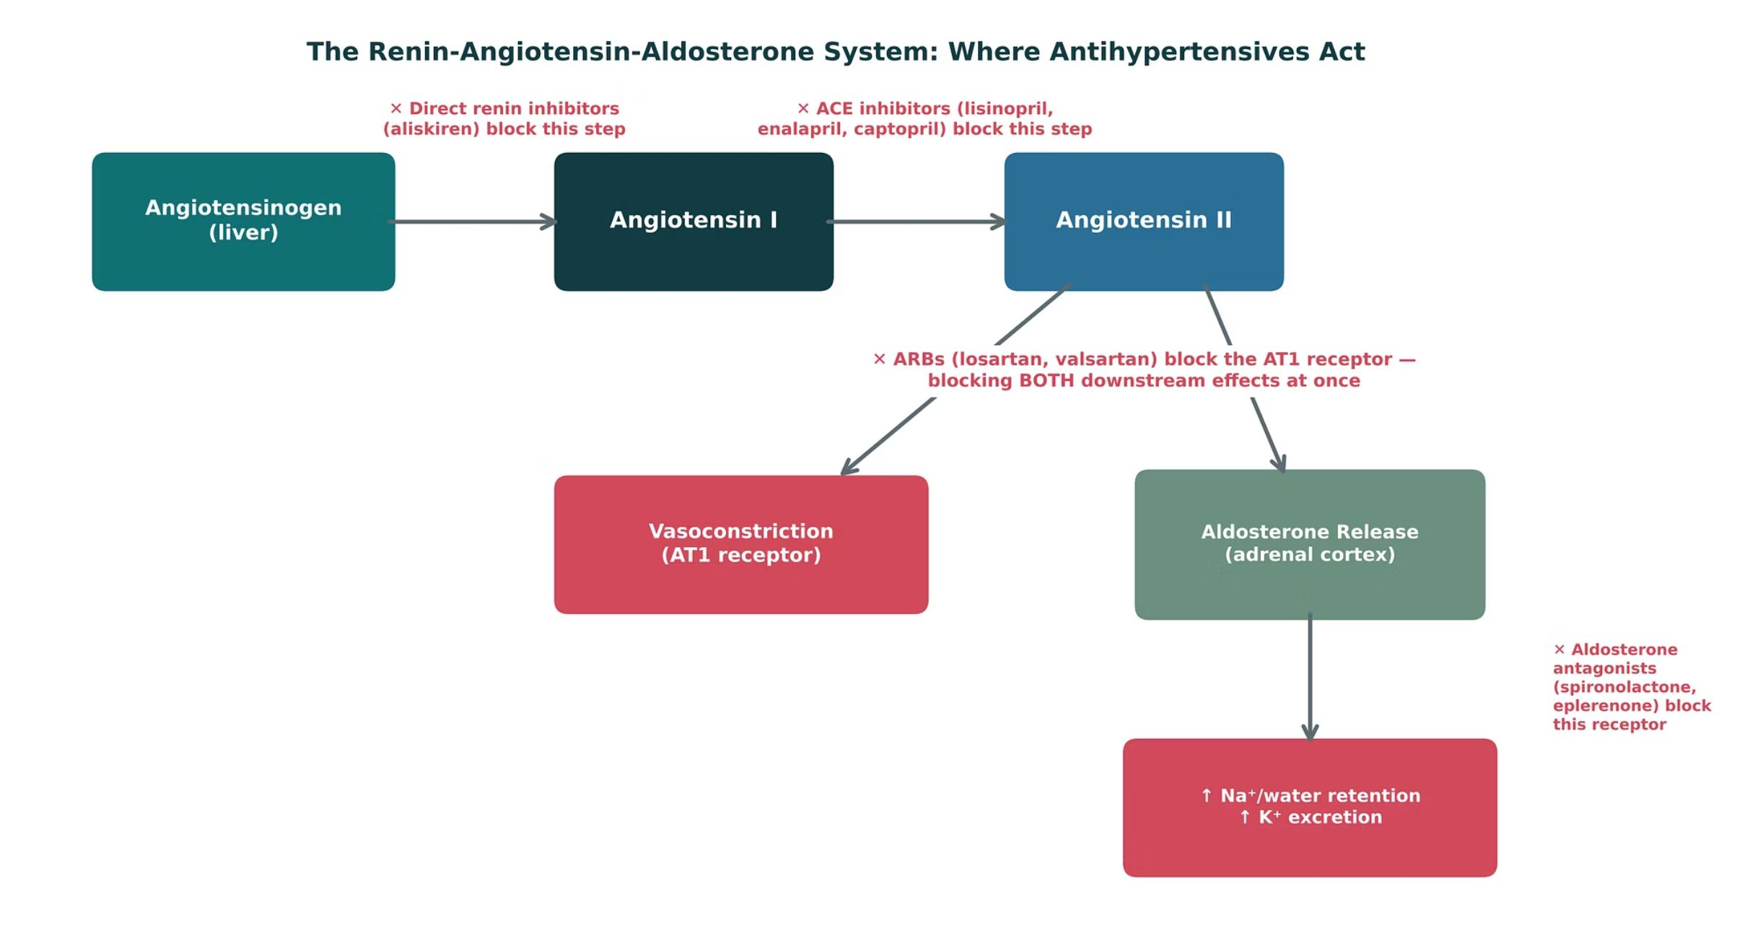
ORIGINAL ILLUSTRATION · FIGURE 8
The Renin-Angiotensin-Aldosterone System: Where Antihypertensives Act
Figure 8. Original illustrative diagram (not from Katzung): angiotensinogen is converted to angiotensin I by renin, then to angiotensin II by ACE; angiotensin II drives both vasoconstriction and aldosterone release. Direct renin inhibitors, ACE inhibitors, ARBs, and aldosterone antagonists each block a different point in this cascade.
Renal Pharmacotherapeutics — Session 2 of 2 — PA Program
4
Notes:
This is the conceptual spine for the entire session — every drug class in Section 4 and much of Section 5 maps onto this single pathway. Walk it step by step before naming any individual drugs, so students see the cascade logic first.
Instructor script:
Walk the cascade before naming drugs: angiotensinogen, renin, angiotensin I, ACE, angiotensin II, vasoconstriction and aldosterone.

Slide 5
FIRST-LINE IN CKD
ACE Inhibitors
Mechanism: block the conversion of angiotensin I to angiotensin II, reducing both vasoconstriction and aldosterone release (Figure 8).
Captopril, lisinopril, enalapril — "-pril" suffix across the class.
Adverse effects: dry cough (bradykinin accumulation — the single most common reason for switching to an ARB), angioedema (rare but potentially life-threatening), and hyperkalemia.
Contraindicated in pregnancy — fetal renal toxicity; avoid in women who are or may become pregnant.
An initial rise in serum creatinine of up to ~30% after starting therapy is expected and acceptable — reflects reduced intraglomerular pressure, not drug-induced kidney injury; a larger rise warrants evaluation for renal artery stenosis.
Renal Pharmacotherapeutics — Session 2 of 2 — PA Program
5
Notes:
The "up to 30% creatinine rise is expected" point is one students frequently get wrong on exams and in practice — many will want to stop the ACE inhibitor at the first sign of a rising creatinine. Be explicit that this is a predictable hemodynamic effect, not toxicity.
Instructor script:
Block ACE. Cough, angioedema, hyperkalemia; pregnancy contraindication; creatinine rise up to about 30% is expected.

Slide 6
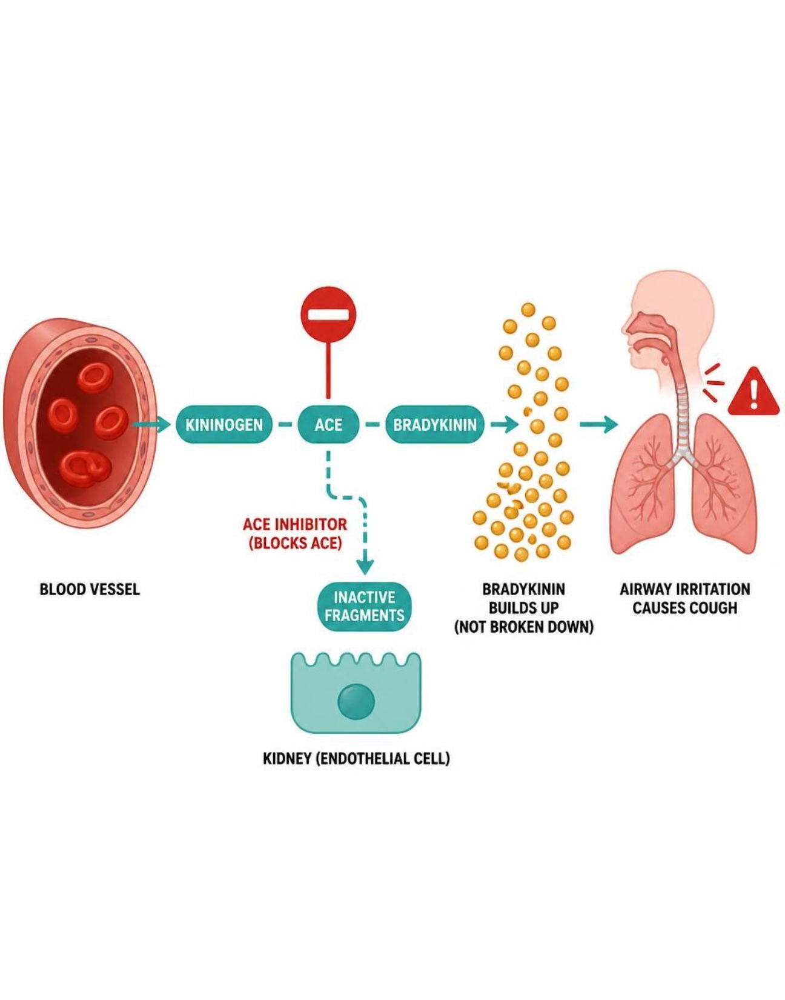
MECHANISM & DEPTH
ACE Inhibitors: Bradykinin, Cough and Angioedema
ACE inhibitor blocks ACE
▼
Less angiotensin II: less vasoconstriction and aldosterone
▼
Less bradykinin breakdown, so bradykinin accumulates
▼
Cough or angioedema
▼
Switch to an ARB for cough
Cough is bradykinin-mediated, not allergic.
Angioedema is rare but can be life-threatening: stop the drug.
ARBs do not raise bradykinin, so they are the usual switch.
Schematic (illustrative)
Figure 9. ACE inhibition and bradykinin accumulation.
Renal Pharmacotherapeutics — Session 2 of 2 — PA Program
6
Notes:
Explain that bradykinin accumulation is the mechanism of ACE-inhibitor cough; switch to an ARB if cough is troublesome.
Instructor script:
ACE also breaks down bradykinin; blocking it raises bradykinin, causing cough and angioedema. ARBs spare bradykinin.

Slide 7
RELATED CLASSES
ARBs and Direct Renin Inhibitors
Angiotensin Receptor Blockers (ARBs)
Direct Renin Inhibitors
– Losartan, valsartan — "-sartan" suffix
– Block the AT1 receptor directly, rather than preventing angiotensin II formation
– No bradykinin-related cough — preferred alternative when ACE inhibitor cough is intolerable
– Same pregnancy contraindication and hyperkalemia risk as ACE inhibitors
– Aliskiren — blocks the rate-limiting first step of the entire cascade
– Limited clinical use; generally not combined with an ACE inhibitor or ARB due to additive hyperkalemia/hypotension risk with no added benefit
– Useful mainly as a teaching example of where a drug could act upstream of ACE
Renal Pharmacotherapeutics — Session 2 of 2 — PA Program
7
Notes:
Aliskiren is included mainly for conceptual completeness on Figure 8 — keep this brief and emphasize that ACE inhibitors and ARBs are the clinically dominant classes, while flagging the combination-therapy caution as a safety point worth remembering.
Instructor script:
Losartan and valsartan block AT1. Aliskiren is limited and never combined with an ACE inhibitor or ARB in diabetes.

Slide 8

THE RENOPROTECTIVE MECHANISM
RAAS Blockers in Chronic Kidney Disease
ACE inhibitors and ARBs are first-line antihypertensive therapy in CKD, especially with proteinuria — not simply because they lower blood pressure.
Mechanism: by reducing angiotensin II, these drugs preferentially dilate the efferent (outflow) arteriole of the glomerulus, lowering intraglomerular pressure and reducing proteinuria — a direct, structural renoprotective effect beyond systemic BP control.
This is the same efferent-arteriole effect that explains the expected creatinine rise on the previous slide — the mechanism and the "side effect" are two faces of the same action.
Monitor potassium and renal function within 1–2 weeks of starting or up-titrating therapy, and periodically thereafter.
Hold or use with caution during acute illness causing volume depletion ("sick day rules") — combined with reduced renal perfusion, RAAS blockade can precipitate acute kidney injury.
Renal Pharmacotherapeutics — Session 2 of 2 — PA Program
8
Notes:
This slide is the clinical payoff of Figure 8 and the pregnancy/creatinine points from the ACE inhibitor slide — make the connection explicit: the drug class students might expect to avoid in kidney disease is actually the preferred therapy, precisely because of how it works at the glomerulus.
Instructor script:
Efferent arteriole dilation lowers intraglomerular pressure and proteinuria.

Slide 9
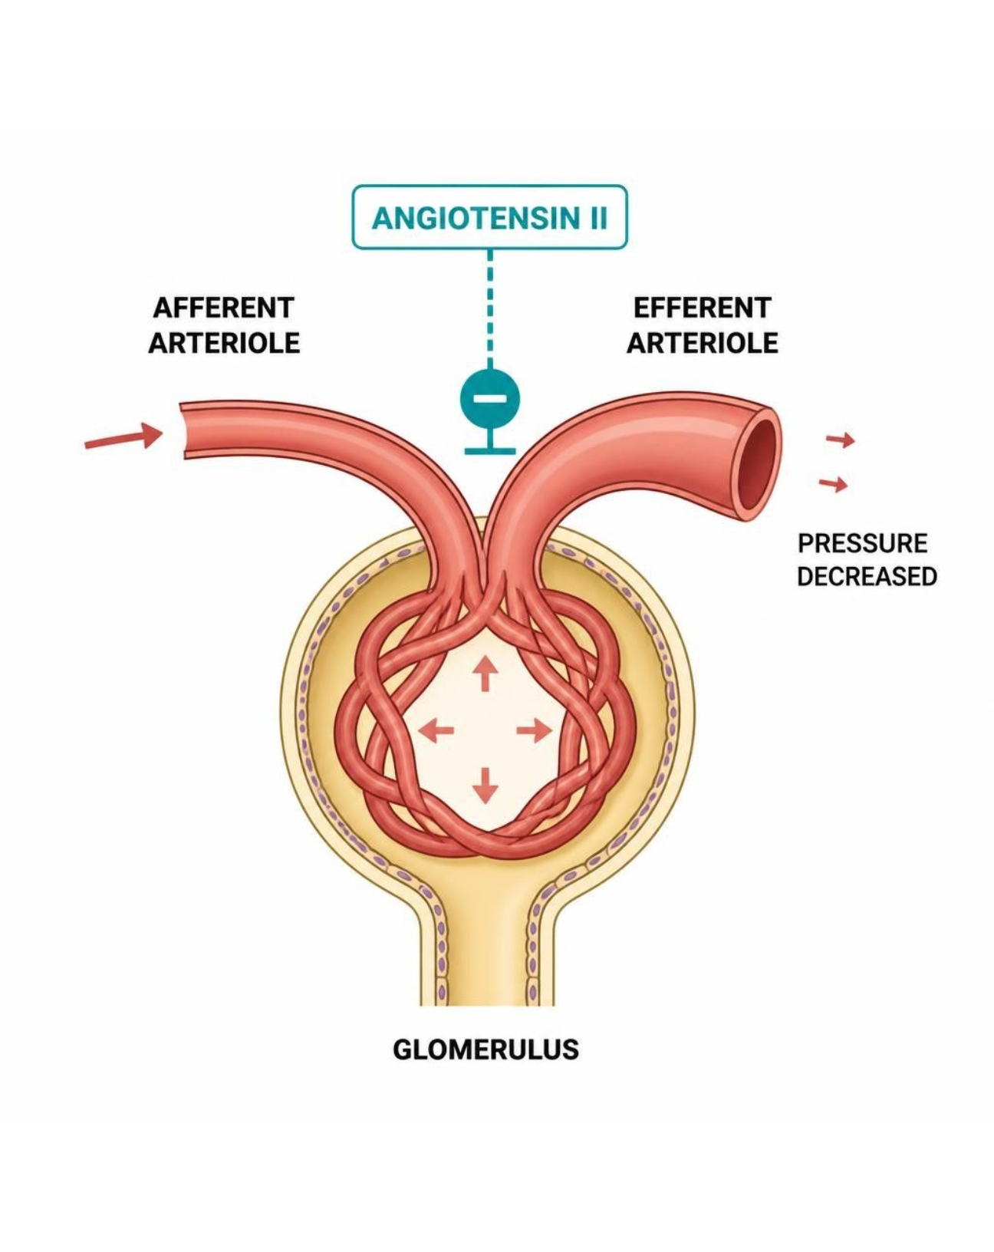
MECHANISM & DEPTH
Efferent Arteriole Dilation: Why Creatinine Rises
Angiotensin II normally constricts the efferent arteriole
▼
ACE inhibitor or ARB removes that signal
▼
Efferent arteriole dilates; intraglomerular pressure falls
▼
Proteinuria falls; creatinine rises up to ~30%
An early creatinine rise is expected and hemodynamic, not nephrotoxicity.
Sick-day rules: hold the ACE inhibitor or ARB during vomiting, diarrhea or dehydration.
A larger rise warrants checking for volume depletion or renal artery stenosis.
Schematic (illustrative)
Figure 10. Efferent arteriole dilation and intraglomerular pressure.
Renal Pharmacotherapeutics — Session 2 of 2 — PA Program
9
Notes:
Frame the creatinine rise as a predictable hemodynamic effect; reinforce sick-day rules.
Instructor script:
The benefit and the creatinine rise are the same action. Monitor potassium and creatinine in 1-2 weeks; use sick-day rules.

Slide 10

CLINICAL CASE
Interpreting a Creatinine Rise After Starting Lisinopril
A patient with hypertension and diabetic nephropathy is started on lisinopril. Two weeks later, a repeat basic metabolic panel shows serum creatinine has risen from 1.1 to 1.4 mg/dL.
Ask yourself: Is this an indication to stop the ACE inhibitor?
Clinical pearl: A rise of roughly 27% is within the expected range for ACE inhibitor initiation, reflecting reduced intraglomerular pressure from efferent arteriolar dilation — not drug toxicity. Therapy should generally continue with ongoing monitoring; a rise beyond approximately 30%, or a much sharper increase, should prompt evaluation for renal artery stenosis or volume depletion.
Renal Pharmacotherapeutics — Session 2 of 2 — PA Program
10
Notes:
This case directly tests whether the renoprotective-mechanism slide landed — a student who reflexively says "stop the drug" has missed the point that this creatinine rise is expected and even reflects the mechanism working as intended.
Instructor script:
1.1 to 1.4 mg/dL is about 27%; continue and monitor.

Slide 11

SECTION
05
Other Antihypertensive Classes & HTN Management in CKD
RAAS blockers are first-line — but rarely the whole story.
Notes:
Section transition. Other major antihypertensive classes come next: CCBs, beta-blockers, diuretics, central agents and direct vasodilators.

Slide 12

BEYOND RAAS BLOCKADE
Other Major Antihypertensive Classes
Calcium Channel Blockers
Beta-Blockers
– Dihydropyridines (amlodipine): arteriolar dilation
– Non-dihydropyridines (diltiazem, verapamil): also ↓ HR/contractility
– Peripheral edema is a class adverse effect
– ↓ heart rate, ↓ contractility, ↓ renin release
– Not generally first-line for uncomplicated HTN, but compelling indications include concurrent CAD/heart failure/arrhythmia
Thiazide / Loop Diuretics
Central Agents & Direct Vasodilators
– Covered in depth in Session 1
– Thiazides first-line with preserved renal function; loops preferred as GFR falls
– Clonidine, methyldopa (central α2 agonists)
– Hydralazine (direct arteriolar vasodilator)
– Reserved for resistant hypertension or specific situations (e.g., methyldopa in pregnancy)
Renal Pharmacotherapeutics — Session 2 of 2 — PA Program
14
Notes:
This four-card slide is a deliberate, brief recap — calcium channel blockers and beta-blockers get fuller treatment later this session (angina) and in cardiovascular coursework. The point here is classification, not exhaustive detail.
Instructor script:
CCBs, beta-blockers, diuretics, central agents and direct vasodilators.

Slide 13
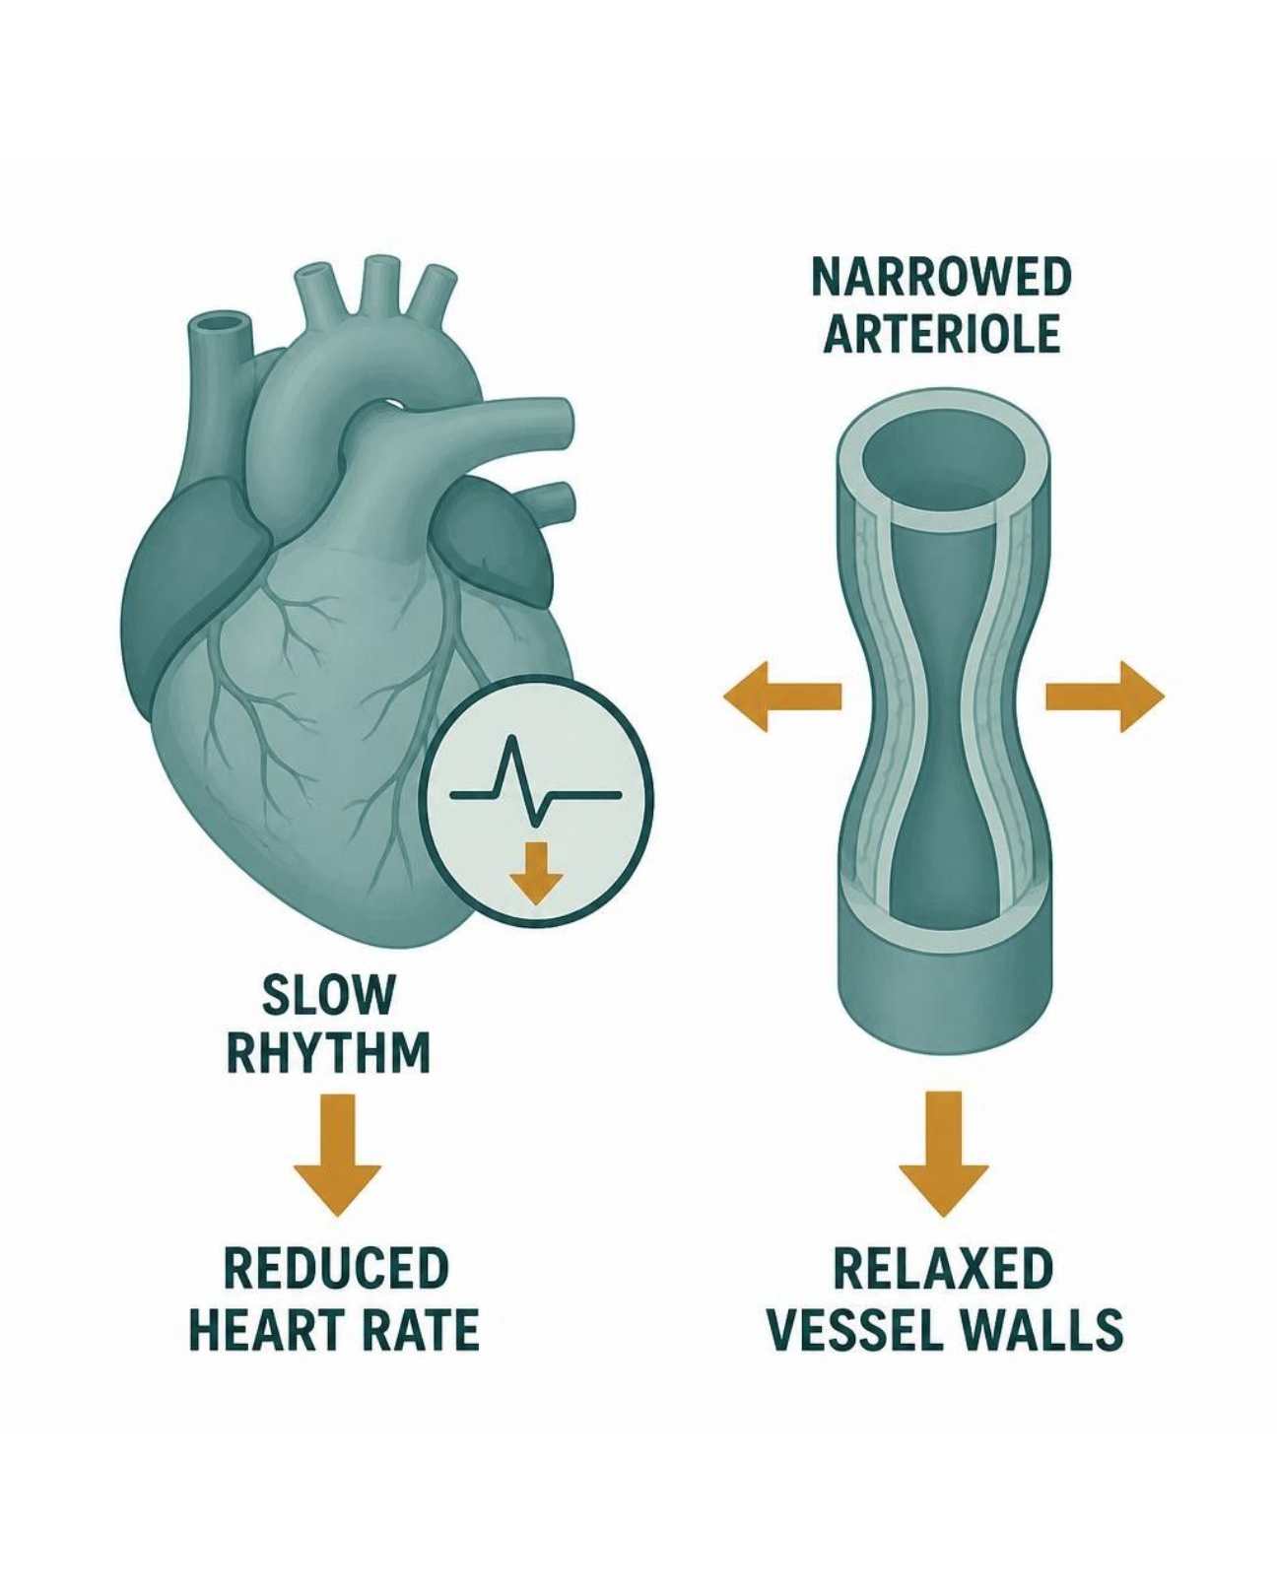
MECHANISM & DEPTH
Calcium Channel Blockers and Beta-Blockers: Different Targets
Dihydropyridine: arteriolar dilation
▼
Afterload falls; blood pressure lowers
▼
Non-DHP CCB or beta-blocker: heart rate and contractility fall
▼
Renin release falls
Diltiazem or verapamil with a beta-blocker risks bradycardia and AV block.
Dihydropyridines pair with beta-blockers without that conduction risk.
Schematic (illustrative)
Figure 11. Vascular versus cardiac targets of antihypertensive drugs.
Renal Pharmacotherapeutics — Session 2 of 2 — PA Program
15
Notes:
Contrast vascular dilation with cardiac slowing; flag the diltiazem or verapamil plus beta-blocker combination.
Instructor script:
Dihydropyridines dilate arterioles; non-dihydropyridines and beta-blockers slow heart rate and contractility. Avoid diltiazem or verapamil with a beta-blocker.

Slide 14

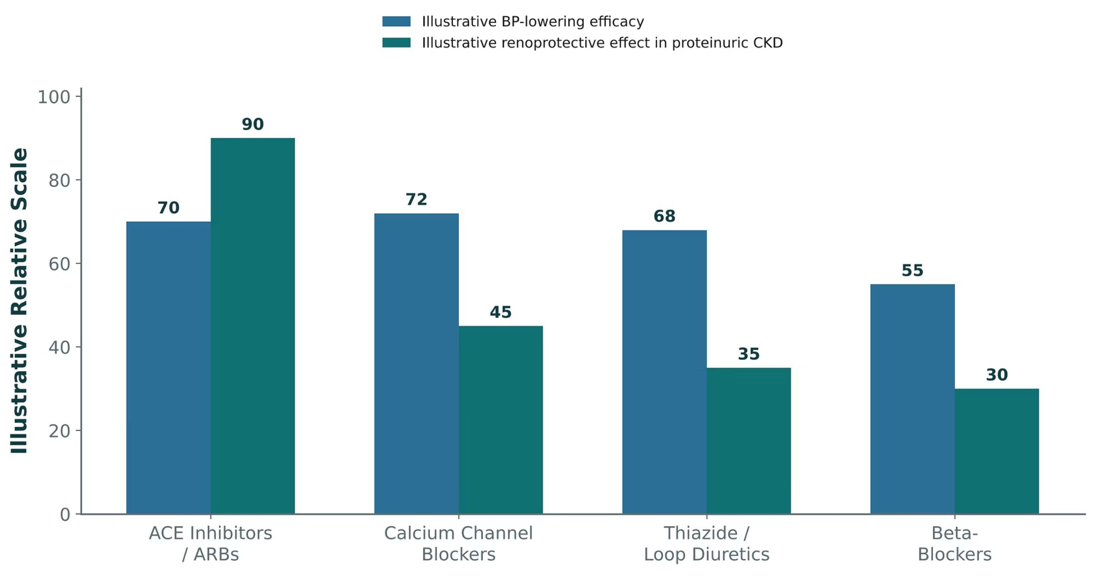
ORIGINAL ILLUSTRATION · FIGURE 12
Antihypertensive Classes: BP-Lowering Efficacy vs. Renoprotection in CKD
Figure 12. Original illustrative comparison (illustrative relative values, not from Katzung): ACE inhibitors/ARBs, calcium channel blockers, thiazide/loop diuretics, and beta-blockers show broadly comparable blood-pressure-lowering efficacy, but ACE inhibitors/ARBs show substantially greater illustrative renoprotective effect in proteinuric CKD.
Renal Pharmacotherapeutics — Session 2 of 2 — PA Program
16
Notes:
Use this figure to directly answer "if all these classes lower blood pressure similarly, why are RAAS blockers preferred in CKD?" — the answer is the renoprotective gap shown here, not a difference in BP control.
Instructor script:
Similar BP lowering; ACE inhibitors and ARBs add renoprotection.

Slide 15

A COMMON COMPLICATION
Resistant Hypertension in CKD
Resistant hypertension (BP above goal despite three or more antihypertensive classes, including a diuretic) is common in CKD, often driven by volume overload.
First step: confirm diuretic therapy is adequate — a thiazide may simply no longer be effective at the patient's current GFR (Session 1's loop-vs-thiazide cutoff).
Switching from a thiazide to a loop diuretic, or increasing loop diuretic dosing, is often the most effective single change in advanced CKD.
Aldosterone antagonists (spironolactone) can be added for resistant hypertension, but require close potassium and renal-function monitoring, especially on top of an ACE inhibitor or ARB.
Renal Pharmacotherapeutics — Session 2 of 2 — PA Program
17
Notes:
This slide ties Session 1 and Session 2 together directly — "resistant hypertension in CKD" is often really a diuretic-selection problem, not a need for an entirely new drug class.
Instructor script:
Check diuretic adequacy first; thiazide to loop switch; add spironolactone with close monitoring.

Slide 16
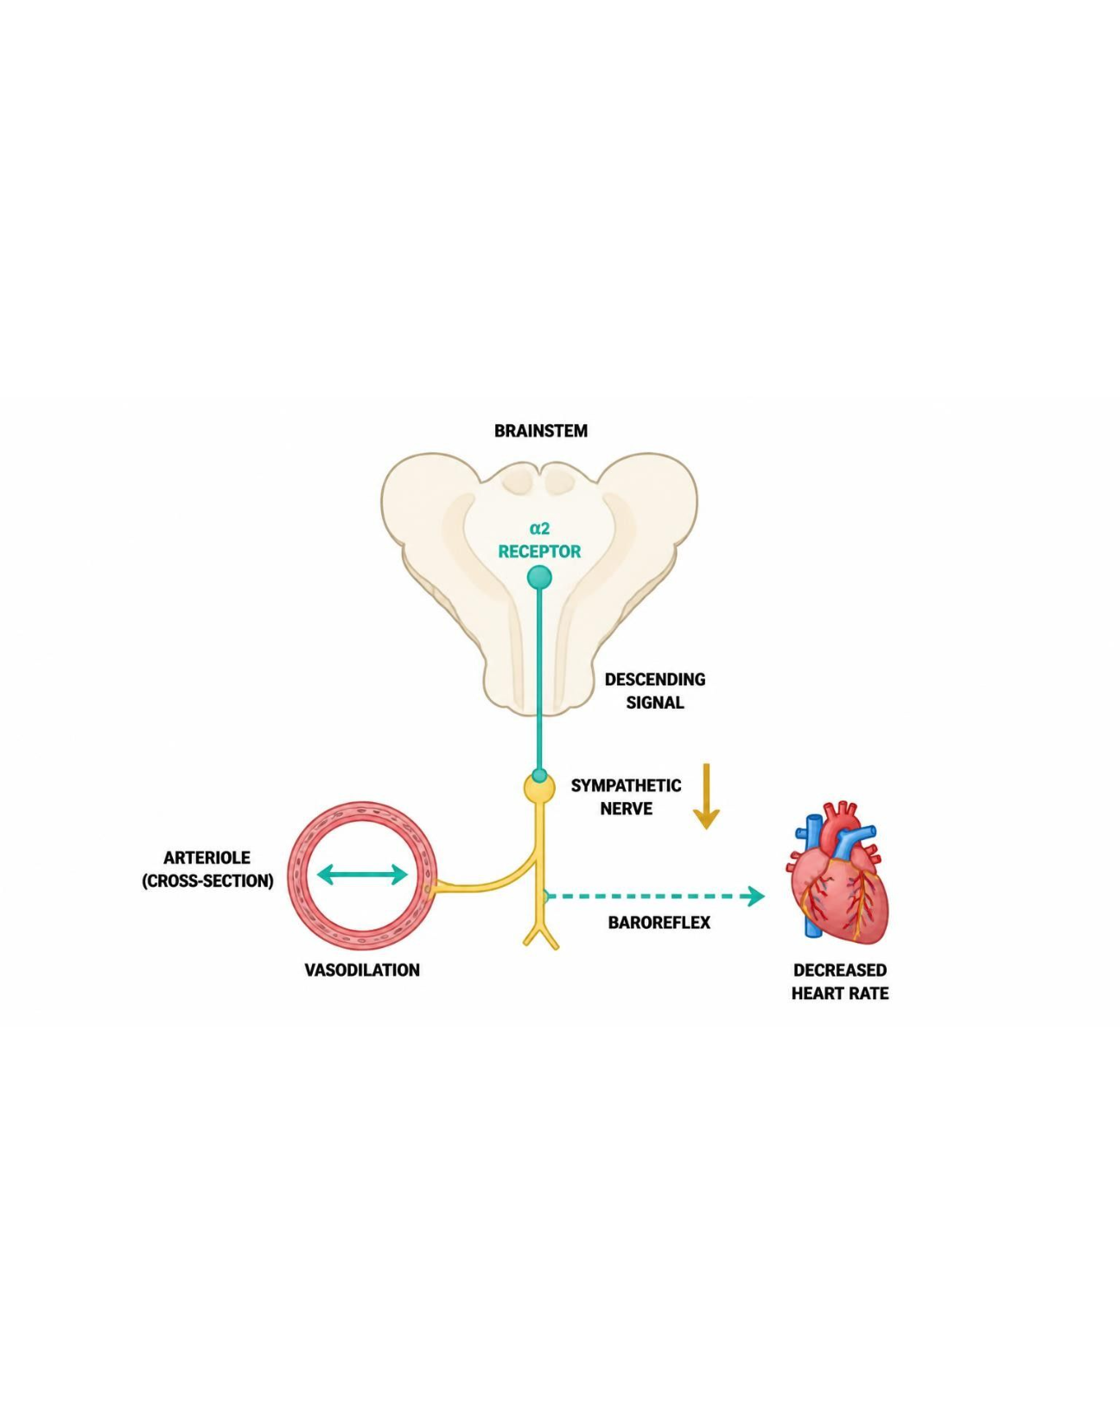
MECHANISM & DEPTH
Central Agents and Hydralazine: When Others Are Not Enough
Clonidine or methyldopa stimulates central α2 receptors
▼
Sympathetic outflow falls, so BP falls
▼
Hydralazine dilates arterioles directly
▼
Reflex tachycardia and fluid retention
Hydralazine must be paired with a beta-blocker and a diuretic.
Methyldopa is used in pregnancy; abrupt clonidine withdrawal causes rebound hypertension.
Schematic (illustrative)
Figure 13. Central agents and direct arteriolar vasodilation.
Renal Pharmacotherapeutics — Session 2 of 2 — PA Program
18
Notes:
Contrast central sympatholytics with direct vasodilators, and stress the beta-blocker and diuretic pairing for hydralazine.
Instructor script:
Clonidine and methyldopa reduce sympathetic outflow; hydralazine dilates arterioles with reflex tachycardia. Methyldopa in pregnancy; clonidine rebound.

Slide 17
CLINICAL CASE
Resistant Hypertension — Where to Look First
A patient with CKD (eGFR 28 mL/min) remains hypertensive despite lisinopril, amlodipine, and hydrochlorothiazide.
Ask yourself: What is the most likely contributor to inadequate control, and what change would you suggest first?
Clinical pearl: At this GFR, hydrochlorothiazide has largely lost its natriuretic efficacy (Session 1). Switching to a loop diuretic such as furosemide or torsemide is usually the most effective next step before adding an entirely new drug class.
Renal Pharmacotherapeutics — Session 2 of 2 — PA Program
19
Notes:
This case is a direct callback to the Session 1 "Choosing a Diuretic for Advancing CKD" case — point out the parallel explicitly if students remember it.
Instructor script:
Case cue: pause and ask the class where to look first before revealing the answer.

Slide 18
SECTION
06
Vasodilators, Angina Pectoris & the Cardiorenal Overlap
Where cardiovascular and renal pharmacology converge — and where that convergence can go wrong.
Notes:
Section transition. This section covers vasodilators and angina, then the cardiorenal overlap.

Slide 19
PRELOAD REDUCTION
Nitrates
Mechanism: release nitric oxide, activating guanylate cyclase and increasing cGMP, producing smooth muscle relaxation — predominantly venodilation at usual doses, reducing preload and myocardial oxygen demand.
Nitroglycerin (sublingual for acute angina; IV/patch for sustained use), isosorbide mononitrate/dinitrate (oral, longer-acting).
Adverse effects: headache (vasodilation), reflex tachycardia, orthostatic hypotension.
Tolerance develops with continuous exposure — a nitrate-free interval (typically overnight) is required to maintain efficacy with long-acting formulations.
Absolute contraindication: concurrent use with PDE5 inhibitors (sildenafil and similar) — the combination can cause life-threatening hypotension.
Renal Pharmacotherapeutics — Session 2 of 2 — PA Program
23
Notes:
The PDE5-inhibitor interaction is one of the highest-stakes medication-safety points in this whole unit — always worth a specific, memorable callout since it is a real-world, repeatedly tested safety question.
Instructor script:
Venodilation, tolerance, nitrate-free interval; PDE5 inhibitor contraindication.

Slide 20
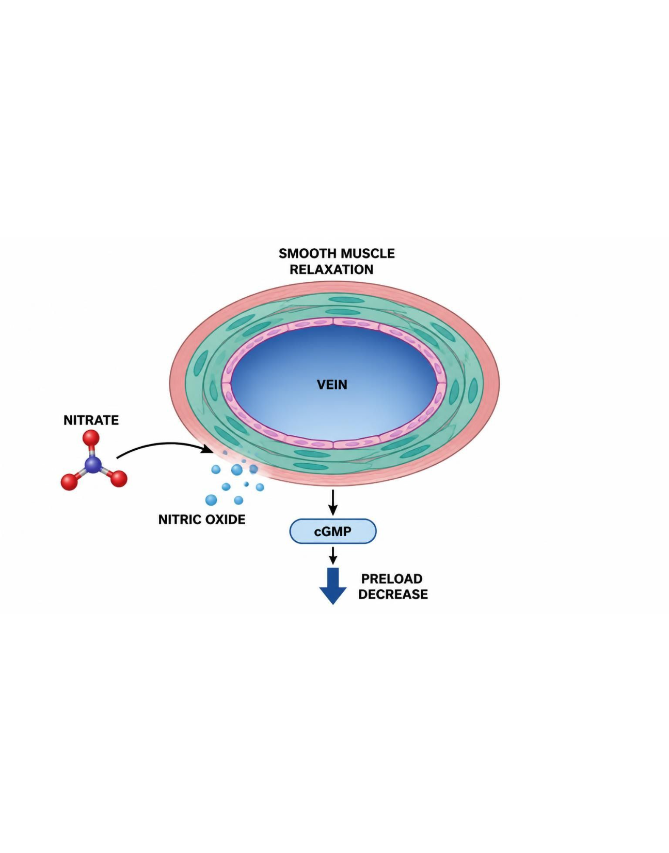
MECHANISM & DEPTH
Nitrates: NO, cGMP and Venodilation
Nitrate donates nitric oxide (NO)
▼
NO activates guanylate cyclase, so cGMP rises
▼
cGMP relaxes smooth muscle: venodilation
▼
Preload and oxygen demand fall
PDE5 inhibitors such as sildenafil block cGMP breakdown, causing severe hypotension with nitrates.
A nitrate-free interval limits tolerance.
Schematic (illustrative)
Figure 14. Nitrate action: NO, cGMP and venodilation.
Renal Pharmacotherapeutics — Session 2 of 2 — PA Program
24
Notes:
Walk through the NO to cGMP pathway, then stress PDE5 inhibitor co-prescription and the nitrate-free interval.
Instructor script:
Nitric oxide, guanylate cyclase, cGMP, relaxation; sildenafil blocks cGMP breakdown.

Slide 21
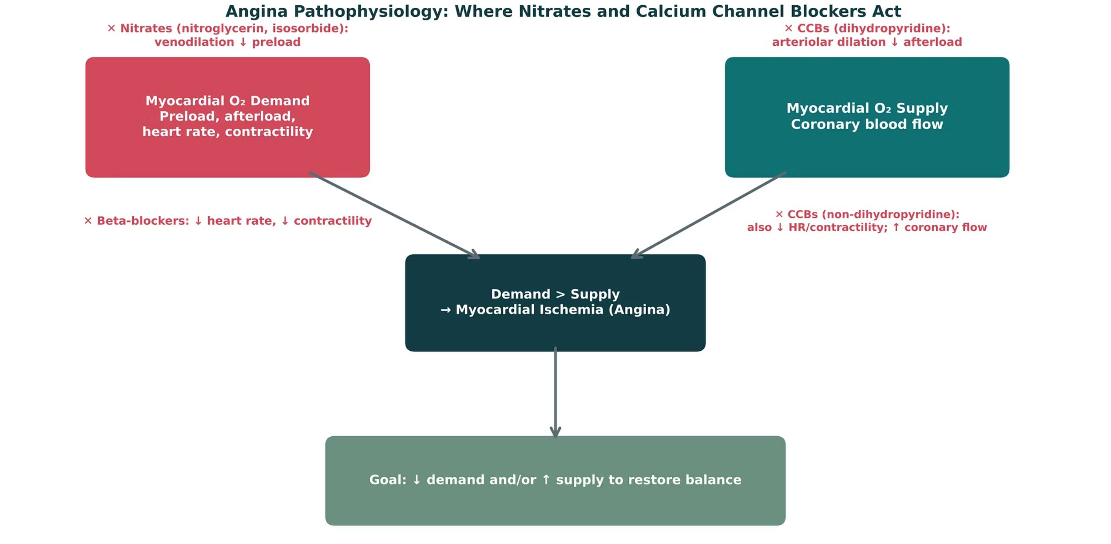
ORIGINAL ILLUSTRATION · FIGURE 15
Angina Pathophysiology: Where Nitrates and Calcium Channel Blockers Act
Figure 15. Original illustrative diagram (not from Katzung): angina results when myocardial oxygen demand exceeds supply; nitrates reduce preload, dihydropyridine CCBs reduce afterload, non-dihydropyridine CCBs also reduce heart rate/contractility and increase coronary flow, and beta-blockers reduce heart rate and contractility.
Renal Pharmacotherapeutics — Session 2 of 2 — PA Program
25
Notes:
This figure organizes every antianginal drug class by exactly which side of the supply/demand equation it affects — have students sort nitrates, each CCB subtype, and beta-blockers onto this diagram from memory before revealing the labels.
Instructor script:
Have students sort drugs by supply or demand effect.

Slide 22
DUAL-PURPOSE AGENTS
Calcium Channel Blockers for Angina
Dihydropyridines (amlodipine, nifedipine) — predominantly arteriolar dilation, reducing afterload; the same mechanism used for hypertension (Section 5).
Non-dihydropyridines (diltiazem, verapamil) — also reduce heart rate and contractility and increase coronary blood flow; avoid combining with beta-blockers due to additive bradycardia/AV block risk.
This is the clearest example in the unit of the same drug class, same mechanism, treating two different conditions (hypertension and angina) — worth stating explicitly as a unifying point.
Adverse effects: peripheral edema and reflex tachycardia (dihydropyridines); bradycardia, AV block, and constipation (non-dihydropyridines, especially verapamil).
Renal Pharmacotherapeutics — Session 2 of 2 — PA Program
26
Notes:
This slide is the deliberate cardiovascular-renal "overlap" moment the lecture title promises — calcium channel blockers are not a separate topic from the antihypertensive content in Section 5, they are the same drugs doing double duty.
Instructor script:
Same class and mechanism treats hypertension and angina.

Slide 23
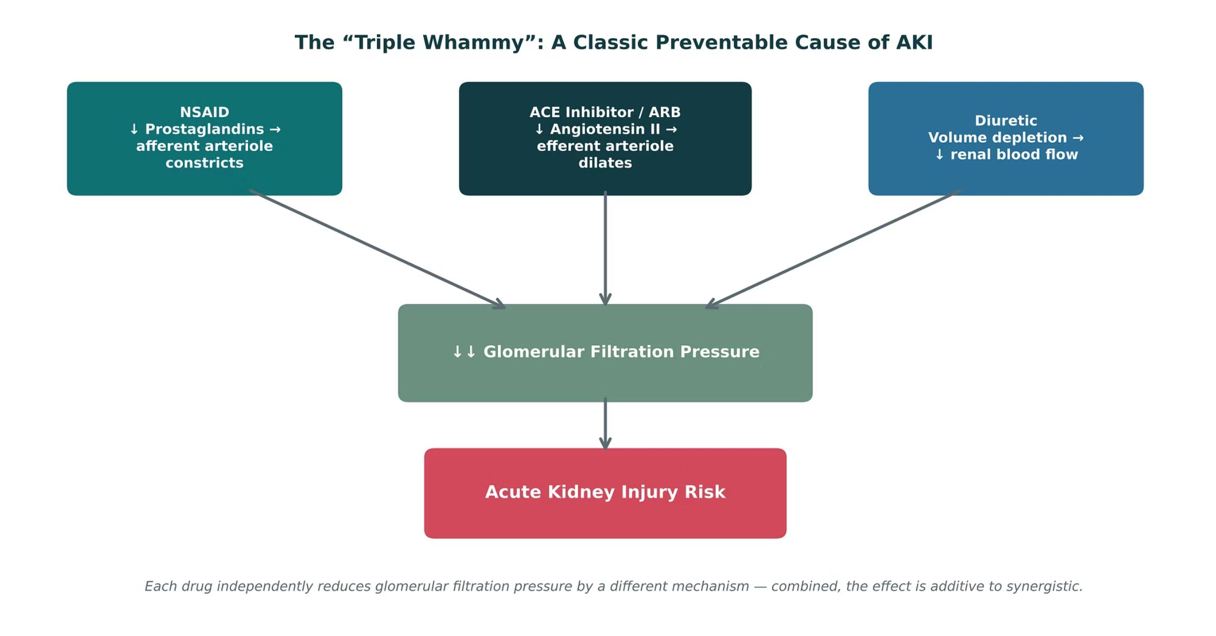
ORIGINAL ILLUSTRATION · FIGURE 16
The "Triple Whammy": A Classic Preventable Cause of AKI
Figure 16. Original illustrative diagram (not from Katzung): an NSAID (afferent arteriolar constriction), an ACE inhibitor or ARB (efferent arteriolar dilation), and a diuretic (volume depletion) each independently reduce glomerular filtration pressure — combined, the effect on kidney perfusion is additive to synergistic, substantially raising acute kidney injury risk.
Renal Pharmacotherapeutics — Session 2 of 2 — PA Program
27
Notes:
This is the capstone cardiorenal-interaction figure for the whole unit — it combines Session 1's diuretic content, this session's RAAS-blocker content, and a drug class (NSAIDs) students will encounter constantly in practice. Make the point explicit: this is an extremely common, often missed, and entirely preventable cause of AKI.
Instructor script:
NSAID plus ACE inhibitor or ARB plus diuretic.

Slide 24
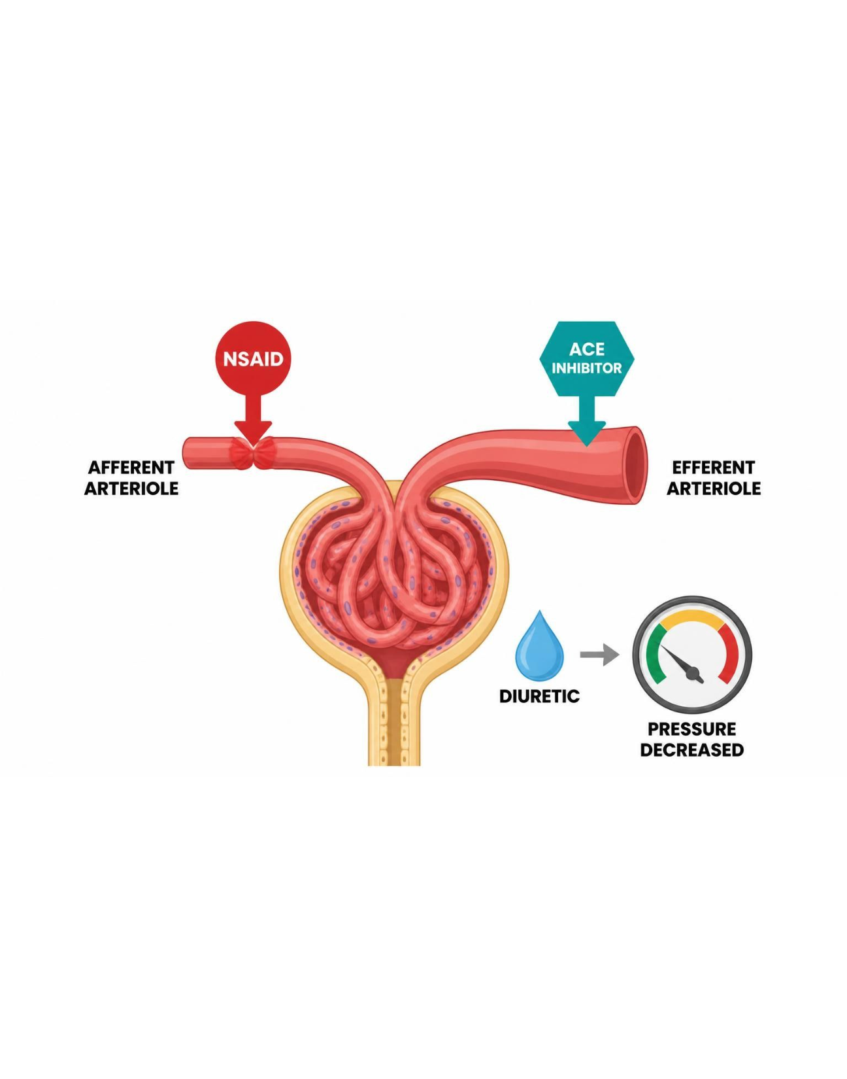
MECHANISM & DEPTH
Triple Whammy: Three Hits on Glomerular Pressure
NSAID constricts the afferent arteriole
▼
ACE inhibitor or ARB dilates the efferent arteriole
▼
Diuretic causes volume depletion
▼
Filtration pressure collapses: AKI
Prevention: counsel patients about over-the-counter NSAIDs.
Schematic (illustrative)
Figure 17. Three hits on glomerular filtration pressure.
Renal Pharmacotherapeutics — Session 2 of 2 — PA Program
28
Notes:
Explain how each of the three drugs lowers glomerular filtration pressure, and ask students to name the OTC NSAIDs patients commonly take.
Instructor script:
Afferent constriction, efferent dilation, volume depletion.

Slide 25
THE BIGGER PICTURE
The Cardiorenal-Hypertension Relationship
Hypertension → CKD
CKD → Hypertension
– Uncontrolled blood pressure causes glomerular capillary injury and nephrosclerosis over time
– A leading cause of CKD progression, alongside diabetes
– Reduced renal function causes volume overload and RAAS activation
– Worsens and complicates blood pressure control, often requiring multiple drug classes
Renal Pharmacotherapeutics — Session 2 of 2 — PA Program
29
Notes:
Direct students to Figure 18 (the next slide) for the visual version of this same bidirectional relationship — this slide states it in words first.
Instructor script:
Hypertension drives CKD and CKD drives hypertension.

Slide 26
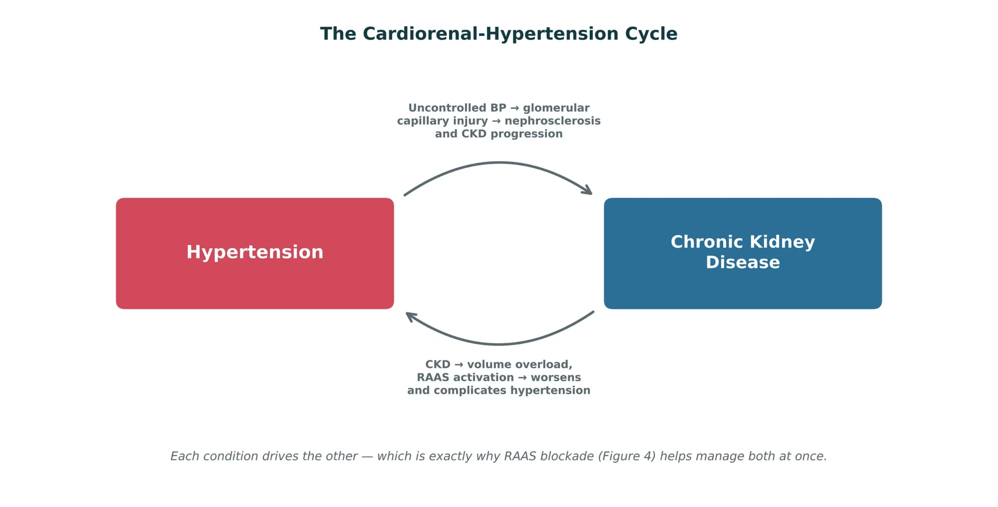
ORIGINAL ILLUSTRATION · FIGURE 18
The Cardiorenal-Hypertension Cycle
Figure 18. Original illustrative diagram (not from Katzung): hypertension and chronic kidney disease drive one another in a self-reinforcing cycle — uncontrolled blood pressure causes glomerular injury and CKD progression, while CKD causes volume overload and RAAS activation that worsens hypertension.
Renal Pharmacotherapeutics — Session 2 of 2 — PA Program
30
Notes:
This figure is the conceptual closer for the whole unit — tie it explicitly back to Figure 8: RAAS blockade is effective precisely because it intervenes in both directions of this cycle at once.
Instructor script:
RAAS blockade interrupts both directions.

Slide 27
CLINICAL CASE
Recognizing the Triple Whammy
An older adult with hypertension (on lisinopril and hydrochlorothiazide) develops a knee injury and starts taking an over-the-counter NSAID regularly for pain. One week later, they present with lethargy and are found to have an acute rise in creatinine.
Ask yourself: What is the most likely explanation, and how could this have been prevented?
Clinical pearl: This is a classic "triple whammy" presentation (Figure 16) — the NSAID, ACE inhibitor, and diuretic each independently reduced glomerular filtration pressure, and together precipitated acute kidney injury. Prevention requires counseling patients on RAAS blockers and diuretics to avoid regular NSAID use and to seek guidance before starting one, even an over-the-counter product.
Renal Pharmacotherapeutics — Session 2 of 2 — PA Program
31
Notes:
This case is the direct clinical application of Figure 16 and a strong closing vignette for the section — it also reinforces IO5.6 (patient counseling), since the preventable element here is entirely about what the patient was or wasn't told about OTC NSAID use.
Instructor script:
Case cue: pause and ask the class to spot the triple whammy before revealing the answer.

Slide 28
DRUG NAMES
Drug Names Reveal the Class: Cardiorenal Agents
Stem
Class
Examples
Memory aid
-pril
ACE inhibitor
Lisinopril, enalapril, captopril
Angiotensin-converting enzyme
-sartan
ARB
Losartan, valsartan
Angiotensin receptor blocker
-kiren
Direct renin inhibitor
Aliskiren
Renin is the top of the cascade
-dipine
Dihydropyridine CCB
Amlodipine, nifedipine
Arteriolar dilation
-olol
Beta-blocker
Metoprolol, atenolol
Heart rate and renin down
-azine / -alazine
Hydralazine vasodilator
Hydralazine
Pair with beta-blocker and diuretic
-onidine
Central alpha-2 agonist
Clonidine
Central, so sympathetic outflow falls
-nitrate / nitro-
Nitrates
Isosorbide, nitroglycerin
Venodilation, preload down
-afil
PDE5 inhibitor
Sildenafil
Never combine with nitrates
-semide
Loop diuretic
Furosemide
Loop of Henle
Renal Pharmacotherapeutics — Session 2 of 2 — PA Program
34
Notes:
Walk the stems row by row and ask students to predict the class from the suffix before revealing it.
Instructor script:
-pril, -sartan, -kiren, -dipine, -olol, -onidine, -afil.

Slide 29

SECTION
07
Putting It All Together
Applying the whole Renal pharmacology toolkit.
Notes:
Section transition. Integration: we now put the drug classes together.

Slide 30
APPLY IT
Which Approach Would You Choose?
Patient A
Patient B
– Advancing CKD, hypertension no longer controlled on a thiazide
– Proteinuric CKD, needs first-line antihypertensive therapy
Patient C
Patient D
– On an ACE inhibitor and a diuretic, about to start a daily OTC NSAID
– Stable angina, already on a beta-blocker, needs additional symptom control
Renal Pharmacotherapeutics — Session 2 of 2 — PA Program
36
Notes:
Have students work in pairs: for each patient, name a first-line approach AND the single biggest safety concern to check before prescribing or counseling.
Instructor script:
Work in pairs: first-line approach and the biggest safety check for each patient.

Slide 31
BIG PICTURE
Key Takeaways
1
Diuretic classes (Session 1) and RAAS-blocking antihypertensives both map onto specific, drug-targetable points in renal physiology — the nephron (Figure 1) and the RAAS cascade (Figure 8), respectively.
2
ACE inhibitors and ARBs are preferred first-line therapy for hypertension in CKD because of their renoprotective efferent-arteriolar mechanism, not just their blood-pressure-lowering effect.
3
Calcium channel blockers exemplify the cardiovascular-renal overlap directly — the same drug class, same mechanism, treats both hypertension and angina.
4
The "triple whammy" (NSAID + ACEi/ARB + diuretic) is a classic, common, and preventable cause of acute kidney injury that draws on content from both sessions at once.
5
Hypertension and chronic kidney disease exist in a bidirectional, self-reinforcing cycle (Figure 18) — which is exactly why managing one well so often means managing the other.
Renal Pharmacotherapeutics — Session 2 of 2 — PA Program
Notes:
Close by connecting back to earlier units: drug-metabolism/dosing concepts (Unit 1) and the biologic-mechanism callbacks from Units 2–4 all reinforce that pharmacology is cumulative — the cardiorenal interface is where several of this course's organ-system units visibly intersect.
Instructor script:
All three threads center on glomerular filtration pressure.

Slide 32

SECTION
08
Lecture Recall Quiz
A cumulative self-test spanning both sessions — use this to review before exams.
Notes:
Section transition. Recall: use the lecture quiz for self-testing.

Slide 33
LECTURE RECALL QUIZ
Lecture Recall Quiz (1 of 2)
1. Why do loop diuretics increase calcium excretion while thiazide diuretics decrease it?
A. Loop diuretics act in the collecting duct; thiazides act in the proximal tubule
B. Loop diuretics collapse the lumen-positive potential that drives paracellular calcium reabsorption; thiazides do not
C. Thiazides block the Na-K-2Cl cotransporter
D. There is no mechanistic difference between the two classes
2. A patient's thiazide diuretic stops controlling blood pressure as CKD advances to an eGFR of 22 mL/min. What is the most appropriate change?
A. Increase the thiazide dose
B. Switch to a loop diuretic
C. Add a second thiazide
D. Discontinue diuretic therapy entirely
3. A patient starts lisinopril for proteinuric CKD and the serum creatinine rises by 25% within two weeks. What is the most appropriate response?
A. Stop the ACE inhibitor immediately
B. Continue therapy with ongoing monitoring, since this rise is expected
C. Double the dose
D. Switch to an NSAID instead
Renal Pharmacotherapeutics — Session 2 of 2 — PA Program
41
Notes:
Use the quiz for self-testing.

Slide 34
LECTURE RECALL QUIZ
Lecture Recall Quiz (2 of 2)
4. Why are ACE inhibitors and ARBs preferred first-line therapy for hypertension in proteinuric CKD?
A. They preferentially dilate the efferent arteriole, lowering intraglomerular pressure and proteinuria
B. They have no renal effects beyond lowering systemic blood pressure
C. They are the only antihypertensive class that can be used in CKD
D. They increase aldosterone release to protect sodium balance
5. A patient on an ACE inhibitor and a diuretic starts a daily OTC NSAID and develops acute kidney injury. What is the mechanism?
A. Three independent reductions in glomerular filtration pressure combining additively
B. NSAIDs have no renal effects
C. The ACE inhibitor directly damages the NSAID
D. This combination has no increased risk
6. Which drug class is used for BOTH hypertension and angina pectoris via the same underlying mechanism?
A. Thiazide diuretics
B. Calcium channel blockers
C. Carbonic anhydrase inhibitors
D. Aldosterone antagonists
Renal Pharmacotherapeutics — Session 2 of 2 — PA Program
42

Slide 35
ANSWER KEY
Lecture Recall Quiz — Answer Key
1. B — Loop diuretics block NKCC2 in the thick ascending limb, collapsing the lumen-positive potential that normally drives paracellular Ca²⁺/Mg²⁺ reabsorption, so calcium excretion rises; thiazides act at the distal tubule and, through a separate mechanism, increase distal calcium reabsorption instead.
2. B — Thiazide diuretics lose most of their natriuretic efficacy once GFR falls below roughly 30 mL/min. Loop diuretics act upstream at the thick ascending limb and remain effective in advanced CKD.
3. B — A creatinine rise of up to approximately 30% after starting an ACE inhibitor or ARB reflects reduced intraglomerular pressure from efferent arteriolar dilation — an expected hemodynamic effect, not toxicity — so therapy should generally continue with monitoring.
4. A — ACE inhibitors and ARBs preferentially dilate the efferent arteriole, lowering intraglomerular pressure and reducing proteinuria — a structural renoprotective effect beyond systemic blood pressure control, which is why they are preferred in proteinuric CKD specifically.
5. A — This is the "triple whammy": the NSAID constricts the afferent arteriole, the ACE inhibitor dilates the efferent arteriole, and the diuretic causes volume depletion — three independent reductions in glomerular filtration pressure that combine additively to synergistically, precipitating AKI.
6. B — Calcium channel blockers treat hypertension via arteriolar dilation (reducing afterload/systemic vascular resistance) and treat angina via the same arteriolar-dilation mechanism (reducing afterload and myocardial oxygen demand) — the clearest example of one drug class, one mechanism, two indications in this unit.
Renal Pharmacotherapeutics — Session 2 of 2 — PA Program
Notes:
Encourage students to revisit this quiz on their own before the exam — it is designed as a standalone recall resource spanning both Unit 5 sessions, separate from the in-lecture quick checks.

Slide 36
APPENDIX 1
Drug Profiles
Formulation, dose, indications, adverse effects, contraindications and toxicity
PO = by mouth
IV = intravenous
SL = sublingual
BID / TID / QID = two / three / four times daily
ER / SR = extended-release / sustained-release
HF = heart failure
MI = myocardial infarction
LV = left ventricular
EF = ejection fraction
AV = atrioventricular
SVT = supraventricular tachycardia
WPW = Wolff-Parkinson-White
CAD = coronary artery disease
ECG = electrocardiogram
ACE = angiotensin-converting enzyme
ARB = angiotensin receptor blocker
AKI = acute kidney injury
CKD = chronic kidney disease
CrCl = creatinine clearance
eGFR = estimated glomerular filtration rate
PDE5 = phosphodiesterase type 5
CYP = cytochrome P450
ICP = intracranial pressure
CBC = complete blood count
IR = immediate-release
Renal Pharmacotherapeutics — Session 2 of 2 — PA Program
44
Notes:
Abbreviation key: PO = by mouth; IV = intravenous; SL = sublingual; BID / TID / QID = two / three / four times daily; ER / SR = extended-release / sustained-release; HF = heart failure; MI = myocardial infarction; LV = left ventricular; EF = ejection fraction; AV = atrioventricular; SVT = supraventricular tachycardia; WPW = Wolff-Parkinson-White; CAD = coronary artery disease; ECG = electrocardiogram; ACE = angiotensin-converting enzyme; ARB = angiotensin receptor blocker; AKI = acute kidney injury; CKD = chronic kidney disease; CrCl = creatinine clearance; eGFR = estimated glomerular filtration rate; PDE5 = phosphodiesterase type 5; CYP = cytochrome P450; ICP = intracranial pressure; CBC = complete blood count; IR = immediate-release.
Instructor script:
Say: These profiles are your study reference. Know the dose logic, the serious adverse effects, the contraindication that changes decisions and the toxicity you would need to recognize.
Class activity (10 minutes): Give groups two or three profiles to teach back in 60 seconds each.
Teaching points: ACE inhibitors (captopril, lisinopril, enalapril), ARBs (losartan, valsartan), aliskiren, CCBs (amlodipine, nifedipine, diltiazem, verapamil), beta-blockers (metoprolol, atenolol), central agents (clonidine, methyldopa), hydralazine, nitrates.
Bloom's prompts: Remember: state lisinopril dosing. Understand: explain the creatinine rise. Apply: counsel an older adult about naproxen. Analyze: explain bradycardia on verapamil plus metoprolol. Evaluate: choose therapy for a woman of reproductive age with proteinuric CKD.

Slide 37
DRUG PROFILE
Captopril (Capoten)
ACE INHIBITOR
FORMULATION
DOSE (ADULT)
INDICATIONS
Tablets 12.5/25/50/100 mg
Hypertension: 12.5-25 mg PO BID-TID (maximum 450 mg/day); heart failure: 6.25-12.5 mg TID
Hypertension, heart failure, post-MI, diabetic nephropathy
ADVERSE EFFECTS
CONTRAINDICATIONS
TOXICITY / OVERDOSE
Cough, hyperkalemia, hypotension, taste change, rash, angioedema
Pregnancy, history of angioedema with ACE inhibitors, bilateral renal artery stenosis, concomitant aliskiren in diabetes
Angioedema, hyperkalemia, hypotension, AKI; take 1 hour before meals; monitor potassium and creatinine
Standard adult dosing for teaching; verify against current prescribing information.
Renal Pharmacotherapeutics — Session 2 of 2 — PA Program
45
Notes:
Captopril (Capoten) | ACE inhibitor | Tablets 12.5/25/50/100 mg | Hypertension: 12.5-25 mg PO BID-TID (maximum 450 mg/day); heart failure: 6.25-12.5 mg TID | Hypertension, heart failure, post-MI, diabetic nephropathy | Cough, hyperkalemia, hypotension, taste change, rash, angioedema | Pregnancy, history of angioedema with ACE inhibitors, bilateral renal artery stenosis, concomitant aliskiren in diabetes | Angioedema, hyperkalemia, hypotension, AKI; take 1 hour before meals; monitor potassium and creatinine

Slide 38
DRUG PROFILE
Lisinopril (Zestril, Prinivil)
ACE INHIBITOR
FORMULATION
DOSE (ADULT)
INDICATIONS
Tablets 2.5/5/10/20/30/40 mg
Hypertension: 10 mg PO daily, titrate to 40 mg (maximum 80 mg); heart failure: start 2.5-5 mg daily
Hypertension, heart failure, post-MI, diabetic nephropathy
ADVERSE EFFECTS
CONTRAINDICATIONS
TOXICITY / OVERDOSE
Dry cough, dizziness, hyperkalemia, creatinine rise up to 30%, angioedema
Pregnancy, angioedema history, bilateral renal artery stenosis, concomitant aliskiren in diabetes
Angioedema, hyperkalemia, symptomatic hypotension, AKI during volume depletion
Standard adult dosing for teaching; verify against current prescribing information.
Renal Pharmacotherapeutics — Session 2 of 2 — PA Program
46
Notes:
Lisinopril (Zestril, Prinivil) | ACE inhibitor | Tablets 2.5/5/10/20/30/40 mg | Hypertension: 10 mg PO daily, titrate to 40 mg (maximum 80 mg); heart failure: start 2.5-5 mg daily | Hypertension, heart failure, post-MI, diabetic nephropathy | Dry cough, dizziness, hyperkalemia, creatinine rise up to 30%, angioedema | Pregnancy, angioedema history, bilateral renal artery stenosis, concomitant aliskiren in diabetes | Angioedema, hyperkalemia, symptomatic hypotension, AKI during volume depletion

Slide 39
DRUG PROFILE
Enalapril (Vasotec)
ACE INHIBITOR (PRODRUG)
FORMULATION
DOSE (ADULT)
INDICATIONS
Tablets 2.5/5/10/20 mg; IV enalaprilat
Hypertension: 5 mg PO daily, titrate to 40 mg daily or divided; heart failure: 2.5 mg BID
Hypertension, heart failure, asymptomatic LV dysfunction
ADVERSE EFFECTS
CONTRAINDICATIONS
TOXICITY / OVERDOSE
Cough, hyperkalemia, dizziness, hypotension, angioedema
Pregnancy, angioedema history, bilateral renal artery stenosis
Hypotension, hyperkalemia, angioedema, AKI; reduce dose when CrCl is below 30 mL/min
Standard adult dosing for teaching; verify against current prescribing information.
Renal Pharmacotherapeutics — Session 2 of 2 — PA Program
47
Notes:
Enalapril (Vasotec) | ACE inhibitor (prodrug) | Tablets 2.5/5/10/20 mg; IV enalaprilat | Hypertension: 5 mg PO daily, titrate to 40 mg daily or divided; heart failure: 2.5 mg BID | Hypertension, heart failure, asymptomatic LV dysfunction | Cough, hyperkalemia, dizziness, hypotension, angioedema | Pregnancy, angioedema history, bilateral renal artery stenosis | Hypotension, hyperkalemia, angioedema, AKI; reduce dose when CrCl is below 30 mL/min

Slide 40
DRUG PROFILE
Losartan (Cozaar)
ANGIOTENSIN RECEPTOR BLOCKER (ARB)
FORMULATION
DOSE (ADULT)
INDICATIONS
Tablets 25/50/100 mg
Hypertension: 50 mg PO daily, up to 100 mg; diabetic nephropathy: 50 mg daily, increase to 100 mg
Hypertension, diabetic nephropathy, stroke risk reduction with LV hypertrophy, heart failure alternative
ADVERSE EFFECTS
CONTRAINDICATIONS
TOXICITY / OVERDOSE
Dizziness, hyperkalemia, creatinine rise, rare angioedema
Pregnancy, concomitant aliskiren in diabetes, bilateral renal artery stenosis
Hypotension, hyperkalemia, fetal toxicity; no bradykinin cough
Standard adult dosing for teaching; verify against current prescribing information.
Renal Pharmacotherapeutics — Session 2 of 2 — PA Program
48
Notes:
Losartan (Cozaar) | Angiotensin receptor blocker (ARB) | Tablets 25/50/100 mg | Hypertension: 50 mg PO daily, up to 100 mg; diabetic nephropathy: 50 mg daily, increase to 100 mg | Hypertension, diabetic nephropathy, stroke risk reduction with LV hypertrophy, heart failure alternative | Dizziness, hyperkalemia, creatinine rise, rare angioedema | Pregnancy, concomitant aliskiren in diabetes, bilateral renal artery stenosis | Hypotension, hyperkalemia, fetal toxicity; no bradykinin cough

Slide 41
DRUG PROFILE
Valsartan (Diovan)
ANGIOTENSIN RECEPTOR BLOCKER (ARB)
FORMULATION
DOSE (ADULT)
INDICATIONS
Tablets 40/80/160/320 mg
Hypertension: 80-160 mg PO daily (maximum 320 mg); heart failure: 40 mg BID, titrate to 160 mg BID
Hypertension, heart failure, post-MI
ADVERSE EFFECTS
CONTRAINDICATIONS
TOXICITY / OVERDOSE
Dizziness, hyperkalemia, fatigue, creatinine rise
Pregnancy, concomitant aliskiren in diabetes, bilateral renal artery stenosis
Hypotension, hyperkalemia, fetal toxicity
Standard adult dosing for teaching; verify against current prescribing information.
Renal Pharmacotherapeutics — Session 2 of 2 — PA Program
49
Notes:
Valsartan (Diovan) | Angiotensin receptor blocker (ARB) | Tablets 40/80/160/320 mg | Hypertension: 80-160 mg PO daily (maximum 320 mg); heart failure: 40 mg BID, titrate to 160 mg BID | Hypertension, heart failure, post-MI | Dizziness, hyperkalemia, fatigue, creatinine rise | Pregnancy, concomitant aliskiren in diabetes, bilateral renal artery stenosis | Hypotension, hyperkalemia, fetal toxicity

Slide 42
DRUG PROFILE
Aliskiren (Tekturna)
DIRECT RENIN INHIBITOR
FORMULATION
DOSE (ADULT)
INDICATIONS
Tablets 150/300 mg
150 mg PO daily, may increase to 300 mg daily; take consistently with respect to meals
Hypertension (rarely first-line)
ADVERSE EFFECTS
CONTRAINDICATIONS
TOXICITY / OVERDOSE
Diarrhea, cough, hyperkalemia, angioedema, hypotension
Pregnancy; do not combine with ACE inhibitors or ARBs in diabetes or with eGFR below 60 mL/min
Hypotension, hyperkalemia, AKI when combined with ACE inhibitors or ARBs
Standard adult dosing for teaching; verify against current prescribing information.
Renal Pharmacotherapeutics — Session 2 of 2 — PA Program
50
Notes:
Aliskiren (Tekturna) | Direct renin inhibitor | Tablets 150/300 mg | 150 mg PO daily, may increase to 300 mg daily; take consistently with respect to meals | Hypertension (rarely first-line) | Diarrhea, cough, hyperkalemia, angioedema, hypotension | Pregnancy; do not combine with ACE inhibitors or ARBs in diabetes or with eGFR below 60 mL/min | Hypotension, hyperkalemia, AKI when combined with ACE inhibitors or ARBs

Slide 43
DRUG PROFILE
Amlodipine (Norvasc)
DIHYDROPYRIDINE CALCIUM CHANNEL BLOCKER
FORMULATION
DOSE (ADULT)
INDICATIONS
Tablets 2.5/5/10 mg; oral suspension
Hypertension or angina: 5 mg PO daily, up to 10 mg daily; start 2.5 mg in older or frail patients
Hypertension, chronic stable angina, vasospastic angina
ADVERSE EFFECTS
CONTRAINDICATIONS
TOXICITY / OVERDOSE
Peripheral edema, flushing, headache, dizziness, gingival hyperplasia
Hypersensitivity, severe aortic stenosis (caution), cardiogenic shock
Profound hypotension with reflex tachycardia, prolonged vasodilation; slow onset and long half-life
Standard adult dosing for teaching; verify against current prescribing information.
Renal Pharmacotherapeutics — Session 2 of 2 — PA Program
51
Notes:
Amlodipine (Norvasc) | Dihydropyridine calcium channel blocker | Tablets 2.5/5/10 mg; oral suspension | Hypertension or angina: 5 mg PO daily, up to 10 mg daily; start 2.5 mg in older or frail patients | Hypertension, chronic stable angina, vasospastic angina | Peripheral edema, flushing, headache, dizziness, gingival hyperplasia | Hypersensitivity, severe aortic stenosis (caution), cardiogenic shock | Profound hypotension with reflex tachycardia, prolonged vasodilation; slow onset and long half-life

Slide 44
DRUG PROFILE
Nifedipine ER (Procardia XL, Adalat CC)
DIHYDROPYRIDINE CALCIUM CHANNEL BLOCKER
FORMULATION
DOSE (ADULT)
INDICATIONS
Extended-release tablets 30/60/90 mg
30-60 mg PO daily, titrate to 90-120 mg daily; avoid immediate-release capsules for hypertension
Hypertension, chronic stable angina, vasospastic angina
ADVERSE EFFECTS
CONTRAINDICATIONS
TOXICITY / OVERDOSE
Peripheral edema, headache, flushing, reflex tachycardia, constipation
Cardiogenic shock, hypersensitivity; avoid immediate-release forms in acute coronary syndrome
Severe hypotension, reflex tachycardia, edema; swallow ER tablet whole
Standard adult dosing for teaching; verify against current prescribing information.
Renal Pharmacotherapeutics — Session 2 of 2 — PA Program
52
Notes:
Nifedipine ER (Procardia XL, Adalat CC) | Dihydropyridine calcium channel blocker | Extended-release tablets 30/60/90 mg | 30-60 mg PO daily, titrate to 90-120 mg daily; avoid immediate-release capsules for hypertension | Hypertension, chronic stable angina, vasospastic angina | Peripheral edema, headache, flushing, reflex tachycardia, constipation | Cardiogenic shock, hypersensitivity; avoid immediate-release forms in acute coronary syndrome | Severe hypotension, reflex tachycardia, edema; swallow ER tablet whole

Slide 45
DRUG PROFILE
Diltiazem (Cardizem)
NON-DIHYDROPYRIDINE CALCIUM CHANNEL BLOCKER
FORMULATION
DOSE (ADULT)
INDICATIONS
Tablets 30/60/90/120 mg; ER capsules 120-420 mg; IV injection
Hypertension: ER 120-240 mg PO daily up to 360 mg; angina: 30 mg QID (immediate-release) or ER daily
Hypertension, angina, atrial fibrillation rate control
ADVERSE EFFECTS
CONTRAINDICATIONS
TOXICITY / OVERDOSE
Bradycardia, AV block, edema, constipation, dizziness, CYP3A4 interactions
Sick sinus syndrome, second- or third-degree AV block, severe hypotension, acute MI with pulmonary congestion, reduced EF
Bradycardia, AV block, heart failure exacerbation; strongly interacts with beta-blockers
Standard adult dosing for teaching; verify against current prescribing information.
Renal Pharmacotherapeutics — Session 2 of 2 — PA Program
53
Notes:
Diltiazem (Cardizem) | Non-dihydropyridine calcium channel blocker | Tablets 30/60/90/120 mg; ER capsules 120-420 mg; IV injection | Hypertension: ER 120-240 mg PO daily up to 360 mg; angina: 30 mg QID (immediate-release) or ER daily | Hypertension, angina, atrial fibrillation rate control | Bradycardia, AV block, edema, constipation, dizziness, CYP3A4 interactions | Sick sinus syndrome, second- or third-degree AV block, severe hypotension, acute MI with pulmonary congestion, reduced EF | Bradycardia, AV block, heart failure exacerbation; strongly interacts with beta-blockers

Slide 46
DRUG PROFILE
Verapamil (Calan, Isoptin)
NON-DIHYDROPYRIDINE CALCIUM CHANNEL BLOCKER
FORMULATION
DOSE (ADULT)
INDICATIONS
Tablets 40/80/120 mg; ER tablets 120/180/240 mg; IV injection
Hypertension: SR 180-240 mg PO daily up to 480 mg; angina: 80-120 mg TID
Hypertension, angina, atrial fibrillation and SVT rate control
ADVERSE EFFECTS
CONTRAINDICATIONS
TOXICITY / OVERDOSE
Constipation, bradycardia, AV block, edema, dizziness, gingival hyperplasia
Sick sinus syndrome, AV block, severe LV dysfunction, WPW with atrial fibrillation, cardiogenic shock
Severe bradycardia, AV block, heart failure; avoid with beta-blockers; raises digoxin levels
Standard adult dosing for teaching; verify against current prescribing information.
Renal Pharmacotherapeutics — Session 2 of 2 — PA Program
54
Notes:
Verapamil (Calan, Isoptin) | Non-dihydropyridine calcium channel blocker | Tablets 40/80/120 mg; ER tablets 120/180/240 mg; IV injection | Hypertension: SR 180-240 mg PO daily up to 480 mg; angina: 80-120 mg TID | Hypertension, angina, atrial fibrillation and SVT rate control | Constipation, bradycardia, AV block, edema, dizziness, gingival hyperplasia | Sick sinus syndrome, AV block, severe LV dysfunction, WPW with atrial fibrillation, cardiogenic shock | Severe bradycardia, AV block, heart failure; avoid with beta-blockers; raises digoxin levels

Slide 47
DRUG PROFILE
Metoprolol (Lopressor, Toprol-XL)
BETA-1 SELECTIVE BETA-BLOCKER
FORMULATION
DOSE (ADULT)
INDICATIONS
Tartrate tablets 25/50/100 mg; succinate ER tablets 25-200 mg; IV injection
Hypertension: tartrate 50 mg PO BID or succinate 50-100 mg daily (maximum 400 mg/day); heart failure: succinate 12.5-25 mg daily, titrate
Hypertension with CAD or HF, angina, post-MI, atrial fibrillation
ADVERSE EFFECTS
CONTRAINDICATIONS
TOXICITY / OVERDOSE
Fatigue, bradycardia, dizziness, cold extremities, sexual dysfunction, bronchospasm at high dose
Severe bradycardia, high-grade AV block, decompensated HF, cardiogenic shock; do not stop abruptly
Bradycardia, hypotension, heart block, bronchospasm; rebound tachycardia with abrupt withdrawal
Standard adult dosing for teaching; verify against current prescribing information.
Renal Pharmacotherapeutics — Session 2 of 2 — PA Program
55
Notes:
Metoprolol (Lopressor, Toprol-XL) | Beta-1 selective beta-blocker | Tartrate tablets 25/50/100 mg; succinate ER tablets 25-200 mg; IV injection | Hypertension: tartrate 50 mg PO BID or succinate 50-100 mg daily (maximum 400 mg/day); heart failure: succinate 12.5-25 mg daily, titrate | Hypertension with CAD or HF, angina, post-MI, atrial fibrillation | Fatigue, bradycardia, dizziness, cold extremities, sexual dysfunction, bronchospasm at high dose | Severe bradycardia, high-grade AV block, decompensated HF, cardiogenic shock; do not stop abruptly | Bradycardia, hypotension, heart block, bronchospasm; rebound tachycardia with abrupt withdrawal

Slide 48
DRUG PROFILE
Atenolol (Tenormin)
BETA-1 SELECTIVE BETA-BLOCKER
FORMULATION
DOSE (ADULT)
INDICATIONS
Tablets 25/50/100 mg
Hypertension: 25-50 mg PO daily (maximum 100 mg); reduce dose when CrCl is below 35 mL/min
Hypertension, angina, post-MI
ADVERSE EFFECTS
CONTRAINDICATIONS
TOXICITY / OVERDOSE
Fatigue, bradycardia, cold extremities, depression, erectile dysfunction
Severe bradycardia, high-grade AV block, decompensated HF; do not stop abruptly
Accumulates in renal impairment, causing bradycardia and hypotension; rebound after abrupt withdrawal
Standard adult dosing for teaching; verify against current prescribing information.
Renal Pharmacotherapeutics — Session 2 of 2 — PA Program
56
Notes:
Atenolol (Tenormin) | Beta-1 selective beta-blocker | Tablets 25/50/100 mg | Hypertension: 25-50 mg PO daily (maximum 100 mg); reduce dose when CrCl is below 35 mL/min | Hypertension, angina, post-MI | Fatigue, bradycardia, cold extremities, depression, erectile dysfunction | Severe bradycardia, high-grade AV block, decompensated HF; do not stop abruptly | Accumulates in renal impairment, causing bradycardia and hypotension; rebound after abrupt withdrawal

Slide 49
DRUG PROFILE
Clonidine (Catapres)
CENTRAL ALPHA-2 AGONIST
FORMULATION
DOSE (ADULT)
INDICATIONS
Tablets 0.1/0.2/0.3 mg; transdermal patch 0.1-0.3 mg/day weekly
Hypertension: 0.1 mg PO BID, titrate (usual maximum 2.4 mg/day); patch 0.1 mg/day weekly
Resistant hypertension, hypertensive urgency adjunct, opioid withdrawal adjunct
ADVERSE EFFECTS
CONTRAINDICATIONS
TOXICITY / OVERDOSE
Sedation, dry mouth, bradycardia, constipation, rebound hypertension
Hypersensitivity; use caution in bradycardia and AV block
Rebound hypertension with abrupt withdrawal; overdose causes bradycardia, hypotension, coma and miosis
Standard adult dosing for teaching; verify against current prescribing information.
Renal Pharmacotherapeutics — Session 2 of 2 — PA Program
57
Notes:
Clonidine (Catapres) | Central alpha-2 agonist | Tablets 0.1/0.2/0.3 mg; transdermal patch 0.1-0.3 mg/day weekly | Hypertension: 0.1 mg PO BID, titrate (usual maximum 2.4 mg/day); patch 0.1 mg/day weekly | Resistant hypertension, hypertensive urgency adjunct, opioid withdrawal adjunct | Sedation, dry mouth, bradycardia, constipation, rebound hypertension | Hypersensitivity; use caution in bradycardia and AV block | Rebound hypertension with abrupt withdrawal; overdose causes bradycardia, hypotension, coma and miosis

Slide 50
DRUG PROFILE
Methyldopa (Aldomet)
CENTRAL ALPHA-2 AGONIST
FORMULATION
DOSE (ADULT)
INDICATIONS
Tablets 250/500 mg
250 mg PO BID-TID, titrate (maximum 3 g/day); preferred oral option for hypertension in pregnancy
Hypertension in pregnancy, resistant hypertension
ADVERSE EFFECTS
CONTRAINDICATIONS
TOXICITY / OVERDOSE
Sedation, depression, dry mouth, positive Coombs test, hepatotoxicity
Active liver disease, concomitant MAO inhibitors, history of methyldopa hepatitis
Hemolytic anemia, hepatitis, drug fever; monitor liver tests and CBC
Standard adult dosing for teaching; verify against current prescribing information.
Renal Pharmacotherapeutics — Session 2 of 2 — PA Program
58
Notes:
Methyldopa (Aldomet) | Central alpha-2 agonist | Tablets 250/500 mg | 250 mg PO BID-TID, titrate (maximum 3 g/day); preferred oral option for hypertension in pregnancy | Hypertension in pregnancy, resistant hypertension | Sedation, depression, dry mouth, positive Coombs test, hepatotoxicity | Active liver disease, concomitant MAO inhibitors, history of methyldopa hepatitis | Hemolytic anemia, hepatitis, drug fever; monitor liver tests and CBC

Slide 51
DRUG PROFILE
Hydralazine (Apresoline)
DIRECT ARTERIOLAR VASODILATOR
FORMULATION
DOSE (ADULT)
INDICATIONS
Tablets 10/25/50/100 mg; IV injection
Hypertension: 10 mg PO QID, titrate to 25-50 mg QID (maximum 300 mg/day); heart failure with isosorbide dinitrate: 25-75 mg TID
Resistant hypertension, hypertensive emergency in pregnancy, heart failure (with nitrate)
ADVERSE EFFECTS
CONTRAINDICATIONS
TOXICITY / OVERDOSE
Headache, reflex tachycardia, fluid retention, flushing, drug-induced lupus
Coronary artery disease without beta-blocker, mitral valve rheumatic disease, hypersensitivity
Reflex tachycardia, angina, lupus-like syndrome with high dose or slow acetylators; pair with beta-blocker and diuretic
Standard adult dosing for teaching; verify against current prescribing information.
Renal Pharmacotherapeutics — Session 2 of 2 — PA Program
59
Notes:
Hydralazine (Apresoline) | Direct arteriolar vasodilator | Tablets 10/25/50/100 mg; IV injection | Hypertension: 10 mg PO QID, titrate to 25-50 mg QID (maximum 300 mg/day); heart failure with isosorbide dinitrate: 25-75 mg TID | Resistant hypertension, hypertensive emergency in pregnancy, heart failure (with nitrate) | Headache, reflex tachycardia, fluid retention, flushing, drug-induced lupus | Coronary artery disease without beta-blocker, mitral valve rheumatic disease, hypersensitivity | Reflex tachycardia, angina, lupus-like syndrome with high dose or slow acetylators; pair with beta-blocker and diuretic

Slide 52
DRUG PROFILE
Nitroglycerin (Nitrostat, Nitro-Dur)
ORGANIC NITRATE
FORMULATION
DOSE (ADULT)
INDICATIONS
Sublingual tablet 0.3/0.4/0.6 mg; spray 0.4 mg; patch 0.1-0.8 mg/h; IV infusion
Acute angina: 0.4 mg SL every 5 minutes up to 3 doses; patch 0.2-0.8 mg/h applied 12-14 hours per day
Acute angina, angina prophylaxis, acute heart failure, hypertensive emergency
ADVERSE EFFECTS
CONTRAINDICATIONS
TOXICITY / OVERDOSE
Headache, flushing, hypotension, reflex tachycardia, dizziness
Concurrent PDE5 inhibitors (sildenafil, tadalafil) or riociguat, severe anemia, increased intracranial pressure, right ventricular infarction
Severe hypotension and syncope, especially with PDE5 inhibitors; tolerance without a nitrate-free interval; methemoglobinemia at very high doses
Standard adult dosing for teaching; verify against current prescribing information.
Renal Pharmacotherapeutics — Session 2 of 2 — PA Program
60
Notes:
Nitroglycerin (Nitrostat, Nitro-Dur) | Organic nitrate | Sublingual tablet 0.3/0.4/0.6 mg; spray 0.4 mg; patch 0.1-0.8 mg/h; IV infusion | Acute angina: 0.4 mg SL every 5 minutes up to 3 doses; patch 0.2-0.8 mg/h applied 12-14 hours per day; IV 5-10 mcg/min titrated | Acute angina, angina prophylaxis, acute heart failure, hypertensive emergency | Headache, flushing, hypotension, reflex tachycardia, dizziness | Concurrent PDE5 inhibitors (sildenafil, tadalafil) or riociguat, severe anemia, increased intracranial pressure, right ventricular infarction | Severe hypotension and syncope, especially with PDE5 inhibitors; tolerance without a nitrate-free interval; methemoglobinemia at very high doses

Slide 53
DRUG PROFILE
Isosorbide mononitrate (Imdur)
ORGANIC NITRATE (LONG-ACTING)
FORMULATION
DOSE (ADULT)
INDICATIONS
ER tablets 30/60/120 mg; immediate-release tablets 10/20 mg
ER: 30-60 mg PO every morning, up to 240 mg/day; immediate-release: 20 mg BID given 7 hours apart
Angina prophylaxis
ADVERSE EFFECTS
CONTRAINDICATIONS
TOXICITY / OVERDOSE
Headache, dizziness, hypotension, flushing
Concurrent PDE5 inhibitors or riociguat, severe anemia, increased intracranial pressure
Hypotension, headache; tolerance requires nitrate-free interval
Standard adult dosing for teaching; verify against current prescribing information.
Renal Pharmacotherapeutics — Session 2 of 2 — PA Program
61
Notes:
Isosorbide mononitrate (Imdur) | Organic nitrate (long-acting) | ER tablets 30/60/120 mg; immediate-release tablets 10/20 mg | ER: 30-60 mg PO every morning, up to 240 mg/day; immediate-release: 20 mg BID given 7 hours apart | Angina prophylaxis | Headache, dizziness, hypotension, flushing | Concurrent PDE5 inhibitors or riociguat, severe anemia, increased intracranial pressure | Hypotension, headache; tolerance requires nitrate-free interval

Slide 54
DRUG PROFILE
Isosorbide dinitrate (Isordil)
ORGANIC NITRATE
FORMULATION
DOSE (ADULT)
INDICATIONS
Tablets 5/10/20/30/40 mg; ER capsules 40 mg; combination with hydralazine (BiDil)
Angina: 10-40 mg PO TID with a 14-hour nitrate-free interval; heart failure: 20-40 mg TID with hydralazine
Angina prophylaxis, heart failure in Black patients (with hydralazine)
ADVERSE EFFECTS
CONTRAINDICATIONS
TOXICITY / OVERDOSE
Headache, flushing, hypotension, reflex tachycardia
Concurrent PDE5 inhibitors or riociguat, severe anemia, increased intracranial pressure
Hypotension, syncope, headache; tolerance without a nitrate-free interval
Standard adult dosing for teaching; verify against current prescribing information.
Renal Pharmacotherapeutics — Session 2 of 2 — PA Program
62
Notes:
Isosorbide dinitrate (Isordil) | Organic nitrate | Tablets 5/10/20/30/40 mg; ER capsules 40 mg; combination with hydralazine (BiDil) | Angina: 10-40 mg PO TID with a 14-hour nitrate-free interval; heart failure: 20-40 mg TID with hydralazine | Angina prophylaxis, heart failure in Black patients (with hydralazine) | Headache, flushing, hypotension, reflex tachycardia | Concurrent PDE5 inhibitors or riociguat, severe anemia, increased intracranial pressure | Hypotension, syncope, headache; tolerance without a nitrate-free interval

Slide 55
Appendix 2: DRUG PROFILE · SUPPORTING
Supporting Drugs at a Glance
NSAIDs
PDE5 inhibitors (such as sildenafil)
Potassium supplements and potassium-sparing diuretics
Blunt antihypertensives; raise AKI risk with ACE inhibitor or ARB plus diuretic
Never combine with nitrates
Hyperkalemia with ACE inhibitors and ARBs
Trimethoprim
Loop and thiazide diuretics
Statins and aspirin
Hyperkalemia
Covered in Session 1
Cardiovascular risk reduction
Digoxin
Rifampin and carbamazepine
Grapefruit juice
Verapamil and diltiazem raise digoxin levels
Raises dihydropyridine calcium channel blocker levels
Lower calcium channel blocker levels
Listed for context; not profiled in detail.
Renal Pharmacotherapeutics — Session 2 of 2 — PA Program
63
Notes:
Supporting drugs at a glance: NSAIDs; PDE5 inhibitors such as sildenafil (never with nitrates); potassium supplements and potassium-sparing diuretics; trimethoprim; loop and thiazide diuretics (Session 1); statins and aspirin; digoxin (verapamil and diltiazem raise levels); rifampin and carbamazepine (lower CCB levels); grapefruit juice (raises dihydropyridine levels).
Instructor script:
Supporting drugs: NSAIDs, PDE5 inhibitors, potassium, trimethoprim, digoxin, rifampin and grapefruit juice explain interactions.
Abbreviation key: Review HF, MI, AV, ECG, ACE, ARB, AKI, CKD, PDE5 and CYP.

Slide 56

APPENDIX 3
Image Attribution
● Original figures in this deck: Figures 8, 12, 15, 16 and 18 (The Renin-Angiotensin-Aldosterone System: Where Antihypertensives Act; Antihypertensive Classes: BP-Lowering Efficacy vs. Renoprotection in CKD; Angina Pathophysiology: Where Nitrates and Calcium Channel Blockers Act; The "Triple Whammy": A Classic Preventable Cause of AKI; The Cardiorenal-Hypertension Cycle) were generated by the course director using the AI tool Claude to illustrate standard, non-copyrighted pharmacologic concepts. They are original diagrams, not reproduced from Katzung’s Basic and Clinical Pharmacology or any other copyrighted source.
● Mechanism illustrations: Figures 9, 10, 11, 13, 14 and 17 are illustrative AI-generated schematics of drug mechanisms, not reproduced from any copyrighted source.
● Reference: Anthropic. (2026). Claude (Sonnet 5) [Large language model]. https://claude.ai
Renal Pharmacotherapeutics — Session 2 of 2 — PA Program
64
Notes:
This slide documents AI-tool use for original figure generation per university citation requirements. It covers every original diagram in this deck (Figures 8, 12, 15, 16 and 18); the mechanism illustrations (Figures 9, 10, 11, 13, 14 and 17) are illustrative AI-generated schematics, and none are reproduced from any textbook.
Instructor script:
The diagrams in this deck were originally generated with Claude; the mechanism schematics are illustrative.

