Slide 1

PA PHARMACOLOGY COURSE · LECTURE 6 · SESSION 1 OF 2
Genitourinary & Reproductive Pharmacology
Session 1: Gonadal Hormones and the Reproductive-Metabolic Overlap | Tuesday, November 24 | 8:30–11:00 AM
Diane S. Allen-Gipson, Ph.D., M.S., Course Director
Notes:
Say: "Today's organizing idea is the hypothalamic-pituitary-gonadal axis. Every drug in this session either replaces a sex steroid, blocks its receptor, blocks its synthesis, or reduces the metabolic driver, insulin resistance, that fuels androgen excess in PCOS."

Slide 2

BY THE END OF THIS LECTURE
Learning Objectives — Session 1
Describe the physiologic roles and clinical uses of estrogens and progestins, including combined and progestin-only hormonal contraception.
Describe the mechanism, tissue-selective actions, and adverse effects of selective estrogen receptor modulators (SERMs) and aromatase inhibitors.
Describe the clinical uses, adverse effects, and monitoring considerations for androgens and antiandrogens.
Explain the pathophysiology of polycystic ovary syndrome (PCOS) as a reproductive-metabolic overlap condition, including the central role of insulin resistance.
Describe the role of metformin and other antidiabetic agents in the management of PCOS and related reproductive-metabolic conditions.
Preview: autonomic pharmacology of the bladder and lower urinary tract continues in Session 2 (Tuesday, December 1).
Genitourinary & Reproductive Pharmacology — Session 1 of 2 — PA Program
2
Notes:
Orient students to the arc of this session: gonadal steroid pharmacology first (estrogens, progestins, SERMs, aromatase inhibitors, androgens/antiandrogens), then the reproductive-metabolic overlap through PCOS. Session 2 shifts to autonomic pharmacology of the lower urinary tract, which is mechanistically distinct but shares several cross-system drug-class connections (e.g., alpha1 blockers, NO-cGMP signaling) that will be flagged throughout.

Slide 3

COURSE MATERIALS
Required & Recommended Readings — Unit 6
Required Text
Supplemental Reading — Session 2
– Katzung's Basic and Clinical Pharmacology, 16th Edition
– Todd W. Vanderah · 2024/2025 · McGraw-Hill Education
– ISBN 1260463303 (eBook)
– AccessMedicine: accessmedicine.mhmedical.com/book.aspx?bookid=3382
– Unit 6 — Genitourinary & Reproductive: Chapter 40 (The Gonadal Hormones and Inhibitors) and selected sections of Chapter 41 (Pancreatic Hormones & Antidiabetic Drugs), focused on the reproductive/metabolic overlap (e.g., PCOS and insulin resistance)
– Chapter 6 (Introduction to Autonomic Pharmacology) — the sections on Autonomic Receptors and Non-Adrenergic, Noncholinergic (NANC) Neurons
– These sections support Session 2's bladder and lower urinary tract content (Tuesday, December 1), not today
– Pharmacotherapy Principles and Practice (Chisholm-Burns et al., 2022) remains available as additional support alongside all assigned chapters
Genitourinary & Reproductive Pharmacology — Session 1 of 2 — PA Program
3
Notes:
Point students to the required readings for today — Chapter 40 and the selected Chapter 41 sections — and flag that the Chapter 6 autonomic-pharmacology sections are supplemental reading specifically for Session 2, where they will frame bladder and lower urinary tract pharmacology.
Instructor script:
Readings: Katzung chapter 40 and selected parts of chapter 41; chapter 6 is supplemental for Session 2.

Slide 4

SECTION
01
Estrogens, Progestins & Hormonal Contraception
The two core gonadal steroid classes, and how they are combined for contraception and hormone therapy.
Notes:
Section transition. Estrogens bind ER-alpha and ER-beta and change transcription.

Slide 5

FROM CHAPTER 40
Estrogens
Mechanism: bind intracellular estrogen receptors (ER-alpha, ER-beta), regulating gene transcription in reproductive, bone, cardiovascular, and CNS tissue.
Physiologic effects: endometrial proliferation, breast development, bone density maintenance, favorable lipid profile effects (↑ HDL, ↓ LDL).
Clinical uses: hormonal contraception (combined with a progestin), menopausal hormone therapy for vasomotor symptoms, and hypogonadism.
Adverse effects: venous thromboembolism (VTE) risk, increased risk with smoking and age over 35, nausea, breast tenderness, and a possible increase in certain hormone-sensitive cancer risks with long-term use.
Contraindications: history of VTE, estrogen-sensitive breast cancer, uncontrolled hypertension, and smokers over age 35 — all raise cardiovascular/thrombotic risk substantially.
Genitourinary & Reproductive Pharmacology — Session 1 of 2 — PA Program
5
Notes:
Estrogen's VTE risk is the single most tested adverse effect in this topic — make sure students can state the major risk factors (smoking, age >35, personal/family VTE history) that shift a patient from "candidate" to "contraindicated."
Instructor script:
Estrogens bind ER-alpha and ER-beta and change transcription. VTE is the most tested adverse effect. Contraindications: VTE history, estrogen-sensitive cancer, uncontrolled hypertension, smoker over 35.

Slide 6
FROM CHAPTER 40
Progestins
Mechanism: bind progesterone receptors, counteracting estrogen-driven endometrial proliferation and thickening cervical mucus.
Clinical uses: a required component of combined hormonal contraception (protects the endometrium from unopposed estrogen), progestin-only contraception, and management of abnormal uterine bleeding.
Progestin-only methods — the "mini-pill," depot medroxyprogesterone acetate (DMPA) injection, the subdermal implant, and the levonorgestrel intrauterine system — avoid estrogen-related VTE risk entirely.
Adverse effects: irregular bleeding/spotting (especially early in use), mood changes, and — with DMPA specifically — reversible bone mineral density loss with prolonged use.
Unopposed estrogen (estrogen without a progestin) in a patient with a uterus significantly increases endometrial cancer risk — this is why progestin-only or combined regimens, never estrogen alone, are used in patients with an intact uterus.
Genitourinary & Reproductive Pharmacology — Session 1 of 2 — PA Program
6
Notes:
The "unopposed estrogen" teaching point is a classic exam item — any patient with a uterus receiving estrogen therapy needs a progestin too, unless she has had a hysterectomy.
Instructor script:
Progestins oppose estrogen-driven proliferation and thicken cervical mucus. DMPA causes reversible bone loss.

Slide 7
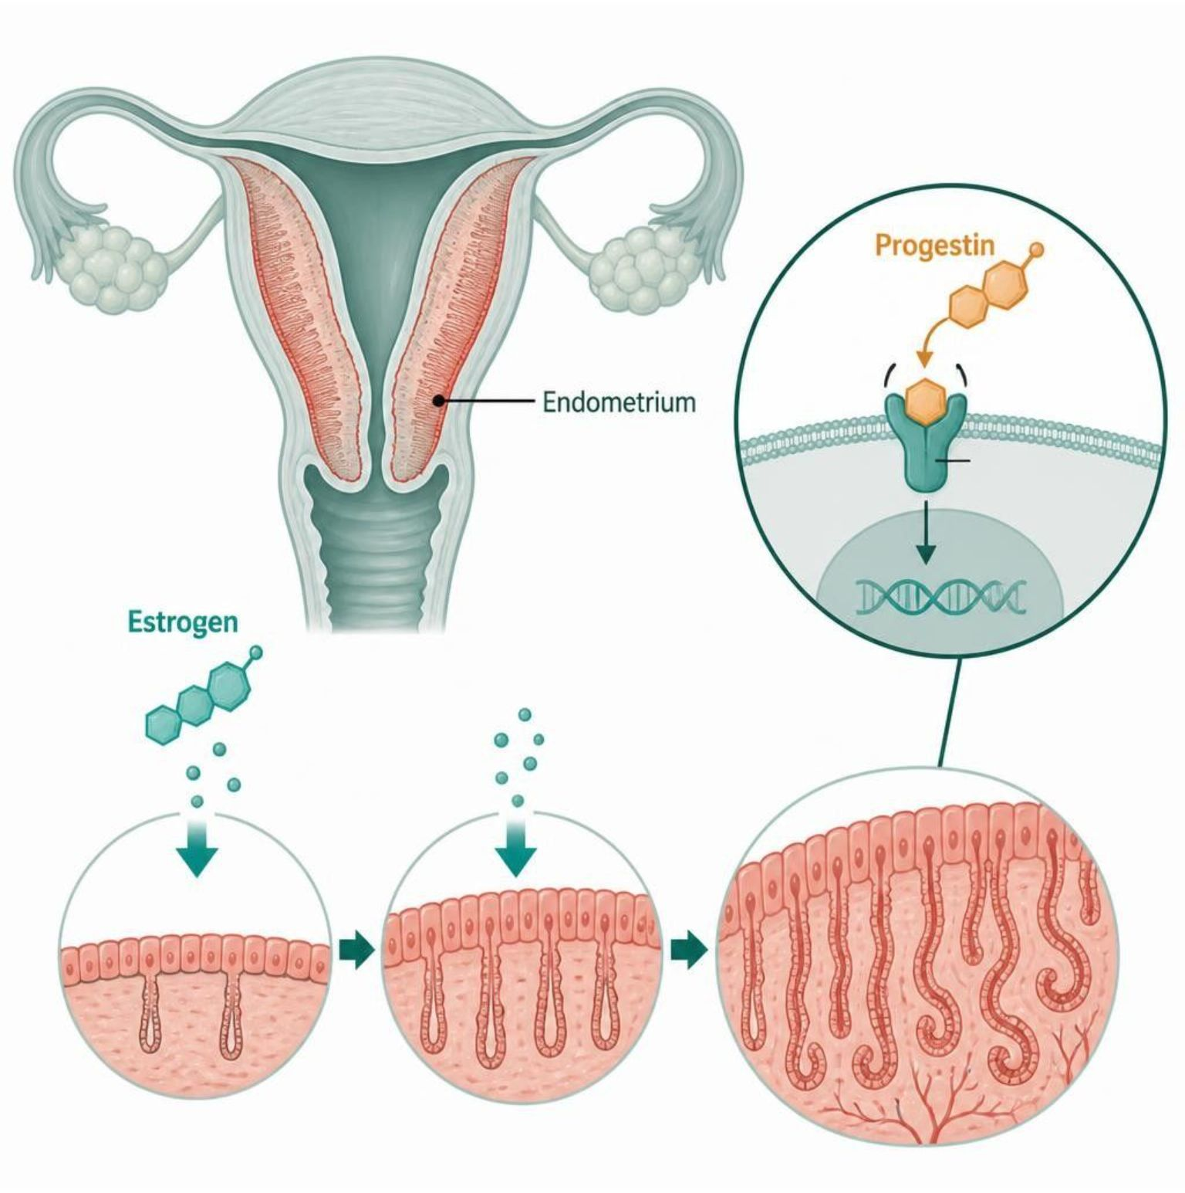
MECHANISM & DEPTH
Unopposed Estrogen: Why a Progestin Is Added
Estrogen binds ER in the endometrium
↓
Proliferation and thickening of the lining
↓
Without progestin: hyperplasia and cancer risk
↓
Progestin binds PR: limits proliferation, matures the endometrium
Schematic (illustrative)
Hysterectomy patients can take estrogen alone.
Figure 1. Progestin counters estrogen's proliferative effect on the endometrium.
Genitourinary & Reproductive Pharmacology — Session 1 of 2 — PA Program
7
Notes:
Explain that the progestin protects the endometrium when the uterus is intact.
Instructor script:
Estrogen drives endometrial proliferation; without a progestin the risk is hyperplasia and cancer. Estrogen alone is acceptable only after hysterectomy.

Slide 8
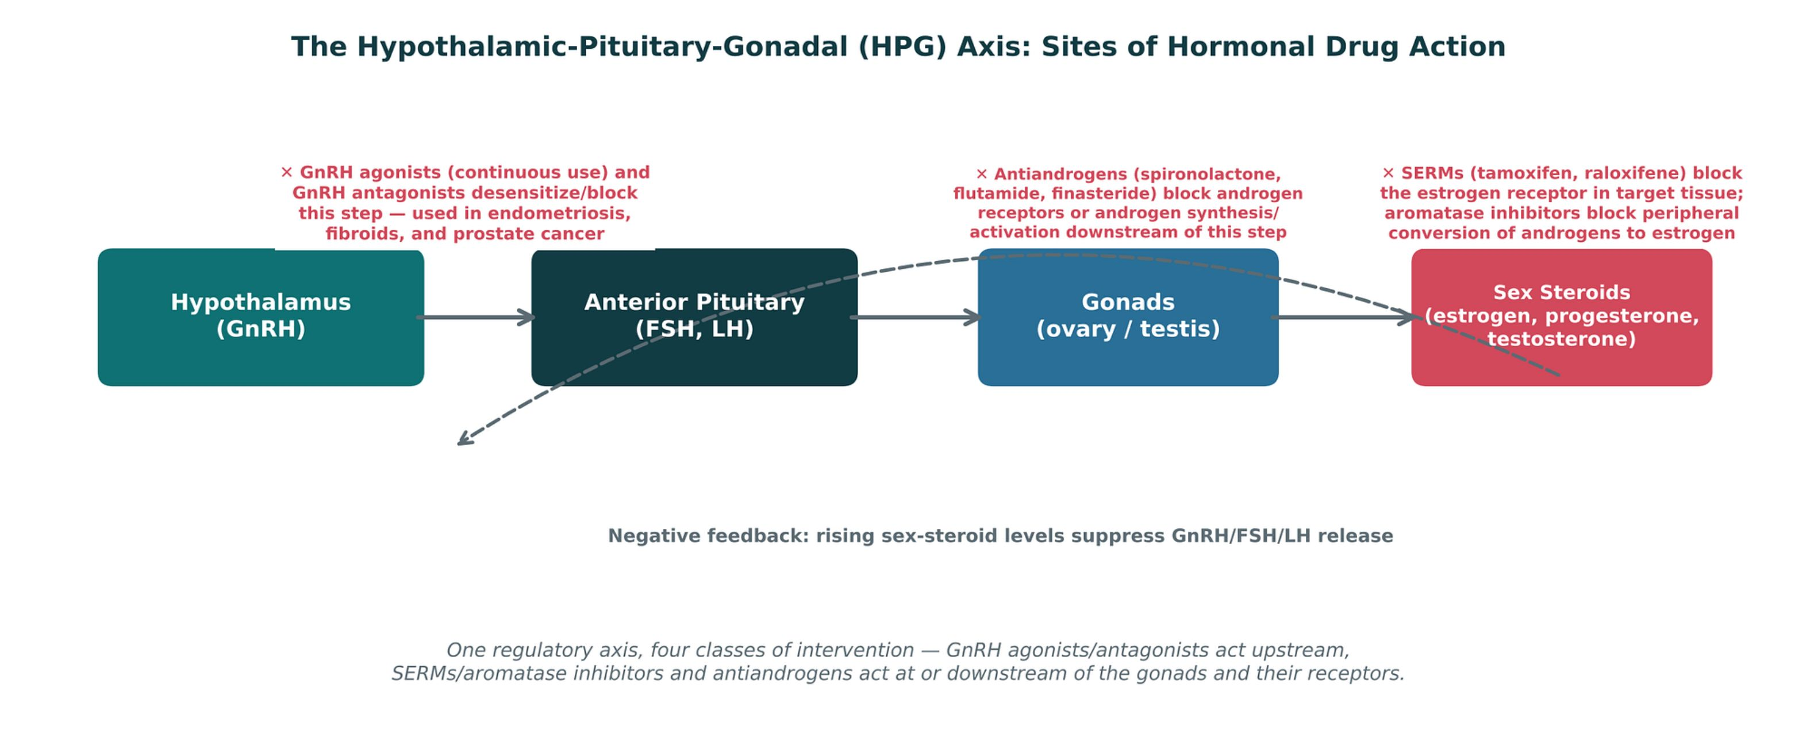
ORIGINAL ILLUSTRATION · FIGURE 2
The Hypothalamic-Pituitary-Gonadal (HPG) Axis: Sites of Hormonal Drug Action
Figure 2. Original illustrative diagram (not from Katzung): GnRH drives FSH/LH release, which drives gonadal sex-steroid production, which in turn negatively feeds back on the hypothalamus and pituitary — with four distinct classes of drugs intervening at different points along this axis.
Genitourinary & Reproductive Pharmacology — Session 1 of 2 — PA Program
8
Notes:
This is the organizing map for the entire session — every drug class that follows (GnRH agonists/antagonists, SERMs, aromatase inhibitors, antiandrogens) gets anchored back to its point of action on this diagram. Spend real time here; it pays off for the rest of the unit.
Instructor script:
Spend real time here; it anchors the session. Name the points where each drug class intervenes.

Slide 9
APPLYING THE PRINCIPLE
Combined Hormonal Contraception vs. Progestin-Only Methods
Combined (Estrogen + Progestin)
Progestin-Only
– Oral pills, transdermal patch, vaginal ring
– Suppresses ovulation via negative feedback on FSH/LH
– Carries estrogen-related VTE risk — requires screening for contraindications
– Often chosen for added benefits: cycle regulation, acne/hirsutism improvement
– Mini-pill, DMPA injection, subdermal implant, levonorgestrel IUD
– No estrogen — safe in patients with VTE history, migraine with aura, or smokers over 35
– More irregular bleeding patterns, especially initially
– DMPA specifically: reversible bone density loss with long-term use
Genitourinary & Reproductive Pharmacology — Session 1 of 2 — PA Program
9
Notes:
Use this slide to reinforce the core decision point in clinical practice: when estrogen is contraindicated, a progestin-only method is not a compromise — it's often the correct first choice.
Instructor script:
When estrogen is contraindicated, a progestin-only method is the correct first choice.

Slide 10

SECTION
02
SERMs, Aromatase Inhibitors, Androgens & Antiandrogens
Tissue-selective and blocking strategies — how drugs can turn hormone signaling on in one tissue and off in another.
Notes:
Section transition. Tamoxifen antagonizes breast and agonizes bone and endometrium.

Slide 11

TISSUE-SELECTIVE ESTROGEN ACTION
Selective Estrogen Receptor Modulators (SERMs)
Mechanism: bind the estrogen receptor, but act as an agonist in some tissues and an antagonist in others — the defining feature of this class.
Tamoxifen: ER antagonist in breast tissue (used for ER-positive breast cancer treatment and prevention) but an ER agonist in bone (preserves density) and, notably, in the endometrium.
Tamoxifen's endometrial agonist activity increases the risk of endometrial hyperplasia and endometrial cancer — patients require counseling on abnormal bleeding and routine gynecologic follow-up.
Raloxifene: ER antagonist in breast tissue and ER agonist in bone, but — unlike tamoxifen — essentially neutral at the endometrium, making it a preferred option for osteoporosis prevention in postmenopausal women without a breast cancer indication.
Both carry an increased VTE risk, similar in magnitude to estrogen therapy itself.
Genitourinary & Reproductive Pharmacology — Session 1 of 2 — PA Program
13
Notes:
The tamoxifen-vs-raloxifene endometrial distinction is a classic high-yield comparison — make sure students can state which one carries the endometrial cancer risk and why (tissue-selective agonism, not a class effect).
Instructor script:
Tamoxifen antagonizes breast, agonizes bone and endometrium. Raloxifene antagonizes breast, agonizes bone, neutral at endometrium. Both raise VTE risk.

Slide 12
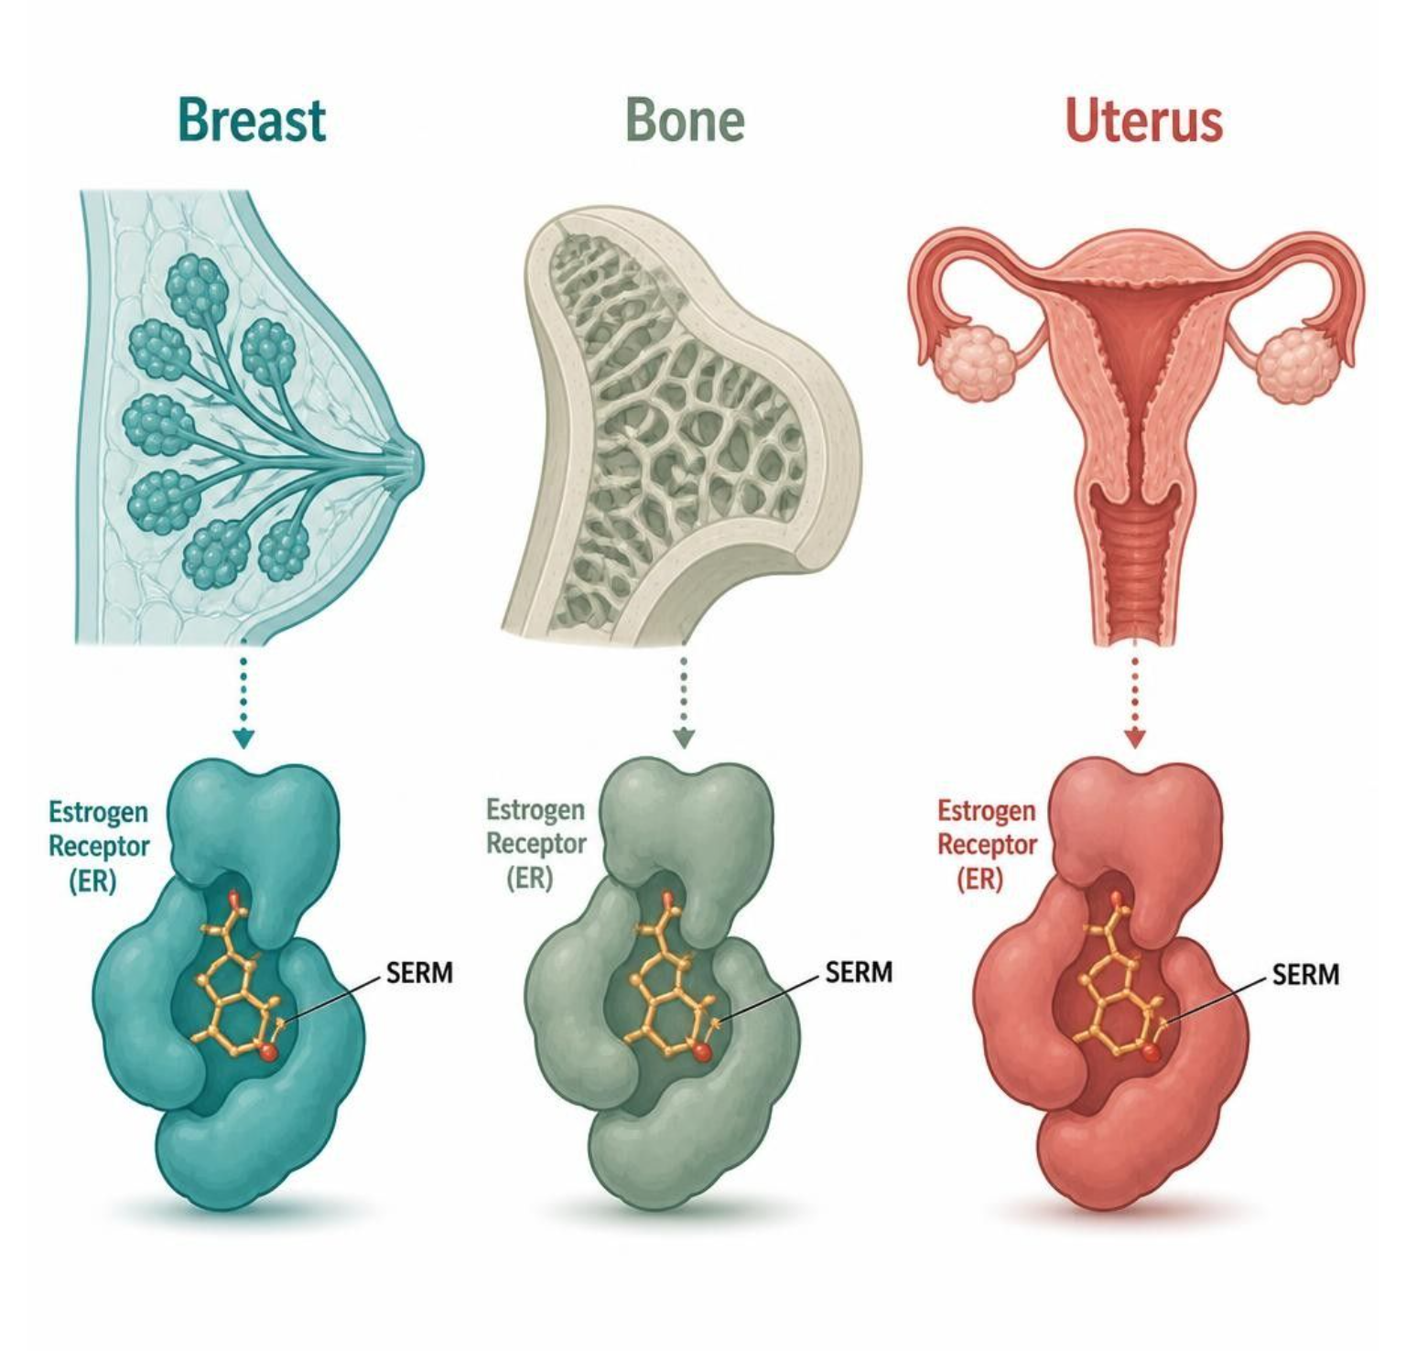
MECHANISM & DEPTH
SERMs: One Receptor, Different Tissue Effects
Tamoxifen: breast blocks (antagonist)
↓
Tamoxifen: bone agonist; endometrium agonist
↓
Raloxifene: breast blocks; bone agonist
↓
Raloxifene: endometrium neutral
↓
Schematic (illustrative)
Both raise VTE risk
Figure 3. Tamoxifen and raloxifene act on the same receptor but differ by tissue; tamoxifen's endometrial agonism carries cancer risk.
Genitourinary & Reproductive Pharmacology — Session 1 of 2 — PA Program
14
Notes:
Tamoxifen's endometrial agonism is the reason for cancer-risk monitoring; raloxifene is neutral there.
Instructor script:
Same receptor, different conformation and co-regulators in each tissue.

Slide 13

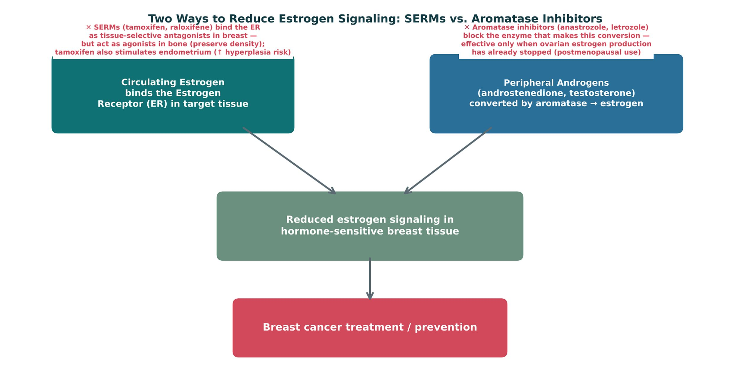
ORIGINAL ILLUSTRATION · FIGURE 4
Two Ways to Reduce Estrogen Signaling: SERMs vs. Aromatase Inhibitors
Figure 4. Original illustrative diagram (not from Katzung): SERMs block the estrogen receptor directly in breast tissue (while remaining agonists elsewhere), while aromatase inhibitors block the peripheral enzymatic conversion of androgens to estrogen — two distinct strategies converging on the same clinical goal in hormone-sensitive breast cancer.
Genitourinary & Reproductive Pharmacology — Session 1 of 2 — PA Program
15
Notes:
Emphasize the postmenopausal-only caveat for aromatase inhibitors — in a premenopausal patient, the ovaries are still the dominant estrogen source and aromatase inhibition alone is insufficient (often combined with ovarian suppression in that population).
Instructor script:
Receptor blockade versus synthesis blockade; aromatase inhibitors are postmenopausal only.

Slide 14
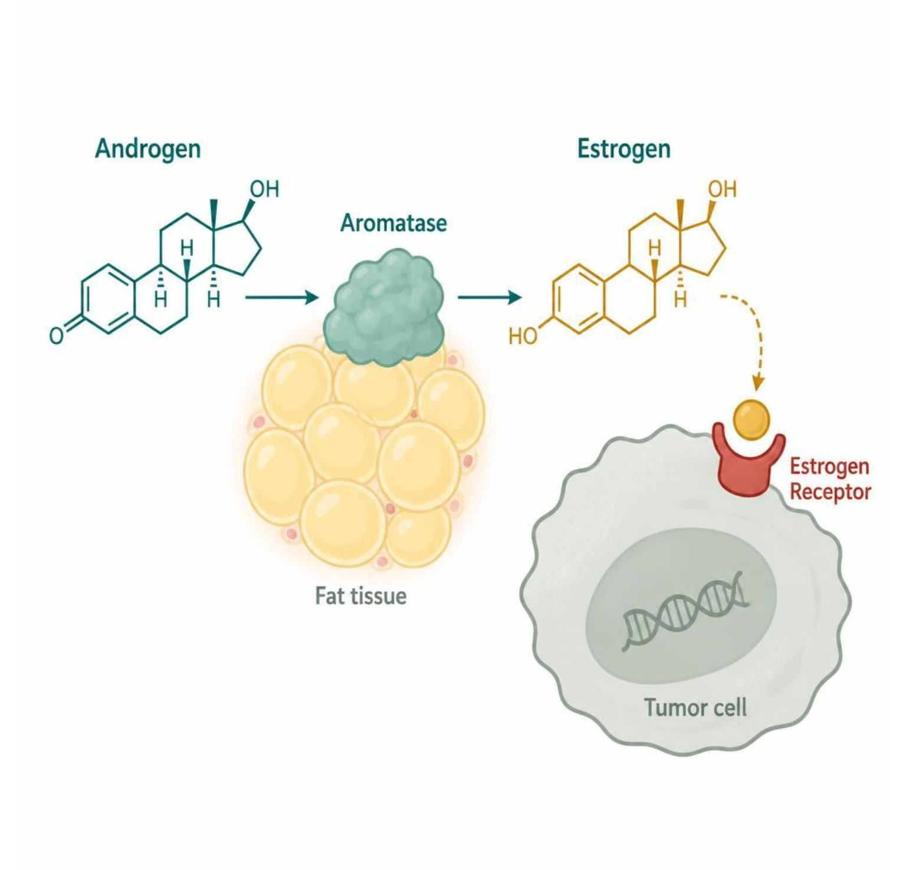
MECHANISM & DEPTH
Aromatase Inhibitors: Blocking Estrogen Synthesis
Androgens (androstenedione, testosterone)
↓
Aromatase in fat tissue converts them to estrogens
↓
Estrogens drive ER-positive tumor growth
↓
Anastrozole and letrozole block aromatase
Postmenopausal use only: ovaries still make estrogen before menopause.
Adverse effects: bone loss and joint pain.
Schematic (illustrative)
Figure 5. Aromatase converts androgens to estrogens in peripheral fat; aromatase inhibitors block this step.
Genitourinary & Reproductive Pharmacology — Session 1 of 2 — PA Program
16
Notes:
Aromatase inhibitors act downstream of the ovary, so they work mainly after menopause.
Instructor script:
Anastrozole and letrozole block conversion of androgens to estrogens. Adverse effects: bone loss and joint pain.

Slide 15
FROM CHAPTER 40
Androgens & Antiandrogens
● Testosterone (androgen): used for male hypogonadism; adverse effects include erythrocytosis, hepatotoxicity (oral formulations), and suppression of endogenous testicular function/fertility. Monitor hematocrit and PSA with long-term use.
● Spironolactone (antiandrogen): blocks the androgen receptor (in addition to its aldosterone-antagonist diuretic effect from Unit 5) — used off-label for hirsutism and acne in women, especially in PCOS.
● Flutamide / bicalutamide (antiandrogens): pure androgen receptor blockers used primarily in prostate cancer, often combined with a GnRH agonist.
● Finasteride / dutasteride (5-alpha-reductase inhibitors): block conversion of testosterone to the more potent dihydrotestosterone (DHT); used for hirsutism and androgenetic alopecia here, and — as Session 2 will cover — for benign prostatic hyperplasia (BPH).
Genitourinary & Reproductive Pharmacology — Session 1 of 2 — PA Program
17
Notes:
Flag finasteride/dutasteride explicitly as a direct bridge to Session 2 — the exact same drugs reappear in the BPH discussion, just applied to a different clinical problem (prostate growth rather than hirsutism).
Instructor script:
Testosterone to DHT via 5-alpha-reductase.

Slide 16
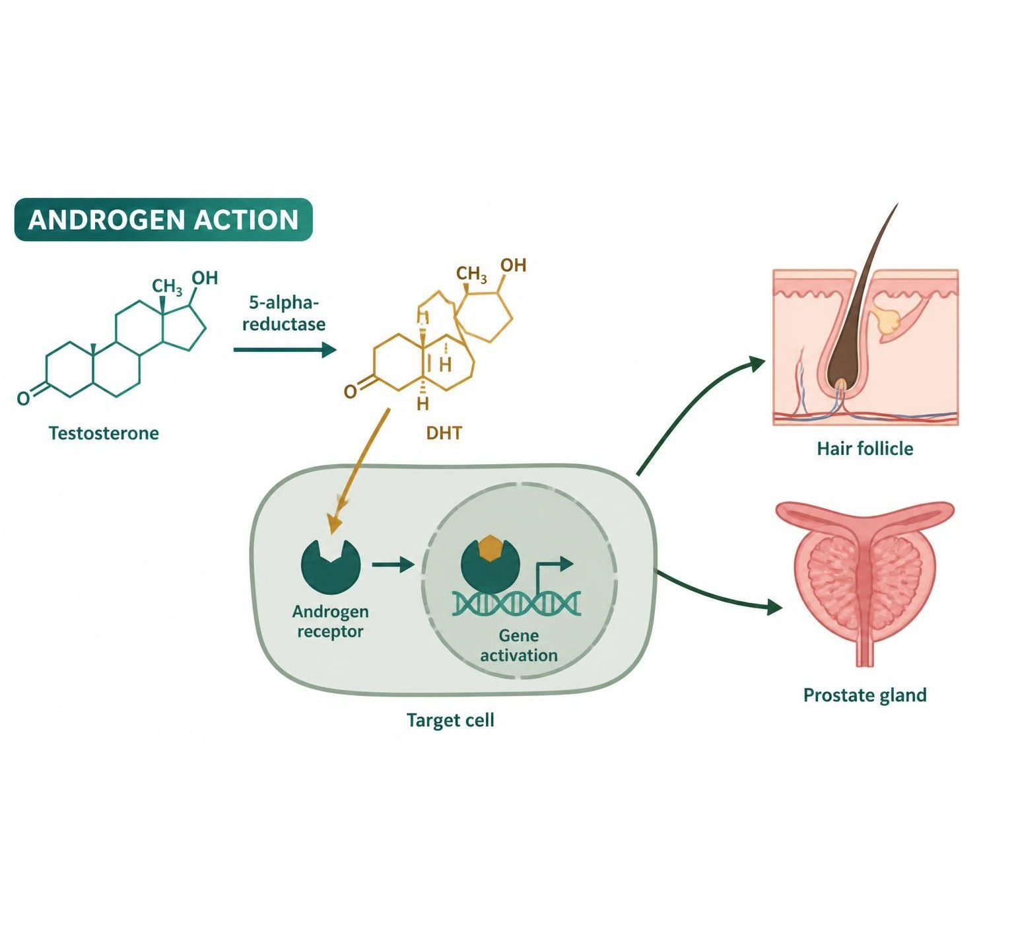
MECHANISM & DEPTH
Androgen Pathway: Where Each Drug Acts
Testosterone (circulating androgen)
↓
5-alpha-reductase converts it to DHT
↓
DHT (more potent androgen)
↓
Binds the androgen receptor
↓
Hair follicle and prostate effects
Finasteride and dutasteride block 5-alpha-reductase, lowering DHT.
Spironolactone, flutamide and bicalutamide block the androgen receptor.
Blocking the enzyme or the receptor both reduce androgen action.
Schematic (illustrative)
Figure 6. Androgen pathway from testosterone to receptor action, with the sites of finasteride, dutasteride, spironolactone, flutamide and bicalutamide.
Genitourinary & Reproductive Pharmacology — Session 1 of 2 — PA Program
18
Notes:
Anchor each drug to its site: the enzyme inhibitors lower DHT; the receptor blockers stop androgen signaling.
Instructor script:
Finasteride and dutasteride block the enzyme; spironolactone, flutamide and bicalutamide block the receptor.

Slide 17
HIGH-YIELD COMPARISON
Estrogen-Pathway Drugs vs. Androgen-Pathway Drugs
Estrogen Pathway
Androgen Pathway
– SERMs (tamoxifen, raloxifene): tissue-selective receptor agonist/antagonist
– Aromatase inhibitors (anastrozole, letrozole): block peripheral estrogen synthesis, postmenopausal use only
– Both used primarily in hormone-sensitive breast cancer
– Antiandrogens (spironolactone, flutamide): block the androgen receptor directly
– 5-alpha-reductase inhibitors (finasteride, dutasteride): block DHT formation
– Used for hirsutism, prostate cancer, alopecia, and — in Session 2 — BPH
Genitourinary & Reproductive Pharmacology — Session 1 of 2 — PA Program
19
Notes:
Use this slide to reinforce the parallel structure across both pathways: a receptor-blocking strategy and a synthesis/activation-blocking strategy exist on both the estrogen and androgen sides.
Instructor script:
A receptor strategy and a synthesis strategy exist on both the estrogen and androgen sides.

Slide 18

CLINICAL CASE
Weighing Tamoxifen's Tissue-Selective Effects
A 52-year-old postmenopausal woman with ER-positive breast cancer is started on tamoxifen. Six months later, she reports new-onset irregular vaginal bleeding.
Ask yourself: What is the most likely explanation, and what should happen next?
Clinical pearl: Tamoxifen acts as an estrogen receptor agonist in the endometrium even while acting as an antagonist in breast tissue — this tissue-selective agonism increases the risk of endometrial hyperplasia and endometrial cancer. New abnormal bleeding on tamoxifen warrants prompt gynecologic evaluation, not reassurance.
Genitourinary & Reproductive Pharmacology — Session 1 of 2 — PA Program
20
Notes:
This case makes the tissue-selectivity concept concrete and clinical — a good checkpoint before the quick check, and a natural point to contrast with raloxifene's neutral endometrial profile.
Instructor script:
New bleeding on tamoxifen needs prompt gynecologic evaluation.

Slide 19

SECTION
03
Reproductive-Metabolic Overlap: PCOS & Antidiabetic Pharmacology
Where Chapter 40 and Chapter 41 meet — insulin resistance as a driver of reproductive endocrine disease.
Notes:
Section transition. Hyperinsulinemia raises ovarian androgen production and lowers SHBG.

Slide 20

FROM CHAPTER 40 & 41
PCOS: A Reproductive-Metabolic Overlap Condition
Polycystic ovary syndrome (PCOS) is defined by a combination of hyperandrogenism, ovulatory dysfunction, and polycystic ovarian morphology — but its pharmacologic management is fundamentally a metabolic problem as much as a reproductive one.
Insulin resistance and compensatory hyperinsulinemia are central to PCOS pathophysiology in most patients, independent of body weight.
Hyperinsulinemia stimulates ovarian theca-cell androgen production directly and lowers hepatic sex hormone-binding globulin (SHBG) production, raising free (biologically active) testosterone.
Clinical features follow directly from this mechanism: hirsutism, acne, and anovulation/irregular cycles from hyperandrogenism; and an elevated long-term risk of type 2 diabetes and metabolic syndrome from the underlying insulin resistance.
This is why PCOS management routinely pulls drugs from Chapter 41 (antidiabetic agents) as well as Chapter 40 (hormonal agents) — the two chapters converge on the same patient.
Genitourinary & Reproductive Pharmacology — Session 1 of 2 — PA Program
24
Notes:
This is the thesis slide for the entire section — make sure students leave understanding that PCOS pharmacology is not purely "gynecologic," which is why it is taught here as a bridge between Chapters 40 and 41.

Slide 21
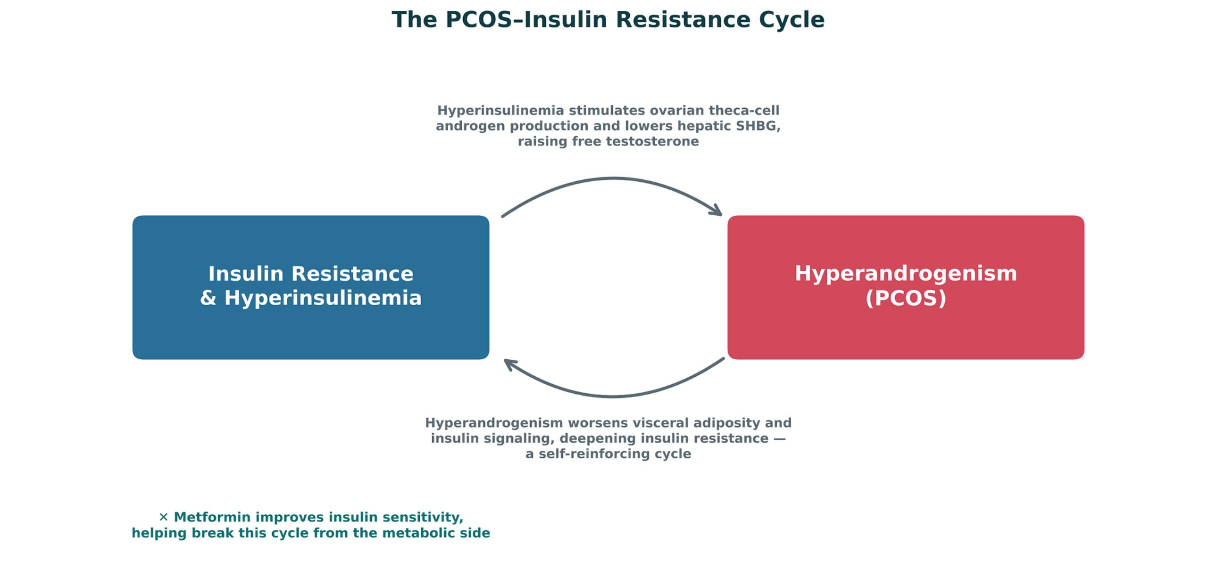
ORIGINAL ILLUSTRATION · FIGURE 7
The PCOS–Insulin Resistance Cycle
Figure 7. Original illustrative diagram (not from Katzung): insulin resistance and hyperandrogenism reinforce one another in a self-sustaining cycle — hyperinsulinemia raises free testosterone, and hyperandrogenism worsens insulin resistance, explaining why metabolic therapy improves reproductive symptoms and vice versa.
Genitourinary & Reproductive Pharmacology — Session 1 of 2 — PA Program
25
Notes:
This figure is the mechanistic payoff of the previous slide — walk both arrows of the cycle explicitly, and preview that the next slide covers where metformin intervenes (the point already flagged at the bottom of this figure).
Instructor script:
Hyperandrogenism worsens insulin resistance. Walk both arrows.

Slide 22

FROM CHAPTER 41
Antidiabetic Agents in Reproductive-Metabolic Management
Metformin: first-line insulin-sensitizing agent in PCOS management; improves insulin sensitivity, can restore ovulatory cycles, and is commonly used alongside or instead of hormonal therapy depending on the patient's goals (cycle regulation vs. fertility).
Metformin is not a direct hormonal agent — it improves hyperandrogenism indirectly, by reducing hyperinsulinemia's stimulatory effect on ovarian androgen production (Figure 7).
Adverse effects: GI upset (common, often transient), and rare but serious lactic acidosis risk in renal impairment — recall the renal dose-adjustment principles from Unit 5.
GLP-1 receptor agonists are increasingly used off-label in PCOS patients with obesity, given their weight-loss and insulin-sensitizing effects — an emerging extension of the same reproductive-metabolic overlap principle.
Combined hormonal contraception (Section 1) remains first-line specifically for cycle regulation and hirsutism/acne when pregnancy is not desired — metformin and hormonal therapy are frequently used together, not as alternatives.
Genitourinary & Reproductive Pharmacology — Session 1 of 2 — PA Program
26
Notes:
Reinforce the Unit 5 callback on metformin's renal dosing caveat — this is a deliberate cross-unit integration point, not a new concept.
Instructor script:
Metformin is first-line metabolic therapy; GLP-1 agonists are emerging off-label.

Slide 23
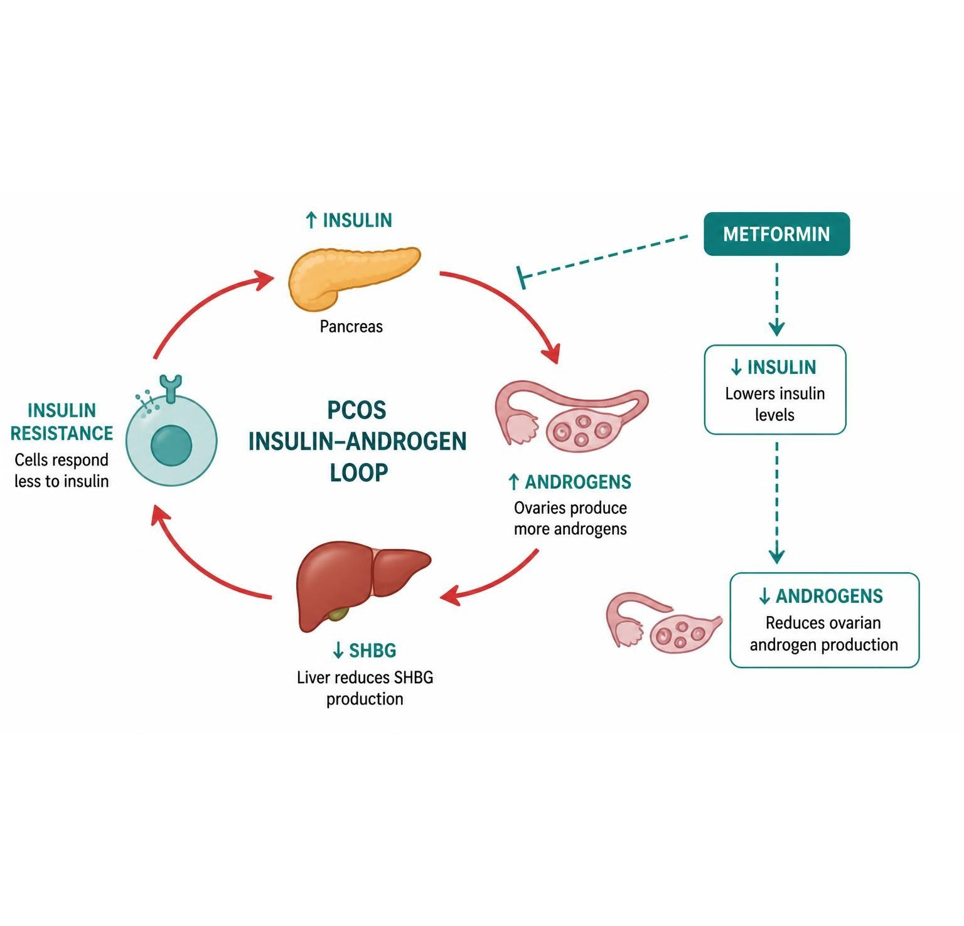
MECHANISM & DEPTH
Metformin in PCOS: Insulin, Androgens and Ovulation
Insulin resistance
↓
High insulin
↓
Ovarian androgens up; liver SHBG down
↓
Free testosterone up
↓
Metformin lowers insulin
↓
Androgens fall; cycles and ovulation can return
Common early effect: GI upset (nausea, diarrhea); take with meals.
Hold for iodinated contrast study or renal impairment.
Schematic (illustrative)
Figure 8. Insulin, androgens and ovulation in PCOS, and where metformin acts in the loop.
Genitourinary & Reproductive Pharmacology — Session 1 of 2 — PA Program
27
Notes:
Explain that metformin acts through insulin, so androgens fall and ovulation can resume in many patients.
Instructor script:
Lower insulin means lower androgens and a chance of ovulation. Hold for contrast with renal impairment.

Slide 24
HIGH-YIELD COMPARISON · TABLE 1
Agents Used in PCOS Management at a Glance
Agent | Primary Goal | Key Teaching Point
Combined hormonal contraception | Cycle regulation, hirsutism/acne | Progestin component opposes unopposed-estrogen endometrial risk
Metformin | Insulin sensitization | First-line metabolic therapy; can restore ovulation; GI upset common
Spironolactone | Antiandrogen effect on hirsutism/acne | Androgen receptor blockade; avoid in pregnancy (teratogenic risk)
GLP-1 receptor agonists | Weight loss, insulin sensitization | Emerging off-label use in PCOS with obesity
Genitourinary & Reproductive Pharmacology — Session 1 of 2 — PA Program
28
Notes:
Use this table as the organizing summary for PCOS pharmacology before the closing case — note that these agents are frequently combined rather than used as single-agent therapy.
Instructor script:
The agents are usually combined, not alternatives.

Slide 25
CLINICAL CASE
Choosing Between Metformin and Combined Contraception in PCOS
A 24-year-old woman with PCOS presents with irregular cycles, hirsutism, and a BMI of 31. She is not currently trying to conceive and has no contraindications to estrogen.
Ask yourself: What are the two major pharmacologic strategies available, and how do their goals differ?
Clinical pearl: Combined hormonal contraception directly regulates cycles and improves hirsutism/acne through its hormonal effects, while metformin addresses the underlying insulin resistance driving the condition metabolically. The two are frequently combined rather than chosen as alternatives — contraception for immediate symptom control, metformin for the metabolic driver and long-term diabetes risk reduction.
Genitourinary & Reproductive Pharmacology — Session 1 of 2 — PA Program
29
Notes:
Use this case to reinforce that PCOS management is rarely single-agent — this is a good moment to ask students to justify combining therapies rather than picking just one.
Instructor script:
The agents are usually combined, not alternatives.

Slide 26
DRUG NAMES
Drug Names Reveal the Class: GU and Reproductive Agents
Stem
Class
Examples
Memory aid
estr-/-estradiol
Estrogen
Estradiol, ethinyl estradiol
Estr- = estrogen
-gest- / -gestrel
Progestin
Levonorgestrel, norethindrone, medroxyprogesterone
Gest- = progestin (pregnancy hormone)
-ifene
SERM
Tamoxifen, raloxifene
-ifene = modulates the estrogen receptor
-trozole
Aromatase inhibitor
Anastrozole, letrozole
-trozole = blocks aromatase
-steride
5-alpha-reductase inhibitor
Finasteride, dutasteride
-steride = blocks steroid enzyme
-lutamide
Antiandrogen
Flutamide, bicalutamide
-lutamide = blocks the androgen receptor
-sterone
Androgen or antagonist
Testosterone, spironolactone
-sterone = steroid; drug sets the effect
-formin
Biguanide
Metformin
-formin = biguanide, lowers insulin
Genitourinary & Reproductive Pharmacology — Session 1 of 2 — PA Program
32
Notes:
Drug names reveal the class: estr-, -gest-, -ifene, -trozole, -steride, -lutamide, -sterone, -formin.

Slide 27
BIG PICTURE
Session 1 Recap — To Be Continued
1
Estrogens and progestins are always paired in a patient with a uterus — unopposed estrogen significantly raises endometrial cancer risk (Chapter 40).
2
SERMs and aromatase inhibitors are two distinct strategies for reducing estrogen signaling in hormone-sensitive breast cancer — tissue-selective receptor modulation (Figure 3) vs. blocking peripheral synthesis (Figure 5), compared in Figure 4.
3
Finasteride and dutasteride (5-alpha-reductase inhibitors) appear here for hirsutism and alopecia — the same drugs return in Session 2 for benign prostatic hyperplasia.
4
PCOS is a reproductive-metabolic overlap condition: insulin resistance and hyperandrogenism reinforce one another (Figure 7), which is why metformin and hormonal therapy are frequently combined.
Session 2 (Tuesday, December 1) shifts to autonomic pharmacology of the bladder and lower urinary tract — a mechanistically different topic, but one that shares several cross-system drug-class connections with content already covered in Units 5 and 6.
5
Genitourinary & Reproductive Pharmacology — Session 1 of 2 — PA Program
Notes:
Close Session 1 by previewing Session 2 explicitly — students should leave knowing gonadal hormone pharmacology is complete, and that autonomic/bladder pharmacology picks up next time, with the 5-alpha-reductase inhibitor callback as a concrete bridge.
Instructor script:
Preview Session 2 and the finasteride bridge.

Slide 28
Appendix 1
Drug Profiles
Study reference for the drugs covered in Session 1
Abbreviation key
PO = by mouth
IM = intramuscular
IV = intravenous
SC = subcutaneous
BID / TID = twice / three times daily
ER = extended-release
IUD = intrauterine device
DMPA = depot medroxyprogesterone acetate
GnRH = gonadotropin-releasing hormone
VTE = venous thromboembolism
DVT / PE = deep vein thrombosis / pulmonary embolism
MI = myocardial infarction
PCOS = polycystic ovary syndrome
BPH = benign prostatic hyperplasia
PSA = prostate-specific antigen
CBC = complete blood count
CYP = cytochrome P450
GI = gastrointestinal
DCIS = ductal carcinoma in situ
eGFR / CrCl = estimated glomerular filtration rate / creatinine clearance
ER-positive = estrogen receptor-positive
Genitourinary & Reproductive Pharmacology — Session 1 of 2 — PA Program
34
Notes:
Abbreviation key: PO = by mouth; IM = intramuscular; IV = intravenous; SC = subcutaneous; BID / TID = twice / three times daily; ER = extended-release; IUD = intrauterine device; DMPA = depot medroxyprogesterone acetate; GnRH = gonadotropin-releasing hormone; VTE = venous thromboembolism; DVT / PE = deep vein thrombosis / pulmonary embolism; MI = myocardial infarction; PCOS = polycystic ovary syndrome; BPH = benign prostatic hyperplasia; PSA = prostate-specific antigen; CBC = complete blood count; CYP = cytochrome P450; GI = gastrointestinal; DCIS = ductal carcinoma in situ; eGFR / CrCl = estimated glomerular filtration rate / creatinine clearance; ER-positive = estrogen receptor-positive.
Instructor script:
Appendix talk track: Say: "Use these as a study reference. Know the dose logic, the serious adverse effect, the contraindication that changes decisions and the toxicity you would need to recognize."
Class activity (10 minutes): Groups teach back two or three profiles in 60 seconds each.
Abbreviation key: Review PO, DMPA, VTE, PCOS, BPH, PSA and CYP.
Teaching points: Hormones (contraceptives, estradiol), SERMs, aromatase inhibitors, androgens and antiandrogens, 5-ARIs, metformin.
Bloom's prompts: Remember: state the tamoxifen dose. Understand: explain why tamoxifen but not raloxifene stimulates the endometrium. Apply: counsel a woman starting rifampin on a combined pill. Analyze: explain bone loss on an aromatase inhibitor. Evaluate: choose therapy for a smoker with PCOS.

Slide 29
DRUG PROFILE
Combined oral contraceptives (ethinyl estradiol plus a progestin)
ESTROGEN PLUS PROGESTIN
FORMULATION
Tablets (21/28-day packs); patch; vaginal ring
DOSE (ADULT)
Ethinyl estradiol 20-35 mcg plus a progestin PO daily; patch weekly for 3 weeks; ring 3 weeks in, 1 week out
INDICATIONS
Contraception, cycle control, dysmenorrhea, acne
ADVERSE EFFECTS
Nausea, breast tenderness, breakthrough bleeding, headache
CONTRAINDICATIONS
VTE or stroke history, smoker 35 or older, migraine with aura, estrogen-sensitive cancer, uncontrolled hypertension, liver disease
TOXICITY / OVERDOSE
VTE, stroke and MI risk; hyperkalemia with drospirenone; rifampin and some antiepileptics lower efficacy
Standard adult dosing for teaching; verify against current prescribing information.
Genitourinary & Reproductive Pharmacology — Session 1 of 2 — PA Program
35
Notes:
Drug: Combined oral contraceptives (ethinyl estradiol plus a progestin)
Class: Estrogen plus progestin
Formulation: Tablets (21/28-day packs); patch; vaginal ring
Adult dose: Ethinyl estradiol 20-35 mcg plus a progestin PO daily; patch weekly for 3 weeks; ring 3 weeks in, 1 week out
Indications: Contraception, cycle control, dysmenorrhea, acne
Adverse effects: Nausea, breast tenderness, breakthrough bleeding, headache
Contraindications: VTE or stroke history, smoker 35 or older, migraine with aura, estrogen-sensitive cancer, uncontrolled hypertension, liver disease
Toxicity / overdose: VTE, stroke and MI risk; hyperkalemia with drospirenone; rifampin and some antiepileptics lower efficacy

Slide 30
DRUG PROFILE
Norethindrone (progestin-only pill)
PROGESTIN
FORMULATION
Tablet 0.35 mg
DOSE (ADULT)
0.35 mg PO daily at the same time, with no pill-free days
INDICATIONS
Contraception when estrogen is contraindicated, breastfeeding
ADVERSE EFFECTS
Irregular bleeding, headache, acne, breast tenderness
CONTRAINDICATIONS
Breast cancer, undiagnosed vaginal bleeding, liver tumor
TOXICITY / OVERDOSE
Efficacy falls if a dose is more than 3 hours late; ectopic pregnancy risk if it fails
Standard adult dosing for teaching; verify against current prescribing information.
Genitourinary & Reproductive Pharmacology — Session 1 of 2 — PA Program
36
Notes:
Drug: Norethindrone (progestin-only pill)
Class: Progestin
Formulation: Tablet 0.35 mg
Adult dose: 0.35 mg PO daily at the same time, with no pill-free days
Indications: Contraception when estrogen is contraindicated, breastfeeding
Adverse effects: Irregular bleeding, headache, acne, breast tenderness
Contraindications: Breast cancer, undiagnosed vaginal bleeding, liver tumor
Toxicity / overdose: Efficacy falls if a dose is more than 3 hours late; ectopic pregnancy risk if it fails

Slide 31
DRUG PROFILE
Medroxyprogesterone depot (Depo-Provera)
INJECTABLE PROGESTIN
FORMULATION
IM 150 mg/mL; SC 104 mg/0.65 mL
DOSE (ADULT)
150 mg IM (or 104 mg SC) every 12-13 weeks
INDICATIONS
Contraception, endometriosis pain, endometrial protection
ADVERSE EFFECTS
Irregular bleeding, weight gain, delayed return of fertility
CONTRAINDICATIONS
Breast cancer, pregnancy, unexplained vaginal bleeding
TOXICITY / OVERDOSE
Boxed warning: loss of bone mineral density; limit prolonged use; VTE
Standard adult dosing for teaching; verify against current prescribing information.
Genitourinary & Reproductive Pharmacology — Session 1 of 2 — PA Program
37
Notes:
Drug: Medroxyprogesterone depot (Depo-Provera)
Class: Injectable progestin
Formulation: IM 150 mg/mL; SC 104 mg/0.65 mL
Adult dose: 150 mg IM (or 104 mg SC) every 12-13 weeks
Indications: Contraception, endometriosis pain, endometrial protection
Adverse effects: Irregular bleeding, weight gain, delayed return of fertility
Contraindications: Breast cancer, pregnancy, unexplained vaginal bleeding
Toxicity / overdose: Boxed warning: loss of bone mineral density; limit prolonged use; VTE

Slide 32
DRUG PROFILE
Levonorgestrel IUD (Mirena)
INTRAUTERINE PROGESTIN
FORMULATION
Intrauterine system 52 mg (about 20 mcg/day)
DOSE (ADULT)
One system placed in the uterus; effective up to 8 years for contraception
INDICATIONS
Contraception, heavy menstrual bleeding, endometrial protection
ADVERSE EFFECTS
Irregular spotting, amenorrhea, ovarian cysts, pelvic pain
CONTRAINDICATIONS
Pregnancy, pelvic infection, uterine anomaly, breast cancer
TOXICITY / OVERDOSE
Uterine perforation, expulsion, infection; check strings
Standard adult dosing for teaching; verify against current prescribing information.
Genitourinary & Reproductive Pharmacology — Session 1 of 2 — PA Program
38
Notes:
Drug: Levonorgestrel IUD (Mirena)
Class: Intrauterine progestin
Formulation: Intrauterine system 52 mg (about 20 mcg/day)
Adult dose: One system placed in the uterus; effective up to 8 years for contraception
Indications: Contraception, heavy menstrual bleeding, endometrial protection
Adverse effects: Irregular spotting, amenorrhea, ovarian cysts, pelvic pain
Contraindications: Pregnancy, pelvic infection, uterine anomaly, breast cancer
Toxicity / overdose: Uterine perforation, expulsion, infection; check strings

Slide 33
DRUG PROFILE
Estradiol (Estrace, Vivelle-Dot)
ESTROGEN
FORMULATION
Oral tablets 0.5/1/2 mg; transdermal patch 0.025-0.1 mg/day; vaginal cream, tablet or ring; injectable valerate
DOSE (ADULT)
Menopausal symptoms: 1-2 mg PO daily or patch 0.05 mg/day twice weekly, lowest effective dose; add a progestin if the uterus is intact
INDICATIONS
Menopausal vasomotor symptoms, genitourinary syndrome of menopause, hypoestrogenism, prevention of osteoporosis (when other agents unsuitable)
ADVERSE EFFECTS
Breast tenderness, nausea, headache, VTE, stroke, endometrial hyperplasia (unopposed), gallbladder disease
CONTRAINDICATIONS
History of VTE or stroke, estrogen-sensitive cancer, undiagnosed vaginal bleeding, active liver disease, pregnancy
TOXICITY / OVERDOSE
Nausea, vomiting, withdrawal bleeding; long-term risk of VTE, stroke, breast cancer; endometrial cancer if unopposed
Standard adult dosing for teaching; verify against current prescribing information.
Genitourinary & Reproductive Pharmacology — Session 1 of 2 — PA Program
39
Notes:
Drug: Estradiol (Estrace, Vivelle-Dot)
Class: Estrogen
Formulation: Oral tablets 0.5/1/2 mg; transdermal patch 0.025-0.1 mg/day; vaginal cream, tablet or ring; injectable valerate
Adult dose: Menopausal symptoms: 1-2 mg PO daily or patch 0.05 mg/day twice weekly, lowest effective dose; add a progestin if the uterus is intact
Indications: Menopausal vasomotor symptoms, genitourinary syndrome of menopause, hypoestrogenism, prevention of osteoporosis (when other agents unsuitable)
Adverse effects: Breast tenderness, nausea, headache, VTE, stroke, endometrial hyperplasia (unopposed), gallbladder disease
Contraindications: History of VTE or stroke, estrogen-sensitive cancer, undiagnosed vaginal bleeding, active liver disease, pregnancy
Toxicity / overdose: Nausea, vomiting, withdrawal bleeding; long-term risk of VTE, stroke, breast cancer; endometrial cancer if unopposed

Slide 34
DRUG PROFILE
Tamoxifen (Nolvadex)
SELECTIVE ESTROGEN-RECEPTOR MODULATOR
FORMULATION
Tablet 10/20 mg
DOSE (ADULT)
20 mg PO daily for 5-10 years in breast cancer
INDICATIONS
Breast cancer treatment and risk reduction, DCIS
ADVERSE EFFECTS
Hot flashes, vaginal discharge, menstrual irregularity
CONTRAINDICATIONS
History of DVT or PE, pregnancy, warfarin (for risk-reduction use)
TOXICITY / OVERDOSE
Endometrial cancer, VTE, stroke, cataracts; CYP2D6 inhibitors (paroxetine, fluoxetine) reduce activation
Standard adult dosing for teaching; verify against current prescribing information.
Genitourinary & Reproductive Pharmacology — Session 1 of 2 — PA Program
40
Notes:
Drug: Tamoxifen (Nolvadex)
Class: Selective estrogen-receptor modulator
Formulation: Tablet 10/20 mg
Adult dose: 20 mg PO daily for 5-10 years in breast cancer
Indications: Breast cancer treatment and risk reduction, DCIS
Adverse effects: Hot flashes, vaginal discharge, menstrual irregularity
Contraindications: History of DVT or PE, pregnancy, warfarin (for risk-reduction use)
Toxicity / overdose: Endometrial cancer, VTE, stroke, cataracts; CYP2D6 inhibitors (paroxetine, fluoxetine) reduce activation

Slide 35
DRUG PROFILE
Raloxifene (Evista)
SELECTIVE ESTROGEN-RECEPTOR MODULATOR
FORMULATION
Tablet 60 mg
DOSE (ADULT)
60 mg PO daily
INDICATIONS
Postmenopausal osteoporosis treatment and prevention, breast cancer risk reduction
ADVERSE EFFECTS
Hot flashes, leg cramps, peripheral edema
CONTRAINDICATIONS
VTE history, pregnancy
TOXICITY / OVERDOSE
Boxed warning: VTE and fatal stroke risk; does not stimulate the endometrium
Standard adult dosing for teaching; verify against current prescribing information.
Genitourinary & Reproductive Pharmacology — Session 1 of 2 — PA Program
41
Notes:
Drug: Raloxifene (Evista)
Class: Selective estrogen-receptor modulator
Formulation: Tablet 60 mg
Adult dose: 60 mg PO daily
Indications: Postmenopausal osteoporosis treatment and prevention, breast cancer risk reduction
Adverse effects: Hot flashes, leg cramps, peripheral edema
Contraindications: VTE history, pregnancy
Toxicity / overdose: Boxed warning: VTE and fatal stroke risk; does not stimulate the endometrium

Slide 36
DRUG PROFILE
Anastrozole (Arimidex)
AROMATASE INHIBITOR
FORMULATION
Tablets 1 mg
DOSE (ADULT)
1 mg PO once daily, usually for 5 years or more
INDICATIONS
Adjuvant and metastatic hormone receptor-positive breast cancer in postmenopausal women
ADVERSE EFFECTS
Hot flashes, joint pain, bone loss, osteoporosis, mood changes, hypercholesterolemia
CONTRAINDICATIONS
Pregnancy; ineffective in premenopausal women unless ovarian function is suppressed
TOXICITY / OVERDOSE
Bone loss and fractures; monitor bone density and lipids; overdose causes mainly GI upset
Standard adult dosing for teaching; verify against current prescribing information.
Genitourinary & Reproductive Pharmacology — Session 1 of 2 — PA Program
42
Notes:
Drug: Anastrozole (Arimidex)
Class: Aromatase inhibitor
Formulation: Tablets 1 mg
Adult dose: 1 mg PO once daily, usually for 5 years or more
Indications: Adjuvant and metastatic hormone receptor-positive breast cancer in postmenopausal women
Adverse effects: Hot flashes, joint pain, bone loss, osteoporosis, mood changes, hypercholesterolemia
Contraindications: Pregnancy; ineffective in premenopausal women unless ovarian function is suppressed
Toxicity / overdose: Bone loss and fractures; monitor bone density and lipids; overdose causes mainly GI upset

Slide 37
DRUG PROFILE
Letrozole (Femara)
AROMATASE INHIBITOR
FORMULATION
Tablets 2.5 mg
DOSE (ADULT)
2.5 mg PO once daily, up to 5 years or extended therapy
INDICATIONS
Hormone receptor-positive breast cancer in postmenopausal women; off-label ovulation induction
ADVERSE EFFECTS
Hot flashes, arthralgia, osteoporosis, fatigue, hypercholesterolemia
CONTRAINDICATIONS
Pregnancy; premenopausal status without ovarian suppression
TOXICITY / OVERDOSE
Bone loss and fractures; monitor bone density; nonspecific toxicity in overdose
Standard adult dosing for teaching; verify against current prescribing information.
Genitourinary & Reproductive Pharmacology — Session 1 of 2 — PA Program
43
Notes:
Drug: Letrozole (Femara)
Class: Aromatase inhibitor
Formulation: Tablets 2.5 mg
Adult dose: 2.5 mg PO once daily, up to 5 years or extended therapy
Indications: Hormone receptor-positive breast cancer in postmenopausal women; off-label ovulation induction
Adverse effects: Hot flashes, arthralgia, osteoporosis, fatigue, hypercholesterolemia
Contraindications: Pregnancy; premenopausal status without ovarian suppression
Toxicity / overdose: Bone loss and fractures; monitor bone density; nonspecific toxicity in overdose

Slide 38
DRUG PROFILE
Testosterone (cypionate, gel, patch)
ANDROGEN
FORMULATION
IM cypionate or enanthate 100-200 mg/mL; gel; patch; pellets
DOSE (ADULT)
Cypionate 100-200 mg IM every 2 weeks (or 50-100 mg weekly); gel 50-100 mg daily
INDICATIONS
Male hypogonadism, delayed puberty
ADVERSE EFFECTS
Acne, erythrocytosis, sleep apnea, gynecomastia, testicular atrophy
CONTRAINDICATIONS
Prostate or breast cancer, polycythemia, pregnancy
TOXICITY / OVERDOSE
Erythrocytosis, thrombosis, secondary exposure with gels; monitor hematocrit, PSA, lipids
Standard adult dosing for teaching; verify against current prescribing information.
Genitourinary & Reproductive Pharmacology — Session 1 of 2 — PA Program
44
Notes:
Drug: Testosterone (cypionate, gel, patch)
Class: Androgen
Formulation: IM cypionate or enanthate 100-200 mg/mL; gel; patch; pellets
Adult dose: Cypionate 100-200 mg IM every 2 weeks (or 50-100 mg weekly); gel 50-100 mg daily
Indications: Male hypogonadism, delayed puberty
Adverse effects: Acne, erythrocytosis, sleep apnea, gynecomastia, testicular atrophy
Contraindications: Prostate or breast cancer, polycythemia, pregnancy
Toxicity / overdose: Erythrocytosis, thrombosis, secondary exposure with gels; monitor hematocrit, PSA, lipids

Slide 39
DRUG PROFILE
Spironolactone (Aldactone)
ALDOSTERONE ANTAGONIST WITH ANTIANDROGEN ACTIVITY
FORMULATION
Tablets 25/50/100 mg
DOSE (ADULT)
Hirsutism or acne (off-label): 50-200 mg PO daily in divided doses; hypertension and heart failure per cardiology dosing
INDICATIONS
Hirsutism and acne in PCOS (off-label), resistant hypertension, heart failure, primary hyperaldosteronism
ADVERSE EFFECTS
Hyperkalemia, menstrual irregularity, breast tenderness, dizziness, gynecomastia in men
CONTRAINDICATIONS
Hyperkalemia, Addison disease, anuria, pregnancy (feminization of a male fetus), concurrent potassium supplements
TOXICITY / OVERDOSE
Life-threatening hyperkalemia, especially with CKD or ACE inhibitors or ARBs; monitor potassium; effective contraception needed
Standard adult dosing for teaching; verify against current prescribing information.
Genitourinary & Reproductive Pharmacology — Session 1 of 2 — PA Program
45
Notes:
Drug: Spironolactone (Aldactone)
Class: Aldosterone antagonist with antiandrogen activity
Formulation: Tablets 25/50/100 mg
Adult dose: Hirsutism or acne (off-label): 50-200 mg PO daily in divided doses; hypertension and heart failure per cardiology dosing
Indications: Hirsutism and acne in PCOS (off-label), resistant hypertension, heart failure, primary hyperaldosteronism
Adverse effects: Hyperkalemia, menstrual irregularity, breast tenderness, dizziness, gynecomastia in men
Contraindications: Hyperkalemia, Addison disease, anuria, pregnancy (feminization of a male fetus), concurrent potassium supplements
Toxicity / overdose: Life-threatening hyperkalemia, especially with CKD or ACE inhibitors or ARBs; monitor potassium; effective contraception needed

Slide 40
DRUG PROFILE
Flutamide (Eulexin)
NONSTEROIDAL ANTIANDROGEN
FORMULATION
Capsules 125 mg
DOSE (ADULT)
250 mg PO three times daily, given with a GnRH agonist in prostate cancer
INDICATIONS
Metastatic prostate cancer in combination with a GnRH agonist
ADVERSE EFFECTS
Hot flashes, gynecomastia, diarrhea, hepatotoxicity, methemoglobinemia
CONTRAINDICATIONS
Severe hepatic impairment, pregnancy
TOXICITY / OVERDOSE
Boxed warning for severe hepatotoxicity; monitor liver tests regularly
Standard adult dosing for teaching; verify against current prescribing information.
Genitourinary & Reproductive Pharmacology — Session 1 of 2 — PA Program
46
Notes:
Drug: Flutamide (Eulexin)
Class: Nonsteroidal antiandrogen
Formulation: Capsules 125 mg
Adult dose: 250 mg PO three times daily, given with a GnRH agonist in prostate cancer
Indications: Metastatic prostate cancer in combination with a GnRH agonist
Adverse effects: Hot flashes, gynecomastia, diarrhea, hepatotoxicity, methemoglobinemia
Contraindications: Severe hepatic impairment, pregnancy
Toxicity / overdose: Boxed warning for severe hepatotoxicity; monitor liver tests regularly

Slide 41
DRUG PROFILE
Bicalutamide (Casodex)
NONSTEROIDAL ANTIANDROGEN
FORMULATION
Tablets 50 mg (150 mg in some regions)
DOSE (ADULT)
50 mg PO once daily with a GnRH agonist in prostate cancer
INDICATIONS
Metastatic prostate cancer in combination with a GnRH agonist
ADVERSE EFFECTS
Hot flashes, gynecomastia, breast tenderness, fatigue, liver enzyme elevation
CONTRAINDICATIONS
Pregnancy (not indicated in women), severe hepatic impairment
TOXICITY / OVERDOSE
Hepatotoxicity (rare); monitor liver tests; potentiates warfarin
Standard adult dosing for teaching; verify against current prescribing information.
Genitourinary & Reproductive Pharmacology — Session 1 of 2 — PA Program
47
Notes:
Drug: Bicalutamide (Casodex)
Class: Nonsteroidal antiandrogen
Formulation: Tablets 50 mg (150 mg in some regions)
Adult dose: 50 mg PO once daily with a GnRH agonist in prostate cancer
Indications: Metastatic prostate cancer in combination with a GnRH agonist
Adverse effects: Hot flashes, gynecomastia, breast tenderness, fatigue, liver enzyme elevation
Contraindications: Pregnancy (not indicated in women), severe hepatic impairment
Toxicity / overdose: Hepatotoxicity (rare); monitor liver tests; potentiates warfarin

Slide 42
DRUG PROFILE
Finasteride (Proscar, Propecia)
5-ALPHA-REDUCTASE INHIBITOR
FORMULATION
Tablet 5 mg (BPH); 1 mg (hair loss)
DOSE (ADULT)
5 mg PO daily for BPH; 1 mg PO daily for male-pattern hair loss
INDICATIONS
BPH, androgenetic alopecia
ADVERSE EFFECTS
Decreased libido, erectile dysfunction, reduced ejaculate, gynecomastia
CONTRAINDICATIONS
Pregnancy and women who may be pregnant (do not handle crushed tablets), hypersensitivity
TOXICITY / OVERDOSE
Lowers PSA by about half; reports of depression; teratogenic to a male fetus
Standard adult dosing for teaching; verify against current prescribing information.
Genitourinary & Reproductive Pharmacology — Session 1 of 2 — PA Program
48
Notes:
Drug: Finasteride (Proscar, Propecia)
Class: 5-alpha-reductase inhibitor
Formulation: Tablet 5 mg (BPH); 1 mg (hair loss)
Adult dose: 5 mg PO daily for BPH; 1 mg PO daily for male-pattern hair loss
Indications: BPH, androgenetic alopecia
Adverse effects: Decreased libido, erectile dysfunction, reduced ejaculate, gynecomastia
Contraindications: Pregnancy and women who may be pregnant (do not handle crushed tablets), hypersensitivity
Toxicity / overdose: Lowers PSA by about half; reports of depression; teratogenic to a male fetus

Slide 43
DRUG PROFILE
Dutasteride (Avodart)
5-ALPHA-REDUCTASE INHIBITOR (TYPES 1 AND 2)
FORMULATION
Capsules 0.5 mg; combination with tamsulosin (Jalyn)
DOSE (ADULT)
0.5 mg PO once daily for BPH; effects take 3-6 months; off-label for hair loss
INDICATIONS
Benign prostatic hyperplasia, off-label androgenetic alopecia and hirsutism
ADVERSE EFFECTS
Decreased libido, erectile dysfunction, ejaculation disorders, breast tenderness, depression
CONTRAINDICATIONS
Pregnancy and women of childbearing potential handling capsules, severe hepatic impairment
TOXICITY / OVERDOSE
Lowers PSA by about half; pregnant partners must avoid handling capsules; monitor PSA and mood
Standard adult dosing for teaching; verify against current prescribing information.
Genitourinary & Reproductive Pharmacology — Session 1 of 2 — PA Program
49
Notes:
Drug: Dutasteride (Avodart)
Class: 5-alpha-reductase inhibitor (types 1 and 2)
Formulation: Capsules 0.5 mg; combination with tamsulosin (Jalyn)
Adult dose: 0.5 mg PO once daily for BPH; effects take 3-6 months; off-label for hair loss
Indications: Benign prostatic hyperplasia, off-label androgenetic alopecia and hirsutism
Adverse effects: Decreased libido, erectile dysfunction, ejaculation disorders, breast tenderness, depression
Contraindications: Pregnancy and women of childbearing potential handling capsules, severe hepatic impairment
Toxicity / overdose: Lowers PSA by about half; pregnant partners must avoid handling capsules; monitor PSA and mood

Slide 44
DRUG PROFILE
Metformin (Glucophage)
BIGUANIDE
FORMULATION
Tablet 500/850/1,000 mg; ER tablet; oral solution
DOSE (ADULT)
Start 500 mg PO daily or BID with meals, titrate to 1,000 mg BID (max 2,550 mg/day)
INDICATIONS
Type 2 diabetes, prediabetes, PCOS (off-label)
ADVERSE EFFECTS
Nausea, diarrhea, metallic taste, vitamin B12 deficiency
CONTRAINDICATIONS
eGFR below 30, acute metabolic acidosis, hypersensitivity
TOXICITY / OVERDOSE
Lactic acidosis (renal impairment, contrast, alcohol, sepsis); hold around iodinated contrast; monitor B12
Standard adult dosing for teaching; verify against current prescribing information.
Genitourinary & Reproductive Pharmacology — Session 1 of 2 — PA Program
50
Notes:
Drug: Metformin (Glucophage)
Class: Biguanide
Formulation: Tablet 500/850/1,000 mg; ER tablet; oral solution
Adult dose: Start 500 mg PO daily or BID with meals, titrate to 1,000 mg BID (max 2,550 mg/day)
Indications: Type 2 diabetes, prediabetes, PCOS (off-label)
Adverse effects: Nausea, diarrhea, metallic taste, vitamin B12 deficiency
Contraindications: eGFR below 30, acute metabolic acidosis, hypersensitivity
Toxicity / overdose: Lactic acidosis (renal impairment, contrast, alcohol, sepsis); hold around iodinated contrast; monitor B12

Slide 45
Appendix 2: DRUG PROFILE · SUPPORTING
Supporting Drugs at a Glance
Enzyme inducers
Rifampin, carbamazepine, phenytoin and St. John's wort lower combined contraceptive efficacy
Warfarin
Testosterone and tamoxifen raise INR
GnRH agonists
Leuprolide is used with antiandrogens in prostate cancer
GLP-1 receptor agonists
Off-label for PCOS with obesity
Clomiphene and letrozole
Ovulation induction, beyond this lecture
Bisphosphonates and calcium with vitamin D
Bone protection with aromatase inhibitors
CYP2D6 inhibitors
Paroxetine and fluoxetine blunt tamoxifen activation
ACE inhibitors, ARBs and potassium
Hyperkalemia with spironolactone
Listed for context; not profiled in detail.
Genitourinary & Reproductive Pharmacology — Session 1 of 2 — PA Program
51
Notes:
Supporting drugs listed for context; not profiled in detail. Enzyme inducers lower combined contraceptive efficacy. Testosterone and tamoxifen raise INR with warfarin. Leuprolide is a GnRH agonist used with antiandrogens in prostate cancer. GLP-1 receptor agonists are off-label for PCOS with obesity. Clomiphene and letrozole are for ovulation induction, beyond this lecture. Bisphosphonates and calcium with vitamin D protect bone with aromatase inhibitors. Paroxetine and fluoxetine (CYP2D6 inhibitors) blunt tamoxifen activation. ACE inhibitors, ARBs and potassium cause hyperkalemia with spironolactone.
Instructor script:
Supporting drugs: enzyme inducers, warfarin, GnRH agonists, CYP2D6 inhibitors and bone-protective drugs explain interactions.

Slide 46
APPENDIX 3
Image Attribution
● Original figures in this deck: Figures 2, 4 and 7 (The Hypothalamic-Pituitary-Gonadal (HPG) Axis: Sites of Hormonal Drug Action; Two Ways to Reduce Estrogen Signaling: SERMs vs. Aromatase Inhibitors; The PCOS–Insulin Resistance Cycle) were generated by the course director using the AI tool Claude to illustrate standard, non-copyrighted pharmacologic concepts. They are original diagrams, not reproduced from Katzung’s Basic and Clinical Pharmacology or any other copyrighted source.
● Mechanism illustrations: Figures 1, 3, 5, 6 and 8 are illustrative AI-generated schematics, not reproduced from any copyrighted source.
● Reference: Anthropic. (2026). Claude (Sonnet 5) [Large language model]. https://claude.ai
Genitourinary & Reproductive Pharmacology — Session 1 of 2 — PA Program
52
Notes:
This slide documents AI-tool use for original figure generation per university citation requirements. It covers every original diagram in this deck (Figures 2, 4 and 7); none are reproduced from any textbook.
Instructor script:
The original Claude-generated diagrams and the illustrative mechanism schematics are credited here.

