Slide 1
L09 · Tue, Nov 17, 2026
Renal Pharmacotherapeutics — Session 1
Pharmacology study deck · organized by drug class
How to read this deck
TB = textbook only (not on the lecture slides)
SG = course study guide only (not on the lecture slides)
Bold = emphasized on the lecture slides
S12 = lecture slide 12 · p. 245 = textbook page 245 · SG U1-R3 = study guide item

Slide 2
START HERE
Learning objectives
IO5.1
Identify major pharmacologic classes used in the management of renal conditions and describe their mechanisms of action.
Renal Dosing & Diuretic Sites, Loop & Thiazide Diuretics, Potassium-Sparing, CAI & Osmotic Diuretics
IO5.2
Describe the indications, contraindications, adverse effects, and clinically significant interactions associated with medications used to treat renal conditions.
Loop & Thiazide Diuretics, Potassium-Sparing, CAI & Osmotic Diuretics
IO5.3
Compare pharmacologic agents within and across therapeutic classes to distinguish clinically relevant differences in efficacy, safety, and use.
Loop & Thiazide Diuretics, Potassium-Sparing, CAI & Osmotic Diuretics
IO5.4
Select appropriate pharmacologic therapy for common renal conditions based on clinical presentation and patient-specific factors.
Loop & Thiazide Diuretics, Potassium-Sparing, CAI & Osmotic Diuretics
L09 · Renal Pharmacotherapeutics — Session 1
2

Slide 3
START HERE
Learning objectives (cont.)
IO5.5
Identify appropriate dosing, administration, and monitoring considerations for medications used in renal conditions.
Renal Dosing & Diuretic Sites
IO5.6
Explain important medication-use and safety information to patients receiving pharmacotherapy for renal.
Potassium-Sparing, CAI & Osmotic Diuretics
SO1
Identify the major pharmacologic classes used in the management of renal conditions — diuretics — and describe their mechanisms of action at specific nephron sites.
Renal Dosing & Diuretic Sites, Loop & Thiazide Diuretics, Potassium-Sparing, CAI & Osmotic Diuretics
SO2
Apply basic pharmacokinetic principles to drug dosing in renal impairment, including creatinine clearance/GFR-based dose and interval adjustment.
Renal Dosing & Diuretic Sites
L09 · Renal Pharmacotherapeutics — Session 1
3

Slide 4
START HERE
Learning objectives (cont.)
SO3
Describe the indications, contraindications, adverse effects, and clinically significant interactions of loop, thiazide, potassium-sparing, carbonic anhydrase inhibitor, and osmotic diuretics.
Loop & Thiazide Diuretics, Potassium-Sparing, CAI & Osmotic Diuretics
SO4
Compare diuretic classes to distinguish clinically relevant differences in efficacy, electrolyte effects, and clinical use.
Loop & Thiazide Diuretics, Potassium-Sparing, CAI & Osmotic Diuretics
SO5
Identify dosing, administration, and monitoring considerations, and explain key medication-safety counseling points for patients on diuretic therapy.
Loop & Thiazide Diuretics, Potassium-Sparing, CAI & Osmotic Diuretics
L09 · Renal Pharmacotherapeutics — Session 1
4

Slide 5

START HERE
About this lecture
Scope, readings & sources
PA PHARMACOLOGY COURSE · LECTURE 5 · SESSION 1 OF 2 — Renal Pharmacotherapeutics. Session 1: Renal Physiology, Dosing Principles, and Diuretic Pharmacology | Tuesday, November 17 | 8:30–11:00 AM S1
Two ideas run through this unit. First, the kidney clears many drugs, so renal function changes dosing. Second, every diuretic works at one specific nephron segment, and that location predicts its effects, its adverse effects and its interactions. S1 (notes); S2 (notes)
Arc of the session: renal physiology and dosing principles first, then the five diuretic classes organized by where they act along the nephron. Preview: antihypertensive therapy in chronic kidney disease and the cardiovascular-renal overlap continue in Session 2 (Thursday, November 19). S2; S2 (notes)
Session 2 builds directly on this foundation — RAAS-blocking antihypertensives are, mechanistically, the natural next step after today’s diuretic content. S2 (notes)
L09 · Renal Pharmacotherapeutics — Session 1
5

Slide 6
START HERE
About this lecture (cont.)
Scope, readings & sources
Readings: Katzung chapters 15 (Diuretic Agents) and 3 (Pharmacokinetics & Pharmacodynamics: Rational Dosing and the Time Course of Drug Action) for today; chapters 11 (Antihypertensive Agents) and 12 (Vasodilators & the Treatment of Angina Pectoris) are supplemental for Session 2, not today. S3; S3 (notes)
Chapter 11 (Antihypertensive Agents) frames hypertension management in chronic kidney disease; Chapter 12 the cardiovascular-renal overlap with angina pharmacology. Both supplemental chapters are covered in Session 2 (Thursday, November 19), not today. S3; S3 (notes)
Required text: Katzung’s Basic and Clinical Pharmacology, 16th Edition (Todd W. Vanderah, 2024/2025, McGraw-Hill Education; ISBN 1260463303 eBook; AccessMedicine). Pharmacotherapy Principles and Practice (Chisholm-Burns et al., 2022) remains additional support alongside all four chapters. S3
Appendix 1 abbreviation key: PO = by mouth; IV = intravenous; IM = intramuscular; SL = sublingual; BID / TID / QID = two / three / four times daily; ER = extended-release; ICP = intracranial pressure; IOP = intraocular pressure. S26; S26 (notes)
L09 · Renal Pharmacotherapeutics — Session 1
6

Slide 7
START HERE
About this lecture (cont.)
Scope, readings & sources
CKD = chronic kidney disease; AKI = acute kidney injury; GFR = glomerular filtration rate; CrCl = creatinine clearance; ENaC = epithelial sodium channel; ACE = angiotensin-converting enzyme; ARB = angiotensin receptor blocker. S26; S26 (notes)
MI = myocardial infarction; HF = heart failure; CYP = cytochrome P450; NSAID = nonsteroidal anti-inflammatory drug; CBC = complete blood count. Use these as a study reference. S26; S26 (notes)
Appendix 2: DRUG PROFILE · SUPPORTING — supporting drugs at a glance, listed for context to explain interactions, not doses. S38; S38 (notes)
The appendix gives Formulation, dose, indications, adverse effects, contraindications and toxicity for each drug. For each, know the dose logic, the key adverse effect, the contraindication that changes decisions and the toxicity you would need to recognize. Standard adult dosing for teaching; verify against current prescribing information. S26; S26 (notes); S27-37
L09 · Renal Pharmacotherapeutics — Session 1
7

Slide 8
START HERE
About this lecture (cont.)
Scope, readings & sources
Original figures in this deck: Figures 1–7 (Renal Dose Adjustment: Dose, Interval, or Both; Diuretic Sites of Action Along the Nephron; The Na-K-2Cl Cotransporter (NKCC2): Loop Diuretic Target; Thiazides: Distal Tubule NCC Block and Calcium Reabsorption; S39
Collecting Duct: Aldosterone Blockers vs. ENaC Blockers; Proximal Tubule: Acetazolamide and Mannitol; Diuretic Class Comparison: Natriuretic Potency). S39
Figures 2, 3 and 7 were generated by the course director using the AI tool Claude to illustrate standard, non-copyrighted pharmacologic concepts; they are original diagrams, not reproduced from Katzung’s Basic and Clinical Pharmacology or any other copyrighted source. S39; S39 (notes)
Figures 1, 4, 5 and 6 are illustrative AI-generated schematics of standard mechanisms, not reproduced from any copyrighted source. Reference: Anthropic. (2026). Claude (Sonnet 5) [Large language model]. https://claude.ai S39; S39 (notes)
L09 · Renal Pharmacotherapeutics — Session 1
8

Slide 9
ROADMAP
Drug classes in this lecture
Renal Dosing & Diuretic Sites
Objectives: SO1, SO2, IO5.1, IO5.5
1
Loop & Thiazide Diuretics
Objectives: SO1, SO3, SO4, SO5, IO5.1, IO5.2, IO5.3, IO5.4
2
Potassium-Sparing, CAI & Osmotic Diuretics
Objectives: SO1, SO3, SO4, SO5, IO5.1, IO5.2, IO5.3, IO5.4, IO5.6
3
L09 · Renal Pharmacotherapeutics — Session 1
9

Slide 10










Drug class 1 of 3
Renal Dosing & Diuretic Sites
Covers objectives: SO1 · SO2 · IO5.1 · IO5.5
Class
Prototype
Mechanism of action
Indications
Adverse effects
Contraindications
Drug interactions
Pharmacokinetics
Monitoring
Clinical pearls
10

Slide 11
RENAL DOSING & DIURETIC SITES
Objectives: SO1 · SO2 · IO5.1 · IO5.5
Class
Class
Where diuretics act, and why renal function changes how every drug is dosed. Renal physiology and pharmacokinetic principles set the dosing logic for everything that follows. S4; S4 (notes)
The kidney is a major route of elimination for many drugs and active metabolites — renal function directly determines how long a drug stays in the body. S5
Glomerular filtration rate (GFR) and creatinine clearance (CrCl) are the standard measures used to estimate renal drug-elimination capacity. S5; S5 (notes)
This is foundational Chapter 3 content applied specifically to the renal unit: renal dosing is not a separate topic but the lens through which every drug in this unit (and this course) should be viewed. S5 (notes)
L09 · Renal Pharmacotherapeutics — Session 1
11

Slide 12
RENAL DOSING & DIURETIC SITES
Objectives: SO1 · SO2 · IO5.1 · IO5.5
Prototype + other drugs named
Prototype + other drugs named
Digoxin, most antibiotics (e.g., vancomycin, many beta-lactams), many direct oral anticoagulants, metformin, and the diuretics covered later in this session are examples of drugs requiring renal dose adjustment. S5; S5 (notes)
L09 · Renal Pharmacotherapeutics — Session 1
12

Slide 13
RENAL DOSING & DIURETIC SITES
Objectives: SO1 · SO2 · IO5.1 · IO5.5
Mechanism of action
Mechanism of action (1/2)
Flow (Figure 1): GFR falls → renally cleared drug or active metabolite accumulates → toxicity. S6; S6 (notes)
Figure 2. Original illustrative diagram (not from Katzung): filtrate flows through the proximal tubule, thick ascending limb, distal convoluted tubule, and collecting duct — each diuretic class blocks sodium reabsorption at a different, specific segment. S7
Share of filtered sodium reabsorbed: proximal tubule about 65%, thick ascending limb about 25%, distal tubule 5-8%, collecting duct 2-3% — this previews the potency ranking in Figure 7. S7 (notes)
This nephron map is the conceptual spine of the session — every diuretic class is anchored back to its segment. S7 (notes)
Match each diuretic class to the nephron segment where it acts: loop diuretics (furosemide) — thick ascending limb; thiazide diuretics (hydrochlorothiazide) — distal convoluted tubule. SG U5-R2; SG U5-M
L09 · Renal Pharmacotherapeutics — Session 1
13

Slide 14
RENAL DOSING & DIURETIC SITES
Objectives: SO1 · SO2 · IO5.1 · IO5.5
Mechanism of action (cont.)
Mechanism of action (2/2)
Potassium-sparing — aldosterone antagonists (spironolactone) and ENaC blockers (amiloride) — collecting duct; carbonic anhydrase inhibitors (acetazolamide) — proximal tubule; osmotic diuretics (mannitol) — throughout. SG U5-R2; SG U5-M
CAI — proximal tubule; osmotic — acts osmotically throughout the filtrate-containing segments, mainly the proximal tubule and descending limb. SG U5-R2; SG U5-M
TB Renal tubule transport mechanisms: the proximal tubule reabsorbs about 66% of Na⁺ and 85% of NaHCO₃; organic acid secretion there delivers most diuretics to their luminal site. p. 262; p. 263
TB Collecting tubule system: only 2–5% of NaCl, but where aldosterone acts and K⁺ is secreted; upstream diuretics deliver more Na⁺ here — the basis of diuretic K⁺ wasting. p. 264; p. 265
TB Renal autacoids: adenosine (A1) lowers GFR; prostaglandins (PGE2) aid loop action; natriuretic peptides (nesiritide) and urodilatin cause natriuresis but have a limited clinical role. p. 266
L09 · Renal Pharmacotherapeutics — Session 1
14

Slide 15
RENAL DOSING & DIURETIC SITES
Objectives: SO1 · SO2 · IO5.1 · IO5.5
Indications · Adverse effects (boxed warnings first)
Indications
Adverse effects (boxed warnings first)
Three levers: reduce the dose, extend the dosing interval, or both — the specific approach depends on the drug. Reduced GFR makes a renally cleared drug accumulate if unadjusted. S6; S8; SG U5-R1
Reduce the maintenance dose when the drug’s effect is concentration-dependent; extend the dosing interval when the drug has a long half-life; monitor for toxicity after each dose change. S6
Loading doses are often unchanged; maintenance doses are what get adjusted. S6 (notes); S8
As GFR falls, renally cleared drugs accumulate — dosing must be adjusted by reducing the dose, extending the interval, or both. S5
Active or toxic metabolites that are renally cleared matter just as much as the parent drug. S8
L09 · Renal Pharmacotherapeutics — Session 1
15

Slide 16
RENAL DOSING & DIURETIC SITES
Objectives: SO1 · SO2 · IO5.1 · IO5.5
Contraindications · Drug interactions
Contraindications
Drug interactions
Not covered in materials
Renal impairment also raises drug-interaction risk — drugs that are individually safe can become dangerous in combination when renal clearance is already reduced (a theme that returns explicitly in Session 2's "triple whammy" discussion). S5
L09 · Renal Pharmacotherapeutics — Session 1
16

Slide 17
RENAL DOSING & DIURETIC SITES
Objectives: SO1 · SO2 · IO5.1 · IO5.5
Pharmacokinetics
Pharmacokinetics
TB Pharmacokinetics in two numbers: volume of distribution links amount in the body to concentration; clearance links elimination rate to concentration. p. 43
TB Maintenance dose = clearance × target concentration (steady state depends only on clearance); loading dose = volume of distribution × target concentration, given slowly IV. p. 51; p. 52
TB Drug accumulation: doses repeated more often than every four half-lives accumulate; steady state takes about four half-lives. p. 47; p. 48
L09 · Renal Pharmacotherapeutics — Session 1
17

Slide 18
RENAL DOSING & DIURETIC SITES
Objectives: SO1 · SO2 · IO5.1 · IO5.5
Monitoring
Monitoring (1/2)
Check creatinine clearance before dosing any renally cleared drug (lower maintenance dose, extend the interval, or check CrCl) — especially in older adults. S6; S8
Reassess as renal function changes — acute illness, dehydration, or new nephrotoxic drugs can drop GFR quickly. S8; S8 (notes)
When in doubt, consult dosing references or clinical pharmacy — this is not a "memorize every number" exercise; the point is the habit of checking renal function before dosing. S8; S8 (notes)
L09 · Renal Pharmacotherapeutics — Session 1
18

Slide 19
RENAL DOSING & DIURETIC SITES
Objectives: SO1 · SO2 · IO5.1 · IO5.5
Monitoring (cont.)
Monitoring (2/2)
TB Distribution & clearance: adjust a renally cleared drug in proportion to creatinine clearance (Cockcroft-Gault; women 85% of the calculated value). p. 55
TB The target concentration strategy: choose a target, predict V and CL from weight and renal function, dose, measure the response, revise, repeat. p. 53
TB Dosing history: without it a drug level loses its predictive value; draw digoxin at least 6 hours after a dose. p. 54; p. 55
L09 · Renal Pharmacotherapeutics — Session 1
19

Slide 20
RENAL DOSING & DIURETIC SITES
Objectives: SO1 · SO2 · IO5.1 · IO5.5
Clinical pearls / "why" hook
Clinical pearls / "why" hook
Renal function determines drug dosing broadly, not just for diuretics — GFR/creatinine clearance should be checked before dosing any renally cleared drug (Chapter 3). S25
TB Textbook case: 85-year-old, 60 kg, CrCl 22 mL/min — digoxin clearance falls to 3.7 L/h, so about 127 mcg/day: two 62.5-mcg tablets. p. 42; p. 56
L09 · Renal Pharmacotherapeutics — Session 1
20

Slide 21
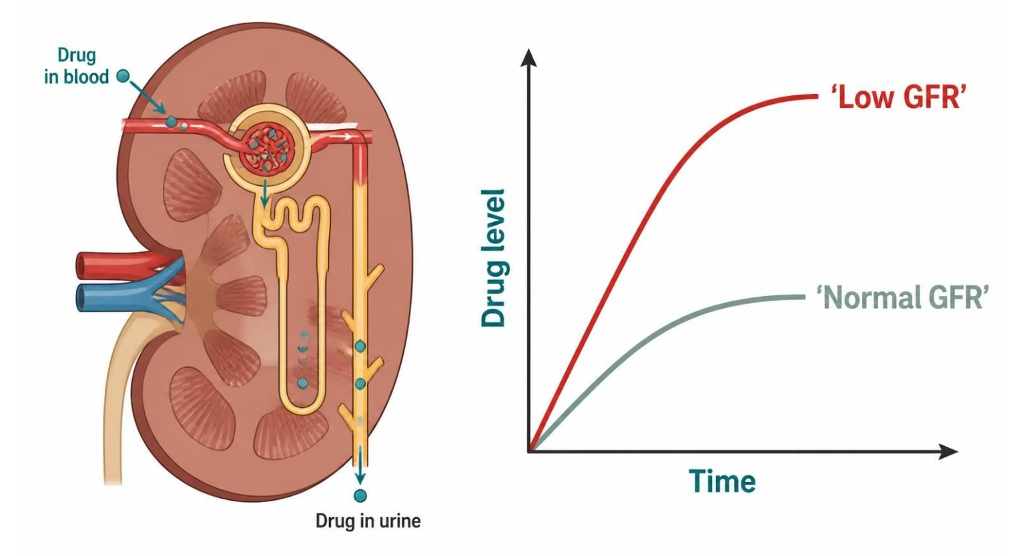
RENAL DOSING & DIURETIC SITES
Objectives: SO1 · SO2 · IO5.1 · IO5.5
Figure 1 · Renal dose adjustment: dose, interval, or both
Schematic (illustrative) — Figure 1. Reduced GFR slows clearance, so a renally cleared drug accumulates to higher levels (illustrative schematic). Fixes: lower the maintenance dose, extend the interval, or both; loading doses are often unchanged. S6; S6 (notes)
L09 · Renal Pharmacotherapeutics — Session 1
21

Slide 22
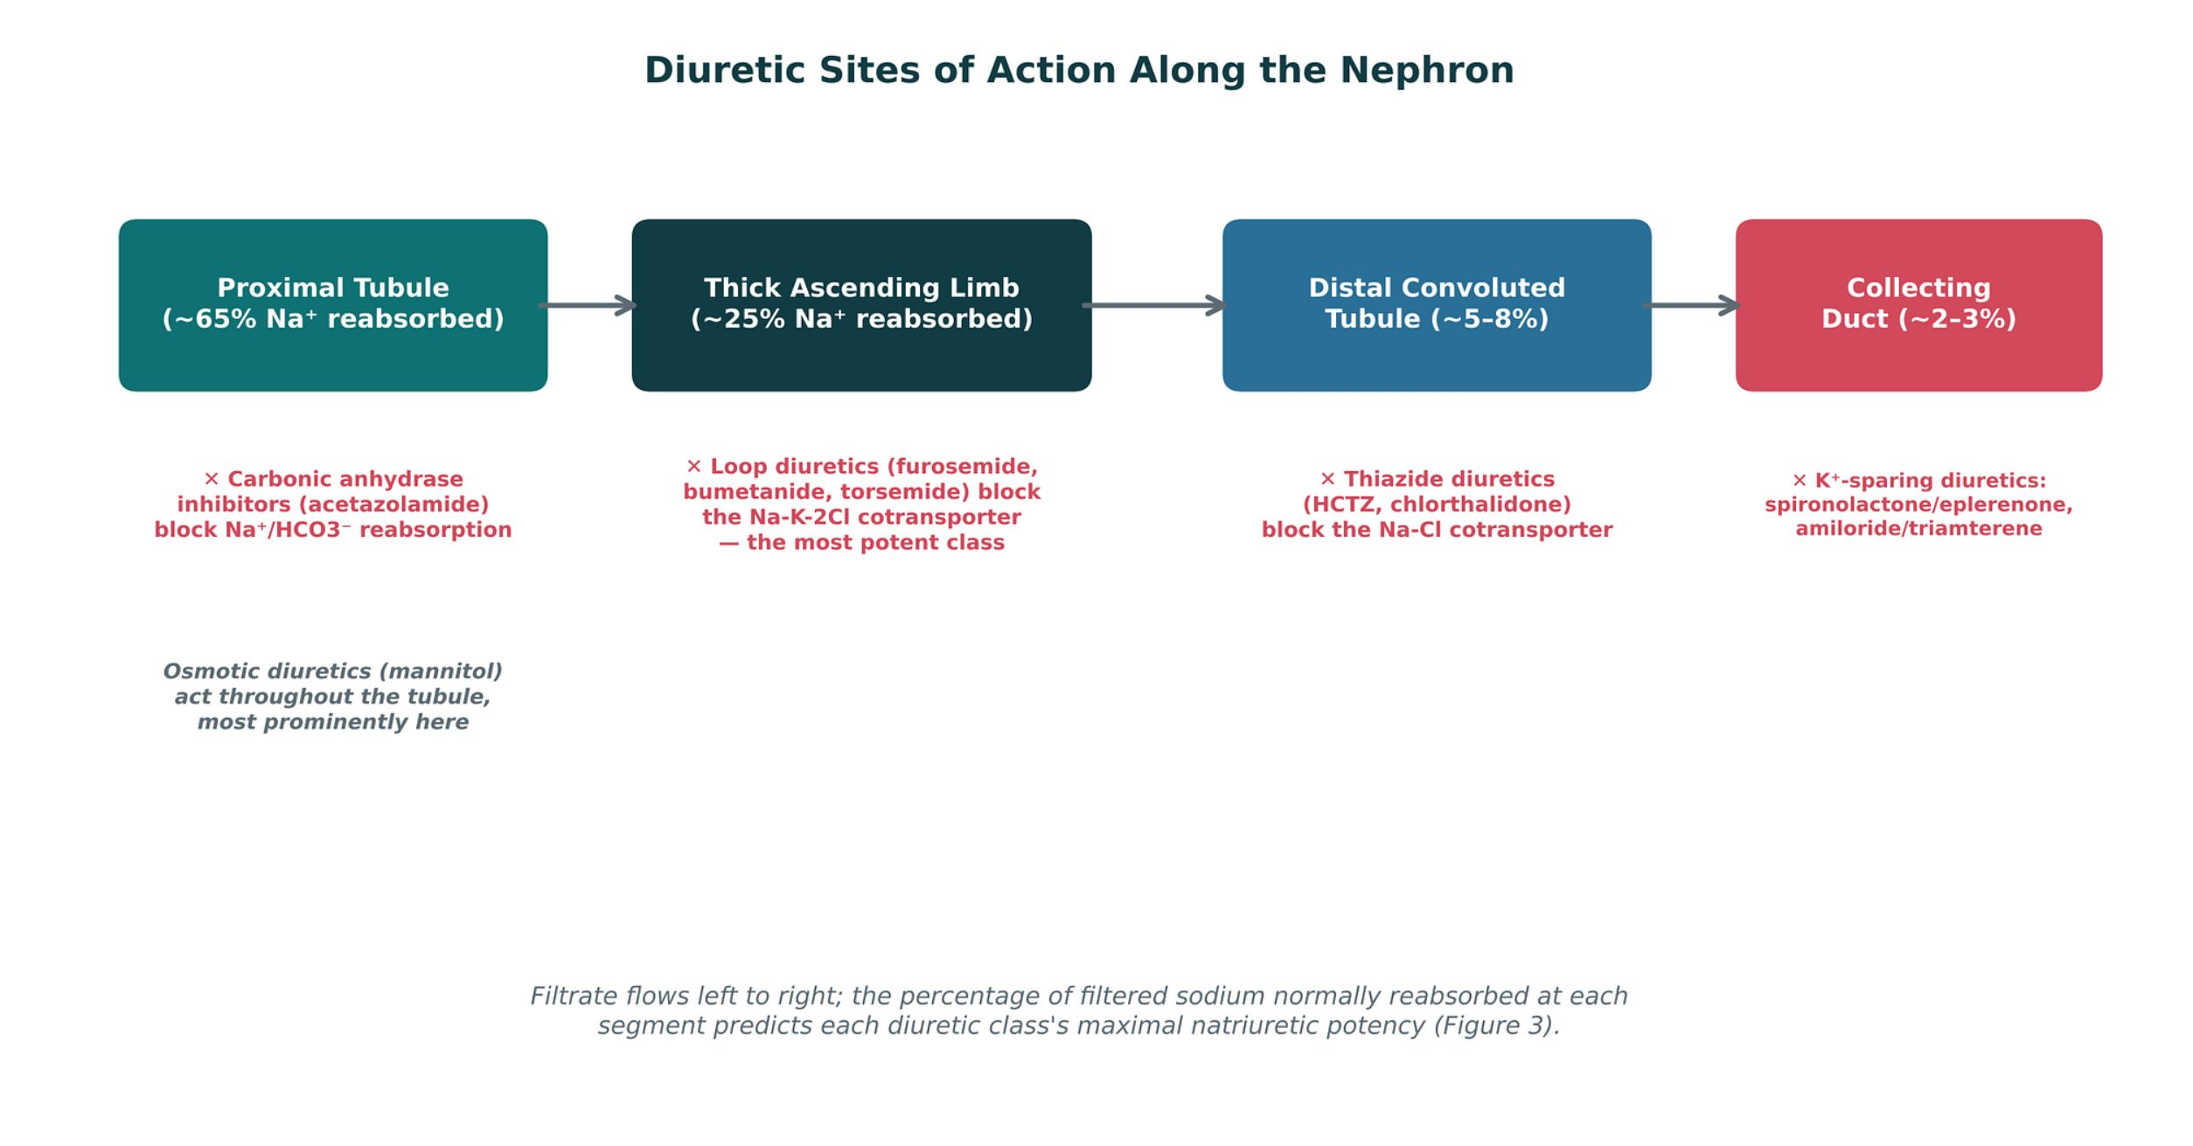
RENAL DOSING & DIURETIC SITES
Objectives: SO1 · SO2 · IO5.1 · IO5.5
Figure 2 · Diuretic sites of action along the nephron
Original illustrative diagram (not from Katzung): filtrate flows left to right through the proximal tubule (~65% of filtered Na⁺), thick ascending limb (~25%), distal convoluted tubule (~5–8%) and collecting duct (~2–3%); each class blocks sodium reabsorption at its own segment, and the share reabsorbed there predicts its potency. S7; S7 (notes)
L09 · Renal Pharmacotherapeutics — Session 1
22

Slide 23
RENAL DOSING & DIURETIC SITES
Objectives: SO1 · SO2 · IO5.1 · IO5.5
Compare: Renal dosing: what changes (S8)
What changes | Practical consideration
Dose, interval, or both — depends on the drug | Estimate CrCl or eGFR before dosing, especially in older adults
Loading dose often unchanged; maintenance dose adjusted | Reassess when illness, dehydration or nephrotoxins drop GFR
Renally cleared active/toxic metabolites count too | Use dosing references or clinical pharmacy
Focus: what tells these apart. Sources: S8
L09 · Renal Pharmacotherapeutics — Session 1
23

Slide 24
RENAL DOSING & DIURETIC SITES
Objectives: SO1 · SO2 · IO5.1 · IO5.5
Memory hooks
Why it happens
Why is the loading dose often unchanged? It fills the volume of distribution, which kidney failure doesn’t shrink much; clearance sets the maintenance dose. S8; p. 51; p. 52
L09 · Renal Pharmacotherapeutics — Session 1
24

Slide 25

RENAL DOSING & DIURETIC SITES
Objectives: SO1 · SO2 · IO5.1 · IO5.5
High-yield summary
If you remember nothing else
Falling GFR → accumulation → toxicity: cut the maintenance dose, stretch the interval, or both; check CrCl first. S6; S8; SG U5-R1
Sodium reabsorbed: proximal ~65%, loop ~25%, distal 5–8%, collecting duct 2–3%. S7 (notes)
L09 · Renal Pharmacotherapeutics — Session 1
25

Slide 26
CLINICAL VIGNETTE
Objectives: SO1 · SO2 · IO5.1 · IO5.5
Question 2
An 80-year-old has pneumonia and dehydration. She takes metformin and a DOAC. What is the best dosing habit?
A
Stop checking renal function in older adults
B
Keep last year’s doses since CrCl is stable
C
Re-estimate CrCl now and adjust renally cleared drugs
D
Double the loading dose of both drugs
E
Adjust only the drugs with toxic metabolites
L09 · Renal Pharmacotherapeutics — Session 1
26
Notes:
Answer on the next slide. Source: S5; S8

Slide 27

CLINICAL VIGNETTE · ANSWER
Objectives: SO1 · SO2 · IO5.1 · IO5.5
Answer 2: C
C. Re-estimate CrCl now and adjust renally cleared drugs
Acute illness and dehydration can drop GFR quickly; estimate CrCl or eGFR and reassess renally cleared drugs (S8). S5; S8
Why the other choices are wrong
A. Stop checking renal function in older adults — Older adults are the priority (S8).
B. Keep last year’s doses since CrCl is stable — GFR can fall quickly (S8).
D. Double the loading dose of both drugs — Loading doses are often unchanged (S8).
E. Adjust only the drugs with toxic metabolites — Parent drugs count too (S8).
L09 · Renal Pharmacotherapeutics — Session 1
27

Slide 28
Drug class 2 of 3
Loop & Thiazide Diuretics
Covers objectives: SO1 · SO3 · SO4 · SO5 · IO5.1 · IO5.2 · IO5.3 · IO5.4
Class
Prototype
Mechanism of action
Indications
Adverse effects
Contraindications
Drug interactions
Pharmacokinetics
Monitoring
Clinical pearls
28

Slide 29
LOOP & THIAZIDE DIURETICS
Objectives: SO1 · SO3 · SO4 · SO5 · IO5.1 · IO5.2 · IO5.3 · IO5.4
Class · Prototype + other drugs named
Class
Prototype + other drugs named
The two workhorse classes — one for potent natriuresis, one for everyday hypertension control. They act on the thick ascending limb and the distal tubule. S9; S9 (notes)
Loops are the most potent class; thiazides are first-line for hypertension. S10; S12
Furosemide, bumetanide, torsemide: loop diuretics. Hydrochlorothiazide: thiazide; chlorthalidone: thiazide-like. S10; S12
L09 · Renal Pharmacotherapeutics — Session 1
29

Slide 30
LOOP & THIAZIDE DIURETICS
Objectives: SO1 · SO3 · SO4 · SO5 · IO5.1 · IO5.2 · IO5.3 · IO5.4
Mechanism of action
Mechanism of action (1/2)
Mechanism: block the Na-K-2Cl cotransporter (NKCC2) in the thick ascending limb — the site responsible for ~25% of filtered sodium reabsorption. S10
Figure 3. Original illustrative diagram (not from Katzung): loop diuretics block NKCC2 in the thick ascending limb, reducing Na+/Cl-/K+ reabsorption and collapsing the lumen-positive potential that normally drives paracellular calcium and magnesium reabsorption — S11
explaining the increased calcium and magnesium excretion seen with this class. The lumen-positive potential (from K⁺ recycling) is the link students skip when they memorize “loops cause hypocalcemia” without the why. S11; S11 (notes); SG U5-R3
Mechanism: block the Na-Cl cotransporter in the distal convoluted tubule — a less potent natriuretic site (~5–8% of filtered sodium) than the loop. S12
L09 · Renal Pharmacotherapeutics — Session 1
30

Slide 31
LOOP & THIAZIDE DIURETICS
Objectives: SO1 · SO3 · SO4 · SO5 · IO5.1 · IO5.2 · IO5.3 · IO5.4
Mechanism of action (cont.)
Mechanism of action (2/2)
Follow the thiazide chain step by step (Figure 4): NCC block in the DCT → sodium and water loss → lower intracellular sodium → calcium retained through the NCX exchanger → falling urinary calcium. S13; S13 (notes); SG U5-R3
Contrast this with loop diuretics, which raise urinary calcium (Figure 3). S13 (notes)
In one line: loop diuretics collapse the lumen-positive potential driving paracellular Ca²⁺/Mg²⁺ reabsorption (↑ excretion); thiazides increase distal calcium reabsorption through a separate mechanism (↓ excretion). SG U5-R3
TB Loops work from the lumen, so their effect tracks proximal secretion; NSAIDs and probenecid compete and reduce it. NSAIDs also blunt the PGE2 contribution. p. 269; p. 270
L09 · Renal Pharmacotherapeutics — Session 1
31

Slide 32
LOOP & THIAZIDE DIURETICS
Objectives: SO1 · SO3 · SO4 · SO5 · IO5.1 · IO5.2 · IO5.3 · IO5.4
Indications
Indications (1/2)
Loops: edema (heart failure, cirrhosis, renal disease) and, at times, hypertension when a thiazide alone is insufficient (e.g., significant renal impairment). S10
Loop diuretics increase calcium excretion — useful in hypercalcemia, and the opposite effect of thiazides. S10; S10 (notes)
Hydrochlorothiazide, chlorthalidone — first-line agents for essential hypertension; chlorthalidone has a longer half-life and is often preferred for 24-hour BP control. S12
Thiazides decrease calcium excretion — can be therapeutically useful in patients with osteoporosis and recurrent calcium-containing kidney stones. S12; S13
L09 · Renal Pharmacotherapeutics — Session 1
32

Slide 33
LOOP & THIAZIDE DIURETICS
Objectives: SO1 · SO3 · SO4 · SO5 · IO5.1 · IO5.2 · IO5.3 · IO5.4
Indications (cont.)
Indications (2/2)
TB Hypercalcemia: normal saline plus IV furosemide (80–120 mg) — a loop alone causes volume contraction and stops working. p. 280
TB Nephrolithiasis: thiazide plus more fluid and less salt; do not restrict dietary calcium. p. 280
TB Diabetes insipidus (nephrogenic, including lithium-induced): thiazides reduce polyuria; amiloride blocks lithium entry; monitor lithium levels. p. 280
TB Nonedematous states, hypertension: chlorthalidone lowers BP more than HCTZ but has more adverse effects; loops reserved for GFR < 30–40 mL/min or heart failure. p. 280
L09 · Renal Pharmacotherapeutics — Session 1
33

Slide 34
LOOP & THIAZIDE DIURETICS
Objectives: SO1 · SO3 · SO4 · SO5 · IO5.1 · IO5.2 · IO5.3 · IO5.4
Adverse effects (boxed warnings first)
Adverse effects (boxed warnings first) (1/2)
Adverse effects: hypokalemia, hypomagnesemia, metabolic alkalosis, ototoxicity (especially with rapid IV administration or high doses), and hyperuricemia. S10
Adverse effects: hyponatremia (can be significant, especially in older adults), hypokalemia, hyperglycemia, hyperuricemia (can precipitate gout), and hypercalcemia. S12
Loops carry greater risk of ototoxicity and more pronounced electrolyte shifts than thiazides. S14
Thiazides: hyponatremia, gout, and hypokalemia are common adverse effects. S13
L09 · Renal Pharmacotherapeutics — Session 1
34

Slide 35
LOOP & THIAZIDE DIURETICS
Objectives: SO1 · SO3 · SO4 · SO5 · IO5.1 · IO5.2 · IO5.3 · IO5.4
Adverse effects (boxed warnings first) (cont.)
Adverse effects (boxed warnings first) (2/2)
TB Thiazide hyperglycemia occurs at HCTZ > 50 mg/d, not at 12.5 mg/d or less; correcting hypokalemia partly reverses it. p. 272
TB Thiazides are the diuretics most associated with gout and cause hypomagnesemia more than loops; loop ototoxicity is usually reversible. p. 271; p. 272; p. 273
TB Risk of hyponatremia with different diuretic classes: thiazides highest (elderly women); loops protective (odds ratio 0.61). p. 272; p. 281
L09 · Renal Pharmacotherapeutics — Session 1
35

Slide 36
LOOP & THIAZIDE DIURETICS
Objectives: SO1 · SO3 · SO4 · SO5 · IO5.1 · IO5.2 · IO5.3 · IO5.4
Contraindications · Drug interactions
Contraindications
Drug interactions
Furosemide carries a sulfonamide-related structure — historical cross-reactivity concern with sulfa allergy, though the clinical risk is now considered low; still worth a careful allergy history. S10; S10 (notes)
Thiazides lose efficacy as GFR falls below approximately 30 mL/min — loop diuretics are generally preferred once renal function is significantly reduced. S12; S13
Digoxin: hypokalemia from loops increases toxicity. Aminoglycosides: additive ototoxicity with loops. S38; S38 (notes)
Lithium: levels rise with thiazides. NSAIDs blunt the diuretic effect and raise AKI risk. S38; S38 (notes)
TB Diuretic combinations: loop agents and thiazides (often metolazone) are synergistic in loop resistance — but cause large fluid shifts and K⁺ wasting. p. 277
L09 · Renal Pharmacotherapeutics — Session 1
36

Slide 37
LOOP & THIAZIDE DIURETICS
Objectives: SO1 · SO3 · SO4 · SO5 · IO5.1 · IO5.2 · IO5.3 · IO5.4
Pharmacokinetics · Monitoring
Pharmacokinetics
Monitoring
Chlorthalidone: long half-life of 40-60 hours. S31
Torsemide: longer half-life and more predictable absorption than furosemide. Bumetanide is about 40 times more potent than furosemide mg for mg. S28; S29
TB Furosemide lasts 2–3 hours; torsemide 4–6 hours and absorbs in 1 hour, nearly as completely as IV. Torsemide is mainly cleared by the liver. p. 269
TB Chemistry & pharmacokinetics: all thiazides are sulfonamides given orally; chlorothiazide is the only parenteral thiazide. p. 271
Loops: monitor potassium, magnesium, creatinine. Thiazides: monitor sodium, potassium, calcium, glucose. S27; S30
IV furosemide slowly (no faster than 4 mg/min) — ototoxicity with rapid IV or high doses. S27
L09 · Renal Pharmacotherapeutics — Session 1
37

Slide 38
LOOP & THIAZIDE DIURETICS
Objectives: SO1 · SO3 · SO4 · SO5 · IO5.1 · IO5.2 · IO5.3 · IO5.4
Clinical pearls / "why" hook
Clinical pearls / "why" hook (1/2)
The calcium-handling difference between loops and thiazides is one of the highest-yield comparison points in this whole unit: loops increase Ca2+ excretion, thiazides decrease it — state it both ways. S10 (notes); S25; SG U5-R3
Case: hypertension and worsening CKD (eGFR now 25 mL/min), well controlled on chlorthalidone for years, but blood pressure has crept up. What is the most likely explanation, and what change in therapy would you consider? S15
Thiazide diuretics lose much of their natriuretic efficacy once GFR falls below roughly 30 mL/min, because there is too little filtered sodium reaching the distal tubule for the drug to act on meaningfully. S15
A loop diuretic, which acts upstream at the thick ascending limb, remains effective even in advanced CKD and is the more appropriate choice here. S15; S15 (notes)
L09 · Renal Pharmacotherapeutics — Session 1
38

Slide 39
LOOP & THIAZIDE DIURETICS
Objectives: SO1 · SO3 · SO4 · SO5 · IO5.1 · IO5.2 · IO5.3 · IO5.4
Clinical pearls / "why" hook (cont.)
Clinical pearls / "why" hook (2/2)
The “thiazides lose efficacy in advanced CKD” point bridges directly to Session 2’s hypertension-in-CKD content. S12 (notes)
TB Edematous states, heart failure: loops are standard, but overdiuresis cuts preload and cardiac output; hypokalemia worsens arrhythmias and digitalis toxicity. p. 278
TB Kidney disease and renal failure: little benefit below GFR 5 mL/min; high-dose loops or loop plus metolazone treat overload; avoid acetazolamide. p. 278; p. 279
TB Textbook case: HCTZ added to chronic furosemide in CKD → 15 kg lost, BP 91/58, creatinine 10.8 — hypovolemic AKI; monitor closely, ideally inpatient. p. 261; p. 285
L09 · Renal Pharmacotherapeutics — Session 1
39

Slide 40
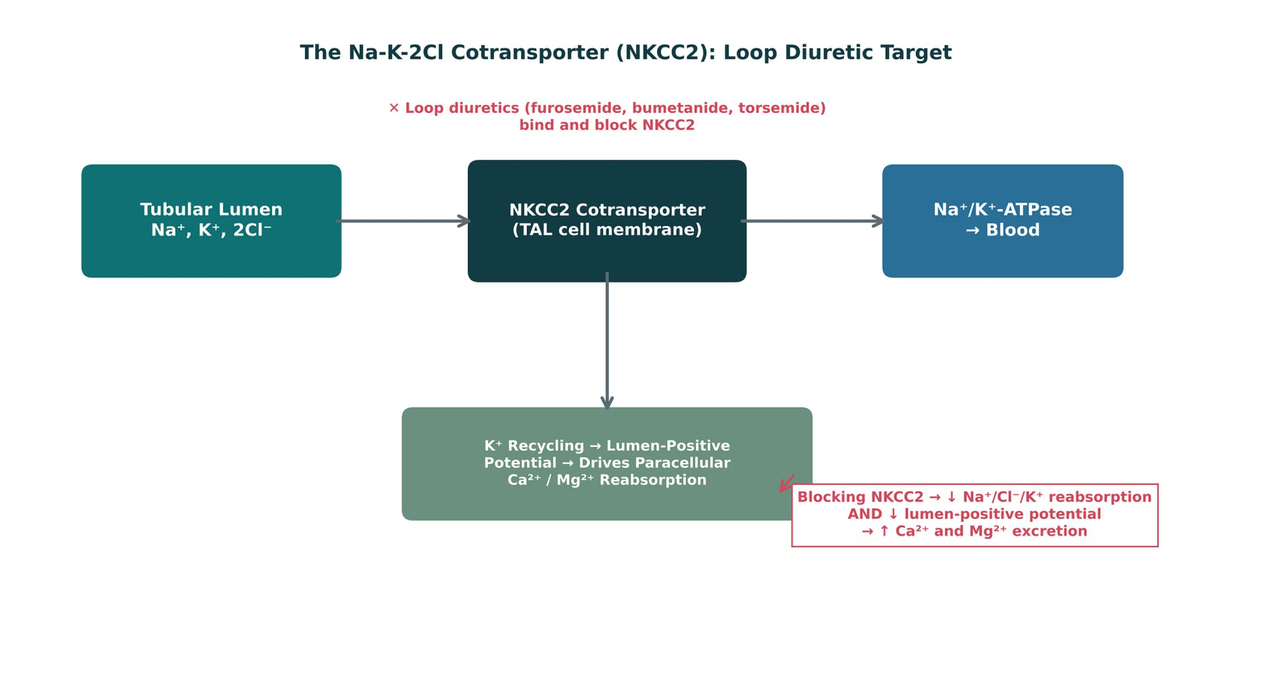
LOOP & THIAZIDE DIURETICS
Objectives: SO1 · SO3 · SO4 · SO5 · IO5.1 · IO5.2 · IO5.3 · IO5.4
Figure 3 · NKCC2: the loop diuretic target
Original illustrative diagram (not from Katzung): blocking NKCC2 in the thick ascending limb cuts Na⁺/K⁺/2Cl⁻ reabsorption and collapses the lumen-positive potential (from K⁺ recycling) that drives paracellular Ca²⁺ and Mg²⁺ reabsorption — so loops raise urinary calcium and magnesium. S11; S11 (notes)
L09 · Renal Pharmacotherapeutics — Session 1
40

Slide 41
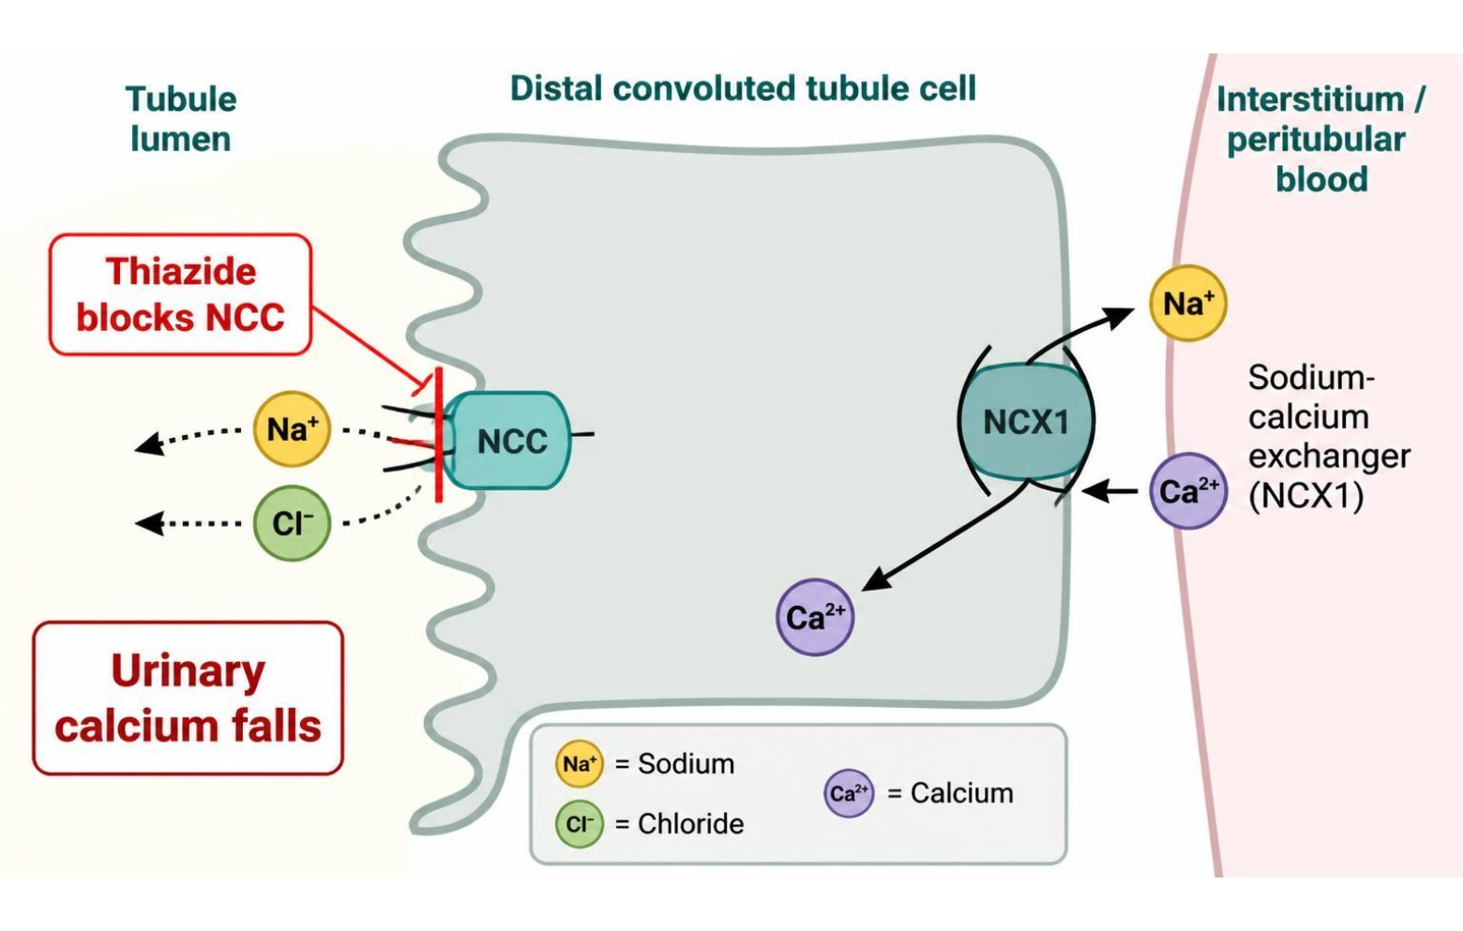
LOOP & THIAZIDE DIURETICS
Objectives: SO1 · SO3 · SO4 · SO5 · IO5.1 · IO5.2 · IO5.3 · IO5.4
Figure 4 · Thiazides: NCC block and calcium reabsorption
Schematic (illustrative) — Figure 4. Distal convoluted tubule: thiazide block of NCC lowers intracellular sodium, which favors Na⁺/Ca²⁺ exchange (NCX), so more calcium is reabsorbed and urinary calcium falls (illustrative schematic). S13; S13 (notes)
L09 · Renal Pharmacotherapeutics — Session 1
41

Slide 42


LOOP & THIAZIDE DIURETICS
Objectives: SO1 · SO3 · SO4 · SO5 · IO5.1 · IO5.2 · IO5.3 · IO5.4
⚠ Sources disagree: Thiazide efficacy in advanced CKD
Lecture slides say
Textbook says
Thiazides lose efficacy below GFR ~30 mL/min; switch to a loop. S12; S15
TB The exact GFR cutoff is debated; chlorthalidone still lowered BP in stage 4 CKD. p. 279; p. 280
L09 · Renal Pharmacotherapeutics — Session 1
42

Slide 43
LOOP & THIAZIDE DIURETICS
Objectives: SO1 · SO3 · SO4 · SO5 · IO5.1 · IO5.2 · IO5.3 · IO5.4
⚠ Sources disagree: Hypomagnesemia
Lecture slides say
Textbook says
Listed as a loop adverse effect. S10
TB More likely with thiazides than with loops. p. 273
L09 · Renal Pharmacotherapeutics — Session 1
43

Slide 44
LOOP & THIAZIDE DIURETICS
Objectives: SO1 · SO3 · SO4 · SO5 · IO5.1 · IO5.2 · IO5.3 · IO5.4
Compare: Loop vs. thiazide diuretics (S14)
 | Loop diuretics | Thiazide diuretics
Site, potency | Thick ascending limb — most potent natriuresis (~25%) | Distal convoluted tubule — modest natriuresis (~5–8%)
Calcium | Increase Ca²⁺ excretion | Decrease Ca²⁺ excretion
Best use | Preferred in edematous states and advanced CKD | First-line for essential hypertension with preserved renal function
Watch for | Greater risk of ototoxicity, more pronounced electrolyte shifts | Lose efficacy as GFR falls below ~30 mL/min
Focus: what tells these apart. Sources: S14; SG U5-R4
L09 · Renal Pharmacotherapeutics — Session 1
44

Slide 45
LOOP & THIAZIDE DIURETICS
Objectives: SO1 · SO3 · SO4 · SO5 · IO5.1 · IO5.2 · IO5.3 · IO5.4
Compare: Loop diuretic profiles: formulation, dose, indications
Drug | Class | Formulation | Adult dose | Indications
Furosemide (Lasix) | Loop diuretic | Tablets 20/40/80 mg; oral solution; IV injection 10 mg/mL | Edema: 20-80 mg PO once or BID, titrate to response (up to 600 mg/day in severe CKD or HF); IV 20-40 mg slowly (no faster than 4 mg/min) | Edema (heart failure, cirrhosis, kidney disease), hypertension, acute pulmonary edema, hypercalcemia
Bumetanide (Bumex) | Loop diuretic | Tablets 0.5/1/2 mg; IV injection 0.25 mg/mL | Edema: 0.5-2 mg PO once or BID (maximum 10 mg/day); IV 0.5-1 mg | Edema in heart failure, hepatic and renal disease
Torsemide (Demadex) | Loop diuretic | Tablets 5/10/20/100 mg | Edema: 10-20 mg PO daily (up to 200 mg/day); hypertension: 5 mg daily | Edema in heart failure, kidney disease, cirrhosis; hypertension
Focus: what tells these apart. Sources: S27; S28; S29
L09 · Renal Pharmacotherapeutics — Session 1
45

Slide 46
LOOP & THIAZIDE DIURETICS
Objectives: SO1 · SO3 · SO4 · SO5 · IO5.1 · IO5.2 · IO5.3 · IO5.4
Compare: Loop diuretic profiles: adverse effects, contraindications, toxicity
Drug | Adverse effects | Contraindications | Toxicity / overdose
Furosemide (Lasix) | Hypokalemia, hypomagnesemia, metabolic alkalosis, volume depletion, hyperuricemia, ototoxicity | Anuria, hypersensitivity; use caution with sulfonamide allergy (low cross-reactivity), hepatic coma | Ototoxicity with rapid IV or high doses, severe volume and electrolyte depletion, AKI; monitor potassium, magnesium, creatinine
Bumetanide (Bumex) | Hypokalemia, hyponatremia, hypomagnesemia, muscle cramps, dizziness, ototoxicity | Anuria, hepatic coma, severe electrolyte depletion, hypersensitivity | About 40 times more potent than furosemide mg for mg; profound diuresis, hypokalemia, ototoxicity
Torsemide (Demadex) | Hypokalemia, dizziness, headache, hyperuricemia, ototoxicity (less than furosemide) | Anuria, hypersensitivity (sulfonylurea or sulfonamide allergy caution) | Volume depletion, hypokalemia, hypotension; longer half-life and more predictable absorption than furosemide
Focus: what tells these apart. Sources: S27; S28; S29
L09 · Renal Pharmacotherapeutics — Session 1
46

Slide 47
LOOP & THIAZIDE DIURETICS
Objectives: SO1 · SO3 · SO4 · SO5 · IO5.1 · IO5.2 · IO5.3 · IO5.4
Compare: Thiazide profiles: formulation, dose, indications
Drug | Class | Formulation | Adult dose | Indications
Hydrochlorothiazide (Microzide) | Thiazide diuretic | Tablets 12.5/25/50 mg; capsules 12.5 mg; many fixed combinations | Hypertension: 12.5-25 mg PO daily (maximum 50 mg); edema: 25-100 mg daily | First-line hypertension, mild edema, calcium kidney stones, nephrogenic diabetes insipidus
Chlorthalidone (Thalitone) | Thiazide-like diuretic | Tablets 12.5/25/50 mg | Hypertension: 12.5-25 mg PO daily (maximum 50 mg); edema: 50-100 mg daily | Hypertension (longer duration, often preferred), edema
Focus: what tells these apart. Sources: S30; S31
L09 · Renal Pharmacotherapeutics — Session 1
47

Slide 48
LOOP & THIAZIDE DIURETICS
Objectives: SO1 · SO3 · SO4 · SO5 · IO5.1 · IO5.2 · IO5.3 · IO5.4
Compare: Thiazide profiles: adverse effects, contraindications, toxicity
Drug | Adverse effects | Contraindications | Toxicity / overdose
Hydrochlorothiazide (Microzide) | Hyponatremia, hypokalemia, hypercalcemia, hyperglycemia, hyperuricemia and gout, photosensitivity | Anuria, sulfonamide allergy; less effective when GFR is below about 30 mL/min | Severe hyponatremia and hypokalemia, volume depletion, hypercalcemia; monitor sodium, potassium, calcium, glucose
Chlorthalidone (Thalitone) | Hypokalemia, hyponatremia, hyperuricemia, hyperglycemia, erectile dysfunction | Anuria, sulfonamide allergy, severe hypokalemia | Profound hypokalemia and hyponatremia (more than hydrochlorothiazide at equal dose); long half-life of 40-60 hours
Focus: what tells these apart. Sources: S30; S31
L09 · Renal Pharmacotherapeutics — Session 1
48

Slide 49

LOOP & THIAZIDE DIURETICS
Objectives: SO1 · SO3 · SO4 · SO5 · IO5.1 · IO5.2 · IO5.3 · IO5.4
Memory hooks
Why it happens
Mnemonic (memory aid)
Why do thiazides fail at eGFR 25? Too little filtered sodium reaches the distal tubule; a loop acts upstream where the sodium still is. S15
Loops Lose calcium; Thiazides Take it back. S10; S12; SG U5-R3
L09 · Renal Pharmacotherapeutics — Session 1
49

Slide 50
LOOP & THIAZIDE DIURETICS
Objectives: SO1 · SO3 · SO4 · SO5 · IO5.1 · IO5.2 · IO5.3 · IO5.4
High-yield summary
If you remember nothing else
Loop = NKCC2, thick ascending limb, most potent, ↑ Ca²⁺ excretion, ototoxicity. Thiazide = NCC, DCT, first-line HTN, ↓ Ca²⁺ excretion. S14; SG U5-R3; SG U5-R4
Thiazides fade below GFR ~30 → switch to a loop. S15; SG U5-R4
L09 · Renal Pharmacotherapeutics — Session 1
50

Slide 51
CLINICAL VIGNETTE · LECTURE QUICK CHECK S15
Objectives: SO1 · SO3 · SO4 · SO5 · IO5.1 · IO5.2 · IO5.3 · IO5.4
Question 4
A patient with hypertension and eGFR now 25 mL/min has crept up in BP despite years on chlorthalidone. What is the best change?
A
Stop diuretics altogether
B
Switch to a loop diuretic
C
Double the chlorthalidone dose
D
Switch to acetazolamide
E
Add hydrochlorothiazide to chlorthalidone
L09 · Renal Pharmacotherapeutics — Session 1
51
Notes:
Answer on the next slide. Source: S15; SG U5-R4

Slide 52
CLINICAL VIGNETTE · ANSWER
Objectives: SO1 · SO3 · SO4 · SO5 · IO5.1 · IO5.2 · IO5.3 · IO5.4
Answer 4: B
B. Switch to a loop diuretic
Thiazides lose much of their efficacy below GFR ~30 because too little sodium reaches the distal tubule; a loop acts upstream and still works (S15). S15; SG U5-R4
Why the other choices are wrong
A. Stop diuretics altogether — A loop remains effective (S15).
C. Double the chlorthalidone dose — The site has too little filtered sodium (S15).
D. Switch to acetazolamide — Weak; avoided in kidney disease (S19; p. 279).
E. Add hydrochlorothiazide to chlorthalidone — Same failing site (S15).
L09 · Renal Pharmacotherapeutics — Session 1
52

Slide 53
CLINICAL VIGNETTE
Objectives: SO1 · SO3 · SO4 · SO5 · IO5.1 · IO5.2 · IO5.3 · IO5.4
Question 6
A patient has recurrent calcium kidney stones and hypertension with normal renal function. Which diuretic fits best?
A
Mannitol (osmotic diuretic)
B
Furosemide (loop diuretic)
C
Hydrochlorothiazide (thiazide)
D
Acetazolamide (CA inhibitor)
E
Bumetanide (loop diuretic)
L09 · Renal Pharmacotherapeutics — Session 1
53
Notes:
Answer on the next slide. Source: S12; S30

Slide 54
CLINICAL VIGNETTE · ANSWER
Objectives: SO1 · SO3 · SO4 · SO5 · IO5.1 · IO5.2 · IO5.3 · IO5.4
Answer 6: C
C. Hydrochlorothiazide (thiazide)
Thiazides decrease calcium excretion, useful in recurrent calcium stones; first-line HTN with preserved renal function (S12; S30). S12; S30
Why the other choices are wrong
A. Mannitol (osmotic diuretic) — IV osmotic agent for ICP/IOP (S37).
B. Furosemide (loop diuretic) — Increases calcium excretion (S10).
D. Acetazolamide (CA inhibitor) — Kidney stones are an adverse effect (S36).
E. Bumetanide (loop diuretic) — Loop; raises urinary calcium (S10).
L09 · Renal Pharmacotherapeutics — Session 1
54

Slide 55
Drug class 3 of 3
Potassium-Sparing, CAI & Osmotic Diuretics
Covers objectives: SO1 · SO3 · SO4 · SO5 · IO5.1 · IO5.2 · IO5.3 · IO5.4 · IO5.6
Class
Prototype
Mechanism of action
Indications
Adverse effects
Contraindications
Drug interactions
Pharmacokinetics
Monitoring
Clinical pearls
55

Slide 56
POTASSIUM-SPARING, CAI & OSMOTIC DIURETICS
Objectives: SO1 · SO3 · SO4 · SO5 · IO5.1 · IO5.2 · IO5.3 · IO5.4 · IO5.6
Class · Prototype + other drugs named
Class
Prototype + other drugs named
Smaller in potency, but each with a distinct and important clinical niche. Potassium-sparing, carbonic anhydrase inhibitor and osmotic diuretics act on the collecting duct and the proximal tubule. S16; S16 (notes)
Two mechanistically distinct subgroups acting at the collecting duct, both reducing potassium and hydrogen ion secretion. S17
Spironolactone, eplerenone: aldosterone receptor antagonists. Amiloride, triamterene: epithelial sodium channel (ENaC) blockers. S17
Carbonic anhydrase inhibitor: acetazolamide. Osmotic diuretic: mannitol. S19
L09 · Renal Pharmacotherapeutics — Session 1
56

Slide 57
POTASSIUM-SPARING, CAI & OSMOTIC DIURETICS
Objectives: SO1 · SO3 · SO4 · SO5 · IO5.1 · IO5.2 · IO5.3 · IO5.4 · IO5.6
Mechanism of action
Mechanism of action (1/2)
Aldosterone binds the mineralocorticoid receptor → increases ENaC and Na/K pump activity → K+ and H+ secreted into the tubule. Blocking either step reduces potassium and hydrogen secretion. S18; S18 (notes)
Spironolactone and eplerenone block the receptor (block aldosterone’s effect directly); amiloride and triamterene block ENaC directly, independent of aldosterone. S17; S18; S18 (notes)
Acetazolamide (carbonic anhydrase inhibitor): blocks Na+/HCO3- reabsorption in the proximal tubule → less HCO3- reabsorbed → bicarbonate diuresis, metabolic acidosis; weak diuretic effect. S19; S20; SG U5-R6
Mannitol (osmotic diuretic): an inert, filtered but poorly reabsorbed solute that holds water in the tubule lumen osmotically — osmotic diuresis. S19; S20
L09 · Renal Pharmacotherapeutics — Session 1
57

Slide 58
POTASSIUM-SPARING, CAI & OSMOTIC DIURETICS
Objectives: SO1 · SO3 · SO4 · SO5 · IO5.1 · IO5.2 · IO5.3 · IO5.4 · IO5.6
Mechanism of action (cont.)
Mechanism of action (2/2)
Side by side: acetazolamide removes bicarbonate reabsorption; mannitol removes water reabsorption by staying in the lumen. Both act before the loop, so their natriuretic potency is modest. S20 (notes)
Figure 6 (Schematic (illustrative)): proximal tubule — carbonic anhydrase inhibition and osmotic holding of water (illustrative schematic). S20
Figure 7. Original illustrative comparison (illustrative values, not from Katzung): loop diuretics block roughly 25% of filtered sodium reabsorption, substantially more than thiazides, carbonic anhydrase inhibitors, or potassium-sparing diuretics — S21
directly reflecting the percentage normally reabsorbed at each nephron segment in Figure 2. This is why loops are reached for first when potent natriuresis is the goal. S21; S21 (notes)
L09 · Renal Pharmacotherapeutics — Session 1
58

Slide 59
POTASSIUM-SPARING, CAI & OSMOTIC DIURETICS
Objectives: SO1 · SO3 · SO4 · SO5 · IO5.1 · IO5.2 · IO5.3 · IO5.4 · IO5.6
Indications
Indications (1/2)
Potassium-sparing agents are often used in combination with a loop or thiazide diuretic specifically to offset potassium loss from the more potent class. S17
Acetazolamide: valued for non-diuretic uses — glaucoma (reduces aqueous humor production), altitude sickness prophylaxis, and metabolic alkalosis correction; also raised intracranial pressure. S19; S20
Mannitol: used to reduce elevated intracranial or intraocular pressure and in certain cases of rhabdomyolysis-associated kidney injury prevention. S19
Know the niche, not an everyday use: acetazolamide = glaucoma/altitude sickness; mannitol = ICP/IOP reduction. S19 (notes)
L09 · Renal Pharmacotherapeutics — Session 1
59

Slide 60
POTASSIUM-SPARING, CAI & OSMOTIC DIURETICS
Objectives: SO1 · SO3 · SO4 · SO5 · IO5.1 · IO5.2 · IO5.3 · IO5.4 · IO5.6
Indications (cont.)
Indications (2/2)
TB Potassium-sparing diuretics fit mineralocorticoid excess: primary (Conn syndrome) or secondary hyperaldosteronism (heart failure, cirrhosis, nephrotic syndrome). p. 274
TB Hepatic cirrhosis: resistant to loops but unusually responsive to spironolactone; aggressive diuresis risks hepatorenal syndrome and encephalopathy. p. 279
TB Renal & cardiac protection: aldosterone antagonists are cardioprotective and lower albuminuria; finerenone slowed CKD in type 2 diabetes. p. 281
TB Idiopathic edema (women 20–30): rule out surreptitious diuretic use; prefer moderate salt restriction. p. 279
L09 · Renal Pharmacotherapeutics — Session 1
60

Slide 61
POTASSIUM-SPARING, CAI & OSMOTIC DIURETICS
Objectives: SO1 · SO3 · SO4 · SO5 · IO5.1 · IO5.2 · IO5.3 · IO5.4 · IO5.6
Adverse effects (boxed warnings first)
Adverse effects (boxed warnings first) (1/2)
Primary adverse effect across the class: hyperkalemia — the risk rises sharply when combined with ACE inhibitors, ARBs, or in renal impairment (a direct preview of Session 2's cardiorenal drug-interaction content). S17; SG U5-R5
Spironolactone also has antiandrogen effects (gynecomastia, menstrual irregularities) that eplerenone largely avoids. S17
Acetazolamide causes a mild metabolic acidosis as a predictable adverse effect, plus potassium loss; watch for kidney stones. S19; S20
Mannitol expands extracellular volume — can worsen volume overload if used inappropriately; avoid it in heart failure and volume depletion. S19; S20
L09 · Renal Pharmacotherapeutics — Session 1
61

Slide 62
POTASSIUM-SPARING, CAI & OSMOTIC DIURETICS
Objectives: SO1 · SO3 · SO4 · SO5 · IO5.1 · IO5.2 · IO5.3 · IO5.4 · IO5.6
Adverse effects (boxed warnings first) (cont.)
Adverse effects (boxed warnings first) (2/2)
TB K⁺-sparing agents can cause hyperchloremic metabolic acidosis (like type IV RTA); triamterene can cause kidney stones and, with indomethacin, acute renal failure. p. 275
TB Acetazolamide: drowsiness, paresthesias, calcium phosphate stones, hyperammonemia in cirrhosis; monitor potassium and phosphorus. p. 268
TB Mannitol: early ECF expansion and hyponatremia, later dehydration, hypernatremia and hyperkalemia; AKI in 6–7% of patients. p. 276
L09 · Renal Pharmacotherapeutics — Session 1
62

Slide 63
POTASSIUM-SPARING, CAI & OSMOTIC DIURETICS
Objectives: SO1 · SO3 · SO4 · SO5 · IO5.1 · IO5.2 · IO5.3 · IO5.4 · IO5.6
Contraindications
Contraindications
Mannitol requires intact renal perfusion to be effective. S19; S20 (notes)
Eplerenone: avoid with potassium above 5.5 mEq/L, CrCl below 30 mL/min, or strong CYP3A4 inhibitors (such as ketoconazole). S33
L09 · Renal Pharmacotherapeutics — Session 1
63

Slide 64
POTASSIUM-SPARING, CAI & OSMOTIC DIURETICS
Objectives: SO1 · SO3 · SO4 · SO5 · IO5.1 · IO5.2 · IO5.3 · IO5.4 · IO5.6
Drug interactions
Drug interactions
Hyperkalemia risk rises with ACE inhibitors, ARBs, or CKD — both block aldosterone’s effect, so the classes are combined carefully. S18; S18 (notes)
Flag the hyperkalemia-with-ACEi/ARB interaction as a preview: this exact combination becomes a major theme in Session 2 when RAAS blockers are introduced. S17 (notes)
Potassium supplements and trimethoprim: hyperkalemia with potassium-sparing diuretics. S38; S38 (notes)
Sulfonamide allergy: caution with loops, thiazides, acetazolamide. Metformin, vancomycin, DOACs: renally cleared; need dose adjustment. S38; S38 (notes)
TB Strong CYP3A4 inhibitors (erythromycin, fluconazole, diltiazem, grapefruit juice) raise eplerenone but not spironolactone levels. p. 275
TB RALES showed spironolactone helps severe heart failure on an ACE inhibitor — afterward hyperkalemia admissions and deaths rose. p. 275
L09 · Renal Pharmacotherapeutics — Session 1
64

Slide 65
POTASSIUM-SPARING, CAI & OSMOTIC DIURETICS
Objectives: SO1 · SO3 · SO4 · SO5 · IO5.1 · IO5.2 · IO5.3 · IO5.4 · IO5.6
Pharmacokinetics · Monitoring
Pharmacokinetics
Monitoring
TB Acetazolamide diuresis fades within 2–3 days (reduce dose in renal insufficiency); mannitol must be given IV — orally it causes osmotic diarrhea. p. 268; p. 275
Spironolactone: monitor potassium and creatinine within 1 week; life-threatening hyperkalemia, especially in CKD or with ACE inhibitor/ARB. S32
Mannitol: monitor osmolality and electrolytes. S37
L09 · Renal Pharmacotherapeutics — Session 1
65

Slide 66
POTASSIUM-SPARING, CAI & OSMOTIC DIURETICS
Objectives: SO1 · SO3 · SO4 · SO5 · IO5.1 · IO5.2 · IO5.3 · IO5.4 · IO5.6
Clinical pearls / "why" hook
Clinical pearls / "why" hook (1/2)
Case: a patient with stage 3 chronic kidney disease and heart failure is taking an ACE inhibitor and is started on spironolactone for additional heart-failure benefit; two weeks later a routine basic metabolic panel shows potassium 6.1 mEq/L. S23
What is the mechanistic explanation for this finding, and what does it suggest about future drug combinations in this unit? S23; S23 (notes)
Both the ACE inhibitor (by reducing aldosterone) and spironolactone (by directly blocking the aldosterone receptor) independently reduce potassium excretion — combined, and in the setting of CKD (which already impairs potassium excretion), the hyperkalemia risk compounds. S23
This is the same additive-risk logic that will reappear as the "triple whammy" in Session 2. The ACEi/aldosterone-antagonist pair is one of three “whammies” formalized next session. S23; S23 (notes)
L09 · Renal Pharmacotherapeutics — Session 1
66

Slide 67
POTASSIUM-SPARING, CAI & OSMOTIC DIURETICS
Objectives: SO1 · SO3 · SO4 · SO5 · IO5.1 · IO5.2 · IO5.3 · IO5.4 · IO5.6
Clinical pearls / "why" hook (cont.)
Clinical pearls / "why" hook (2/2)
Recap: diuretic classes are organized by nephron site (Figure 2): loop diuretics (thick ascending limb) are most potent, followed by thiazides (distal tubule), then potassium-sparing and carbonic anhydrase inhibitors. S25
Recap: loop and thiazide diuretics have opposite effects on calcium excretion (Figure 3); potassium-sparing diuretics carry a hyperkalemia risk that compounds with ACE inhibitors or ARBs. S25
Session 2 (Thursday, November 19) continues with antihypertensive therapy in chronic kidney disease and the cardiovascular-renal overlap, including vasodilators and angina pharmacology — RAAS blockers and the triple whammy first. S25; S25 (notes)
TB SGLT2 inhibitors block proximal glucose and Na⁺ reabsorption; main indication now cardiorenal protection. Adverse reactions: sixfold genital fungal infections in women, initial GFR dip. p. 268; p. 269
TB Antidiuretic hormone antagonists (vaptans): oral tolvaptan (V2), IV conivaptan (V1a and V2) for SIADH when water restriction fails; watch sodium and liver tests. p. 276; p. 277
L09 · Renal Pharmacotherapeutics — Session 1
67

Slide 68
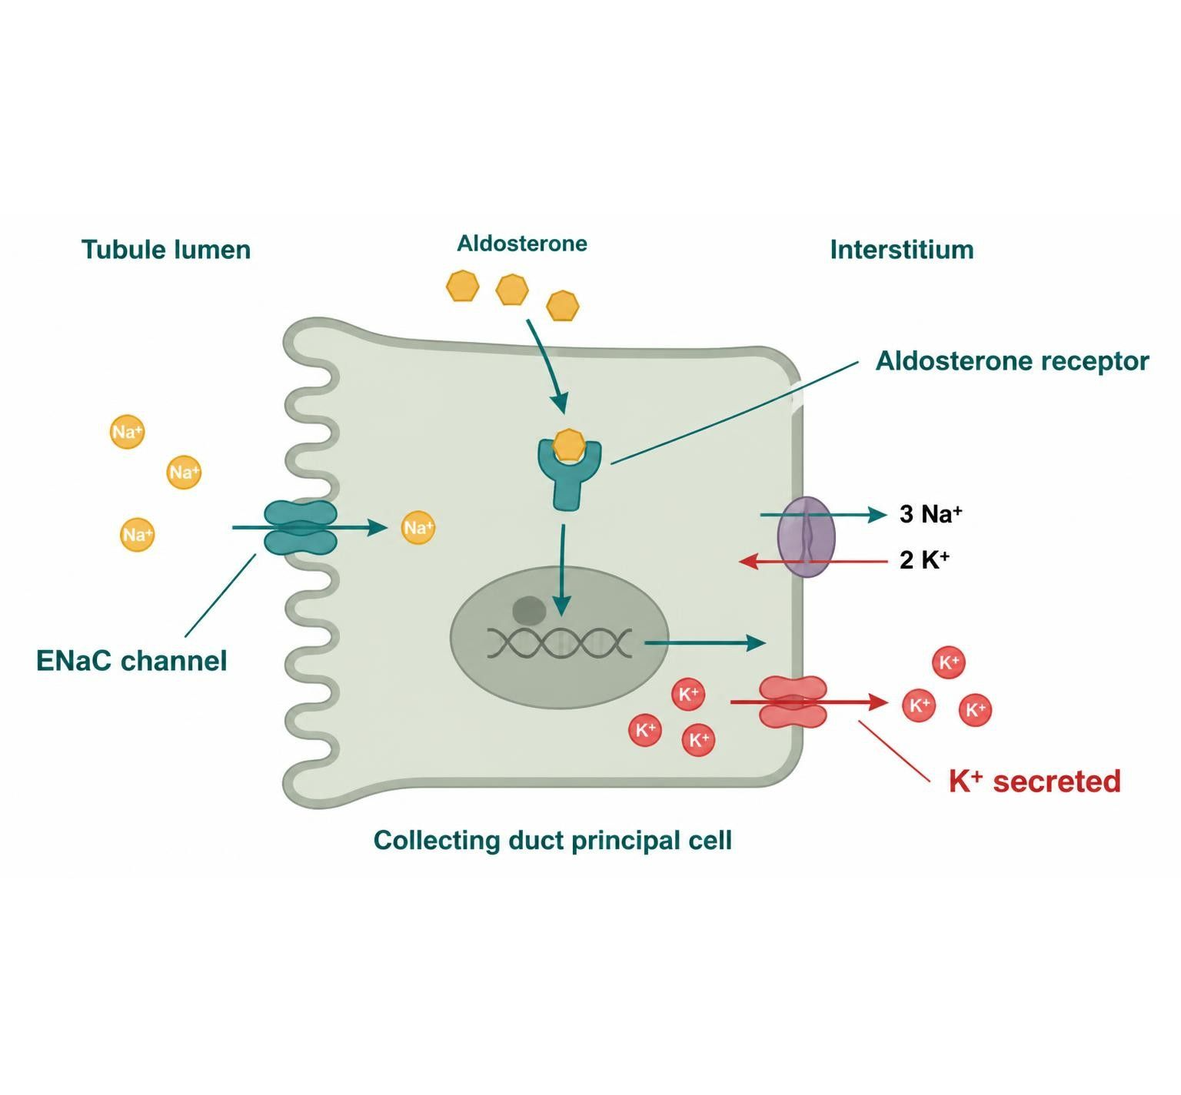
POTASSIUM-SPARING, CAI & OSMOTIC DIURETICS
Objectives: SO1 · SO3 · SO4 · SO5 · IO5.1 · IO5.2 · IO5.3 · IO5.4 · IO5.6
Figure 5 · Collecting duct: aldosterone blockers vs. ENaC blockers
Schematic (illustrative) — Figure 5. Collecting duct: aldosterone-receptor blockers and ENaC blockers act at different steps (illustrative schematic). One blocks the hormone’s receptor, the other blocks the channel the hormone turns on; both raise potassium. S18; S18 (notes)
L09 · Renal Pharmacotherapeutics — Session 1
68

Slide 69
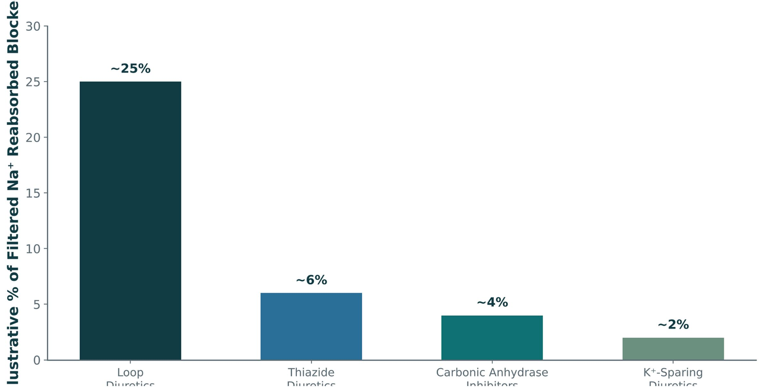
POTASSIUM-SPARING, CAI & OSMOTIC DIURETICS
Objectives: SO1 · SO3 · SO4 · SO5 · IO5.1 · IO5.2 · IO5.3 · IO5.4 · IO5.6
Figure 7 · Diuretic class comparison: natriuretic potency
Original illustrative comparison (illustrative values, not from Katzung): loops block about 25% of filtered sodium reabsorption, thiazides about 6%, carbonic anhydrase inhibitors about 4%, potassium-sparing diuretics about 2% — the same nephron-segment logic as Figure 2, now quantified. S21; S21 (notes)
L09 · Renal Pharmacotherapeutics — Session 1
69

Slide 70
POTASSIUM-SPARING, CAI & OSMOTIC DIURETICS
Objectives: SO1 · SO3 · SO4 · SO5 · IO5.1 · IO5.2 · IO5.3 · IO5.4 · IO5.6
⚠ Sources disagree: Mannitol dose for raised ICP/IOP
Lecture slides say
Textbook says
0.25–1 g/kg IV over 30–60 minutes. S37
TB 1–2 g/kg IV. p. 275
L09 · Renal Pharmacotherapeutics — Session 1
70

Slide 71
POTASSIUM-SPARING, CAI & OSMOTIC DIURETICS
Objectives: SO1 · SO3 · SO4 · SO5 · IO5.1 · IO5.2 · IO5.3 · IO5.4 · IO5.6
Compare: Diuretic classes at a glance (Table 1)
Class | Example agent(s) | Key teaching point
Loop | Furosemide, bumetanide, torsemide | Most potent; blocks NKCC2; ↑ Ca²⁺ excretion; ototoxicity risk
Thiazide | Hydrochlorothiazide, chlorthalidone | First-line for HTN; ↓ Ca²⁺ excretion; loses efficacy at low GFR
K⁺-sparing | Spironolactone, eplerenone, amiloride, triamterene | Hyperkalemia risk, especially with ACEi/ARB
CAI / Osmotic | Acetazolamide / mannitol | Niche uses: glaucoma, altitude sickness / ↑ ICP, ↑ IOP
Focus: what tells these apart. Sources: S22; S22 (notes)
L09 · Renal Pharmacotherapeutics — Session 1
71

Slide 72
POTASSIUM-SPARING, CAI & OSMOTIC DIURETICS
Objectives: SO1 · SO3 · SO4 · SO5 · IO5.1 · IO5.2 · IO5.3 · IO5.4 · IO5.6
Compare: Figure 6 · Proximal tubule: carbonic anhydrase inhibition and osmotic holding of water (Schematic (illustrative))
 | Acetazolamide | Mannitol
How | Blocks carbonic anhydrase → less HCO₃⁻ reabsorbed | Filtered, not reabsorbed → water held in lumen
Result | Bicarbonate diuresis, metabolic acidosis | Osmotic diuresis
Uses | Glaucoma, altitude sickness, raised intracranial pressure | Raised ICP or IOP
Watch for | Metabolic acidosis, potassium loss, kidney stones | Expands extracellular volume; avoid in heart failure and volume depletion
Focus: what tells these apart. Sources: S20; S20 (notes)
L09 · Renal Pharmacotherapeutics — Session 1
72

Slide 73
POTASSIUM-SPARING, CAI & OSMOTIC DIURETICS
Objectives: SO1 · SO3 · SO4 · SO5 · IO5.1 · IO5.2 · IO5.3 · IO5.4 · IO5.6
Compare: Drug names reveal the class (S24)
Stem | Class | Examples | Memory aid
-semide | Loop | Furosemide, torsemide | Works at the thick ascending limb; strongest class
-tanide | Loop | Bumetanide | About 40× furosemide potency, mg for mg
-thiazide | Thiazide | Hydrochlorothiazide | Acts at the distal convoluted tubule
-thalidone | Thiazide-like | Chlorthalidone | Same site, longer action
-onolactone / -erenone | Aldosterone antagonist | Spironolactone, eplerenone | Blocks the mineralocorticoid receptor
-ride | ENaC blocker | Amiloride | Blocks the sodium channel directly
-zolamide | Carbonic anhydrase inhibitor | Acetazolamide | Proximal tubule; bicarbonate diuresis
mannitol / -itol | Osmotic diuretic | Mannitol | Filtered, holds water in the lumen
Focus: what tells these apart. Sources: S24; S24 (notes)
L09 · Renal Pharmacotherapeutics — Session 1
73

Slide 74
POTASSIUM-SPARING, CAI & OSMOTIC DIURETICS
Objectives: SO1 · SO3 · SO4 · SO5 · IO5.1 · IO5.2 · IO5.3 · IO5.4 · IO5.6
Compare: Supporting drugs at a glance (S38)
Drug(s) | Why it matters here
ACE inhibitors and ARBs | Hyperkalemia with potassium-sparing diuretics
NSAIDs | Blunt diuretic effect; raise AKI risk
Lithium | Levels rise with thiazides
Digoxin | Hypokalemia from loops increases toxicity
Aminoglycosides | Additive ototoxicity with loops
Potassium supplements and trimethoprim | Hyperkalemia with potassium-sparing diuretics
Sulfonamide allergy | Caution with loops, thiazides, acetazolamide
Metformin, vancomycin, DOACs | Renally cleared; need dose adjustment
Focus: what tells these apart. Sources: S38; S38 (notes)
L09 · Renal Pharmacotherapeutics — Session 1
74

Slide 75
POTASSIUM-SPARING, CAI & OSMOTIC DIURETICS
Objectives: SO1 · SO3 · SO4 · SO5 · IO5.1 · IO5.2 · IO5.3 · IO5.4 · IO5.6
Compare: Potassium-sparing profiles: formulation, dose, indications
Drug | Class | Formulation | Adult dose | Indications
Spironolactone (Aldactone) | Aldosterone receptor antagonist (potassium-sparing) | Tablets 25/50/100 mg; oral suspension | Hypertension: 25-100 mg daily; heart failure: 12.5-25 mg daily; primary hyperaldosteronism: 100-400 mg daily | Heart failure, resistant hypertension, primary hyperaldosteronism, edema, ascites
Eplerenone (Inspra) | Selective aldosterone receptor antagonist | Tablets 25/50 mg | Heart failure post-MI: 25 mg daily, increase to 50 mg; hypertension: 50 mg daily, may increase to BID | Heart failure after myocardial infarction, hypertension
Focus: what tells these apart. Sources: S32; S33; S34; S35
L09 · Renal Pharmacotherapeutics — Session 1
75

Slide 76
POTASSIUM-SPARING, CAI & OSMOTIC DIURETICS
Objectives: SO1 · SO3 · SO4 · SO5 · IO5.1 · IO5.2 · IO5.3 · IO5.4 · IO5.6
Compare: Potassium-sparing profiles: formulation, dose, indications (cont.)
Drug | Class | Formulation | Adult dose | Indications
Amiloride (Midamor) | ENaC blocker (potassium-sparing) | Tablets 5 mg | 5 mg PO daily, may increase to 10 mg (maximum 20 mg/day) | Adjunct to loop or thiazide to preserve potassium, lithium-induced nephrogenic diabetes insipidus
Triamterene (Dyrenium; Maxzide and Dyazide combinations) | ENaC blocker (potassium-sparing) | Capsules 50/100 mg; combination tablets with hydrochlorothiazide (37.5/25 and 75/50 mg) | Alone: 100 mg PO BID (maximum 300 mg/day); combination: 37.5/25 to 75/50 mg daily | Edema, hypertension, hypokalemia prevention
Focus: what tells these apart. Sources: S32; S33; S34; S35
L09 · Renal Pharmacotherapeutics — Session 1
76

Slide 77
POTASSIUM-SPARING, CAI & OSMOTIC DIURETICS
Objectives: SO1 · SO3 · SO4 · SO5 · IO5.1 · IO5.2 · IO5.3 · IO5.4 · IO5.6
Compare: Potassium-sparing profiles: adverse effects, contraindications, toxicity
Drug | Adverse effects | Contraindications | Toxicity / overdose
Spironolactone (Aldactone) | Hyperkalemia, gynecomastia, menstrual irregularity, breast tenderness, GI upset | Hyperkalemia, Addison disease, anuria; avoid with potassium supplements and caution with ACE inhibitors or ARBs | Life-threatening hyperkalemia, especially in CKD or with ACE inhibitor/ARB; monitor potassium and creatinine within 1 week
Eplerenone (Inspra) | Hyperkalemia, dizziness, hypertriglyceridemia, fewer antiandrogen effects | Potassium above 5.5 mEq/L, CrCl below 30 mL/min, strong CYP3A4 inhibitors (such as ketoconazole) | Hyperkalemia; levels rise sharply with CYP3A4 inhibitors; monitor potassium and creatinine
Amiloride (Midamor) | Hyperkalemia, nausea, headache, weakness | Potassium above 5.5 mEq/L, anuria, significant renal impairment, concomitant potassium supplements | Hyperkalemia with arrhythmias, especially in diabetes and CKD; monitor potassium
Triamterene (Dyrenium; Maxzide and Dyazide combinations) | Hyperkalemia, nausea, kidney stones, blue urine, folate antagonism | Hyperkalemia, severe renal impairment, anuria, concomitant potassium supplements | Hyperkalemia, nephrolithiasis, AKI with NSAIDs; monitor potassium and creatinine
Focus: what tells these apart. Sources: S32; S33; S34; S35
L09 · Renal Pharmacotherapeutics — Session 1
77

Slide 78
POTASSIUM-SPARING, CAI & OSMOTIC DIURETICS
Objectives: SO1 · SO3 · SO4 · SO5 · IO5.1 · IO5.2 · IO5.3 · IO5.4 · IO5.6
Compare: Acetazolamide and mannitol profiles: formulation, dose, indications
Drug | Class | Formulation | Adult dose | Indications
Acetazolamide (Diamox) | Carbonic anhydrase inhibitor | Tablets 125/250 mg; extended-release capsules 500 mg; IV 500 mg | Glaucoma: 250 mg PO 1-4 times daily; altitude sickness: 125-250 mg BID starting a day before ascent; edema: 250-375 mg daily | Glaucoma, altitude sickness prophylaxis, metabolic alkalosis, idiopathic intracranial hypertension
Mannitol (Osmitrol) | Osmotic diuretic | IV solutions 10%, 15%, 20% and 25% | Raised ICP or IOP: 0.25-1 g/kg IV over 30-60 minutes; repeat 0.25-0.5 g/kg every 4-8 hours as needed | Raised intracranial pressure, raised intraocular pressure, oliguria prevention in selected cases
Focus: what tells these apart. Sources: S36; S37
L09 · Renal Pharmacotherapeutics — Session 1
78

Slide 79
POTASSIUM-SPARING, CAI & OSMOTIC DIURETICS
Objectives: SO1 · SO3 · SO4 · SO5 · IO5.1 · IO5.2 · IO5.3 · IO5.4 · IO5.6
Compare: Acetazolamide and mannitol profiles: adverse effects, contraindications, toxicity
Drug | Adverse effects | Contraindications | Toxicity / overdose
Acetazolamide (Diamox) | Metabolic acidosis, paresthesias, hypokalemia, kidney stones, taste changes | Sulfonamide allergy, severe renal or hepatic disease, hyponatremia, hypokalemia, adrenal failure | Severe metabolic acidosis, hypokalemia, confusion, bone marrow suppression (rare)
Mannitol (Osmitrol) | Fluid and electrolyte shifts, headache, nausea, thirst, hyponatremia | Anuria, severe dehydration, active intracranial bleeding, severe pulmonary edema, heart failure | Volume overload with pulmonary edema, hyperosmolality, AKI, hypo- or hypernatremia; monitor osmolality and electrolytes
Focus: what tells these apart. Sources: S36; S37
L09 · Renal Pharmacotherapeutics — Session 1
79

Slide 80
POTASSIUM-SPARING, CAI & OSMOTIC DIURETICS
Objectives: SO1 · SO3 · SO4 · SO5 · IO5.1 · IO5.2 · IO5.3 · IO5.4 · IO5.6
Compare: Other renal agents in the reading (textbook)
Drug / group | Mechanism | Point
SGLT2 inhibitors (dapagliflozin, empagliflozin, canagliflozin) | Block proximal Na⁺/glucose cotransport | Cardio- and renoprotective; genital fungal infections
Finerenone | Nonsteroidal mineralocorticoid antagonist | Less hyperkalemia (2.8%); slows diabetic CKD
Metolazone | Thiazide-like | Added to loops for synergy; start 2.5 mg weekly
Ethacrynic acid | Loop, not a sulfonamide | Option for true sulfa allergy
Tolvaptan / conivaptan | V2 / V1a+V2 ADH antagonists | SIADH, heart-failure hyponatremia; liver tests
Dorzolamide, brinzolamide | Topical carbonic anhydrase inhibitors | Glaucoma without systemic effects
Focus: what tells these apart. Sources: p. 267; p. 268; p. 273; p. 276; p. 277; p. 281
L09 · Renal Pharmacotherapeutics — Session 1
80

Slide 81
POTASSIUM-SPARING, CAI & OSMOTIC DIURETICS
Objectives: SO1 · SO3 · SO4 · SO5 · IO5.1 · IO5.2 · IO5.3 · IO5.4 · IO5.6
Memory hooks
Why it happens
Mnemonic (memory aid)
Why does ACE inhibitor + spironolactone raise potassium so much? Both cut aldosterone’s effect — one lowers the hormone, the other blocks its receptor — and CKD already limits K⁺ excretion. S23
Stems: -semide, -tanide loop · -thiazide, -thalidone distal · -onolactone / -erenone, -ride collecting duct · -zolamide proximal · mannitol / -itol osmotic. Read the Stem, name the Class, recall the Examples and the Memory aid. S24; S24 (notes)
L09 · Renal Pharmacotherapeutics — Session 1
81

Slide 82
POTASSIUM-SPARING, CAI & OSMOTIC DIURETICS
Objectives: SO1 · SO3 · SO4 · SO5 · IO5.1 · IO5.2 · IO5.3 · IO5.4 · IO5.6
High-yield summary
If you remember nothing else
Potassium-sparing: aldosterone antagonists (spironolactone, eplerenone) and ENaC blockers (amiloride, triamterene); hyperkalemia worsens with ACEi/ARB or CKD. S17; SG U5-R5
Acetazolamide = glaucoma, altitude sickness, alkalosis; mannitol = ICP/IOP. S19; SG U5-R6
L09 · Renal Pharmacotherapeutics — Session 1
82

Slide 83
CLINICAL VIGNETTE · LECTURE QUICK CHECK S23
Objectives: SO1 · SO3 · SO4 · SO5 · IO5.1 · IO5.2 · IO5.3 · IO5.4 · IO5.6
Question 12
A stage 3 CKD patient with heart failure on an ACE inhibitor starts spironolactone. Two weeks later K⁺ is 6.1 mEq/L. What explains this?
A
Spironolactone blocks NKCC2 in the loop
B
CKD increases renal potassium excretion
C
The rise is from acetazolamide-like acidosis
D
ACE inhibitors raise aldosterone and potassium
E
Both drugs cut aldosterone’s effect, compounded by CKD
L09 · Renal Pharmacotherapeutics — Session 1
83
Notes:
Answer on the next slide. Source: S23; SG U5-R5

Slide 84
CLINICAL VIGNETTE · ANSWER
Objectives: SO1 · SO3 · SO4 · SO5 · IO5.1 · IO5.2 · IO5.3 · IO5.4 · IO5.6
Answer 12: E
E. Both drugs cut aldosterone’s effect, compounded by CKD
The ACE inhibitor lowers aldosterone and spironolactone blocks its receptor; both reduce K⁺ excretion, and CKD compounds it (S23). S23; SG U5-R5
Why the other choices are wrong
A. Spironolactone blocks NKCC2 in the loop — It blocks the mineralocorticoid receptor (S18).
B. CKD increases renal potassium excretion — CKD impairs it (S23).
C. The rise is from acetazolamide-like acidosis — Not acetazolamide (S23).
D. ACE inhibitors raise aldosterone and potassium — They reduce aldosterone (S23).
L09 · Renal Pharmacotherapeutics — Session 1
84

Slide 85
CLINICAL VIGNETTE
Objectives: SO1 · SO3 · SO4 · SO5 · IO5.1 · IO5.2 · IO5.3 · IO5.4 · IO5.6
Question 14
A man needs an aldosterone antagonist for heart failure but developed painful gynecomastia on one before. Which fits?
A
Acetazolamide (CA inhibitor)
B
Eplerenone (selective blocker)
C
Amiloride (ENaC blocker)
D
Hydrochlorothiazide (thiazide)
E
Spironolactone (higher dose)
L09 · Renal Pharmacotherapeutics — Session 1
85
Notes:
Answer on the next slide. Source: S17; S33

Slide 86
CLINICAL VIGNETTE · ANSWER
Objectives: SO1 · SO3 · SO4 · SO5 · IO5.1 · IO5.2 · IO5.3 · IO5.4 · IO5.6
Answer 14: B
B. Eplerenone (selective blocker)
Spironolactone has antiandrogen effects (gynecomastia) that eplerenone largely avoids (S17; S33). S17; S33
Why the other choices are wrong
A. Acetazolamide (CA inhibitor) — Carbonic anhydrase inhibitor (S19).
C. Amiloride (ENaC blocker) — Not an aldosterone receptor blocker (S17).
D. Hydrochlorothiazide (thiazide) — Not an aldosterone antagonist (S12).
E. Spironolactone (higher dose) — Causes the gynecomastia (S17).
L09 · Renal Pharmacotherapeutics — Session 1
86

