Slide 1

FINAL YEAR PROJECT 1
SESSION 2026/2027

Slide 2
TITLE
Should include
  Objective
  Method
  Contribution

Slide 3
ABSTRACT
Introduction
Problem statements
Objectives
Method
Conclusion
Results

Slide 4
OBJECTIVES
The objectives of the research are:
To design/study ….
To implement/apply/develop …
To test ….

Slide 5
DEVELOPMENT VS RESEARCH
For FYP 2
Development – 100% development
Research – MUST produce a paper

Slide 6
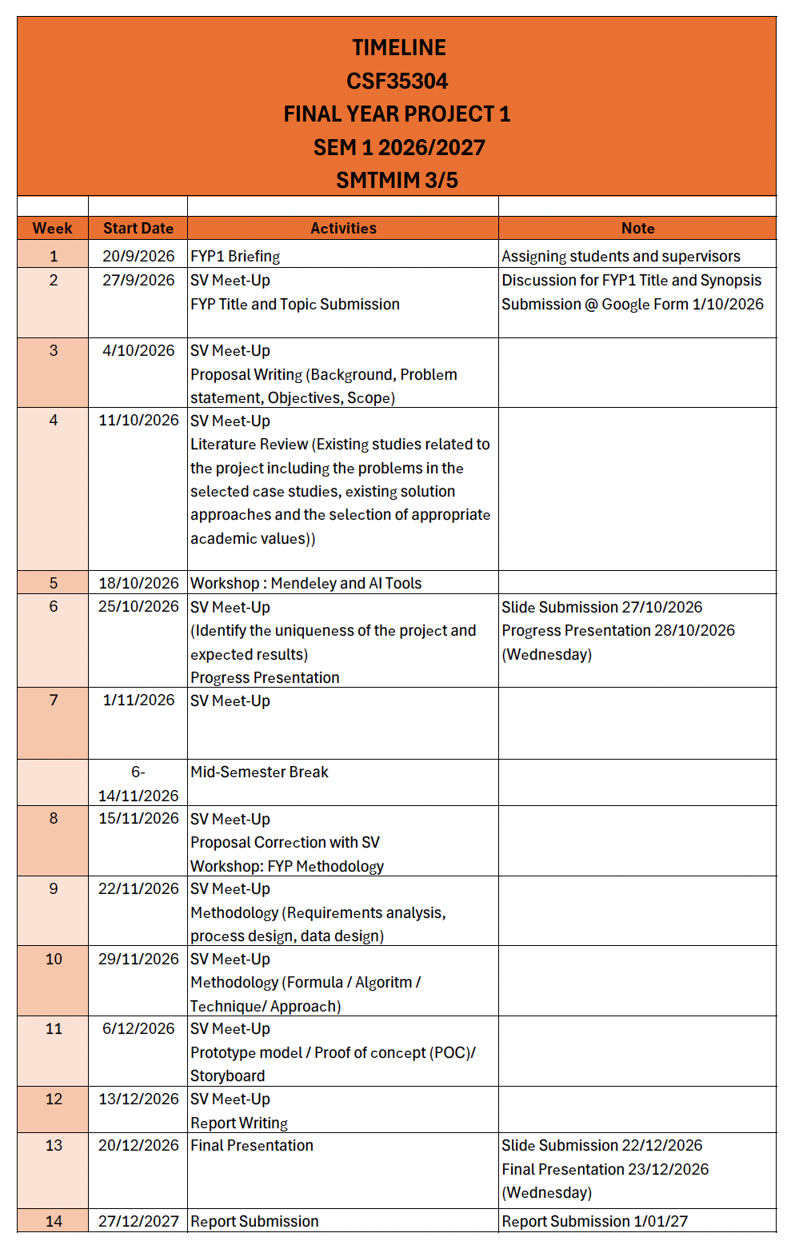

Slide 7
PROPOSAL
Introduction
Background
Problem Statement
Scope
Limitation
Literature Review
Expected Results
At least 10 articles
Objectives

