Slide 1


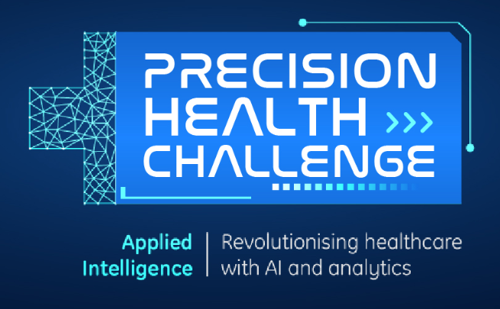
Intelligent Rehabilitation System
-By Team Vahini
( NIT Rourkela )

Slide 2
Problem statement & Proposed solution
Target: Providing an Efficient and Intelligent Rehabilitation System using IoT & AI techniques
EEG &
EMG signals
Acquisition
Server
&
Data visualization
Processing
&
AI Algorithms
Paralysed
Patients
Visual
Feedback
&
Result Analysis
Hardware
&
Actuation

Slide 3
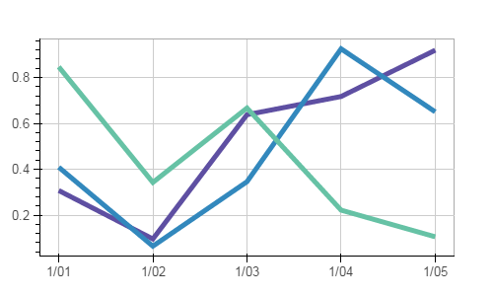
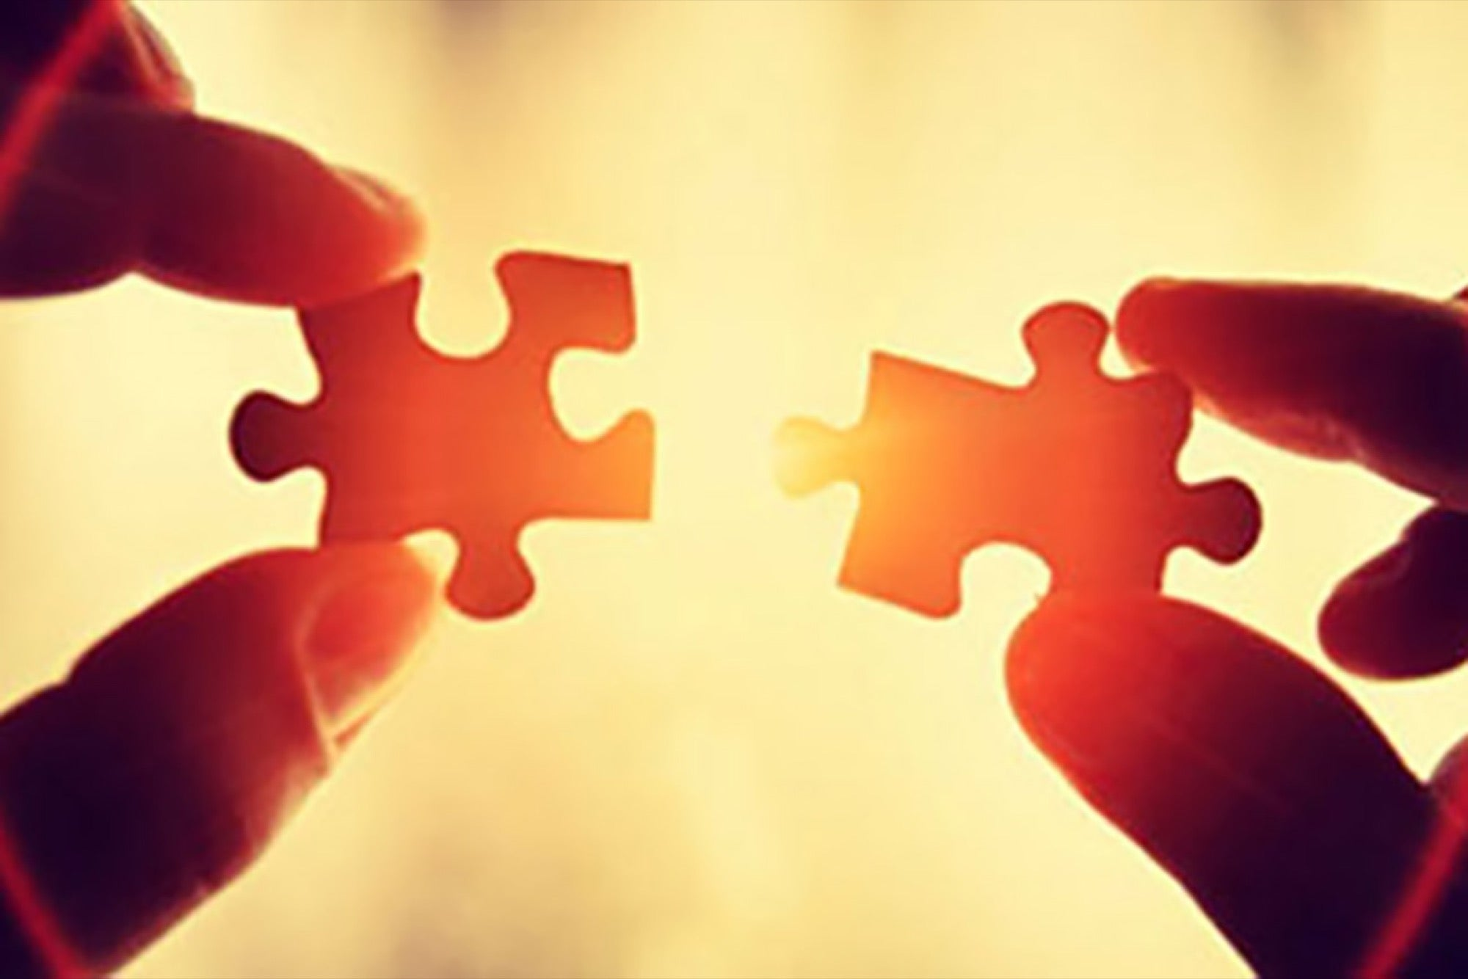
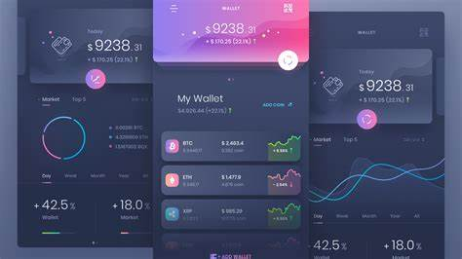
Novelty of Idea
Connecting patients
with
Therapists and Doctors
Instantaneous Result Analysis
&
Weekly Report Updates
An Interactive
&
Integrated environment

Slide 4
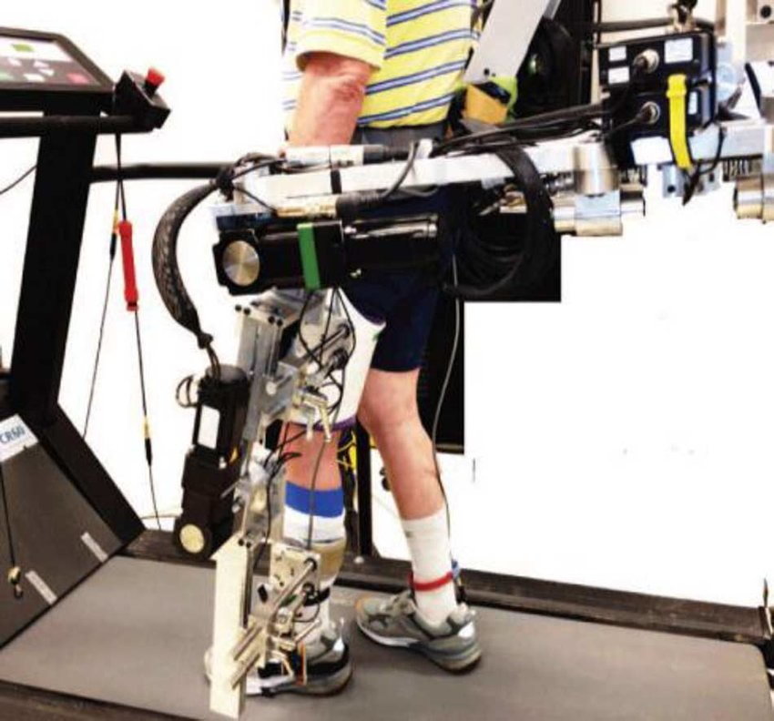
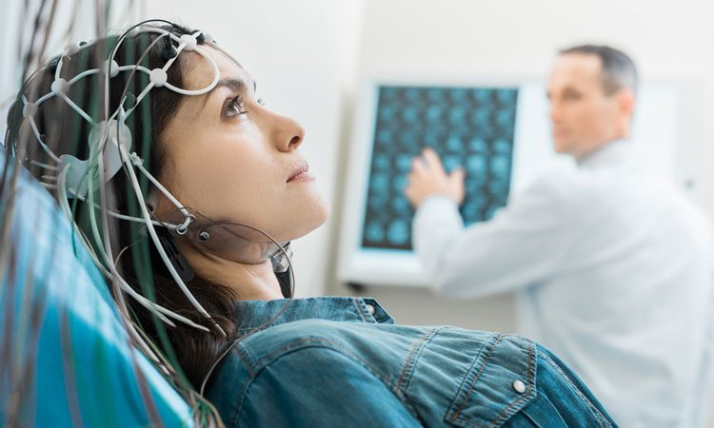
Scalability
Horizontal Scalability
Vertical Scalability

Slide 5
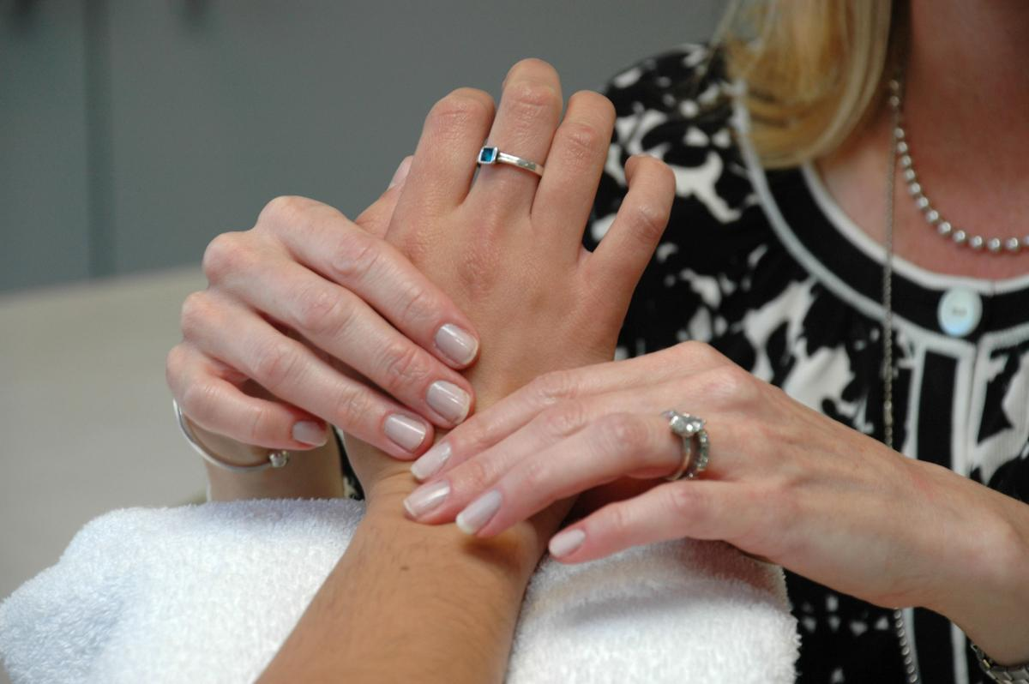
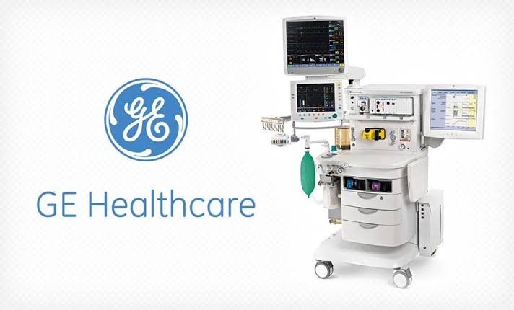
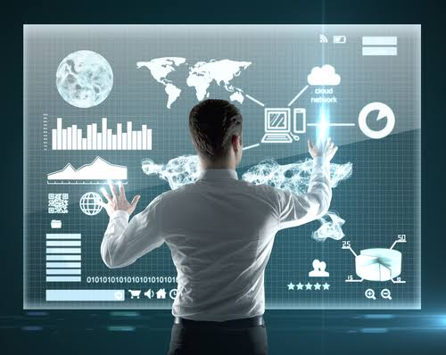
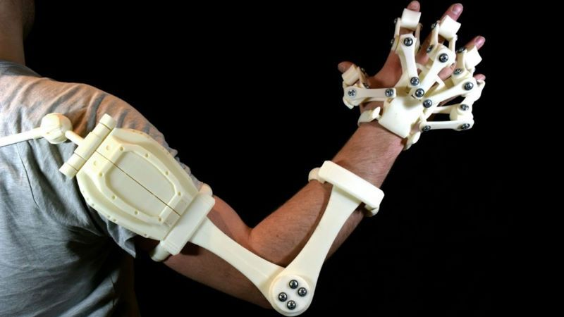
Integration and Adaptability
+
+
Easier Integration
Intuitive Interface
Easy to use

Slide 6
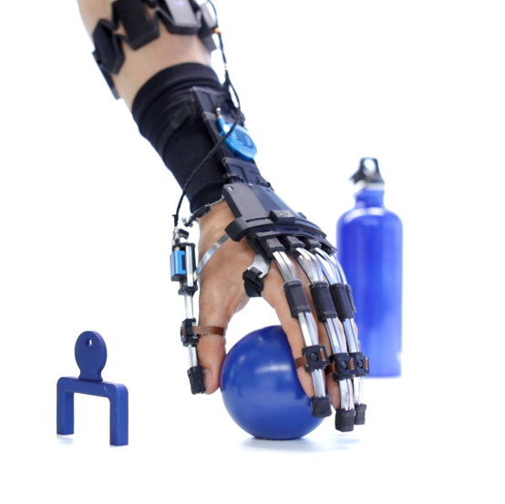
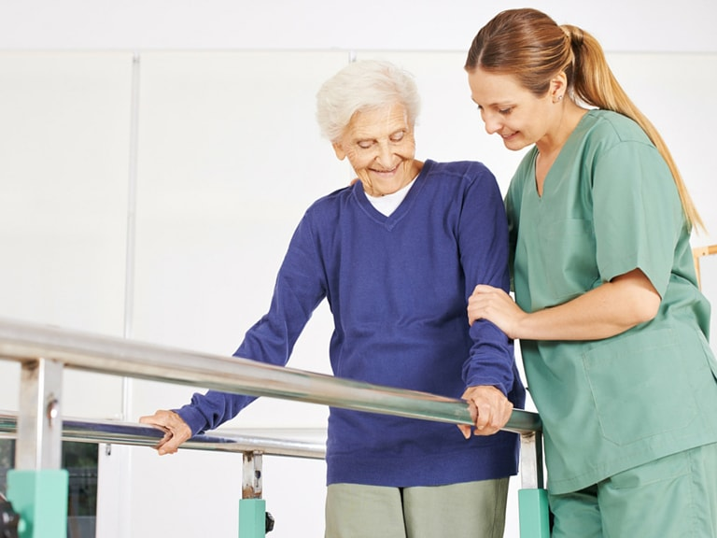
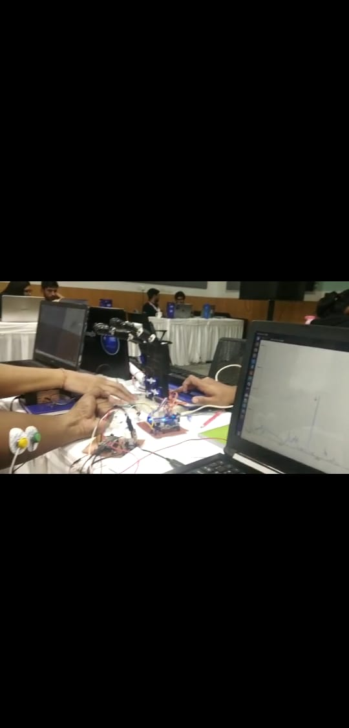
Impact of Idea
Automation & Intelligent Assistance
Higher Outreach
Light Weight
&
Computationally less expensive

Slide 7
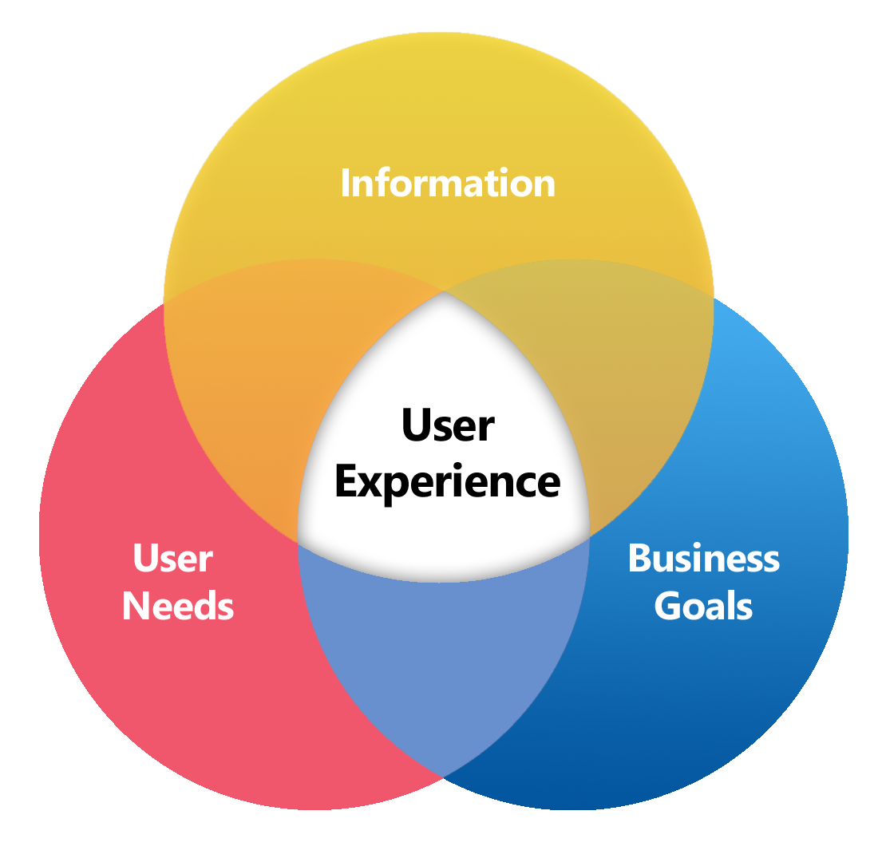

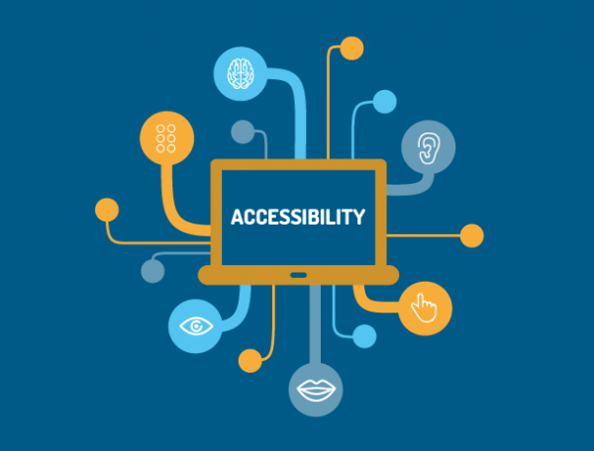
Improvising current Healthcare
+
=
Improvement in patient
experience
Cost Effectiveness
Easy Accessibility

Slide 8
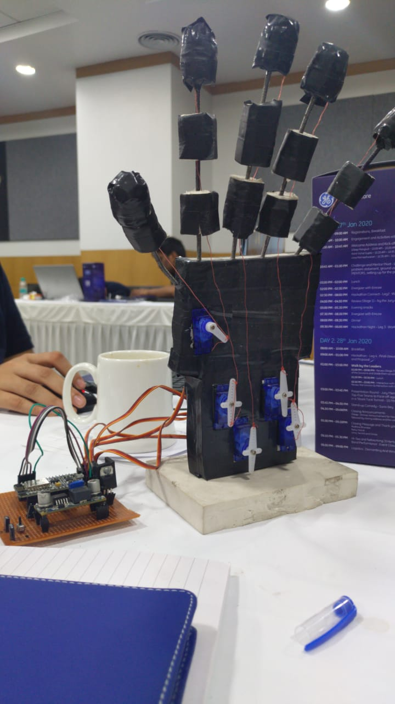
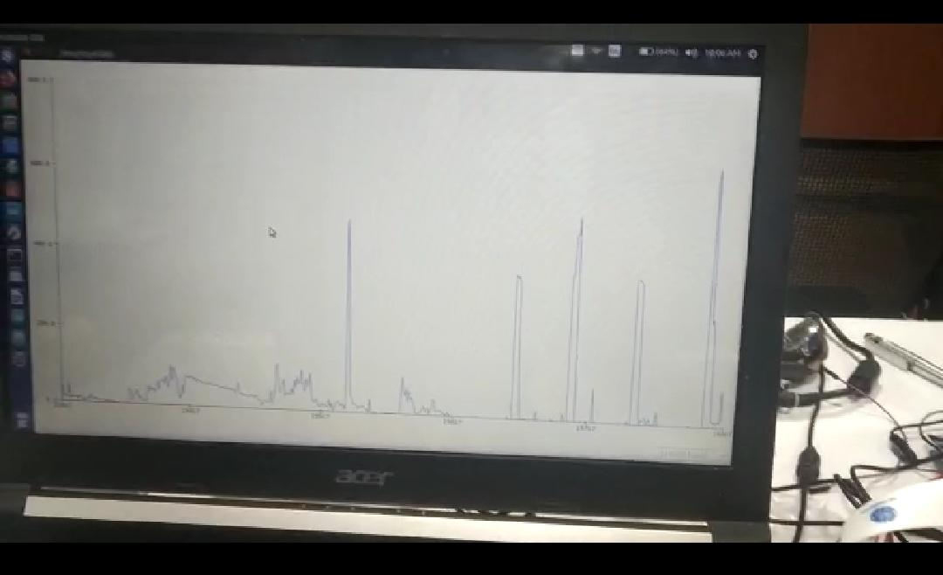
Prototyping
Exoskeleton
Real-Time Analysis

Slide 9
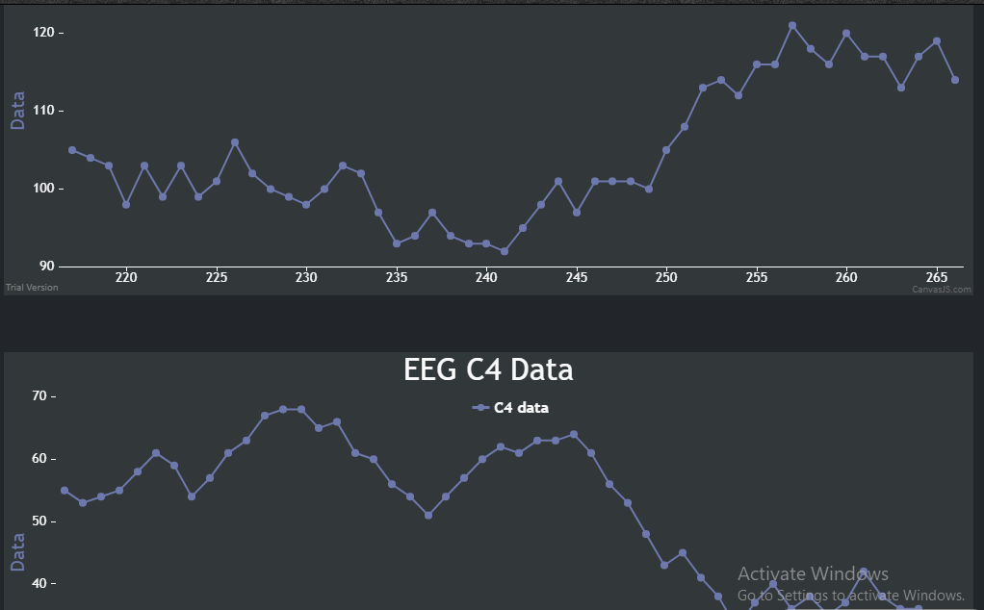
Productization
Productization
Easy to use Plug and Play(P&P) device
Can process any generalized time series data
Easy to deploy software with a simple PHP backend
Simple Hardware design

Slide 10
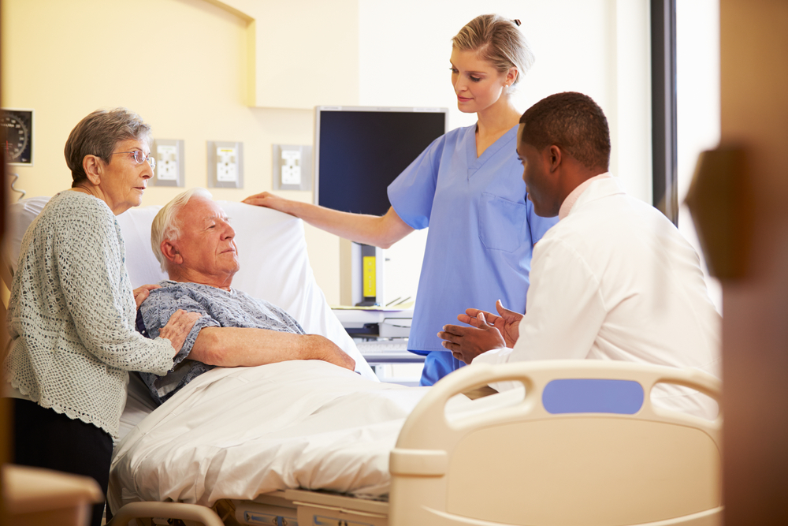

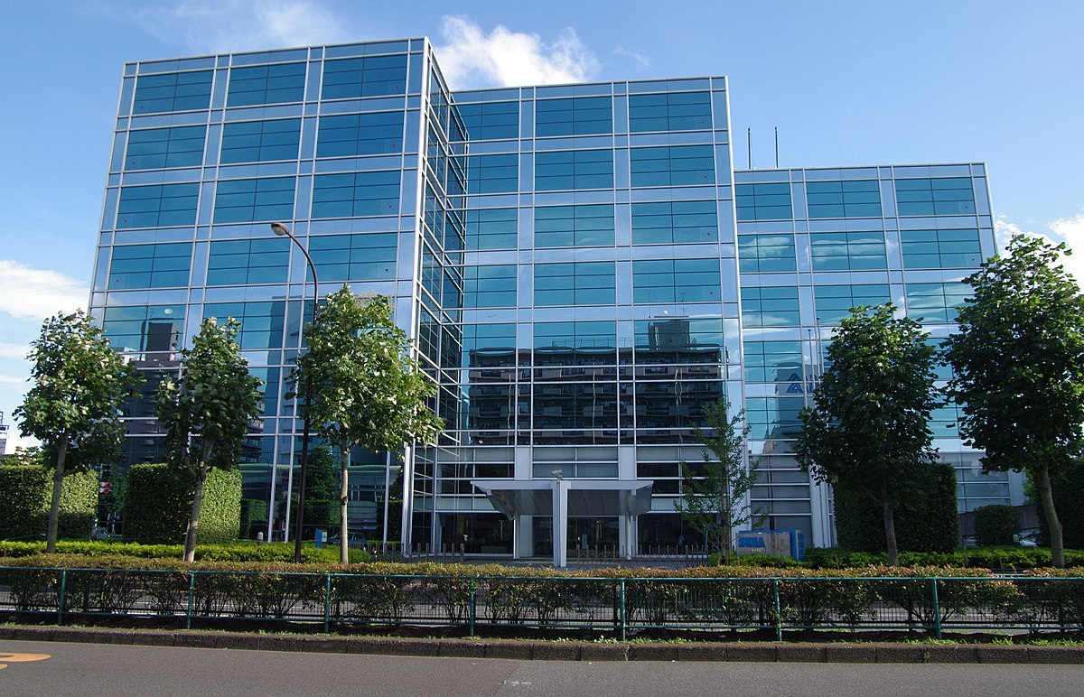
Stake Holders
- Post-Stroke Patients
Amputees
Brain haemorrhage Patients
Cognitive Impaired
Doctors
Therapists
Data scientist
Company
Hospitals
Rehabilitation Centres

Slide 11
THANK YOU

