Slide 1

Exploratory Data Analysis
Bank Marketing (Campaign)
08.20.2023
by Bizma Azeem and Elif Nur Kemiksiz

Slide 2

Agenda
Executive Summary
Problem Statement
Approach
EDA
EDA Summary
Recommendations

Slide 3
Executive Summary
In this project, we conducted a data analysis on taxi usage in different cities and demographic groups in the United States to determine the most appropriate taxi investment for XYZ. The findings provide critical recommendations for the firm to consider when making an investment.

Slide 4
Problem Statement
ABC Bank aims to launch a new term deposit product. However, their current marketing approach lacks precision, making it difficult to identify customers most likely to be interested. This leads to missed sales opportunities and potentially wasted marketing resources.

Slide 5
Approach
By leveraging a targeted marketing approach, we aim to identify high-potential customers for the new term deposit product, optimizing outreach and maximizing sales success.

Slide 6
EDA
The analysis revealed that certain customer segments and demographics are more likely to purchase term deposits. Additionally, some marketing channels are more effective in specific regions.

Slide 7
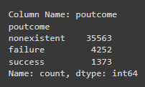
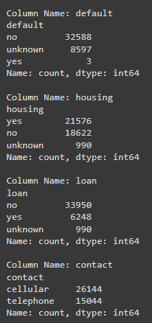
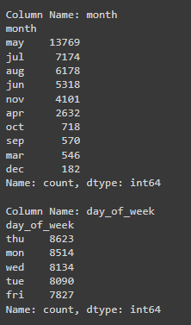
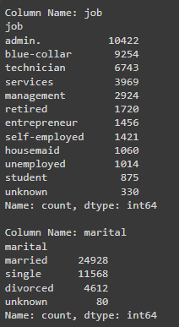
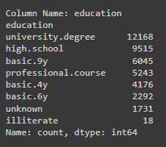
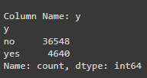
Summary Statistics of All Features:

Slide 8
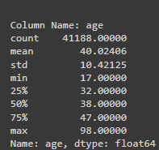
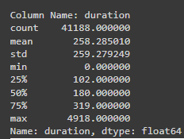
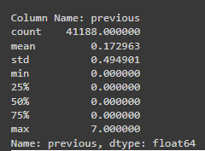
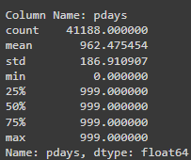
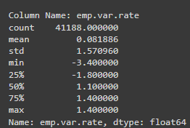
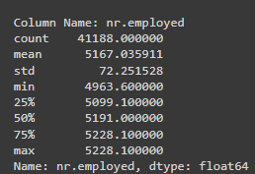
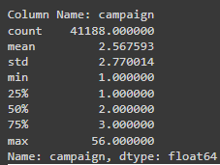
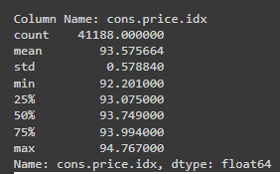
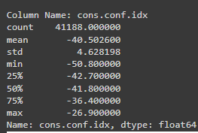
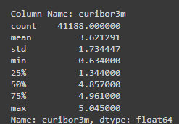
Summary Statistics of All Features:

Slide 9
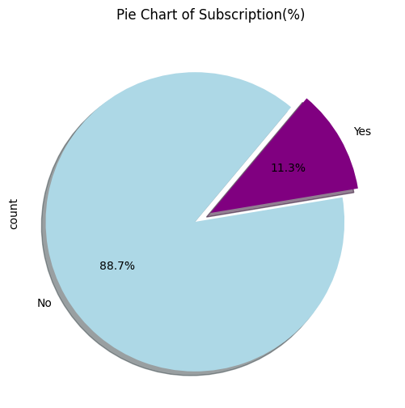
Pie Chart of Subscription rate:

Slide 10
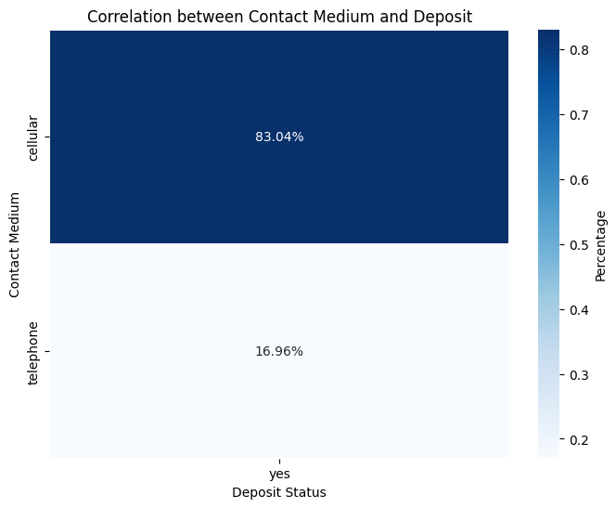
Heatmap of Contact medium of Subscribed Customers:

Slide 11
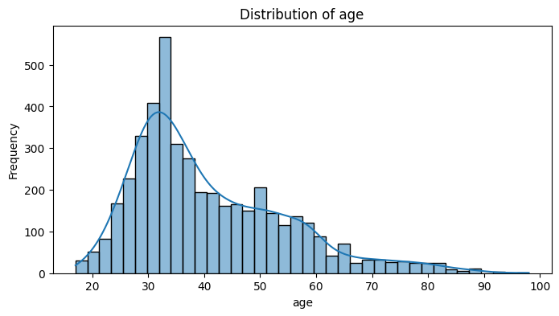
Distribution of Age in Dataset:

Slide 12
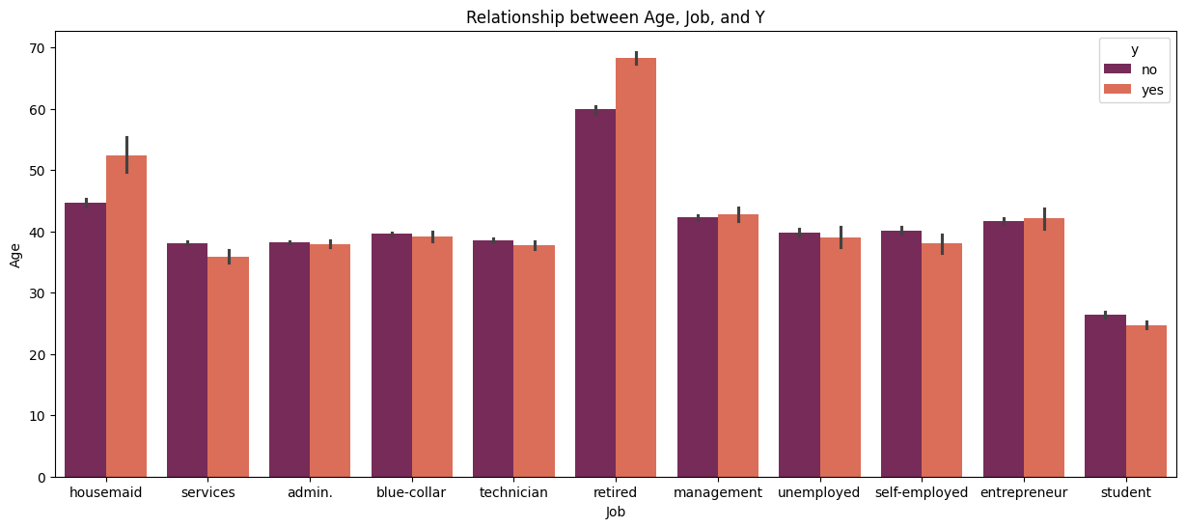
Relationship between Age, Job and Y:

Slide 13
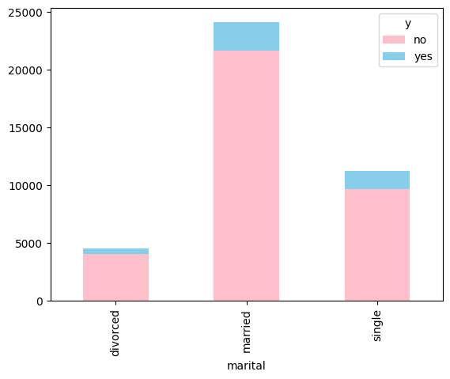
Distribution of marital status with respect to subscription status:

Slide 14
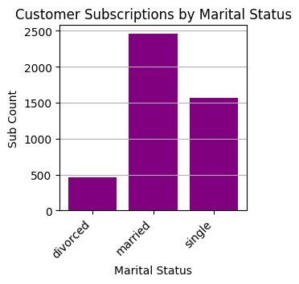
Distribution of marital status of Subscribed Customers:

Slide 15
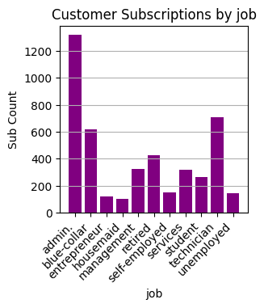
Distribution of Job of Subscribed Customers:

Slide 16
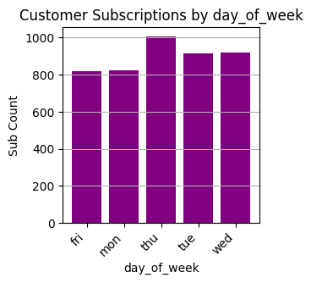
Distribution of day-of_week of Subscribed Customers:

Slide 17
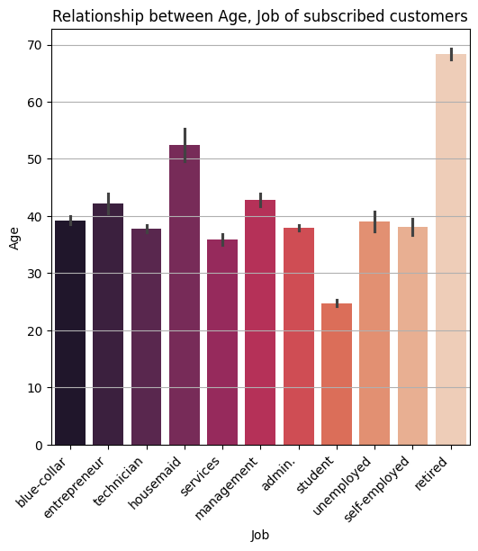
Distribution of Job and Age of customers who subscribed:

Slide 18
Hypothesis Testing
for Targeted Marketing.

Slide 19
Hypothesis # 1 :
Do marital status and education level
influence customers' decisions to purchase term deposits?

Slide 20
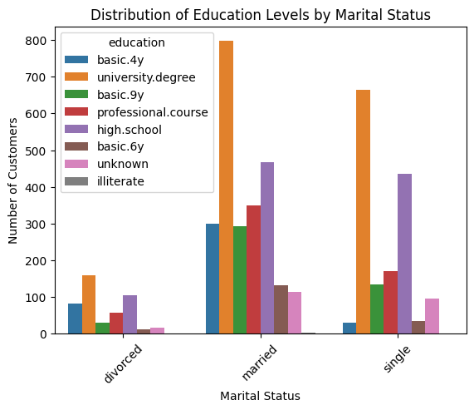
Distribution of Education level and Marital status of customers who subscribed:
Yes, There seem to have some
relation between marital status
and education level.
Single and married people with
university level education are
more likely
to make a purchase,
but this need further analysis.

Slide 21
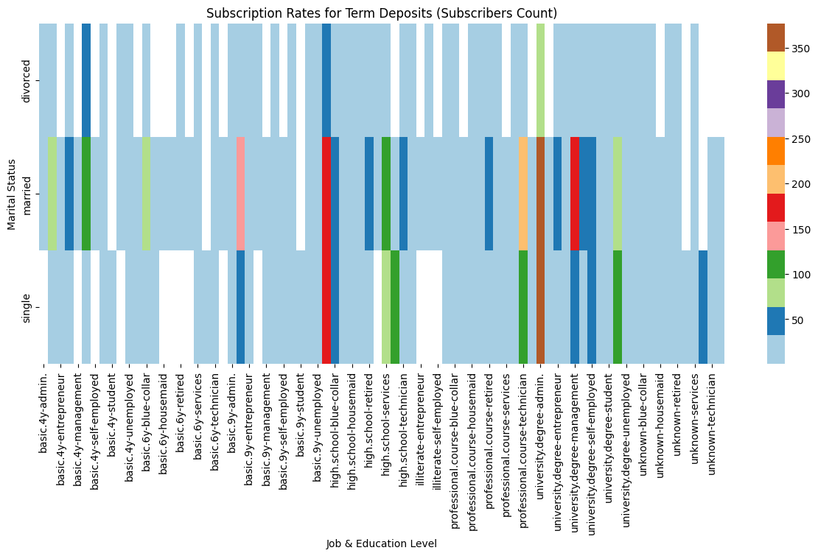
Distribution of Education level and Marital status of customers who subscribed:
Factors like having a
university degree,
working in administration,
and marital status
(single or married)
might be associated with
a customer's decision to
purchase a term deposit.
Lets analyze it further

Slide 22
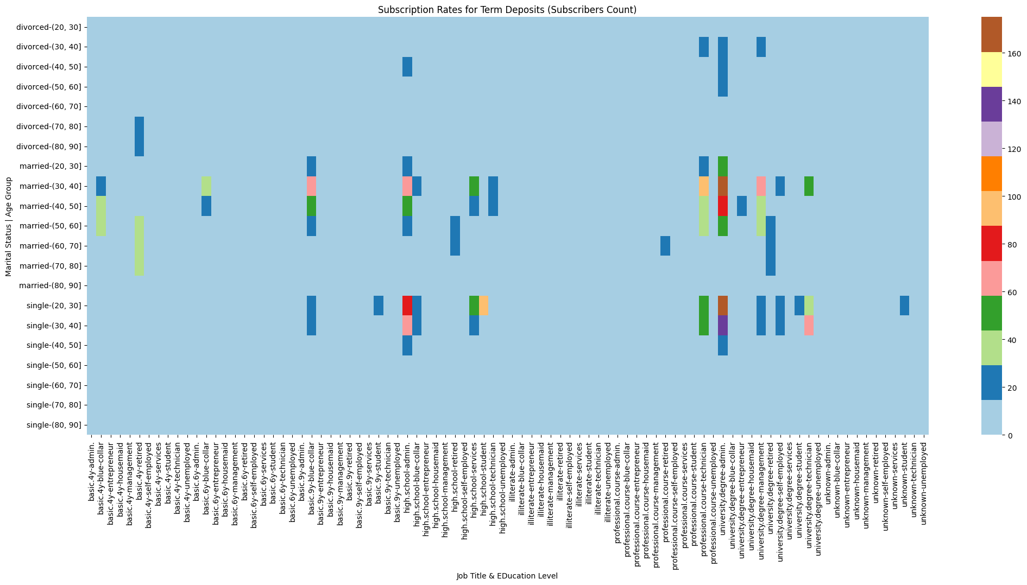
Distribution of Education level and Marital status of customers who subscribed:
The data suggests a
trend where customers
working in administration,
who are single between
the ages of 20 and 40
or married between 30
and 50, have higher
subscription rates.
Hypothesis # 1
Accepted.

Slide 23
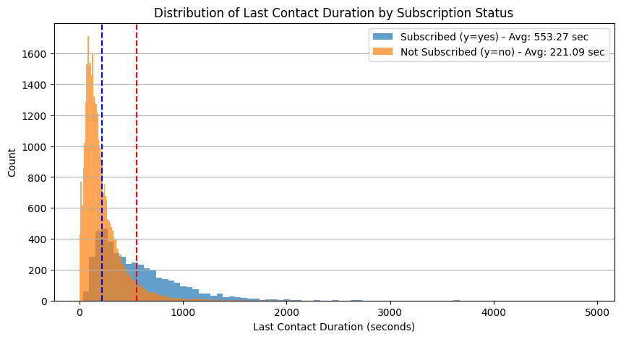
Distribution of call duration feature with respect to subscription status:

Slide 24
Hypothesis # 2 :
Does contact medium and number of contacts during campaign influence customers' buying decision?

Slide 25
Distribution of Correlation between Contact Medium and Deposit status of customers who subscribed:
The data suggests a trend where the 'cellular' contact medium appears to be associated with a higher purchase rate compared to the 'telephone' medium.

Slide 26
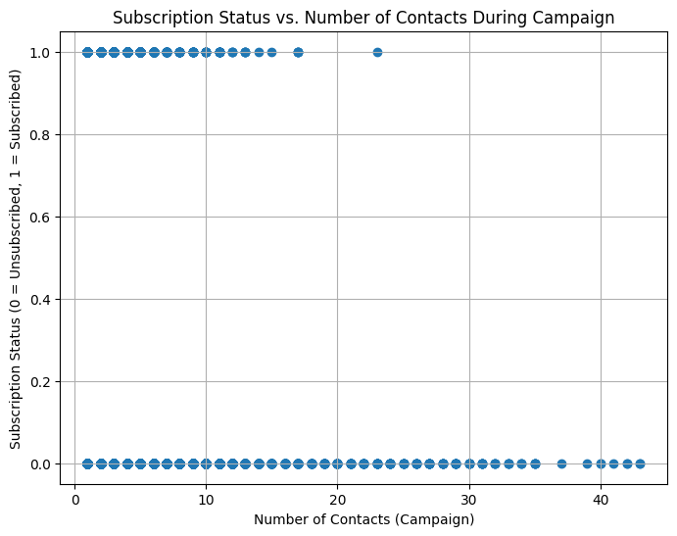
Distribution of Correlation between Contact Medium and Deposit status of customers who subscribed:
While the current data doesn't show a strong correlation, a more comprehensive analysis could provide further insights into the impact of contact frequency.
While contact medium seem to influence but impact of contact frequency needs further analysis.
Hypothesis # 2 Rejected.

Slide 27
Hypothesis # 3 :
Customers who have been previously contacted (e.g., through phone calls, marketing campaigns) are more likely to subscribe to the service compared to new customers who have not been contacted before?

Slide 28
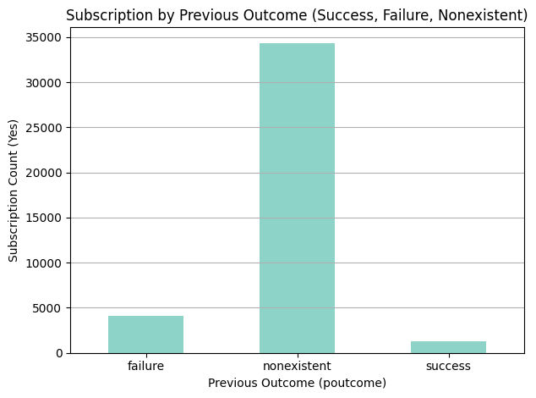
Subscription by Previous Outcome:
Previous outcome does not seem to influence subscription decision.Further investigation needed.

Slide 29
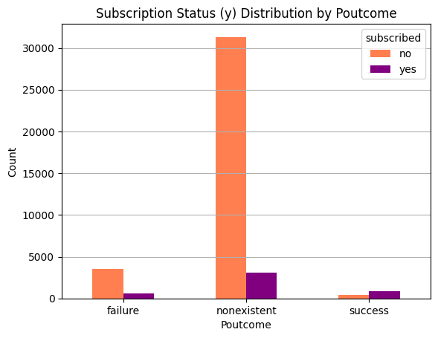
Subscription Status Distribution by Poutcome:
pdays also does not seem to influence subscription decision. Further investigation needed

Slide 30
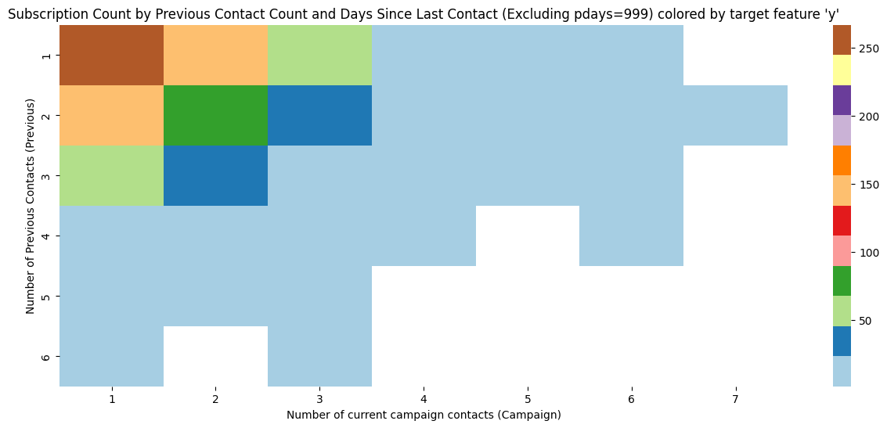
Subscription Count by Previous Contact Count and Days Since Last Contact:
As the heatmap depicts, previous contacts does seem to influence buyers' decision.
Hypothesis # 3 Approved!

Slide 31
Hypothesis # 4 :
Do weekdays within certain months lead to higher subscription rates?

Slide 32
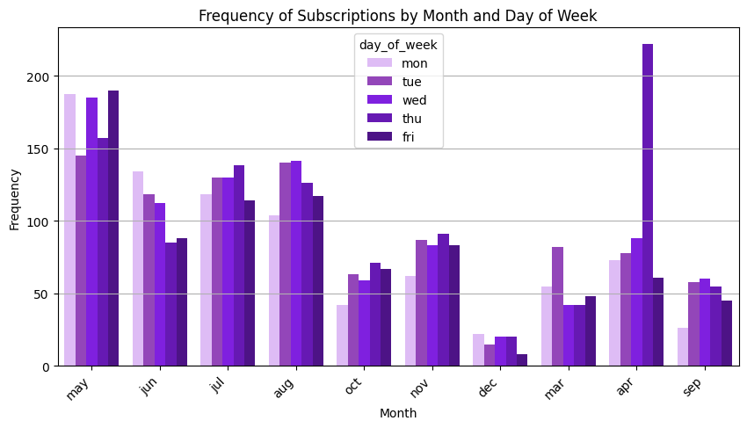
Frequency of Subscriptions by Month and Day of Week:
There is a potential association between weekdays in May and Thursdays in April with higher subscription rates compared to other weekdays in different months.
Hypothesis # 4 Approved

Slide 33
Hypothesis # 5 :
Does longer call duration ultimately influence buyers' buying decisions?

Slide 34
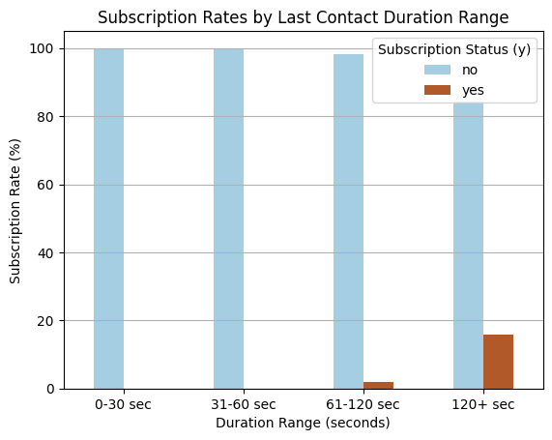
Subscription Status Distribution by Poutcome:
Duration is an important feature as it directly influence target variable 'y'. i.e If call duration is 0, then 'y' is also 0(No).
The graph shows that longer duration can ultimately influence buyers' decision.But further investigation is needed.
Hypothesis # 5 Accepted

Slide 35
Hypothesis # 6 :
Customers with default status , personal and housing loans are less likely to subscribe.

Slide 36
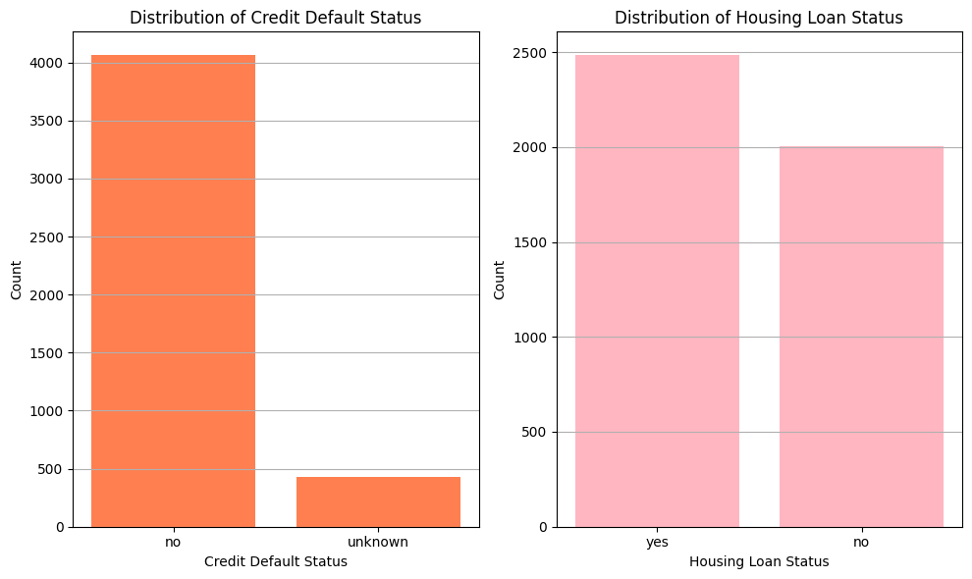
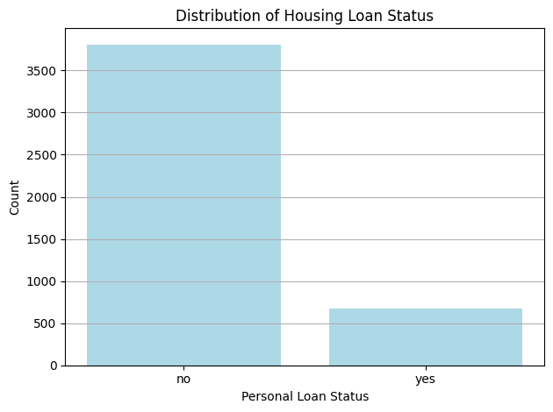
Distribution of Credit Default Status, Distribution of Housing Loan Status, Distribution of Housing Loan Status
Although buyers with personal loan or default status were less likely to buy term deposit. but that's not the case for housing loan. Subscribed customers dataset have a high number of buyers who have housing loan. So, they can be a potential candidates for target marketing.
Hypothesis # 6 Rejected.

Slide 37
Hypothesis # 7 :
Consumers' economical factors affect their buying' decisions.

Slide 38
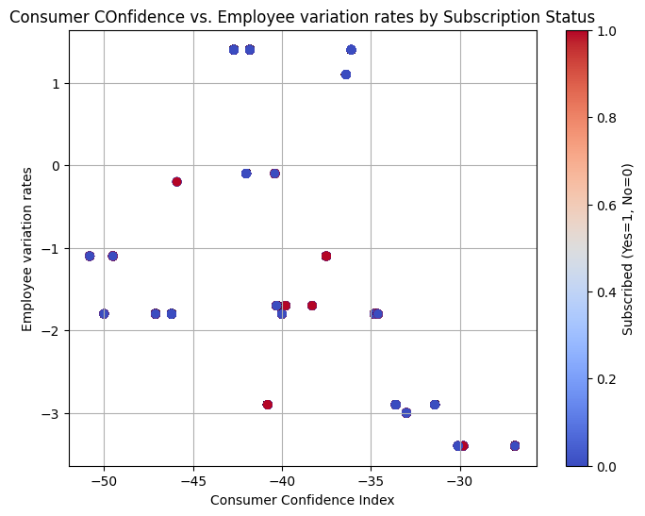
Consumer COnfidence vs. Employee variation rates by Subscription Status
This graph depicts that customers with low emp.var.rate and high cons.conf.idx are more likely to purchase.

Slide 39
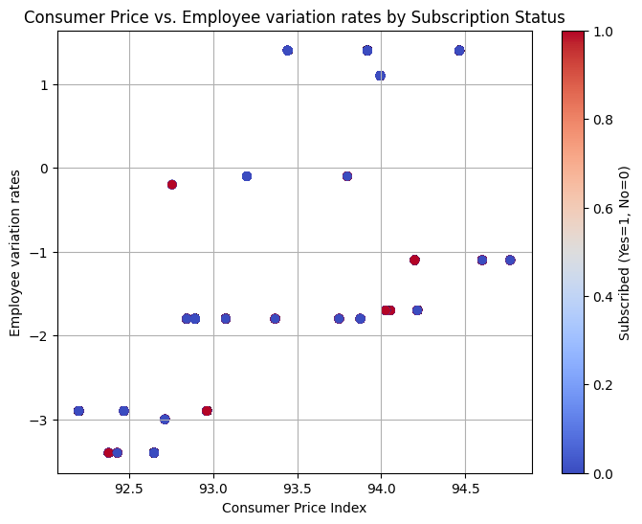
Consumer Price vs. Employee variation rates by Subscription Status
Graphs depict that CCI, CPI and EVR have very weak association. Further investigation needed.

Slide 40
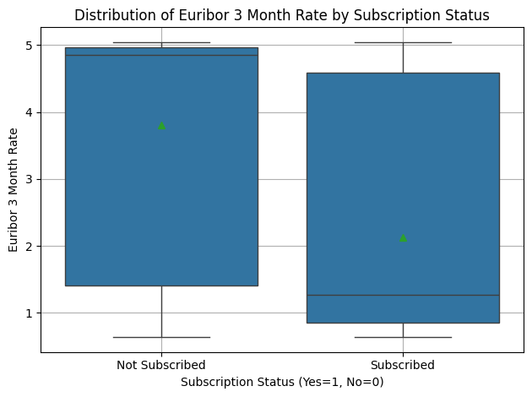
Distribution of Euribor 3 Month Rate by Subscription Status
Customers who subscribed have relatively lower euriborm than those who didn't.

Slide 41
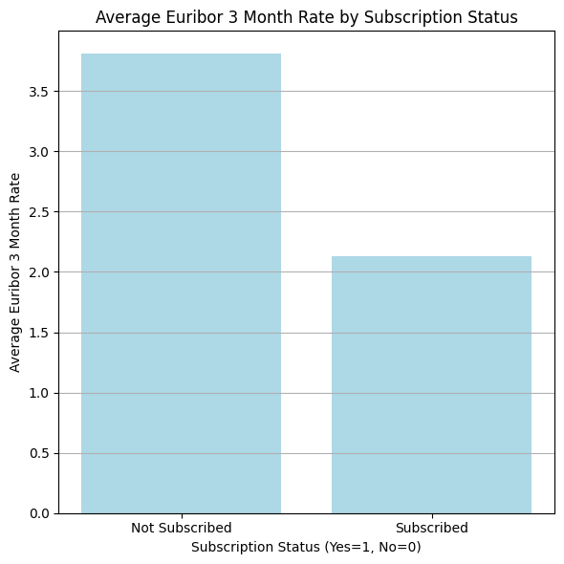
Average Euribor 3 Month Rate by Subscription Status
Customers who fall within the Euribor 3 month rate range of 0.0 to 2.3 might have a higher concentration of subscriptions compared to customers with Euribor 3 month rates outside this range.

Slide 42
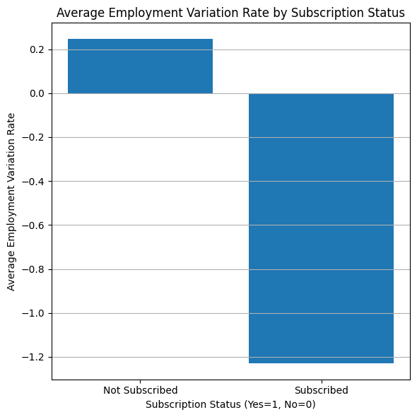
Average Employment Variation Rate by Subscription Status
The graphs suggests that customers with lower Emp variation rate are likely to subscribe.

Slide 43
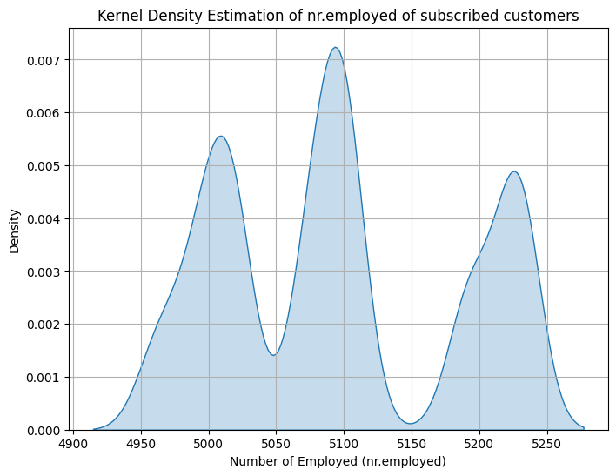
Kernel Density Estimation of nr.employed of subscribed customers
The multimodal distribution of nr.employed indicates the presence of multiple employer categories. This might require using statistical methods suited for non-normal distributions for accurate analysis
Customers' financial conditions does seem to impact their decision.
Hypothesis # 7 Approved.

Slide 44
EDA Summary
Our exploration of the data has shed light on various factors influencing customer decisions regarding term deposit subscriptions. While specific demographics (retired, mid-aged housemaids), contact methods (cellular), loan status (existing housing loans), seasonal patterns (May weekdays, April Thursdays), and social and economic factors (CPI, CCI, employment variation rates) emerged as key considerations, it's crucial to acknowledge the need for further investigation in all these aspects for a truly comprehensive marketing strategy.

Slide 45
Key Findings :
An interesting trend emerged from our analysis: a higher proportion of customers who subscribed to term deposits were married, worked in administrative positions, and held university degrees.
Our analysis suggests a link between customer engagement during the initial calls of the current campaign and their likelihood of subscribing to a term deposit. Customers who demonstrated interest or responded positively during these first interactions seemed more receptive to the product.
Our exploration of the data revealed interesting patterns in customer demographics and their likelihood to subscribe to term deposits. Customers who were retired or in the older age bracket, followed by those in mid-age and working as housemaids, showed a higher propensity to subscribe compared to other demographics.
Our analysis revealed an interesting trend regarding the preferred contact method for term deposit subscriptions. Customers reached via cellular phone calls had a higher subscription rate compared to those contacted through traditional telephone calls.
An interesting insight emerged from our data analysis: customers with existing housing loans were more likely to subscribe to term deposits compared to those without housing loans.
tailoring marketing campaigns to target this specific demographic (married, admin, university degree) as they seem to be more receptive to term deposit products.

Slide 46
Recommendations :
Tailoring marketing campaigns to target this specific demographic (married, admin, university degree) as they seem to be more receptive to term deposit products.
Prioritize outreach to customers who actively engaged during the initial calls (e.g., asking questions, and expressing interest), the bank can focus its resources on those most likely to convert.
Tailoring messaging and communication strategies to resonate with the needs and interests of retirees, older adults, and middle-aged housemaids can potentially increase the effectiveness of the marketing efforts.
ABC Bank might consider prioritizing cellular communication methods within its marketing campaigns.
ABC Bank could consider incorporating a targeted marketing strategy for customers with existing housing loans
Prioritizing weekday outreach during May and Thursdays in April could potentially lead to higher conversion rates.
tailoring marketing campaigns to target this specific demographic (married, admin, university degree) as they seem to be more receptive to term deposit products.

Slide 47
Conclusion
By continuously investigating these areas and integrating the findings into your marketing strategy, ABC Bank can develop a future-proof approach that resonates with customers and achieves optimal results. A data-driven and adaptable approach that prioritizes responsible lending practices and ethical communication will ultimately lead to a successful marketing campaign.

Slide 48
Recommended
Models for Dataset:
Logistic Regression (Base Model)
Support Vector Machine
Decision Tree
Random Forest
XGBoost
LightGBM

Slide 49
Thank You

