Slide 1
Dr. Sultan Daud Khan

Slide 2
Introduction to digital logic design
Digital logic design techniques form the basis of all digital integrated circuits.
Digital systems store, move, and process information
The information represents a broad range of phenomena from the physical and man-made world

Slide 3
Topics to be covered in this course
Boolean algebra
Logic gates and networks
Combinational logic circuit synthesis and optimization
Number representation and arithmetic circuits
Flip-flops, registers, and counters
Finite state machines
Synchronous sequential circuits
Digital system design
Asynchronous sequential circuits
Testing and testability of logic circuits

Slide 4
Number Systems
Number system in digital electronics is used to represent information
Different number systems
decimal,
binary,
octal,
and hexadecimal
Base or Radix
radix of the number system is the total number of the digit used in the number system

Slide 5
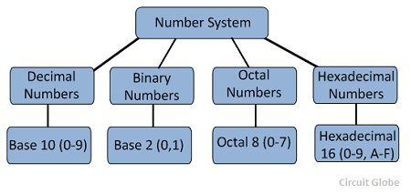

Slide 6
Decimal Number System
The number system is having digit 0, 1, 2, 3, 4, 5, 6, 7, 8, 9;
This number system is known as a decimal number system because total ten digits are involved.
The base of the decimal number system is 10.

Slide 7
Binary Number System
Binary number system which uses only two digits 0 and1
The base of binary number system is 2 because it has only two digit 0 and 1.

Slide 8
Octal Number and Hexa decimal number system
The octal system has the base of eight as it uses eight digits 0, 1, 2, 3, 4, 5, 6, 7.
Hexadecimal number system consists of the following sixteen number of digits.
0, 1, 2, 3, 4, 5, 6, 7, 8, 9, A, B, C, D, E, F.

Slide 9
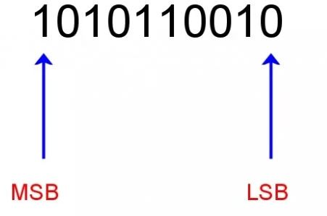
Conversion from Decimal to Binary Number system

Slide 10
Procedure
Write down the decimal number.
Divide the number by 2.
Write the result underneath.
Write the remainder on the right hand side. This will be 0 or 1.
Divide the result of the division by 2 and again write down the remainder.
Continue dividing and writing down remainders until the result of the division is 0.
The most significant bit (MSB) is at the bottom of the column of remainders and the least significant bit (LSB) is at the top.
Read the series of 1s and 0s on the right from the bottom up. This is the binary equivalent of the decimal number.

Slide 11
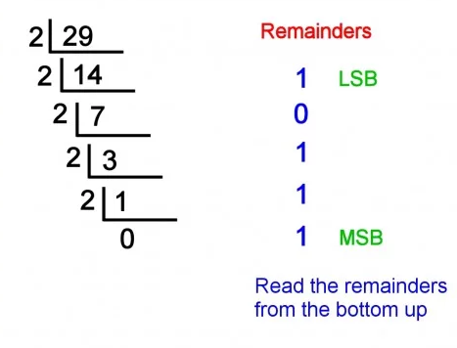
Example ( conv

Slide 12
Steps to convert Binary to Decimal
Converting from binary to decimal involves multiplying the value of each digit (i.e. 1 or 0) by the value of the placeholder in the number
Write down the number.
Starting with the LSB, multiply the digit by the value of the place holder.
Continue doing this until you reach the MSB.
Add the results together

Slide 13
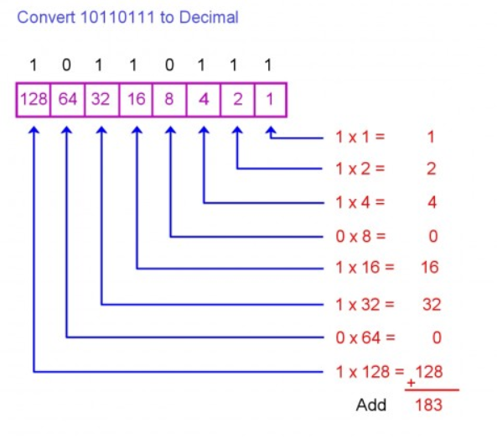
Example (conversion from binary to decimal

Slide 14
Convert decimal fraction to binary number
We divide the number into two parts, i.e., integer part and fractional part and deal each part independently.
Convert the integral part of decimal to binary equivalent
Convert the fractional part of decimal to binary equivalent
Multiply the fractional decimal number by 2.
Integer part of resultant decimal number will be first digit of fraction binary number.
Repeat step 1 using only fractional part of decimal number and then step 2.

Slide 15
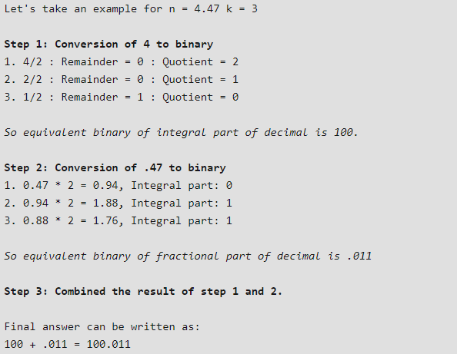
Example

Slide 16
Convert Binary fraction to Decimal
Input: n = 110.101
Output: 6.625
Input: n = 101.1101
Output: 5.8125

Slide 17
Important steps for conversion
A) Convert the integral part of binary to decimal equivalent
Multiply each digit separately from left side of radix point till the first digit by 2⁰, 2¹, 2²,… respectively.
Add all the result coming from step 1.
Equivalent integral decimal number would be the result obtained in step 2.
B) Convert the fractional part of binary to decimal equivalent
Divide each digit from right side of radix point till the end by 2¹, 2², 2³, … respectively.
Add all the result coming from step 1.
Equivalent fractional decimal number would be the result obtained in step 2.
C) Add both integral and fractional part of decimal number.

Slide 18
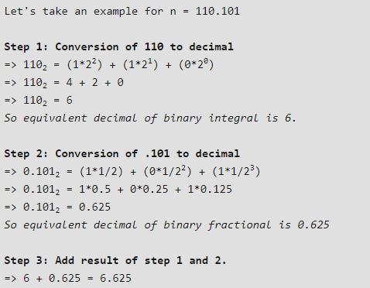
Example

Slide 19
Convert Octal Number to Binary Number
Input : Octal = 345
Output : Binary = 011100101
Explanation :
Equivalent binary value of 3: 011
Equivalent binary value of 4: 100
Equivalent binary value of 5: 101

Slide 20
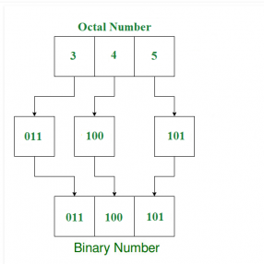
Important Steps

Slide 21
Convert Hexadecimal Number to Binary
Input: Hexadecimal = 1AC5
Output: Binary = 0001101011000101
Explanation:
Equivalent binary value of 1: 0001
Equivalent binary value of A: 1010
Equivalent binary value of C: 1100
Equivalent binary value of 5: 0101

Slide 22
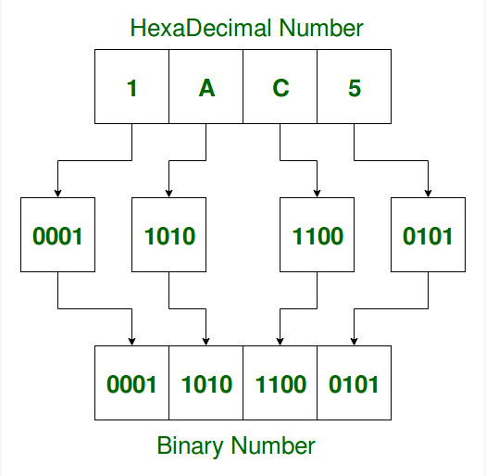
Important Steps

