Slide 1
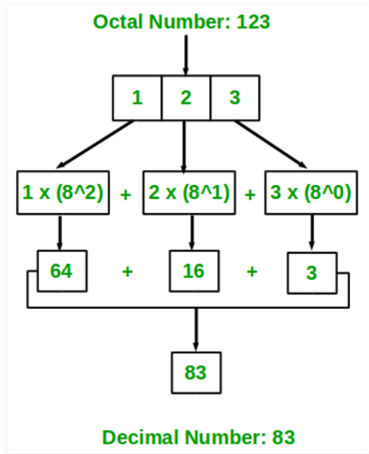
Octal to Decimal Conversion
Input : 67
Output : 55

Slide 2
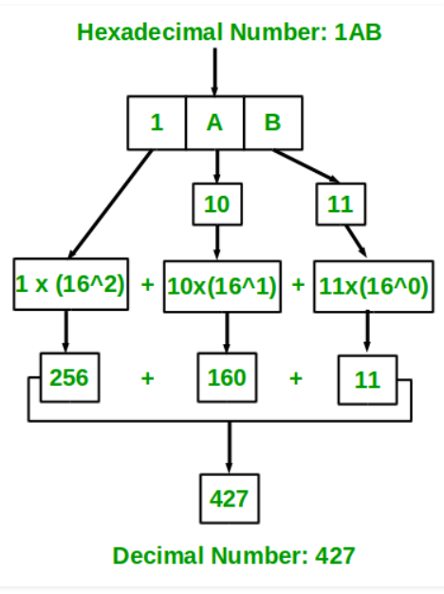
Hexadecimal to Decimal
Input : 67
Output : 103

Slide 3




Conversion of fraction Octal to Decimal Numbers

Slide 4
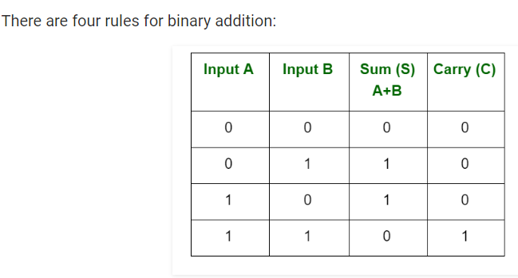
Binary Arithmetic

Slide 5
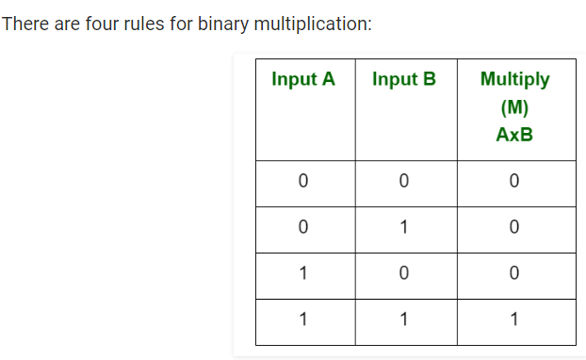
Binary multiplication

Slide 6
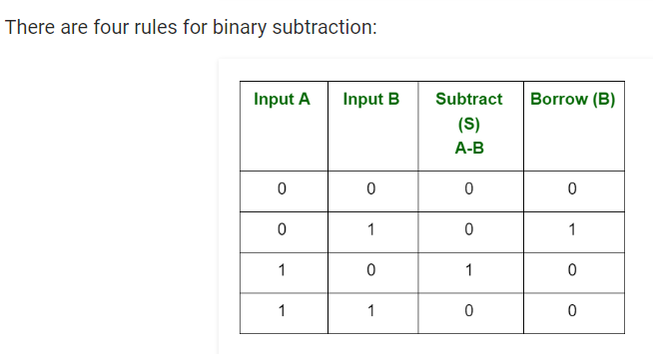
Binary Subtraction

Slide 7

Hexadecimal addition
A₁₆ + 5₁₆
F₁₆

Slide 8



Convert binary to octal and hexadecimal numbers
For octal: partition the binary number into a group of three digits
For hexadecimal: Partition the binary number into a group of four digits.

Slide 9

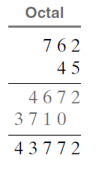
Multiplication of Octal Numbers
Method:

Slide 10



Binary Coded Decimal
Binary-coded decimal (BCD) is a class of binary encodings of decimal numbers where each decimal digit is represented by a fixed number of bits, usually four or eight.
BCD numbers are decimal numbers even though they are represented in 1’s and 0’s

Slide 11
ASCII Codes
American Standard Code for Information Interchange
Binary codes to encode alphanumeric characters
7 bits are required to encode each character
Why ASCII?
To use a common language for exchanging files and documents.

Slide 12
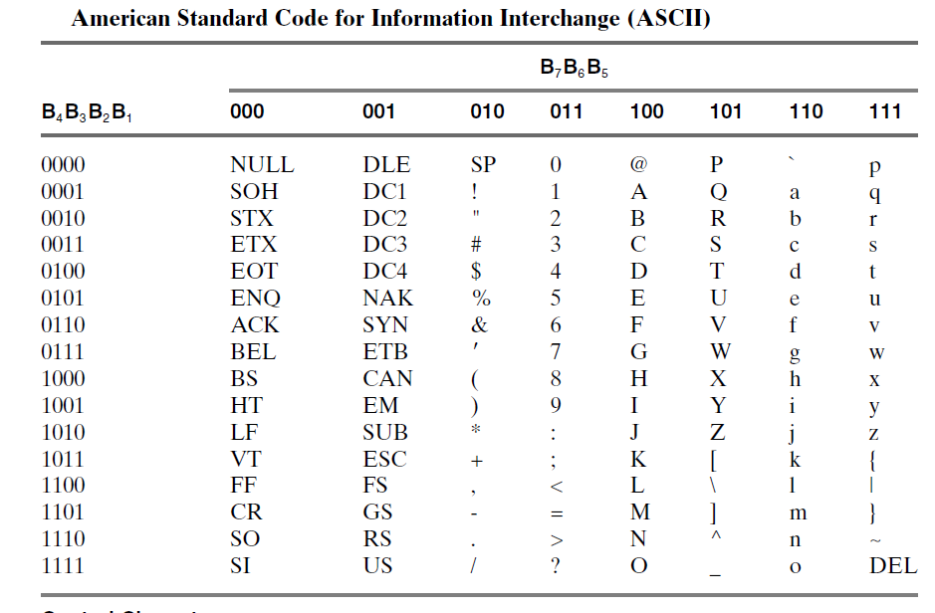

Slide 13
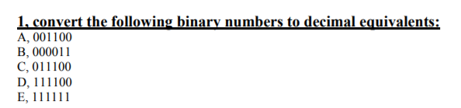

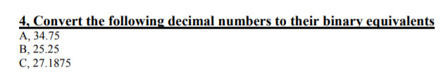
Assignment # 1
1
2
3

