Slide 1
Logic Gates
In the earliest computers, switches were opened and closed by magnetic fields produced by energizing coils in relays. The switches in turn opened and closed the current paths.
Later, vacuum tubes that open and close current paths electronically replaced relays.
Today, transistors are used as electronic switches that open and close current paths.

Slide 2
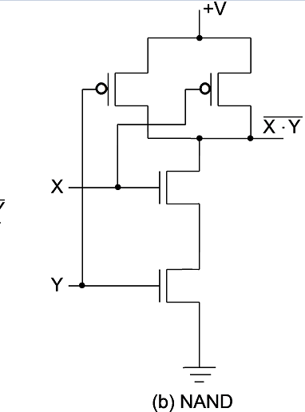
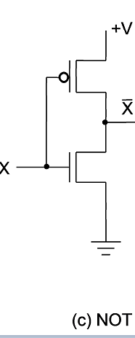
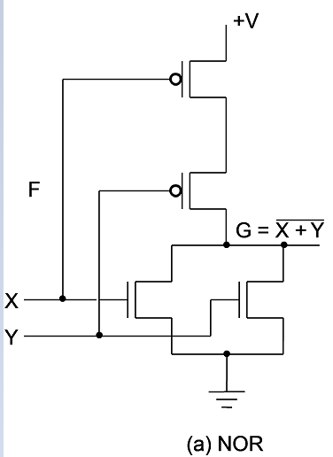
Logic Gates (continued)
Implementation of logic gates with transistors (See Reading Supplement − CMOS Circuits)
Transistor of logic functions are called logic gates or just gates
Notes:
The transistor without the “bubble” on its input is an N-type field effect transistor. It acts like a closed switch between its top and bottom terminals with an H (1) applied to its input on its left. It acts like an open switch with an L (0) applied to its input. The transistor with the “bubble” on its input is a P-type field effect transistor. The +V at the top provides an H (1) and the Ground symbol at the bottom provides an L (0). By modeling the two types of field effect transistors as switches, one can see how the series and parallel interconnections can produce 1’s and 0’s on the outputs on the right in response to applied 1’s and 0’s on the inputs on the left. NOR and
NAND are OR and AND, each followed by a NOT respectively.

Slide 3
Logic Gate Symbols and Behavior
Logic gates have special symbols:
And waveform behavior in time as follows:

Slide 4
Logic Diagrams and Expressions
Truth Table
Equation
X Y Z
F
=
X
+
Y
⋅
Z
0 0 0
0
F
=
X
+
Y
Z
0 0 1
1
0 1 0
0
Logic Diagram
0 1 1
0
X
1 0 0
1
1 0 1
1
Y
F
1 1 0
1
Z
1 1 1
1
Boolean equations, truth tables and logic diagrams describe the same function!
Truth tables are unique; expressions and logic diagrams are not. This gives flexibility in implementing functions.

Slide 5
Boolean Algebra
An algebraic structure defined on a set of at least two elements, B, together with three binary operators (denoted +, · and ) that satisfies the following basic identities:
1.
X
+ 0
=
X
2.
X
. 1
=
X
3.
X
1
1
4.
X
. 0
0
+
=
=
5.
X + X
=
X
6.
X . X
=
X
7.
X + X
=
1
8.
X . X
=
0
9.
X = X
10.
X + Y
=
Y + X
11.
XY
=
YX
Commutative
12.
(X + Y)
+
Z
=
X + (Y
+
Z)
13.
(XY)
Z
=
X(Y
Z)
Associative
14.
X(Y +
Z)
=
XY
+
XZ
15.
X
+ YZ
=
(X + Y)
(X + Z)
Distributive
DeMorgan
16.
X + Y
=
X . Y
17.
X . Y
=
X + Y
’
s

Slide 6
Some Properties of Identities & the Algebra
The dual of an algebraic expression is obtained by interchanging + and · and interchanging 0’s and 1’s.
The identities appear in dual pairs. When there is only one identity on a line the identity is self-dual, i. e., the dual expression = the original expression.

Slide 7
Some Properties of Identities & the Algebra (Continued)
Unless it happens to be self-dual, the dual of an expression does not equal the expression itself.
Example: F = (A + C) · B + 0
dual F = (A · C + B) · 1 = A · C + B
Example: G = X · Y + (W + Z)
dual G = ((X+Y) · (W · Z)’)
= ((X+Y) ·(W' + Z')
Notes:
Dual G = ((X+Y) · (W · Z)') = ((X+Y) ·(W' + Z')
Dual H = (A + B)(A + C)(B + C). Using the Boolean identities,
= (A +BC) (B+C) = AB + AC + BC. So H is self-dual.

Slide 8

Example: H = A · B + A · C + B · C
(A + B)(A + C)(B + C).
(A +BC) (B+C)
AB + AC + BC.
So H is self-dual.

Slide 9
Useful Theorems
(
)
(
)
x
⋅
y
+
x
⋅
y
=
y
x
+
y
x
+
y
=
y
M
inimizatio
n
(
)
x
+
x
⋅
y
=
x
+
y
x
⋅
x
+
y
=
x
⋅
y
Simplifica
tion
x
⋅
y
+
x
⋅
z
+
y
⋅
z
=
x
⋅
y
+
x
⋅
z
Consensus
(
)
(
)
(
)
(
)
(
)
x
+
y
⋅
x
+
z
⋅
y
+
z
=
x
+
y
⋅
x
+
z
x
+
y
=
x
⋅
y
x
⋅
y
=
x
+
y
DeMorgan'
s
Laws

